Slide 1

Automotive Technology Principles, Diagnosis, and Service
Sixth Edition
Chapter 67
Heating and Air-Conditioning System Service
Copyright © 2018, 2015, 2011 Pearson Education, Inc. All Rights Reserved

Slide 2
LEARNING OBJECTIVES
67.1 Discuss blower motor service, cooling system service, and refrigerant recovery procedures.
67.2 Describe evacuation procedures and how to identify non-condensable gas in refrigerant.
67.3 Explain how to recycle refrigerants, recharge a system, and retrofit a CFC-12 system to a HFC-134A system.
67.4 Describe how to service the compressor, condenser, evaporator, receiver/drier or accumulator/drier, and orifice tube/expansion valve.

Slide 3
BLOWER MOTOR SERVICE
Blower motor-related services include the following components.
  Blower motor
  Relays and switches
  Mechanical, electrical, and vacuum components

Slide 4
QUESTION 1: ?
What components should be checked if a blower motor resistor
is found to be defective?

Slide 5
ANSWER 1:
The blower motor and the connections.

Slide 6
COOLING SYSTEM SERVICE
Thermostat Replacement
  A defective (stuck open) thermostat can cause a lack of heat from the heater.
Heater Hose Replacement
  Check heater hoses for signs of deterioration and replace as needed.
Cooling Fan
  Inspect the cooling fan for dents, nicks, or other faults that can cause a vibration or reduce airflow through the radiator.

Slide 7
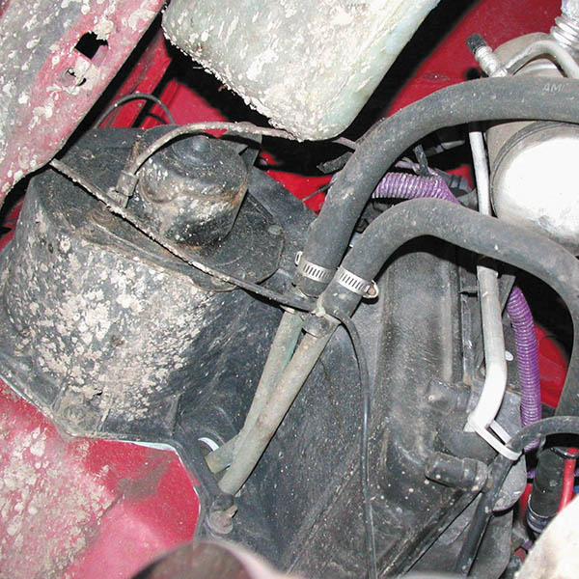
Figure 67.1 Some heater hoses are best inspected by hoisting the vehicle and inspecting them from underneath the vehicle as shown

Slide 8
REFRIGERANT RECOVERY PROCEDURES (1 OF 2)
Leak Repair Procedures
  After a leak has been found, the refrigerant should be recovered and the faulty part repaired or replaced.
Refrigerant Recovery
  Refrigerant should be recovered and not allowed to be discharged into the atmosphere.
Refrigerant Identification
  All refrigerant should be identified before it is recovered.
  Identify the use of sealers.

Slide 9
REFRIGERANT RECOVERY PROCEDURES (2 OF 2)
Repairs or Replacement of Components
  After all refrigerant has been removed from the system, repairs can be accomplished.
Refrigerant Line Connections
  Refrigerant line connections must be vapor tight, easy to connect and disconnect, and withstand rapid and extreme temperature changes.
Service Valves
  Service valves and caps with O-rings keep the dirt out and the system sealed.

Slide 10
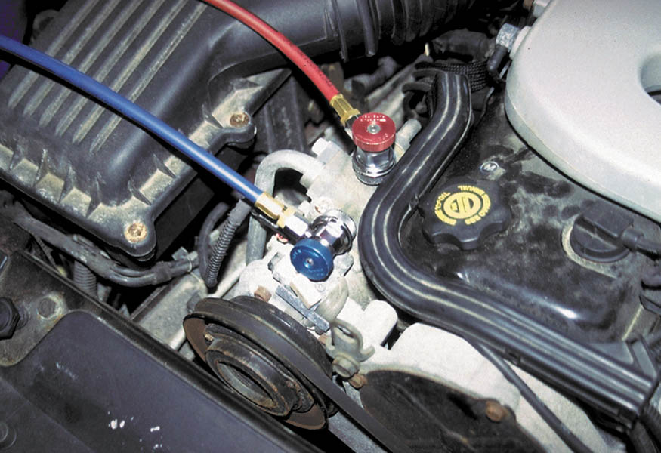
Figure 67.2 HFC-134a systems use quick-disconnect fittings that are larger than those used for CFC-12 systems

Slide 11
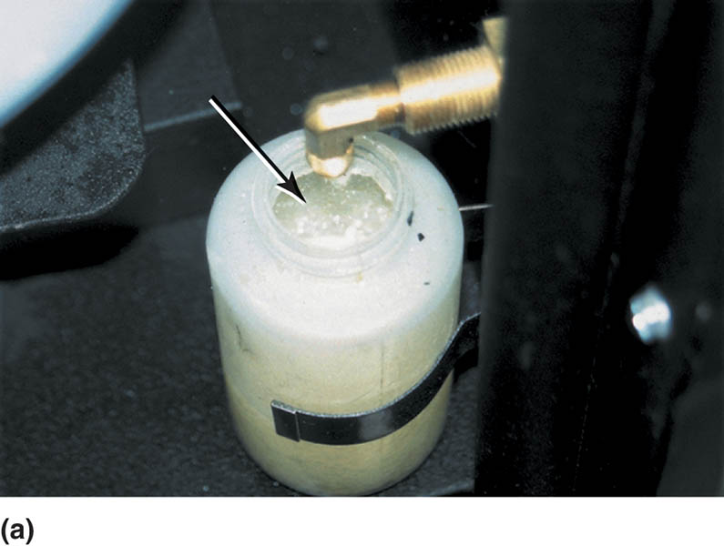
Figure 67.3 (a) Refrigerant oil must be retrieved and measured when the refrigerant is recovered from the system

Slide 12
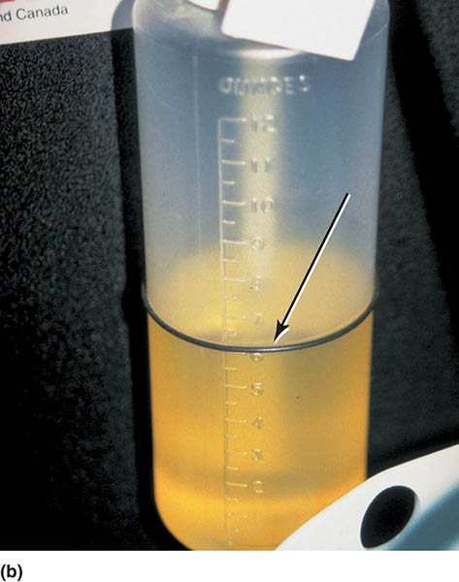
Figure 67.3 (b) A rubber O-ring is used to indicate the level of refrigerant oil already in the container. The exact same amount of refrigerant oil must be installed as was removed when the system is recharged

Slide 13
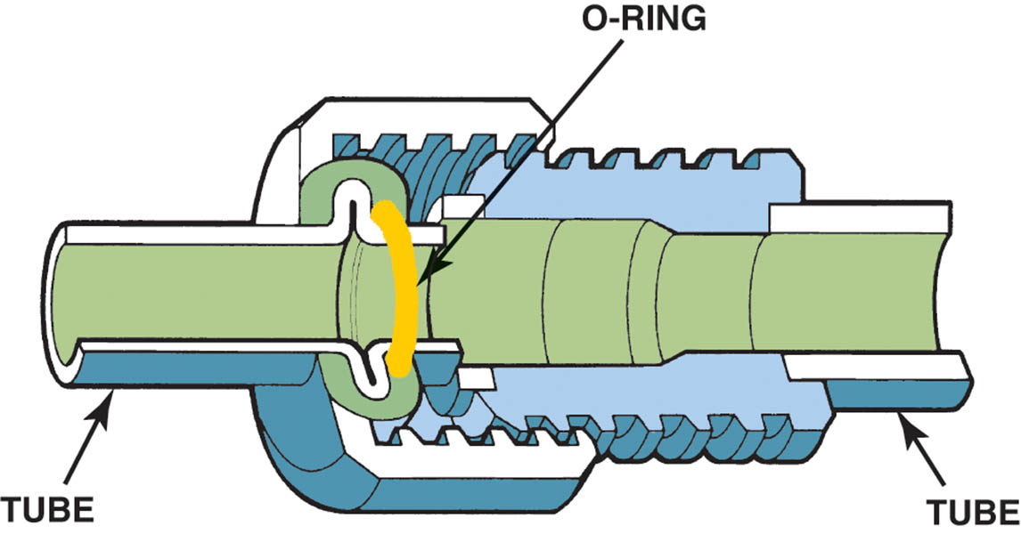
Figure 67.4 O-rings are usually made of neoprene rubber or highly saturated nitriles (HSN) to withstand high temperatures and flexing. O-rings should be changed during a retrofit procedure

Slide 14
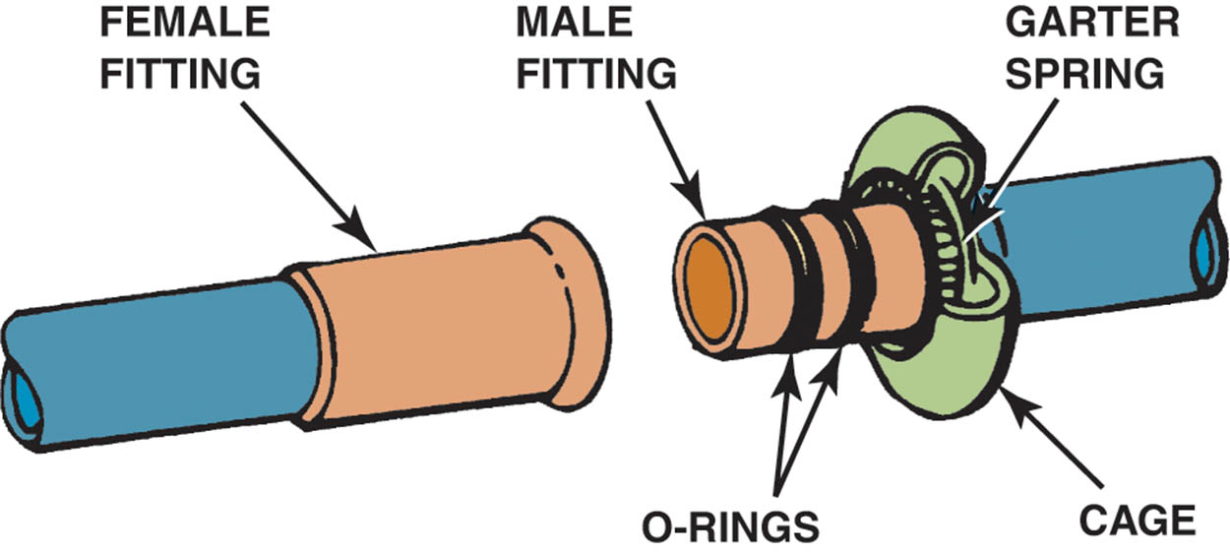
Figure 67.5 A Ford spring-lock coupling

Slide 15
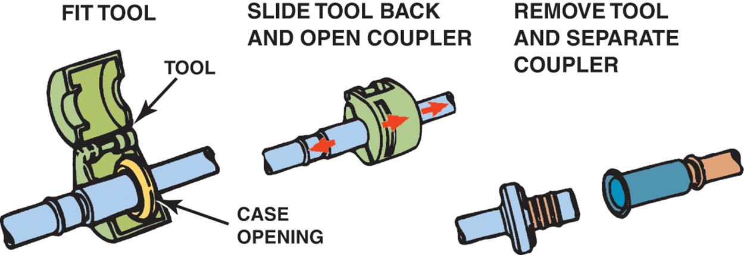
Figure 67.6 A special tool is needed to remove and install the Ford spring-lock coupling

Slide 16
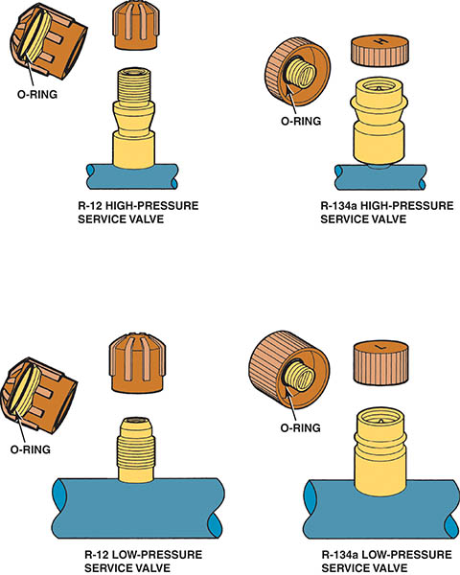
Figure 67.7 The service cap O-ring becomes the primary seal if the service valve leaks

Slide 17
QUESTION 2: ?
Why should a refrigerant identifier be used before recovering the refrigerant?

Slide 18
ANSWER 2:
To detect the presence of contaminated refrigerant or sealer.

Slide 19
EVACUATION PROCEDURES
Evacuation means that a vacuum is applied to the system to vaporize any moisture that may be in the system.
For best results, the vacuum should be higher than 29-in. Hg.

Slide 20
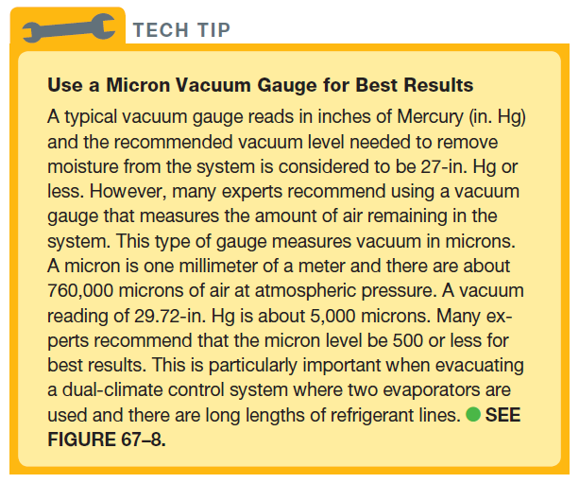
Tech Tip

Slide 21
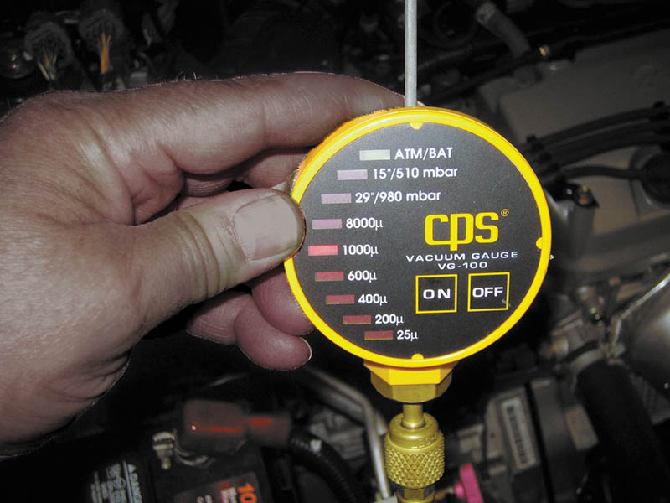
Figure 67.8 An air-conditioning vacuum gauge that reads in microns

Slide 22
NONCONDENSABLE GASSES
Refrigerant should be checked for the presence of air, which is called a non-condensable gas.
There are two ways to determine if there is air (non-condensable gas) in the refrigerant, including:
  Use a refrigerant identifier.
  Measure the temperature and pressure of the refrigerant.

Slide 23
REFRIGERANT RECYCLING
After refrigerant has been recovered, it needs to be recycled for further use.
Most air-conditioning machines include the ability to recycle the refrigerant to the following SAE J1991 specification:
  Moisture
  Refrigerant oil
  Non-condensable gases (air)

Slide 24
QUESTION 3: ?
What are two ways a non-condensable gas can be identified?

Slide 25
ANSWER 3:
A refrigerant identifier or by measuring the refrigerant temperature and pressure.

Slide 26
RECHARGING A SYSTEM
After the system has been evacuated, it can be recharged with refrigerant.
Most vehicles have a placard or sticker that indicates the correct amount of refrigerant to use.
Follow the operating instructions for the equipment you are using.

Slide 27
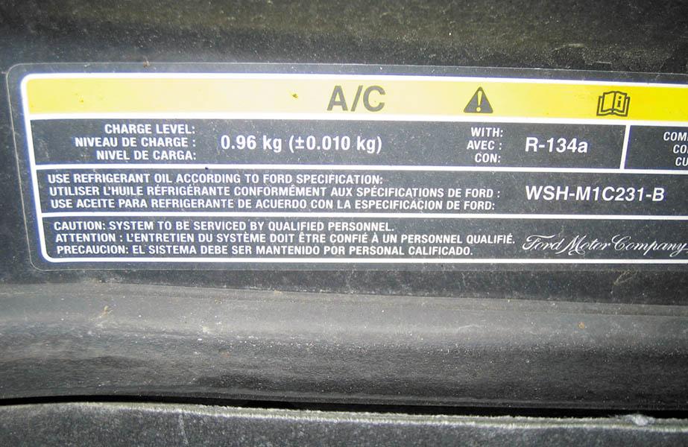
Figure 67.9 A typical under-hood sticker that identifies the refrigerant and the amount needed to charge the system in kilograms (0.96 kg is equal to 0.44 pounds)

Slide 28
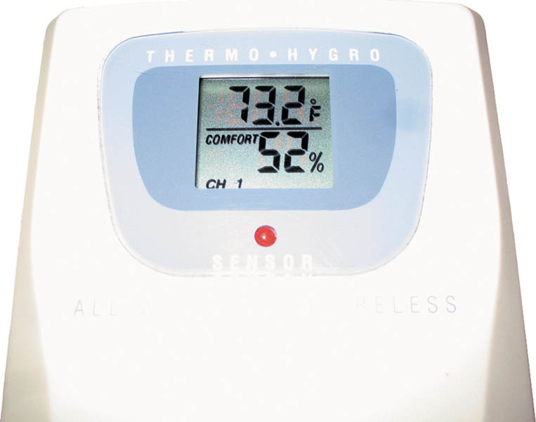
Figure 67.10 A temperature and humidity gauge is a useful tool for air-conditioning work. The higher the relative humidity, the more difficult it is for the air-conditioning system to lower the temperature inside the vehicle

Slide 29
RETROFITTING A CFC-12 SYSTEM TO A HCF-134A SYSTEM
Due to environmental and cost concerns, many service technicians are retrofitting (adapting) CFC-12 systems to HFC-134a systems.
Whenever making the change, several tasks have to be performed, including:
  Replacing the service fittings, replacing the oil, and changing the labeling. It may also be necessary to replace hoses, O-rings, switches, condensers, and compressors.

Slide 30
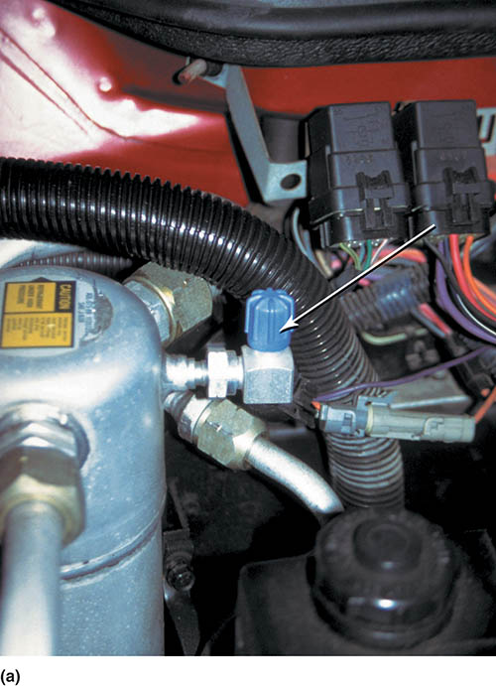
Figure 67.11 (a) When a system is retrofitted from CFC-12 to HFC-134a, the proper service fittings have to be used to help assure that cross-contamination does not occur

Slide 31
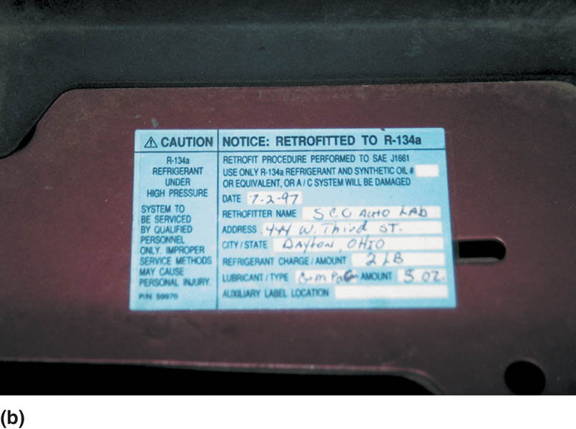
Figure 67.11 (b) An under-hood sticker is also installed indicating that the system was retrofitted to HFC-134a and when it was done and by whom

Slide 32
COMPRESSOR SERVICE (1 OF 2)
Compressor Drive Belt
  Always check the compressor drive belt(s) whenever servicing the air-conditioning system and replace as needed.
Compressor Clutch Service
  Some compressors allow for the replacement of the clutch and the adjustment of the air gap according to service information instruction.

Slide 33
COMPRESSOR SERVICE (2 OF 2)
Compressor Removal
  If testing indicates the compressor has failed it should be replaced after the refrigerant is recovered.

Slide 34
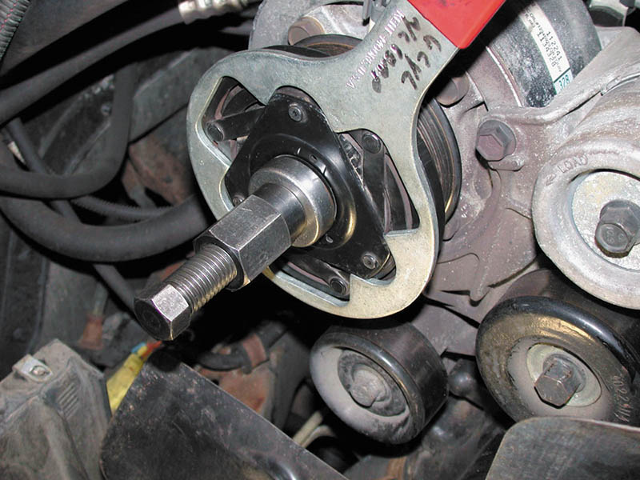
Figure 67.12 A special tool is needed to remove and install the magnetic clutch on the air-conditioning compressor

Slide 35
CONDENSER SERVICE
Inspect the condenser for airflow restriction and clean as needed.
Often a “fin comb” is needed to straighten the fins of the condenser, which may have been bent by road debris.
If the condenser is replaced, ensure the proper amount of refrigerant oil is added back into the system.

Slide 36
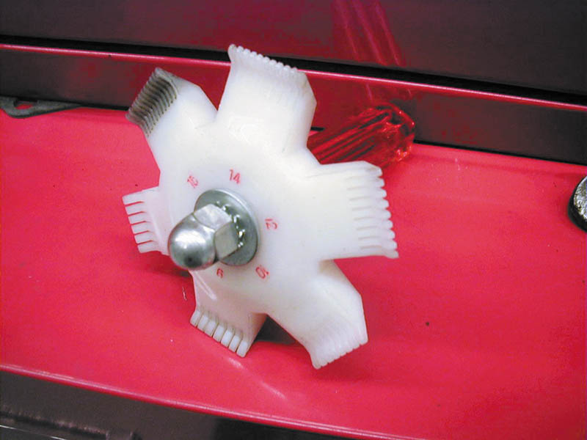
Figure 67.13 A fin comb is used to straighten the fins on the condenser to help increase airflow and heat transfer

Slide 37
EVAPORATOR SERVICE
If the evaporator has been tested and found to be clogged or leaking, it has to be replaced.
In most vehicles this is a major job involving disassembly of the dash.

Slide 38
RECEIVER /DRIER OR ACCUMULATOR/DRIER SERVICE
Most experts recommend that the receiver/drier or accumulator/drier be replaced anytime the refrigerant system is opened and other repairs or services are being performed.
After replacing these items, determine the quantity of refrigerant oil so that the proper amount can be added to the system when it is recharged.

Slide 39
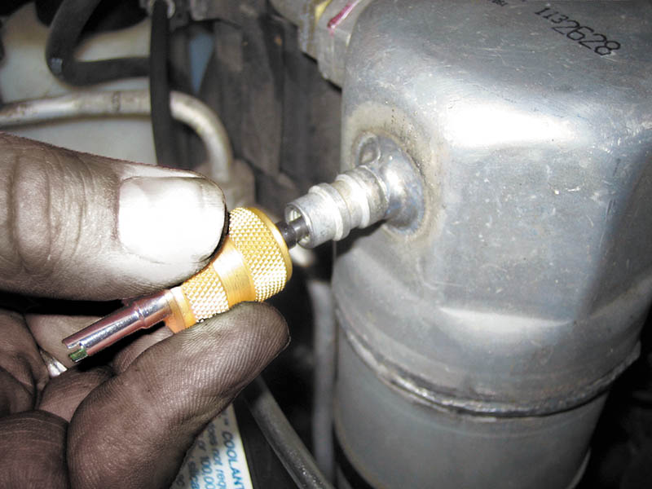
Figure 67.14 Always be sure that the service valves are snug before evacuating the system. They are a common place for small refrigerant leaks

Slide 40
ORIFICE TUBE/ EXPANSION VALVE SERVICE
If the orifice tube is found to be clogged or the expansion valve has been determined to be not operating correctly, they require replacement.
Always follow the vehicle manufacturer’s recommended replacement procedures and adhere to all precautions.

Slide 41

Copyright

