Slide 1

Automotive Technology Principles, Diagnosis, and Service
Sixth Edition
Chapter 66
Heating and Air-conditioning System Diagnosis
Copyright © 2018, 2015, 2011 Pearson Education, Inc. All Rights Reserved

Slide 2
LEARNING OBJECTIVES
66.1 List the steps to diagnose HVAC problems.
66.2 Explain how to diagnose a heating system problem.
66.3 Describe how to check the performance of the A/C system.
66.4 Explain the procedures to measure temperature and pressure in A/C systems.

Slide 3
HVAC DIAGNOSTIC PROCEDURE
Step 1: Verify the customer complaint (concern).
Step 2: Do a through visual inspection.
Step 3: Check for diagnostic trouble codes.
Step 4: Check for related technical service bulletins (TSBs).
Step 5: Determine the root cause.
Step 6: Verify the repair.

Slide 4
HEATER DIAGNOSIS
Thermostat Diagnosis
A thermostat that is stuck open will cause the engine to be slow to warm, resulting in poor heat.
Heater Core
If both heater hoses are not hot, the heater control valve may be defective.
A restricted heater core can cause a lack of heat.
Coolant Level
Make sure the cooling system is full and no air pockets exist.

Slide 5
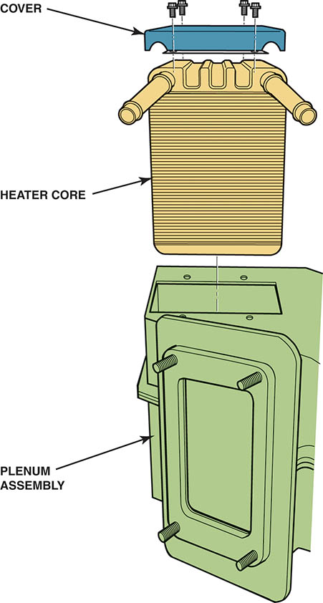
Figure 66.1 T he heater core is mounted inside a heater plenum chamber where air passes over it to absorb heat from the warmed engine coolant

Slide 6
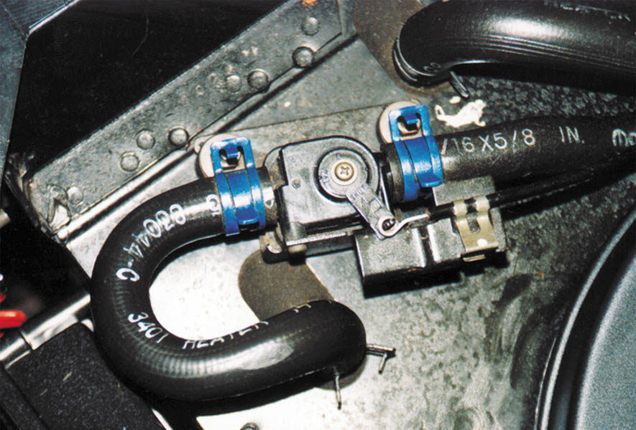
Figure 66.2 A cable-controlled heater control valve. This valve is normally open, allowing engine coolant to flow through the heater core. When the air conditioning is switched to maximum cooling, the valve shuts off the flow of coolant to the heater

Slide 7
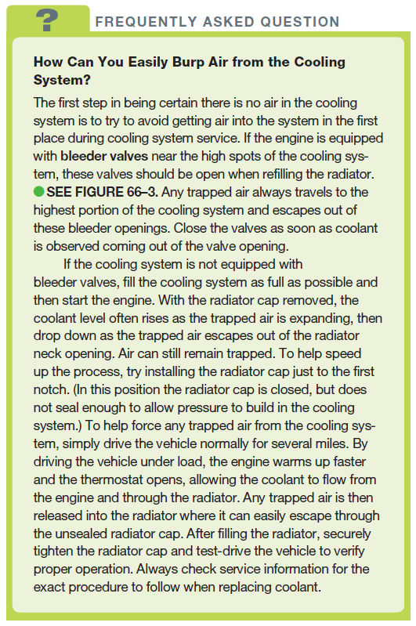
FREQUENTLY ASKED QUESTION

Slide 8
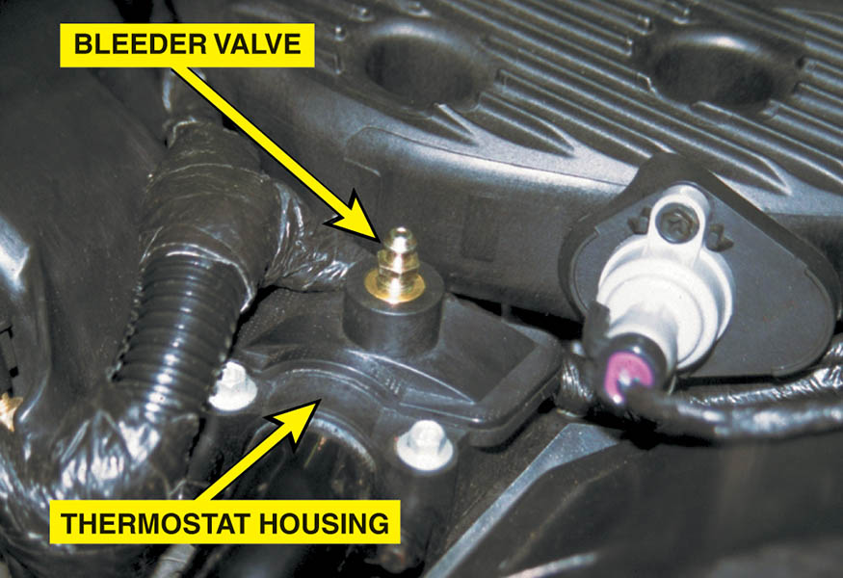
Figure 66.3 Many engines are equipped with a bleeder valve to permit a technician to bleed any trapped air from the cooling system. The valve is loosened as coolant is poured into the system. Because air is lighter than coolant, the air tends to float toward the highest part of the cooling system

Slide 9
QUESTION 1: ?
How will low coolant levels affect the performance of the heater?

Slide 10
ANSWER 1:
Low coolant levels will result in a lack of heat.

Slide 11
CHECKING AC SYSTEM PERFORMANCE
Step 1: Operate the system at 1500-2000 PRM for five minutes.
Step 2: Verify the compressor clutch is engaged.
Step 3: Measure the air temperature at the center outlet. Should be 35°F to 45°F.
Step 4: Identify the refrigerant
Step 5: Connect pressure gauges and obtain low and high pressure readings.

Slide 12
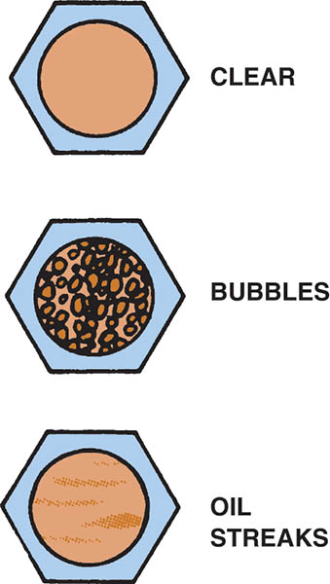
Figure 66.4 Many older CFC-12 systems are equipped with a sight glass either on or near the receiver–drier. A fully-charged (or completely empty) system is indicated by a clear sight glass. Bubbles or foam indicate that the system is not fully charged. An empty system may have oil streaks on the sight glass being moved by the vapor remaining in the system

Slide 13
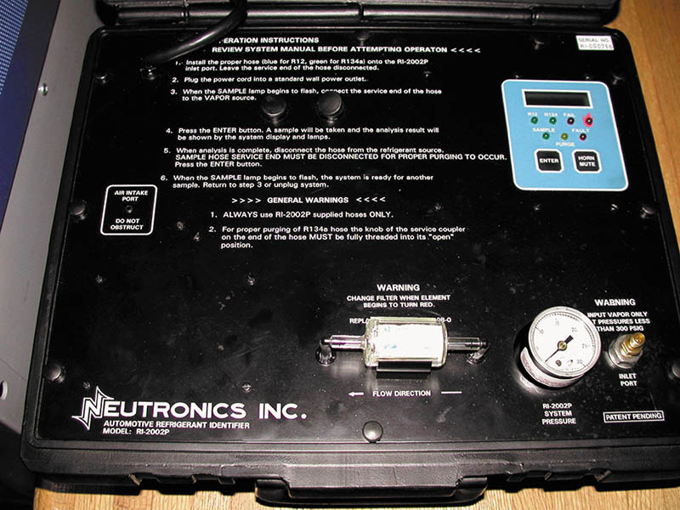
Figure 66.5 A typical refrigerant identification machine. The readout indicates what kind of refrigerant is in the system. If a blend or some other contaminated refrigerant is discovered, it should be recovered and stored in a separate container to keep it from contaminating fresh refrigerant

Slide 14
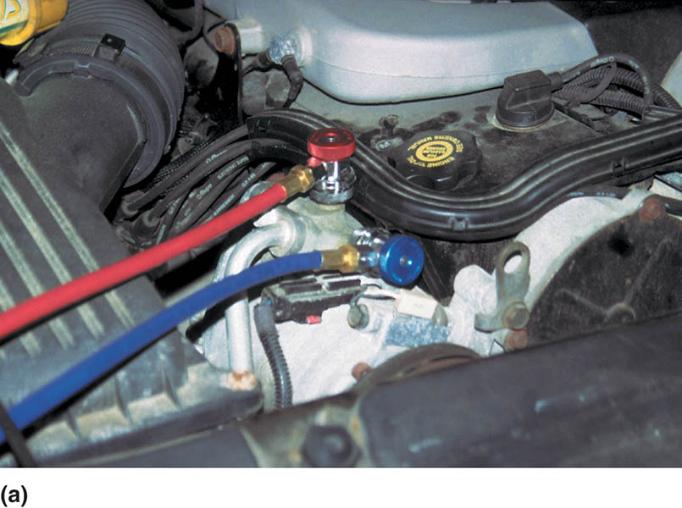
Figure 66.6 (a) Both high-pressure (red) and low-pressure (blue) hoses have been attached to the vehicle

Slide 15
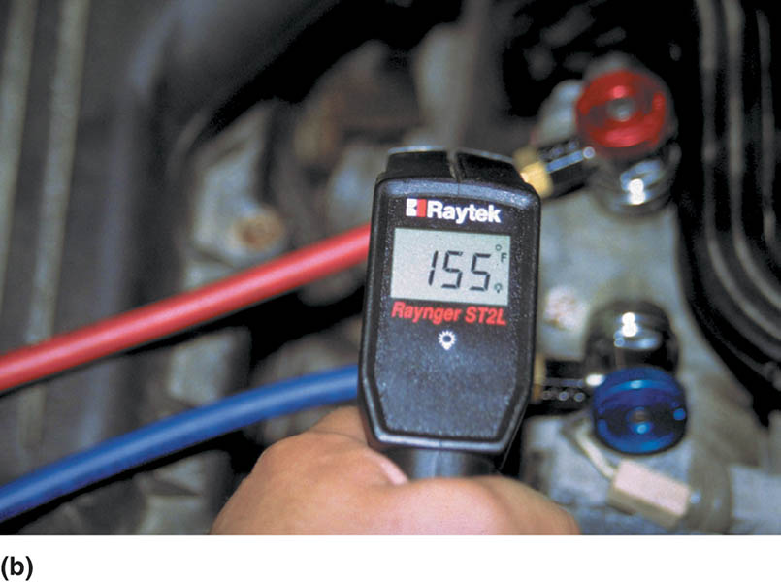
Figure 66.6 (b) High-side pressure can be compared to the temperature of the outlet from the compressor. Here a service technician is using an infrared pyrometer to measure the temperature

Slide 16
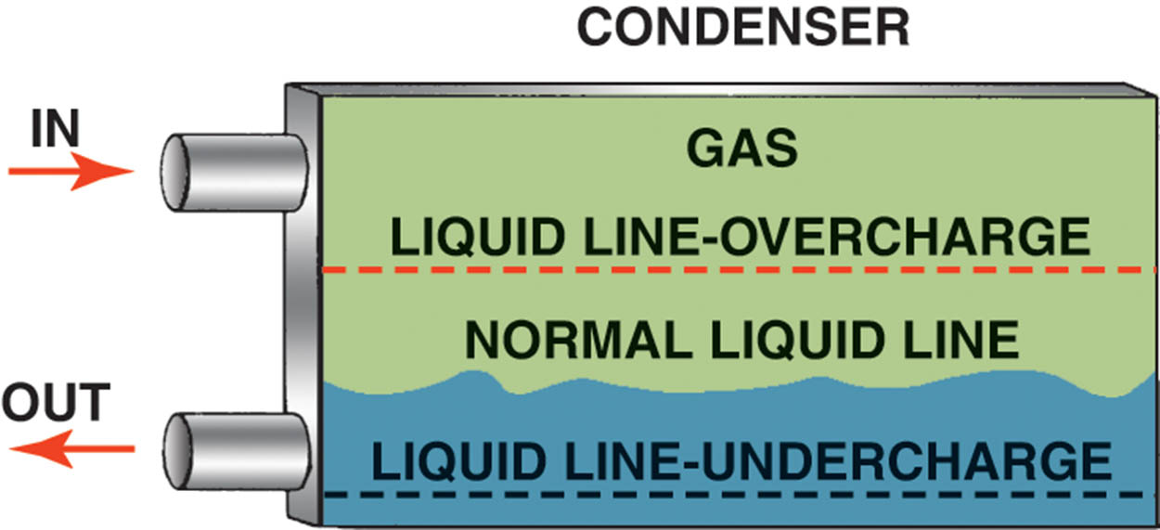
Figure 66.7 Hot refrigerant condenses in the condenser when it loses its heat to the outside air. Note how the level of the liquid line changes when undercharged or overcharged

Slide 17
TEMPERATURE AND PRESSURE MEASUREMENTS
Temperature and pressure are directly related.
The high side pressure is directly related to the amount of heat that needs to be removed at the condenser.
The low side pressure indicates the boiling point of the refrigerant in the evaporator.
Low refrigerant levels, a lack of air flow and contaminated refrigerant can affect these values.

Slide 18
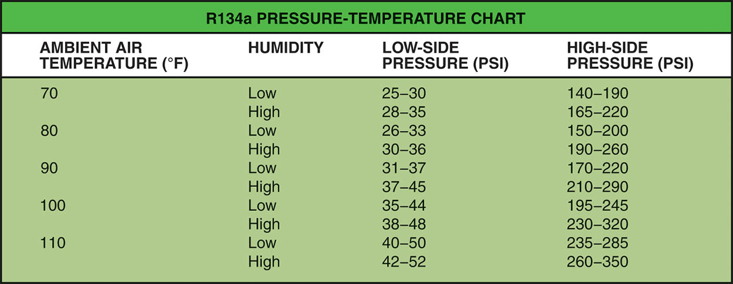
Figure 66.8 The average R-134a pressure–temperature readings during a performance test. The high-side pressure of R-12 systems is lower at higher temperatures. With the engine off and the system allowed to equalize, both low-side and high-side pressures should be equal

Slide 19
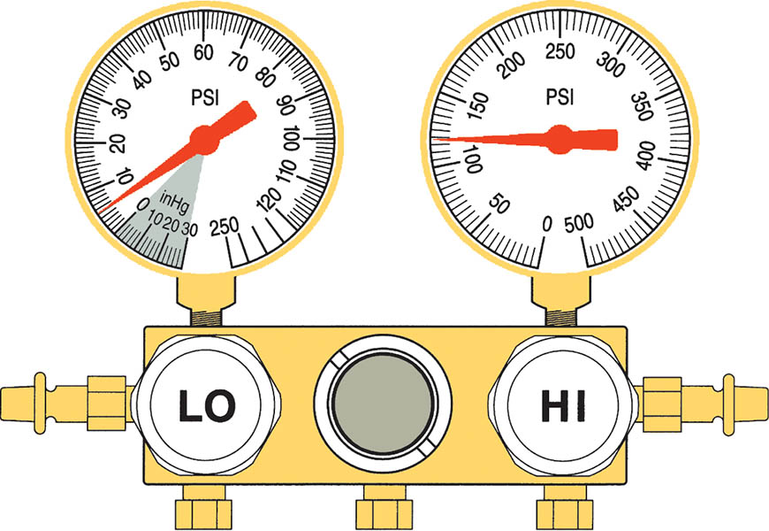
Figure 66.9 When both low- and high-side pressures are low, the system is undercharged with refrigerant

Slide 20
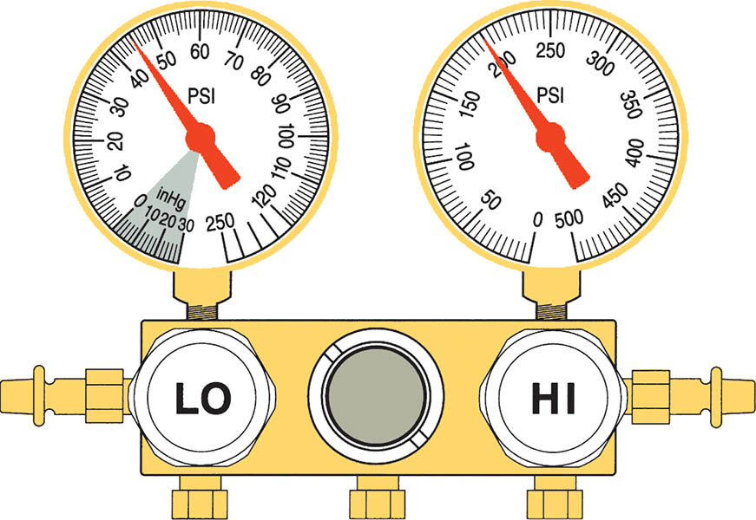
Figure 66.10 Both low- and high-side pressures higher than normal indicate that the system is overcharged with refrigerant

Slide 21
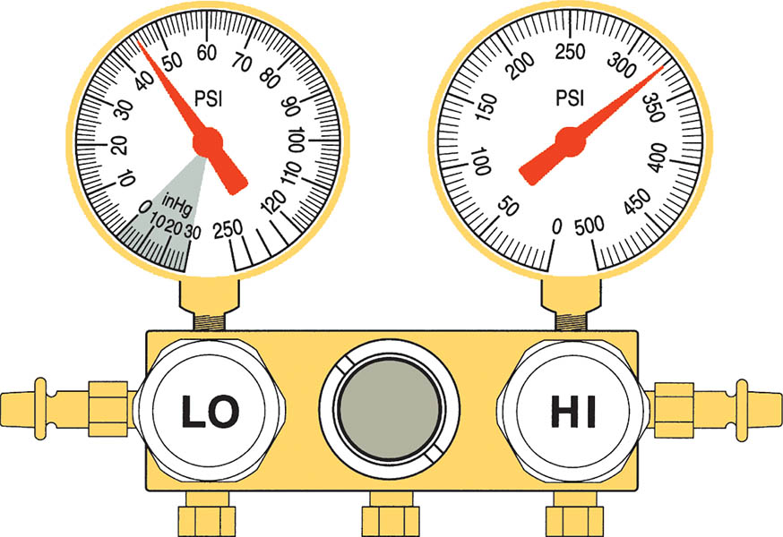
Figure 66.11 Lack of proper airflow across the condenser is usually the cause of this condition

Slide 22
QUESTION 2: ?
What affect will low refrigerant levels have on the pressure readings?

Slide 23
ANSWER 2:
The low and high pressure readings will both read low.

Slide 24
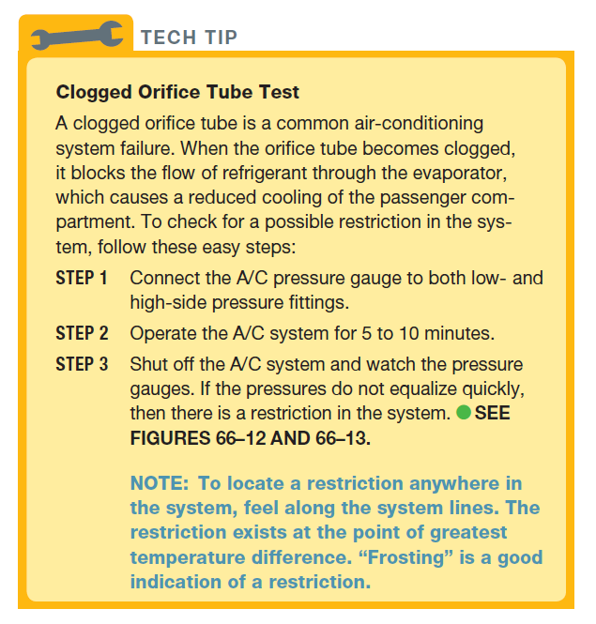
Tech Tip

Slide 25
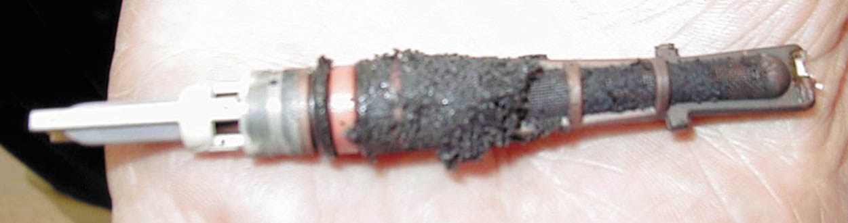
Figure 66.12 A clogged orifice tube

Slide 26
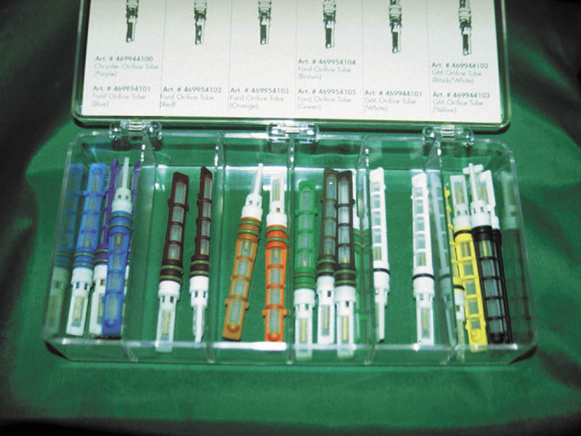
Figure 66.13 Assortment of orifice tubes. Note that each is color coded and identified on the lid of the assortment. Even though some technicians have purposely installed an orifice tube with a larger opening in an attempt to increase cooling, it is always safe to use the exact orifice tube specified for the vehicle being serviced

Slide 27
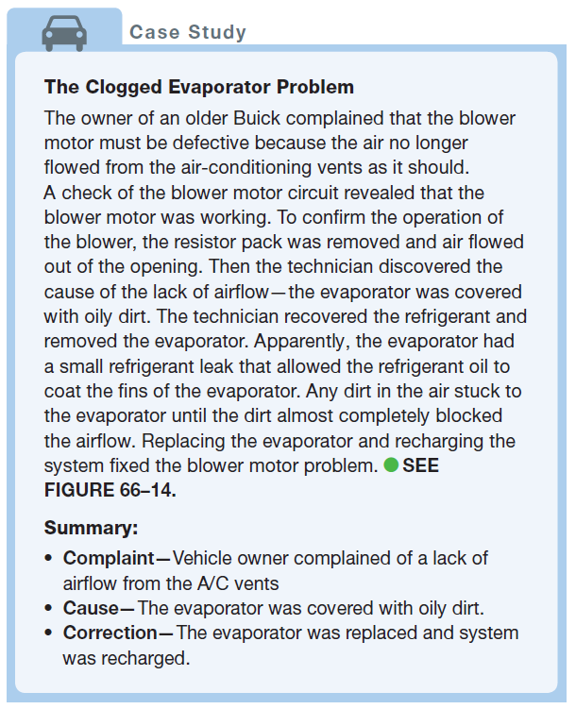
CASE STUDY

Slide 28
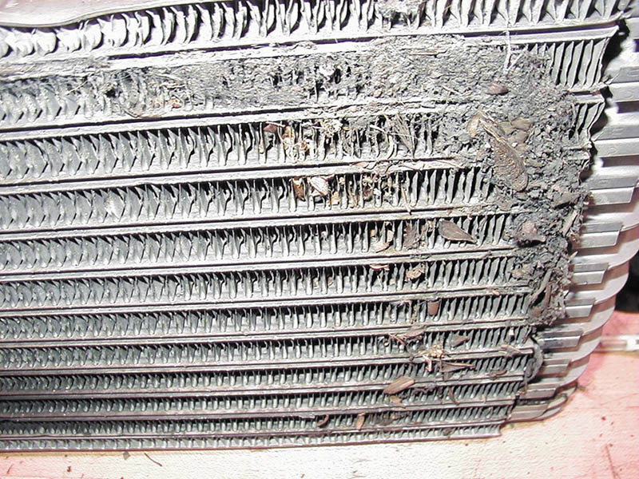
Figure 66.14 A partially clogged evaporator

Slide 29
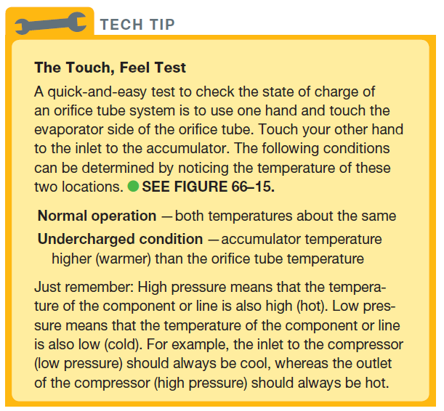
TECH TIP

Slide 30
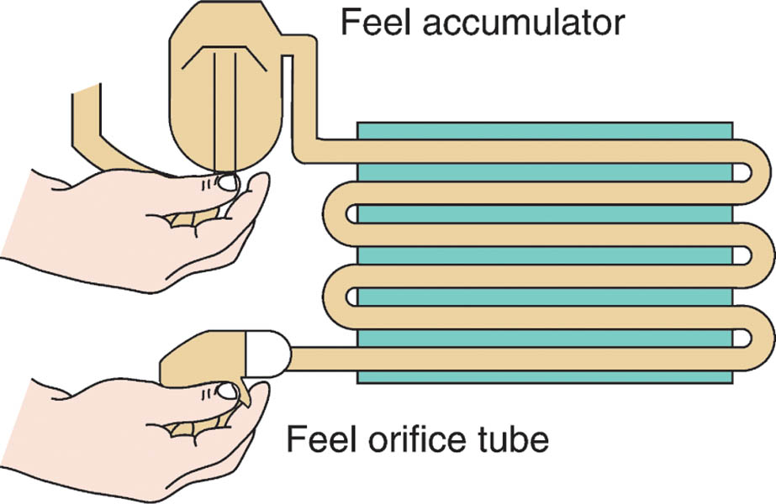
Figure 66.15 If the system is fully charged, the outlet temperature of the line leaving the evaporator should be about the same as the temperature of the line entering the evaporator after the expansion valve

Slide 31
LEAK DETECTION
Visual Inspection
Electronic Leak Detector
Dye in the Refrigerant
Soap Solution

Slide 32
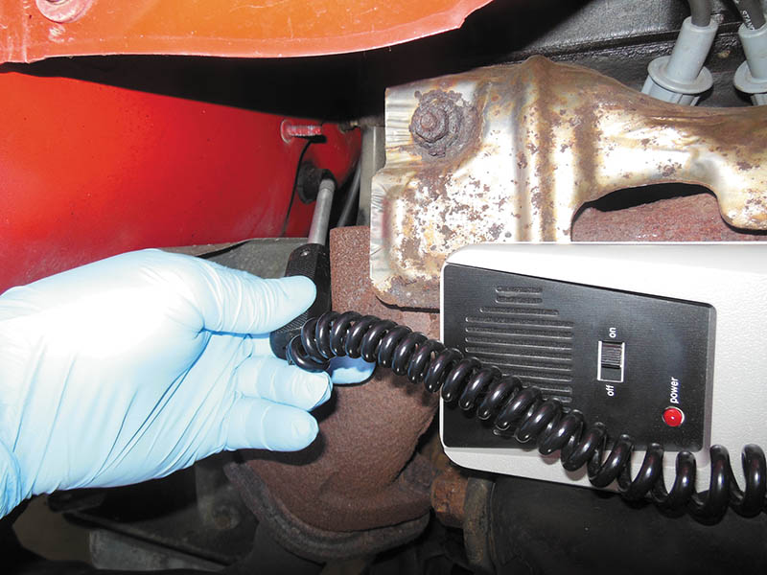
Figure 66.16 Typical electronic refrigerant leak detector. Many are capable of detecting either CFC-12 or HFC-134a

Slide 33
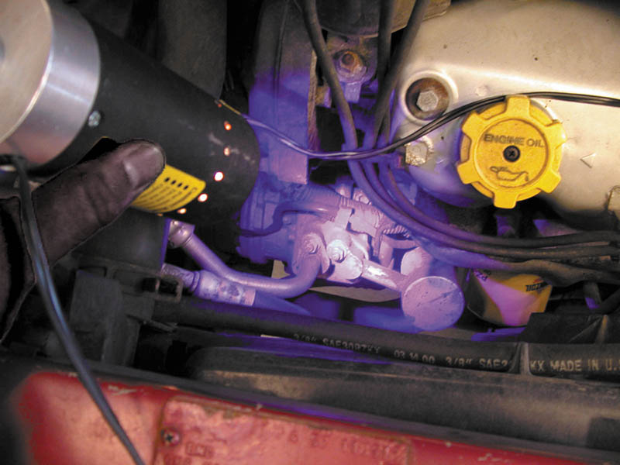
Figure 66.17 A black light being used to look for refrigerant leaks after a fluorescent dye was installed in the system

Slide 34
QUESTION 3: ?
What are the various methods that can be used to detect refrigerant leaks?

Slide 35
ANSWER 3:
Visual inspection, electronic leak detector, dye in the refrigerant, and soap solution.

Slide 36
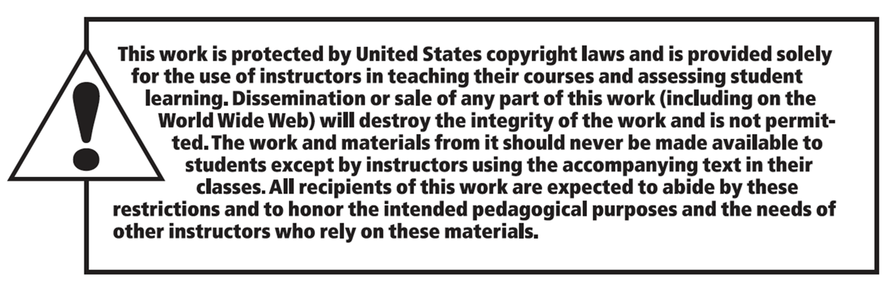
Copyright

