Slide 1

Automotive Technology Principles, Diagnosis, and Service
Sixth Edition
Chapter 64
Air Management Systems
Copyright © 2018, 2015, 2011 Pearson Education, Inc. All Rights Reserved

Slide 2
LEARNING OBJECTIVES
64.1 Discuss the different components of an air management system.
64.2 Explain airflow control and air temperature control in an A/C system.
64.3 Discuss air filtration, air ducts, and plenum and control doors.
64.4 Explain nonelectrical and electronic HVAC controls.

Slide 3
INTRODUCTION (1 OF 2)
Terminology
  A system that contains the HVAC plenum, ducts, and air doors is called the air management system.
Airflow is usually controlled by three or more doors, which are called flap doors or valves by some manufacturers.
  Air inlet door is used to select outside or inside air inlet.
  Temperature-Blend door is used to adjust air temperature.
  Mode door is used to select air discharge location.

Slide 4
INTRODUCTION (2 OF 2)
The use of these components allows the system to provide airflow under the following conditions:
  1. Fresh outside air or recirculated air
  2. Air conditioning
  3. Defrost
  4. Heat.
The control head is connected to various parts through electrical connections, vacuum connections, mechanical cables, or a combination of these.

Slide 5
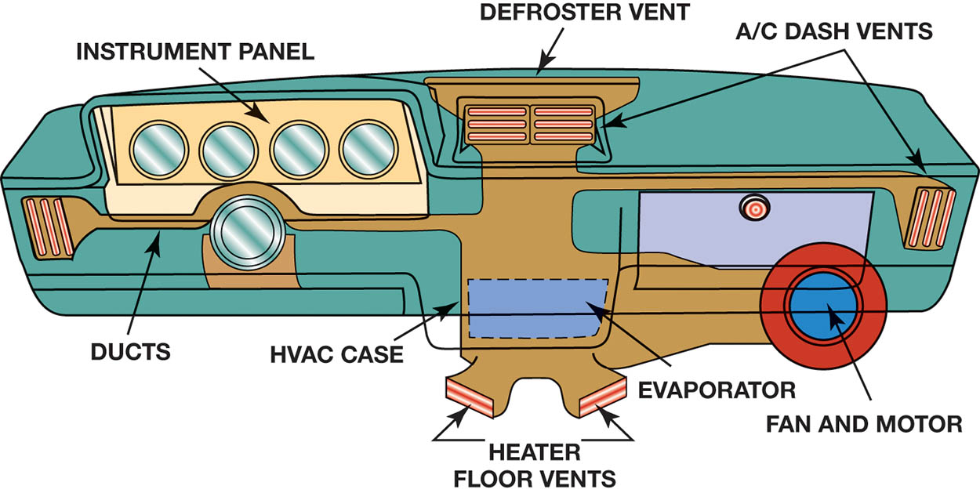
Figure 64.1 The HVAC airflow is directed toward the windshield, dash or floor vents, or combinations, depending on the system settings.

Slide 6
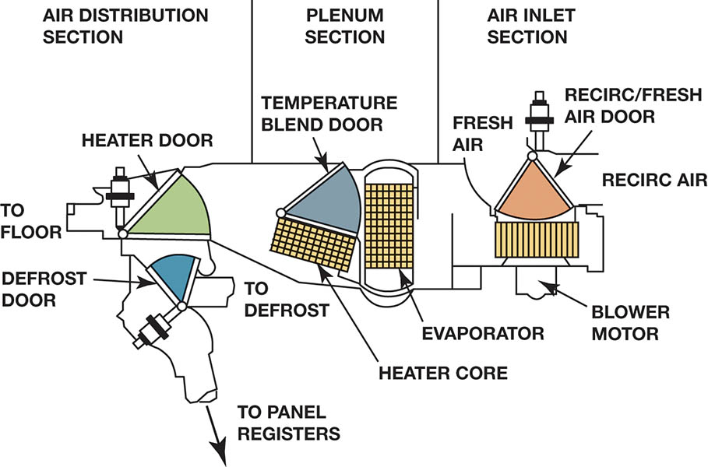
Figure 64.2 The three major portions of the A/C and heat system are air inlet, plenum, and air distribution. The shaded portions show the paths of the four control doors.

Slide 7
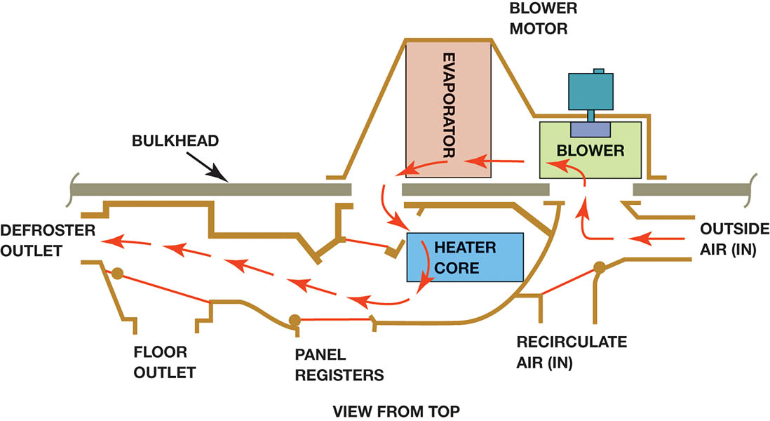
Figure 64.3 In the defog or defrost mode position, the air is directed through the evaporator to remove the moisture from the air before being sent through the heater core to warm the air.

Slide 8
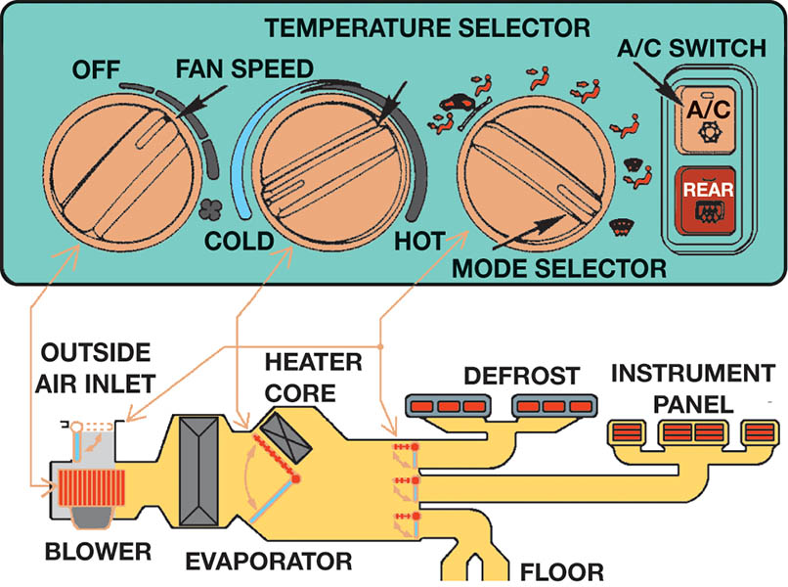
Figure 64.4 Most HVAC control heads include a control for turning units on and setting the mode of operation, a control for adjusting the temperature, and a control for the fan speed.

Slide 9
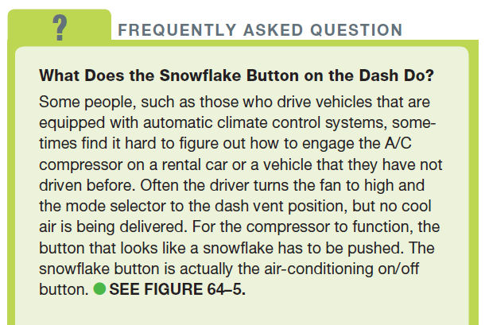
FREQUENTLY ASKED QUESTION

Slide 10
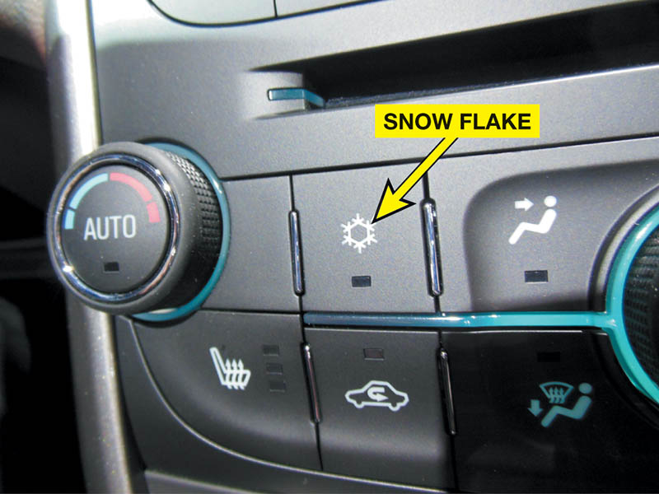
Figure 64.5 The A/C compressor is turned on or off by depressing the “snowflake” button on the dash.

Slide 11
QUESTION 1: ?
What are the three main HVAC doors?

Slide 12
ANSWER 1:
Mode, Temperature, Air Inlet.

Slide 13
AIRFLOW CONTROL
Operation
  The amount or volume of HVAC air is controlled by blower speed.
Type of Doors
  A flap door that swings about 45° to 90°.
  A rotary door has openings at the side and edge, and the door rotates about 100° to one of four different positions.
  A sliding mode door, also called a rolling door, is used when space in the instrument panel is small.

Slide 14
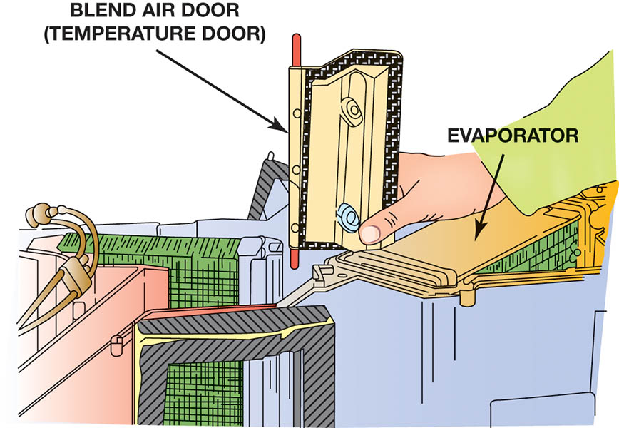
Figure 64.6 Many air control doors swing on their upper and lower pivots, shown in red.

Slide 15
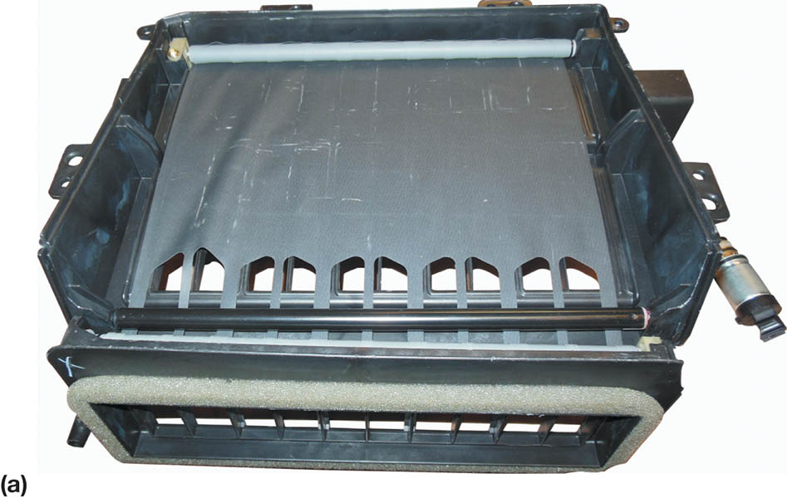
Figure 64.7 (a) A typical rolling-door type HVAC door that is shown almost fully closed

Slide 16
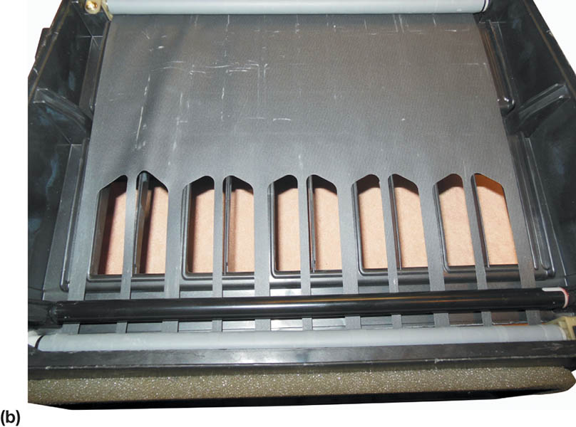
Figure 64.7 (b) The same door is shown about half open

Slide 17
AIR TEMPERATURE CONTROL
Temperature Control Using Airflow
  The air is heated or cooled as it passes through the evaporator and heater core.
Temperature Control Using a Variable Compressor
  Compressor displacement is adjusted to cool the evaporator just enough to cool the air to the desired temperature.

Slide 18
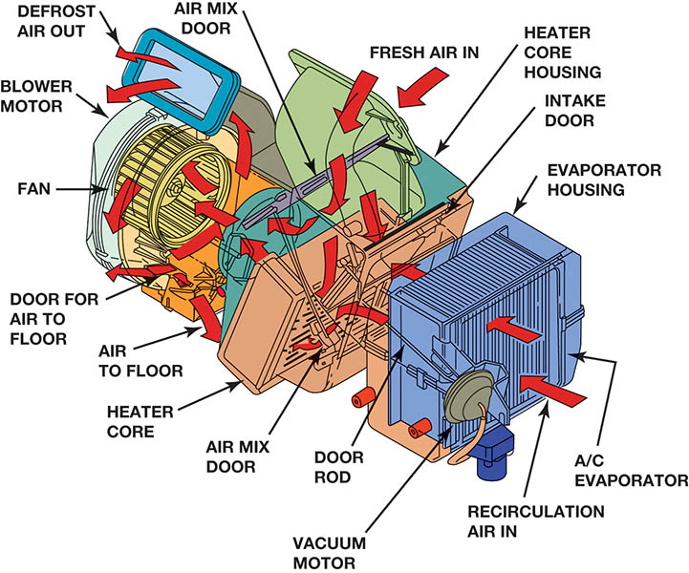
Figure 64.8 The blower motor forces air to flow through the A/C evaporator to remove moisture from the air before it is sent through the heater core where the air is heated before being directed to the defrost and floor vents.

Slide 19
AIR FILTRATION
Terminology
  Most HVAC systems include a cabin filter to remove small dust or pollen particles from the incoming airstream.
This filter is also called a/an:
  HVAC air filter
  Interior ventilation filter
  Micron filter
  Particulate filter
  Pollen filter

Slide 20
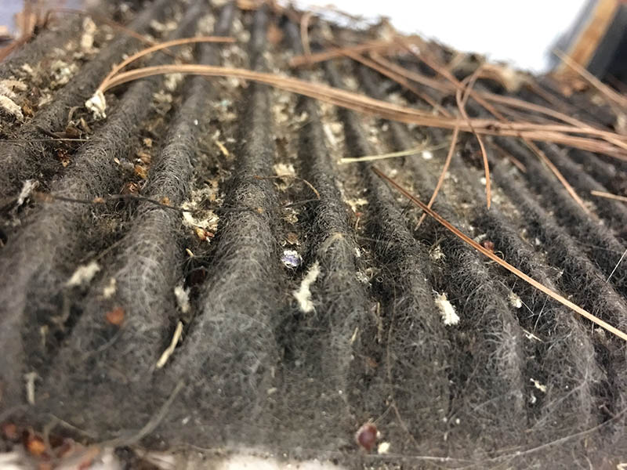
Figure 64.9 An extremely dirty cabin filter removed from a Subaru Legacy. The owner had complained about a lack of airflow from the air-conditioning vents. A new cabin filter corrected the concern.

Slide 21
CASES AND DUCTS
Construction
  The evaporator and heater housing is molded from reinforced plastic and contains the following components:
  Evaporator
  Heater Core
  Blower Motor
  Most of the Air Control Doors
The housing, called a plenum, is connected to the air inlets and outlets using formed plastic.

Slide 22
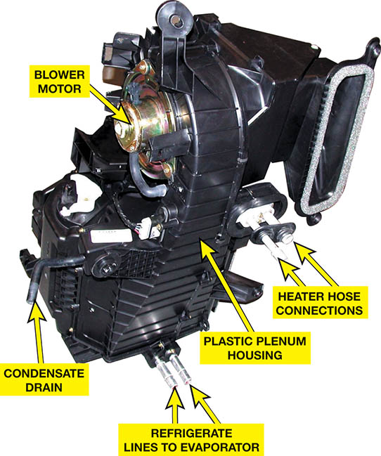
Figure 64.10 A typical HVAC housing that often has to be removed from the vehicle as an assembly to get access to the heater core and evaporator.

Slide 23
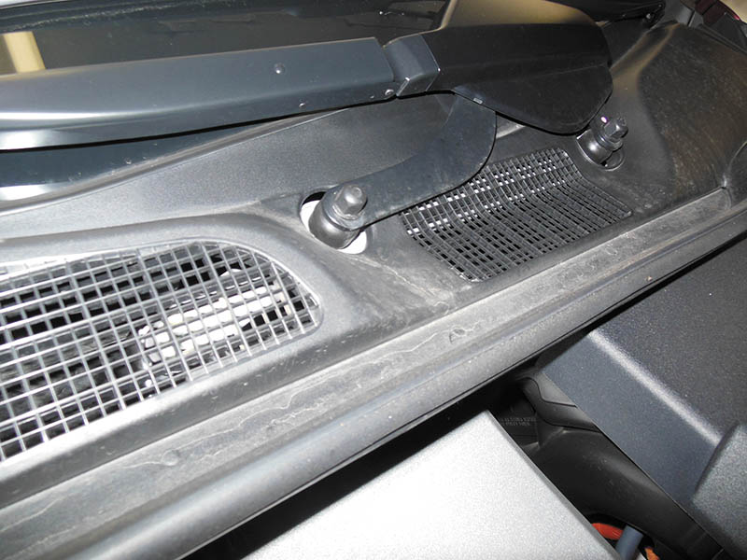
Figure 64.11 The air inlet to the HVAC system is usually at the base of the windshield and covered with a plastic screen (grille) to help keep debris, such as leaves, from entering the system.

Slide 24
PLENUM AND CONTROL DOORS (1 OF 4)
Air Inlet Control Door
  Fresh Air Door
  Recirculation Door
  Outside Air Door
Door can be positioned to allow:
  Fresh air to enter while shutting off the recirculation opening.
  Air to return or recirculate from inside the vehicle while shutting off fresh air
  A mix of fresh air and return air.

Slide 25
PLENUM AND CONTROL DOORS (2 OF 4)
Temperature-Blend Door
  The door used to control interior temperature
Some other names for this door include:
  Air-mix door
  Temperature door
  Blend door
  Diverter door
  Bypass door

Slide 26
PLENUM AND CONTROL DOORS (3 OF 4)
Air Distribution and Outlets
  Air from the plenum can flow into one or two of three outlet paths:
  1. The A/C registers (vents) in the face of the instrument panel
  2. The defroster registers at the base of the windshield
  3. The heater outlets at the floor under the instrument panel.
Airflow to these ducts is controlled by one or more mode doors.

Slide 27
PLENUM AND CONTROL DOORS (4 OF 4)
Mode/function control sets the doors as follows:
  A/C: in-dash registers with outside air inlet
  Max A/C: in-dash registers with recirculation
  Heat: floor level with outside air inlet
  Max Heat: floor level with recirculation
  Bi-level: both in-dash and floor discharge
  Defrost: windshield registers
Dual-zone air distribution allows the driver and passenger to select different temperature settings.

Slide 28
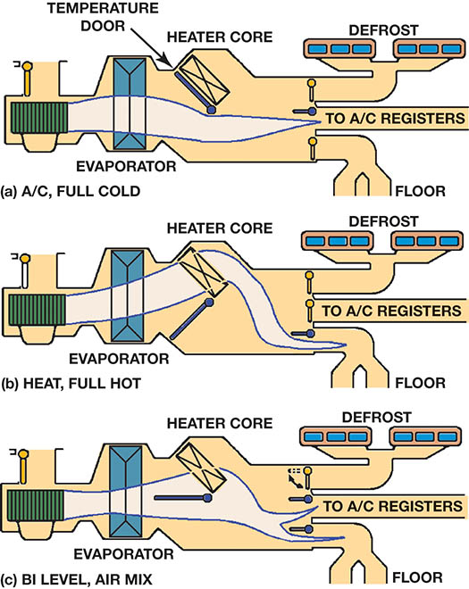
Figure 64.12 (a) The temperature and mode doors swing to direct all of the cool air past the heater core

Slide 29
Figure 64.12 (b) through the core to become hot

Slide 30
Figure 64.12 (c) or to blend hot and cool air

Slide 31
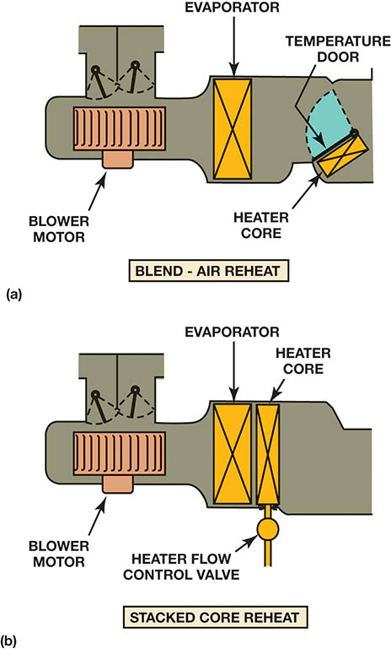
Figure 64.13 (a) In a blend-air system, all of the air is cooled. Then some of it is reheated and blended with the cool air to get the right temperature.

Slide 32
Figure 64.13 (b) In a reheat system, all of the air is cooled and then reheated to the correct temperature

Slide 33
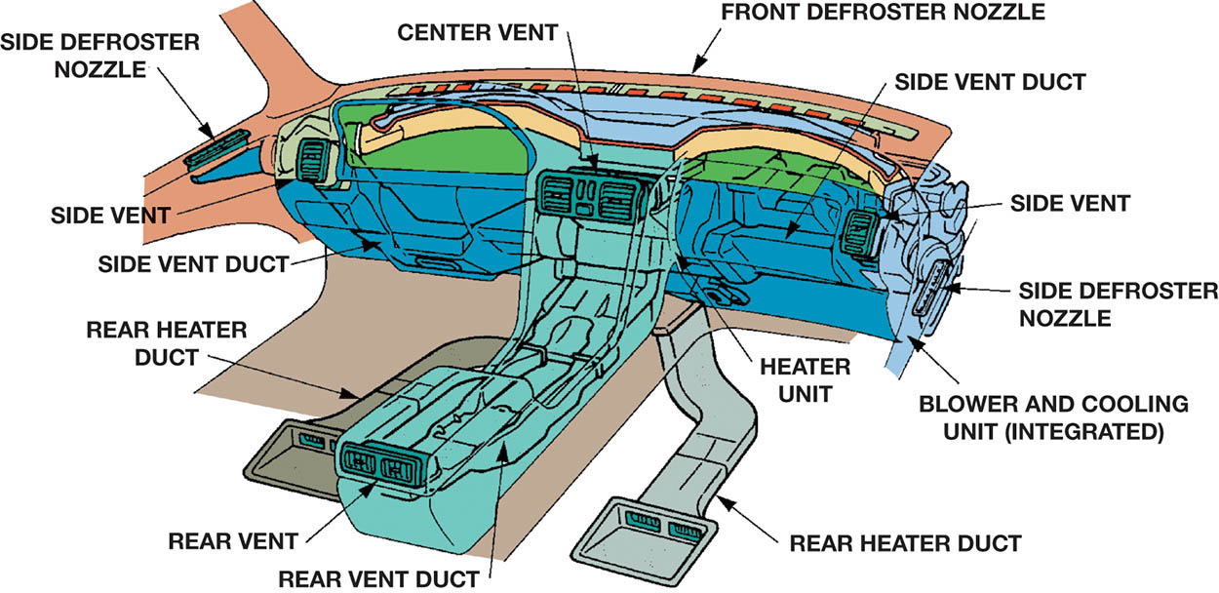
Figure 64.14 Ducts are placed in the center console or on the floor under the front seats to provide heated and cooled air to the rear seat passengers.

Slide 34
NON-ELECTRIC HVAC CONTROLS
Cable-Operated Systems
  Most early control heads used purely mechanical operation for the doors, and one or more cables connected the function lever to the air inlet and mode doors.
Vacuum-Operated Systems
  Many vehicles use vacuum actuators, sometimes called vacuum motors, to operate the air inlet and mode doors.
  The doors are controlled by a vacuum valve that is operated by the control head.

Slide 35
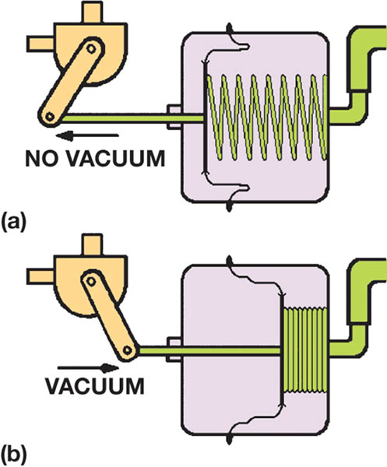
Figure 64.15 (a) With no vacuum signal, the spring extends the actuator shaft to place the door in a certain position. (b) A vacuum signal pulls the shaft inward and moves the door to the other position.

Slide 36
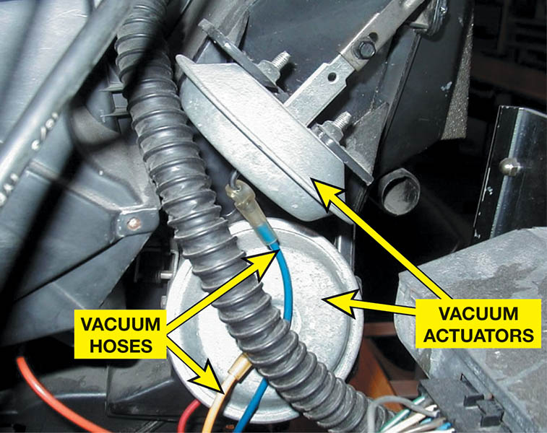
Figure 64.16 Many older vehicles used vacuum actuators to move the HVAC doors. When vacuum actuators operate, they alter the air–fuel mixture in the engine. Because vacuum controls affect engine operation and, therefore, emissions, recent vehicles use electric control systems.

Slide 37
ELECTRONIC HVAC CONTROLS (1 OF 2)
Overview
  Most recent vehicles use electrical function switches at the HVAC control head.
  The system uses an electric actuator(s) (motor) to operate the air distribution and temperature-blend doors.
Two-Wire Actuators
  A typical two-wire actuator rotates when electric impulses are sent to the brushes by the HVAC control head.

Slide 38
ELECTRONIC HVAC CONTROLS (2 OF 2)
Three-Wire Actuators
  A typical three-wire actuator uses a power, ground, and an input signal wire from the HVAC control module.
Five-Wire Actuators
  A five-wire actuator uses two wires to power the motor (power and ground) and three wires for a potentiometer that is used to signal the HVAC control module of the motor’s location.
An HVAC actuator may need to be calibrated after the actuator has been replaced.

Slide 39
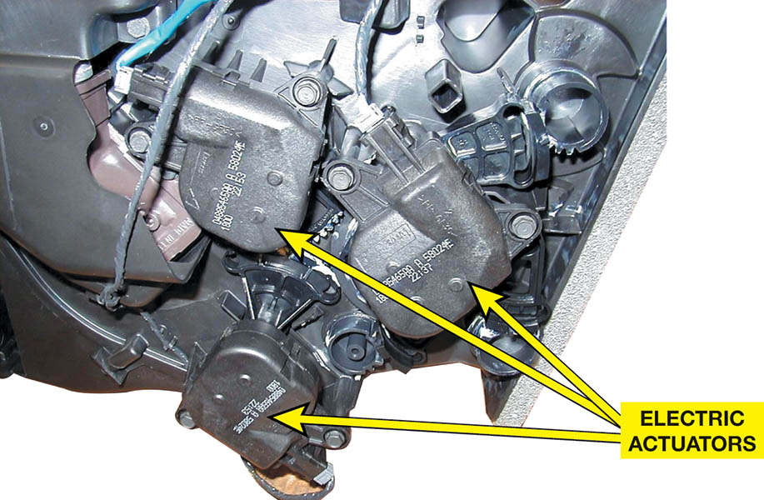
Figure 64.17 Three compact, electric actuators/servomotors operate the doors in this part of the HVAC case

Slide 40
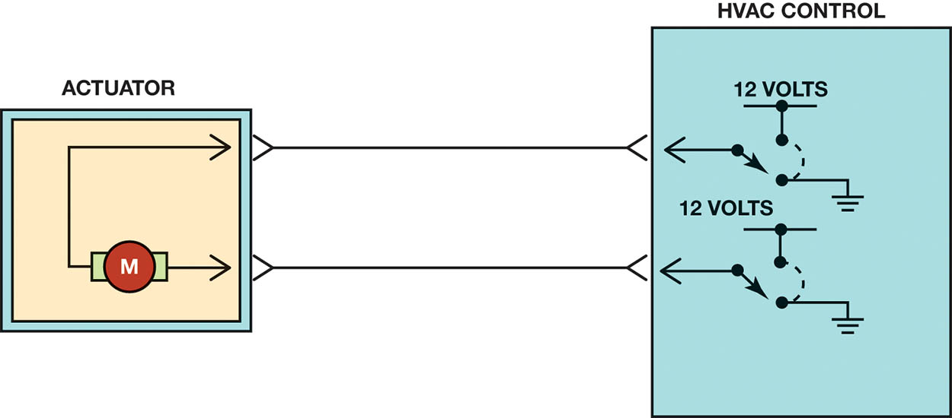
Figure 64.18 A two-wire HVAC electronic actuator where the direction of rotation is controlled by the HVAC control head or module, which changes the direction of rotation by changing the polarity of the power and ground connection at the motor.

Slide 41
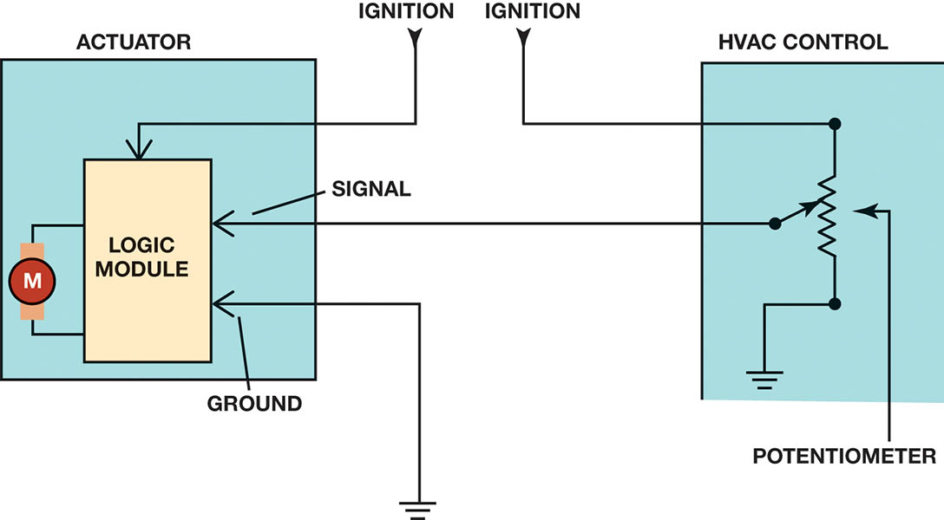
Figure 64.19 Three-wire actuators include a logic chip inside the motor assembly. The HVAC control module then sends a 0-volt to 5-volt signal to the motor assembly to control the direction of rotation.

Slide 42
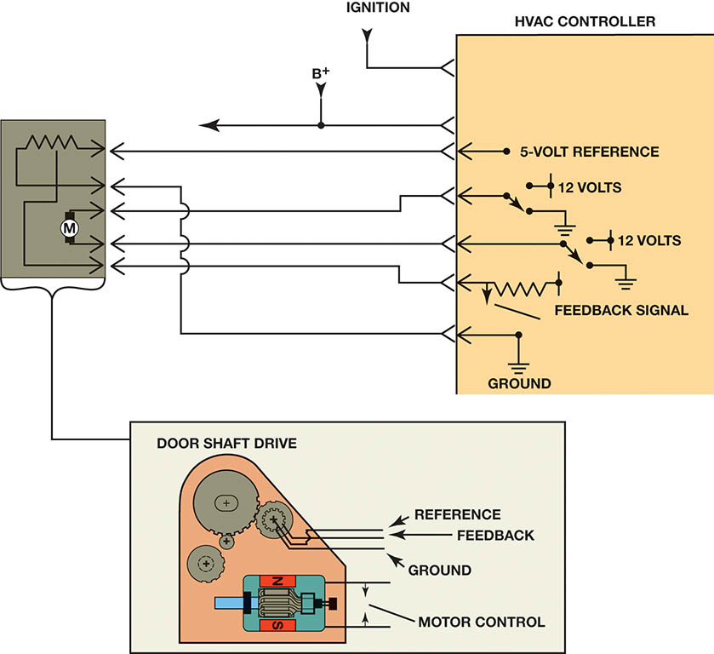
Figure 64.20 A typical five-wire HVAC actuator showing the two wires used to power the motor and the three wires used for the motor position potentiometer.

Slide 43
QUESTION 2: ?
What is the purpose of the three wire used by a three-wire actuator?

Slide 44
ANSWER 2:
Power, ground, and a signal from the control module.

Slide 45
BLOWER MOTOR (1 OF 2)
Purpose and Function
  The blower motor moves air inside the vehicle.
Parts and Operation
  A permanent magnet motor that gets its power from the battery and the ground through a variable resistor.
Variable Speed Control
  Achieved through a fixed resistor pack or an electronically controlled module.

Slide 46
BLOWER MOTOR (2 OF 2)
Blower Motor Diagnosis
  If it does not operate at any speed:
    Defective ground wire or ground wire connection
    Defective blower motor (not repairable; must be replaced)
    Open circuit in the power-side circuit, including fuse, wiring, or fan switch.
  If the blower works on lower speeds, but not on high speed, the problem is usually an in-line fuse or high-speed relay.

Slide 47
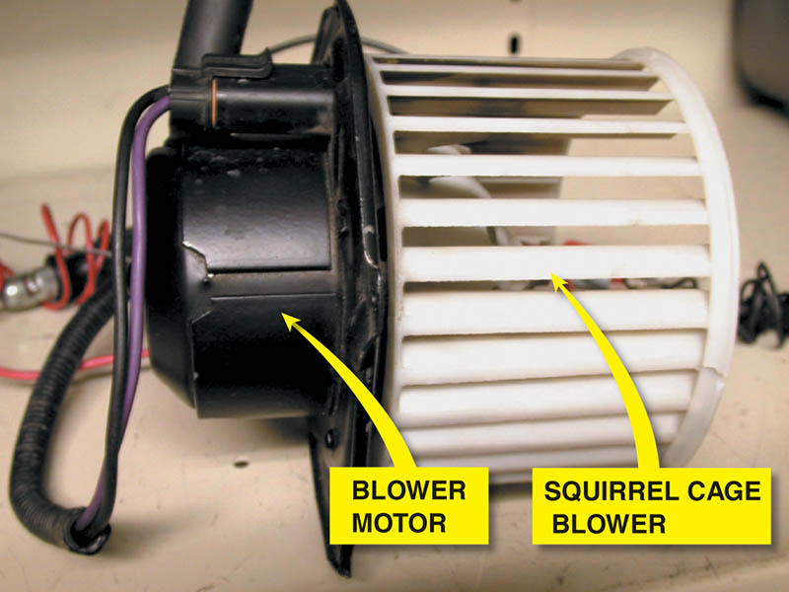
Figure 64.21 A squirrel cage blower motor. A replacement blower motor usually does not come equipped with the squirrel cage blower, so it has to be switched from the old motor

Slide 48
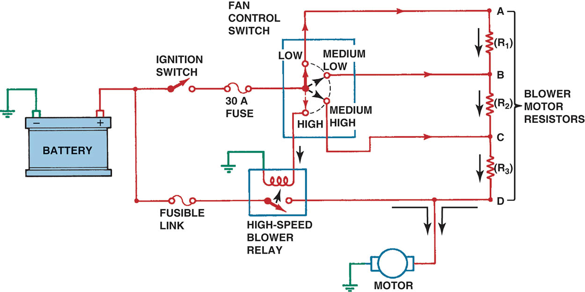
Figure 64.22 A blower motor circuit with four speeds controlled ng resistors. The three lowest fan speeds (low, medium-low, and medium-high) use the blower motor resistors to drop the voltage to the motor and reduce current to the motor.

Slide 49
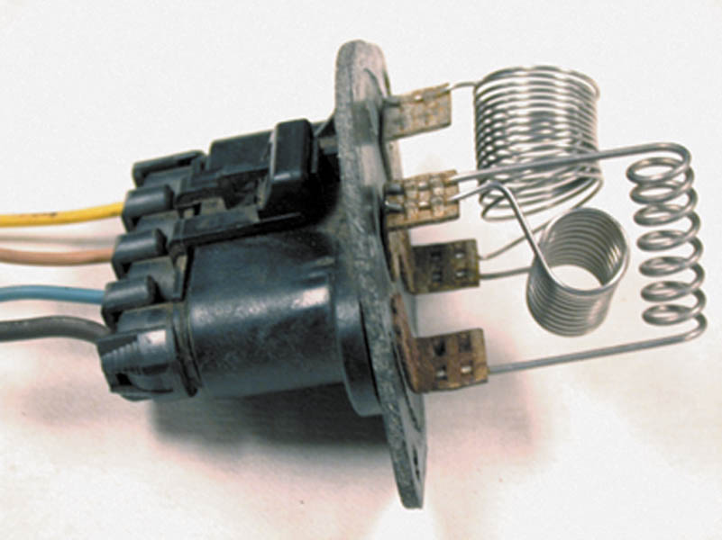
Figure 64.23 A blower motor resistor pack used to control blower motor speed. Some blower motor resistors are flat and look like a credit card and are called “credit card resistors

Slide 50
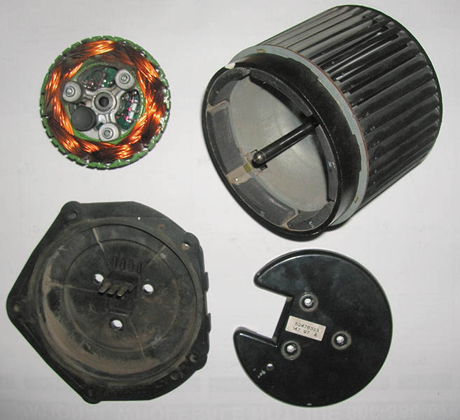
Figure 64.24 A brushless DC motor that uses the body computer to control the speed

Slide 51
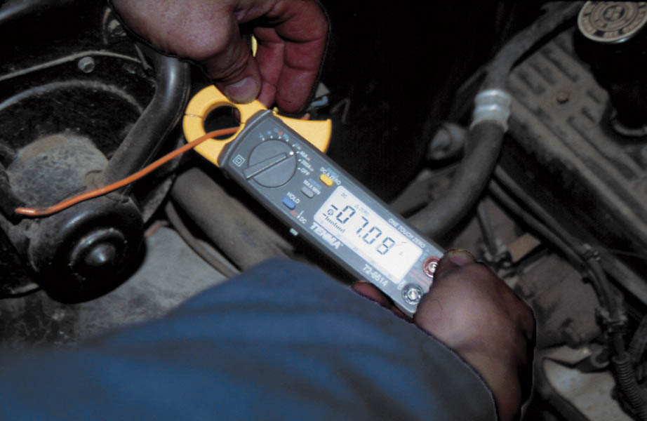
Figure 64.25 Using a mini AC/DC clamp-on multimeter to measure the current drawn by a blower motor

Slide 52
QUESTION 3: ?
A blower motor only operates on high speed. What is the most likely cause?

Slide 53
ANSWER 3:
A bad blower motor resistor pack.

Slide 54

Copyright

