Slide 1

Automotive Technology Principles, Diagnosis, and Service
Sixth Edition
Chapter 63
Heating and Air-Conditioning Components and Operation
Copyright © 2018, 2015, 2011 Pearson Education, Inc. All Rights Reserved

Slide 2
LEARNING OBJECTIVES (1 of 2)
63.1 Describe how an automotive heating, ventilation, and air-conditioning system works.
63.2 Describe the parts and operation of the heating system.
63.3 Explain the air-conditioning refrigeration cycle.
63.4 Describe the operation of expansion valve systems, orifice tube systems, and thermostatic control systems.

Slide 3
LEARNING OBJECTIVES (2 of 2)
63.5 Discuss the refrigerants used and their impact on the environment.
63.6 Explain the function of refrigerant oils, condensers, and evaporators.
63.7 Explain the function of receiver-dryers, accumulators, refrigerant lines and hoses, thermostatic expansion valves, and fixed-orifice tubes.
63.8 Explain the operation of a compressor and its controls.

Slide 4
HVAC PURPOSE AND FUNCTION (1 Of 4)
Principles Involved
All matter is found in one of three different phases or states: solid, liquid, or vapor (gas).
Changes of State
A solid is a substance that cannot be compressed and has strong resistance to flow.
A liquid is a substance that cannot be compressed.
A vapor is a substance that can be easily compressed, has no resistance to flow, and no fixed volume.

Slide 5
HVAC PURPOSE AND FUNCTION (2 OF 4)
Heat and Temperature
Molecules in a substance tend to vibrate rapidly in all directions, and this disorganized energy is called heat.
Temperature is measured in degrees. Heat is measured in calories (c).
Heat is also measured in British Thermal Units (BTU).
Latent Heat
Latent heat is the “extra” heat that is needed to transform a substance from one state to another.

Slide 6
HVAC PURPOSE AND FUNCTION (3 OF 4)
Temperature, Volume, and Pressure of Vapor
A vapor has no fixed volume.
Increasing the temperature of a vapor, while keeping the volume confined in the same space, increases the pressure.
Increasing the pressure by compressing a vapor increases the temperature.

Slide 7
HVAC PURPOSE AND FUNCTION (4 OF 4)
Pressure-Temperature Relationships
The temperature at which a liquid boils (and vapor condenses) rises and falls with the pressure.
Pressure in a sealed system that contains both liquid and vapor rises and falls with the temperature.
Humidity
Refers to water vapor present in the air.
Absolute humidity is the measurement of the weight of the water vapor in a given volume of air.
Relative humidity is the percentage of moisture in the air compared to how much moisture air is capable of.

Slide 8
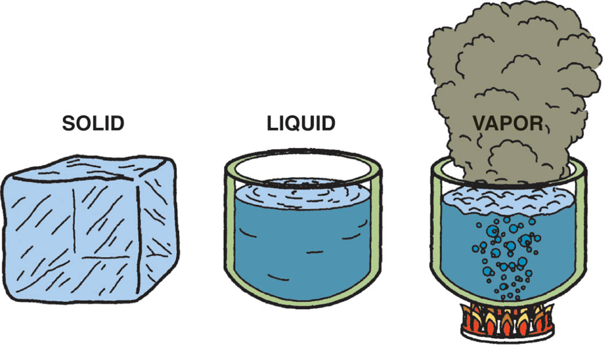
Figure 63.1 Water is a substance that can be found naturally in solid, liquid, and vapor states

Slide 9
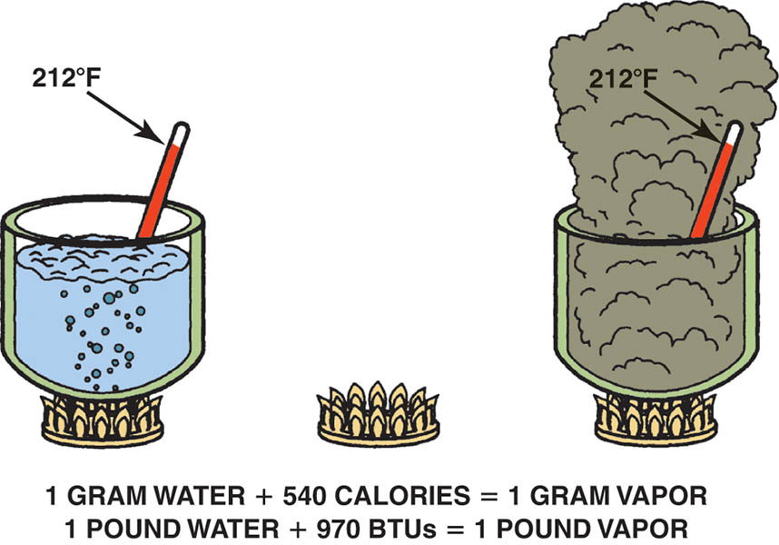
Figure 63.2 The extra heat required to change a standard amount of water at its boiling point to a vapor is called latent heat of vaporization

Slide 10
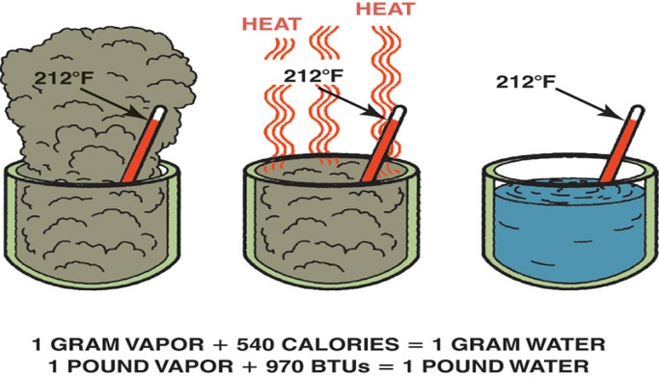
Figure 63.3 The latent heat of vaporization that water vapor stores is given off when the vapor condenses to a liquid. The temperature stays the same

Slide 11
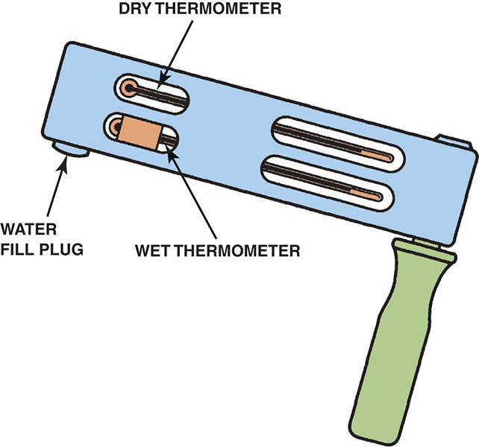
Figure 63.4 A sling psychrometer is used to measure relative humidity. A digital meter that reads both temperature and humidly is a low cost tool that are usually used when servicing air conditioning systems

Slide 12
HEATING SYSTEM
Purpose and Function
The heater system is designed to provide passenger comfort and the heat needed to defrost windshield and front side windows in many vehicles.
Parts and Operation
Heater hose
Heater Core
Heater valve
Blower motor

Slide 13
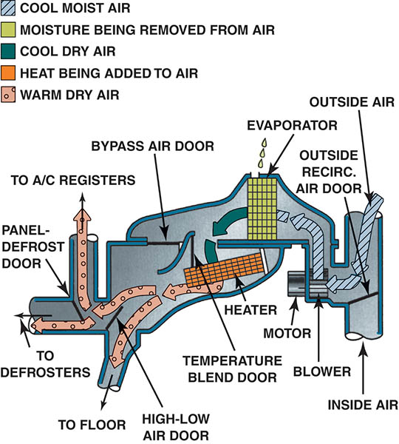
Figure 63.5 Typical flow of air through an automotive heat, ventilation, and air conditioning system when placed in the heat position

Slide 14
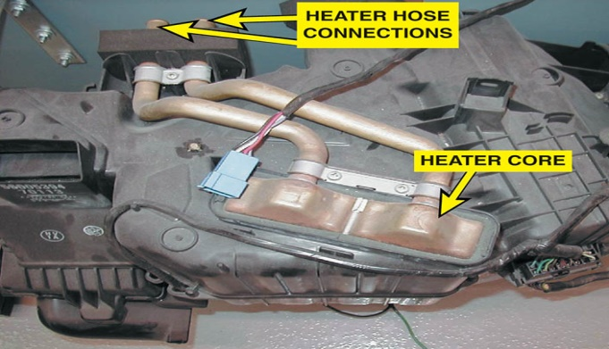
Figure 63.6 A typical heater core as installed in an HVAC housing

Slide 15
AIR CONDITIONING REFRIGERATION CYCLE
1. The liquid refrigerant evaporates in a small radiator-type unit called the evaporator.
2. The compressor compresses the low-pressure refrigerant gas into a high-pressure gas and forces the refrigerant through the system.
3. This high-pressure gas flows into the condenser. The high-pressure gas changes to form a high-pressure liquid as the heat is removed.
4. The high-pressure liquid then flows through a device that meters the flow into the evaporator. When the high pressure of the liquid drops, it causes the refrigerant to vaporize.
5. Air is blown through the evaporator by the blower motor. The air is cooled as heat is removed from the air and transferred to the refrigerant in the evaporator.

Slide 16
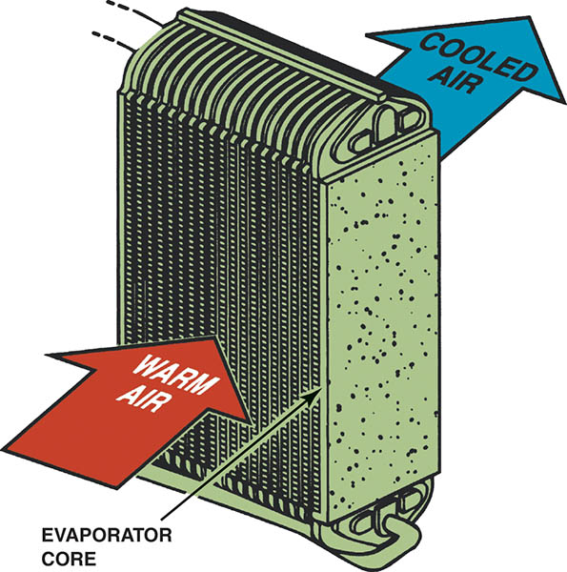
Figure 63.7 The compressor provides the mechanical force needed to pressurize the refrigerant

Slide 17
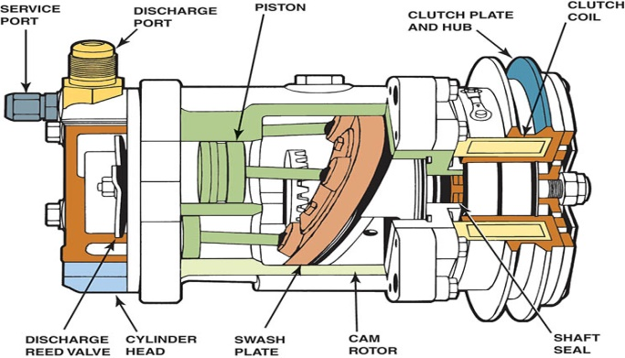
Figure 63.8 The evaporator removes heat from the air that enters a vehicle by transferring it to the vaporizing refrigerant

Slide 18
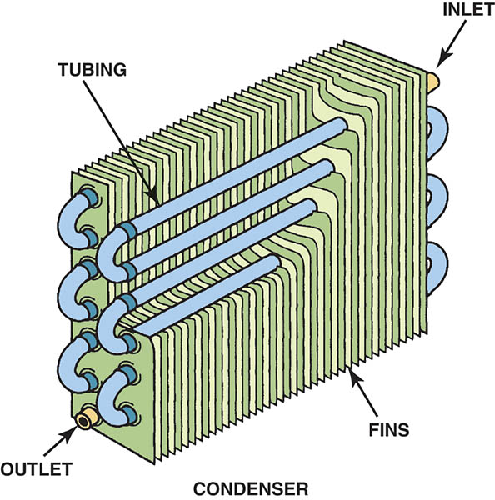
Figure 63.9 The condenser changes the refrigerant vapor into a liquid by transferring heat from the refrigerant to the air stream that flows between the condenser fins

Slide 19
EXPANSION VALVE SYSTEMS
An expansion valve is attached to the inlet to the evaporator and controls the amount of refrigerant flow into the evaporator.
The expansion valve varies the flow of the refrigerant based on the temperature at the outlet of the evaporator.
This type of system is called the thermostatic expansion valve system— usually abbreviated TEV or TXV

Slide 20
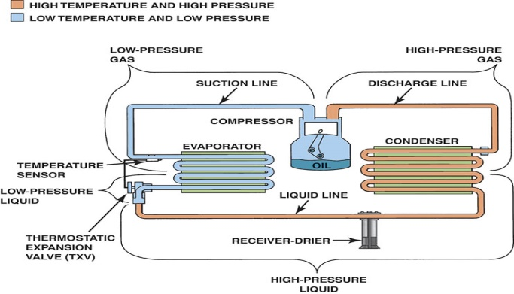
Figure 63.10 A typical air-conditioning system that uses an expansion valve. A temperature sensor bulb is attached to the outlet of the evaporator to control the amount of refrigerant allowed to flow into the evaporator

Slide 21
ORFICE TUBE SYSTEMS
Many air-conditioning systems today use a fixed-orifice tube at the inlet to the evaporator.
Refrigerant flow is controlled by the cycling the compressor on and off based on the input from a low pressure switch.
This type of system is commonly called a cycling clutch orifice tube (or CCOT) system.

Slide 22
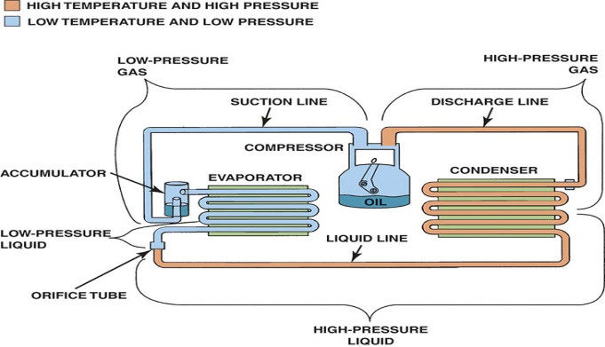
Figure 63.11 A typical automotive air-conditioning system that uses a cycling clutch and an orifice tube

Slide 23
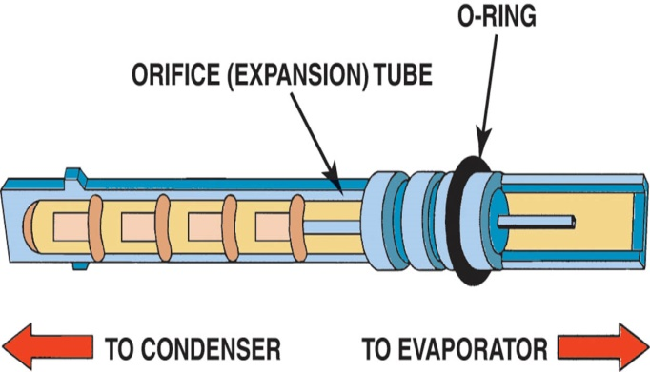
Figure 63.12 Typical orifice tube

Slide 24
ANSWER 1:
To separate the high and low pressure sides of the refrigeration system.

Slide 25
QUESTION 1: ?
What is the purpose of the fixed-orifice tube, and the thermal expansion valve.

Slide 26
THERMOSTATIC CONTROL
A commonly used method to control evaporator temperature is to use a thermostat to control the compressor.
Air-conditioning compressors use an electromagnetic clutch.
When the thermostat senses that the temperature is near freezing, 32°F (0°C), the switch opens the electrical circuit to the compressor.

Slide 27
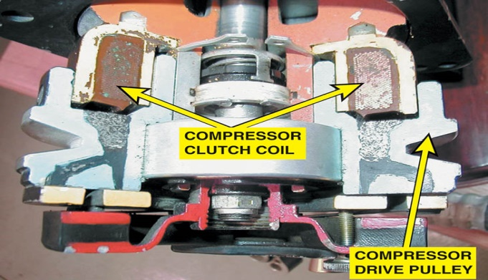
Figure 63.13 A cutaway of an air-conditioning compressor electromagnetic clutch

Slide 28
REFRIGERANTS
One of the first refrigerants was CFC-12, commonly referred to as R-12 or by its brand name Freon.
HFC-134a, also called R-134a, has been selected by vehicle manufacturers to replace the ozone-harming CFC.
HFC-134a is a smaller molecule than CFC-12. Therefore, HFC-134a can more easily leak out through small holes or openings in the system.

Slide 29
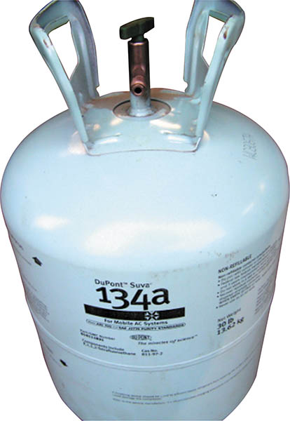
Figure 63.14 R-134a is available in 12-oz cans, as well as larger 30-lb containers

Slide 30
REFRIGERANTS AND THE ENVIRONMENT
Montreal Protocol
A conference was held in Montreal, Canada, in 1987, where the United States and 22 other countries agreed to limit the production of ozone-depleting refrigerants.
Section 609 of the Clean Air Act required the following:
Technicians who work on air conditioning to be trained and certified.
Recovery and recycling equipment must be used.
Each shop must comply with EPA relues.

Slide 31
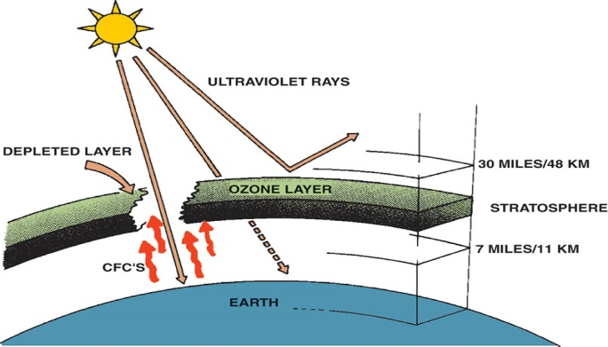
Figure 63.15 A depletion of the ozone layer allows more ultraviolet radiation from the sun to reach Earth’s surface

Slide 32
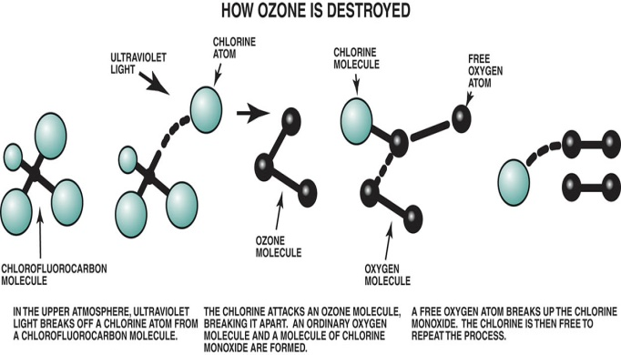
Figure 63.16 Chlorofluorocarbon molecules break apart in the atmosphere

Slide 33
HFO-1234YF
Description
Also called R1234yf is the refrigerant required in all vehicles starting in MY 2021.
Ozone Depletion and Global Warming Potential
R1234yf does not deplete the ozone layer, but is believed to have the potential to cause climate change.
Flammability
R-1234yf is mildly flammable.
Do not smoke or have an open flame while working on or servicing a vehicle equipped with R-1234yf.

Slide 34
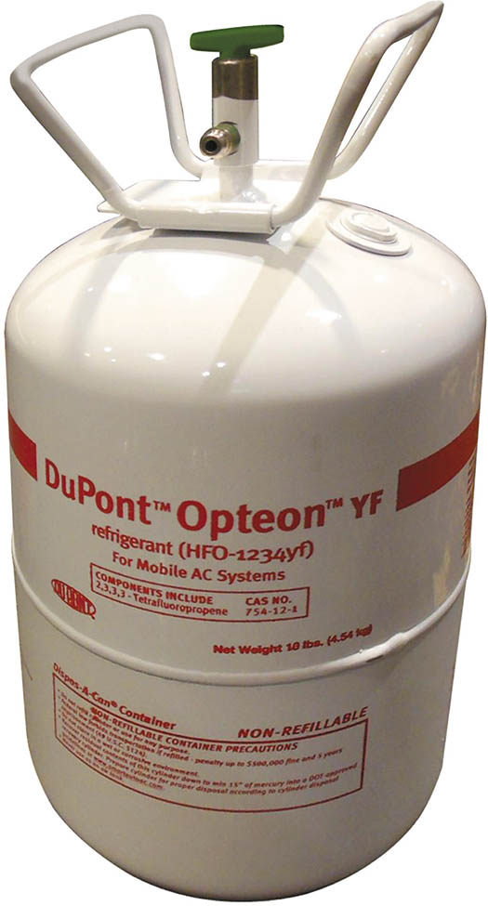
Figure 63.17 Due to the cost of R-1234yf, most shops will purchase 10 or 20 pound containers compared to the normal 30 pound container that most shops purchased for R-134a

Slide 35
REFRIGERANT OILS
The oil carried by the refrigerant through the various components is often the only source of lubrication for the compressor.
HFC-134a and HFO-1234yf systems must use synthetic polyalkyline glycol, usually referred to as PAG oil.
Viscosity of PAG oil varies.
Always use the type and viscosity of oil specified by the manufacturer.

Slide 36
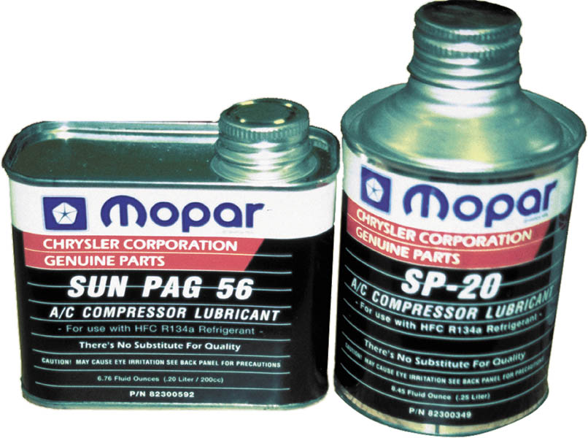
Figure 63.18 PAG oil used in Chrysler vehicles equipped with HFC-134a refrigerant. Notice that different oils are used for different systems, depending primarily on the manufacturer of the compressor.

Slide 37
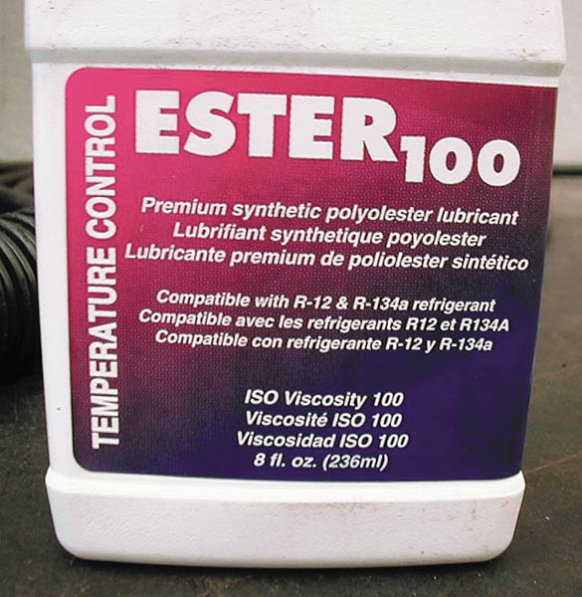
Figure 63.19 Ester refrigerant oils are often specified for use when retrofitting an R-12 system to R-134a by companies who supply refit kits.

Slide 38
CONDENSER
A condenser is like a radiator because it is designed to radiate heat from the refrigerant to the outside air.
As the heat travels into the air, the high-pressure gas refrigerant changes state and becomes a high-pressure liquid.
To help in the heat transfer, most vehicles are equipped with cooling fans.

Slide 39
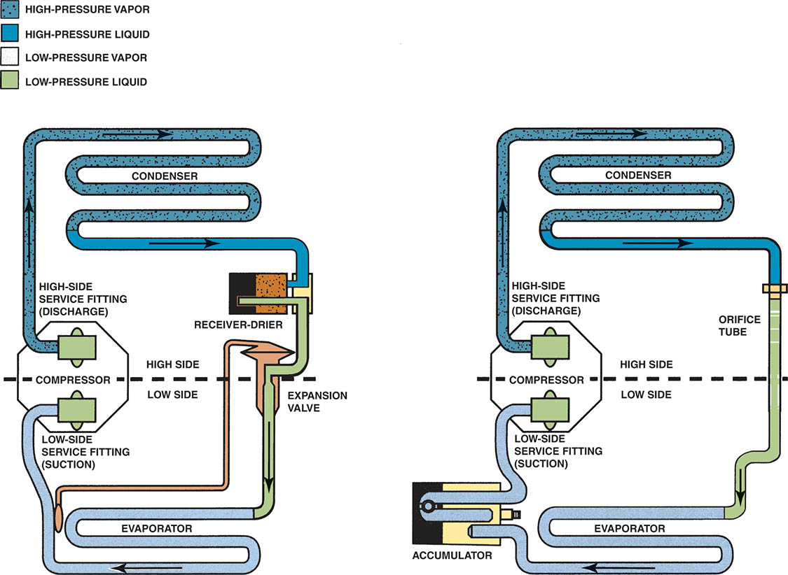
Figure 63.20 The condenser serves the same function for both the orifice-tube and the expansion valve–type air-conditioning system

Slide 40
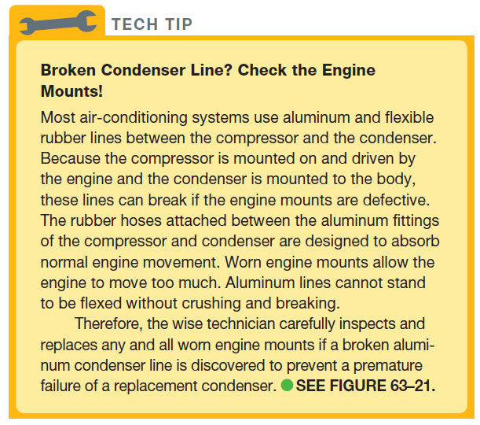
Tech Tip

Slide 41
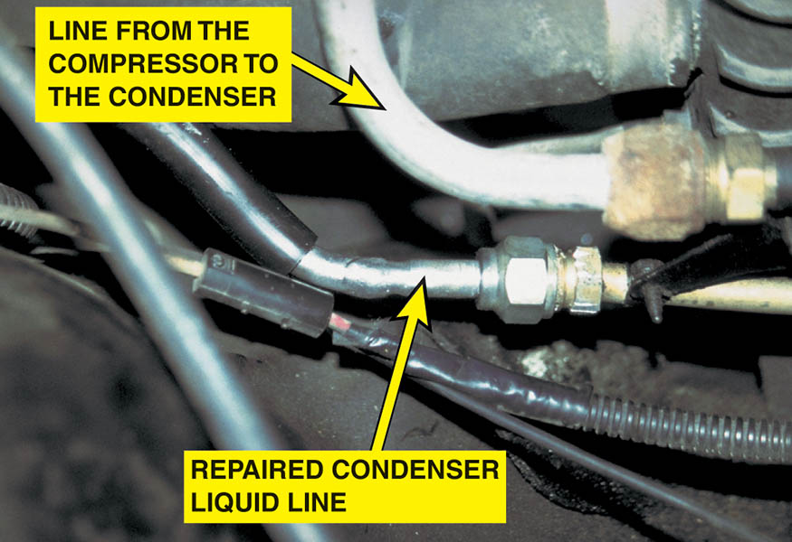
Figure 63.21 A repaired condenser refrigerant line

Slide 42
EVAPORATOR
The purpose of the evaporator is to transfer heat from the air to the refrigerant flowing through it.
A blower motor equipped with a squirrel cage–type fan circulates air through the evaporator and forces the cooler air into the passenger compartment.
Because the evaporator is cold (usually just above the freezing point of 32°F [0°C]), any moisture in the air is removed, lowering the relative humidity.

Slide 43
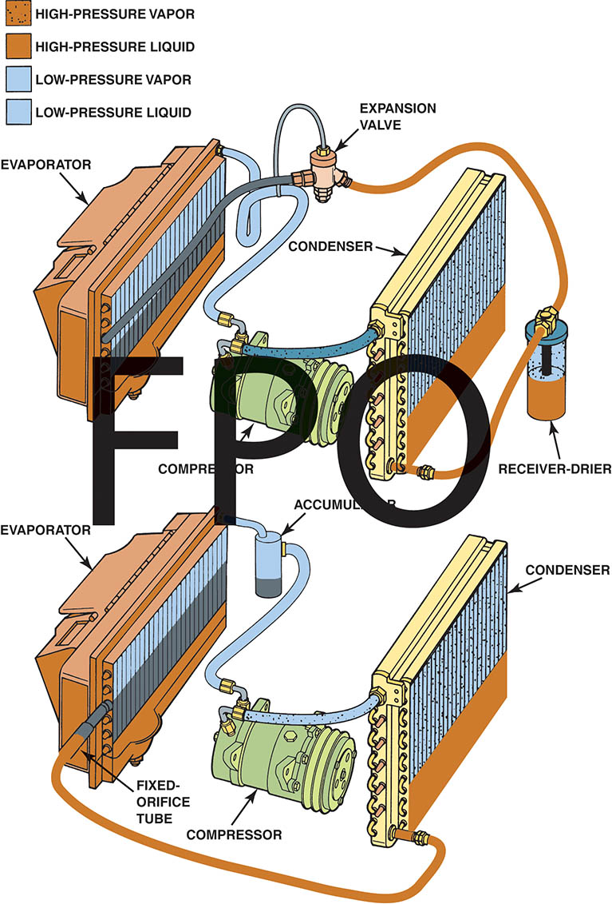
Figure 63.22 The evaporator allows the liquid refrigerant to evaporate and absorb heat from the passenger compartment

Slide 44
RECEIVER-DRIER
A receiver–drier is used on an air-conditioning system that uses an expansion valve.
The receiver–drier is located between the condenser and the evaporator.
The purpose of the receiver is to provide temporary storage for the liquid refrigerant and it also usually includes a filter to trap debris and a desiccant to remove moisture.

Slide 45
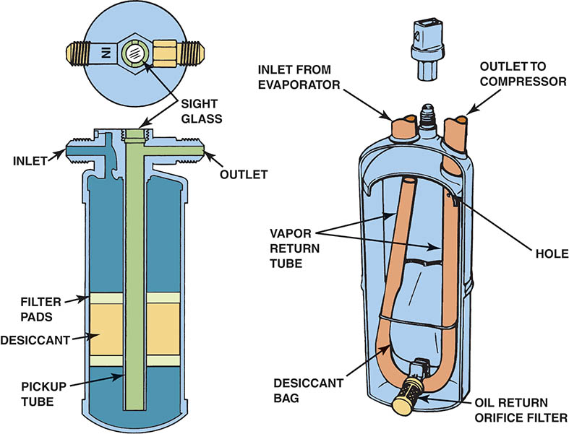
Figure 63.23 Expansion-valve systems store excess refrigerant in a receiver–drier, which is located in the high-side liquid section of the system.

Slide 46
ACCUMULATOR
An accumulator is used on systems that use an orifice tube.
It is located between the evaporator and the compressor.
It prevents liquid refrigerant from entering the compressor, removes moisture and traps debis.

Slide 47
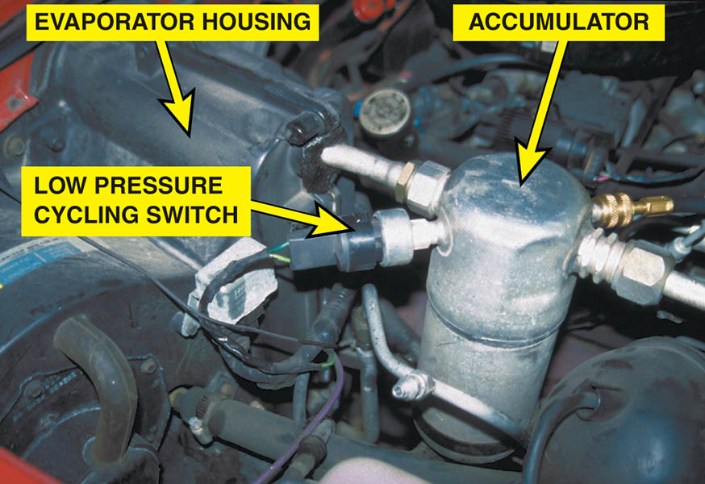
Figure 63.24 A typical accumulator used on a cycling clutch orifice-tube (CCOT) system

Slide 48
QUESTION 2: ?
Why is desiccant needed in automotive air-conditioning systems.

Slide 49
ANSWER 2:
To absorb unwanted moisture in the system.

Slide 50
REFRIGERANT LINES AND HOSES
Aluminum tubing is used to connect many stationary items together, like the condenser to the receiver–drier and the receiver–drier to the evaporator.
Rubber lines are usually used to and from the compressor.
Most hoses use a non-permeable inside layer of material that prevents the loss of refrigerant through the hose itself.

Slide 51
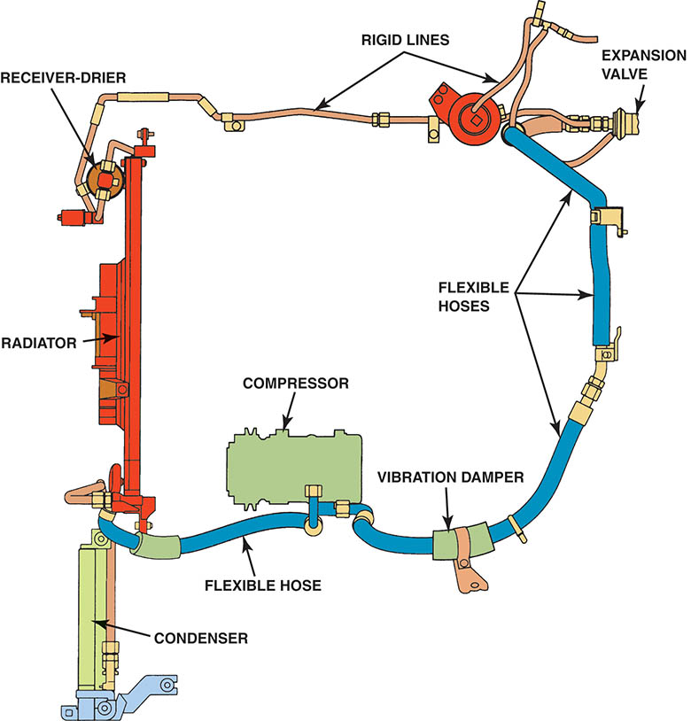
Figure 63.25 Rigid lines and flexible hoses are used throughout the air-conditioning system. The line to and from the compressor must be flexible because it is attached to the engine.

Slide 52
THERMOSTATIC EXPANSION VALVES
Thermostatic expansion valve (TXV) systems use a temperature-sensitive bulb located on the evaporator outlet tube.
A pressure sensitive diaphragm inside the TXV body to control the size of the variable orifice.
This regulates the rate at which liquid refrigerant flows into the evaporator.

Slide 53
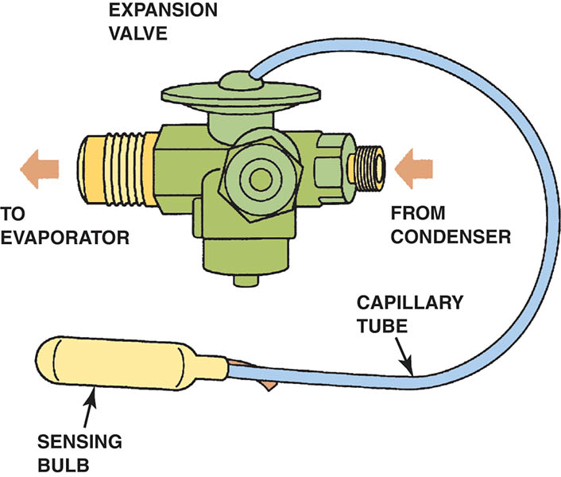
Figure 63.26 A typical expansion valve, which uses an inlet and outlet attachment for the evaporator, and a temperature-sensing bulb that is attached to the evaporator outlet tube

Slide 54
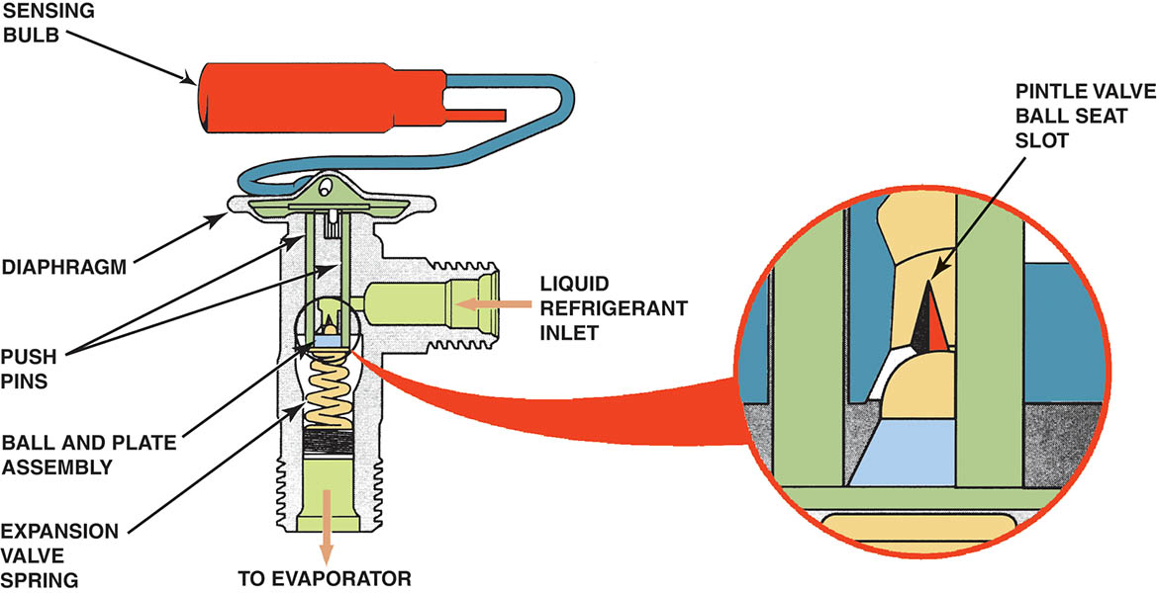
Figure 63.27 A slot cut in the ball seat inside the expansion valve permits a small amount of refrigerant and oil to pass through at all times, even when the valve is closed. This flow of oil through the system is necessary to make sure the compressor receives the oil it needs for lubrication

Slide 55
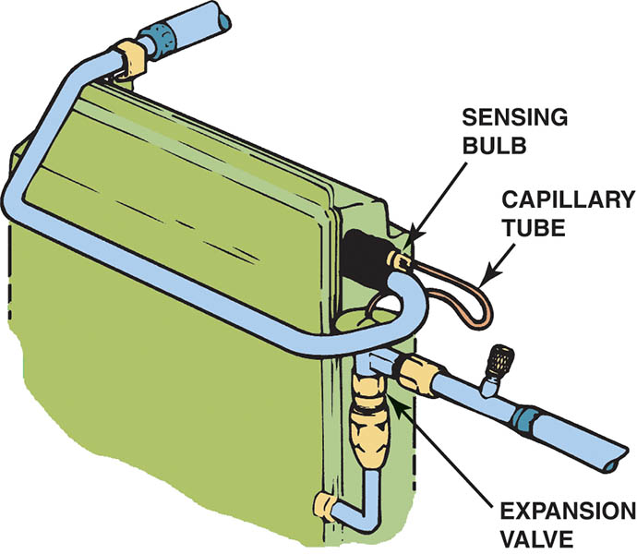
Figure 63.28 The sensing bulb is attached to the evaporator outlet tube. Refrigerant inside the bulb expands or contracts in response to the evaporator temperature

Slide 56
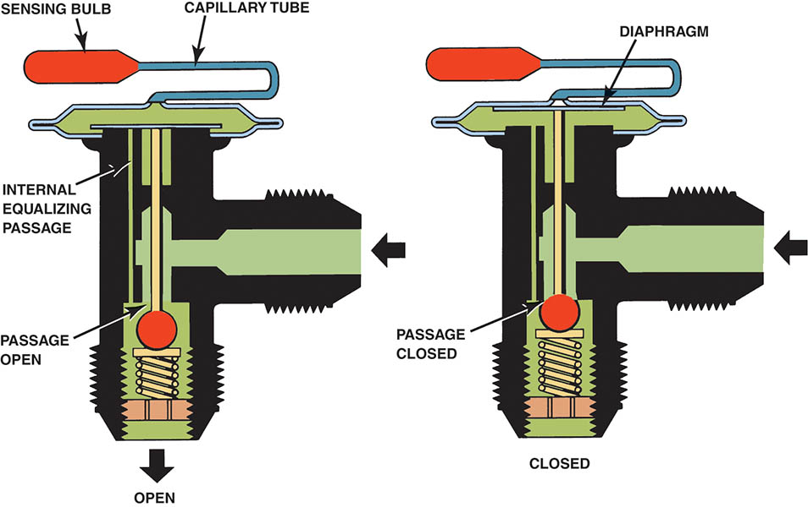
Figure 63.29 Pressure from the capillary tube pushes on the spring-loaded diaphragm to open the expansion valve. As the pressure in the capillary tube contracts, the reduced pressure on the diaphragm allows the valve to close

Slide 57
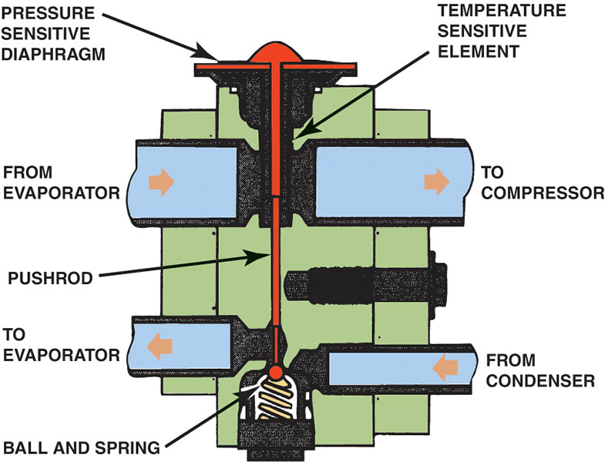
Figure 63.30 An H-valve (H-block) combines the temperature-sensing and pressure-regulating functions into a single assembly

Slide 58
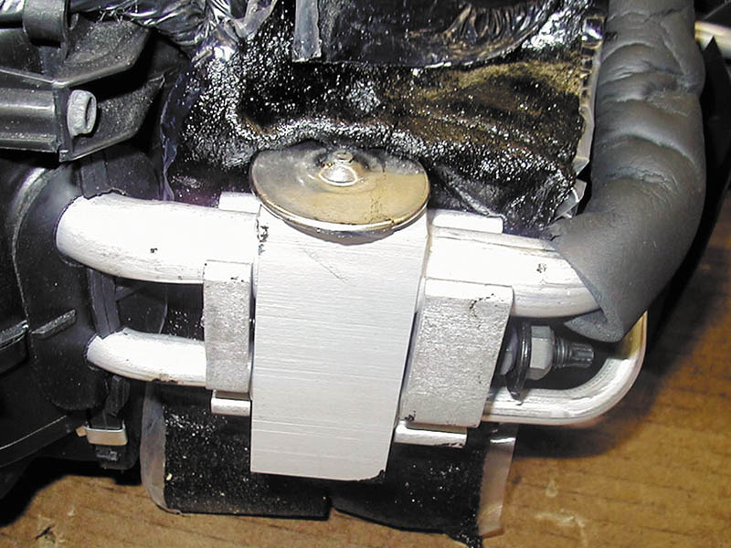
Figure 63.31 An H-valve as used on a Chrysler minivan

Slide 59
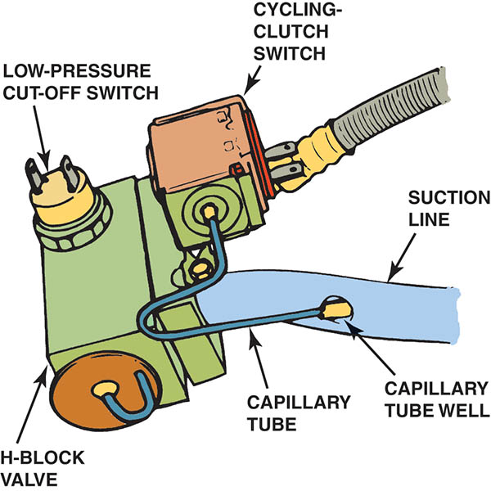
Figure 63.32 In this Chrysler system, a low-pressure cutoff switch and a cycling-clutch switch are mounted on the H-valve

Slide 60
FIXED-ORFICE TUBES
The fixed-orifice tubes provide a restriction that separates the high-pressure from the low-pressure side of the system.
AT the fixed-orifice tube the refrigerant undergoes rapid expansion and changes from a warm, high-pressure liquid to a cold, low-pressure liquid.
The orifice tube, located between the condenser and the evaporator inlet.

Slide 61
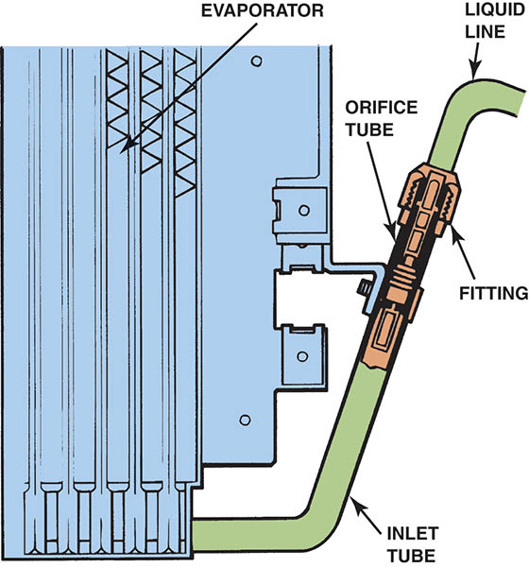
Figure 63.33 The orifice tube is usually located at the inlet tube to the evaporator

Slide 62
COMPRESSORS (1 OF 2)
The compressor performs the following functions:
Compresses the low-pressure gas refrigerant from the evaporator into a high-pressure gas.
Raises the temperature of the gas.
Acts as the pump used to circulate the refrigerant.
Is the major reason why there is refrigerant oil in the system.

Slide 63
COMPRESSORS (2 OF 2)
Positive-Displacement Compressors
Displaces a constant, uniform volume of refrigerant for each revolution or operating cycle.
Variable Displacement Compressors
As the swash plate changes its angle, the stroke of the piston is increased for more cooling or decreased to reduce the amount of cooling by varying the volume of refrigerant.

Slide 64
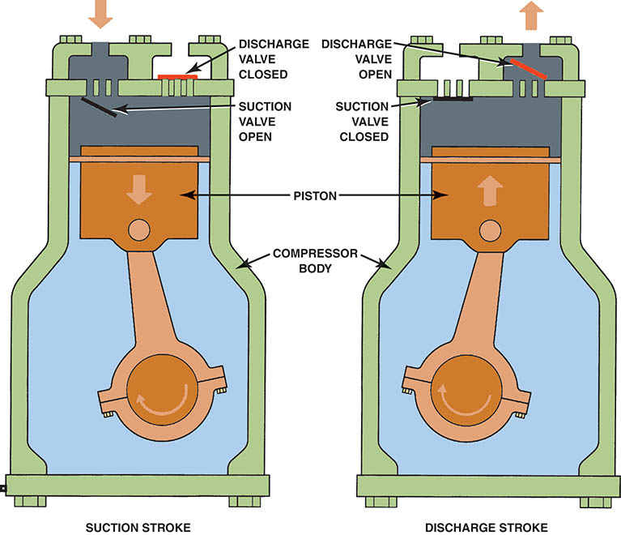
Figure 63.34 In a positive-displacement compressor, the descending piston creates a drop in pressure inside the cylinder. The resulting pressure differential allows low-side pressure to force the suction valve open.

Slide 65
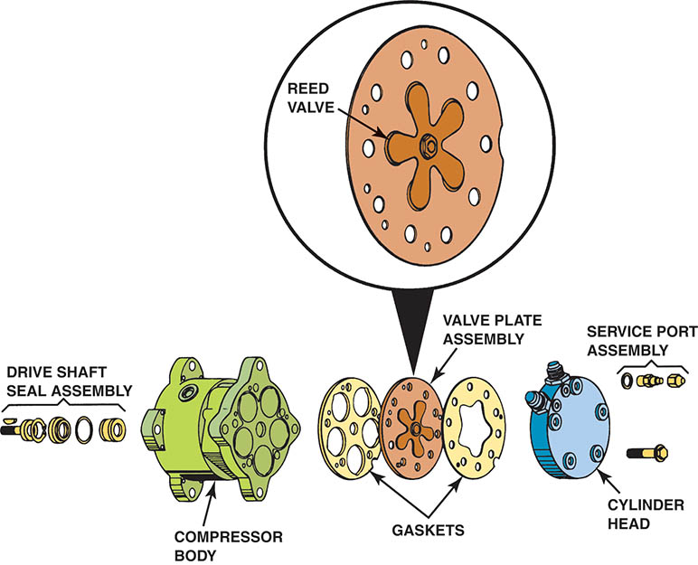
Figure 63.35 A reed valve is a one-way check valve that flaps away from the valve plate to open, and toward the valve plate to close

Slide 66
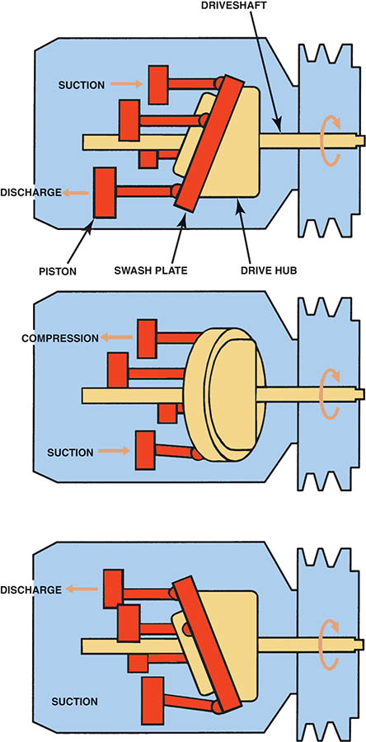
Figure 63.36 The swash plate, attached to the crankshaft at an angle, converts the pulley’s rotary motion to axial motion, which drives the pistons in a reciprocating motion

Slide 67
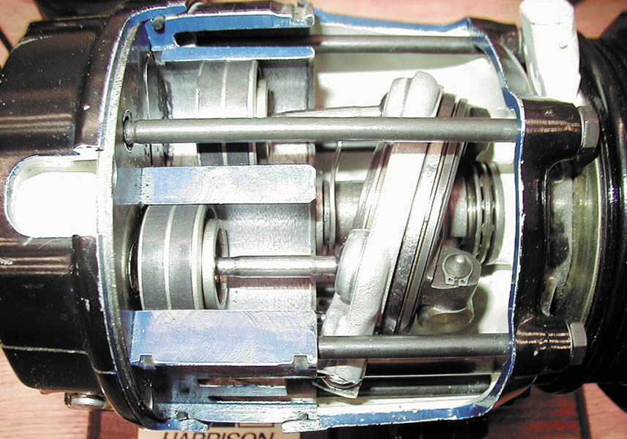
Figure 63.37 A V-5 variable displacement compressor. Internal pressures act on the swash plate, which changes the stroke of the piston and then displacement based on the pressures in the system

Slide 68
COMPRESSOR CONTROLS
Low Pressure Switch
This switch also prevents the air-conditioning compressor from being engaged when the temperature/Pressures are too low.
High Pressure Switch
If the pressure exceeds a certain level (typically 375 PSI [2,600 kPa]), the pressure switch opens, thereby preventing possible damage to the system.
Power Steering Switch
Opens the compressor circuit when the steering wheel is turned to reduce engine load.

Slide 69
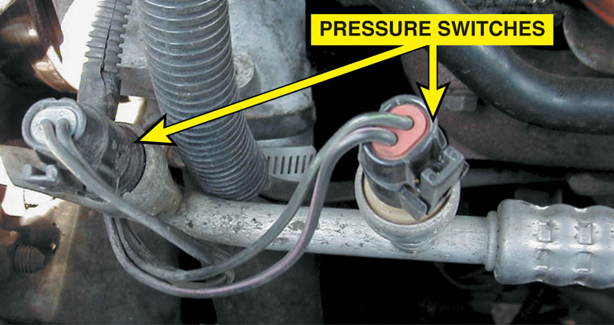
Figure 63.38 Typical air-conditioning pressure switches. A service manual is needed to determine the function of each switch. One switch could be the low-pressure switch and the other a high-pressure switch

Slide 70
QUESTION 3: ?
What is the purpose and function of the low pressure and high
pressure switches?

Slide 71
ANSWER 3:
To prevent the system from operating when damage may occur.

Slide 72

Copyright

