Slide 1

Automotive Technology Principles, Diagnosis, and Service
Sixth Edition
Chapter 62
Audio System Operation and Diagnosis
Copyright © 2018, 2015, 2011 Pearson Education, Inc. All Rights Reserved

Slide 2
LEARNING OBJECTIVES (1 of 2)
62.1 Describe how AM, FM, and satellite radio work.
62.2 Describe radios, receivers, antennas, and antenna diagnosis.
62.3 Discuss the purpose, function, and types of speakers, and explain the decibel scale.
62.4 Discuss crossovers, after-market sound system upgrades, and voice recognition systems.

Slide 3
LEARNING OBJECTIVES (2 of 2)
62.5 Explain how Bluetooth and satellite radio systems work.
62.6 List causes and corrections of radio noise and interference.
62.7 This chapter will help prepare for the ASE Electrical/Electronic Systems (A6) certification test content area “F” (Body Electrical Systems Diagnosis and Repair).

Slide 4
AUDIO FUNDAMENTALS (1 Of 5)
Introduction
  Audio systems produce audible sounds and include the following:
  Radio (AM, FM, and satellite)
  Antenna systems that are used to capture electronic energy broadcast to radios
  Speaker systems
  Aftermarket enhancement devices that increase the sound energy output of an audio system
  Diagnosis of audio-related problems

Slide 5
AUDIO FUNDAMENTALS (2 OF 5)
Types of Energy
  Electromagnetic energy or radio waves.
  Acoustical energy, usually called sound.
Terminology
  Radio frequency (RF), Is the number of times a particular waveform repeats itself in a given amount of time
  Hertz (Hz). A measurement of a waveform. A signal with a frequency of 1 Hz is one radio wavelength per second.

Slide 6
AUDIO FUNDAMENTALS (3 OF 5)
Modulation
  Modulation is the term used to describe when information is added to a constant frequency.
  Amplitude modulation (AM)
  Frequency modulation (FM)
Radio Wave Transmission
  More than one signal can be carried by a radio wave. This process is called sideband operation.

Slide 7
AUDIO FUNDAMENTALS (4 OF 5)
Noise
  Radio Frequency Interference (RFI) is one type of electromagnetic interference (EMI) and is the frequency that interferes with radio transmission.
AM Characteristics
  Reception can be achieved over long distances from the transmitter because the waves can bounce off the ionosphere.

Slide 8
AUDIO FUNDAMENTALS (5 OF 5)
FM Characteristics
  Because FM waves have a high RF and a short wavelength, they travel only a short distance.
Multipath
  Multipath is caused by reflected, refracted, or line-sight signals reaching an antenna at different times. Multipath results from the radio receiving two signals to process on the same frequency.

Slide 9
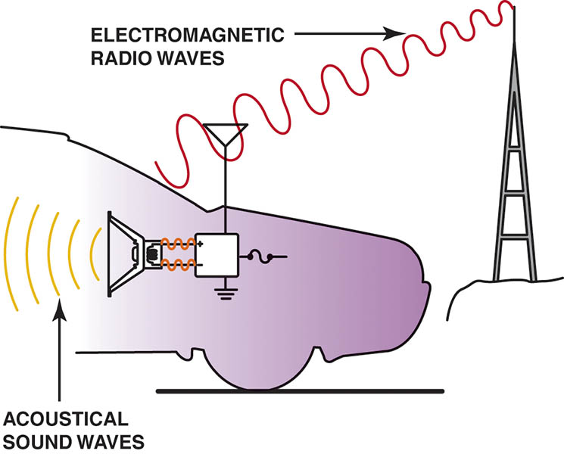
Figure 62.1 Audio systems use both electromagnetic radio waves and sound waves to reproduce sound inside the vehicle

Slide 10
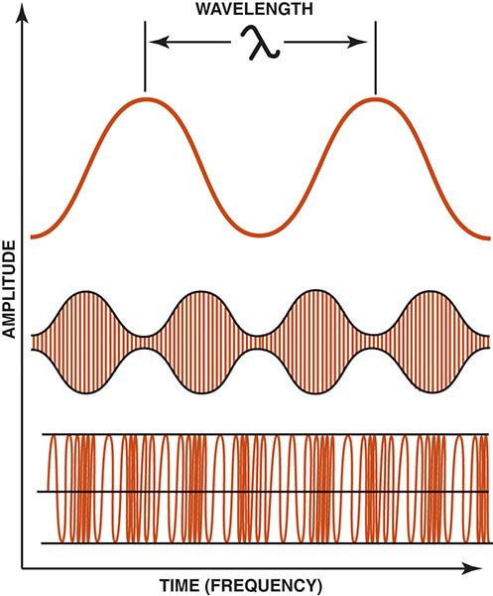
Figure 62.2 The relationship among wavelength, frequency, and amplitude

Slide 11

Figure 62.3 The amplitude changes in AM broadcasting

Slide 12
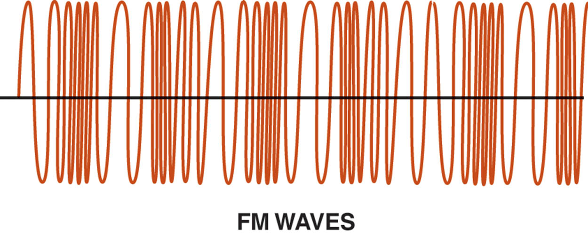
Figure 62.4 The frequency changes in FM broadcasting and the amplitude remains constant

Slide 13
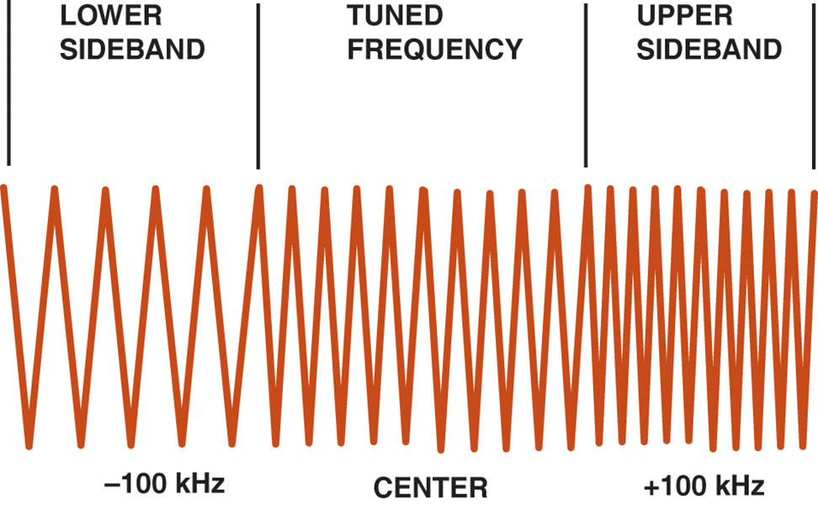
Figure 62.5 Using upper and lower sidebands allows stereo to be broadcast. The receiver separates the signals to provide left and right channels

Slide 14
QUESTION 1: ?
Why do AM signals travel farther than FM signals?

Slide 15
ANSWER 1:
The AM waves bounce off the ionosphere.

Slide 16
RADIOS AND RECEIVERS
Most late-model radios and receivers use five input/output circuits.
  Power
  Ground
  Serial Data
  Antenna Input
  Speaker Outputs

Slide 17
ANTENNAS
Types of Antennas
  Slot antenna
  Rear window defogger grid
  Powered mast
  Fixed mast antenna
  Integrated antenna

Slide 18
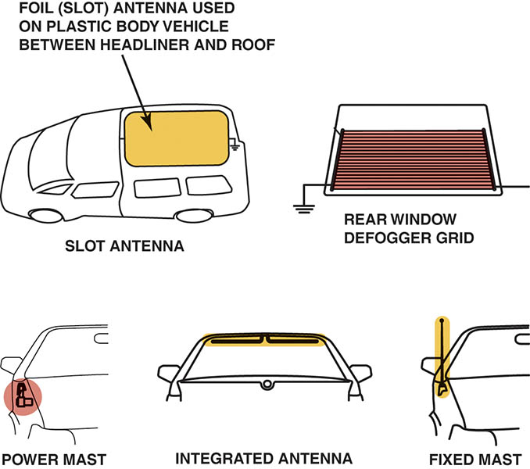
Figure 62.6 The five types of antennas used on General Motors vehicles include the slot antenna, fixed mast antenna, rear window defogger grid antenna, powered mast antenna, and integrated antenna

Slide 19
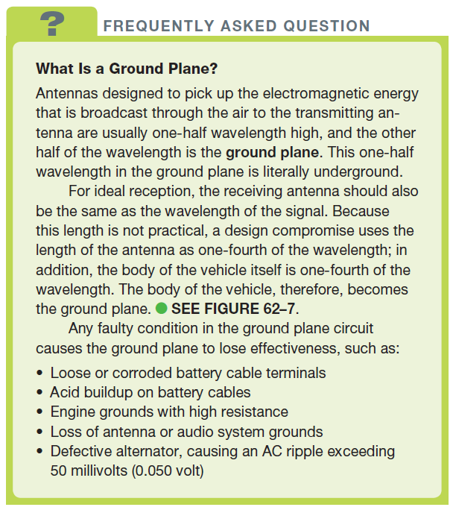
FREQUENTLY ASKED QUESTION

Slide 20
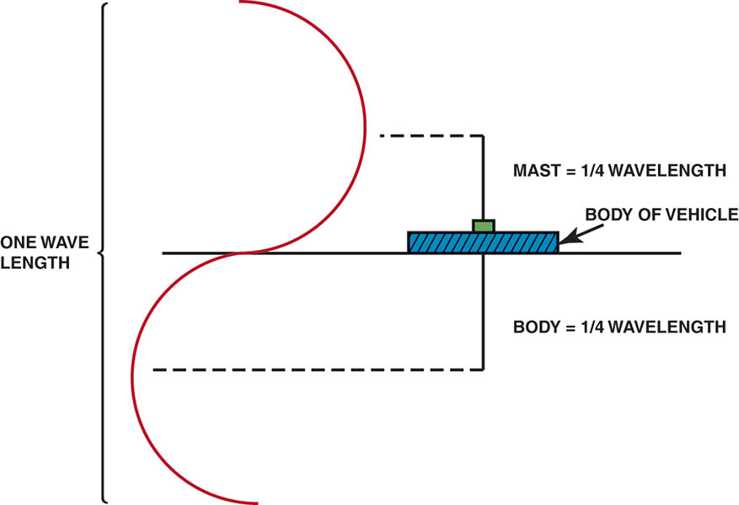
Figure 62.7 The ground plane is actually one-half of the antenna

Slide 21
ANTENNA DIAGNOSIS (1 OF 2)
Antenna Height
  Most fixed-length antennas are exactly 31 inches (79 cm).
Antenna Testing
  An ohmmeter should read infinity between the center antenna lead and the antenna case.
  The case of the antenna must be properly grounded to the vehicle body
  The cable should have less than 5 ohms resistance end-to-end.

Slide 22
ANTENNA DIAGNOSIS (2 OF 2)
Power Antenna Testing and Service
  Most power antennas use a circuit breaker and a relay to power a reversible, permanent magnet (PM) electric motor that moves a nylon cord attached to the antenna mast.
  The power antenna mast is tested in the same way as a fixed-mast antenna.
  All power antennas should be kept clean by wiping the mast with a soft cloth and lightly oiling with light oil, such as WD-40 or a similar-grade oil.

Slide 23
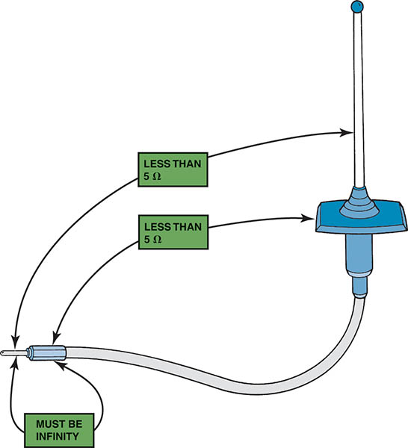
Figure 62.8 If all ohmmeter readings are satisfactory, the antenna is good

Slide 24
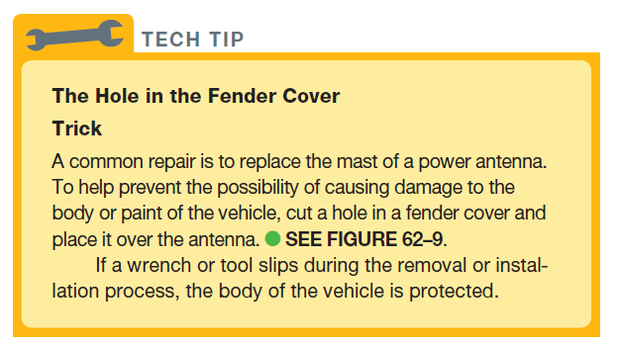
Tech Tip

Slide 25
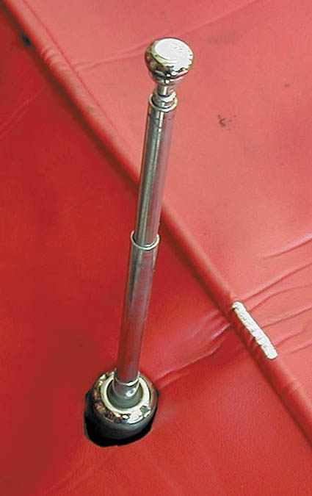
Figure 62.9 Cutting a small hole in a fender cover helps to protect the vehicle when replacing or servicing an antenna

Slide 26
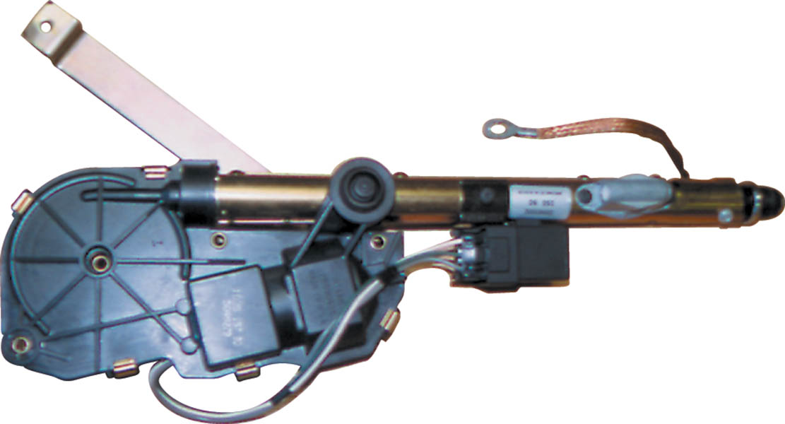
Figure 62.10 A typical power antenna assembly. Note the braided ground wire used to ensure that the antenna has a good ground plane

Slide 27
SPEAKERS
Purpose and Function
  The purpose of any speaker is to reproduce the original sound as accurately as possible.
Impedance Matching
  All speakers used on the same radio or amplifier should have the same internal coil resistance.
Speaker Wiring
  Typical “speaker wire” is about 22 gauge (0.35 mm2).

Slide 28
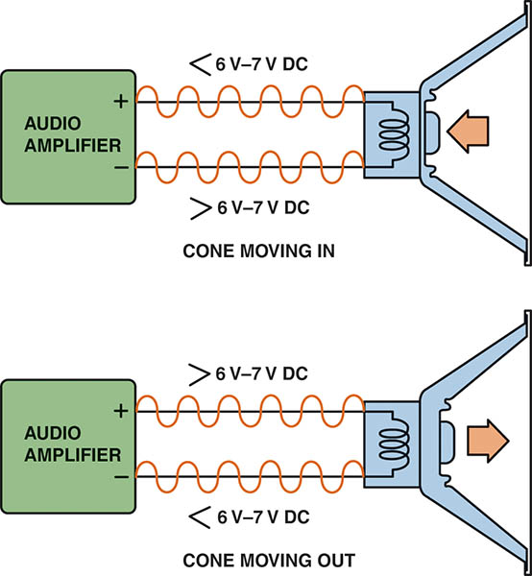
Figure 62.11 Between 6 and 7 volts is applied to each speaker terminal, and the audio amplifier then increases the voltage on one terminal and at the same time decreases the voltage on the other terminal, causing the speaker cone to move.

Slide 29
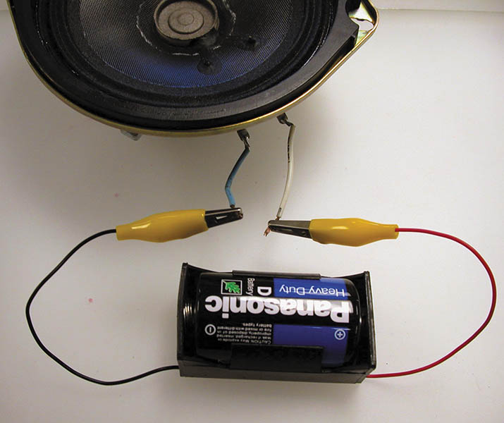
Figure 62.12 A typical automotive speaker with two terminals. The polarity of the speakers can be identified by looking at the wiring diagram in the service manual or by using a 1.5-volt battery to check. When the battery positive is applied to the positive terminal of the speaker, the cone moves outward. When the battery leads are reversed, the speaker cone moves inward

Slide 30
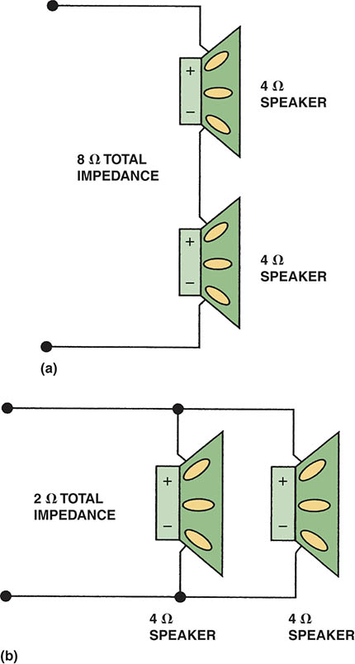
Figure 62.13 (a) Two 4-ohm speakers connected in series result in total impedance of 8 ohms. (b) Two 4-ohm speakers connected in parallel result in total impedance of 2-ohms

Slide 31
SPEAKER TYPES
Tweeter
  A speaker designed to reproduce high-frequency sounds, usually between 4,000 and 20,000 Hz (4 and 20 kHz).
Midrange
  A speaker is designed and manufactured to be able to best reproduce sounds in the middle of the human hearing range, from 400 to 5,000 Hz.
Subwoofer
  Produces the lowest frequency of sounds, usually 125 Hz.

Slide 32
SOUND LEVELS
Decibel Scale
  A decibel (dB) is a measure of sound power
  The dB scale is not linear (straight line) but logarithmic
  A small difference in dB rating means a big difference in the sound volume of the speaker.
Decibel Examples
  Quiet, faint 30 dB: whisper, quiet library
  Loud 70 dB: vacuum cleaner, city traffic
  Hearing loss possible 110 dB: loud rock music

Slide 33
CROSSOVERS
Definition
  A crossover is designed to separate the frequency of a sound and send a certain frequency range, such as low-bass sounds, to a woofer designed to reproduce these low-frequency sounds.
Passive Crossover
  Does not use an external power source.
Active Crossover
  Uses an external power source.

Slide 34
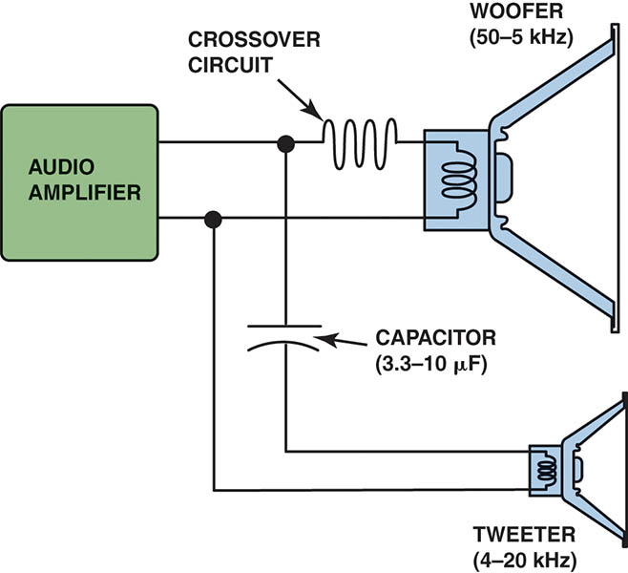
Figure 62.14 Crossovers are used in audio systems to send high-frequency sounds to the small (tweeter) speakers and low frequency sounds to larger (woofer) speakers

Slide 35
AFTERMARKET SOUND SYSTEM UPGRADE (1 OF 2)
Power and Ground Upgrades
  A separate battery for the audio system
  An inline fuse near the battery to protect the wiring and the components
  Wiring that is properly sized to the amperage draw of the system
  Ground wires at least the same gauge as the power-side wiring
Powerline Capacitor
  Provide the electrical reserve energy needed by the amplifier to provide deep bass notes.

Slide 36
AFTERMARKET SOUND SYSTEM UPGRADE (2 OF 2)
Capacitor Installation
  A powerline capacitor connects to the power leads between the inline fuse and the amplifier
  To safely connect a large capacitor, it must be precharged.
  Follow the manufacturers procedure to properly precharge the capacitor.

Slide 37
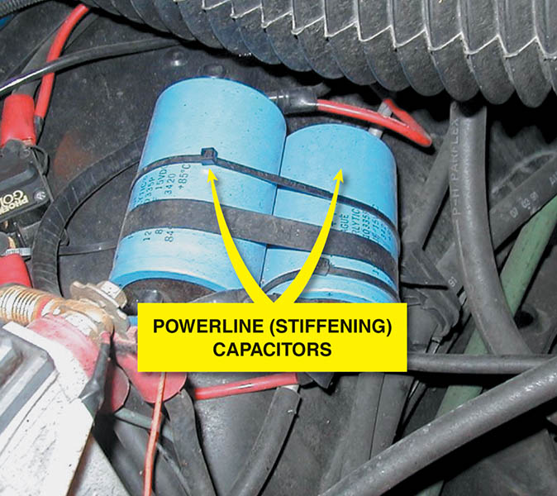
Figure 62.15 Two capacitors connected in parallel provide the necessary current flow to power large subwoofer speakers

Slide 38
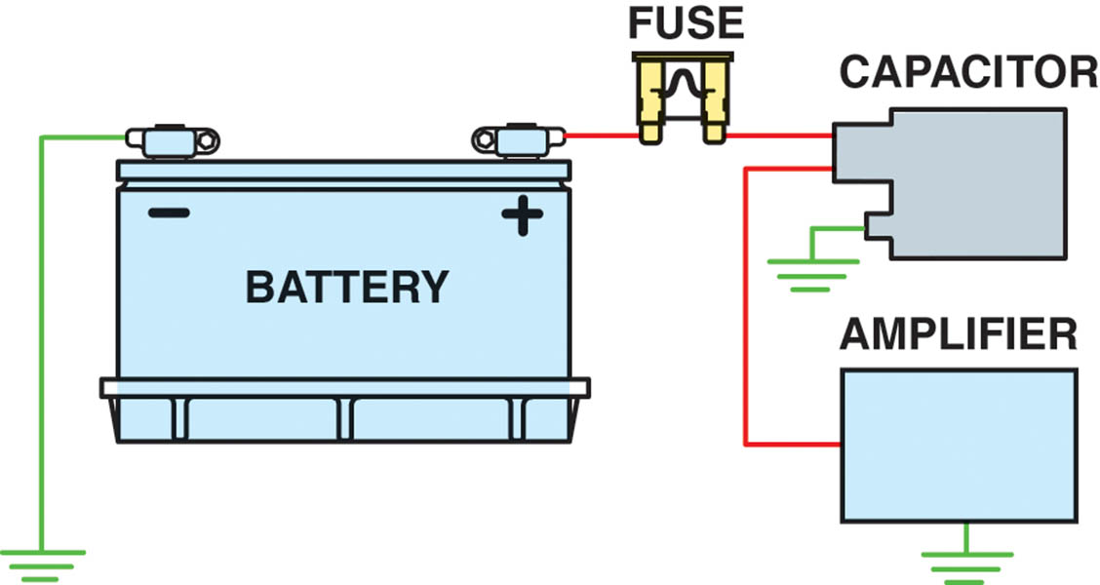
Figure 62.16 A powerline capacitor should be connected through the power wire to the amplifier, as shown. When the amplifier requires more electrical power (watts) than the battery can supply, the capacitor discharges into the amplifier.

Slide 39
VOICE RECOGNITION
Parts and Operation
  It allows the driver of a vehicle to perform tasks, such as locate an address in a navigation system by using voice commands rather than buttons.
Diagnosis and Service
  Verify the customer concern
  Check for aftermarket accessory interference
  Check for codes
  Follow the troubleshooting procedure

Slide 40
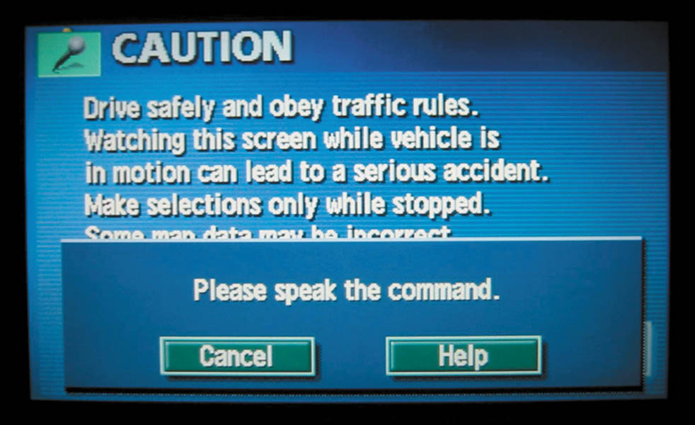
Figure 62.17 Voice commands can be used to control many functions, including navigation systems, climate control, telephone, and radio

Slide 41
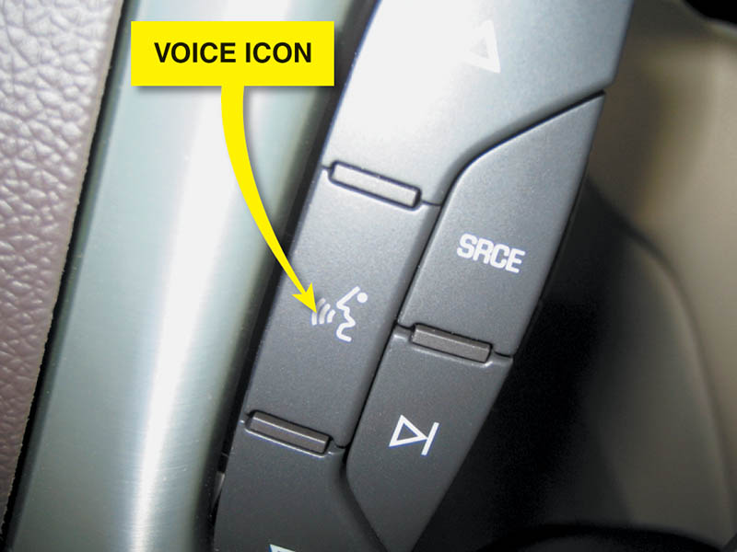
Figure 62.18 The voice command icon on the steering wheel of a Cadillac

Slide 42
BLUETOOTH
Operation
  Bluetooth is a (radio frequency) standard for short range communications.
  It operates in the ISM (industrial, scientific, and medical) band between 2.4000 and 2.4835 MHz.
  A Bluetooth receiver can be built into the navigation or existing sound system.
  A built-in microphone allows the driver to use voice commands to operate vehicle features as well as telephone conversations.

Slide 43
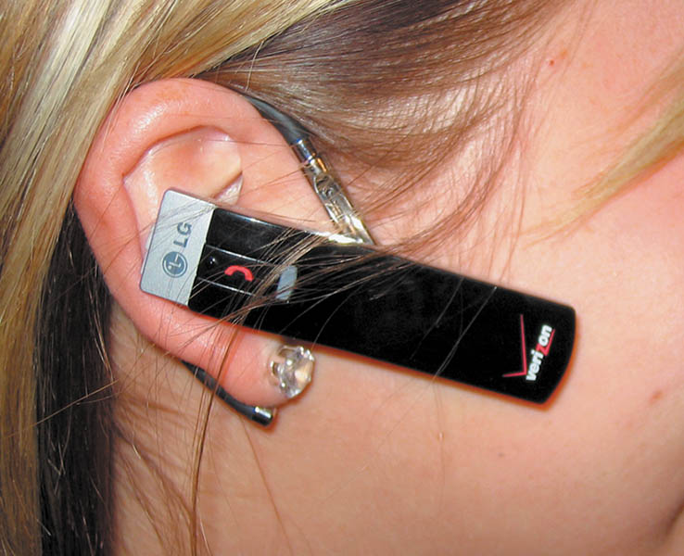
Figure 62.19 Bluetooth earpiece that contains a microphone and speaker unit that is paired to a cellular phone. The telephone has to be within 33 ft (10 m) of the earpiece

Slide 44
SATELLIGHT RADIO (1 OF 2)
Parts and Operation
  Satellite radio, also called Satellite Digital Audio Radio Services or SDARS, is a fee-based system that uses satellites to broadcast high-quality radio.
Sirus/XM Radio
  The most common satellite radio service offered.
  An optional in most vehicles.
Reception
  Reception affected by anything that would block signal.

Slide 45
SATELLIGHT RADIO (2 OF 2)
Antenna
  Must be able to receive satellite and repeater signals.
Diagnosis and Service
  Ensure the service is current
  Check the antenna for damage
  Follow manufacturer and provider test procedures

Slide 46
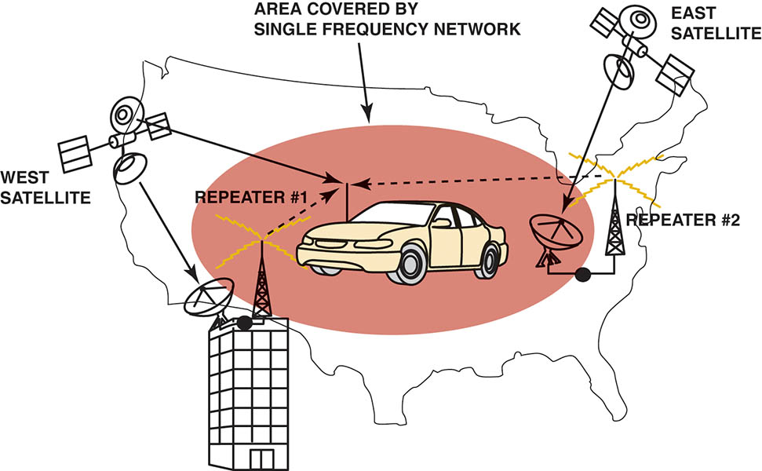
Figure 62.20 SDARS uses satellites and repeater stations to broadcast radio

Slide 47
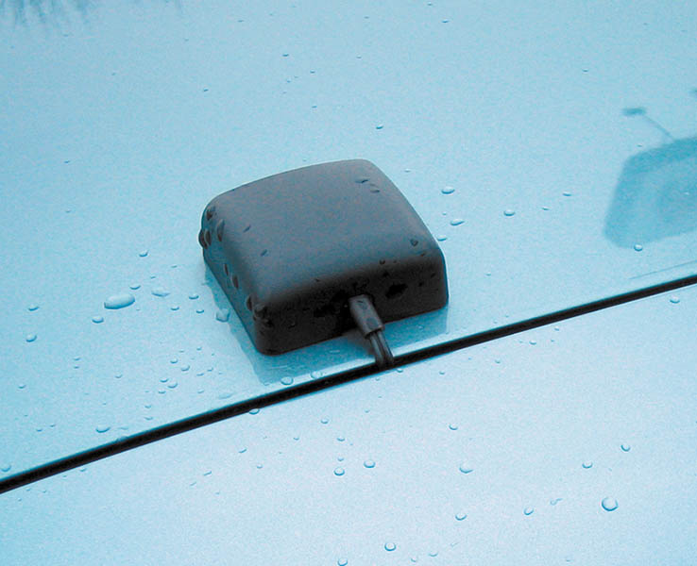
Figure 62.21 An aftermarket XM radio antenna mounted on the rear deck lid. The deck lid acts as the ground plane for the antenna

Slide 48
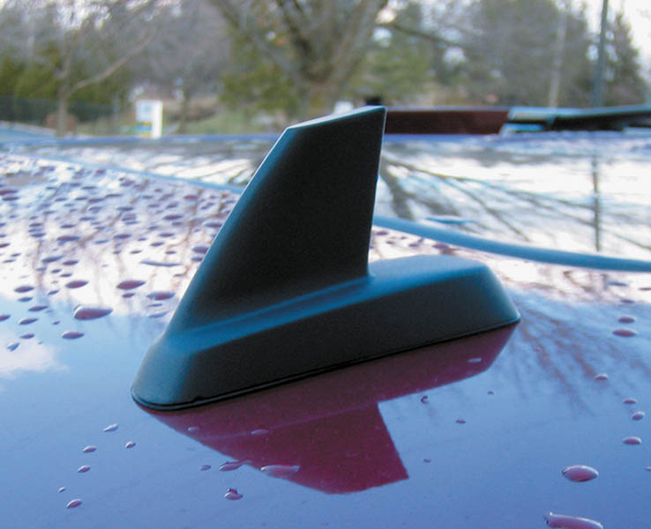
Figure 62.22 A shark-fin-type factory antenna used for both XM and OnStar

Slide 49
QUESTION 2: ?
What can affect the reception of a satellite radio signal?

Slide 50
ANSWER 2:
Anything tall enough to block the signal.

Slide 51
RADIO INTERFERENCE
Definition
  Caused by variations in voltage in the powerline or may be picked up by the antenna.
Capacitor Usage
  Used to eliminate ignition noise in the system.
Radio Choke
  A coil of wire used to eliminate ignition noise in the radio.
Braided Ground Wire
  Used when electrical noise is a concern.

Slide 52
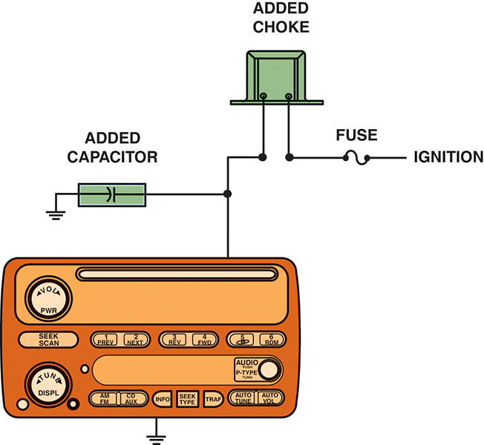
Figure 62.23 A radio choke and/or a capacitor can be installed in the power feed lead to any radio, amplifier, or equalizer

Slide 53
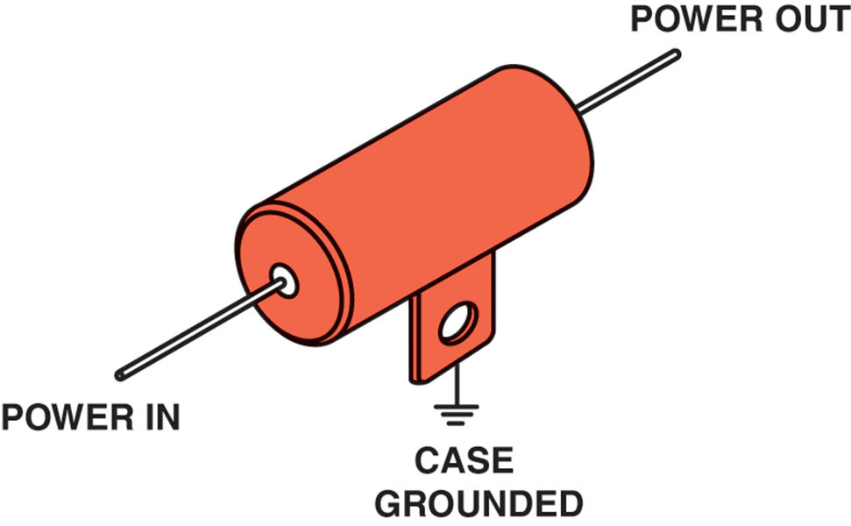
Figure 62.24 Many automobile manufacturers install a coaxial capacitor, like this one, in the power feed wire to the blower motor to eliminate interference caused by the blower motor

Slide 54
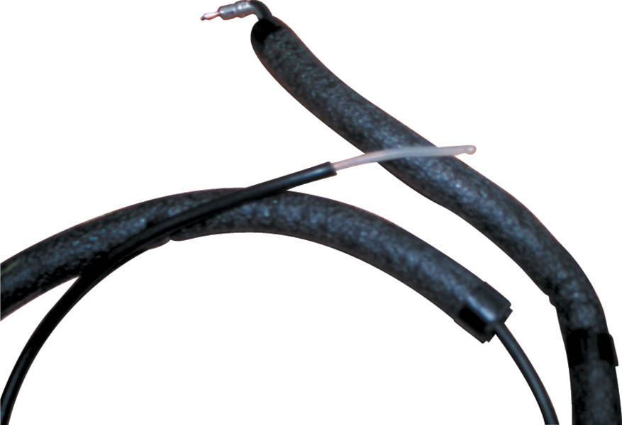
Figure 62.25 A “sniffer” can be made from an old antenna lead-in cable by removing about 3 inches of the outer shielding from the end.

Slide 55
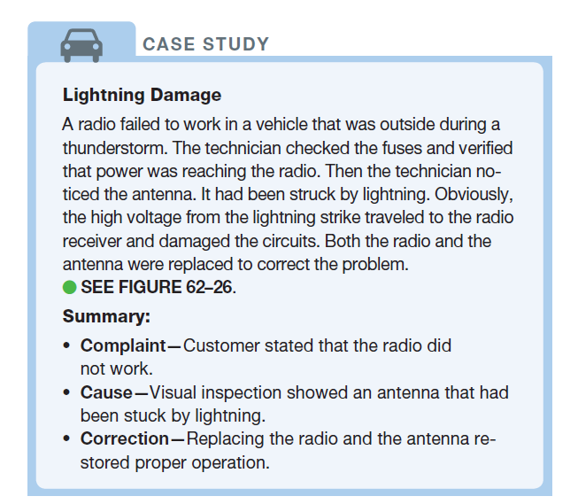
CASE STUDY

Slide 56
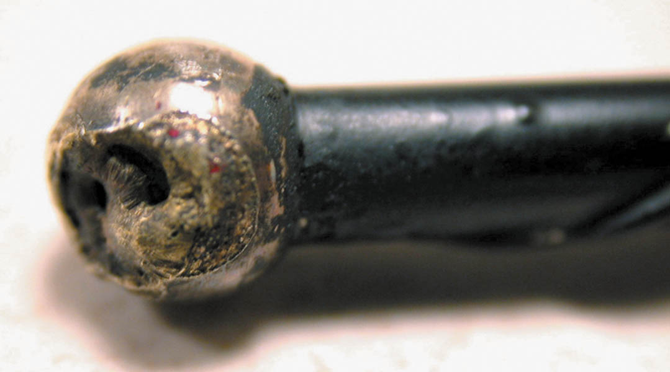
Figure 62.26 The tip of this antenna was struck by lightning

Slide 57
QUESTION 3: ?
What two items may need to be added to the wiring of a vehicle
to control or reduce radio noise?

Slide 58
ANSWER 3:
Capacitor or Radio Choke

Slide 59

Copyright

