Slide 1

Automotive Technology Principles, Diagnosis, and Service
Sixth Edition
Chapter 60
Airbag and Pretensioner Circuits
Copyright © 2018, 2015, 2011 Pearson Education, Inc. All Rights Reserved

Slide 2
LEARNING OBJECTIVES (1 of 2)
60.1 Explain how safety belts and retractors function.
60.2 Explain the operation of front airbags.
60.3 Describe the procedures to diagnose and repair common faults in airbag systems.
60.4 Explain how the passenger presence system works.

Slide 3
LEARNING OBJECTIVES (2 of 2)
60.5 Describe how seat and side curtain airbags function.
60.6 Describe the data recorded by an event data recorder when an airbag is deployed.
60.7 This chapter will help prepare for the ASE Electrical/Electronic Systems (A6) certification test content area “H” (Accessories Diagnosis and Repair).

Slide 4
SAFETY BELTS AND RETRACTORS (1 OF 2)
Safety Belts
  Most safety belts include three-point support and are constructed of nylon webbing about 2 inches (5 cm) wide.
Belt Retractors
  Emergency locking retractors, which lock the position of the safety belt in the event of a collision or rollover.
  Emergency and web speed-sensitive retractors, which allow freedom of movement for the driver and passenger, but lock if the vehicle is accelerating too fast or if the vehicle is decelerating too fast

Slide 5
SAFETY BELTS AND RETRACTORS (2 OF 2)
Safety Belt Lights and Chimes
  All late-model vehicles are equipped with a safety belt warning light on the dash and a chime that sounds if the belt is not fastened.
Pretensioners
  A pretensioner is an explosive (pyrotechnic) device that is part of the seat belt retractor assembly and tightens the seat belt as the airbag is being deployed

Slide 6
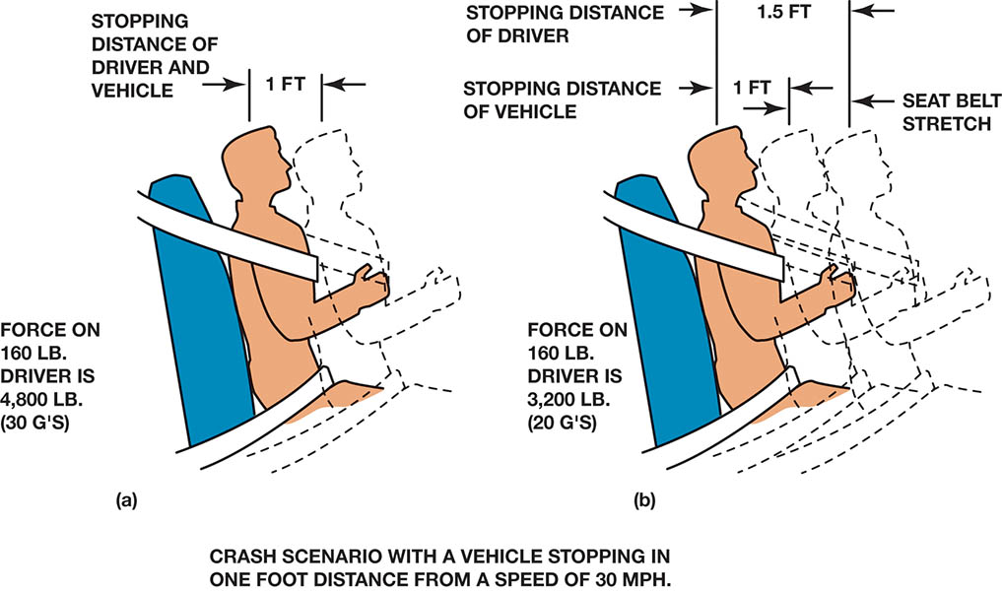
Figure 60.1 (a) safety belts are the primary restraint system. (b) during a collision, the stretching of the safety belt slows the impact to help reduce bodily injury

Slide 7
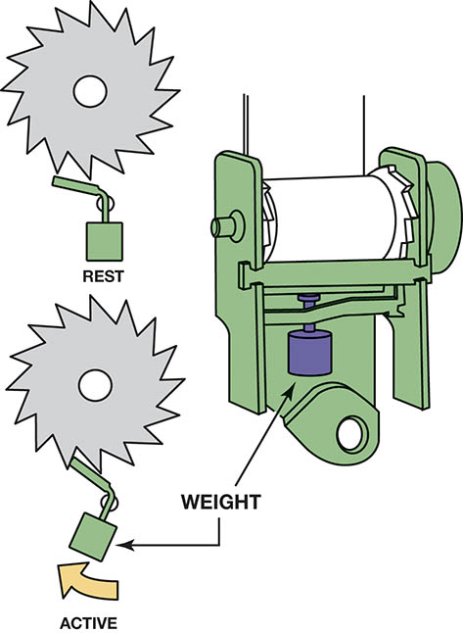
Figure 60.2 Most safety belts have an inertia-type mechanism that locks the belt in the event of rapid movement

Slide 8
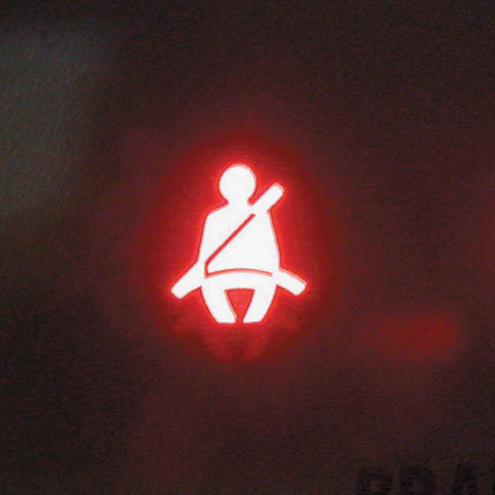
Figure 60.3 A typical safety belt warning light

Slide 9
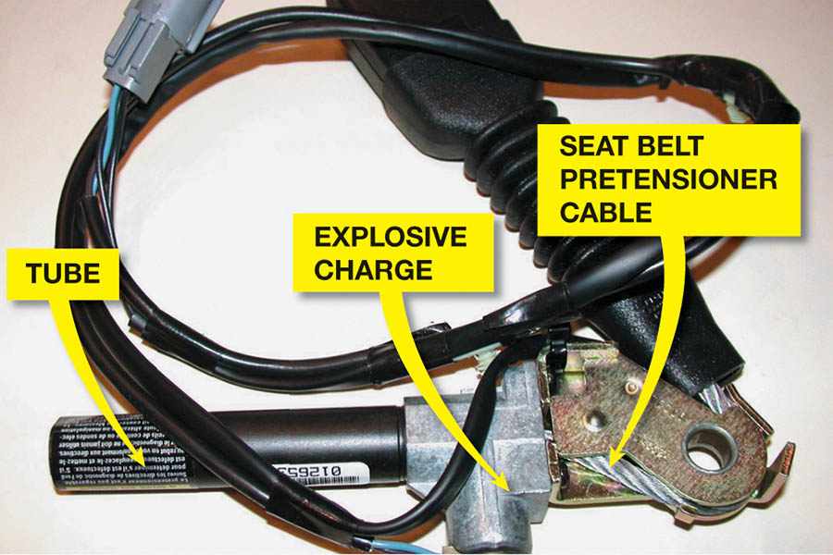
Figure 60.4 A small explosive charge in the pretensioner forces the end of the seat belt down the tube, which removes any slack in the seat belt

Slide 10
QUESTION 1: ?
What is the purpose of a pretensioner?

Slide 11
ANSWER 1:
To position the occupant properly for the airbag deployment.

Slide 12
FRONT AIRBAGS (1 OF 5)
Purpose and Function
  Airbag passive restraints are designed to cushion the driver (or passenger, if the passenger side is so equipped) during a frontal collision.
Airbag systems may be known by many different names, including the following:
  Supplemental restraint system (SRS)
  Supplemental inflatable restraints (SIR)
  Supplemental air restraints (SAR)

Slide 13
FRONT AIRBAGS (2 OF 5)
Parts Involved
  Sensors
  Airbag (inflator) module
  Clockspring wire coil in the steering column
  Control module
  Wiring and connectors

Slide 14
FRONT AIRBAGS (3 OF 5)
Operation
  To cause a deployment of the airbag, two sensors must be triggered at the same time. The arming sensor and the forward sensor.
  The squib uses electrical power and converts it into heat for ignition of the propellant used to inflate the airbag.
Types of Airbag Inflators
  Solid fuel – Sodium Azide pellets
  Compressed gas – Argon gas

Slide 15
FRONT AIRBAGS (4 OF 5)
Time For Airbag Deployment
  Collision occurs: 0.0 millisecond
  Sensors detect collision: 16 milliseconds (0.016 second)
  Airbag is deployed and seam cover rips: 40 milliseconds (0.040 second)
  Airbag is fully inflated: 100 milliseconds (0.100 second)
  Airbag deflated: 250 milliseconds (0.250 second)
In other words, an airbag deployment occurs and is over in about a quarter of a second.

Slide 16
FRONT AIRBAGS (5 OF 5)
Sensor Operation – All three types of sensors act as a switch to complete the circuit.
  Magnetically retained gold-plated ball sensor
  Rolled up stainless-steel ribbon-type sensor
  Integral sensor
Two-Stage Airbags
  Low-stage deployment
  High-stage deployment
  Low-stage and High-stage deployment
Airbag wiring is yellow for identification purposes.

Slide 17
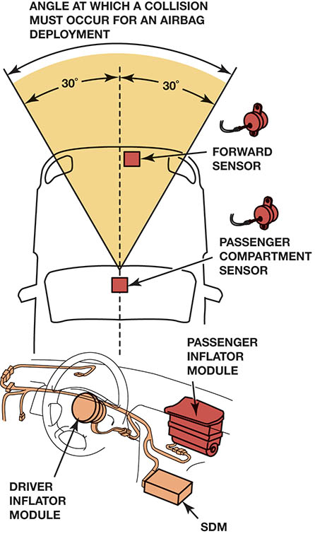
Figure 60.5 A typical airbag system showing many of the components. The SDM is the “sensing and diagnostic module” and includes the arming sensor, as well as the electronics that keep checking the circuits for continuity and the capacitors that are discharged to deploy the airbags

Slide 18
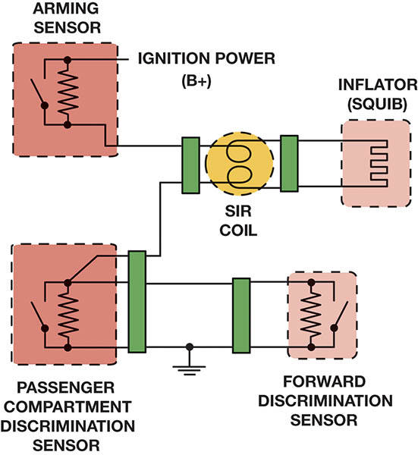
Figure 60.6 A simplified airbag deployment circuit. Note that both the arming sensor and at least one of the discriminating sensors must be activated at the same time. The arming sensor provides the power, and either one of the discriminating sensors can provide the ground for the circuit

Slide 19
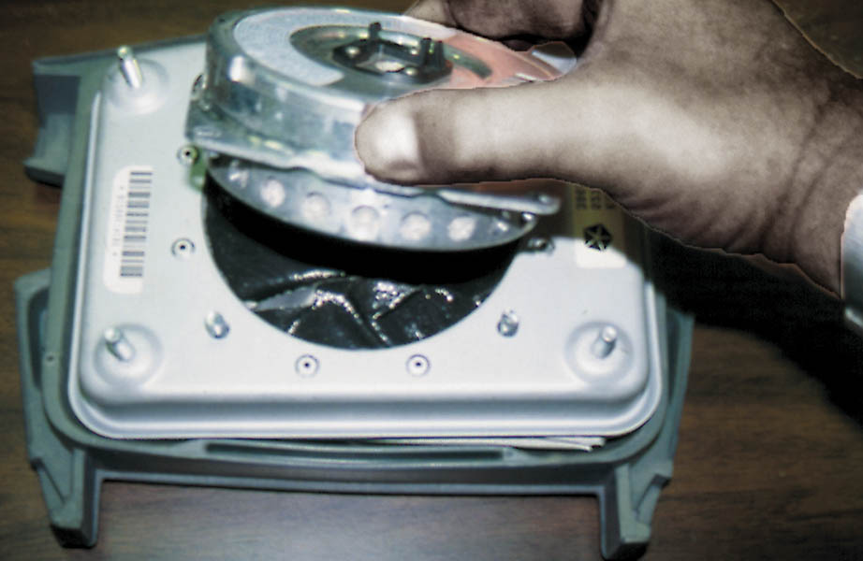
Figure 60.7 The inflator module is being removed from the airbag housing. The squib, inside the inflator module, is the heating element that ignites the pyrotechnic gas generator that rapidly produces nitrogen gas to fill the airbag

Slide 20
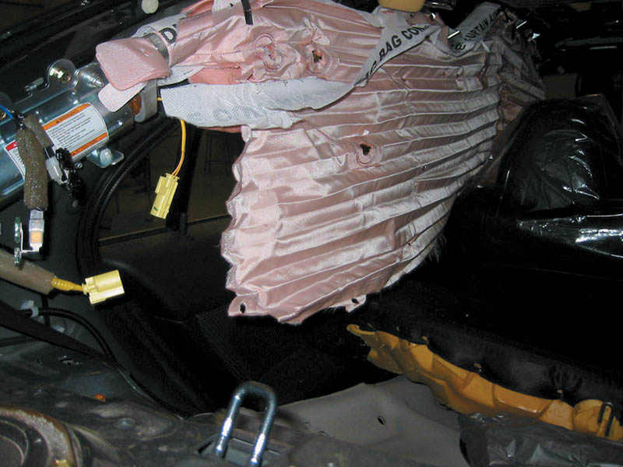
Figure 60.8 This figure shows a deployed side curtain airbag on a training vehicle

Slide 21
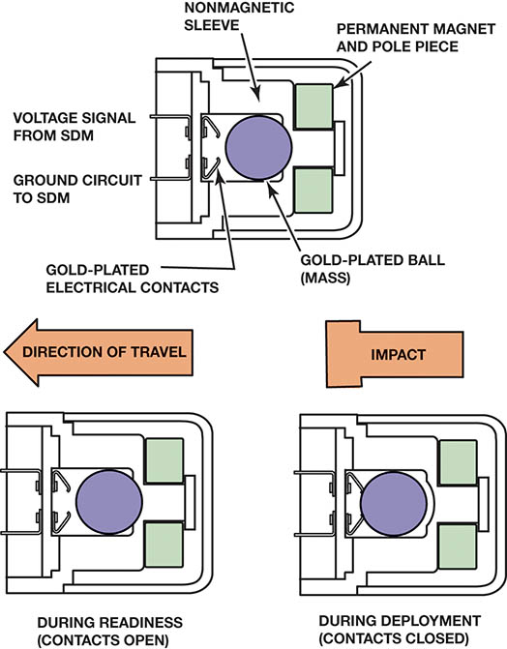
Figure 60.9 An airbag magnetic sensor

Slide 22
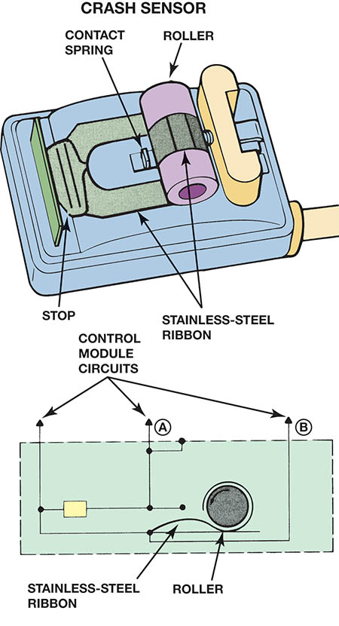
Figure 60.10 Some vehicles use a ribbon-type crash sensor

Slide 23
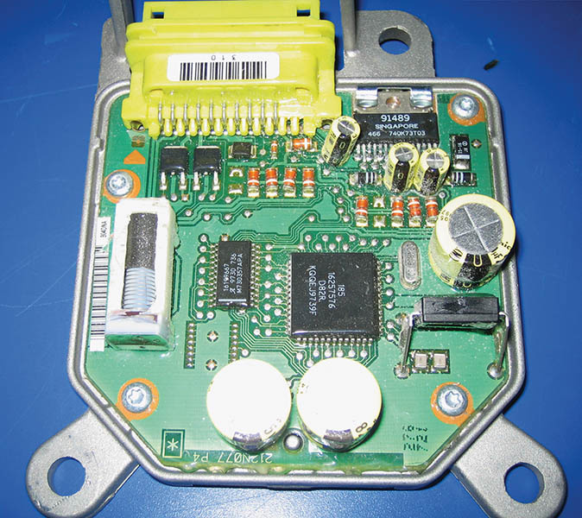
Figure 60.11 A sensing and diagnostic module that includes an accelerometer

Slide 24
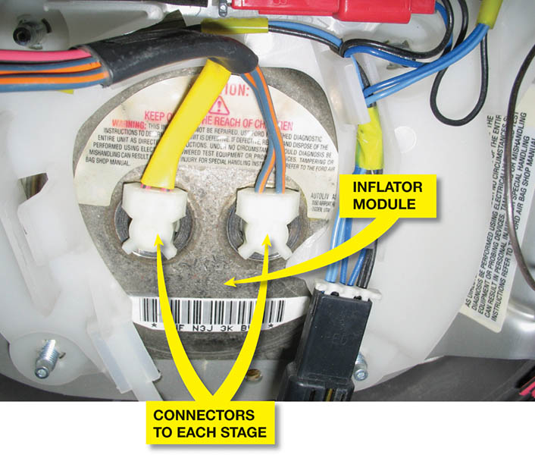
Figure 60.12 A driver’s side airbag showing two inflator connectors. One is for the lower-force inflator and the other is for the higher-force inflator. Either can be ignited, or both at the same time if the deceleration sensor detects a severe impact

Slide 25
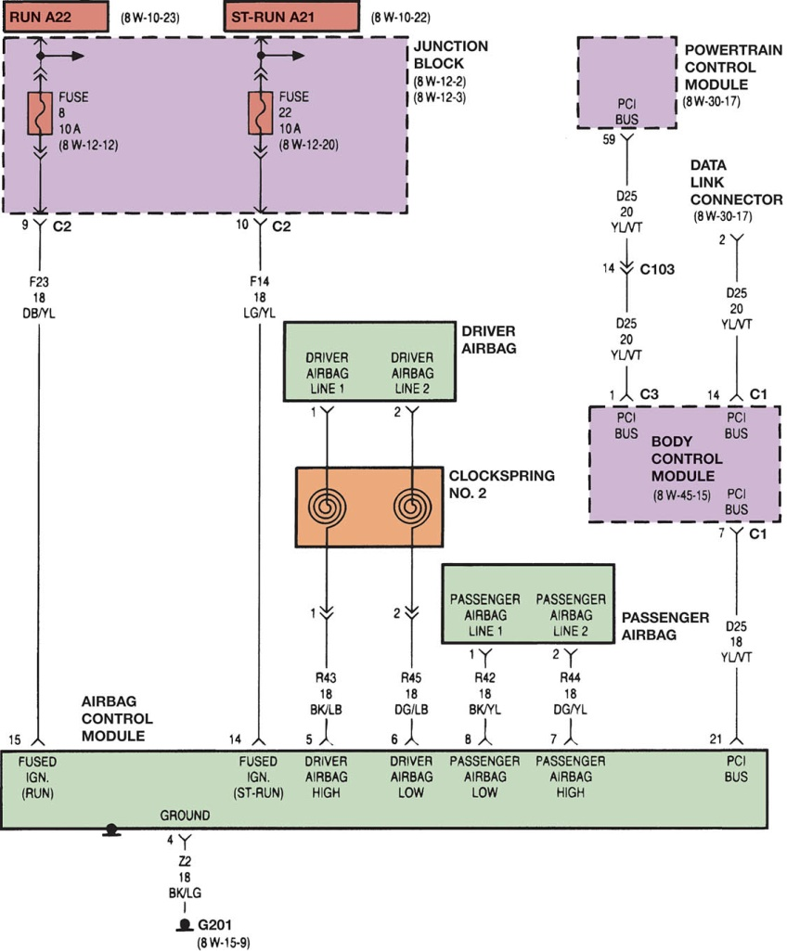
Figure 60.13 The airbag control module is linked to the powertrain control module (PCM) and the body control module (BCM) on this Chrysler system. Notice the airbag wire connecting the module to the airbag through the clockspring. Both power, labeled “driver airbag high,” and ground, labeled “driver airbag low,” are conducted through the clockspring

Slide 26
QUESTION 2: ?
What are the two types of airbag inflators?

Slide 27
ANSWER 2:
Solid fuel – Sodium Azide, and compressed gas – Argon Gas.

Slide 28
AIRBAG DIAGNOSIS TOOLS AND EQUIPMENT (1 OF 2)
Self-Test Procedure
  The electrical portion of airbag systems is constantly checked by the circuits within the airbag energizing power unit or through the airbag controller.
Diagnosis and service of airbag systems usually require some or all of the following items.
  Digital multimeter, air bag load tool, scan tool, shorting bars, airbag system tester, special wire-repair tools.

Slide 29
AIRBAG DIAGNOSIS TOOLS AND EQUIPMENT (2 OF 2)
Precautions
  Always follow all precautions and warning stickers.
  Maintain a safe working distance from all airbags.
  After a collision, the inflator module and all sensors usually must be replaced.
  Avoid using a self-powered test light on air bag systems.
  Always hold the inflator away from your body.
  Never jar or strike a sensor.
  If handling a deployed inflator module, always wear gloves.

Slide 30
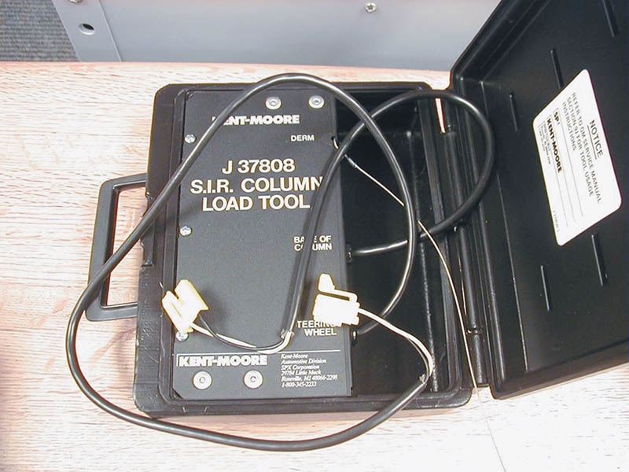
Figure 60.14 An airbag diagnostic tester. Included in the plastic box are electrical connectors and a load tool that substitutes for the inflator module during troubleshooting

Slide 31
AIRBAG SYSTEM SERVICE
Dis-arming
  Disconnect the negative battery cable, remove the airbag fuse, disconnect the airbag connectors.
Diagnostic and Service Procedures
  Use service information to determine how the circuit is designed and the correct sequence of tests to be followed.
Self-Diagnosis
  Airbag systems can detect system electrical faults, disable the system and illuminate the warning lamp.

Slide 32
DRIVER SIDE AIRBAG MODULE REPLACEMENT
Airbag Module Removal
  1. Turn the steering wheel until the front wheels are positioned straight ahead
  2. Switch the ignition off and disconnect the negative battery cable. (wait ten minutes)
  3. Loosen and remove the nuts or screws that hold the airbag module in place.
  4. Carefully lift the airbag module from the steering wheel and disconnect the electrical connector.
When installing the airbag module, make sure the clock-spring is correctly positioned.

Slide 33
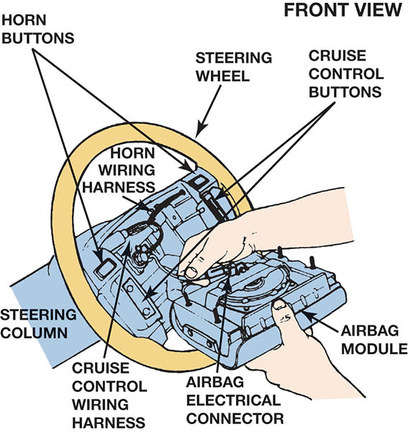
Figure 60.15 After disconnecting the battery and the yellow connector at the base of the steering column, the airbag inflator module can be removed from the steering wheel and the yellow airbag electrical connector at the inflator module be disconnected

Slide 34
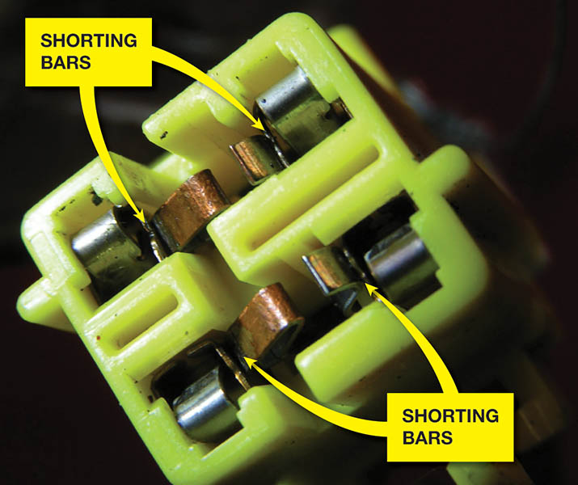
Figure 60.16 Shorting bars are used in most airbag connectors. These spring-loaded clips short across both terminals of an airbag connector when it is disconnected to help prevent accidental deployment of the airbag.

Slide 35
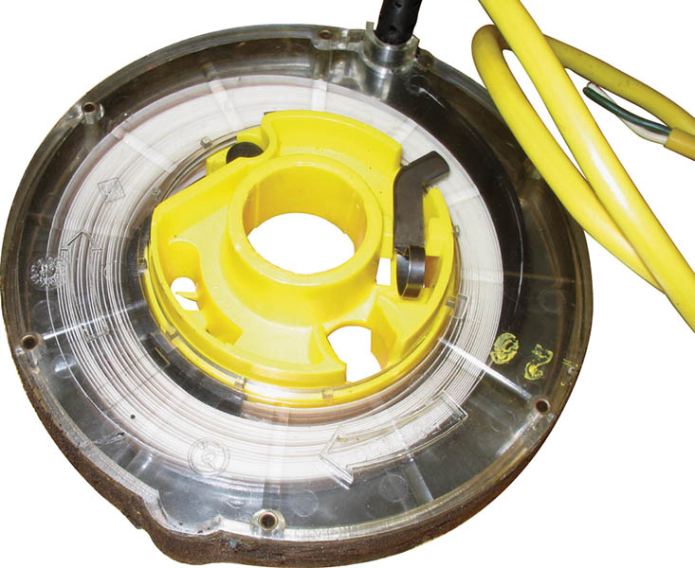
Figure 60.17 An airbag clockspring showing the flat conductor wire. It must be properly positioned to ensure proper operation

Slide 36
SAFETY WHEN MANUALLY DEPLOYING AIRBAGS
When possible, deploy the airbag outside of the vehicle.
Wear the proper hearing and eye protection.
Deploy the airbag with the trim cover facing up.
Stay at least 20 ft. (6 m) from the airbag.
Allow the airbag module to cool.
Follow the vehicle manufacturer’s recommendations.

Slide 37
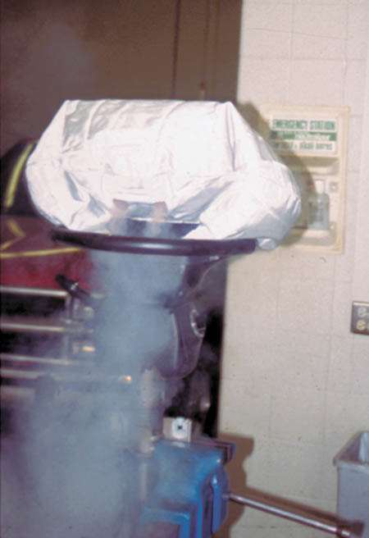
Figure 60.18 An airbag being deployed as part of a demonstration in an automotive laboratory

Slide 38
OCCUPANT DETECTION SYSTEMS
Purpose and Function
  The passenger side airbag must be disabled or deployed with reduced force when the seat is empty or child or small adult is present.
Type of Seat Sensor
  Gel-filled bladder sensor.
  Capacitive strip sensors.
  Force-sensing resistor sensors.
A scan tool and weights are use to check and calibrate the system.

Slide 39
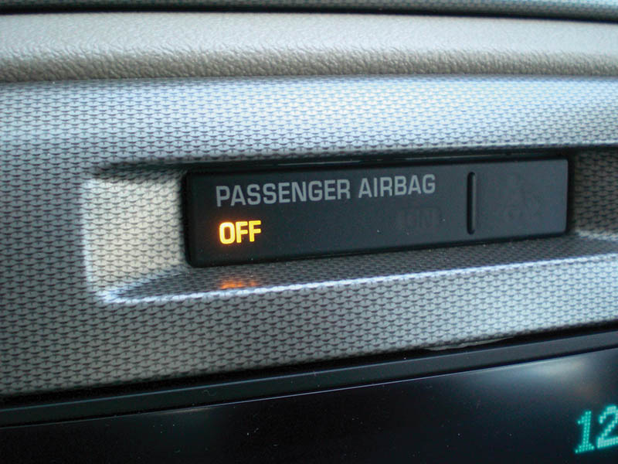
Figure 60.19 A dash warning lamp lights if the passenger side airbag is off because no passenger was detected by the seat sensor

Slide 40
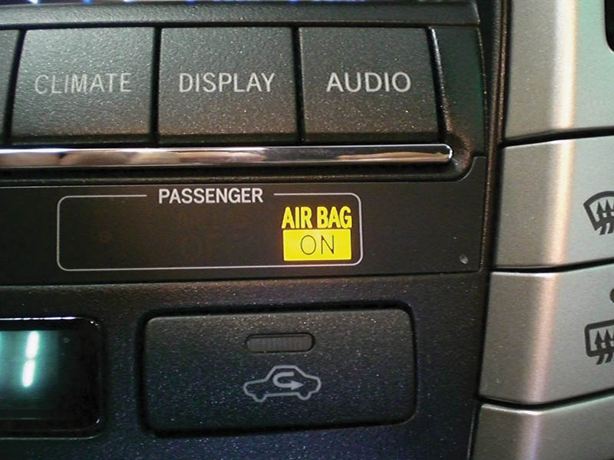
Figure 60.20 The passenger side airbag “on” lamp lights if a passenger is detected on the passenger seat

Slide 41
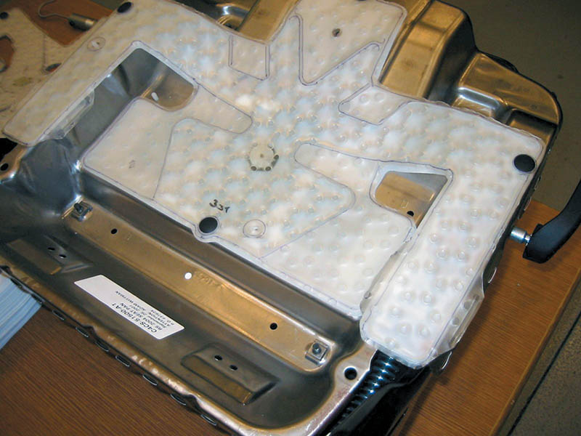
Figure 60.21 A gel-filled (bladder-type) occupant detection sensor showing the pressure sensor and wiring

Slide 42
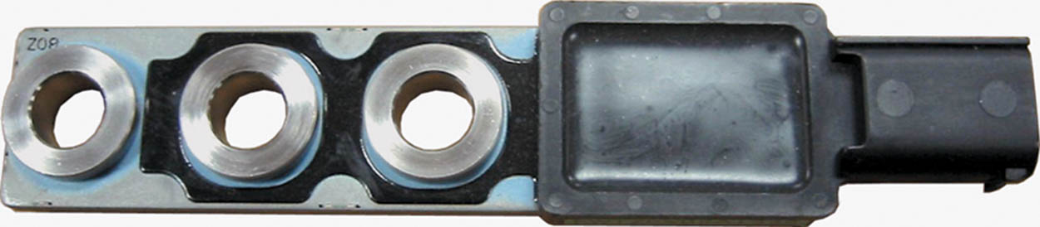
Figure 60.22 A resistor-type occupant detection sensor. The weight of the passenger strains these resistors, which are attached to the seat, thereby signaling to the module the weight of the occupant

Slide 43
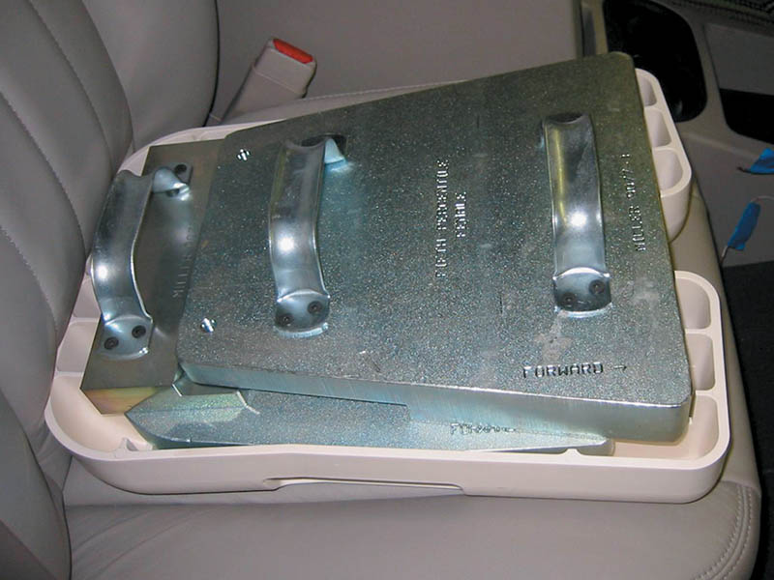
Figure 60.23 A test weight is used to calibrate the occupant detection system on a Chrysler vehicle

Slide 44
QUESTION 3: ?
What are the three types of seat sensors?

Slide 45
ANSWER 3:
Gel-filled, capacitive strip, and force sensing resistor.

Slide 46
SEAT AND SIDE CURTAIN AIRBAGS
Seat Airbags
  Generally mounted in the side bolster of the seat.
Side Curtain Airbags
  Mounted in the headliner or door panel.
Deployment of both systems dependent on side impact sensors and their controllers.

Slide 47
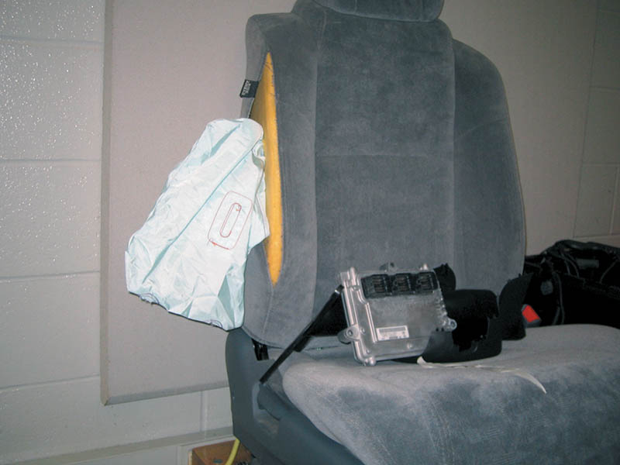
Figure 60.24 A typical seat (side) airbag that deploys from the side of the seat

Slide 48
EVENT DATA RECORDERS
Parts and Operation
  Used to record parameters just before and slightly after an airbag deployment.
Data Extraction
  Can only be achieved using a piece of equipment known as the Crash Data Retrieval System.
  Cannot be performed by the service technician
  Must have specific training and authorization to retrieve the data.

Slide 49

Copyright

