Slide 1

Automotive Technology Principles, Diagnosis, and Service
Sixth Edition
Chapter 6
Shop Safety
Copyright © 2018, 2015, 2011 Pearson Education, Inc. All Rights Reserved

Slide 2
LEARNING OBJECTIVES (1 of 2)
6.1 Describe the personal protective equipment (PPE) technicians use.
6.2. Explain safety tips for automotive technicians.
6.3. Discuss shop safety procedures regarding electricity.

Slide 3
LEARNING OBJECTIVES (2 of 2)
6.4 Discuss the purpose of fire extinguishers, fire blankets, and first aid and eye wash stations.
6.5 Describe safety procedures for working with hybrid electric vehicles.

Slide 4
PERSONAL PROTECTIVE EQUIPMENT (1 0f 4)
Safety Glasses
  Wear at all times
  ANSI Z87.1standard
  Full face shied recommended when using grinder or power washer

Slide 5
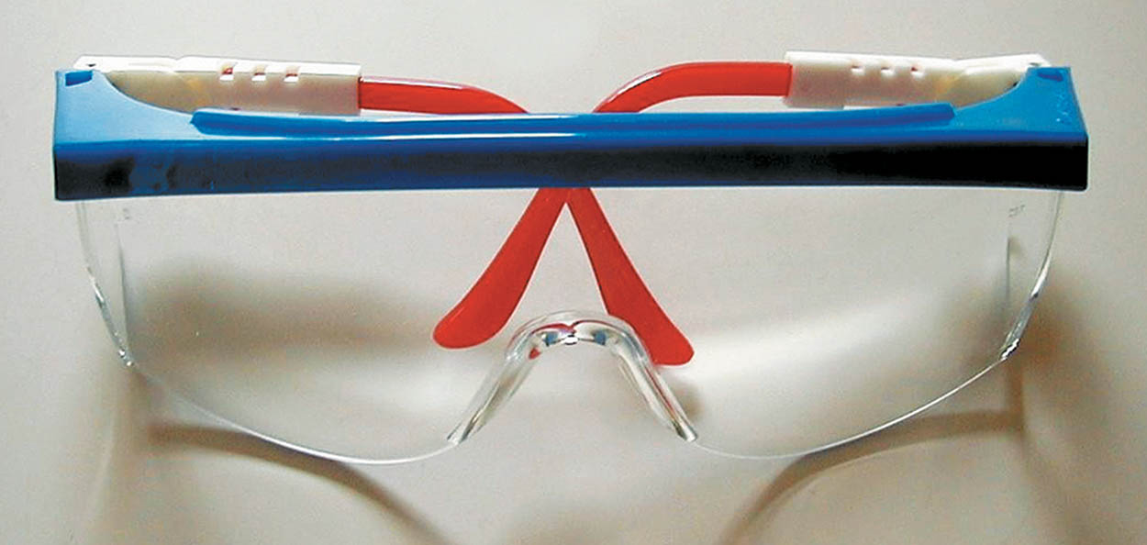
Figure 6.1 Safety glasses should be worn at all times when working on or around any vehicle or servicing any component

Slide 6
PERSONAL PROTECTIVE EQUIPMENT (2 of 4)
Steel-Toed Shoes
  Good investment
  Safer than canvas or cloth

Slide 7
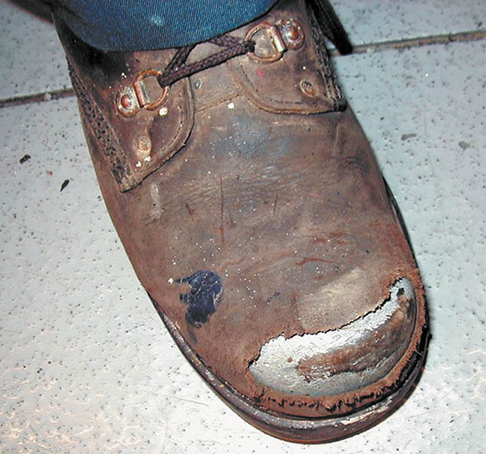
Figure 6.2 Steel-toed shoes are a worthwhile investment to help prevent foot injury due to falling objects. Even these well-worn shoes can protect the feet of this service technician

Slide 8
PERSONAL PROTECTIVE EQUIPMENT (3 of 4)
Gloves
  Latex
  Vinyl
  Polyurethane
  Nitrile
  Mechanics

Slide 9
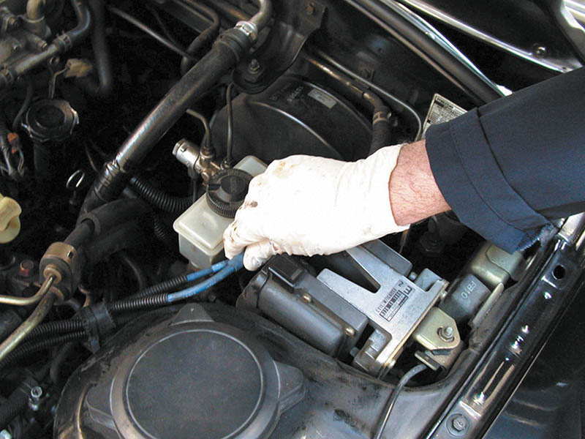
Figure 6.3 Protective gloves, such as these vinyl gloves, are available in several sizes. Select the size that allows the gloves to fit snugly. Vinyl gloves last a long time and often can be worn all day to help protect your hands from dirt and possible hazardous materials

Slide 10
PERSONAL PROTECTIVE EQUIPMENT (4 of 4)
Bump Cap
  Protects head when working under vehicle.
Hands, Jewelry, Clothing
  Remove jewelry and keep hands clean.
Hearing Protection
  Used when noise is greater than 90 dB

Slide 11
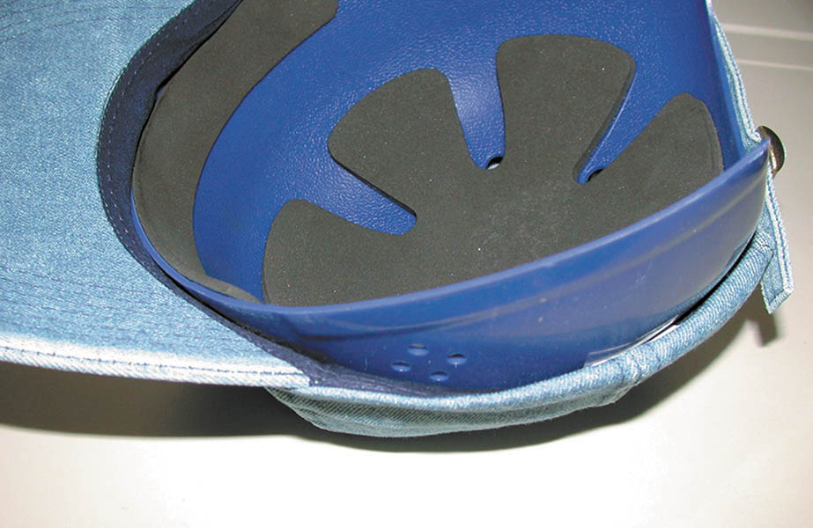
Figure 6.4 One version of a bump cap is this padded plastic insert that is worn inside a regular cloth cap

Slide 12

Figure 6.5 Remove all jewelry before performing service work on any vehicle

Slide 13
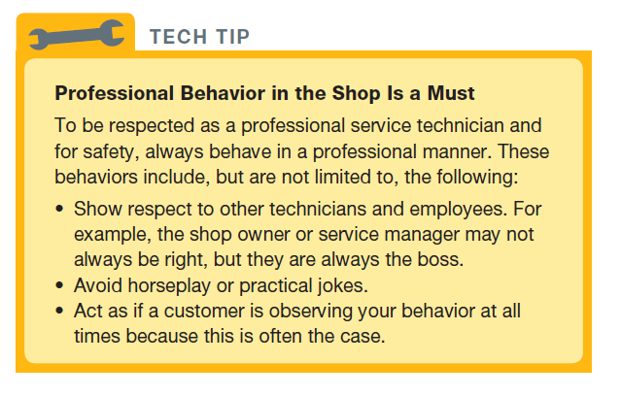
TECH TIP

Slide 14
QUESTION 1: ?
What are the four items that are personal protective equipment?

Slide 15
ANSWER 1:
Safety glasses, steel-toed boot, bump cap, and gloves.

Slide 16
SAFETY TIPS FOR TECNICIANS (1 of 2)
Lifting
  Secure grip and solid footing
  Do not twist
  Ask for help
  Push rather than pull
Exhaust Hose
  Make sure properly connected to vehicle

Slide 17
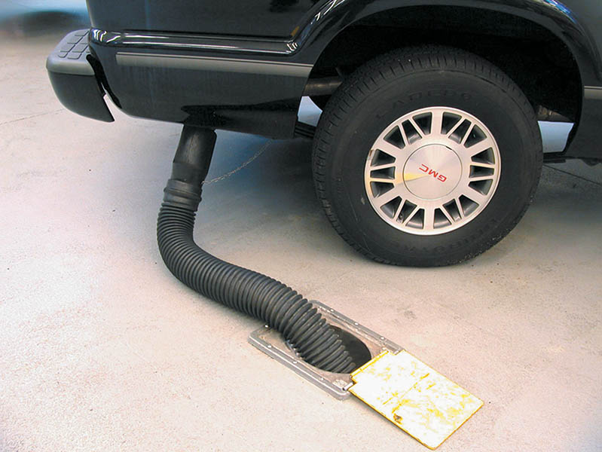
Figure 6.6 Always connect an exhaust hose to the tailpipe of the engine of a vehicle to be run inside a building

Slide 18
SAFETY TIPS FOR TECHNICIANS (2 of 2)
Work Height
  Place tools nearby to avoid strain
Hood
  Ensure it is securely open
Moving Vehicles
  Get help or used motorized pusher

Slide 19
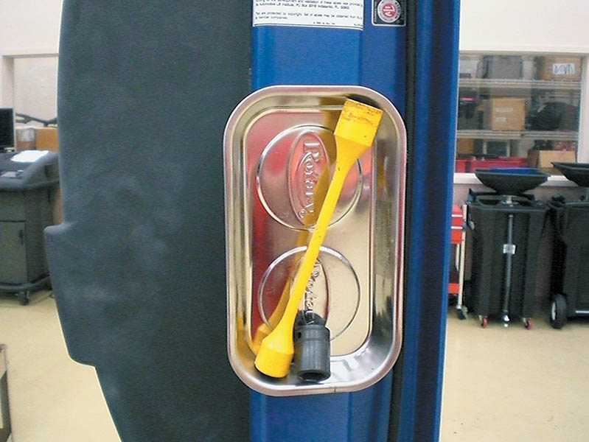
Figure 6.7 A magnetic tray is a helpful item to keep tools needed up where they can be easily reached without having to bend over, saving time and energy over the course of a long day in the shop

Slide 20
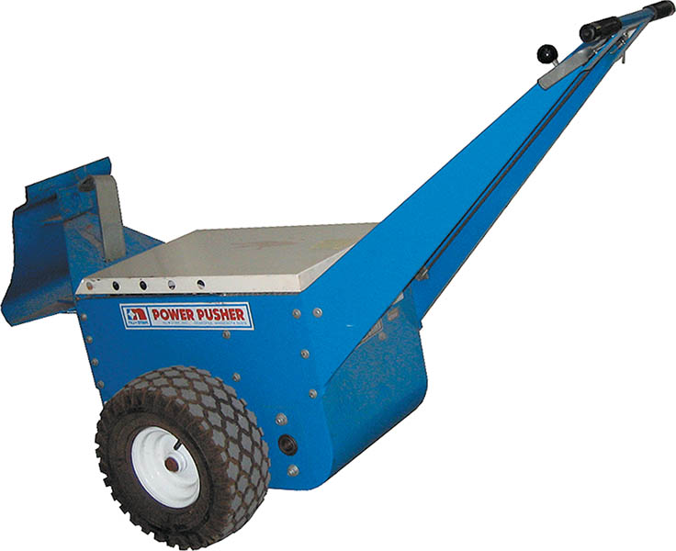
Figure 6.8 An electric pusher used to push vehicles into or around the shop

Slide 21
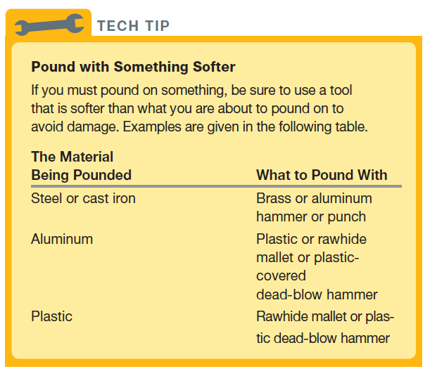
Tech Tip

Slide 22
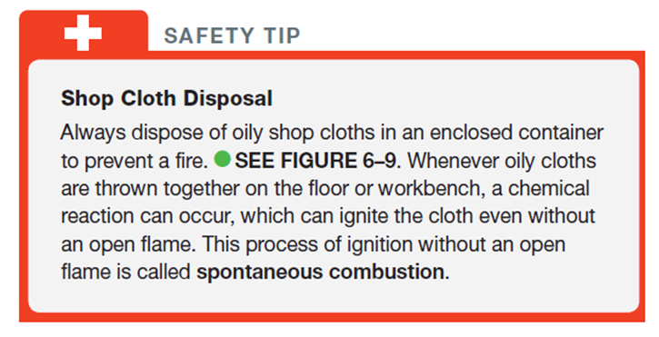
SAFETY TIP

Slide 23
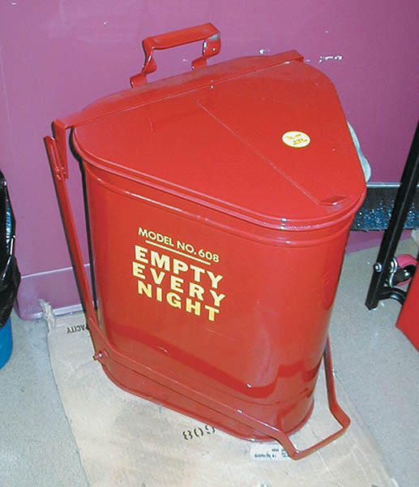
Figure 6.9 All oily shop cloths should be stored in a metal container equipped with a lid to help prevent spontaneous combustion

Slide 24
ELECTRICAL SAFETY
Electrical Cord Safety
  Use three prong grounded outlets and cords
Jump Starting and Battery Safety
  Use quality jumper cables or jumper box
  The last connection should be on the block away from the battery
.

Slide 25
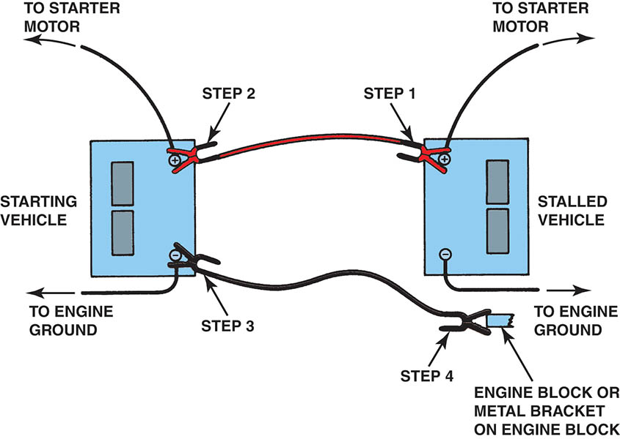
Figure 6.10 Jumper cable usage guide

Slide 26
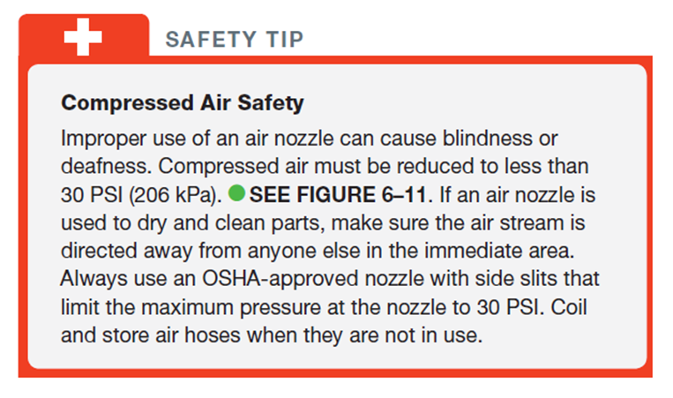
SAFETY TIP

Slide 27
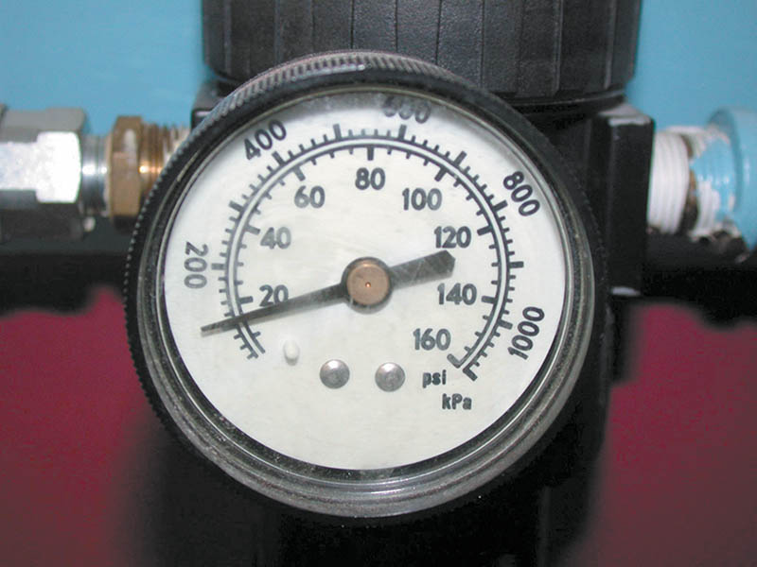
Figure 6.11 The air pressure going to the nozzle should be reduced to 30 PSI or less

Slide 28
FIRE SAFETY (1 of 3)
Fire Extinguishers
  Class A is designed for use on general combustibles, such as cloth, paper, and wood.
  Class B is designed for use on flammable liquids and greases, including gasoline, oil, thinners, and solvents.
  Class C is used only on electrical fires.
  Class D is effective only on combustible metals, such as powdered aluminum, sodium, or magnesium.

Slide 29
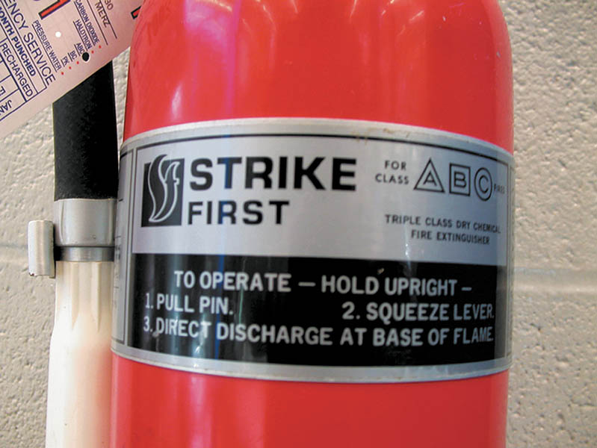
Figure 6.12 A typical fire extinguisher designed to be used on type class A, B, or C fires. The area around the fire extinguisher must be free and clear to allow easy access

Slide 30
FIRE SAFETY (2 of 3)
Types of Fire Extinguishers
  Water
    Reduces temperature where fire cannot be sustained
  Carbon Dioxide (CO2)
    Removes oxygen from the fire and reduces the temperature
  Dry Chemical (Yellow)
    Coats the flammable material which eliminates the oxygen from the fire

Slide 31
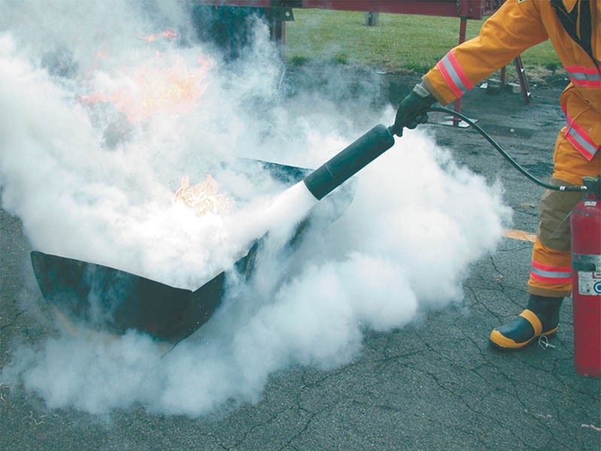
Figure 6.13 A C O₂ fire extinguisher being used on a fire set in an open steel drum during a demonstration at a fire department training center

Slide 32
FIRE SAFETY (3 of 3)
Fire Blankets
  Used when a person is on fire
  Smothers the flames
First Aid and Eye Wash Stations
  First aid station contains emergency supplies
  Eye wash station used to rinse liquids or chemicals
Evacuation Routes
  Easy to read instructions on how to exit in an emergency

Slide 33
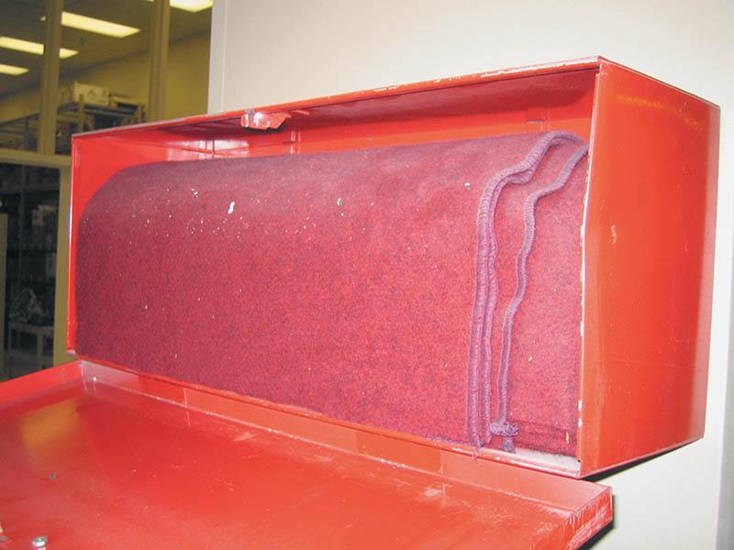
Figure 6.14 A treated wool blanket is kept in this easy-to-open wall-mounted holder and should be placed in a centralized location in the shop

Slide 34
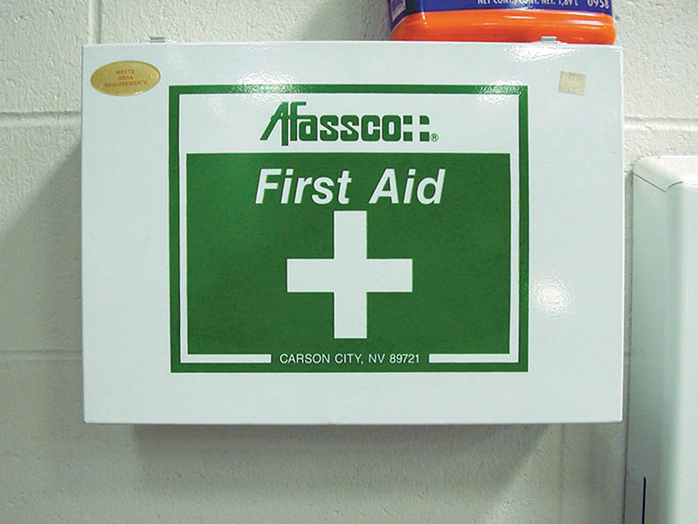
Figure 6.15 A first aid box should be centrally located in the shop and kept stocked with the recommended supplies

Slide 35
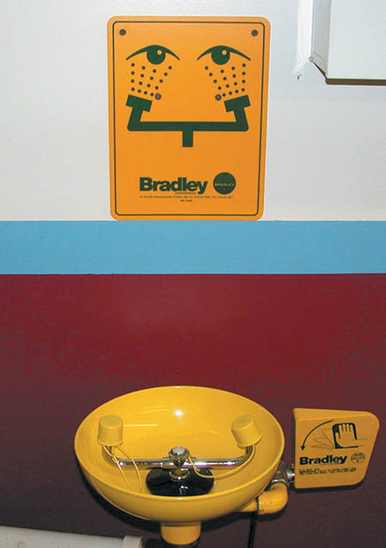
Figure 6.16 A typical eye wash station. Often a thorough flushing of the eyes with water is the best treatment in the event of eye contamination

Slide 36
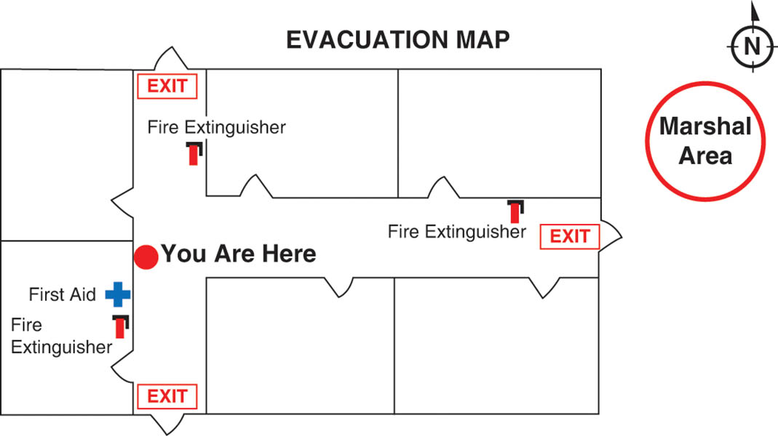
Figure 6.17 The evacuation routes from where you are in the building is shown on maps that are attached to the walls in schools and commercial buildings

Slide 37
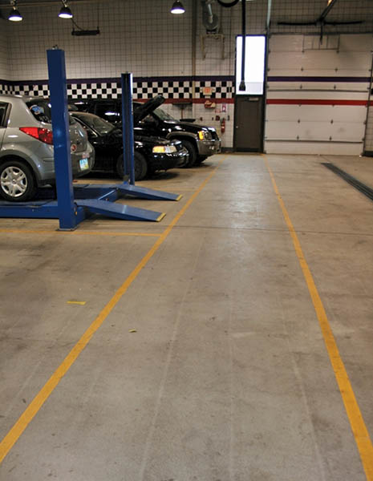
Figure 6.18 A properly marked aisle using yellow paint strips leading to an exit

Slide 38
QUESTION 2: ?
What are the three types of fire extinguisher?

Slide 39
ANSWER 2:
Water, Carbon Dioxide, and Dry Chemical.

Slide 40
HYBRID ELECTRIC VEHICLE SAFETY
Safely Shut Off High Voltage System
  Turn off ignition key
  Disconnect the high voltage circuits

Slide 41
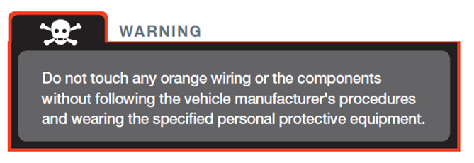
WARNING

Slide 42
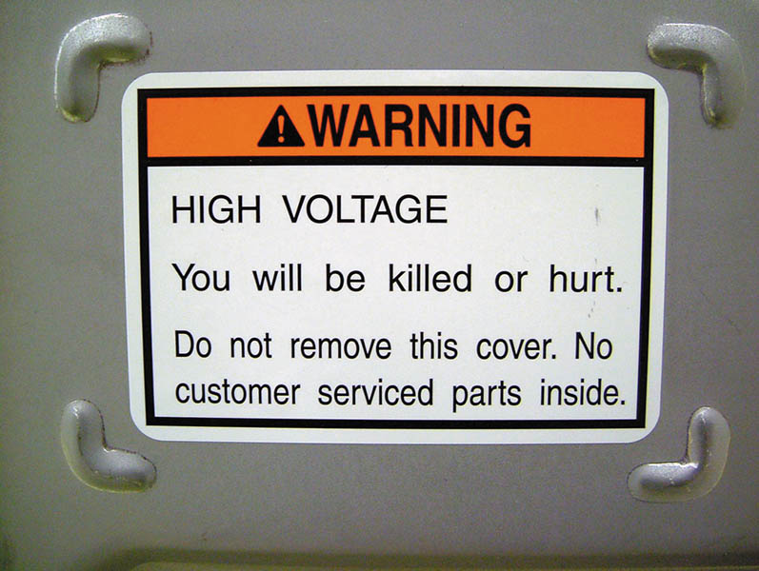
Figure 6.19 A warning label on a Honda hybrid warns that a person can be killed due to the high-voltage circuits under the cover

Slide 43
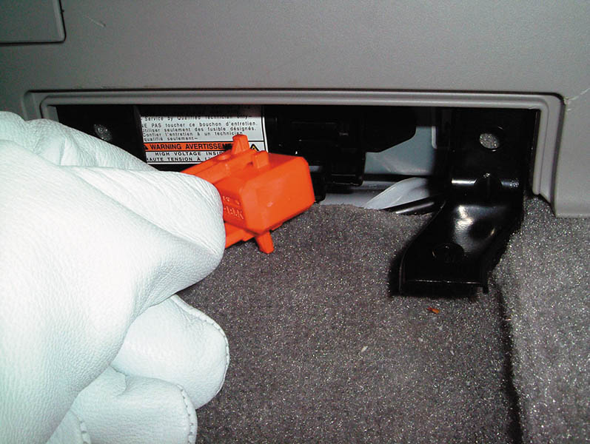
Figure 6.20 The high-voltage disconnect switch is in the trunk area on a Toyota Prius. Insulated rubber lineman’s gloves should be worn when removing this plug

Slide 44
QUESTION 3: ?
What safety precautions should be taken when working on a hybrid electric vehicle?

Slide 45
ANSWER 3:
Wear insulated rubber lineman’s gloves.

Slide 46

Copyright

