Slide 1

Automotive Technology Principles, Diagnosis, and Service
Sixth Edition
Chapter 59
Immobilizer Systems
Copyright © 2018, 2015, 2011 Pearson Education, Inc. All Rights Reserved

Slide 2
LEARNING OBJECTIVES
59.1 Describe the purpose and function of a security system.
59.2 Explain how an immobilizer system works and identify its major component.
59.3 Compare immobilizer systems in Chrysler, Ford, and General Motors vehicles.
59.4 Explain how to diagnose a fault with an immobilizer system.

Slide 3
VEHICLE SECURITY SYSTEMS
Purpose and Function
The purpose and function of a security system on a vehicle is to prevent the unauthorized use (theft) of the vehicle.
This function is accomplished with a lock on the door and a lock on the ignition.

Slide 4
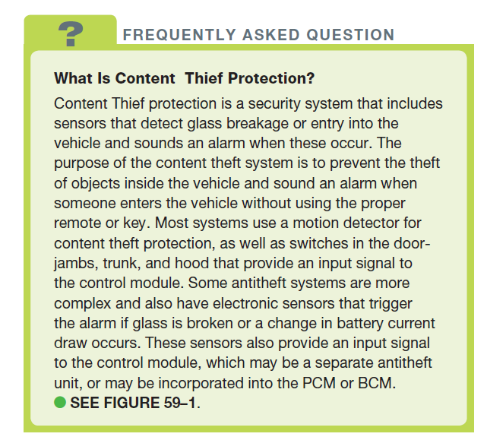
FREQUENTLY ASKED QUESTION

Slide 5
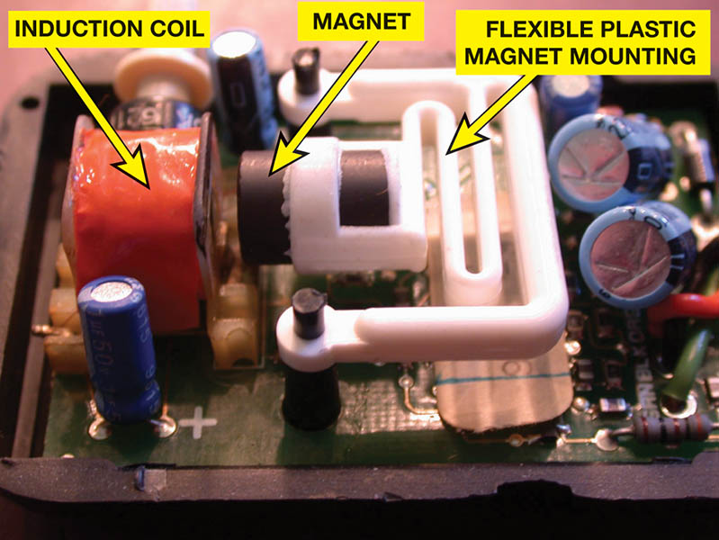
Figure 59.1 A shock sensor used in alarm and antitheft systems. If the vehicle is moved, the magnet moves relative to the coil, inducing a small voltage that triggers the alarm

Slide 6
IMMOBILIZER SYSTEMS (1 OF 3)
Normal Operation
The engine cranks and starts and the immobilizer symbol on the dash flashes on and off for about two seconds, and then goes off.
Immobilizer System Parts
Key fob – remote keyless entry (RKE)
Transponder key
Transceiver

Slide 7
IMMOBILIZER SYSTEMS (2 OF 3)
Immobilizer System Operation
The key identification (ID) numbers are stored in a nonvolatile memory of the immobilizer module.
At each start, the module compares the ID number of the transponder key used with those stored in the memory.
The immobilizer module controls the starter circuit and the security light and signals the PCM to activate fuel injection and ignition when the ID number and code word verification have been successful.

Slide 8
IMMOBILIZER SYSTEMS (3 OF 3)
Security Light Operation
Normal operation of the security light includes a self-test and flashes a few times, then goes out.
If a fault is detected, the security light continues to flash and the engine may not start.
Precautions
Do not drop key
Key the key dry
Do not expose the key to magnetic fields
Do not expose to high temperatures

Slide 9
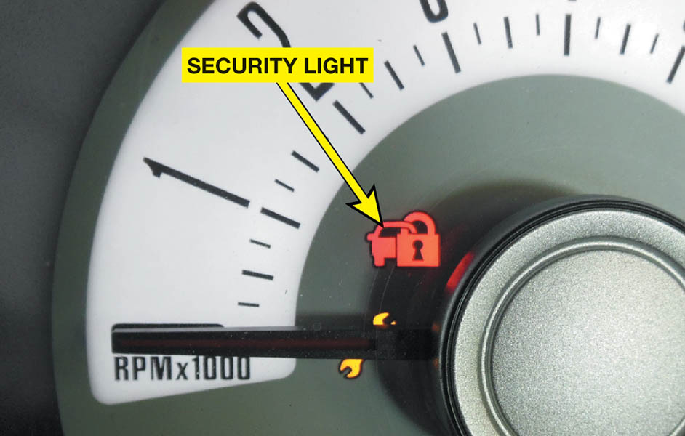
Figure 59.2 The security system symbol used on a Ford. The symbol varies by make, model, and year, so check service information to determine what symbol is used on the vehicle being diagnosed

Slide 10
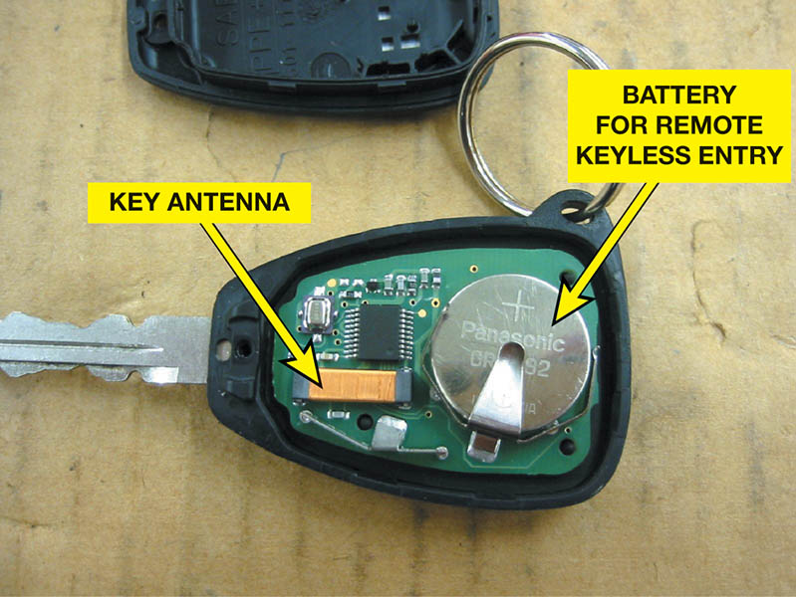
Figure 59.3 A typical key with the cover removed showing the battery used to power the door lock and the antenna used for the immobilizer system

Slide 11
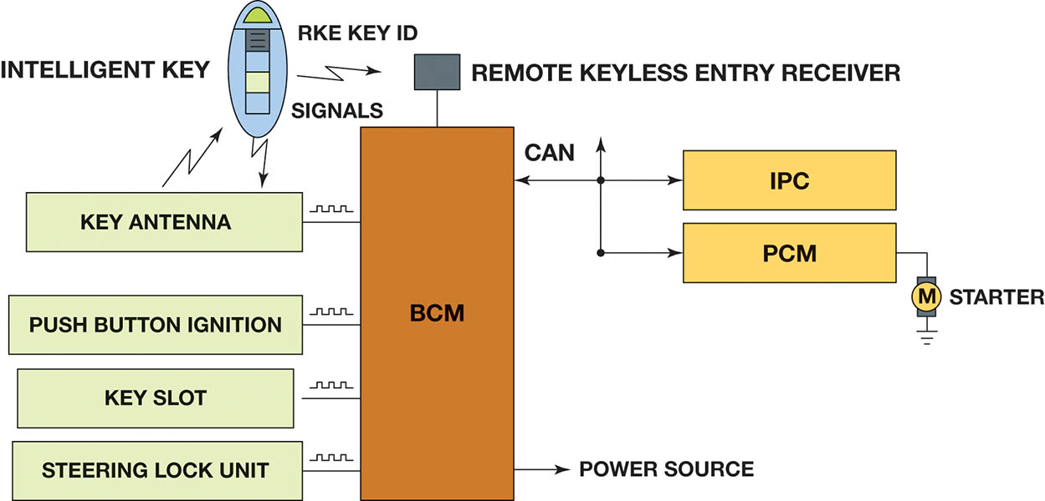
Figure 59.4 The remote keyless entry is used to unlock the doors as well as create the signals to the powertrain control module (PCM) used to control the starter motor and/ or the fuel system and the warning lamp on the instrument panel cluster (IPC)

Slide 12
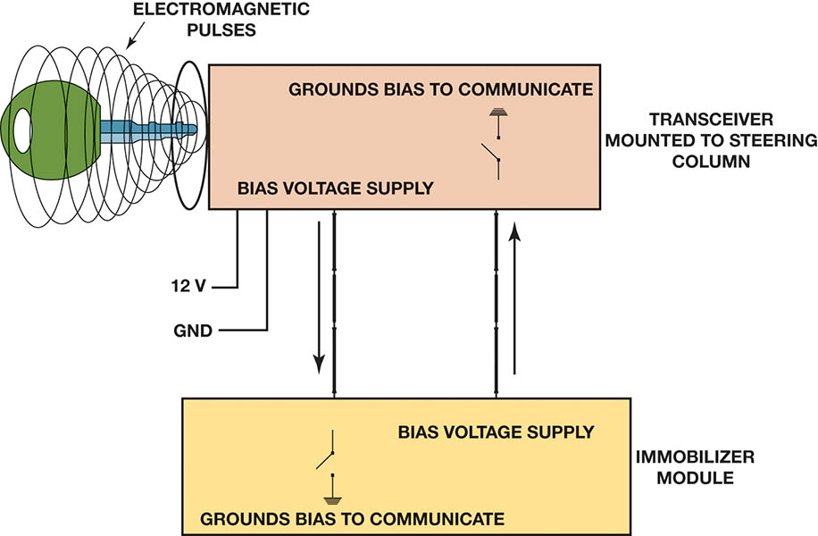
Figure 59.5 A typical immobilizer circuit showing the communication between the key and the transceiver. The transceiver then communicates with the immobilizer module over data lines

Slide 13
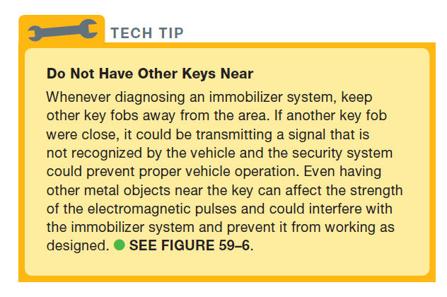
Tech Tip

Slide 14
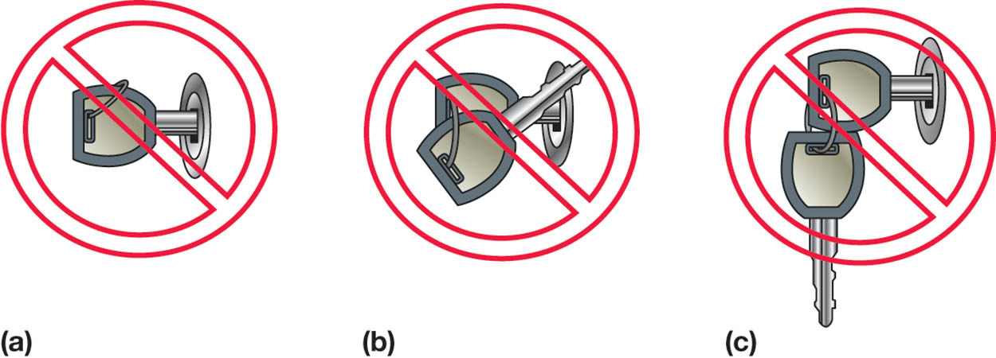
Figure 59.6 (a) Avoid using a key where the key ring is over the top of the key, which can interfere with the operation of the immobilizer system. (b) Do not angle another key upward from the key being used to help prevent interference with the magnetic field used to energize the key. (c) Do not have the keys from another vehicle near the key being used

Slide 15
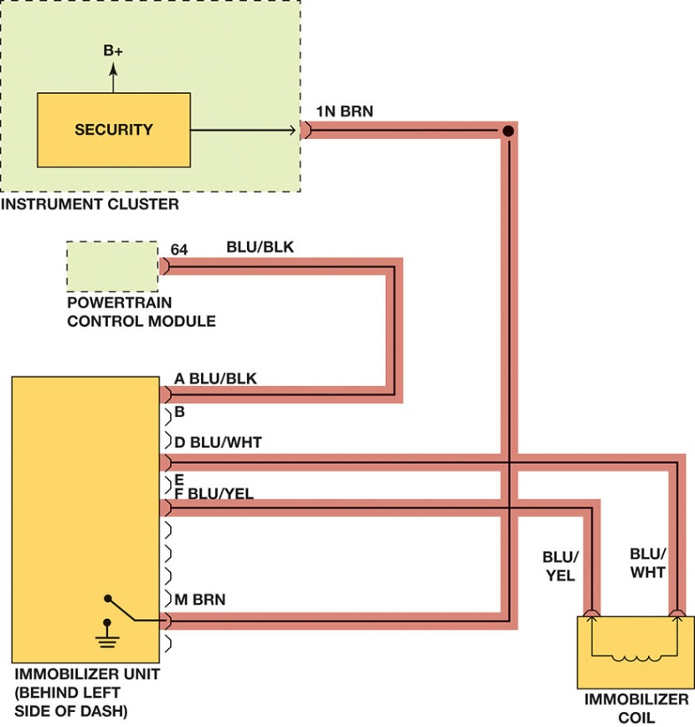
Figure 59.7 Check service information for the exact wiring diagram (schematic) for the vehicle being tested. Highlighting the wires and noting their color helps when following the specified testing procedures

Slide 16
QUESTION 1: ?
What faults will an immobilizer system cause?

Slide 17
ANSWER 1:
Cranks-no start, start and die, no-crank.

Slide 18
QUESTION 2: ?
A typical immobilizer system consists of what parts?

Slide 19
ANSWER 2:
Key fob, transponder key, and transceiver.

Slide 20
CHRYSLER IMMOBILZER SYSTEM (1 OF 2)
Beginning in 1998, Chrysler started a security system known as the Sentry Key Immobilizer System (SKIS).
The transponder then returns a unique signal back to the SKIM, giving it the okay for the vehicle to start and continue to run.

Slide 21
CHRYSLER IMMOBILZER SYSTEM (2 OF 2)
Chrysler Self-Programming Additional Sentry Keys
Purchase a blank key and have it cut to fit the lock cylinder.
Insert the original key #1 into the ignition and turn to ON.
Wait 5 seconds and turn the key to OFF.
Immediately insert the original key #2 into the ignition and turn to ON.
Wait 10 seconds for the SKIS indicator in the dash to start to flash.
Turn the ignition off, insert the new blank key, and turn the ignition back on.

Slide 22
FORD PATS SYSTEM
The Ford antitheft system is called the Passive Antitheft System (PATS).
Ford Programming for additional PATS Keys
Insert the first programmed ignition key into the ignition lock cylinder and turn to on.
Within 5 seconds of turning the ignition switch to the LOCK position, insert the second programmed ignition key into the ignition lock cylinder and turn to on.
Within 5 seconds of turning the ignition switch to the LOCK position, insert a new un-programmed ignition key into the ignition lock cylinder and turn on.

Slide 23
GENERAL MOTORS ANTITHEFT SYSTEM
The type of antitheft system used on General Motors vehicles has included many different systems.
Vehicle Antitheft system
Passkey I
Passkey II
Passlock I
Passlock II

Slide 24
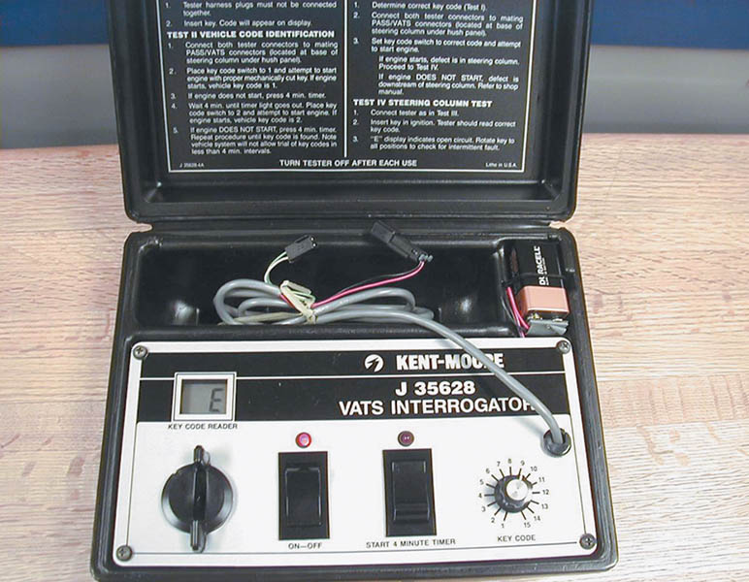
Figure 59.8 A special tool is needed to diagnose a General Motors VATS security system and special keys that contain a resistor pellet

Slide 25
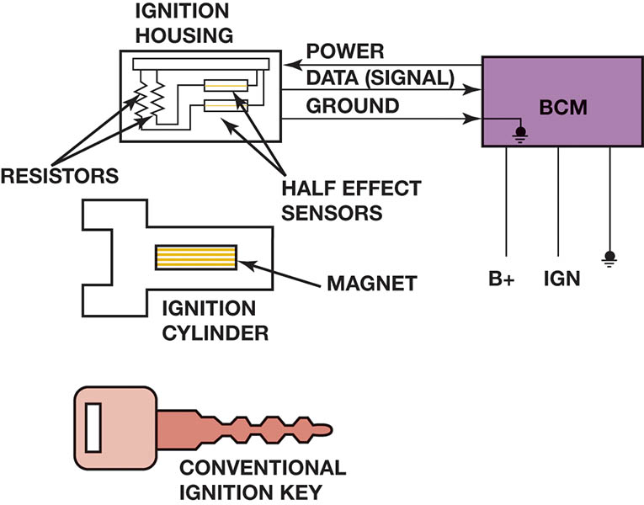
Figure 59.9 The Passlock series of General Motors security systems uses a conventional key. The magnet is located in the ignition lock cylinder and triggers the Hall-effect sensors

Slide 26
TESTING IMMOBILIZER SYSTEMS
Diagnostic Steps
Verify the customer concern
Visual Inspection
Check security light status
Check for trouble codes
Check Technical Service Bulletins (TSBs)
Perform pinpoint tests
Determine the root cause
Verify the repair

Slide 27
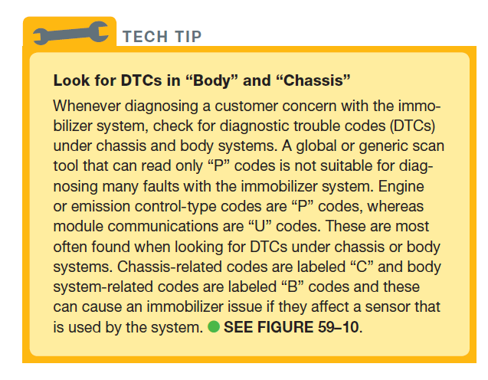
TECH TIP

Slide 28
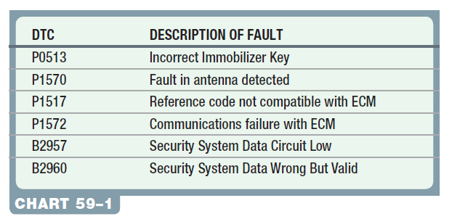
Chart 59-1 Sample diagnostic trouble codes for an immobilizer system. These codes vary by make, model, and year of manufacture, so check service information for the exact vehicle being diagnosed.

Slide 29
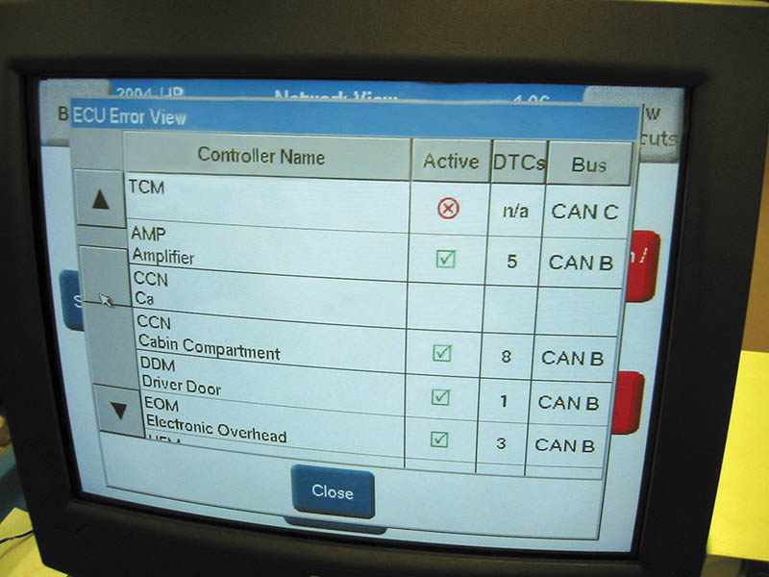
Figure 59.10 Scan tools, such as this factory tool being used on a Chrysler, are capable of many diagnostic functions that can help the technician zero in on the root cause of a problem

Slide 30
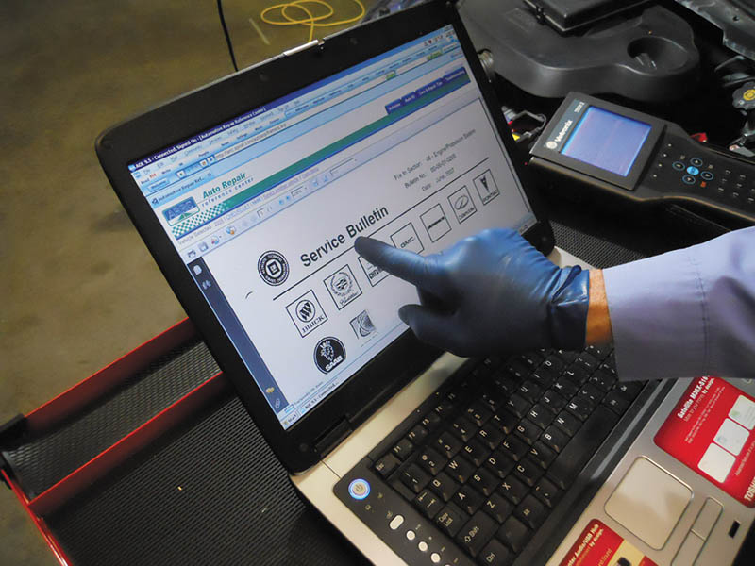
Figure 59.11 After checking for stored diagnostic trouble codes (DTCs), the wise technician checks service information for any technical service bulletins (TSBs) that may relate to the vehicle being serviced.

Slide 31
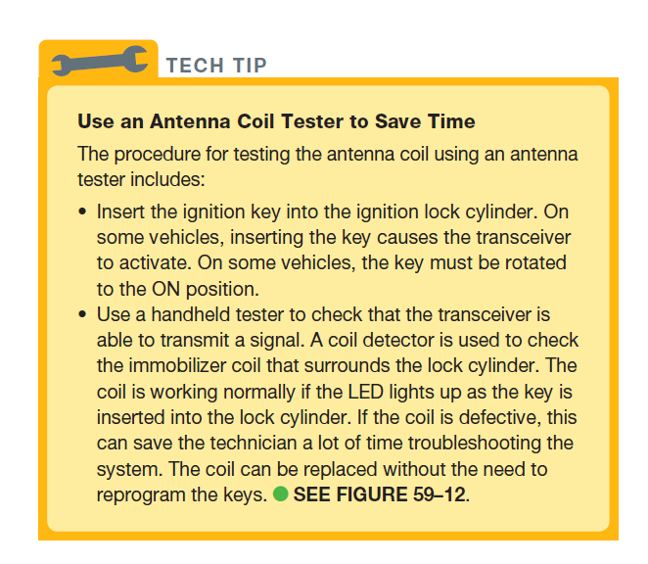
TECH TIP

Slide 32
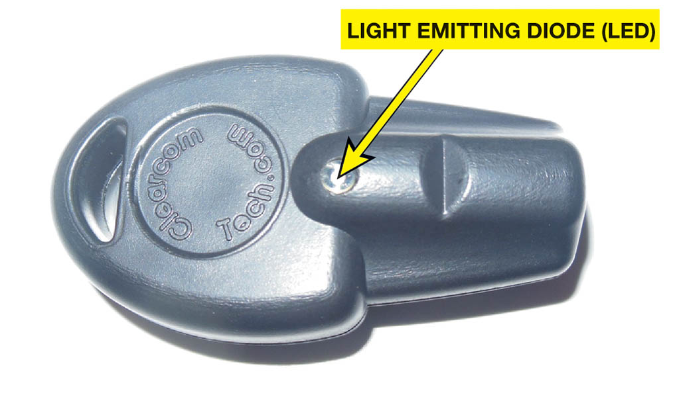
Figure 59.12 Immobilizer coil detectors can be found online by searching for immobilizer transponder coil detector

Slide 33
QUESTION 3: ?
An antenna coil tester is used to test what part of the immobilizer system?

Slide 34
ANSWER 3:
Electromagnetic pulses

Slide 35

Copyright

