Slide 1

Automotive Technology Principles, Diagnosis, and Service
Sixth Edition
Chapter 58
Safety, Comfort, and Convenience Circuits
Copyright © 2018, 2015, 2011 Pearson Education, Inc. All Rights Reserved

Slide 2
LEARNING OBJECTIVES (1 of 3)
58.1 Describe how the horn operates and diagnose faulty horn operation.
58.2 Explain the testing and diagnosis of windshield wipers and windshield washers.
58.3 Describe the operation of cruise control, including radar cruise control systems.
58.4 Discuss electrically heated rear window defogger systems.

Slide 3
LEARNING OBJECTIVES (2 of 3)
58.5 Explain the operation and testing procedures for power windows and locks.
58.6 Discuss the operation of power sunroofs, moon roofs, and sun shades.
58.7 Describe the operation of power seats and heated/cooled seats, plus heated steering wheels and mirrors.
58.8 Explain the operation of adjustable pedals and folding outside mirrors.

Slide 4
LEARNING OBJECTIVES (3 OF 3)
58.9 Describe the operation and diagnosis of remote keyless entry, garage door openers, and remote start systems.
58.10 This chapter will help prepare for the ASE Electrical/Electronic Systems (A6) certification test content area “G” (Repair Body Electrical Systems Diagnosis and Repair).

Slide 5
HORNS
Purpose and Function
Horns are electric devices that emit a loud sound used to alert other drivers or persons in the area.
Horn Circuits
The horn circuit consists of fused power that is controlled by a relay when the switch is grounded.
Computer –Controlled Horns
The BCM controls the horn relay based on an input from the switch.

Slide 6
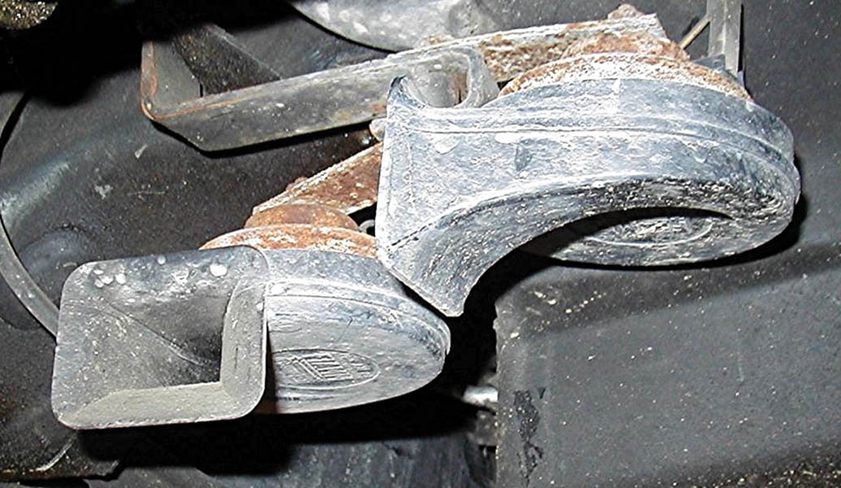
Figure 58.1 Two horns are used on this vehicle. Many vehicles use only one horn, often hidden underneath the vehicle

Slide 7
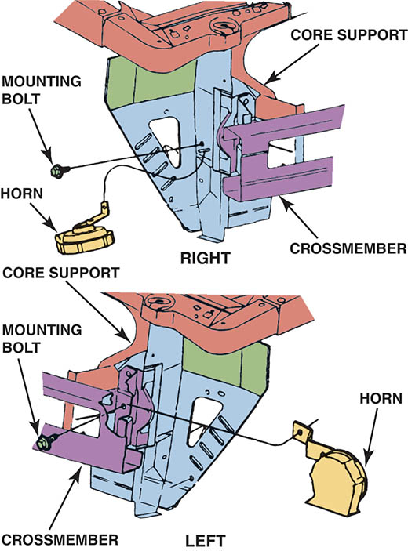
Figure 58.2 Horns are generally mounted on the radiator core support by bolts and nuts or sheet metal screws.

Slide 8
HORN DIAGNOSIS
Scan Tool Testing
A scan tool can be used to test a horn that is computer controlled.
Horn Circuit Testing
Typically, a digital multimeter (DMM) is used to perform voltage drop and continuity checks to isolate the failure.
Horn replacement
The horns are typically mounted on either side of the radiator support.

Slide 9
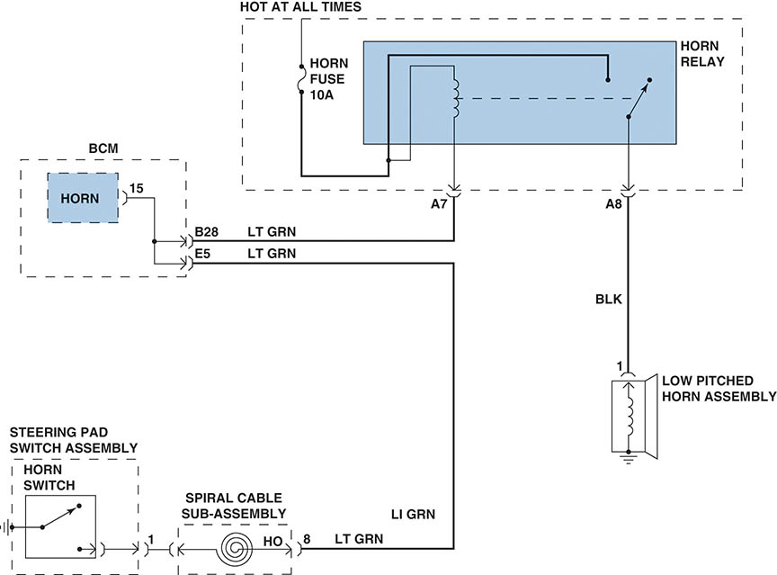
Figure 58.3 A typical schematic of a horn circuit. Note that the horn relay can be activated by either the horn switch in the steering wheel or by the body control module (BCM)

Slide 10
QUESTION 1: ?
What are the advantages of using the BCM to able to operate the horns?

Slide 11
ANSWER 1:
Improve diagnostics and use for systems such as theft alarm and remote keyless entry.

Slide 12
WINDSHIELD WIPERS (1 OF 5)
Purpose and Function
Windshield wipers are used to keep the viewing area of the windshield clear of rain.
Computer Controlled Wipers
The BCM to control the actual operation of the wiper based on the input from the switch.

Slide 13
WINDSHIELD WIPERS (2 OF 5)
Wiper and Washer Components
Wiper motor(s)
Gearbox
Wiper arms and linkage
Wiper blades
Washer pump
Hoses and jets (nozzles)
Fluid reservoir
Switches, wiring and connectors

Slide 14
WINDSHIELD WIPERS (3 OF 5)
Windshield Wiper Motors
Series-wound field
Shunt field
Wiper Motor Operation
Wiper motors using a permanent magnet motor have a low-speed positive brush, a high-speed positive brush and a ground (negative) brush to conduct electricity.

Slide 15
WINDSHIELD WIPERS (4 OF 5)
Park Position
Windshield wiper motor park operation is controlled by the wiper motor module using an input from the park switch within the wiper motor assembly.
Variable Wipers
A term used to describe the operation of the wipers that operate on an interval that can be delayed when the rain is light.

Slide 16
WINDSHIELD WIPERS (5 OF 5)
Windshield Wiper Diagnosis
Electrical failures can typically be diagnosed with a scan tool and a multimeter.
Electrical failures can include
Defective wiper switch or connections
Failed motors or park switches
Mechanical failures can include
Stripped gears or linkage connections
Loose or separated connection at motor
Loose linkage

Slide 17
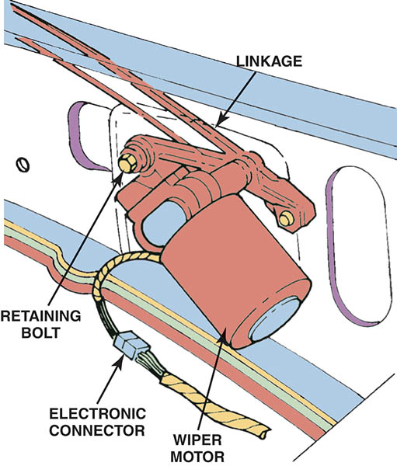
Figure 58.4 The motor and linkage bolt to the body and connect to the switch with a wiring harness

Slide 18
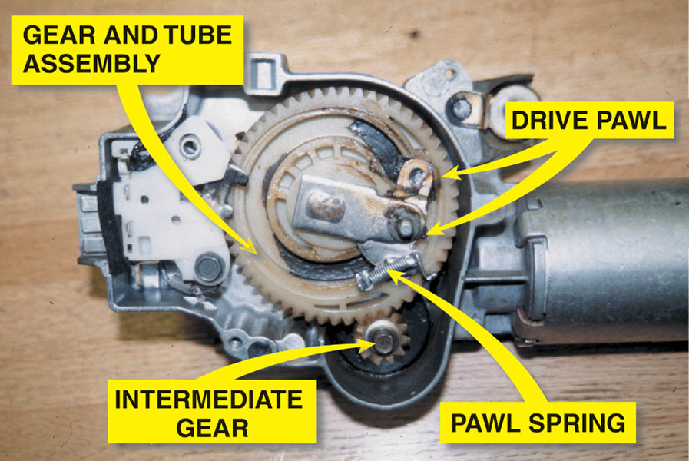
Figure 58.5 A typical wiper motor with the housing cover removed. The motor itself has a worm gear on the shaft that turns the small intermediate gear, which then rotates the gear and tube assembly.

Slide 19
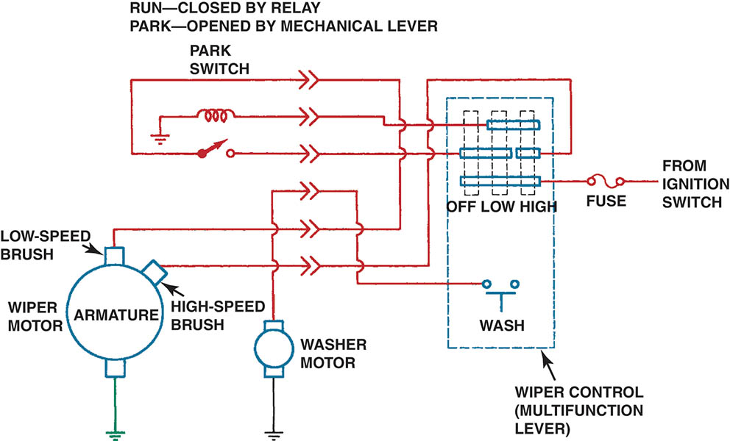
Figure 58.6 A wiring diagram of a two-speed windshield wiper circuit using a three-brush, two-speed motor. The dashed line for the multifunction lever indicates that the circuit shown is only part of the total function of the steering column lever

Slide 20
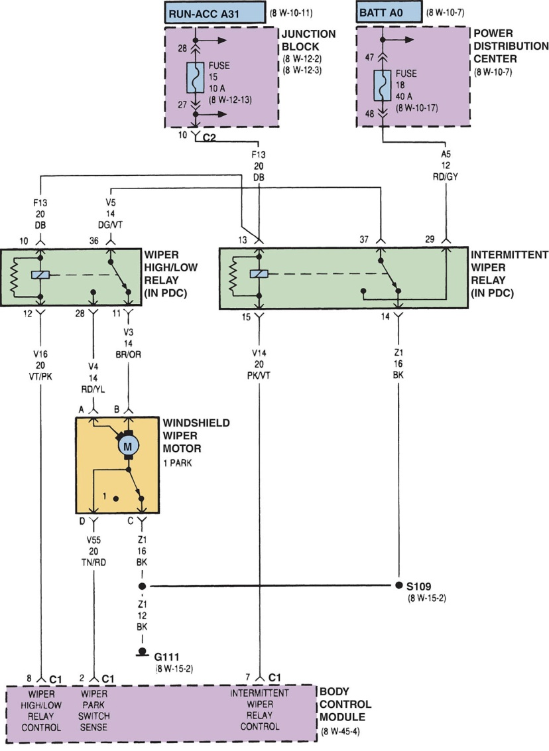
Figure 58.7 A circuit diagram is necessary to troubleshoot a windshield wiper problem

Slide 21
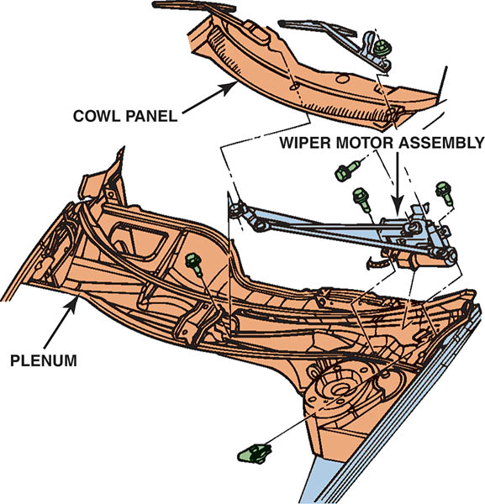
Figure 58.8 The wiper motor and linkage mount under the cowl panel on many vehicles

Slide 22
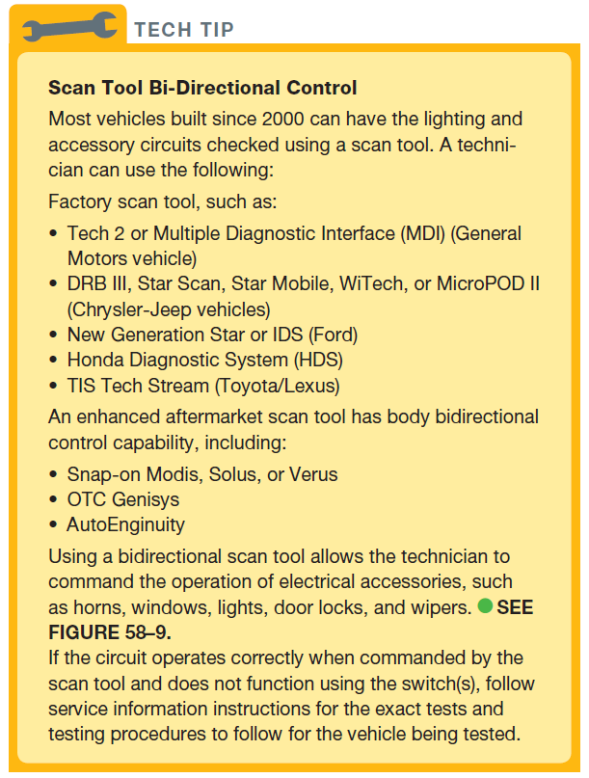
Tech Tip

Slide 23
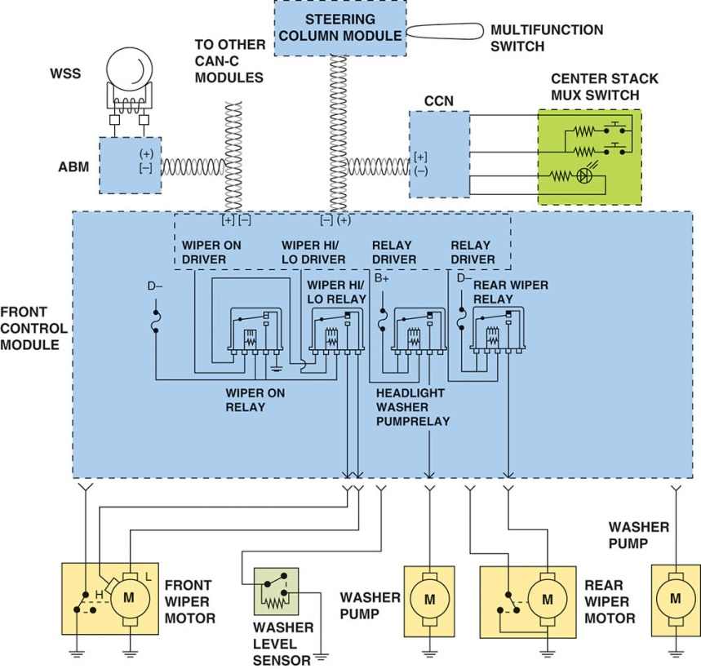
Figure 58.9 A typical schematic showing how a scan tool connected to the CAN bus could be used to operate the components connected to the bus

Slide 24
WINDSHIELD WASHERS (1 OF 2)
Operation
Used to squirt washer fluid onto the surface of the windshield where wipers are used.
Rear Washers
Used to squirt washer fluid on the rear glass. Typically a shared reservoir with the front washers.
Headlight Washers
Used to wash the surface of the headlight. May be equipped with a wiper blade.

Slide 25
WINDSHIELD WASHERS (2 OF 2)
Windshield Washer Diagnosis
Make sure the reservoir has fluid and is not frozen.
If the pump does not operate it is an electrical problem.
If the fluid does not reach the nozzle it is a distribution problem.
Windshield Washer Service
Washer motors are not repairable and are replaced if defective.
Pumps are located on or inside the washer reservoir tank or cover.

Slide 26
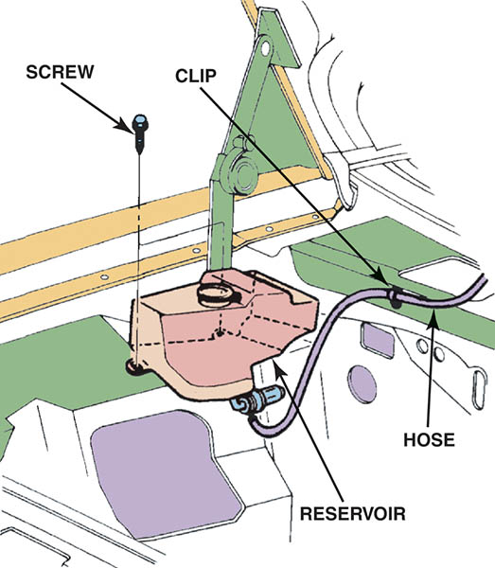
Figure 58.10 A typical windshield washer reservoir and pump assembly

Slide 27
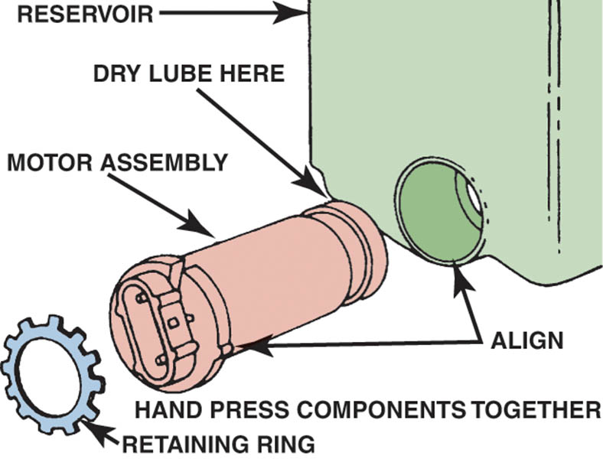
Figure 58.11 Washer pumps usually install into the reservoir and are held in place with a retaining ring

Slide 28
RAIN-SENSE WIPERS
Parts and Operation
Rain-sense wiper systems use a sensor located on the inside and at the top of the windshield to detect rain droplets.
The wiper switch can be left on the sense position all the time, and if no rain is sensed, the wipers do not swipe.
The unit contains four infrared (IR) diodes, two photocells, and a microprocessor.
Follow the vehicle manufacturer’s recommended diagnosis and testing procedures.

Slide 29
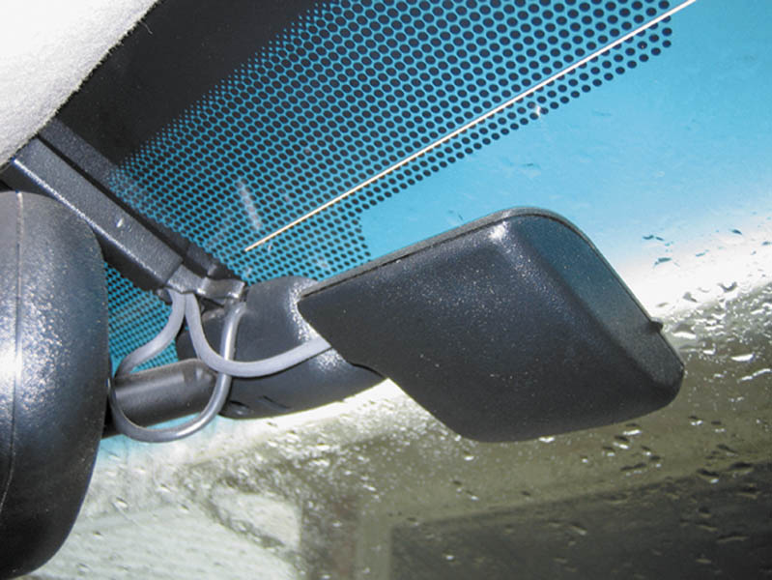
Figure 58.12 A typical rain-sensing module located on the inside of the windshield near the inside rearview mirror

Slide 30
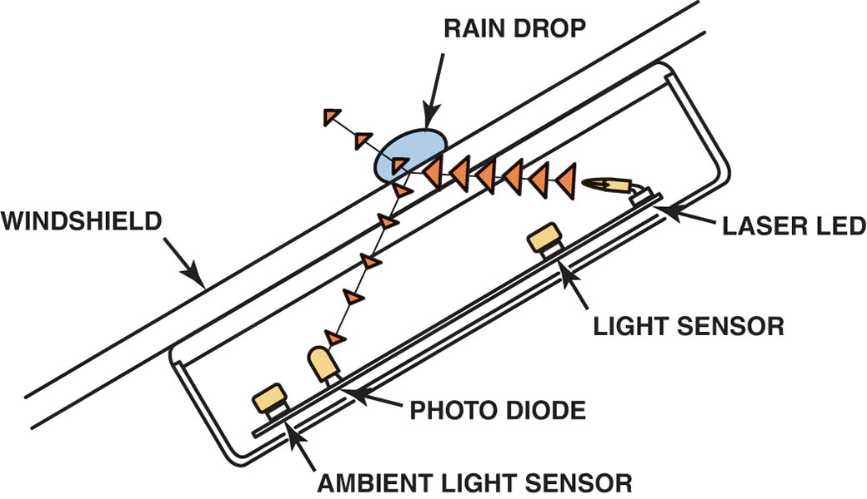
Figure 58.13 The electronics in the rain-sense wiper module can detect the presence of rain drops under various lighting conditions

Slide 31
CRUISE CONTROL (1 OF 2)
Purpose and Function
Is used to maintain a preset vehicle speed, even up gentle grades.
Cruise Control Operation
A typical cruise control system can be set only if the vehicle speed is 25 MPH (40 km/h) or more.
The clutch cannot be depressed or the brakes applied.

Slide 32
CRUISE CONTROL (2 OF 2)
Electronic Throttle Cruise Control
Vehicles equipped with such a system do not use throttle actuators for the cruise control, but instead use the electronic throttle to control vehicle speed.
Diagnosis and Service
A fault with the accelerator position sensor, the brake switch or the electronic throttle control system will disable the system.

Slide 33
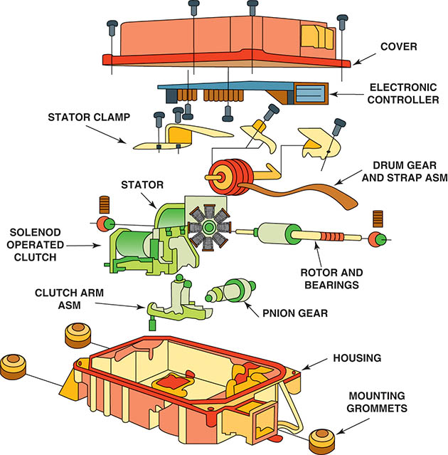
Figure 58.14 An exploded view of a cruise control assembly used on a vehicle that does not have an electronic throttle. The stepper motor is connected to the throttle of the engine.

Slide 34
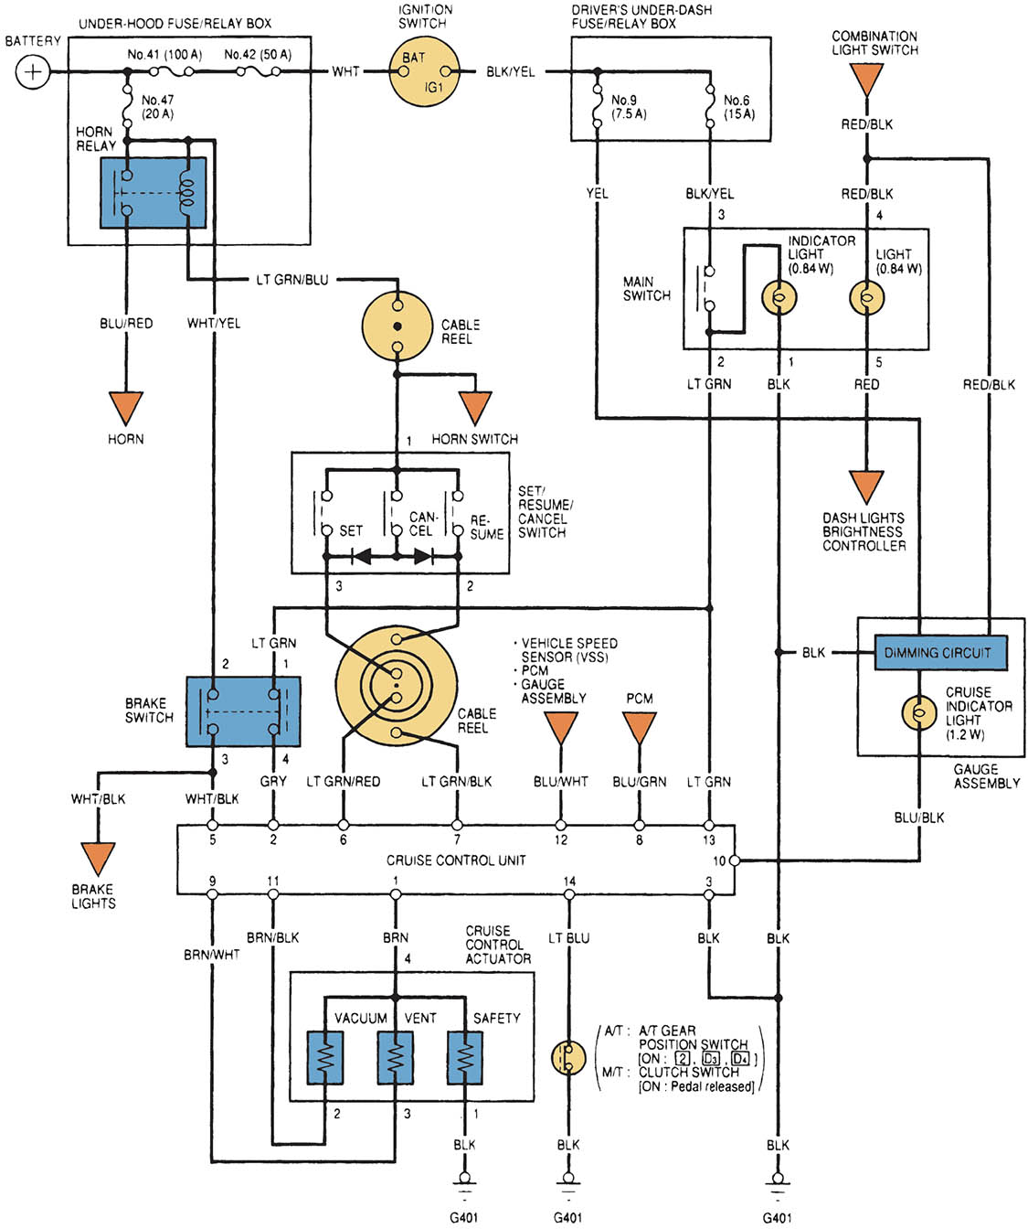
Figure 58.15 Circuit diagram of a typical electronic cruise control system

Slide 35
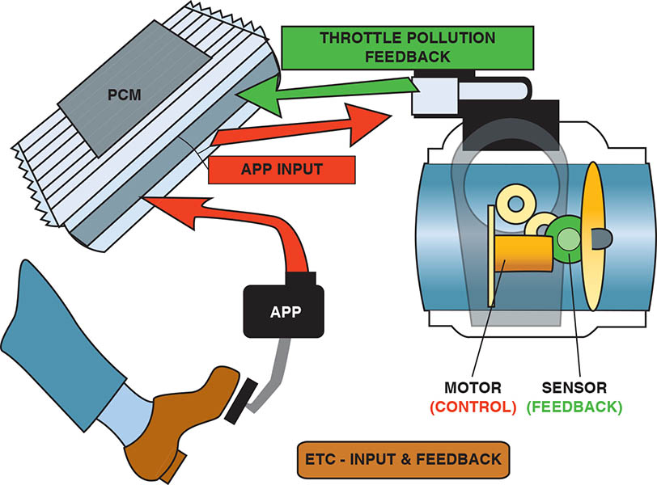
Figure 58.16 The electronic throttle control (ETC) system uses a sensor that measures the position and the speed of the driver’s foot on the accelerator pedal. A throttle position sensor measures the throttle angle. An electric motor operates the movement of the throttle plate using commands from the PCM

Slide 36
RADAR CRUISE CONTROL (1 OF 2)
Purpose and Function
Radar cruise control is designed to give the driver more control over the vehicle by keeping an assured clear distance, usually 2 to 3 seconds, behind the vehicle in front.
Terminology: May be known as:
Adaptive Cruise Control
Dynamic Cruise Control
Active Cruise Control
Autonomous Cruise Control

Slide 37
RADAR CRUISE CONTROL (2 OF 2)
Parts and Operation
Radar cruise control systems use long-range radar (LRR) to detect faraway objects in front of the moving vehicle.
Some systems use a short-range radar (SRR) and/ or infrared (IR), or optical cameras to detect distances for when the distance between the moving vehicle and another vehicle in front is reduced.
Refer to the manufactures service information for specific diagnostic and calibration information.

Slide 38
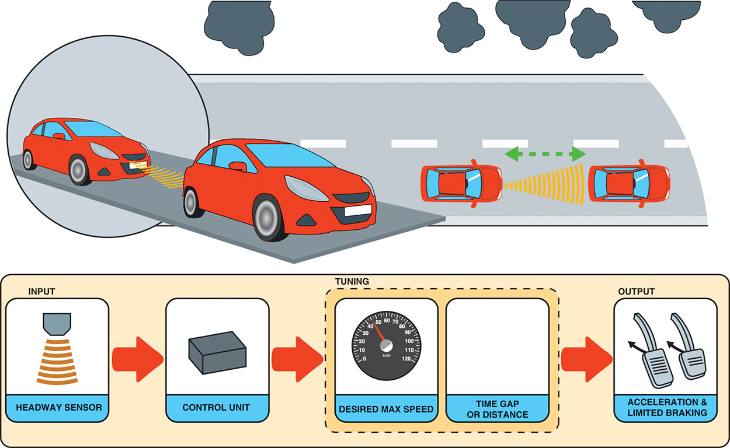
Figure 58.17 Adaptive cruise control can use radar to determine the distance of another vehicle in front. The control unit then checks the driver selected speed and the sets the distance between the vehicles to determine what action is needed. The PCM then can operate the throttle or the brakes through the antilock brake/electronic stability control system to slow the vehicle, if needed, to maintain the set distance

Slide 39
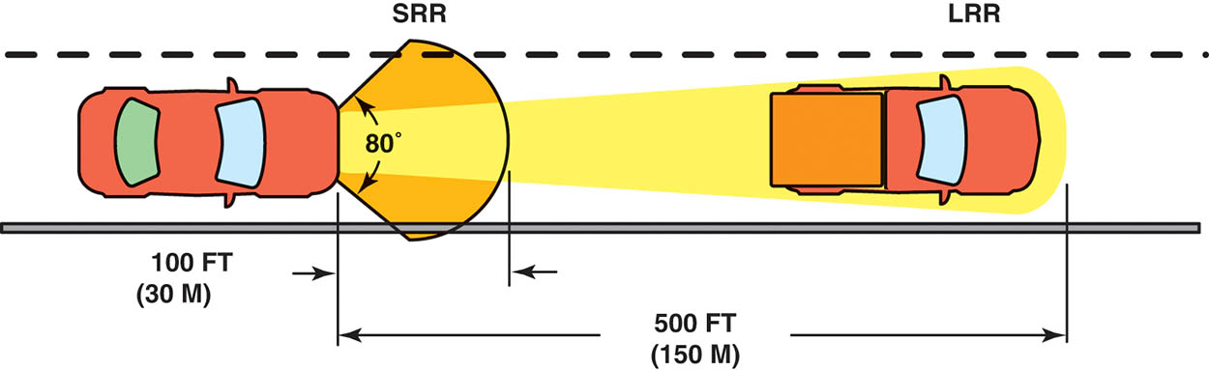
Figure 58.18 Most radar cruise control systems use radar, both long and short range. Some systems use optical or infrared cameras to detect objects

Slide 40
QUESTION 2: ?
What is the purpose of a radar cruise control system?

Slide 41
ANSWER 2:
To help the driver control the spacing between vehicles.

Slide 42
HEATED REAR WINDOW DEFOGGERS
Parts and Operation
Uses an electrical grid baked on the glass that warms the glass to about 85°F (29°C) and clears it of fog or frost.
Heated Rear Window Defogger Diagnosis
Troubleshooting a nonfunctioning rear window defogger unit involves using a test light or a voltmeter to check for voltage to the grid.
If a break in the grid exceeds two inches, most manufacturers recommend replacing the glass.

Slide 43
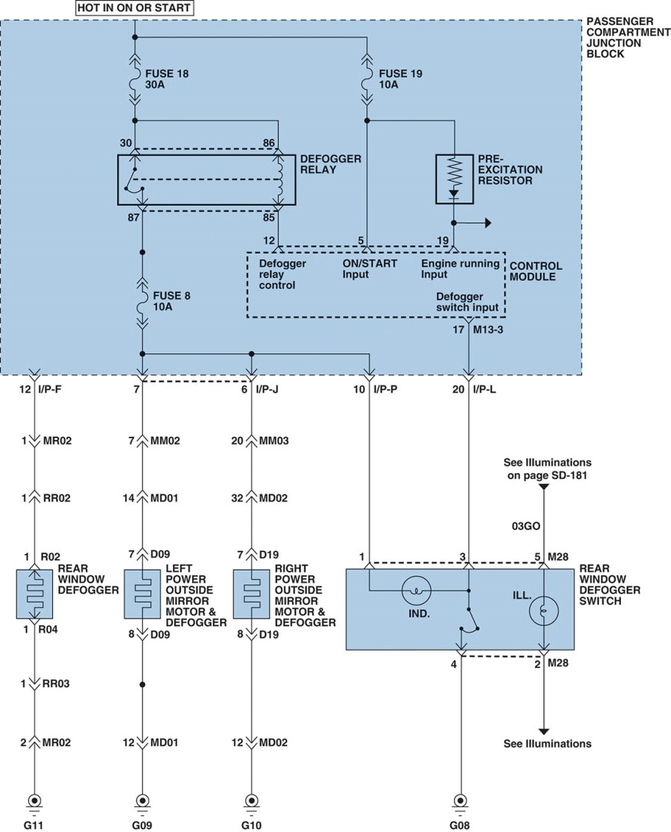
Figure 58.19 A schematic showing that the side view mirrors are heated along with the rear window defogger whenever the rear window switch (lower right) is turned to the on position

Slide 44
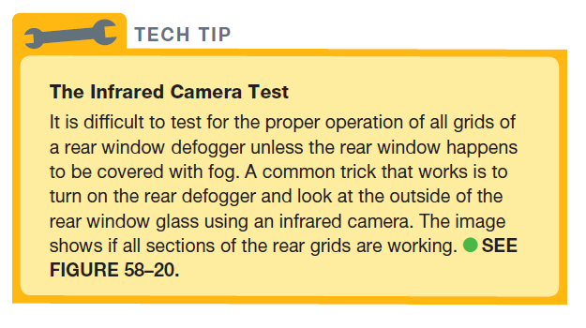
TECH TIP

Slide 45
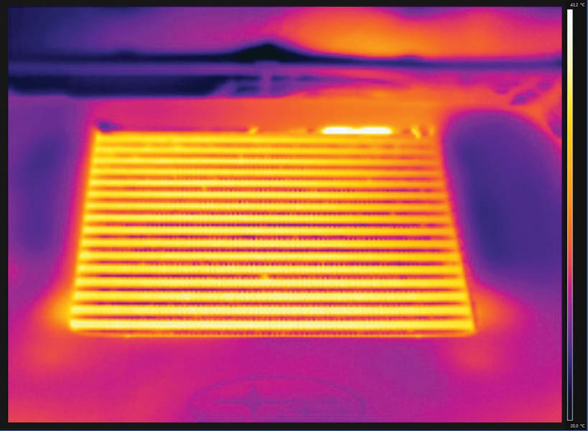
Figure 58.20 A typical image captured using an infrared camera of a rear defogger that is working as designed

Slide 46
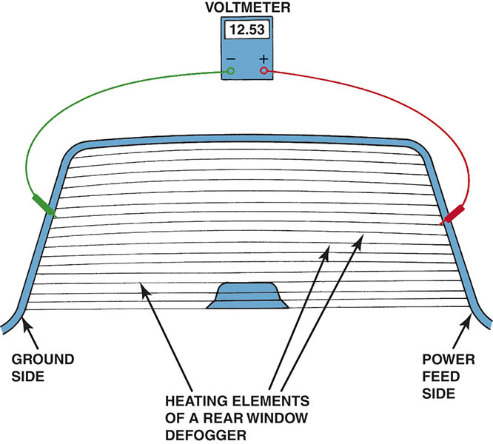
Figure 58.21 A rear window defogger electrical grid can be tested using a voltmeter to check for a decreasing voltage as the meter lead is moved from the power side toward the ground side.

Slide 47
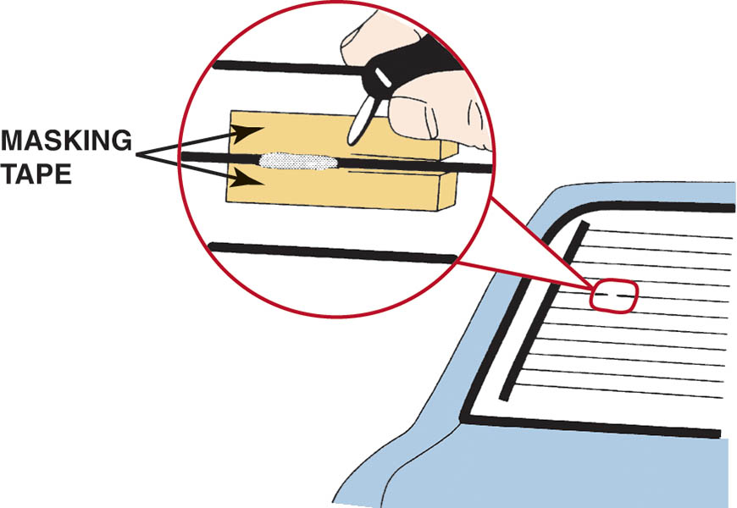
Figure 58.22 The typical repair material contains conductive silver-filled polymer, which dries in 10 minutes and is usable in 30 minutes

Slide 48
POWER WINDOWS (1 OF 3)
Switches and Controls
They can be operated by both a master control switch located beside the driver and additional independent switches located at each electric window.
Some power window systems use a lockout/child safety switch located on the driver’s controls to prevent operation of the power windows from the independent switches.
Designed to operate with the key on and if equipped, in retained accessory power mode, after the key is off for a fixed amount of time or until the door is opened.

Slide 49
POWER WINDOWS (2 OF 3)
Power Window Motors
Most use permanent magnet (PM) electric motors.
Reverse direction by reversing the polarity of the two wires going to the motor.
Each motor is protected by an internal positive temperature coefficient (PTC) electronic circuit breaker.
Auto Down/Up Features
Allow the window to automatically go down or up after clicking the detent position in the switch.
Must be equipped with the automatic reversal system.

Slide 50
POWER WINDOWS (3 OF 3)
Troubleshooting Power Windows
Check for proper operation of all power windows.
Check that a child-proof switch is not enabled.
Check for codes with a scan tool.
Relearn or reprogram windows after component replacement.

Slide 51
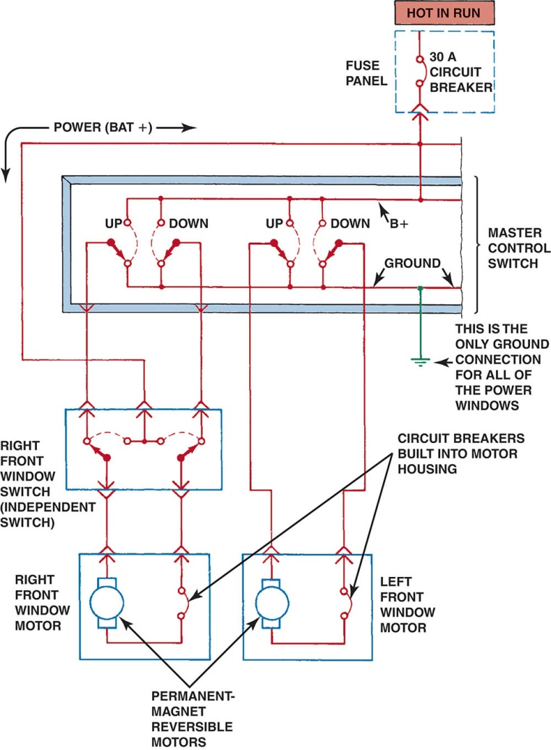
Figure 58.23 A typical power window circuit using PM motors. Control of the direction of window operation is achieved by directing the polarity of the current through the non-grounded motors.

Slide 52
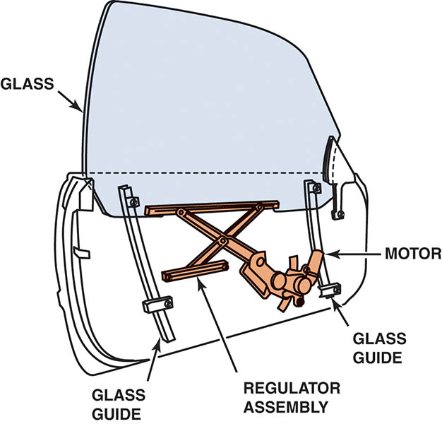
Figure 58.24 An electric motor and a regulator assembly raise and lower the glass on a power window

Slide 53
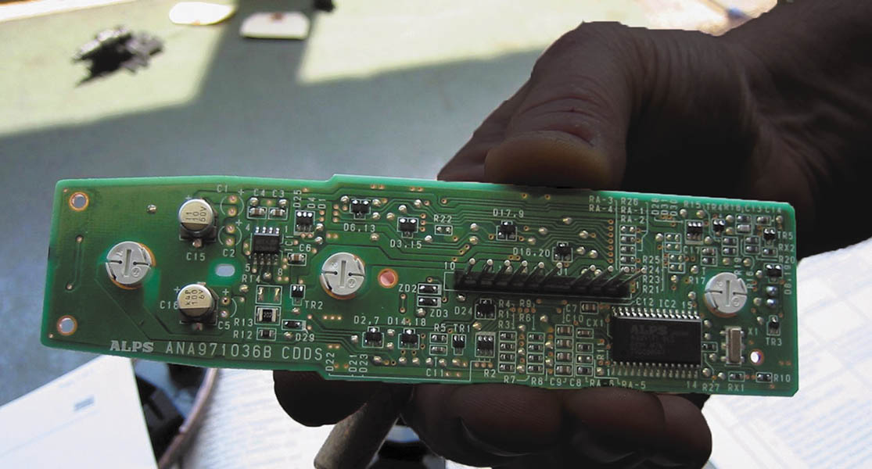
Figure 58.25 A master power window control panel with the buttons and the cover removed

Slide 54
ELECTRIC POWER DOOR LOCKS
Parts and Operation
Electric power door locks use a permanent magnet (PM) reversible motor to lock or unlock all vehicle door locks from a control switch or switches.
Troubleshooting Power Door Locks
Use a factory or factory-level aftermarket scan tool and try operating the locks using the bidirectional control.
If a single door lock failure, check electrical connections and binding of mechanisms.

Slide 55
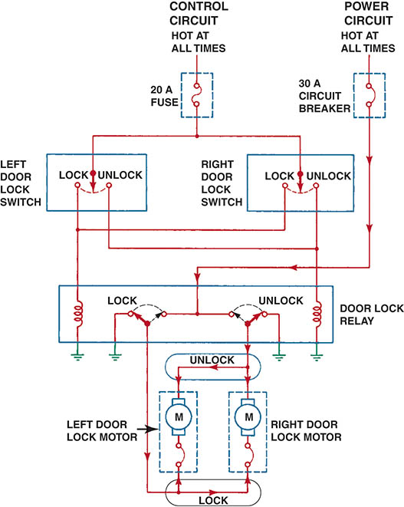
Figure 58.26 A typical electric power door lock circuit diagram. Note that the control circuit is protected by a fuse, whereas the power circuit is protected by a circuit breaker. Power door locks typically use reversible permanent magnet (PM) non-grounded electric motors.

Slide 56
TRUNK/LIFT GATE LOCKS
Circuit Description
The electric power trunk/lift gate lock uses a permanent magnet (PM) reversible motor to lock or unlock the trunk/lift gate lock from a control switch or with the remote.

Slide 57
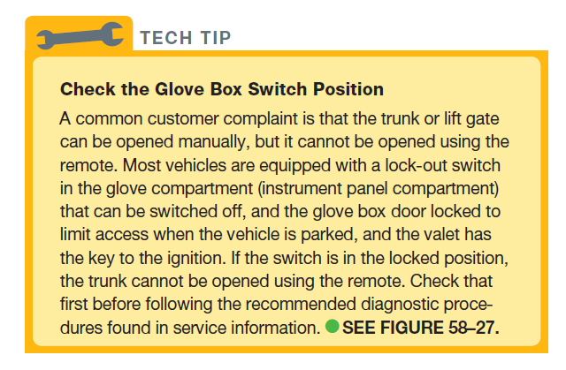
TECH TIP

Slide 58
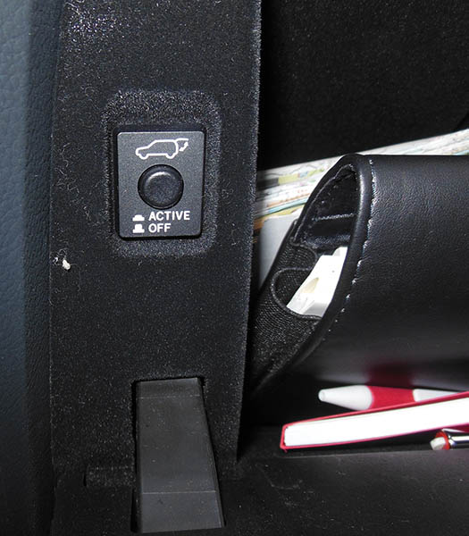
Figure 58.27 The switch to disable the outside opening of the trunk/lift gate is often in the glove box

Slide 59
POWER SUN ROOF/ MOON ROOF (1 OF 2)
Definitions
Sun roof - A sun roof is basically any kind of panel on the roof of a car that permits light, air, or both to come into a vehicle, but only if the panel is opened.
Moon roof - A moon roof is made of a tinted glass panel that can be either tilted open or completely retracted to operate as an open window in the roof.
Operation
Most moon or sun roof systems use permanent magnet (PM) electric motors to open and close the moveable glass panel.

Slide 60
POWER SUN ROOF/ MOON ROOF (2 OF 2)
Diagnosis and Service
Water leaks - Engineers refer to water seals around moon roofs as “controlling the flow of water” and not necessarily trying to provide a water-proof seal.
Electrical/Mechanical Issues - Electrical or mechanical issues can prevent the moon roof from opening or closing. Most vehicle manufacturers include a crank or a way to close the roof if the roof fails to close due to an electrical fault.

Slide 61
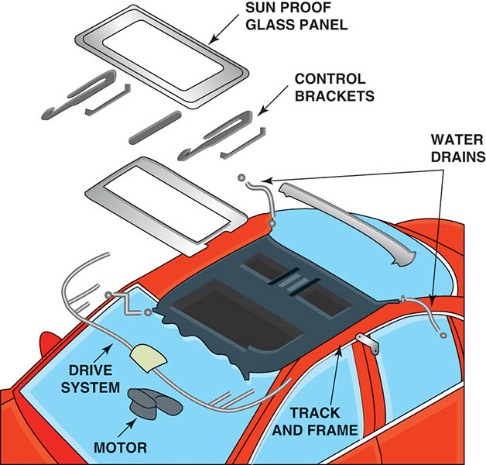
Figure 58.28 An exploded view of a typical moveable roof showing the location of the motor and the drain tubes that direct the water to the ground

Slide 62
SUN SHADES
Description
Sun shades are fabric or screen-like material installed on the inside of the vehicle that can be raised, lowered, or moved to block the rays of the sun from entering the interior of the vehicle.
Sun shades are vehicle-specific, so check service information for the exact procedures to follow when servicing or repairing a sun shade.

Slide 63
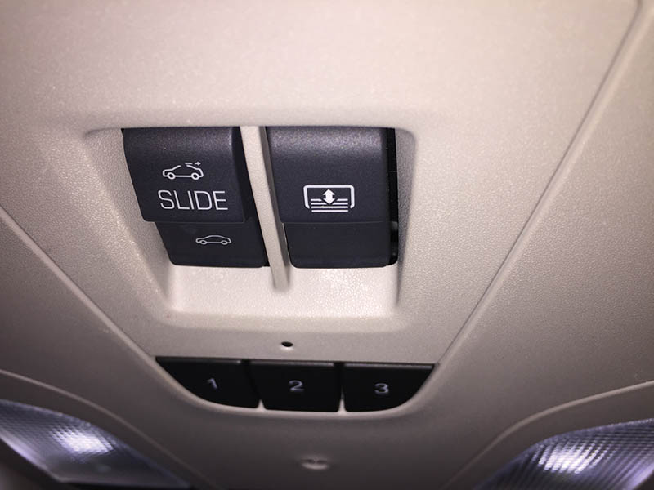
Figure 58.29 The control for the operation of the powered inside sun shade on this Chevrolet Impala is in the overhead control panel

Slide 64
POWER SEATS (1 OF 2)
Parts and Operation
A typical power-operated seat includes a reversible electric motor and a transmission assembly that may have three solenoids or motors, and six drive cables that turn the six seat adjusters.
Power Seat Motor(s)
Power seats use a permanent magnet motor with built-in circuit protection to power the movement of the seat.

Slide 65
POWER SEATS (2 OF 2)
Memory Seat
Memory seats use a potentiometer to sense the position of the seat.
The seat position can be programmed into the BCM or memory seat module, and stored by position number 1, 2, or 3.
The driver pushes the desired button or key fob and the seat moves to the stored position.

Slide 66
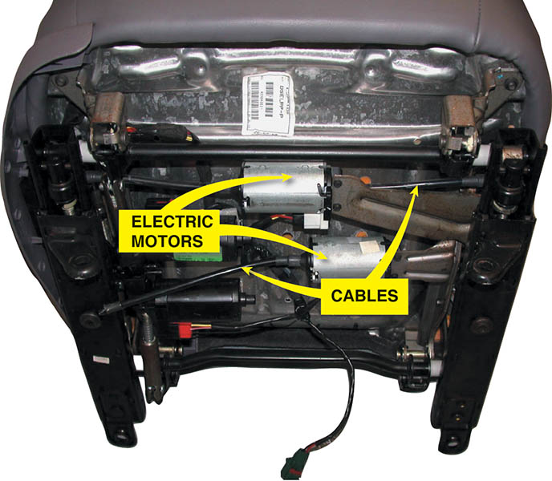
Figure 58.30 A power seat uses electric motors under the seat, which drive cables that extend to operate screw jacks (up and down) or gears to move the seat forward and back

Slide 67
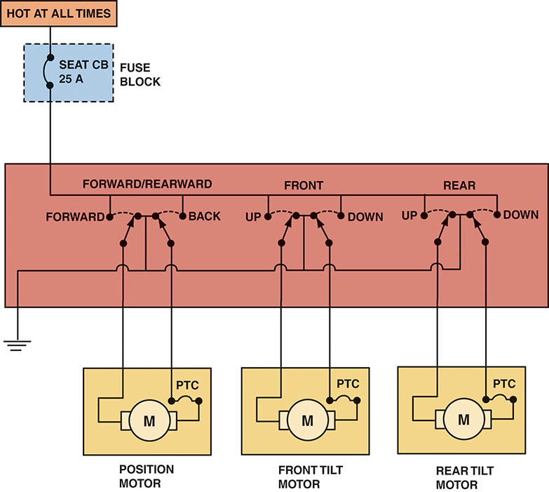
Figure 58.31 A typical power seat circuit diagram. The seat control switch can change the direction in which the motor(s) runs by reversing the direction in which the current flows through the motor

Slide 68
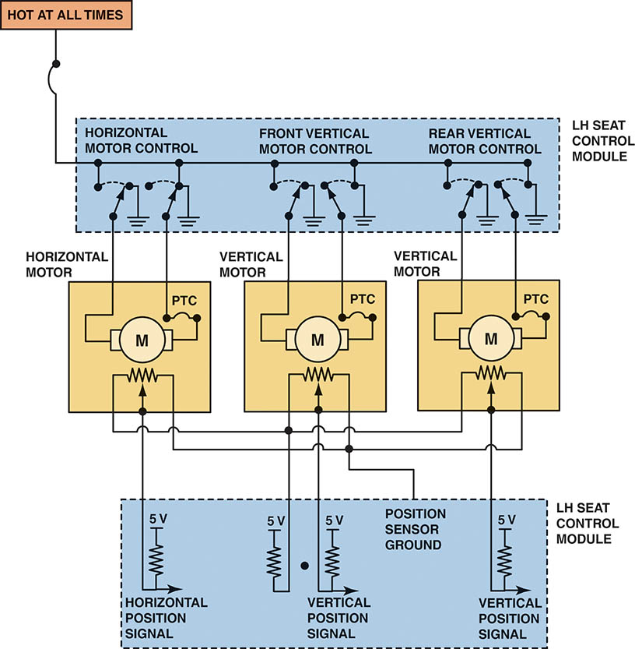
Figure 58.32 A typical memory seat module showing the three-wire potentiometer used to determine seat position

Slide 69
ELECTRICALLY HEATED SEATS
Parts and Operation
Use electric heating elements in the seat bottom, as well as in the seat back, in many vehicles.
A temperature sensor in the seat cushion is used to regulate the temperature.
Diagnosis and Service
Using service information, check for power and ground at the control module and to the heating element in the seat.

Slide 70
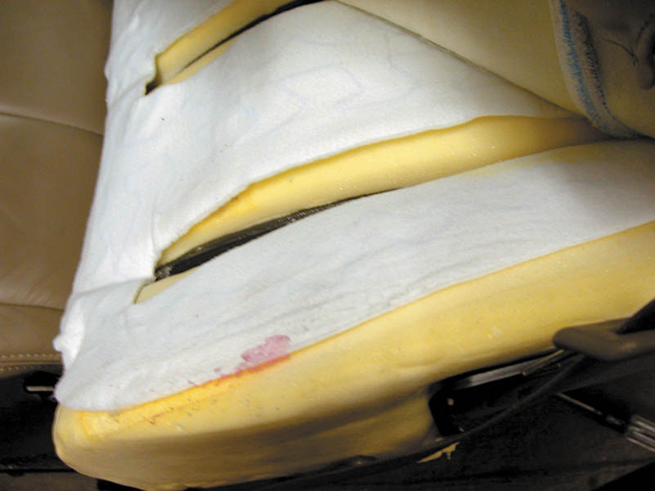
Figure 58.33 The heating element of a heated seat is a replaceable part, but service requires that the upholstery be removed. The yellow part is the seat foam material and the entire white cover is the replaceable heating element. This is then covered by the seat material

Slide 71
HEATED AND COOLED SEATS
Parts and Operation
Most electrically heated and cooled seats use a thermoelectric device (TED) located under the seat cushion and seat back.
Consists of positive and negative connections between two ceramic plates.
Electrical current flow determines which plate is headed and which is cooled.

Slide 72
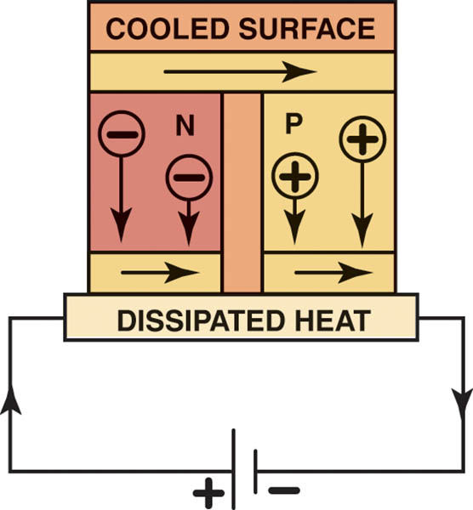
Figure 58.34 A Peltier effect device is capable of heating or cooling, depending on the polarity of the applied current

Slide 73
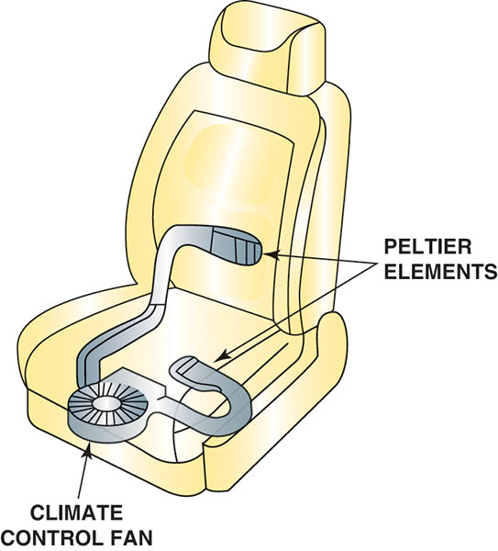
Figure 58.35 A fan is used to move the heated or cooled air to heat or cool the bottom or the back of the seat

Slide 74
HEATED STEERING WHEEL
Operation
A signal is sent to the control module and electrical current flows through the heating element in the rim of the steering wheel.
The temperature of the steering wheel is usually calibrated to stay at about 90°F (32°C).
Always follow the vehicle manufacturer’s recommended diagnosis and testing procedures for heated steering wheel diagnosis and repair.

Slide 75
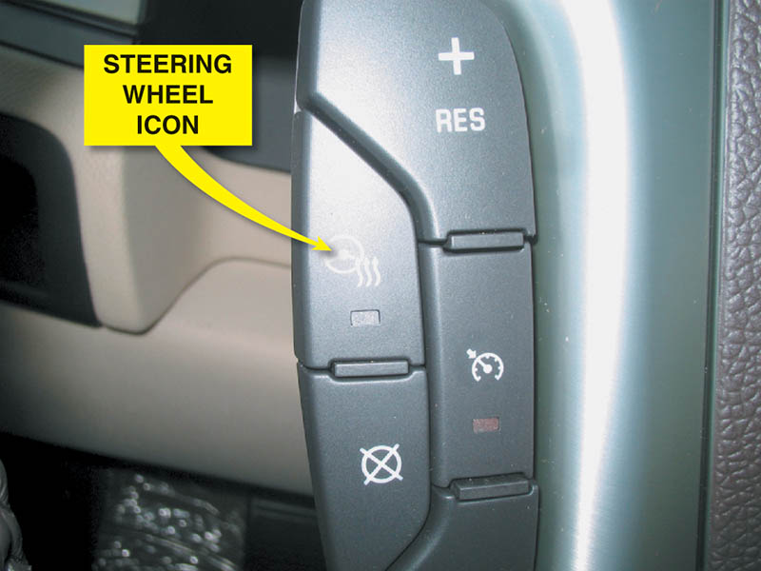
Figure 58.36 The heated steering wheel is controlled by a switch on the steering wheel in this vehicle

Slide 76
HEATED MIRRORS
Purpose and Function
To heat the surface of the mirror, which evaporates moisture on the surface.
Parts and Operation
Heated outside mirrors are often tied into the same electrical circuit as the rear window defogger.
Diagnosis
Check the service information for the specific procedures.

Slide 77
ADJUSTABLE PEDALS
Purpose and Function
The ability place the brake pedal and the accelerator pedal at a desired level.
Both are on movable brackets (that operate together) that are motor operated.
Diagnosis and Service
Follow the vehicle manufacturer’s recommended troubleshooting procedure.

Slide 78
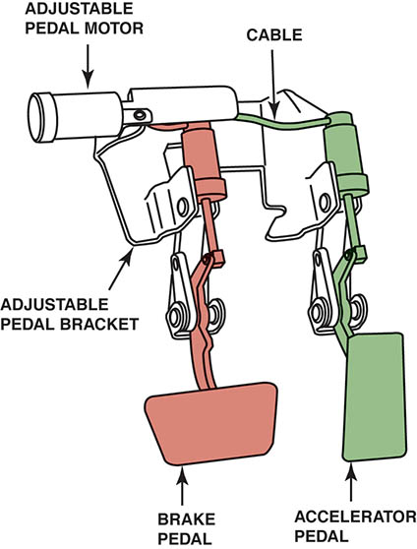
Figure 58.37 A typical adjustable pedal assembly. Both the accelerator and the brake pedal can be moved forward and rearward by using the adjustable pedal position switch

Slide 79
FOLDING OUTSIDE MIRRORS
A control inside is used to fold both mirrors inward when needed, such as when entering a garage or a tight parking spot.
For diagnosis and servicing of outside folding mirrors, check service information for details.

Slide 80
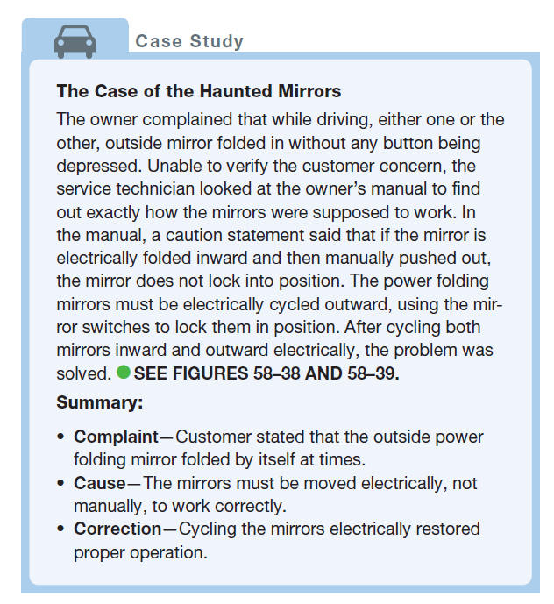
CASE STUDY

Slide 81
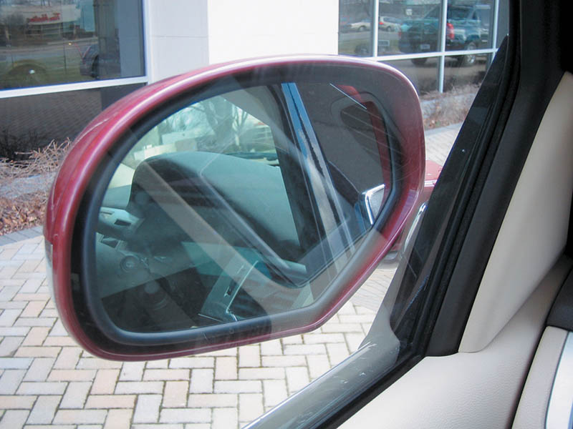
Figure 58.38 Electrically folded mirror in the folded position

Slide 82
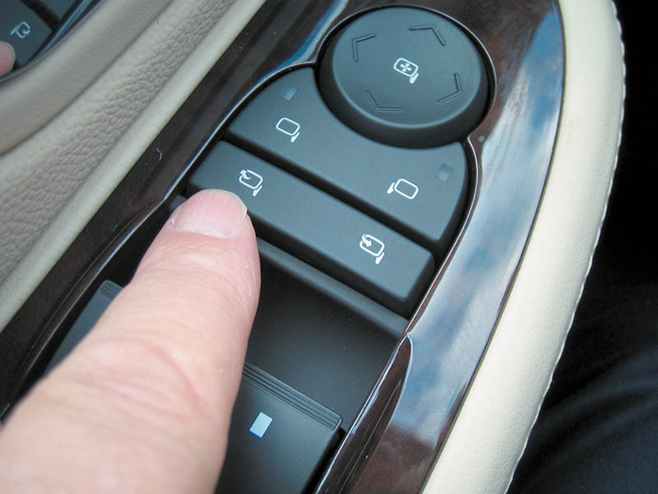
Figure 58.39 The electric mirror control is located on the driver’s side door panel on this Cadillac Escalade

Slide 83
KEYLESS ENTRY (1 OF 2)
System Description
Even though some vehicles use a keypad located on the outside of the door, most keyless entry systems use a wireless transmitter built into the key fob or remote.
Rolling Code Reset Procedure
If the transmitter does not work, try to resynchronize the transmitter to the receiver by depressing and holding both the lock and the unlock button for 10 seconds when within range of the receiver.

Slide 84
KEYLESS ENTRY (2 OF 2)
Passive Keyless Entry System
A passive system uses the key fob as a transmitter, which communicates with the vehicle as it comes close.
Depending on the system, the vehicle is automatically unlocked when a button or sensor on the door handle or trunk release is depressed.
Keyless Entry Diagnosis
A small battery powers the transmitter, and a weak battery is a common cause of remote power locks failing to operate.

Slide 85
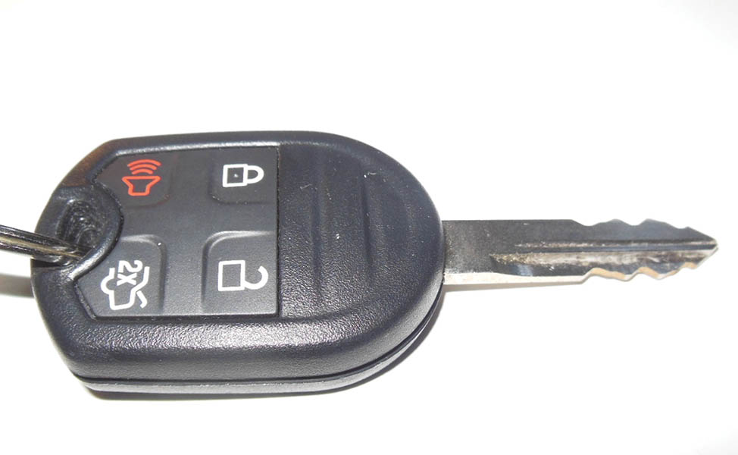
Figure 58.40 A key fob remote

Slide 86
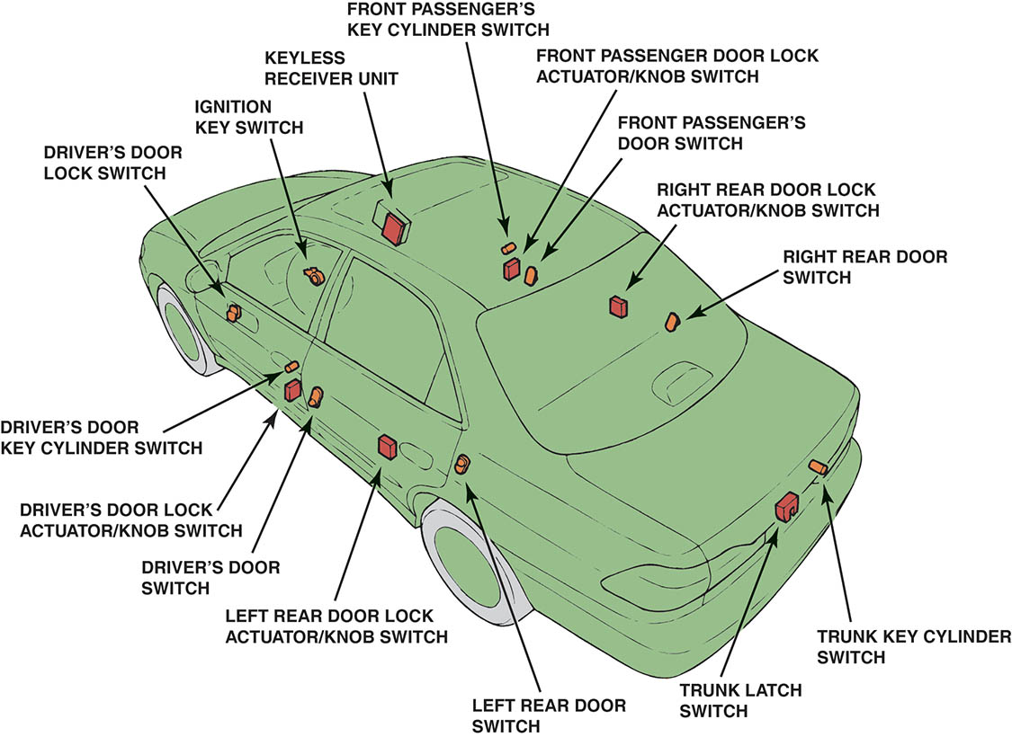
Figure 58.41 A typical vehicle showing the location of the various components of the remote keyless entry system

Slide 87
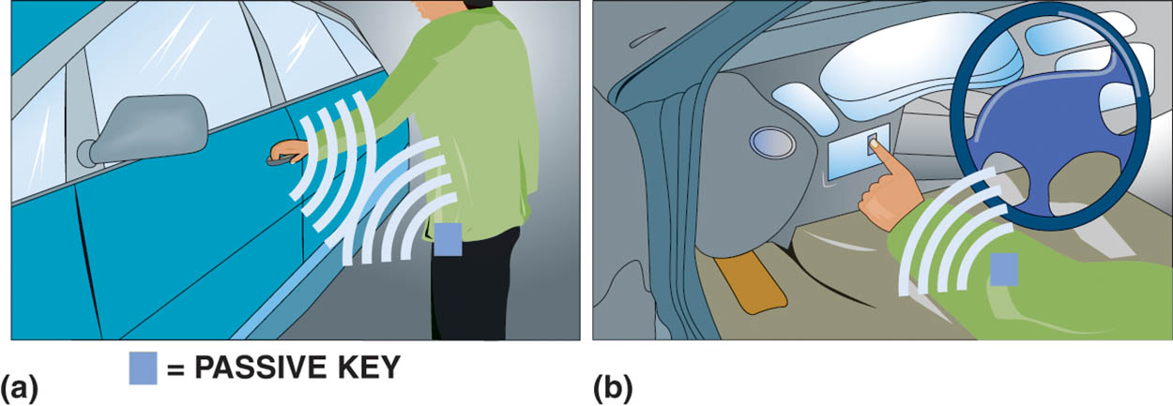
Figure 58.42 (a) If the passive key is within about 15 feet (5 meters) of the vehicle when the door handle is touched, the door unlocks, allowing access to the interior. (b) The engine starts if the smart key is detected being inside the vehicle

Slide 88
QUESTION 3: ?
What is meant by a “rolling code”?

Slide 89
ANSWER 3:
The changing of the coding between the keyless remote and the vehicle every time a button is pushed to prevent theft.

Slide 90
GARAGE DOOR OPENER
Operation
HomeLink or Car2U is a device installed in many new vehicles that duplicates the radio-frequency code of the original garage door opener.
Programming
When a vehicle is purchased, it must be programmed using the transmitter for the garage door opener or other device.
Diagnosis
Ensure the garage door opener is compatable.

Slide 91
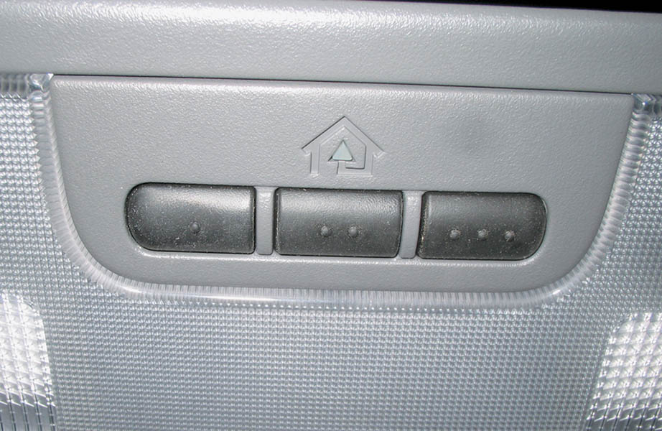
Figure 58.43 Typical HomeLink garage door opener buttons. Notice that three different units can be controlled from the vehicle using the HomeLink system

Slide 92
REMOTE START
Purpose and Function
Remote start is the ability to start the engine of the vehicle from a distance by using a remote control.
Factory-installed systems use the same remote.
Parts and Operation
The engine runs for about ten minutes and then shuts off.
Check service information for conditions that allow remote start.

Slide 93
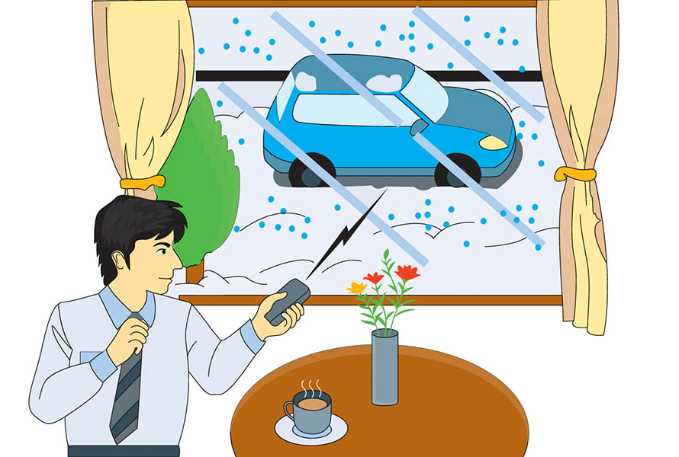
Figure 58.44 A remote start system allows the engine to be started from a distance, usually form inside the house before leaving for the day. Most systems only allow the engine for run for ten minutes

Slide 94

Copyright

