Slide 1

Automotive Technology Principles, Diagnosis, and Service
Sixth Edition
Chapter 57
Driver Information and Navigation Systems
Copyright © 2018, 2015, 2011 Pearson Education, Inc. All Rights Reserved

Slide 2
LEARNING OBJECTIVES (1 of 2)
57.1 Identify the meaning of dash warning symbols.
57.2 Describe steering wheel controls, voice activation, and maintenance indicators.
57.3 Discuss the operation of head-up display, night vision, and digital electronic displays.
57.4 Describe how speedometers and odometers work.

Slide 3
LEARNING OBJECTIVES (2 of 2)
57.5 Discuss the diagnosis of oil pressure lamp, temperature lamp, brake warning lamp, and other analog dash instruments.
57.6 Describe how a navigation system works.
57.7 Explain the operation and diagnosis of Telematics systems, backup camera, backup sensor, and lane departure warning system.

Slide 4
DASH WARNING SYMBOLS (1 OF 2)
Purpose and Function
  Symbols are used instead of words because they are universal in a global vehicle market.
Bulb Check
  All of the warning lights come on as part of a self-test, and to help the driver or technician spot any warning light that may be burned out or not operating.

Slide 5
DASH WARNING SYMBOLS (2 OF 2)
Green or White Symbols
  Used to notify the driver that certain functions are working
Amber Symbols
  A fault or an issue has occurred that may require attention soon.
Red Warning Symbols
  Red symbols mean that a serious fault has been detected and that immediate attention is required

Slide 6
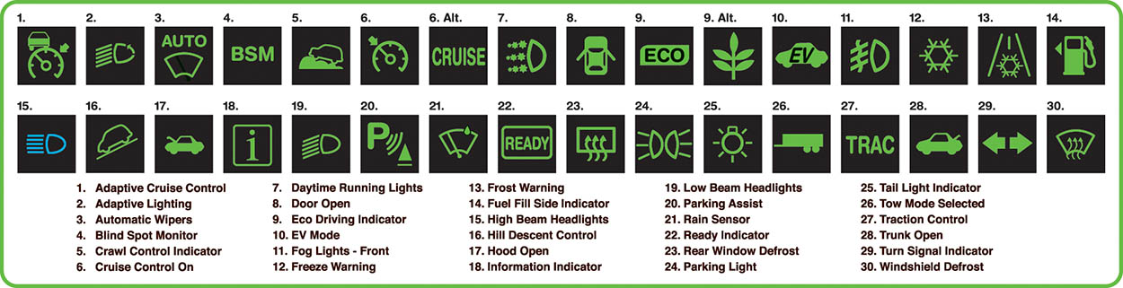
Figure 57.1 Green and blue symbols are used to inform the driver what is in operation

Slide 7
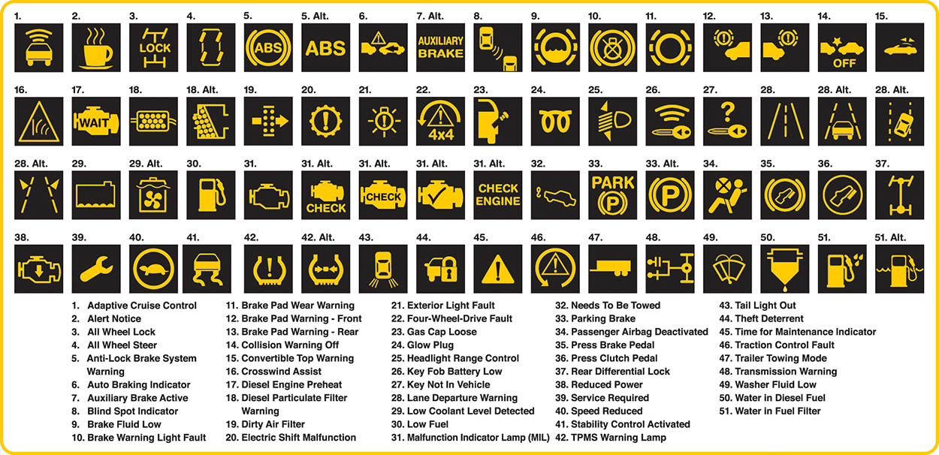
Figure 57.2 Amber warning symbols inform the driver of a potential concern

Slide 8
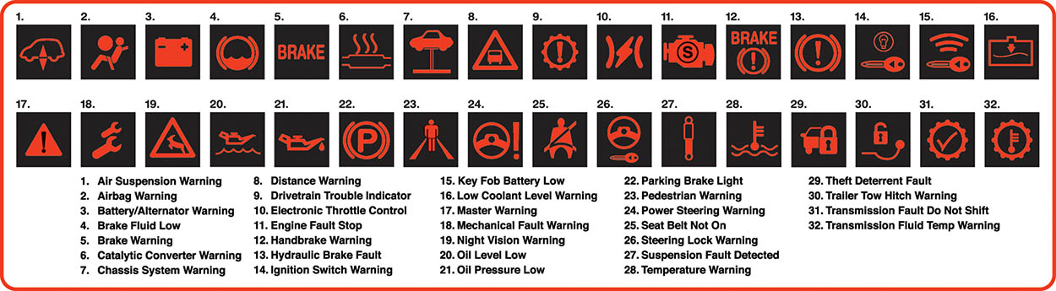
Figure 57.3 Red dash symbols are used to warn the driver of a fault requiring immediate action

Slide 9
QUESTION 1: ?
What do the colors of the dash symbols mean?

Slide 10
ANSWER 1:
Green or blue indicate something is working, amber indicates something will need attention soon and red indicates that attention is needed immediately.

Slide 11
STEERING WHEEL CONTROLS
Purpose
  The purpose of having steering wheel controls is to allow the driver to keep their hands on the wheel and their eyes on the road at all times.
Function
  Radio controls
  Cruise control
  Telephone answering and calls
  Voice commands

Slide 12
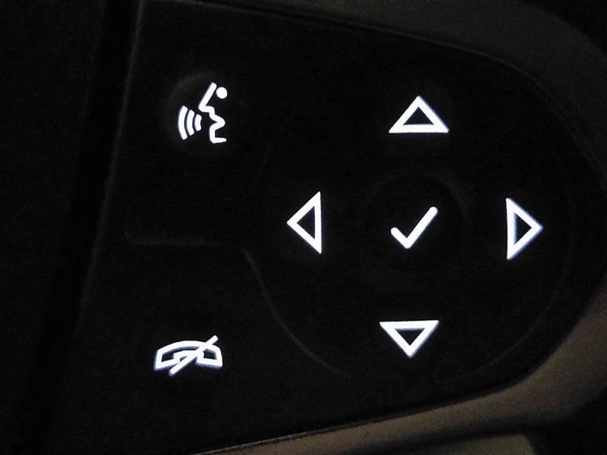
Figure 57.4 Steering wheel controls allow the driver to select a function while keeping their hands on the wheel and their eyes on the road

Slide 13
VOICE ACTIVATION
Purpose
  Used to perform various functions or settings in the vehicle.
Functions
  Phone calls
  Text messages
  Climate-control settings
  Source of audio
  Navigation system

Slide 14
MAINTENANCE INDICATORS
Purpose and Function
  Used to inform the driver that routine maintenance is needed.
Reset Maintenance Indicators
  Refer to the service information or the owners manual for procedure.

Slide 15
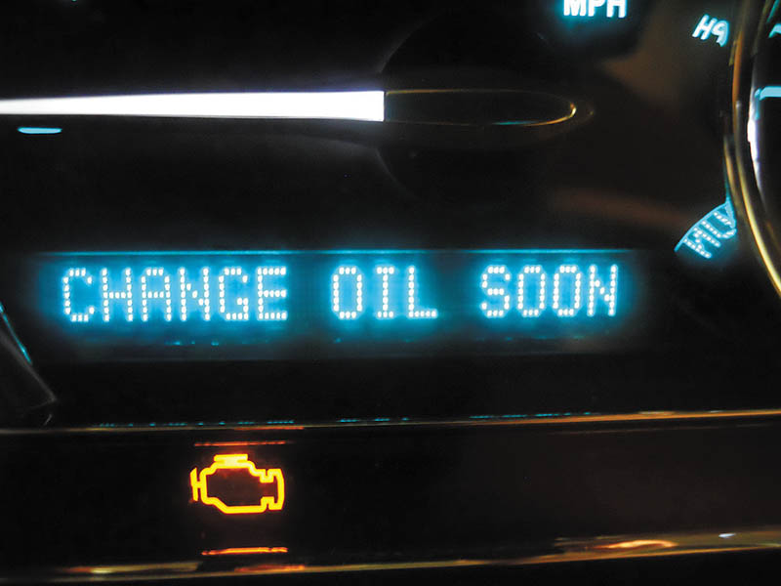
Figure 57.5 Maintenance reminders are often messages displayed on the instrument panel informing the driver of needed service, such as the need to change the engine oil

Slide 16
ANALOG AND DIGITAL DISPLAYS
Terminology
  An analog display uses a needle to show the values.
  A digital display uses numbers to indicate values.
Stepper Motor Analog Gauges
  Most analog dash displays use a stepper motor to move the needle.
Network Communication
  Data is shared digitally with the instrument cluster from various modules.

Slide 17
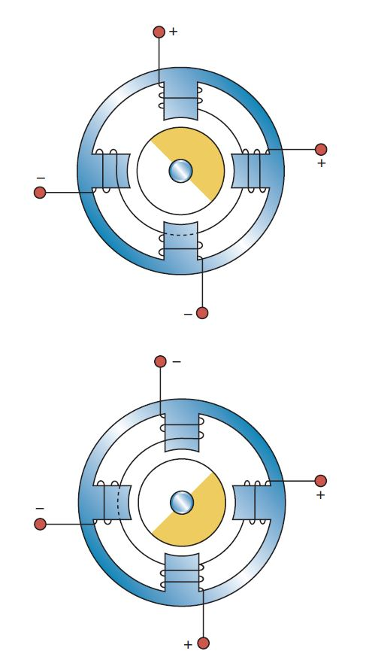
Figure 57.6 Most stepper motors use four wires that are pulsed by the computer to rotate the armature in steps

Slide 18
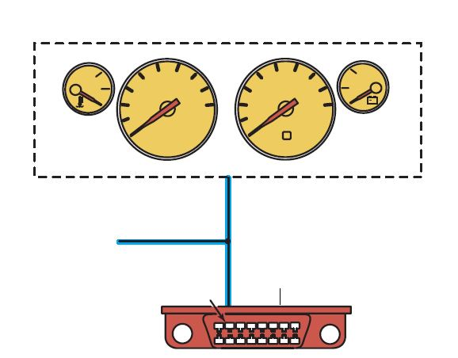
Figure 57.7 A typical instrument display uses data from the sensors over serial data lines to the individual gauges

Slide 19
HEADS-UP DISPLAY
Purpose
  A supplemental display that projects the vehicle speed and sometimes other data, such as turn-signal information, onto the windshield.
Operation
  The HUD unit is installed in the instrument panel (IP) and uses a mirror to project vehicle information onto the inside surface of the windshield.

Slide 20
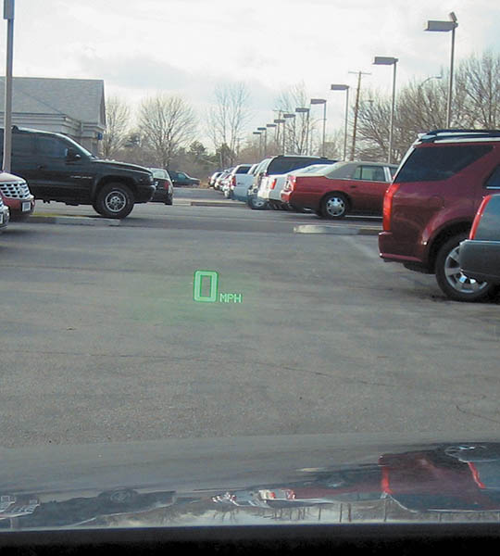
Figure 57.8 A typical head-up display showing zero miles per hour, which is actually projected on the windshield from the head-up display in the dash

Slide 21
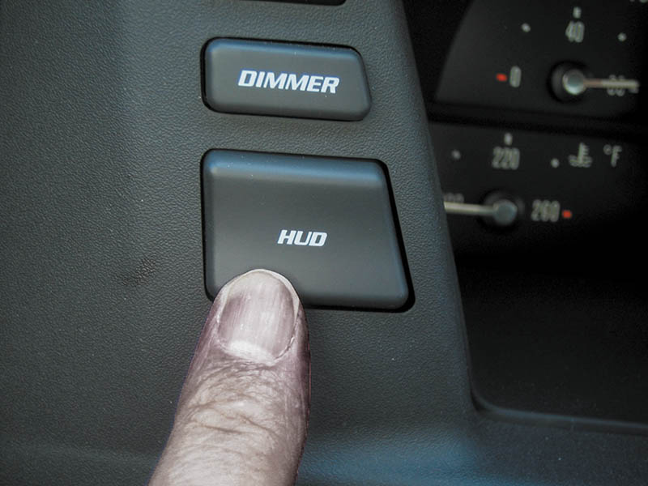
Figure 57.9 The dash-mounted control for the head-up display on this Cadillac allows the driver to move the image up and down on the windshield for best viewing

Slide 22
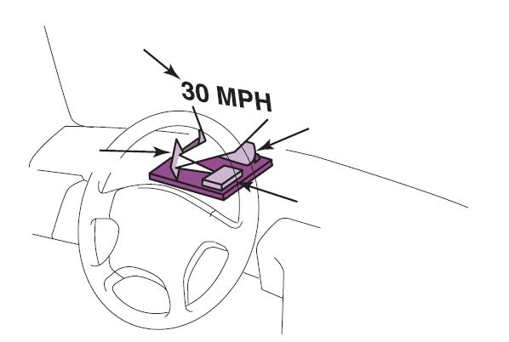
Figure 57.10 A typical head-up display (HUD) unit

Slide 23
NIGHT VISION
Purpose and Function
  Uses a camera that is capable of observing objects in the dark to assist the driver while driving at night.
Operation
  The camera creates pictures based on the heat energy emitted by objects, rather than from light reflected on an object, as in a normal optical camera.
Diagnosis and Service
  Follow the manufacturer’s recommended testing and service procedures.

Slide 24
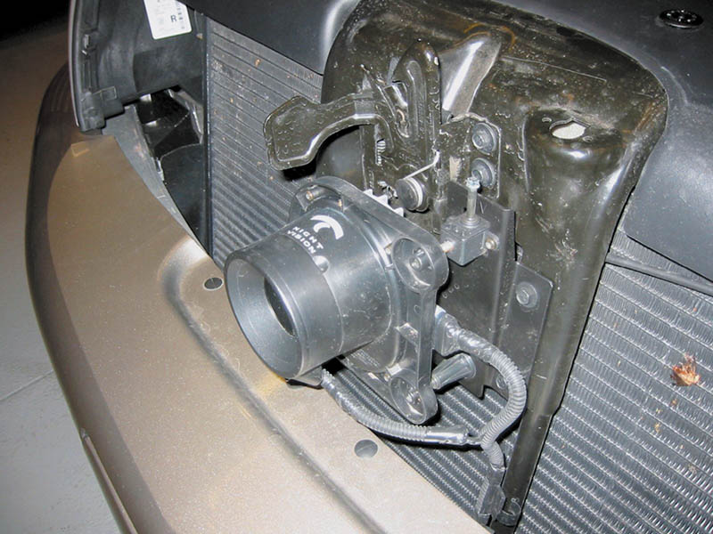
Figure 57.11 A night vision camera behind the grille of a Cadillac

Slide 25
QUESTION 2: ?
Night vision is used to detect what type of objects?

Slide 26
ANSWER 2:
People or objects that emit heat energy that cannot be seen in the darkness.

Slide 27
ELECTRONIC DISPLAYS (1 OF 2)
Light-Emitting Diode (LED)
  The light-emitting diode (LED) is a semiconductor that is constructed to release energy in the form of light
Vacuum Tube Fluorescent Displays
  The VTF display generates its bright light in a manner similar to that of a TV screen, where a chemical-coated light-emitting element called phosphor is hit with high-speed electrons.

Slide 28
ELECTRONIC DISPLAYS (2 OF 2)
Liquid Crystal Displays
  LCD construction consists of a special fluid sandwiched between two sheets of polarized glass.
  A small voltage is applied to the fluid through a conductive film laminated to the glass plates.
WOW Display
  When a vehicle equipped with a digital dash is started, all segments of the electronic display are turned on at full brilliance for 1 or 2 seconds.

Slide 29
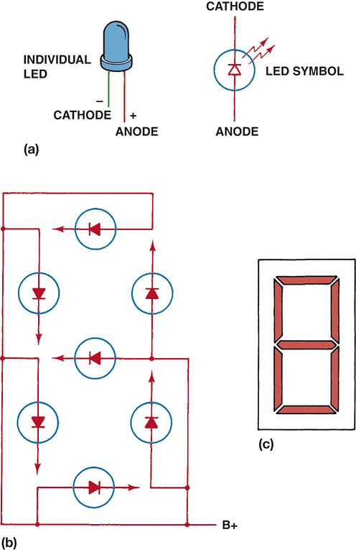
Figure 57.12 (a) Symbol and line drawing of a typical light-emitting diode (LED). (b) Grouped in seven segments, this array is called a seven-segment LED display with a common anode (positive connection). the dash computer toggles the cathode (negative) side of each individual segment to display numbers and letters. (c) When all segments are turned on, the number 8 is displayed

Slide 30
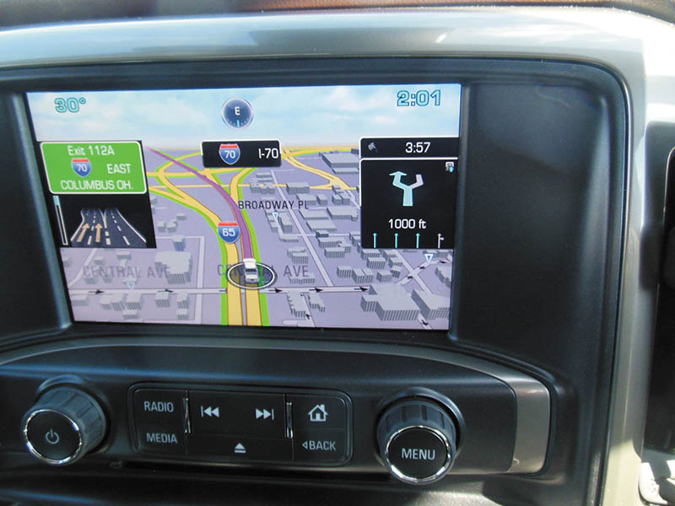
Figure 57.13 A typical LCD navigation system display

Slide 31
VIRTUAL DISPLAY
Purpose and Function
  A virtual display is a dash that allows the driver to select what data is being displayed.
Operation
  The dash display is all that is really different because all the data comes to the IPC on the data bus.
  The display can be changed to meet the needs of the driver.

Slide 32
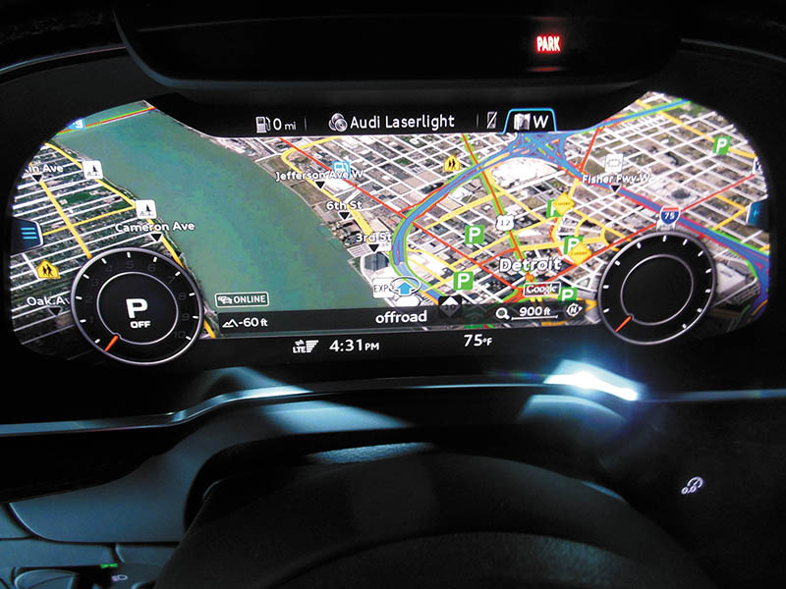
Figure 57.14 A virtual dash being used to show a navigation screen that takes up all of the center dash area. This driver-selectable dash display can show almost any combination of dash instruments to meet the desires of the driver

Slide 33
TOUCH SCREENS
Purpose
  Allow the driver to use a finger to perform functions displayed on the screen.
Operation
  A capacitive touchscreen panel reacts to the human touch. The touch location is sent to the controller for processing.
Touch Screen Feedback
  A haptic response (beep or vibration) improves the experience by providing feedback.

Slide 34
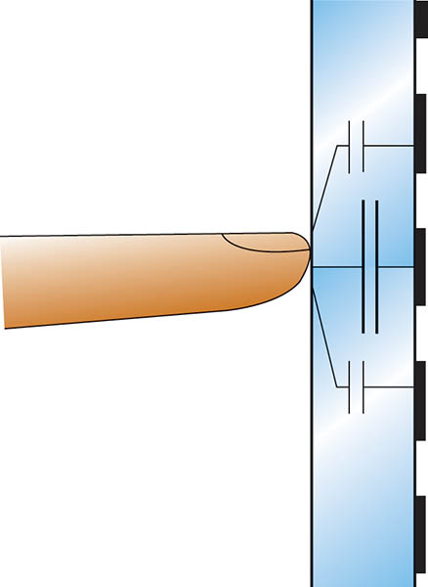
Figure 57.15 Schematic of a capacitive touchscreen

Slide 35
SPEEDOMETERS/ ODOMETERS
Operation
  Dash displays use an electric vehicle speed sensor on the output of the transmission or from the input from the wheel speed sensors (WSS).
Odometers
  An odometer is a dash display that indicates the total miles traveled by the vehicle.
  Uses either an electrically driven mechanical odometer or a digital display odometer to indicate miles traveled

Slide 36
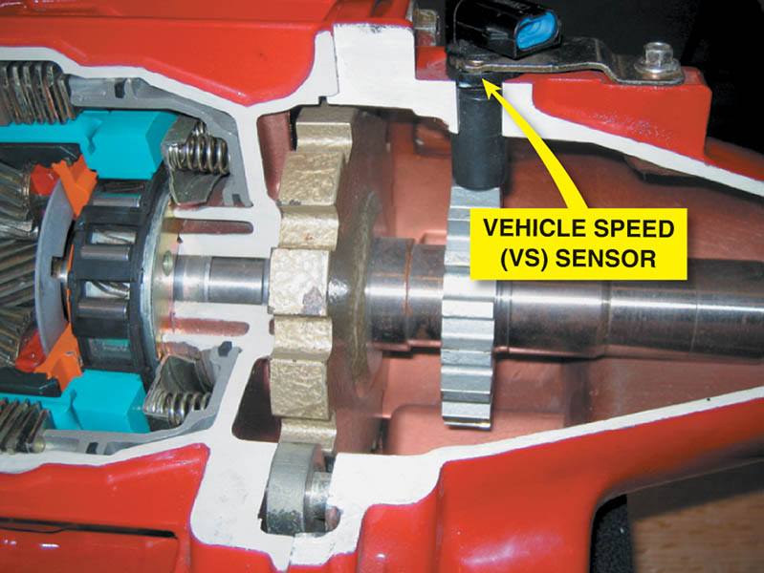
Figure 57.16 A vehicle speed sensor located in the extension housing of the transmission. Some vehicles use the wheel speed sensors for vehicle speed information

Slide 37
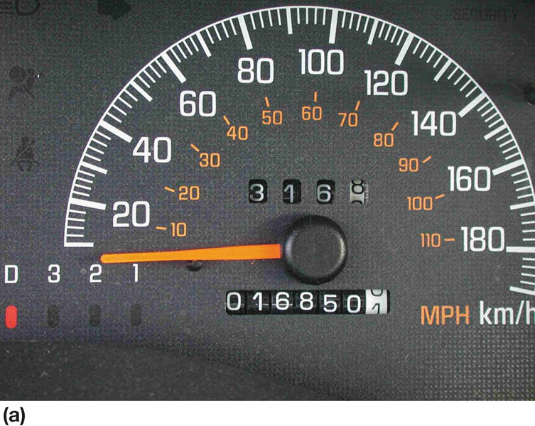
Figure 57.17 (a) Some odometers are mechanical and are operated by a stepper motor

Slide 38
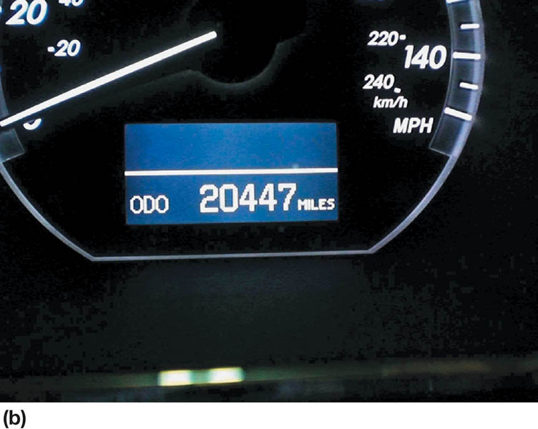
Figure 57.17 (b) Many vehicles are equipped with an electronic odometer

Slide 39
DASH GAUGES (1 OF 2)
Fuel Level
  Fuel level gauges use a fuel tank sending unit that consists of a float attached to a variable resistor.
  As the resistance of the tank unit changes, the dash-mounted gauge also changes to show the level of the fuel in the tank.
Oil Pressure
  The oil pressure lamp operates through use of an oil pressure sending unit, which is a switch screwed into the engine block, and grounds the electrical circuit.

Slide 40
DASH GAUGES (2 OF 2)
Coolant Temperature
  Most vehicles use the engine coolant temperature (ECT) sensor for engine temperature gauge operation.
Dash Instrument Diagnosis
  Use a factory or factory-level scan tool to check for codes.
  Use the bidirectional control features on the scan tool to actuate the dash display.
  Always follow the specified testing and diagnostic procedures found in service information for the vehicle being tested.

Slide 41
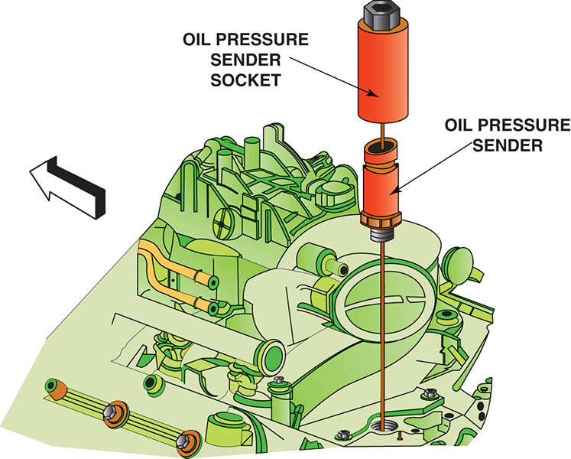
Figure 57.18 A sending unit socket being used to remove an oil pressure sender unit

Slide 42
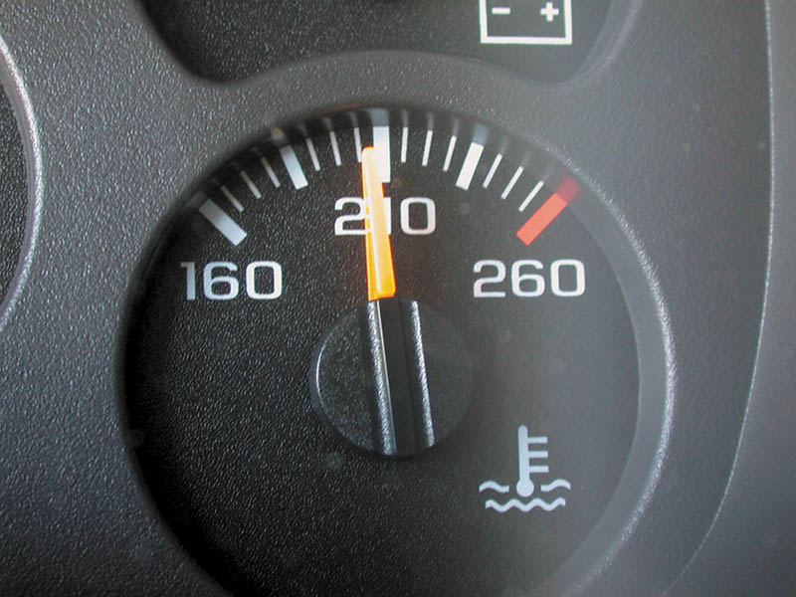
Figure 57.19 A temperature gauge showing normal operating temperature between 180°F and 215°F, depending on the specific vehicle and engine

Slide 43
NAVIGATION AND GPS
Purpose and Function
  The global positioning system (GPS) uses 24 satellites in orbit around the earth to provide signals for navigation devices.
Navigation System Parts and Operation
  GPS satellite signals
  YAW sensor
  Vehicle speed sensor
  Audio input/output

Slide 44
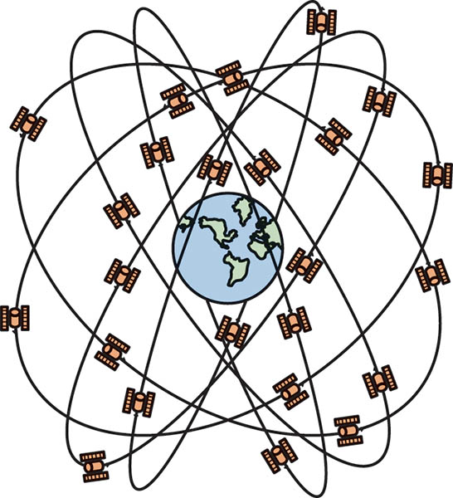
Figure 57.20 Global positioning systems use 24 satellites in high earth orbit whose signals are picked up by navigation systems. The navigation system computer then calculates the location based on the position of the satellite overhead

Slide 45
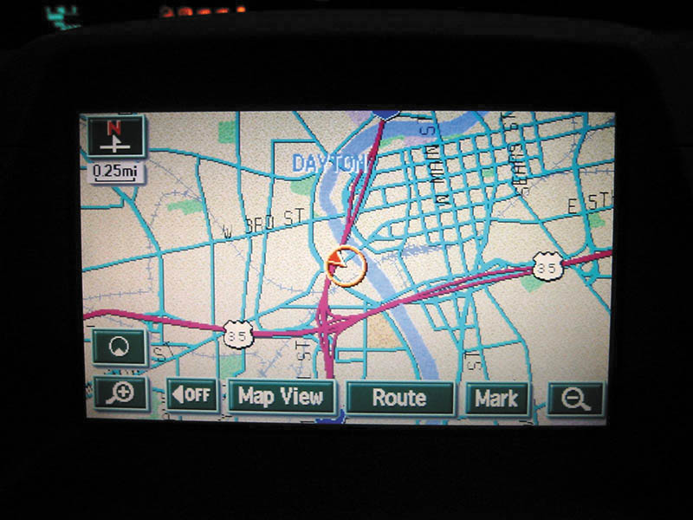
Figure 57.21 A typical GPS display screen showing the location of the vehicle

Slide 46
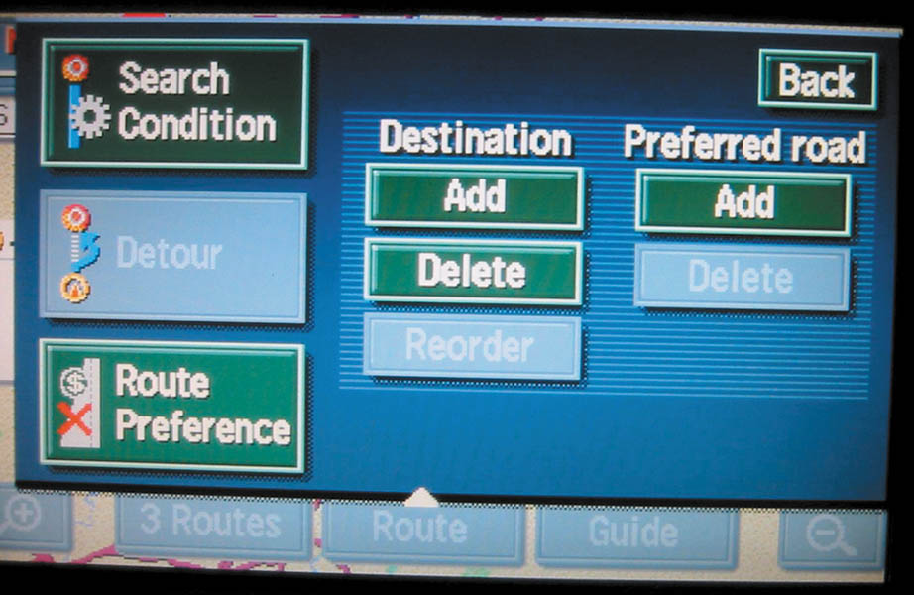
Figure 57.22 A typical navigation display showing various options. Some systems do not allow access to these if the vehicle is in gear and/or moving

Slide 47
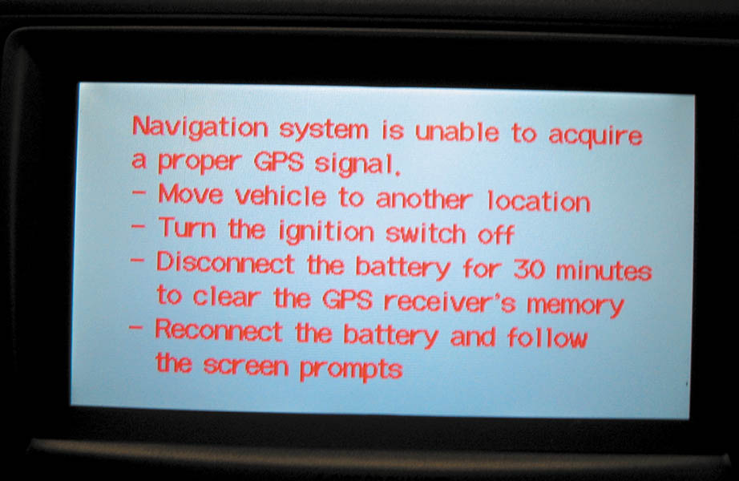
Figure 57.23 A screen display of a navigation system that is unable to acquire usable signals from GPS satellites

Slide 48
QUESTION 3: ?
How does a navigation system determine the location of the
vehicle?

Slide 49
ANSWER 3:
GPS Satellites.

Slide 50
TELEMATICS
What is telematics?
  Telematics is an interconnected system that combines telecommunications (cellular systems) and GPS navigation satellite system technology.
Parts and Operation
  Automatic notification of airbag deployment.
  Emergency services.
  Stolen vehicle location assistance.
  Remote door unlock.
  Roadside assistance.

Slide 51
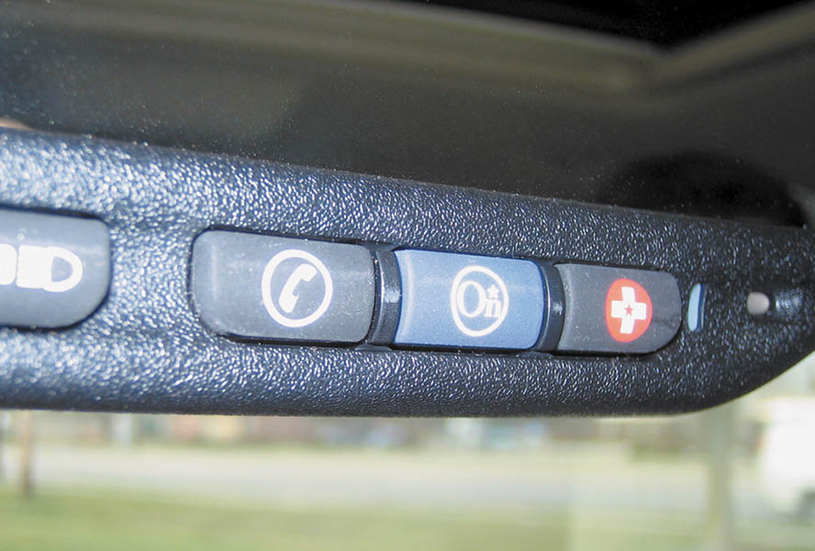
Figure 57.24 The three-button OnStar control is located on the inside rearview mirror. The left button (telephone handset icon) is pushed if a hands-free cellular call is to be made. The center button is depressed to contact an OnStar advisor and the right emergency button is used to request that help be sent to the vehicle’s location

Slide 52
BACKUP CAMERA
Parts and Operation
  Used to display the area at the rear of the vehicle in a screen display on the dash, or in the inside rear-view mirror when the gear selector is placed in reverse.
Rear Camera Image Issues
  Dark conditions
  Physical damage
  Dirt, mud, ice, snow
  Excessive temperatures
  Glare

Slide 53
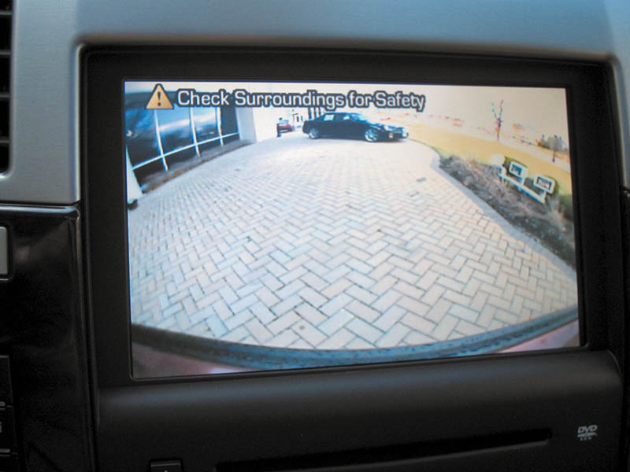
Figure 57.25 A typical view displayed on the navigation screen from the backup camera

Slide 54
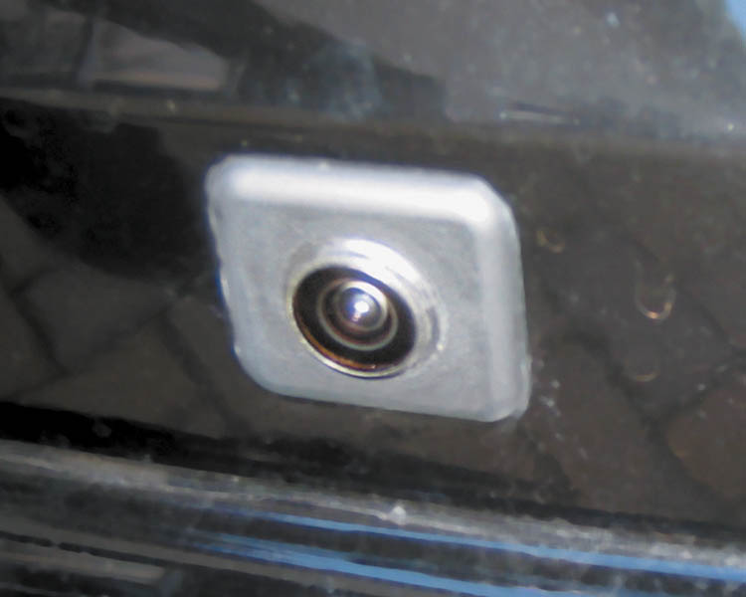
Figure 57.26 A typical fisheye-type backup camera usually located near the center on the rear of the vehicle near the license plate

Slide 55
PARKING ASSIST
Components
  Ultrasonic object sensors
  Electromagnetic parking sensors (EPS)
  Blind spot monitor
Operation
  The system is active from the time the engine is started until the vehicle exceeds a speed of approximately 6 MPH (10 km/h).
  Also active when the vehicle is backing up.

Slide 56
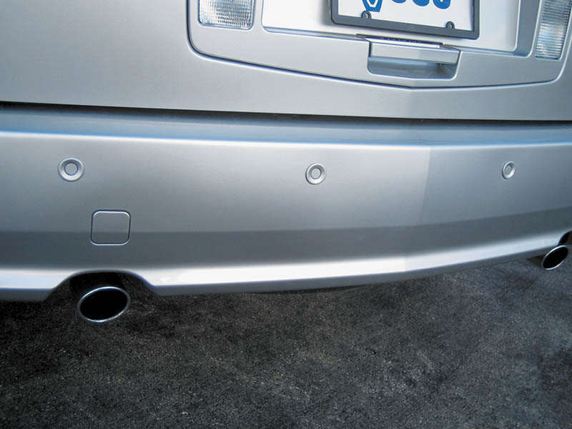
Figure 57.27 The small round buttons in the rear bumper are ultrasonic sensors used to sense distance to an object

Slide 57
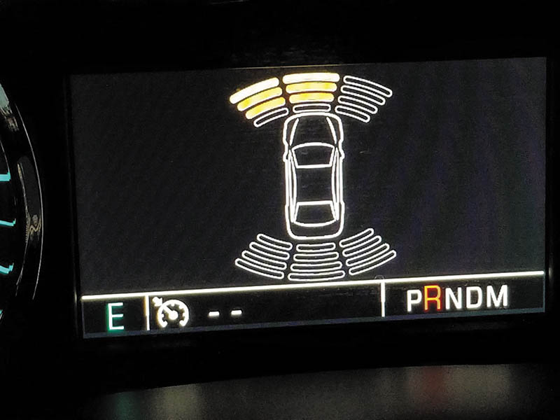
Figure 57.28 The dash display on a Chevrolet pickup truck showing that an object is being detected at the front and left-front of the vehicle

Slide 58
LANE DEPARTURE WARNING
Parts and Operation
  Uses cameras to detect if the vehicle is crossing over lane marking lines on the pavement.
  Some systems use two cameras, one mounted on each outside rearview mirror.
  Some systems use infrared sensors located under the front bumper
Diagnosis and Service
  After a visual inspection, follow the vehicle manufacturer’s recommended diagnosis procedures to locate and repair the fault in the system.

Slide 59
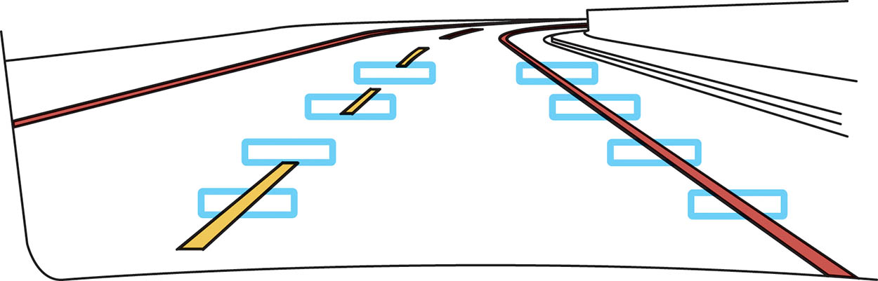
Figure 57.29 A lane departure warning system often uses cameras to sense the road lines and warns the driver if the vehicle is not staying within the lane, unless the turn signal is on

Slide 60

Copyright

