Slide 1
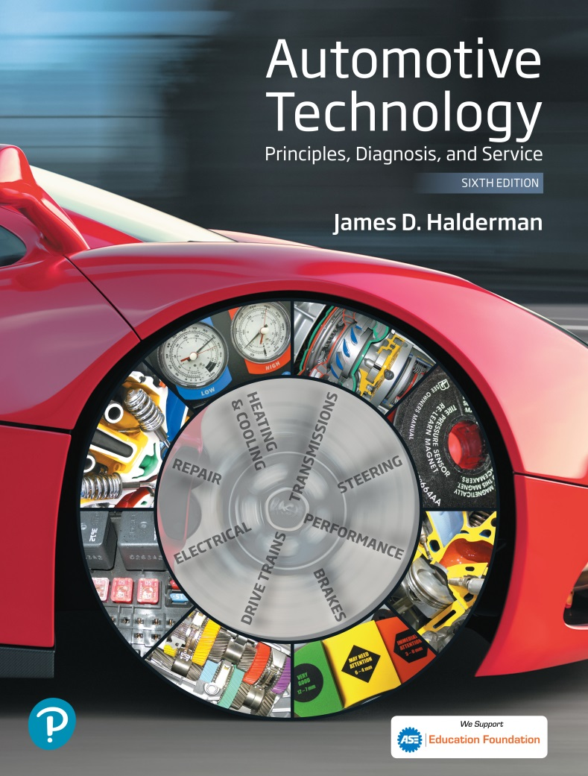
Automotive Technology Principles, Diagnosis, and Service
Sixth Edition
Chapter 56
Lighting and Signaling Circuits
Copyright © 2018, 2015, 2011 Pearson Education, Inc. All Rights Reserved

Slide 2
LEARNING OBJECTIVES (1 of 2)
56.1 Explain lighting systems in an automobile and list the advantages of using LED lights.
56.2 Read and interpret a bulb chart.
56.3 Discuss the operation of brake lights and turn signals.
56.4 Describe daytime running lights, fog lights, driving lights, types of headlights, adaptive headlights, and how to aim headlights.

Slide 3
LEARNING OBJECTIVES (2 of 2)
56.5 Describe automatic dimming mirrors, courtesy lights, and illuminated entry.
56.6 Explain the procedures to inspect and troubleshoot lighting and signaling systems.
56.7 This chapter will help you prepare for the ASE Electrical/Electronic Systems (A6) certification test content area “E” (Lighting Systems Diagnosis and Repair).

Slide 4
LIGHTING SYSTEMS (1 OF 2)
Non-Computer-Controlled Lighting
  Older vehicles used the headlight switch to operate all the lights, including:
  Headlights
  Taillights
  Side-marker lights
  Front parking lights
  Dash lights
  Interior (dome) light(s)

Slide 5
LIGHTING SYSTEMS (2 OF 2)
Body Control Module- Controlled Lighting
  The Body Control Module (BCM) is often referred to as a central organizational module.
Benefits include:
  Monitors the current flow through the circuit and turns on a warning light if there is a failure.
  The modules turn off the lights after a time delay to prevent the battery from being drained.
  In a failsafe mode, all exterior lights default to on for safety.

Slide 6
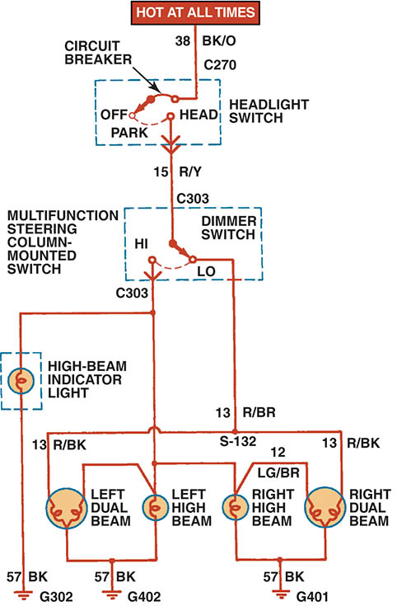
Figure 56.1 A typical headlight circuit diagram on an older vehicle that does not use a controller, such as the body control module (BCM) to control the operation of the lights.

Slide 7
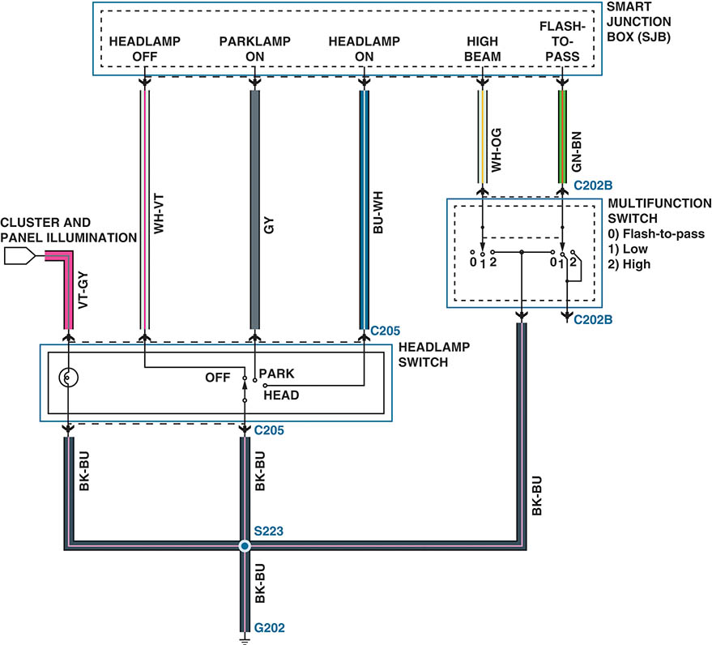
Figure 56.2 A schematic showing the inputs from the multi-function switch and the headlight switch to the smart junction box (SJB). The SJB then uses the body control module (BCM) to operate the lights.

Slide 8
LED LIGHTING
Parts and Operation
  An LED is a P–N junction diode that emits light when a suitable voltage is applied to the leads.
LED Features
  Faster Illumination
  Longer Service Life
  Lower Current Draw
Testing Bulbs
  The bulbs can be visually inspected or tested using an ohm meter.

Slide 9
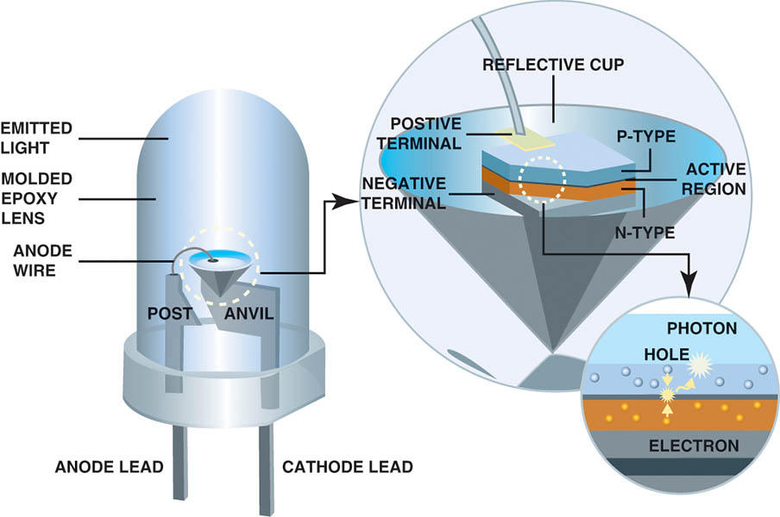
Figure 56.3 An LED emits light when a photon is released at the P-N junction

Slide 10
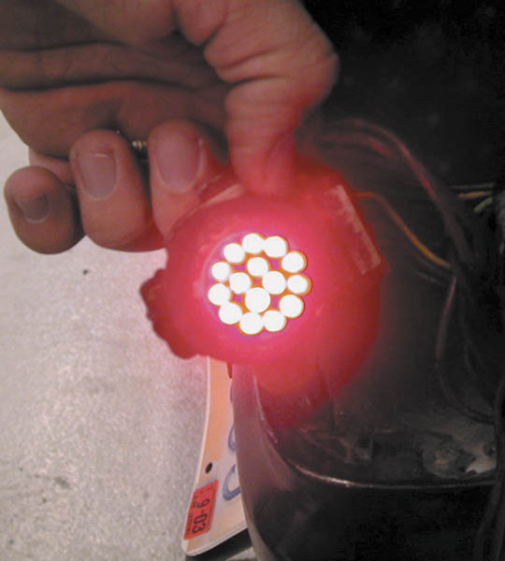
Figure 56.4 A replacement LED taillight bulb is constructed of many small, individual light-emitting diodes

Slide 11
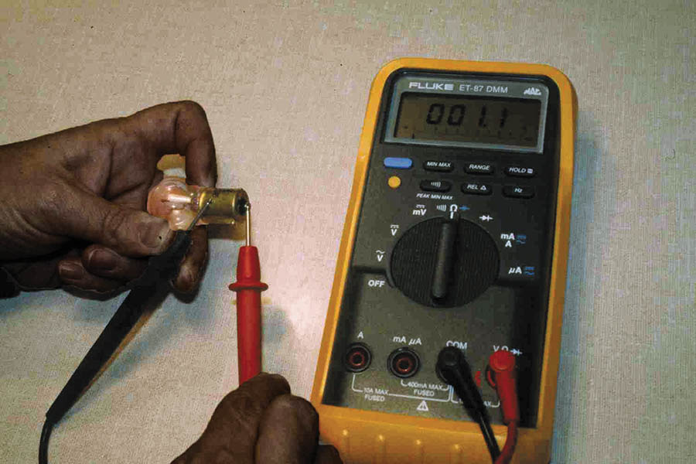
Figure 56.5 This single-filament bulb is being tested with a digital multimeter set to read resistance in ohms. The reading of 1.1 ohms is the resistance of the bulb when cold. As soon as current flows through the filament, the resistance increases about 10 times.

Slide 12
BULB NUMBERS
Trade Number
  The number used on automotive bulbs is called the bulb trade number, as recorded with the American National Standards Institute (ANSI).
Bulb Number Suffixes
  A–amber (painted glass)
  B–blue
  HD–heavy duty
  NA–natural amber (amber glass)
  Q–Quartz halogen

Slide 13
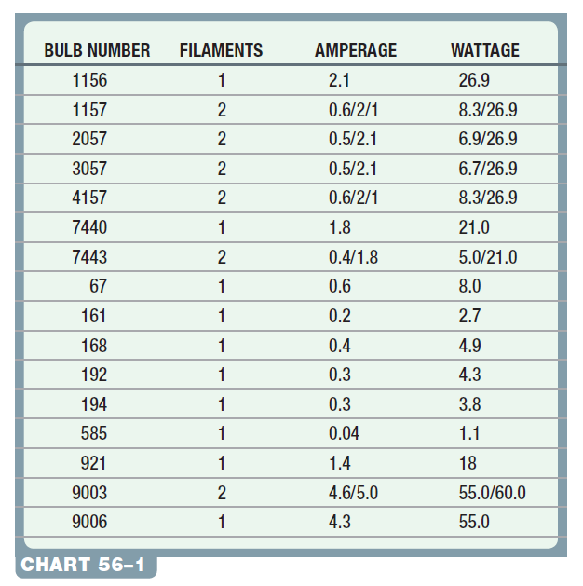
Chart 56-1 Some automotive bulb trade numbers with their amperage and wattage rating. Check service information for the exact bulb to use.

Slide 14
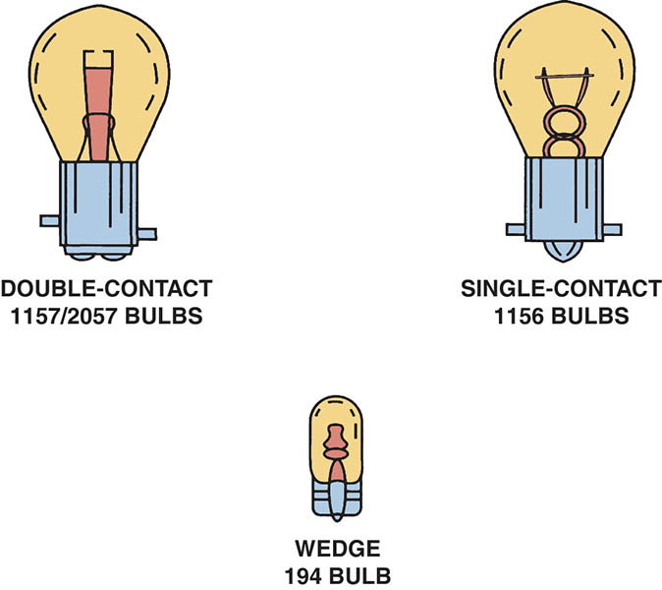
Figure 56.6 Dual-filament (double-contact) bulbs contain both a low-intensity filament for taillights or parking lights, and a high-intensity filament for brake lights and turn signals. Bulbs come in a variety of shapes and sizes.

Slide 15
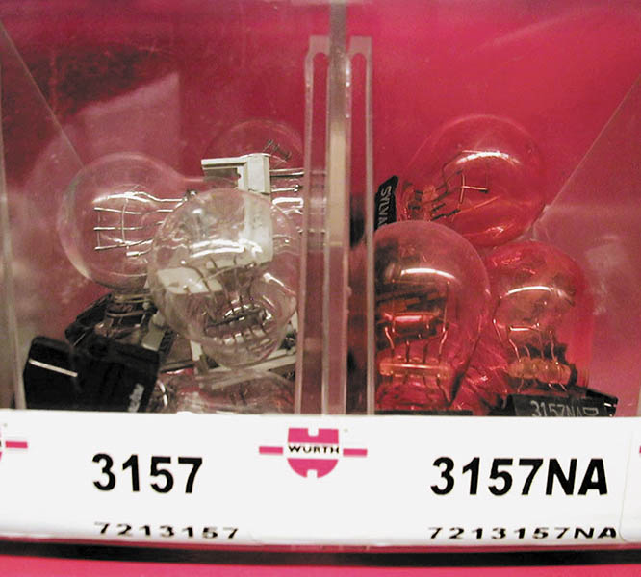
Figure 56.7 Bulbs that have the same trade number have the same operating voltage and wattage. NA means that the bulb uses a natural amber glass ampoule with clear turn signal lenses

Slide 16
QUESTION 1: ?
Why should the exact same trade number of bulb be used as a replacement?

Slide 17
ANSWER 1:
To ensure the bulb emits the correct lumens.

Slide 18
BRAKE LIGHTS (1 OF 2)
Terminology
  Brake lights, also called stop lights, use the high-intensity filament of a double-filament bulb or LEDs.
One Filament Stop/Turn Bulbs
  The stop and turn signals are both provided by one filament.
Two Filament Stop/Turn Bulbs
  Separate filaments for the stop and turn lamps, the brake and turn signal switches are not connected.

Slide 19
BRAKE LIGHTS (2 OF 2)
BCM-Controlled Brake Lights
The input from the brake pedal switch or sensor is used by other systems in the vehicle as an input signal for the following systems:
  Shift interlock
  Push-button start
  Cruise control
  Antilock braking system (ABS)

Slide 20
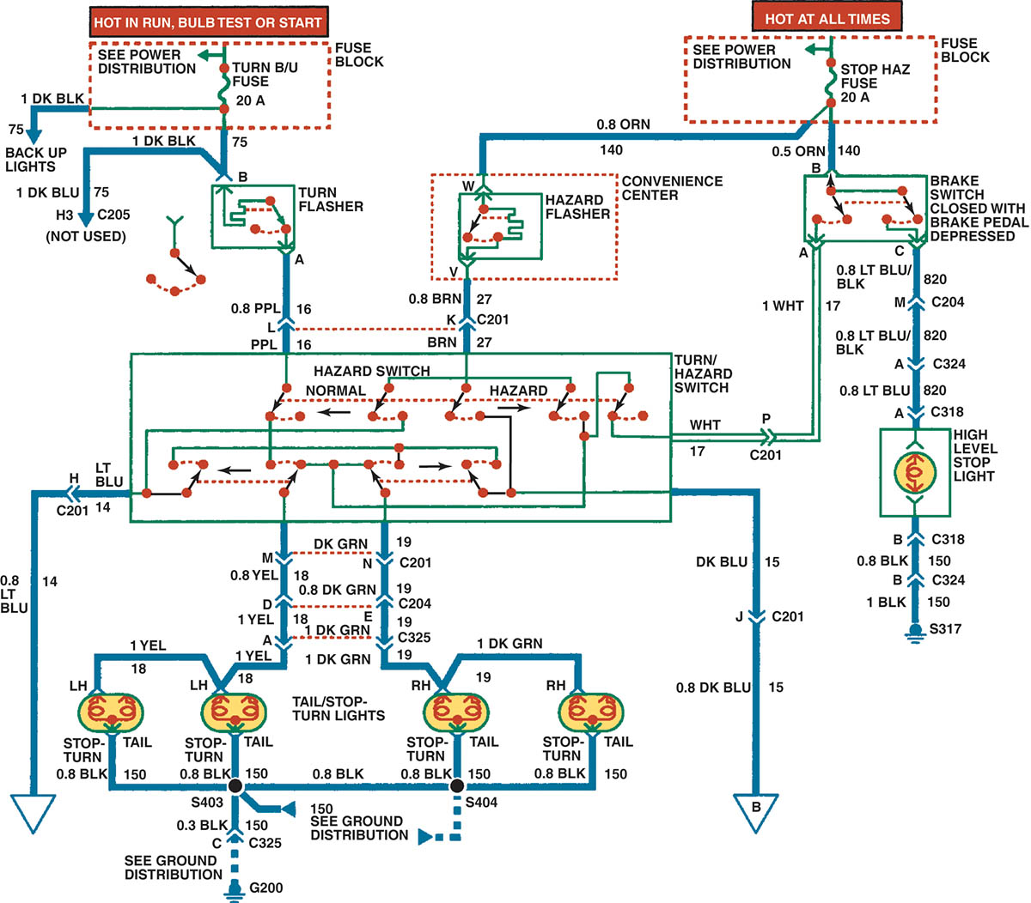
Figure 56.8 A typical older-type brake light circuit showing the brake switch and all of the related circuit components

Slide 21
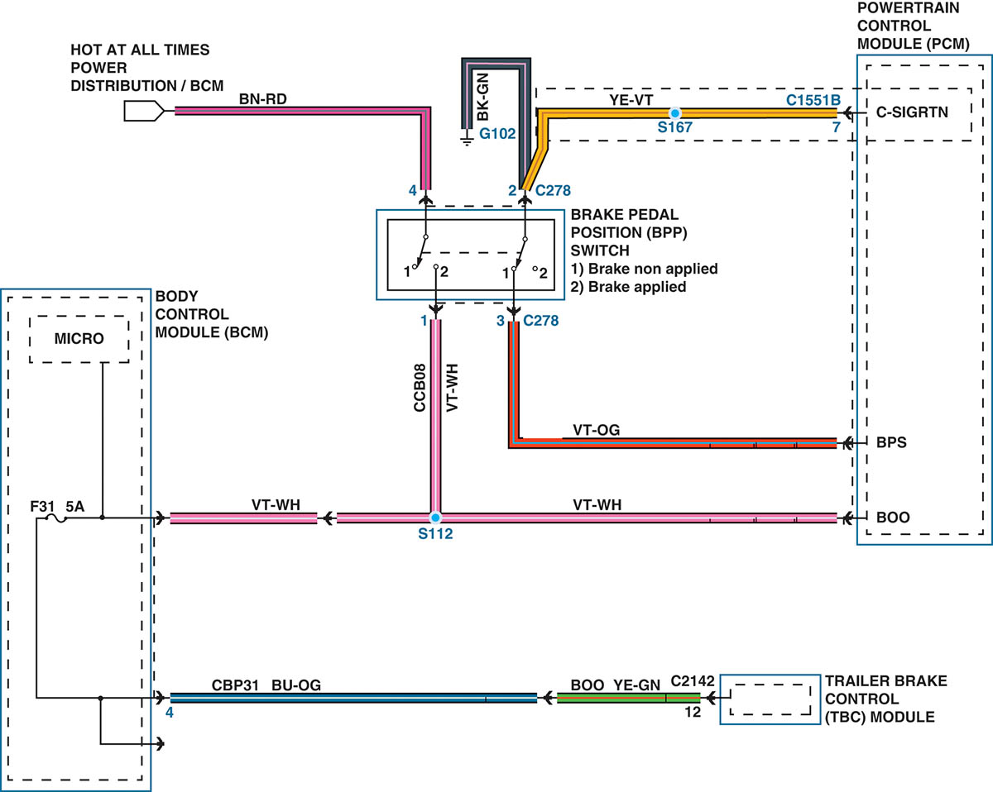
Figure 56.9 A schematic of the BCM-controlled brake light circuit that includes the brake pedal position (BPP) switch, which creates signals to the powertrain control module (PCM) with inputs labeled BPS (brake pedal position) and BOO (brake on-off)

Slide 22
TURN SIGNALS (1 OF 2)
Mechanical System Operation
  In older systems, the turn signal circuit is supplied power from the ignition switch and operated by a lever and a switch.
BCM-Controlled Turn Signals
  The BCM sends a signal through the data lines to the lighting module(s) to flash the lights.

Slide 23
TURN SIGNALS (2 OF 2)
Bulb Outage Warning
  The lighting module, usually the BCM, monitors the current flow though all of the lights.
Hazard Warning Lights
  The hazard warning, also called four-way flashers, is a device installed in a vehicle lighting system with the primary function of causing both the left and right turn signal lamps to flash when the hazard warning switch is activated.

Slide 24
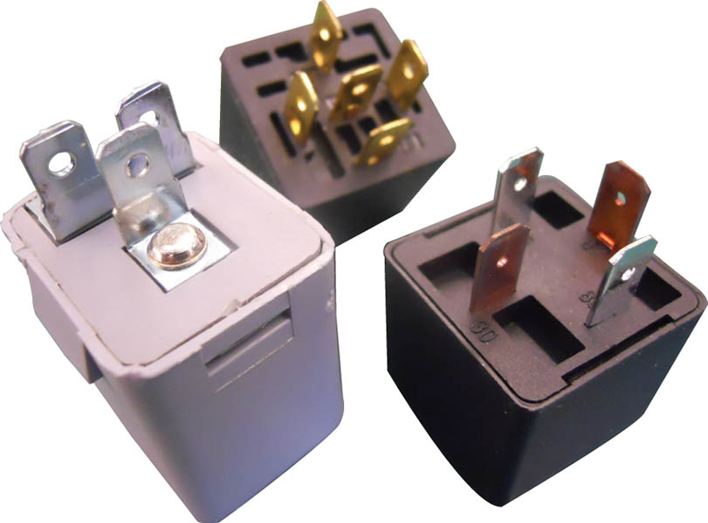
Figure 56.10 Three styles of flasher units

Slide 25
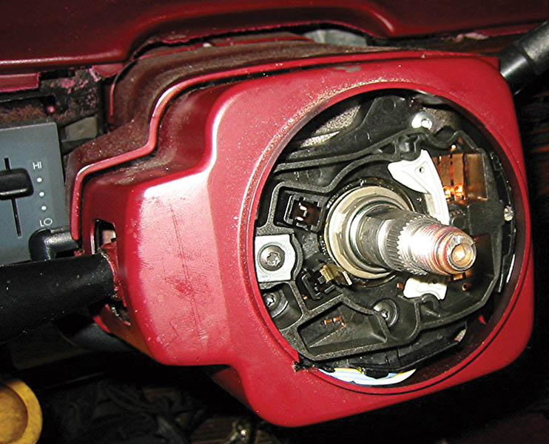
Figure 56.11 A steering column with the steering wheel removed, showing the turn signal cancelling cam used to return the lever to the neutral position after a turn. The switches are an input to the body control module for left and right turn signal operation

Slide 26
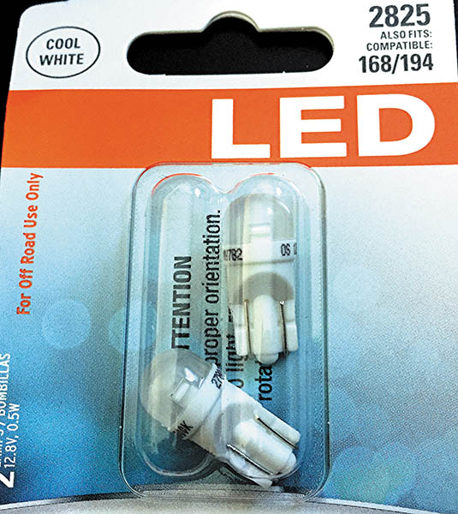
Figure 56.12 Replacement side marker LED lamps that could be used to replace standard bulbs. However, the current draw is lower and using these bulbs could cause the lamp outage warning lamp to be turned on

Slide 27
DAYTIME RUNNING LIGHTS
Purpose and Function
  Daytime running lights (DRLs) are lights at the front of the vehicle that are on all the time the engine is running, unless they are turned off, or when the headlights are on.
DRLs involve operation of the following:
  Front parking lights
  Separate DRL lamps
  Headlights (at a reduced current)

Slide 28
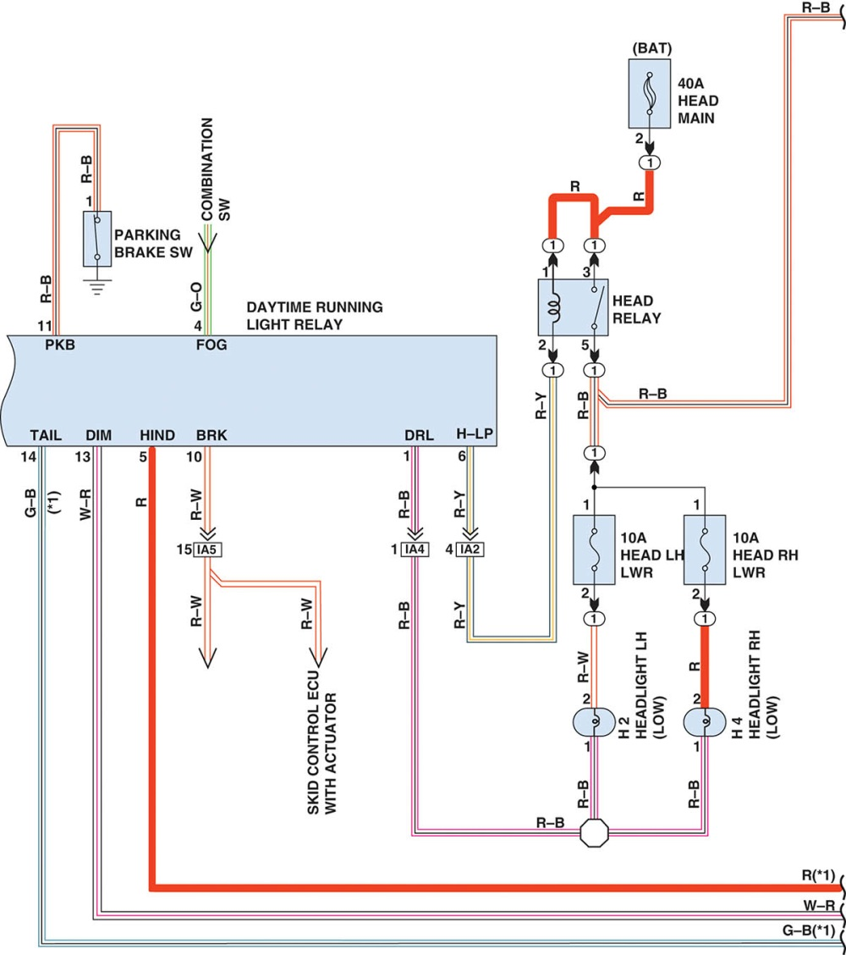
Figure 56.13 A schematic showing a DRL circuit that uses the headlights. Also notice that each headlight has its own fuse to protect the circuit. Check service information for how the DRLs operate on the vehicle being serviced

Slide 29
HEADLIGHTS (1 OF 2)
Headlight Switches
  Older vehicles use the headlight switch to operate the exterior and interior lights.
Composite Headlights
  Composite headlights are constructed using a replaceable bulb and a fixed lens cover that is part of the vehicle.

Slide 30
HEADLIGHTS (2 OF 2)
Bulb Faults
  Gray color. Low voltage to the bulb (check for corroded socket or connector)
  White (cloudy) color. Indication of an air leak
  Broken filament. Usually caused by excessive vibration
  Blistered glass. Indication that someone has touched the glass
Cloudy Headlight Restoration
  The process of restoring the surface of a composite headlight assembly

Slide 31

Figure 56.14 A Typical headlight circuit diagram on an older vehicle that does not use a controller, such as the BCM, to control the operation of the lights.

Slide 32
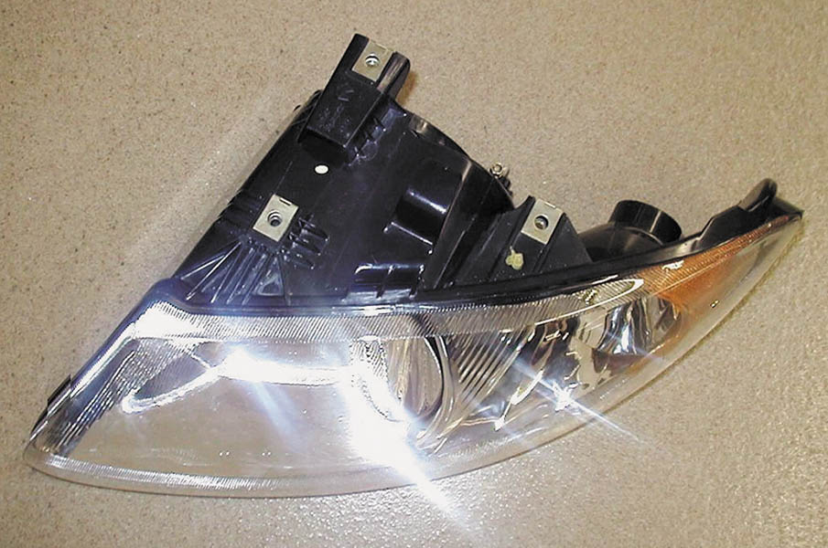
Figure 56.15 A typical composite headlamp assembly. The lens, housing, and bulb sockets are usually included as a complete assembly

Slide 33
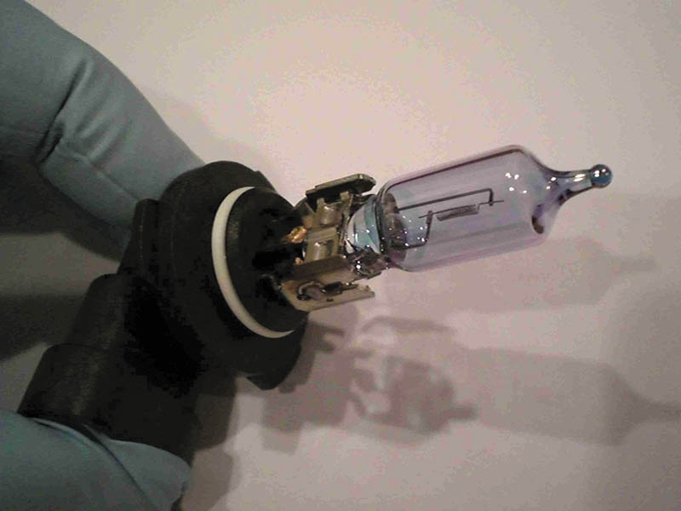
Figure 56.16 Handle a halogen bulb by the base to prevent the skin’s oil from getting on the glass

Slide 34
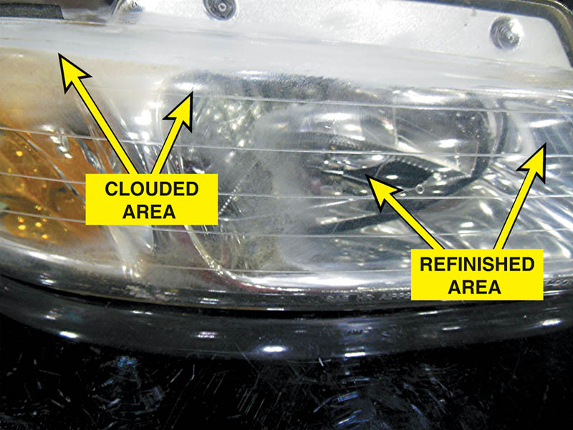
Figure 56.17 The right side of this headlight assembly has been restored, but still needs to be polished. The left side is cloudy and not yet restored

Slide 35
QUESTION 2: ?
Why is it important to avoid touching a halogen bulb with your fingers?

Slide 36
ANSWER 2:
To prevent the bulb from failing prematurely.

Slide 37
HIGH-INTENSITY DISCHARGE HEADLIGHTS (1 OF 2)
Parts and Operation
  High-intensity discharge (HID) headlights produce light that is crisper, clearer, and brighter than light produced by a halogen headlight.
Stages of HID Headlamp Operation
  1. Start-up or stroke state
  2. Run-up state
  3. Steady state

Slide 38
HIGH-INTENSITY DISCHARGE HEADLIGHTS (2 OF 2)
Bi-Xenon Headlights
  Uses a shutter to block some of the light during low-beam operation, and then mechanically move to expose more of the light from the bulb for high-beam operation.
HID Headlight Failure Symptoms
  A light flickers
  Lights go out (caused when the ballast assembly detects repeated bulb restrikes)
  Color changes to a dim pink glow

Slide 39
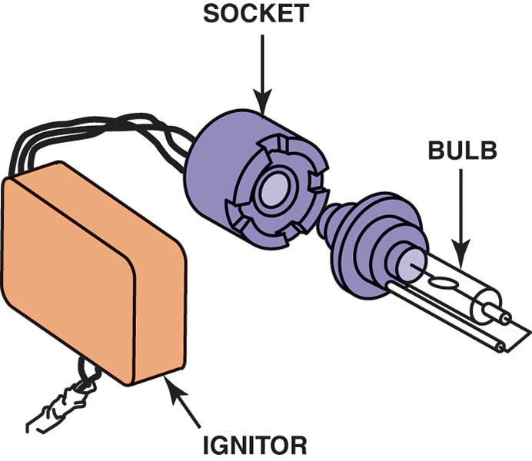
Figure 56.18 The igniter contains the ballast and transformer needed to provide high-voltage pulses to the arc-tube bulb

Slide 40
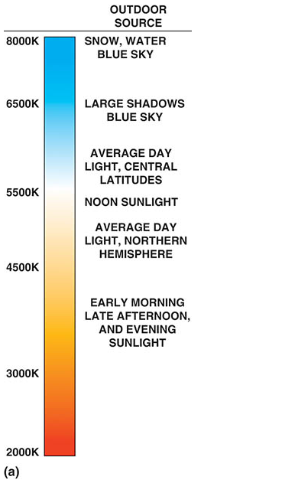
Figure 56.19 (a) The color of light is measured in degrees Kevin (K). The higher the temperature of the light is, the bluer the appearance.

Slide 41
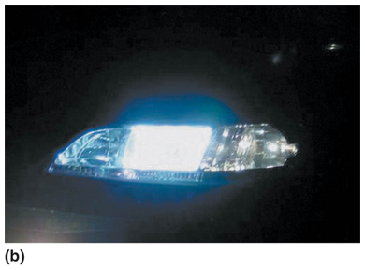
Figure 56.19 (b) HID (xenon) headlights emit a whiter light than halogen headlights and usually look blue compared to halogen bulbs

Slide 42
LED HEADLIGHTS
The advantages of LED headlights compared to other types include:
  Long service life
  Reduced electrical power required
The disadvantages of LED headlights include:
  Higher cost
  Many small LEDs are required to create the necessary light output

Slide 43
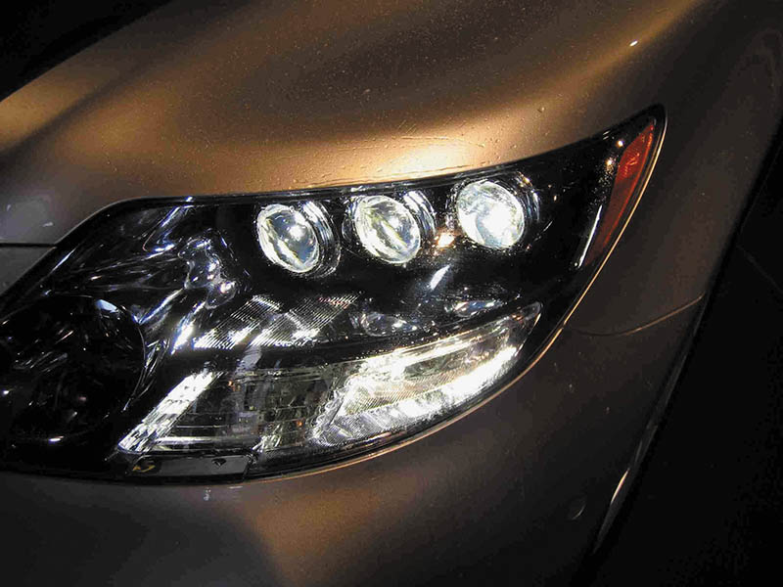
Figure 56.20 LED headlights usually require multiple units to provide the needed light, as seen on this Lexus LS600h

Slide 44
QUESTION 3: ?
What are the advantages of LED lights?

Slide 45
ANSWER 3:
Long service life and reduced power consumption.

Slide 46
ADAPTIVE FRONT LIGHTING SYSTEM (1 Of 2)
Purpose and Function
  An adaptive (or advanced) front lighting system, or AFS, is a system that mechanically moves the headlights to follow the direction of the front wheels.
Parts and Operation
  The vehicle has to be moving above a predetermined speed. Self leveling motors are used to keep the lights properly aligned.

Slide 47
ADAPTIVE FRONT LIGHTING SYSTEM (2 OF 2)
Diagnosis and Service
  Start by checking that the AFS is switched on.
  Check that the system performs a self-test during start-up.
  Verify that both low-beam and high-beam lights function correctly.
  Use a scan tool to test for any AFS-related diagnostic trouble codes.

Slide 48
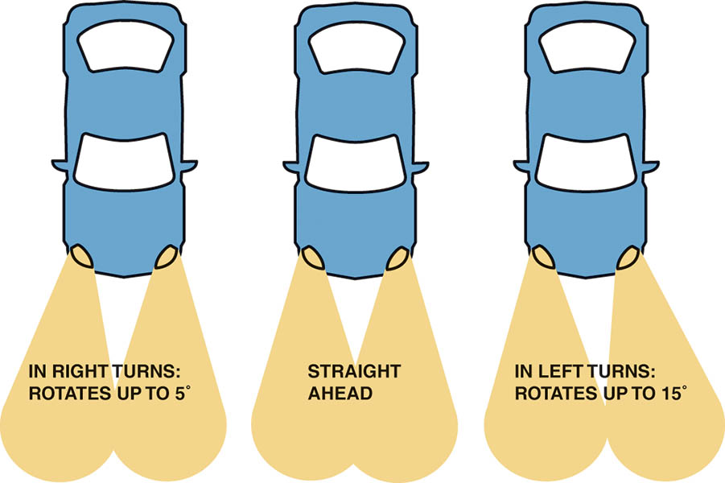
Figure 56.21 Adaptive front lighting systems rotate the low beam headlight in the direction of travel

Slide 49
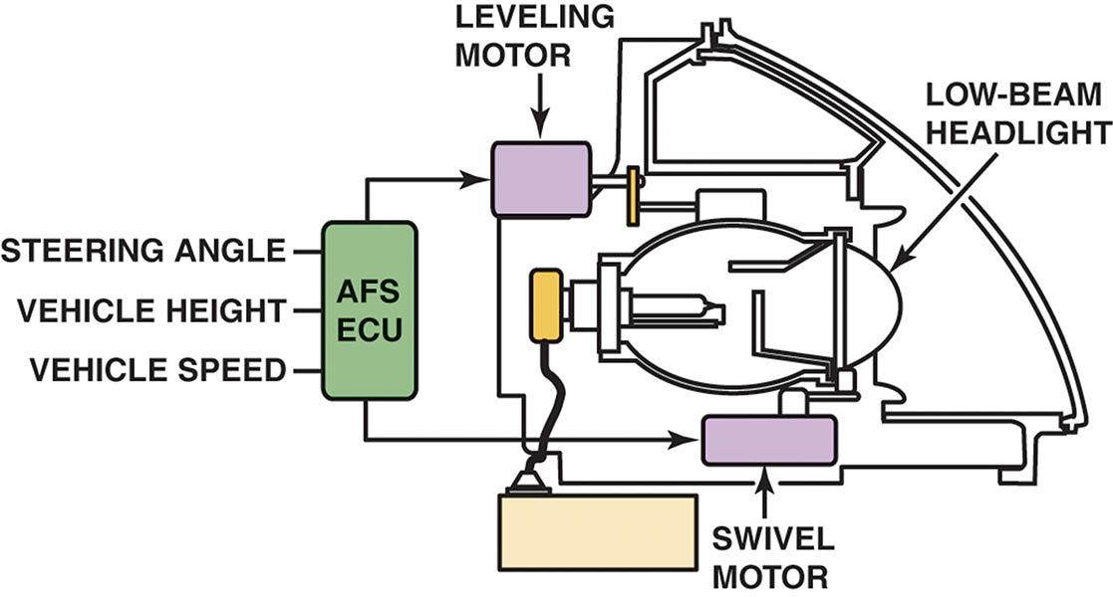
Figure 56.22 A typical adaptive front lighting system uses two motors: one for the up and down movement and the other for rotating the low-beam headlight to the left and right

Slide 50
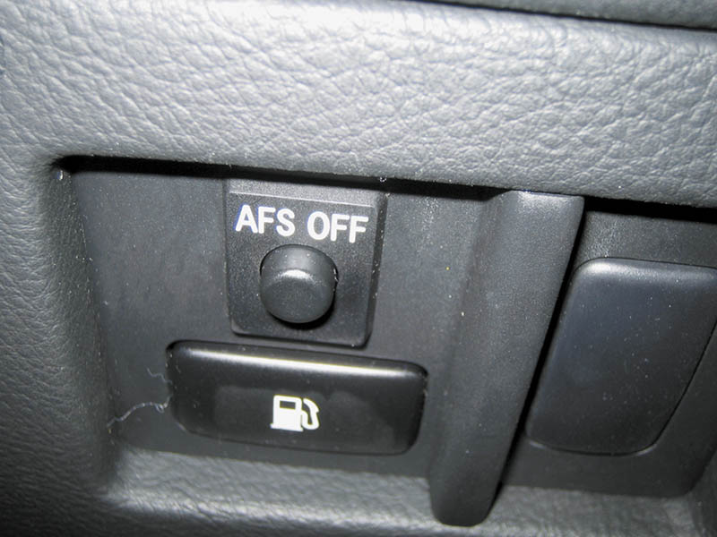
Figure 56.23 Typical dash-mounted switch that allows the driver to turn off the front lighting system

Slide 51
AUTOMATIC HEADLIGHTS
Purpose and Function
  Turn on the headlights when the light sensor detects low ambient light level.
Controls
  Most vehicles allow the driver to select the headlights in the “AUTO” position or turn them on and off manually

Slide 52

Figure 56.24 A dash symbol used to inform the driver that the automatic headlights are on

Slide 53
HEADLIGHT HIGH/LOW BEAM SWITCH
Dimmer Switch
  The switch used to switch between the two circuits is often called the dimmer switch or the high/low switch.
  The dimmer switch is usually hand-operated by a lever on the steering column.

Slide 54
AUTO DIMMING HEADLIGHTS
Purpose and Function
  A system that causes the headlights to switch from high-intensity beams to low-intensity beams when the system detects the headlights from an approaching vehicle.
Types of Systems
  Photo resistor-based system
  Camera-based systems

Slide 55
HEADLIGHT AIMING
According to U.S. federal law, all headlights, regardless of shape, must be able to be aimed using headlight-aiming equipment
The headlights are equipped with adjusting screws that can be used to aim the headlights.

Slide 56
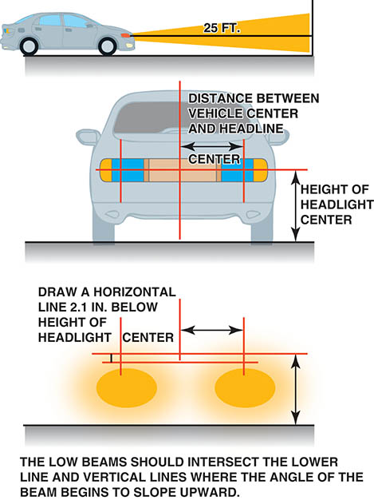
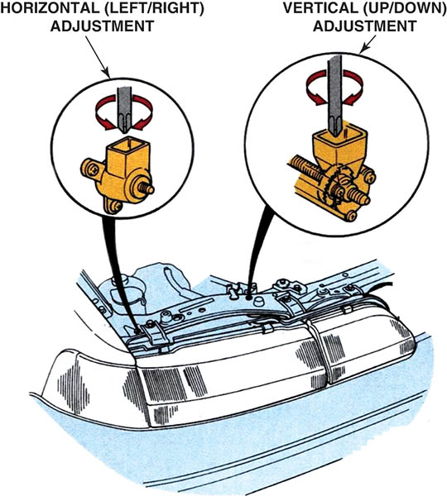
Figure 56.25 (a) A typical headlight-aiming diagram as found in service information. (b) Adjustments to move the headlight-aiming point left or right or up and down are usually made using a screwdriver to move the headlight housing

Slide 57
FOG LIGHTS AND DRIVING LIGHTS
Fog Lights
  Fog lights have a unique beam that is flat and wide, and is positioned low on the vehicle, usually near the front bumper.
Driving Lights
  Driving lights are designed to send powerful beams far ahead, illuminating the next stretch of road

Slide 58
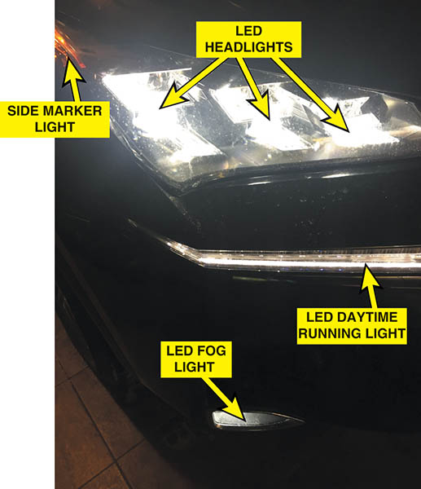
FIGURE 56–26 Fog lights are often included on many vehicles, such as these on a Lexus SUV.

Slide 59
AUTOMATIC DIMMING MIRRORS
Parts and Operation
  Automatic dimming mirrors use electrochromic technology to dim the mirror in proportion to the amount of headlight glare from other vehicles at the rear.
Diagnosis and Service
  Check for power and ground
  Confirm the operation of the forward facing sensor
  In most cases the mirror is replaced as an assembly

Slide 60
COURTESTY LIGHTS
Courtesy lights are a generic term primarily used for interior lights, including overhead (dome) and under-the-dash (courtesy) lights.
Many newer vehicles operate the interior lights through the BCM or through an electronic module.

Slide 61
ILLUMINATED ENTRY
The interior lights are turned on for a given amount of time when the outside door handle or remote keyless entry (RKE) fob is operated while the doors are locked.

Slide 62
LIGHTING SYSTEM DIAGNOSIS
STEP 1 Verify the customer concern.
STEP 2 Perform a visual inspection.
STEP 3 Connect a factory or enhanced scan tool with bidirectional control of the control modules to check for proper operation of the affected lighting circuit.
STEP 4 Follow the diagnostic procedure, as found in service information, to determine the root cause of the problem.

Slide 63
TAILLIGHT BULB REPLACEMENT

Slide 64
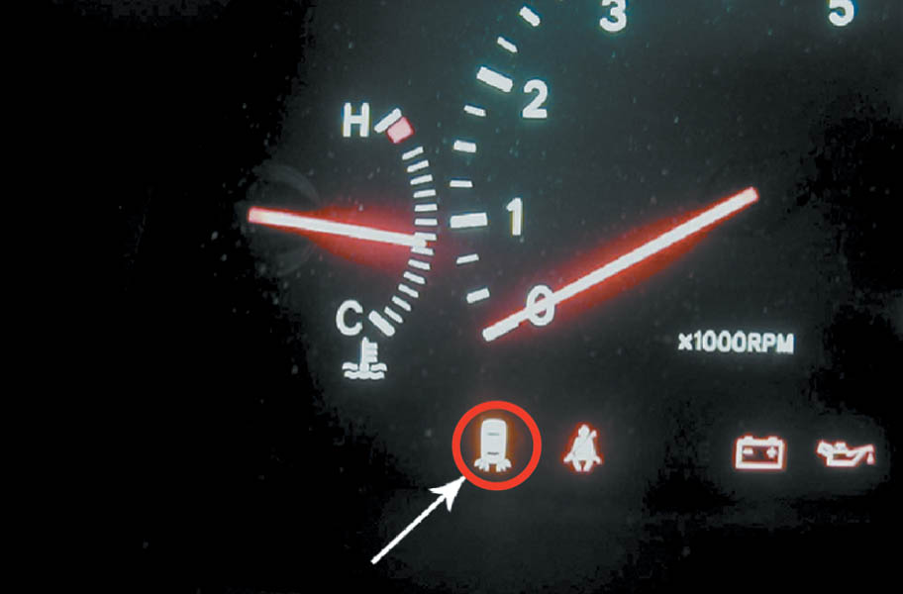
1. The driver noticed that the taillight fault indicator (icon) on the dash was on any time the lights were on.

Slide 65
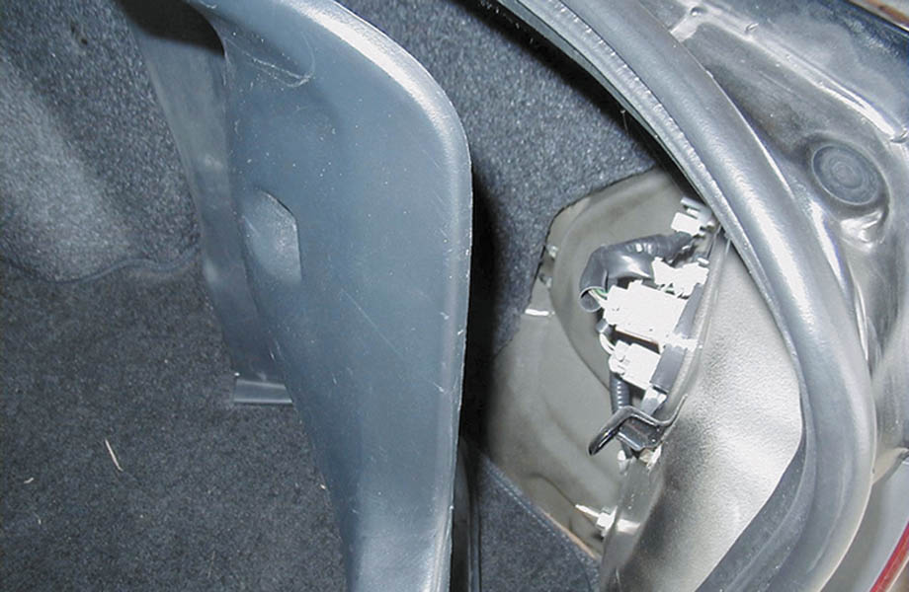
2. A visual inspection at the rear of the vehicle indicated that the right rear taillight bulb did not light. Removing a few screws from the plastic cover revealed the taillight assembly.

Slide 66
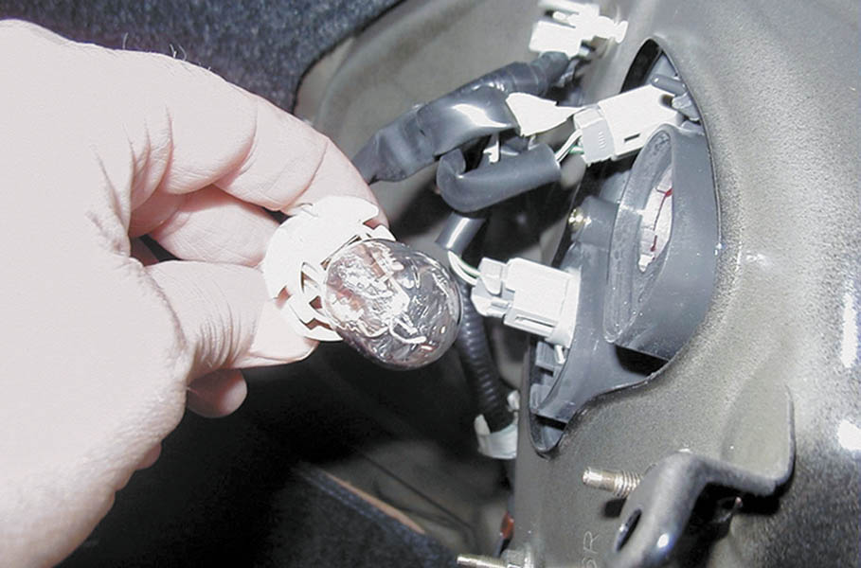
3. The bulb socket is removed from the taillight assembly by gently twisting the base of the bulb counterclockwise.

Slide 67
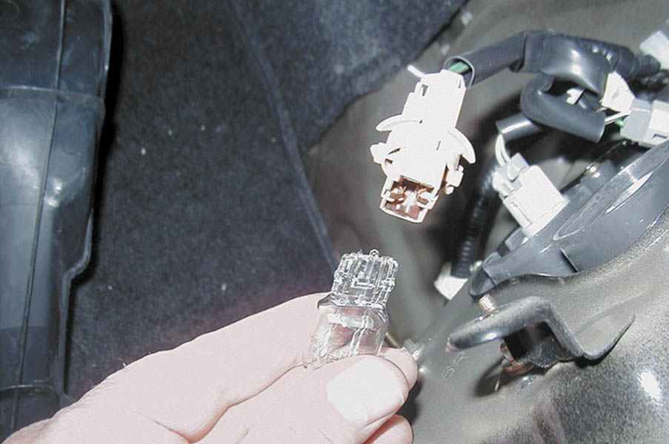
4. The bulb is removed from the socket by gently grasping the bulb and pulling the bulb straight out of the socket. Many bulbs required that you rotate the bulb 90° (1/4 turn) to release the retaining bulbs.

Slide 68
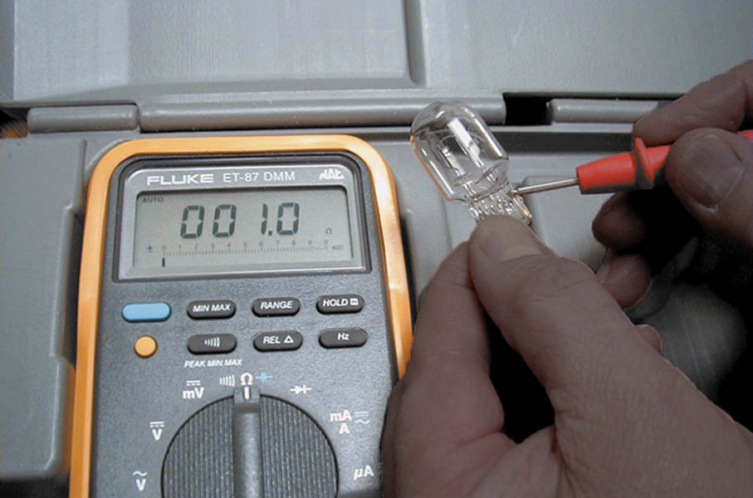
5. The new 7443 replacement bulb is being checked with an ohmmeter to be sure that it is okay before it is installed in the vehicle.

Slide 69
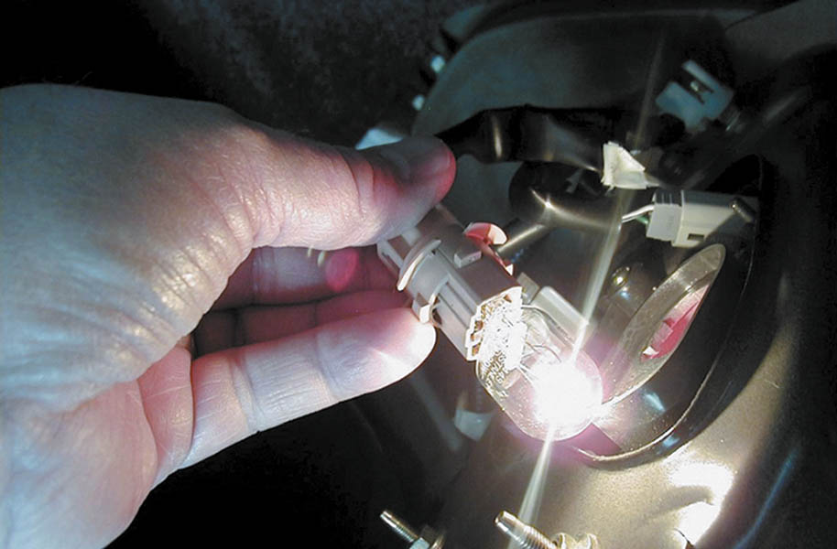
6. The replacement bulb in inserted into the taillight socket and the lights are turned on to verify proper operation before putting the components back together.

Slide 70

Copyright

