Slide 1

Automotive Technology Principles, Diagnosis, and Service
Sixth Edition
Chapter 55
Charging System Diagnosis and Service
Copyright © 2018, 2015, 2011 Pearson Education, Inc. All Rights Reserved

Slide 2
LEARNING OBJECTIVES (1 of 2)
55.1 Discuss the various methods to test the charging system.
55.2 Describe how to inspect and adjust the drive belts.
55.3 Discuss the alternator output test and minimum required output.

Slide 3
LEARNING OBJECTIVES (2 of 2)
55.4 Explain how to remove, disassemble, reassemble, and install an alternator and test its component parts.
55.5 Describe remanufactured alternators.
55.6 This chapter will help prepare for the ASE Electrical/Electronic Systems (A6) certification test content area “D” (Charging System Diagnosis and Repair).

Slide 4
CHARGING SYSTEM TESTING AND SERVICE (1 OF 2)
Battery State Of Charge
  The battery must be at least 75% charged before testing the alternator and the charging system.
Charging Voltage Test
  Set digital multimeter to DC Volts
  Connect the meter leads to the battery
  Operate the engine at 2000 RPM
  Specifications: 13.5-15.0 Volts

Slide 5
CHARGING SYSTEM TESTING AND SERVICE (2 OF 2)
Scan Testing the Charging System
  Many vehicles use a computer-controlled charging system can be diagnosed using a scan tool.
  The charging voltage can be monitored
  The field circuit can be controlled

Slide 6
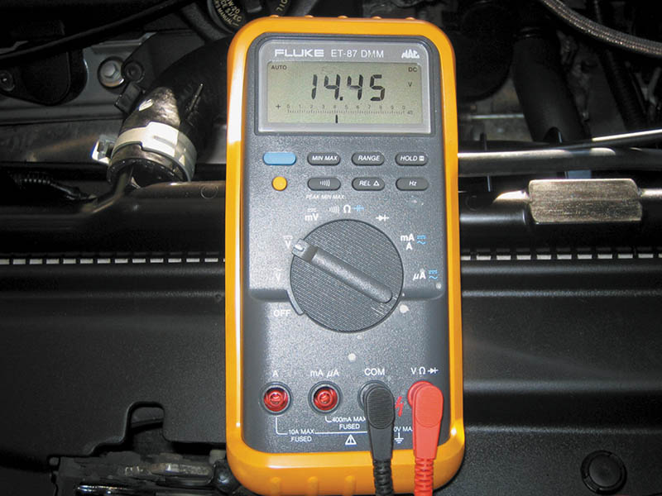
Figure 55.1 The digital multimeter should be set to read DC volts, with the red lead connected to the positive (+) battery terminal and the black meter lead connected to the negative (-) battery terminal

Slide 7
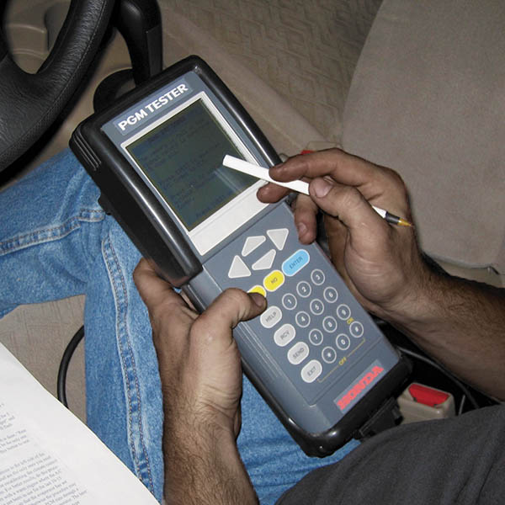
Figure 55.2 A scan tool can be used to diagnose charging system problems

Slide 8
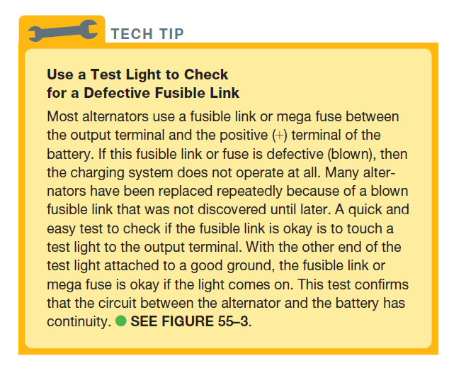
Tech Tip

Slide 9
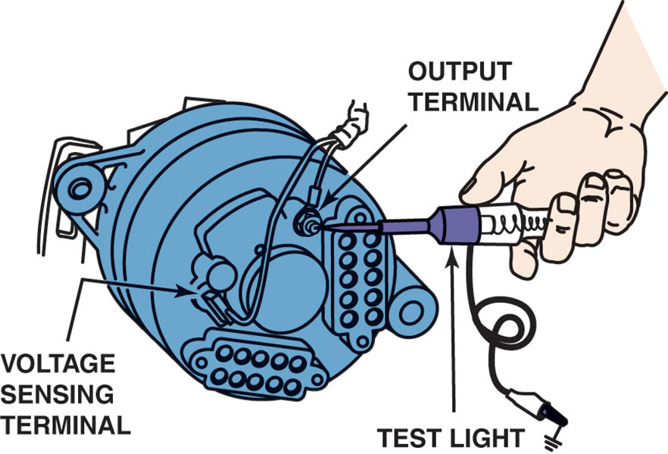
Figure 55.3 Before replacing an alternator, the wise technician checks that battery voltage is present at the output and battery voltage sense terminals.

Slide 10
DRIVE BELT INSPECTION AND ADJUSTMENT
Belt Visual Inspection
  Replace any serpentine belt that has more than three cracks in any one rib that appears in a 3-inch span.
Belt Tension Measurement
  Belt tension gauge
  Marks on a tensioner
  Torque wrench readings
  Deflection
Overrunning Clutch
  Check for proper operation

Slide 11
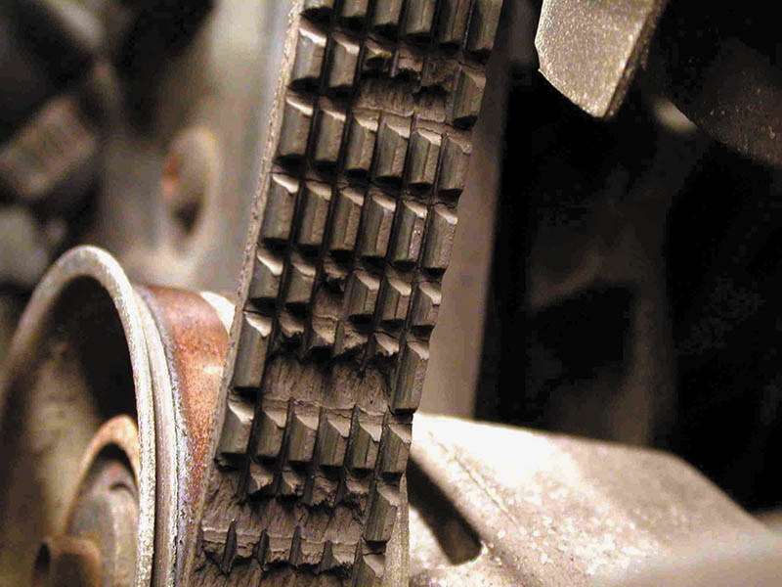
Figure 55.4 (a) This accessory drive belt is worn and requires replacement. Newer belts are made from ethylene propylene diene monomer (EPDM). This rubber does not crack like older belts and may not show wear, even though the ribs do wear and can cause slippage

Slide 12
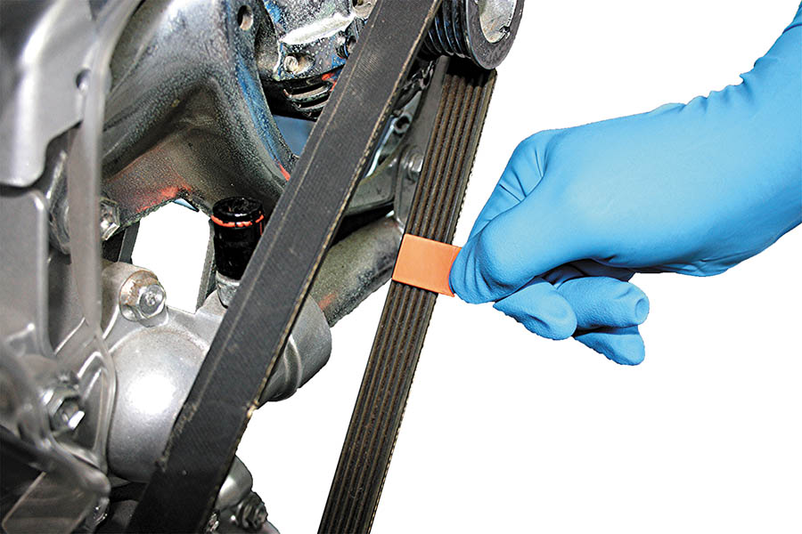
Figure 55.4 (b) A belt wear gauge being used to check a belt. It should fit tightly but if it is able to be moved side to side, then the belt is worn and should be replaced

Slide 13
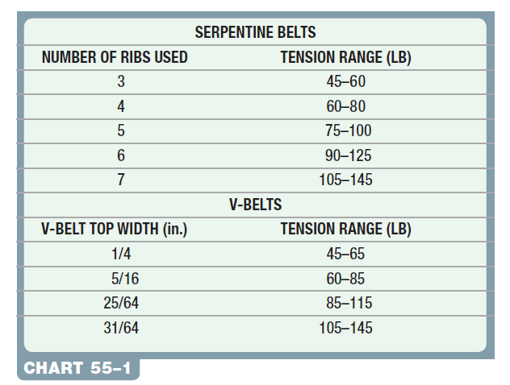
Chart 55-1 Typical belt tension for various widths of belts. Tension is the force needed to depress the belt as displayed on a belt tension gauge.

Slide 14
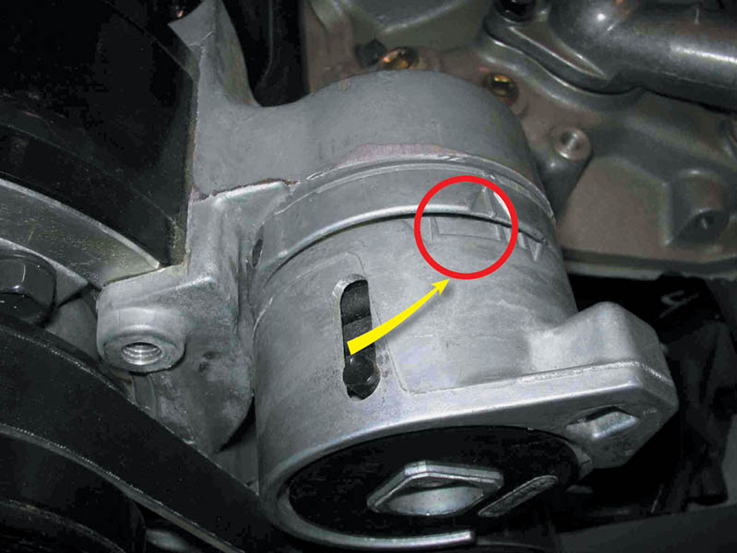
Figure 55.5 Check service information for the exact marks where the tensioner should be located for proper belt tension

Slide 15
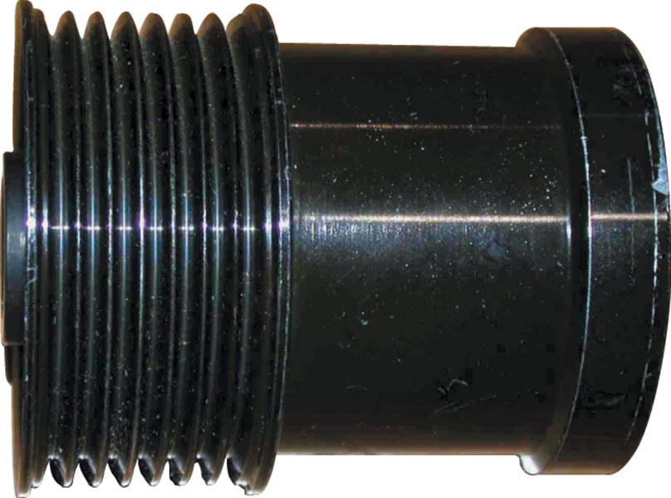
Figure 55.6 This overrunning alternator dampener (OAD) is longer than an overrunning alternator pulley (OAP) because it contains a dampener spring, as well as a one-way clutch. Be sure to check that it locks in one direction

Slide 16
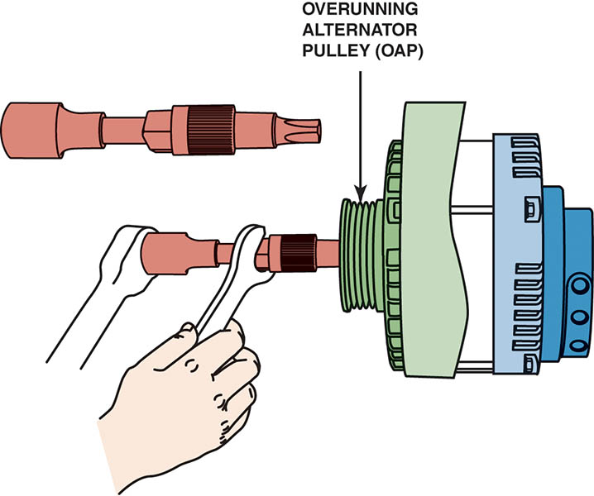
Figure 55.7 A special tool is needed to remove and install overrunning alternator pulleys or dampeners

Slide 17
QUESTION 1: ?
What are the four ways to measure belt tension?

Slide 18
ANSWER 1:
  Belt tension gauge, marks on a tensioner, torque wrench readings, deflection.

Slide 19
AC RIPPLE VOLTAGE CHECK
Principles
  A good alternator should produce very little AC voltage or current output.
Testing AC Ripple Voltage
  Set the digital meter to read AC volts.
  Start the engine and operate it at 2,000 RPM
  Connect the voltmeter leads to the battery terminals.
  Turn on the headlights
  The voltmeter should read less than 400 millivolts (0.4 volt) AC.

Slide 20
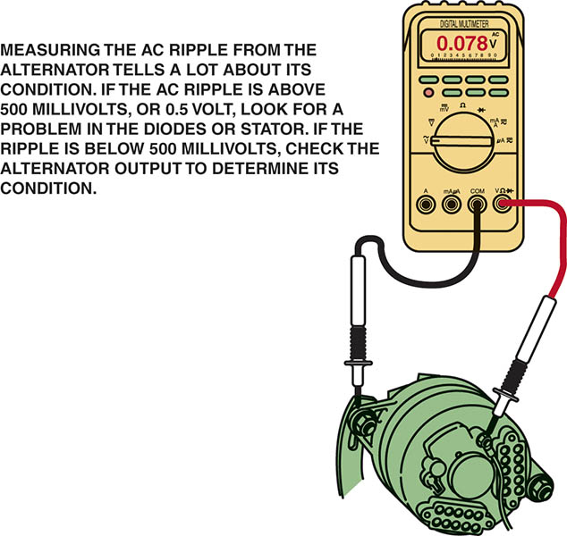
Figure 55.8 Testing AC ripple at the output terminal of the alternator is more accurate than testing at the battery due to the resistance of the wiring between the alternator and the battery.

Slide 21
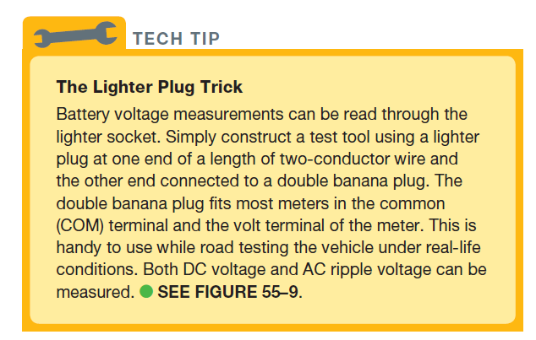
TECH TIP

Slide 22
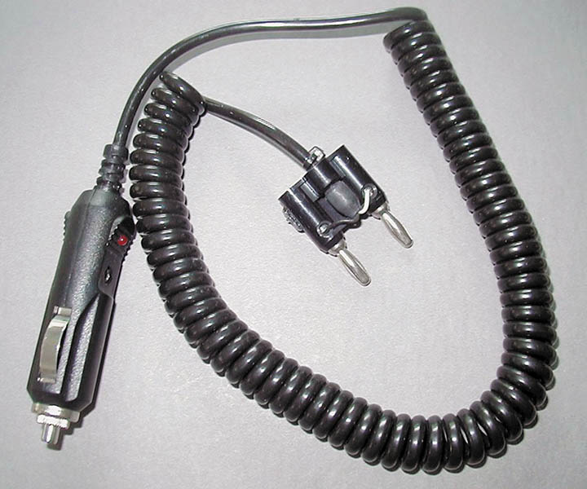
Figure 55.9 Charging system voltage can be easily checked at the lighter plug by connecting a lighter plug to the voltmeter through a double banana plug

Slide 23
TESTING AC RIPPLE CURRENT
A mini clamp-on meter capable of measuring AC amperes can be used to check the alternator.
  Start the engine and turn on the lights
  Using a mini clamp-on digital multimeter, place the clamp around either cables
  Switch the meter to read AC amperes and record the reading
  The results should be within 10% of the specified alternator rating

Slide 24
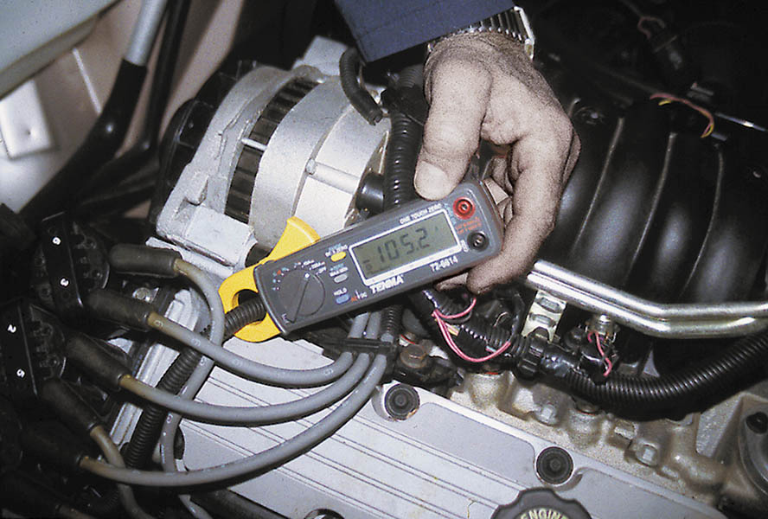
Figure 55.10 A mini clamp-on meter can be used to measure alternator output, as shown here (105.2 amperes). Then the meter can be used to check AC ripple by selecting AC amps on the rotary dial. AC ripple should be less than 10% of the DC output

Slide 25
QUESTION 2: ?
What is the purpose of the AC ripple test?

Slide 26
ANSWER 2:
To ensure the alternator is properly converting the AC to DC.

Slide 27
CHARGING SYSTEM VOLTAGE DROP TESTING
Voltage Drop Test Procedure
  Start the engine and run it at 2000 RPM
  Turn on the headlights to create an electrical load
  Using any voltmeter set to read DC volts
  Connect the positive test lead (red) to the output terminal of the alternator.
  Attach the negative test lead (black) to the positive post of the battery.
  If there is less than a 0.4 volt (400 millivolts) reading, then all wiring and connections are satisfactory

Slide 28
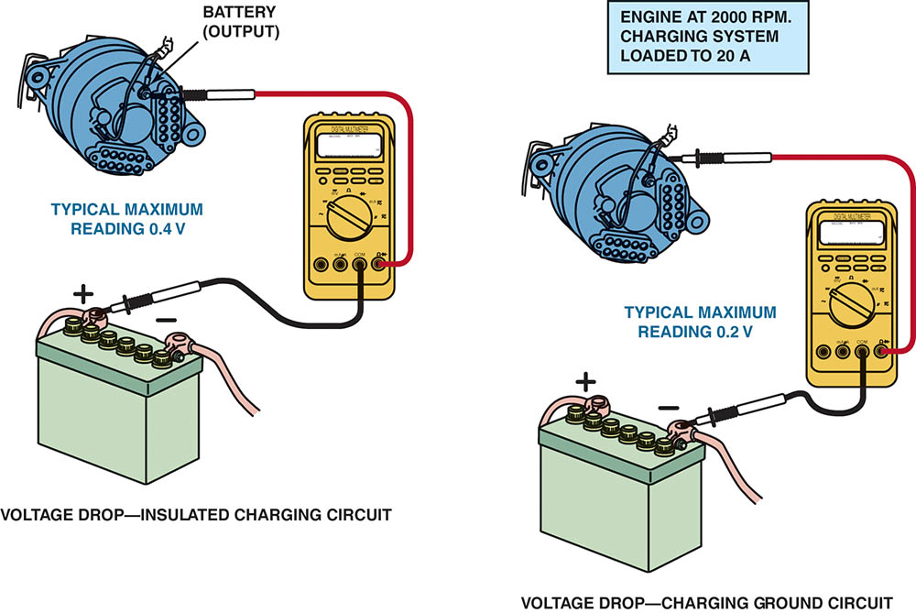
Figure 55.11 Voltmeter hookup to test the voltage drop of the charging circuit

Slide 29
ALTERNATOR OUTPUT TEST
Carbon Pile Test Procedure
  Connect the starting and charging test leads according to the manufacturer’s instructions
  Turn off all electrical accessories
  Start the engine and operate it at 2,000 RPM
  Turn the load increase control slowly to obtain the highest reading on the ammeter scale
  Do not allow the voltage to drop below 12.6 volts.
  Compare the output reading to factory specifications

Slide 30
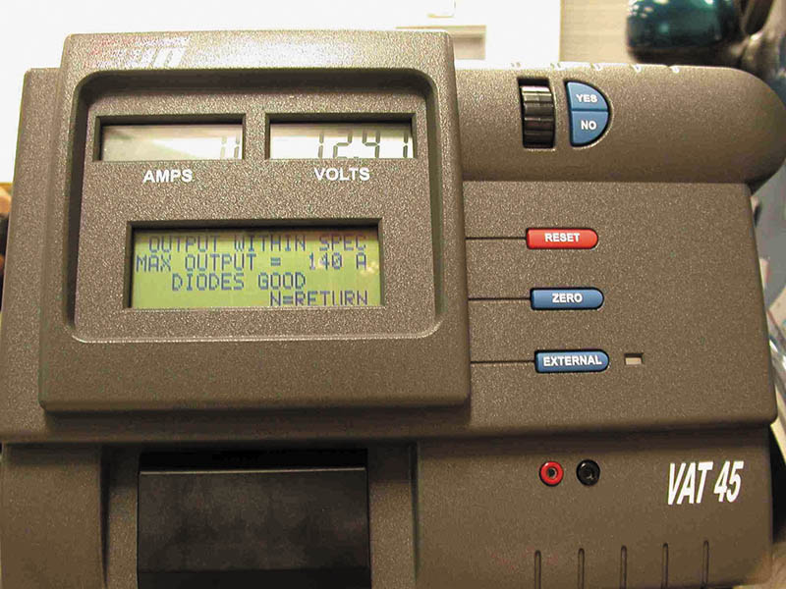
Figure 55.12 A typical tester used to test batteries as well as the cranking and charging system. Always follow the operating instructions

Slide 31
MINIMUM REQUIRED ALTERNATOR OUTPUT
Connect the ammeter according to the instructions
  Start the engine and operate to about 2,000 RPM
  Turn on any accessories that may be used continuously (lights, wipers, rear defogger, etc.)
Observe the ammeter. The current indicated is the electrical load that the alternator is able to exceed to keep the battery fully charged.

Slide 32
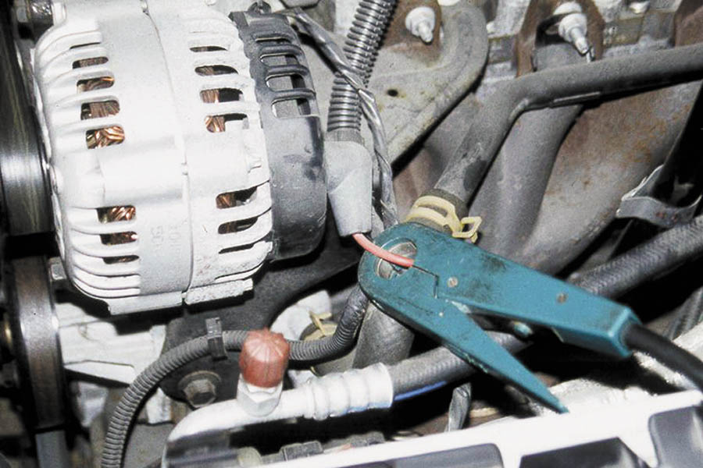
Figure 55.13 The best place to install a charging system tester amp probe is around the alternator output terminal wire, as shown in the figure

Slide 33
QUESTION 3: ?
What is the purpose of the alternator output test?

Slide 34
ANSWER 3:
To determine the maximum output capability of the alternator.

Slide 35
ALTERNATOR REMOVAL
A typical removal procedure includes the following steps.
  Disconnect the negative (-) terminal from the battery
  Remove the accessory drive belt
  Remove electrical wiring, fasteners, spacers, and brackets
  Remove the alternator

Slide 36
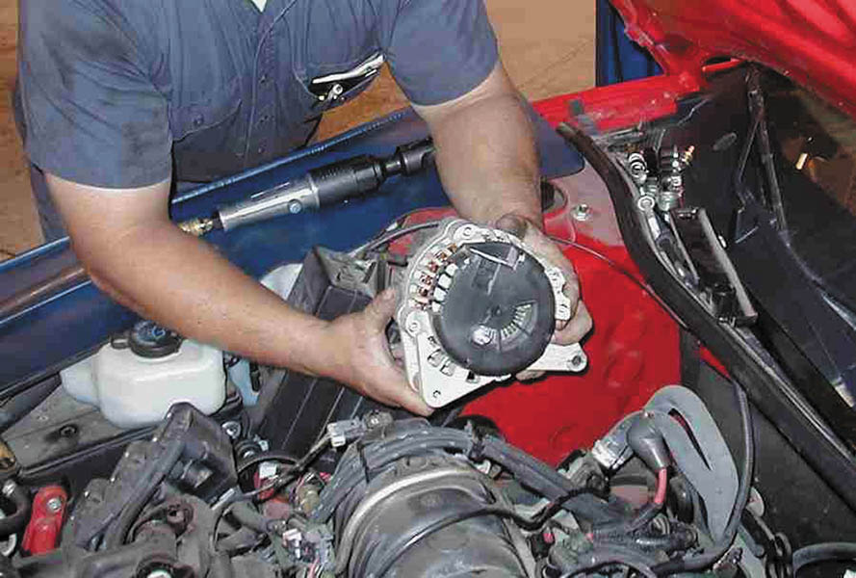
Figure 55.14 Replacing an alternator is not always as easy as it is from a Buick with a 3800 V-6, where the alternator is easy to access. Many alternators are difficult to access and require the removal of other components

Slide 37
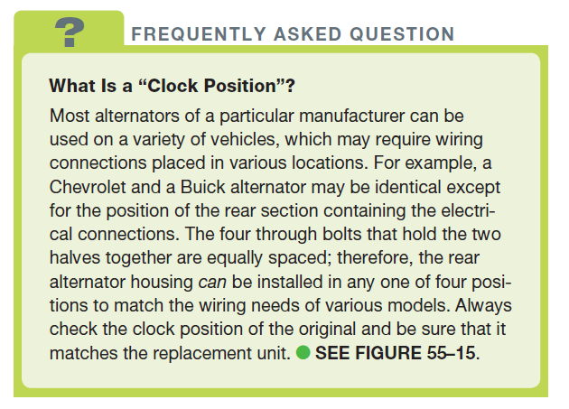
FREQUENTLY ASKED QUESTION

Slide 38
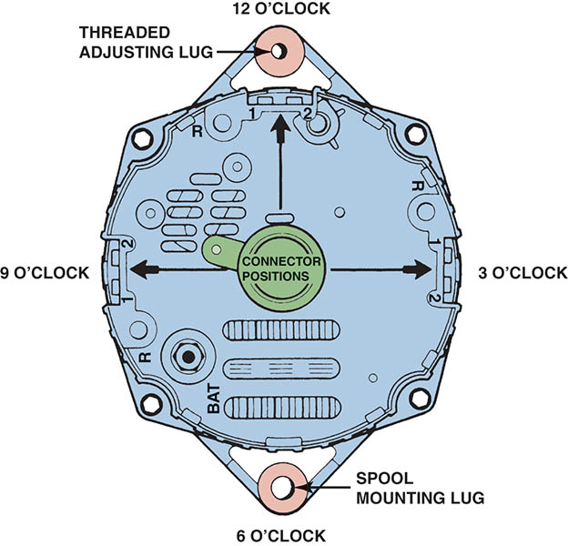
Figure 55.15 Explanation of clock positions. Because the four through bolts are equally spaced, it is possible for an alternator to be installed in one of four different clock positions.

Slide 39
ALTERNATOR DISASSEMBLY (1 OF 2)
Disassembly Procedure
  Mark the case to ensure proper reassembly
  Remove the through bolts and separate the two halves
  Remove the rectifier and voltage regulator
Rotor Testing
  Measure the resistance between the slip rings using an ohmmeter
  If a rotor is found to be bad it must be replaced

Slide 40
ALTERNATOR DISASSEMBLY (2 OF 2)
Stator Testing
  The stator must be disconnected before testing
  There should be low resistance at all three stator leads
  If the stator is shorted-to-ground and must be repaired or replaced.
Testing the Diode Trio
  The multimeter should indicate 0.5 to 0.7 volt (500 to 700 millivolts) one way and OL (overlimit) after reversing the test leads and touching all three connectors of the diode trio.

Slide 41
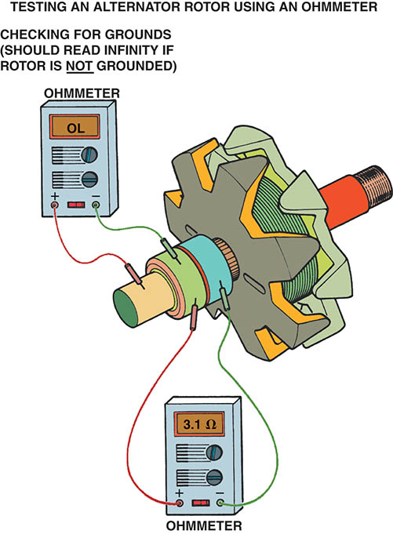
Figure 55.16 Testing an alternator rotor using an ohmmeter

Slide 42
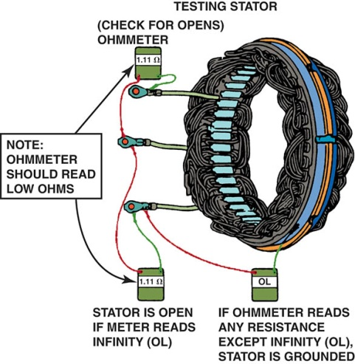
Figure 55.17 If the ohmmeter reads infinity between any two of the three stator windings, the stator is open and, therefore, defective.

Slide 43
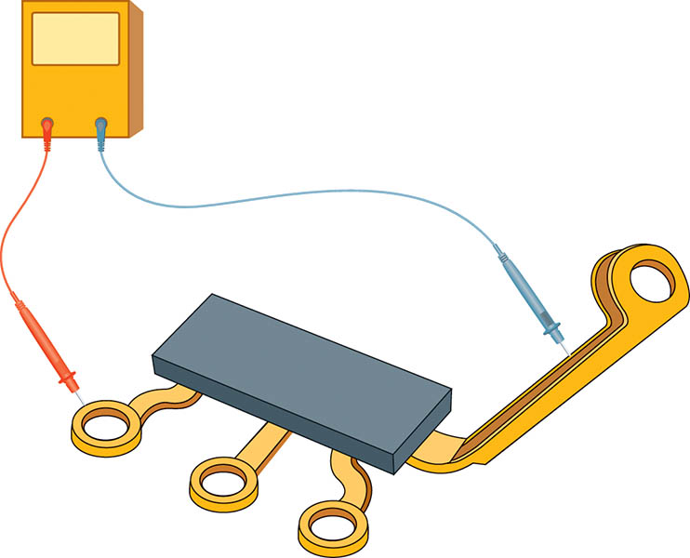
Figure 55.18 A diode trio can be tested using an analog (needle-type) ohmmeter or a digital meter set to “diode check”

Slide 44
TESTING THE RECIFIER
The rectifier(s) (diodes) should be tested using a multimeter (DMM) that is set to “diode check” position.
A good diode should have high resistance (OL) one way (reverse bias) and low voltage drop of 0.5 to 0.7 volt (500 to 700 millivolts) the other way (forward bias).

Slide 45
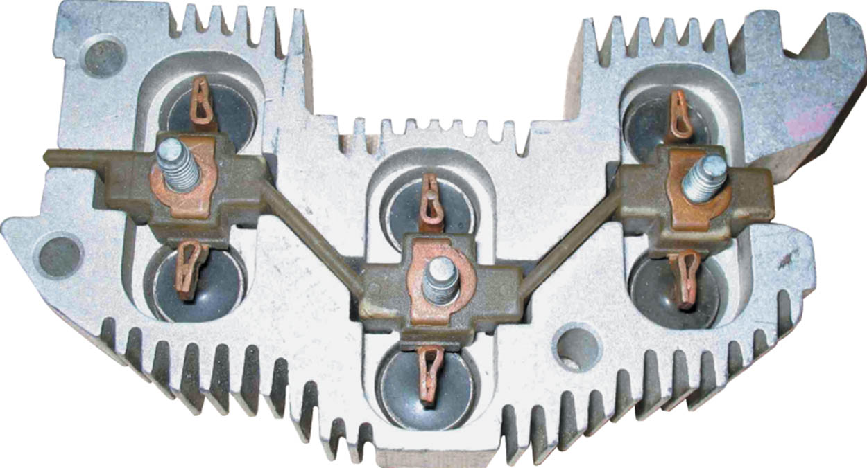
Figure 55.19 A typical rectifier bridge that contains all six diodes in one replaceable assembly

Slide 46
REASSEMBLING THE ALTERNATOR
After testing or servicing, the alternator rectifier(s), regulator, stator, and brush holder must be reassembled using the following steps.
  Insert a wire through the holes in the brush holder to hold the brushes against the springs.
  Install the rotor and front-end frame in proper alignment with the mark made on the outside of the alternator housing.
  Alternators should be tested on a bench tester

Slide 47
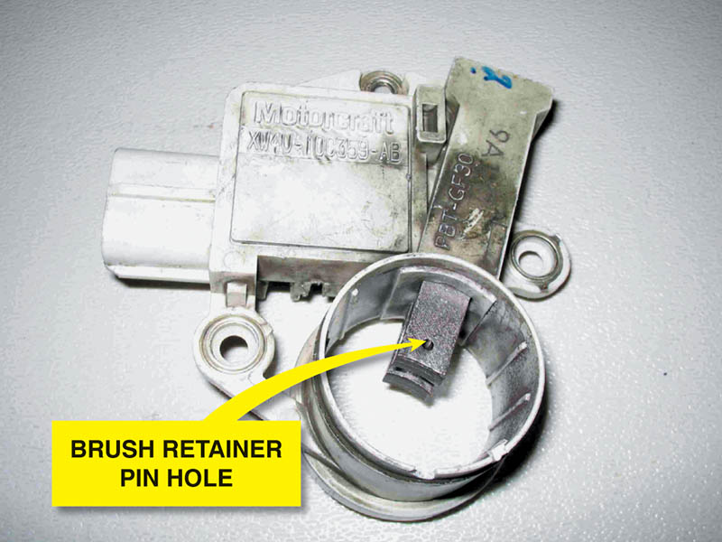
Figure 55.20 A brush holder assembly with new brushes installed. The holes in the brushes are used to hold the brushes up in the holder when it is installed in the alternator.

Slide 48
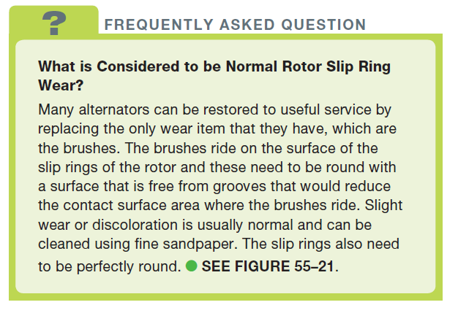
FREQUENTLY ASKED QUESTION

Slide 49
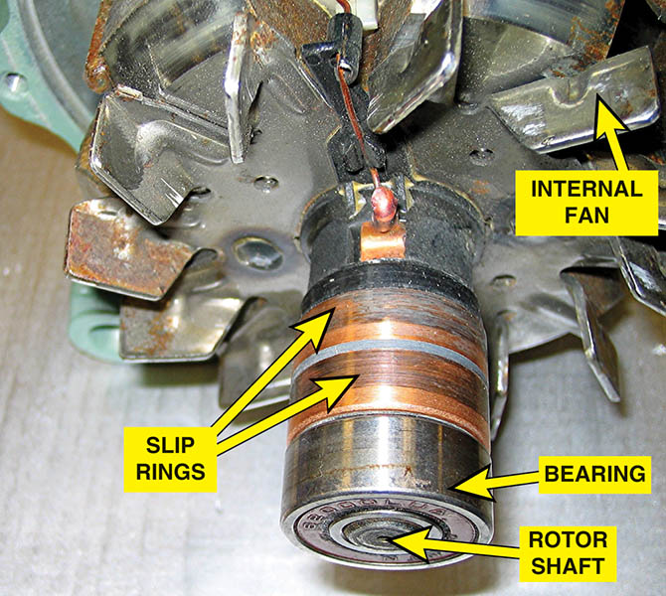
Figure 55.21 An example of a rotor assembly that, if tested to be within specification, is suitable to be reinstalled after the slip rings have been cleaned

Slide 50
REMANUFACTURERED ALTERNATORS
Remanufactured or rebuilt alternators are totally disassembled and rebuilt.
Used alternators are returned and used as cores.
Every alternator is tested prior to shipping

Slide 51
ALTERNATOR INSTALLATION
Verify that the replacement alternator is correct
Install the alternator wiring on the alternator and install the alternator
Install and properly tension the drive belt
Reconnect the negative battery cable
Start the engine and verify proper charging circuit operation

Slide 52
ALTERNATOR OVERHAUL

Slide 53
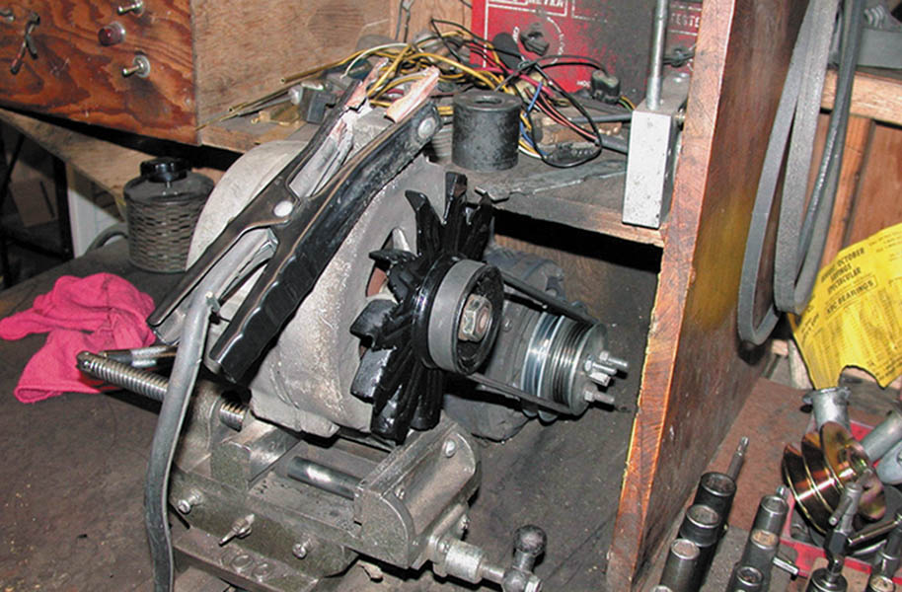
1. Before the alternator is disassembled, it is spin tested and connected to a scope to check for possible defective components.

Slide 54
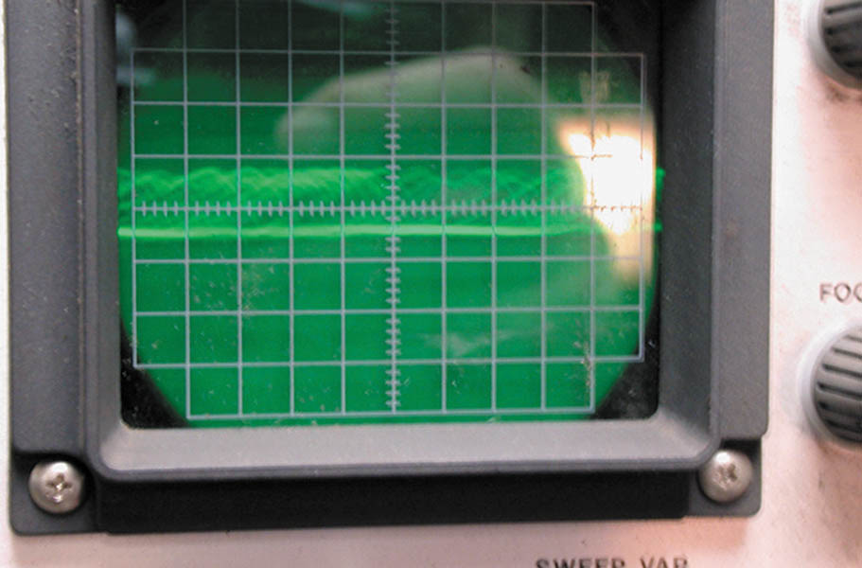
2. The scope pattern shows that the voltage output is far from being a normal pattern. This pattern indicates serious faults in the rectifier diodes.

Slide 55
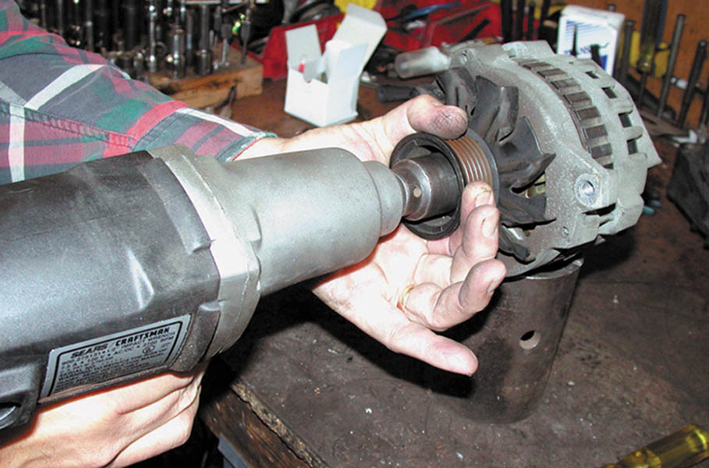
3. The first step is to remove the drive pulley. This rebuilder is using an electric impact wrench to accomplish the task.

Slide 56
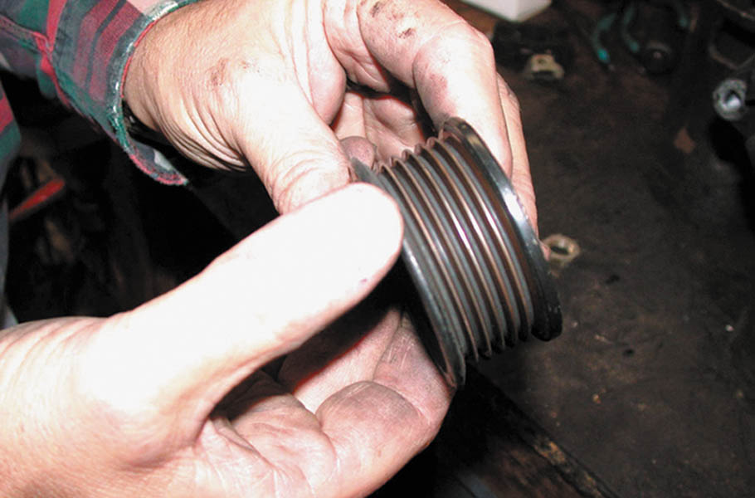
4. Carefully inspect the drive galley for damage of embedded rubber from the drive belt. The slightest fault can cause a vibration, noise, or possible damage to the alternator.

Slide 57
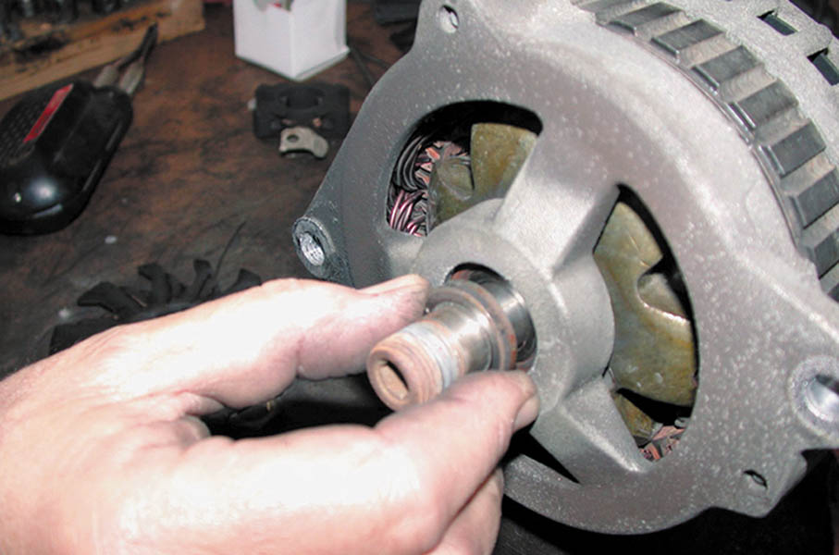
5. Remove the external fan (if equipped) and then the spacers, as shown.

Slide 58
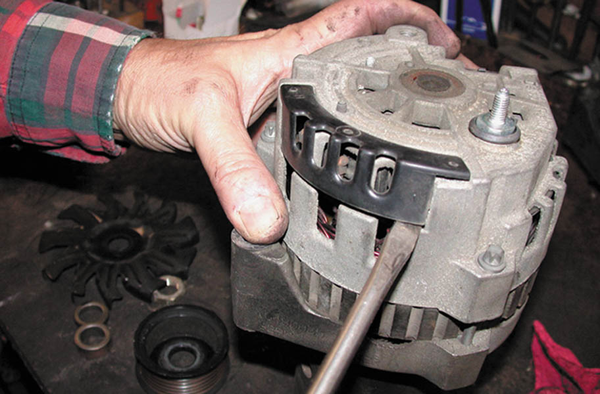
6. Next pop off the plastic cover (shield) covering the stator/rectifier connection.

Slide 59
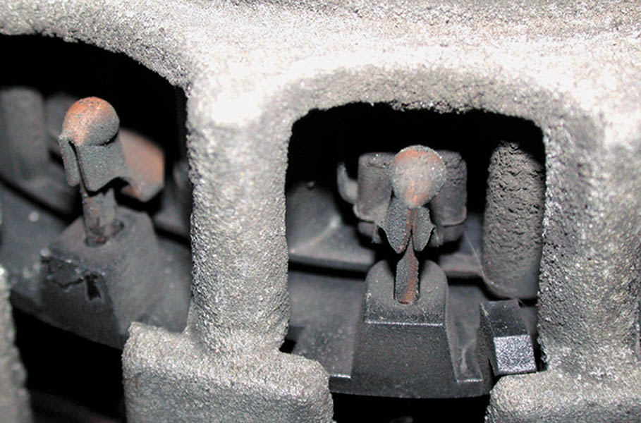
7. After the cover has been removed, the stator connections to the rectifier can be seen.

Slide 60
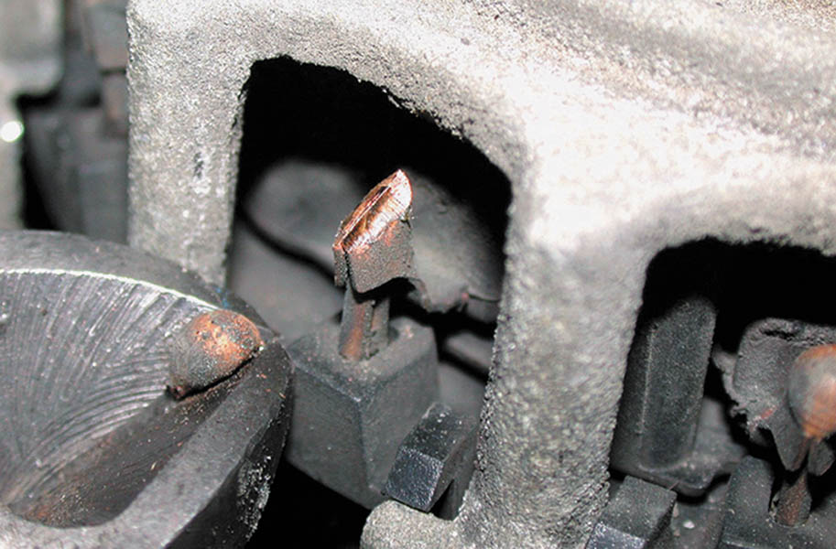
8. Using a diagonal cutter, cut the weld to separate the stator from the rectifier.

Slide 61
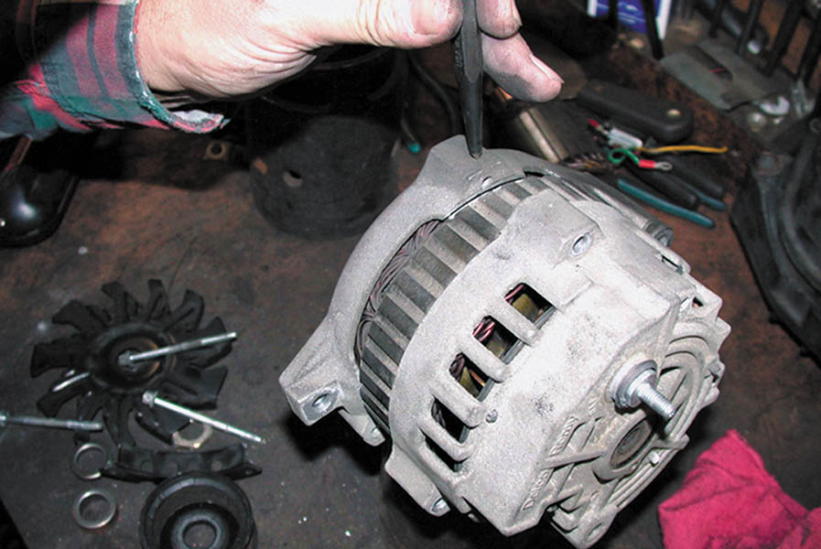
9. Before separating the halves of the case, this technician uses a punch to mark both halves.

Slide 62
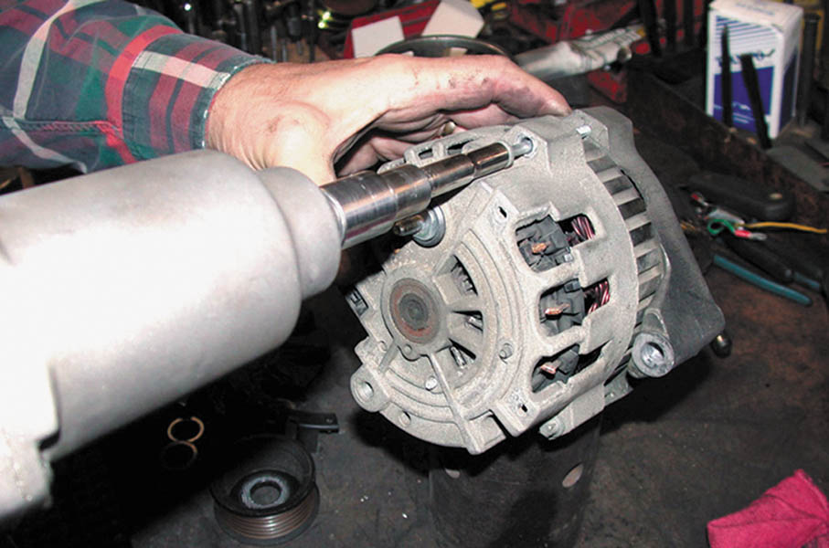
10. After the case has been marked, the through bolts are removed.

Slide 63
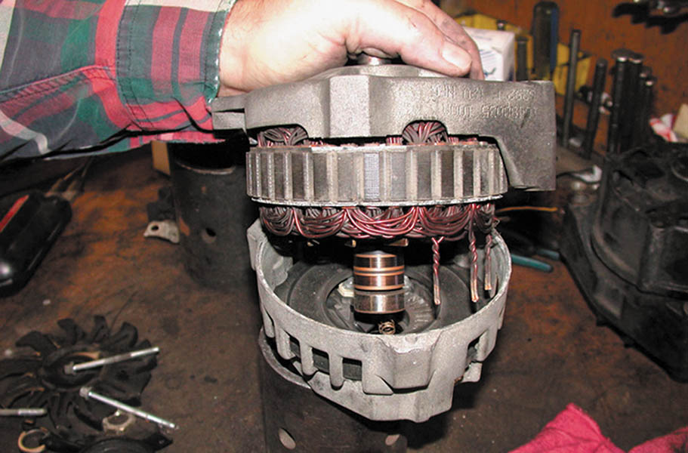
11. The drive-end (DE) housing and the stator are being separated from the rear (slip-ring-end) housing.

Slide 64
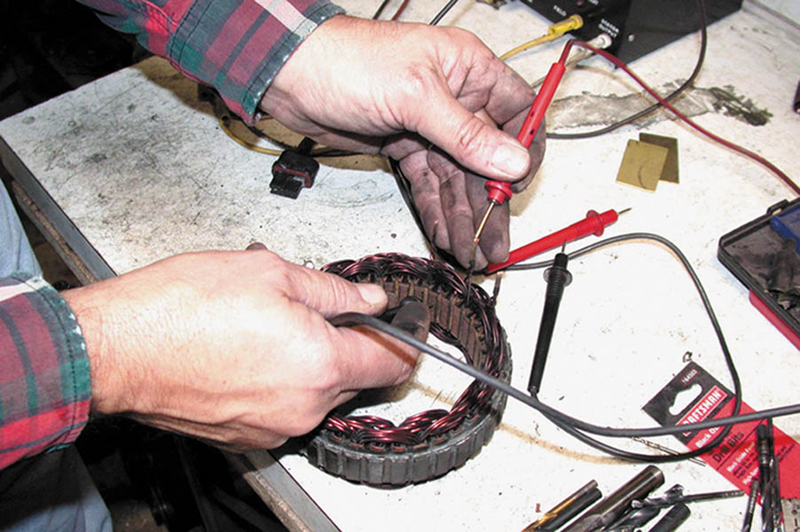
12. The stator is checked by visual inspection for discoloration or other physical damage, and then checked with an ohmmeter to see if the windings are shorted-to-ground.

Slide 65
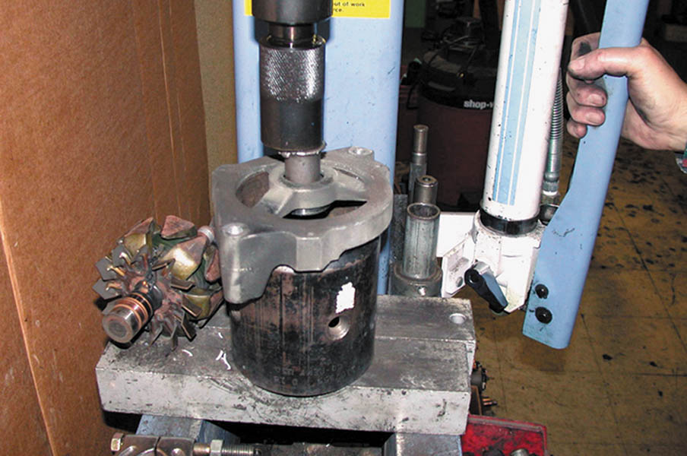
13. The front bearing is removed from the drive-end housing using a press.

Slide 66
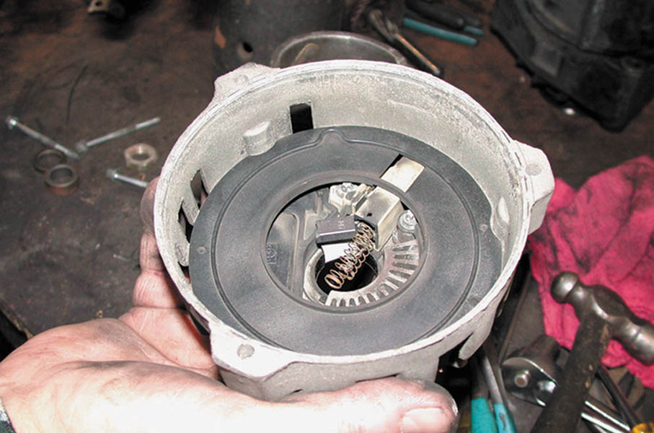
14. A view of the slip-ring-end (SRE) housing showing the black plastic shield, which helps direct air flow across the rectifier.

Slide 67
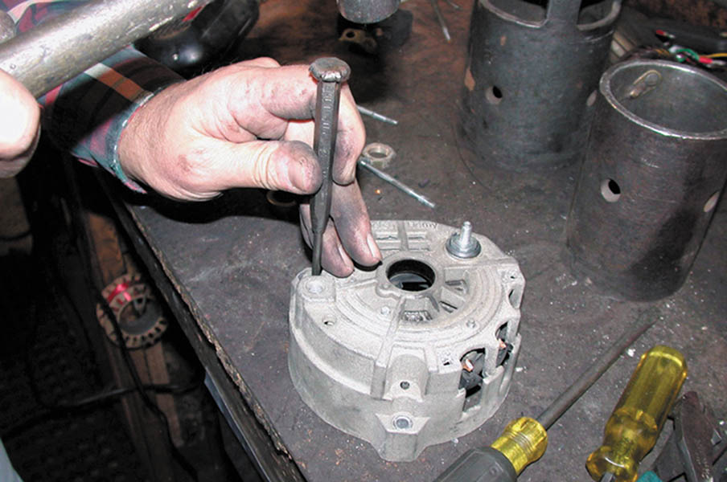
15. A punch is used to dislodge the plastic shield retaining clips.

Slide 68
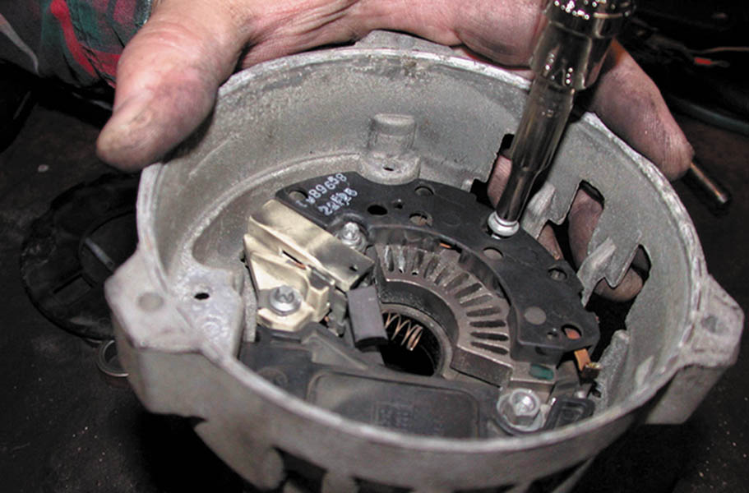
16. After the shield has been removed, the rectifier, regulator, and brush holder assembly can be removed by removing the retaining screws.

Slide 69
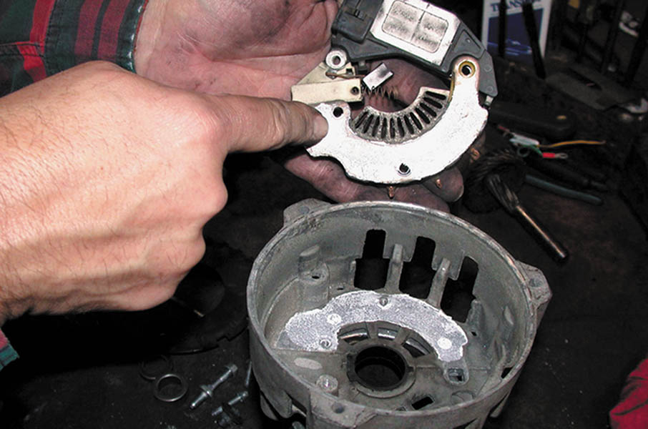
17. The heat transfer grease is visible when the rectifier assembly is lifted out of the rear housing.

Slide 70
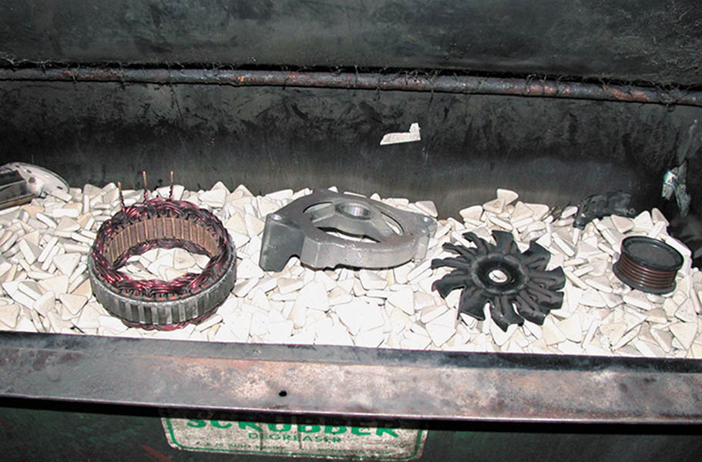
18. The parts are placed into a tumbler where ceramic stones and a water-based solvent are used to clean the parts.

Slide 71
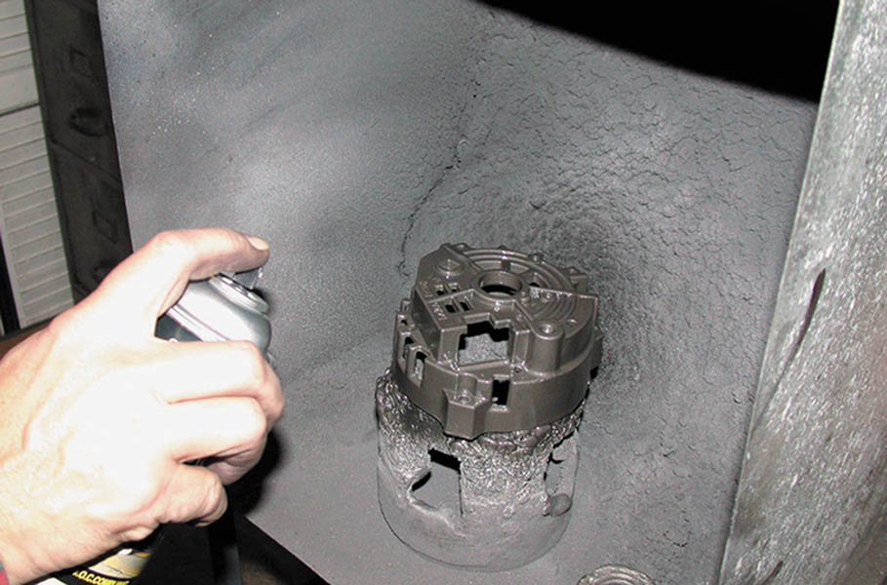
19. This rebuilder is painting the housing using a high-quality industrial grade spray paint to make the rebuilt alternator look like new.

Slide 72
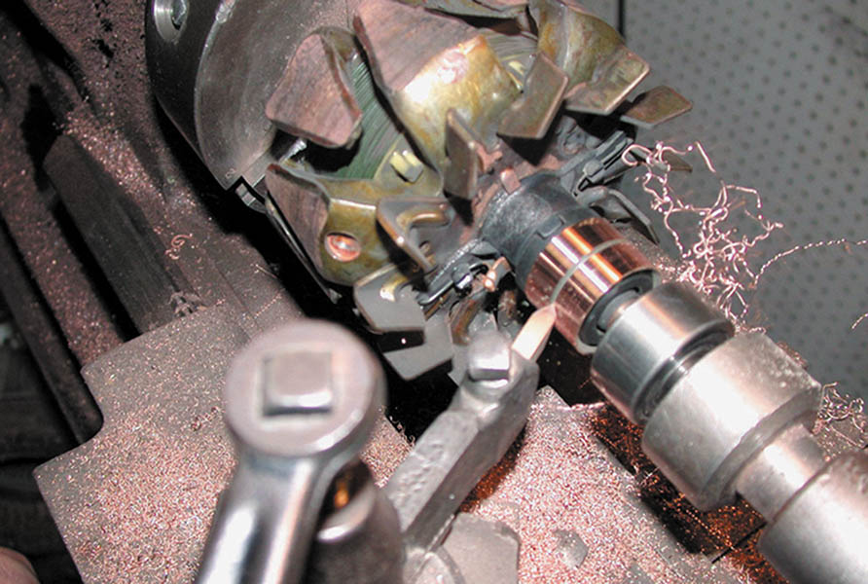
20. The slip rings on the rotor are being machined on a lathe.

Slide 73
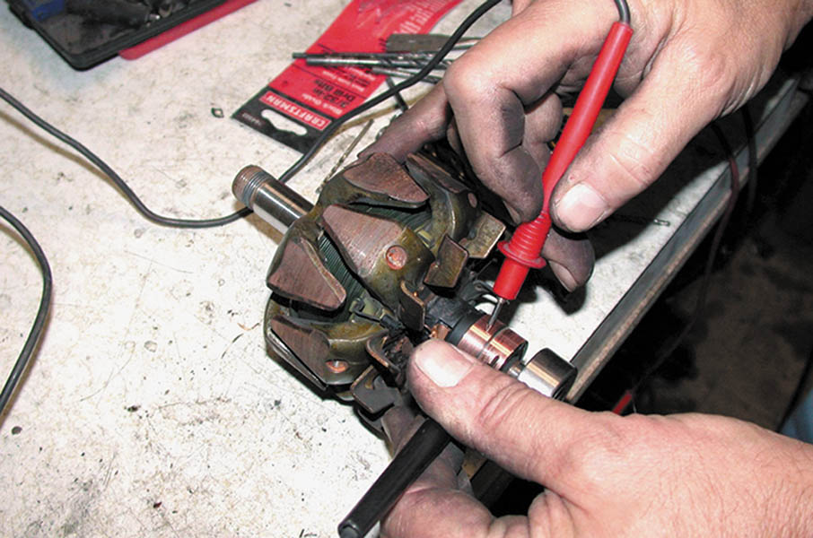
21. The rotor is being tested using an ohmmeter. The specifications for the resistance between the slip rings on the CS-130 are 2.2 to 3.5 ohms.

Slide 74
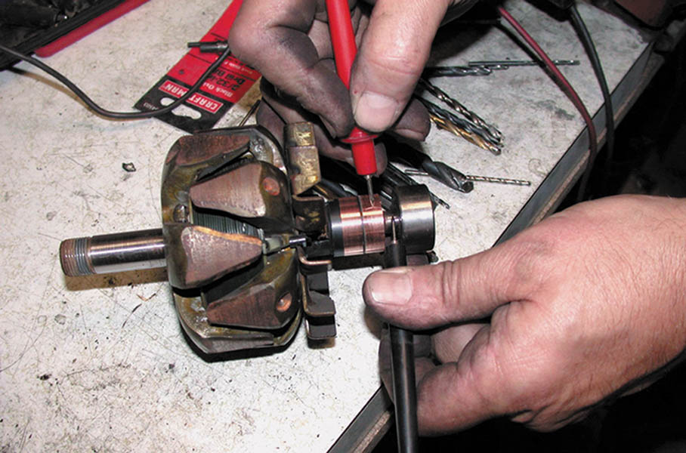
22. The rotor is also tested between the slip ring and the rotor shaft. This reading should be infinity.

Slide 75
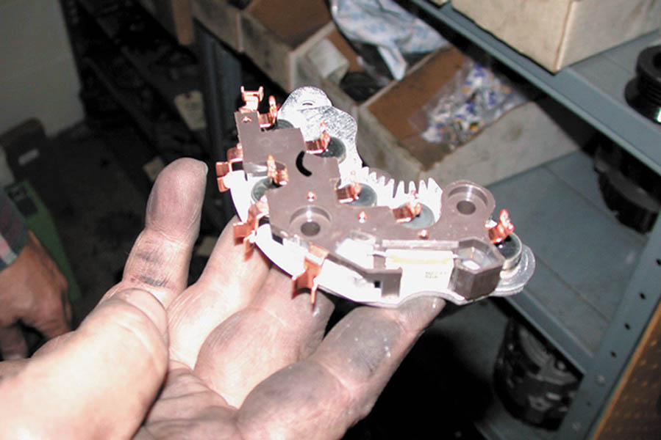
23. A new rectifier. This replacement unit is significantly different than the original but is designed to replace the original unit and meets the original factory specifications.

Slide 76

24. Silicone heat transfer compound is applied to the heat sink of the new rectifier.

Slide 77

25. Replacement brushes and springs are assembled into the brush holder.

Slide 78

26. The brushes are pushed into the brush holder and retained by a straight wire, which extends through the rear housing of the alternator. This wire is then pulled out when the unit is assembled.

Slide 79

27. Here is what the CS alternator looks like after installing the new brush holder assembly, rectifier bridge, and voltage regulator.

Slide 80

28. The junction between the rectifier bridge and the voltage regulator is soldered.

Slide 81

29. The plastic deflector shield is snapped back into location using a blunt chisel and a hammer. This shield directs the airflow from the fan over the rectifier bridge and voltage regulator.

Slide 82

30. Before the stator windings can be soldered to the rectifier bridge, the varnish insulation is removed from the ends of the leads.

Slide 83

31. After the stator has been inserted into the rear housing the stator leads are soldered to the copper lugs of the rectifier bridge.

Slide 84

32. New bearings are installed. A spacer is placed between the bearing and the slip rings to help prevent the possibility that the bearing could move on the shaft and short against the slip ring.

Slide 85

33. The slip-ring-end housing is aligned with the marks made during disassembly and is pressed into the drive-end housing.

Slide 86

34. The retaining bolts, which are threaded into the drive-end housing from the back of the alternator, are installed.

Slide 87

35. The external fan and drive pulley are installed and the retaining nut is tightened on the rotor shaft.

Slide 88

36. The scope pattern shows that the diodes and stator are functioning correctly and voltage check indicates that the voltage regulator is also functioning correctly.

Slide 89

Copyright

