Slide 1

Automotive Technology Principles, Diagnosis, and Service
Sixth Edition
Chapter 54
Charging System
Copyright © 2018, 2015, 2011 Pearson Education, Inc. All Rights Reserved

Slide 2
LEARNING OBJECTIVES (1 of 2)
54.1 Explain why an alternator generates an AC and changes it to DC.
54.2 Describe an alternator’s construction, including overrunning pulleys.
54.3 Describe the components and operation of an alternator.
54.4 Discuss how an alternator works.

Slide 3
LEARNING OBJECTIVES (2 of 2)
54.5 List the factors determining an alternator’s output voltage and current.
54.6 Explain how the voltage and heat produced by an alternator are regulated.
54.7 Discuss computer-controlled alternators.
54.8 This chapter will help prepare for the ASE Electrical/Electronic Systems (A6) certification test content area “C” (Starting System Diagnosis and Repair).

Slide 4
PRINCIPLE OF ALTERNATOR OPERATION
Terminology
The Society of Automotive Engineers (SAE) term for the unit that generates electricity is generator. The term alternator is most commonly used in the trade.
Principles: The amount of current generated can be increased by:
Increasing the speed of the conductors through the magnetic field
Increasing the number of conductors passing through the magnetic field
Increasing the strength of the magnetic field

Slide 5
ALTERNATOR CONSTRUCTION
Housing
An alternator is constructed using a two-piece cast aluminum housing
A front ball bearing is pressed into the front housing, called the drive-end (DE) housing
The rear housing, or the slip-ring-end (SRE) housing, usually contains either a roller bearing or ball bearing

Slide 6
QUESTION 1: ?
How can the amount of current an alternator generates increase?

Slide 7
ANSWER 1:
Increase the speed of the conductors, increase the number of conductors, increase the strength of the magnetic field.

Slide 8
ALTERNATOR OVERRUNING PULLEYS
Purpose and Function
The purpose of this pulley is to help eliminate noise and vibration in the accessory drive belt system
May use a dampener spring inside, plus a one-way clutch
Manufacturer Specific System Names
Isolating Decoupler Pulley (IDP)
Active Alternator Pulley (AAP)
Alternator Decoupler Pulley (ADP)
Alternator Overrunning Decoupler Pulley

Slide 9
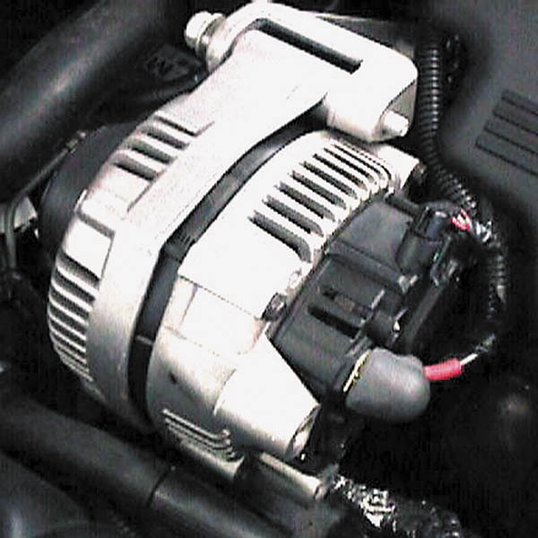
Figure 54.1 A typical alternator on a Chevrolet V-8 engine that is driven by the accessory drive belt at the front of the engine

Slide 10
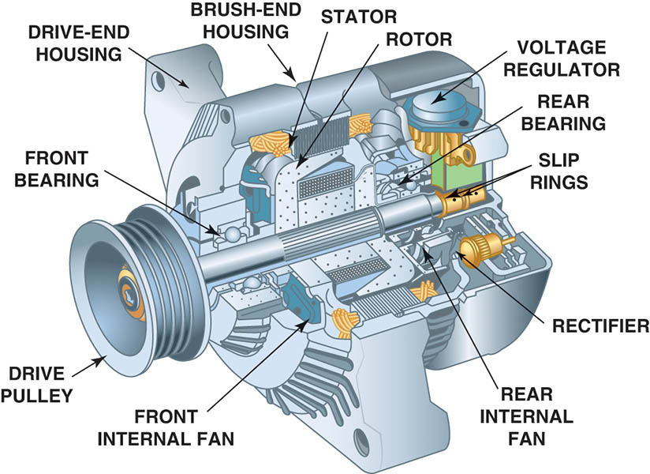
Figure 54.2 The end frame toward the drive belt is called the drive-end housing and the rear section is called the slip-ring-end housing

Slide 11
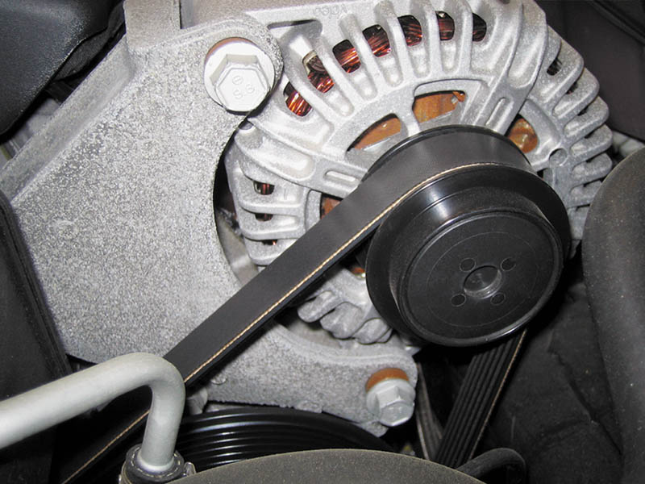
Figure 54.3 An OAP on a Chevrolet Corvette alternator

Slide 12
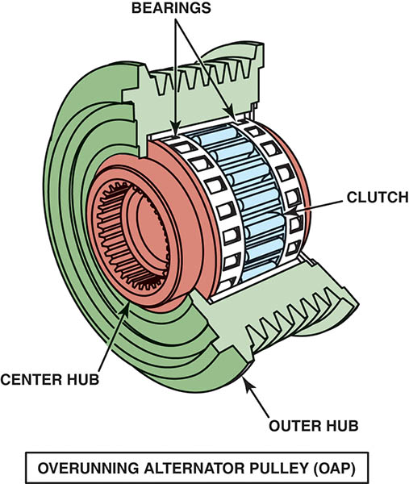
Figure 54.4 An exploded view of an overrunning alternator pulley showing all of the internal parts

Slide 13
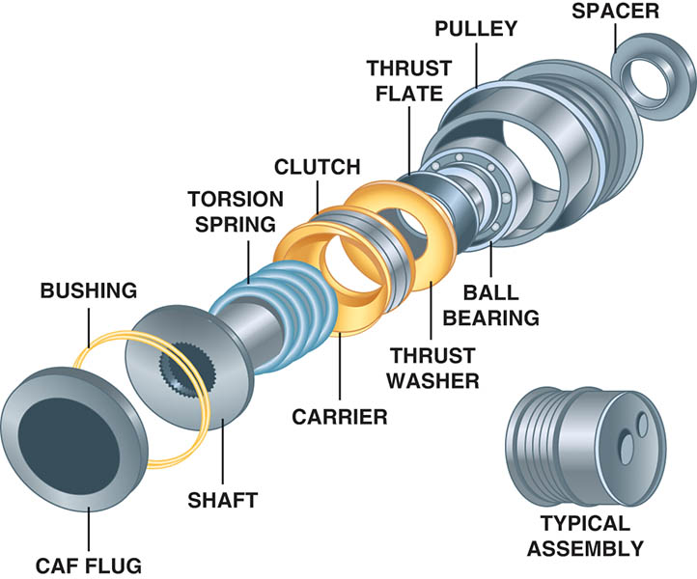
Figure 54.5 An overrunning alternator damper (OAD) is not a simple one-way clutch or a solid pulley, but instead is engineered to dampen noises and vibrations in the front accessory drive belt system

Slide 14
QUESTION 2: ?
What is the purpose of an OAP or OAD?

Slide 15
ANSWER 2:
Reduce noise and vibration.

Slide 16
ALTERNATOR COMPONENTS AND OPERATION (1 OF 2)
Rotor Construction
The rotor is constructed of many turns of copper wire coated with a varnish insulation wound over an iron core.
How Rotors Create Magnetic Fields
Current through the slip rings causes the “fingers” of the rotor to become alternating north and south magnetic poles.

Slide 17
ALTERNATOR COMPONENTS AND OPERATION (2 OF 2)
Rotor Current
The maximum rated alternator output in amperes depends on the number and gauge of the rotor windings
Stator Construction
The stator consists of the stationary coil windings inside the alternator
Diodes
A semiconductor that operate as a one-way electrical check valve

Slide 18
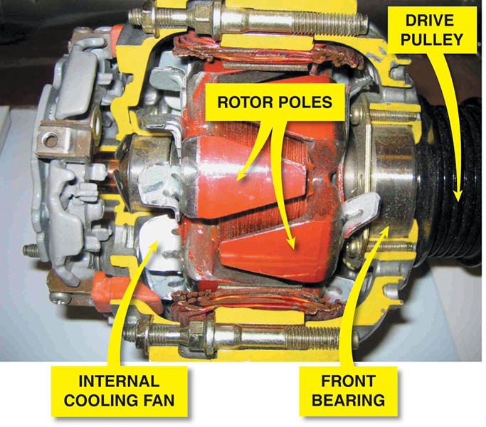
Figure 54.6 A cutaway of an alternator, showing the rotor and cooling fan that is used to force air through the unit to remove the heat created when it is charging the battery and supplying electrical power for the vehicle

Slide 19
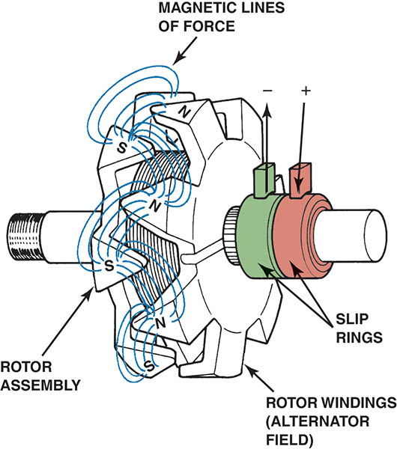
Figure 54.7 Rotor assembly of a typical alternator. Current through the slip rings causes the “fingers” of the rotor to become alternating north and south magnetic poles.

Slide 20
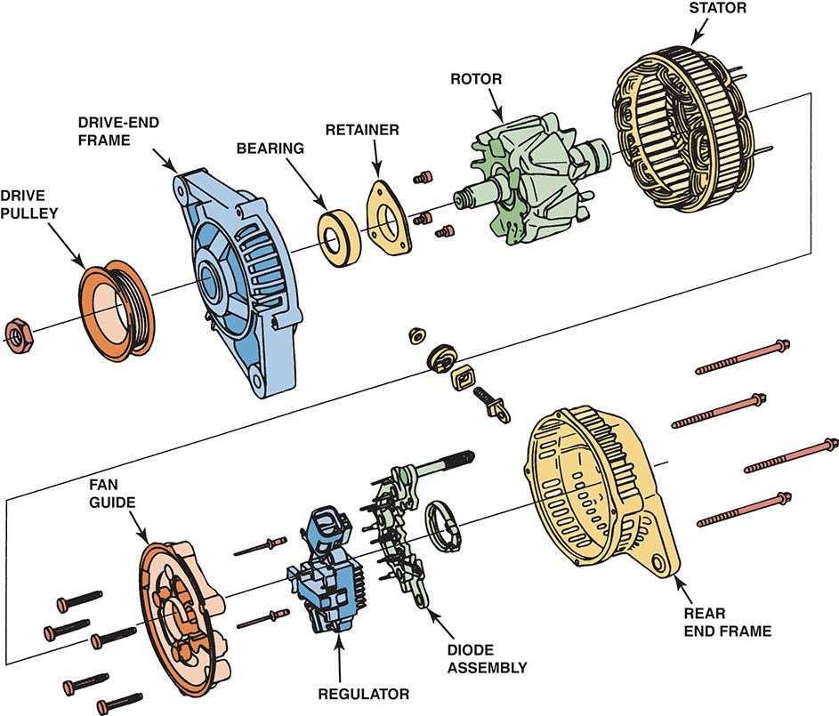
Figure 54.8 An exploded view of a typical alternator showing all of its internal parts including the stator windings

Slide 21
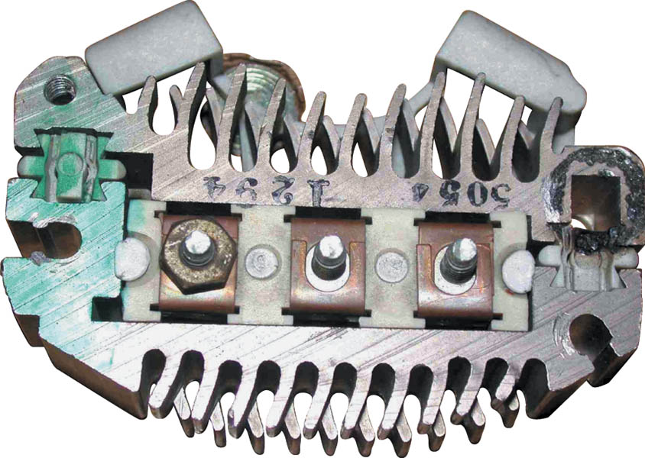
Figure 54.9 A rectifier usually includes six diodes in one assembly and is used to rectify AC voltage from the stator windings into DC voltage suitable for use by the battery and electrical devices in the vehicle

Slide 22
HOW AN ALTERNATOR WORKS (1 OF 2)
Field Current is Produced
The magnetic field of the rotor generates a current in the stator windings by electromagnetic induction.
Current is Induced in the Stator
The induced current in the stator windings is an alternating current because of the alternating magnetic field of the rotor.

Slide 23
HOW AN ALTERNATOR WORKS (2 OF 2)
Wye-Connected Stators
In a Wye-type stator connection, the currents must combine because two windings are always connected in series.
Delta-Connected Stators
Current induced in each winding flows to the diodes in a parallel circuit.

Slide 24
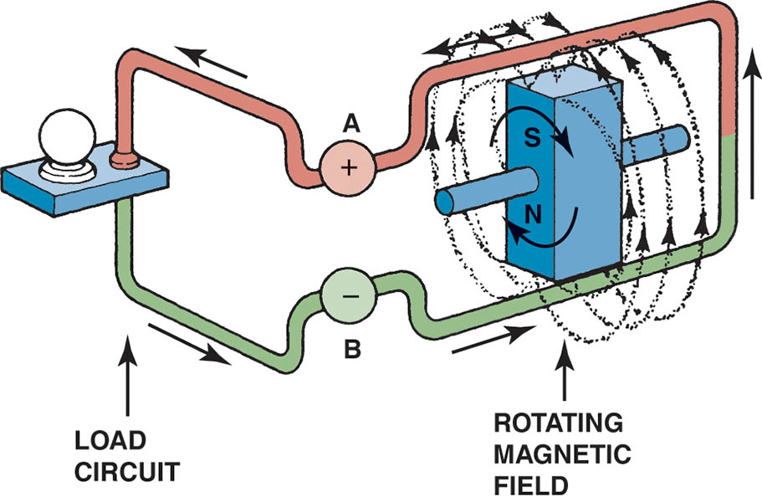
Figure 54.10 Magnetic lines of force cutting across a conductor induce a voltage and current in the conductor

Slide 25
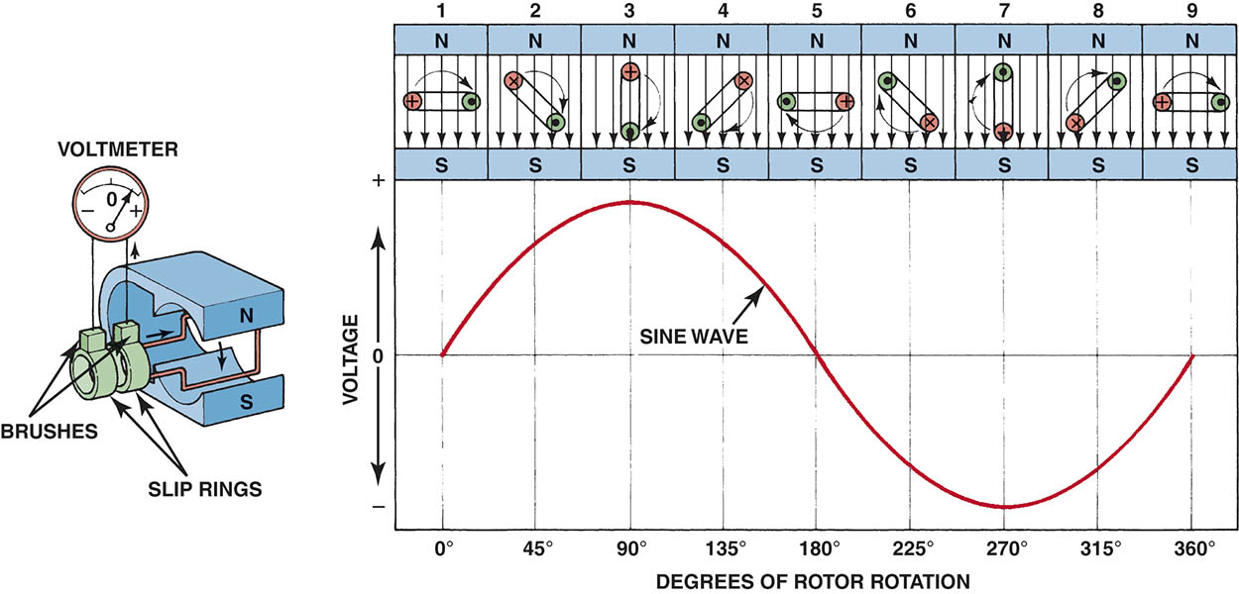
Figure 54.11 A sine wave (shaped like the letter S on its side) voltage curve is created by one revolution of a winding as it rotates in a magnetic field

Slide 26
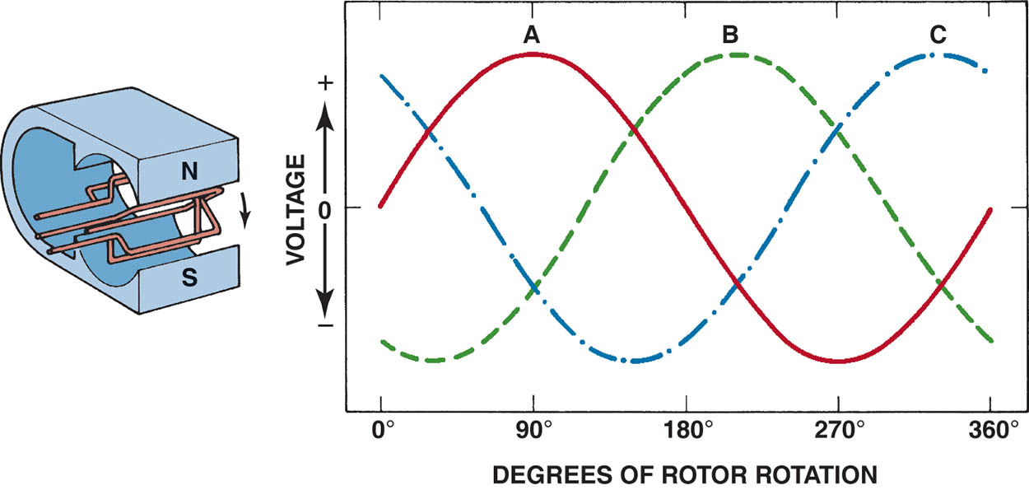
Figure 54.12 When three windings (A, B, and C) are present in a stator, the resulting current generation is represented by the three sine waves. The voltages are 120 degrees out of phase. The connection of the individual phases produces a three-phase alternating voltage

Slide 27
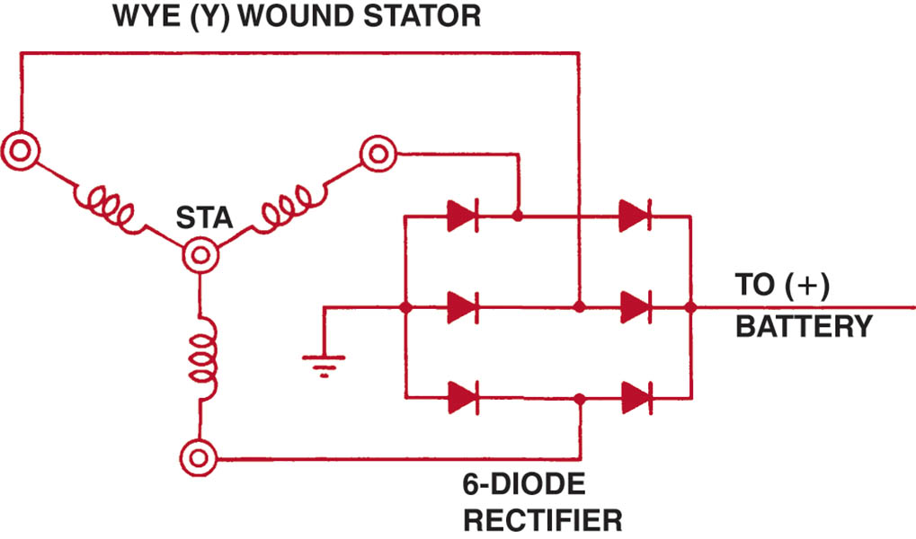
Figure 54.13 Wye-connected stator winding

Slide 28
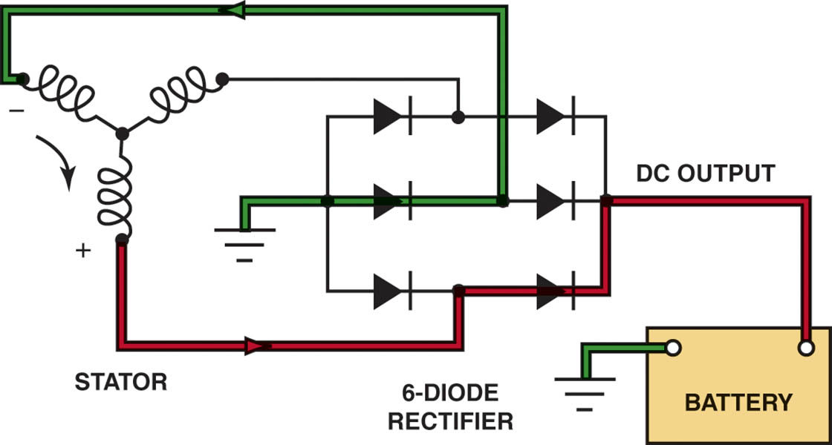
Figure 54.14 As the magnetic field, created in the rotor, cuts across the windings of the stator, a current is induced. It is the flow of current through the diodes that converts the AC voltage produced in the stator windings to DC voltage available at the output terminal of the alternator

Slide 29
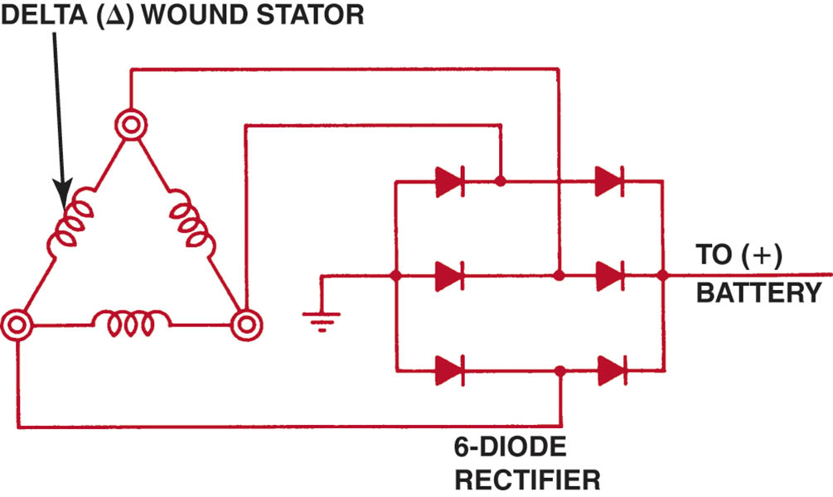
Figure 54.15 Delta-connected stator winding

Slide 30
ALTERNATOR OUTPUT FACTORS
The output voltage and current of an alternator depend on the following factors.
Speed of rotation
Number of conductors
Strength of the magnetic field

Slide 31
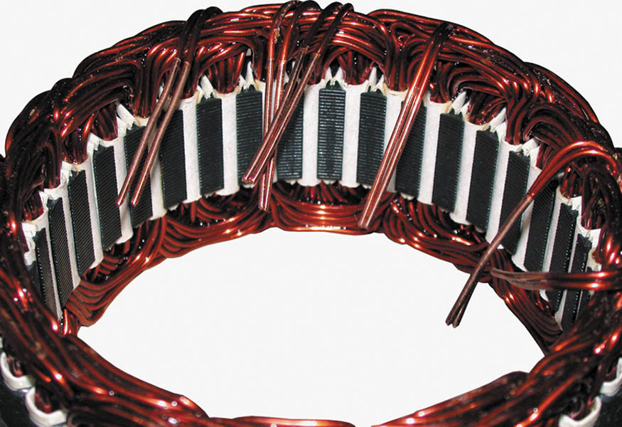
Figure 54.16 A stator assembly with six, rather than the normal three, windings

Slide 32
ALTERNATOR VOLTAGE REGULATION
Regulator Operation
The control of the field current is accomplished by opening and closing the ground side of the field circuit through the rotor on most alternators.
The zener diode is a major electronic component that makes voltage regulation possible.
Battery Condition and Charging Voltage
The alternator may supply the needed current, but may not reach maximum charging voltage.
Voltage regulators compensate for temperature.

Slide 33
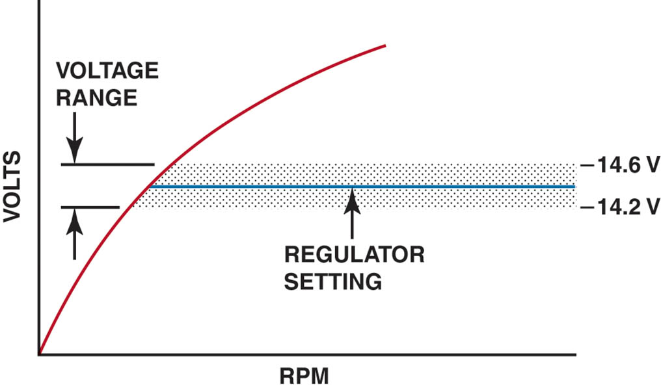
Figure 54.17 Typical voltage regulator range

Slide 34
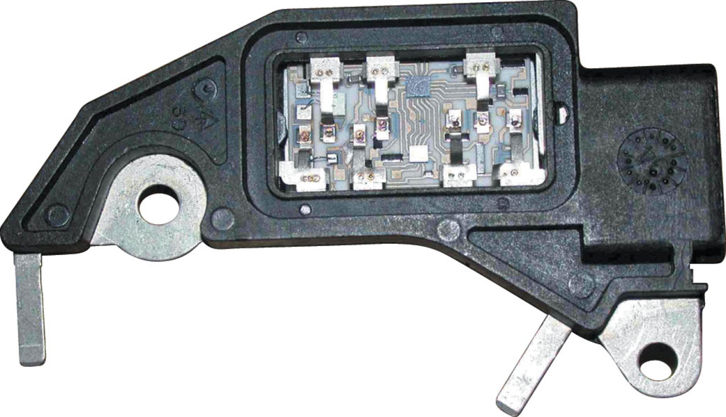
Figure 54.18 A typical electronic voltage regulator with the cover removed showing the circuits inside

Slide 35
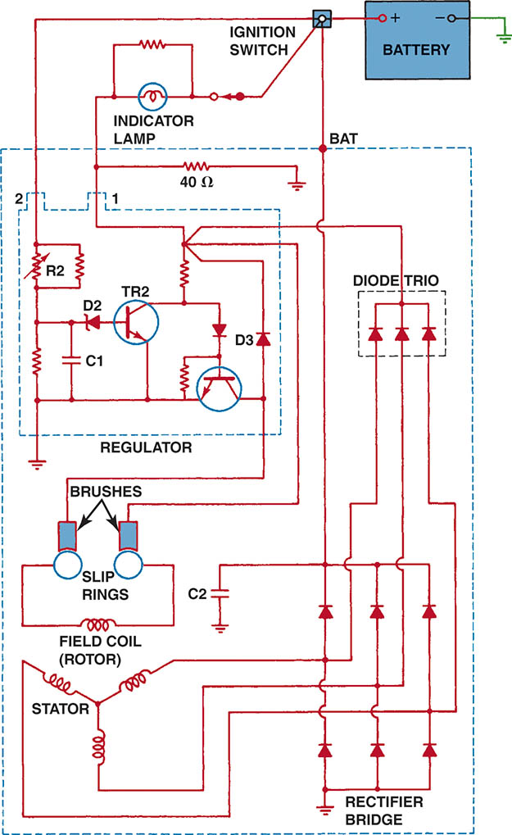
Figure 54.19 Typical General Motors SI-style alternator with an integral voltage regulator.

Slide 36
ALTERNATOR COOLING
The types of cooling include:
External fan
Internal fan(s)
Both an external fan and an internal fan
Coolant cooled

Slide 37
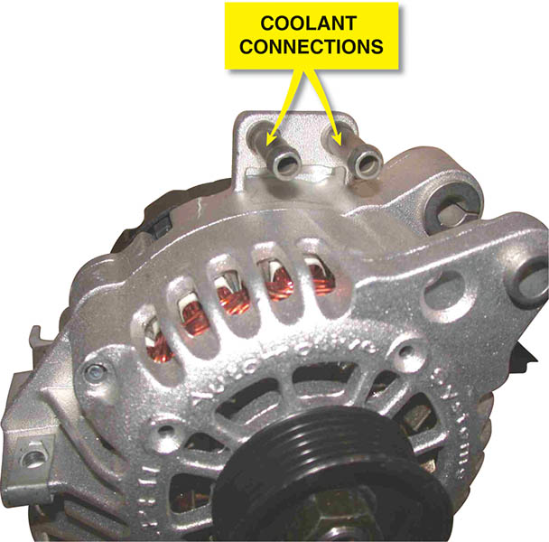
Figure 54.20 A coolant-cooled alternator showing the hose connections where coolant from the engine flows through the rear frame of the alternator

Slide 38
QUESTION 3: ?
How can an alternator be cooled?

Slide 39
ANSWER 3:
Internal fans, external fans, and engine coolant.

Slide 40
COMPUTER-CONTROLLED ALTERNATORS
Computers can interface with the charging system in three ways.
The computer can activate the charging system by turning on and off the field current to the rotor.
The computer can monitor the operation of the alternator and increase engine speed.
The computer can control the alternator by controlling alternator output to match the needs of the electrical system.

Slide 41
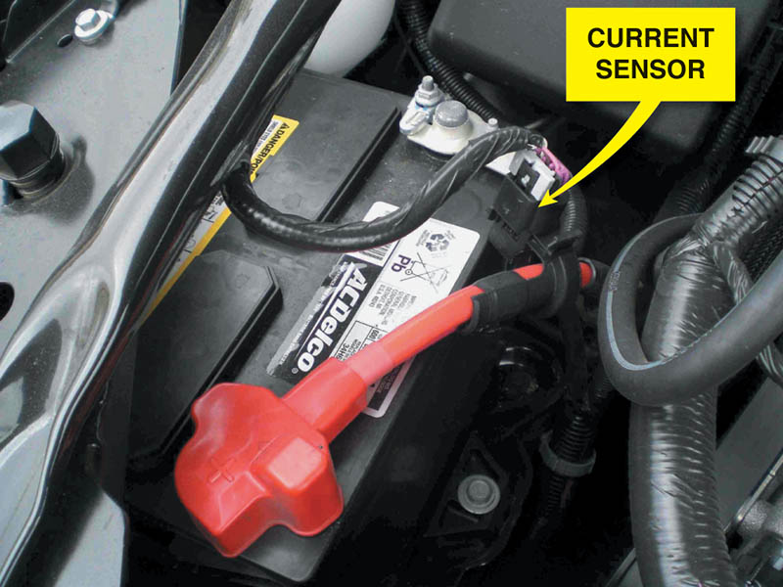
Figure 54.21 A Hall-effect current sensor attached to the positive battery cable is used as part of the EPM system

Slide 42
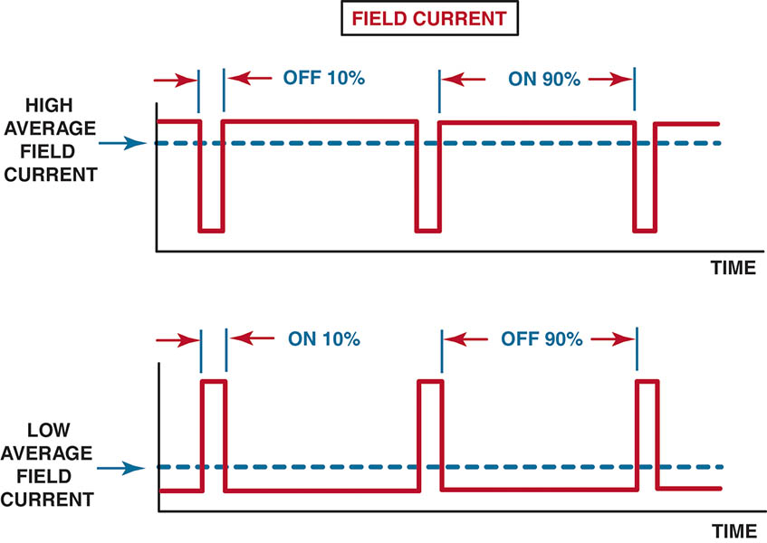
Figure 54.22 The amount of time current is flowing through the field (rotor) determines the alternator output

Slide 43
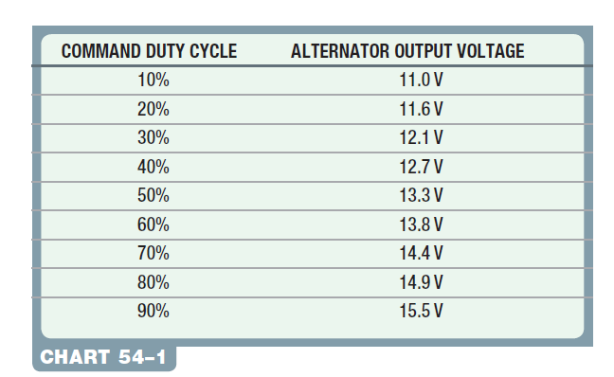
Chart 54-1 The output voltage is controlled by varying the duty cycle as controlled by the PCM.

Slide 44

Copyright

