Slide 1

Automotive Technology Principles, Diagnosis, and Service
Sixth Edition
Chapter 53
Cranking System Diagnosis and Service
Copyright © 2018, 2015, 2011 Pearson Education, Inc. All Rights Reserved

Slide 2
LEARNING OBJECTIVES (1 of 2)
53.1 Explain the procedure to troubleshoot a starting system problem.
53.2 Discuss how to perform a voltage drop test on the cranking circuit.
53.3 Perform control circuit testing and starter amperage test, and determine necessary action.
53.4 Describe the procedure to remove a starter motor.

Slide 3
LEARNING OBJECTIVES (2 of 2)
53.5 Explain starter motor service and bench testing.
53.6 Describe the procedure to install a starter motor.
53.7 Describe how to ensure proper clearance between the starter pinion and the engine flywheel.
53.8 This chapter will help prepare for the ASE Electrical/Electronic Systems (A6) certification test content area “C” (Battery and Starting Systems Diagnosis and Repair).

Slide 4
STARTING SYSTEM TROUBLESHOOTING PROCEDURE
Overview
Check all system components for proper operation
Steps Involved
Step 1: Verify the customer concern.
Step 2: Visually inspect the battery and battery connections.
Step 3:Test battery condition.
Step 4: Check the control circuit.
Step 5: Check voltage drop of the starter circuit.

Slide 5
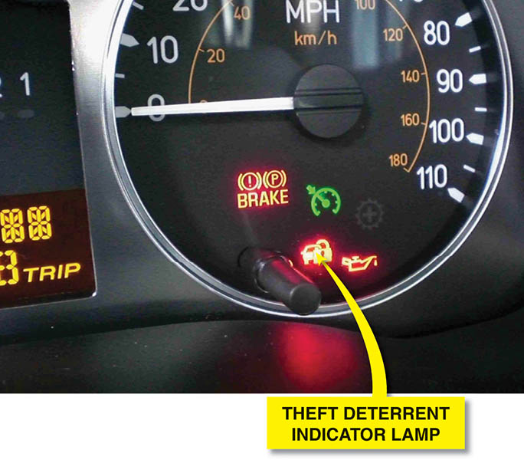
Figure 53.1 A theft deterrent indicator lamp of the dash. A flashing lamp usually indicates a fault in the system, and the engine may not start

Slide 6
VOLTAGE DROP TESTING
Voltage drop is the drop in voltage that occurs when current is flowing through a resistance.
Test Procedure
Disable the ignition or fuel injection
Connect voltmeter between battery and starter motor
Crank the engine and observe the reading while cranking
Test voltage drop across solenoid
Check voltage drop on ground side of circuit

Slide 7
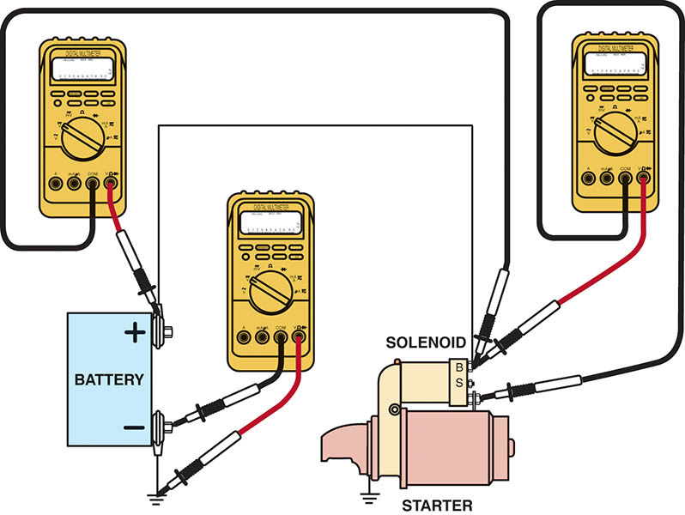
Figure 53.2 Voltmeter hookups for voltage drop testing of a solenoid-type cranking circuit

Slide 8
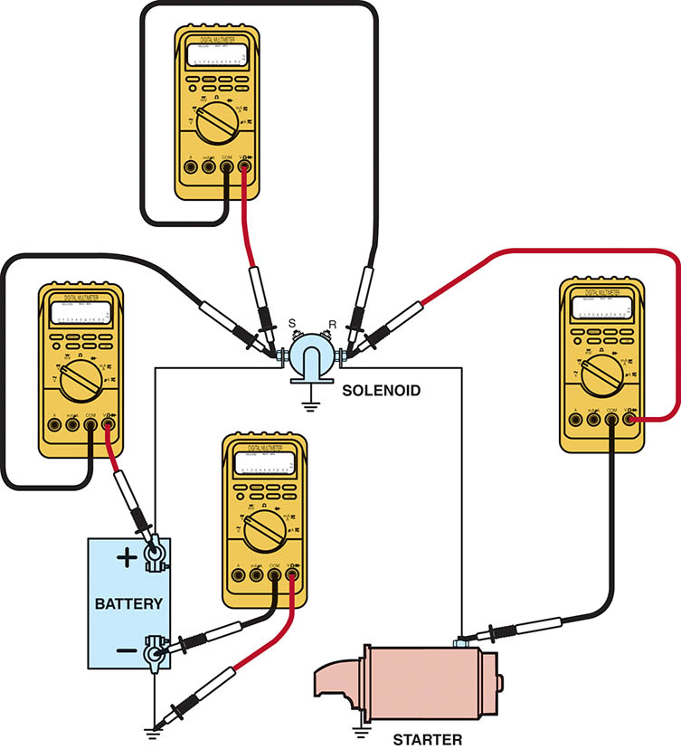
Figure 53.3 Voltmeter hookups for voltage drop testing of a Ford cranking circuit

Slide 9
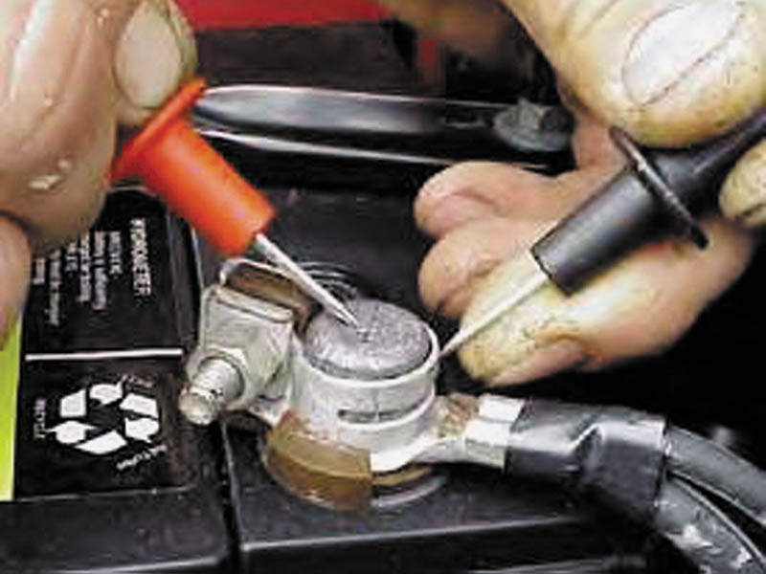
Figure 53.4 Place one voltmeter lead on the battery terminal and the other voltmeter lead on the cable end and crank the engine. The voltmeter reads the difference in voltage between the two leads, which should not exceed 0.20 volt (200 millivolts)

Slide 10
QUESTION 1: ?
What is the purpose of the voltage drop testing?

Slide 11
ANSWER 1:
To ensure no unwanted resistance exists in the circuit.

Slide 12
CONTROL CIRCUIT TESTING
An open or break anywhere in the control circuit prevents the operation of the starter motor.
Components to checked:
Neutral safety or clutch switch
Blown crank fuse
Open at the ignition switch in the crank position
Starter relay or module, if equipped
Antitheft controls

Slide 13
STARTER AMPERAGE TEST
Reason for Starter Amperage Test
Slow or no cranking of the engine
Test Preparation
Battery is sufficiently charged (75% or more)
Specifications:
4-cylinder engines = 150 to 185 amperes
6-cylinder engines = 160 to 200 amperes
8-cylinder engines = 185 to 250 amperes

Slide 14
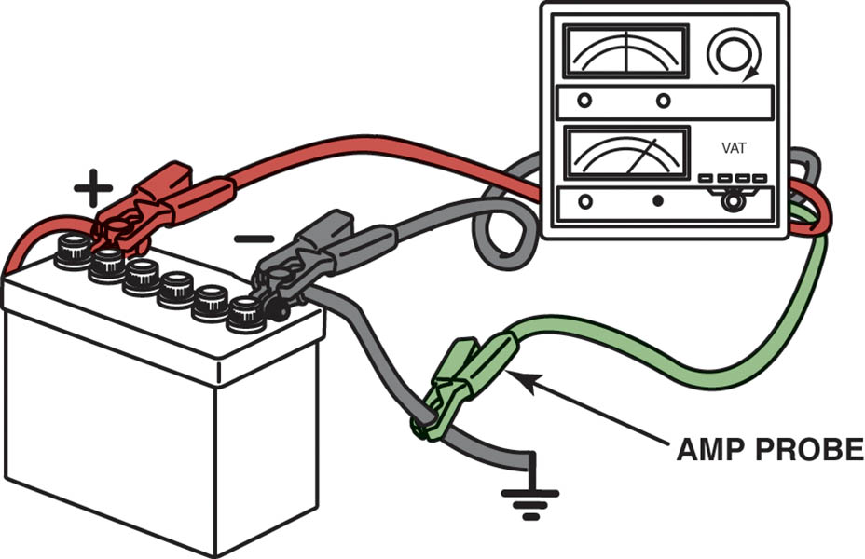
Figure 53.5 A starter amperage tester uses an amp probe around the positive or negative battery cables

Slide 15
STARTER REMOVAL
Procedure:
Disconnect the negative battery cable.
Hoist the vehicle safely (as needed).
Remove the starter retaining bolts
Gain access to the wiring
Disconnect and label the wire(s)
Inspect the flywheel (flexplate) for ring gear damage.

Slide 16
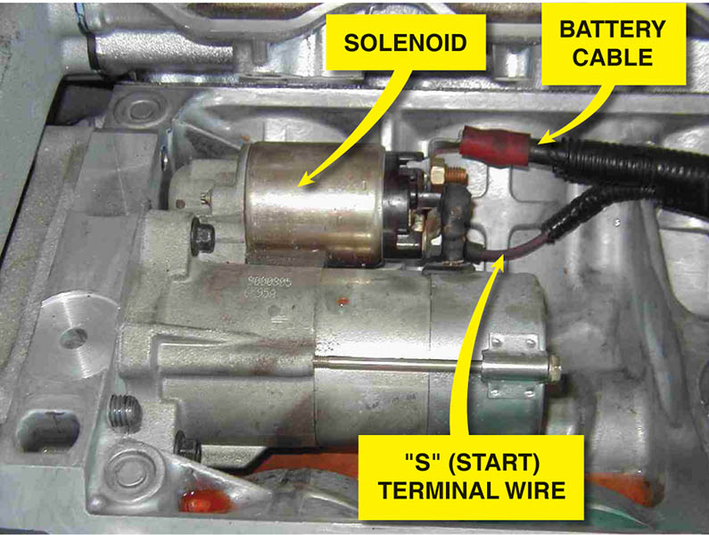
Figure 53.6 The starter is located under the intake manifold on this Cadillac Northstar engine

Slide 17
QUESTION 2: ?
What are the steps in removing a typical starter motor?

Slide 18
ANSWER 2:
Disconnect the negative battery cable.
Hoist the vehicle safely (as needed).
Remove the starter retaining bolts
Gain access to the wiring
Disconnect and label the wire(s)
Inspect the flywheel (flexplate) for ring gear damage.

Slide 19
STARTER MOTOR SERVICE
Purpose
Most starter motors are replaced as an assembly
Some older starters can be serviced
Inspection and Testing
Solenoid
Starter armature
Starter motor field coils
Starter brush inspection

Slide 20
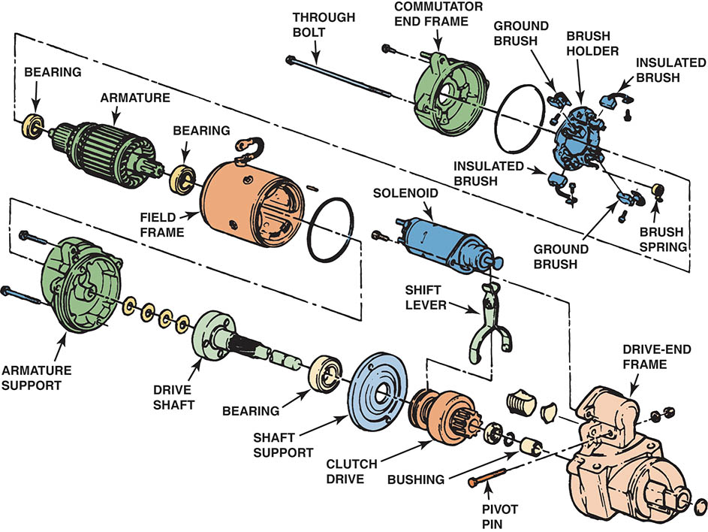
Figure 53.7 An exploded view of a typical solenoid-operated starter

Slide 21
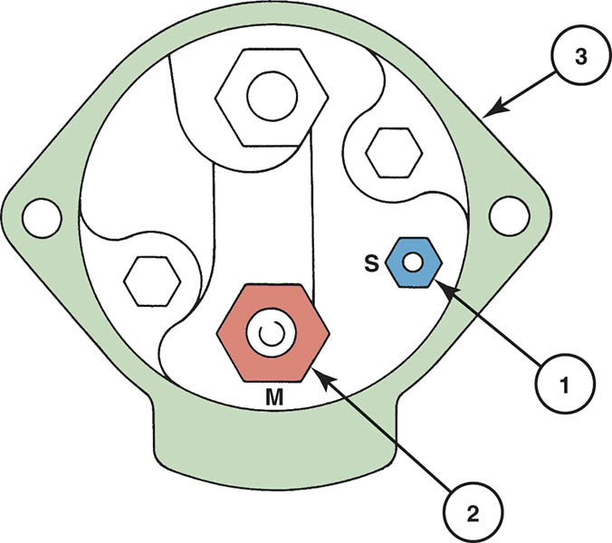
Figure 53.8 GM solenoid ohmmeter check. The reading between 1 and 3 (S terminal and ground) should be 0.4 to 0.6 ohm (hold-in winding). The reading between 1 and 2 (S terminal and M terminal) should be 0.2 to 0.4 ohm (pull-in winding)

Slide 22
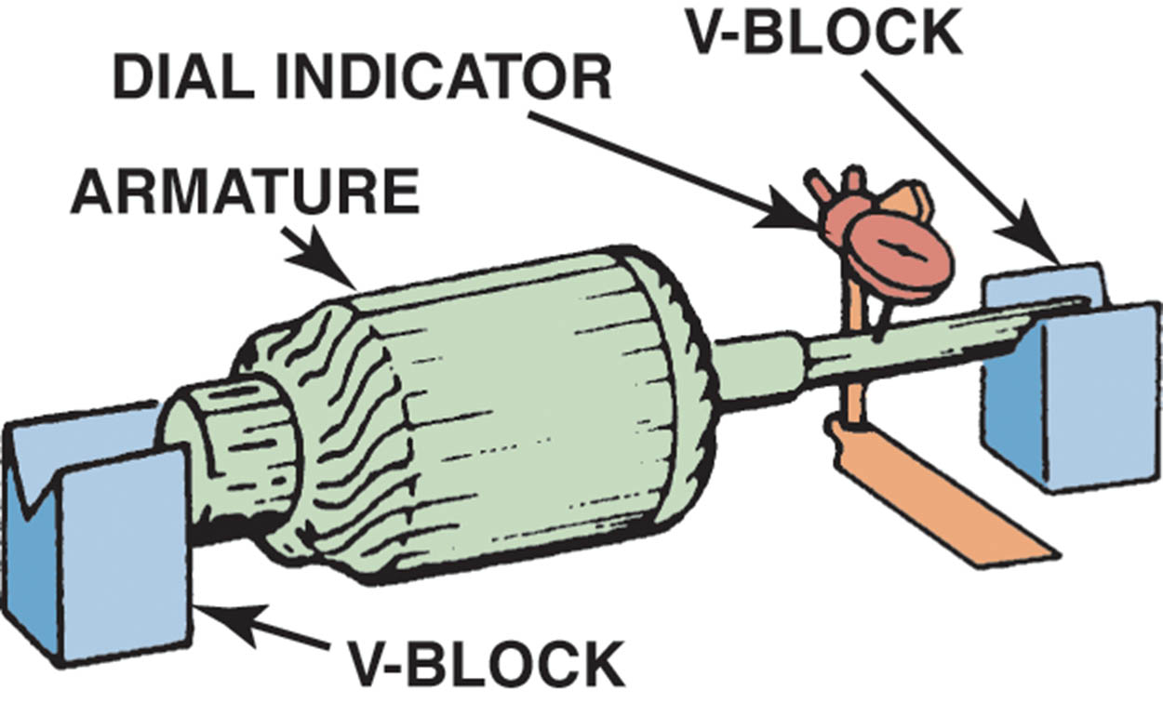
Figure 53.9 Measuring an armature shaft for runout using a dial indicator and V-blocks

Slide 23
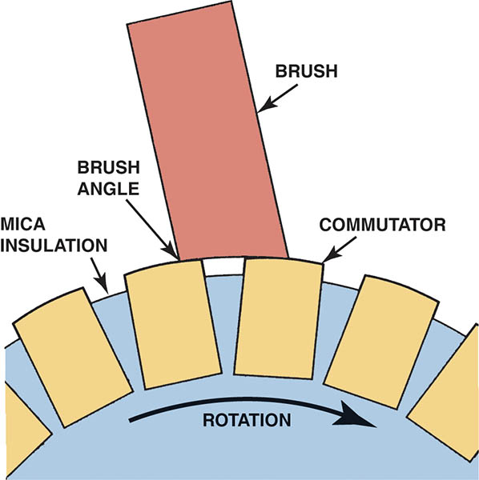
Figure 53.10 Replacement starter brushes should be installed so the beveled edge matches the rotation of the commutator

Slide 24
BENCH TESTING
Every starter should be tested before installation in a vehicle.
Bench testing is the usual method of ensuring starter has been properly repaired.
Clamping the starter in a vise
Connect heavy-gauge jumper wires (minimum 4 gauge) to both a good battery and the starter.
The starter motor operates within specifications.

Slide 25
QUESTION 3: ?
What is the purpose of bench testing the starter motor?

Slide 26
ANSWER 3:
To ensure it operates properly before it is reinstalled on the vehicle.

Slide 27
STARTER INSTALLATION
Check service information for the exact wiring connections
Verify that all electrical connections on the starter-motor are in good condition
Attach the power and control wires
Install the starter, and torque all the fasteners to factory specifications
Perform a starter amperage draw test and check for proper engine cranking.

Slide 28
STARTER DRIVE TO FLYWHEEL CLEARANCE
Need for Shims
Many starters use shims, which are thin metal strips, between the flywheel and the engine block mounting pad to provide the proper clearance.
Symptoms of Clearance Problems
Clearance too Great: A high pitched whine during cranking.
Clearance to Small: The starter may bind, crank slowly.

Slide 29
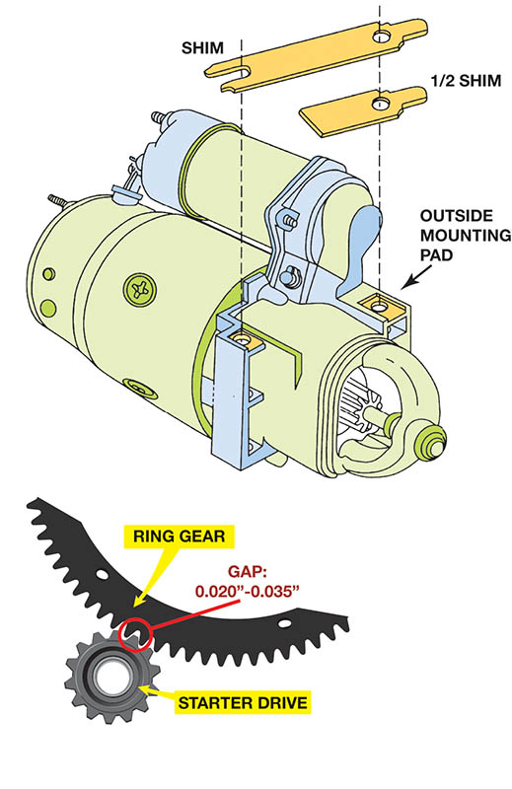
Figure 53.11 A shim (or half shim) may be needed to provide the proper clearance between the flywheel teeth of the engine and the pinion teeth of the starter

Slide 30
STARTING SYSTEM SYMPTOM GUIDE
The following list may help to identify possible starting system concerns.
Starter motor whines
Starter rotates slowly
Starter fails to rotate
Starter produces grinding noise
Starter clicks when engaged

Slide 31
STARTER OVERHAUL

Slide 32
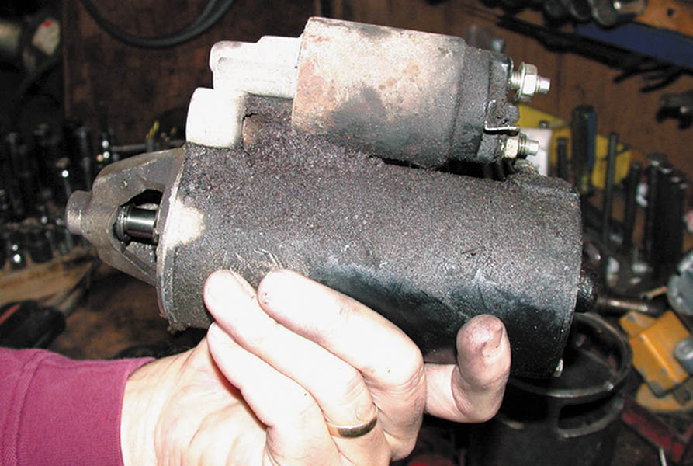
1. This dirty and greasy starter can be restored to useful service.

Slide 33
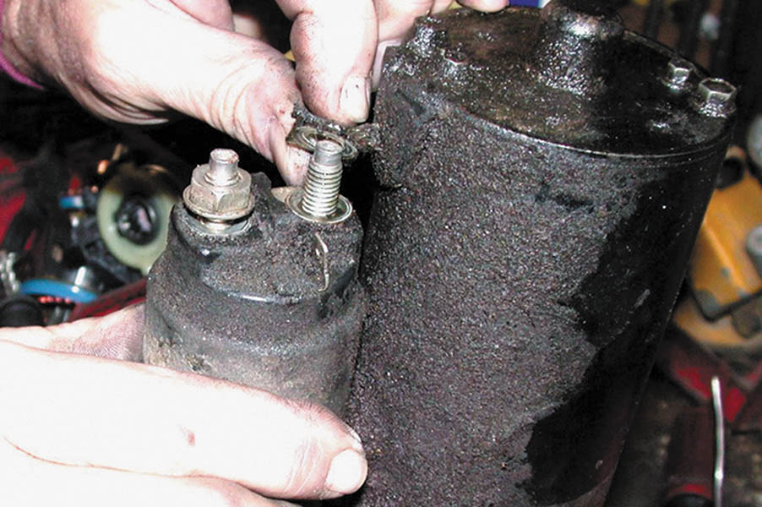
2. The connecting wire between the solenoid and the starter is removed.

Slide 34
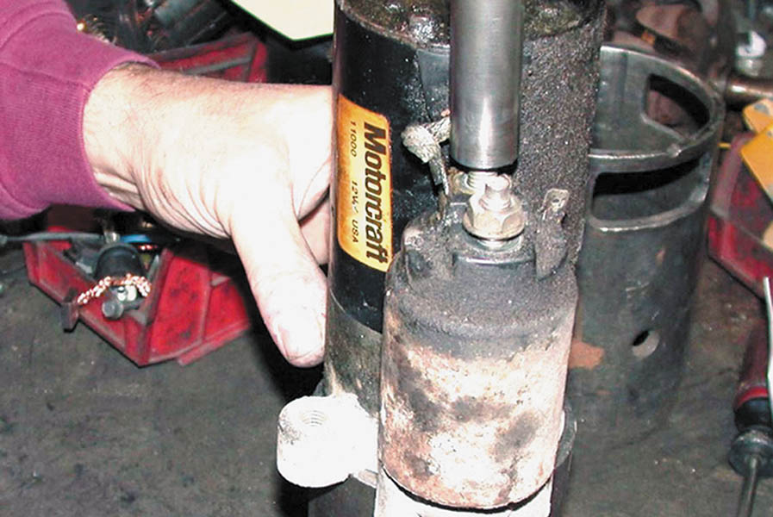
3. An old starter field housing is being used to support the drive-end housing of the starter as it is being disassembled. This rebuilder is using an electric impact wrench to remove the solenoid fasteners.

Slide 35
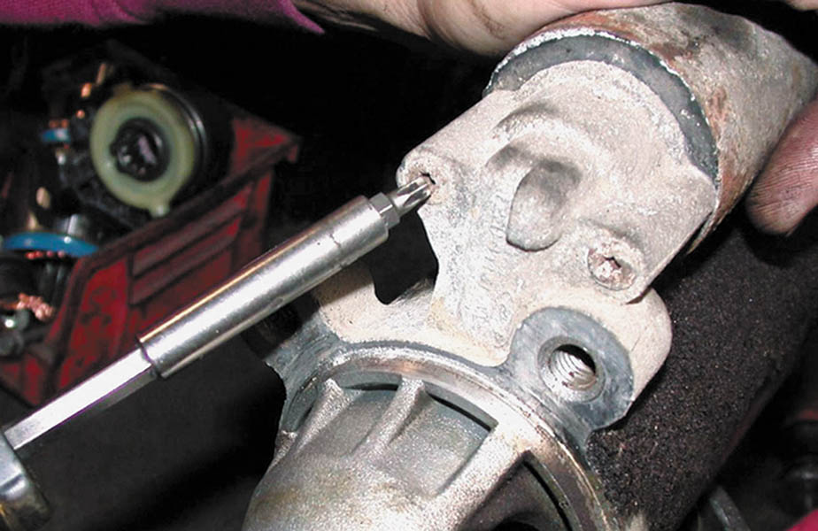
4. A Torx driver is used to remove the solenoid attaching screws.

Slide 36
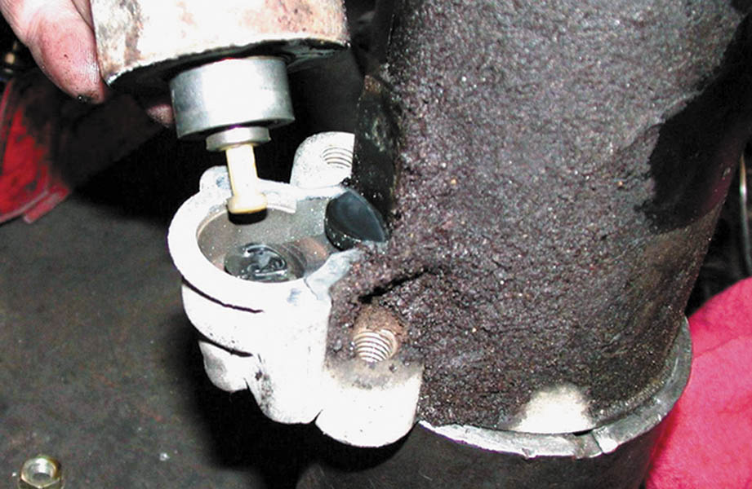
5. After the retaining screws have been removed, the solenoid can be separated from the starter motor. This rebuilder always replaces the solenoid.

Slide 37
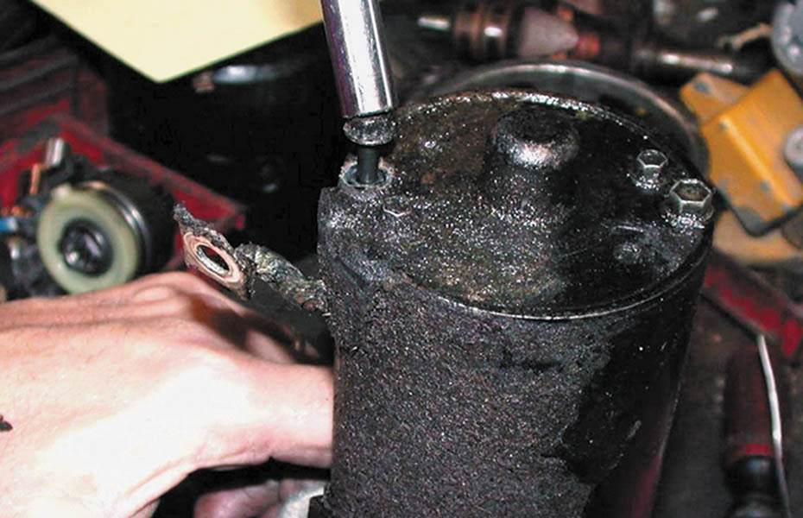
6. The through bolts are being removed.

Slide 38
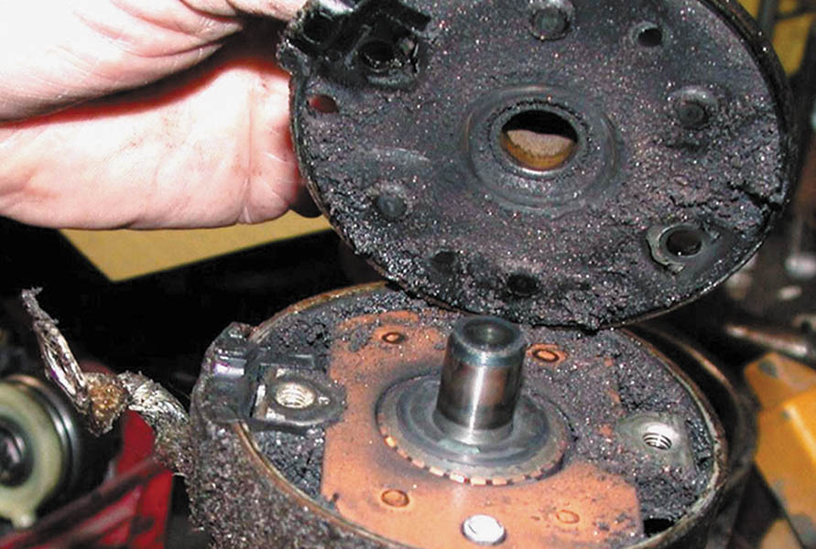
7. The brush end plate is removed.

Slide 39
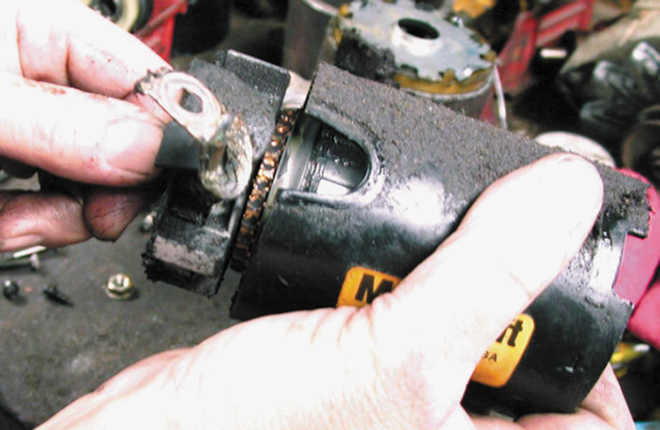
8. The armature assembly is removed from the field frame.

Slide 40
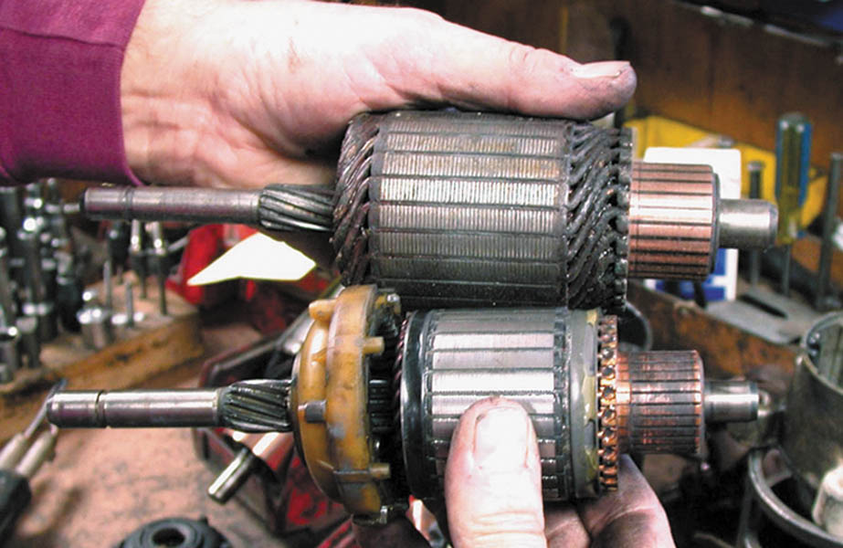
9. Notice that the length of a direct-drive starter armature (top) is the same length as the overall length of a gear-reduction armature, except smaller in diameter.

Slide 41
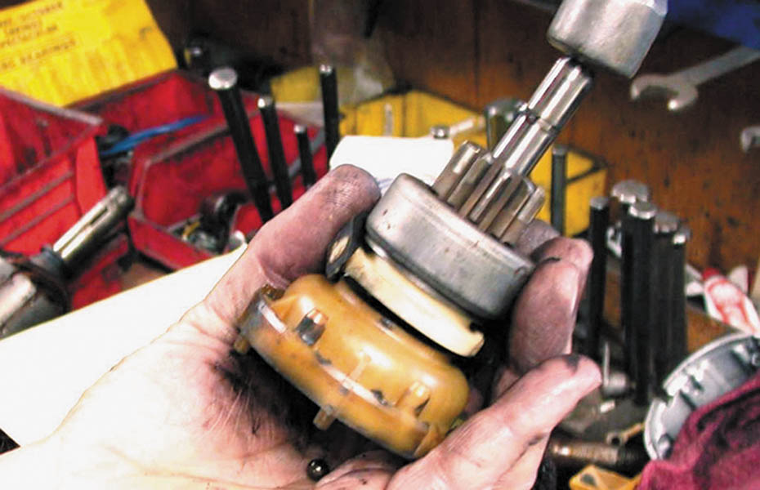
10. A light tap with a hammer dislodges the armature thrust ball (in the palm of the hand) from the center of the gear-reduction assembly.

Slide 42
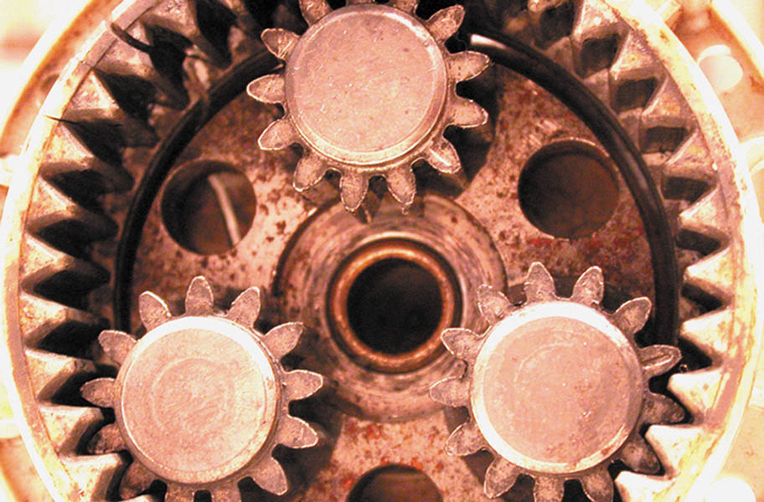
11. This figure shows the planetary ring gear and pinion gears.

Slide 43
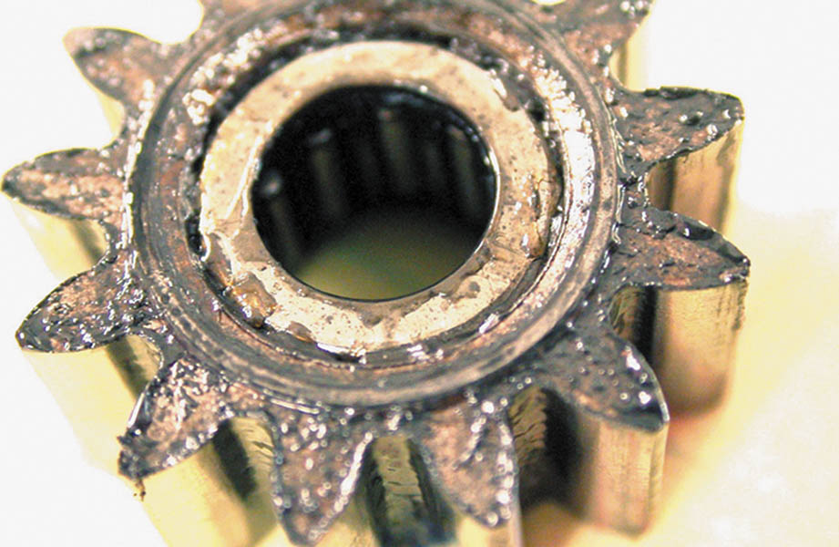
12. A close-up of one of the planetary gears, which shows the small needle bearings on the inside.

Slide 44
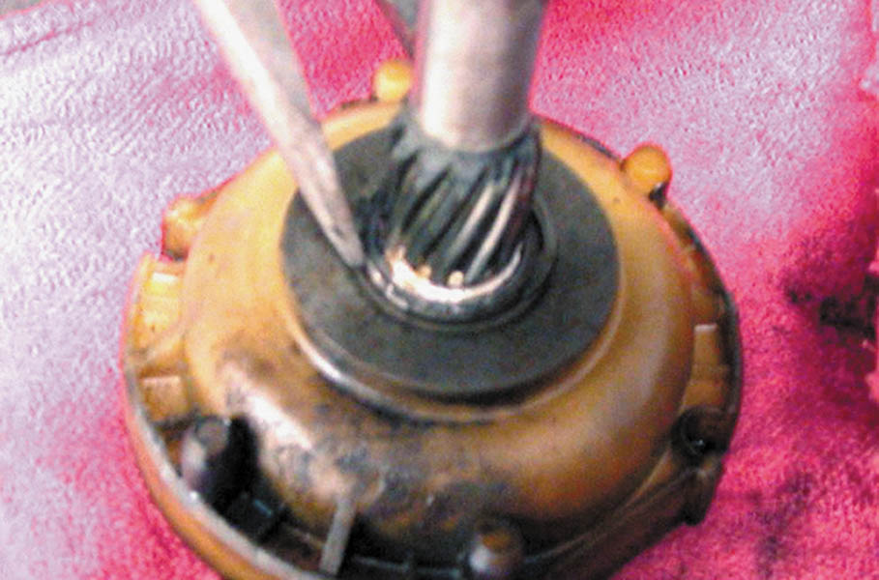
13. The clip is removed from the shaft so the planetary gear assembly can be separated and inspected.

Slide 45
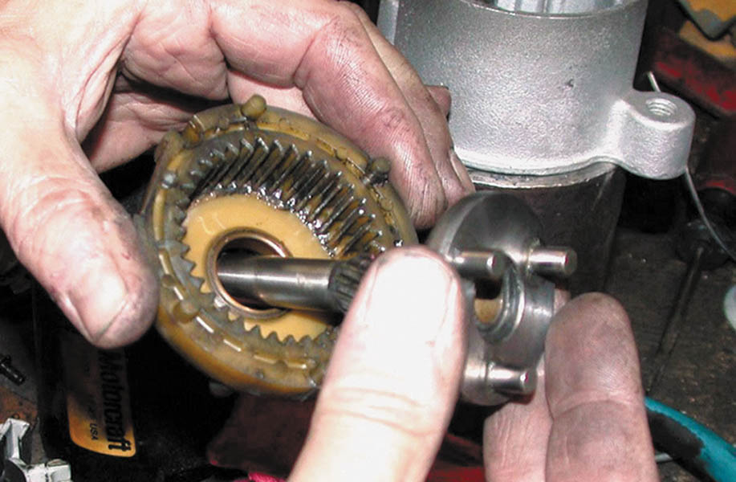
14. The shaft assembly is being separated from the stationary gear assembly.

Slide 46
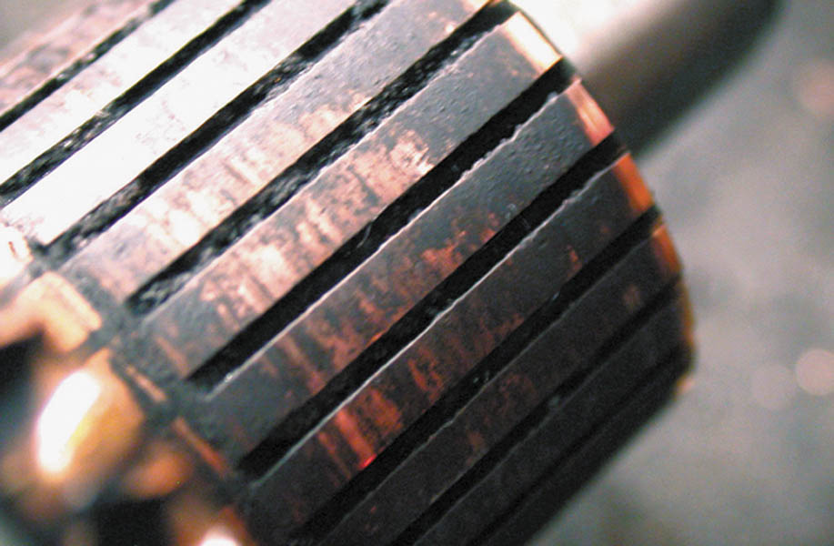
15. The commutator on the armature is discolored and the brushes may not have been making good contact with the segments.

Slide 47
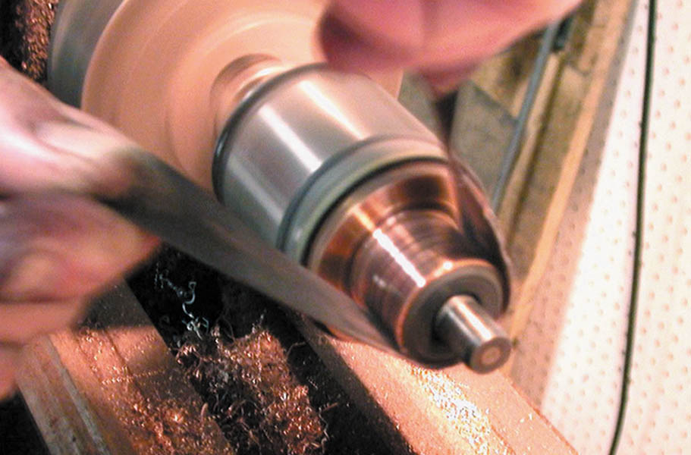
16. All of the starter components are placed in a tumbler with water-based cleaner. The armature is installed in a lathe and the commutator is resurfaced using emery cloth.

Slide 48
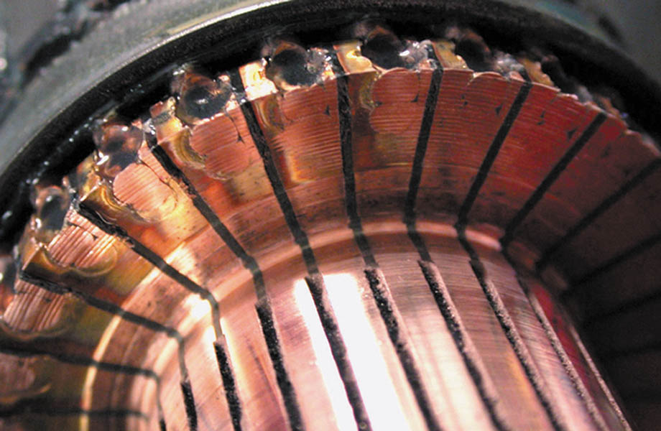
17. The finished commutator looks like new.

Slide 49
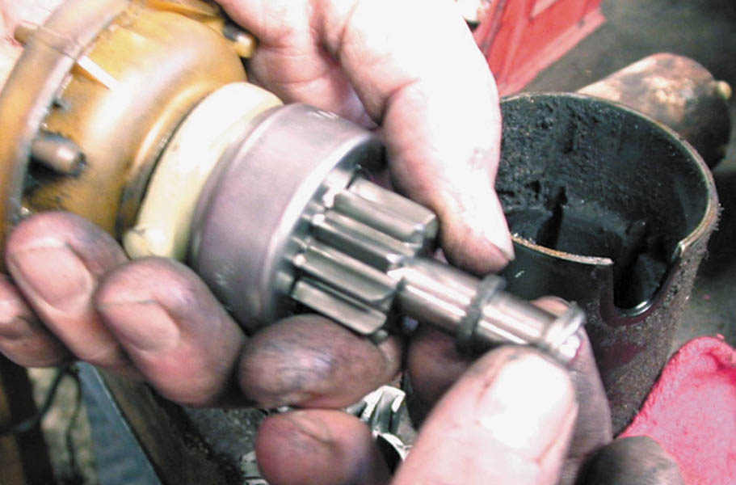
18. Starter reassembly begins by installing a new starter drive on the shaft assembly. The stop ring and stop ring retainer are then installed.

Slide 50
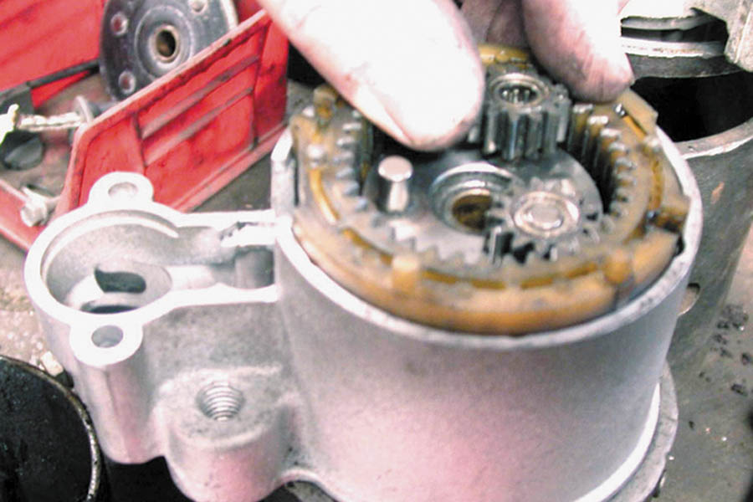
19. The gear-reduction assembly is positioned along with the shift fork (drive lever) into the cleaned drive-end housing.

Slide 51
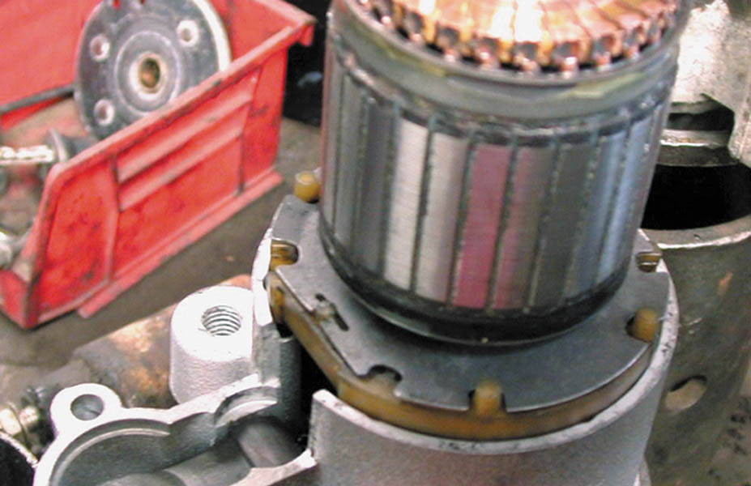
20. After gear retainer has been installed over the gear reduction assembly, the armature is installed.

Slide 52
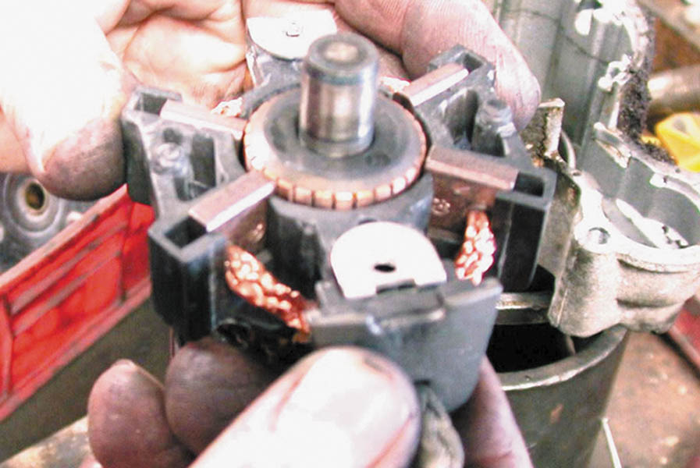
21. New brushes are being installed into the brush holder assembly.

Slide 53
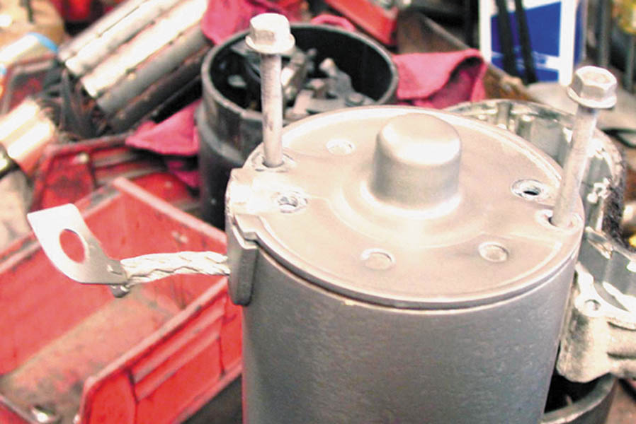
22. The brush end plate and the through bolts are installed, being sure that the ground connection for the brushes is clean and tight.

Slide 54
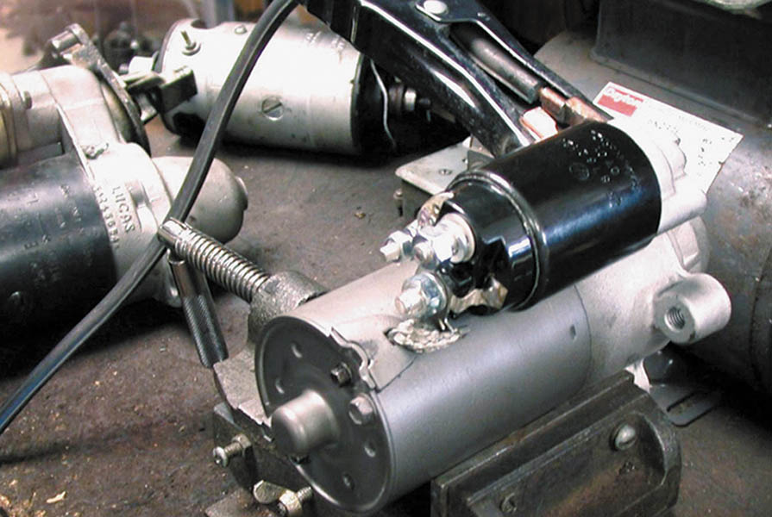
23. This starter was restored to useful service by replacing the solenoid, the brushes, and the starter drive assembly, plus a thorough cleaning and attention to detail in the reassembly.

Slide 55

Copyright

