Slide 1
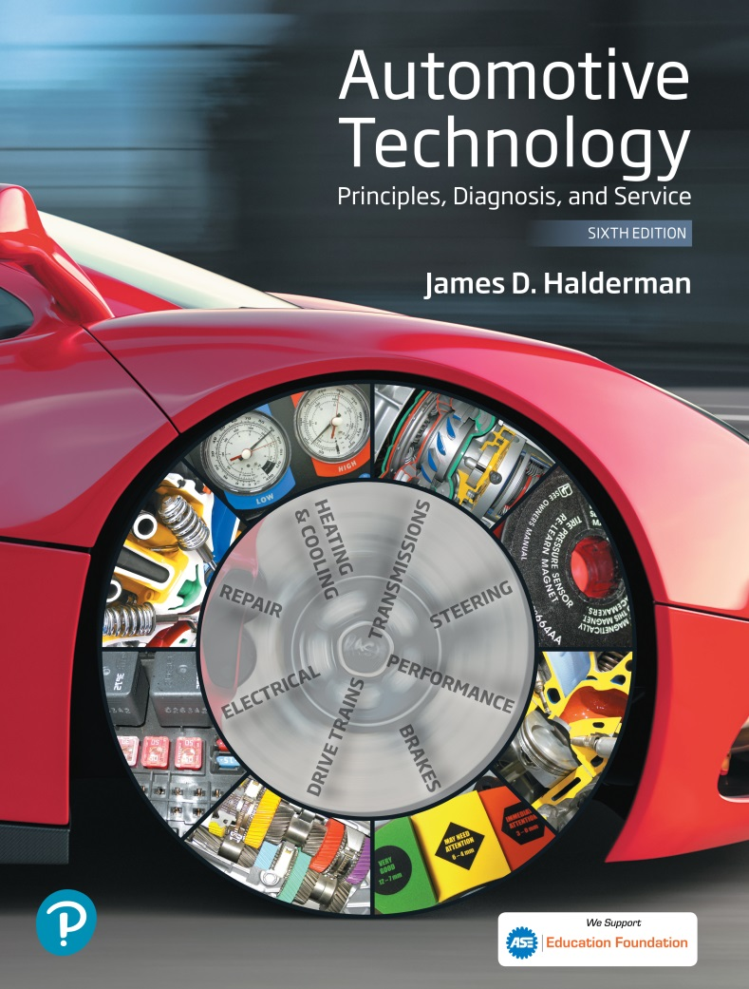
Automotive Technology Principles, Diagnosis, and Service
Sixth Edition
Chapter 52
Cranking System
Copyright © 2018, 2015, 2011 Pearson Education, Inc. All Rights Reserved

Slide 2
LEARNING OBJECTIVES (1 of 2)
52.1 Describe the parts and operation of a cranking circuit and explain computer-controlled starting.
52.2 Discuss how a starter motor converts electrical power into mechanical power.
52.3 List the different types of starters motors.

Slide 3
LEARNING OBJECTIVES (2 of 2)
52.4 Describe gear reduction starters.
52.5 Describe the function of starter drives and solenoids.
52.6 This chapter will help prepare for the ASE Electrical/Electronic Systems (A6) certification test content area “C” (Starting System Diagnosis and Repair).

Slide 4
CRANKING CIRCUIT
Parts Involved
Starter Motor
Battery
Starter Solenoid or Relay
Starter Drive
Ignition Switch
Control Circuit Parts and Operation
The ignition switch does not operate the starter unless the automatic transmission is in neutral or park, or the clutch pedal is depressed on manual transmission/transaxle vehicles

Slide 5
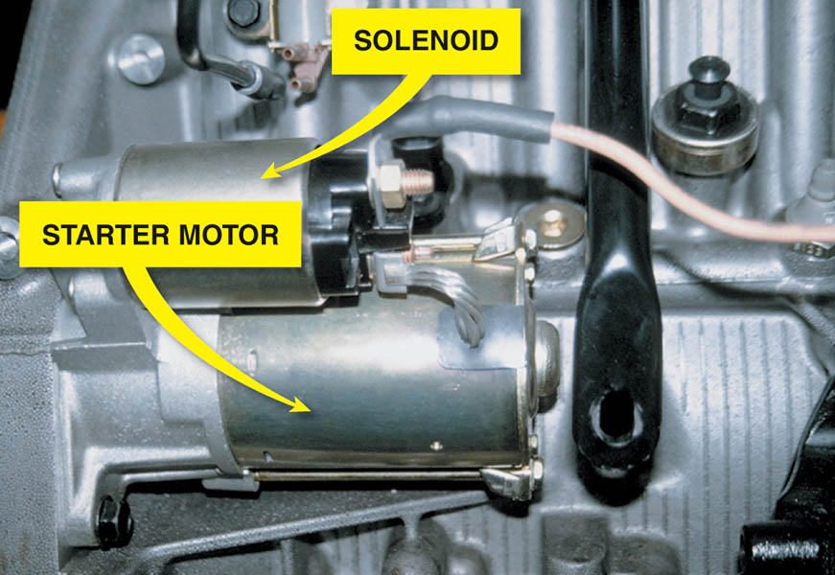
Figure 52.1 A typical solenoid-operated starter

Slide 6
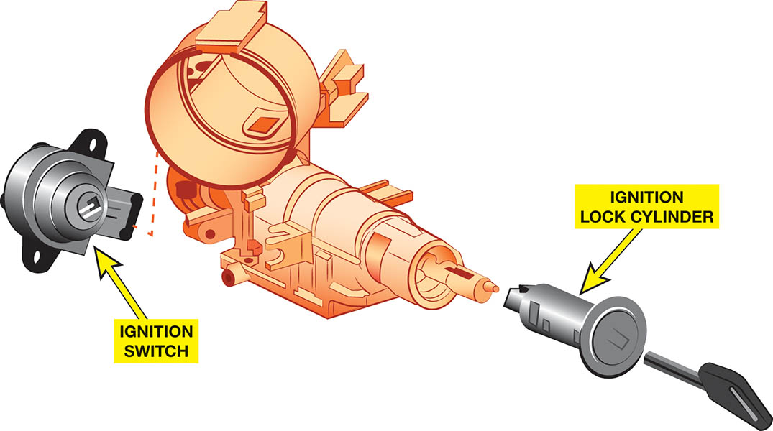
Figure 52.2 The lock cylinder is often a separate part from the electrical ignition switch and operates it directly or uses a link between two components

Slide 7
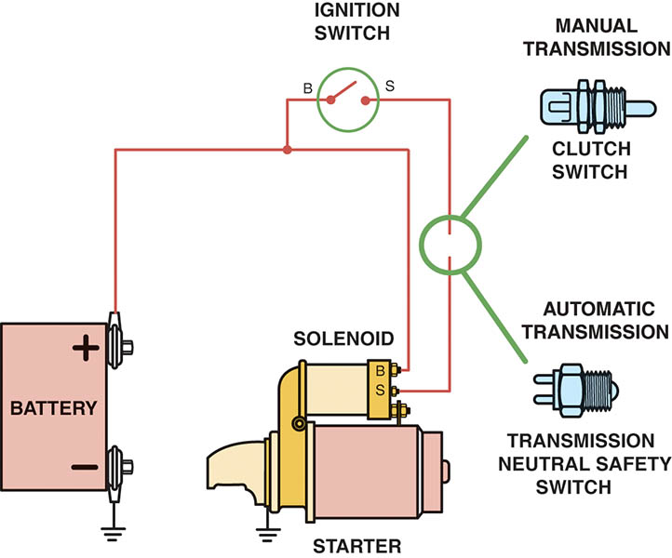
Figure 52.3 To prevent the engine from cranking, an electrical switch is usually installed to open the circuit between the ignition switch and the starter solenoid

Slide 8
QUESTION 1: ?
What are the parts in a typical cranking circuit?

Slide 9
ANSWER 1:
Starter Motor, Battery, Starter Solenoid or Relay, Starter Drive, and Ignition Switch

Slide 10
COMPUTER-CONTROLLED STARTING
Operation
The ignition switch start position on the push-to-start button is used as an input signal to the powertrain control module (PCM).
Remote Starting
Allows the driver to start the engine of the vehicle from a distance of about 200 ft (65 m).
The doors remain locked to reduce the possibility of theft.

Slide 11
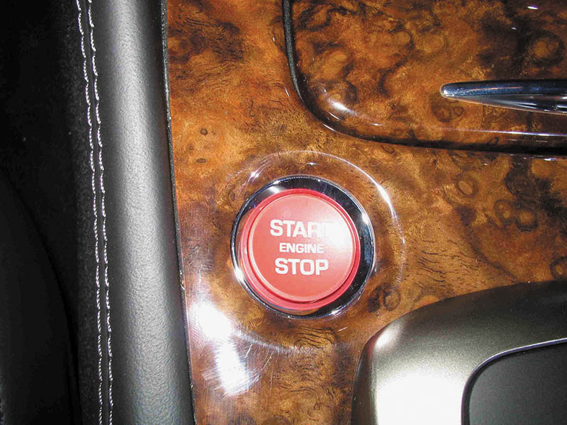
Figure 52.4 Instead of using an ignition key to start the engine, some vehicles are using a start button, which is also used to stop the engine, as shown on this Jaguar

Slide 12
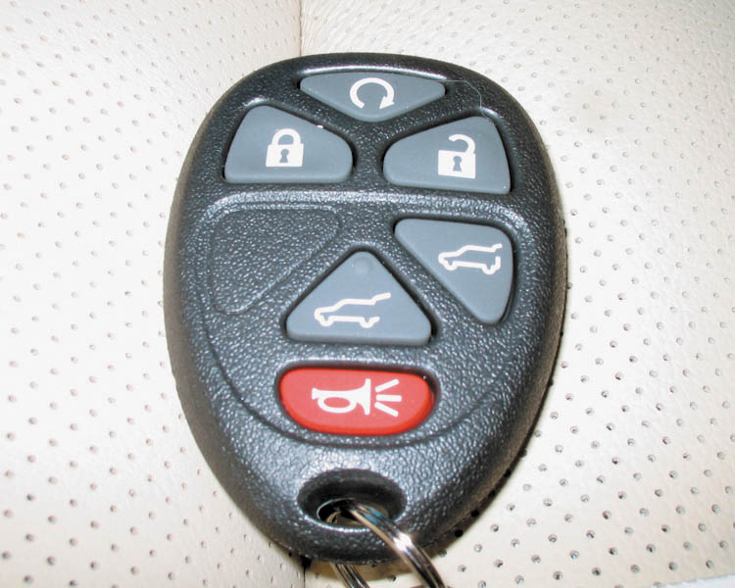
Figure 52.5 The top button on this key fob is the remote start button

Slide 13
STARTER MOTOR OPERATION (1 OF 2)
Principles
A starter motor uses electromagnetic principles to convert electrical energy from the battery (up to 300 amperes) to mechanical power (up to 8 horsepower [6 kilowatts]) to crank the engine.
Series Motors
A series motor develops its maximum torque at the initial start (0 RPM) and develops less torque as the speed increases.

Slide 14
STARTER MOTOR OPERATION (2 OF 2)
Shunt Motors
Shunt-type electric motors have the field coils in parallel (or shunt) across the armature.
Permanent Magnet Motors
Permanent magnet starters use gear reduction to multiply starter motor torque.
Compound Motors
Some of the field coils are connected to the armature in series and some are connected directly to the battery in parallel (shunt) with the armature.

Slide 15
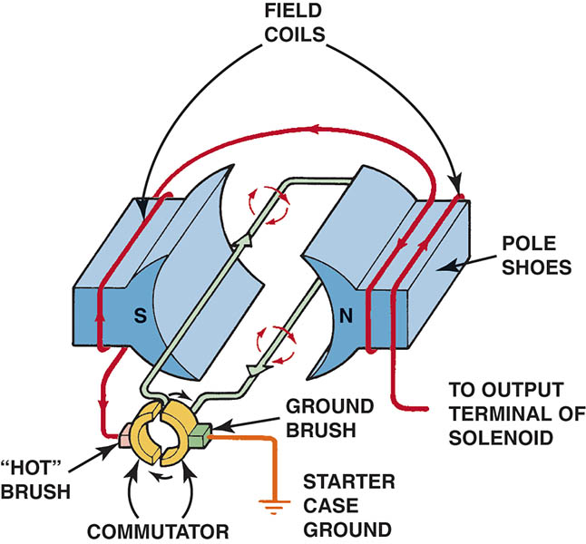
Figure 52.6 This series-wound electric motor shows the basic operation with only two brushes: one hot brush and one ground brush.

Slide 16
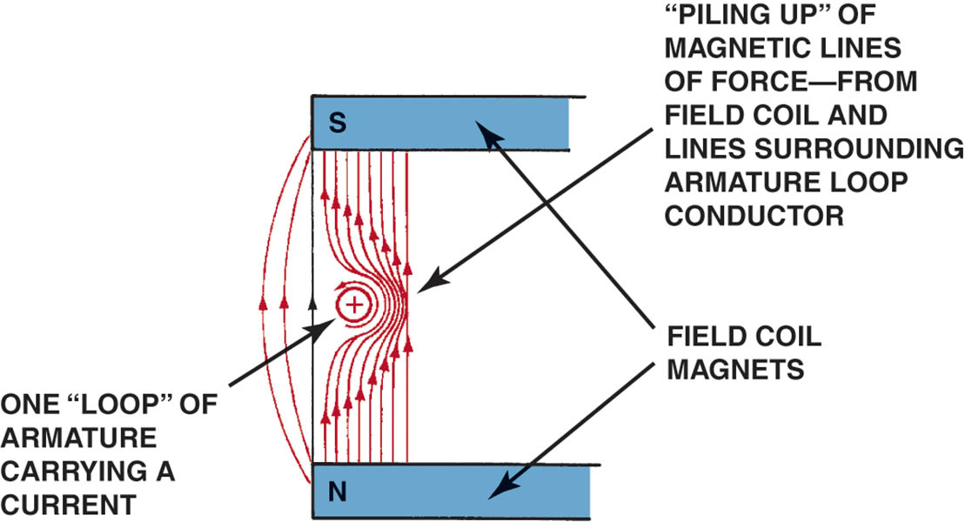
Figure 52.7 The interaction of the magnetic fields of the armature loops and field coils creates a stronger magnetic field on the right side of the conductor, causing the armature loop to move toward the left

Slide 17
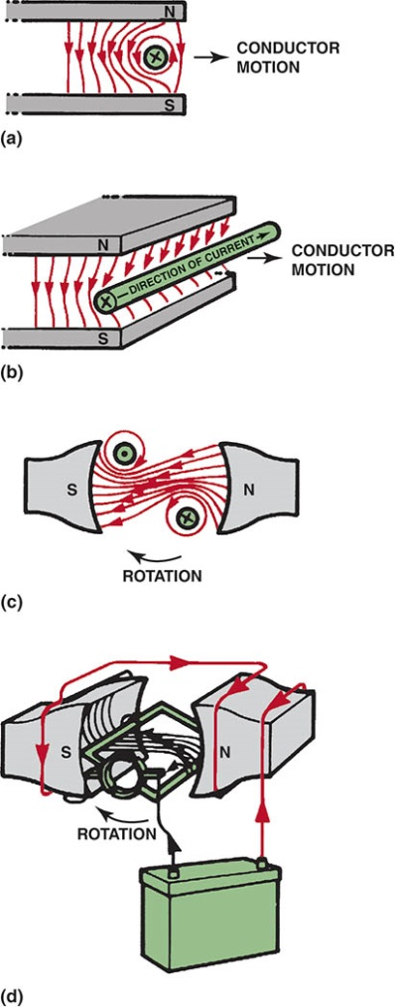
Figure 52.8 The armature loops rotate due to the difference in the strength of the magnetic field. The loops move from a strong magnetic field strength toward a weaker magnetic field strength

Slide 18
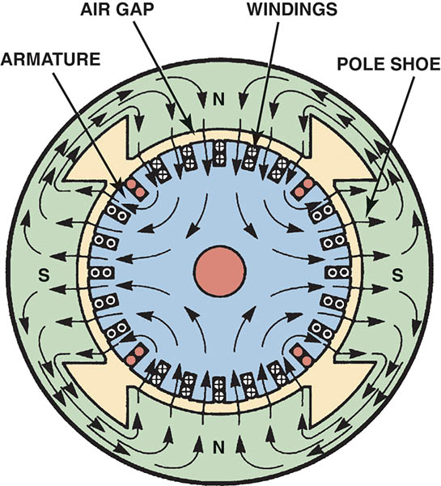
Figure 52.9 Magnetic lines of force in a four-pole motor

Slide 19
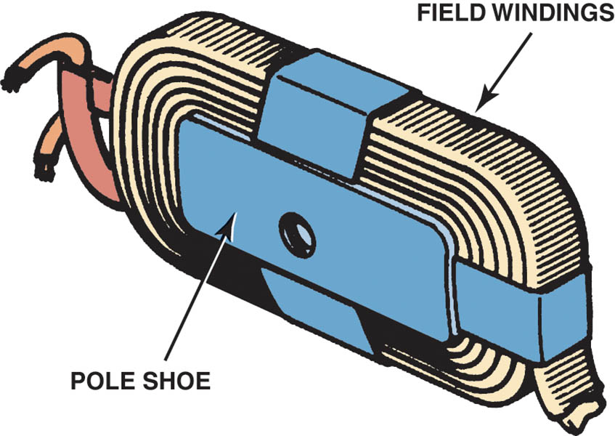
Figure 52.10 A pole shoe and field winding

Slide 20
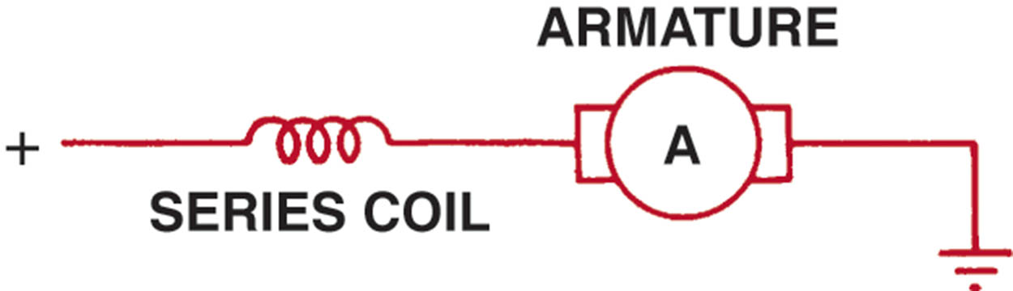
Figure 52.11 This wiring diagram illustrates the construction of a series-wound electric motor. Notice that all current flows through the field coils, then through the armature (in series) before reaching ground

Slide 21
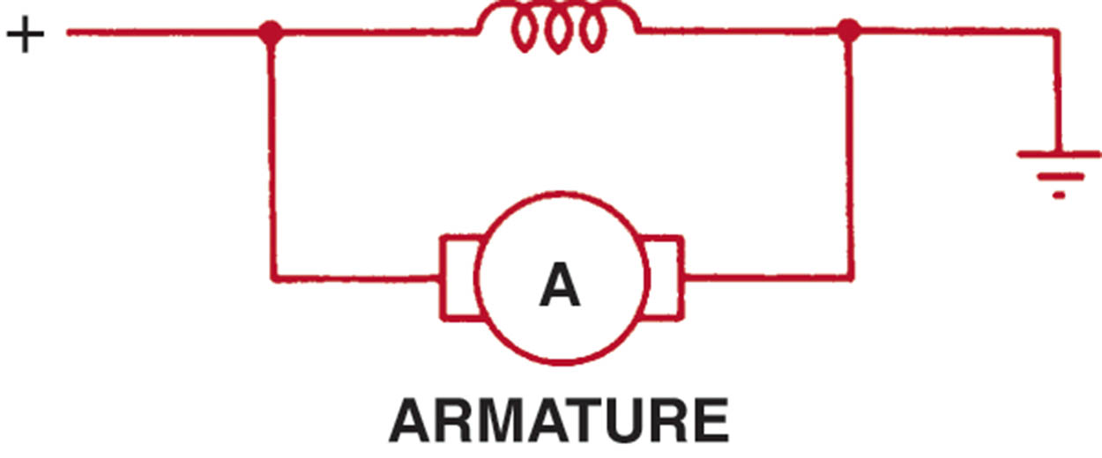
Figure 52.12 This wiring diagram illustrates the construction of a shunt-type electric motor and shows the field coils in parallel (or shunt) across the armature

Slide 22
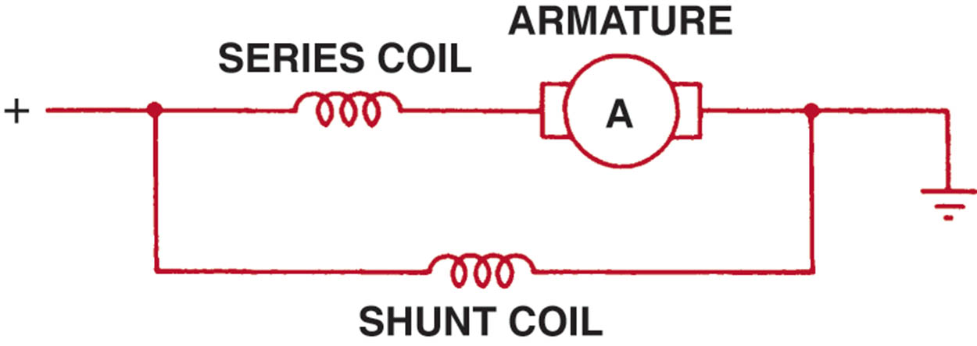
Figure 52.13 A compound motor is a combination of series and shunt types, using part of the field coils connected electrically in series with the armature and part in parallel (shunt)

Slide 23
HOW THE STARTER MOTOR WORKS
Parts Involved
Field Coils
Armature
Field Housing
Starter Brushes
To supply the proper current to the armature, a four-pole motor must have four brushes riding on the commutator.
Permanent Magnet Fields
Used in place of the electromagnetic field coils.

Slide 24
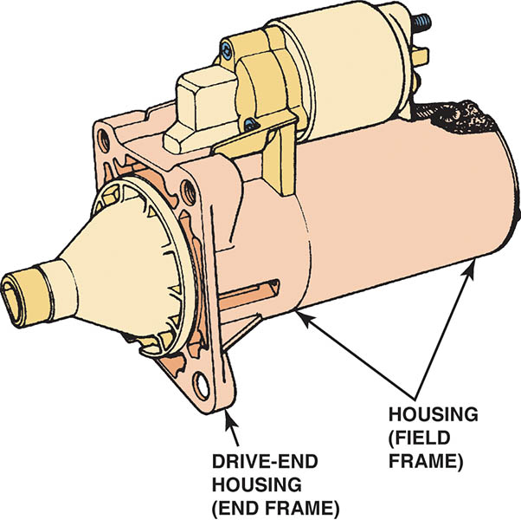
Figure 52.14 A typical starter motor showing the drive-end housing

Slide 25
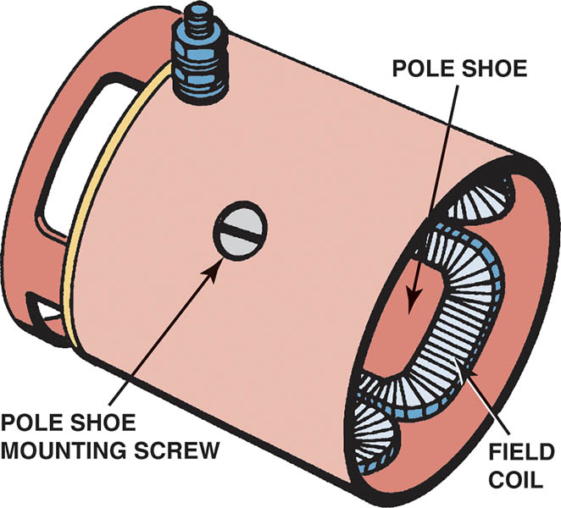
Figure 52.15 Pole shoes and field windings installed in the housing

Slide 26
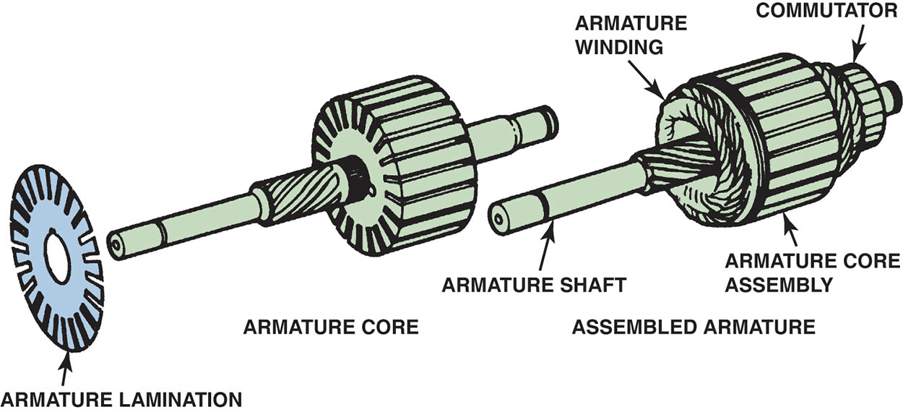
Figure 52.16 A typical starter motor armature. The armature core is made from thin sheet metal sections assembled on the armature shaft, which is used to increase the magnetic field strength

Slide 27
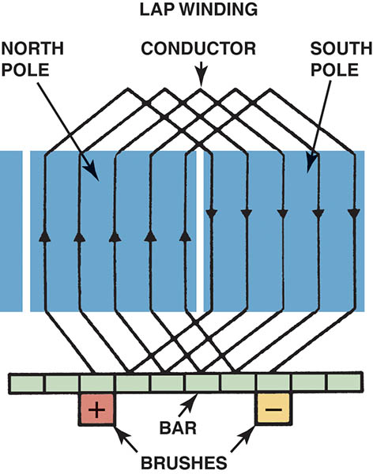
Figure 52.17 An armature showing how its copper wire loops are connected to the commutator

Slide 28
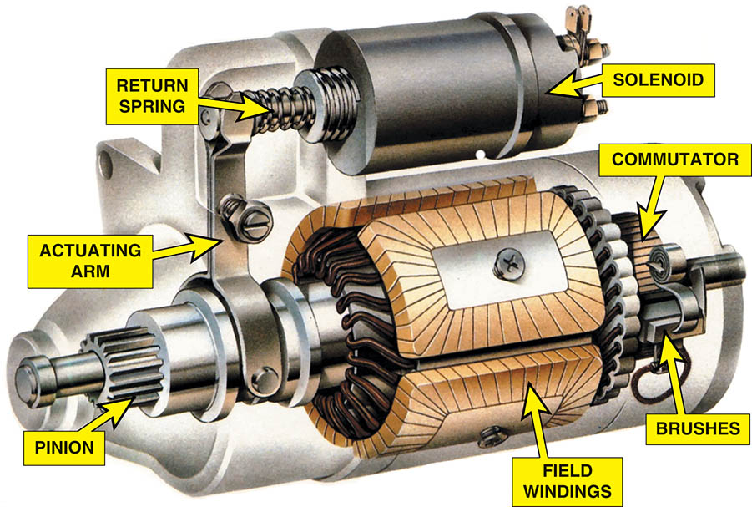
Figure 52.18 A cutaway of a typical starter motor showing the commutator, brushes, and brush spring

Slide 29
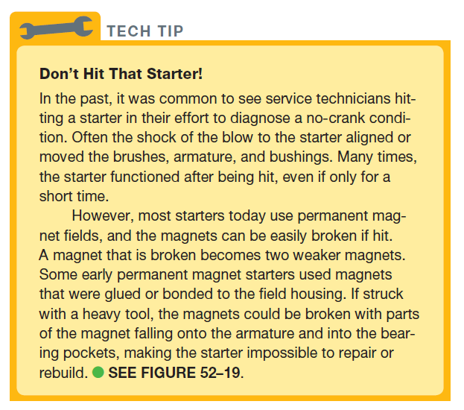
Tech Tip

Slide 30
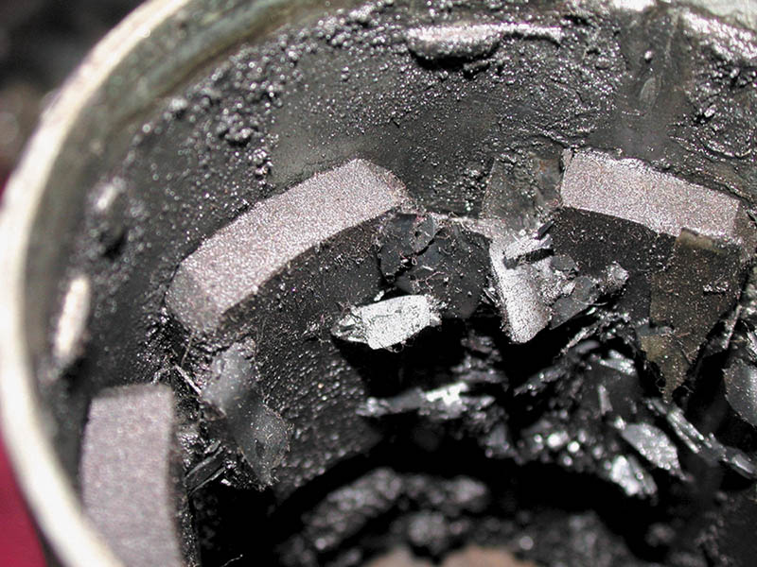
Figure 52.19 This starter permanent magnet field housing was ruined when someone used a hammer on the field housing in an attempt to “fix” a starter that did not work. A total replacement is the only solution in this case

Slide 31
GEAR-REDUCTION STARTERS
Purpose and Function
The purpose of the gear reduction (typically 2:1 to 4:1) is to increase starter motor speed and provide the torque multiplication necessary to crank an engine.
Produces the necessary cranking power with reduced starter amperage requirements
Uses a planetary gear set (a type of gear reduction) to provide the necessary torque for starting

Slide 32
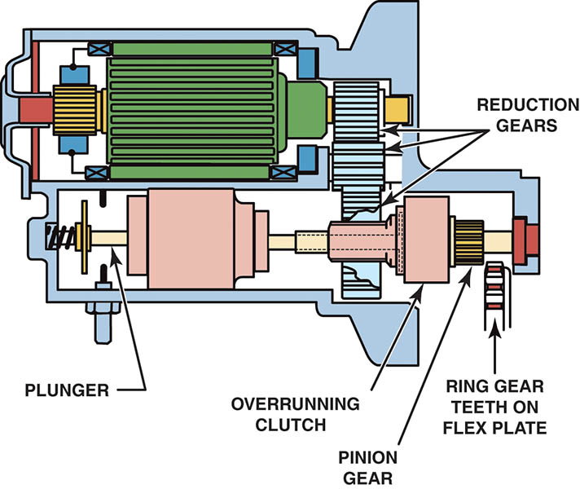
Figure 52.20 A typical gear-reduction starter

Slide 33
STARTER DRIVES (1 Of 2)
Purpose and Function
A starter drive includes small pinion gears that mesh with and rotate the larger gear on the engine flywheel or flex plate for starting.
Starter Drive Gear Ratio
The engine ring gear to starter pinion ratio is between 15:1 and 20:1.

Slide 34
STARTER DRIVES (2 OF 2)
Starter Drive Operation
Uses a type of one-way clutch that allows the starter to rotate the engine, but then turns freely if the engine speed is greater than the starter motor speed.
Failure Mode
The major wear occurs in the overrunning clutch section of the starter drive unit.
The entire starter drive is replaced as a unit.

Slide 35
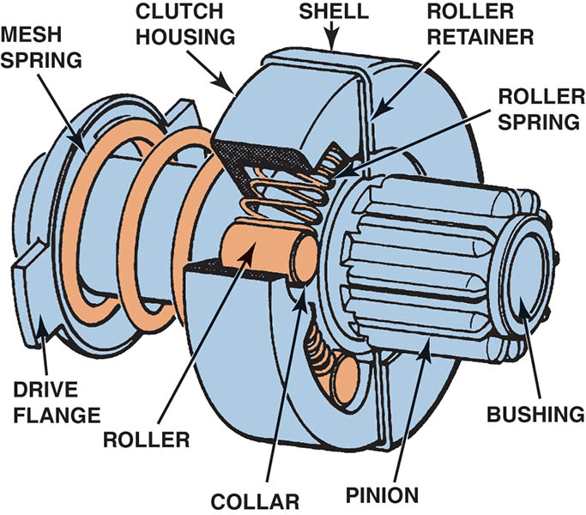
Figure 52.21 A cutaway of a typical starter drive showing all of the internal parts

Slide 36
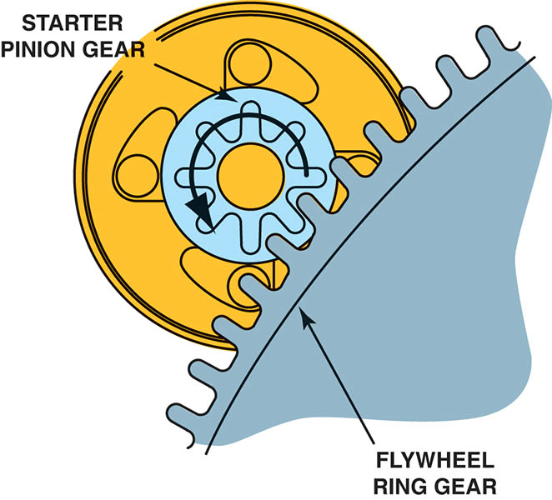
Figure 52.22 The ring gear to pinion gear ratio is usually 15:1 to 20:1

Slide 37
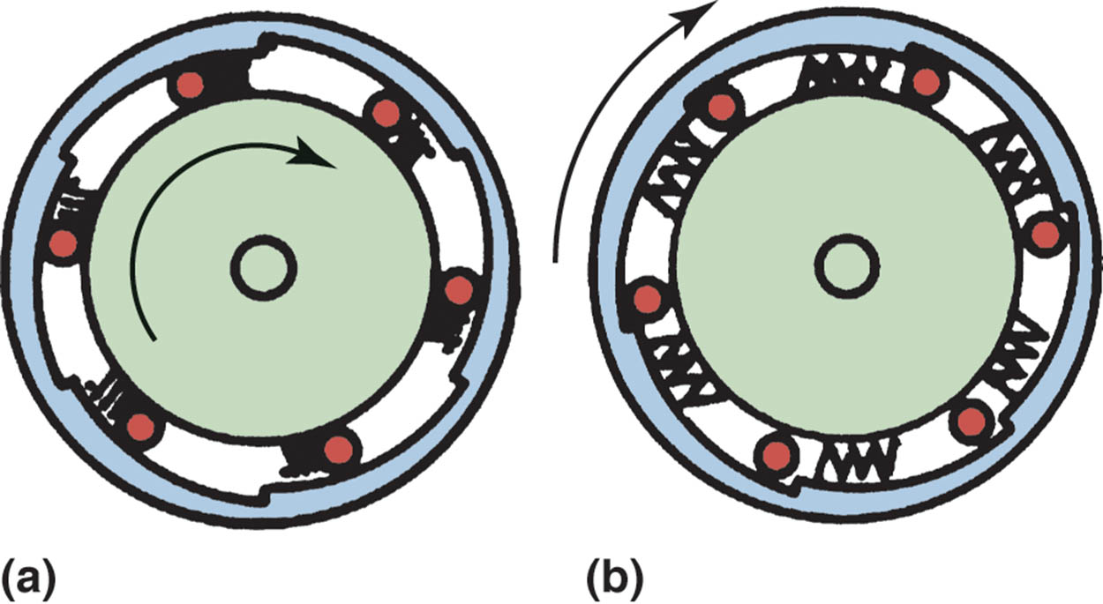
Figure 52.23 Operation of the overrunning clutch. (a) Starter motor is driving the starter pinion and cranking the engine. The rollers are wedged against spring force into their slots. (b) The engine has started and is rotating faster than the starter armature. Spring force pushes the rollers so they can rotate freely

Slide 38
QUESTION 2: ?
What is the typical engine ring rear to starter pinion ratio?

Slide 39
ANSWER 2:
15:1 to 20:1

Slide 40
STARTER SOLENOIDS
Solenoid Operation
A starter solenoid is an electromagnetic switch containing two separate, but connected, electromagnetic windings.
Solenoid Windings
The two internal windings contain approximately the same number of turns but are made from different-gauge wire.

Slide 41
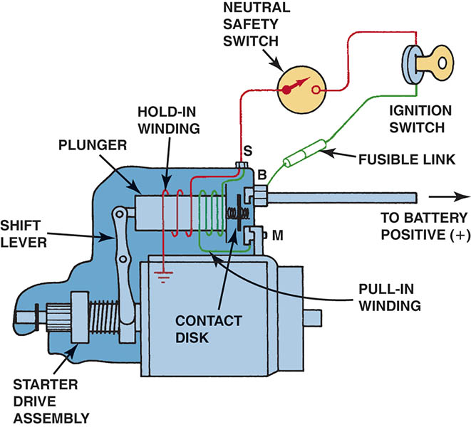
Figure 52.24 Wiring diagram of a typical starter solenoid. Notice that both the pull-in winding and the hold-in winding are energized when the ignition switch is first turned to the “start” position.

Slide 42
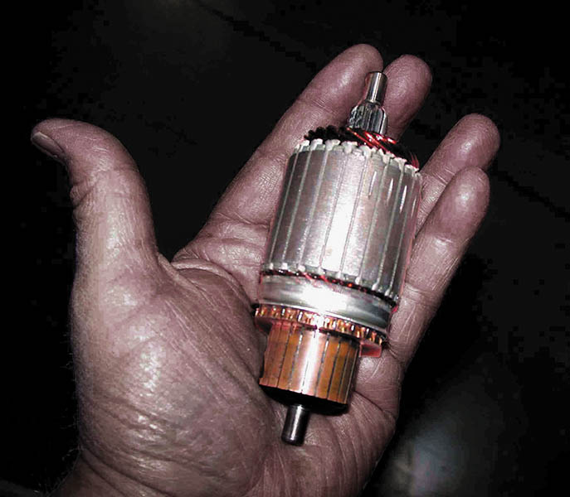
Figure 52.25 A palm-size starter armature

Slide 43
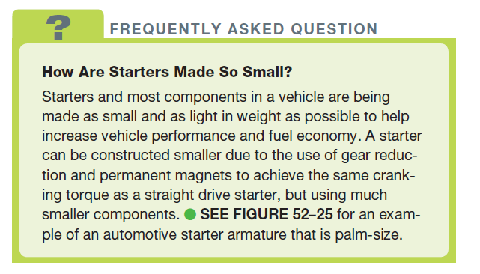
FREQUENTLY ASKED QUESTION

Slide 44
START-STOP SYSTEMS (1 OF 2)
Purpose and Function
Stop-start systems are designed to increase fuel economy and reduce exhaust emissions.
Conditions for Start-Stop to Occur
Accelerator pedal not depressed
Vehicle speed is low or zero
Battery state-of-charge above threshold
Hood is closed

Slide 45
START-STOP SYSTEMS (2 OF 2)
Start-Stop System Components
An AGM or ELA battery
Battery Sensor
Low Engine Speeds
Hood Switch
HVAC Control Unit
Starter Motor Design
Advanced Engagement (AE) Starter
Tandem Solenoid (TS) Starter

Slide 46
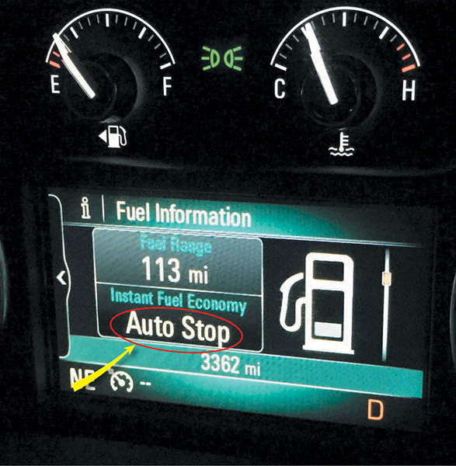
Figure 52.26 A Buick Auto Stop system lets the driver know when the engine is stopped

Slide 47
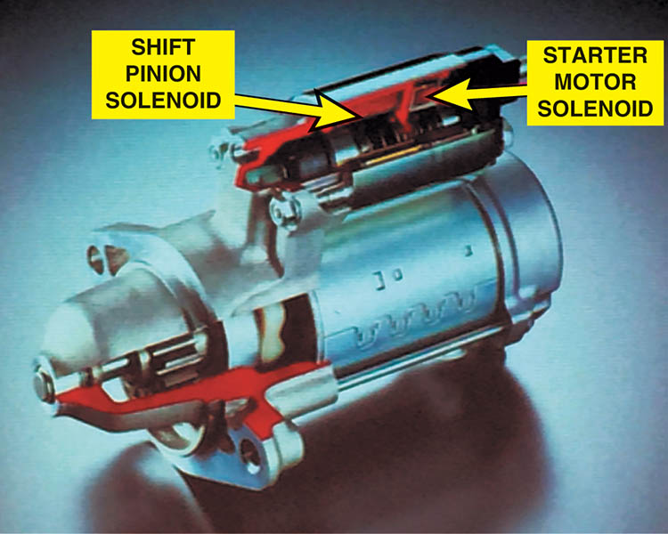
Figure 52.27 Using two solenoids allows independent control of the pinion gear and motor energization

Slide 48
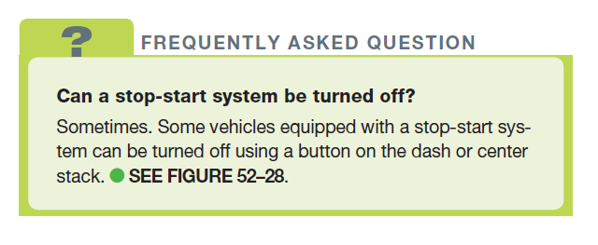
FREQUENTLY ASKED QUESTION

Slide 49
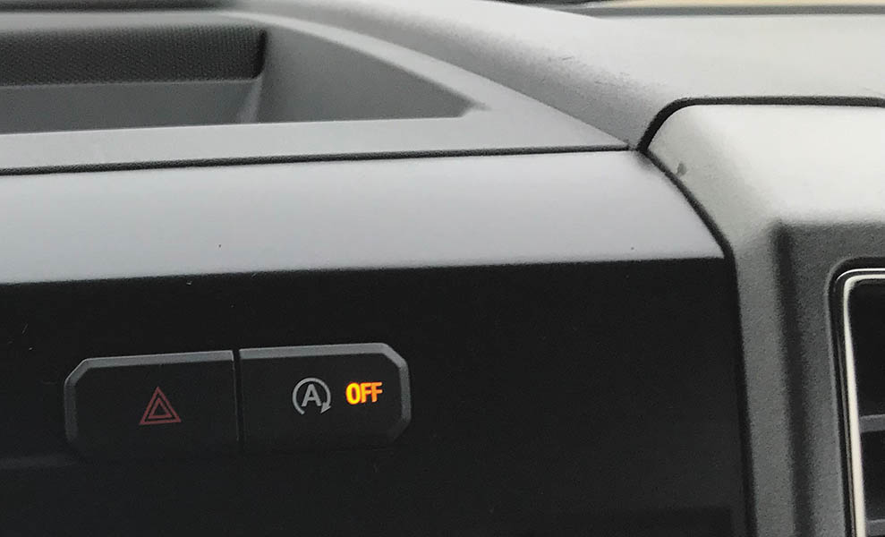
Figure 52.28 The stop-start system on this Ford F-150 pickup truck can be turned off using a switch on the dash

Slide 50
QUESTION 3: ?
What are the main advantages of a start-stop system?

Slide 51
ANSWER 3:
Improved fuel economy and reduced tailpipe emissions.

Slide 52

Copyright

