Slide 1

Automotive Technology Principles, Diagnosis, and Service
Sixth Edition
Chapter 50
Batteries
Copyright © 2018, 2015, 2011 Pearson Education, Inc. All Rights Reserved

Slide 2
LEARNING OBJECTIVES (1 of 2)
50.1 Describe the construction of a battery.
50.2 Describe how a battery works.
50.3 Discuss how charge indicators work.

Slide 3
LEARNING OBJECTIVES (2 of 2)
50.4 Discuss valve regulated batteries and the causes of battery failure.
50.5 List battery ratings and battery sizes.
50.6 This chapter will help you prepare for the ASE Electrical/Electronic Systems (A6) certification test content area “B” (Battery Diagnosis and Service).

Slide 4
INTRODUCTION
Purpose and Function
The primary purpose of an automotive battery is to provide a source of electrical power for starting, and for electrical demands that exceed alternator output.
Why Batteries are Important
The battery also acts as a voltage stabilizer for the entire electrical system.

Slide 5
BATTERY CONSTRUCTION (1 OF 3)
Case
Constructed of polypropylene, a thin (approximately 0.08 inch or 0.02 millimeter thick), strong, and lightweight plastic.
Grids
Each positive and negative plate in a battery is constructed on a framework, or grid, made primarily of lead.
Positive Plates
The positive plates have lead dioxide (peroxide) placed onto the grid framework

Slide 6
BATTERY CONSTRUCTION (2 OF 3)
Negative Plates
The negative plates are pasted to the grid with a pure porous lead.
Separators
Non-conducting separators are used, which allow room for the reaction of the acid with both plate materials.
Cells
Cells are constructed of positive and negative plates with insulating separators between each plate.

Slide 7
BATTERY CONSTRUCTION (3 OF 3)
Partitions
Each cell is separated from the other cells by partitions, which are made of the same material as that used for the outside case of the battery.
Electrolyte
The term used to describe the acid solution in a battery.

Slide 8
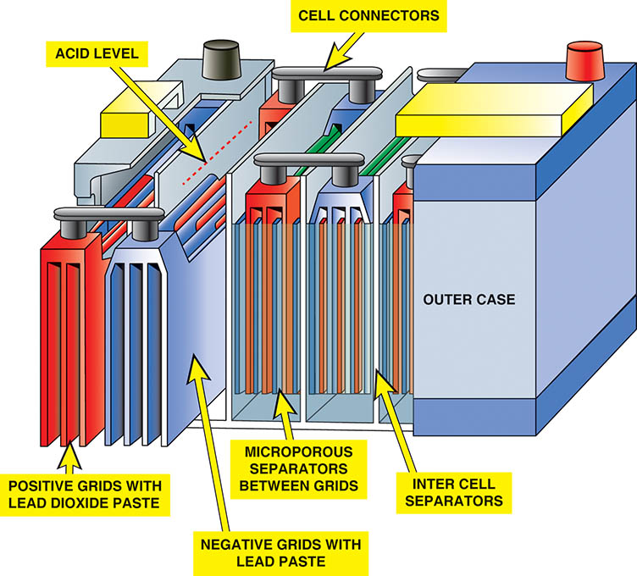
Figure 50.1 Batteries are constructed of plates grouped into cells and installed in a plastic case

Slide 9
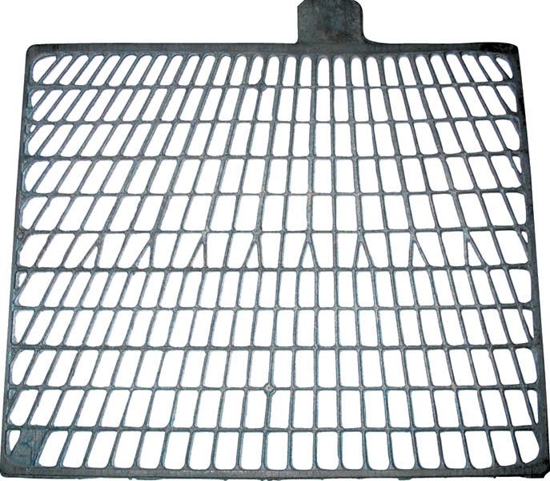
Figure 50.2 A grid from a battery used in both positive and negative plates

Slide 10
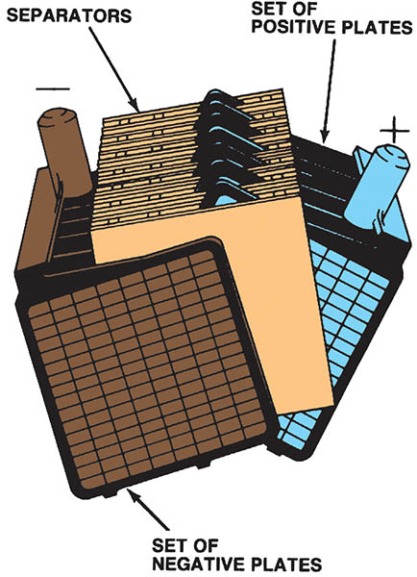
Figure 50.3 Two groups of plates are combined to form a battery element

Slide 11
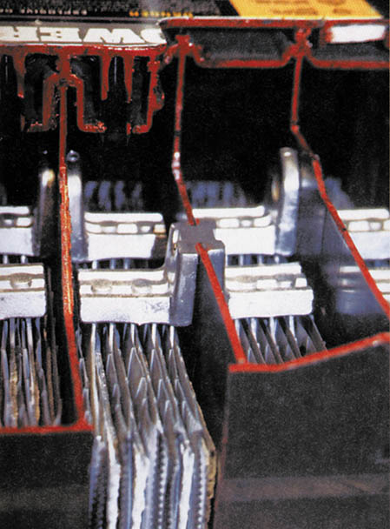
Figure 50.4 A cutaway battery showing the connection of the cells to each other through the partition

Slide 12
QUESTION 1: ?
What is a battery separator?

Slide 13
ANSWER 1:
A Non-conducting spacer, which allow room for the reaction of the acid with both plate materials.

Slide 14
HOW A BATTERY WORKS (1 OF 2)
Principles Involved
When two dissimilar metals are placed in an acid, electrons flow between the metals if a circuit is connected between them.
During Discharging
The acid (SO4) is leaving the electrolyte and getting onto both plates.

Slide 15
HOW A BATTERY WORKS (2 OF 2)
Fully Discharged State
Both the positive and the negative plates are PbSO4 (lead sulfate) and the electrolyte has become water.
During Charging
The sulfate from the acid leaves both the positive and the negative plates and returns to the electrolyte, where it becomes a normal-strength sulfuric acid solution.

Slide 16
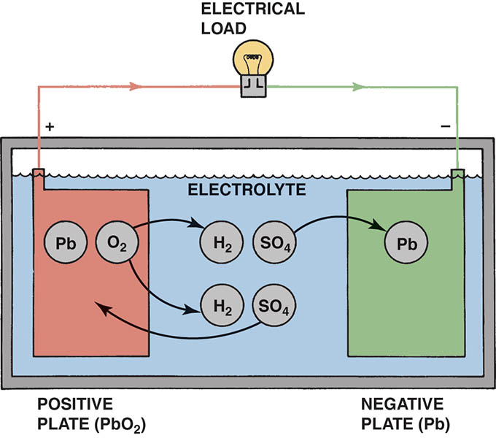
Figure 50.5 Chemical reaction for a lead–acid battery that is fully charged being discharged by the attached electrical load

Slide 17
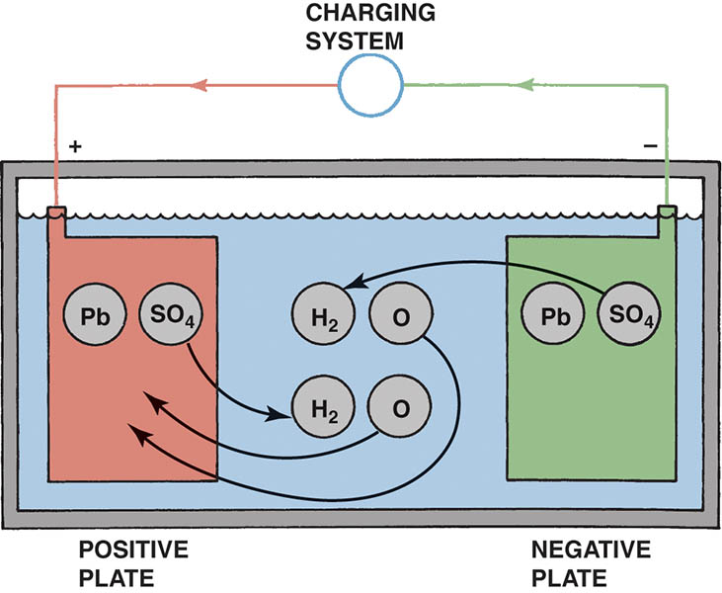
Figure 50.6 Chemical reaction for a lead–acid battery that is fully discharged being charged by the attached generator

Slide 18
SPECIFIC GRAVITY
Definition
The amount of sulfate in the electrolyte.
Charge Indicators
The indicator is simply a small, ball-type hydrometer that is installed in one cell.
The hydrometer is testing only one cell
May not accurately reflect condition of other cells.

Slide 19
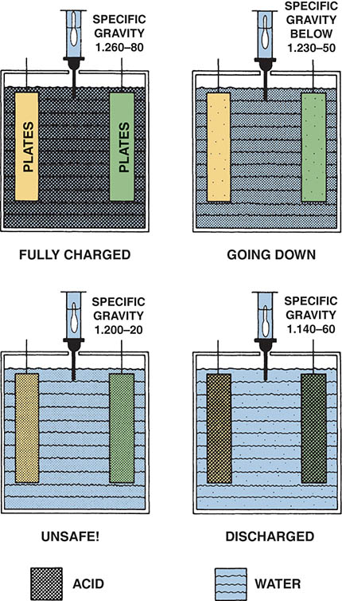
Figure 50.7 As the battery becomes discharged, the specific gravity of the battery acid decreases. Because the electrolyte is close to water when discharged, a dead battery can freeze in cold weather

Slide 20
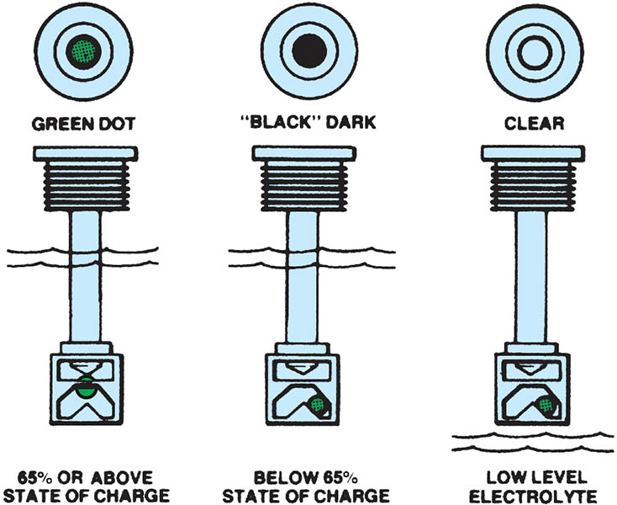
Figure 50.8 Typical battery charge indicator. If the specific gravity is low (battery discharged), the ball drops away from the reflective prism. When the battery is charged enough, the ball floats and reflects the color of the ball (usually green) back up through the sight glass and the sight glass is dark

Slide 21
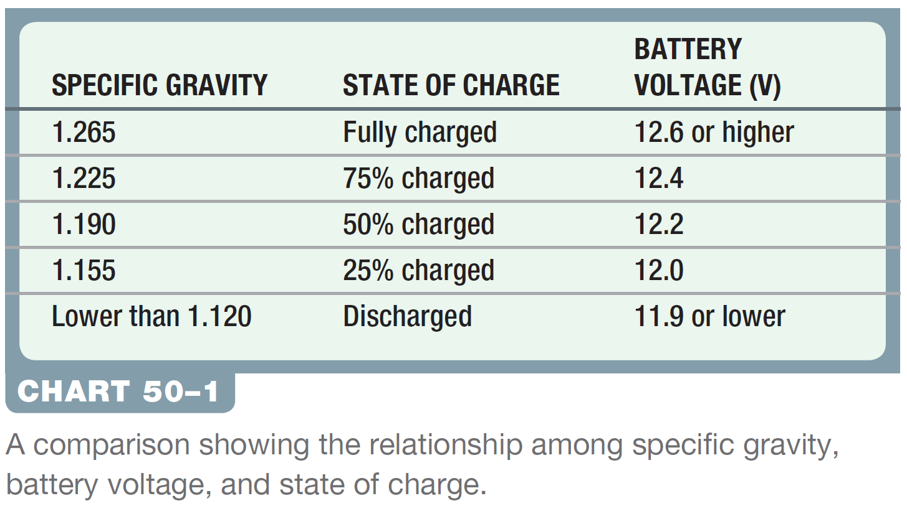
Chart 50-1 A comparison showing the relationship among specific gravity, battery voltage, and state of charge.

Slide 22
BATTERY CONSTRUCTION TYPES (1 OF 2)
Flooded Batteries
Conventional batteries use a liquid electrolyte and are called flooded lead acid (FLA) batteries.
Enhanced Flooded Batteries
Is a flooded battery (NOT an absorbed glass mat battery) that is optimized to work with stop/start vehicle systems.
Absorbed Glass Mat (AGM)
The acid used in an (AGM) battery is totally absorbed into the separator, making the battery leak proof and spill proof.

Slide 23
BATTERY CONSTRUCTION TYPES (2 OF 2)
Gelled Electrolyte Battery
Silica is added to the electrolyte, which turns the electrolyte into a substance similar to gelatin.
Valve-Regulated Lead-Acid Batteries
Use a low-pressure venting system that releases excess gas and automatically reseals if a buildup of gas is created due to overcharging.

Slide 24
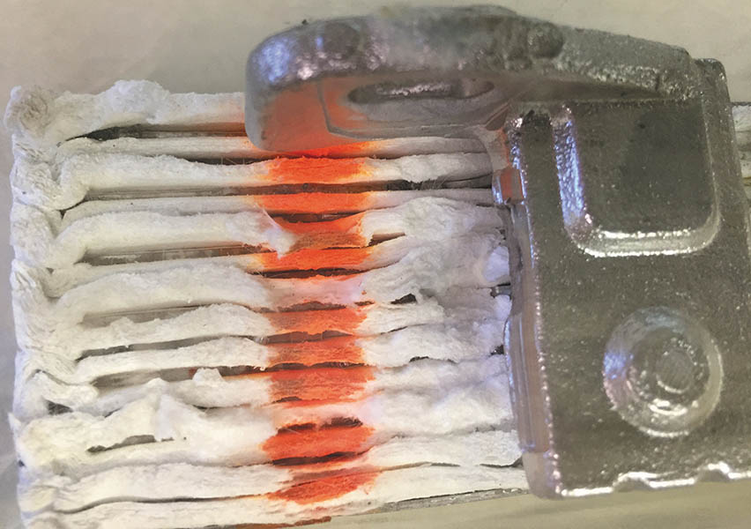
Figure 50.9 A close up of a AGM cell showing the mat totally encasing the plates

Slide 25
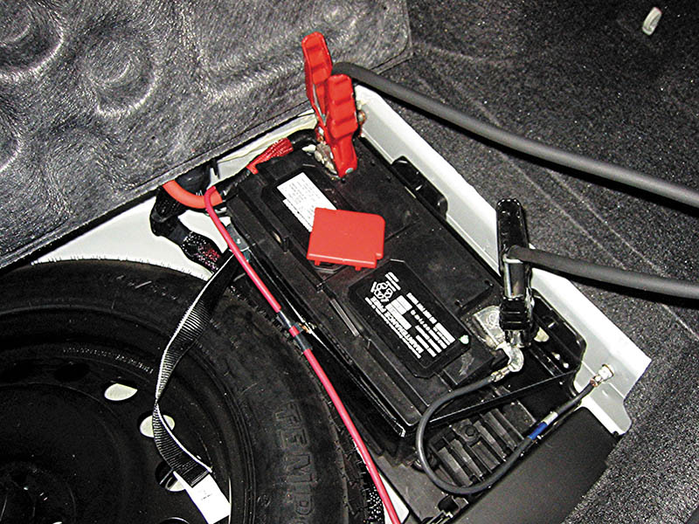
Figure 50.10 A AGM battery under the floor next to the spare tire on a Lexus NX300h hybrid-electric vehicle

Slide 26
CAUSES AND TYPES OF BATTERY FAILURE (1 OF 2)
Normal Life
A useful service life of three to seven years
Battery Sulfation
When a battery is left in a discharged condition
Charging Voltage
Overcharging also causes the active plate material to disintegrate and fall out of the supporting grid framework

Slide 27
CAUSES AND TYPES OF BATTERY FAILURE (2 OF 2)
Battery Hold-Downs
Battery hold-down clamps or brackets help reduce vibration, which can greatly reduce the capacity and life of any battery.
Battery Vent Tubes
If a battery is installed inside a vehicle, vent tubes are used to route battery fumes to the outside so they don't get into the passenger compartment.

Slide 28
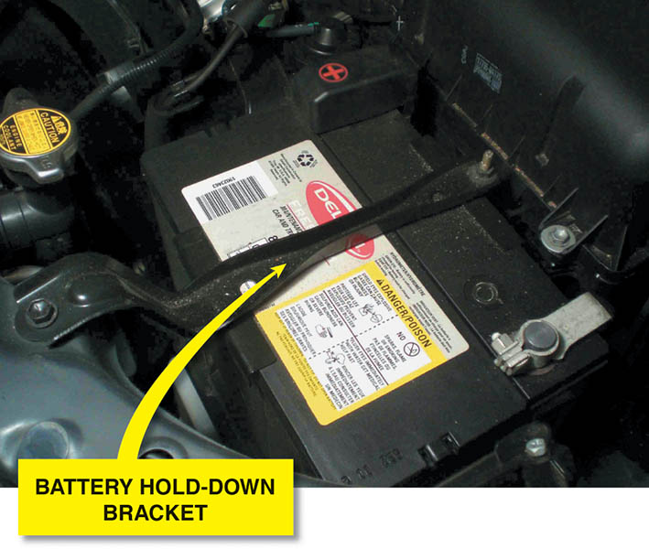
Figure 50.11 A typical battery hold-down bracket. All batteries should use a bracket to prevent battery damage due to vibration and shock

Slide 29
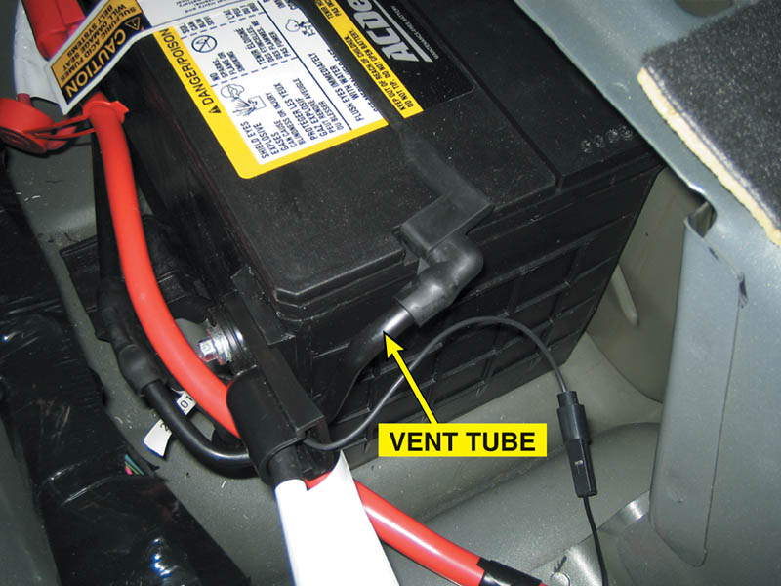
Figure 50.12 A battery installed under the rear seat of a Cadillac showing the vent tubes

Slide 30
QUESTION 2: ?
What is meant by a sulfated battery?

Slide 31
ANSWER 2:
When a battery is left in a discharged condition, the lead sulfate re-crystallizes into hard lead
sulfate.

Slide 32
BATTERY RATINGS (1 OF 2)
Cold-Cranking Amps
The number of amperes that can be supplied by a battery at 0°F (-18°C) for 30 seconds while the battery still maintains a voltage of 1.2 volts per cell or higher.
Cranking Amps
The number of amperes that can be supplied by a battery at 32°F (0°C).
Marine Cranking Amps
Similar to cranking amperes and is tested at 32°F (0°C).

Slide 33
BATTERY RATINGS (2 OF 2)
Reserve Capacity
The number of minutes that the battery can produce 25 amperes and still have a battery voltage of 1.75 volts per cell (10.5 volts for a 12-volt battery).
Ampere Hour
Measures how many amperes of current the battery can produce over a period of time.

Slide 34

Figure 50.13 This battery has a cranking amperes (CA) rating of 1,000. This means that this battery is capable of cranking an engine for 30 seconds at a temperature of 32°F (0°C) at a minimum of 1.2 volts per cell (7.2 volts for a 12-volt battery)

Slide 35
BATTERY SIZES
BCI Group Sizes
Battery sizes are standardized by the Battery Council International (BCI).
Typical Group Size Applications
24/24F (top terminals)
34/78 (dual terminals, both side and top posts)
35 (top terminals)
65 (top terminals)
75 (side terminals)
78 (side terminals)

Slide 36
QUESTION 3: ?
What does the BCI group number mean?

Slide 37
ANSWER 3:
The battery is a specific size and terminal configuration.

Slide 38

Copyright

