Slide 1

Automotive Technology Principles, Diagnosis, and Service
Sixth Edition
Chapter 49
CAN and Network Communications
Copyright © 2018, 2015, 2011 Pearson Education, Inc. All Rights Reserved

Slide 2
LEARNING OBJECTIVES (1 of 2)
49.1 Discuss how networks connect to the data link connector and to other modules.
49.2 Describe the types of networks and serial communications used on vehicles.
49.3 Describe the features of a controller area network.

Slide 3
LEARNING OBJECTIVES (2 of 2)
49.4 Compare the network communications of common U.S., Asian, and European vehicle brands.
49.5 Explain how to diagnose module communication faults.
49.6 List the shared features of all OBD-II vehicles.
49.7 This chapter will help you prepare for the ASE Electrical/Electronic Systems (A6) certification test content area “A” (General Electrical/Electronic System Diagnosis).

Slide 4
MODULE COMMUNICATIONS AND NETWORKS
Need for Network
A typical vehicle has 10 or more modules, and they communicate with each other over data lines or hard wiring, depending on the application.
Advantages
A decreased number of wires are needed
Common sensor data can be shared

Slide 5
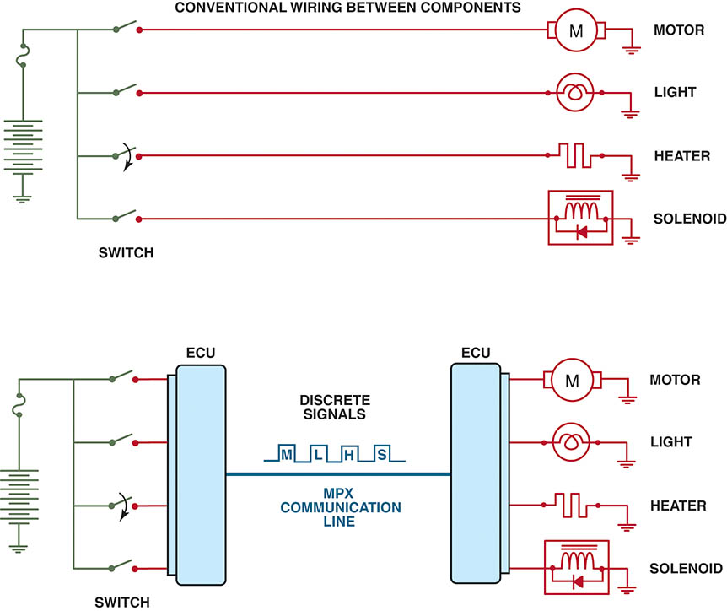
Figure 49.1 Module communications makes controlling multiple electrical devices and accessories easier by utilizing simple low-current switches to signal another module, which does the actual switching of the current to the device

Slide 6
QUESTION 1: ?
Why is a communication network used?

Slide 7
ANSWER 1:
A decreased number of wires are needed and common sensor data can be shared.

Slide 8
NETWORK FUNDAMENTALS
Modules and Nodes
Each module, also called a node, must communicate to other modules.
Types of Communication
Differential
Parallel
Serial data
Multiplexing

Slide 9
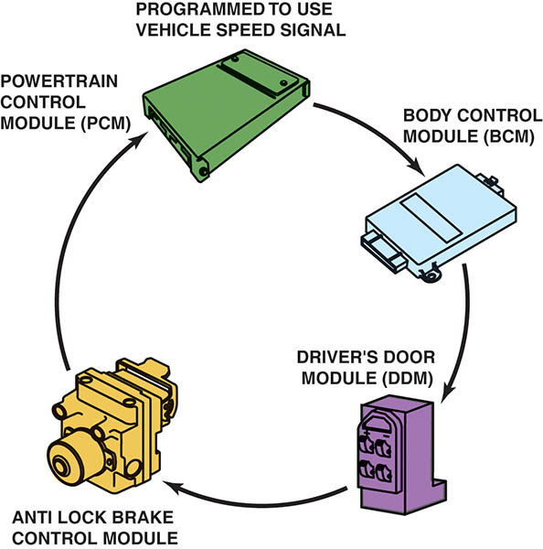
Figure 49.2 A network allows all modules to communicate with other modules

Slide 10
MODULE COMMUNICATIONS CONFIGURATION
Ring Link Networks
All modules are connected in a ring
Star Link Networks
Each module is connected at a single point
Ring/Star Hybrid
In a ring/star network, the modules are connected using both types of network configurations

Slide 11
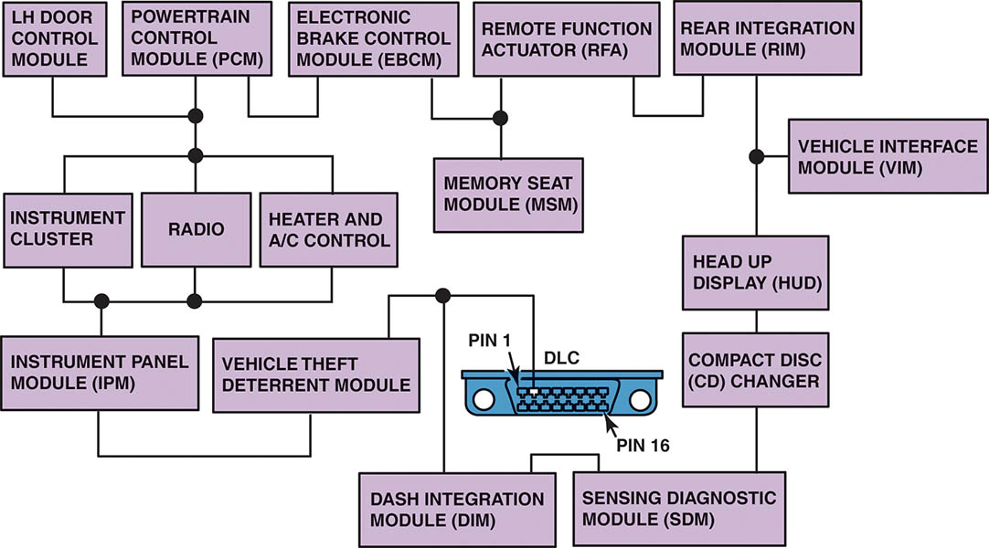
Figure 49.3 A ring link network reduces the number of wires it takes to interconnect all of the modules

Slide 12
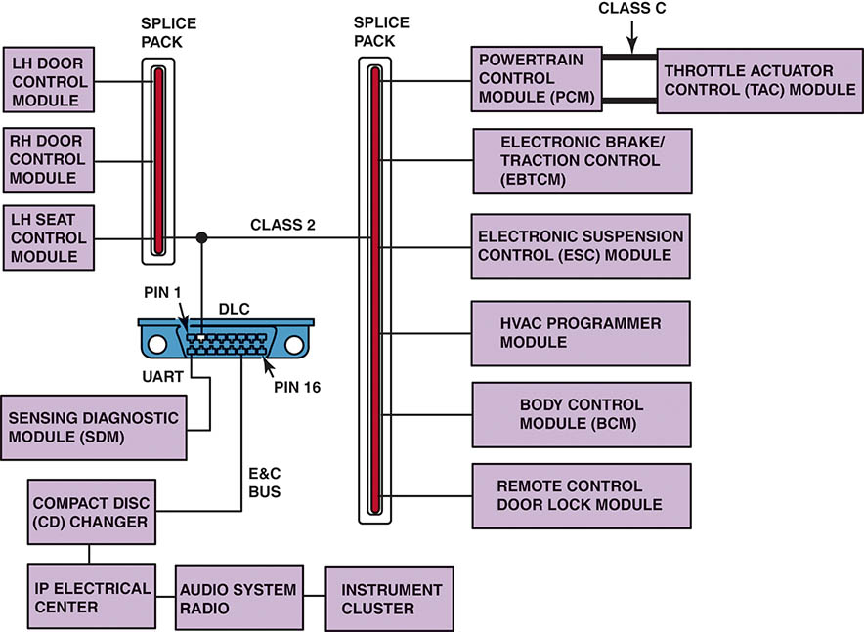
Figure 49.4 In a star link network, all of the modules are connected using splice packs

Slide 13
NETWORK COMMUNICATION CLASSIFICATIONS
Class A
Low-speed networks, meaning less than 10,000 bits per second (bps, or 10 Kbs)
Class B
Medium-speed networks, meaning 10,000 to 125,000 bps (10 to 125 Kbs)
Class C
High-speed networks, meaning 125,000 to 1,000,000 bps

Slide 14
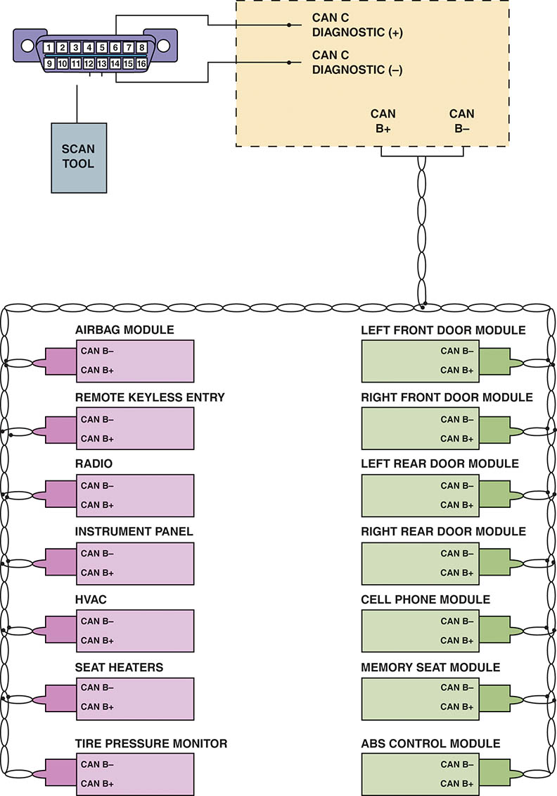
Figure 49.5 A typical BUS system showing module CAN communications and twisted pairs of wire

Slide 15
GM COMMUNICATIONS PROTOCOLS (1 OF 2)
UART
UART uses a fixed pulse-width switching between 0 and 5 volts.
Entertainment and Comfort Communications
Serial data is similar to UART, but uses a 0 to 12 volts toggle.
Class 2 Communications
Operates by toggling between 0 and 7 volts at a transfer rate of 10.4 Kbs.

Slide 16
GM COMMUNICATIONS PROTOCOLS (2 OF 2)
Keyword Communication
Keyword data BUS signals are toggled from 0 to 12 volts when communicating.
GM LAN
Low speed GM LAN
High Speed GM LAN
CANDi Module needed when use Tech2

Slide 17
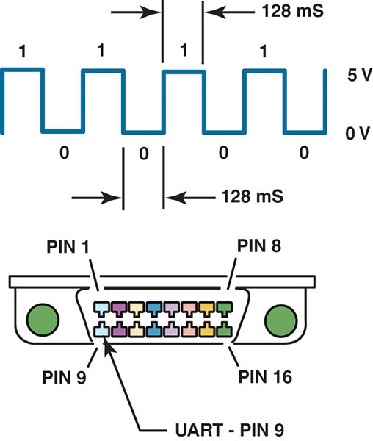
Figure 49.6 UART serial data master control module is connected to the data link connector (DLC) at pin 9

Slide 18
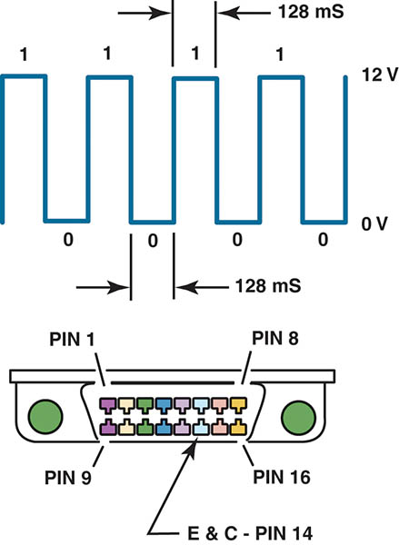
Figure 49.7 The E & C serial data is connected to the data link connector at pin 14

Slide 19
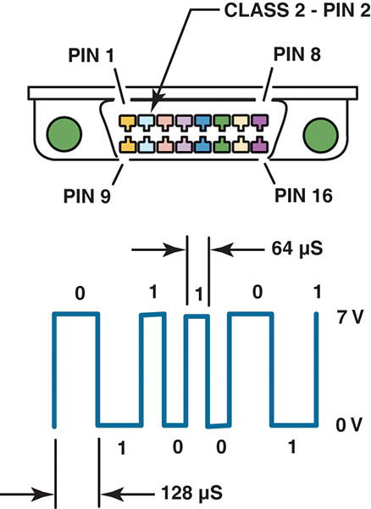
Figure 49.8 Class 2 serial data communication is accessible at the data link connector at pin 2

Slide 20
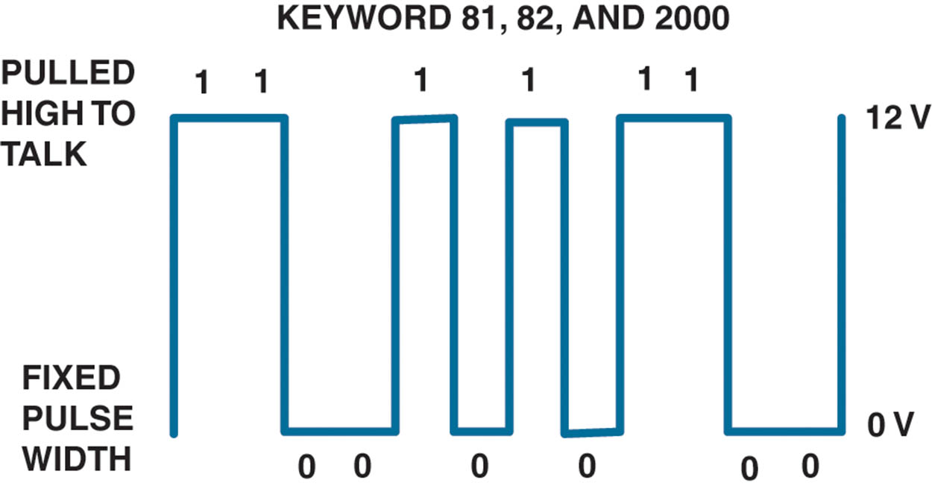
Figure 49.9 Keyword 82 operates at a rate of 8,192 bps, similar to UART, and keyword 2000 operates at a baud rate of 10,400 bps (the same as a Class 2 communicator)

Slide 21
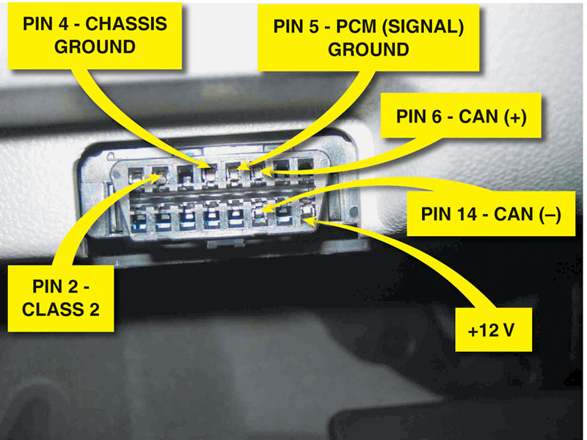
Figure 49.10 GMLAN uses pins at terminals 6 and 14. Pin 1 is used for low-speed GMLAN on 2006 and newer GM vehicles

Slide 22
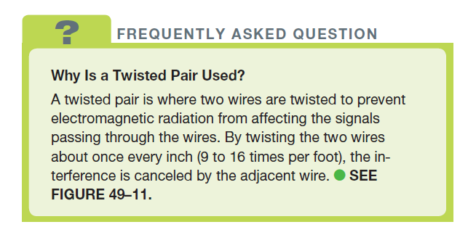
FREQUENTLY ASKED QUESTION

Slide 23
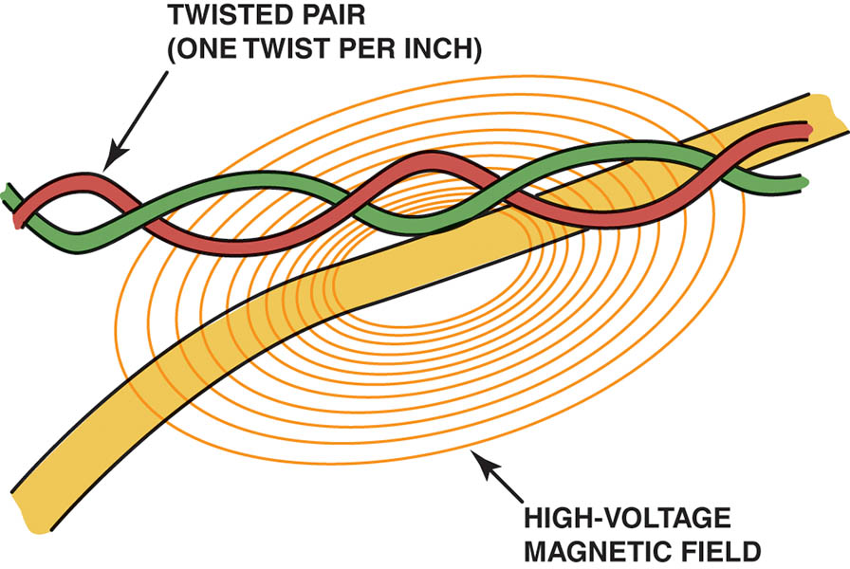
Figure 49.11 A twisted pair is used by several different network communications protocols to reduce interference that can be induced in the wiring from nearby electromagnetic sources

Slide 24
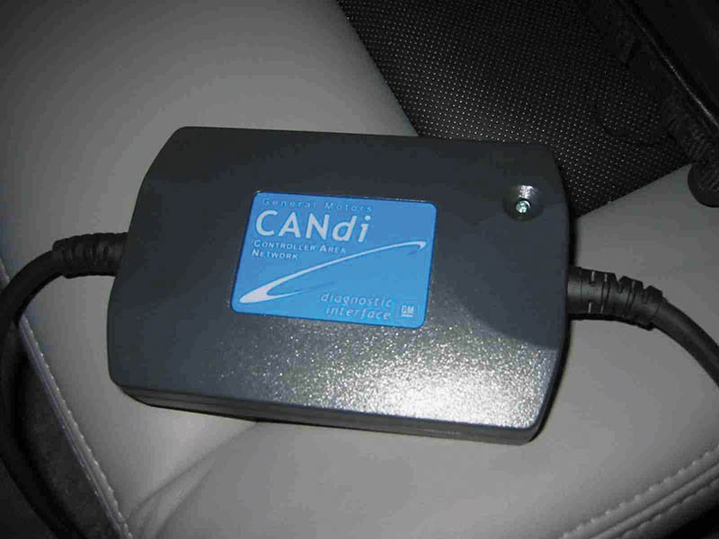
Figure 49.12 A CANDi module flashes the green LED rapidly if communication is detected

Slide 25
QUESTION 2: ?
Why are the two wires twisted if used for network communications?

Slide 26
ANSWER 2:
To reduce the effects of outside electrical interference.

Slide 27
FORD NETWORK COMMUNICATION PROTOCOLS
Standard Corporate Protocol
SCP uses the J-1850 protocol and is active with the key on.
CAN Protocol
Newer Fords use the CAN for scan tool diagnosis
SPC and UART-Based Protocols
Some newer Fords retain SCP and UART-based protocol (UBP) for some modules.

Slide 28
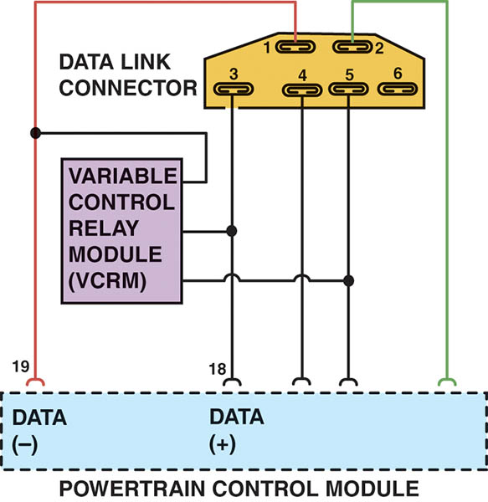
Figure 49.13 A Ford OBD-I diagnostic link connector showing that SCP communication uses terminals in cavities 1 (upper left) and 3 (lower left)

Slide 29
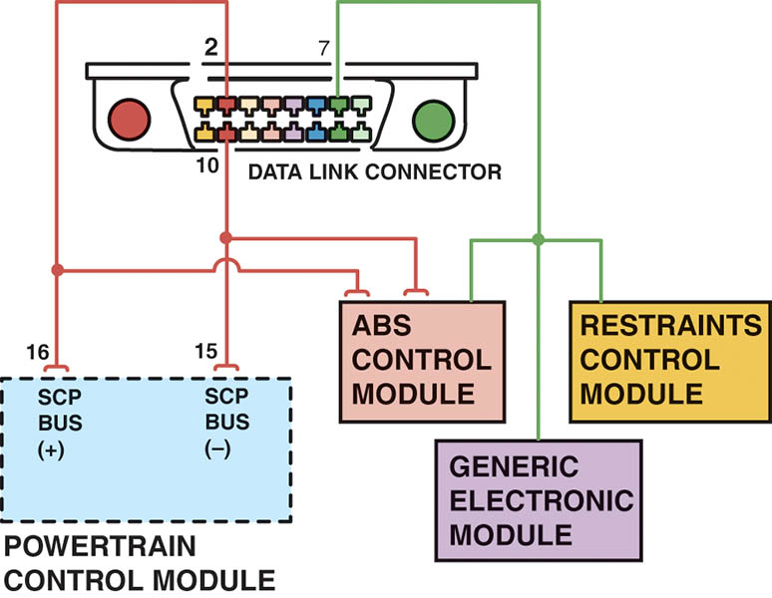
Figure 49.14 A scan tool can be used to check communications with the SCP BUS through terminals 2 and 10 and to the other modules connected to terminal 7 of the data link connector

Slide 30
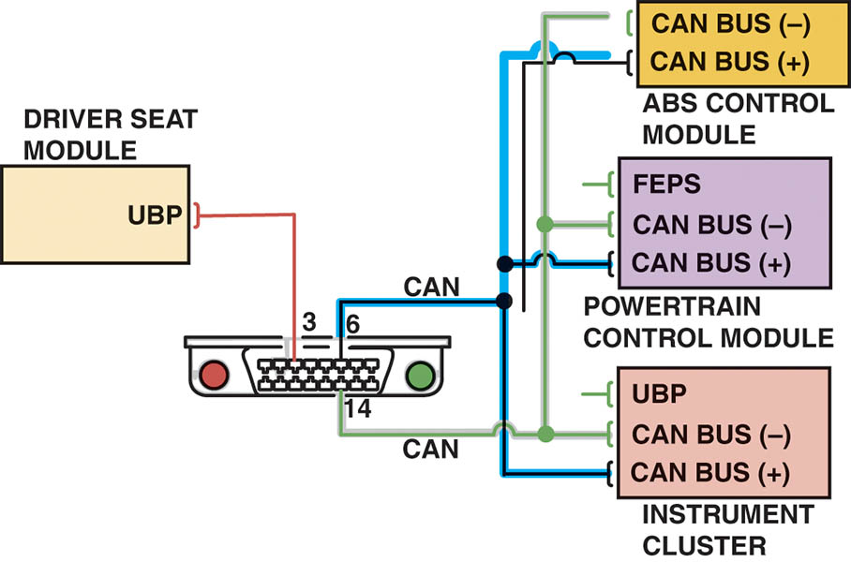
Figure 49.15 Many Fords use UBP module communications along with CAN

Slide 31
CHRYSLER COMMUNICATION PROTOCOLS
CCD
Since the late 1980s, the Chrysler Collision Detection (CCD) multiplex network is used for scan tool and module communications
Programmable Communication Interface
A one wire J1850 communication protocol that connects at the OBD-II DLC at terminal 2.
Serial Communication Interface
Used for most scan tool and flash reprogramming functions until it was replaced with CAN.

Slide 32
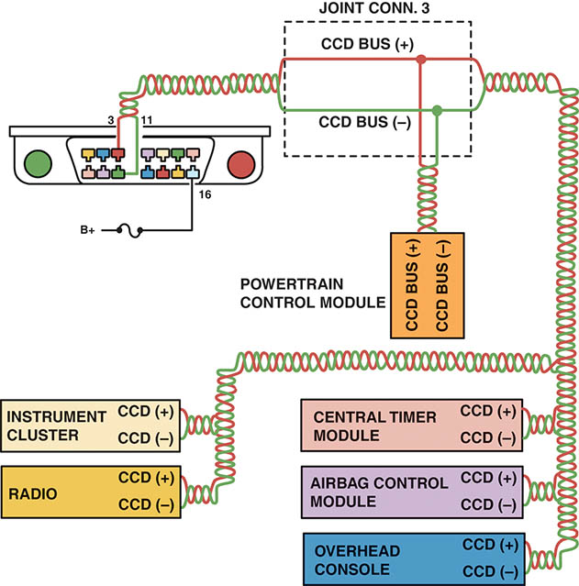
Figure 49.16 CCD signals are labeled plus (+) and minus (-) and use a twisted pair of wires. Notice that terminals 3 and 11 of the data link connector are used to access the CCD BUS from a scan tool. Pin 16 is used to supply 12 volts to the scan tool

Slide 33
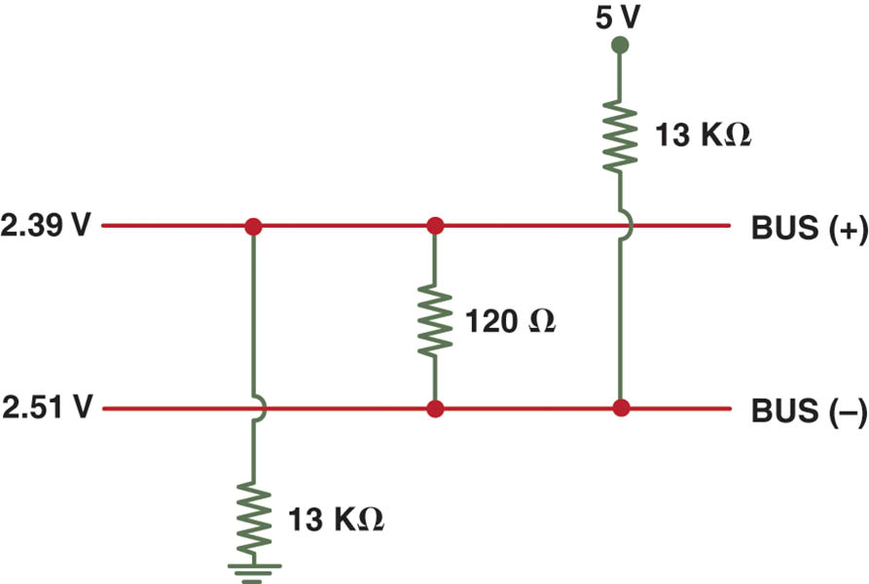
Figure 49.17 The differential voltage for the CCD BUS is created by using resistors in a module

Slide 34
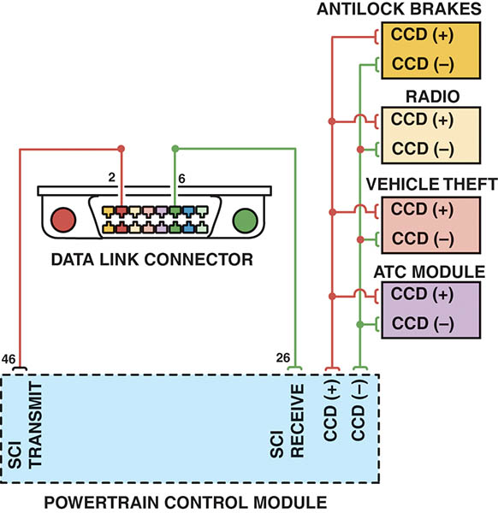
Figure 49.18 Many Chrysler vehicles use both SCI and CCD for module communication

Slide 35
CONTROLLER AREA NETWORK
Background
Robert Bosch Corporation developed the CAN protocol, which was called CAN 1.2, in 1993.
CAN Features
Faster than other communication protocols
Cost-effective because it is an easier system to use
CAN Class A, B and C
There are three classes of CAN and they operate at different speeds. The networks can all be linked using a gateway within the same vehicle.

Slide 36
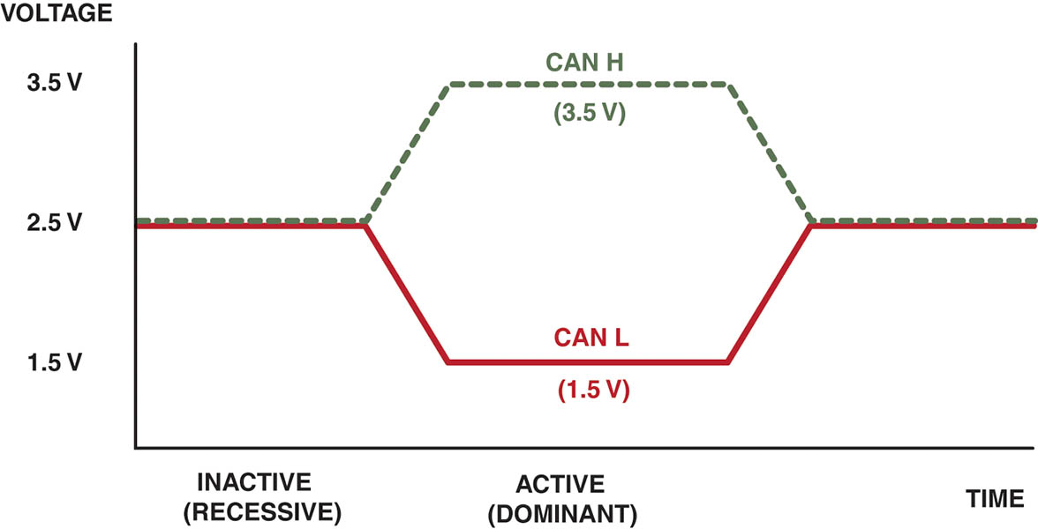
Figure 49.19 CAN uses a differential type of module communication. When no communication is occurring, both wires have 2.5 volts applied. When communication is occurring, CAN H goes up 1 to 3.5 volts and CAN L goes down 1 to 1.5 volts

Slide 37
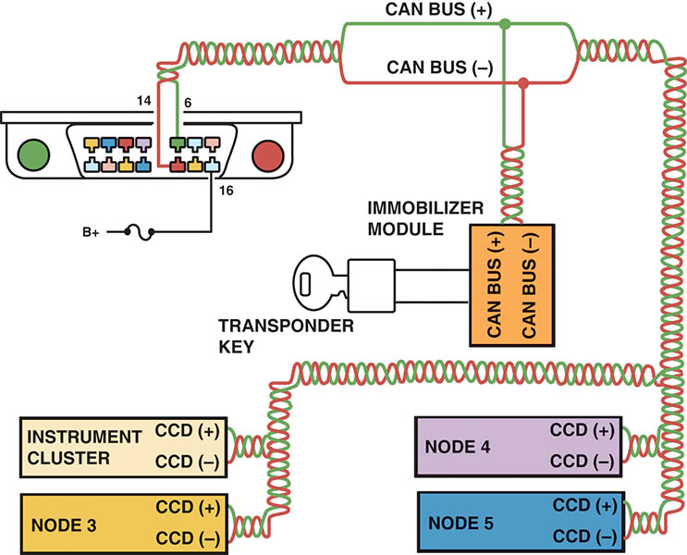
Figure 49.20 A typical (generic) system showing how the CAN BUS is connected to various electrical accessories and systems in the vehicle

Slide 38
HONDA/TOYOTA COMMUNICATIONS
The primary BUS communication on pre-CAN-equipped vehicles is ISO 9141-2 using terminals 7 and 15 at the OBD-II DLC.
A factory scan tool or an aftermarket scan tool equipped with enhanced original equipment (OE) software is needed to access many of the BUS messages.

Slide 39
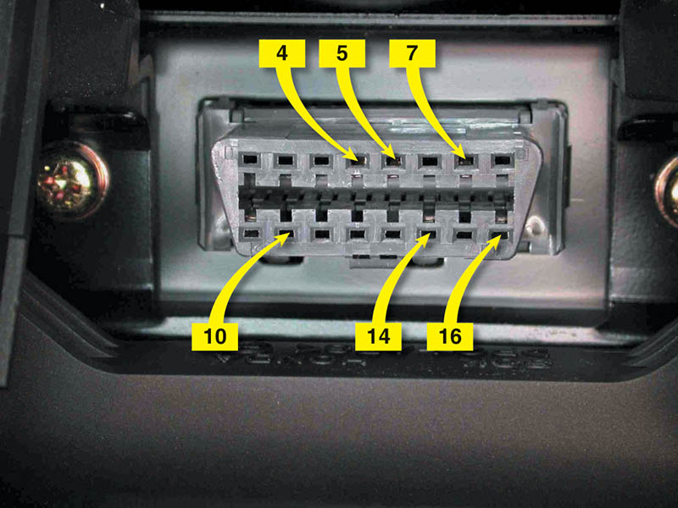
Figure 49.21 A DLC from a pre-CAN Acura. It shows terminals in cavities 4, 5 (grounds), 7, 10, 14, and 16 (B+)

Slide 40
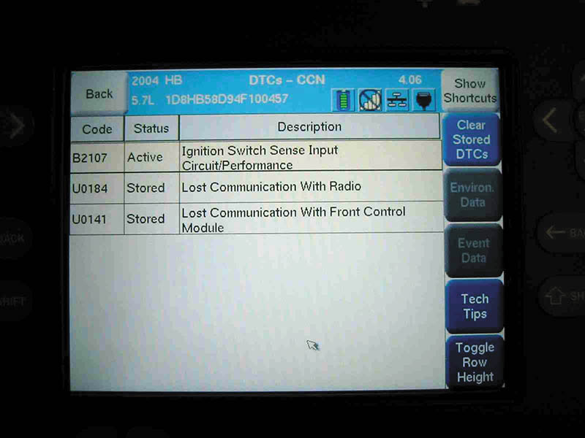
Figure 49.22 A Honda scan display showing a B and two U codes, all indicating a BUS-related problem(s)

Slide 41
EUROPEAN BUS COMMUNICATIONS
Media-Oriented Transport BUS
Motorola Interconnect BUS
Distributed System Interface BUS
Bosch-Siemans-Temic BUS
Byteflight BUS
Flexray BUS
Domestic Digital BUS
Local Interconnect Network BUS

Slide 42
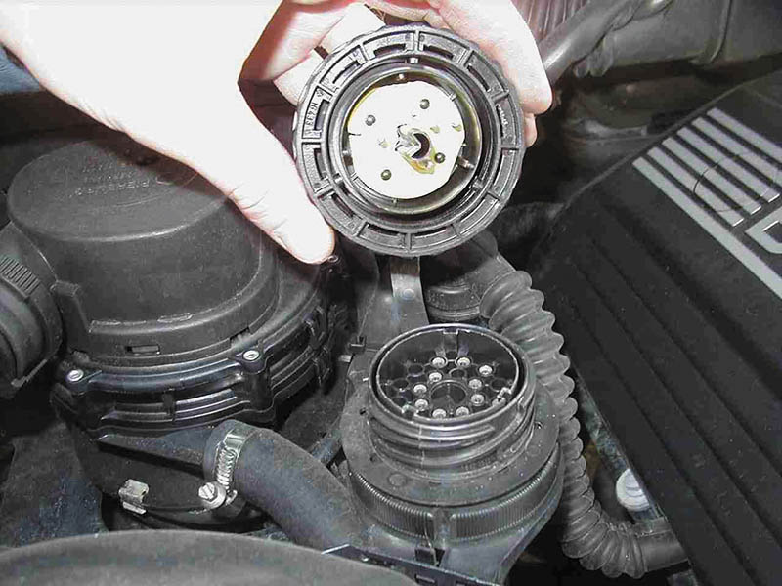
Figure 49.23 A typical 38-cavity diagnostic connector as found on many BMW and Mercedes vehicles under the hood. The use of a breakout box (BOB) connected to this connector can help gain access to module BUS information

Slide 43
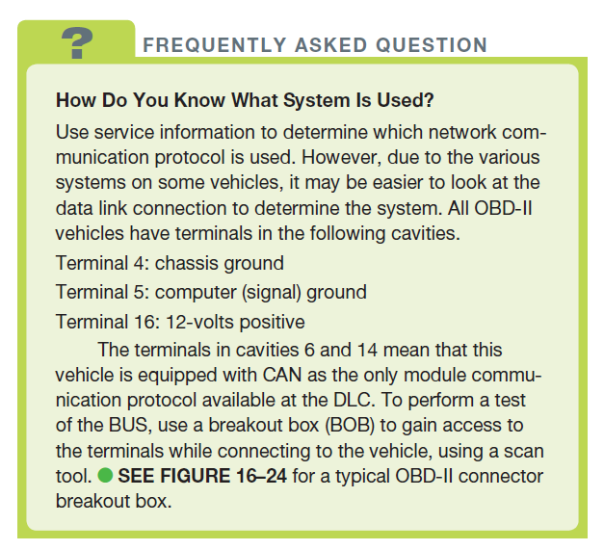
FREQUENTLY ASKED QUESTION

Slide 44
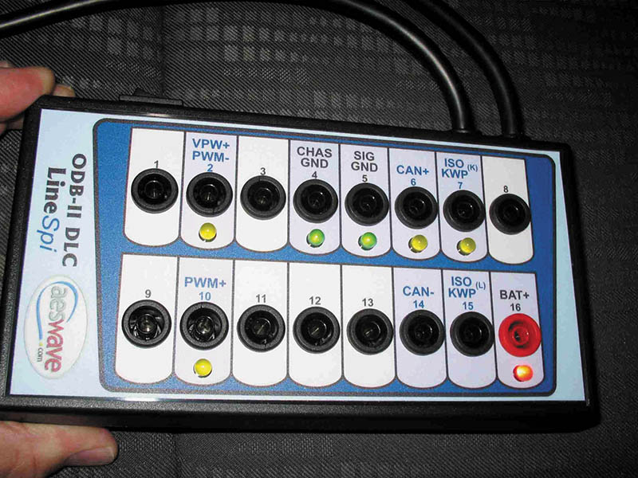
Figure 49.24 A breakout box (BOB) used to access the BUS terminals while using a scan tool to activate the modules. This breakout box is equipped with LEDs that light when circuits are active

Slide 45
NETWORK COMMUNICATIONS DIAGNOSIS
Step 1: Check everything that does and does not work.
Step 2: Perform module status test.
Step 3: Check the resistance of the terminating resistors.
Step 4: Check data BUS for voltages.
Step 5: Use a DSO to monitor the BUS waveforms
Step 6: Isolate and repair the fault.

Slide 46
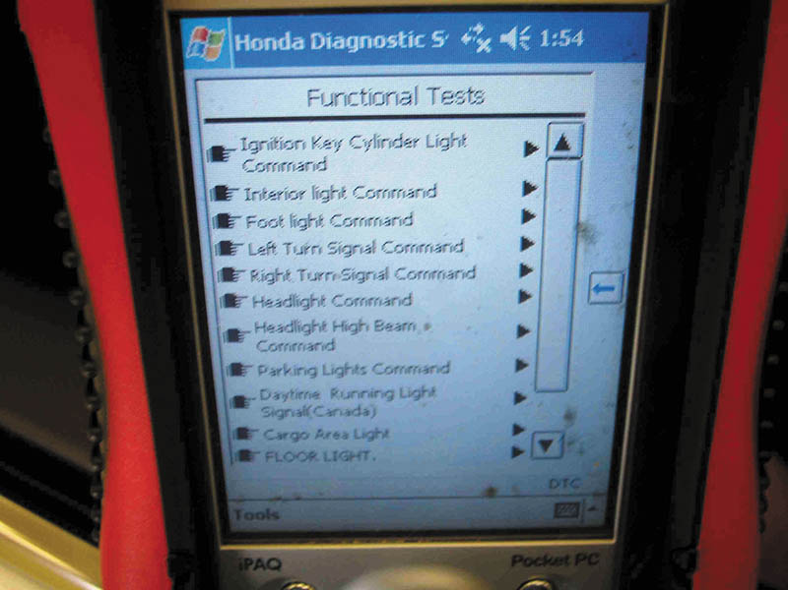
Figure 49.25 This Honda scan tool allows the technician to turn on individual lights and operate individual power windows and other accessories that are connected to the BUS system

Slide 47
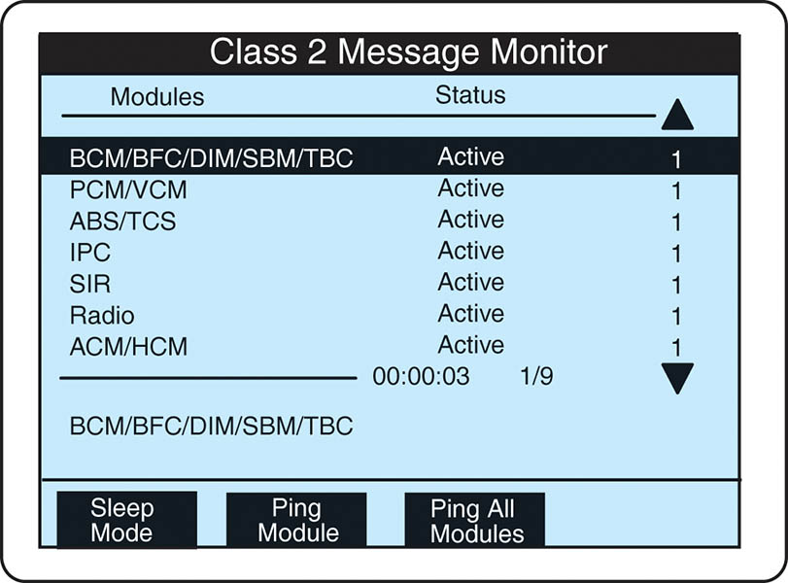
Figure 49.26 Modules used in a General Motors vehicle can be “pinged” using a Tech 2 scan tool

Slide 48
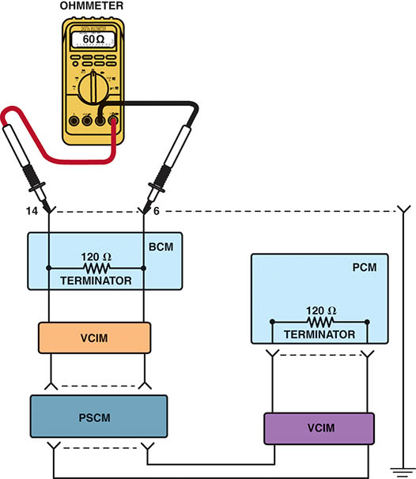
Figure 49.27 Checking the terminating resistors using an ohmmeter at the DLC

Slide 49
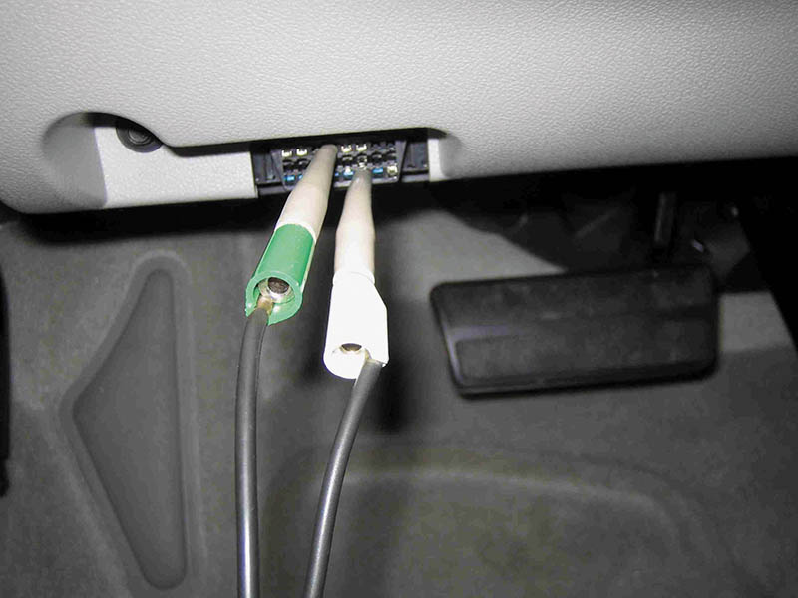
Figure 49.28 Use front-probe terminals to access the data link connector. Always follow the specified back-probe and front-probe procedures as found in service information

Slide 50
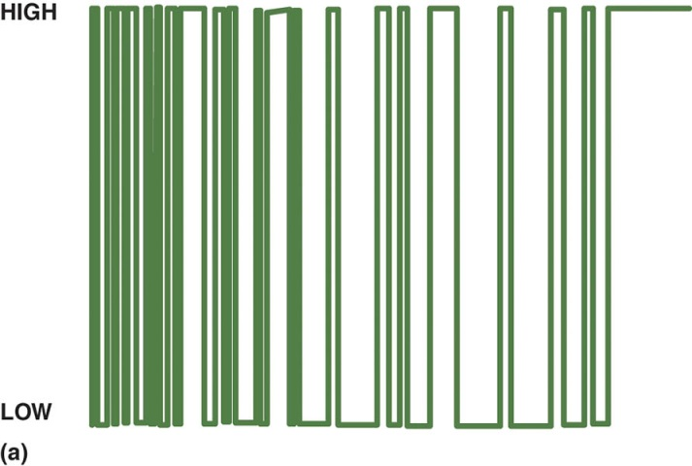
Figure 49.29 (a) Data is sent in packets, so it is normal to see activity and then a flat line between messages

Slide 51
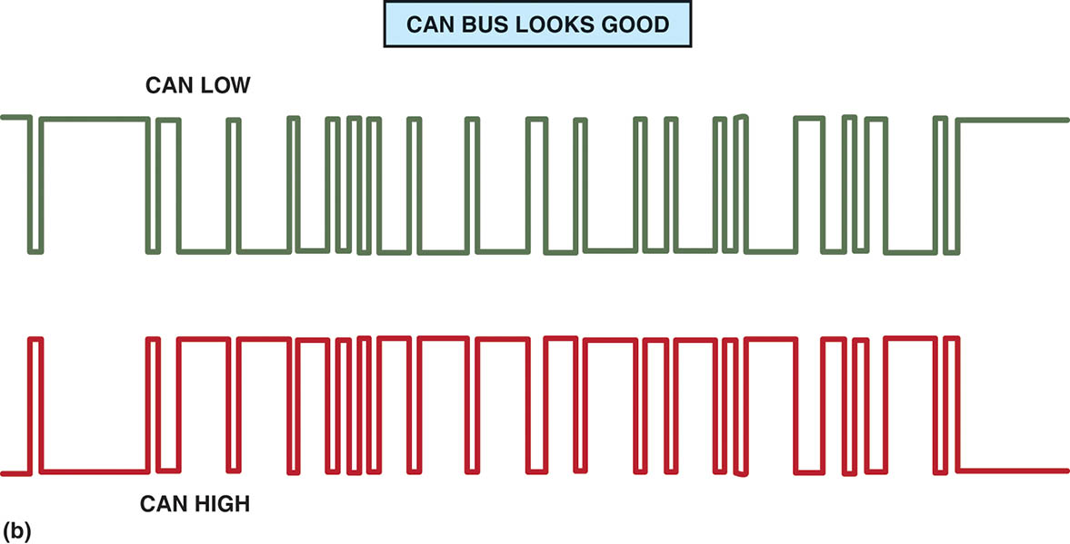
Figure 49.29 (b) A CAN BUS should show voltages that are opposite when there is normal communications. CAN H circuit should go from 2.5 volts at rest to 3.5 volts when active. The CAN L circuit goes from 2.5 volts at rest to 1.5 volts when active

Slide 52
OBDII DATA LINK CONNECTOR
All OBD-II vehicles use a 16-pin connector that includes:
Pin 4 = chassis ground
Pin 5 = signal ground
Pin 16 = battery power (4 A max)
Manufacturer specific pins very by make, model, and year.

Slide 53
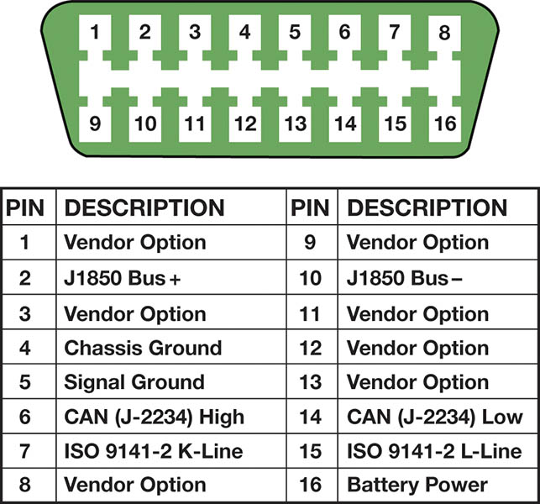
Figure 49.30 A 16-pin OBD-II DLC with terminals identified. Scan tools use the power pin (16) and ground pin (4) for power so that a separate cigarette lighter plug is not necessary on OBD-II vehicles

Slide 54
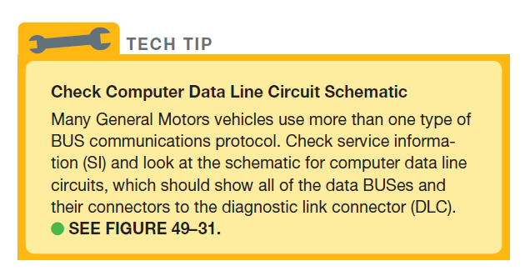
TECH TIP

Slide 55
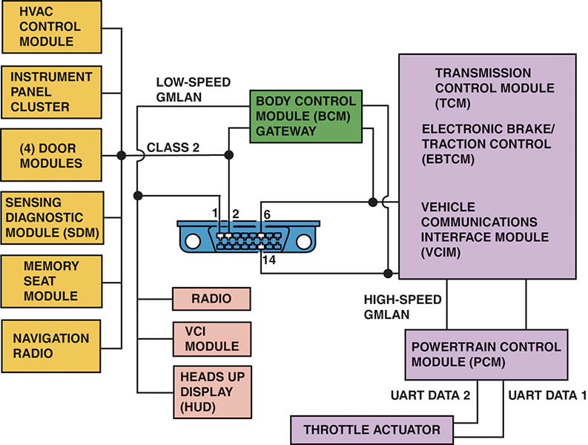
Figure 49.31 This schematic of a Chevrolet Equinox shows that the vehicle uses a GMLAN BUS (DLC pins 6 and 14), plus a Class 2 (pin 2) and UART. Pin 1 connects to the low-speed GMLAN network

Slide 56
QUESTION 3: ?
What are the three common pins in a DLC Connector?

Slide 57
ANSWER 3:
Pin 4: Chassis Ground, Pin 5: Signal Ground and Pin 16: Battery Voltage.

Slide 58
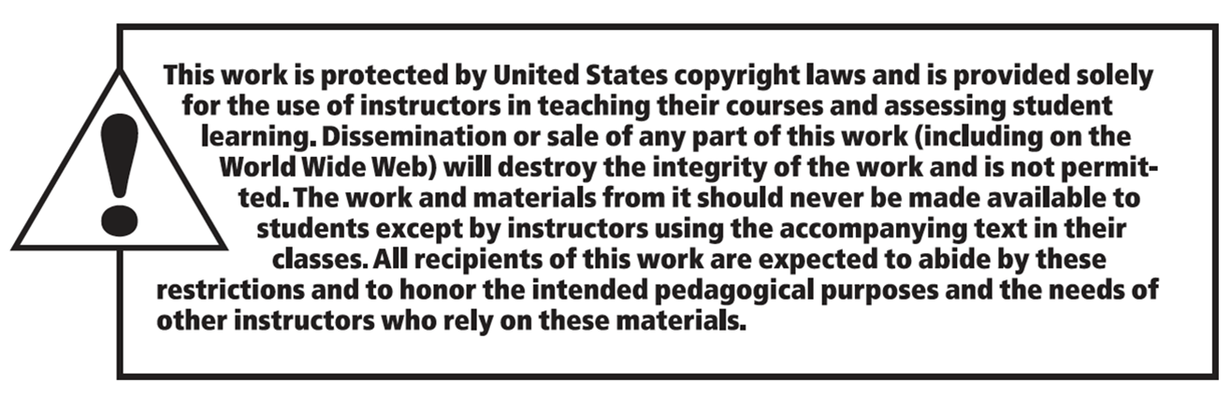
Copyright

