Slide 1
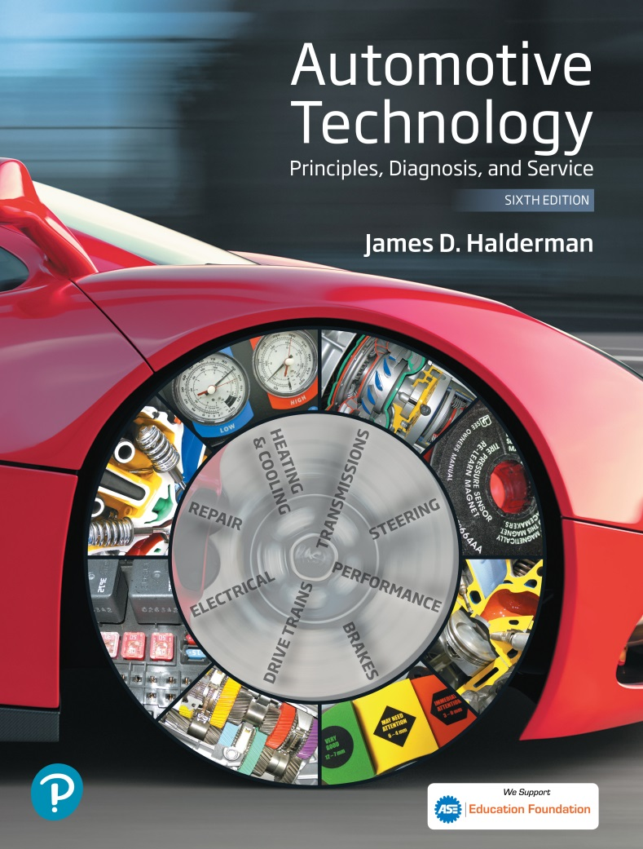
Automotive Technology Principles, Diagnosis, and Service
Sixth Edition
Chapter 48
Electronic Fundamentals
Copyright © 2018, 2015, 2011 Pearson Education, Inc. All Rights Reserved

Slide 2
LEARNING OBJECTIVES (1 of 2)
48.1 Identify semiconductor components how converters and inverters are used, and explain precautions for working with semiconductor circuits.
48.2 Describe how diodes and transistors work, and how to test them.
48.3 Identify the failure causes of electronic components.

Slide 3
LEARNING OBJECTIVES (2 of 2)
48.4 List ways to avoid electrostatic discharge.
48.5 This chapter will help you prepare for the ASE Electrical/Electronic Systems (A6) certification test content area “A” (General Electrical/Electronic System Diagnosis).

Slide 4
SEMICONDUCTORS
Definition
Semiconductors are materials that contain exactly four electrons in the outer orbit of their atom structure and are, therefore, neither good conductors nor good insulators.
Examples of Semiconductors
Germanium
Silicone

Slide 5
SEMICONDUCTORS
Construction
When another material is added to a semiconductor material in very small amounts, it is called doping.
N-Type Material
N-type material is silicon or germanium that is doped with an element such as phosphorus, arsenic, or antimony, each having five electrons in its outer orbit.
P-Type Material
P-type material is produced by doping silicon or germanium with the element boron or the element indium.

Slide 6
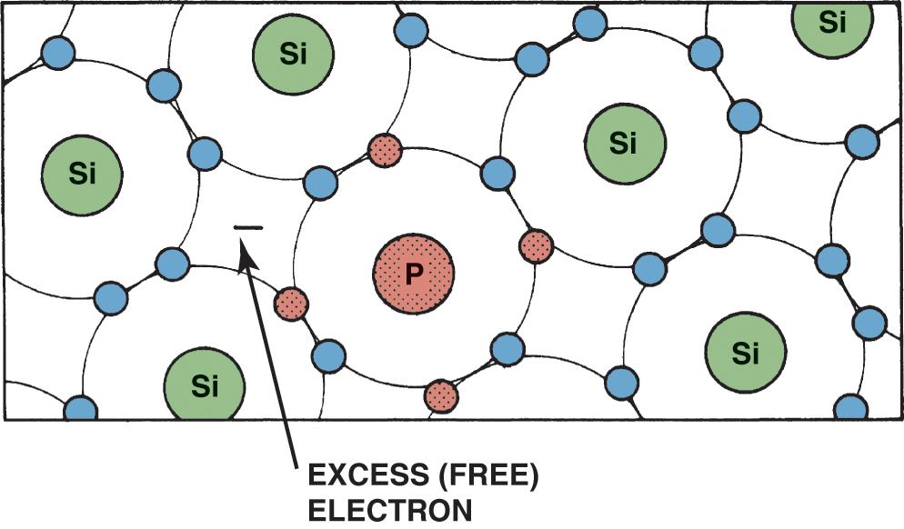
Figure 48.1 N-type material. Silicon (Si) doped with a material (such as phosphorus) with five electrons in the outer orbit results in an extra free electron

Slide 7
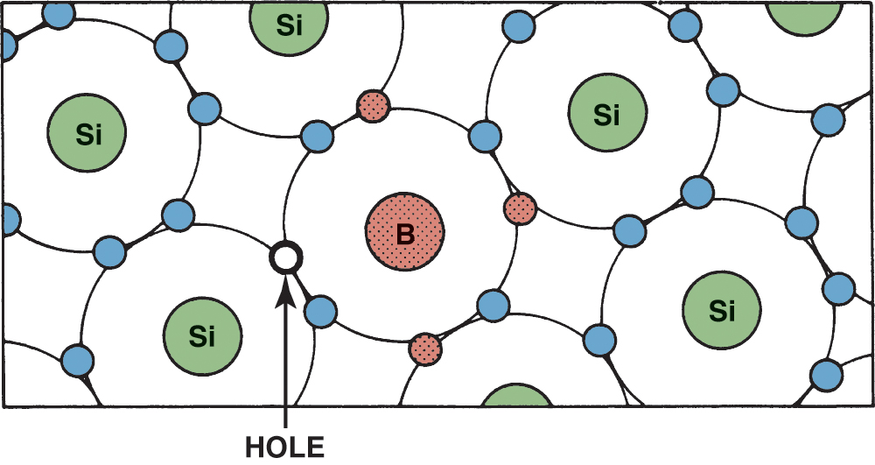
Figure 48.2 P-type material. Silicon (Si) doped with a material, such as boron (B), with three electrons in the outer orbit results in a hole capable of attracting an electron

Slide 8
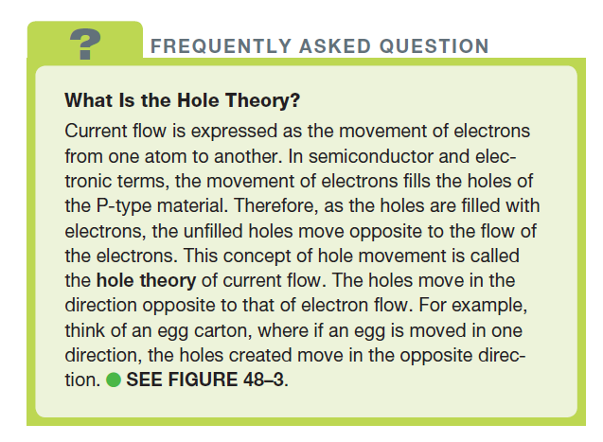
FREQUENTLY ASKED QUESTION

Slide 9
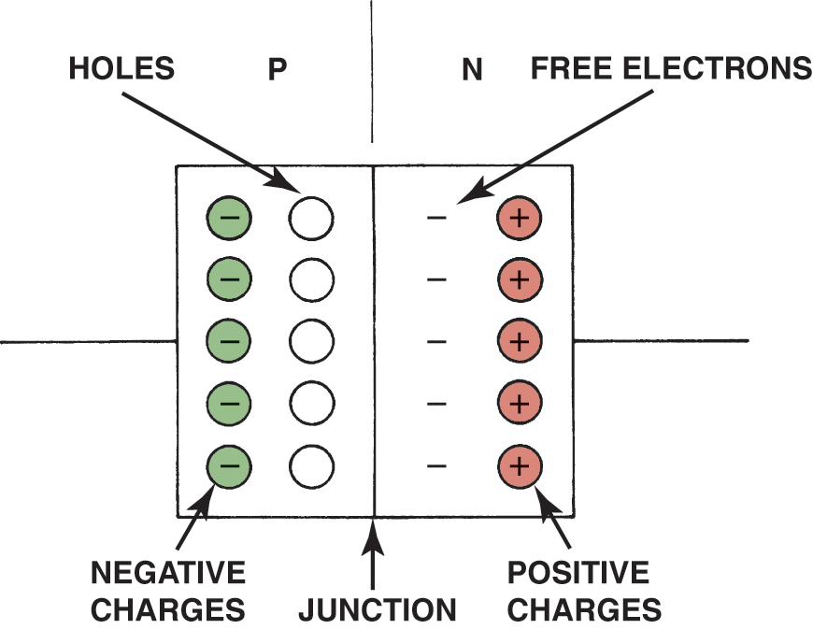
Figure 48.3 Unlike charges attract and the current carriers (electrons and holes) move toward the junction

Slide 10
SUMMARY OF SEMICONDUCTORS
The two types of semiconductor materials are P type and N type.
In P-type semiconductors, electrical conduction occurs mainly as a result of holes (absence of electrons).
In N-type semiconductors, electrical conduction occurs mainly as a result of electrons (excess of electrons).

Slide 11
QUESTION 1: ?
What is the difference between P-type material and N-type material?

Slide 12
ANSWER 1:
The material used to dope the silicon or germanium.

Slide 13
DIODES
Construction
A diode is an electrical one-way check valve made by combining a P-type material and an N-type material.
Operation
The N-type material has one extra electron, which can flow into the P-type material. The P type requires electrons to fill its holes.
Diodes allow current flow only when current of the correct polarity is connected to the circuit.

Slide 14
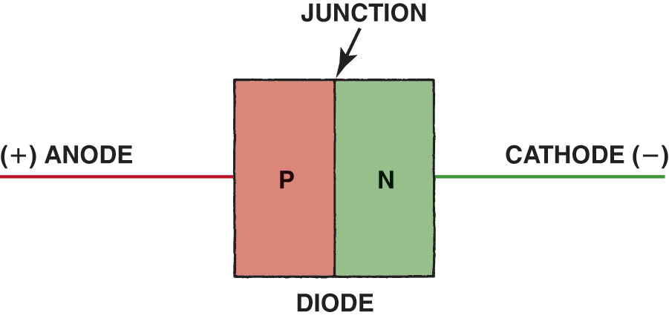
Figure 48.4 A diode is a component with P-type and N-type materials together. The negative electrode is called the cathode and the positive electrode is called the anode

Slide 15
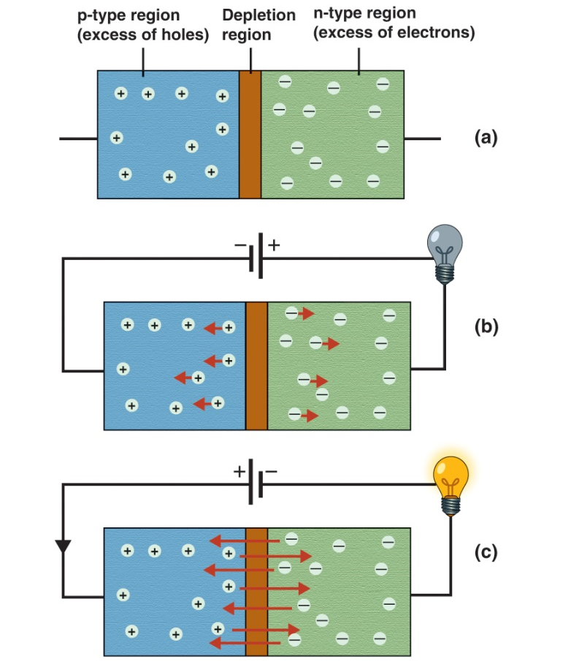
Figure 48.5 (a) A diode consist of P-type and N-type materials separated by a depletion region.(b) When connected to a voltage source in the reverse bias situation, no current flows across the depletion region.(c) When the diode is connected in the forward bias direction, current flows across the depletion region.

Slide 16
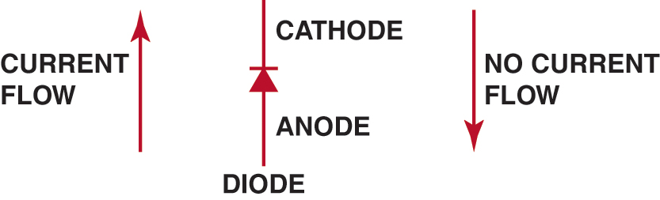
Figure 48.6 Diode symbol and electrode names. The stripe on one end of a diode represents the cathode end of the diode

Slide 17
ZENER DIODES
Construction
A zener diode is a specially constructed diode designed to operate with a reverse-bias current.
Operation
A zener diode acts as any diode in that it blocks reverse-bias current, but only up to a certain voltage.
Above this certain voltage (called the breakdown voltage or the zener region), a zener diode conducts current in the opposite direction without damage to the diode.

Slide 18
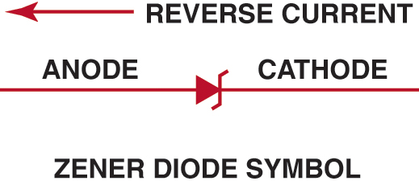
Figure 48.7 A zener diode blocks current flow until a certain voltage is reached, then it permits current to flow

Slide 19
HIGH-VOLTAGE SPIKE PRTECTION (1 OF 2)
Clamping Diodes
A diode can be installed across the leads to the coil to redirect the high-voltage spike back into the coil, protecting the rest of the circuit.
Clamping Diode Application
Air Conditioning Clutch Coil
Blower Motor
Relays

Slide 20
HIGH-VOLTAGE SPIKE PRTECTION (2 OF 2)
De-spiking Zener Diodes
Zener diodes are most commonly used in electronic fuel-injection circuits that control the firing of the injectors.
De-spiking Resistors
Instead of a diode installed in parallel with the coil windings, a resistor can be used.

Slide 21
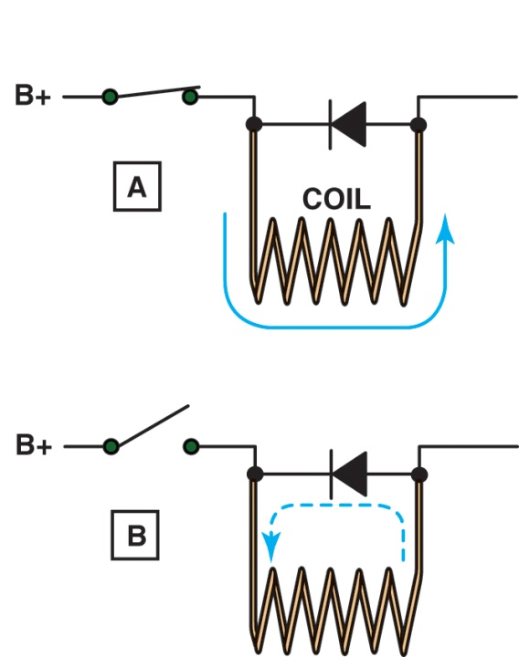
Figure 48.8 (a) When the coil is energized, the diode is reverse biased and the current is blocked from passing through the diode. (b) When the switch is opened, the magnetic field surrounding the coil collapses, producing a high-voltage surge. This voltage surge forward biases the diode, and the surge is dissipated harmlessly back through the windings of the coil.

Slide 22
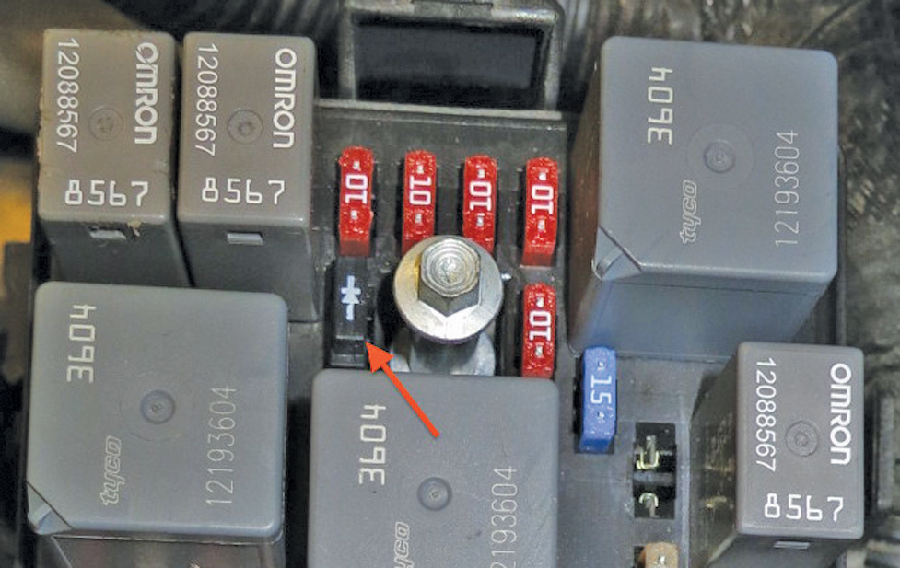
Figure 48.9 A diode connected to both terminals of the air-conditioning compressor clutch used to reduce the high voltage spike that results when a coil (compressor clutch coil) is de-energized

Slide 23
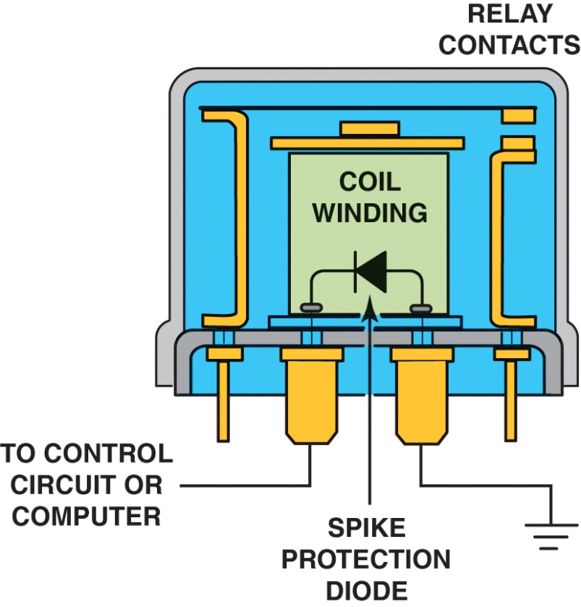
Figure 48.10 Spike protection diodes are commonly used in computer-controlled circuits to prevent damaging high-voltage surges that occur any time current flowing through a coil is stopped

Slide 24
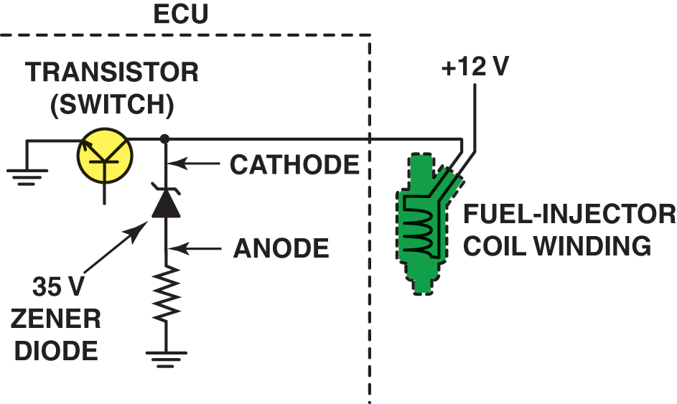
Figure 48.11 A zener diode is commonly used inside automotive computers to protect delicate electronic circuits from high-voltage spikes.

Slide 25
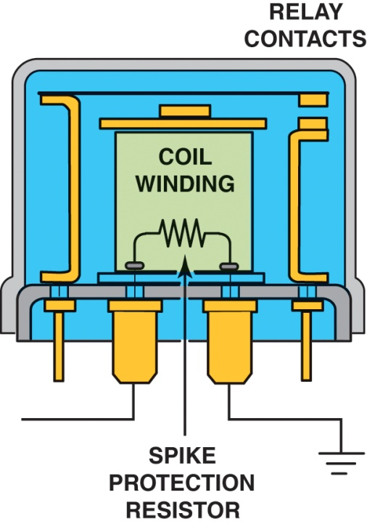
Figure 48.12 A despiking resistor is used in many automotive applications to help prevent harmful high-voltage surges from being created when the magnetic field surrounding a coil collapses when the coil circuit is opened

Slide 26
DIODE RATINGS
Specifications
Maximum current flow in the forward-bias direction
The rating of resistance to reverse-bias voltage is called the peak inverse voltage (PIV) rating
Diode Voltage Drop
The voltage drop across a diode is about the same voltage as that required to forward bias the diode.

Slide 27
QUESTION 2: ?
How can a diode be used to suppress high-voltage surges in
automotive components or circuits containing a coil?

Slide 28
ANSWER 2:
A diode can be installed across the leads to the coil to redirect the high-voltage spike back into the coil.

Slide 29
LIGHT-EMITTING DIODES
Light-emitting diodes (LED) radiate light when current flows through the diode in the forward-bias direction.
If an LED is connected across a 12-volt automotive battery, a resistor must be connected in series to prevent destruction of the P-N junction.

Slide 30
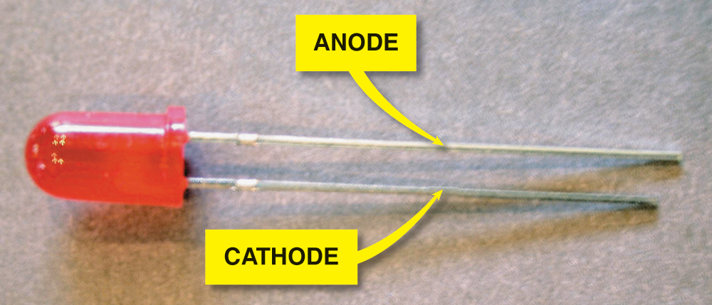
Figure 48.13 A typical light-emitting diode (LED). This particular LED is designed with a built-in resistor so that 12-volts DC may be applied directly to the leads without an external resistor.

Slide 31
PHOTODIODES
Purpose and Function
Photodiodes are specially constructed to respond to various wavelengths of light with a “window” built into the housing
Construction
When light energy strikes the diode, electrons are released and the diode conducts in the forward-bias direction.

Slide 32
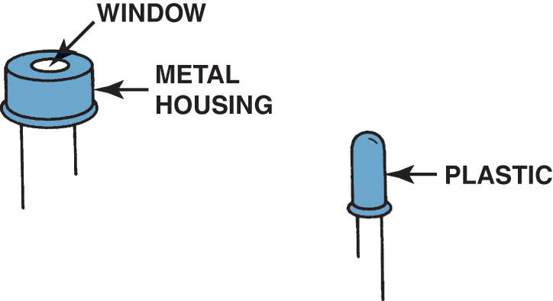
Figure 48.14 Typical photodiodes. They are usually built into a plastic housing so that the photodiode itself may not be visible

Slide 33

Figure 48.15 Symbol for a photodiode. The arrows represent light striking the P-N junction of the photodiode

Slide 34
PHOTO-RESISTORS
A photo-resistor is a semiconductor material (usually cadmium sulfide) that changes resistance with the presence or absence of light.
Dark = High resistance
Light = Low resistance
Can be used to control headlight dimmer relays and automotive headlights.

Slide 35
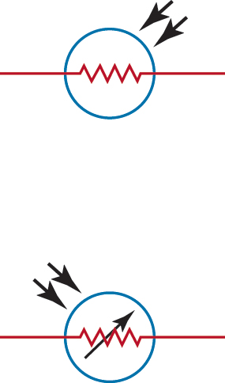
Figure 48.16 Either symbol may be used to represent a photo-resistor

Slide 36
SILICON-CONTROLLED RECTIFIERS
Construction
A Silicon-Controlled Rectifier (SCR) is a semiconductor device that looks like two diodes connected end to end.
Uses of an SCR
SCRs can be used to construct a circuit for a center high-mounted stoplight (CHMSL).

Slide 37
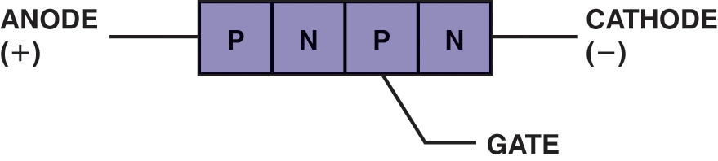
Figure 48.17 Symbol and terminal identification of an SCR

Slide 38
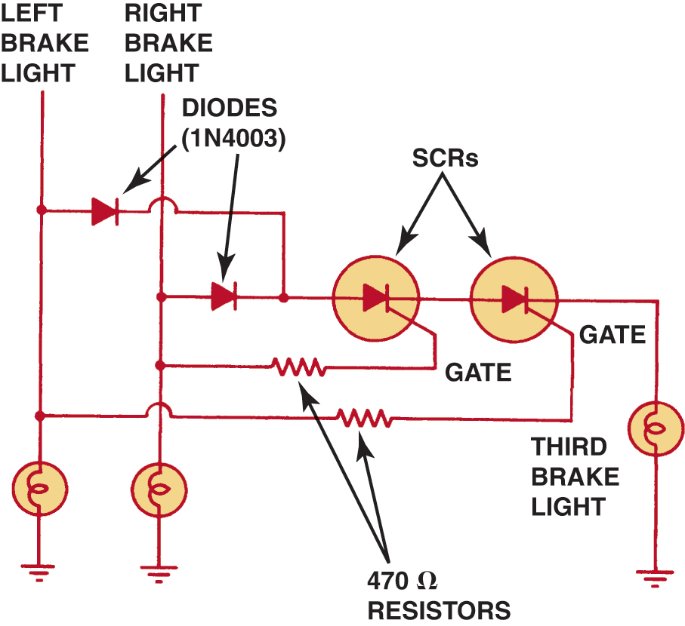
Figure 48.18 Wiring diagram for a center high-mounted stoplight (CHMSL) using SCRs

Slide 39
THERMISTORS
Construction
A thermistor is a semiconductor material, such as silicon, that has been doped to provide a given resistance.
When the thermistor is heated, the electrons within the crystal gain energy and electrons are released.
Uses of Thermistors
A thermistor is commonly used as a temperature-sensing device for coolant temperature and intake manifold air temperature.

Slide 40
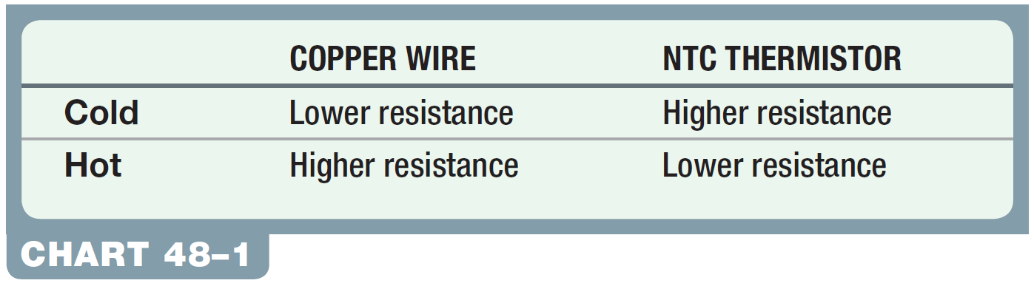
Chart 48-1 The resistance changes opposite to that of a copper wire with changes in temperature.

Slide 41
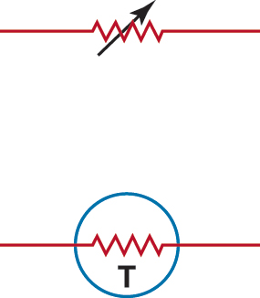
Figure 48.19 Symbols used to represent a thermistor

Slide 42
RECTIFIER BRIDGES
Definition
A rectifier is an electronic device (such as a diode) used to convert a changing voltage into a straight or constant voltage.
A rectifier bridge is a group of diodes that is used to change an AC circuit into a DC circuit.

Slide 43
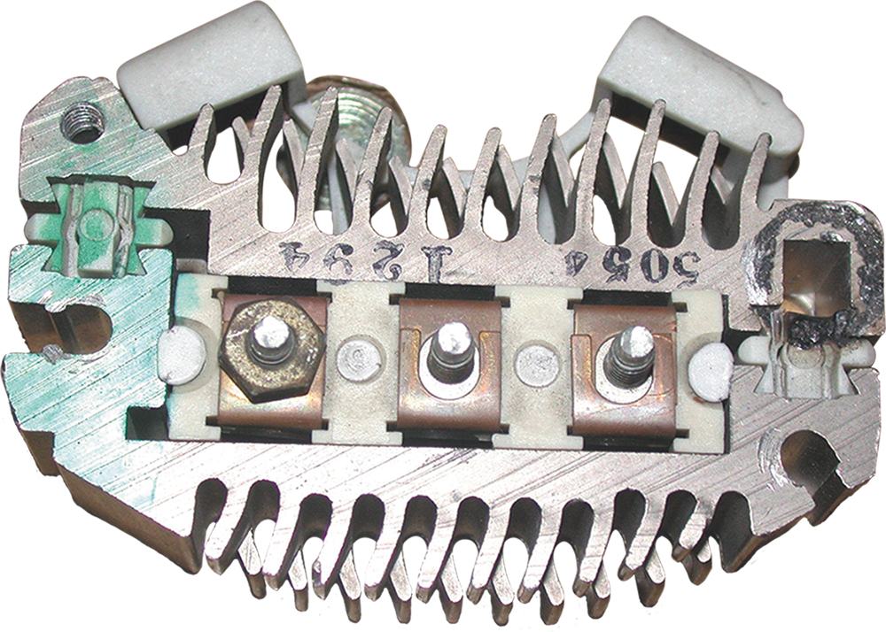
Figure 48.20 This rectifier bridge contains six diodes; the three on each side are mounted in an aluminum-finned unit to help keep the diode cool during alternator operation

Slide 44
TRANSISTORS (1 OF 2)
Purpose and Function
A transistor is a semiconductor device that can perform the following electrical functions.
Act as an electrical switch in a circuit
Act as an amplifier of current in a circuit
Regulate the current in a circuit
Construction
A transistor that has P-type material on each end with N-type material in the center is called a PNP transistor. Another type, with the exact opposite arrangement, is called an NPN transistor.

Slide 45
TRANSISTORS (2 OF 2)
Transistor Symbols
All transistor symbols contain an arrow indicating the emitter part of the transistor. The arrow points in the direction of current flow (conventional theory).
How a Transistor Works
A transistor allows current flow if the electrical conditions allow it to switch on, in a manner similar to the working of an electromagnetic relay.
The electrical conditions are determined, or switched, by means of the base.

Slide 46
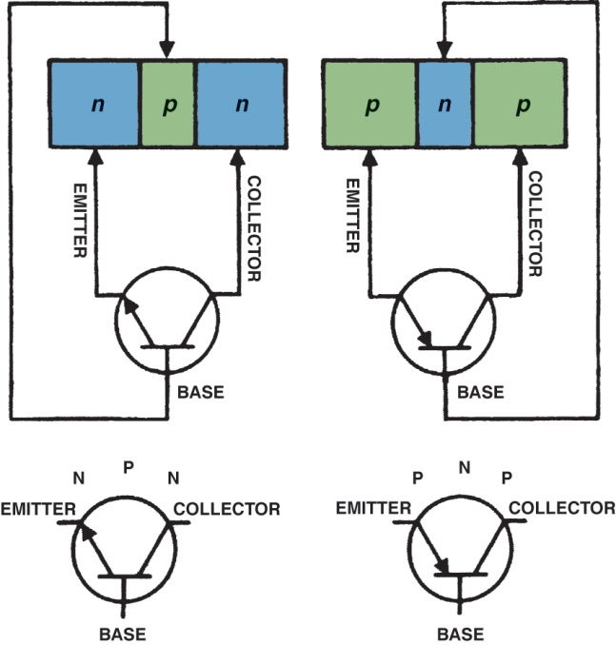
Figure 48.21 Basic transistor operation. A small current flowing through the base and emitter of the transistor turns on the transistor and permits a higher amperage current to flow from the collector and the emitter

Slide 47
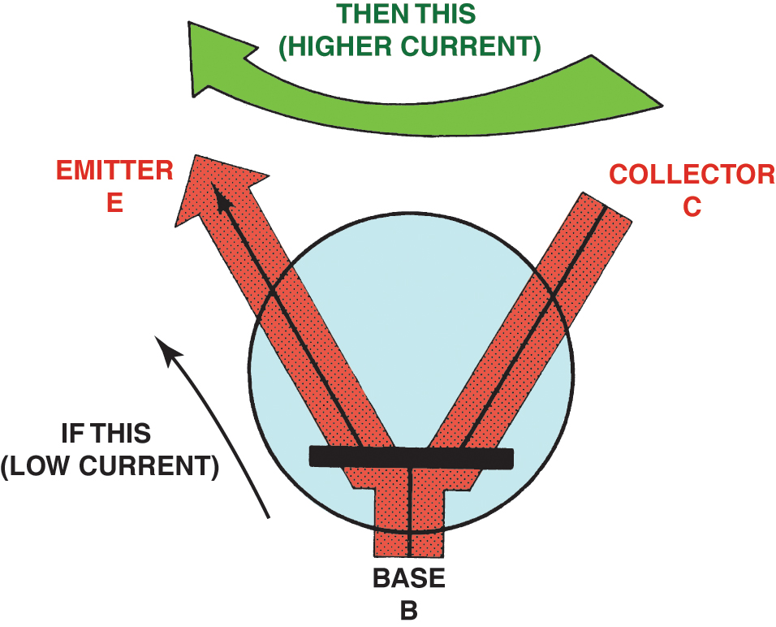
Figure 48.22 Basic transistor operation. A small current flowing through the base and emitter of the transistor turns on the transistor and permits a higher amperage current to flow from the collector and the emitter

Slide 48
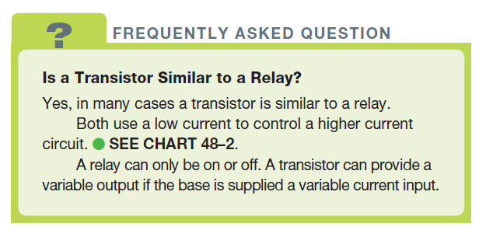
FREQUENTLY ASKED QUESTION

Slide 49
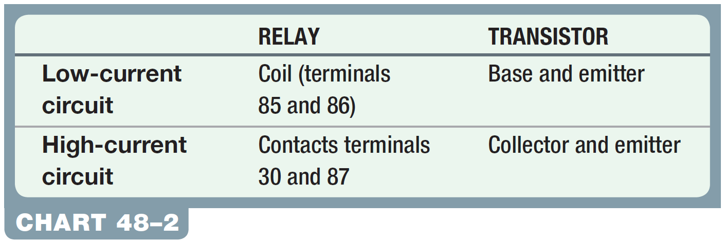
Chart 48-2 Comparison between the control (low-current) and high-current circuits of a transistor compared to a mechanical relay.

Slide 50
FIELD-EFFECT TRANSISTORS
Field-effect transistors (FETs) have been used in most automotive applications since the mid-1980s.
They use less electrical current and rely mostly on the strength of a small voltage signal to control the output.
Many FETs are constructed of metal oxide semiconductor (MOS) materials, called MOSFETs.

Slide 51
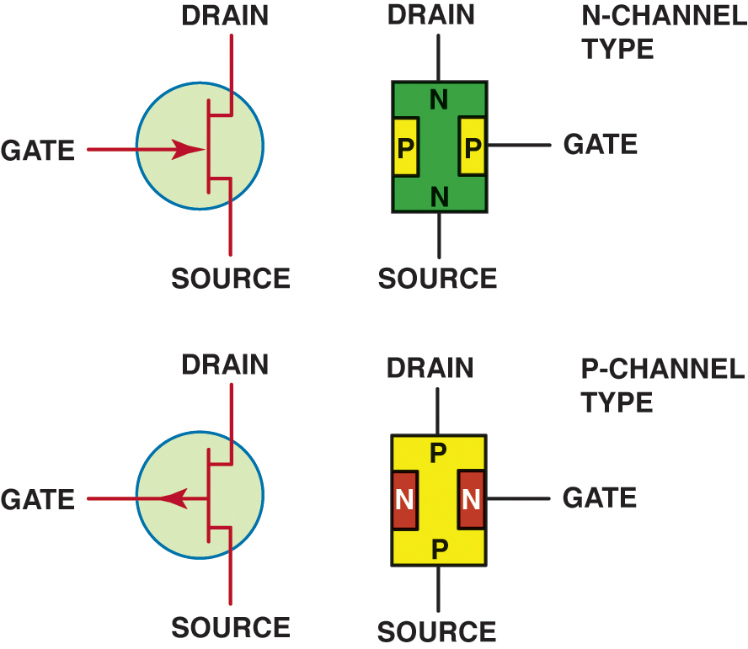
Figure 48.23 The three terminals of a field-effect transistor (FET) are called the source, gate, and drain

Slide 52
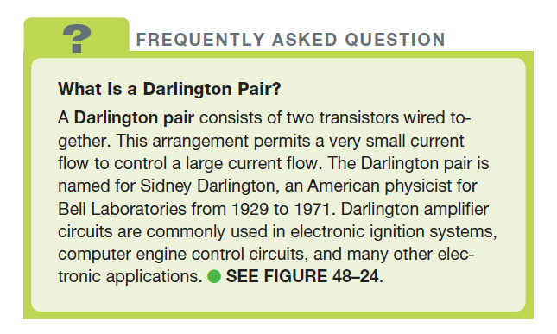
FREQUENTLY ASKED QUESTION

Slide 53
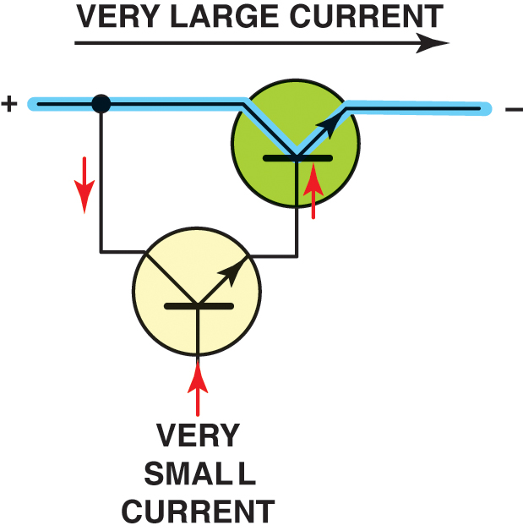
Figure 48.24 A Darlington pair consists of two transistors wired together, allowing for a very small current to control a larger current flow circuit

Slide 54
PHOTOTRANSISTORS
Similar in operation to a photodiode, a phototransistor uses light energy to turn on the base of a transistor.
A phototransistor may or may not have a base lead.
Phototransistors, along with photo diodes, are frequently used in steering wheel controls.

Slide 55
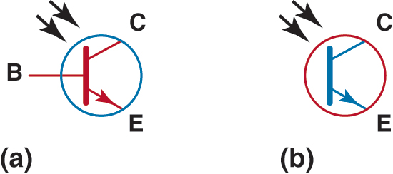
Figure 48.25 Symbols for a phototransistor. (a) This symbol uses the line for the base; (b) this symbol does not.

Slide 56
INTERGRATED CIRCUITS
Purpose and Function
Individual diodes, transistors, and other semiconductor devices combined (integrated) into one group of circuits.
Construction
Integrated circuits are usually encased in a plastic housing called a CHIP with two rows of inline pins.
Heat Sink
Any area around an electronic component that is designed to conduct heat away from electronic parts.

Slide 57
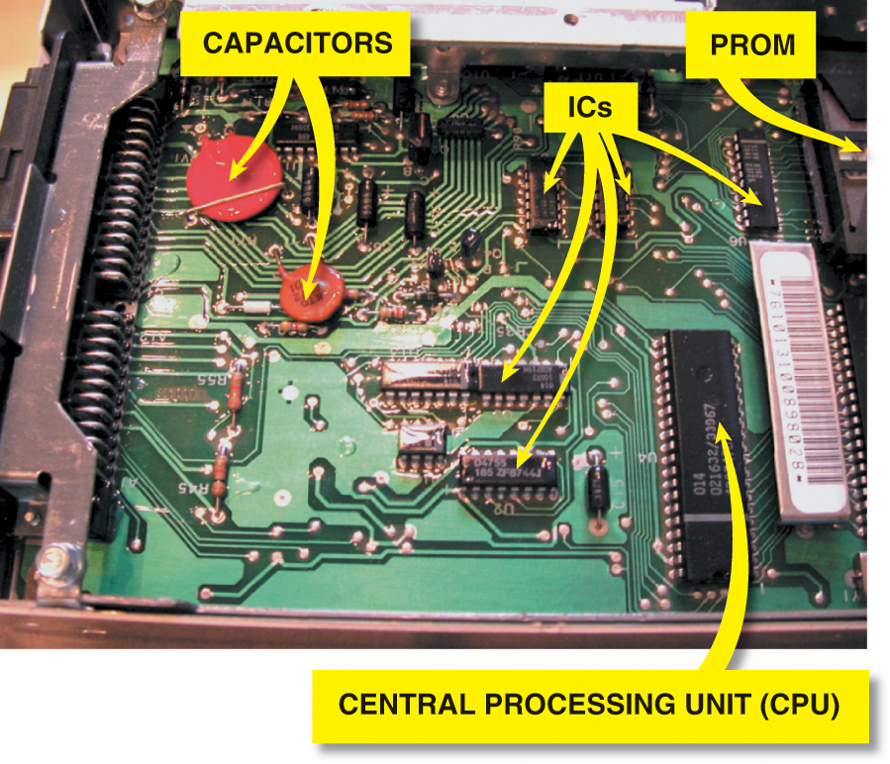
Figure 48.26 A typical automotive computer with the case removed to show all of the various electronic devices and integrated circuits (ICs). The CPU is an example of a DIP chip and the large red and orange devices are ceramic capacitors

Slide 58
TRANSISTOR GATES
Purpose and Function
A gate is an electronic circuit whose output depends on the location and voltage of two inputs.
Construction
For the transistor to turn on, a voltage difference between the base of the transmitter and the emitter should be at least a 0.6 volt.
Operation
Gates represent logic circuits that can be constructed so that the output depends on the voltage of the inputs to the bases of transistors.

Slide 59
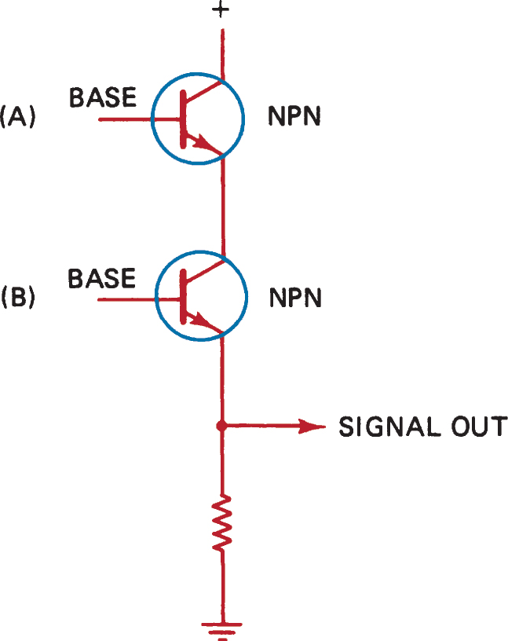
Figure 48.27 Typical AND gate circuit using two transistors. The emitter is always the line with the arrow. Notice that both transistors must be turned on before there is voltage present at the point labeled “signal out.”

Slide 60
OPERATIONAL AMPLIFIERS
Operational amplifiers (op-amps) are used in circuits to control and amplify digital signals.
Op-amps are frequently used for motor control for airflow door operation as part of the climate control system.
Op-amps can provide the proper voltage polarity and current (amperes) to control the direction of permanent magnetic (PM) motors.

Slide 61
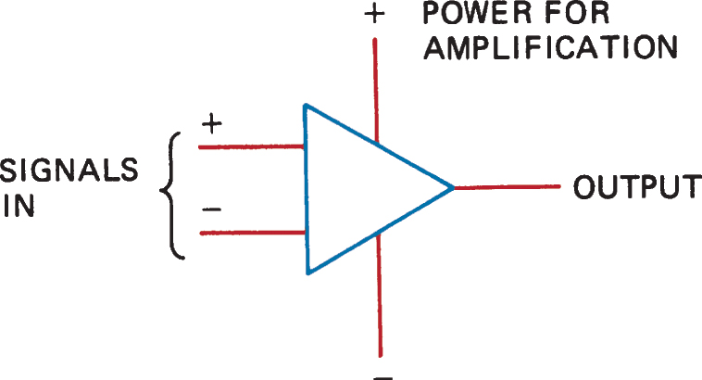
Figure 48.28 Symbol for an operational amplifier (op-amp)

Slide 62
ELECTRONIC COMPONENT FAILURE CAUSES
Frequent causes of premature failure include the following:
Poor Connections
Heat
Voltage Spikes
Excessive Current

Slide 63
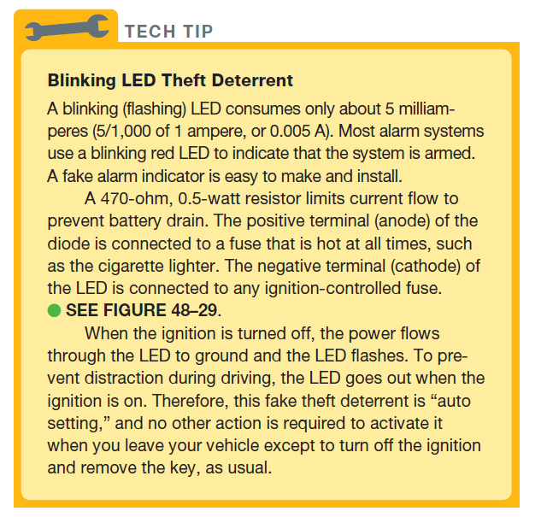
TECH TIP

Slide 64
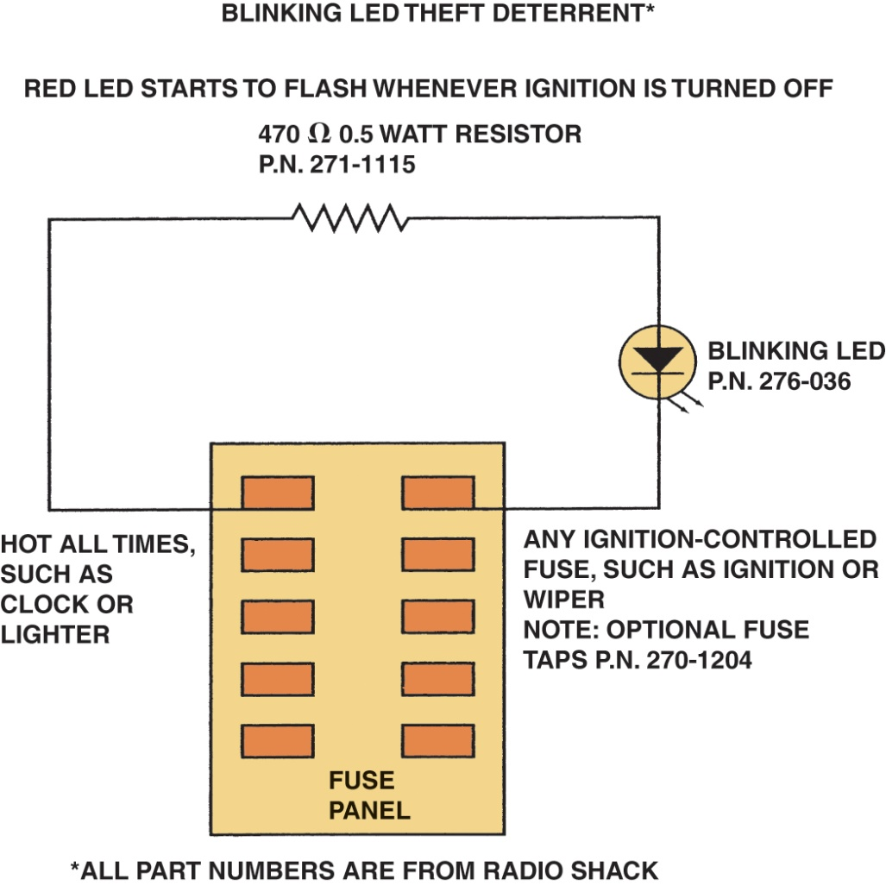
Figure 48.29 Schematic for a blinking LED theft deterrent

Slide 65
HOW TO TEST DIODES AND TRANSISTORS (1 OF 2)
Testers
Diodes and transistors can be tested with an ohmmeter. The diode or transistor being tested must be disconnected from the circuit.
Diodes
A good diode should give an over limit (OL) reading with the test leads attached to each lead of the diode in one way, and a voltage reading of 0.400 to 0.600 volt when the leads are reversed.

Slide 66
HOW TO TEST DIODES AND TRANSISTORS (2 OF 2)
Transistors
Using a digital meter set to the diode-check position, a good transistor should show a voltage drop of 0.400 to 0.600 volt between the following:
The emitter (E) and the base (B) and between the base (B) and the collector (C) with a meter connected one way, and OL when the meter test leads are reversed.
An OL reading (no continuity) in both directions when a transistor is tested between the emitter (E) and the collector (C).

Slide 67
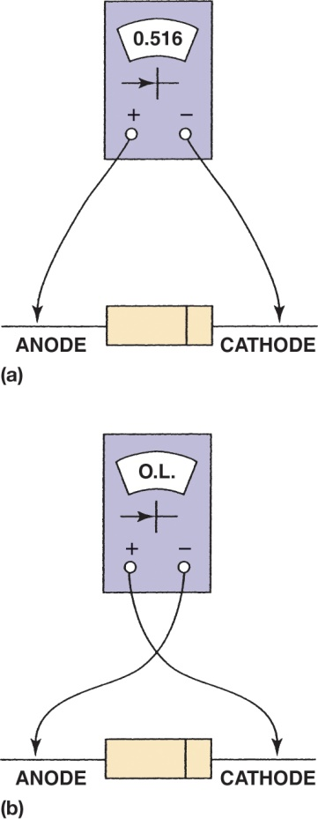
Figure 48.30 To check a diode, select “diode check” on a digital multimeter. (a) When the diode is forward biased, the meter should display a voltage between 0.500 and 0.700 volt (500 to 700 millivolts). (b) When the meter leads are reversed, the meter should read OL (over limit) because the diode is reverse biased and blocking current flow

Slide 68
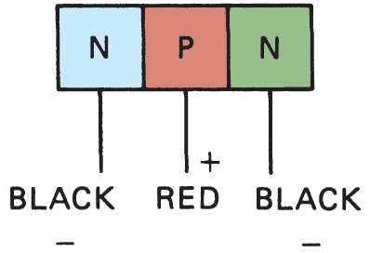
Figure 48.31 With the mater leads connected to a good diode as shown below, there should be low resistance. With the leads reversed there should be no resistance.

Slide 69
CONVERTERS AND INVERTERS
Converters
DC to DC converters (usually written as DC–DC converter) are electronic devices used to transform DC voltage from one level to another higher or lower level.
Inverters
An inverter is an electronic circuit that changes DC into AC. In most DC-AC inverters, the switching transistors, which are usually MOSFETs, are turned on alternately for short pulses.

Slide 70
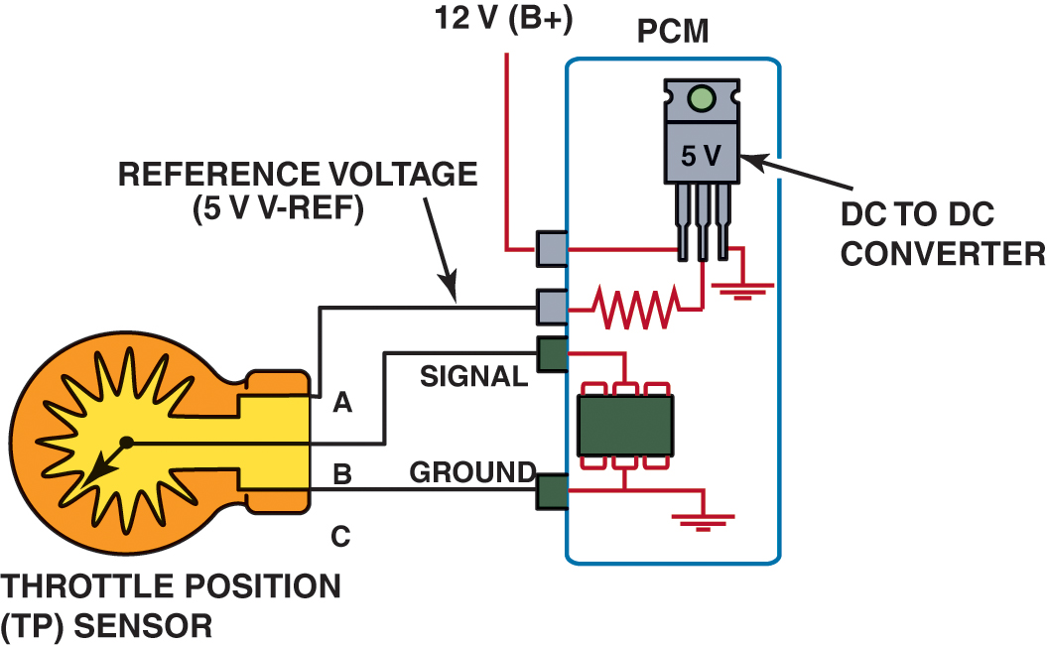
Figure 48.32 A DC to DC converter is built into most powertrain control modules (PCMs) and is used to supply the 5-volt reference, called V-ref, to many sensors used to control the internal combustion engine

Slide 71
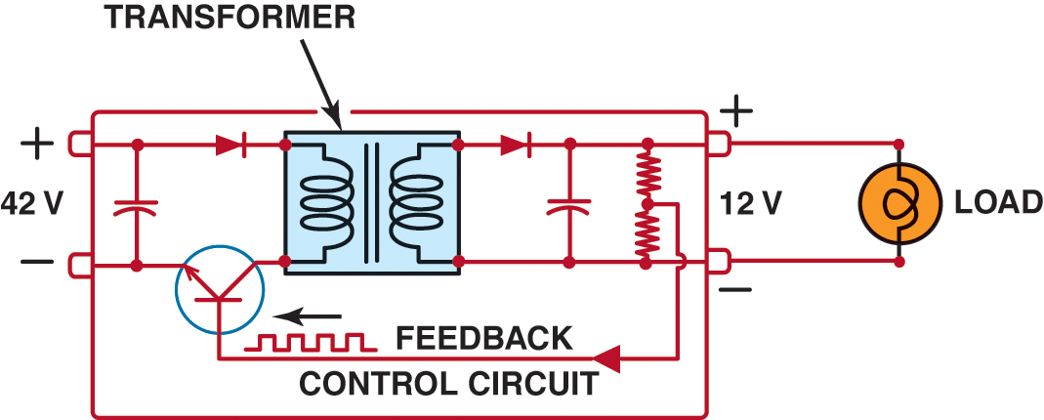
Figure 48.33 This DC–DC converter is designed to convert 42 volts to 14 volts, to provide 12-volts power to accessories on a hybrid-electric vehicle operating with a 42-volt electrical system

Slide 72
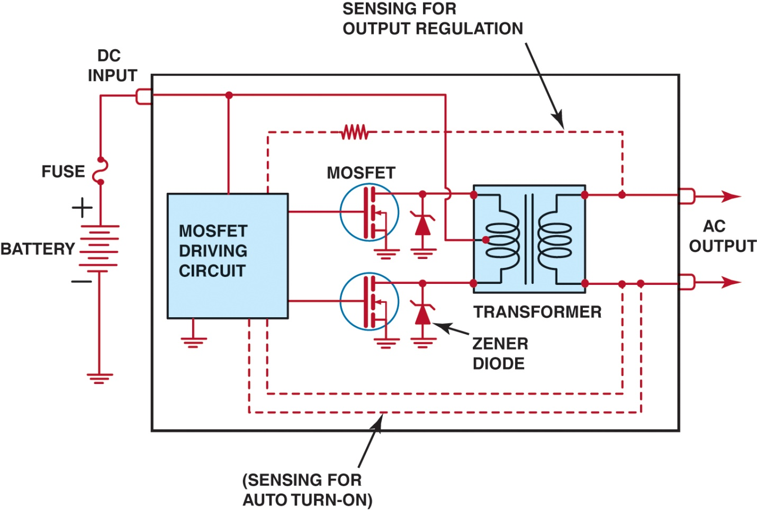
Figure 48.34 A typical circuit for an inverter designed to change direct current from a battery to alternating current for use by the electric motors used in a hybrid-electric vehicle

Slide 73
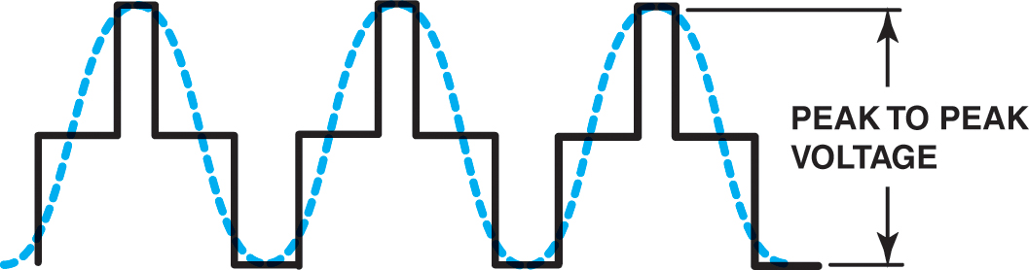
Figure 48.35 The switching (pulsing) MOSFETs create a waveform called a modified sine wave (solid lines), compared to a true sine wave (dotted lines)

Slide 74
ELECTROSTATIC DISCHARGE
Definition
Electrostatic discharge (ESD) is created when static charges build up on the human body when movement occurs.
Avoiding ESD
Before handling any electronic component, ground yourself by touching a metal surface to drain away any static charge.
Do not touch the terminals of electronic components.

Slide 75
QUESTION 3: ?
To what precautions should all service technicians adhere, to avoid damage to electronic and computer circuits?

Slide 76
ANSWER 3:
Before handling any electronic component, ground yourself by
touching a metal surface to drain away any static charge, and do not touch the terminals of electronic components.

Slide 77
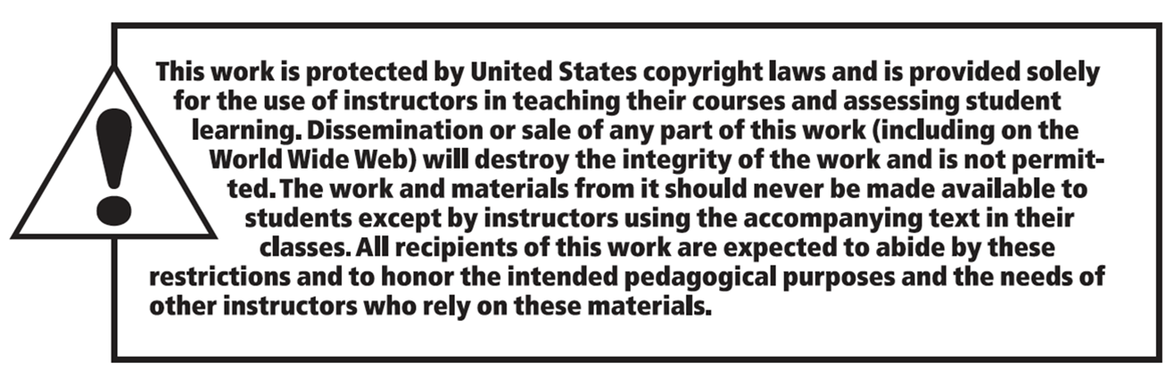
Copyright

