Slide 1
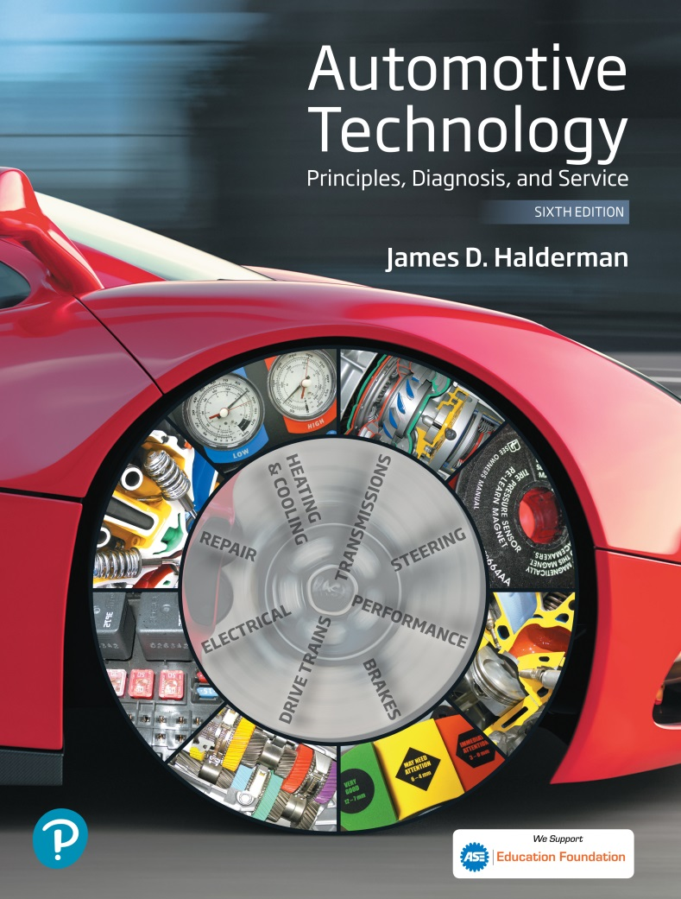
Automotive Technology Principles, Diagnosis, and Service
Sixth Edition
Chapter 47
Magnetism and Electromagnetism
Copyright © 2018, 2015, 2011 Pearson Education, Inc. All Rights Reserved

Slide 2
LEARNING OBJECTIVES (1 of 2)
47.1 Define magnetism and explain the concepts of magnetic induction, permeability, and reluctance.
47.2 Explain how an electromagnet works.
47.3 Explain how electromagnetism is used in relays and solenoids.

Slide 3
LEARNING OBJECTIVES (2 of 2)
47.4 Explain how magnetism and voltage are related.
47.5 Describe how an ignition coil works.
47.6 Describe ways to reduce electromagnetic interference.
47.7 This chapter will help you prepare for the ASE Electrical/Electronic Systems (A6) certification test content area “A” (General Electrical/ Electronic System Diagnosis).

Slide 4
FUNDAMENTALS OF MAGNETISM (1 OF 4)
Definition
Magnetism is a form of energy that is caused by the motion of electrons in some materials.
Like electricity, magnetism cannot be seen.
Magnetite is the most naturally occurring magnet.
Many other materials can be artificially magnetized to some degree, depending on their atomic structure.

Slide 5
FUNDAMENTALS OF MAGNETISM (2 OF 4)
Lines of Force
The lines that create a field of force around a magnet are believed to be caused by the way groups of atoms are aligned in the magnetic material.
Magnetic Induction
If a piece of iron or steel is placed in a magnetic field, it also becomes magnetized.

Slide 6
FUNDAMENTALS OF MAGNETISM (3 OF 4)
Attracting or Repelling
When unlike poles are placed close together, the lines exit from one magnet and enter the other.
If like poles are placed close together, the curving flux lines meet head-on, forcing the magnets apart.

Slide 7
FUNDAMENTALS OF MAGNETISM (4 OF 4)
Permeability
The degree that some materials allow the magnetic force to pass through more easily than others.
Reluctance
The degree that certain materials resist the passage of magnetic force.

Slide 8
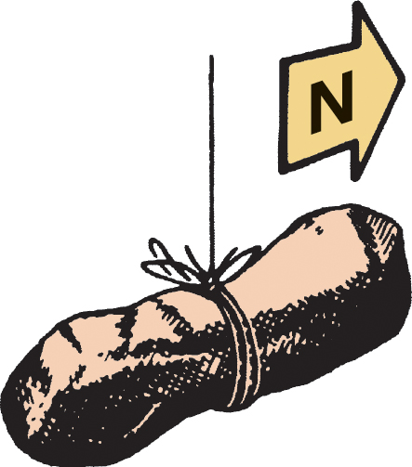
Figure 47.1 A freely suspended natural magnet (lodestone) points toward the magnetic north pole

Slide 9
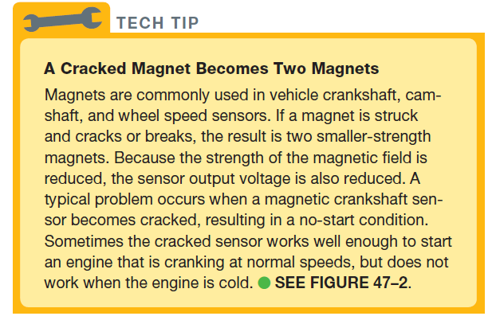
Tech Tip

Slide 10
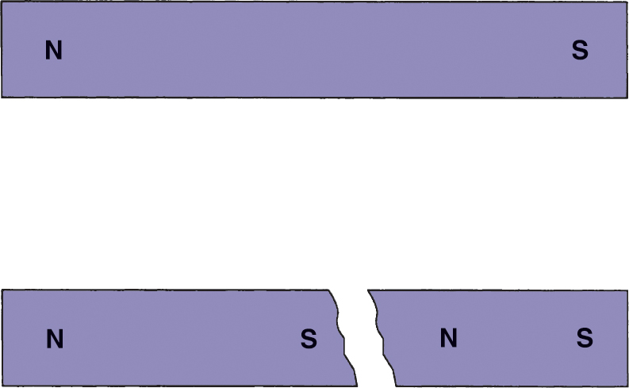
Figure 47.2 If a magnet breaks or is cracked, it becomes two weaker magnets

Slide 11
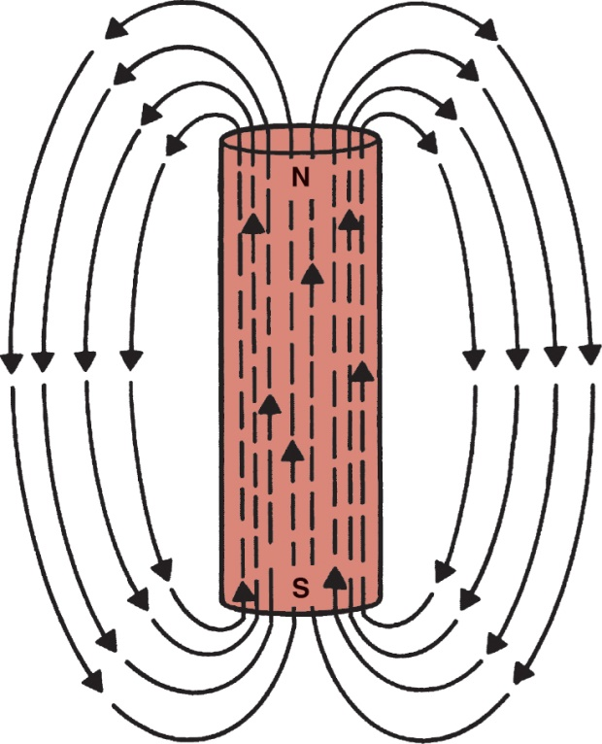
Figure 47.3 Magnetic lines of force leave the north pole and return to the south pole of a bar magnet

Slide 12
QUESTION 1: ?
What is the result if a magnet cracks?

Slide 13
ANSWER 1:
Two weaker magnets are created.

Slide 14
ELECTROMAGNETISM (1 OF 3)
Definition
A current carrying conductor surrounded by a magnetic field, many time stronger than a conventional magnet.
Creating an Electromagnet
Wrap a nail with 20 turns of insulated wire and connect the ends to the terminals of a 1.5 volt dry cell battery.
Straight Conductor
The magnetic field surrounding a straight, current-carrying conductor consists of several concentric cylinders of flux that are the length of the wire.

Slide 15
ELECTROMAGNETISM (2 OF 3)
Left-Hand and Right-Hand Rules
The left-hand rule for magnetic field direction is used with the electron flow theory.
The right-hand rule for magnetic field direction is used with the conventional theory of electron flow.
Field Interaction
Conductors with opposing magnetic fields move apart into weaker fields.
Motor Principle
Use the magnetic field interaction to convert electrical energy into mechanical energy.

Slide 16
ELECTROMAGNETISM (3 OF 3)
Coil Conductor
If several loops of wire are made into a coil, then the magnetic flux density is strengthened.
Electromagnetic Strength
The magnetic field can be strengthened (increased) in three ways.
Place a soft iron core in the center of the coil.
Increase the number of turns of wire in the coil.
Increase the current flow through the coil windings.

Slide 17
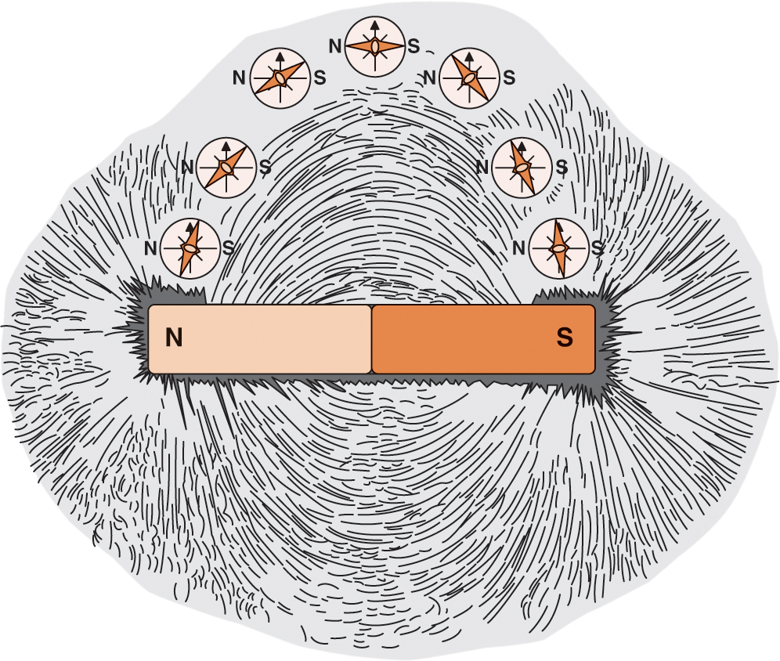
Figure 47.4 Iron filings and a compass can be used to observe the magnetic lines of force

Slide 18
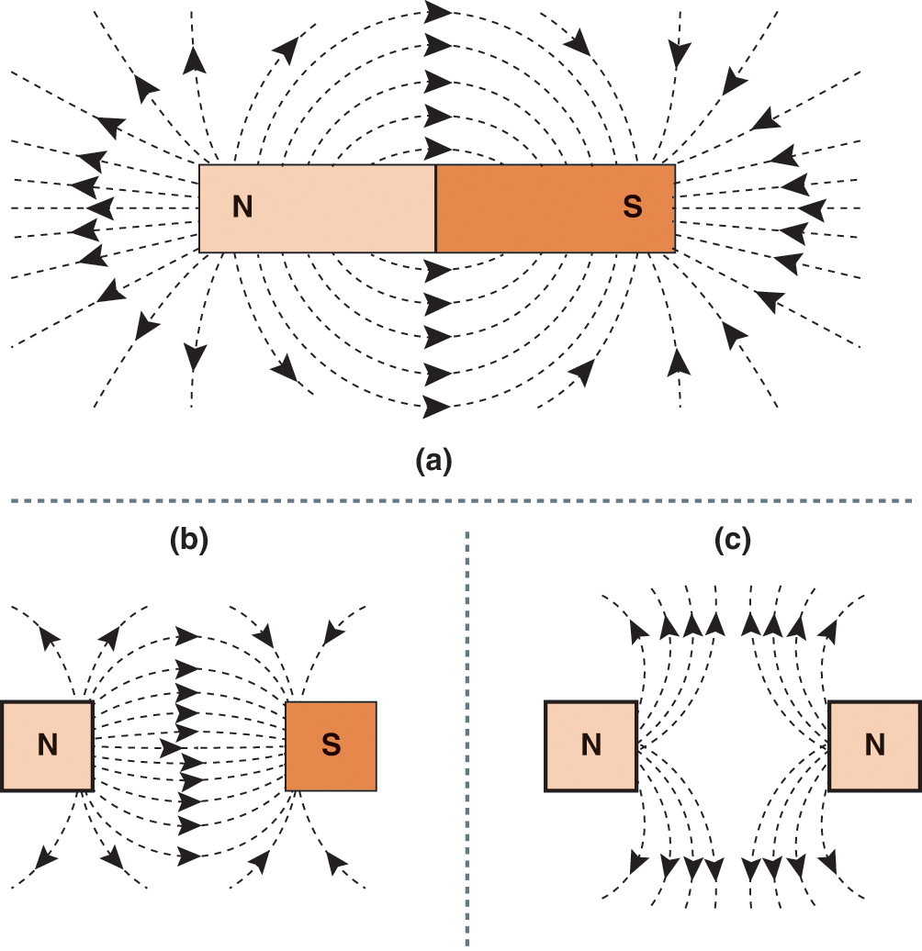
Figure 47.5 (a) Magnetic lines of force spread out from around an isolated magnet. (b) Opposite poles attract. (c) Similar poles repel

Slide 19
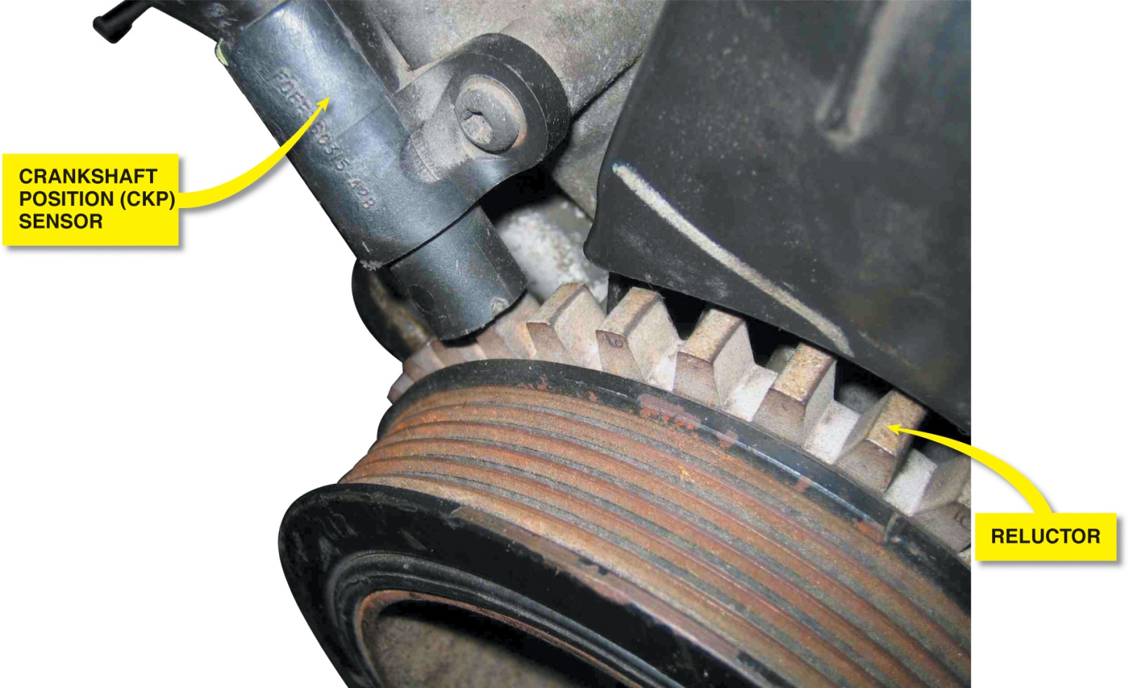
Figure 47.6 A crankshaft position sensor and reluctor (notched wheel)

Slide 20
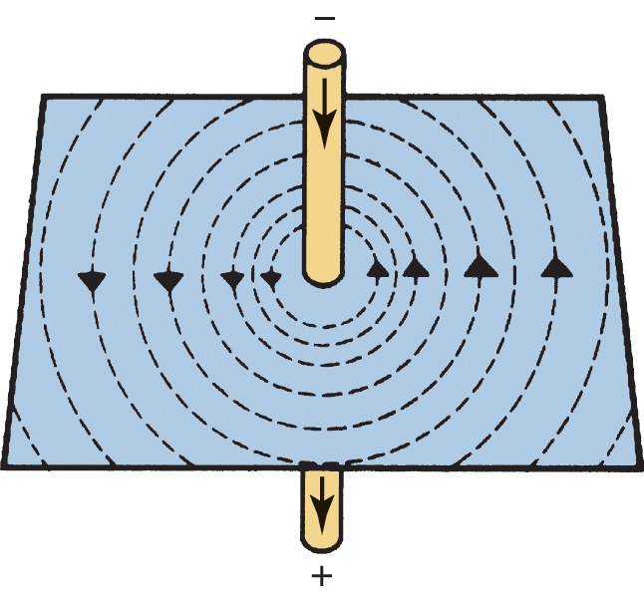
Figure 47.7 A magnetic field surrounds a straight, current-carrying conductor

Slide 21
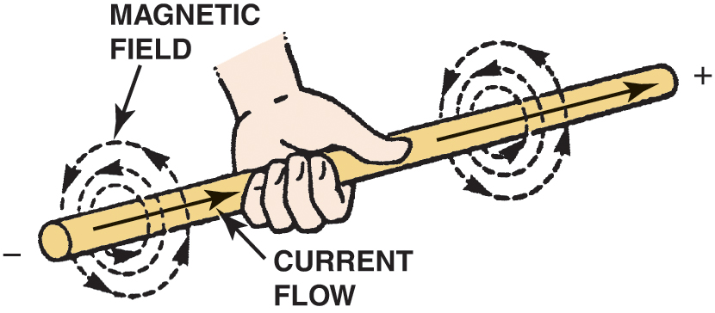
Figure 47.8 The left-hand rule for magnetic field direction is used with the electron flow theory

Slide 22
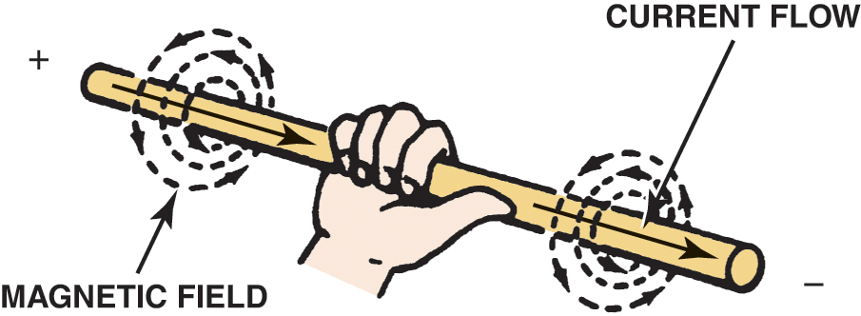
Figure 47.9 The right-hand rule for magnetic field direction is used with the conventional theory of electron flow

Slide 23
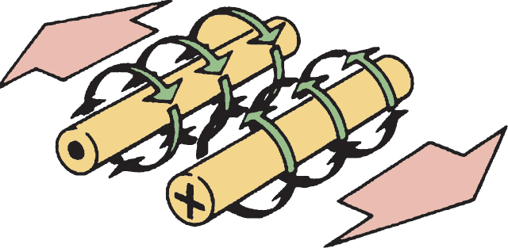
Figure 47.10 Conductors with opposing magnetic fields move apart into weaker fields

Slide 24
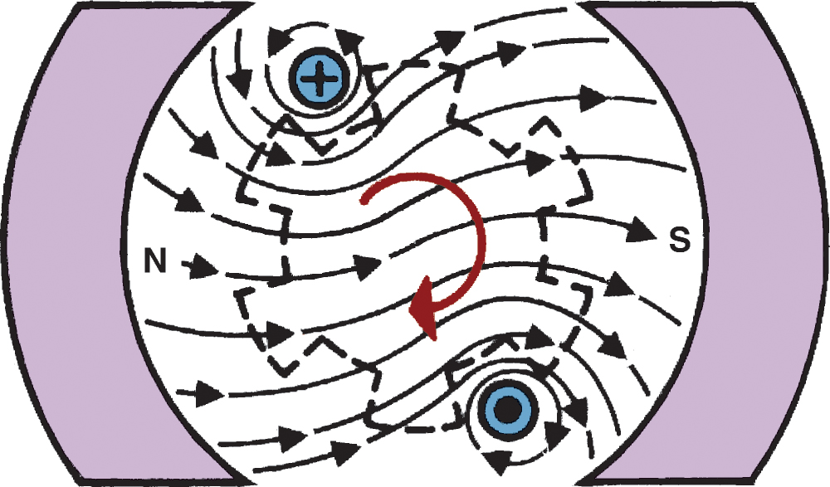
Figure 47.11 Electric motors use the interaction of magnetic fields to produce mechanical energy

Slide 25
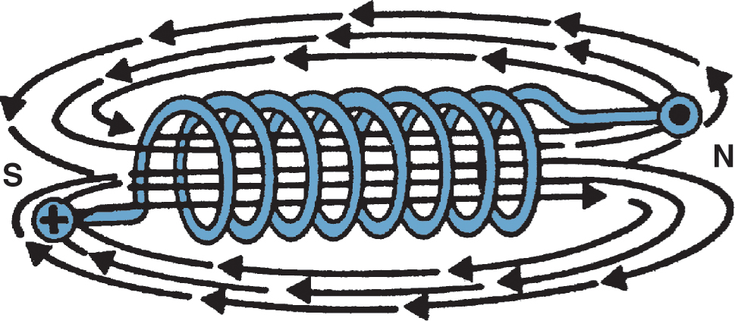
Figure 47.12 The magnetic lines of flux surrounding a coil look like those surrounding a bar magnet

Slide 26
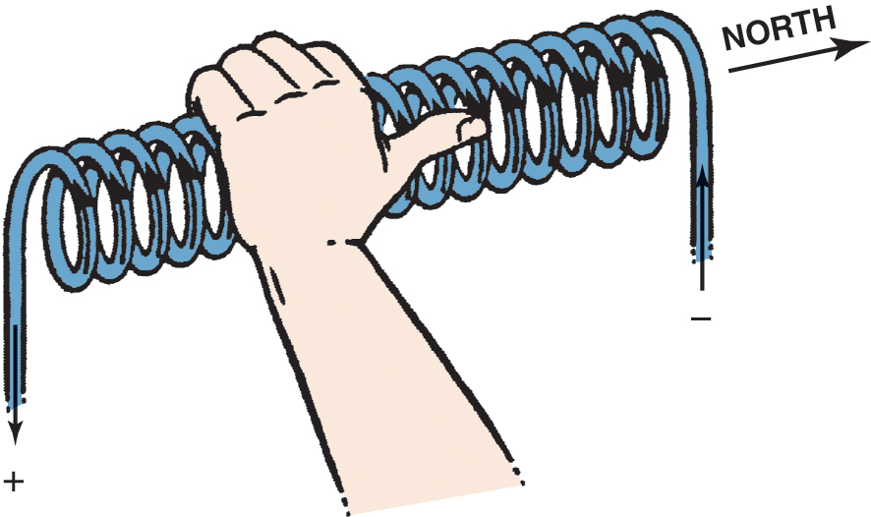
Figure 47.13 The left-hand rule for coils is shown

Slide 27
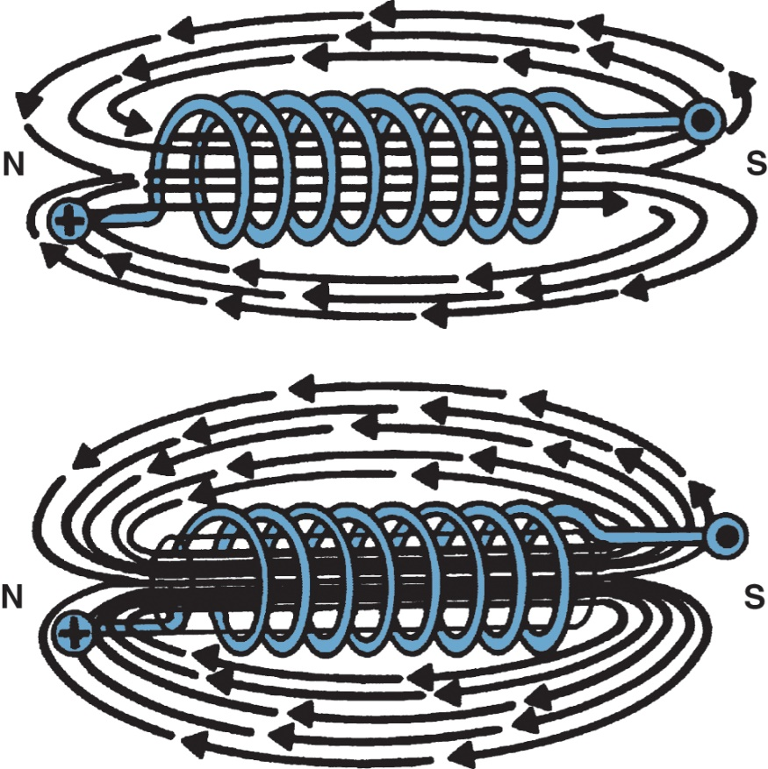
Figure 47.14 An iron core concentrates the magnetic lines of force surrounding a coil

Slide 28
USE OF ELECTROMAGNETISM
Relays
A simple relay contains an electromagnetic coil in series with a battery and a switch.
Solenoid
A solenoid is an example of an electromagnetic switch that uses a moveable core.

Slide 29
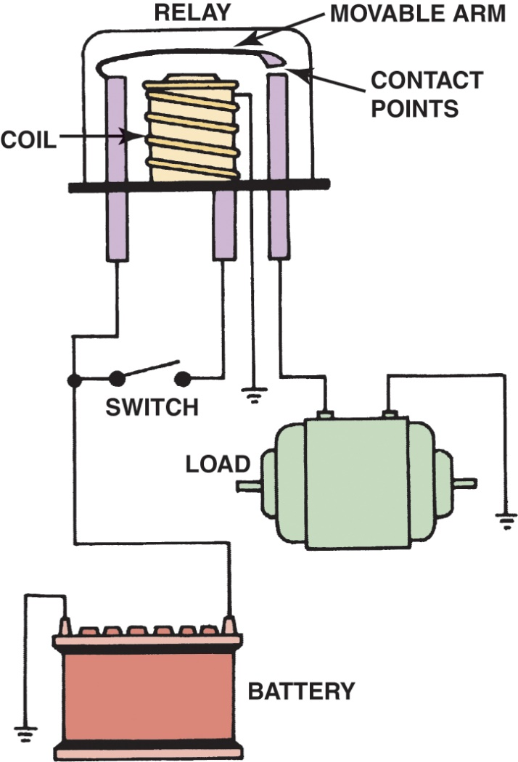
Figure 47.15 An electromagnetic switch that has a movable arm is referred to as a relay

Slide 30
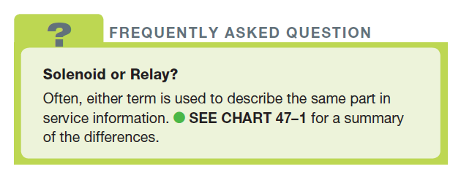
FREQUENTLY ASKED QUESTION

Slide 31
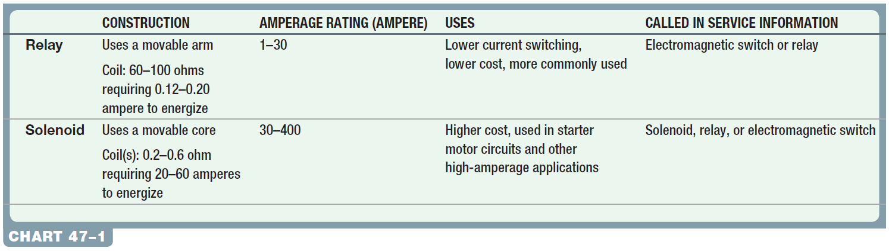
Chart 47-1 Comparison between a relay and a solenoid.

Slide 32
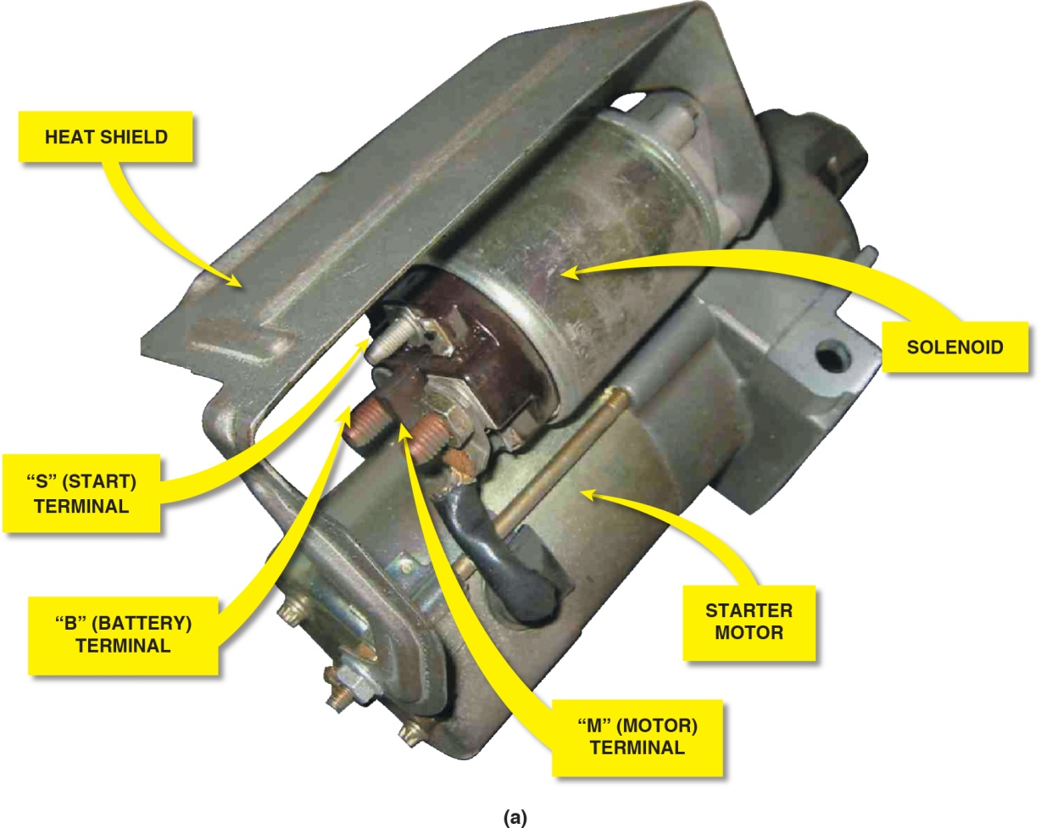
Figure 47.16 (a) A starter with attached solenoid. All the current needed by the starter flows through the two large terminals of the solenoid and through the solenoid contacts inside

Slide 33
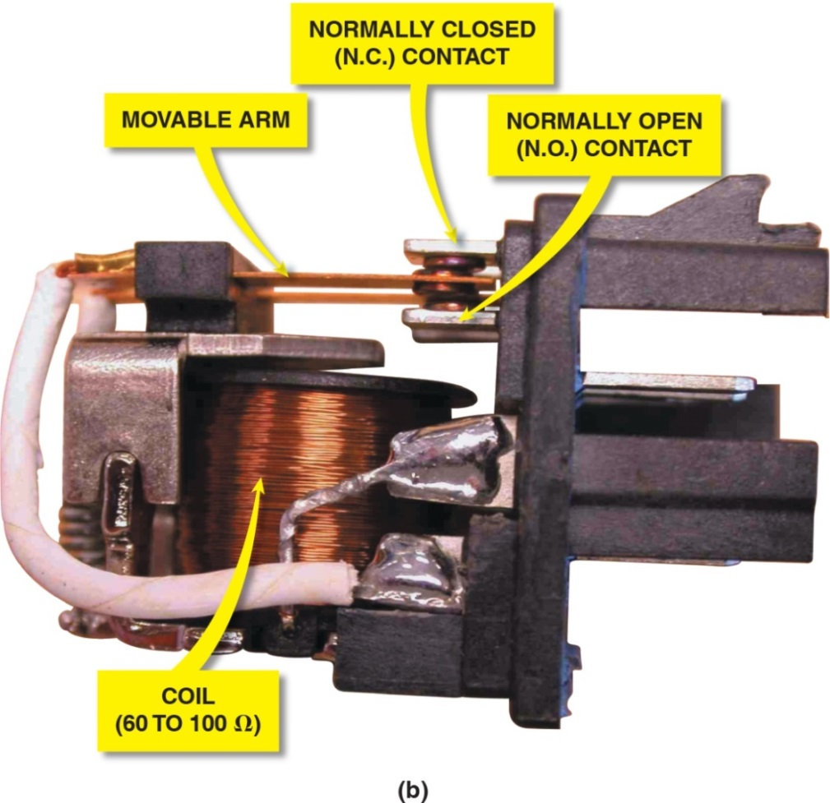
Figure 47.16 (b) A relay is designed to carry lower current, compared to a solenoid, and uses a movable arm

Slide 34
ELECTROMAGNETIC INDUCTION (1 OF 2)
Principles Involved
Electricity can be produced by using the relative movement of an electrical conductor and a magnetic field.
Voltage Intensity
The amount of the voltage depends on the rate at which the flux lines are broken.
Lenz’s Law
An induced current moves so that its magnetic field opposes the motion that induced the current.

Slide 35
ELECTROMAGNETIC INDUCTION (2 OF 2)
Self-Induction
As current increases, the flux lines continue to expand, cutting across the wires of the coil and actually inducing another voltage within the same coil.
Mutual Induction
When two coils are close together, energy may be transferred from one to the other by magnetic coupling.

Slide 36
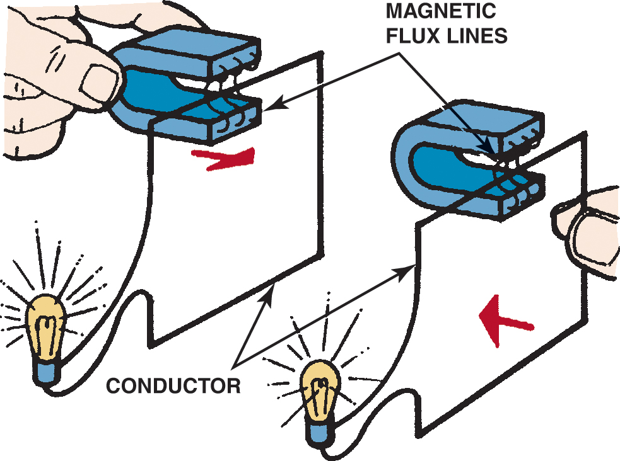
Figure 47.17 Voltage can be induced by the relative motion between a conductor and magnetic lines of force

Slide 37
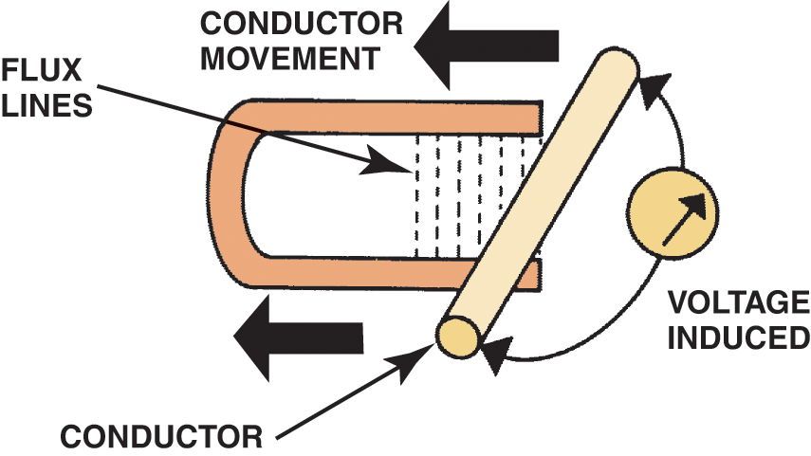
Figure 47.18 Maximum voltage is induced when conductors cut across the magnetic lines of force (flux lines) at a 90-degree angle

Slide 38
QUESTION 2: ?
What is the difference between mutual induction and self-induction?

Slide 39
ANSWER 2:
In mutual induction there are two coils, in self-induction there is a single coil.

Slide 40
IGNITION COILS
Ignition Coil Windings
Ignition coils use two windings and are wound on the same iron core.
Ignition Coil Construction
A core of laminated soft iron is surrounded by the secondary windings. The secondary windings are surrounded by the primary windings.
Ignition Coil Operation
The coil is fed battery voltage when the key is on and the ground is controlled by an ignition module.

Slide 41
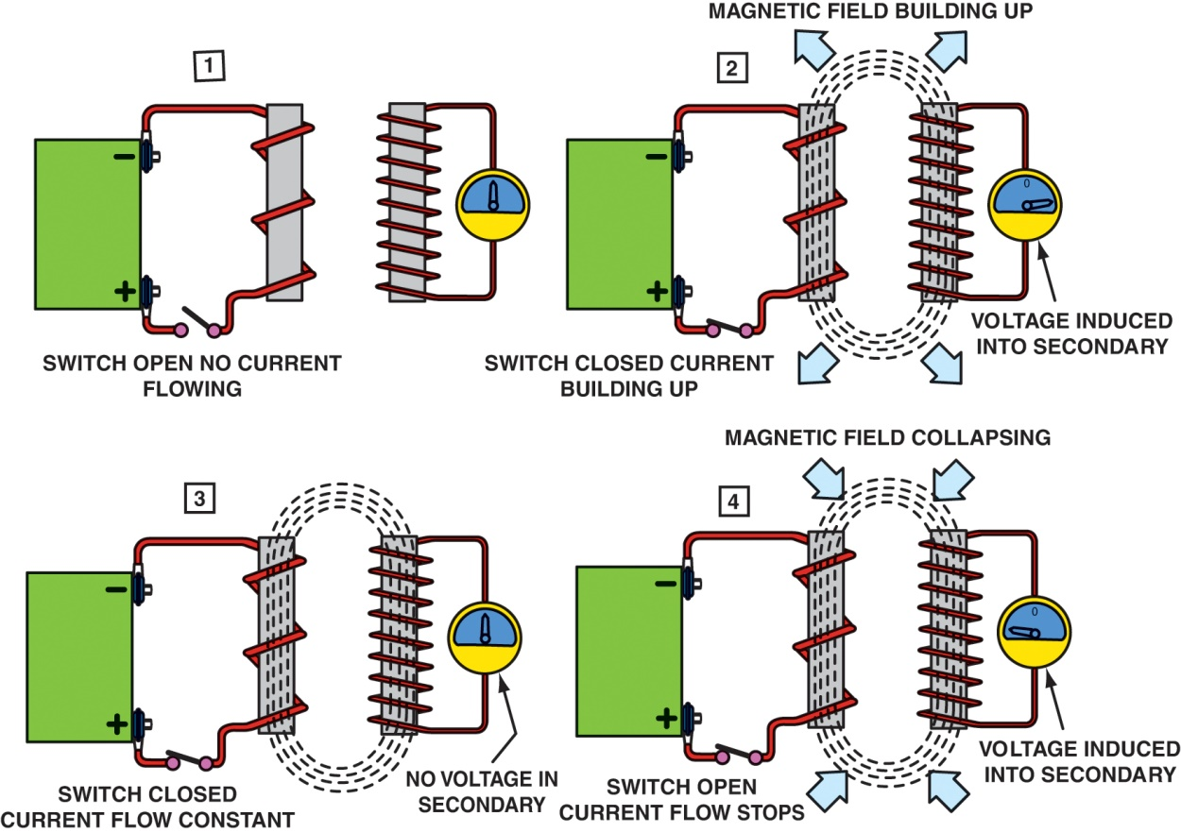
Figure 47.19 Mutual induction occurs when the expansion or collapse of a magnetic field around one coil induces a voltage in a second coil

Slide 42
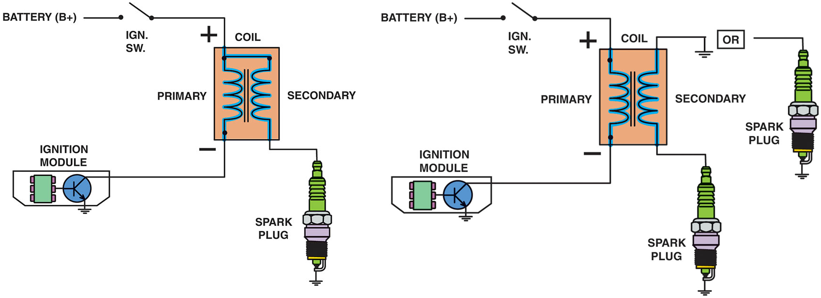
Figure 47.20 Some ignition coils are electrically connected, called “married” (left figure), whereas others use separated primary and secondary windings, called “divorced” (right figure)

Slide 43
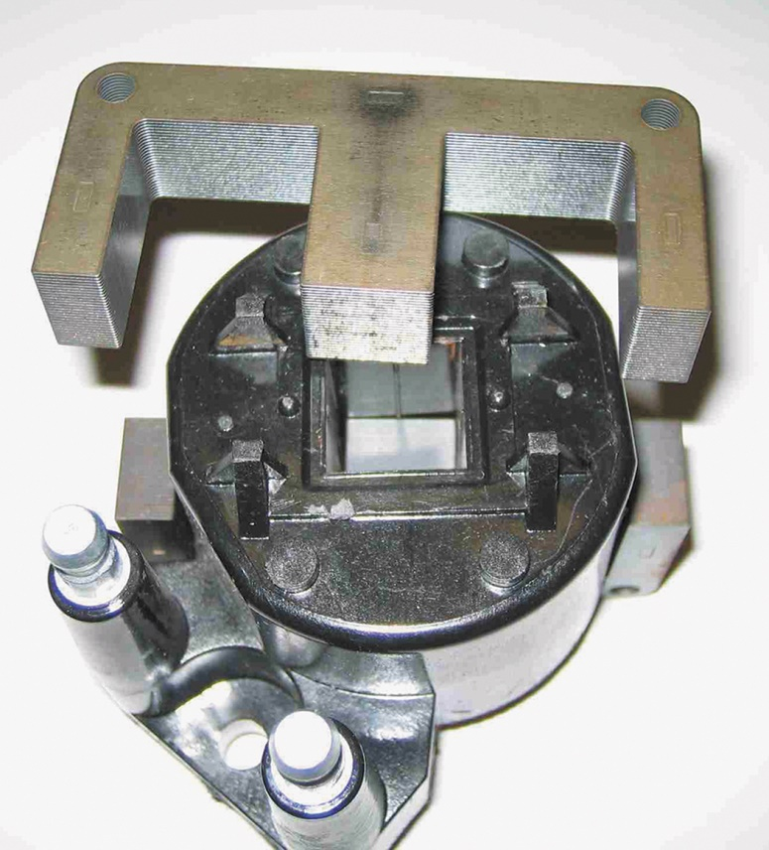
Figure 47.21 A GM waste-spark ignition coil showing the section of laminations that is shaped like the letter E. These mild steel laminations improve the efficiency of the coil

Slide 44
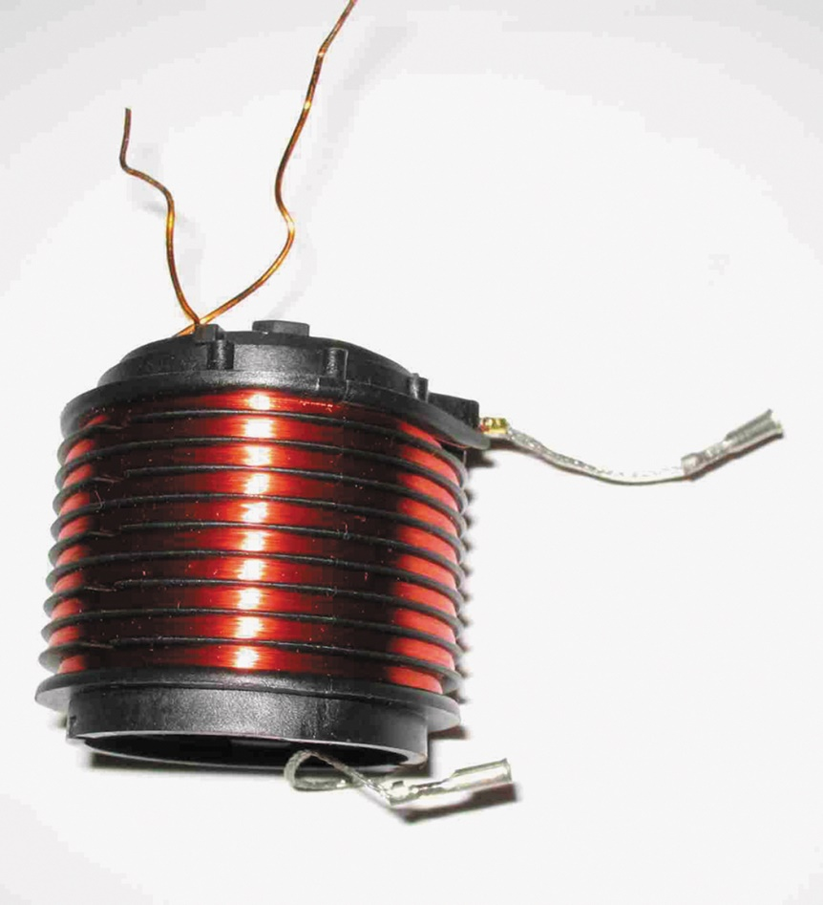
Figure 47.22 The coil-on-plug (COP) design typically uses a bobbin-type coil

Slide 45
ELECTROMAGNETIC INTERFERENCE
Definition
Electrical interference caused by radio frequency or electromagnetic fields.
How is EMI Created
When the current in a conductor is turned on/off fast enough, a high-frequency signal wave is created.
EMI Suppression Devices
Capacitors, coils, shielding, and ground wires or cables

Slide 46
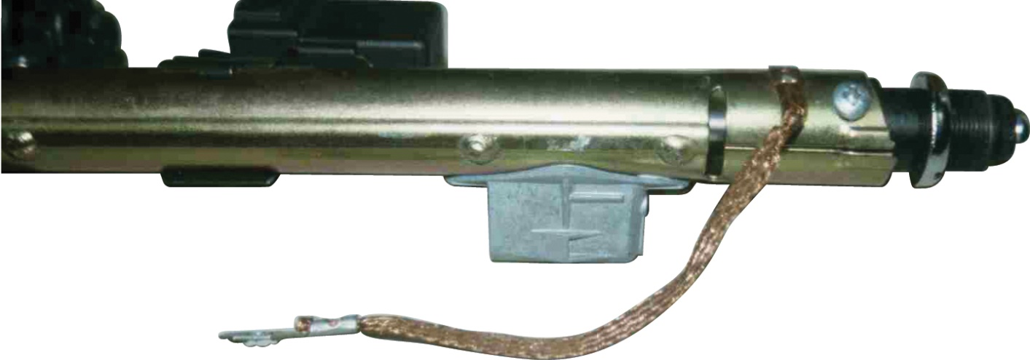
Figure 47.23 To help prevent underhood electromagnetic devices from interfering with the antenna input, it is important that all ground wires, including the one from this power antenna, be properly grounded

Slide 47
QUESTION 3: ?
How can EMI be reduced or controlled?

Slide 48
ANSWER 3:
Capacitors, coils, shielding, and ground wires or cables.

Slide 49
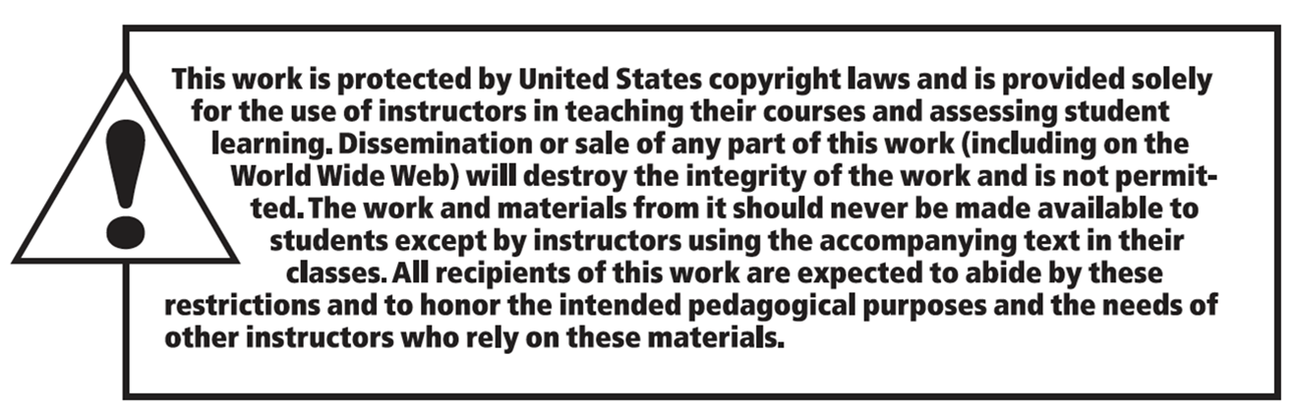
Copyright

