Slide 1
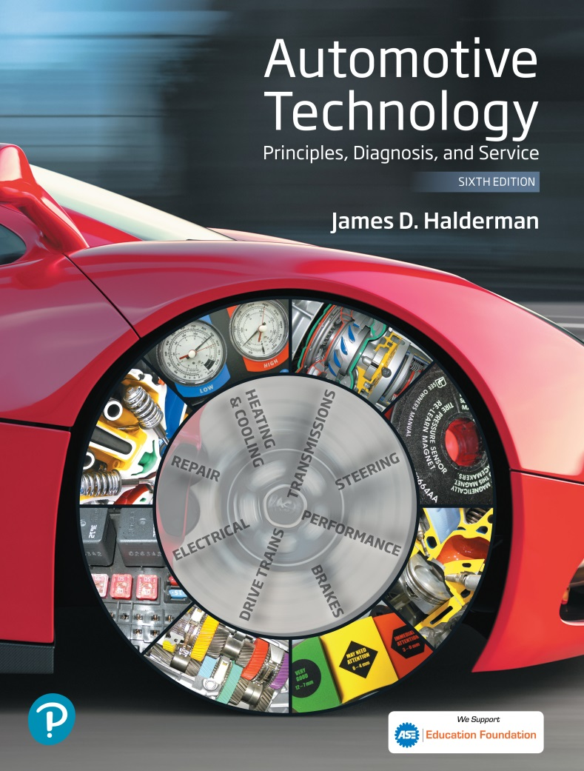
Automotive Technology Principles, Diagnosis, and Service
Sixth Edition
Chapter 46
Capacitance and Capacitors
Copyright © 2018, 2015, 2011 Pearson Education, Inc. All Rights Reserved

Slide 2
LEARNING OBJECTIVES
46.1 Explain capacitance and the construction and operation of capacitors, and factors of capacitance.
46.2 Explain the uses of capacitors and discuss capacitors in series and parallel circuits.
46.3 This chapter will help you prepare for the ASE Electrical/Electronic Systems (A6) certification test content area “A” (General Electrical/ Electronic System Diagnosis).

Slide 3
CAPACITANCE
Definition
Capacitance is the ability of an object or surface to store an electrical charge.
Capacitors are also called condensers.

Slide 4
CAPICITOR CONSTRUCTION AND OPERATION
Construction
A capacitor (also called a condenser) consists of two conductive plates with an insulating material between them. The insulating material is commonly called a dielectric.
Operation
When a capacitor is placed in a closed circuit, the voltage source (battery) forces electrons around the circuit. Because electrons cannot flow through the dielectric of the capacitor, excess electrons collect on what becomes the negatively charged plate.

Slide 5
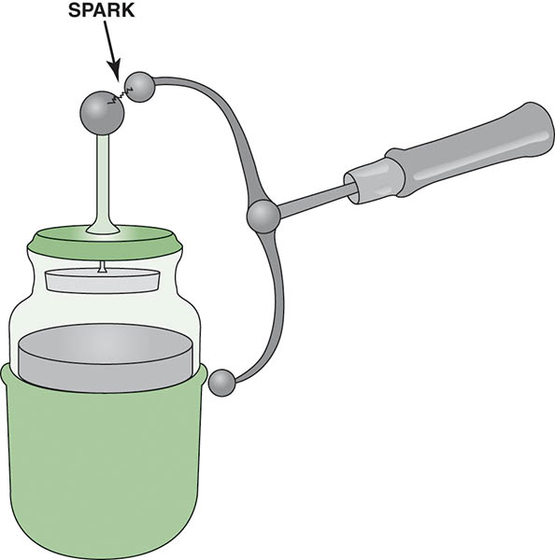
Figure 46.1 A Leyden jar can be used to store an electrical charge

Slide 6
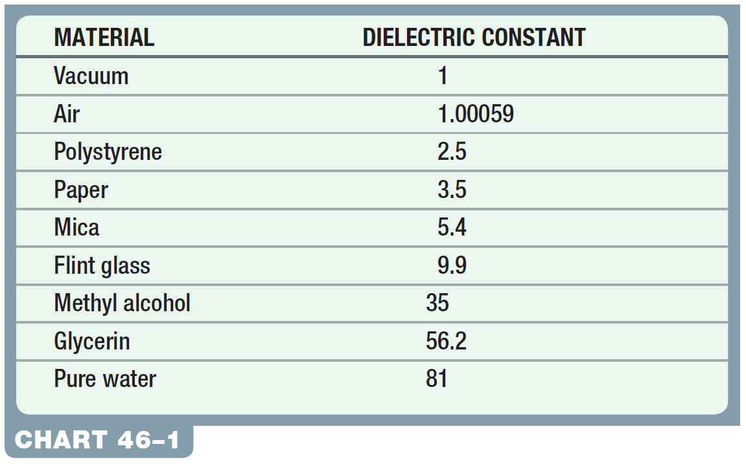
Chart 46-1 The higher the dielectric constant is, the better are the insulating properties between the plates of the capacitor.

Slide 7
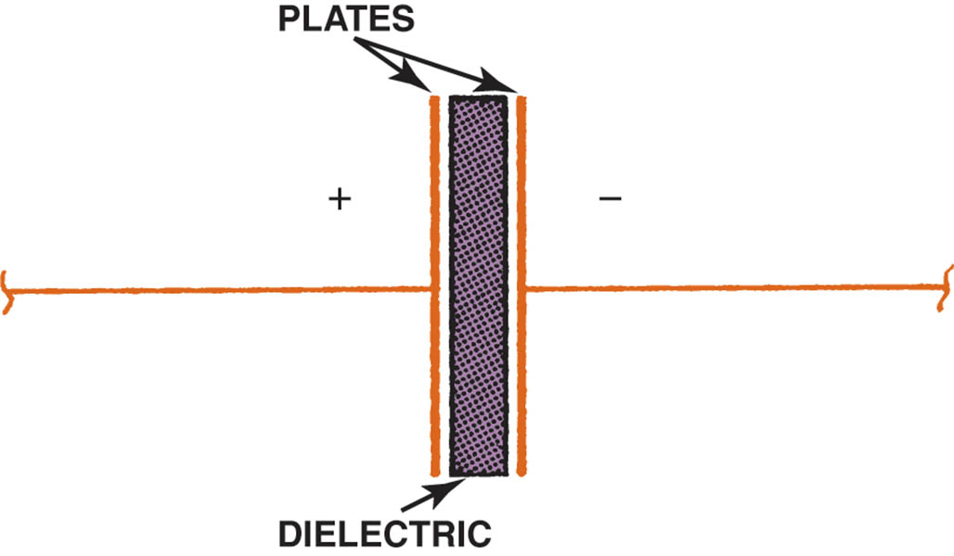
Figure 46.2 This simple capacitor is made of two plates separated by an insulating material, called a dielectric.

Slide 8
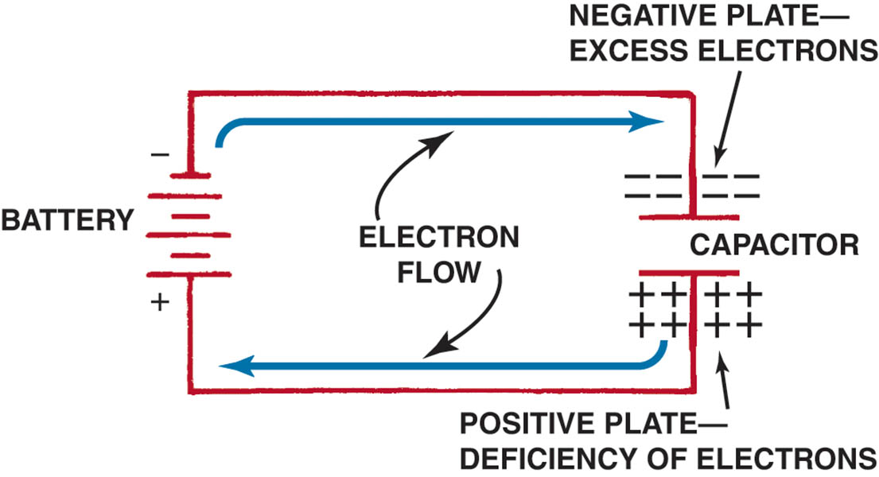
Figure 46.3 As the capacitor is charging, the battery forces electrons through the circuit.

Slide 9
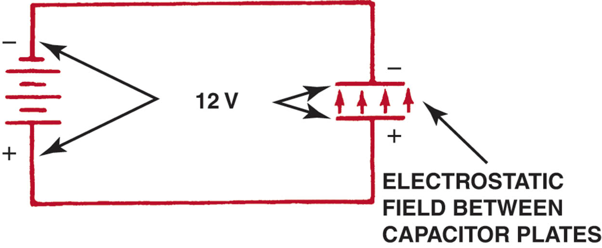
Figure 46.4 When the capacitor is charged, there is equal voltage across the capacitor and the battery. An electrostatic field exists between the capacitor plates. No current flows in the circuit.

Slide 10
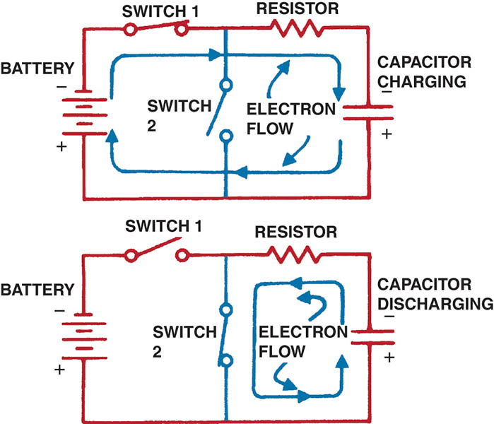
Figure 46.5 The capacitor is charged through one circuit (top) and discharged through another (bottom).

Slide 11
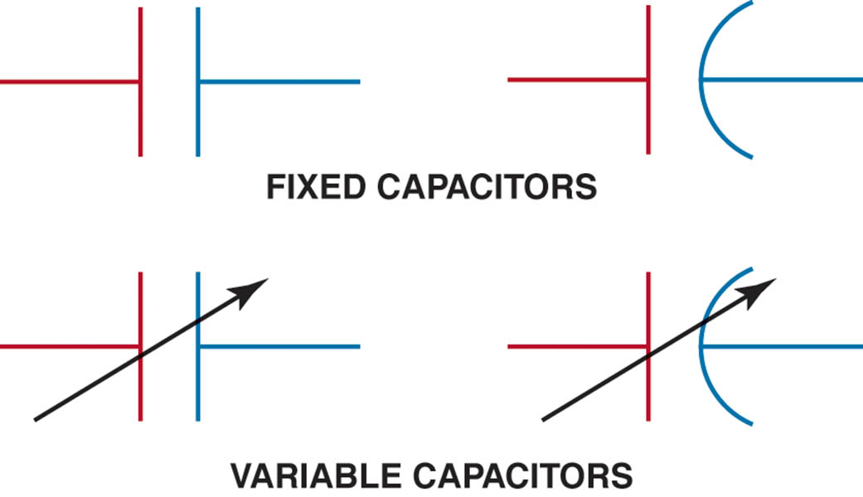
Figure 46.6 Capacitor symbols as shown in electrical diagrams. The negative plate is often shown curved.

Slide 12
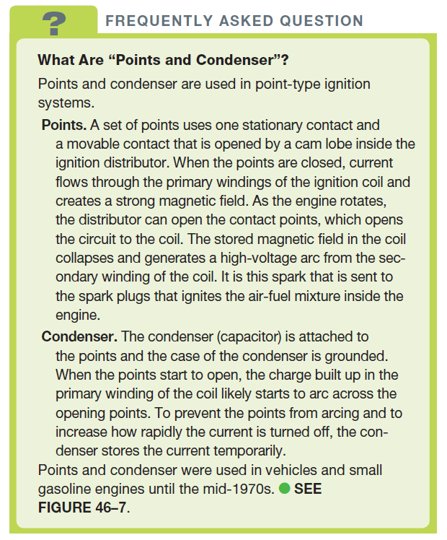
FREQUENTLY ASKED QUESTION

Slide 13
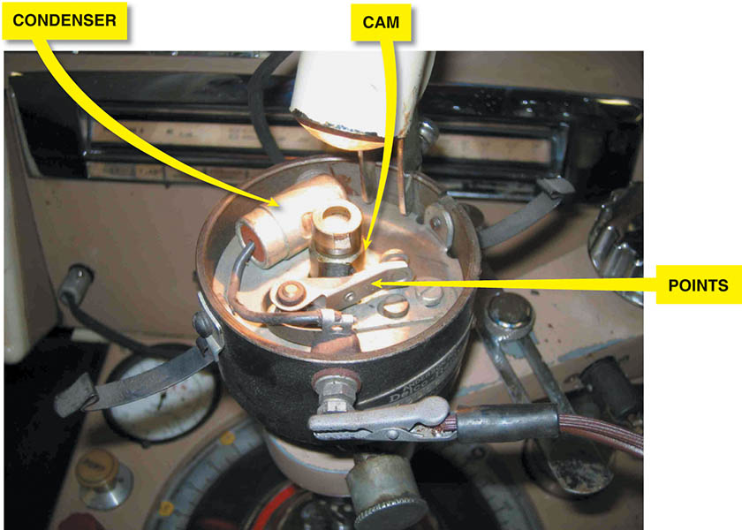
Figure 46.7 A point-type distributor shown with the condenser from an old vehicle being tested on a distributor machine

Slide 14
QUESTION 1: ?
How does a capacitor store an electrical charge?

Slide 15
ANSWER 1:
The capacitor holds its charge until it is connected into an external circuit through which it can discharge.

Slide 16
FACTORS OF CAPACITANCE
Capacitance is governed by three main factors.
The surface area of the plates
The distance between the plates
The dielectric material
Measurement of Capacitance
Capacitance is measured in farads, which is named after Michael Faraday (1791–1867), an English physicist.

Slide 17
USES FOR CAPACITORS
Spike Suppression
Noise Filtering
Supplemental Power Source
Timer Circuits
Computer Memory
Condenser Microphones

Slide 18
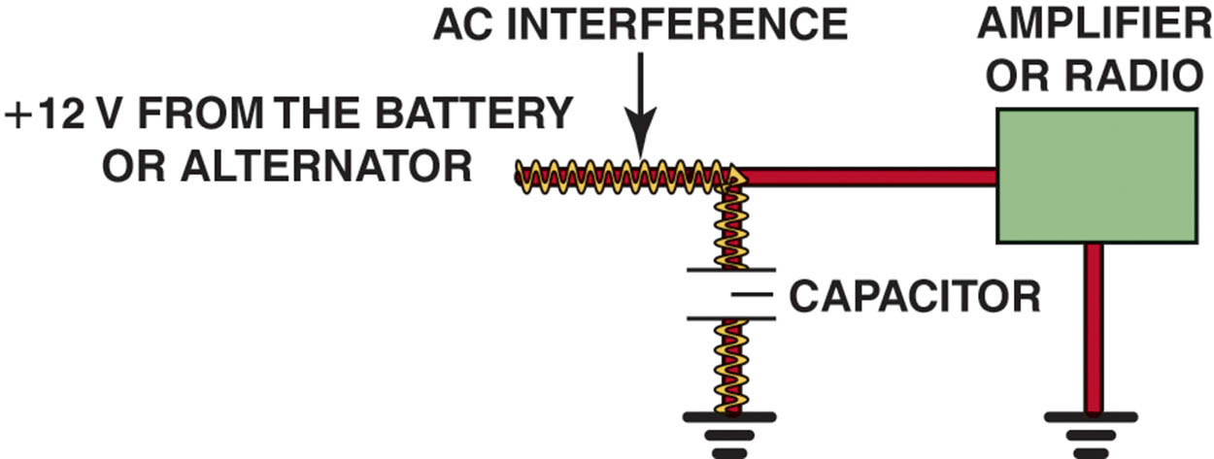
Figure 46.8 A capacitor blocks direct current (DC), but passes alternating current (AC). A capacitor makes a very good noise suppressor because most of the interference is AC.

Slide 19
QUESTION 2: ?
How can a capacitor be used as a noise filter?

Slide 20
ANSWER 2:
Block the DC signal as this is where most of the noise comes from.

Slide 21
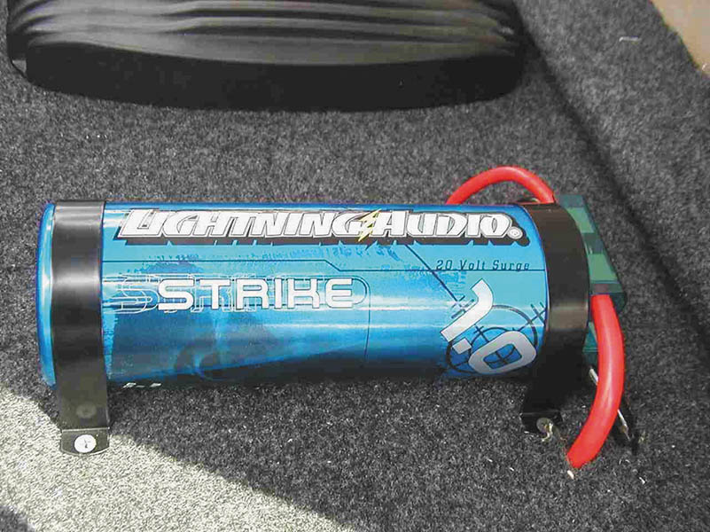
Figure 46.9 A 1 farad capacitor used to boost the power to large speakers

Slide 22
CAPACITORS IN CIRCUITS
Capacitors in Parallel Circuits
Capacitance can be increased in a circuit by connecting capacitors in parallel.
Capacitors in Series Circuits
Capacitance in a circuit can be decreased by placing capacitors in series.

Slide 23
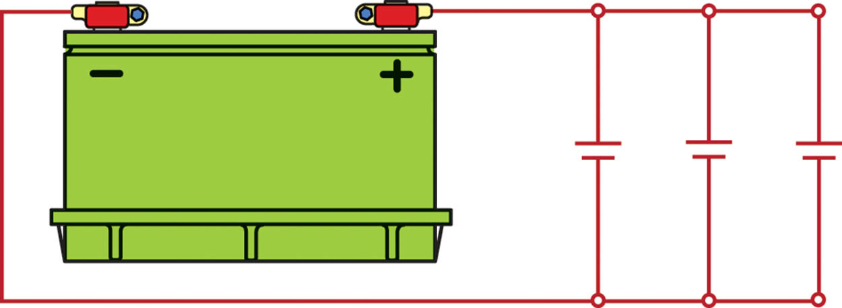
Figure 46.10 Capacitors in parallel effectively increase the capacitance.

Slide 24
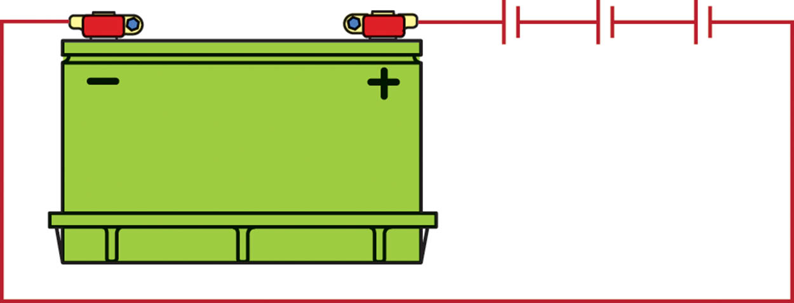
Figure 46.11 Capacitors in series decrease the capacitance.

Slide 25
QUESTION 3: ?
Where can a capacitor be used as a power source?

Slide 26
ANSWER 3:
In a speaker.

Slide 27
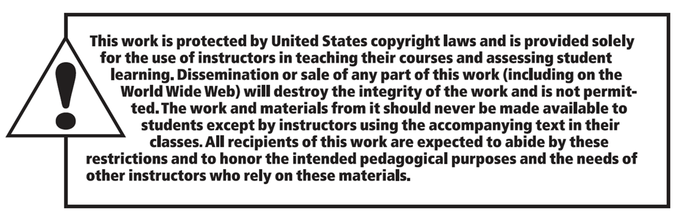
Copyright

