Slide 1
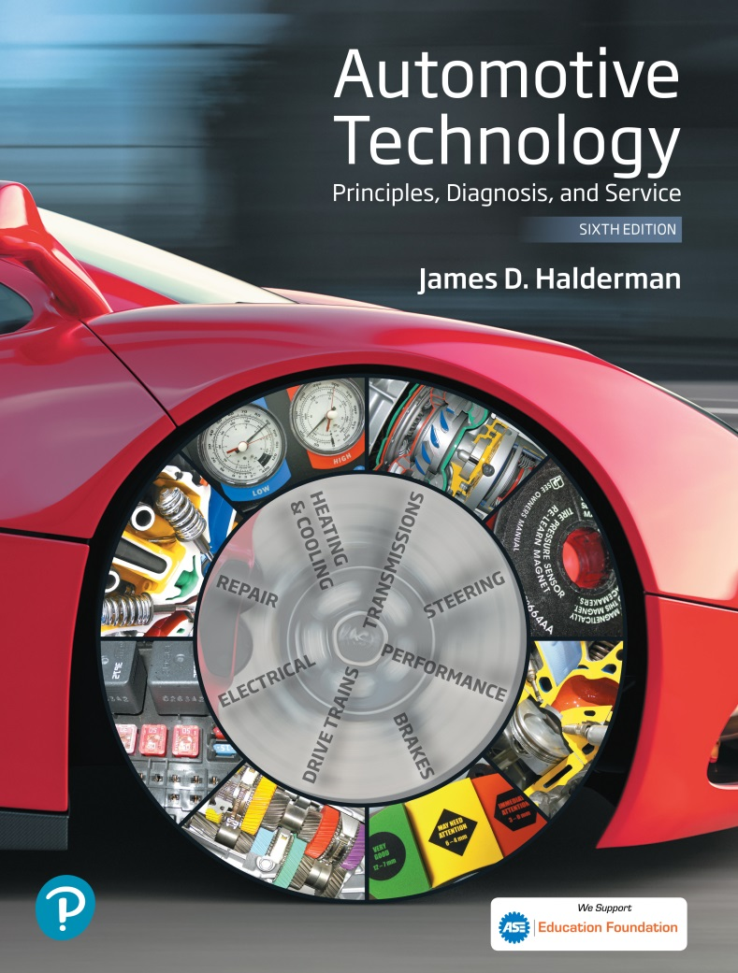
Automotive Technology Principles, Diagnosis, and Service
Sixth Edition
Chapter 44
Automotive Wiring and Wire Repair
Copyright © 2018, 2015, 2011 Pearson Education, Inc. All Rights Reserved

Slide 2
LEARNING OBJECTIVES (1 of 2)
44.1 Explain automotive wiring and wire gauge systems.
44.2 Explain the purpose of ground wires, battery cables, and jumper cables.
44.3 Describe how fuses, fusible links, circuit breakers, and PTC circuit protector protect circuits and wiring.

Slide 3
LEARNING OBJECTIVES (2 of 2)
44.4 List the steps for removing a terminal from a connector.
44.5 List the steps for performing each method of wire repair.
44.6 Explain the types of electrical conduit.

Slide 4
AUTOMOTIVE WIRING
Definition and Terminology
Most automotive wire is made from strands of copper covered by plastic insulation.
American Wire Gauge (AWG)
As the gauge number increases, the size of the conductor wire decreases.
Metric Wire Gauge
Sizes measured in square millimeters (mm2) of cross-sectional area.

Slide 5
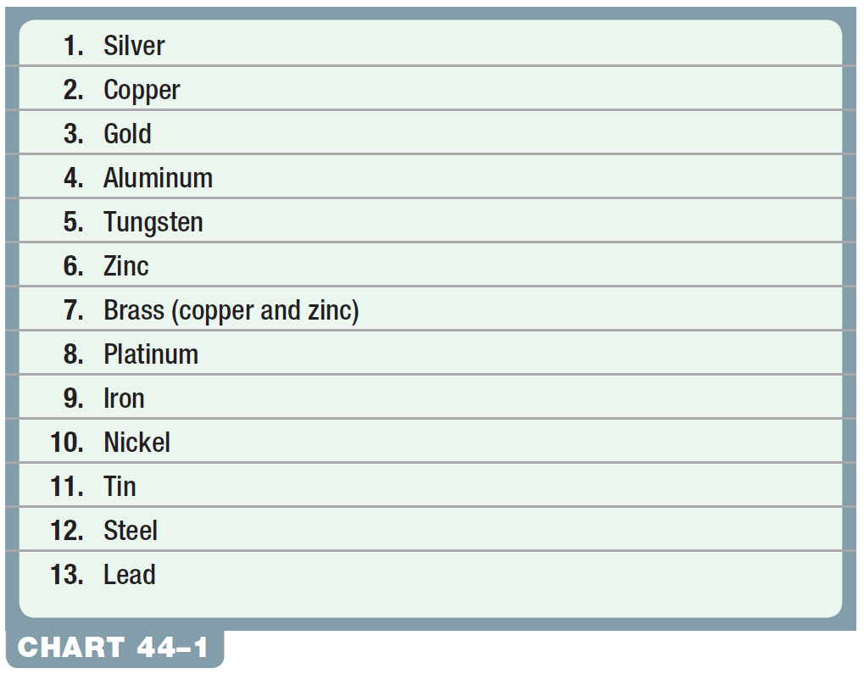
Chart 44-1 The list of relative conductivity of metals, showing silver to be the best.

Slide 6
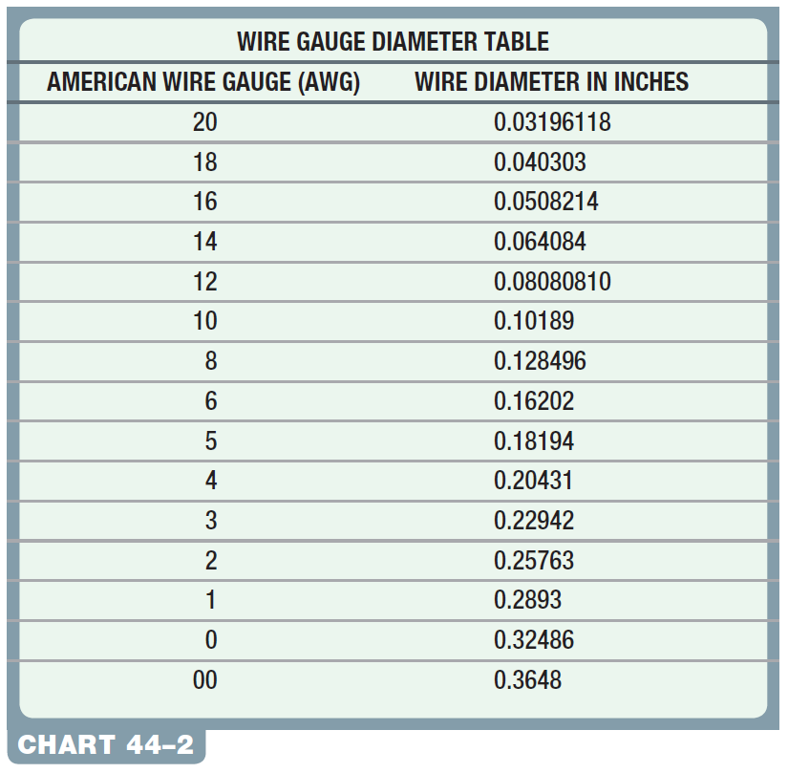
Chart 44-2 American wire gauge (AWG) number and the actual conductor diameter in inches.

Slide 7
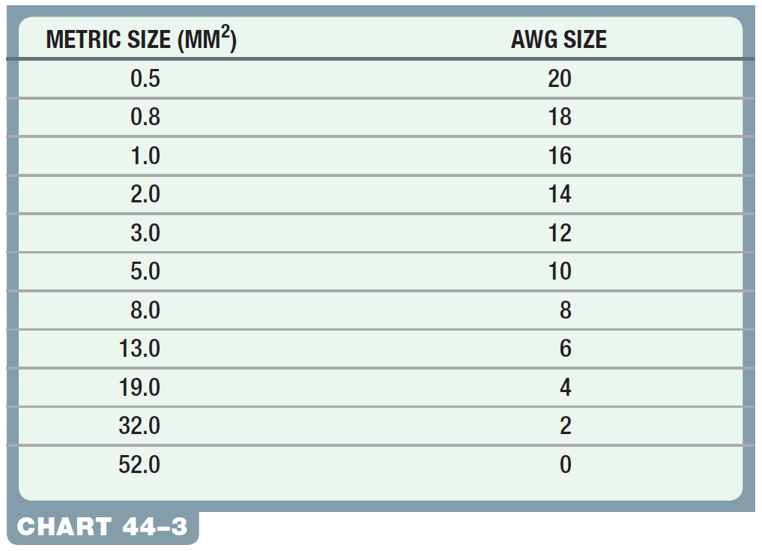
Chart 44-3 Metric wire size in square millimeters (mm²) conversion chart to American wire gauge (AWG).

Slide 8
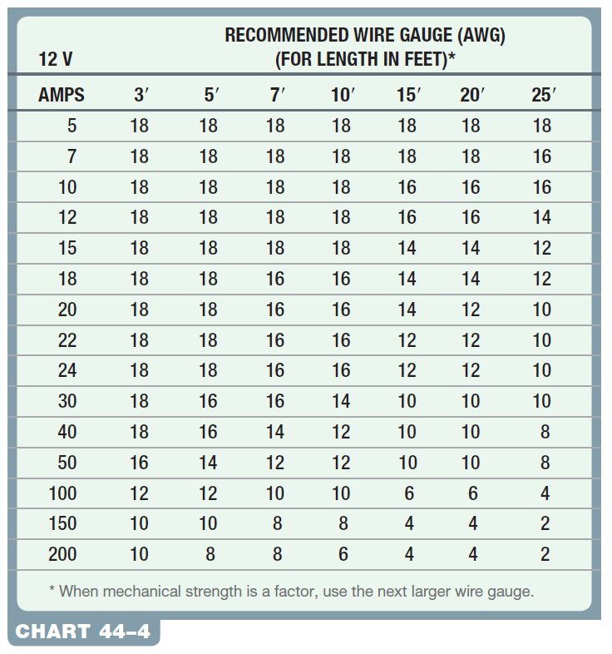
Chart 44-4 Recommended AWG wire size increases as the length increases because all wires have internal resistance. The longer the wire is, the greater the resistance. The larger the diameter is, the lower the resistance.

Slide 9
QUESTION 1: ?
What is the difference between the American wire gauge
(AWG) system and the metric system?

Slide 10
ANSWER 1:
The method that the wire is sized.

Slide 11
GROUND WIRES
Purpose and Function
All vehicles use ground wires between the engine and body and/or between the body and the negative terminal of the battery.
Skin Effect
The skin effect is the term used to describe how high-frequency AC electricity flows through a conductor.

Slide 12
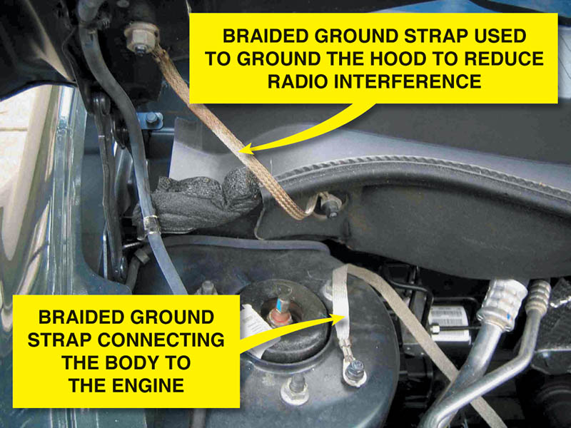
Figure 44.1 All lights and accessories ground to the body of the vehicle.

Slide 13
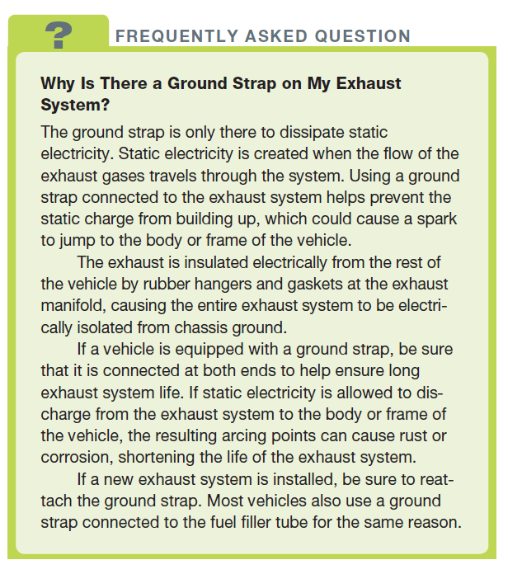
FREQUENTLY ASKED QUESTION

Slide 14
BATTERY CABLES
Battery cables are the largest wires used in the automotive electrical system. The cables are usually 4-gauge, 2-gauge, or 1-gauge wires (19 mm2 or larger).

Slide 15
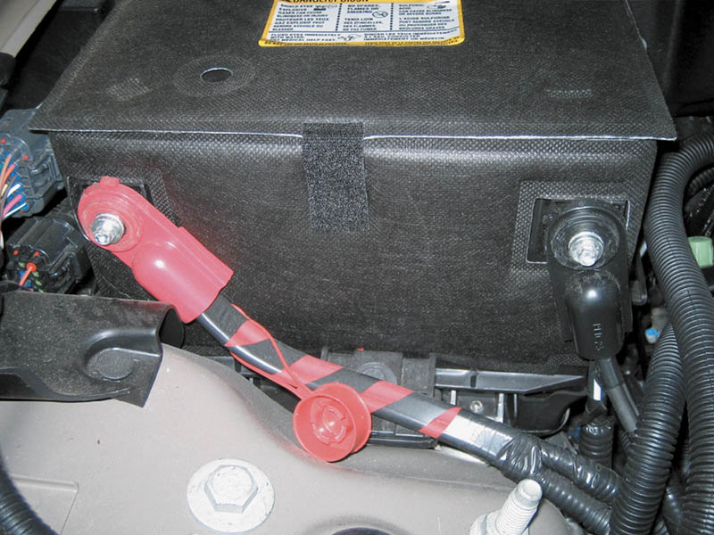
Figure 44.2 Battery cables are designed to carry heavy starter current and are, therefore, usually 4 gauge or larger wire.

Slide 16
JUMPER CABLES
Jumper cables are 4- to 2/0-gauge electrical cables with large clamps attached, and are used to connect the discharged battery of one vehicle to the good battery of another vehicle.
1/0 AWG welding cable can be used to construct an excellent set of jumper cables using welding clamps on both ends.

Slide 17
FUSES AND CIRCUIT PROTECTION DEVICES (1 OF 5)
Construction
A fuse is constructed of a fine tin conductor inside a glass, plastic, or ceramic housing.
Fuse Ratings
The fuse rating is normally about 20% higher than the normal current in the circuit.
Blade Fuses
Colored blade-type fuses are also referred to as ATO fuses and have been used since 1977.

Slide 18
FUSES AND CIRCUIT PROTECTION DEVICES (2 OF 5)
Mini Fuses
To save space, many vehicles use mini (small) blade fuses.
Maxi Fuses
Maxi fuses are a large version of blade fuses and are used to replace fusible links in many vehicles.
Pacific Fuse Element
First used in the late 1980s, Pacific fuse elements (also called a fuse link or auto link) are used to protect wiring from a direct short-to-ground.

Slide 19
FUSES AND CIRCUIT PROTECTION DEVICES (3 OF 5)
Testing Fuses
All fuses should be tested with a test light.
Circuit Breakers
Circuit breakers are mechanical units made of two different metals (bimetallic) that deform when heated, and open a set of contact points that work in the same manner as an “off” switch.
PTC Circuit Protectors
Positive temperature coefficient circuit protectors are solid-state (without moving parts).

Slide 20
FUSES AND CIRCUIT PROTECTION DEVICES (4 OF 5)
Fusible Links
A fusible link is a type of fuse that consists of a short length (6 to 9 inches long) of standard copper-strand wire covered with a special nonflammable insulation.
Mega Fuse
Many newer vehicles are equipped with mega fuses instead of fusible links to protect high-amperage circuits.

Slide 21
FUSES AND CIRCUIT PROTECTION DEVICES (5 OF 5)
Checking Fusible Links and Mega Fuses
To check a fusible link, gently pull on each end to see if it stretches.
Check a Mega fuse with a test light.
Replacing a Fusible Link
Check service information for the exact length, gauge, and type of fusible link required.
Replace the fusible link with the specified fusible link wire and according to the instructions found in the service information.

Slide 22
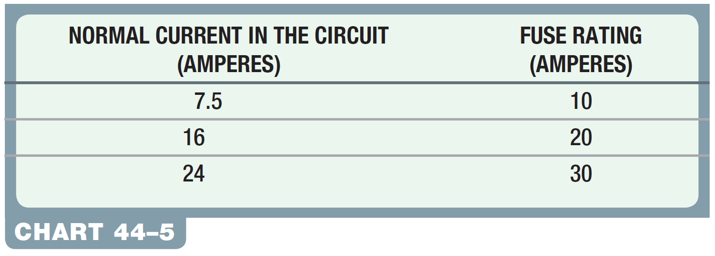
Chart 44-5 The fuse rating should be 20% higher than the maximum current in the circuit to provide the best protection for the wiring and the component being protected.

Slide 23
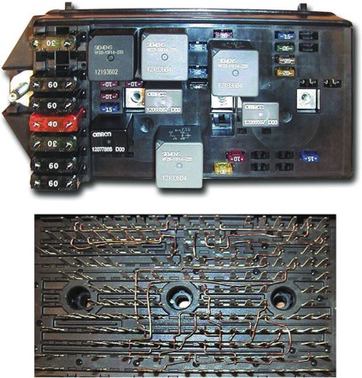
Figure 44.3 A typical Underhood Electrical Center (UHEC). Most are referred to as an “intelligent power distribution box” or a “smart junction box,” because underneath (lower figure) are wires that join the circuits from the maxi fuses to other fuses and to or from relays.

Slide 24
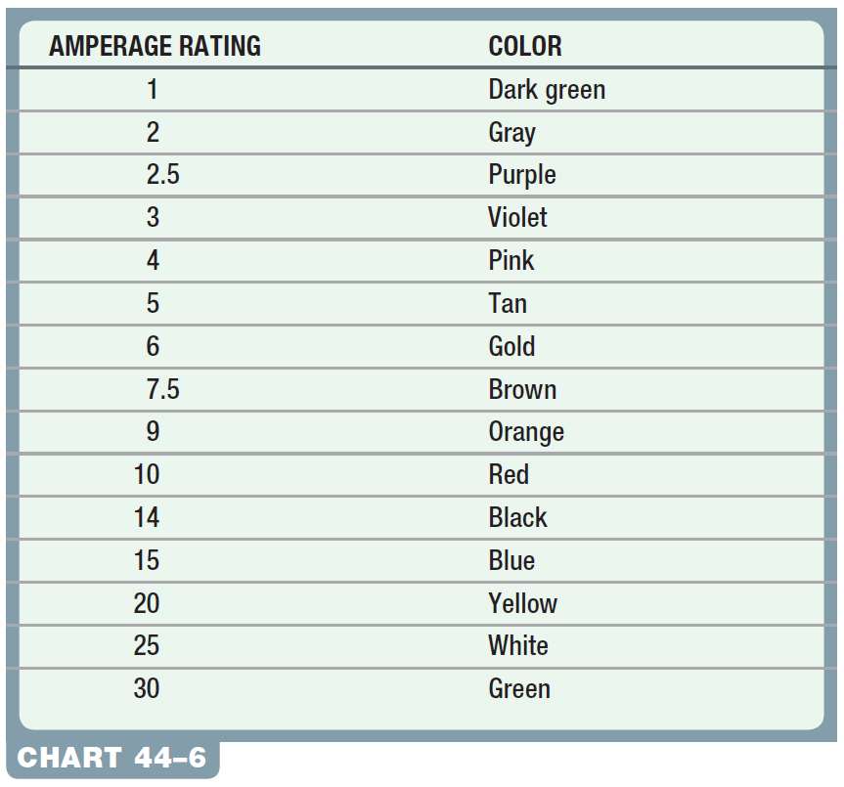
Chart 44-6 The amperage rating and the color of the blade fuse are standardized.

Slide 25
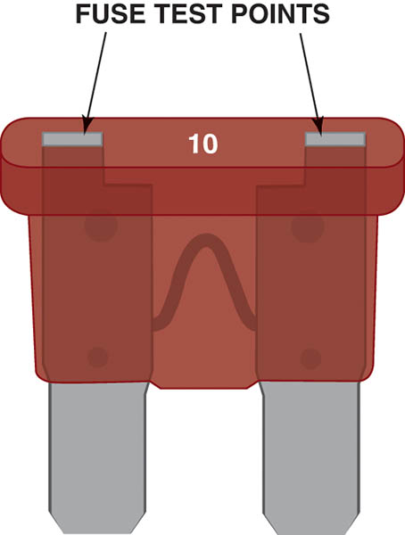
Figure 44.4 Blade-type fuses can be tested through openings in the plastic at the top of the fuse

Slide 26
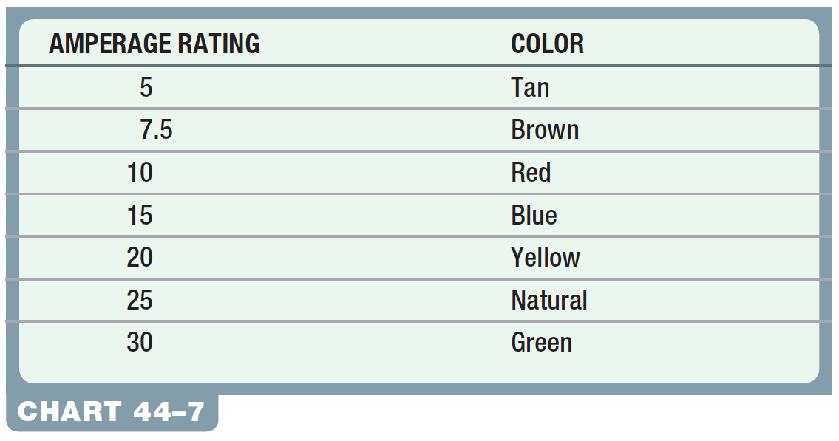
Chart 44-7 Mini fuse amperage rating and colors.

Slide 27
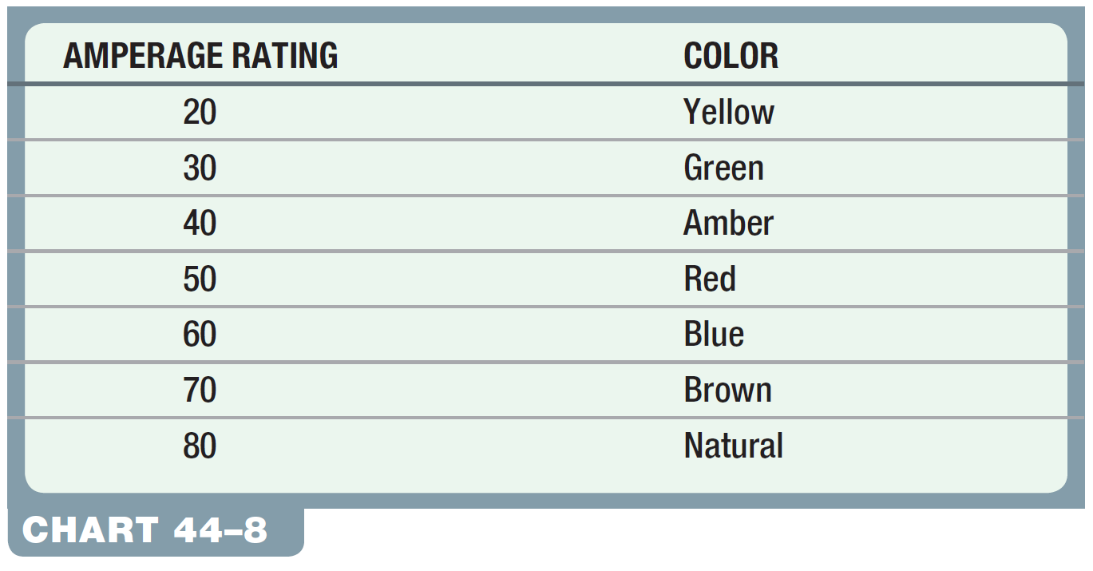
Chart 44-8 Maxi fuse amperage rating and colors.

Slide 28
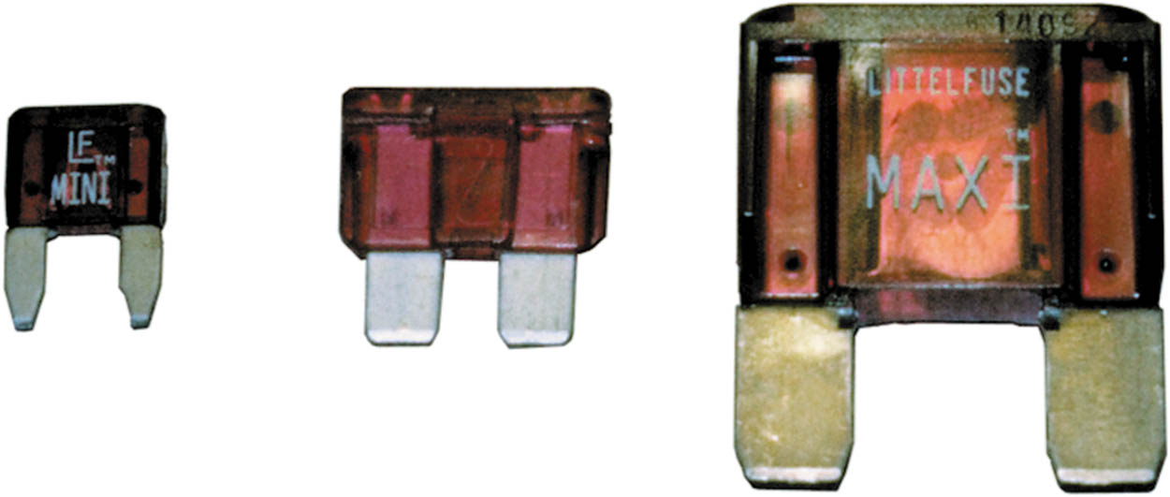
Figure 44.5 Three sizes of blade-type fuses: mini on the left, standard or ATO type in the center, and maxi on the right

Slide 29
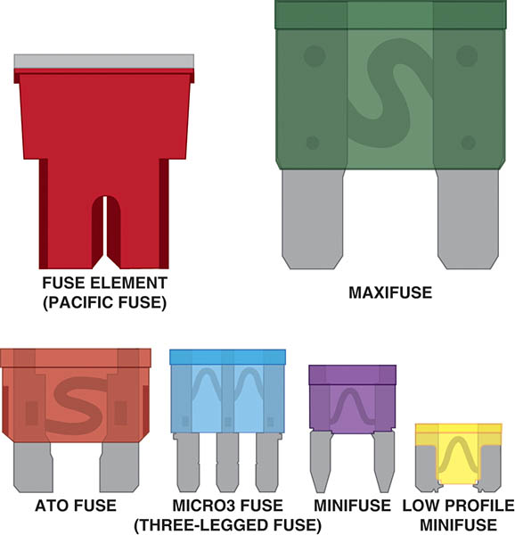
Figure 44.6 A comparison of the various types of protective devices used in most vehicles

Slide 30
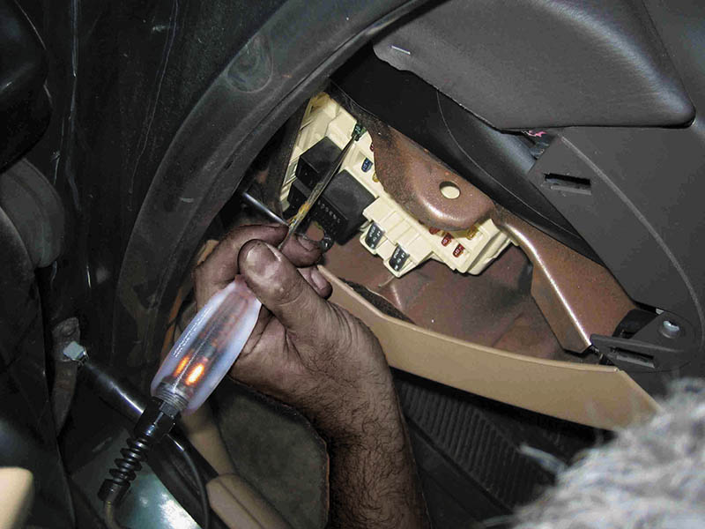
Figure 44.7 To test a fuse, use a test light to check for power at the power side of the fuse.

Slide 31
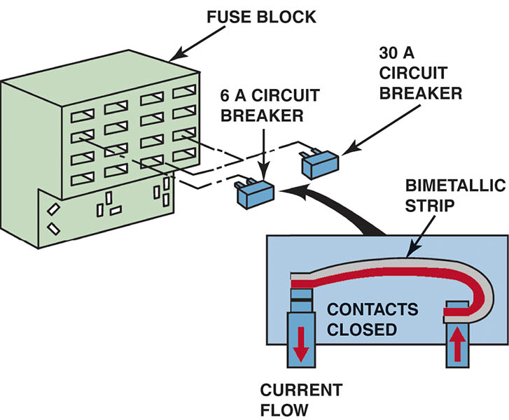
Figure 44.8 Typical blade circuit breaker fits into the same space as a blade fuse.

Slide 32

Figure 44.9 Electrical symbols used to represent circuit breakers

Slide 33
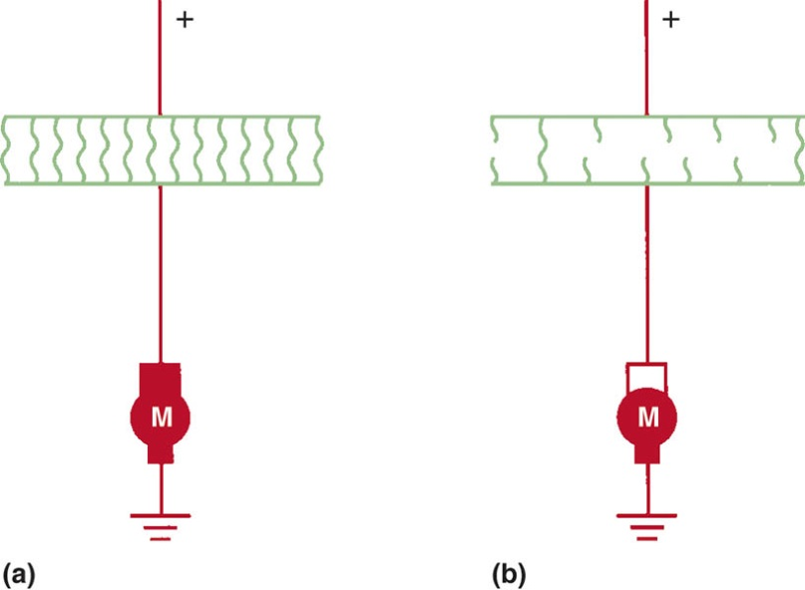
Figure 44.10 (a) With normal current flow, the temperature of the PTC circuit protector remains normal. (b) When current exceeds the amperage rating of the PTC circuit protector, the polymer material that makes up the electronic circuit protector increases in resistance.

Slide 34
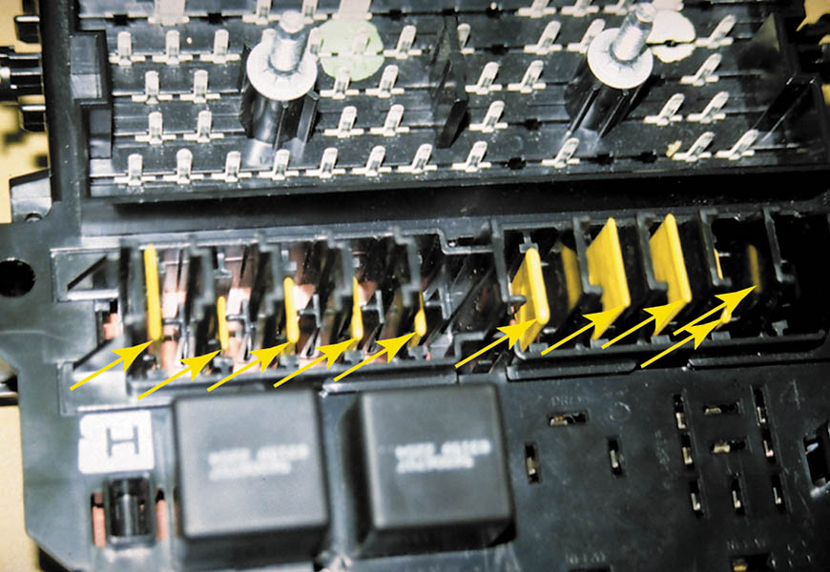
Figure 44.11 PTC circuit protectors are used extensively in the power distribution center of this Chrysler vehicle

Slide 35
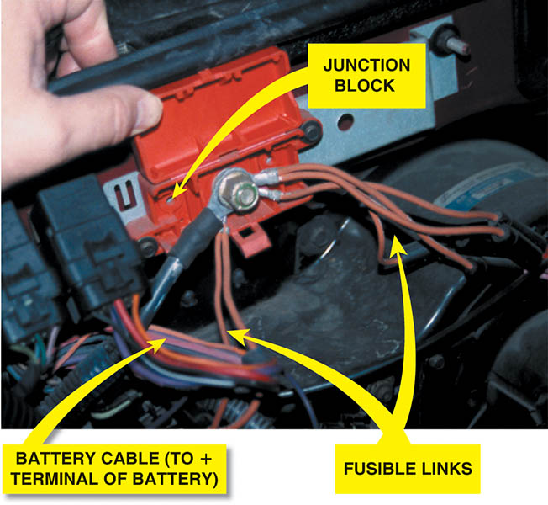
Figure 44.12 Fusible links are usually located close to the battery and are usually attached to a junction block.

Slide 36
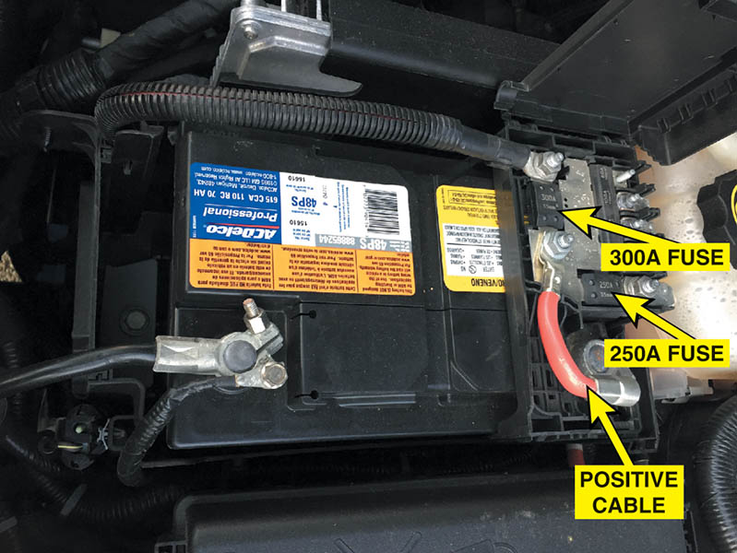
Figure 44.13 Several maxi fuses are used on this Chevrolet to protect all the circuits, including the 300 A fuse that is connected directly to the positive battery cable

Slide 37
QUESTION 2: ?
How do fuses, PTC circuit protectors, circuit breakers, and
fusible links protect a circuit?

Slide 38
ANSWER 2:
The tin is designed to melt and open the circuit if excessive current flows through the fuse.

Slide 39
TERMINALS AND CONNECTORS
A terminal is a metal fastener attached to the end of a wire, which makes the electrical connection.
The term connector usually refers to the plastic portion that snaps or connects together, making the mechanical connection.

Slide 40
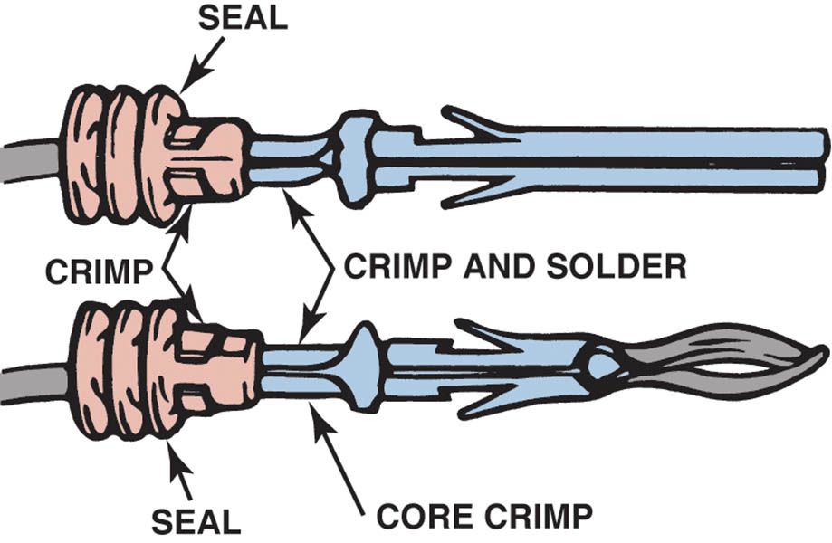
Figure 44.14 Some terminals have seals attached to help seal the electrical connections

Slide 41
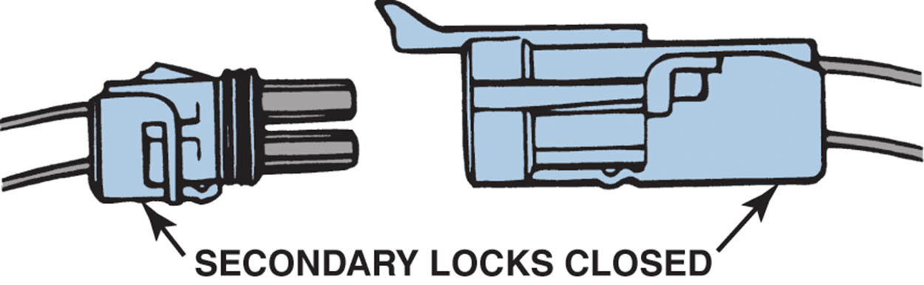
Figure 44.15 Separate a connector by opening the lock and pulling the two apart

Slide 42
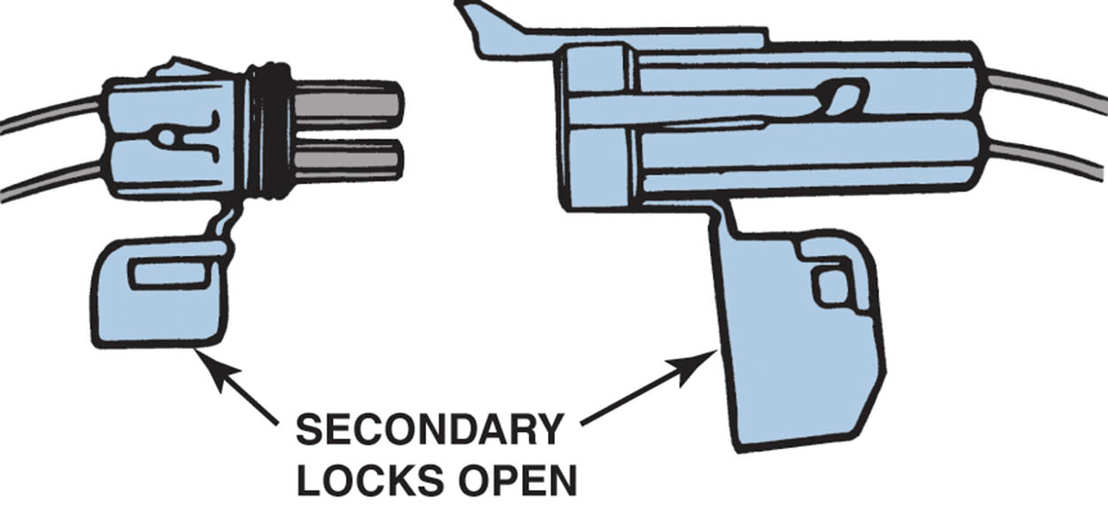
Figure 44.16 The secondary locks help retain the terminals in the connector

Slide 43
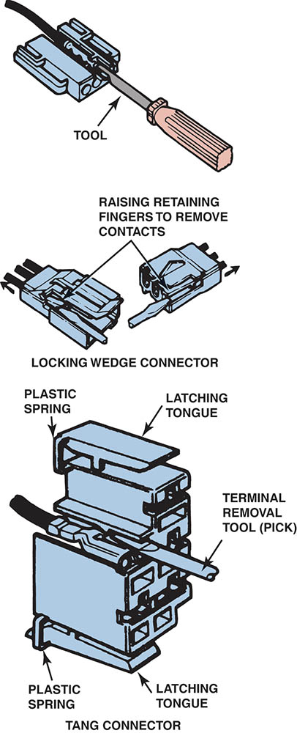
Figure 44.17 Use a small removal tool, sometimes called a pick, to release terminals from the connector

Slide 44
WIRE REPAIR (1 OF 2)
Solder
Solder is an alloy of tin and lead used to make a good electrical contact between two wires or connections in an electrical circuit.
Crimping Terminals
Terminals can be crimped to create a good electrical connection if the proper type of crimping tool is used.
.

Slide 45
WIRE REPAIR (2 OF 2)
Crimp and Seal Connectors
Crimp-and-seal connectors contain a sealant and shrink tubing in one piece and are not simply butt connectors.
Aluminum Wire Repair
If any aluminum wire must be repaired or replaced, the manufacturer specific procedure should be used to be assured of a proper repair.

Slide 46
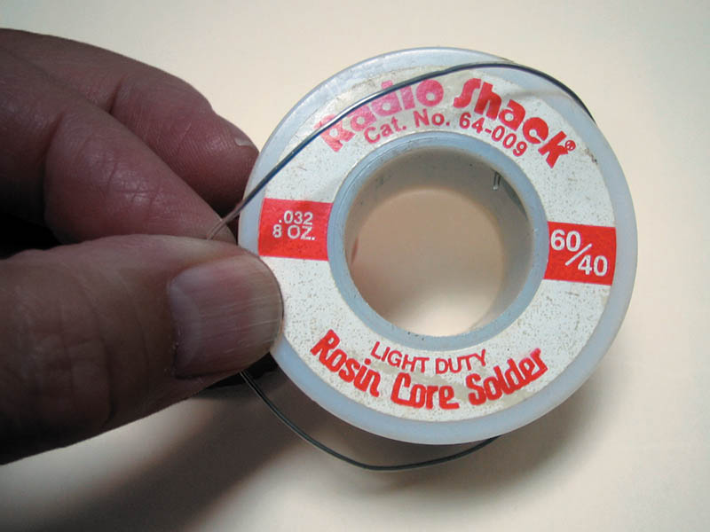
Figure 44.18 Always use rosin-core solder for electrical or electronic soldering. Also, use small-diameter solder for small soldering irons.

Slide 47
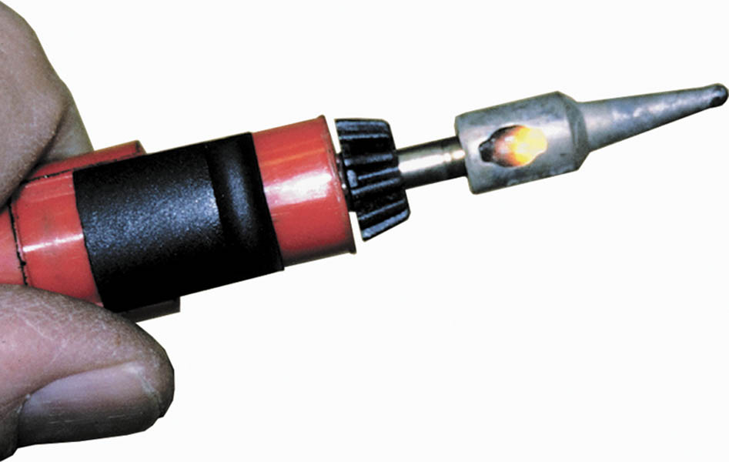
Figure 44.19 A butane-powered soldering tool. The cap has a built-in striker to light a converter in the tip of the tool.

Slide 48
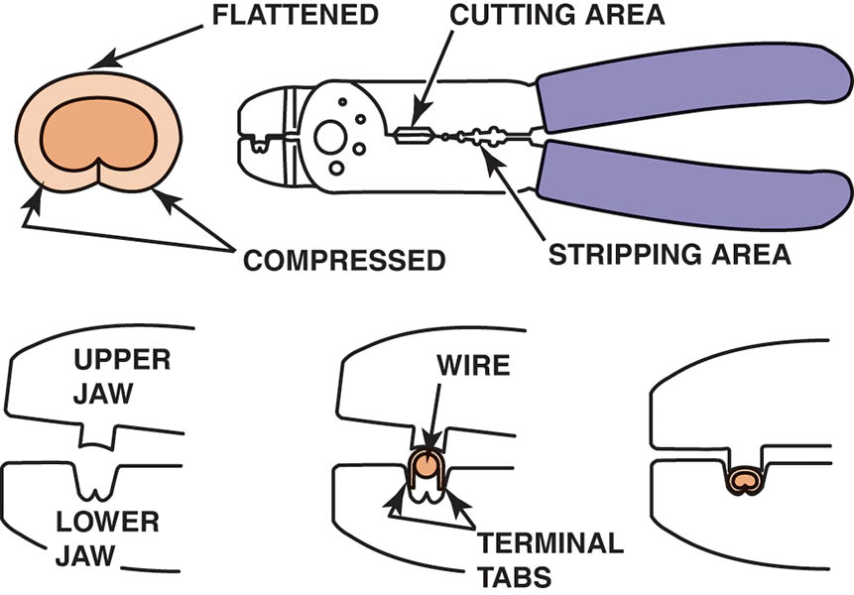
Figure 44.20 Notice that to create a good crimp the open part of the terminal is placed in the jaws of the crimping tool toward the anvil or the W-shape part

Slide 49
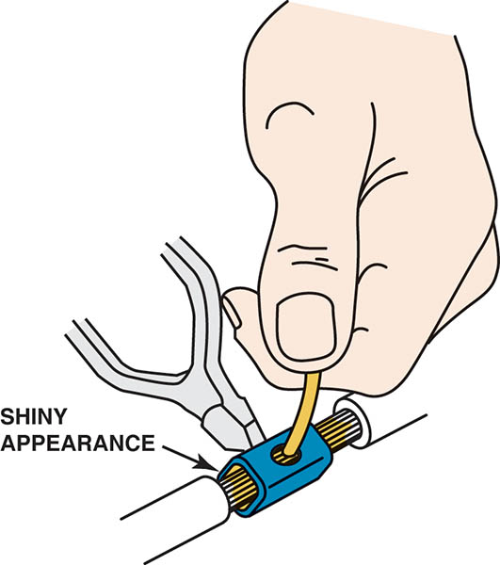
Figure 44.21 All hand-crimped splices or terminals should be soldered to be assured of a good electrical connection

Slide 50
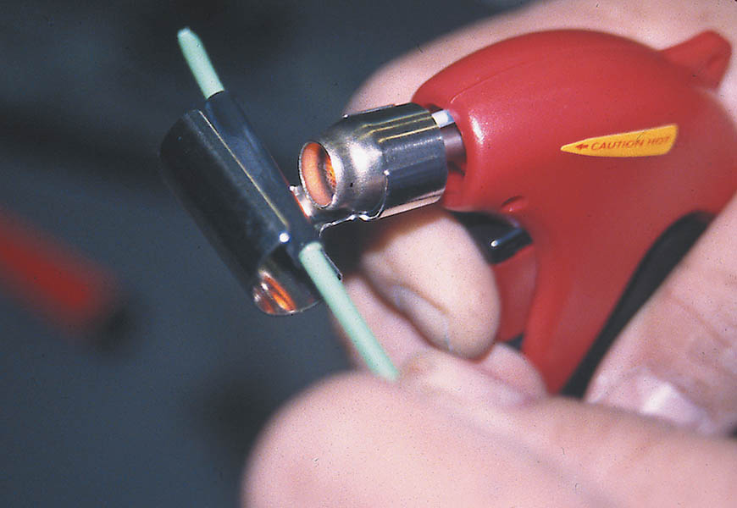
Figure 44.22 A butane torch especially designed for use on heat shrink applies heat without an open flame, which could cause damage

Slide 51
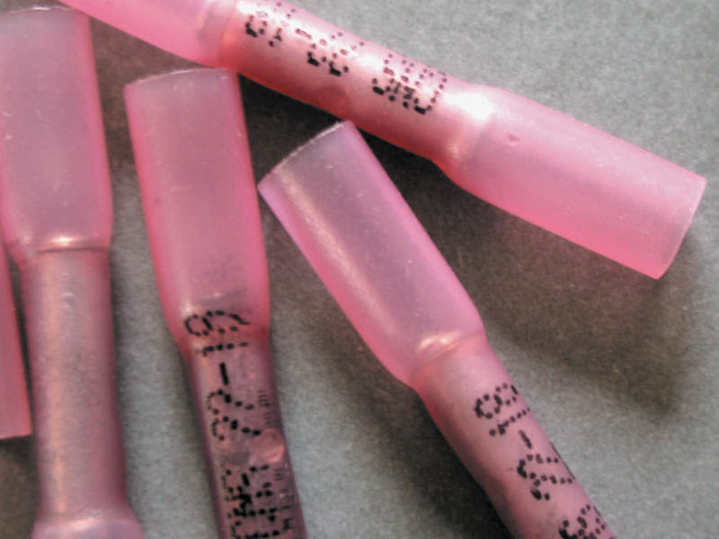
Figure 44.23 A typical crimp-and-seal connector. This type of connector is first lightly crimped to retain the ends of the wires and then it is heated.

Slide 52
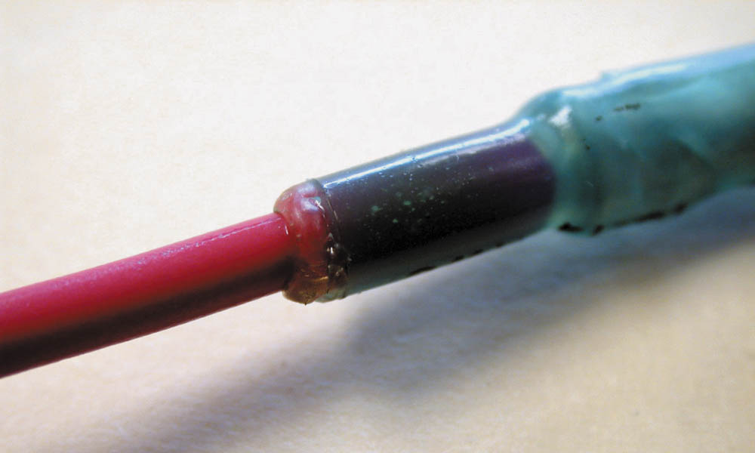
Figure 44.24 Heating the crimp-and-seal connector melts the glue and forms an effective seal against moisture

Slide 53
QUESTION 3: ?
How should a wire repair be done if the repair is under the hood where it is exposed to the outside?

Slide 54
ANSWER 3:
Vehicle manufacturers recommend all wire repairs performed under the hood, or where the repair could be exposed to the elements, be weatherproof.

Slide 55
ELECTRICAL CONDUIT
Black Conduit with Green or Blue Stripe
This conduit is designed for high temperatures and is used under the hood and near hot engine parts.
Blue or Yellow Conduit
This color conduit is used to cover wires that have voltages ranging from 12 to 42 volts.
Orange Conduit
This color conduit is used to cover wiring that carries high-voltage current above 60 volts.

Slide 56
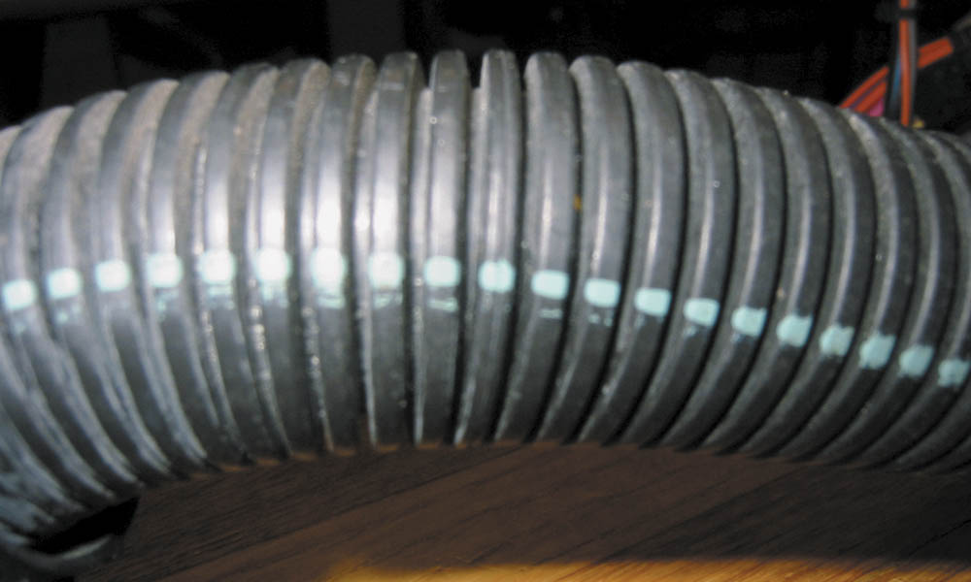
Figure 44.25 Conduit that has a paint stripe is constructed of plastic that can withstand high underhood temperatures

Slide 57
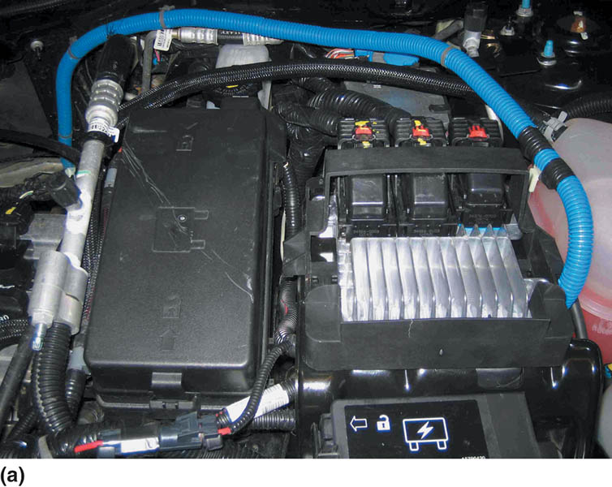
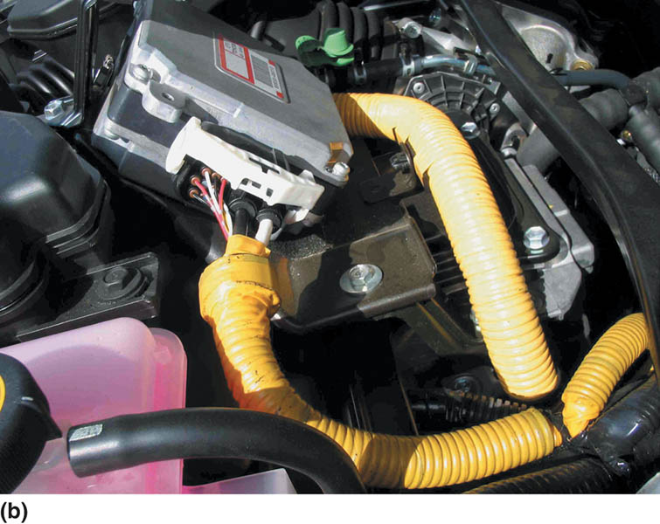
Figure 44.26 (a) Blue conduit is used to cover circuits that carry up to 42 volts. (b) Yellow conduit can also be used to cover 42-volt wiring

Slide 58
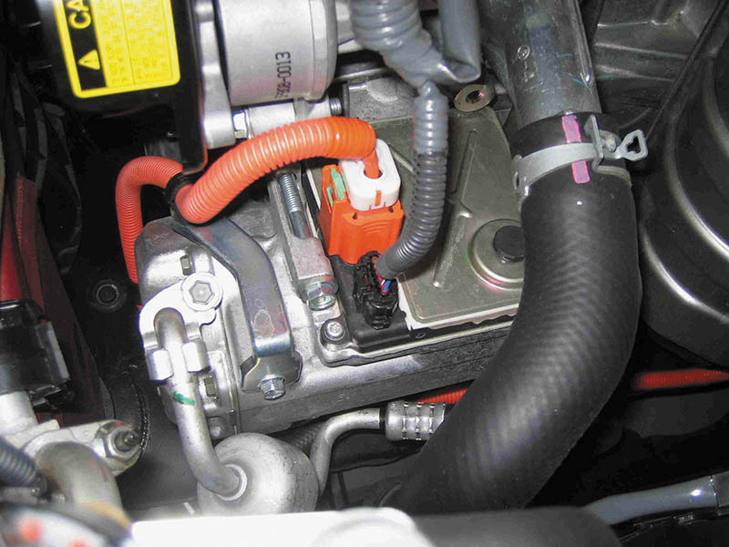
Figure 44.27 Always follow the vehicle manufacturer’s instructions, which include the use of linesman’s (high-voltage) gloves, if working on circuits that are covered in orange conduit

Slide 59
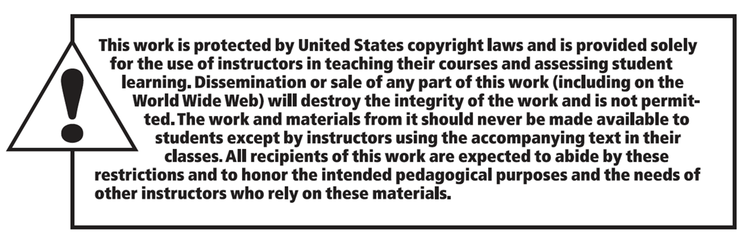
Copyright

