Slide 1

Automotive Technology Principles, Diagnosis, and Service
Sixth Edition
Chapter 43
Oscilloscopes and Graphing Multimeters
Copyright © 2018, 2015, 2011 Pearson Education, Inc. All Rights Reserved

Slide 2
LEARNING OBJECTIVES (1 of 2)
43.1 Compare the different types of oscilloscopes and explain how to setup and adjust oscilloscopes.
43.2 Explain time base and volts per division settings.
43.3 Describe the use of DC or AC coupling when displaying waveforms on an oscilloscope.

Slide 3
LEARNING OBJECTIVES (2 of 2)
43.4 Explain how to interpret pulse trains, channels, and triggers on a scope.
43.5 Explain how to use a scope and discuss graphing multimeters and scan tools.
43.6 This chapter will help you prepare for the ASE Electrical/Electronic Systems (A6) certification test content area “A” (General Electrical/ Electronic System Diagnosis).

Slide 4
TYPES OF OSCILLOSCOPES
An oscilloscope (usually called a scope) is a visual voltmeter with a timer that shows when a voltage changes.
  An analog scope uses a cathode ray tube (CRT)
  A digital scope commonly uses a liquid crystal display (LCD)

Slide 5
QUESTION 1: ?
What are the differences between an analog and a digital oscilloscope?

Slide 6
ANSWER 1:
  An analog scope uses a cathode ray tube (CRT)
  A digital scope commonly uses a liquid crystal display (LCD)

Slide 7
OSCILLOSCOPE DISPLAY GRID
A typical scope face usually has eight or ten grids vertically (up and down) and ten grids horizontally (left to right).
The transparent scale (grid), used for reference measurements, is called a graticule.
Voltage is displayed on a scope starting with zero volts at the bottom and higher voltage being displayed vertically.
The scope illustrates time left to right.

Slide 8
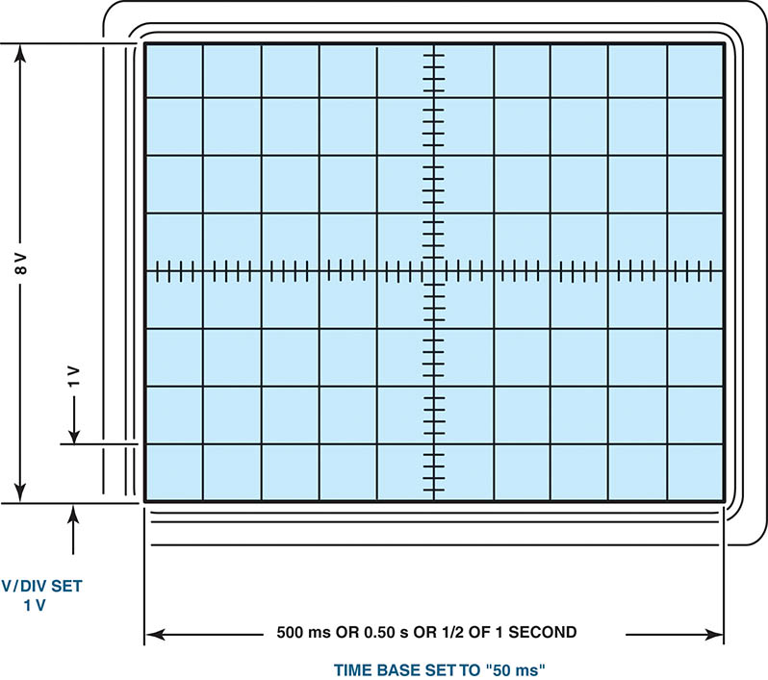
Figure 43.1 A scope display allows technicians to take measurements of voltage patterns. In this example, each vertical division is 1 volt and each horizontal division is set to represent 50 milliseconds

Slide 9
SCOPE SETUP AND ADJUSTMENTS
Setting the Time Base
  Setting the time base means setting how much time is displayed in each block, called a division.
Volts Per Division
The volts per division, abbreviated V/div, should be set so that the entire anticipated waveform can be viewed.

Slide 10
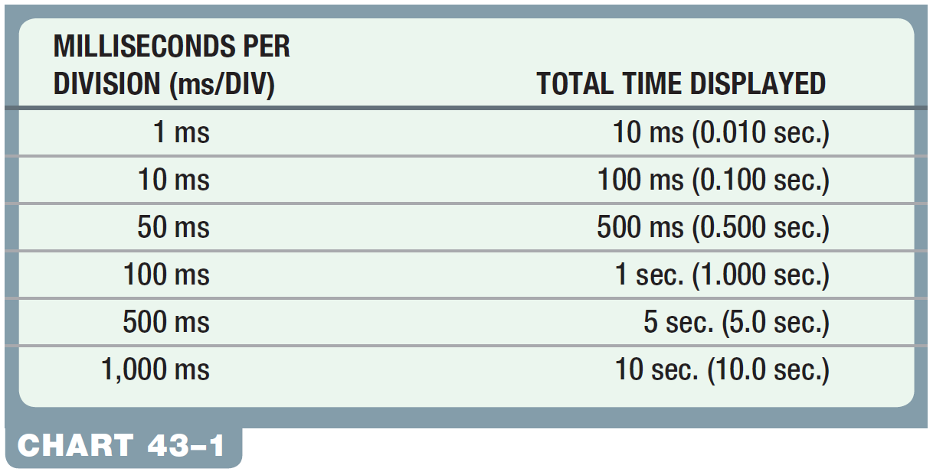
Chart 43-1 The time base is milliseconds (ms) and total time of an event that can be displayed.

Slide 11
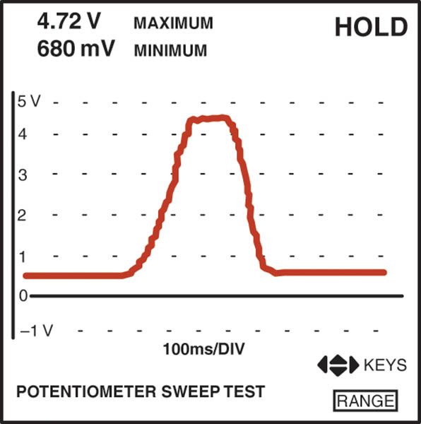
Figure 43.2 The digital storage oscilloscope (DSO) displays the entire waveform of a throttle position (TP) sensor from idle to wide-open throttle and returns to idle.

Slide 12
AC VOLTAGE
Definition
  Whereas direct current (DC) flows in one direction, alternating current (AC) voltage changes direction continuously. The voltage varies over time and the waveform is a sine wave.

Slide 13
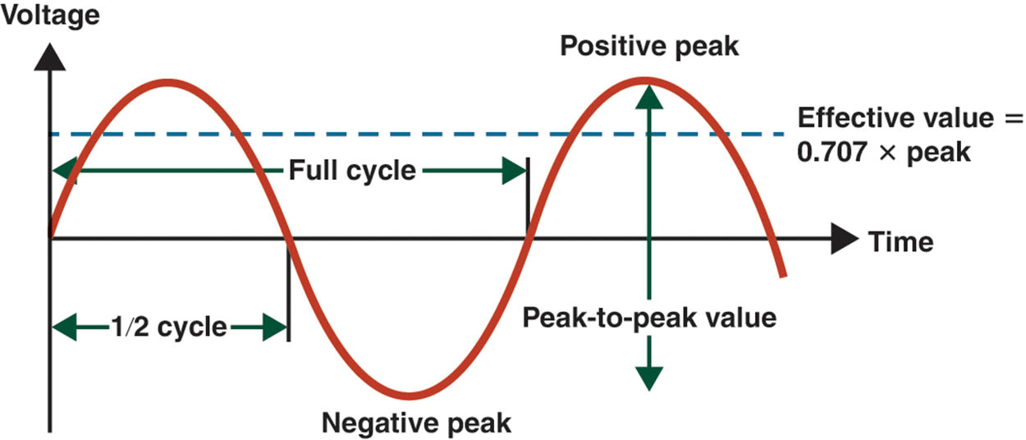
Figure 43.3 AC voltage varies over time from positive voltage to negative voltage. The effective value (0.707 of peak) is the level of DC required to deliver the same power

Slide 14
DC AND AC COUPLING
DC Coupling
  DC coupling is the most used position on a scope because it allows the scope to display both AC and DC voltage signals present in the circuit.
AC Coupling
  When the AC coupling position is selected, a capacitor is placed into the meter lead circuit, which effectively blocks all DC voltage signals, but allows the AC portion of the signal to pass and be displayed.

Slide 15
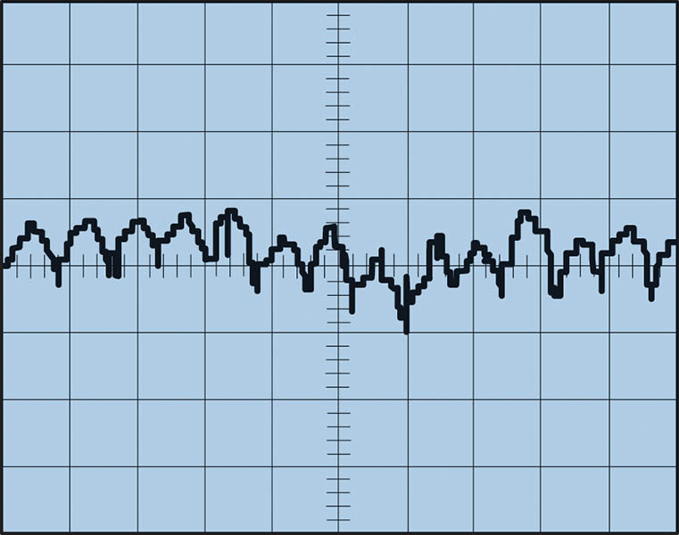
Figure 43.4 Ripple voltage is created from the AC voltage from an alternator. Some AC ripple voltage is normal, but if the AC portion exceeds 0.5 V, then a bad diode is the most likely cause.

Slide 16
QUESTION 2: ?
What is the difference between DC coupling and AC coupling?

Slide 17
ANSWER 2:
  When the AC coupling position is selected, a capacitor is placed into the meter lead circuit, which effectively blocks all DC voltage signals, but allows the AC portion of the signal to pass and be displayed.

Slide 18
PULSE TRAINS
Frequency
  Frequency is the number of cycles per second measured in hertz.
Duty Cycle
  Duty cycle refers to the percentage of on-time of the signal during one complete cycle.
Pulse Width
  The pulse width is a measure of the actual on-time measured in milliseconds.

Slide 19
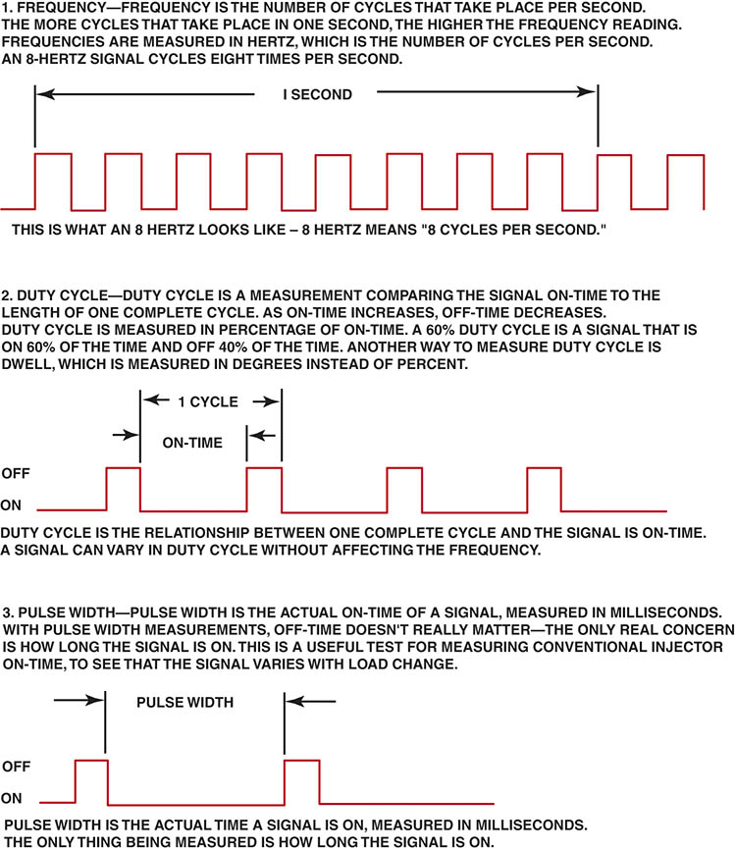
Figure 43.5 A pulse train is any electrical signal that turns on and off, or goes high and low in a series of pulses. Ignition module and fuel-injector pulses are examples of a pulse train signal

Slide 20
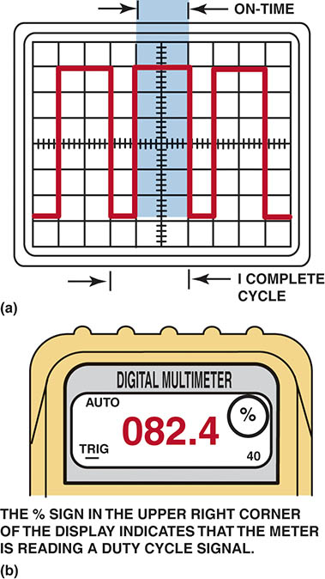
Figure 43.6 (a) A scope representation of a complete cycle, showing both on-time and off-time. (b) A meter display, indicating the on-time duty cycle in percentage (%). Note the trigger and negative (−) symbol.

Slide 21
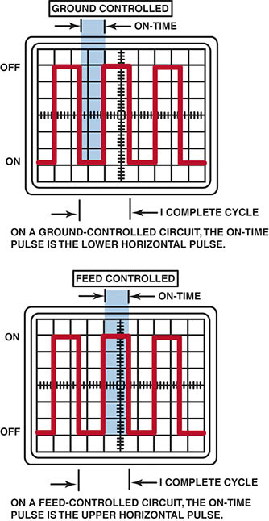
Figure 43.7 Most automotive computer systems control the device by opening and closing the ground to the component

Slide 22
NUMBER OF CHANNELS
Single Channel
  A single-channel scope is capable of displaying only one sensor signal waveform at a time.
Two Channel
  A two-channel scope can display the waveform from two separate sensors or components at the same time.
Four Channel
  A four-channel scope allows the technician to view up to four different sensors or actuators on one display.

Slide 23
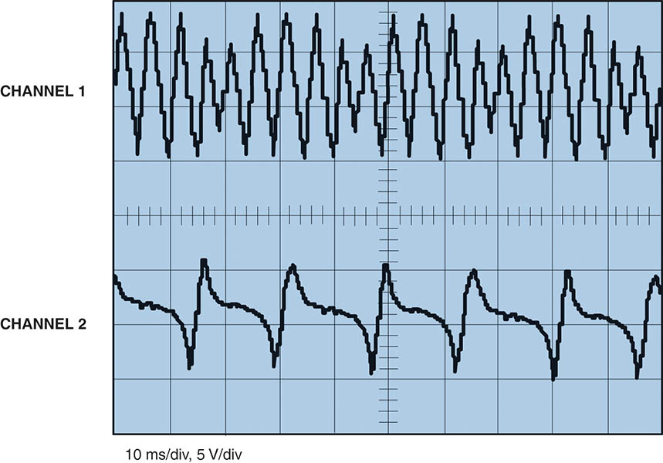
Figure 43.8 A two-channel scope being used to compare two signals on the same vehicle

Slide 24
TRIGGERS
External Trigger
  An external trigger is when the waveform starts when a signal is received from another external source, rather than from the signal pickup lead.
Trigger Level
  Trigger level is the voltage that must be detected by the scope before the pattern is displayed.
Trigger Slope
  The trigger slope is the voltage direction that a waveform must have in order to start the display.

Slide 25
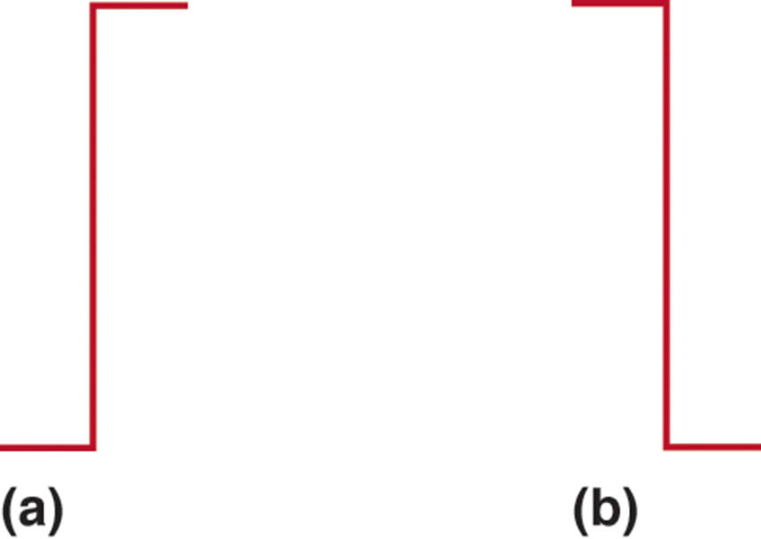
Figure 43.9 (a) A symbol for a positive trigger—a trigger occurs at a rising (positive) edge of the signal (waveform). (b) A symbol for a negative trigger—a trigger occurs at a falling (negative) edge of the signal (waveform)

Slide 26
QUESTION 3: ?
What is the difference between a positive trigger and a negative
trigger?

Slide 27
ANSWER 3:
  The trigger slope is the voltage direction that a waveform must have in order to start the display.

Slide 28
USING A SCOPE
Using Scope Leads
  Most scopes, both analog and digital, normally use the same test leads.
  These leads usually attach to the scope through a BNC connector.
Measuring Battery Voltage with a Scope
  Easy to do
  Great way to practice the techniques

Slide 29
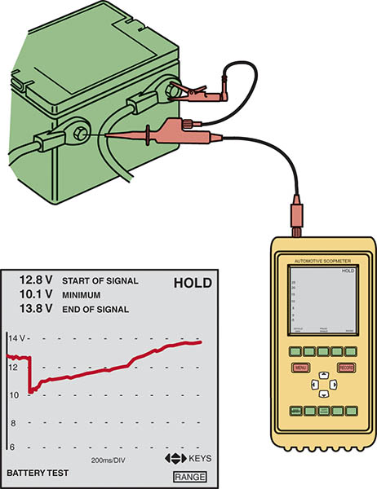
Figure 43.10 Constant battery voltage is represented by a flat horizontal line. In this example, the engine was started and the battery voltage dropped to about 10 V, as shown on the left side of the scope display. When the engine started, the voltage is shown as climbing

Slide 30
GRAPHING MULTIMETER
A graphing multimeter, abbreviated GMM, is a cross between a digital meter and a digital storage oscilloscope.
A graphing multimeter displays the voltage levels at two places:
  On a display screen
  In a digital readout

Slide 31
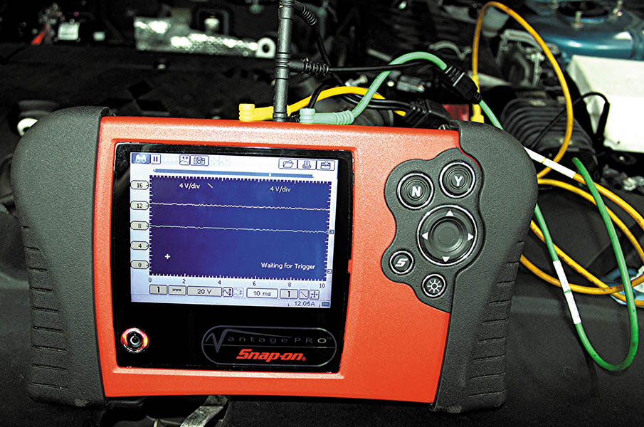
Figure 43.11 A typical graphing multimeter that can be used as a digital meter, plus it can show the voltage levels on the display screen

Slide 32
GRAPHING SCAN TOOL
Many scan tools are capable of displaying the voltage levels captured by the scan tool through the data link connector (DLC) on a screen.
This feature is helpful where changes in voltage levels are difficult to detect by looking at numbers that are constantly changing.

Slide 33

Copyright

