Slide 1

Automotive Technology Principles, Diagnosis, and Service
Sixth Edition
Chapter 42
Circuit Testers and Digital Meters
Copyright © 2018, 2015, 2011 Pearson Education, Inc. All Rights Reserved

Slide 2
LEARNING OBJECTIVES (1 of 2)
42.1 Discuss how to safely set up and use a fused jumper wire, a test light, and a logic probe.
42.2 Describe the uses of digital multimeters and inductive ammeters.
42.3 Discuss diode check and frequency.

Slide 3
LEARNING OBJECTIVES (2 of 2)
42.4 Describe the prefixes used with electrical units and how to read digital meters.
42.5 Explain how to safely use a digital meter to read voltage, resistance, and current, and compare to factory specifications.
42.6 This chapter will help you prepare for the ASE Electrical/Electronic Systems (A6) certification test content area “A” (General Electrical/Electronic System Diagnosis).

Slide 4
FUSED JUMPER WIRE
A fused jumper wire is used to check a circuit by bypassing the switch or to provide a power or ground to a component.
It should include a fuse, an alligator clip ends, and a good-quality insulated wire.
A fused jumper wire can be used to help diagnose a component or circuit by performing the following procedures.
Supply power or ground.

Slide 5
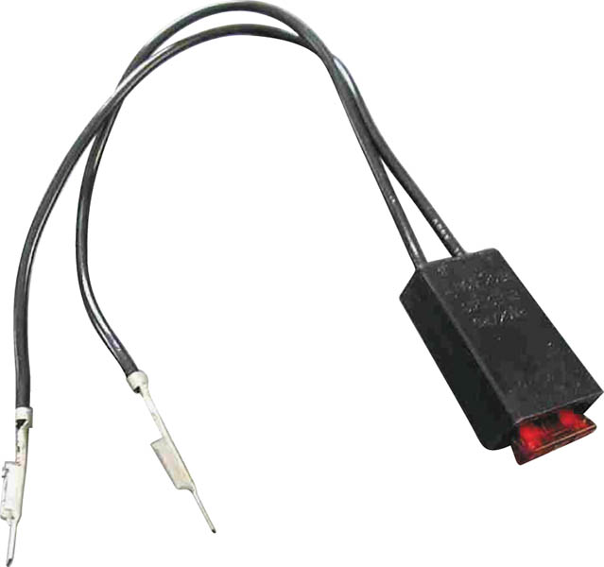
Figure 42.1 A technician-made fused jumper lead, which is equipped with a red 10-ampere fuse. This fused jumper wire uses terminals for testing circuits at a connector instead of alligator clips

Slide 6
TEST LIGHTS
Non-powered Test Lights
A test light is simply a lightbulb with a probe and a ground wire attached.
Use of a 12-Volt Test Light
Check electrical power
Check grounds
High-Impedance Test Light
Has a high internal resistance and, therefore, draws very low current in order to light

Slide 7
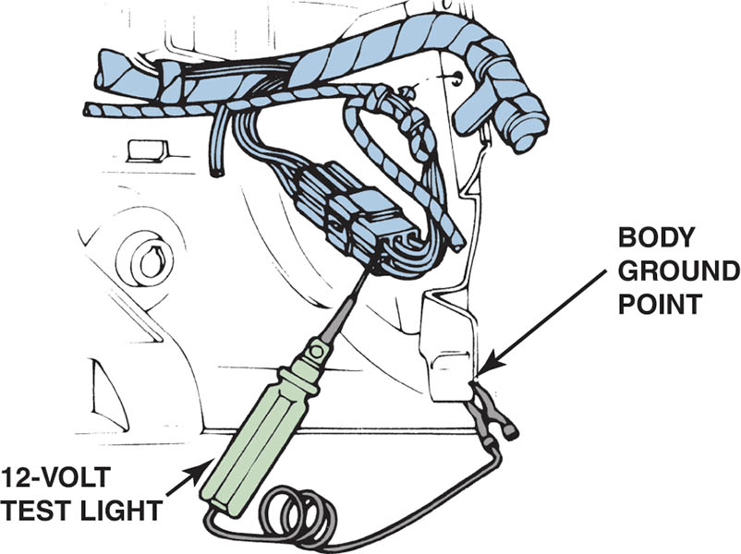
Figure 42.2 A 12-volt test light is attached to a good ground while probing for power

Slide 8
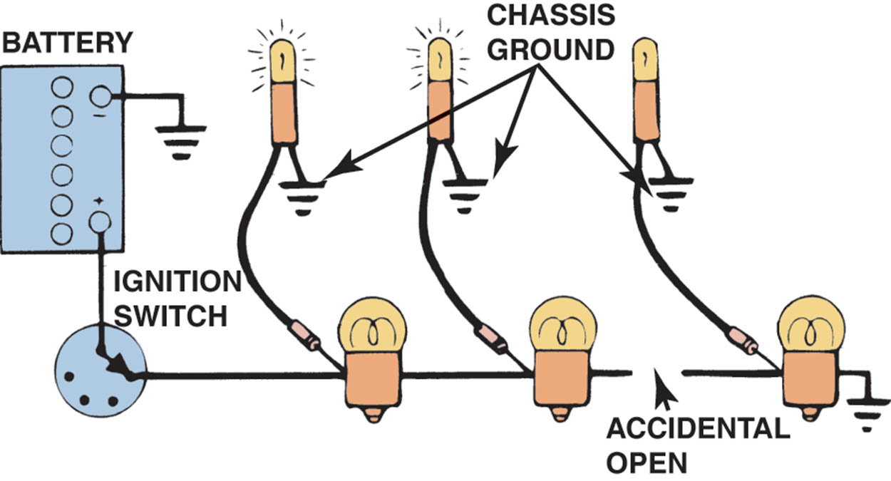
Figure 42.3 A test light can be used to locate an open in a circuit. Note that the test light is grounded at a different location than the circuit itself

Slide 9
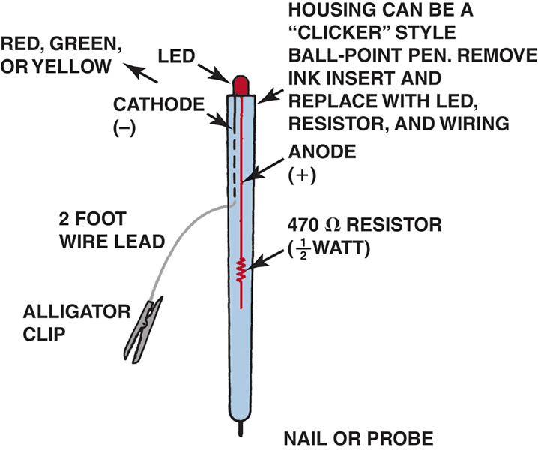
Figure 42.4 An LED test light can be easily made using low-cost components and an old ink pen. With the 470-ohm resistor in series with the LED, this tester only draws 0.025 ampere (25 milliamperes) from the circuit being tested.

Slide 10
LOGIC PROBE
A logic probe is an electronic device that lights up a red (usually) LED if the probe is touched to battery voltage. If the probe is touched to ground, a green (usually) LED lights.
A logic probe must first be connected to a power and ground source, such as the vehicle battery.

Slide 11
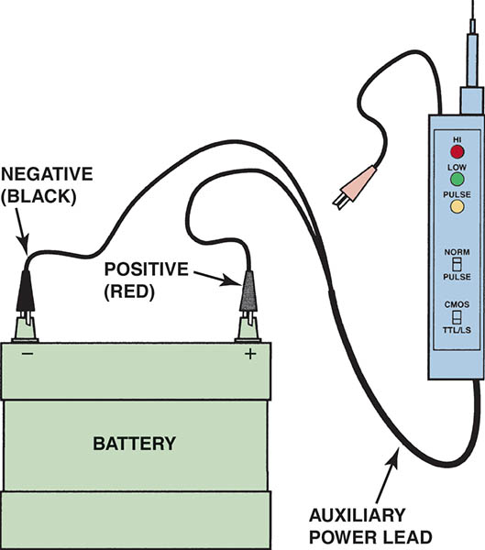
Figure 42.5 A logic probe connected to the vehicle battery. When the tip probe is connected to a circuit, it can check for power, ground, or a pulse

Slide 12
DIGITAL MULTIMETERS (1 OF 2)
Terminology
Digital multimeter (DMM) and digital volt-ohm-meter (DVOM) are terms commonly used for electronic high-impedance test meters.
High impedance means that the electronic internal resistance of the meter is high enough to prevent excessive current draw from any circuit being tested.
Most meters today have a minimum of 10 million ohms (10 megohms) of resistance.

Slide 13
DIGITAL MULTIMETERS (2 OF 2)
Measuring Voltage
DC Volts (DCV) and AC Volts (ACV)
Manual or automatically ranged
Measuring Resistance
Measure when no current is flowing in the circuit.
Measuring Current
The ammeter has to be installed in the circuit (in series) so that it can measure all the current flow in that circuit

Slide 14
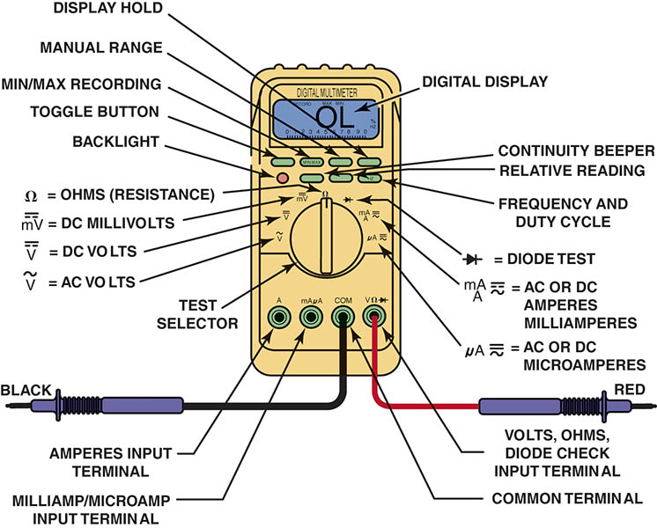
Figure 42.6 Typical digital multimeter. The black meter lead is always placed in the COM terminal. The red meter test lead should be in the volt-ohm terminal, except when measuring current in amperes

Slide 15
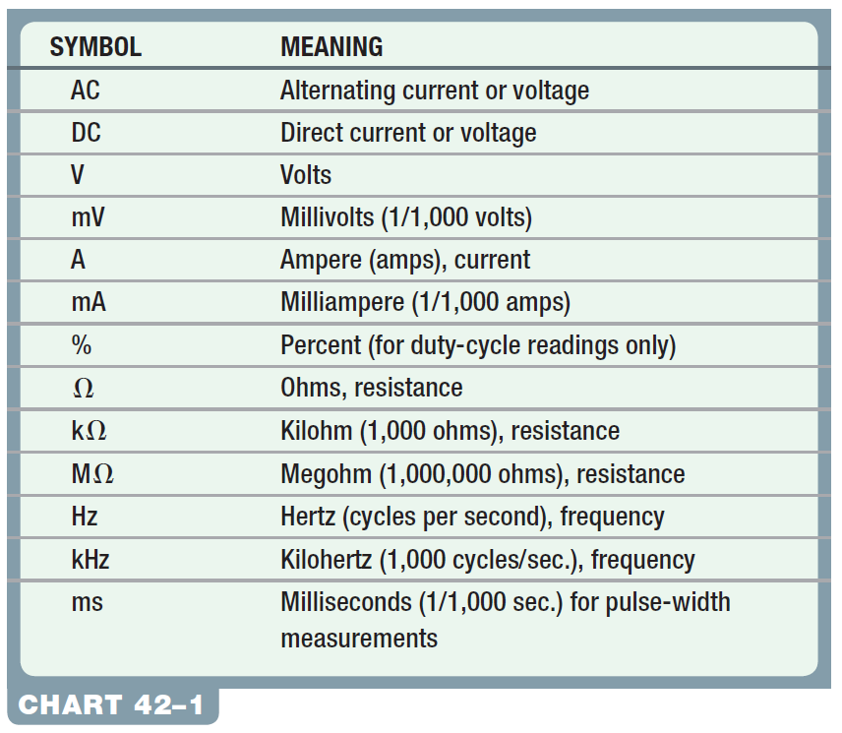
Chart 42-1 Common symbols and abbreviations used on digital meters

Slide 16
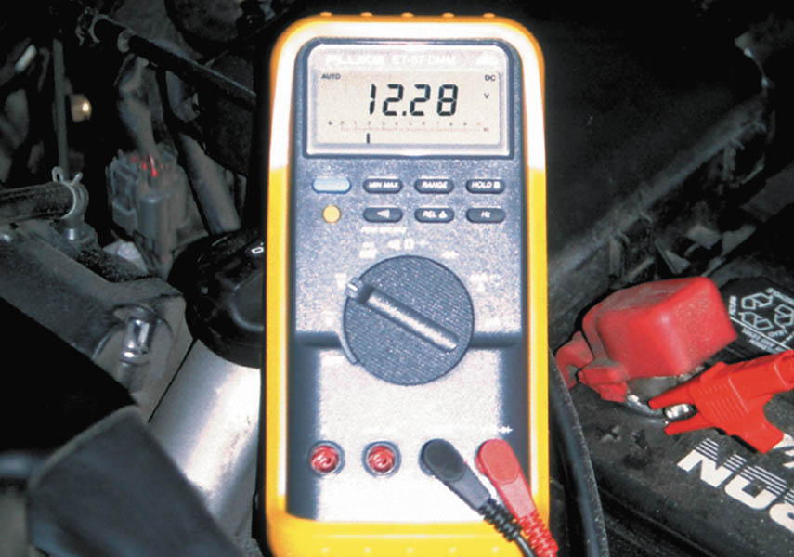
Figure 42.7 Typical digital multimeter (DMM) set to read DC volts

Slide 17
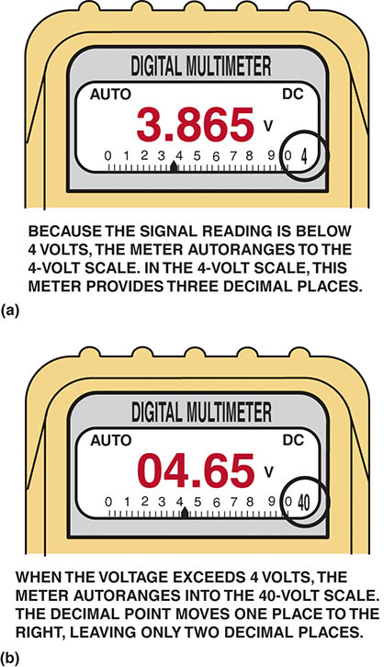
Figure 42.8a A typical autoranging digital multimeter automatically selects the proper scale to read the voltage being tested. The scale selected is usually displayed on the meter face.

Slide 18
42.8b The range is now set to the 40-volt scale, meaning that the meter can read up to 40 volts on the scale.

Slide 19
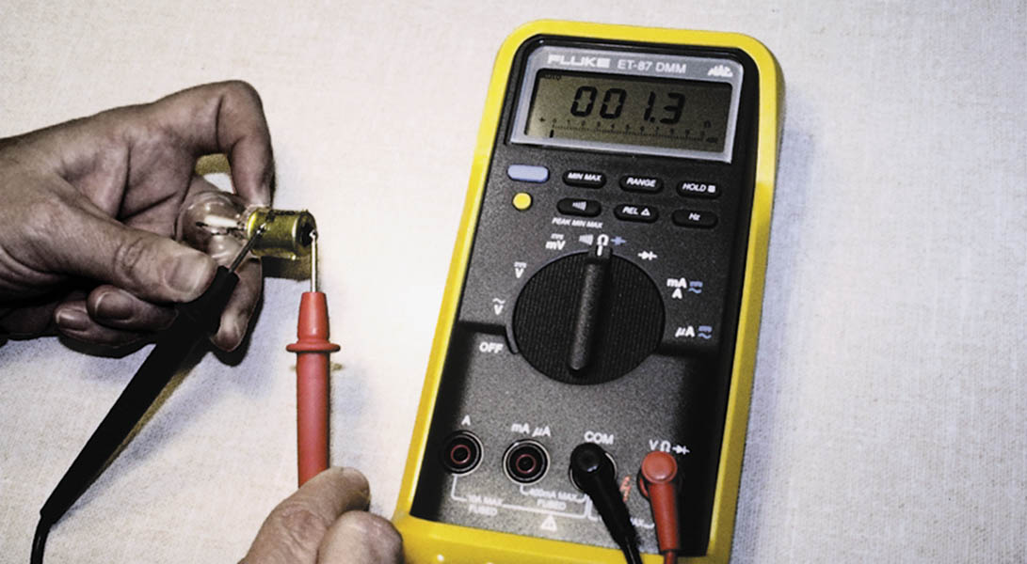
Figure 42.9 Using a digital multimeter set to read ohms (Ω) to test this light bulb. The meter reads the resistance of the filament

Slide 20
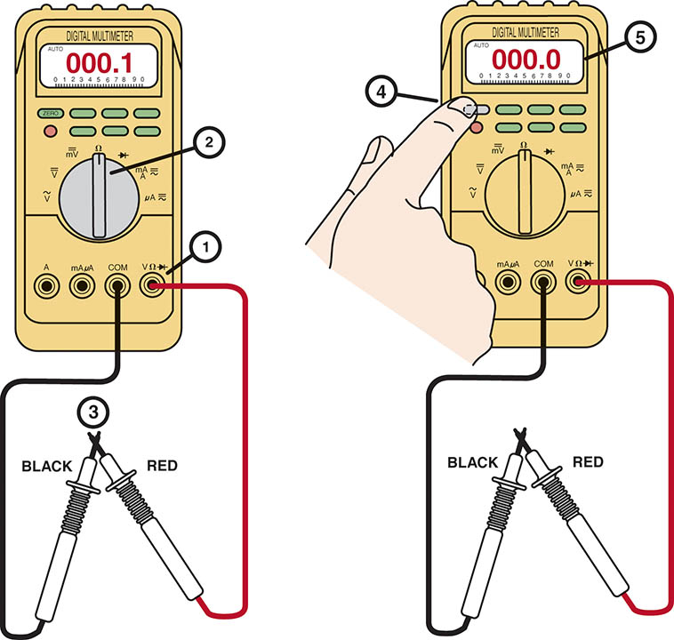
Figure 42.10 Many digital multimeters can have the display indicate zero to compensate for test lead resistance. (1) Connect leads in the VΩ and COM meter terminals. (2) Select the Ω scale. (3) Touch the two meter leads together. (4) Push the “zero” or “relative” button on the meter. (5) The meter display now indicates zero ohms of resistance

Slide 21
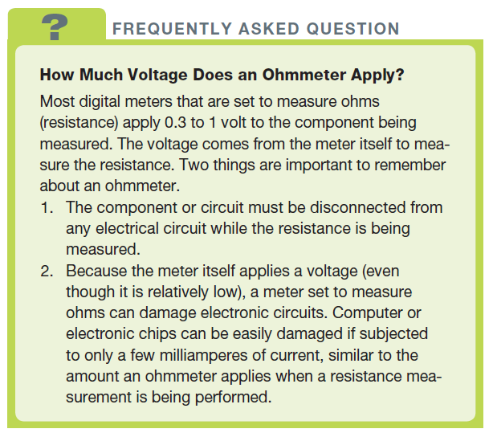
FREQUENTLY ASKED QUESTION

Slide 22
QUESTION 1: ?
Why must an ohmmeter be connected to a disconnected circuit
or component?

Slide 23
ANSWER 1:
The meter provides power to the circuit/component being tested.

Slide 24
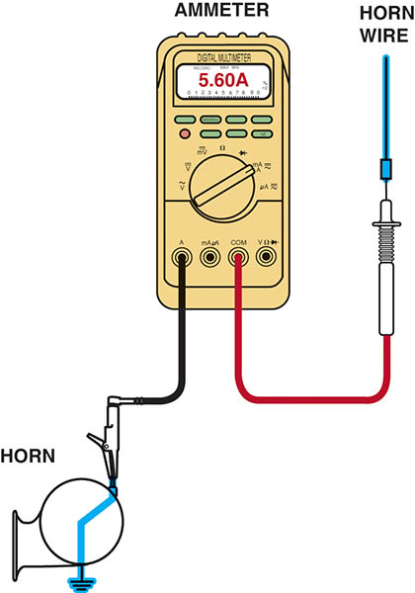
Figure 42.11 Measuring the current flow required by a horn requires that the ammeter be connected to the circuit in series and the horn button be depressed by an assistant

Slide 25
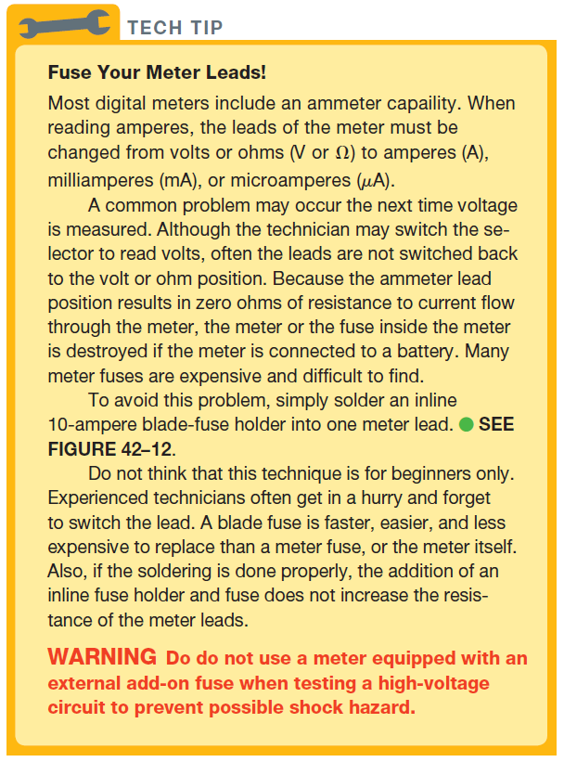
Tech Tip

Slide 26
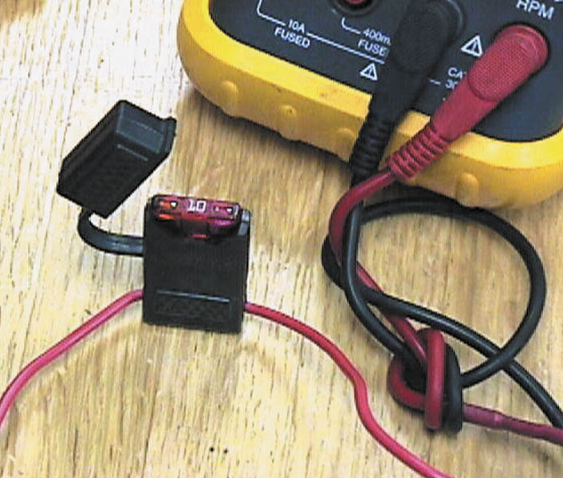
Figure 42.12 Note the blade-type fuse holder soldered in series with one of the meter leads. A 10-ampere fuse helps protect the internal meter fuse (if equipped).

Slide 27
INDUCTIVE AMMETERS
Operation
Inductive ammeters do not make physical contact with the circuit.
They measure the strength of the magnetic field surrounding the wire carrying the current, and use a Hall-effect sensor to measure current.
AC/DC Clamp-on Digital Multimeters
There is no need to break the circuit to measure current (amperes).

Slide 28
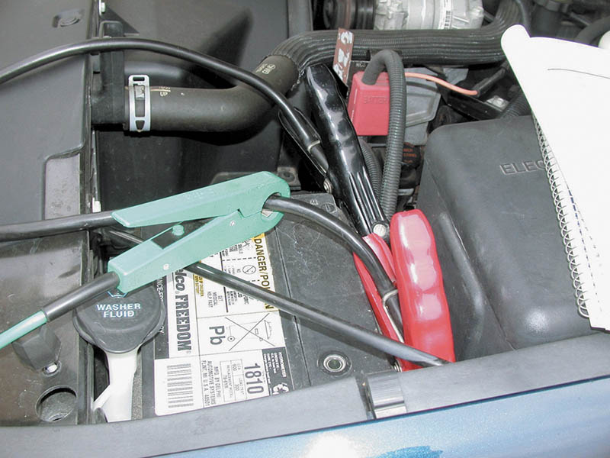
Figure 42.13 An inductive ammeter clamp is used with all starting and charging testers to measure the current flow through the battery cables

Slide 29
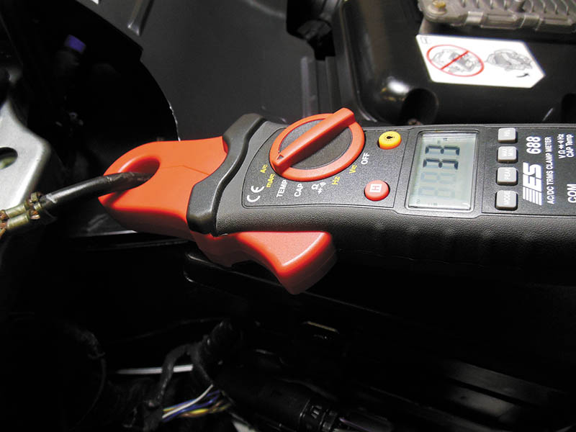
Figure 42.14 A typical mini clamp-on-type digital multimeter. This meter is capable of measuring alternating current (AC) and direct current (DC) without requiring that the circuit be disconnected to install the meter in series.

Slide 30
QUESTION 2: ?
How is an ammeter connected to an electrical circuit?

Slide 31
ANSWER 2:
In series

Slide 32
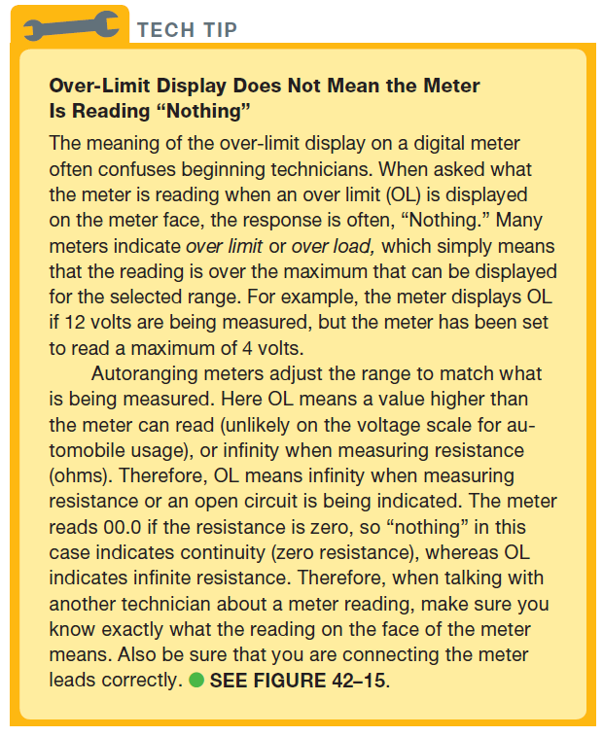
TECH TIP

Slide 33
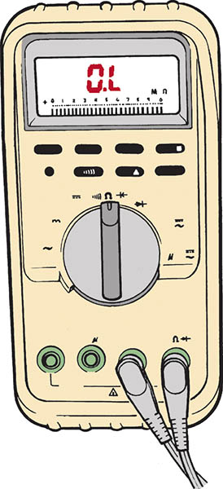
Figure 42.15 Typical digital multimeter showing OL (over limit) on the readout with the ohms (Ω) unit selected. This usually means that the unit being measured is open (infinite resistance) and has no continuity

Slide 34
DIODE CHECK, DUTY CYCLE, AND FREQUENCY
Diode Check
Used to check diodes, including light-emitting diodes (LEDs).
Duty Cycle
Duty cycle is the amount of time, by percentage, that a signal is on compared to being off.
Frequency
Frequency is a measure of how many times per second a signal changes.

Slide 35
ELECTRICAL UNIT PREFIXES
Always check the face of the meter display for the unit being measured.
The prefixes can be confusing because most digital meters can express values in more than one unit, especially if the meter is autoranging.

Slide 36
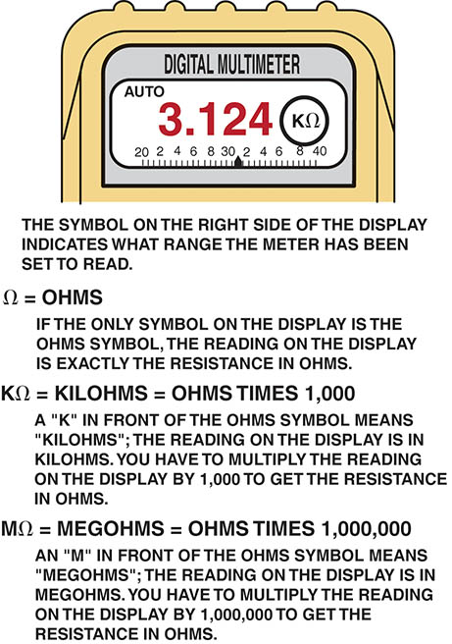
Figure 42.16 Always look at the meter display when a measurement is being made, especially if using an autoranging meter

Slide 37
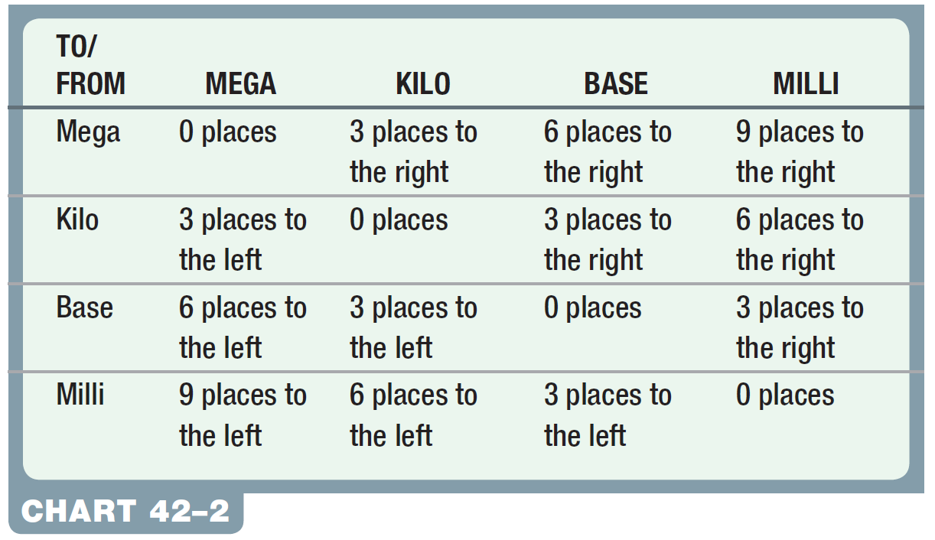
Chart 42-2 A conversion chart showing the decimal point location for the various prefixes.

Slide 38
HOW TO READ DIGITAL METERS
1. Select the proper unit of electricity for what is being measured.
2. Place the meter leads into the proper input terminals.
3. Measure the component being tested.
4. Interpret the reading.

Slide 39
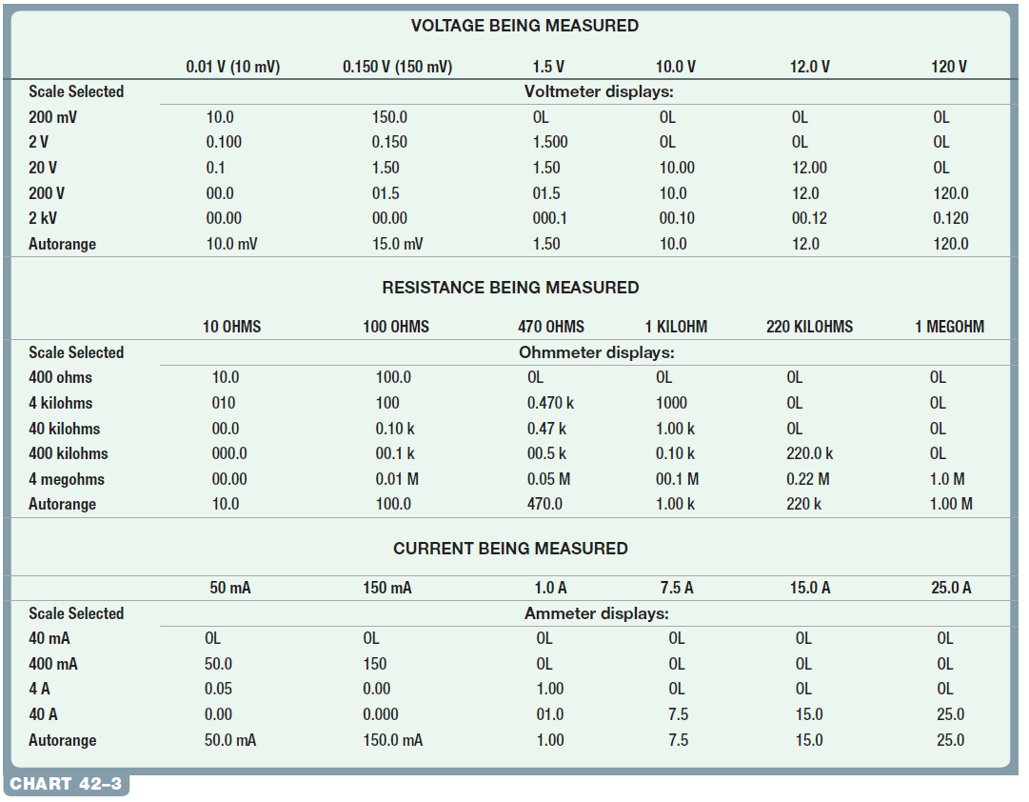
Chart 42-3 Sample meter readings, using manually set and autoranging selection on the digital meter control.

Slide 40
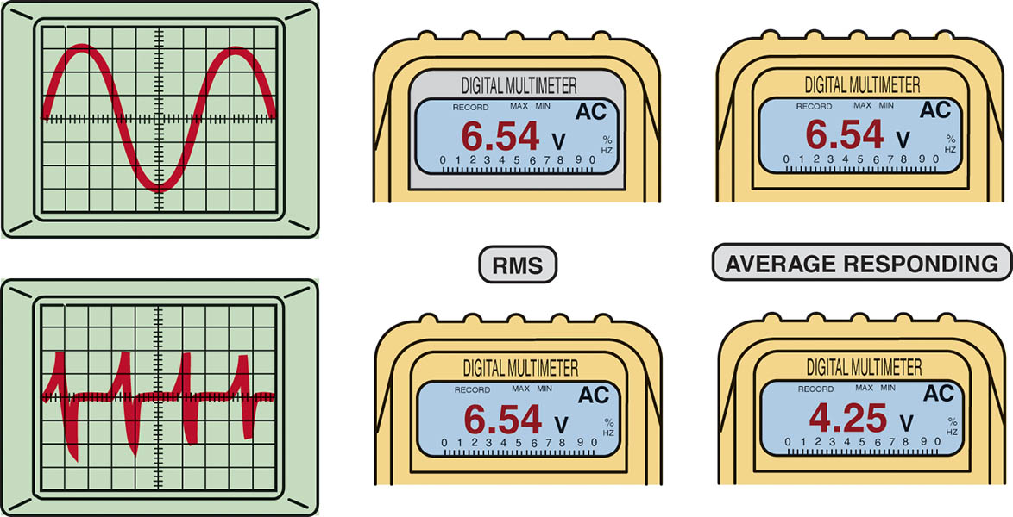
Figure 42.17 When reading AC voltage signals, a true RMS meter (such as a Fluke 87) provides a different reading than an average responding meter (such as a Fluke 88).

Slide 41
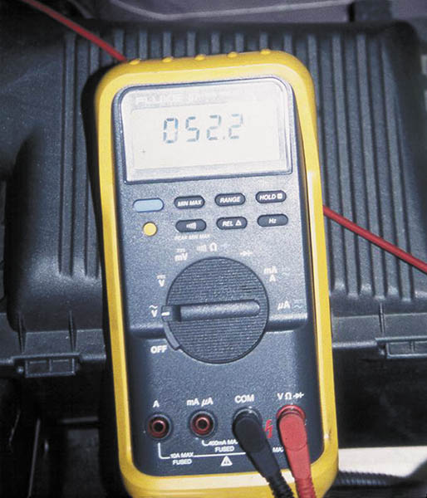
Figure 42.18 This meter display shows 052.2 AC volts. Notice that the zero beside the 5 indicates that the meter can read over 100 volts AC with a resolution of 0.1 volt

Slide 42
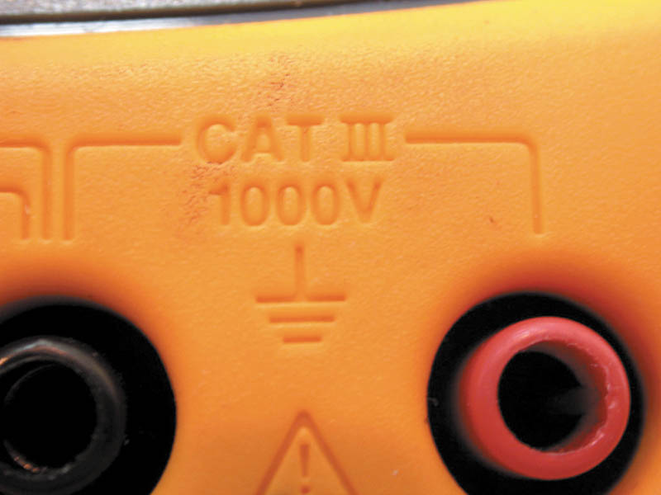
Figure 42.19 Be sure to use only a meter that is CAT III-rated when taking electrical voltage measurements on a hybrid vehicle

Slide 43
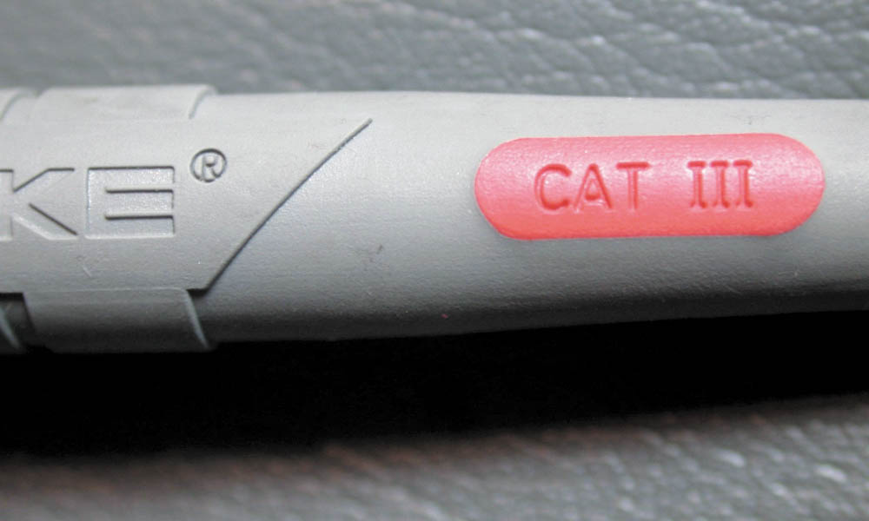
Figure 42.20 Always use meter leads that are CAT III-rated on a meter that is also CAT III-rated, to maintain the protection needed when working on hybrid vehicles

Slide 44
DIGITAL METER USAGE

Slide 45
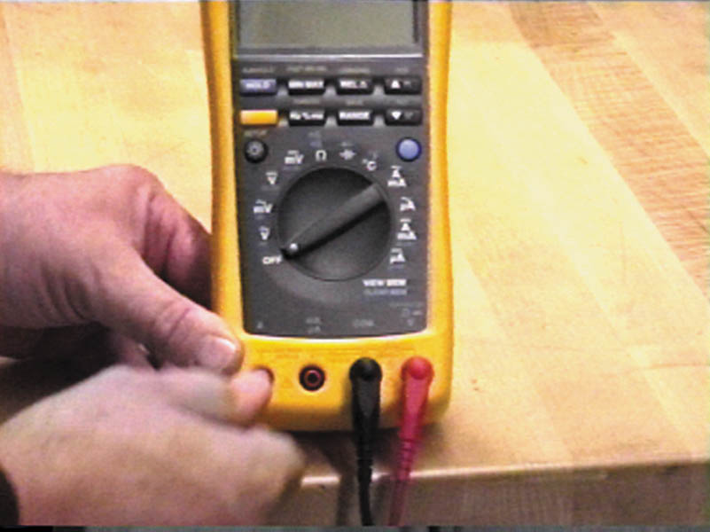
1. For most electrical measurements, the black meter lead is inserted in the terminal labeled “COM” and the red meter lead is inserted into the terminal labeled “V”.

Slide 46
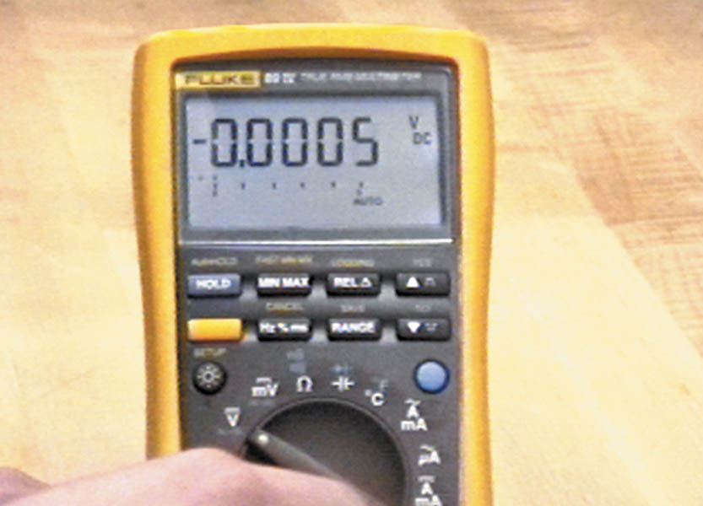
2. To use a digital meter, turn the power switch and select the unit of electricity to be measured. In this case, the rotary switch is turned to select DC volts V.

Slide 47
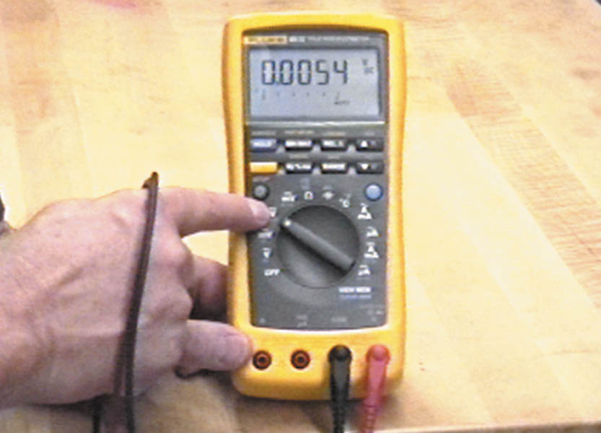
3. For most automotive electrical use, such as measuring battery voltage, select DC volts.

Slide 48
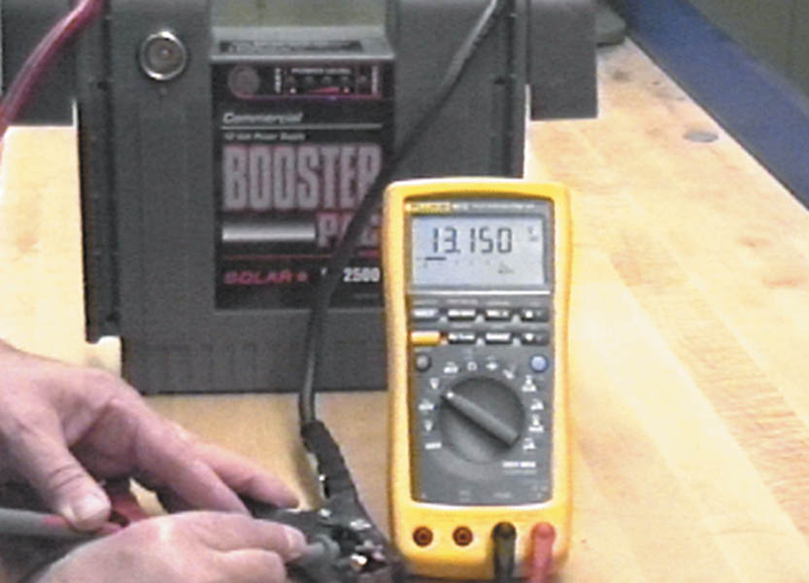
4. Connect the red meter lead to the positive (+) terminal of a battery and the black meter lead to the negative (-) terminal. The meter reads the voltage difference between the leads.

Slide 49
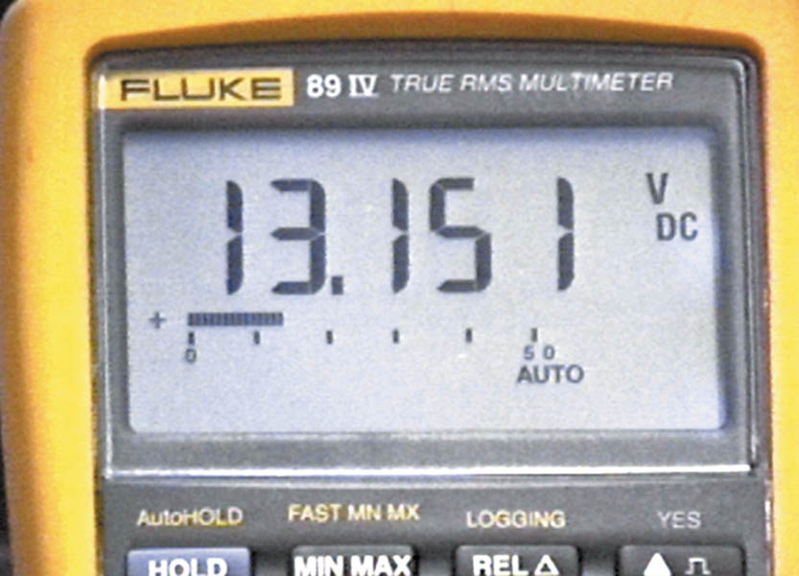
5. This jump-start battery unit measures 13.151 volts with the meter set on auto ranging on the DC voltage scale.

Slide 50
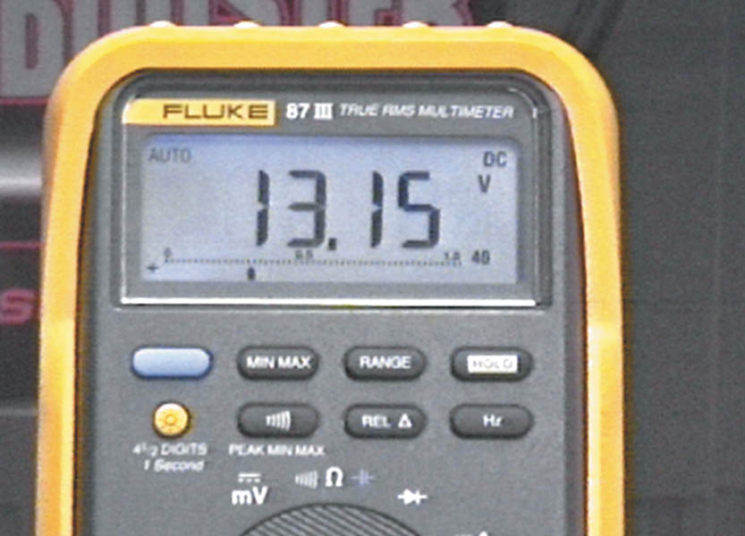
6. Another meter (Fluke 87 III) displays four digits when measuring the voltage of the battery jump-start unit.

Slide 51
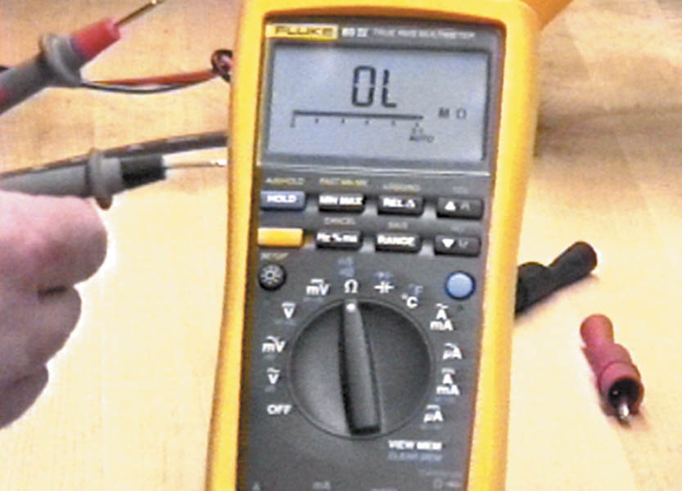
7. To measure resistance, turn the rotary dial to the ohm (Ω) symbol. With the meter leads separated, the meter display reads OL (over limit).

Slide 52
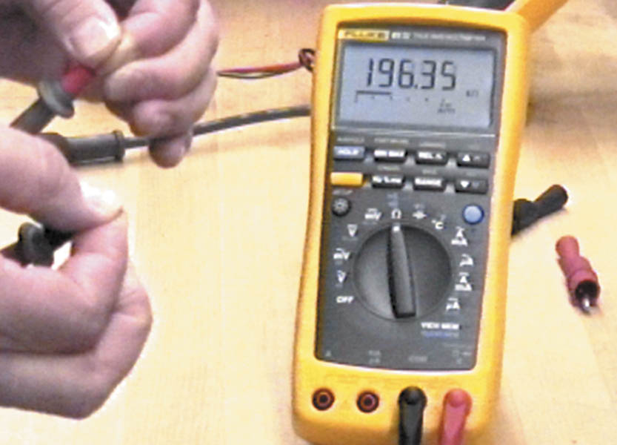
8. The meter can read your own body resistance if you grasp the meter lead terminals with your fingers. The reading on the display indicates 196.35 kΩ.

Slide 53
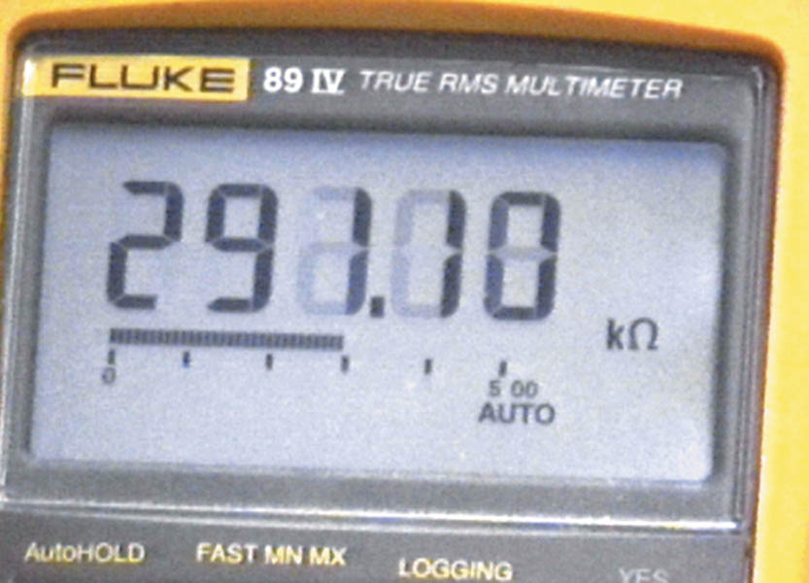
9. When measuring anything, be sure to read the symbol on the meter face. In this case, the meter reading is 291.10 kΩ.

Slide 54
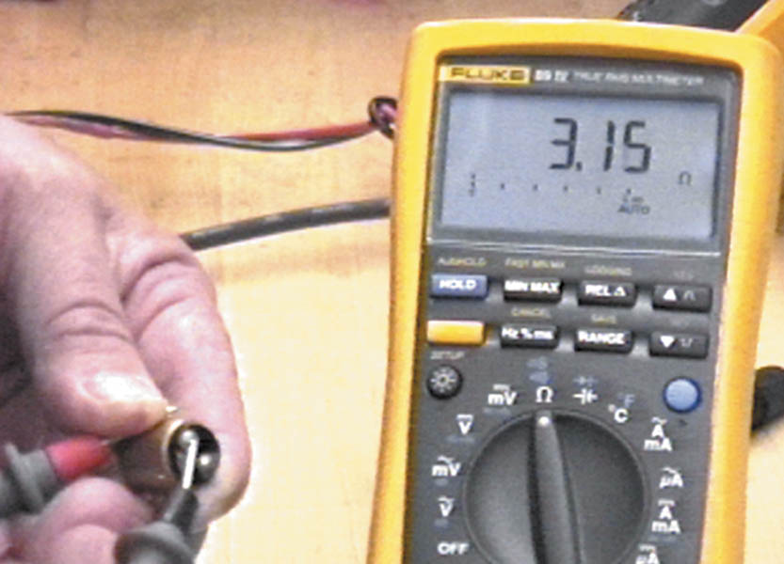
10. A meter set on ohms can be used to check the resistance of a light bulb filament. In this case, the meter reads 3.15 ohms. If the bulb were bad (filament open), the meter displays OL.

Slide 55
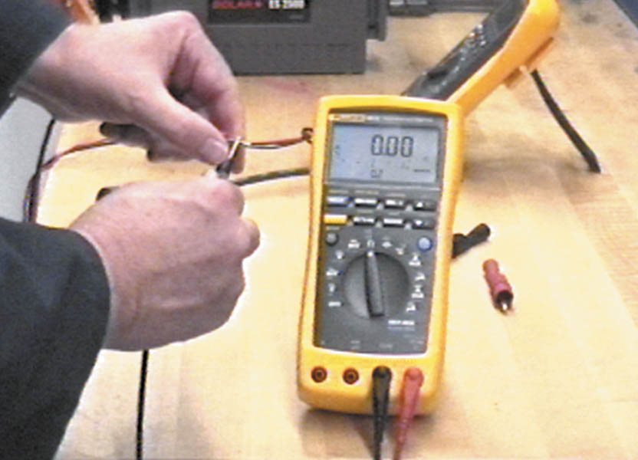
11. A digital meter set to read ohms should measure 0.00, as shown, when the meter leads are touched together.

Slide 56
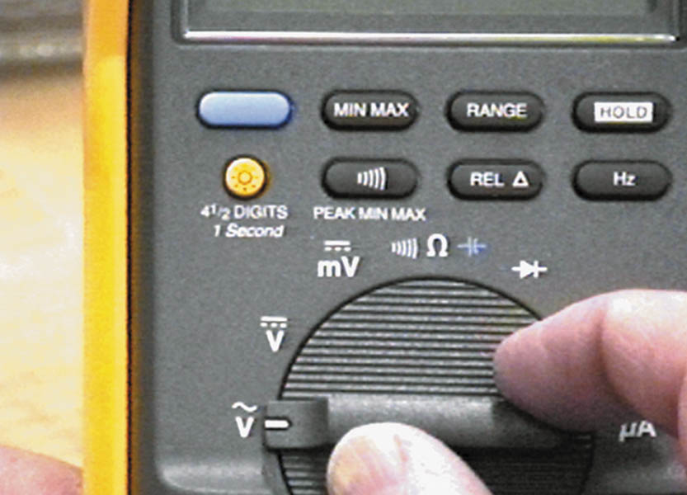
12. The large letter V means volts and the wavy symbol over the V means that the meter measures alternating-current (AC) voltage, if this position is selected.

Slide 57
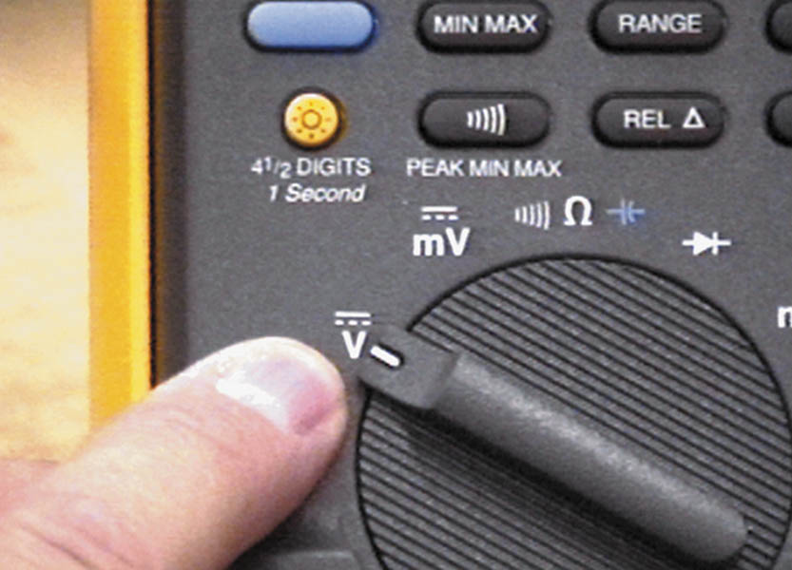
13. The next symbol is a V with a dotted and a straight line overhead. This symbol stands for direct-current (DC) volts. This position is most used for automotive service.

Slide 58
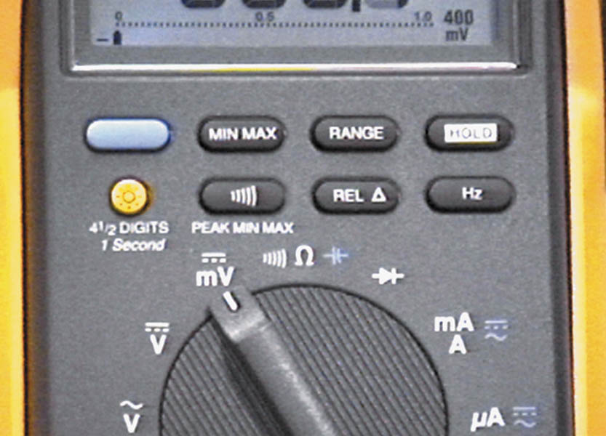
14. The symbol mV indicates millivolts or 1/1,000 of a volt (0.001). The solid and dashed line above the mV means DC mV.

Slide 59
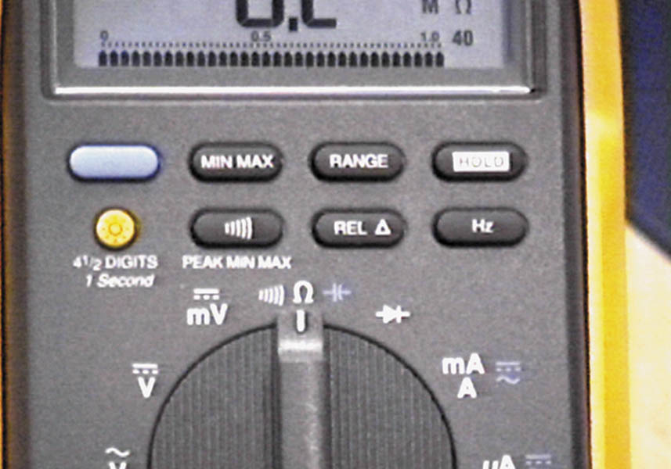
15. The rotary switch is turned to Ω (ohms) unit of resistance measure. The symbol to the left of the Ω symbol is the beeper or continuity indicator.

Slide 60
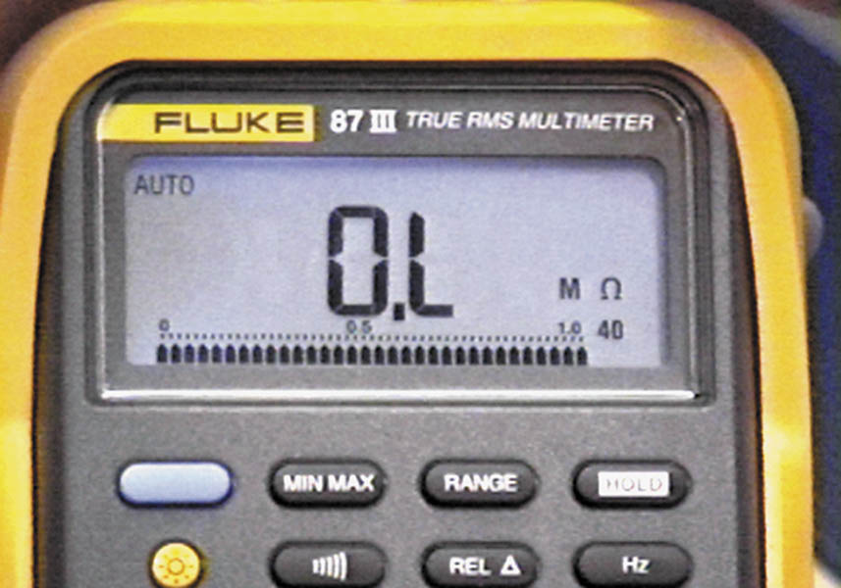
16. Notice that AUTO is in the upper left and the M Ω is in the lower right. M Ω means megaohms or that the meter is set to read in millions of ohms.

Slide 61
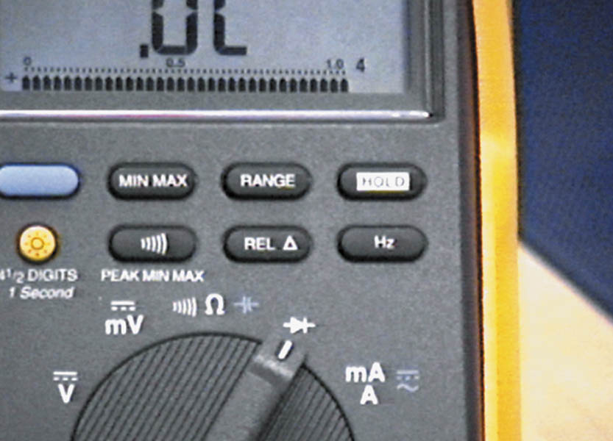
17. The symbol shown is that of a diode. In this position, the meter applies a voltage to a diode and the meter reads the voltage drop across the junction of a diode.

Slide 62
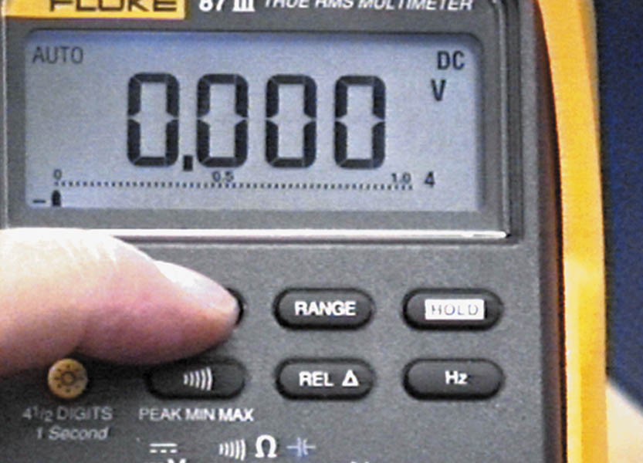
18. One of the most useful features of this meter is the MIN/MAX feature. By pushing the MIN/MAX button, the meter is able to display the highest (MAX) and the lowest (MIN) reading.

Slide 63
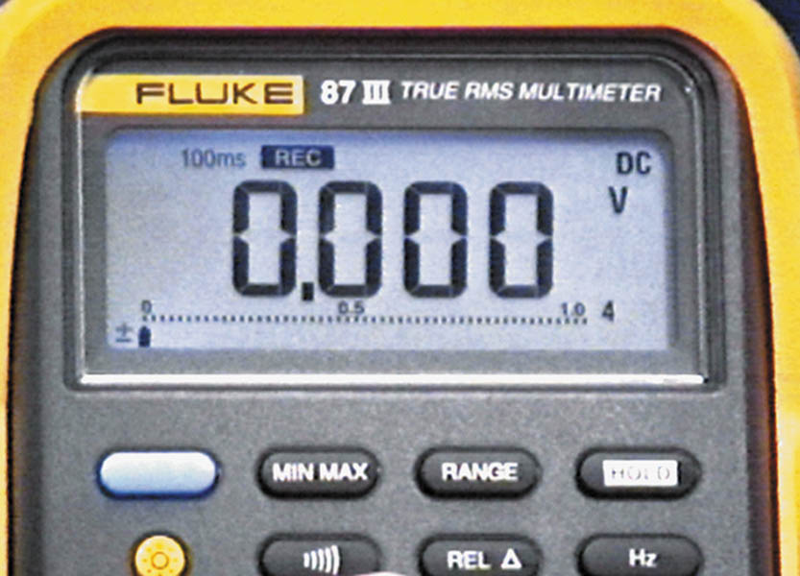
19. Pushing the MIN/MAX button puts the meter into record mode. Note the 100 ms and “rec” on the display. In this position, the meter is capturing any voltage change that lasts 100 ms (0.1 sec.) or longer.

Slide 64
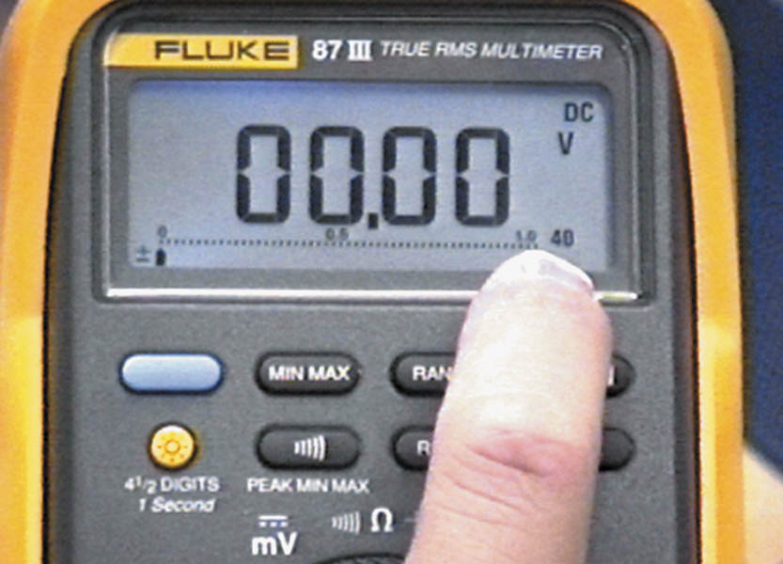
20. To increase the range of the meter, touch the range button. Now the meter is set to read voltage up to 40-volts DC.

Slide 65
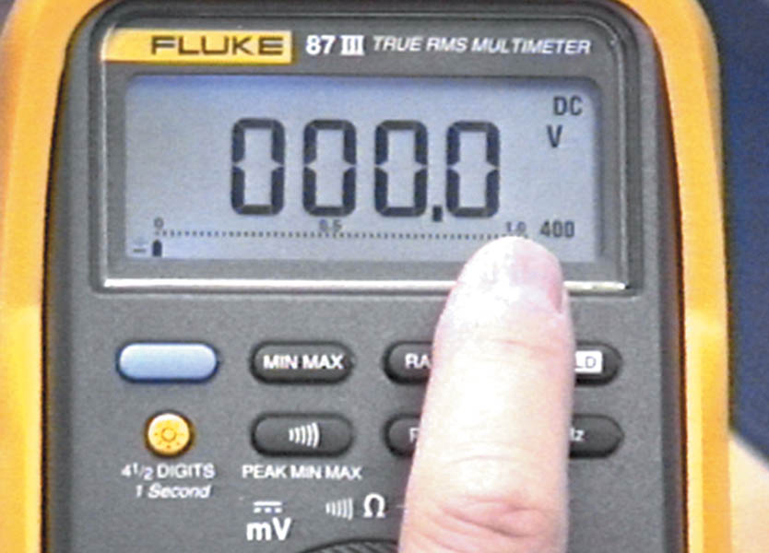
21. Pushing the range button one more time changes the meter scale to the 400-voltage range. Notice that the decimal point has moved to the right.

Slide 66
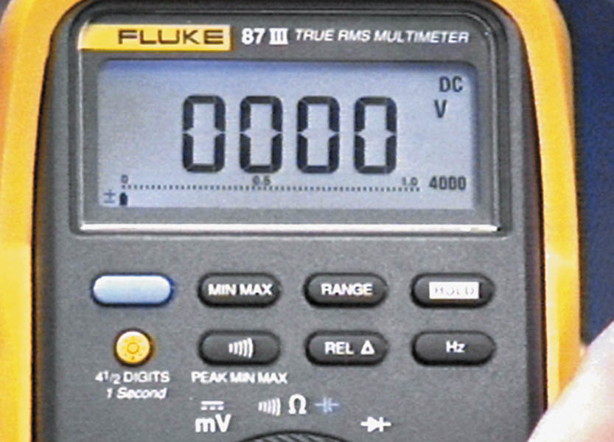
22. Pushing the range button again changes the meter to the 4,000-volt range. This range is not suitable to use in automotive applications.

Slide 67
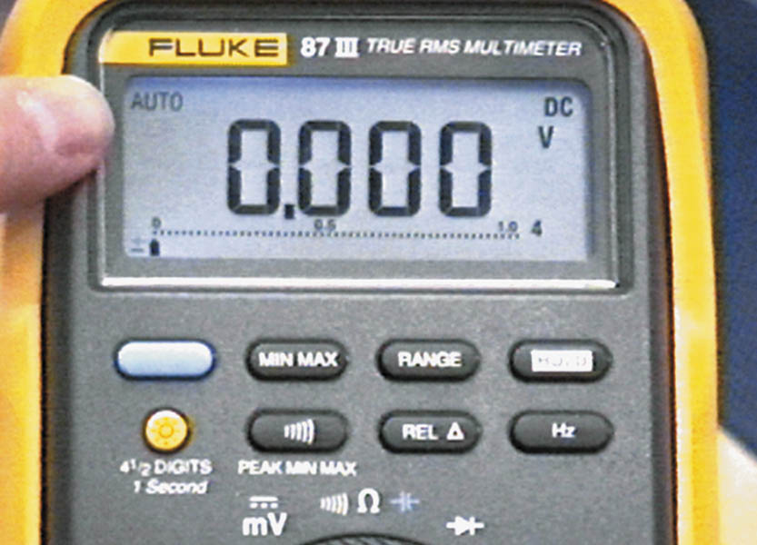
23. By pushing and holding the range button, the meter resets to autorange. Autorange is the preferred setting for most automotive measurements, except when using MIN/MAX record mode.

Slide 68
QUESTION 3: ?
What is meant when a meter reads “OL” when measuring ohms?

Slide 69
ANSWER 3:
Over limit or “open circuit”

Slide 70

Copyright

