Slide 1
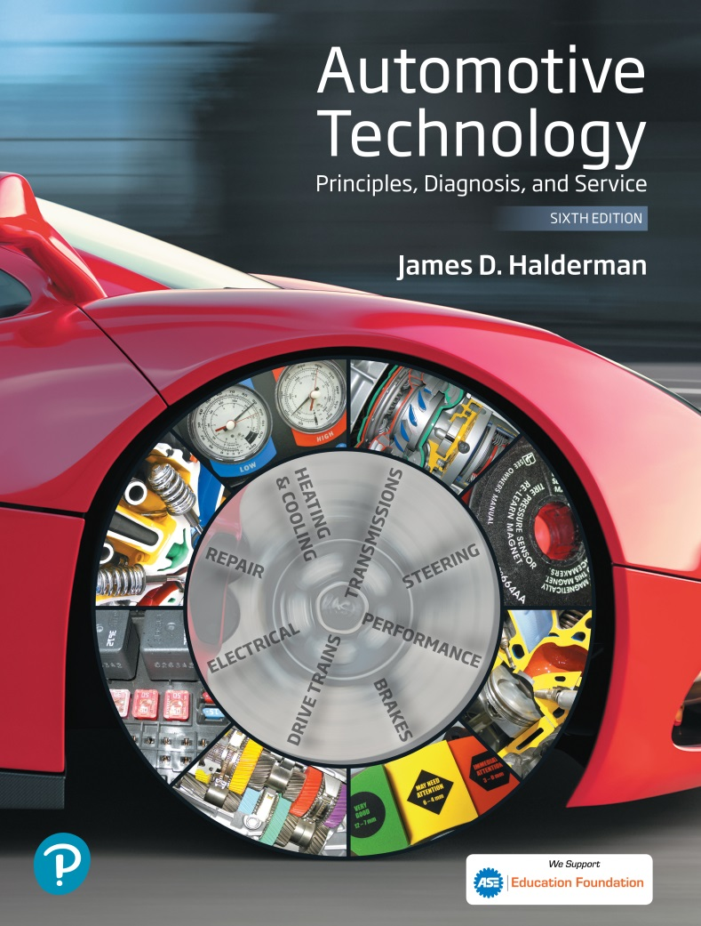
Automotive Technology Principles, Diagnosis, and Service
Sixth Edition
Chapter 40
Electrical Circuits and Ohm’s Law
Copyright © 2018, 2015, 2011 Pearson Education, Inc. All Rights Reserved

Slide 2
LEARNING OBJECTIVES (1 of 2)
40.1 Identify the parts of a complete circuit.
40.2 Describe the characteristics of different types of circuit.
40.3 Explain Ohm’s law as it applies to automotive circuits.

Slide 3
LEARNING OBJECTIVES (2 of 2)
40.4 Explain Watt’s law as it applies to automotive circuits.
40.5 This chapter will help you prepare for the ASE Electrical/Electronic Systems (A6) certification test content area “A” (General Electrical/Electronic System Diagnosis).

Slide 4
CIRCUITS
Definition
A circuit is a complete path that electrons travel from a power source (such as a battery) through a load, such as a lightbulb, and back to the power source.
Parts of a Complete Circuit
Power source
Protection
Power path
Electrical load
Return path

Slide 5
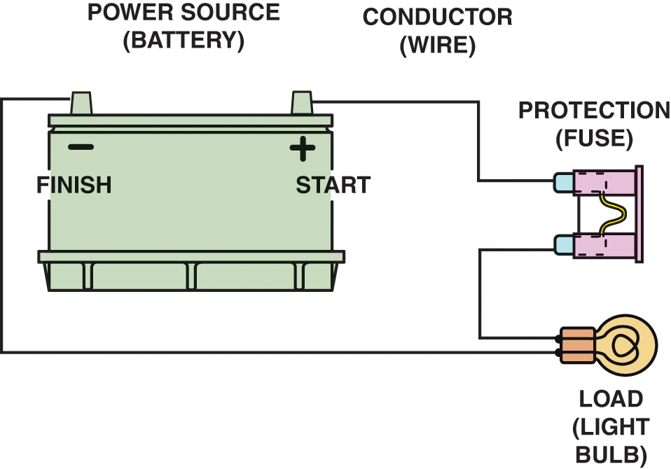
Figure 40.1 All complete circuits must have a power source, a power path, protection (fuse), an electrical load (lightbulb in this case), and a return path back to the power source

Slide 6
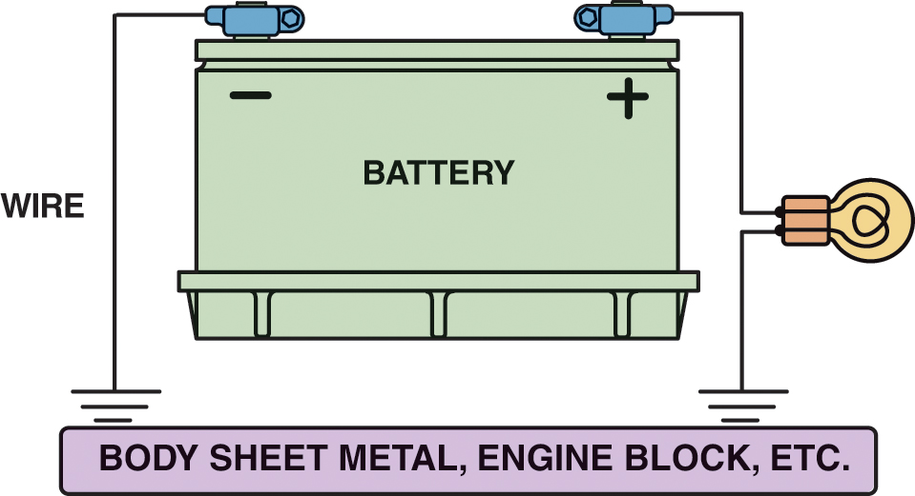
Figure 40.2 The return path back to the battery can be any electrical conductor, such as a copper wire or the metal frame or body of the vehicle

Slide 7
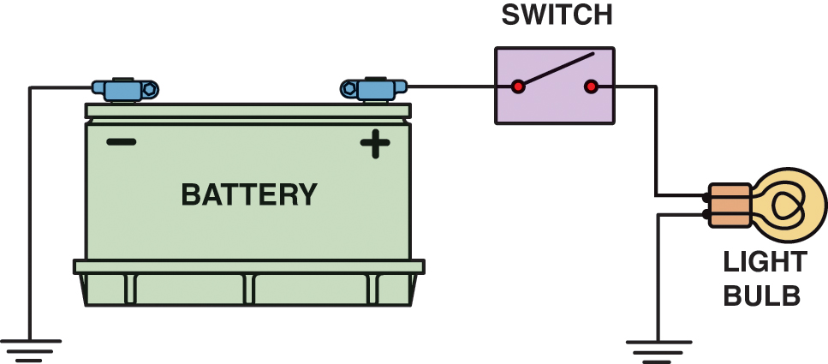
Figure 40.3 An electrical switch opens the circuit and no current flows. The switch could also be on the return (ground) path wire

Slide 8
QUESTION 1: ?
What is included in a complete electrical circuit?

Slide 9
ANSWER 1:
A power source, circuit protection, power path, electrical load, and a return path.

Slide 10
CIRCUIT FAULT TYPES (1 OF 2)
Open Circuit
An open circuit is any circuit that is not complete, or that lacks continuity.
Short-to-Voltage
A short-to-voltage occurs when the power side of one circuit is electrically connected to the power side of another circuit.

Slide 11
CIRCUIT FAULT TYPES (2 OF 2)
Short-to-Ground
A short-to-ground is a type of short circuit that occurs when the current bypasses part of the normal circuit and flows directly to ground.
High Resistance
High resistance in a circuit is caused by an unwanted load.

Slide 12
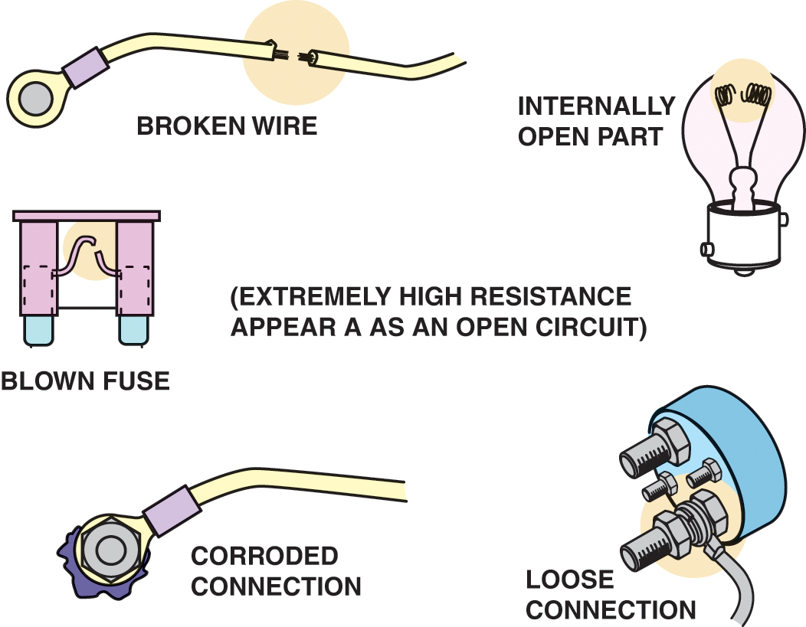
Figure 40.4 Examples of common causes of open circuits. Some of these causes are often difficult to find

Slide 13
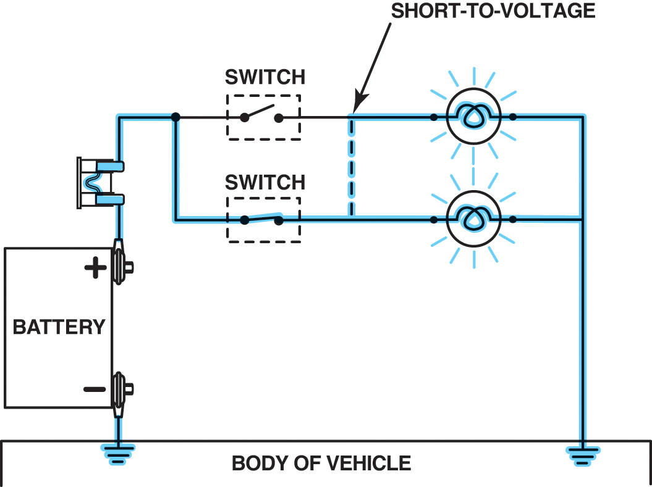
Figure 40.5 A short circuit permits electrical current to bypass some or all of the resistance in the circuit

Slide 14
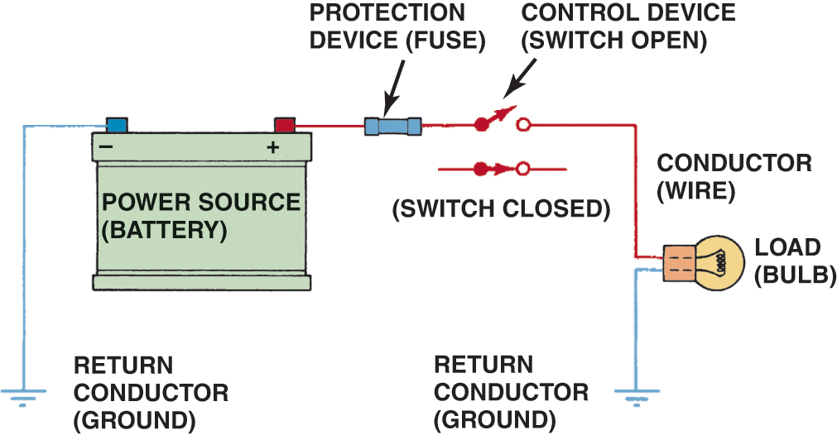
Figure 40.6 A fuse or circuit breaker opens the circuit to prevent possible overheating damage in the event of a short circuit

Slide 15
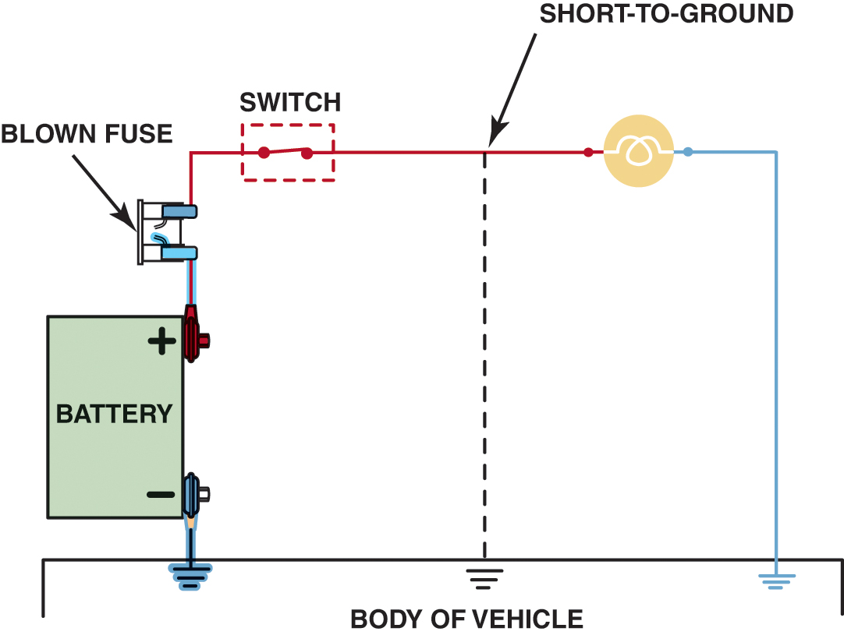
Figure 40.7 A short-to-ground affects the power side of the circuit. Current flows directly to the ground return, bypassing some or all of the electrical loads in the circuit.

Slide 16
QUESTION 2: ?
What is the difference between a short-to-voltage and a short-to-ground?

Slide 17
ANSWER 2:
A short to voltage is when the power of one circuit is unintentionally connected to another circuit. A short to ground is when part of a circuit is bypassed to ground.

Slide 18
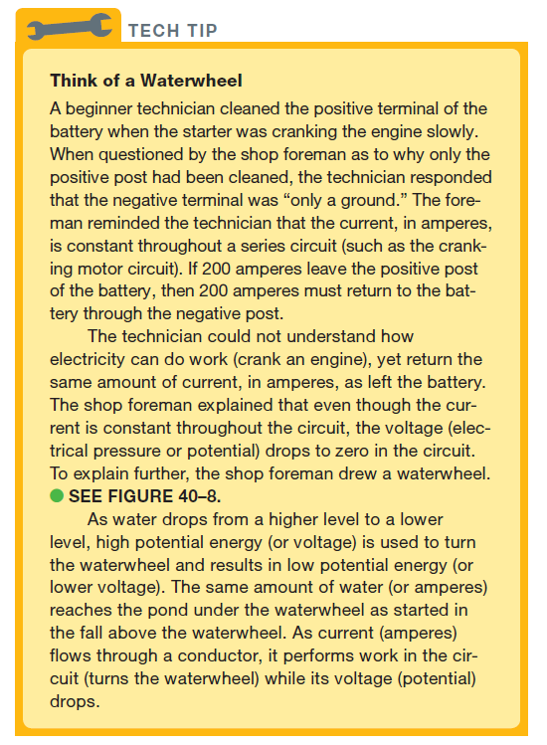
Tech Tip

Slide 19
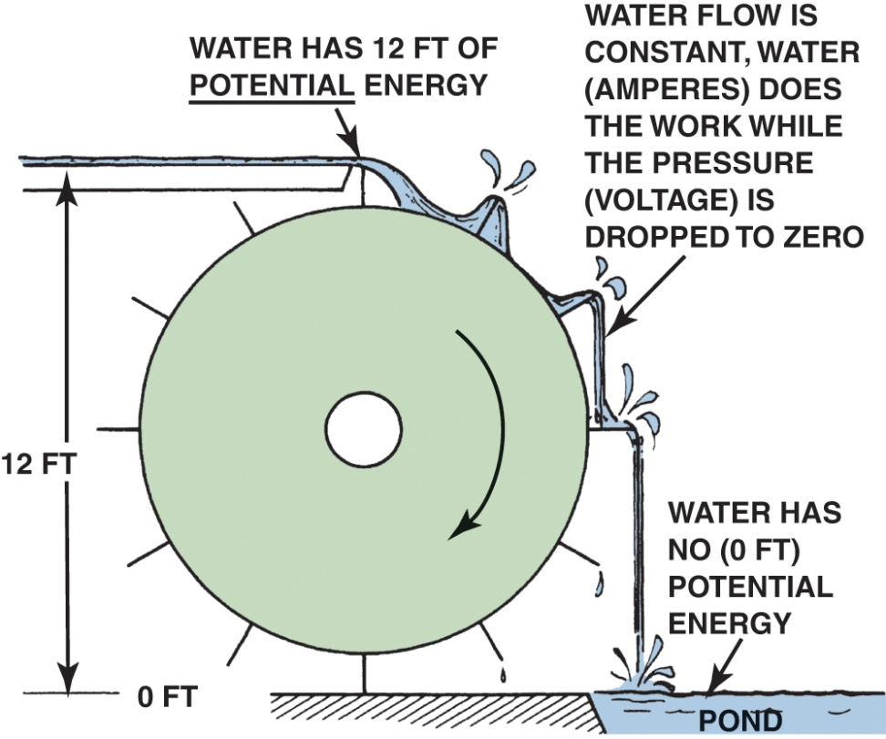
Figure 40.8 Electrical flow through a circuit is similar to water flowing over a waterwheel. The more water (amperes in electricity), the greater the amount of work (waterwheel).

Slide 20
OHM’S LAW
Definition
It requires 1 volt to push 1 ampere through 1 ohm of resistance.
Formulas
Ohm’s law can also be stated as a simple formula used to calculate one value of an electrical circuit if the other two are known.

Slide 21
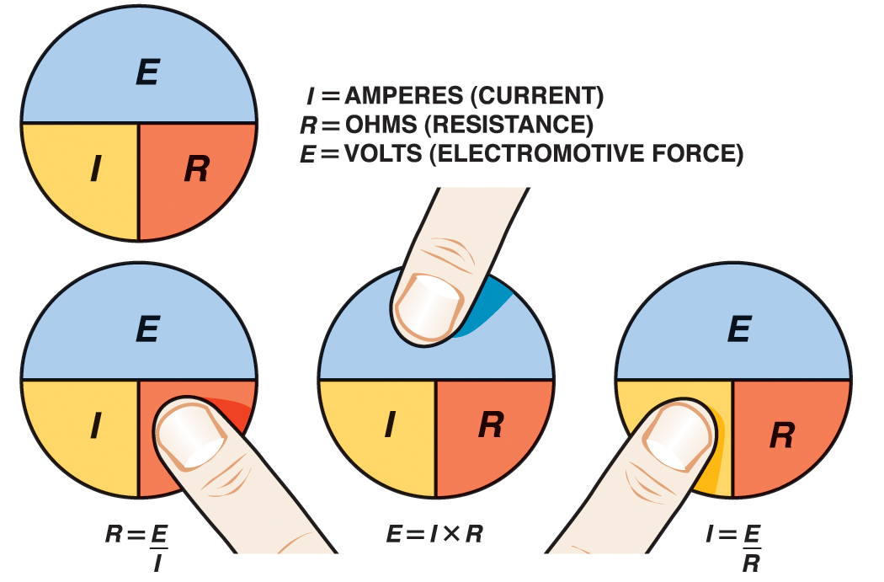
Figure 40.9 To calculate one unit of electricity when the other two are known, simply use your finger and cover the unit you do not know.

Slide 22
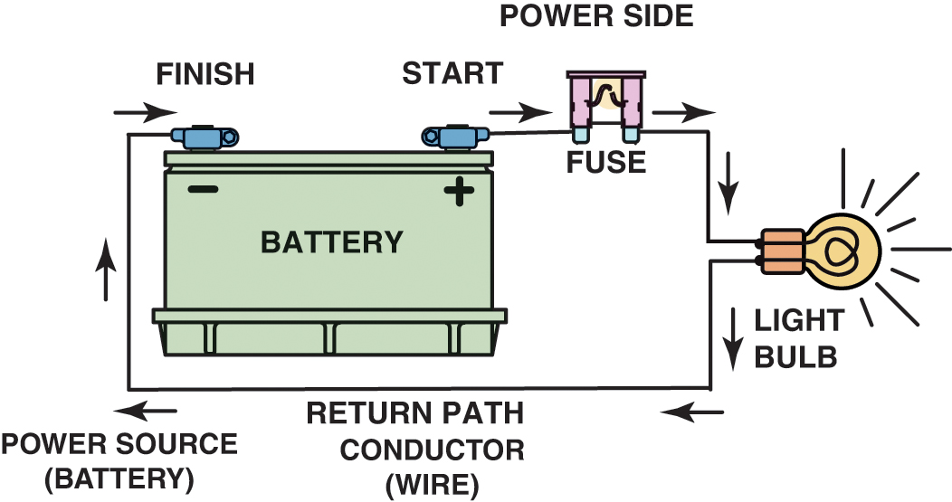
Figure 40.10 This closed circuit includes a power source, power-side wire, circuit protection (fuse), resistance (bulb), and return path wire. In this circuit, if the battery has 12 volts and the electrical load has 4 ohms, then the current through the circuit is 3 amperes

Slide 23
WATT’S LAW
Background
A watt is a unit of electrical power represented by a current of 1 ampere through a circuit with a potential difference of 1 volt.
Formulas
The symbol for a watt is the capital letter W. The formula for watts is: W = I x E
Magic Circle
The formulas for calculating any combination of electrical units are shown in the magic circle.

Slide 24
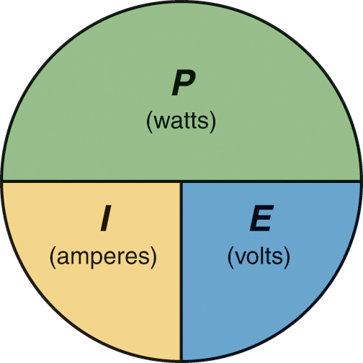
Figure 40.11 To calculate one unit when the other two are known, simply cover the unknown unit to see what unit needs to be divided or multiplied to arrive at the solution

Slide 25
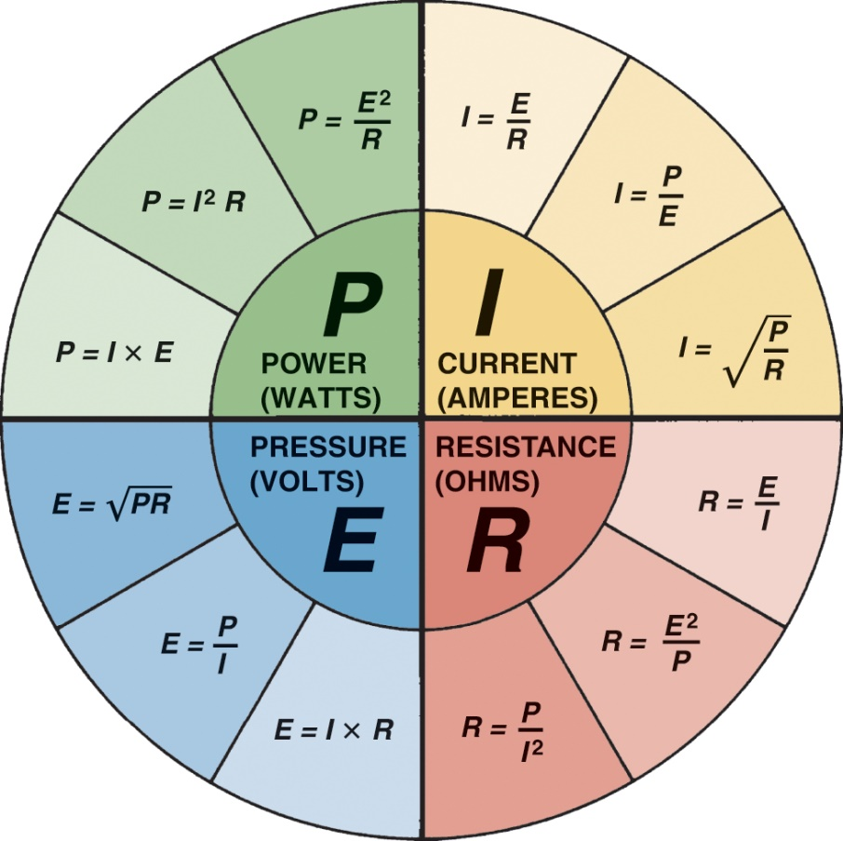
Figure 40.12 “Magic circle” of most formulas for problems involving Ohm’s law. Each quarter of the “pie” has formulas used to solve for a particular unknown value

Slide 26
QUESTION 3: ?
What is Ohm’s law?

Slide 27
ANSWER 3:
It requires 1 volt to push 1 ampere through 1 ohm of resistance.

Slide 28

Copyright

