Slide 1

Automotive Technology Principles, Diagnosis, and Service
Sixth Edition
Chapter 4
Working as a Professional Service Technician
Copyright © 2018, 2015, 2011 Pearson Education, Inc. All Rights Reserved

Slide 2
LEARNING OBJECTIVES (1 of 2)
4.1 Discuss how to start a new job and be a good employee.
4.2 Describe a service technician’s duties and use of work orders.
4.3 Describe the types and pricing of parts.

Slide 3
LEARNING OBJECTIVES (2 of 2)
4.4 Describe the advantages of having a mentor.
4.5 List useful business skills for service technicians to develop.
4.6 List housekeeping duties service technicians typically perform.
4.7 Explain formal and informal evaluations.

Slide 4
PROFESSIONALISM
Practice consistency
Keep your word
Develop technical expertise
Become a teammate with your coworkers
Be accountable

Slide 5
COMMUNICATIONS
Types of Communication:
Listening
Talking
Nonverbal communication
Telephone communication
Writing
Reading

Slide 6
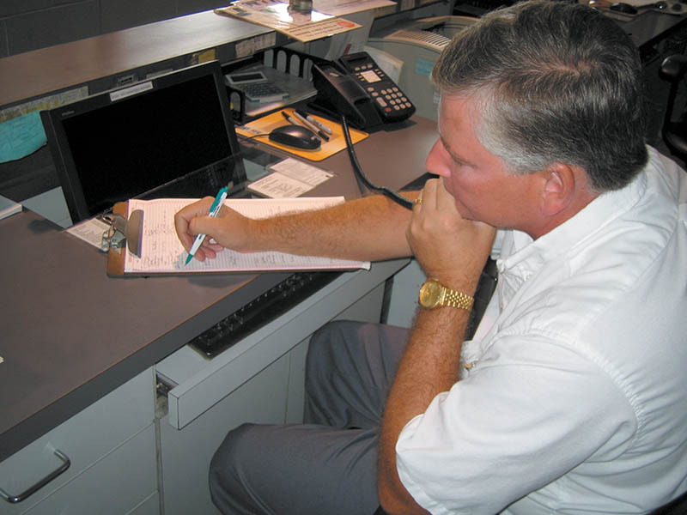
Figure 4.1 When answering the telephone, be sure to have paper and pen or pencil handy to record the customer information

Slide 7
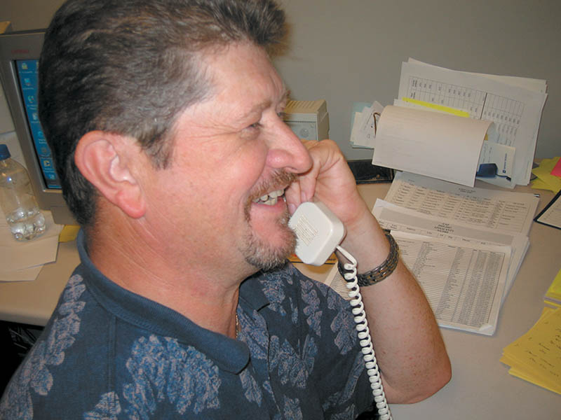
Figure 4.2 If you smile while talking on the telephone, your attitude will be transmitted to the customer

Slide 8
QUESTION 1: ?
What type of communication does not involve listening or talking?

Slide 9
ANSWER 1:
Nonverbal communication.

Slide 10
WHAT HAPPENS THE FIRST DAY
Introduction the technician to key people.
Show the technician the facility and explain the regulations of the organization.
Establish the technician’s work area.
Determine the technician’s skills and abilities.

Slide 11
DUTIES OF A SERVICE TECHNICIAN
Reading the repair order
Talking to the customer
Estimating a repair
Documenting the work order
Following recommended procedures

Slide 12
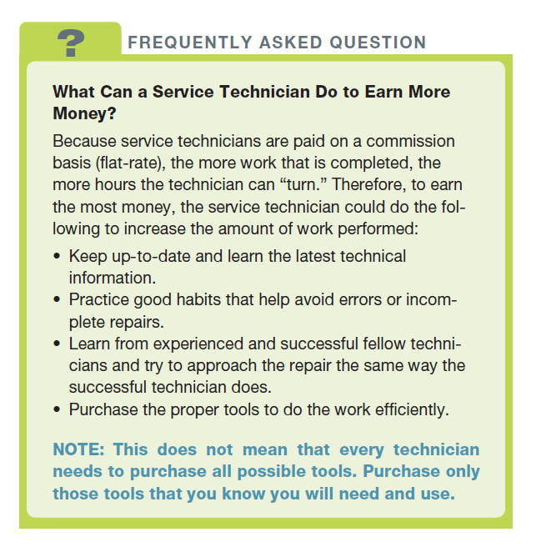
FREQUENTLY ASKED QUESTION

Slide 13
FLAGGING A WORK ORDER
Technician number
Work order number
Actual clock time
Amount of time allocated for repair

Slide 14
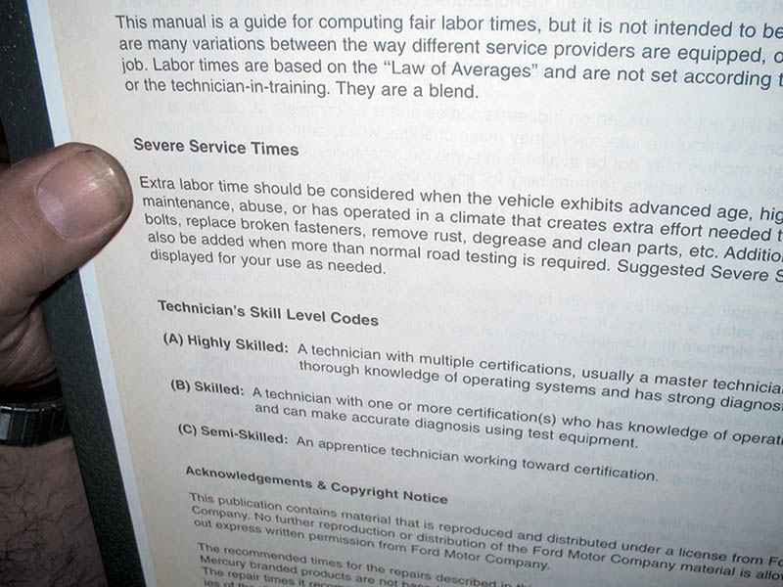
Figure 4.3 Note the skill levels of the technician and the extra time that should be added if work is being performed on a vehicle that has excessive rust or other factors as stated in the time guide

Slide 15
SUBLET REPAIRS
Repair or part of repair completed outside of the repair facility.
Examples:
Radiator repair
Engine rebuild
Expenses add to work order as a sublet repair.
.

Slide 16
PARTS REPLACEMENT
R&R: Remove and Replace
R&I: Remove and Inspect
Original Equipment Parts
Aftermarket Parts
New versus remanufactured parts
Used parts

Slide 17
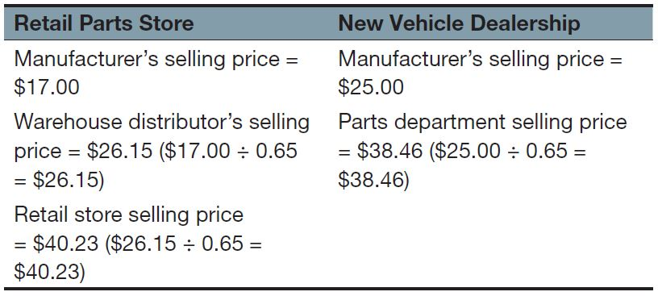
TABLE 1

Slide 18
WORKING WITH A MENTOR
Role of Mentor
Teacher
Coach
Counselor
Advisor
Qualifications of a good mentor
Trade proficiency
Good coaching/mentoring skills and techniques
Leadership/role model

Slide 19
QUESTION 2: ?
What is a mentor?

Slide 20
ANSWER 2:
A mentor is a coach, teacher, counselor and advisor.

Slide 21
TEAMWORK
Team Building
A group of individuals working together to achieve a common goal.
Leadership Roles
More experienced technician
Provides help with paperwork, parts, and shop issues.

Slide 22
GOAL SETTING AND BUSINESS MEETINGS
Goal Setting
To focus efforts on improving your personal and professional life.
Business Meetings
All technicians attend
Typically has an agenda
Attendees from inside and outside the shop

Slide 23
ADVANCEMENT SKILLS
Always verify the concern
Perform a through visual inspection
Use a scan tool to check for DTCs
Check service information for TSBs
Follow trouble charts
Locate and correct the problem
Verify the repair and document the RO

Slide 24
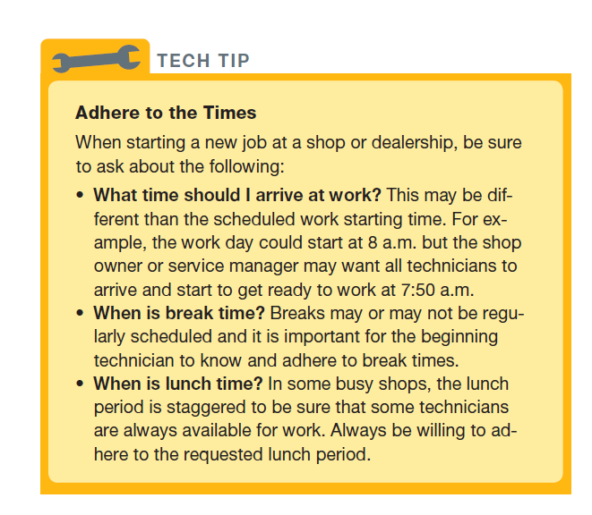
Tech Tip

Slide 25
HOUSEKEEPING DUTIES
Tool box
Clean floor
Items kept off floor
Keep areas around exits and fire extinguishers clear.
Avoid spraying chemicals in the air.

Slide 26
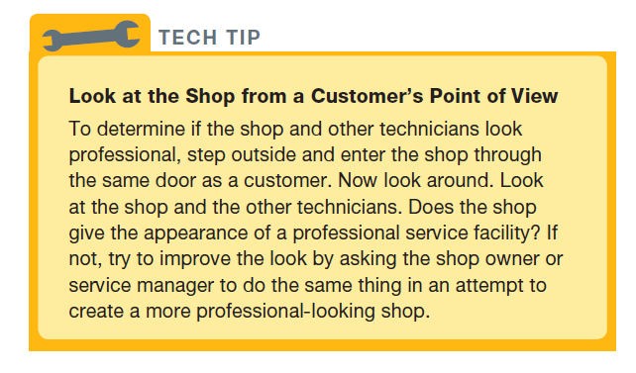
Tech Tip

Slide 27
JOB EVALUATION
Formal Evaluation
May or may not be written
Occurs on a regular basis
Covers many points
Informal Evaluation
Generally a beginning technician
Simple observations

Slide 28
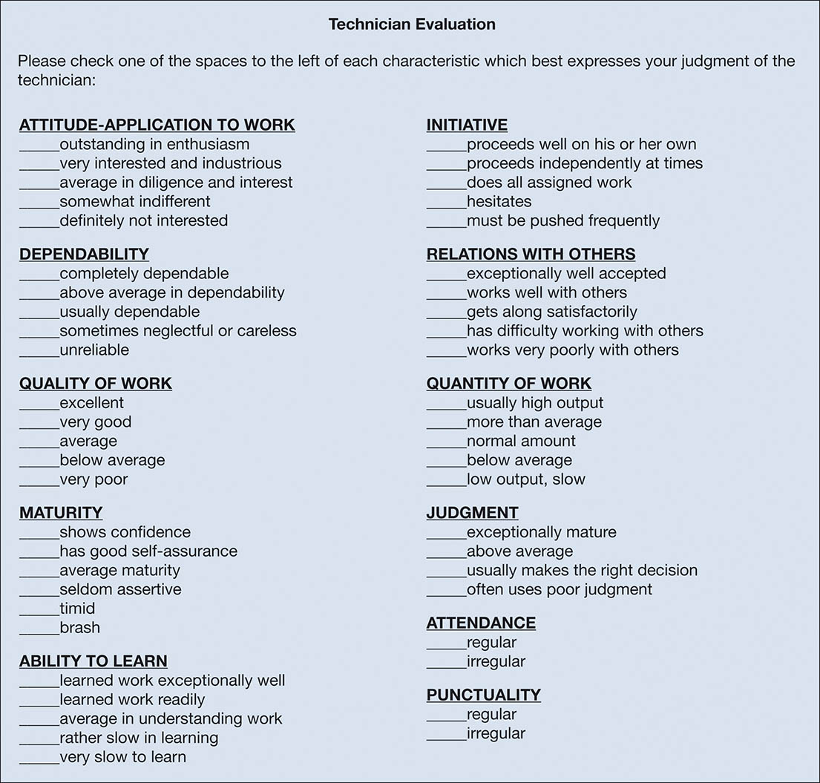
UNNUMBERED FIGURE 1

Slide 29
QUESTION 3: ?
What makes an evaluation formal?

Slide 30
ANSWER 3:
The evaluation occurs on a regular basis and covers many points.

Slide 31
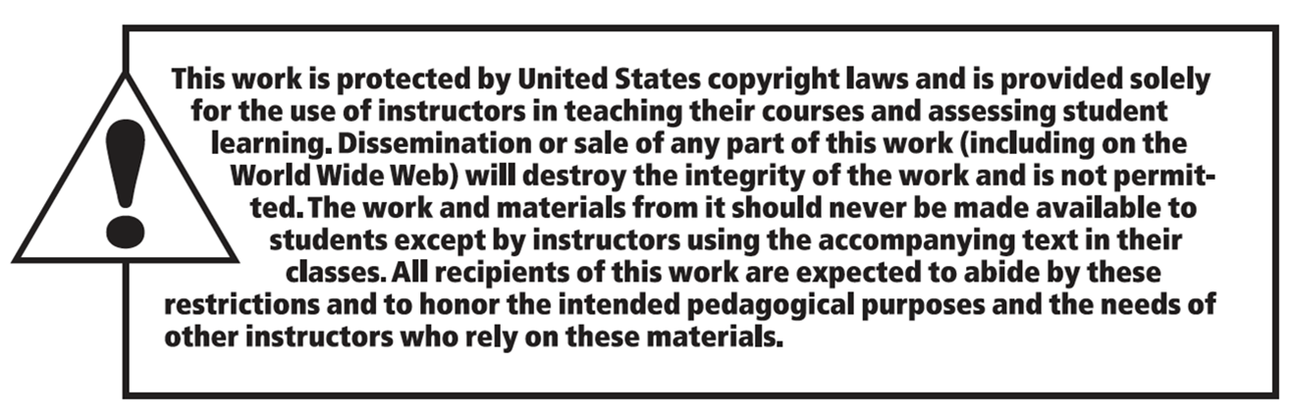
COPYRIGHT

