Slide 1
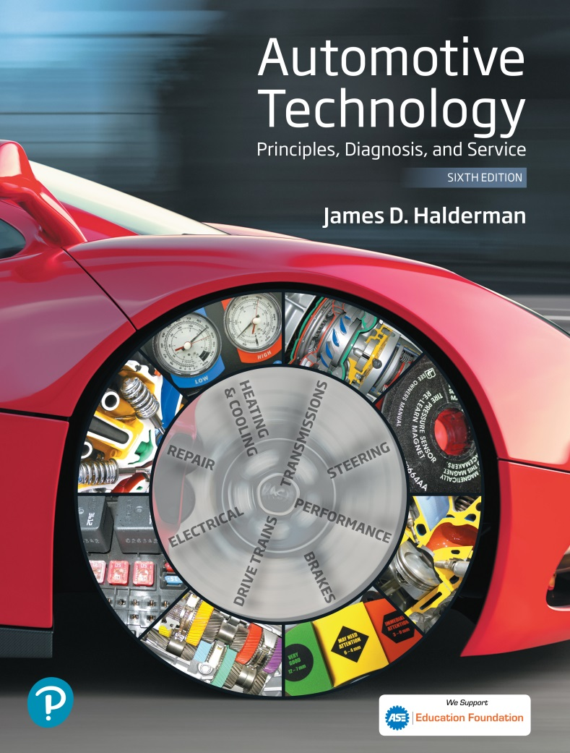
Automotive Technology Principles, Diagnosis, and Service
Sixth Edition
Chapter 39
Electrical Fundamentals
Copyright © 2018, 2015, 2011 Pearson Education, Inc. All Rights Reserved

Slide 2
LEARNING OBJECTIVES (1 of 2)
39.1 Discuss the fundamentals of electricity and explain how electrons move through a conductor.
39.2 Explain the units of electrical measurement, and discuss the relationship among volts, amperes, and ohms.
39.3 Discuss the different sources of electricity.

Slide 3
LEARNING OBJECTIVES (2 of 2)
39.4 Explain conductors and resistance, and describe the function of resistors.
39.5 This chapter will help you prepare for the ASE Electrical/Electronic Systems (A6) certification test content area “A” (General Electrical/ Electronic System Diagnosis).

Slide 4
INTRODUCTION
Electricity may be difficult for some people to learn for the following reasons.
  It cannot be seen.
  Only the results of electricity can be seen.
  It has to be detected and measured.
  The test results have to be interpreted.

Slide 5
ELECTRICITY (1 OF 4)
Definition
  Electricity is the movement of electrons from one atom to another.
The dense center of each atom is called the nucleus. The nucleus contains:
  Protons, which have a positive charge
  Neutrons, which are electrically neutral (have no charge)

Slide 6
ELECTRICITY (2 OF 4)
Positive and Negative Charges
  The orbiting electrons are negatively charged, while the protons are positively charged.
Magnets and Electrical Charges
  An ordinary magnet has two ends, a north pole and a south pole. Like poles repel and opposite poles attract.
Ions
  When an atom is not balanced, it becomes a charged particle called an ion.

Slide 7
ELECTRICITY (3 OF 4)
Electron Shells
  Electrons orbit around the nucleus in definite paths. These paths form shells, like concentric rings, around the nucleus.
Free and Bound Electrons
  A valance ring with three or less electrons will attract free electrons.
  A valance ring with five or more electrons will tightly hold electrons; referred to as bound electrons.

Slide 8
ELECTRICITY (4 OF 4)
Conductors
  Conductors are materials with fewer than four electrons in their atom’s outer orbit.
Insulators
  Insulators are materials with more than four electrons in their atom’s outer orbit.
Semiconductors
  Materials with exactly four electrons in their outer orbit are neither conductors nor insulators, they are considered semiconductors.

Slide 9
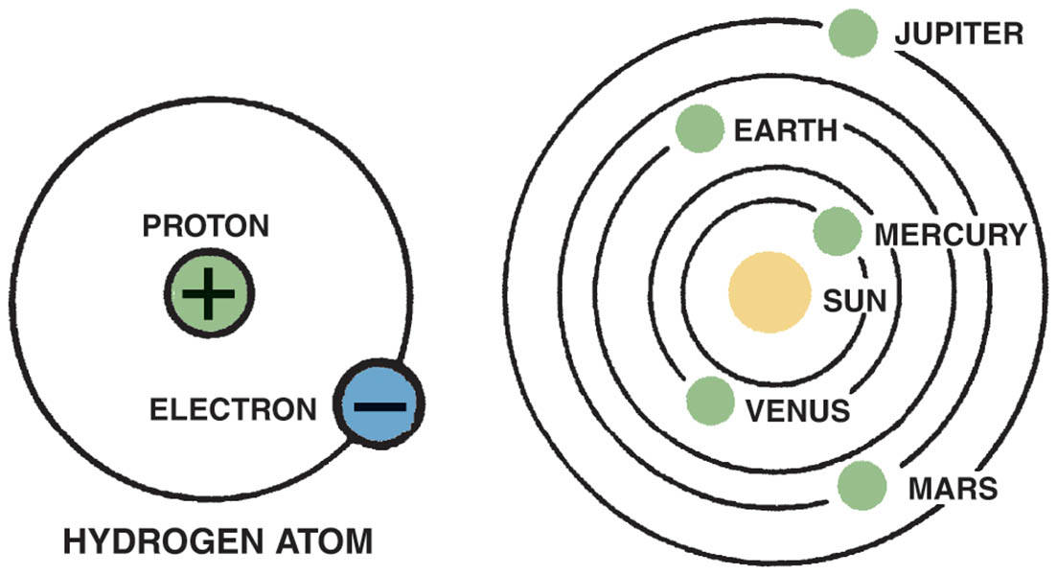
Figure 39.1 In an atom (left), electrons orbit protons in the nucleus just as planets orbit the sun in our solar system (right)

Slide 10
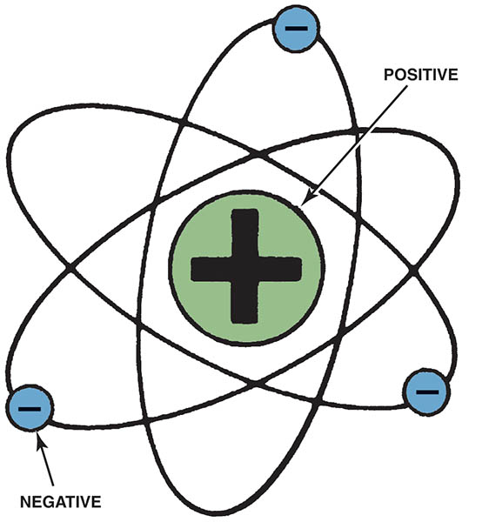
Figure 39.2 The nucleus of an atom has a positive (+) charge and the surrounding electrons have a negative (−) charge

Slide 11
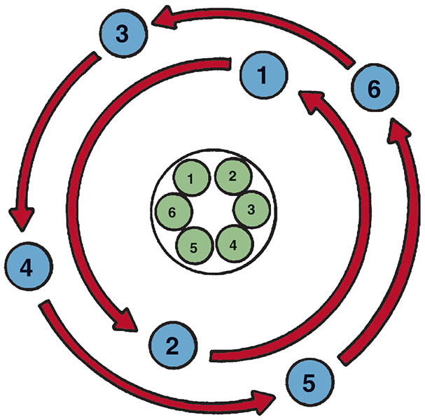
Figure 39.3 This figure shows a balanced atom. The number of electrons is the same as the number of protons in the nucleus

Slide 12
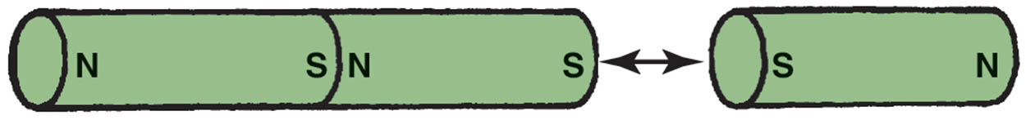
Figure 39.4 Unlike charges attract and like charges repel

Slide 13
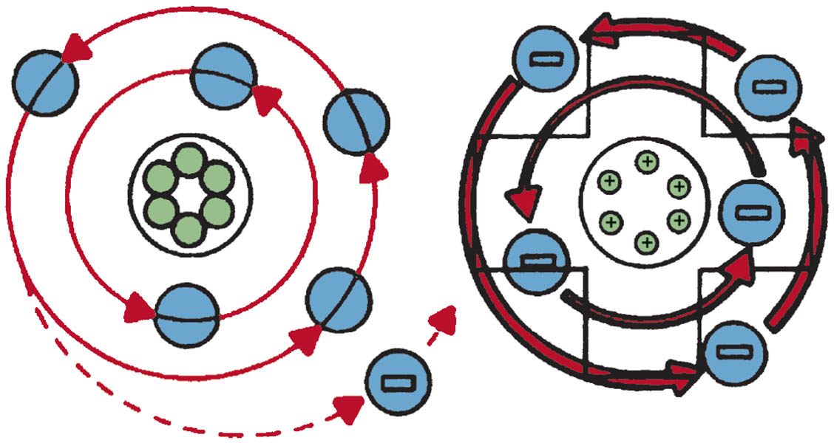
Figure 39.5 An unbalanced, positively charged atom (ion) attracts electrons from neighbouring atoms

Slide 14
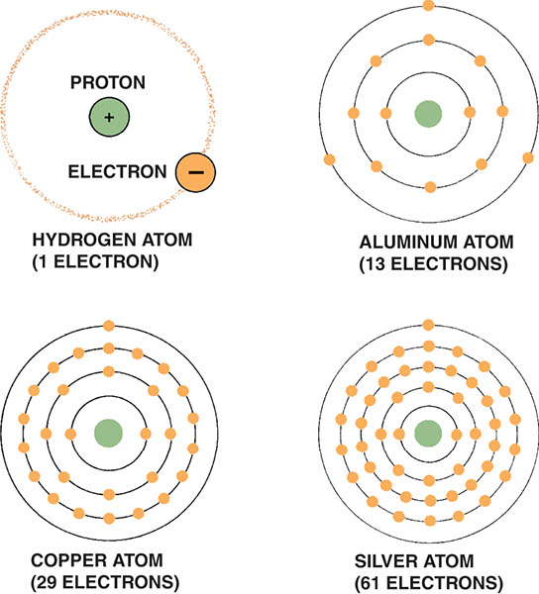
Figure 39.6 The hydrogen atom is the simplest atom, with only one proton, one neutron, and one electron. More complex elements contain higher numbers of protons, neutrons, and electrons

Slide 15
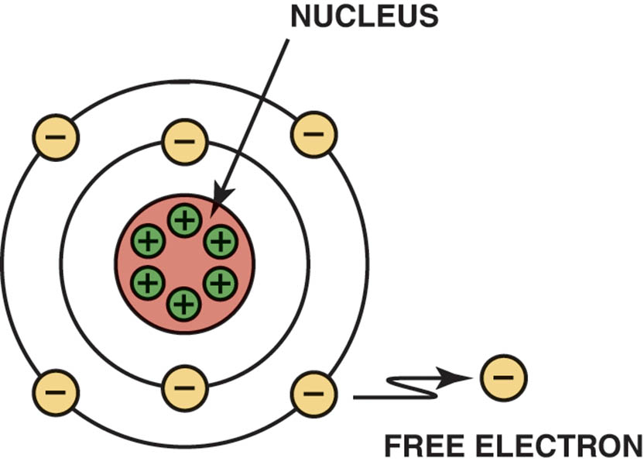
Figure 39.7 Electrons in the outer orbit, or shell, can often be drawn away from the atom and become free electrons

Slide 16
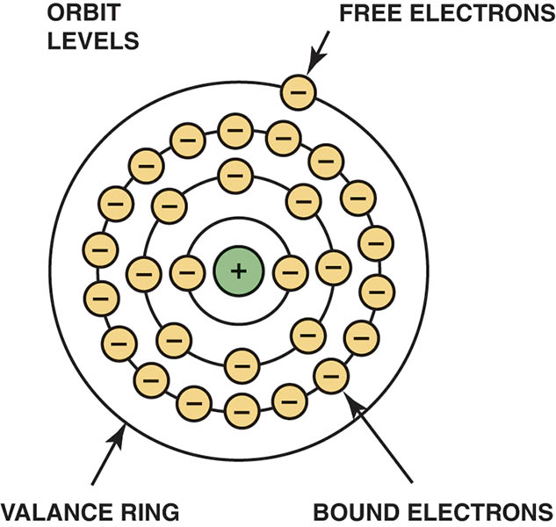
Figure 39.8 As the number of electrons increases, they occupy increasing energy levels that are farther from the center of the atom

Slide 17
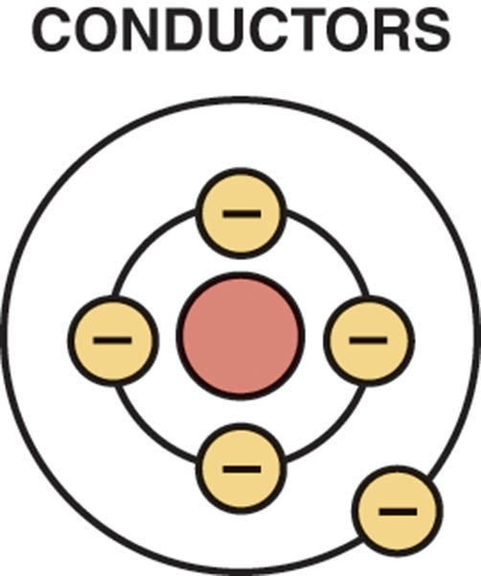
Figure 39.9 A conductor is any element that has one to three electrons in its outer orbit

Slide 18
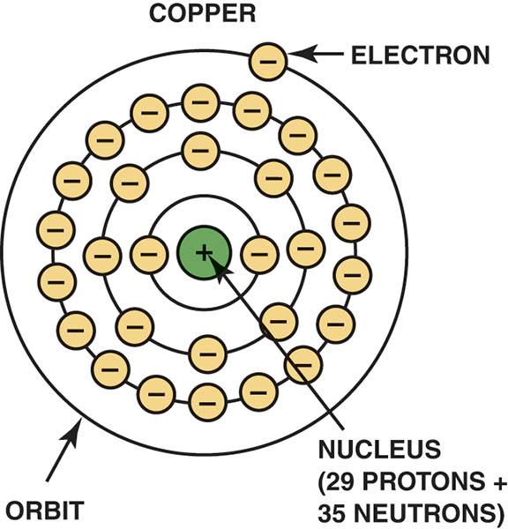
Figure 39.10 Copper is an excellent conductor of electricity because it has just one electron in its outer orbit, making it easy to be knocked out of its orbit and flow to other nearby atoms.

Slide 19
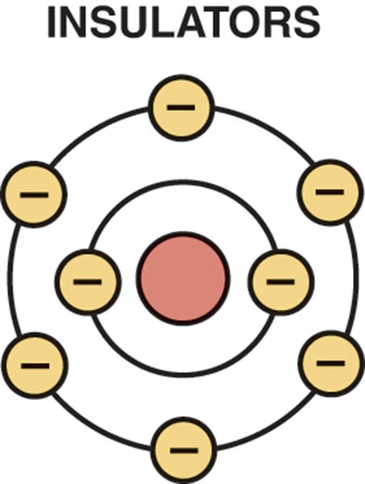
Figure 39.11 Insulators are elements with five to eight electrons in the outer orbit

Slide 20
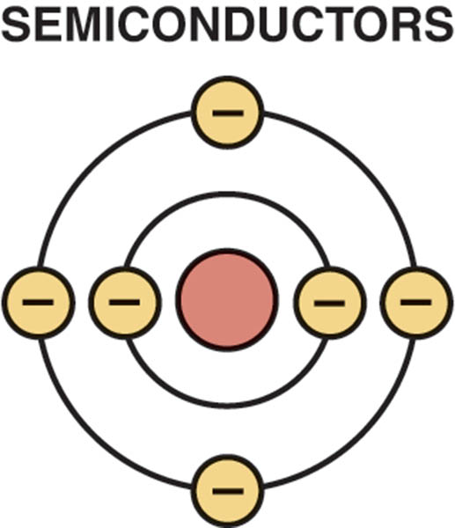
Figure 39.12 Semiconductor elements contain exactly four electrons in the outer orbit

Slide 21
QUESTION 1: ?
What is electricity?

Slide 22
ANSWER 1:
  Electricity is the movement of electrons from one atom to another.

Slide 23
HOW ELECTRONS MOVE THROUGH A CONDUCTOR
Current Flow
  For current to flow, there must be an imbalance of excess electrons at one end of the circuit and a deficiency of electrons at the opposite end of the circuit.
Conventional Theory Versus Electron Theory
  Conventional Theory: The flow of electrons from positive to negative.
  Electron Theory: The flow of electrons from negative to positive.
  Automotive applications use the conventional theory.

Slide 24
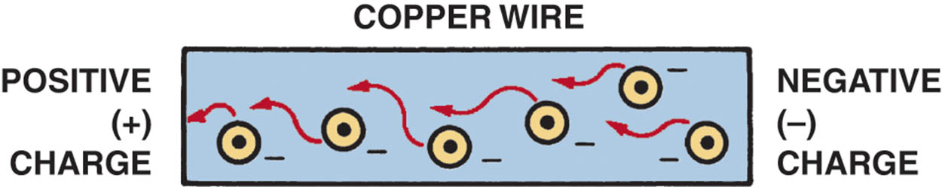
Figure 39.13 Current electricity is the movement of electrons through a conductor

Slide 25
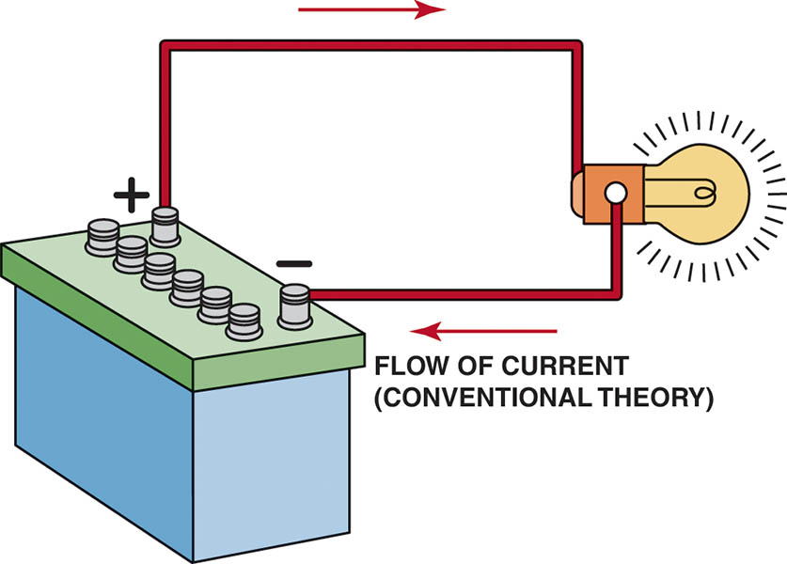
Figure 39.14 Conventional theory states that current flows through a circuit from positive (+) to negative (−). Automotive electricity uses the conventional theory in all electrical diagrams and schematics

Slide 26
UNITS OF ELECTRICITY (1 OF 2)
Ampere
  The ampere is the unit used throughout the world to measure current flow.
Volts
  The volt is the unit of measurement for electrical pressure.

Slide 27
UNITS OF ELECTRICITY (2 OF 2)
Ohms
  Resistance to the flow of current through a conductor is measured in units called ohms.
Watts
  A watt is the electrical unit for power, the capacity to do work.

Slide 28
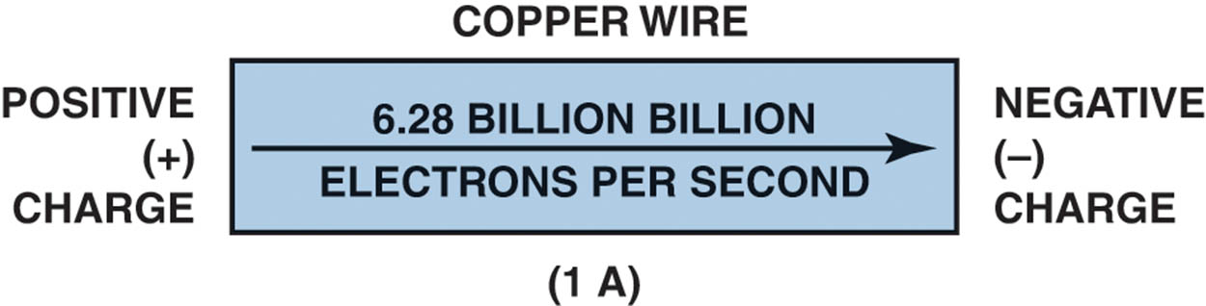
Figure 39.15 One ampere is the movement of 1 coulomb (6.28 billion billion electrons) past a point in 1 second

Slide 29
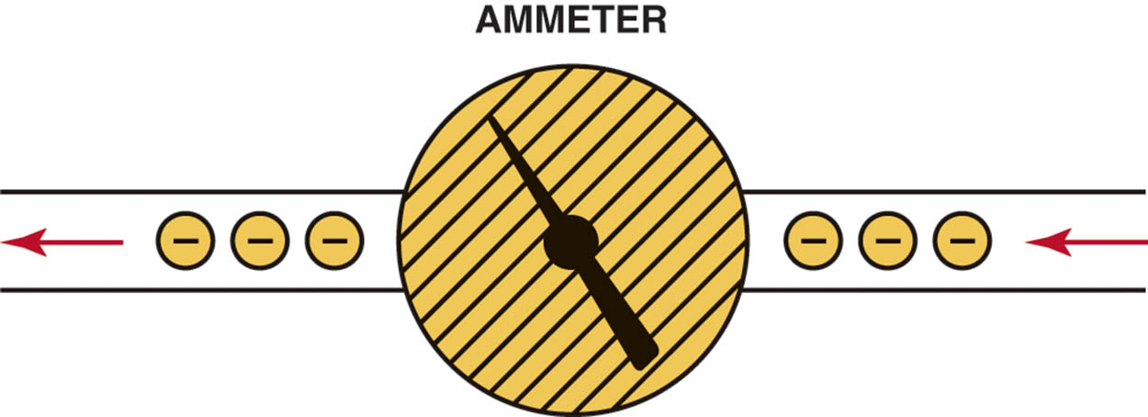
Figure 39.16 An ammeter is installed in the path of the electrons similar to a water meter used to measure the flow of water in gallons per minute. The ammeter displays current flow in amperes

Slide 30
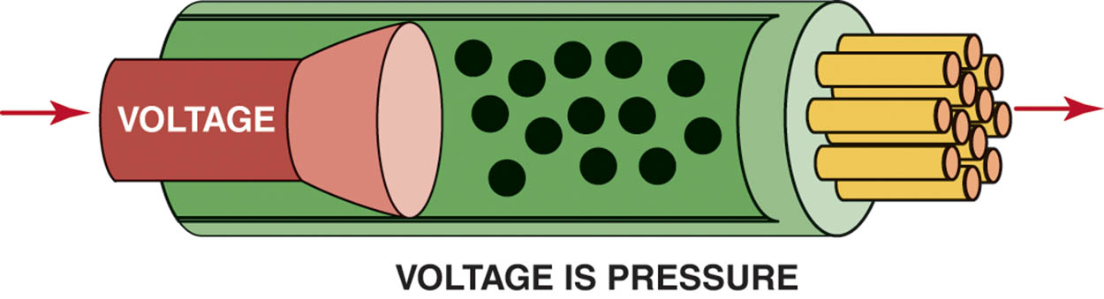
Figure 39.17 Voltage is the electrical pressure that causes the electrons to flow through a conductor

Slide 31
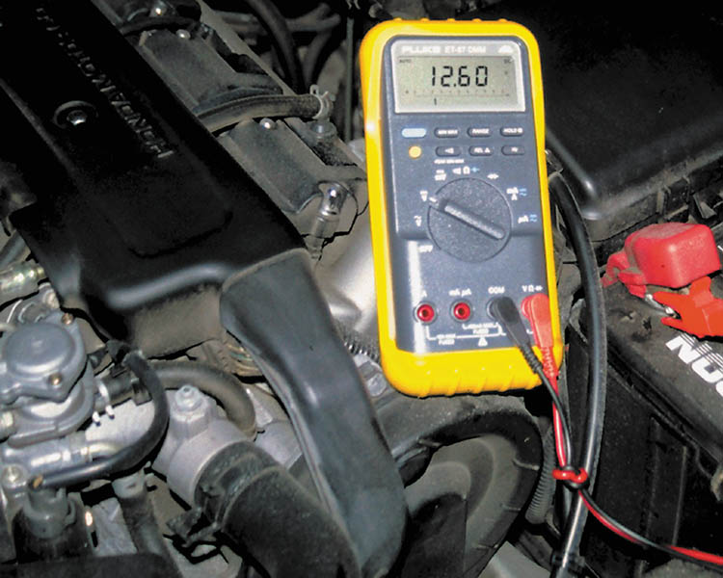
Figure 39.18 This digital multimeter set to read DC volts is being used to test the voltage of a vehicle battery. Most multimeters can also measure resistance (ohms) and current flow (amperes)

Slide 32
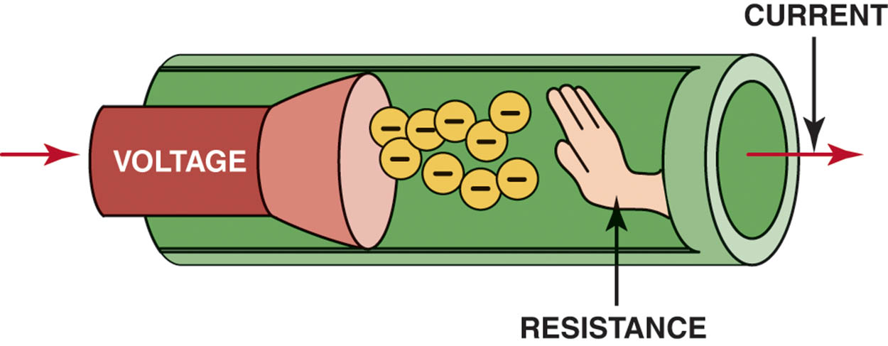
Figure 39.19 Resistance to the flow of electrons through a conductor is measured in ohms

Slide 33
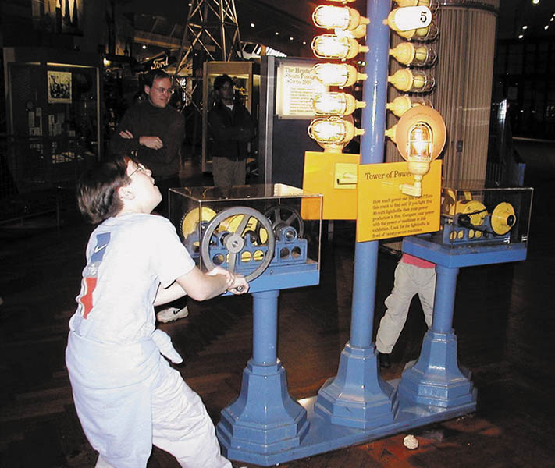
Figure 39.20 A display at the Henry Ford Museum in Dearborn, Michigan, which includes a hand-cranked generator and a series of lightbulbs.

Slide 34
SOURCES OF ELECTRICITY (1 OF 3)
Friction
  When certain different materials are rubbed together, the friction causes electrons to be transferred from one to the other.
Heat
  When pieces of two different metals are joined together at both ends and one junction is heated, current passes through the metals.

Slide 35
SOURCES OF ELECTRICITY (2 OF 3)
Light
  When certain metals are exposed to light, some of the light energy is transferred to the free electrons of the metal.
Pressure
  The generation of a voltage due to pressure applied to a crystal.

Slide 36
SOURCES OF ELECTRICITY (3 OF 3)
Chemical
  Two different materials (usually metals) placed in a conducting and reactive chemical solution create a difference in potential, or voltage, between them.
Magnetism
  Electricity can be produced if a conductor is moved through a magnetic field or a moving magnetic field is moved near a conductor.

Slide 37
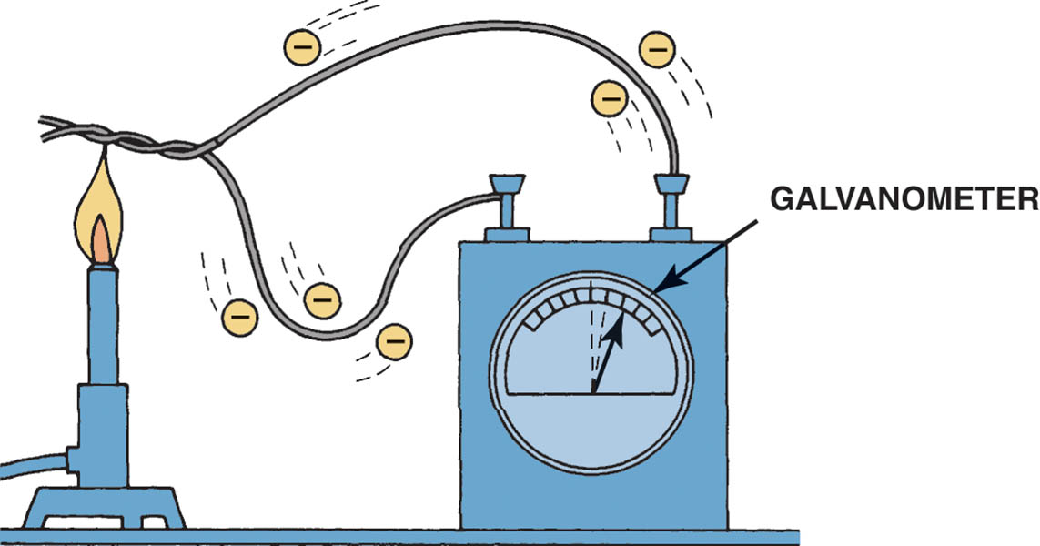
Figure 39.21 Electron flow is produced by heating the connection of two different metals. A galvanometer is an analog (needle type) meter designed to detect weak voltage signals

Slide 38
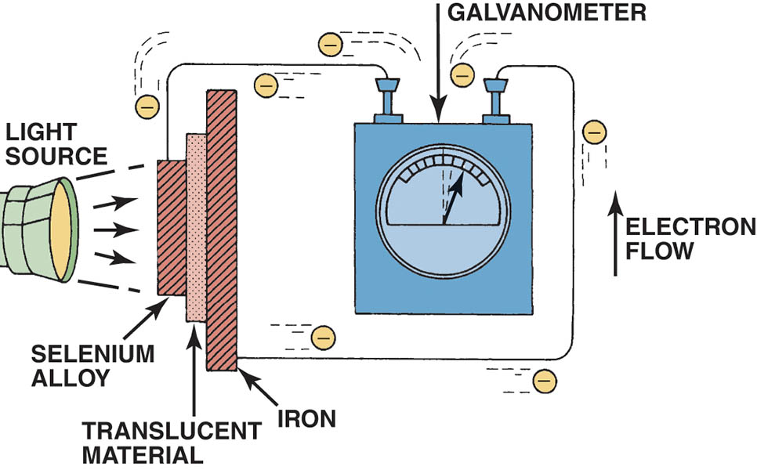
Figure 39.22 Electron flow is produced by light striking a light sensitive material

Slide 39
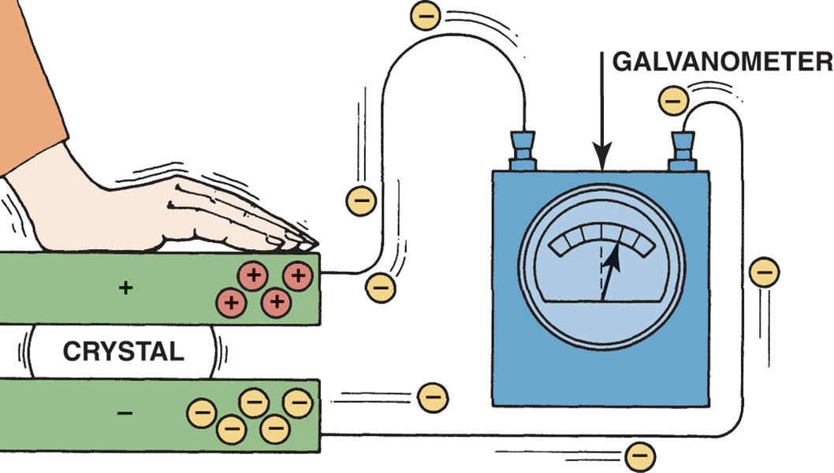
Figure 39.23 Electron flow is produced by pressure on certain crystals

Slide 40
QUESTION 2: ?
What are the six sources of electricity?

Slide 41
ANSWER 2:
Friction, heat, light, pressure, chemical, and magnetism.

Slide 42
CONDUCTORS AND RESISTANCE
All conductors have some resistance to current flow.
  If the conductor length is doubled, its resistance doubles.
  If the conductor diameter is increased, its resistance is reduced.
  As the temperature increases, the resistance of the conductor also increases.
  Materials used in the conductor have an impact on its resistance.

Slide 43
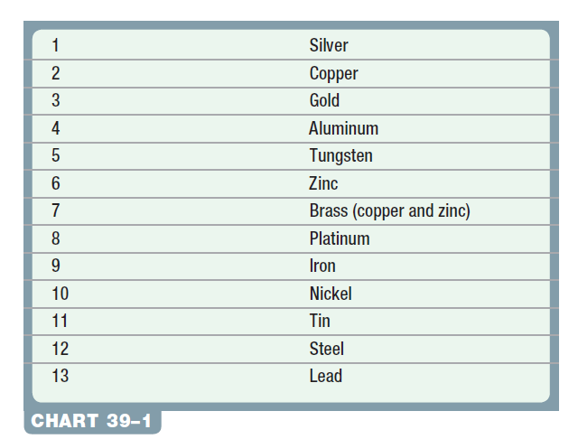
Chart 39-1 Conductor ratings (starting with the best).

Slide 44
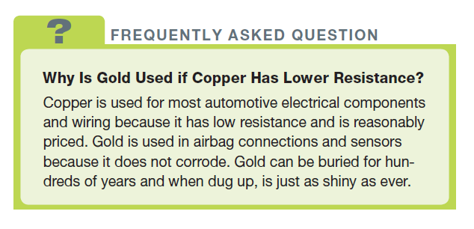
FREQUENTLY ASKED QUESTION

Slide 45
QUESTION 3: ?
What is the relationship between the length of a wire and its
resistance?

Slide 46
ANSWER 3:
  If the conductor length is doubled, its resistance doubles.

Slide 47
RESISTORS
Fixed Resistors
  Resistors represent an electrical load, or resistance to current flow.
Variable Resistors
  A potentiometer is a three-terminal variable resistor where a wiper contact provides a variable voltage output.
  A rheostat is a two-terminal unit in which all of the current flows through the movable arm.

Slide 48
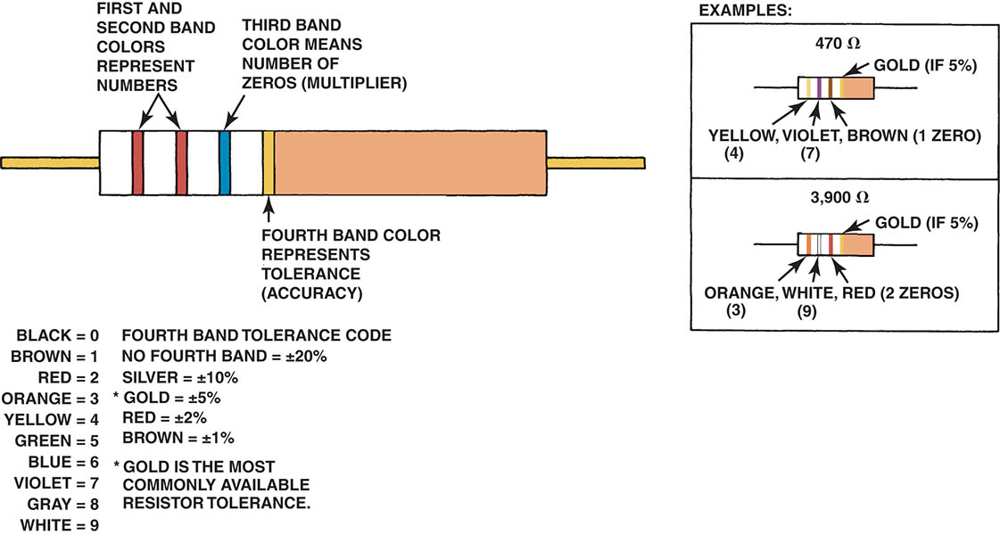
Figure 39.24 This figure shows a resistor color-coded interpretation

Slide 49
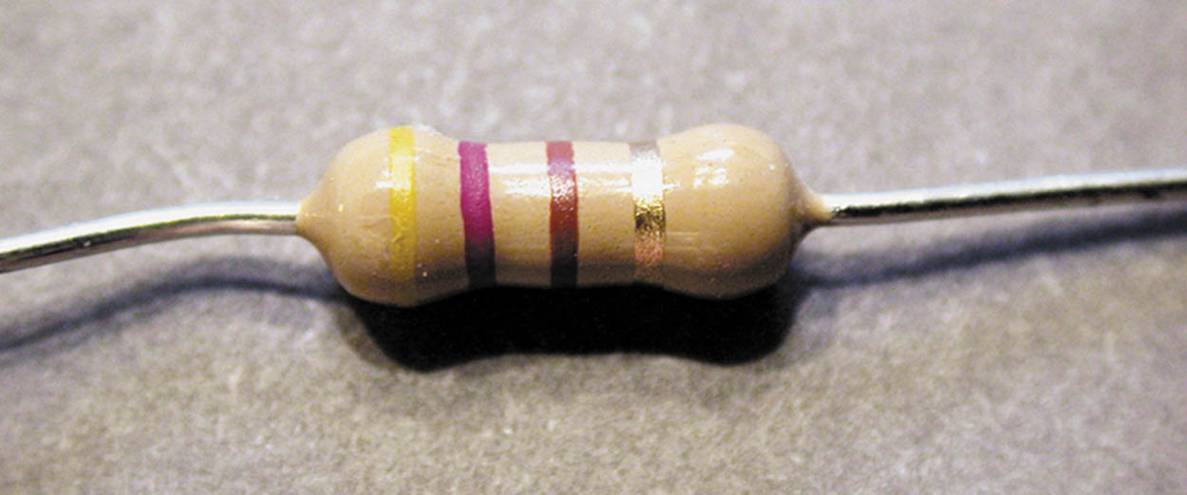
Figure 39.25 A typical carbon resistor

Slide 50
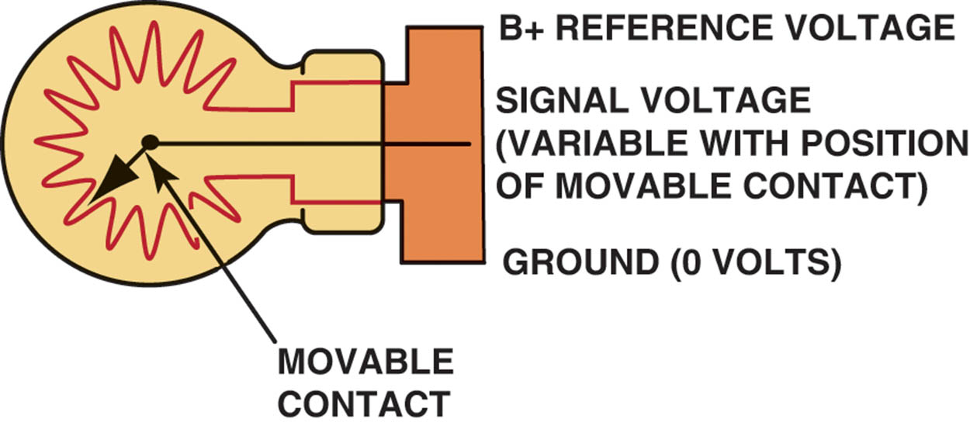
Figure 39.26 A three-wire variable resistor is called a potentiometer

Slide 51
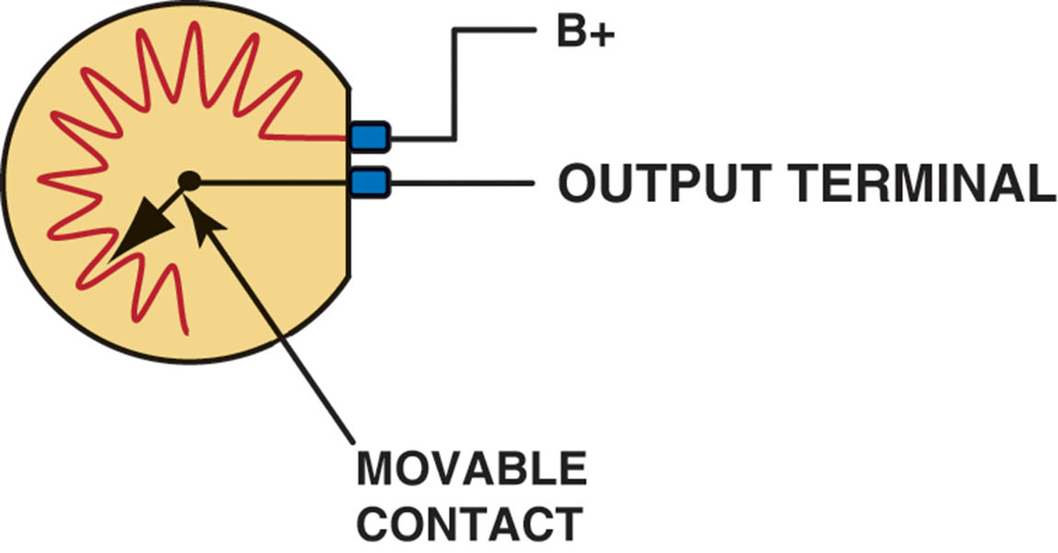
Figure 39.27 A two-wire variable resistor is called a rheostat

Slide 52

Copyright

