Slide 1

Automotive Technology Principles, Diagnosis, and Service
Sixth Edition
Chapter 38
Engine Installation and Break-in
Copyright © 2018, 2015, 2011 Pearson Education, Inc. All Rights Reserved

Slide 2
LEARNING OBJECTIVES
38.1 Discuss the pre-installation checklist.
38.2 Explain the procedure for transmission installation.
38.3 Explain the process of dressing the engine and engine installation.
38.4 Explain engine start and discuss the break-in precautions of an overhauled engine.

Slide 3
PRE-INSTALLATION CHECKLIST
Need for a Checklist
  Guarantees that all accessories are correctly reinstalled on the engine.
Engine Installation Checklist
  Be sure the battery is fully charged
  Pre-lube the engine and check for proper oil pressure
  Check all electrical connectors and wiring harnesses
  Check all vacuum and fuel lines
  Make sure all fluids are correct and the fuel is fresh
  Check the radiator and drive belts

Slide 4
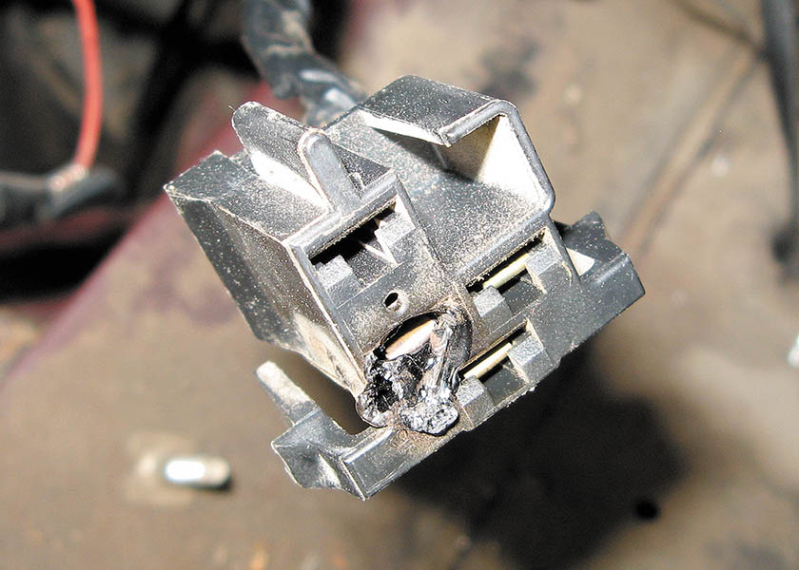
Figure 38.1 A partially melted electrical connector indicates that excessive current flow was present. The cause of the excessive current should be located and corrected before the engine is started

Slide 5
QUESTION 1: ?
Why is a pre-installation checklist used?

Slide 6
ANSWER 1:
  It guarantees that all accessories are correctly reinstalled on the engine.

Slide 7
TRANSMISSION INSTALLATION
Manual Transmission Installation
  Use a new clutch assembly
  Install the bell housing
  Check the release yoke for proper movement
  Carefully install the transmission into the pilot bearing
Automatic Transmission Installation
  Install the torque converter in the transmission
  Secure the bell housing to the block
  Fasten the torque converter to the drive plate

Slide 8
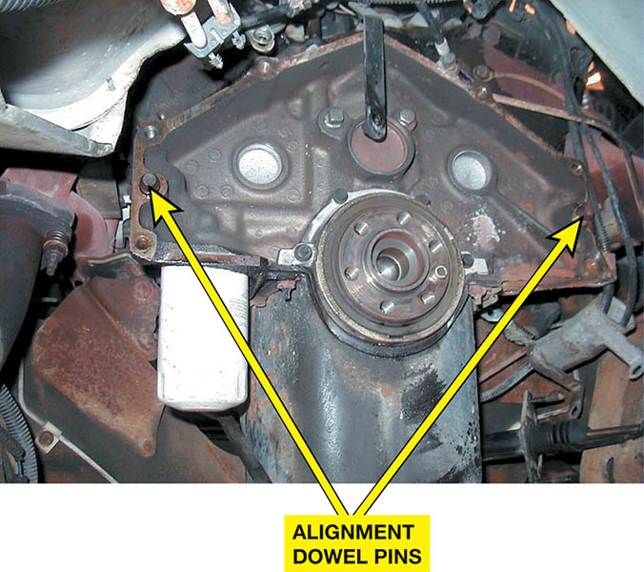
Figure 38.2 Bell housing alignment dowel pins are used to ensure proper alignment between the engine block and the transmission

Slide 9
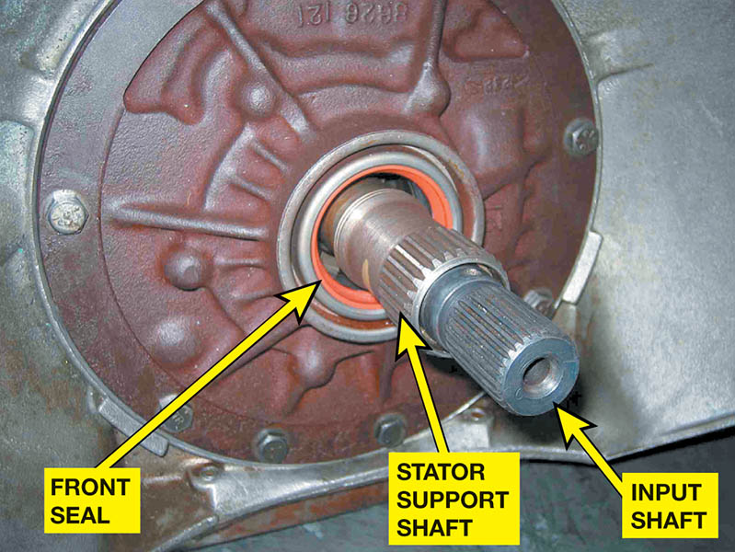
Figure 38.3 The internal splines inside the torque converter must be properly aligned with all of the splines of the automatic transmission

Slide 10
DRESSING THE ENGINE
Dressing the engine is a term used to describe the process of attaching all of the auxiliary items to the engine.
  Starter motor
  Fuel rail and related components
  Oxygen sensors
  Engine and transmission wiring harnesses
  Ignition components
  Belt driven components
  Front accessories

Slide 11
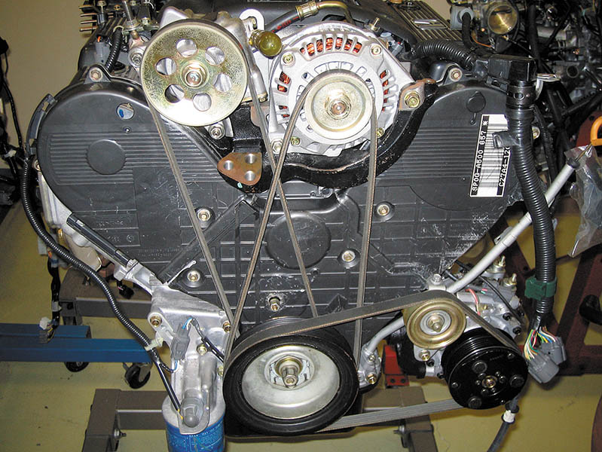
Figure 38.4 It is often easier to install all of the accessory drive belts before the engine is installed in the vehicle

Slide 12
QUESTION 2: ?
What is involved in “dressing the engine”?

Slide 13
ANSWER 2:
The process of attaching all of the auxiliary items to the engine.

Slide 14
ENGINE INSTALLATION
Secure the engine
Install the engine
  Rear-wheel drive the engine is tipped in
  Front-wheel drive the engine is installed from bottom
Reconnect components and connectors
Connect and fill the cooling system
Reinstall the electrical system and verify operation.

Slide 15
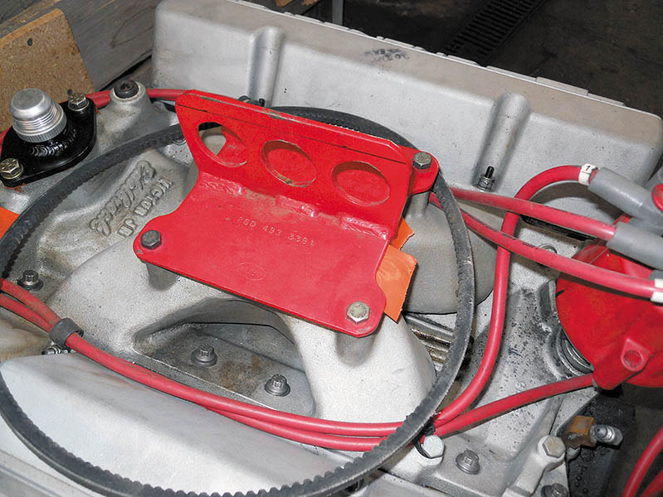
Figure 38.5 A fixture installed that is used as a place to attach the hosting chains

Slide 16
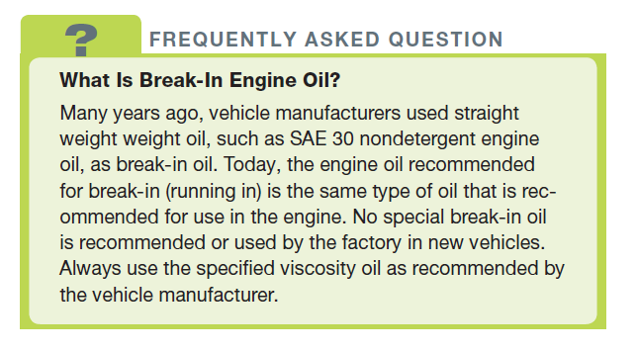
FREQUENTLY ASKED QUESTION

Slide 17
ENGINE START
Precautions
  Give everything one last inspection
Start-Up
  Maintaining engine speed above 1,500 RPM for the first 10 minutes of engine operation must be performed to break in a flat-bottom lifter camshaft.
Normal Operating Temperature
  The temperature at which the upper radiator hose is hot and pressurized.

Slide 18
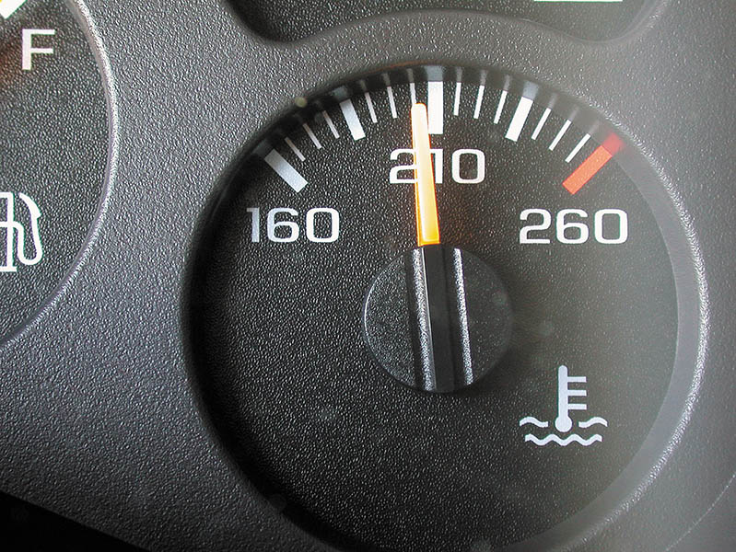
Figure 38.6 Even though the dash gauge may show normal operating temperature, a scan tool or an infrared pyrometer can also be used to verify proper coolant temperature

Slide 19
BREAK-IN PRECAUTIONS
Never add cold water to the cooling system while the engine is running.
Never lug any engine.
Apply loads to an engine for short periods of time to assist the breaking-in process.
Change the oil and filter at 500 miles (800 km) or after 20 hours of operation.
Check for leaks after the engine has gone through several warm-up and cooling down periods.

Slide 20
QUESTION 3: ?
What is meant by lugging an engine?

Slide 21
ANSWER 3:
Lugging means increasing the throttle opening without increasing engine speed (RPM).

Slide 22

Copyright

