Slide 1

Automotive Technology Principles, Diagnosis, and Service
Sixth Edition
Chapter 36
Gaskets and Sealants
Copyright © 2018, 2015, 2011 Pearson Education, Inc. All Rights Reserved

Slide 2
LEARNING OBJECTIVES (1 of 2)
36.1 Discuss the need for gaskets and sealants.
36.2 Describe head gaskets and the types of head gaskets.
36.3 Discuss cover gasket materials and gasket failures.

Slide 3
LEARNING OBJECTIVES (2 of 2)
36.4 Discuss the purpose and function of oil seals.
36.5 Discuss the purpose and function of assembly sealants.

Slide 4
PURPOSE AND FUNCTION
Need for Gaskets and Sealants
Gaskets and sealants are used in engines to seal gaps and potential gaps between two or more parts.
Gasket and Sealant Requirements
Withstand normal engine temperatures
Withstand normal engine vibrations
Withstand acids and chemicals normally found
Expand and contract at different rates

Slide 5
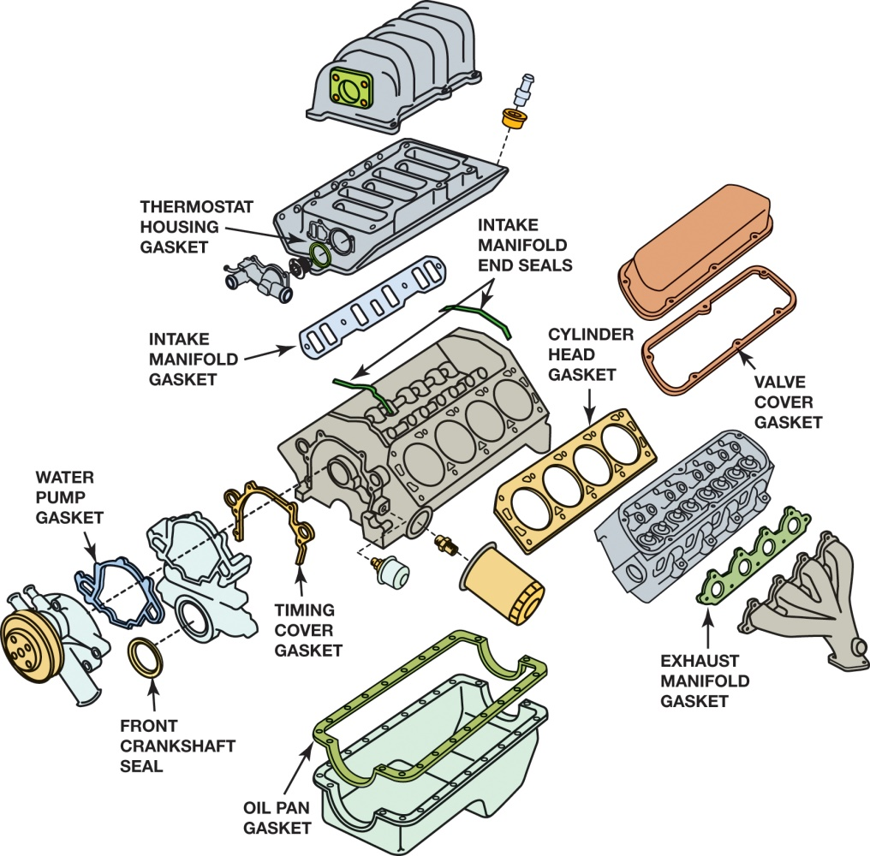
Figure 36.1 Gaskets are used in many locations in the engine

Slide 6
QUESTION 1: ?
What is the purpose of a gasket?

Slide 7
ANSWER 1:
Seal gaps and potential gaps between two or more parts.

Slide 8
HEAD GASKETS
Requirements Needed
High clamping loads
Wide operating temperature range
Types of Head Gaskets
Perforated steel core gaskets
Multilayered steel gaskets (MLS)

Slide 9
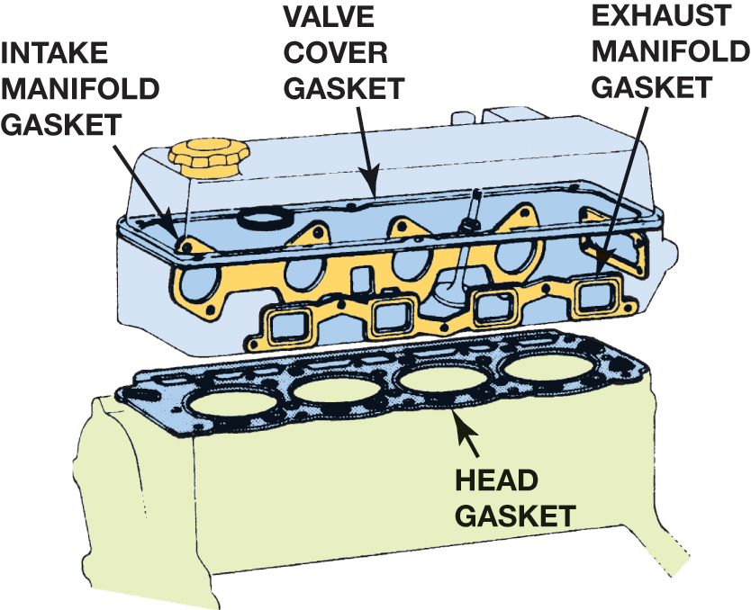
Figure 36.2 Gaskets help prevent leaks between two surfaces

Slide 10
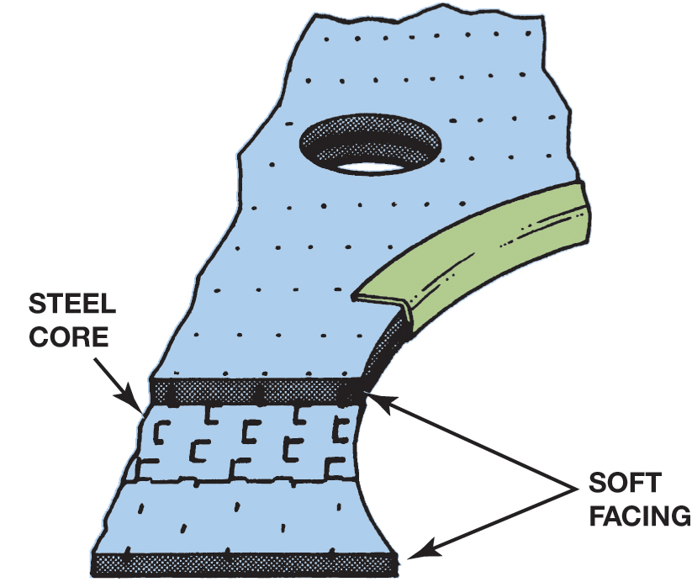
Figure 36.3 A typical perforated steel core head gasket with a graphite or composite facing material

Slide 11
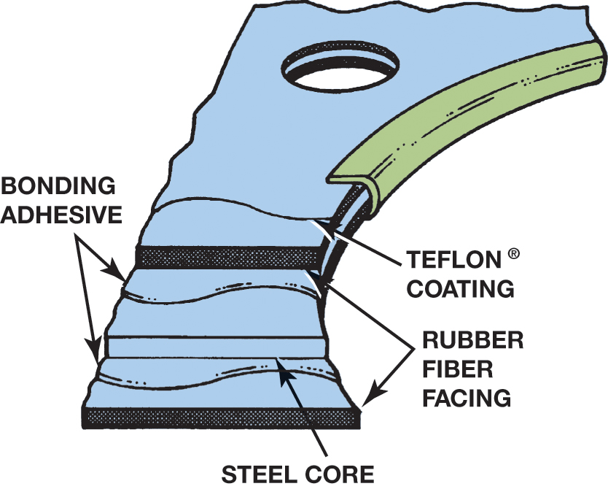
Figure 36.4 A solid steel core head gasket with a nonstick coating, which allows some movement between the block and the head

Slide 12
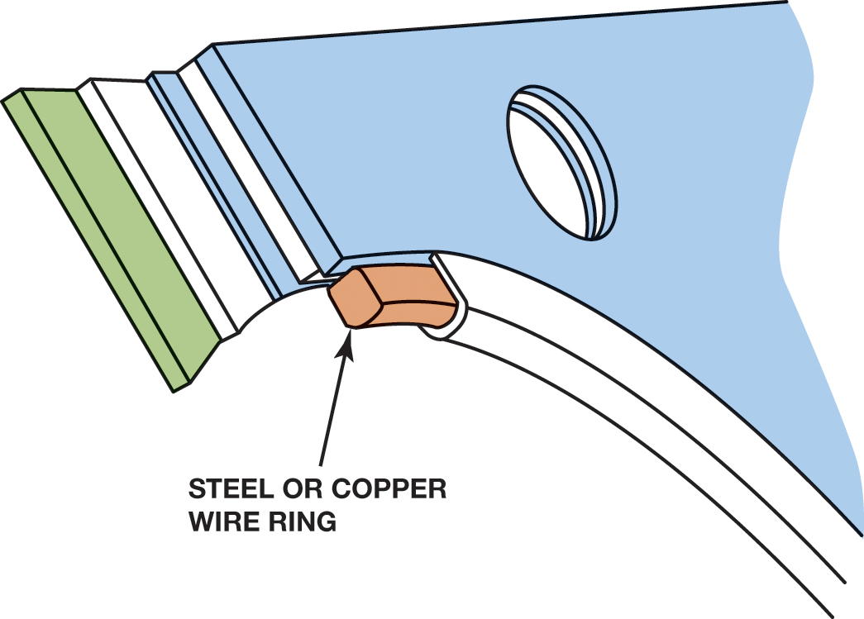
Figure 36.5 The armor ring can be made from steel or copper

Slide 13
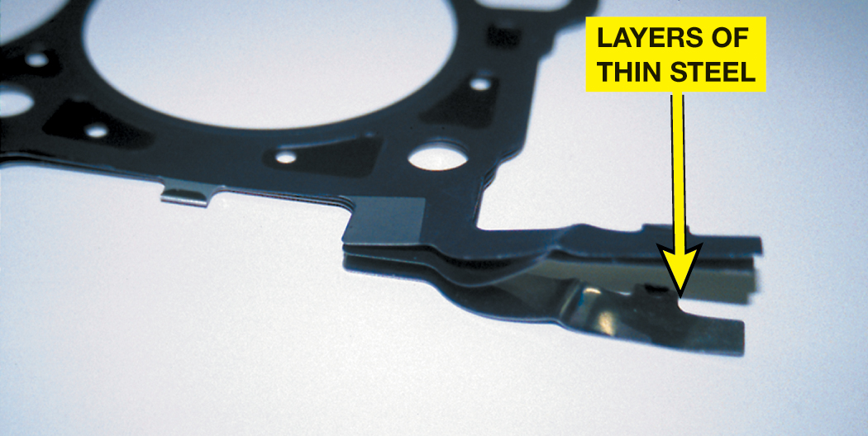
Figure 36.6 Multilayer steel (MLS) gaskets are used on many newer all-aluminum engines, as well as on engines that use a cast block with aluminum cylinder heads.

Slide 14
QUESTION 2: ?
Why is armor used in head gaskets?

Slide 15
ANSWER 2:
So the head gasket can withstand high cylinder pressures.

Slide 16
COVER GASKET MATERIALS (1 OF 2)
Cover Gasket Requirements
The gasket must be impermeable to the fluids it is designed to seal in or out.
The gasket must conform to the shape of the surface, and it must be resilient, or elastic, to maintain the sealing force as it is compressed.

Slide 17
COVER GASKET MATERIALS (2 OF 2)
Types of Gaskets
Cork gaskets
Fiber gaskets
Synthetic rubber gaskets
Rubber-coated metal gaskets
Formed in place gaskets
Plastic/rubber gaskets

Slide 18
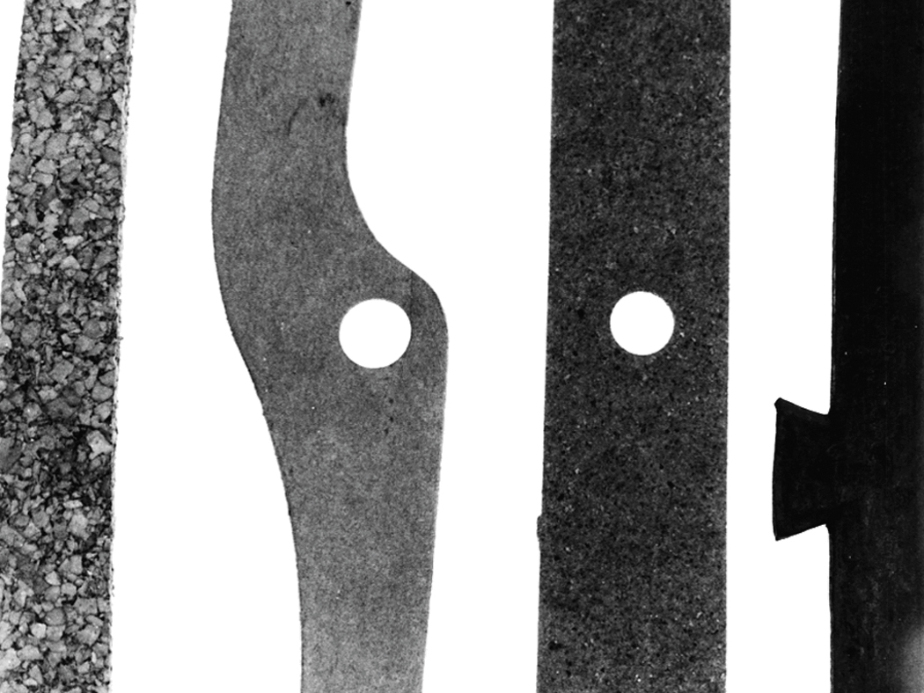
Figure 36.7 Left to right: Cork-rubber, paper, composite, and synthetic rubber (elastomer) gaskets

Slide 19
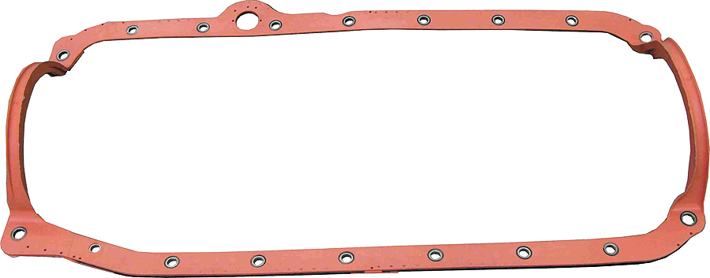
Figure 36.8 Rubber-coated steel gaskets have replaced many oil pan gaskets that once had separate side rail gaskets and end seals

Slide 20
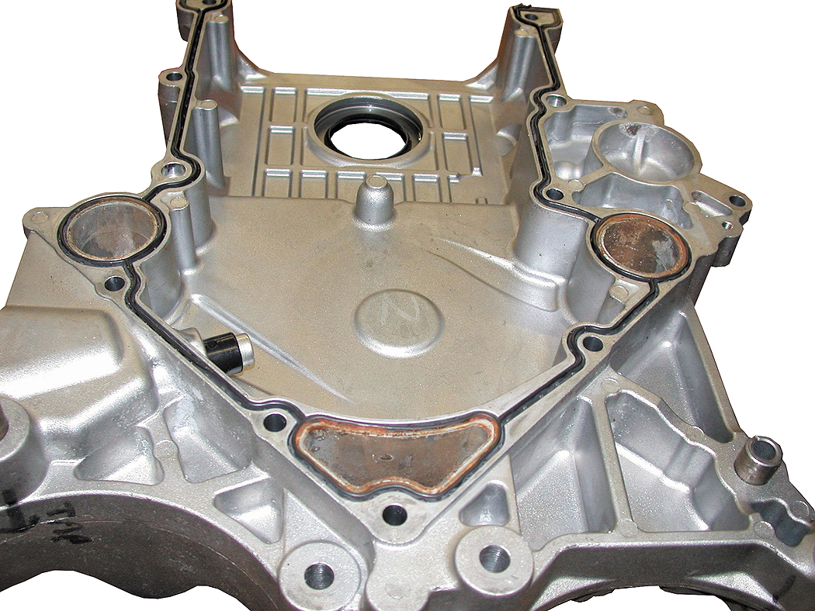
Figure 36.9 Formed in place gaskets often use silicone rubber and are applied at the factory using a robot.

Slide 21
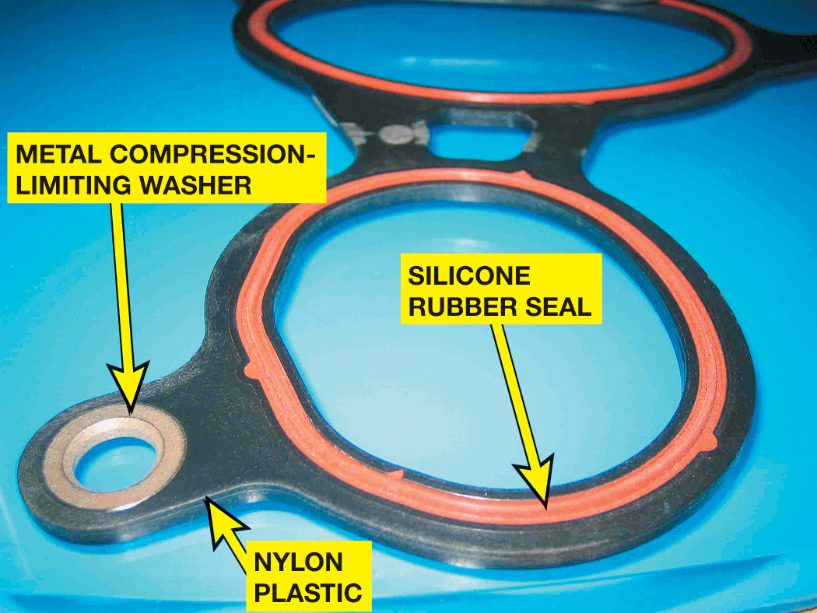
Figure 36.10 A typical intake manifold gasket showing the metal washer at each fastener location, which keeps the gasket from being compressed too much

Slide 22
GASKET FAILURES
Causes of Gasket Failures
Detonation (spark knock or ping) may cause extreme pressure
A plugged PCV system can increase crankcase pressure
Improper installation, such as incorrect torqueing sequence

Slide 23
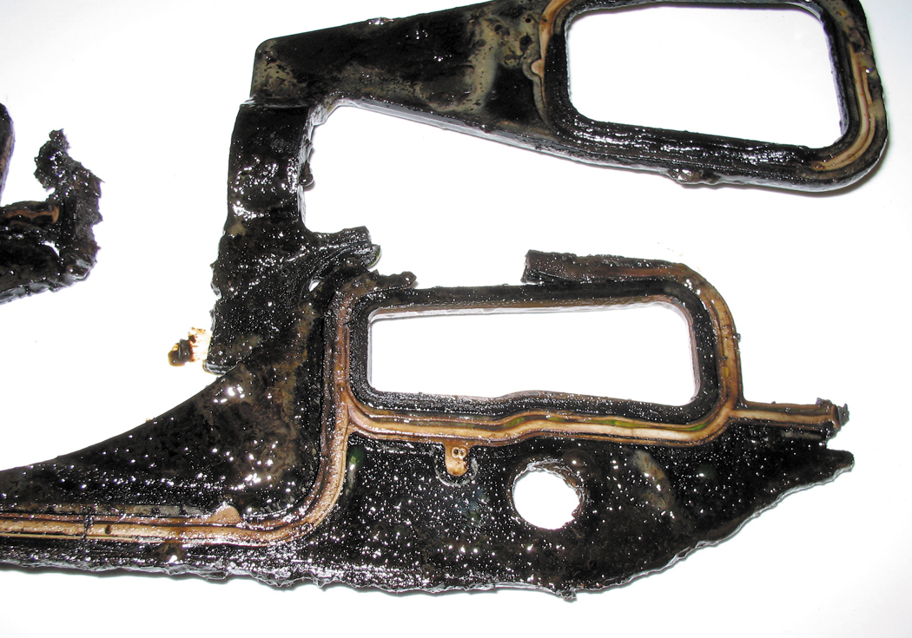
Figure 36.11 This intake manifold gasket was damaged due to fretting. Newer designs allow for more movement between the intake manifold and the cylinder head

Slide 24
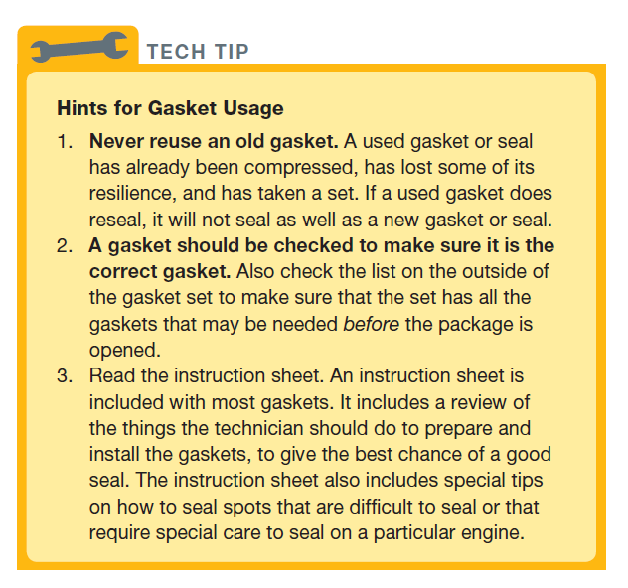
Tech Tip

Slide 25
OIL SEALS
Purpose and Function
Oil seals allow the shaft to rotate and seal the area around the shaft to prevent oil or coolant from leaking.
Seal Materials
Buna-N
Viton® (fluorocarbon)
Teflon® (polytetrafluorethylene, also called PTFE)

Slide 26
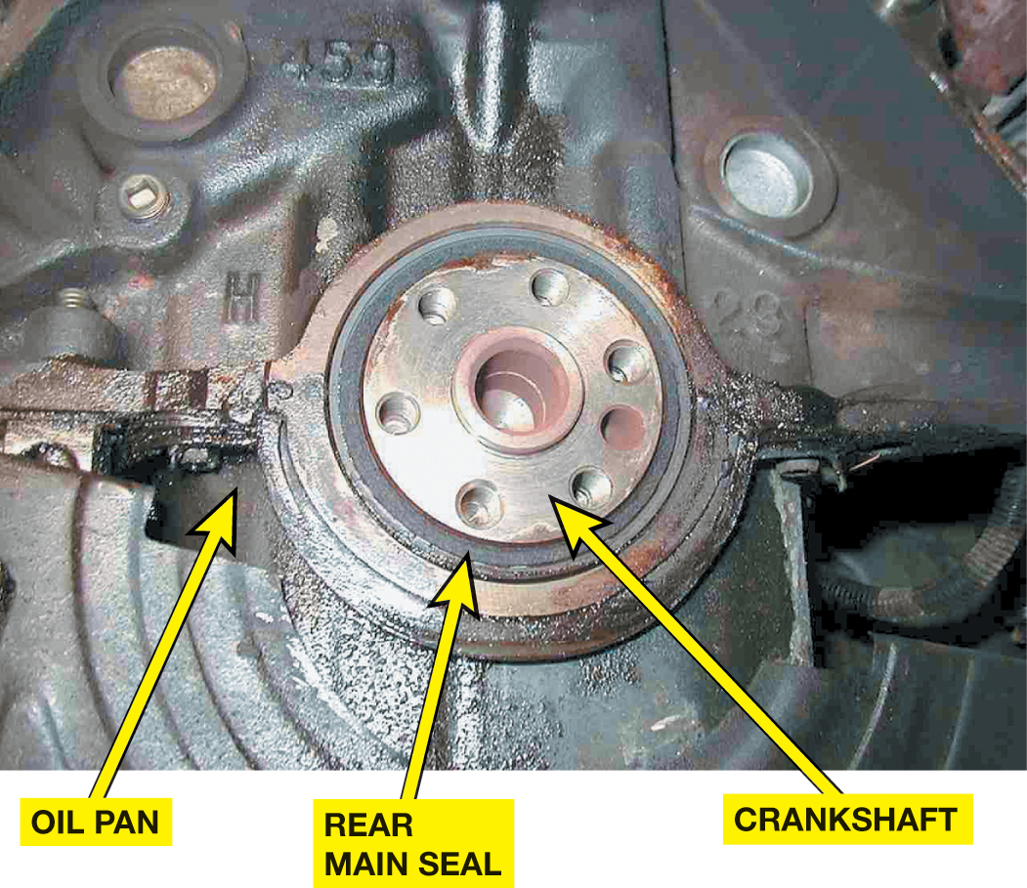
Figure 36.12 A rear main seal has to be designed to seal oil from leaking around the crankshaft under all temperature conditions

Slide 27
ASSEMBLY SEALANTS
RTV Silicone
Anaerobic Sealers
Non-hardening Sealers
Anti-seize Compounds

Slide 28
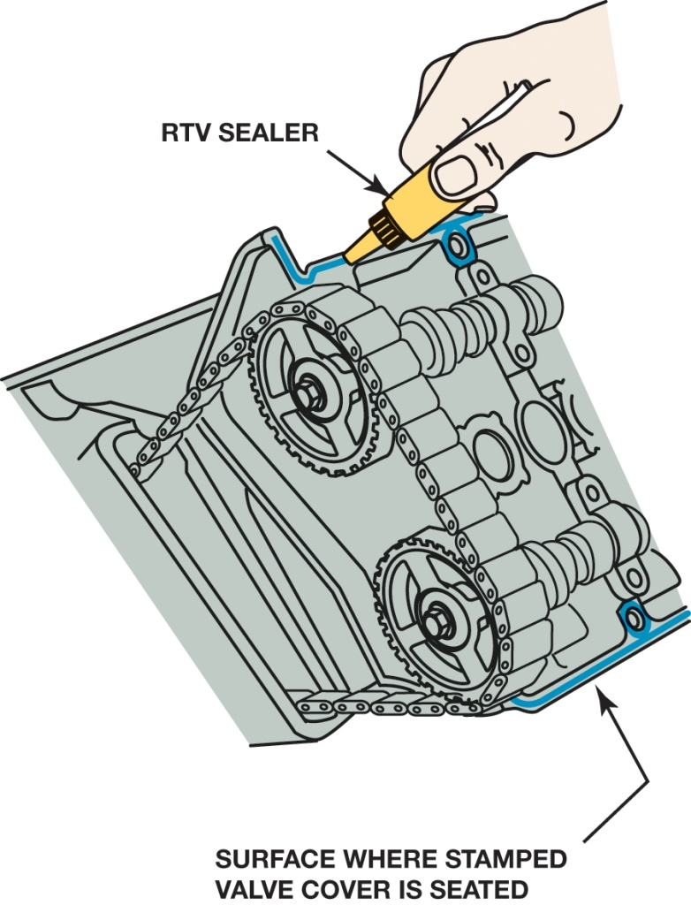
Figure 36.13 Room-temperature vulcanization (RTV) is designed to be a gasket substitute on non-machined surfaces.

Slide 29
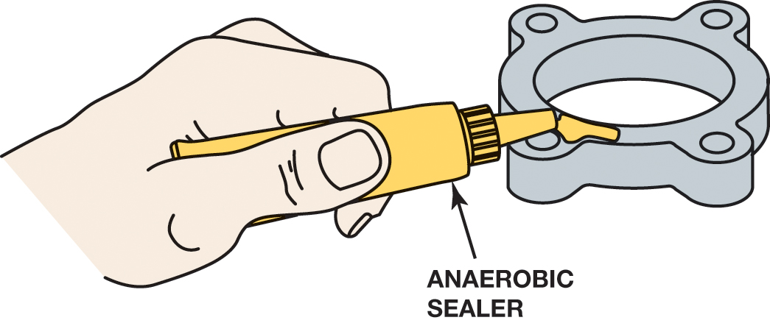
Figure 36.14 Anaerobic sealer is used to seal machined surfaces. Always follow the instructions on the tube for best results

Slide 30
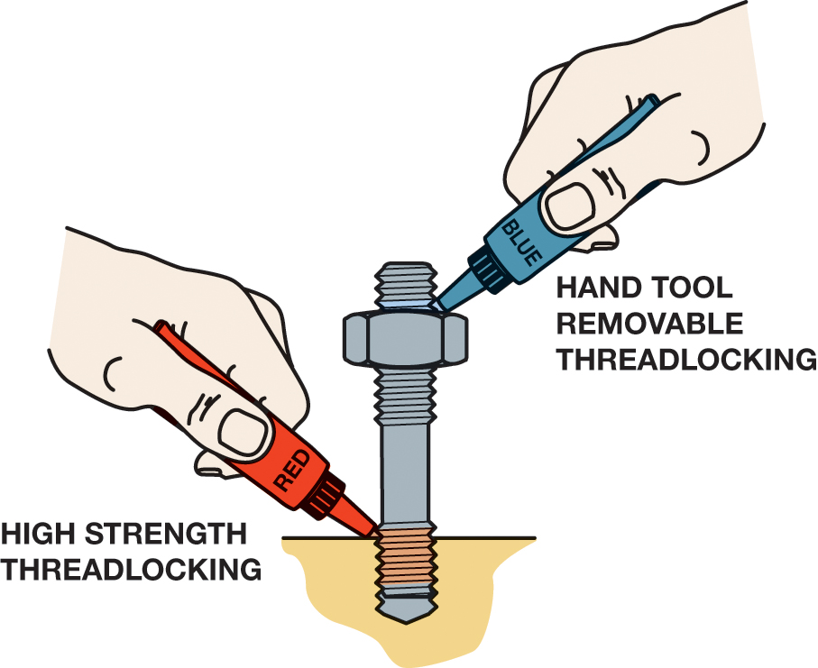
Figure 36.15 The strength of the thread locker depends on whether the fastener is to be removed by hand (blue). High strength thread locker (red) can only be removed if heated

Slide 31
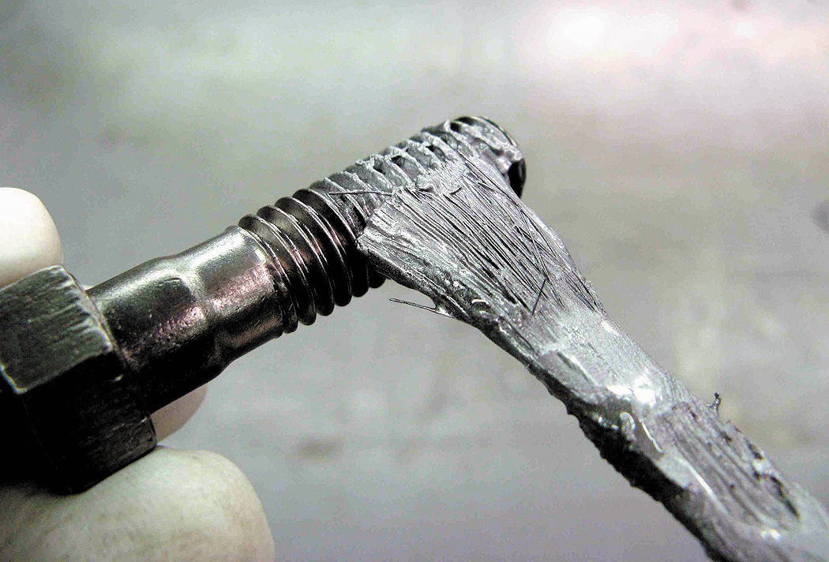
Figure 36.16 Applying anti-seize compound to the threads of a bolt helps prevent the threads from galling or rusting

Slide 32
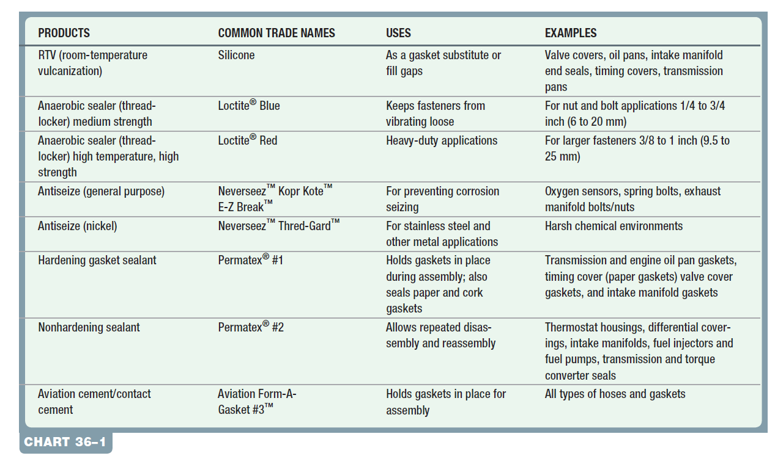
Chart 36-1 Summary chart showing where sealants are used and their common trade names.

Slide 33
QUESTION 3: ?
What is needed for an anaerobic sealer to cure?

Slide 34
ANSWER 3:
The absence of air.

Slide 35
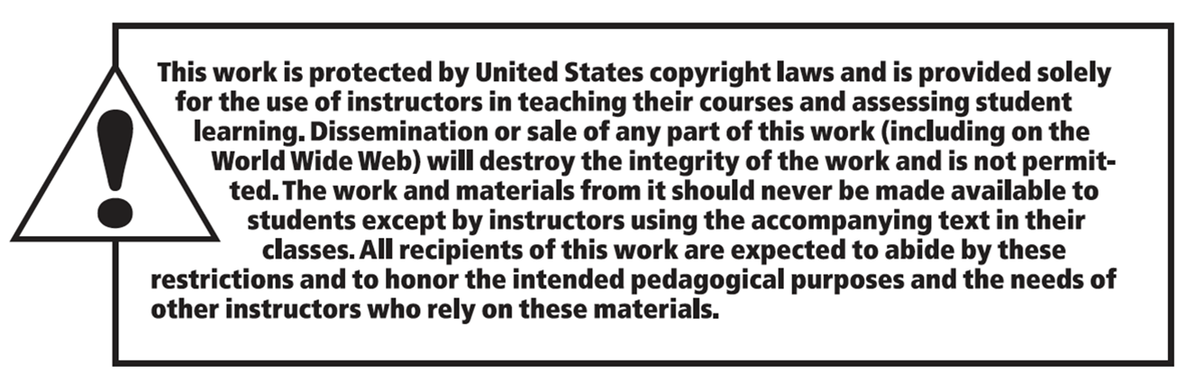
Copyright

