Slide 1
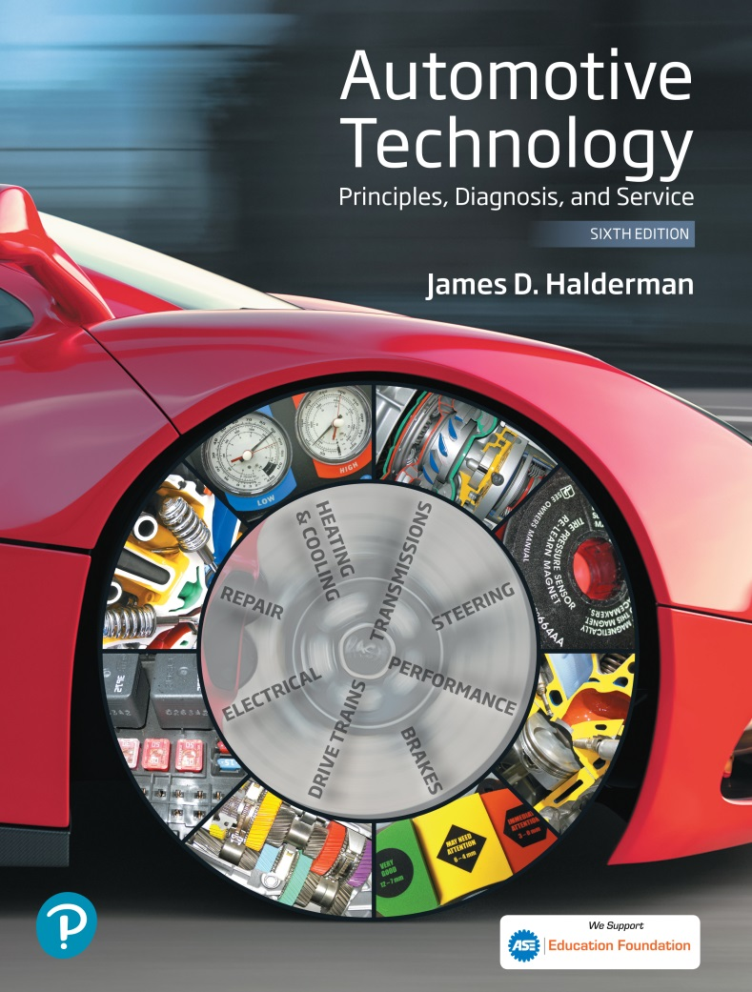
Automotive Technology Principles, Diagnosis, and Service
Sixth Edition
Chapter 35
Crankshafts, Balance Shafts, and Bearings
Copyright © 2018, 2015, 2011 Pearson Education, Inc. All Rights Reserved

Slide 2
LEARNING OBJECTIVES (1 of 2)
35.1 Explain the purpose of crankshaft, crankshaft construction, and crankshaft oiling holes.
35.2. Discuss the different engine crankshaft types.
35.3. Explain the purpose and function of counterweights.
35.4 Explain externally and internally balanced engines, and primary and secondary engine balance.

Slide 3
LEARNING OBJECTIVES (2 of 2)
35.5 Explain the purpose of balance shafts.
35.6 Discuss crankshaft service.
35.7 Describe engine bearings and discuss the importance of bearing clearance.
35.8 Discuss camshaft bearings.

Slide 4
CRANKSHAFT (1 OF 2)
Purpose and Function
Power from expanding gases in the combustion chamber is delivered to the crankshaft through the piston, piston pin, and connecting rod.
Main Bearing Journals
The main bearings support the crankshaft and allow it to rotate easily without excessive wear.
Rod Bearing Journals
Also called crank pins, offset from the centerline of the crank, provide a mounting location for the rod.

Slide 5
CRANKSHAFT (2 OF 2)
Surface Finish
Surface finish is measured in micro-inches; and the smaller the number, the smoother the surface.
Journal Hardness
Case Hardening
Nitriding
Tuftriding

Slide 6
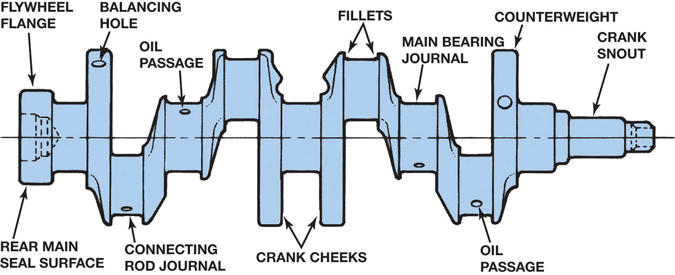
Figure 35.1 Typical crankshaft with main journals that are supported by main bearings in the block. Rod journals are offset from the crankshaft centerline

Slide 7
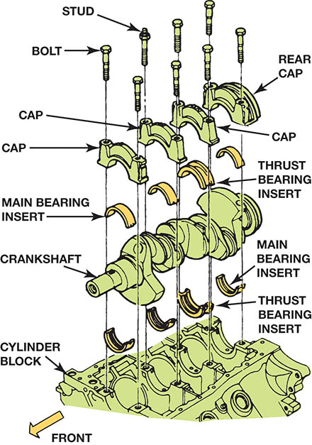
Figure 35.2 The crankshaft rotates on main bearings. Longitudinal (end-to-end) movement is controlled by the thrust bearing.

Slide 8
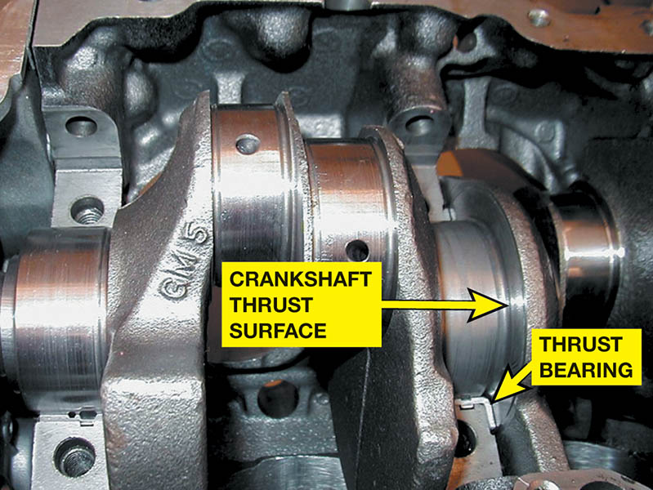
Figure 35.3 A ground surface on one of the crankshaft cheeks next to a main bearing supports thrust loads on the crank

Slide 9
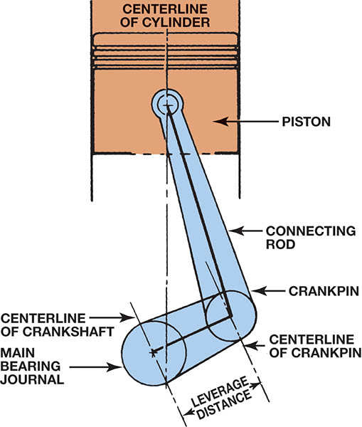
Figure 35.4 The distance from the crankpin centerline to the centerline of the crankshaft determines the stroke, which is the leverage available to turn the crankshaft

Slide 10
QUESTION 1: ?
What is the main job of the crankshaft bearings?

Slide 11
ANSWER 1:
Support the crankshaft.

Slide 12
CRANKSHAFT CONSTRUCTION
Forged
Forged crankshafts are stronger than the cast crankshaft, but they are more expensive.
Cast Crankshafts
Casting materials and techniques have improved cast crankshaft quality so that cast crankshafts are used in most production automotive engines.
Billet Crankshafts
A billet crankshaft is machined from a solid piece of forged steel called a billet.

Slide 13
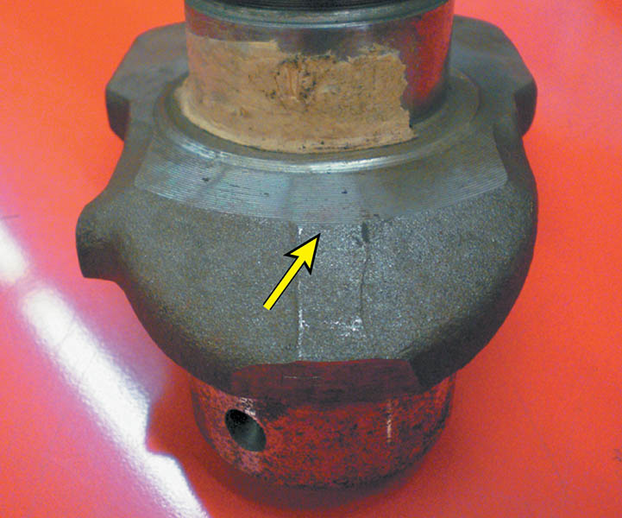
Figure 35.5 Wide separation lines of a forged crankshaft

Slide 14
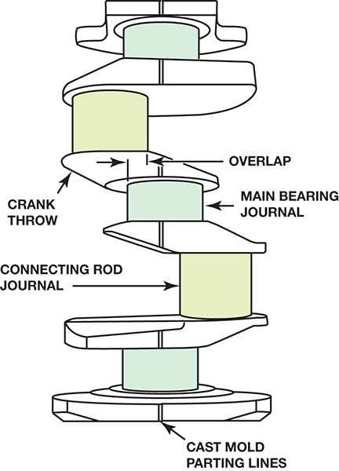
Figure 35.6 Cast crankshaft showing the bearing journal overlap and a straight, narrow cast mold parting line. The amount of overlap determines the strength of the crankshaft

Slide 15
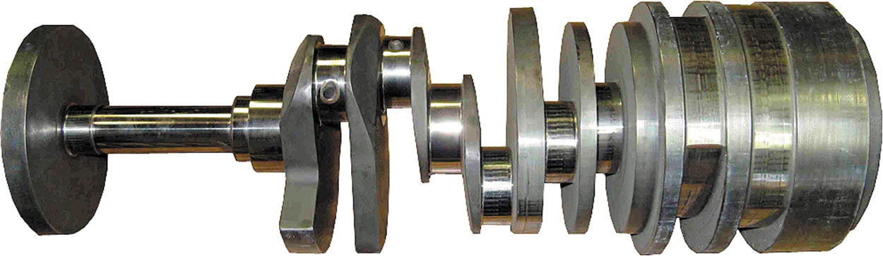
Figure 35.7 A billet crankshaft showing how it is machined from a solid chuck of steel, usually 4340 steel, at the right and the finished crankshaft on the left

Slide 16
CRANKSHAFT OILING HOLES
Purpose and Function
The crankshaft is drilled to allow oil from the main bearing oil groove to be directed to the connecting rod bearings.
The oil on the bearings forms a hydrodynamic oil film to support bearing loads.

Slide 17
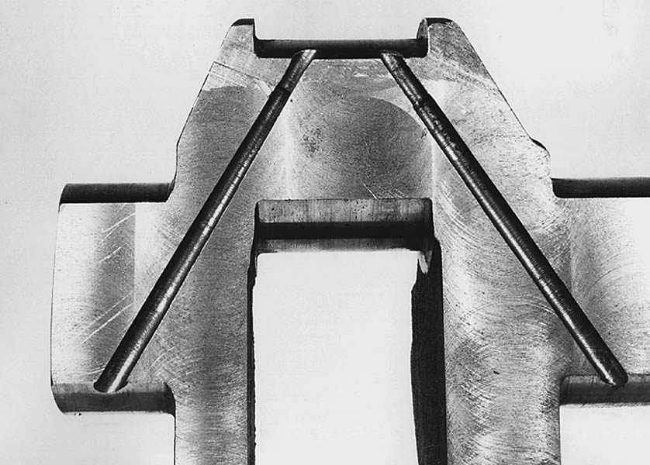
Figure 35.8 Crankshaft sawed in half, showing drilled oil passages between the main and rod bearing journals

Slide 18
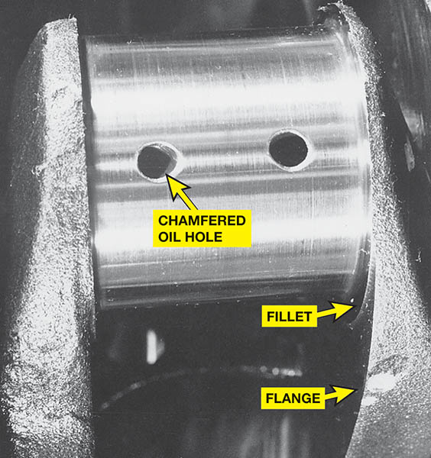
Figure 35.9 Typical chamfered hole in a crankshaft bearing journal

Slide 19
ENGINE CRANKSHAFT TYPES (1 OF 3)
V-8 Engine Arrangement
The V-8 engine crankshaft has two planes, so there is one throw every 90 degrees.
Four Cylinder Engine Crankshafts
The crankshaft used on four-cylinder inline engines has four throws on a single plane.
Five Cylinder Engine Crankshafts
The inline five-cylinder engine has a five-throw crankshaft with one throw at each 72 degrees.

Slide 20
ENGINE CRANKSHAFT TYPES (2 OF 3)
Three Cylinder Engine Crankshafts
A three-cylinder engine uses a 120-degree three-throw crankshaft with four main bearings.
Inline Six Cylinder Crankshafts
Inline six-cylinder engine crankshafts ride on four or seven main bearings and use six crank throws in three planes 120 degrees apart.

Slide 21
ENGINE CRANKSHAFT TYPES (3 OF 3)
90 Degree V-6 Engine Crankshafts
The crank throws for an even-firing V-6 engine are split, making separate crankpins for each cylinder.
60 Degree V-6 Engine Crankshafts
The adjacent pairs of crankpins on the crankshaft used in the 60-degree V-6 engine have a splay angle of 60 degrees.

Slide 22
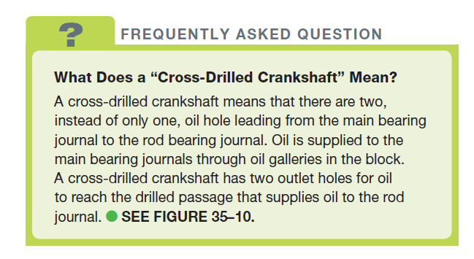
FREQUENTLY ASKED QUESTION

Slide 23
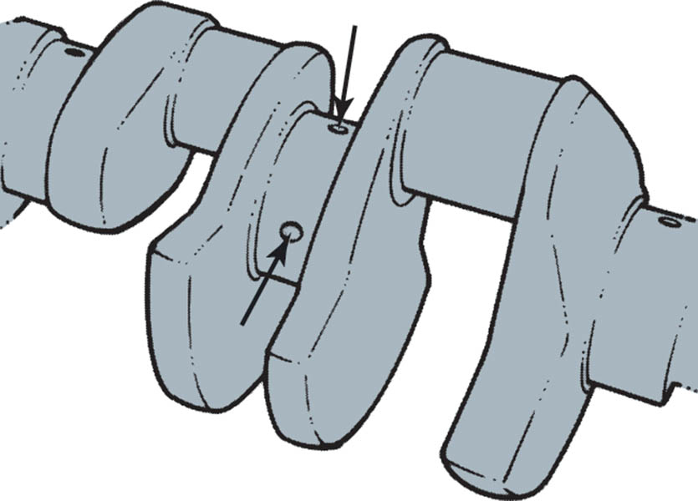
Figure 35.10 A cross-drilled crankshaft is used on some production engines and is a common racing modification

Slide 24
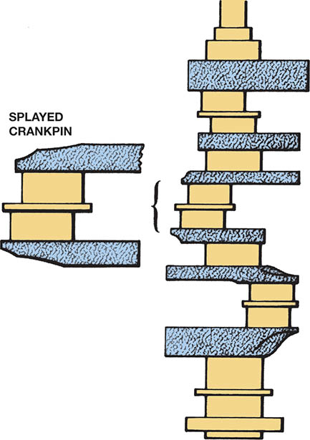
Figure 35.11 A splayed crankshaft design is used to create an even-firing 90-degree V-6

Slide 25
COUNTERWEIGHTS
Purpose and Function
Crankshafts are balanced by counterweights, which are cast, forged, or machined as part of the crankshaft.
Vibration Damage
The crankshaft must be rigid enough to keep the deflection forces to a minimum.
If vibrations are too great the crankshaft may fail.
Harmful crankshaft twisting vibrations are dampened with a torsional vibration damper.

Slide 26
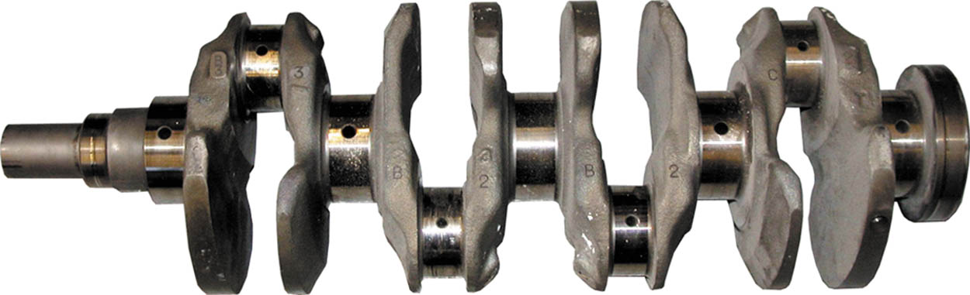
Figure 35.12 A fully counterweighted four-cylinder crankshaft

Slide 27
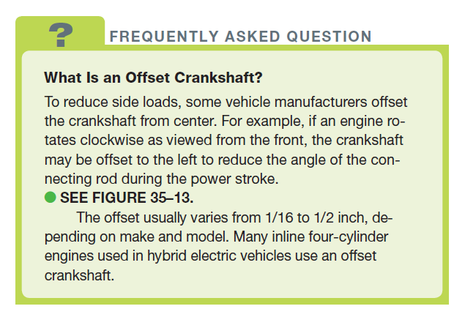
FREQUENTLY ASKED QUESTION

Slide 28
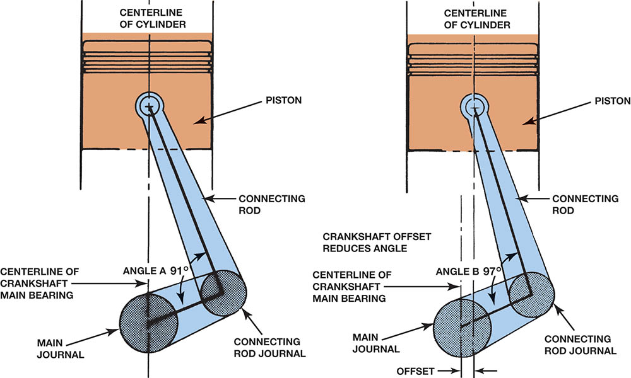
Figure 35.13 The crank throw is halfway down on the power stroke. The piston on the left without an offset crankshaft has a sharper angle than the engine on the right with an offset crankshaft

Slide 29
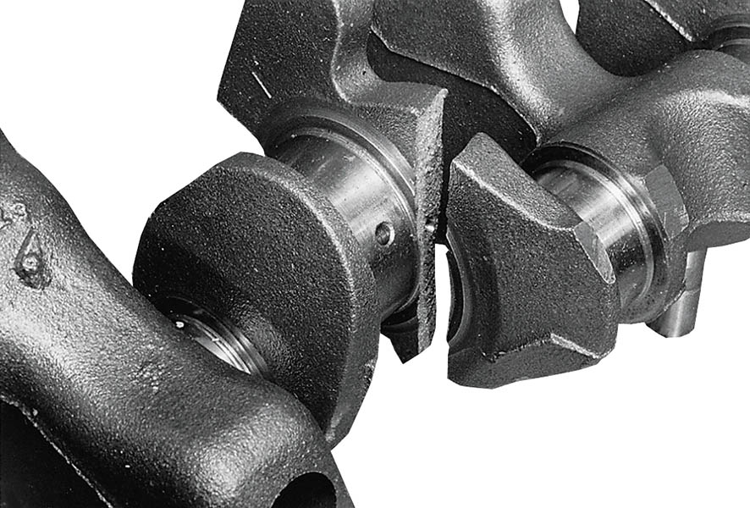
Figure 35.14 A crankshaft broken as a result of using the wrong torsional vibration damper

Slide 30
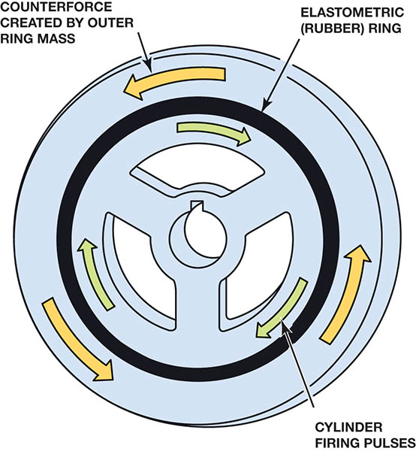
Figure 35.15 The hub of the harmonic balancer is attached to the front of the crankshaft. The elastomer (rubber) between the inertia ring and the center hub allows the absorption of crankshaft firing impulses

Slide 31
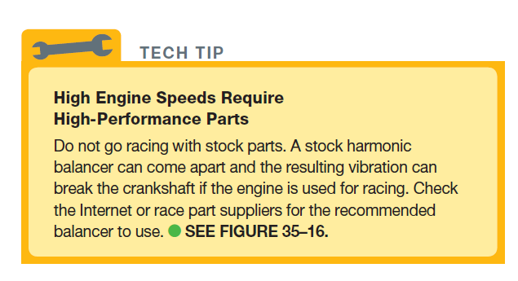
Tech Tip

Slide 32
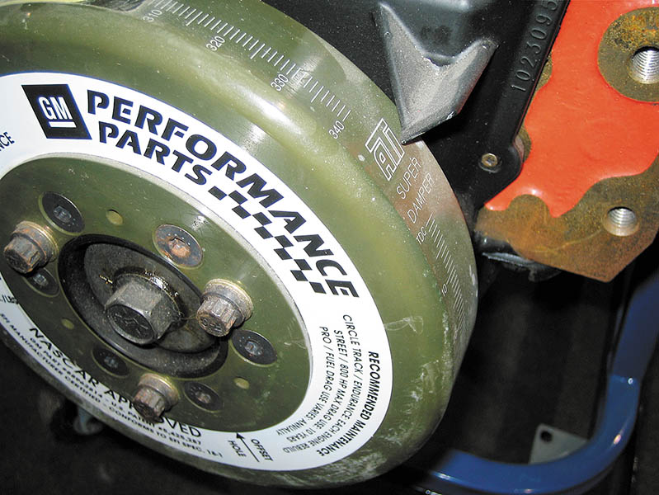
Figure 35.16 A General Motors high-performance balancer used on a race engine

Slide 33
EXTERNALLY AND INTERNALLY BALANCED ENGINES
Externally Balanced
Weight is added to the harmonic balancer (vibration damper) and flywheel or the flexplate.
Internally Balanced
All rotating parts of the engine are individually balanced, including the harmonic balancer and flywheel (flexplate).

Slide 34
PRIMARY AND SECONDARY ENGINE BALANCE
Primary Balance
When pistons move up and down in the cylinders, they create a primary vibration
A counterweight on the crankshaft opposite the piston/rod assembly helps reduce this vibration.
Secondary Balance
A vibration at twice engine speed
A weak high-frequency vibration caused by a slight difference in the inertia of the pistons at top dead center, compared to bottom dead center

Slide 35
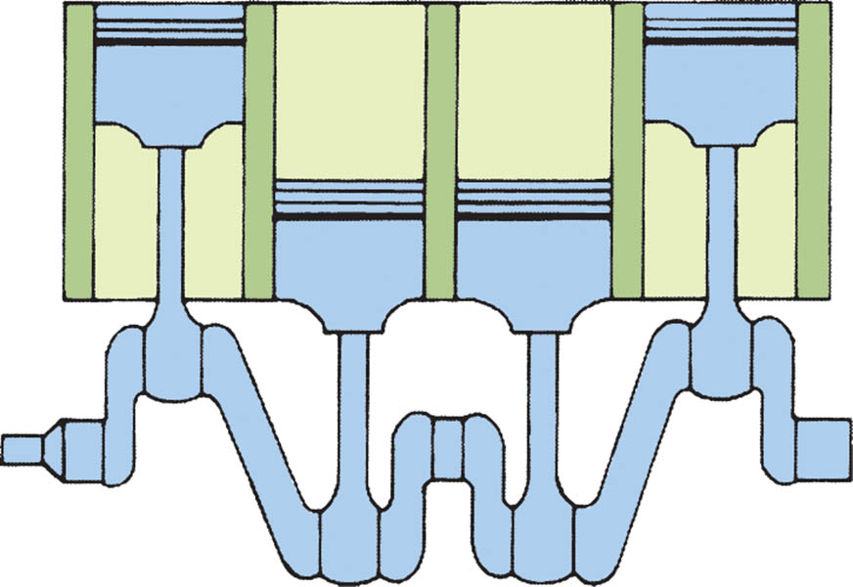
Figure 35.17 In a four-cylinder engine, the two outside pistons move upward at the same time as the inner pistons move downward, which reduces primary unbalance

Slide 36
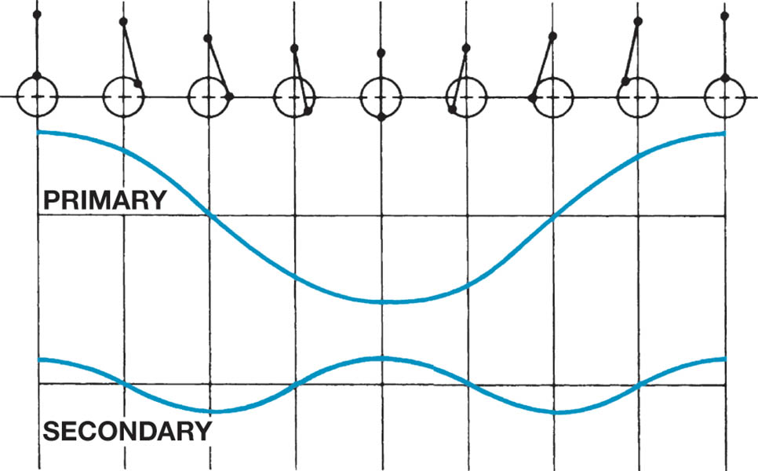
Figure 35.18 Primary and secondary vibrations in relation to piston position

Slide 37
BALANCE SHAFTS
Purpose and Function
Some engines use balance shafts to dampen normal engine vibrations.
Balance Shaft Applications
Most four-cylinder engines larger than 2.2 liters
Many 90 V-6 engines

Slide 38
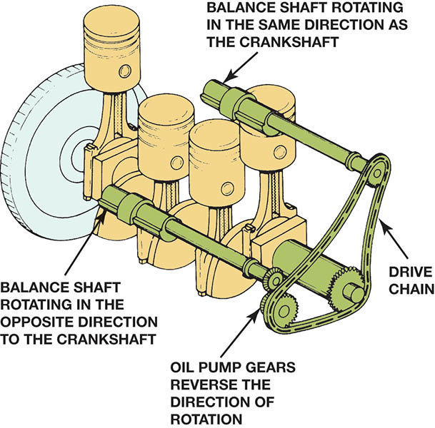
Figure 35.19 Two counter-rotating balance shafts used to counter-balance the vibrations of a four-cylinder engine

Slide 39
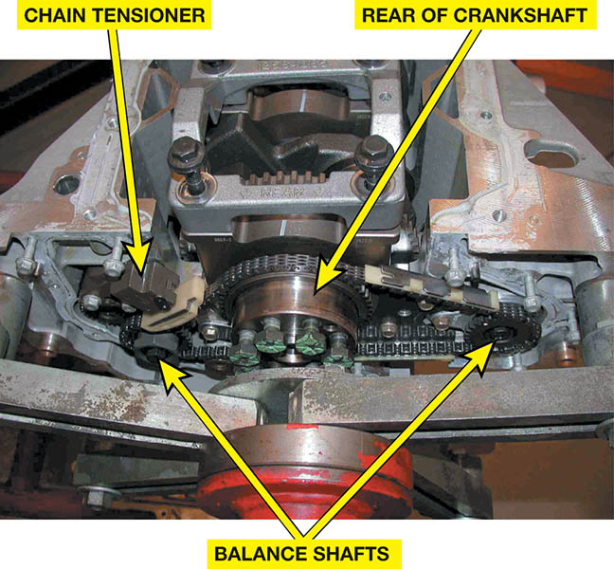
Figure 35.20 This General Motors four-cylinder engine uses two balance shafts driven by a chain at the rear of the crankshaft

Slide 40
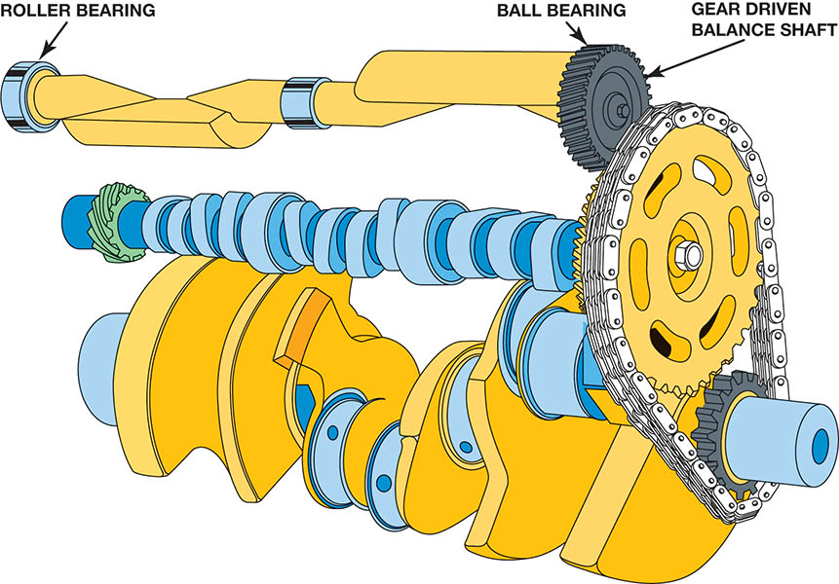
Figure 35.21 Many 90-degree V-6 engines use a balance shaft to reduce vibrations and effectively cancel a rocking motion (rocking couple) that causes the engine to rock front to back

Slide 41
QUESTION 2: ?
What are the two methods of balancing an engine?

Slide 42
ANSWER 2:
Externally and internally.

Slide 43
CRANKSHAFT SERVICE (1 OF 3)
Visual Inspection
Inspection for wear, cracks, thread damage, warpage, and damaged seal surfaces.
Measuring the Crankshaft
Checked for size, taper, and out-of-round condition.
Crankshaft Grinding
Grind the journal to an undersize with a smooth surface finish.

Slide 44
CRANKSHAFT SERVICE (2 OF 3)
Crankshaft Polishing
The journal is polished after grinding, using a 320-grit polishing cloth and oil to remove the fine metal “fuzz” remaining on the journal.
Welding a Crankshaft
Salvage a crankshaft by building up a bearing journal and then grinding it to the original journal size.

Slide 45
CRANKSHAFT SERVICE (3 OF 3)
Stress Relieving the Crankshaft
Stress relief is achieved by shot peening the fillet area of the journals with #320 steel shot.
Storing Crankshafts
All crankshafts should be coated with oil to keep them from rusting, and stored vertically until time for engine assembly.

Slide 46
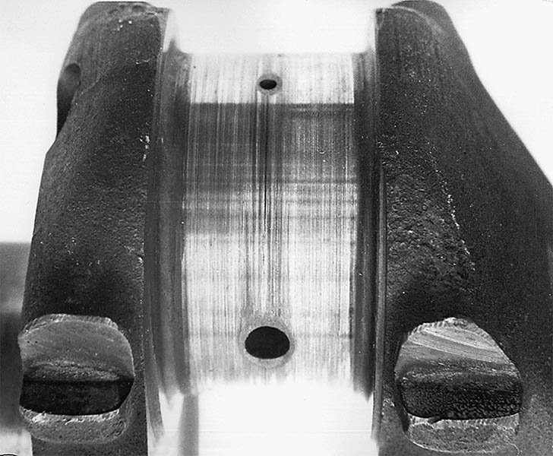
Figure 35.22 Scored connecting rod bearing journal

Slide 47
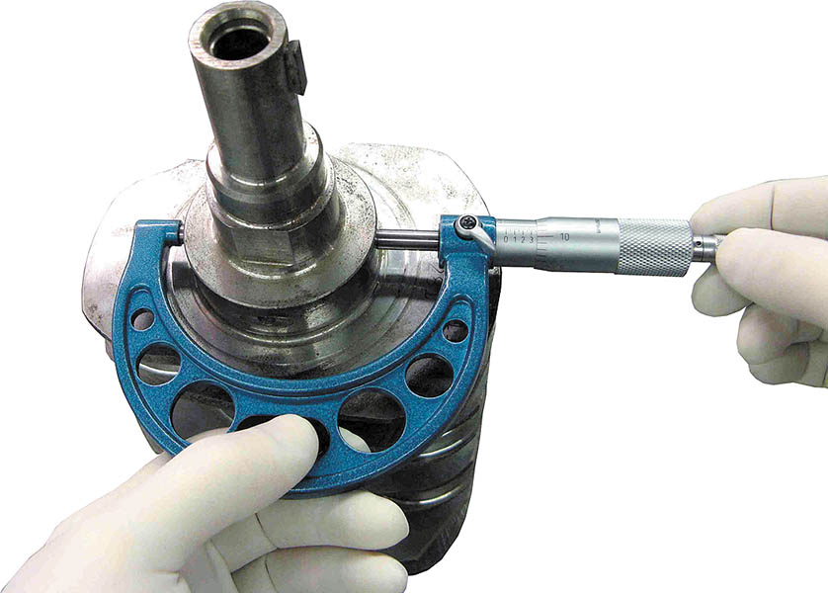
Figure 35.23 All crankshaft journals should be measured for diameter, as well as taper and out-of-round

Slide 48
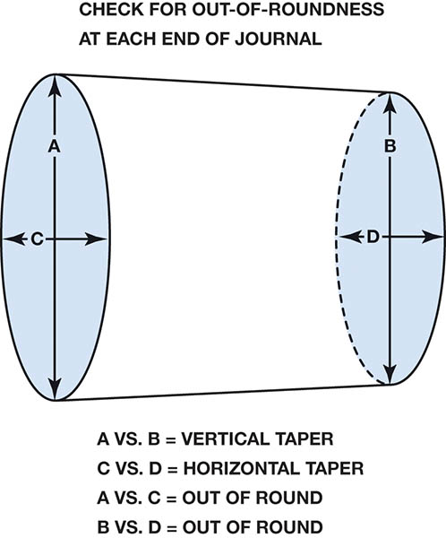
Figure 35.24 Check each journal for taper and out-of-round

Slide 49
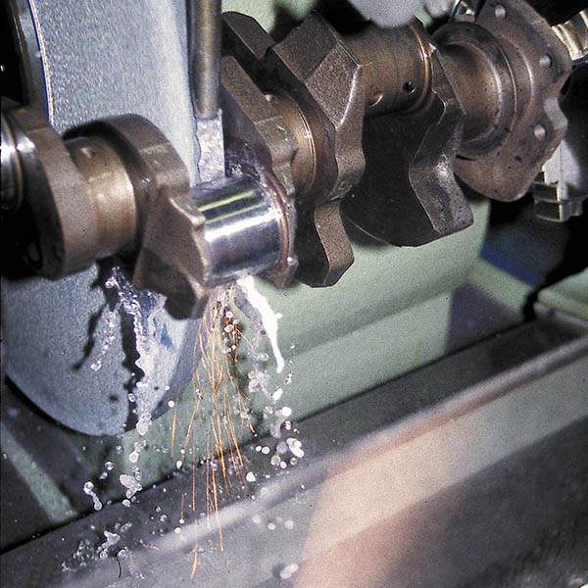
Figure 35.25 The rounded fillet area of the crankshaft is formed by the corners of the grinding stone

Slide 50
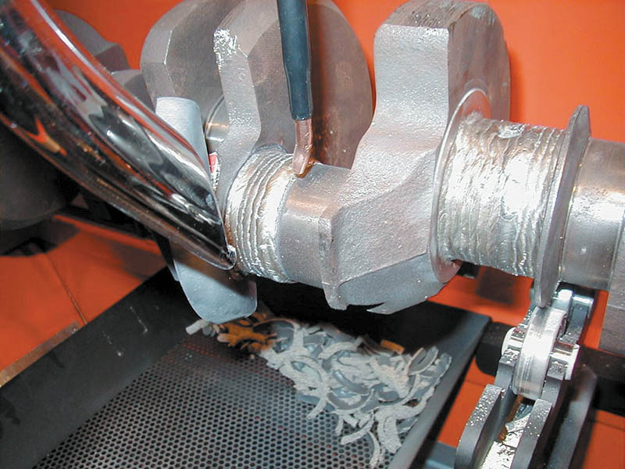
Figure 35.26 An excessively worn crankshaft can be restored to useful service by welding the journals, and then machining them back to the original size

Slide 51
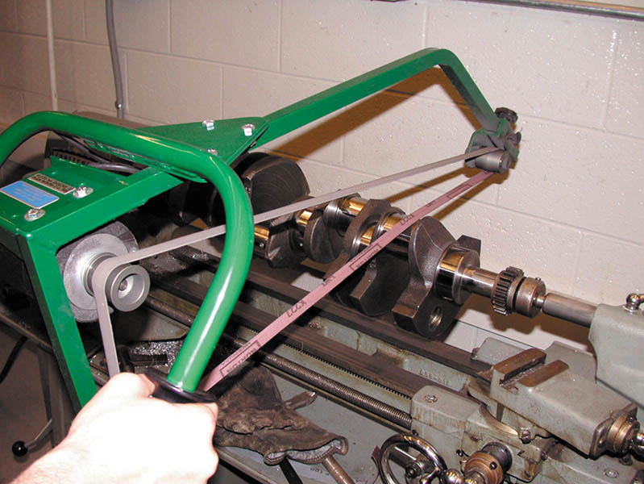
Figure 35.27 All crankshafts should be polished after grinding. Both the crankshaft and the polishing cloth are being revolved

Slide 52
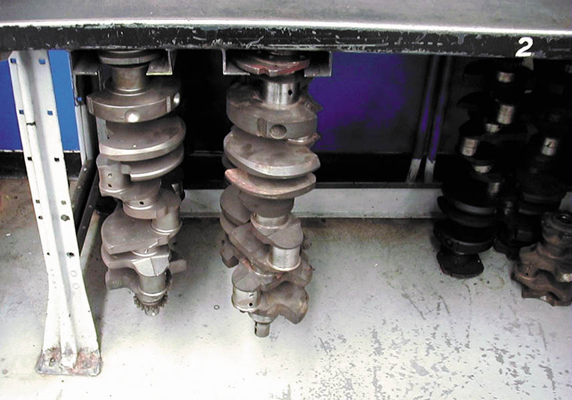
Figure 35.28 Crankshafts should be stored vertically to prevent possible damage or warpage. This clever bench-mounted tray for crankshafts not only provides a safe place to store crankshafts, but is also out of the way and cannot be accidentally tipped

Slide 53
ENGINE BEARINGS (1 Of 4)
Introduction
Engine bearings are the main supports for the major moving parts of any engine.
Types of Bearings
Plain Bearings
Sleeve Bearings
Bearing Materials
Babbitt
Cooper-lead Alloy
Aluminum

Slide 54
ENGINE BEARINGS (2 OF 4)
Bearing Sizes
Bearings are usually available in standard (std.) size, and in measurements 0.010, 0.020, and 0.030 inch undersize.
Bearing Loads
The forces on the engine bearings vary with engine speed and load.

Slide 55
ENGINE BEARINGS (3 OF 4)
Bearing Fatigue
Bearing metals, like other metals, tend to fatigue and break after being flexed or bent a number of times.
Bearing Conformability
The ability of bearing materials to creep or flow slightly to match shaft variations is called conformability.

Slide 56
ENGINE BEARINGS (4 OF 4)
Bearing Embedability
The bearings must be capable of embedding small particles into the bearing surface so that they will not score the shaft.
Bearing Damage Resistance
Bearings have a characteristic called score resistance. It prevents the bearing materials from seizing to the shaft during oil film breakdown.

Slide 57
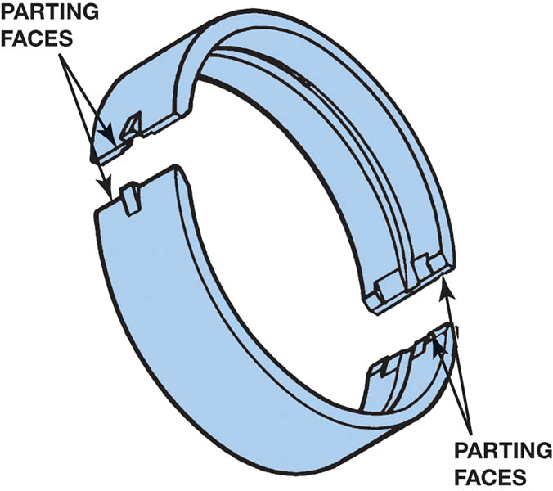
Figure 35.29 The two halves of a plain bearing meet at the parting faces

Slide 58
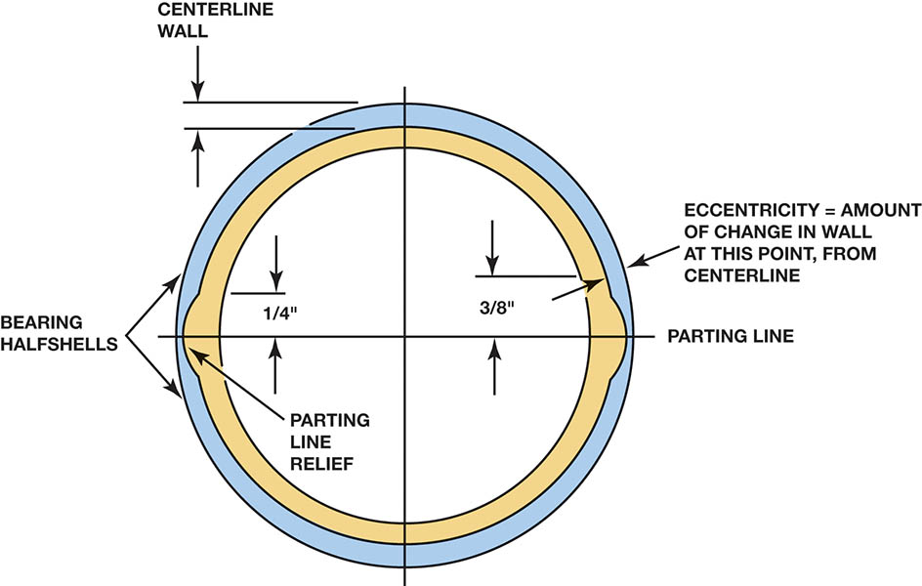
Figure 35.30 Bearing wall thickness is not the same from the center to the parting line. This is called eccentricity and is used to help create an oil wedge between the journal and the bearing

Slide 59
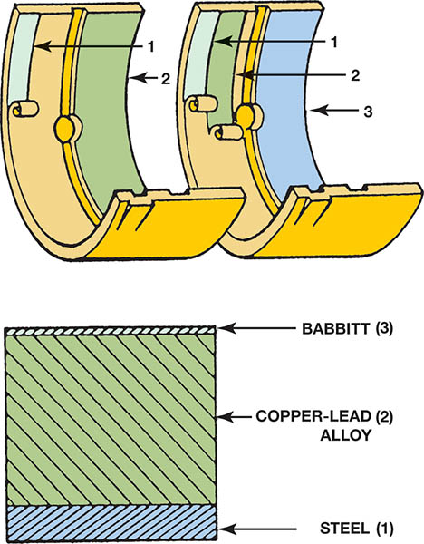
Figure 35.31 Typical two- and three-layer engine bearing inserts showing the relative thickness of the various materials

Slide 60
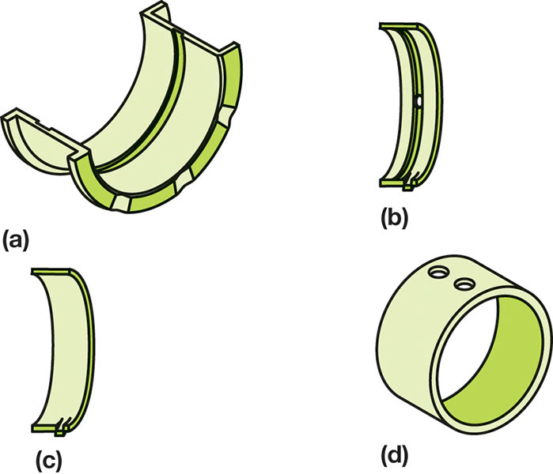
Figure 35.32 Typical bearing shell types found in modern engines: (a) half-shell thrust bearing, (b) upper main bearing insert, (c) lower main bearing insert, (d) full round-type camshaft bearing

Slide 61
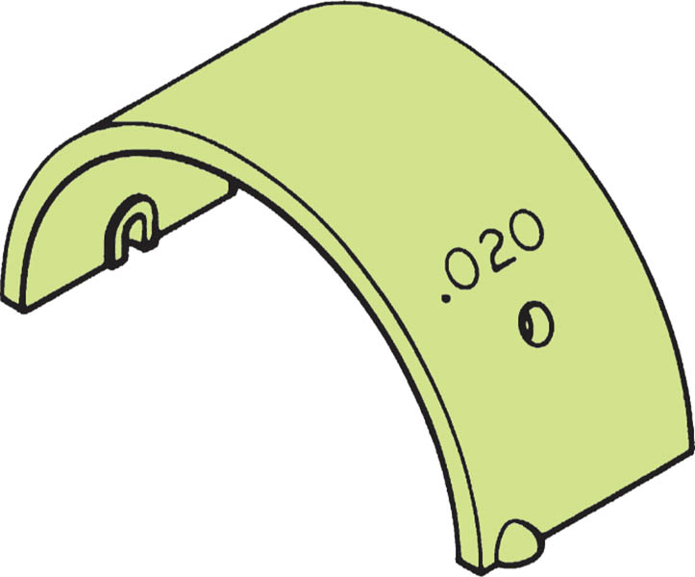
Figure 35.33 Bearings are often marked with an undersize dimension. This bearing is used on a crankshaft with a ground journal that is 0.020 inch (0.76 mm) smaller in diameter than the stock size

Slide 62
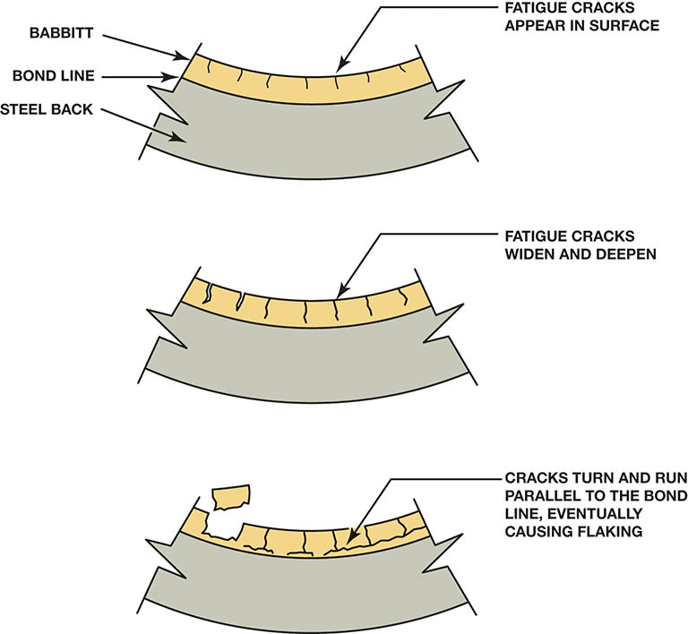
Figure 35.34 Work hardened bearing material becomes brittle and cracks, leading to bearing failure

Slide 63
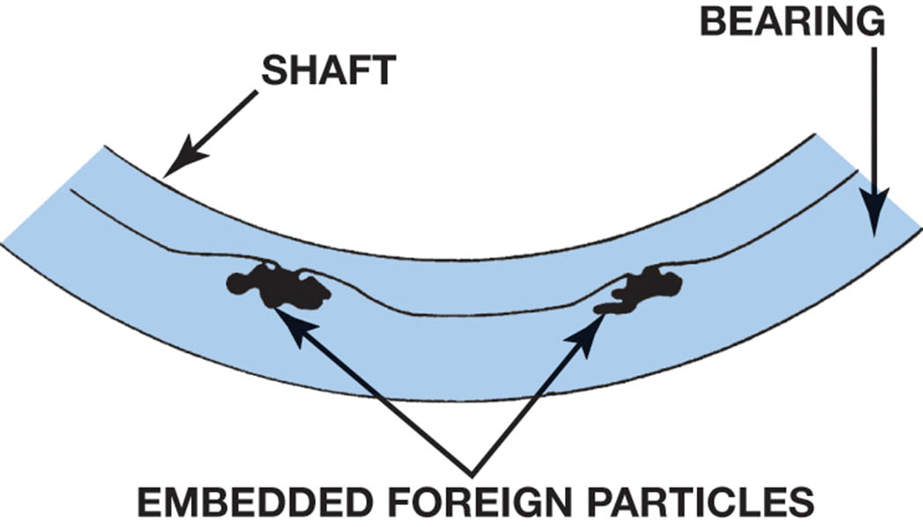
Figure 35.35 Bearing material covers foreign material (such as dirt) as it embeds into the bearing

Slide 64
BEARING CLEARANCE (1 OF 2)
Importance
Doubling the journal clearance will allow more than four times more oil to flow from the edges of the bearing.
Checking Bearing Clearance
Plastigauge®
Measure journal and inside of bearing, then subtract. The difference is the clearance.

Slide 65
BEARING CLEARANCE (2 OF 2)
Bearing Spread and Crush
Spread holds the bearing shell in the housing while the engine is being assembled.
Crush is when the bearing cap is tightened, the ends of the two bearing shells touch and are forced together.
Bearing Tang
A tang or lip helps locate the bearing shell in the housing.

Slide 66
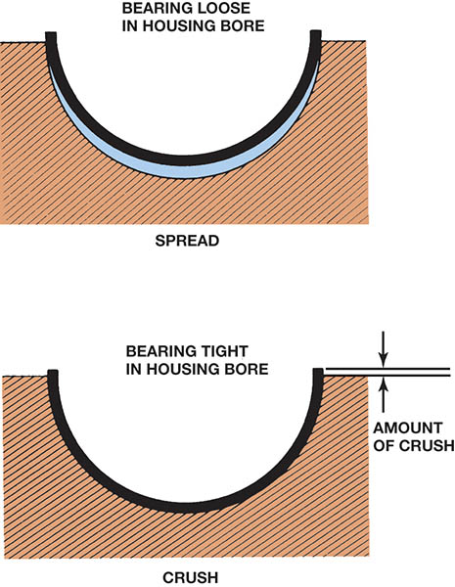
Figure 35.36 Bearing spread and crush

Slide 67
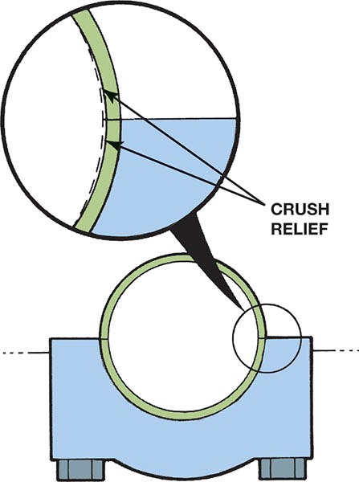
Figure 35.37 Bearings are thinner at the parting line faces to provide crush relief

Slide 68
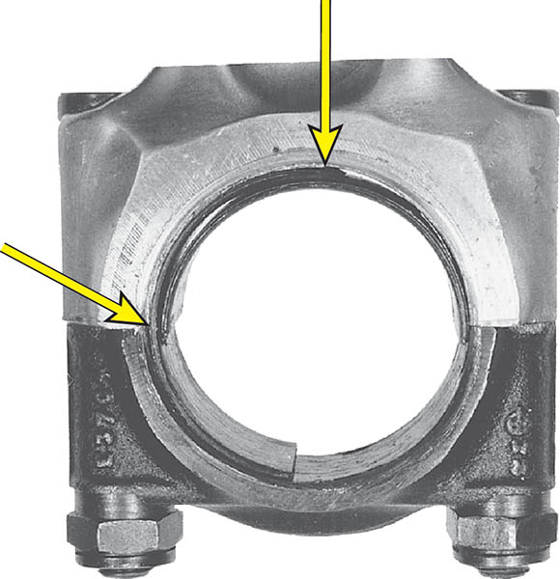
Figure 35.38 Spun bearing. The lower cap bearing has rotated under the upper rod bearing

Slide 69
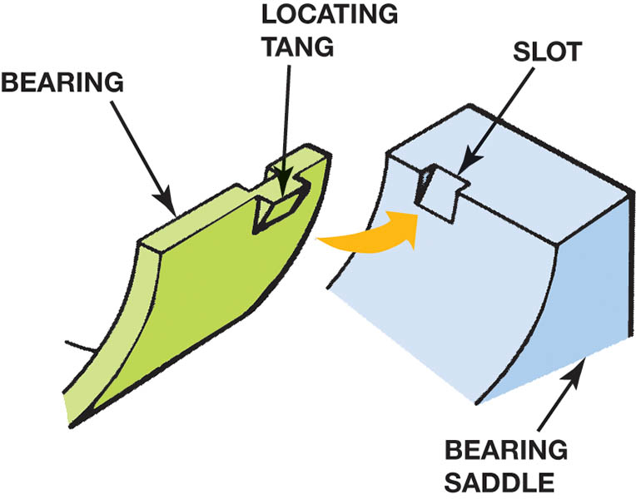
Figure 35.39 The tang (lug) and slot help index the bearing in the bore

Slide 70
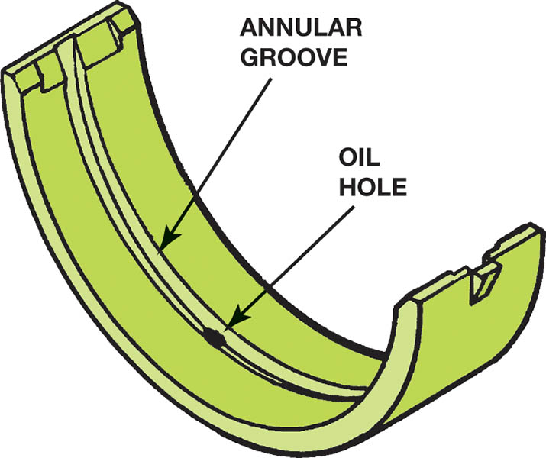
Figure 35.40 Many bearings are manufactured with a groove down the middle to improve the oil flow around the main journal

Slide 71
CAMSHAFT BEARINGS
Types of Camshaft Bearings
Full round bearings
Split-type (half shell) bearings
Camshaft Bearing Installation
In many engines, each cam bearing is a different size.
The cam bearing journal size must be checked.
The location of each new cam bearing can be marked.
Many vehicle manufacturers specify that the cam bearings should be installed “dry”

Slide 72
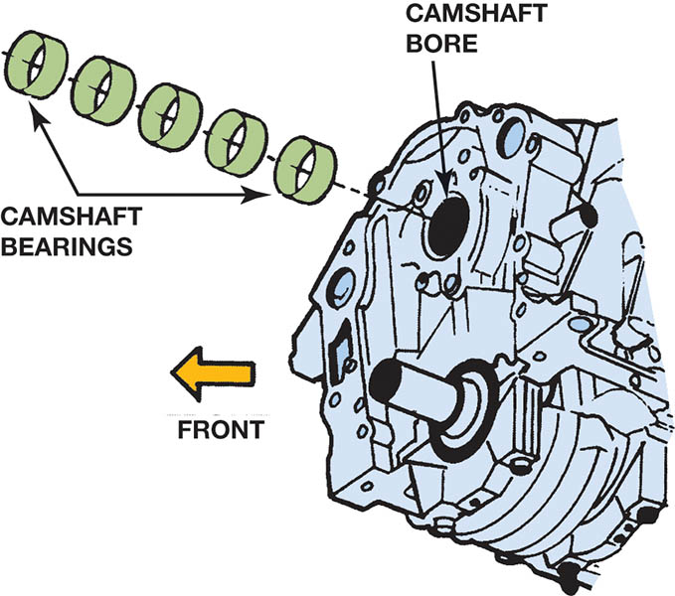
Figure 35.41 Cam-in-block engines support the camshaft with sleeve-type bearings

Slide 73
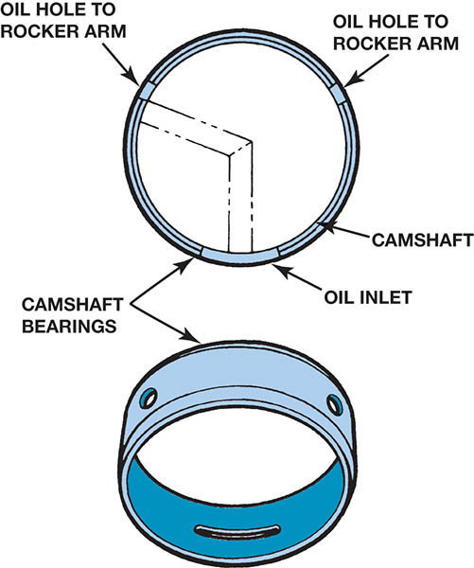
Figure 35.42 Camshaft bearings must be installed correctly so that oil passages are not blocked

Slide 74
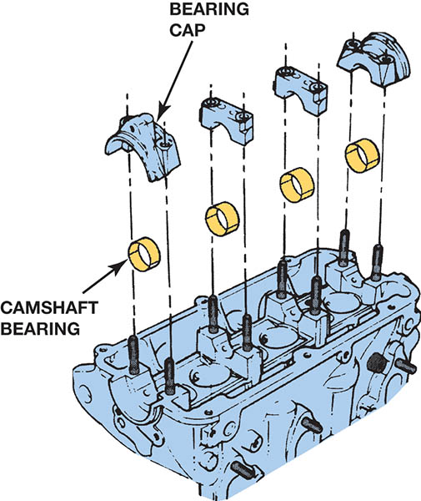
Figure 35.43 Some overhead camshaft engines use split bearing inserts

Slide 75
QUESTION 3: ?
What is the purpose of bearing spread?

Slide 76
ANSWER 3:
Hold the bearing in place during installation.

Slide 77

Copyright

