Slide 1

Automotive Technology Principles, Diagnosis, and Service
Sixth Edition
Chapter 34
Engine Blocks
Copyright © 2018, 2015, 2011 Pearson Education, Inc. All Rights Reserved

Slide 2
LEARNING OBJECTIVES (1 of 2)
34.1 Explain the construction of engine blocks.
34.2 Explain the procedure for engine block service.
34.3 Explain block preparation for assembly.

Slide 3
ENGINE BLOCKS (1 OF 3)
Construction
Gray Cast Iron
Cast Aluminum
Die-Cast Aluminum Alloy
Block Manufacturing
Cast-iron cylinder block sand casting technology continues to be improved.
Aluminum Blocks
Styrofoam is often used as a core when casting an aluminum block

Slide 4
ENGINE BLOCKS (2 OF 3)
Bedplate Design Blocks
A bedplate is a structural member that attaches to the bottom of the block and supports the crankshaft.
Casting Numbers
Casting numbers can be used to check dimensions, such as the cubic inch displacement, and other information, such as year of manufacture.
Block Deck
The cylinder head is fastened to the top surface of the block, know as the block deck.

Slide 5
ENGINE BLOCKS (3 OF 3)
Cooling Passages
In most cylinder designs, the cooling passages extend nearly to the bottom of the cylinder.
Lubricating Passages
Carry lubricating oil to the required locations. This is accomplished through oil drilled galleries and oil gallery plugs.
Main Bearing Caps
The main bearing caps are cast or manufactured from sintered or billeted materials, separately from the block.

Slide 6
QUESTION 1: ?
What is the purpose of a bedplate?

Slide 7
ANSWER 1:
To support the crankshaft and provide the block with structural support.

Slide 8
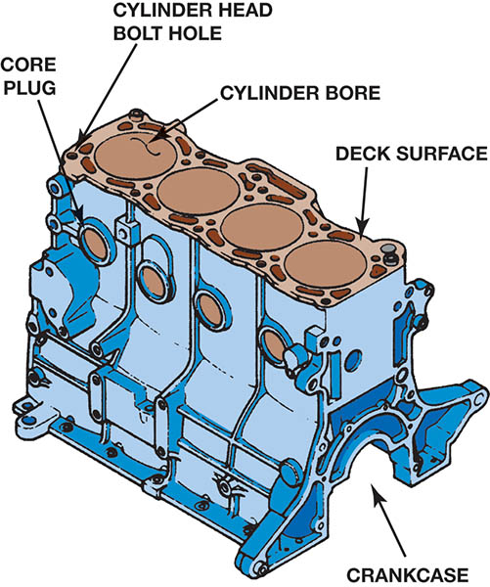
Figure 34.1 The cylinder block usually extends from the oil pan rails at the bottom to the deck surface at the top

Slide 9
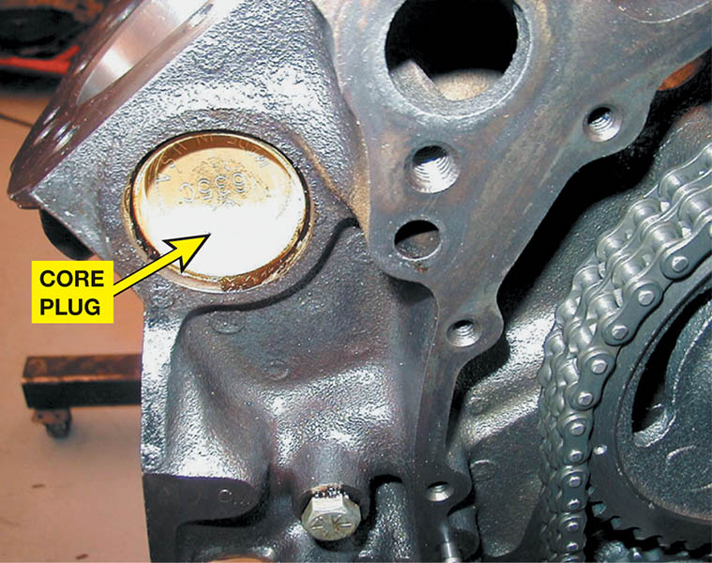
Figure 34.2 An expansion (core) plug is used to block the opening in the cylinder head or block the holes where the core sand was removed after the part was cast

Slide 10
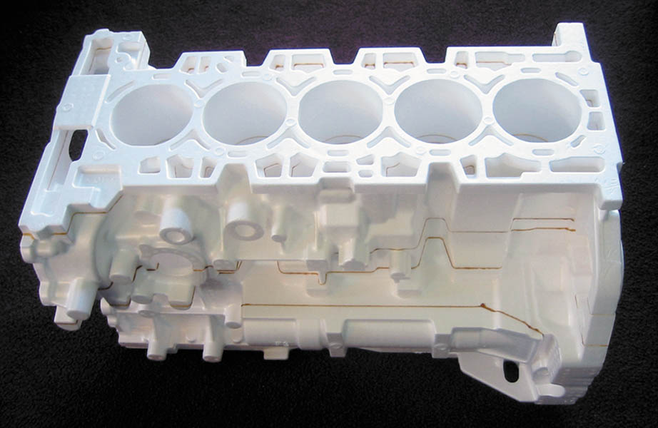
Figure 34.3 A Styrofoam casting mold used to make the five cylinder engine blocks for the Chevrolet Colorado and the Hummer H3.

Slide 11
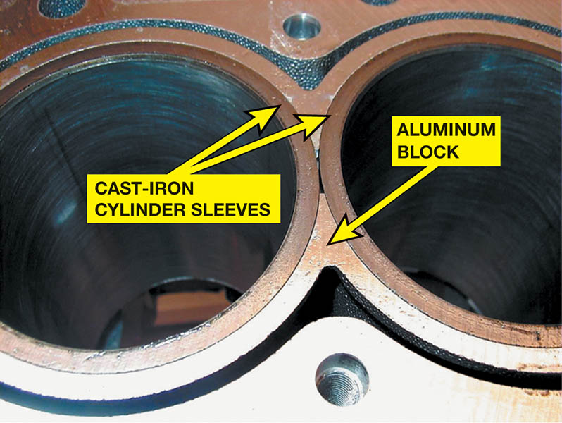
Figure 34.4 Cast-iron dry sleeves are used in aluminium blocks to provide a hard surface for the rings

Slide 12
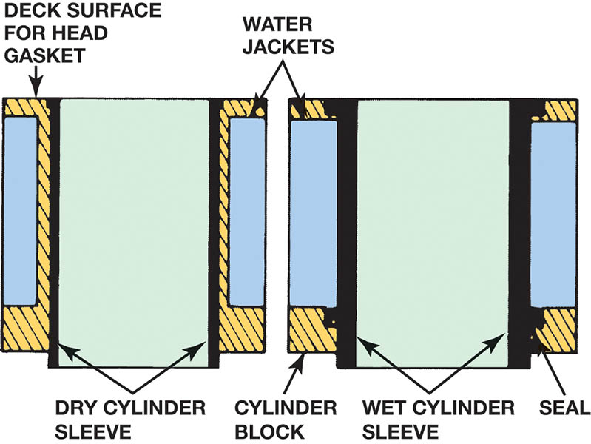
Figure 34.5 A dry sleeve is supported by the surrounding cylinder block. A wet sleeve must be thicker to be able to withstand combustion pressures without total support from the block

Slide 13
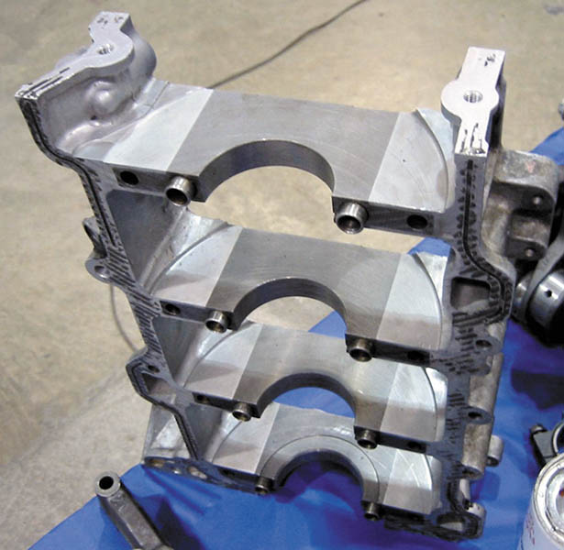
Figure 34.6 A bedplate is a structural part of the engine, which is attached between the block and the oil pan and supports the crankshaft

Slide 14
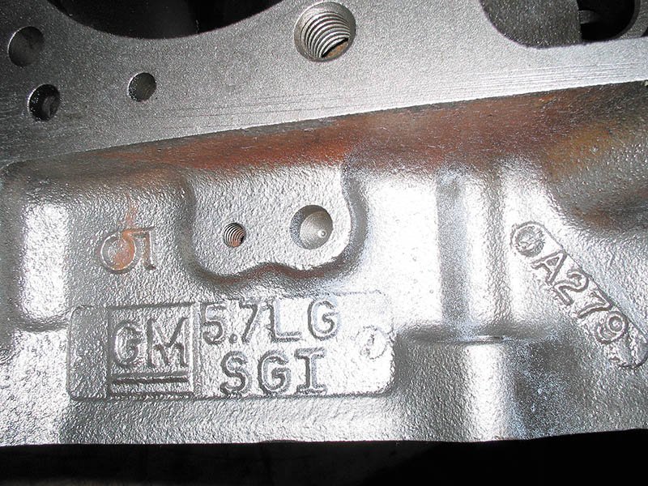
Figure 34.7 Casting numbers identify the block

Slide 15
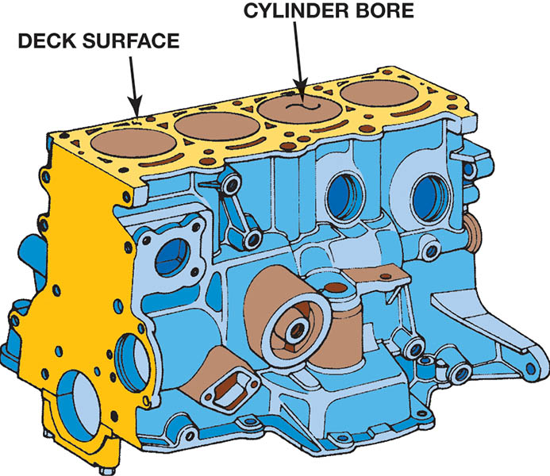
Figure 34.8 The deck is the machined top surface of the block

Slide 16
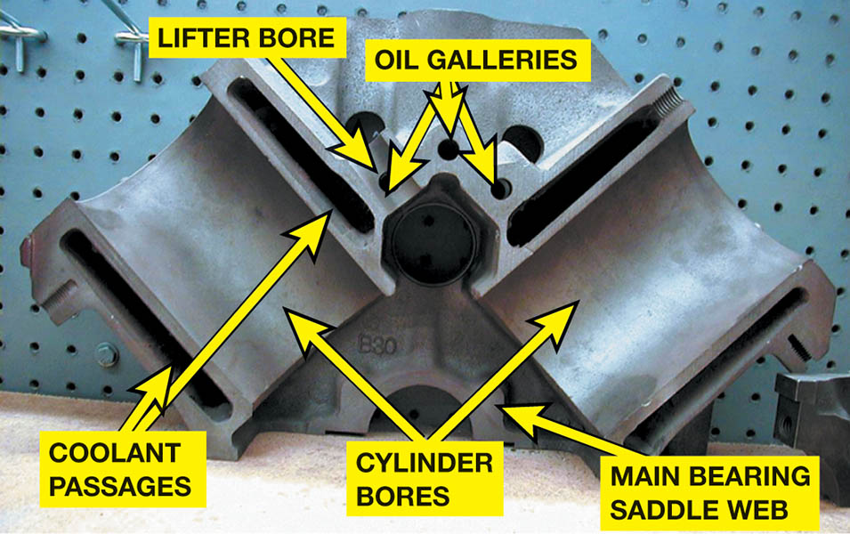
Figure 34.9 Cutaway of a Chevrolet V-8 block showing all of the internal passages

Slide 17
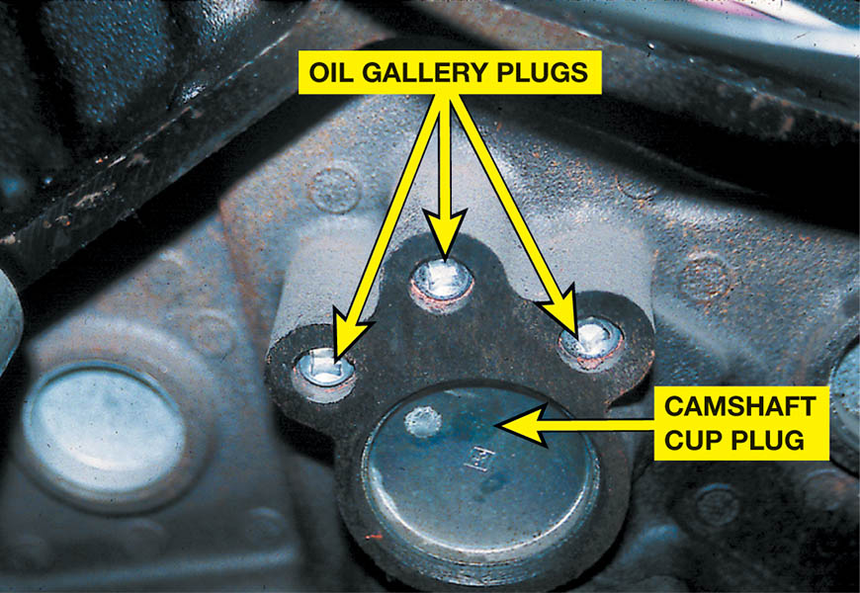
Figure 34.10 Typical oil gallery plugs on the rear of a Chevrolet small block V-8 engine

Slide 18
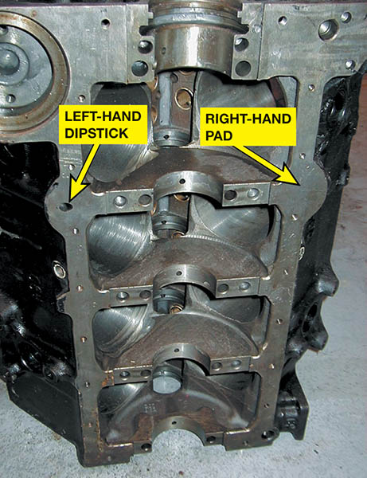
Figure 34.11 Small block Chevrolet block. Note the left-hand dipstick hole and a pad cast for a right-hand dipstick

Slide 19
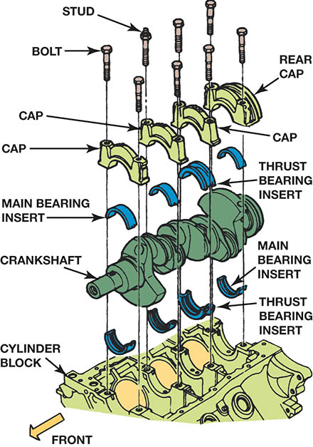
Figure 34.12 Two-bolt main bearing caps provide adequate bottom end strength for most engines

Slide 20
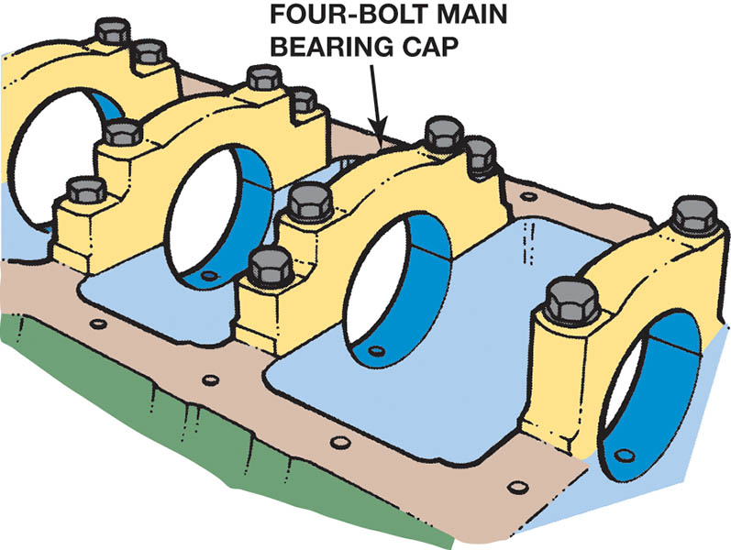
Figure 34.13 High-performance and truck engines often use four-bolt main bearing caps for greater durability

Slide 21
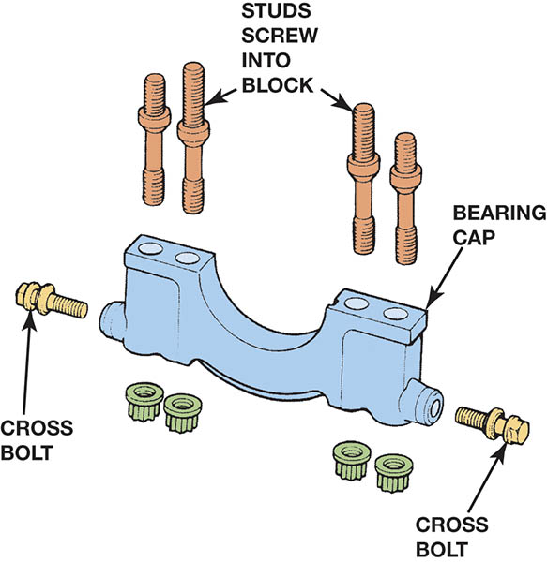
Figure 34.14 Some engines add to the strength of a four-bolt main bearing cap by also using cross bolts through the bolt on the sides of the main bearing caps

Slide 22
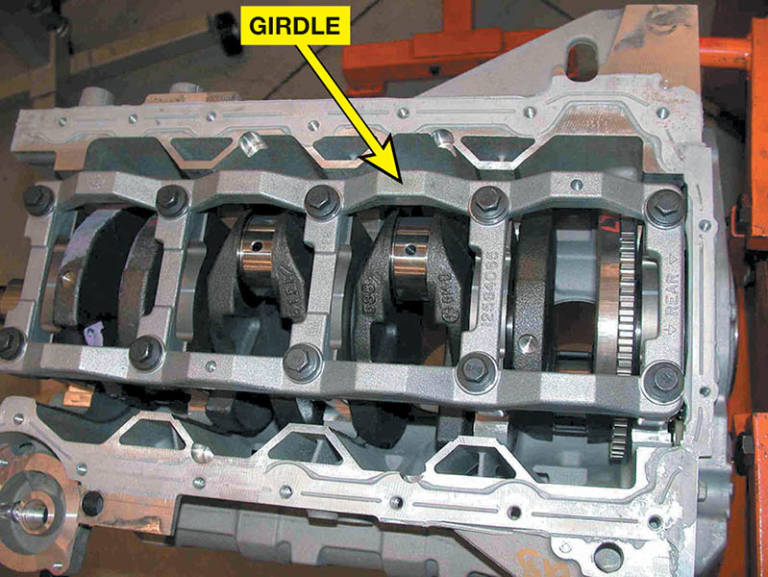
Figure 34.15 A girdle is used to tie all of the main bearing caps together

Slide 23
ENGINE BLOCK SERVICE (1 OF 4)
Procedures
OPERATION 1: Main bearing housing bore alignment.
OPERATION 2 Machining of the block deck surface.
OPERATION 3 Cylinder boring and honing.
Main Bearing Housing Bore Alignment
The main bearing journals of a straight crankshaft are in alignment. If not, the crankshaft tends to bend as it rotates.

Slide 24
ENGINE BLOCK SERVICE (2 OF 4)
Arbor Check Method
The arbor is installed, then all main caps are tightened to specifications. After tightening, the arbor is checked to make sure it rotates freely, indicating a true centerline.
Machining The Deck Surface Of A Block
The block deck must be resurfaced in a surfacing machine that can control the amount of metal removed when it is necessary to match the size of the combustion chambers.

Slide 25
ENGINE BLOCK SERVICE (3 OF 4)
Deck Surface Finishing
60 to 100 Ra (65 to 110 RMS) for cast iron
50 to 60 Ra (55 to 65 RMS) for aluminum block decks to be assured of a proper head gasket surface
Cylinder Boring
Cylinders should be measured across the engine (perpendicular to the crankshaft), where the greatest wear occurs.

Slide 26
ENGINE BLOCK SERVICE (4 OF 4)
Sleeving the Cylinder
Cylinder blocks with deep gouges may be able to be salvaged by sleeving the cylinder.
Cylinder Honing
Honing the cylinder provides the proper surface finish on the cylinder wall for the rings to seat against.
Chamfering the Cylinder Bore
Removing the top edge of the cylinder bores have sharp edges.

Slide 27
QUESTION 2: ?
Why is it important to check main bore alignment?

Slide 28
ANSWER 2:
A crankshaft will tend to bend as it turns if the alignment is not correct.

Slide 29
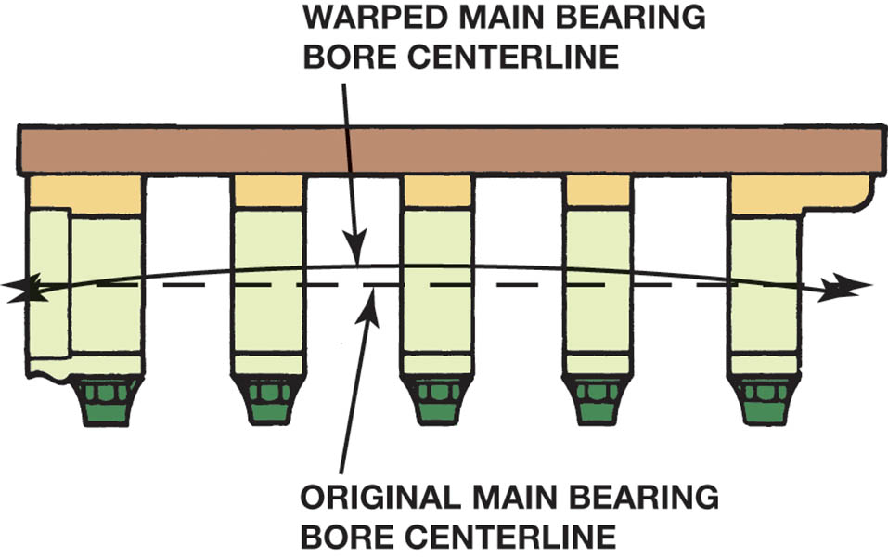
Figure 34.16 The main bearing bores of a warped block usually bend into a bowed shape. The greatest distortion is in the center bores

Slide 30
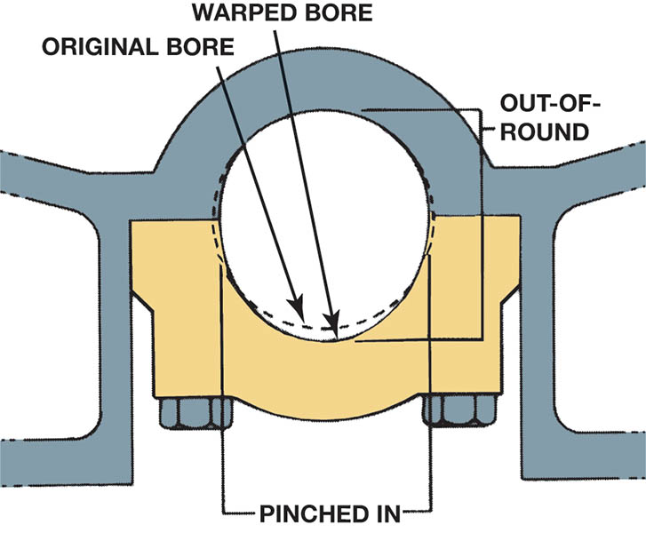
Figure 34.17 When the main bearing caps bow downward, they also pinch in at the parting line

Slide 31
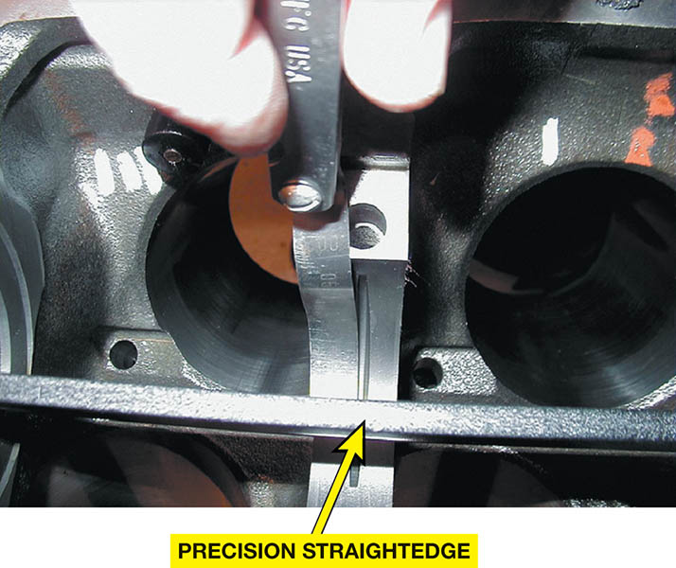
Figure 34.18 The main bearing bore alignment can be checked using a precision straightedge and a feeler gauge

Slide 32
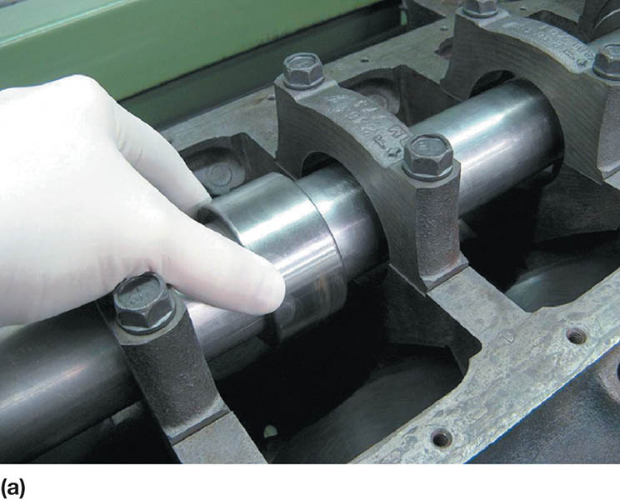
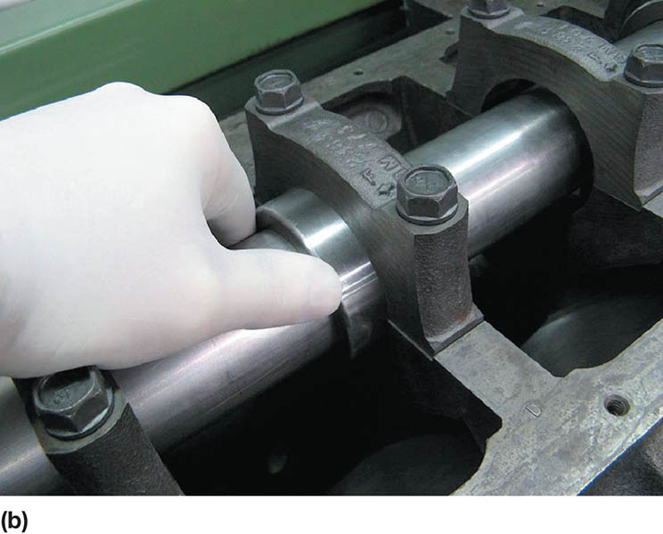
Figure 34.19 (a) A precision arbor can be used to check the main bearing bore alignment. (b) If the sleeve can be inserted into all of the main bearing bores, then they are aligned

Slide 33
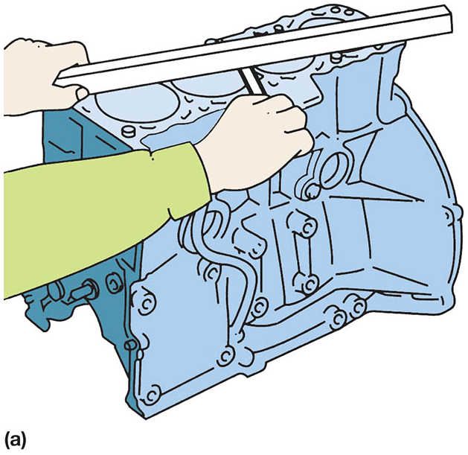
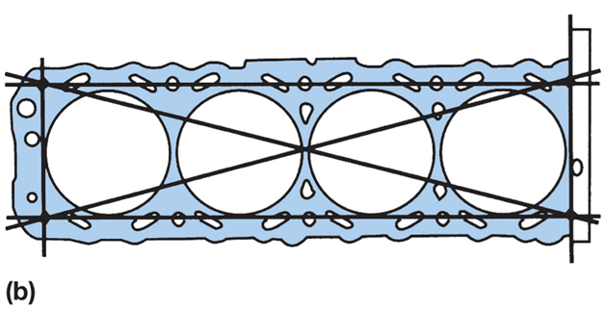
Figure 34.20 (a) Checking the flatness of the block deck surface using a straightedge and a feeler gauge. (b) To be sure that the top of the block is flat, check the block in six locations as shown

Slide 34
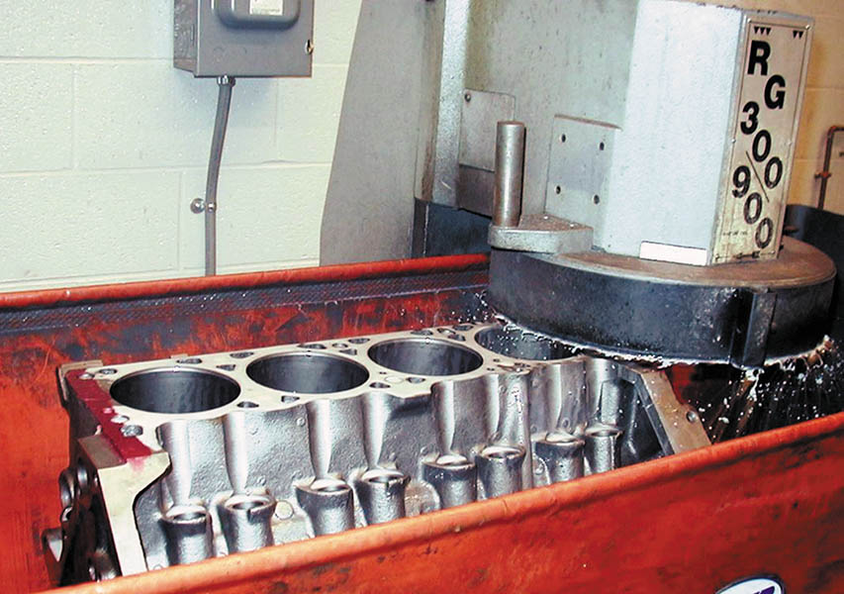
Figure 34.21 Grinding the deck surface of the block

Slide 35
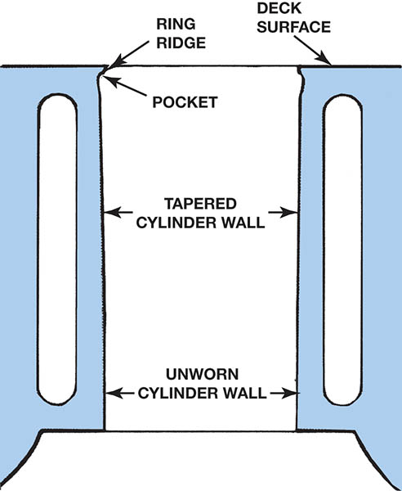
Figure 34.22 Cylinders wear in a taper, with most of the wear occurring at the top of the cylinder where the greatest amount of heat and pressure are created. The ridge is formed because the very top part of the cylinder is not contacted by the rings

Slide 36
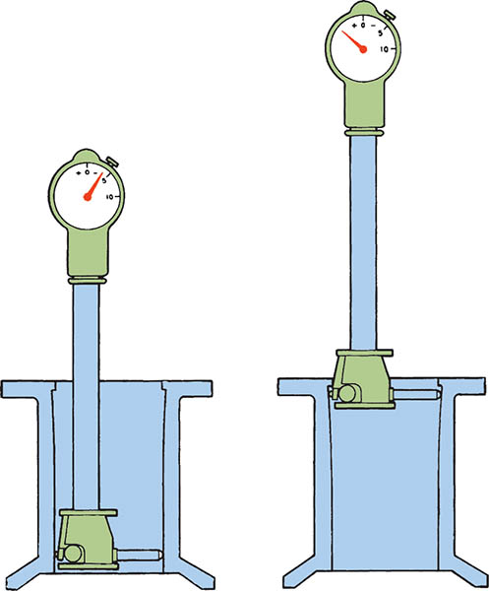
Figure 34.23 Adjust a dial bore gauge as per the gauge’s instructions and then measure the bore diameter at the top just below the ridge (maximum wear section) and at the bottom below the ring travel (minimum wear section).

Slide 37
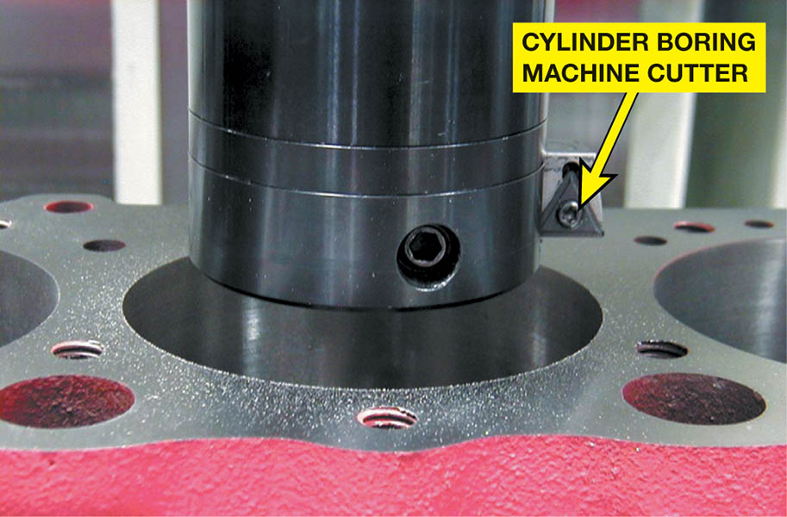
Figure 34.24 A cylinder boring machine is used to enlarge cylinder bore diameter so a replacement oversize piston can be used to restore a worn engine to useful service, or to increase the displacement of the engine in an attempt to increase power output

Slide 38
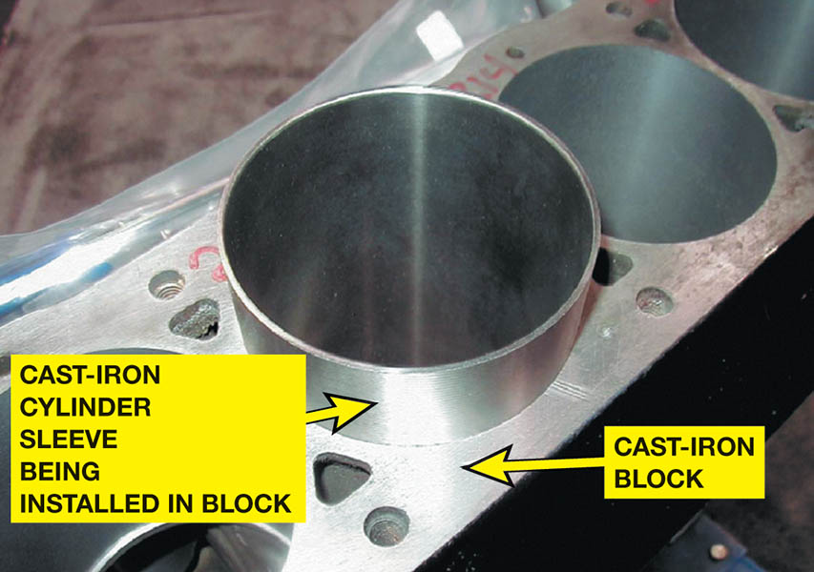
Figure 34.25 A dry cylinder sleeve can also be installed in a cast-iron block to repair a worn or cracked cylinder

Slide 39
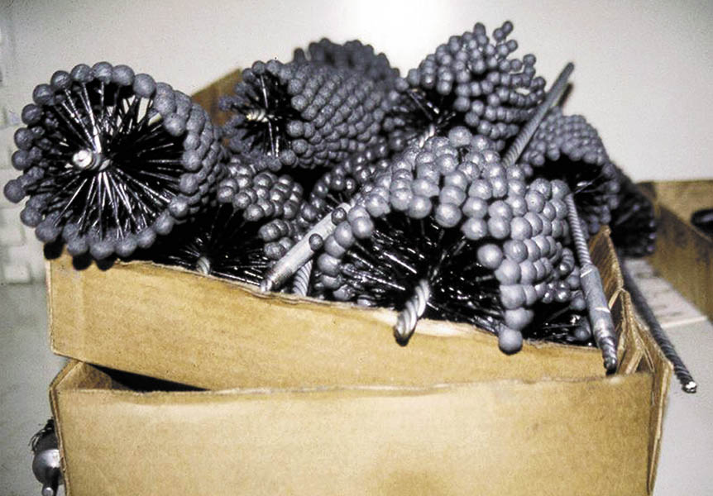
Figure 34.26 An assortment of ball-type deglazing hones. This type of hone does not straighten wavy cylinder walls

Slide 40
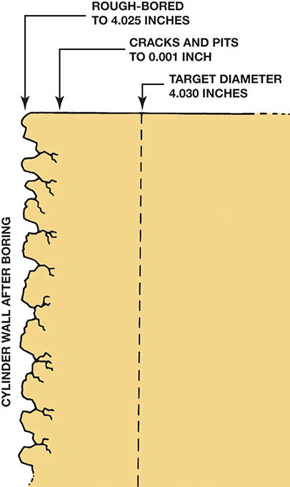
Figure 34.27 After boring, the cylinder surface is rough, pitted, and fractured to a depth of about 0.001 inch

Slide 41
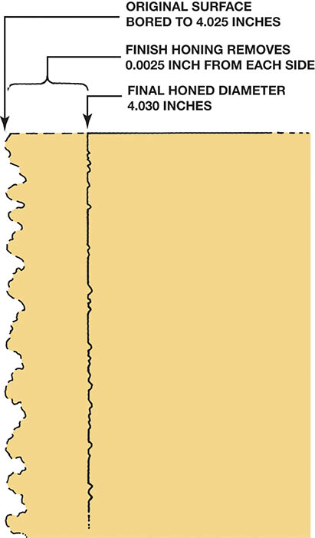
Figure 34.28 Honing enlarges the cylinder bore to the final size and leaves a plateau surface finish that retains oil

Slide 42
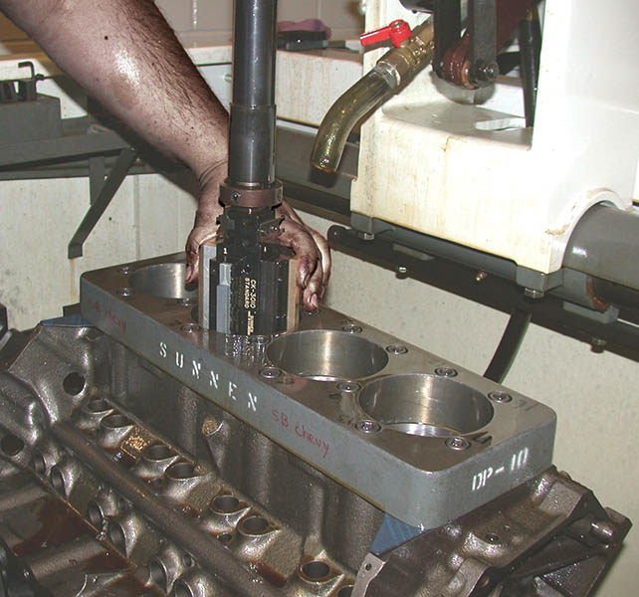
Figure 34.29 A torque plate being used during a cylinder honing operation. The thick piece of metal is bolted to the block and simulates the forces exerted on the block by the head bolts when the cylinder head is attached

Slide 43
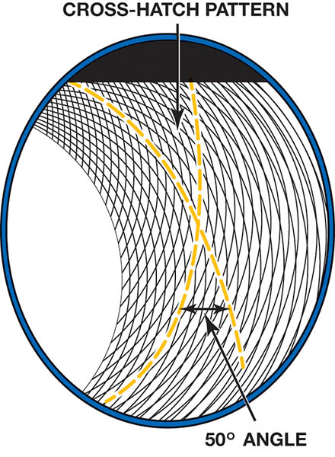
Figure 34.30 The crosshatched pattern holds oil to keep the rings from wearing excessively, and also keeps the rings against the cylinder wall for a gas-tight fit

Slide 44
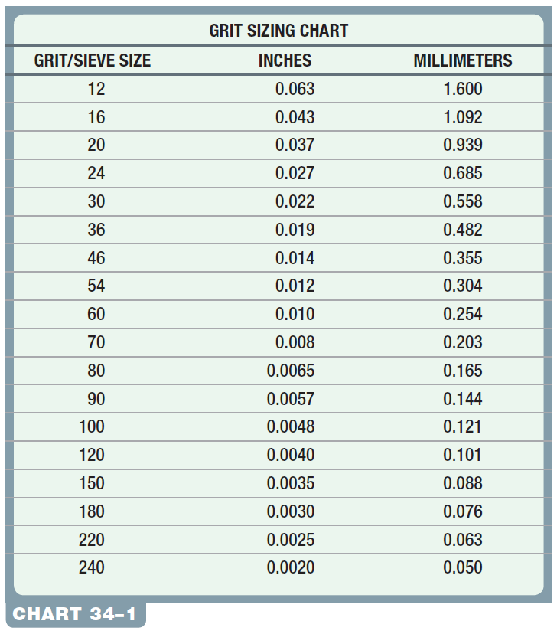
Chart 34-1 Grit size numbers and their dimensions in inches and millimeters.

Slide 45
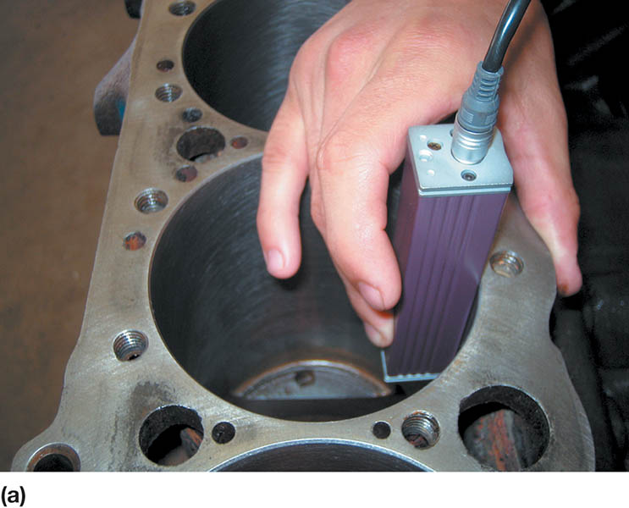
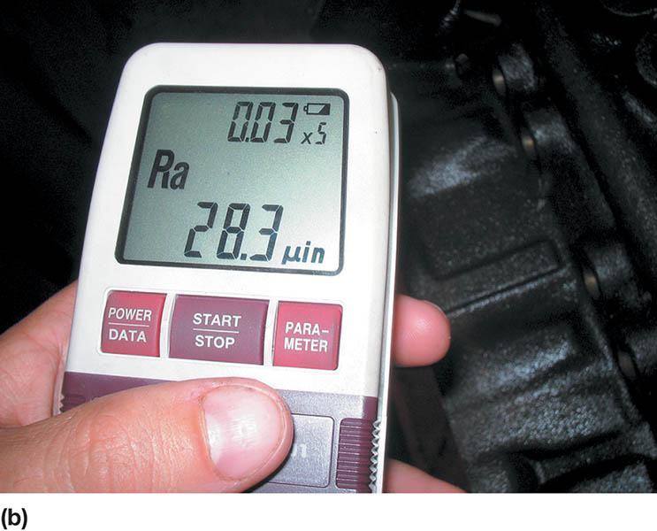
Figure 34.31 (a) The surface finish tool is being held against the cylinder wall. (b) The reading indicates the Ra roughness of the cylinder. More work is needed if moly piston rings are to be used

Slide 46
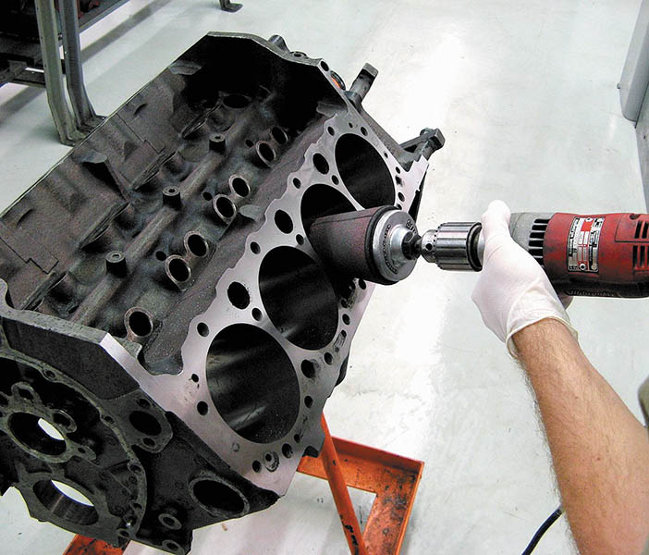
Figure 34.32 Using a tapered sanding cone to remove the sharp edges at the top of the cylinders created when the block was machined

Slide 47
BLOCK PREPARATION FOR ASSEMBLY
Block Cleaning
The block is scrubbed until it is absolutely clean. This can be determined by wiping the cylinder wall with a clean lint-free cloth. The cloth will pick up no soil when the cylinder wall is clean.
Block Detailing
1. All oil passages (galleries) should be cleaned
2. All tapped holes should be cleaned with the correct thread chaser.
3. Coat the newly cleaned block with fogging oil to prevent rust.

Slide 48
QUESTION 3: ?
Why is detailing a block important?

Slide 49
ANSWER 3:
To remove any unwanted dirt and grit that would cause abnormal wear.

Slide 50
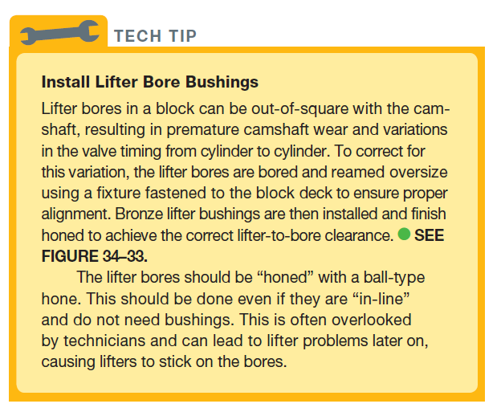
Tech Tip

Slide 51
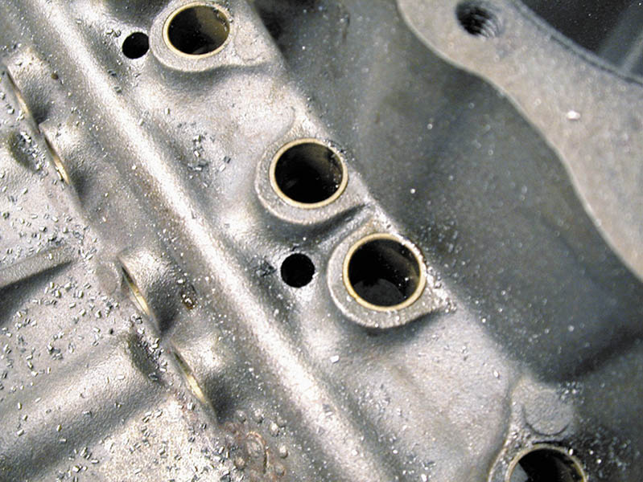
Figure 34.33 High-performance engine builders often install bronze sleeves in the lifter bores

Slide 52
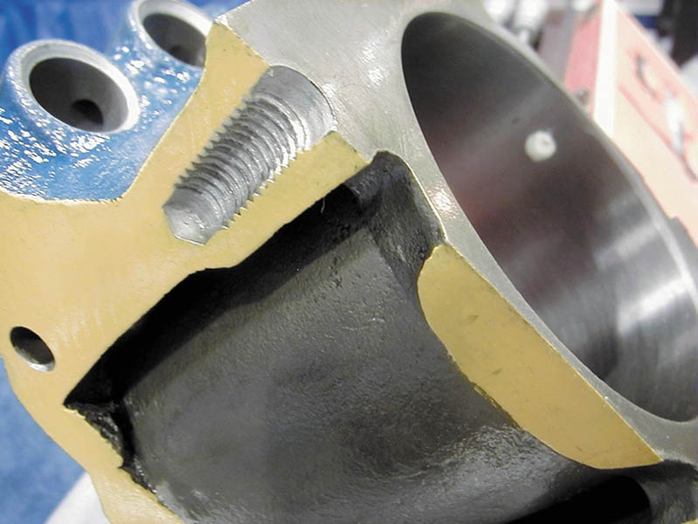
Figure 34.34 Notice on this cutaway engine block that some of the head bolt holes do not extend too far into the block and dead end. Debris can accumulate at the bottom of these holes and it must be cleaned out before final assembly

Slide 53
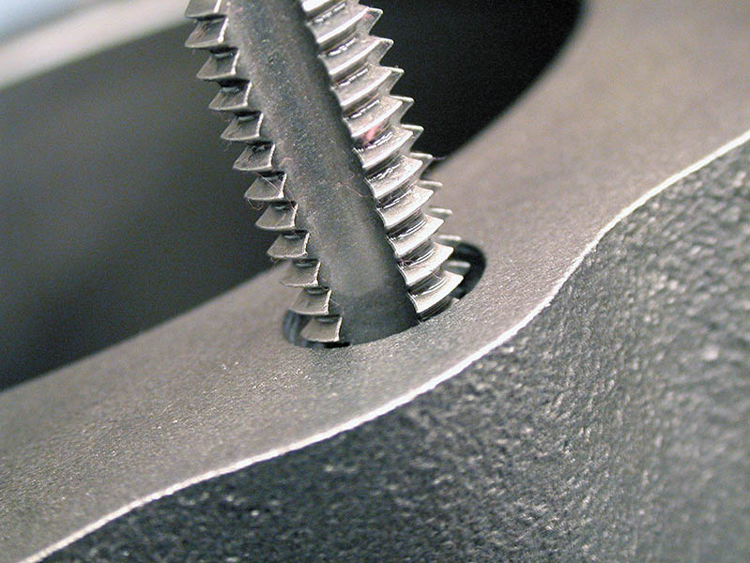
Figure 34.35 A tread chaser or bottoming tap should be used in all threaded holes before assembling the engine

Slide 54

Copyright

