Slide 1

Automotive Technology Principles, Diagnosis, and Service
Sixth Edition
Chapter 33
Pistons, Rings and Connecting Rods
Copyright © 2018, 2015, 2011 Pearson Education, Inc. All Rights Reserved

Slide 2
LEARNING OBJECTIVES (1 of 2)
33.1 Explain the purpose, function, and construction of pistons.
33.2 Discuss piston pins and their retaining methods.
33.3 Explain piston rings and their construction.

Slide 3
LEARNING OBJECTIVES (2 of 2)
33.4 Discuss connecting rods and their service.
33.5 Explain piston and rod assembly and piston ring service.

Slide 4
PISTONS
Purpose and Function
  Transfer force
  Seal the combustion chamber
  Conduct heat
Piston Operation
  As the piston moves downward and then upward it starts, accelerates, and stops twice in each crankshaft revolution.
  The reciprocating action of the piston produces large inertia forces.

Slide 5
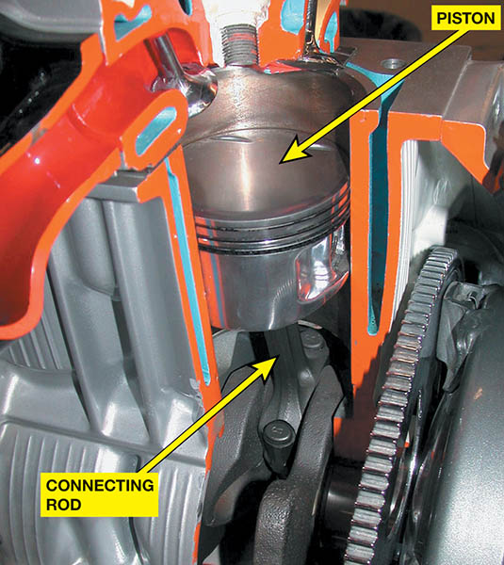
Figure 33.1 The piston seals the bottom of the combustion chamber and is attached to a connecting rod

Slide 6
PISTON CONSTRUCTION (1 OF 5)
Piston Ring Grooves
  Located between the piston head and skirt
  The width of the grooves and the number of rings determines minimum piston height.
Cast Pistons
  Cast aluminum pistons usually are made using gravity die casting in which molten aluminum alloy and about 10% silicon are poured into a mold.

Slide 7
PISTON CONSTRUCTION (2 OF 5)
Hypereutectic Pistons
  The silicon content is increased to about 16% of the alloy.
  25% weight reduction and lower expansion rate.
  More expensive because they are more difficult to cast and machine.
Forged Pistons
  Forged pistons have a dense grain structure and are very strong, so are often used in turbocharged or supercharged engines.

Slide 8
PISTON CONSTRUCTION ( 3 OF 5)
Piston Head Designs
  Flat Top
  Raised Domes (Pop-Ups)
  Dish (Depression)
Slipper Skirt Pistons
  Shorter on the two sides that are not thrust surfaces.
  Lighter weight
  Allows for a shorter overall engine height

Slide 9
PISTON CONSTRUCTION (4 OF 5)
Cam Ground Pistons
  As the cam ground piston is heated, it expands along the piston pin so that it becomes nearly round at its normal operating temperatures.
Piston Finish
  Scuffing can be reduced by coating the piston skirts with tin 0.0005 inch (0.0125 mm) thick or a moly graphite coating.

Slide 10
PISTON CONSTRUCTION ( 5 OF 5)
Piston Head Size
  The top or head of the piston is smaller in diameter than the rest of the piston.
Piston Strut Inserts
  The struts add strength to the piston in the piston pin area where additional strength is needed.
  The struts help control thermal expansion.
  Prevents cold piston slap and noise.

Slide 11
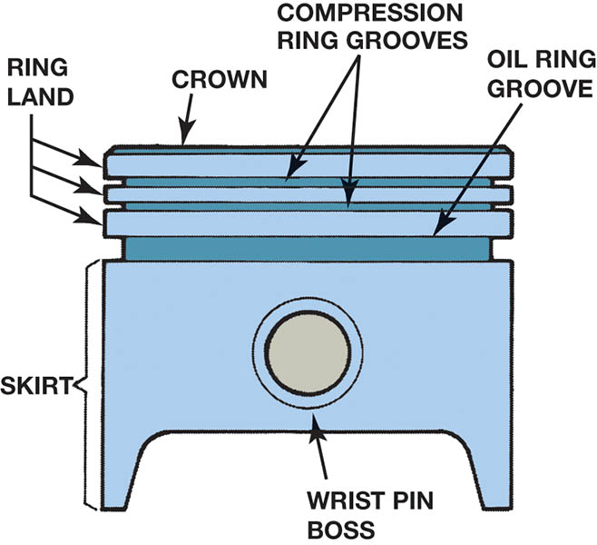
Figure 33.2 All pistons share the same parts in common

Slide 12
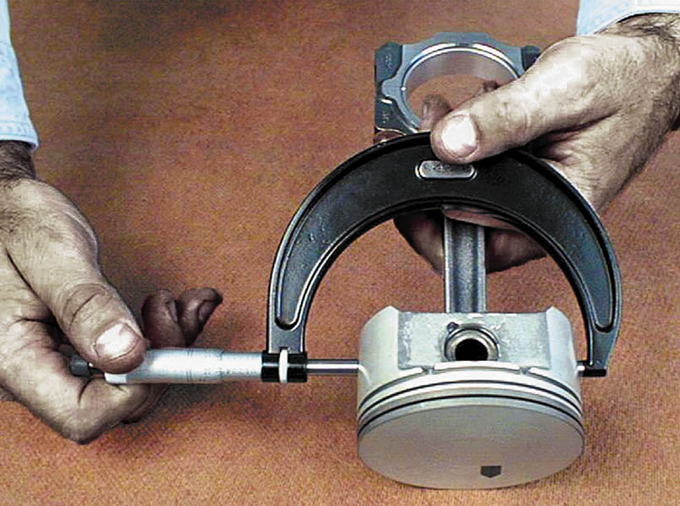
Figure 33.3 A piston diameter is measured across the thrust surfaces

Slide 13
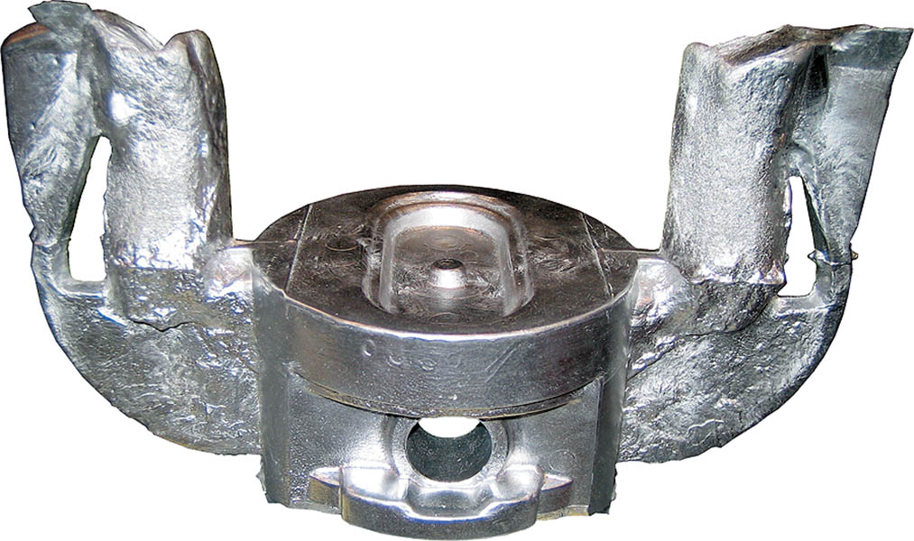
Figure 33.4 A cast piston showing the sprues which were used to fill the mold with molten aluminium alloy

Slide 14
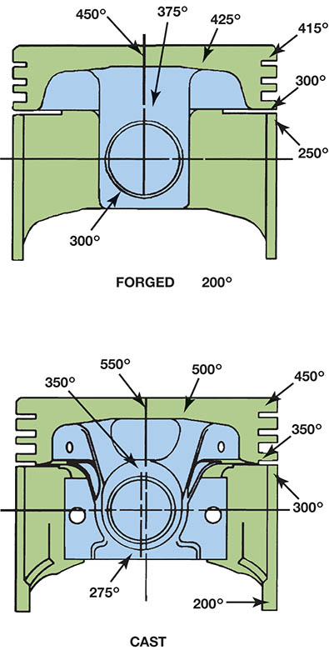
Figure 33.5 The top of the piston temperature can be 100°F (38°C) lower on a forged piston compared to a cast piston

Slide 15
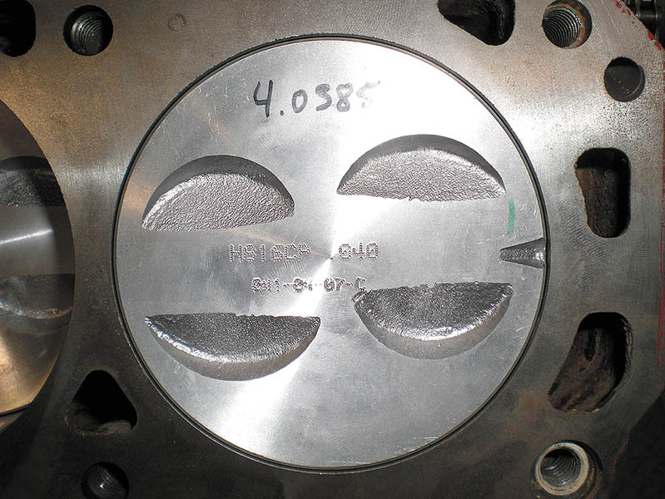
Figure 33.6 Valve reliefs are used to provide valve clearance

Slide 16
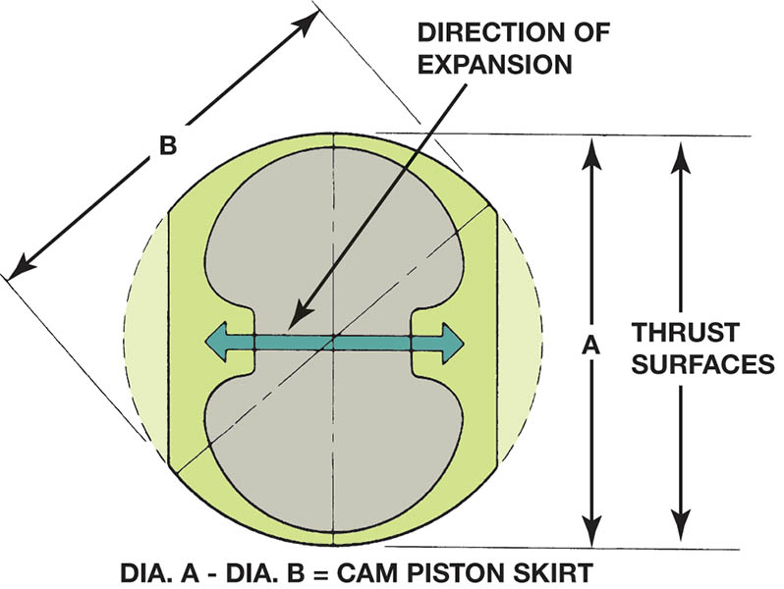
Figure 33.7 Piston cam shape. The largest diameter is across the thrust surfaces and perpendicular to the piston pin (labeled A)

Slide 17
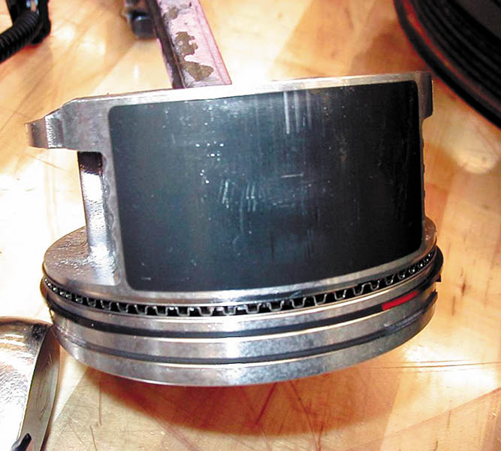
Figure 33.8 A moly graphite coating on this piston from a General Motors 3800 V-6 engine helps to prevent piston scuffing

Slide 18
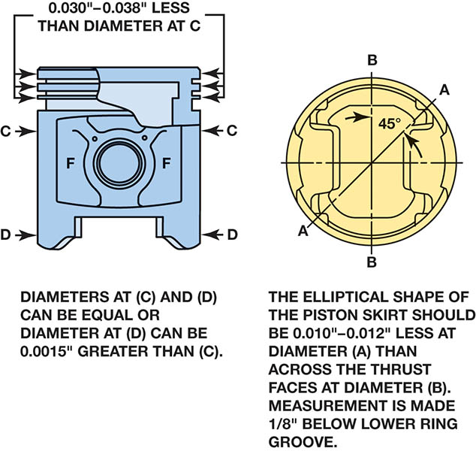
Figure 33.9 The head of the piston is smaller in diameter than the skirt of the piston to allow it to expand when the engine is running

Slide 19
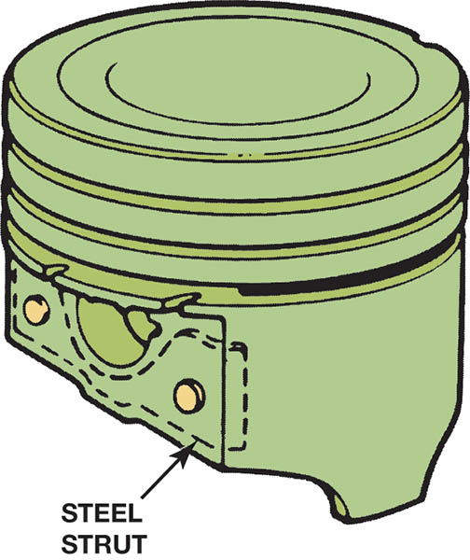
Figure 33.10 Steel struts cast inside the piston help control expansion and add strength to the piston pin area

Slide 20
QUESTION 1: ?
What make a piston a Hypereutectic piston?

Slide 21
ANSWER 1:
  The silicon content is increased to about 16% of the alloy.

Slide 22
PISTON PINS
Piston pins are used to attach the piston to the connecting rod.
Piston Pin Offset
  They are located toward the major thrust surface, from the piston centerline to reduce piston slap and noise.
Piston Pin Fit
  If the piston pin is loose in the piston or in the connecting rod, it makes a sound while the engine is running. This is often described as a double knock.

Slide 23
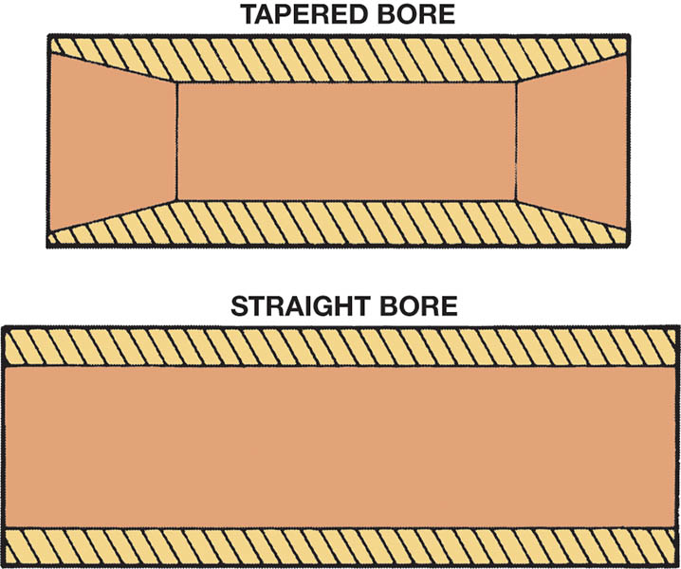
Figure 33.11 Most piston pins are hollow to reduce weight and have a straight bore. Some pins have a tapered bore to reinforce the pin

Slide 24
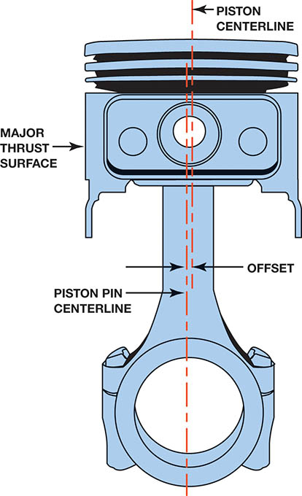
Figure 33.12 Piston pin offset toward the major thrust surface

Slide 25
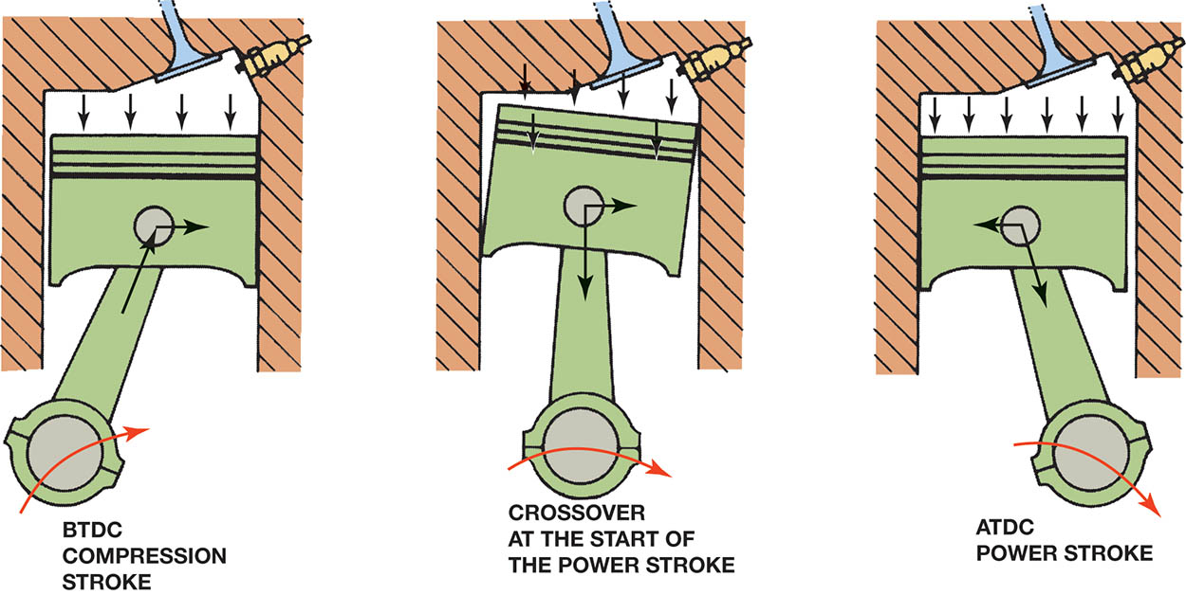
Figure 33.13 Engine rotation and rod angle during the power stroke cause the piston to press harder against one side of the cylinder, called the major thrust surface

Slide 26
PISTON PIN RETAINING METHODS
Full Floating
  Most full-floating piston pins use some type of lock ring to retain the piston pin.
  Internal snap ring called a circle clip
  Spiral lock ring
Interference Fit
  The pin is installed by heating the rod to expand the hole or by pressing the pin into the rod.

Slide 27
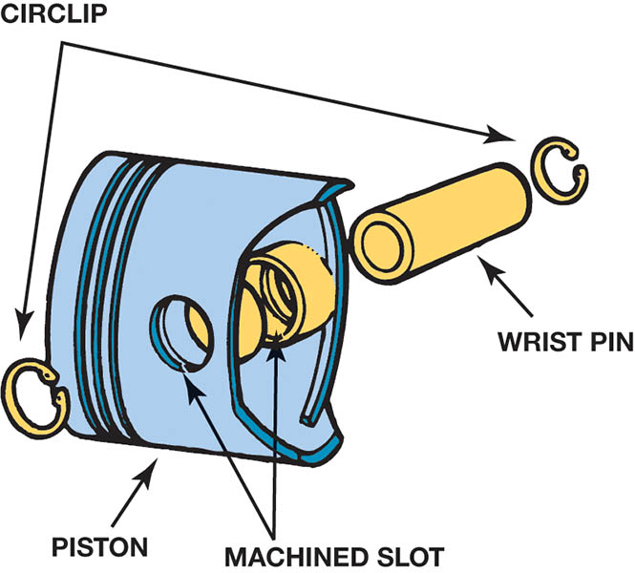
Figure 33.14 Circlips hold full-floating piston pins in place

Slide 28
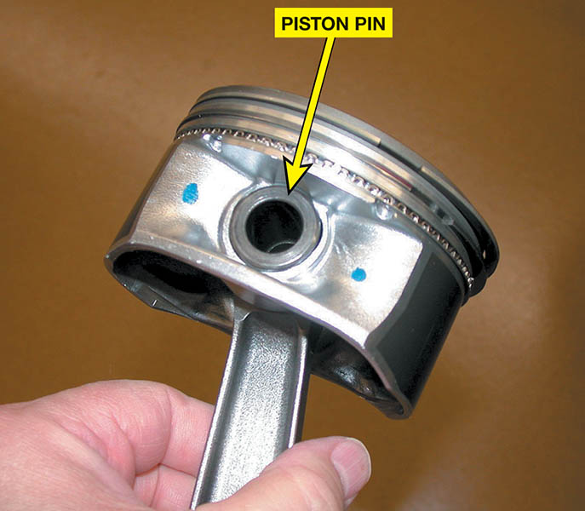
Figure 33.15 A typical interference fit piston pin

Slide 29
QUESTION 2: ?
How is the piston pin retained in the piston and rod assembly?

Slide 30
ANSWER 2:
A lock ring or an interference fit.

Slide 31
PISTON RINGS (1 OF 3)
Purpose and Function
  They form a sliding combustion chamber seal that prevents the high-pressure combustion gases from leaking past the piston.
  They keep engine oil from getting into the combustion chamber.
  The rings transfer some of the piston heat to the cylinder wall, where it is removed from the engine through the cooling system.

Slide 32
PISTON RINGS (2 OF 3)
Classifications
  Compression rings
  Oil control rings
Compression Rings
  A compression ring is designed to form a seal between the moving piston and the cylinder wall, while at the same time keeping friction to a minimum.
Oil Control Rings
  The scraping action allows oil to return through the expander and openings in the piston.

Slide 33
PISTON RINGS (3 OF 3)
Ring Gap
  The piston ring gap allows some leakage past the top compression ring. This leakage is useful in providing pressure on the second ring to develop a dynamic sealing force.
Piston Ring Shapes
  Tapered Face
  Positive Twist
  Reverse Twist
  Scraper or Barrel Face

Slide 34
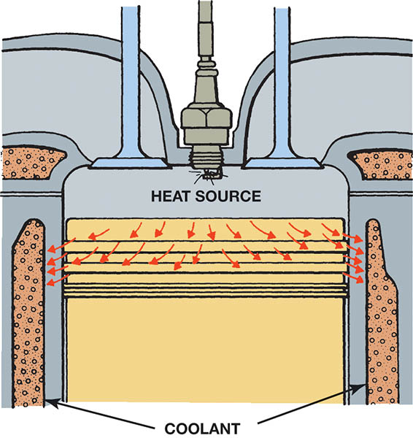
Figure 33.16 The rings conduct heat from the piston to the cylinder wall

Slide 35
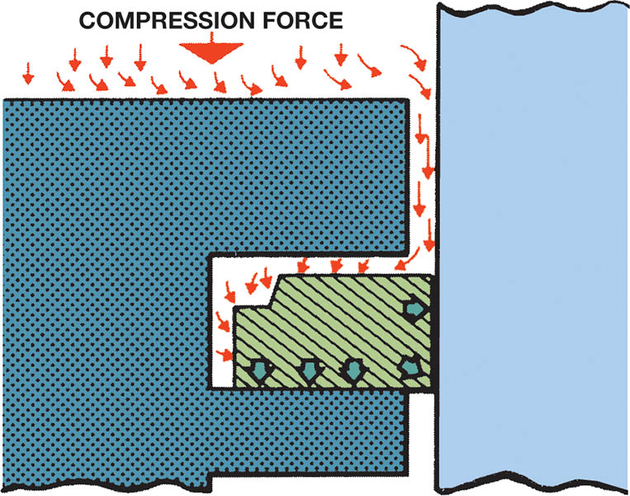
Figure 33.17 Combustion chamber pressure forces the ring against the cylinder wall and the bottom of the ring groove to effectively seal the cylinder

Slide 36
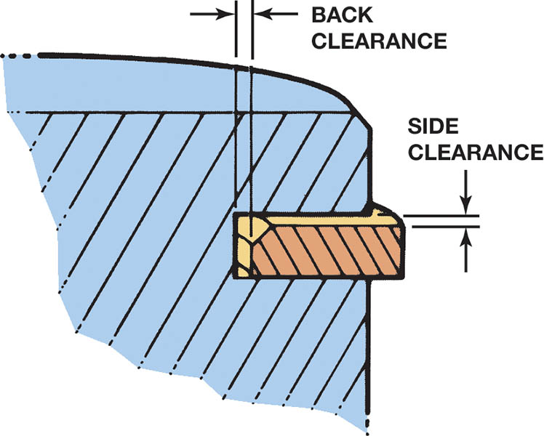
Figure 33.18 The side and back clearances must be correct for the compression rings to seal properly

Slide 37
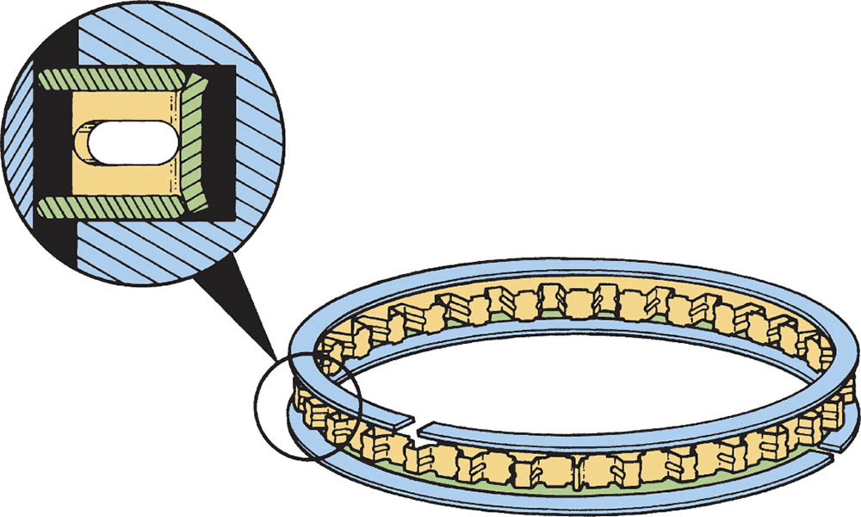
Figure 33.19 This typical three-piece oil control ring uses a hump-type stainless steel spacer-expander. The expander separates the two steel rails and presses them against the cylinder wall

Slide 38
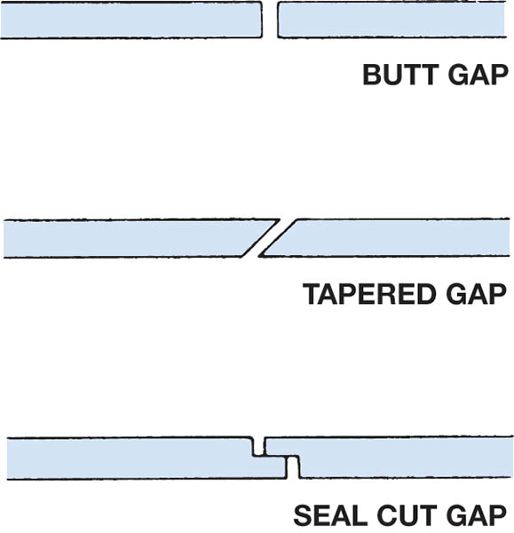
Figure 33.20 Typical piston ring gaps

Slide 39
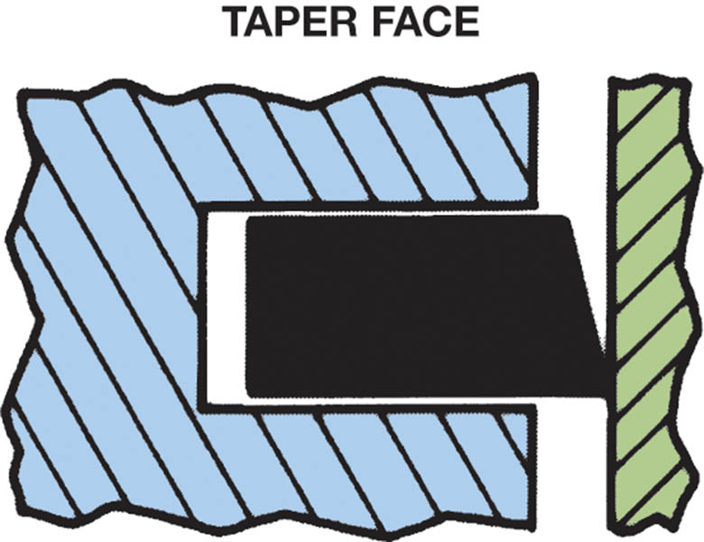
Figure 33.21 The taper face ring provides oil control by scraping the cylinder wall. This style of ring must be installed right side up or the ring does not seal and oil is drawn into the combustion chamber

Slide 40
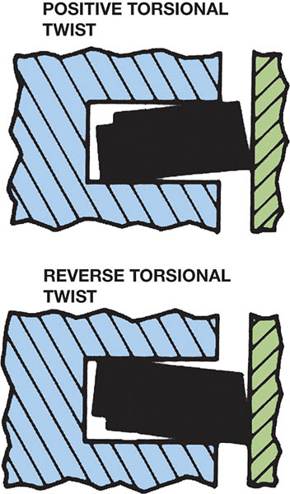
Figure 33.22 Torsional twist rings provide better compression sealing and oil control than regular taper rings

Slide 41
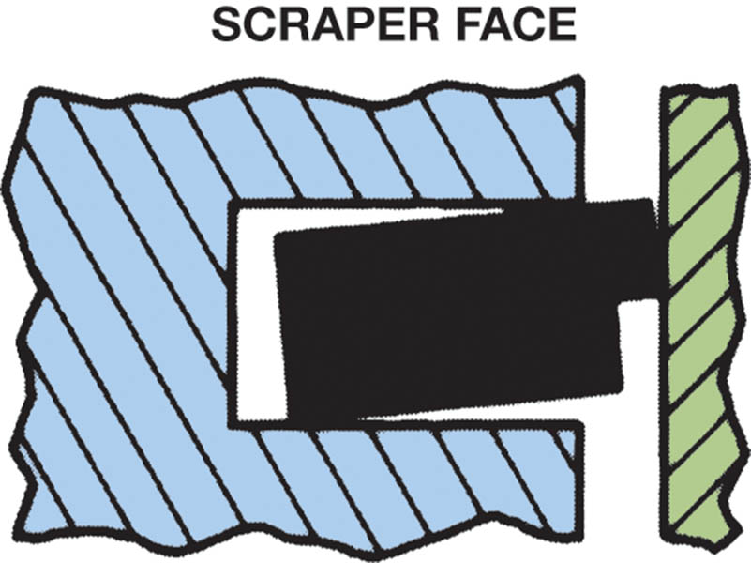
Figure 33.23 Scraper-type rings provide improved oil control

Slide 42
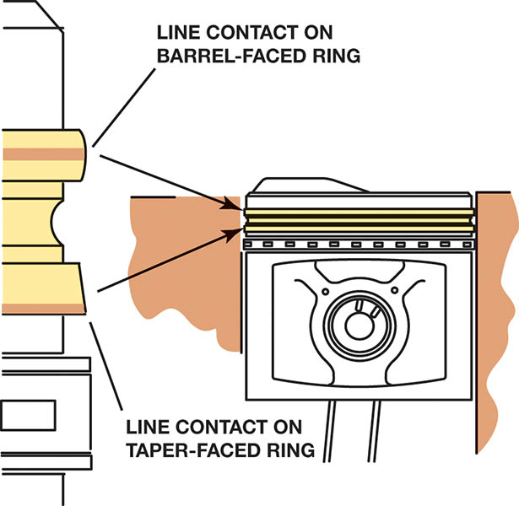
Figure 33.24 The upper barrel face ring has a line showing contact with the cylinder wall. The second taper face ring shows contact along the lower edge of the ring

Slide 43
PISTON RING CONSTRUCTION (1 OF 3)
Materials
  Plain cast iron
  Pearlitic cast iron
  Nodular cast iron
  Steel
  Ductile iron
Chromium Piston Rings
  About 0.004 inch (0.01 mm) of chrome is then plated on the ring face.

Slide 44
PISTON RING CONSTRUCTION (2 OF 3)
Molybdenum Piston Rings
  Most molybdenum face piston rings have a groove that is 0.004 to 0.008 inch (0.1 to 0.2 mm) deep cut into the ring face. This groove is filled with molybdenum, using a metallic (or plasma) spray method.
Moly-Chrome-Carbide Rings
  The coating has properties that include the hardness of the chrome and carbide combined with the heat resistance of molybdenum.

Slide 45
PISTON RING CONSTRUCTION (3 OF 3)
Ceramic-Coated Rings
  The ceramic-coated ring surface is created by applying a ceramic coating to the ring using a process called physical vapor deposition (PVD).

Slide 46
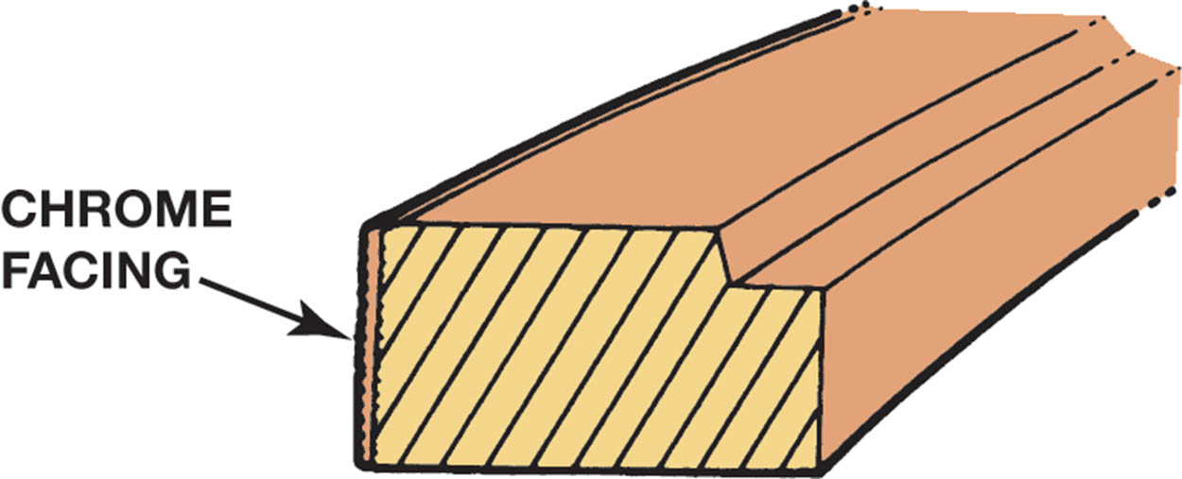
Figure 33.25 The chrome facing on this compression ring is about 0.004 inch (0.10 mm) thick

Slide 47
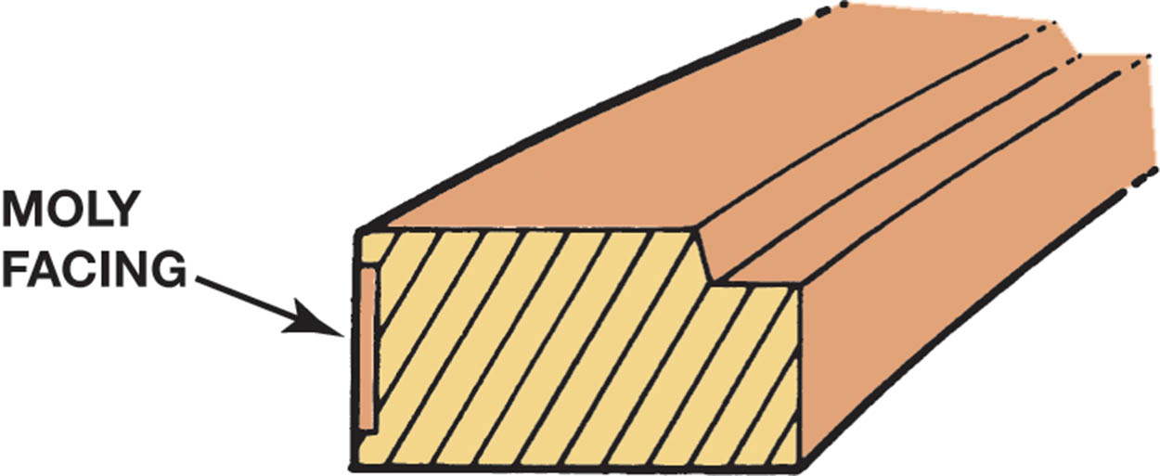
Figure 33.26 The moly facing on this compression ring is about 0.005 inch (0.13 mm) thick

Slide 48
CONNECTING RODS (1 OF 2)
Purpose and Function
  The connecting rod transfers the force and reciprocating motion of the piston to the crankshaft.
Cast Connecting Rods
  Cast connecting rods can be identified by their narrow parting line.
Forged Connecting Rods
  The forging method produces lighter weight and stronger, but more expensive, connecting rods.

Slide 49
CONNECTING RODS (2 OF 2)
Powdered Metal Connecting Rods
  Each rod is created using a measured amount of material so that rod balancing and, therefore, engine balancing, is now achieved without extra weighting and machining operations.
  This powder is then placed in a die and compacted (forged) under a pressure of 30 to 50 tons per square inch.
  The big end is then fractured using a large press. The uneven parting line helps ensure a perfect match when the pieces are assembled.

Slide 50
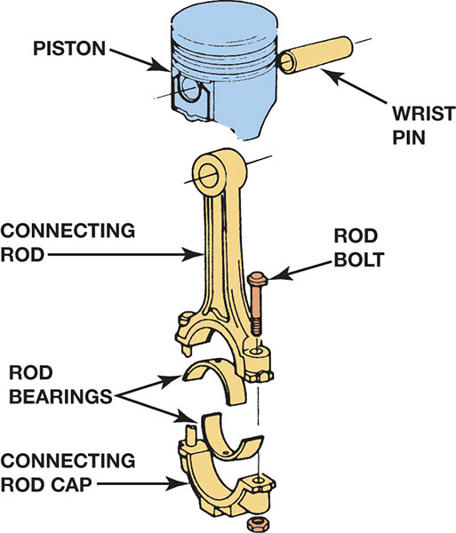
Figure 33.27 The connecting rod is the most highly stressed part of any engine because combustion pressure tries to compress it and piston inertia tries to pull it apart

Slide 51
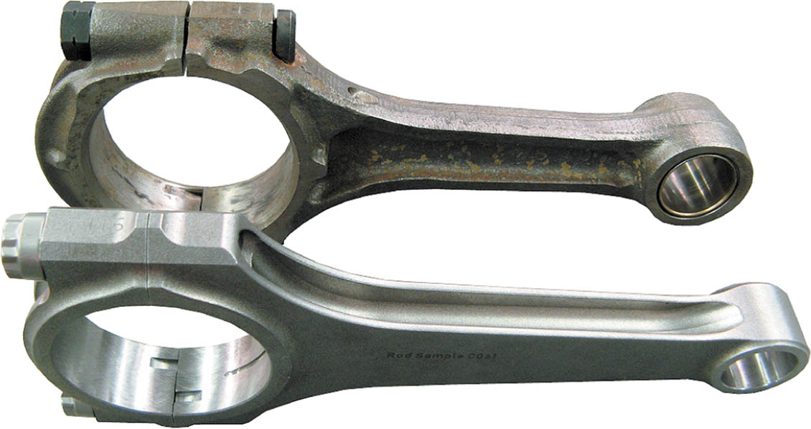
Figure 33.28 The I-beam shape is the most common (top connecting rod), but the H-beam shape is common in high-performance and racing engine applications

Slide 52
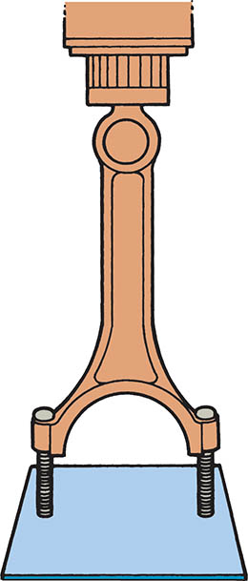
Figure 33.29 Rod bolts are quickly removed using a press

Slide 53
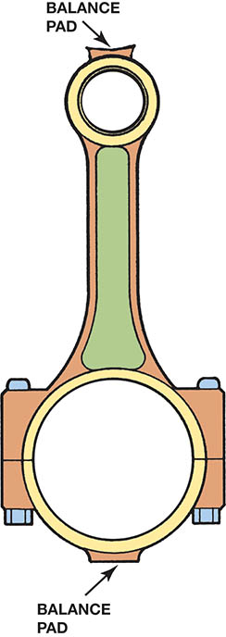
Figure 33.30 Some rods have balancing pads on each end of the connecting rod

Slide 54
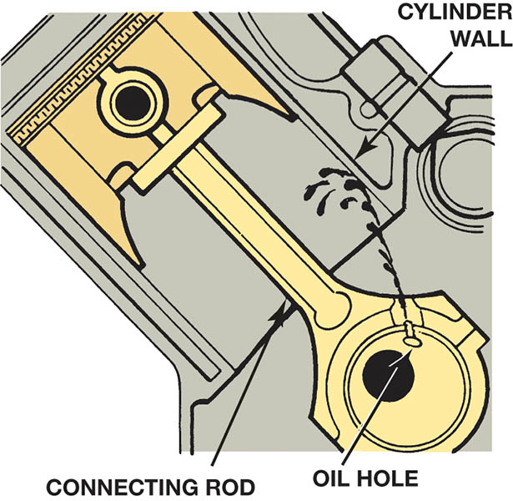
Figure 33.31 Some connecting rods have spit holes to help lubricate the cylinder wall or piston pin

Slide 55
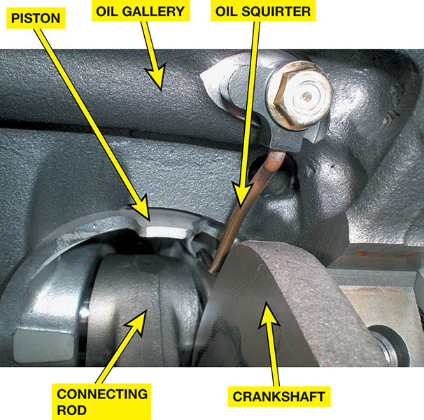
Figure 33.32 Some engines, such as this Ford diesel, are equipped with oil squirters that spray or stream oil toward the underneath side of the piston head to cool the piston

Slide 56
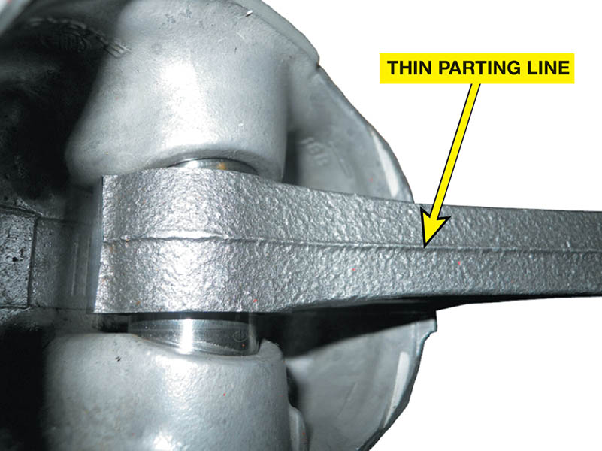
Figure 33.33 A cast connecting rod is found on many stock engines and can be identified by the thin parting line

Slide 57
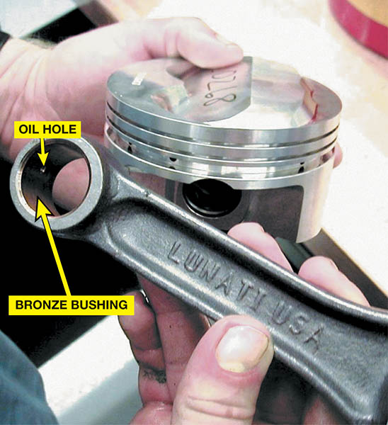
Figure 33.34 This high-performance connecting rod uses a bronze bushing in the small end of the rod and an oil hole to allow oil to reach the full-floating piston pin

Slide 58
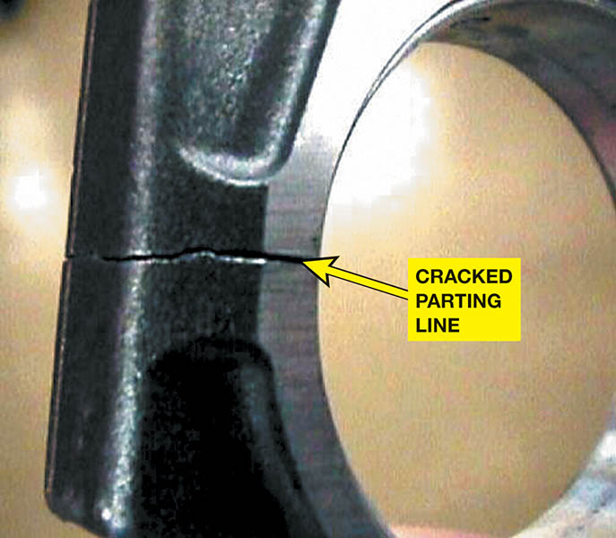
Figure 33.35 Powdered metal connecting rods feature a fractured parting line at the big end of the rod

Slide 59
CONNECTING ROD SERVICE
Removing Pistons From Rod
  Requires a special holding fixture.
Inspection
  Before connecting rod reconditioning, the rod should be checked for twist.
Reconditioning Procedure
  The parting surfaces of the rod and cap are smoothed to remove all high spots before resizing.
  The hole is then bored or honed to be perfectly round and of the size and finish required

Slide 60
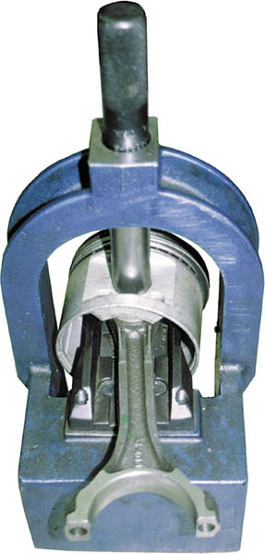
Figure 33.36 A press used to remove the connecting rod from the piston

Slide 61
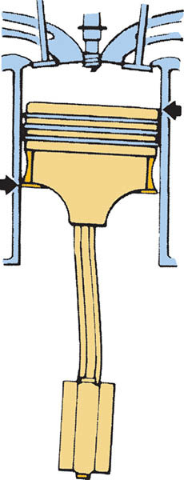
Figure 33.37 If the rod is twisted, it causes diagonal-type wear on the piston skirt

Slide 62
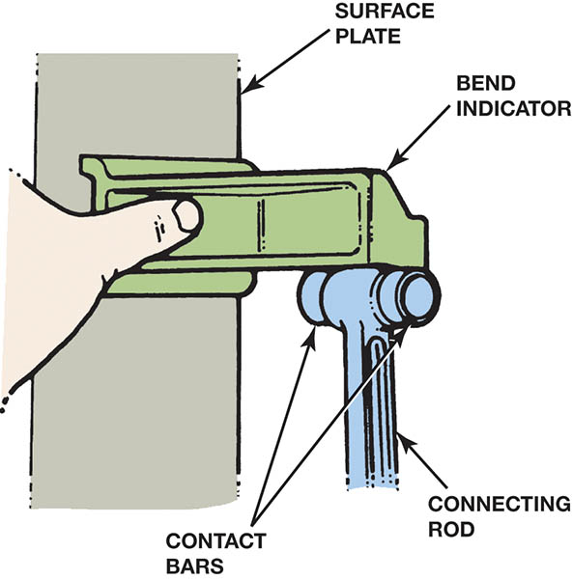
Figure 33.38 A rod alignment fixture is used to check a connecting rod for bends or twists

Slide 63
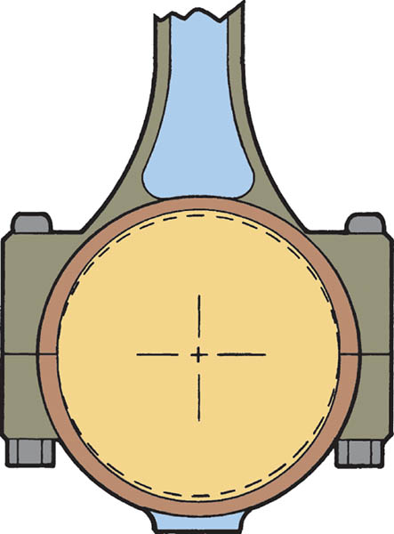
Figure 33.39 Rod bearing bores normally stretch from top to bottom, with most wear concentrated on the rod cap

Slide 64
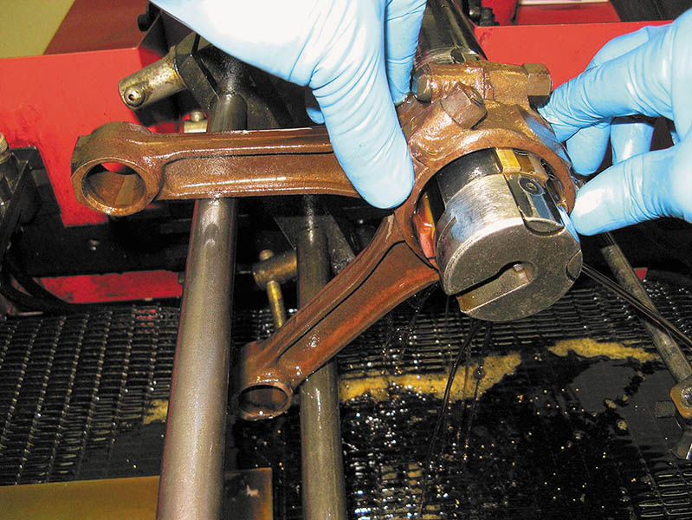
Figure 33.40 To help ensure that the big ends are honed straight, many experts recommend placing two rods together when performing the honing operation

Slide 65
PISTON AND ROD ASSEMBLY
Interference Fit Rods
  The small eye of the connecting rod is heated before the pin is installed.
Full-Floating Rods
  The full-floating piston pin is held in place with a lock ring at each end of the piston pin.

Slide 66
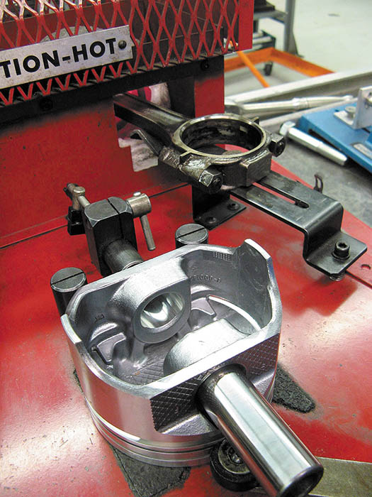
Figure 33.41 The small end of the rod is being heated in an electric heater and the piston is positioned properly so the piston pin can be installed as soon as the rod is removed from the heater

Slide 67
PISTON RING SERVICE
Step 1: Check the side clearance
Step 2: Check the ring gap
Step 3: Install oil control rings
Step 4: Install the compression rings
Step 5: Double check everything

Slide 68
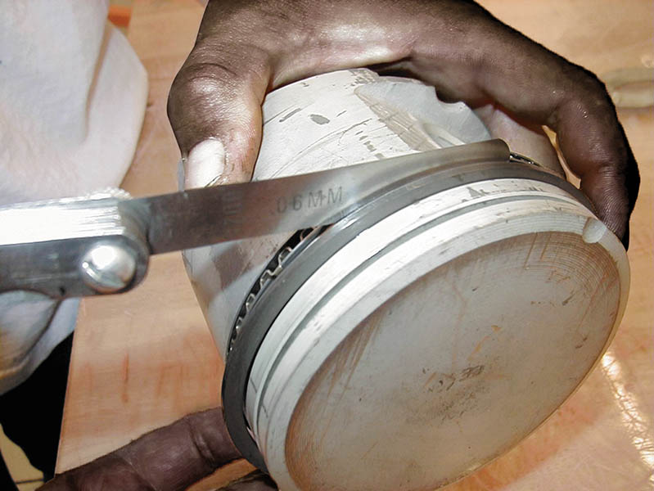
Figure 33.42 The side clearance of the piston ring is checked with a feeler gauge

Slide 69
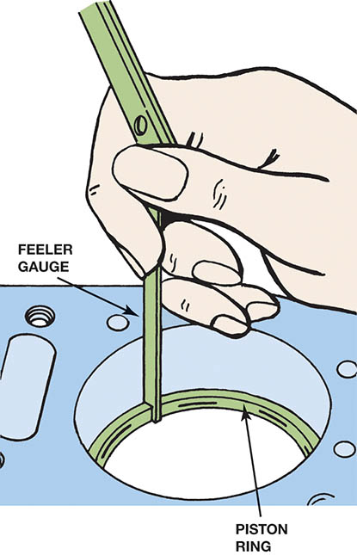
Figure 33.43 The ring gap is measured using a feeler gauge

Slide 70
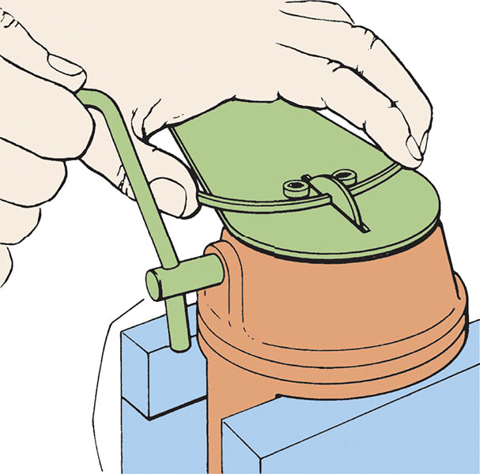
Figure 33.44 A hand-operated piston ring end gap grinder being used to increase the end gap of a piston ring so that it is within factory specifications

Slide 71
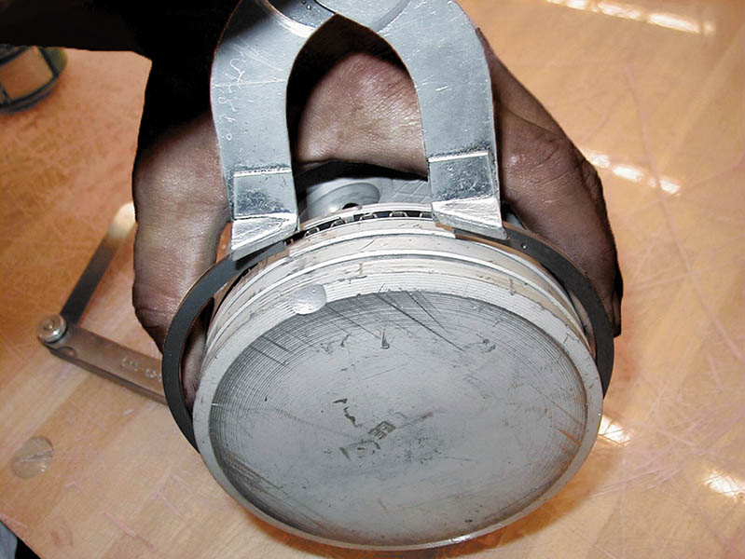
Figure 33.45 A typical ring expander being used to install a piston ring on a piston

Slide 72
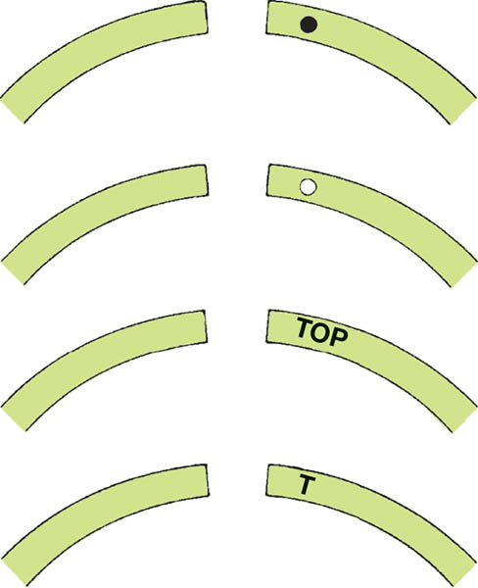
Figure 33.46 Identification marks used to indicate the side of the piston ring to be placed toward the head of the piston

Slide 73
QUESTION 3: ?
What causes the piston ring groove clearance to widen in service?

Slide 74
ANSWER 3:
The pounding of each ring in its groove gradually increases the piston ring side clearance.

Slide 75
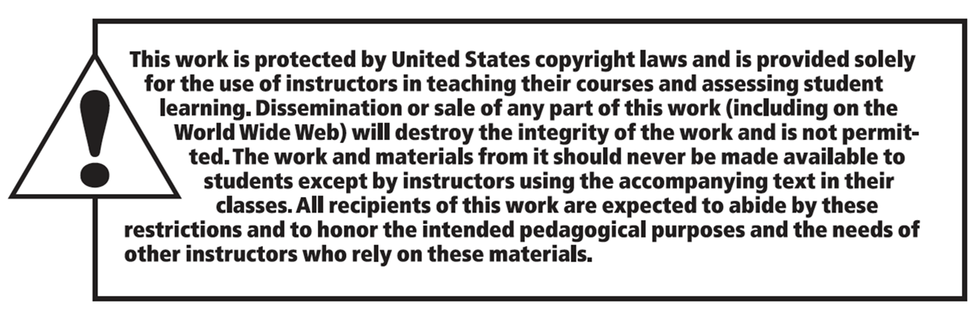
Copyright

