Slide 1

Automotive Technology Principles, Diagnosis, and Service
Sixth Edition
Chapter 32
Camshafts and Valve Trains
Copyright © 2018, 2015, 2011 Pearson Education, Inc. All Rights Reserved

Slide 2
LEARNING OBJECTIVES (1 of 2)
32.1 Describe the purpose and function of camshaft and camshaft design.
32.2 Discuss camshaft drives and camshaft movement.
32.3 Discuss rocker arms, pushrods, and lifters or tappets.
32.4 Explain overhead camshaft valve trains, their lubrication, and problem diagnosis.

Slide 3
LEARNING OBJECTIVES (2 of 2)
32.5 Explain camshaft specifications.
32.6 Explain how to remove, measure, and select a camshaft.
32.7 Explain variable valve timing, and variable lift and cylinder deactivation systems.

Slide 4
CAMSHAFT
Purpose and Function
The major function of a camshaft is to open the valves.
Operation: Camshaft is driven by
Timing Gears
Timing Chain
Timing Belt
Camshaft Location
In Block
In Cylinder Head

Slide 5
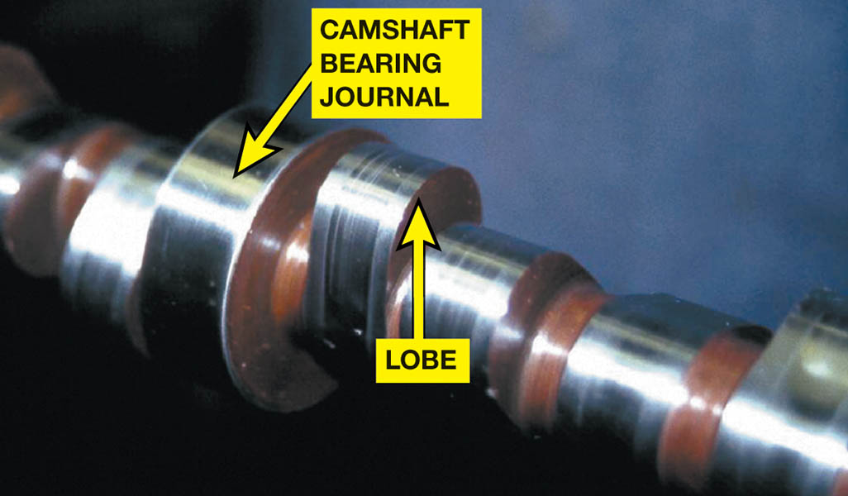
Figure 32.1 This high-performance camshaft has a lobe that opens the valve quickly and keeps it open for a long time

Slide 6
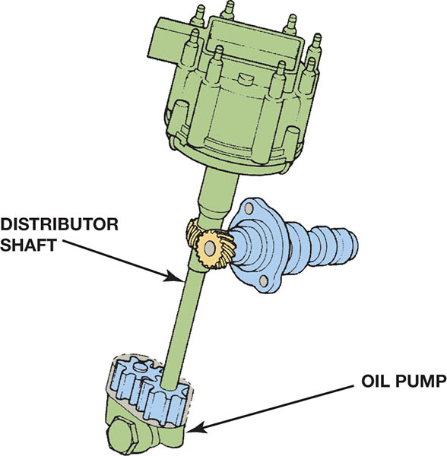
Figure 32.2 The camshaft drives the distributor and the oil pump through a shaft from the end of the distributor

Slide 7
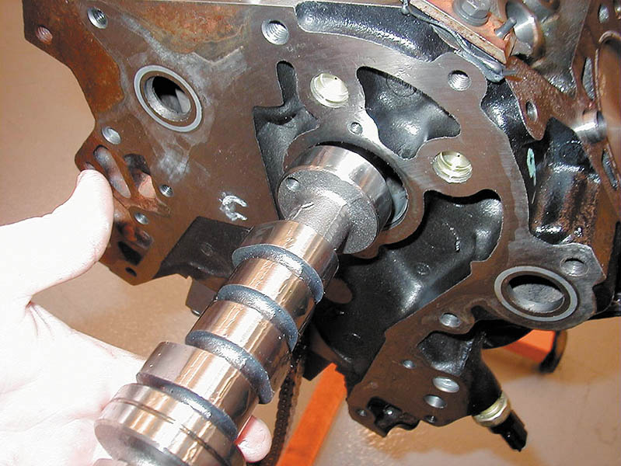
Figure 32.3 The camshaft rides on bearings inside the engine block above the crankshaft on a typical cam-in-block engine

Slide 8
CAMSHAFT DESIGN (1 OF 2)
Construction
Cast Iron
Composite Steel
Components
Lobes
Bearing Journals
Accessory Drive Gears

Slide 9
CAMSHAFT DESIGN (2 OF 2)
Camshaft Bearing Journals
Design depends on camshaft location
Hardness
Camshafts are hardened through liquid nitriding and gas nitriding.
Camshaft Lubrication
Main galley transferring lubricant to the camshaft journal.
An eccentric cam lobe for the high-pressure fuel pump on engines equipped with gasoline direct injection (GDI).

Slide 10
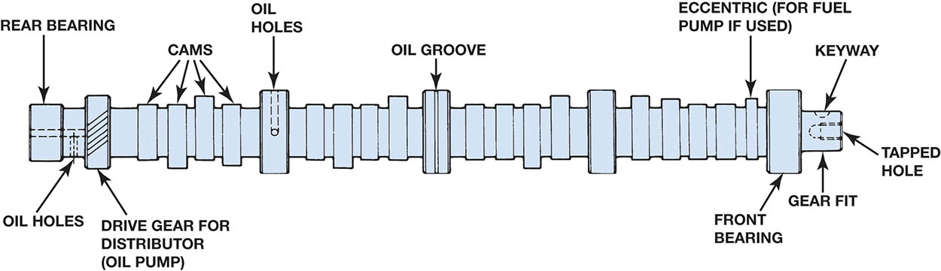
Figure 32.4 Parts of a cam and camshaft terms (nomenclature)

Slide 11
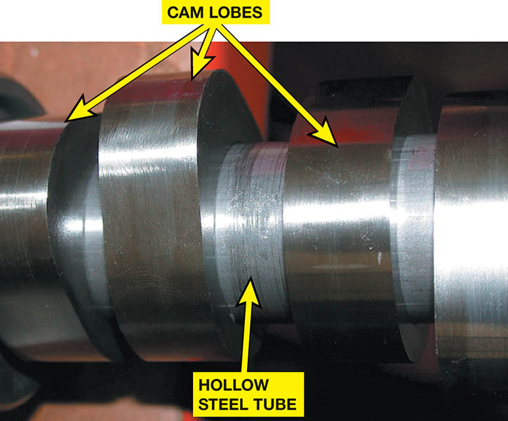
Figure 32.5 A composite camshaft is lightweight and yet flexible, because the hollow tube can absorb twisting forces and the lobes are hard enough to withstand the forces involved in opening valves

Slide 12
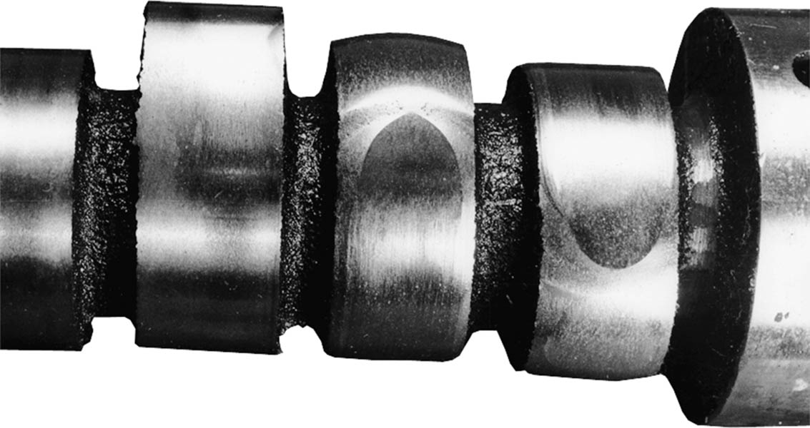
Figure 32.6 Worn camshaft with two lobes worn to the point of being almost round

Slide 13
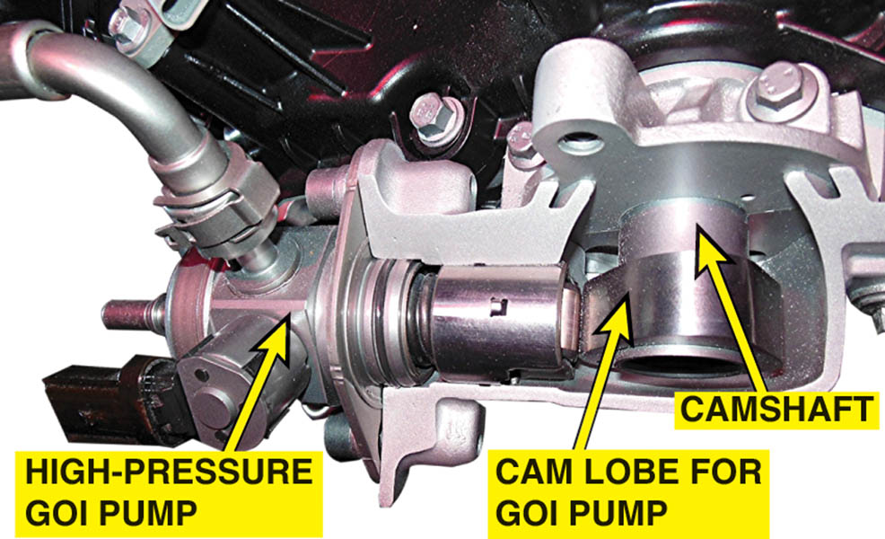
Figure 32.7 The camshaft powers the high-pressure fuel pump on engines equipped with gasoline direct injection

Slide 14
QUESTION 1: ?
How is the camshaft driven by the crankshaft?

Slide 15
ANSWER 1:
Timing gear, timing chain and timing belt.

Slide 16
CAMSHAFT DRIVES (1 OF 2)
Crankshaft drives the camshaft with
Timing gear
Timing chain
Timing belt
Timing Chain
Roller chain
Flat-link or Morse type
Tensioner
On the unloaded side of chain

Slide 17
CAMSHAFT DRIVES (2 OF 2)
Timing Belts
Rubber or fabric reinforced with Kevlar or fiberglass.
Replaced approximately ever 60,000 miles (100,000 Km)
Freewheeling Engine
No damage occurs when a timing belt fails.
Interference Engine
The valves will strike the top of the pistons when the timing belt fails.

Slide 18
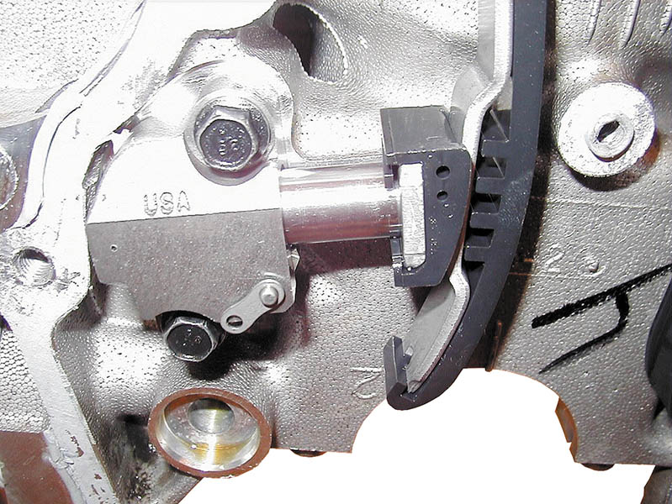
Figure 32.8 A timing chain hydraulic tensioner

Slide 19
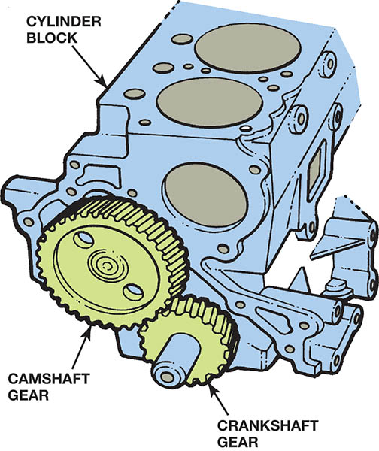
Figure 32.9 The larger camshaft gear is usually given a helical cut to help reduce noise.

Slide 20
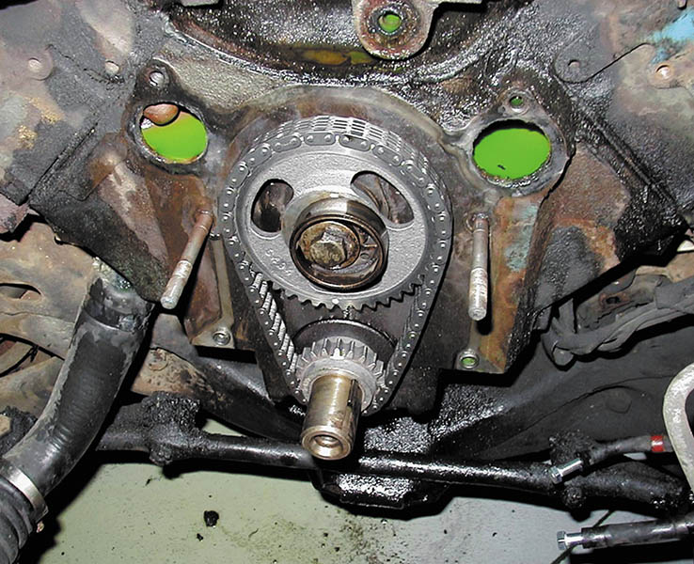
Figure 32.10 A replacement silent chain and sprockets. The original camshaft sprocket was aluminium with nylon teeth to help control noise. This replacement set should give the owner many thousands of miles of useful service

Slide 21
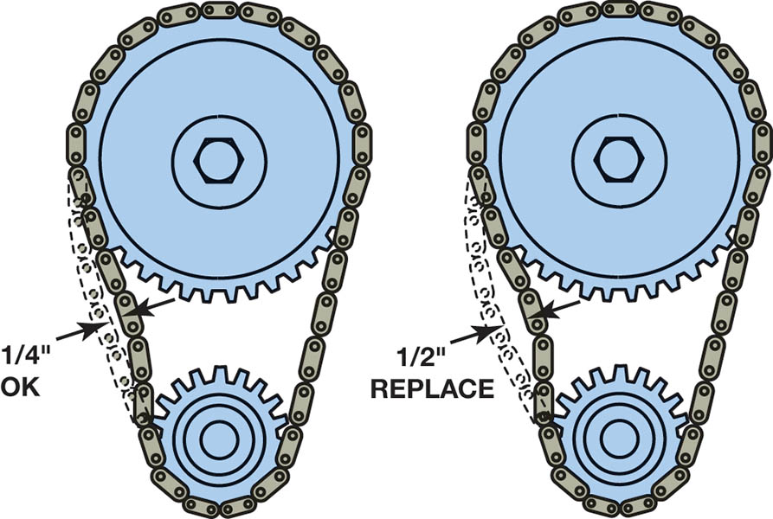
Figure 32.11 The industry standard for when a to replace a timing chain and gears is when a 1/2 inch (13 mm) or more of slack is measured in the chain.

Slide 22
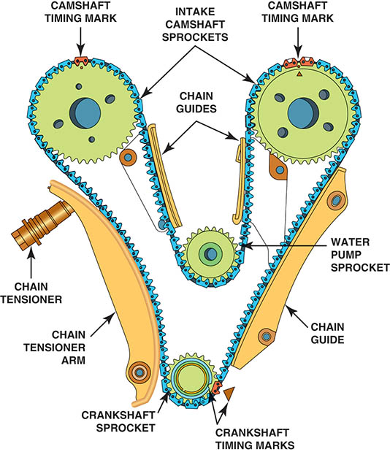
Figure 32.12 A typical overhead camshaft engine showing the location of the tensioner, water pump, and chain guide as well as the timing marks

Slide 23
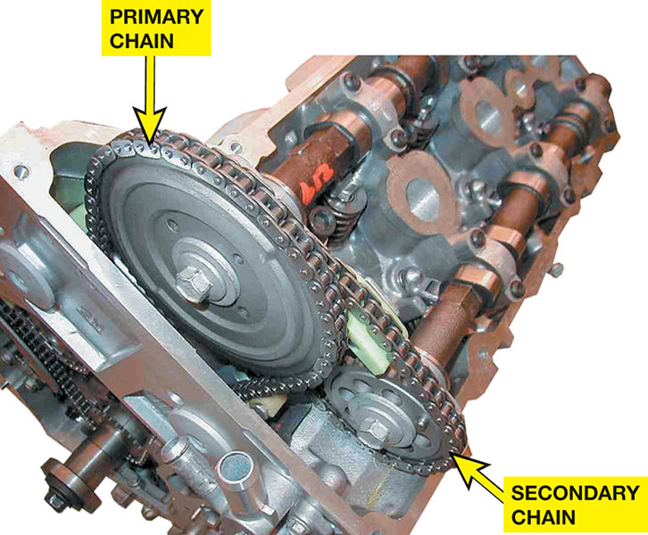
Figure 32.13 This dual overhead camshaft (DOHC) engine uses one chain from the crankshaft to the intake cam and a secondary chain to rotate the exhaust camshaft

Slide 24
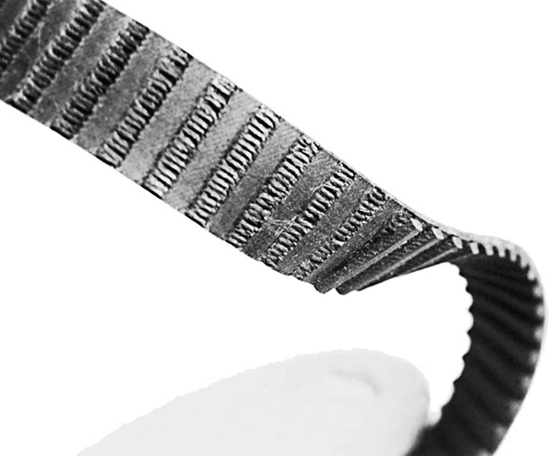
Figure 32.14 A timing belt failed when the teeth were sheared off. This belt failed at 88,000 miles because the owner failed to replace it at the recommended interval of 60,000 miles

Slide 25
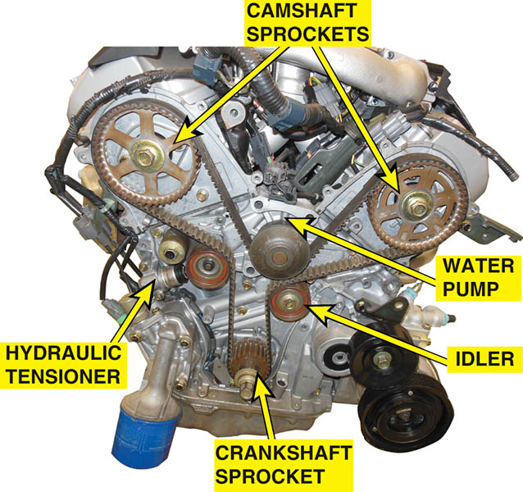
Figure 32.15 This timing belt broke because an oil leak from one of the camshaft seals caused oil to get into and weaken the belt.

Slide 26
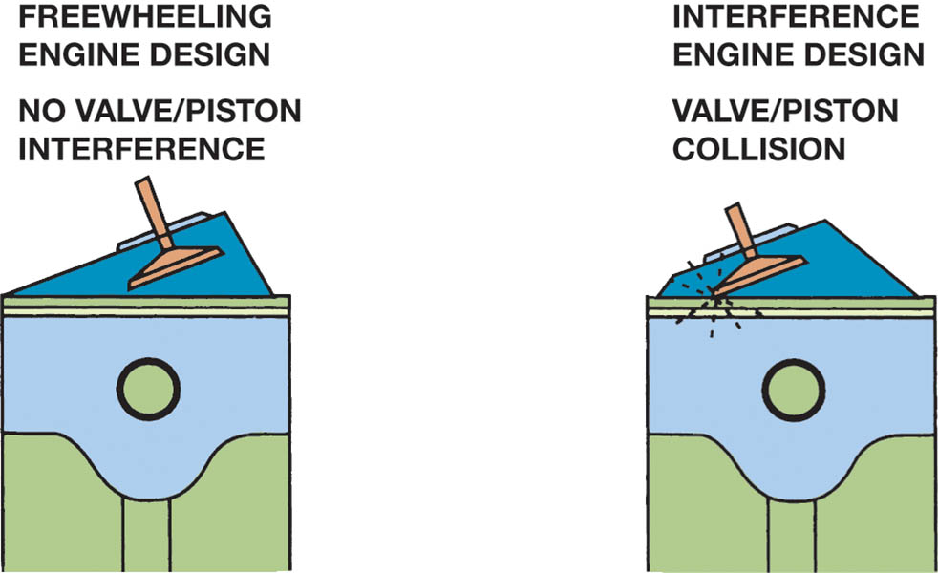
Figure 32.16 Many engines are of the interference design. If the timing belt (or chain) breaks, the piston and the valve will collide.

Slide 27
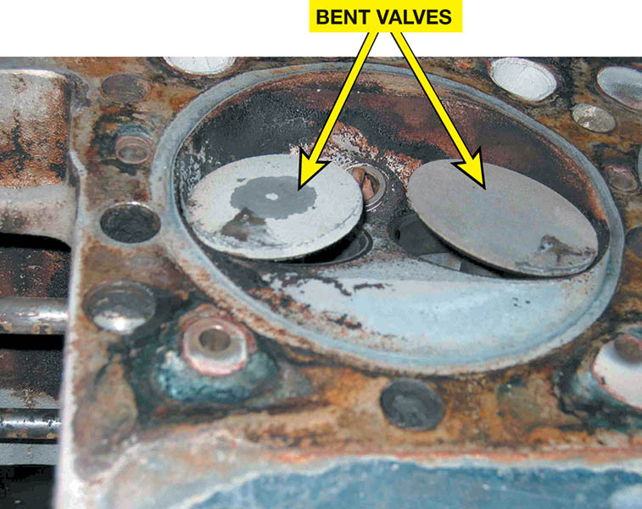
Figure 32.17 A head from a Mercedes showing bent valves when the timing chain stretched and skipped over the crankshaft sprocket.

Slide 28
QUESTION 2: ?
What is meant by an “interference” engine?

Slide 29
ANSWER 2:
If the timing is incorrect, the valves will strike the top of the pistons.

Slide 30
CAMSHAFT MOVEMENT
Cam Chucking
The movement of the camshaft lengthwise in the engine during operation.
Controlled with the use of thrust plates
Flat Bottom Lifters
Rotate because the contact point with lobe is slightly off center.
Camshaft Lobe Lift
Lift different for intake and exhaust valves

Slide 31
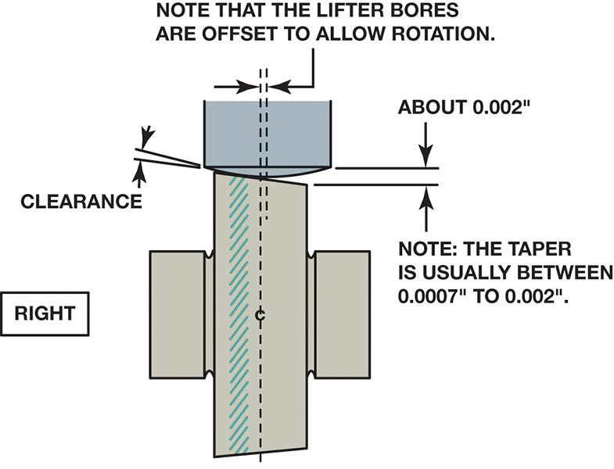
Figure 32.18 The slight angle and the curve on the bottom of a flat bottom lifter cause the lifter and the pushrod to rotate during normal operation

Slide 32
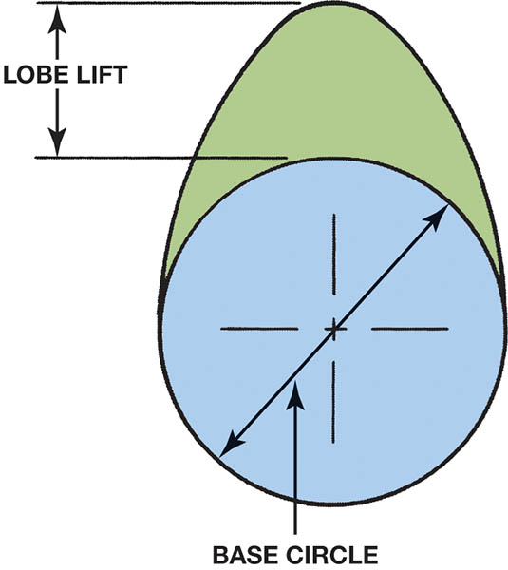
Figure 32.19 The lobe lift is the amount the cam lobe lifts the lifter. The blue circle is called the base circle.

Slide 33
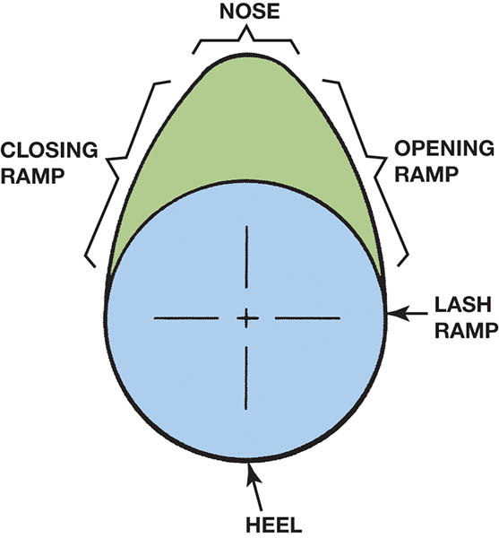
Figure 32.20 The ramps on the cam lobe allow the valves to be opened and closed quickly, yet under control, to avoid damaging valve train components.

Slide 34
ROCKER ARMS
A rocker arm reverses the upward movement of the pushrod to produce a downward movement on the tip of the valve.
Construction
Cast
Forged
Stamped Steel
Mounting Systems
Shaft-Mounted
Stud-Mounted
Pedestal-Mounted

Slide 35
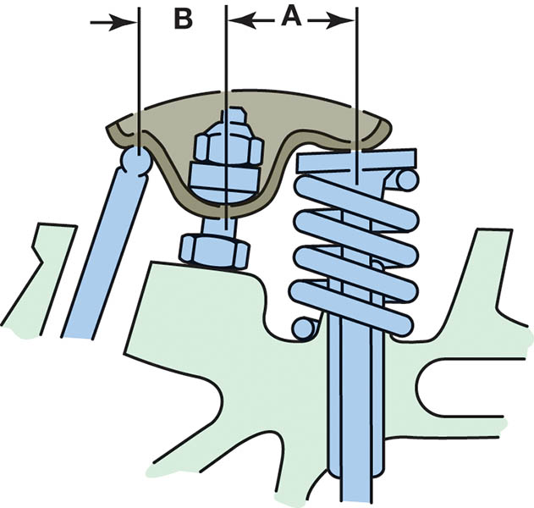
Figure 32.21 A 1.5:1 ratio rocker arm means that dimension A is 1.5 times the length of dimension B.

Slide 36
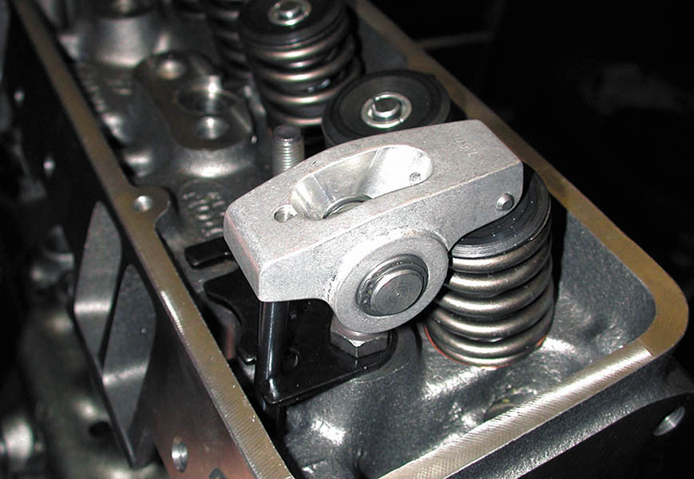
Figure 32.22 A high-performance aluminium roller rocker arm. Both the pivot and the tip that contacts the stem of the valve are equipped with rollers to help reduce friction for more power and better fuel economy

Slide 37
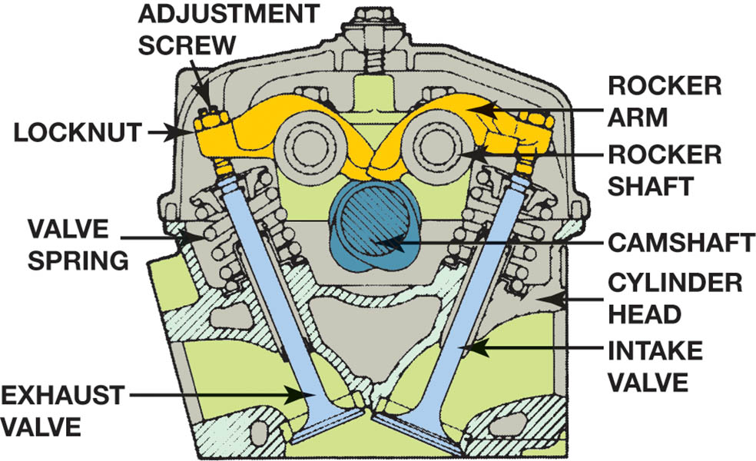
Figure 32.23 Some engines today use rocker shafts to support rocker arms, such as the V-6 engine with a single overhead camshaft located in the center of the cylinder head

Slide 38
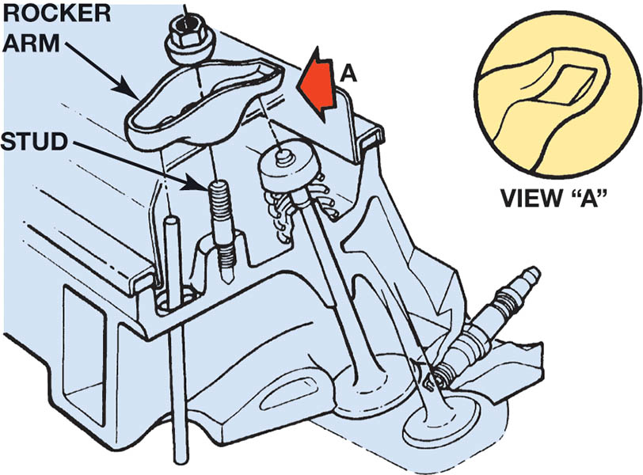
Figure 32.24 A typical stud-mounted rocker arm

Slide 39
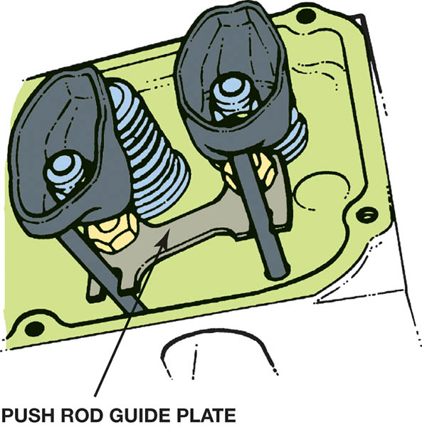
Figure 32.25 Pushrod guide plates are bolted to the head and help stabilize the valve train, especially at high engine speeds

Slide 40
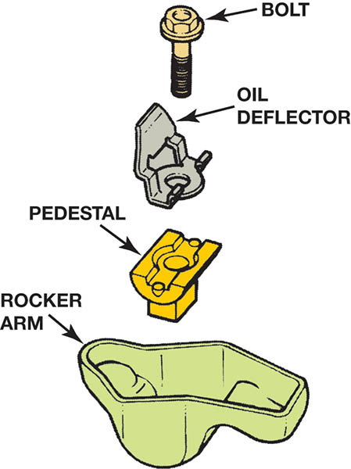
Figure 32.26 A pedestal-type rocker arm design that uses one bolt for each rocker arm and is nonadjustable. If valve lash needs to be adjusted, different length pushrod(s) must be used

Slide 41
PUSH RODS
Pushrods transfer the lifting motion of the valve train from the cam lobe and lifters to the rocker arms.
Types of Pushrods
Hollow pushrods
Solid pushrods
Hollow pushrods are difficult to clean. It is recommended they be replaced when servicing.

Slide 42
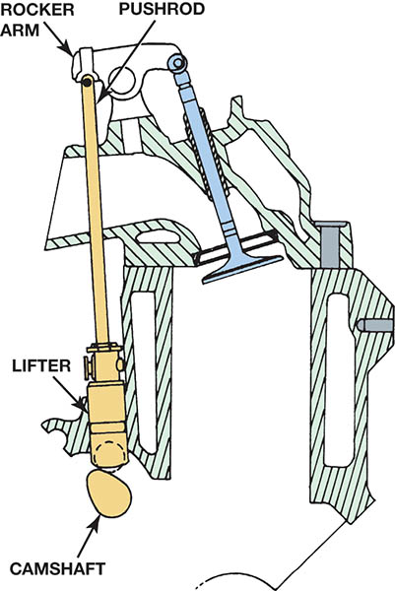
Figure 32.27 Overhead valve engines are also known as pushrod engines because of the long pushrod that extends from the lifter to the rocker arm

Slide 43
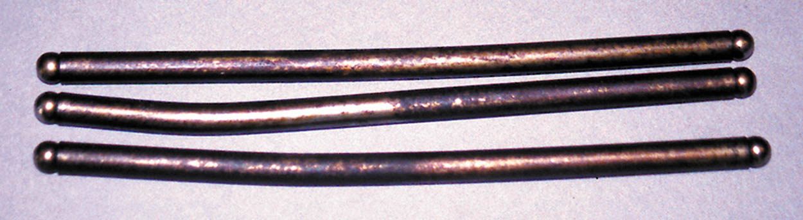
Figure 32.28 When the timing chain broke, the valves stopped moving up and down, but the pistons kept moving and hit the valves, causing the pushrods to bend

Slide 44
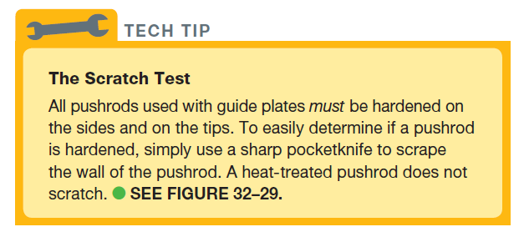
Tech Tip

Slide 45
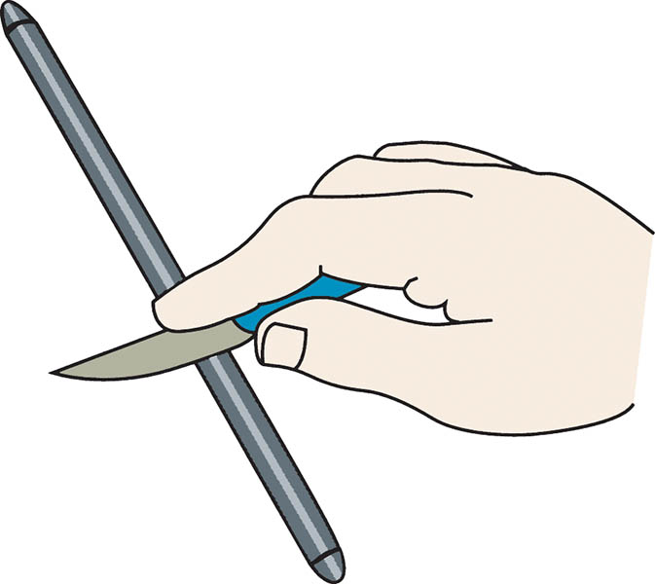
Figure 32.29 Hardened pushrods should be used in any engine that uses pushrod guides (plates). To determine if the pushrod is hardened, simply try to scratch the side of the pushrod with a pocketknife

Slide 46
LIFTERS OR TAPPETS
Valve lifters or tappets follow the contour or shape of the camshaft lobe.
Valve Lash
Valve train clearance
Mechanical or automatic hydraulic adjustment
Solid Lifters
Require a mechanical adjustment
Hydraulic Lifters
Automatically takes up the valve adjustment

Slide 47
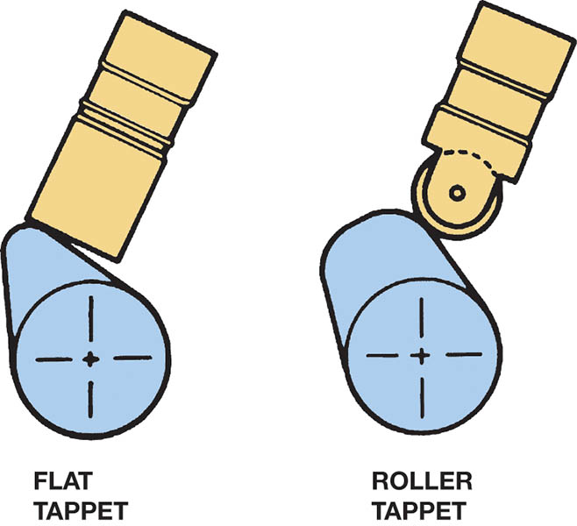
Figure 32.30 Older engines used flat-bottom lifters, whereas all engines since the 1990s use roller lifters

Slide 48
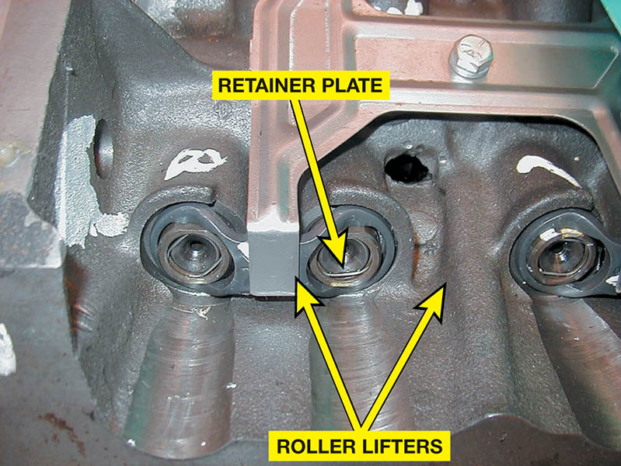
Figure 32.31 All roller lifters must use some method to keep the lifter straight and not rotating

Slide 49
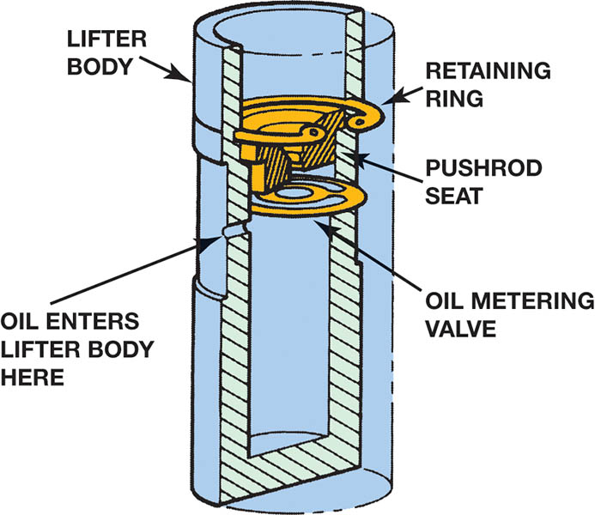
Figure 32.32 A cutaway of a flat-bottom solid lifter. Because this type of lifter contains a retaining ring and oil holes, it is sometimes confused with a hydraulic lifter that also contains additional parts.

Slide 50
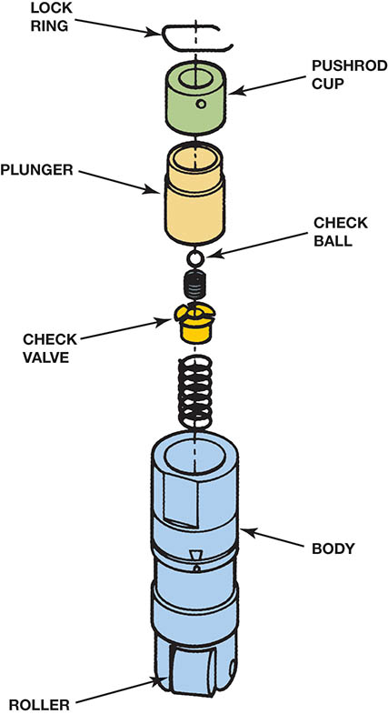
Figure 32.33 An exploded view of a hydraulic roller lifter

Slide 51
OVERHEAD CAMSHAFT VALVE TRAINS
Overhead camshaft engines use several different types of valve opening designs.
Open valves with a bucket
Cam follower
Rocker arm through a hydraulic lifter
Hydraulic lash adjuster
The lifters in an OHV engine are lubricated through oil passages drilled through the block.

Slide 52
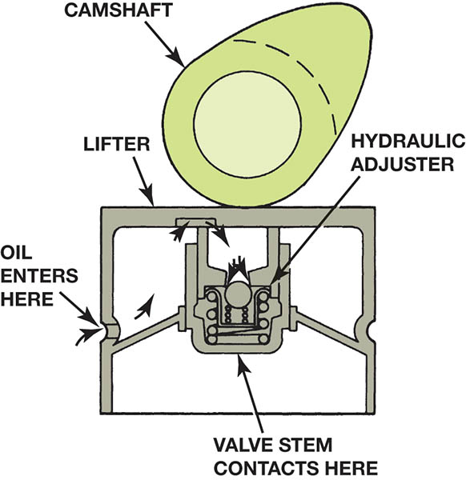
Figure 32.34 Hydraulic lifters may be built into bucket type lifters on some overhead camshaft engines

Slide 53
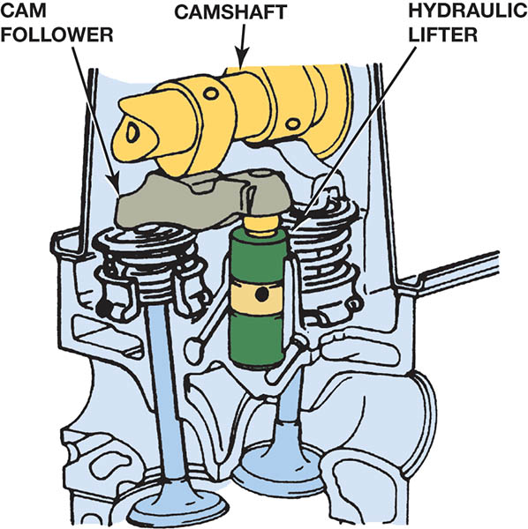
Figure 32.35 The use of cam followers allows the use of hydraulic lifters with an overhead camshaft design

Slide 54
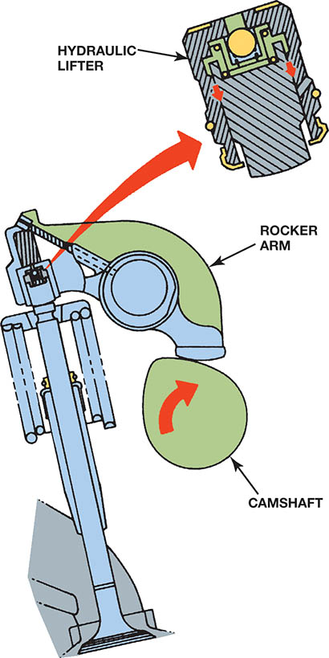
Figure 32.36 Hydraulic lash adjusters (HLA) are built into the rocker arm on some OHC engines. Sometimes HLAs may not bleed down properly if the wrong viscosity (SAE rating) oil is used

Slide 55
VALVE TRAIN PROBLEM DIAGNOSIS
Noise heard due to component wear.
Wear may be a result of
Oil level
Oil condition
Oil pressure
Incorrect oil filter
Incorrect oil

Slide 56
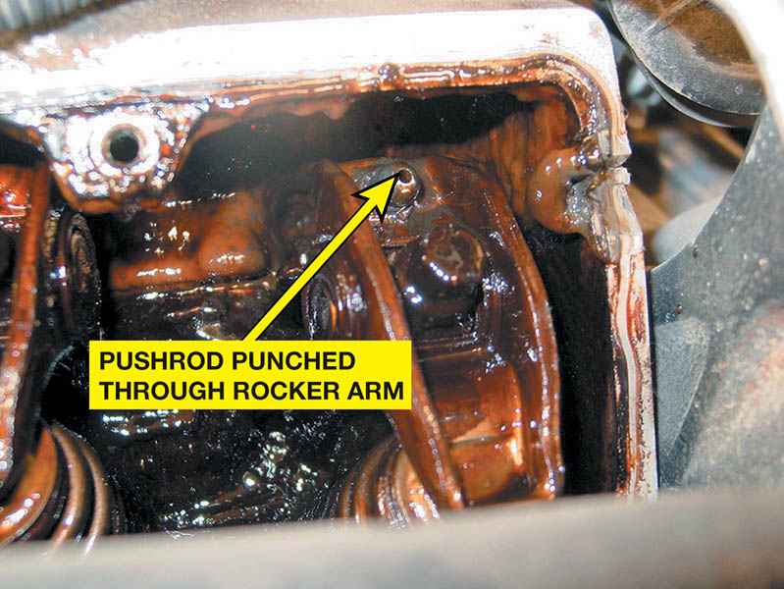
Figure 32.37 The cause of a misfire diagnostic trouble code was discovered to be a pushrod that had worn through the rocker arm on a General Motors 3.1 liter V-6 engine

Slide 57
CAMSHAFT SPECIFICATIONS
Duration
The number of degrees of crankshaft (not camshaft) rotation for which a valve is lifted off the seat.
Valve Overlap
The number of degrees of crankshaft rotation during which both intake and exhaust valves are open.
Lobe Centers
The separation between the centerlines of the intake and exhaust lobes

Slide 58
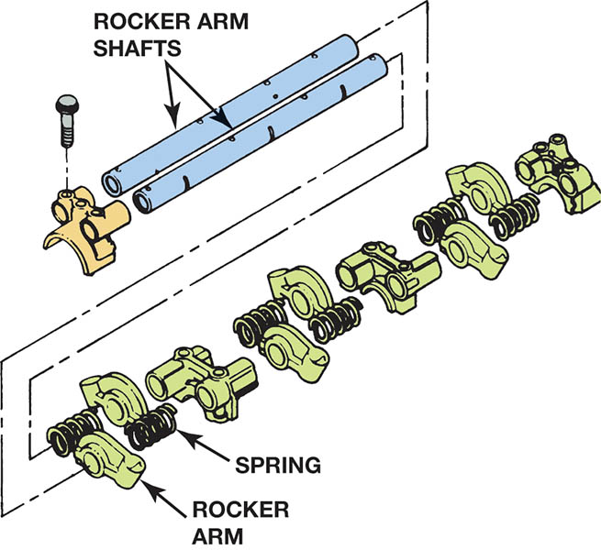
Figure 32.38 Shaft-mounted rocker arms are held in position by an assortment of springs, spacers, and washers, which should be removed so that the entire shaft can be inspected for wear

Slide 59
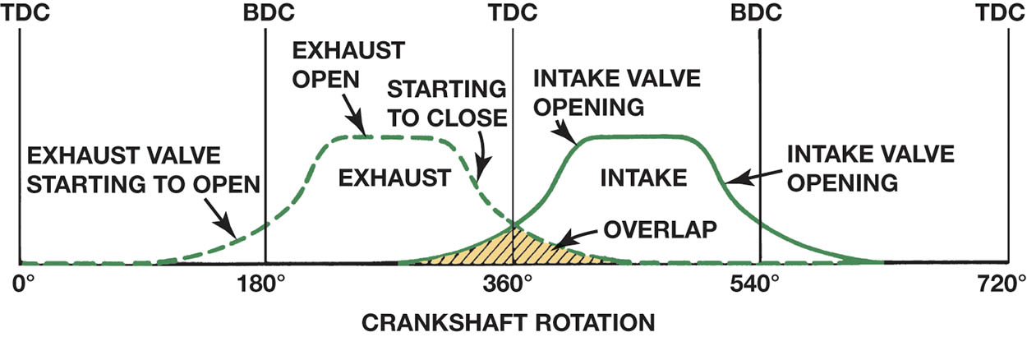
Figure 32.39 Graphic representation of a typical camshaft showing the relationship between the intake and exhaust valves. The shaded area represents the overlap period of 100 degrees

Slide 60
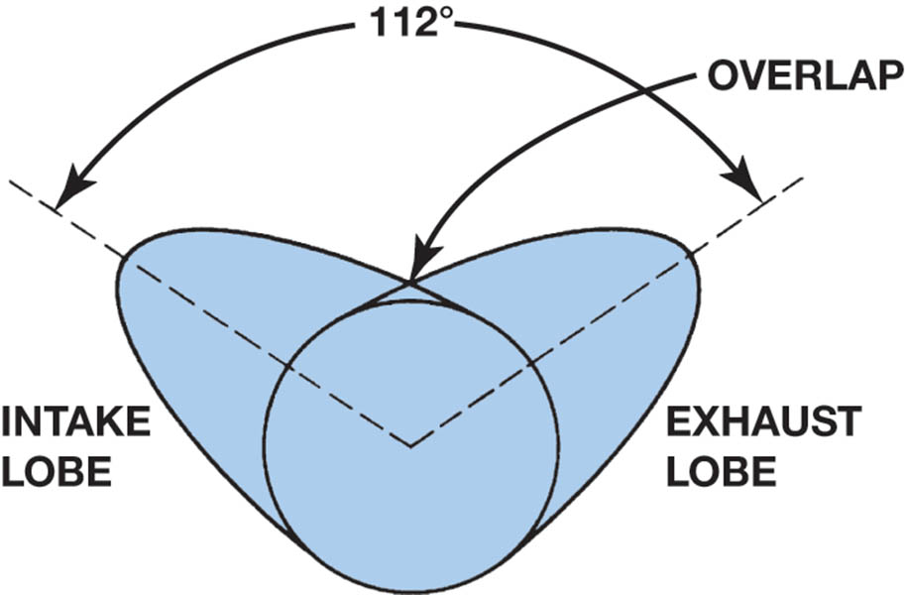
Figure 32.40 As the lobe center angle decreases, the overlap increases, with no other changes in the lobe profile lift and duration

Slide 61
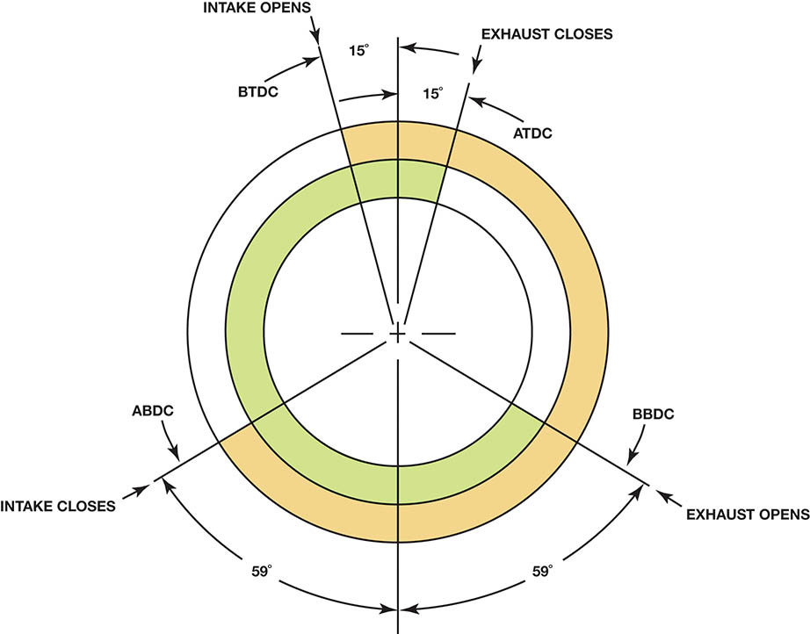
Figure 32.41 Typical cam timing diagram

Slide 62
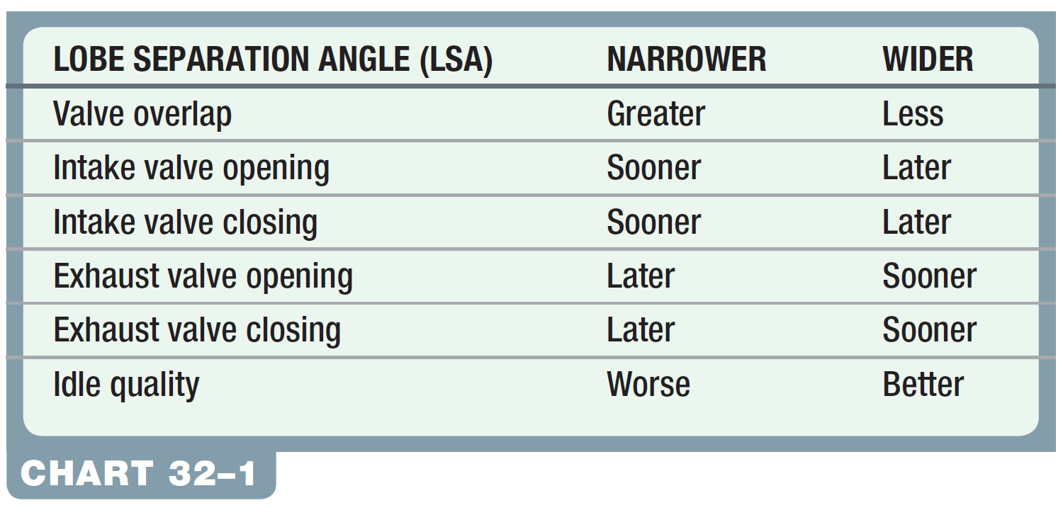
Chart 32-1 Changing the lobe separation angle has major effect on engine operation.

Slide 63
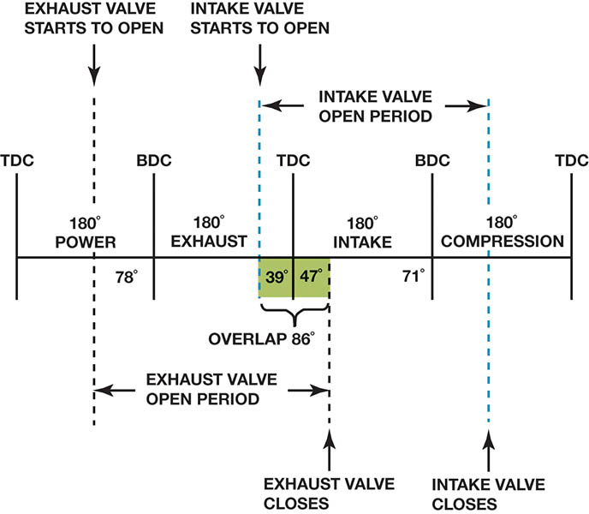
Figure 32.42 Typical high-performance camshaft specifications on a straight-line graph. Intake valve duration = 39 + 180 + 71 = 290 degrees. Exhaust valve duration = 7 + 180 + 47 = 234 degrees.

Slide 64
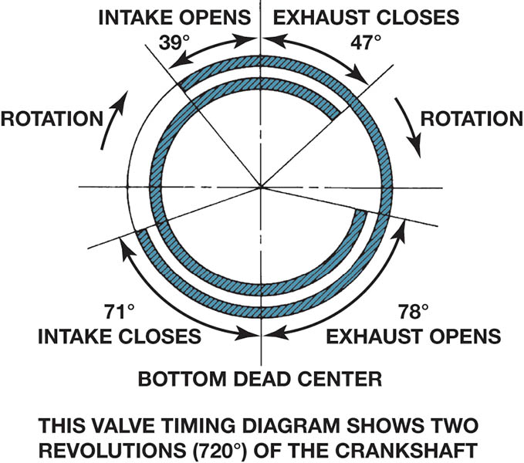
Figure 32.43 Typical camshaft valve timing diagram with the same specifications as those shown in Figure 32–36

Slide 65
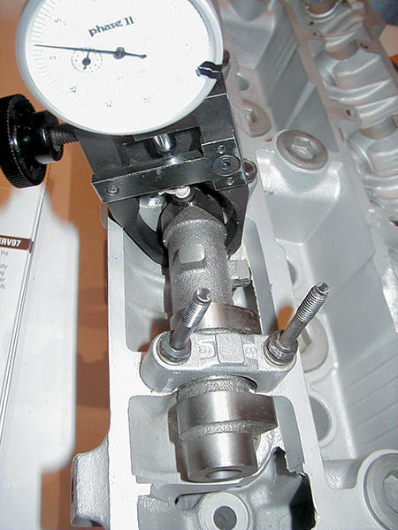
Figure 32.44 A dial indicator being used to measure cam lobe height

Slide 66
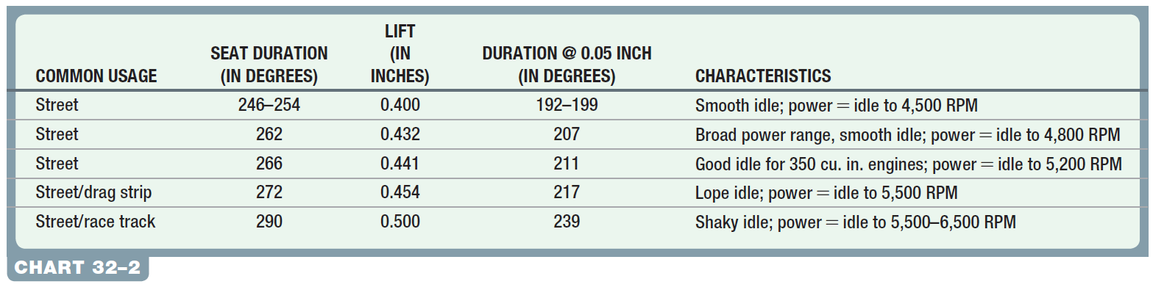
Chart 32-2 A comparison showing the effects of valve timing and lift on engine performance.

Slide 67
VARIABLE VALVE TIMING
Changes the camshaft specifications during different operating modes.
The general types of variable valve timing include:
Intake valve timing only
Exhaust valve timing only
Both intake and exhaust valve timing
Operation
The camshaft position actuator oil control valve (OCV) directs oil from the oil feed in the head to the appropriate camshaft position actuator oil passages.

Slide 68
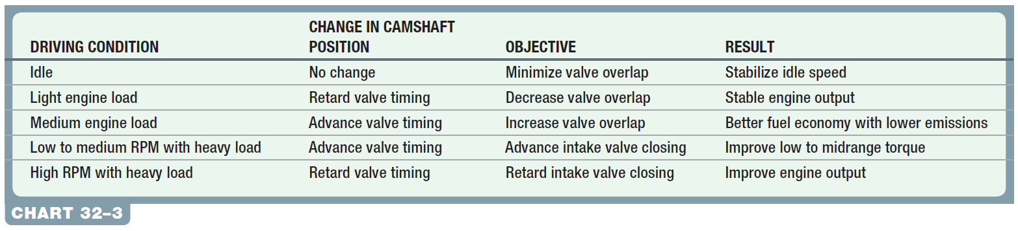
Chart 32-3 The purpose for varying the cam timing includes providing for more engine torque and power over a wide engine speed and load range.

Slide 69
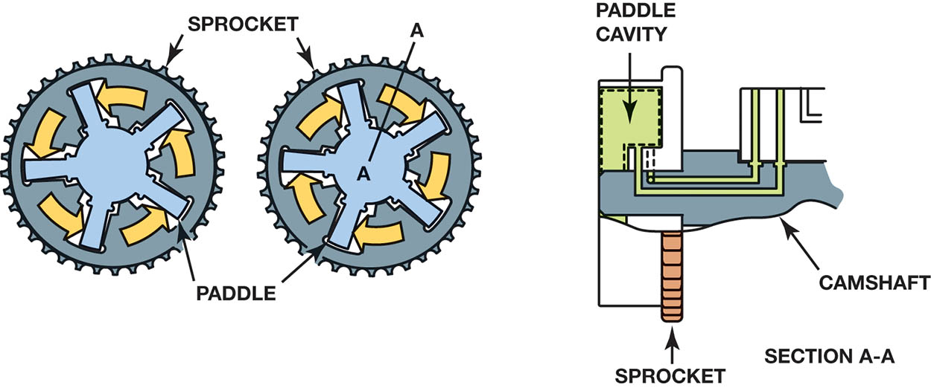
Figure 32.45 Camshaft rotation during advance and retard

Slide 70
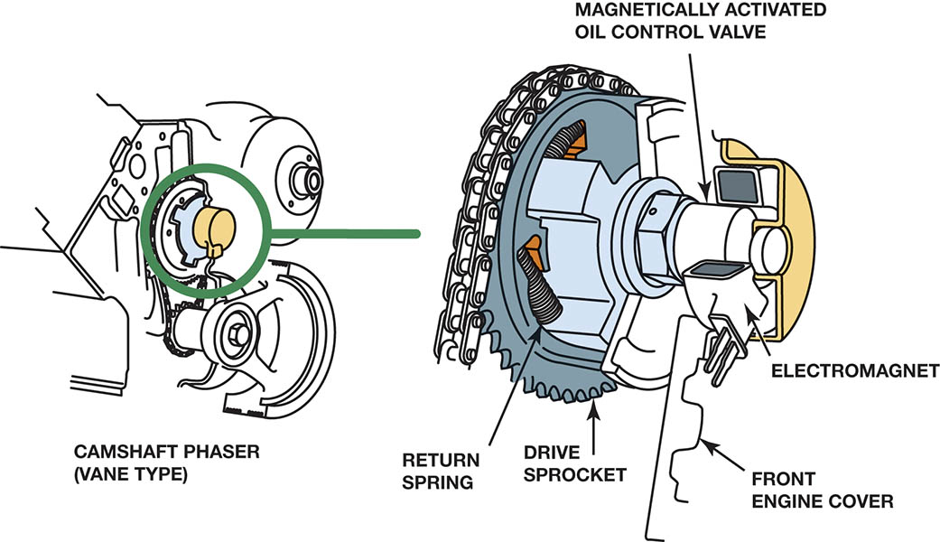
Figure 32.46 The camshaft is rotated in relation to the crankshaft by the PCM to provide changes in valve timing

Slide 71

Chart 32-4 Changing the exhaust cam timing mainly helps reduce exhaust emissions, whereas changing the intake cam timing mainly helps the engine produce increased power and torque.

Slide 72

Figure 32.47 Spline cam phaser assembly

Slide 73

Figure 32.48 A spline phaser

Slide 74

TECH TIP

Slide 75

Figure 32.49 The screen(s) protect the solenoid valve from dirt and debris that can cause the valve to stick.

Slide 76

Figure 32.50 A vane phaser is used to move the camshaft, using changes in oil pressure from the oil control valve

Slide 77

Figure 32.51 A magnetically controlled vane phaser

Slide 78

Figure 32.52 A camshaft position actuator used in a cam-in-block engine

Slide 79
VARIABLE LIFT AND CYLINDER DEACTIVATION SYSTEMS
Variable Lift
This system uses two different camshafts for low and high RPM.
Engine oil controlled
Cylinder Deactivation
Some engines are designed to operate on four of eight cylinders, or three of six cylinders, during low load conditions to improve fuel economy.
The system uses two-stage hydraulic valve lifters.

Slide 80

Figure 32.53 A plastic mockup of a Honda VTEC system that uses two different camshaft profiles—one for low-speed engine operation and the other for high speed

Slide 81

Figure 32.54 Engine oil pressure is used to switch cam lobes on a VTEC system

Slide 82

Figure 32.55 Oil pressure applied to the locking pin causes the inside of the lifter to freely move inside the outer shell of the lifter, thereby keeping the valve closed

Slide 83

Figure 32.56 Active fuel management includes many different components and changes to the oiling system, which makes routine oil changes even more important on engines equipped with this system

Slide 84
QUESTION 3: ?
How does variable valve timing help improve engine operation
and reduce emissions?

Slide 85
ANSWER 3:
By changing the timing of the opening and closing of the intake and exhaust valves, the level of NOx emissions can be lowered.

Slide 86

Copyright

