Slide 1

Automotive Technology Principles, Diagnosis, and Service
Sixth Edition
Chapter 31
Valve and Seat Service
Copyright © 2018, 2015, 2011 Pearson Education, Inc. All Rights Reserved

Slide 2
LEARNING OBJECTIVES (1 of 2)
31.1 Discuss intake and exhaust valves.
31.2. Describe valve seats and the valve fault diagnosis procedure.
31.3. Explain valve springs, keepers, and rotators.
31.4 Discuss the procedure for valve reconditioning, valve face grinding, and valve seat reconditioning.

Slide 3
LEARNING OBJECTIVES (2 of 2)
31.5 Discuss valve guide pilots, valve seat grinding stones, and valve seat cutters.
31.6 Explain valve seat testing and replacement.
31.7 Discuss valve stem height and installed height.
31.8 Explain valve stem seals and describe the procedure of installing valves.

Slide 4
INTAKE AND EXHAUST VALVES (1 OF 2)
Terminology
Automotive engine valves are of a poppet valve design. The term poppet refers to the shape of the valve.
Parts Involved
Valve, spring(s), retainer, keepers, seal and seat.
Valve Size Relationships
Intake valve head diameters that measure approximately 45% of the bore size.
The exhaust valve head diameter is approximately 38% of the cylinder bore size.

Slide 5
INTAKE AND EXHAUST VALVES (2 OF 2)
Valve Materials
Alloy Steel, Stellite, Inconal, Titanium, Stainless Steel, Aluminized
Sodium Filled Valves
A hollow stem exhaust valves that are partially filled with metallic sodium. The sodium in the valve becomes a liquid at operating temperatures.
The sodium transfers heat from the valve head to the valve stem.

Slide 6
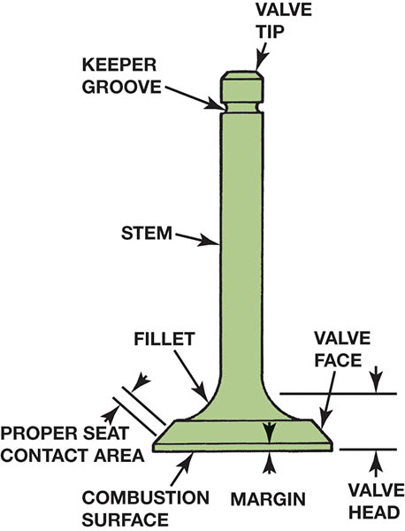
Figure 31.1 Identification of the parts of a valve

Slide 7
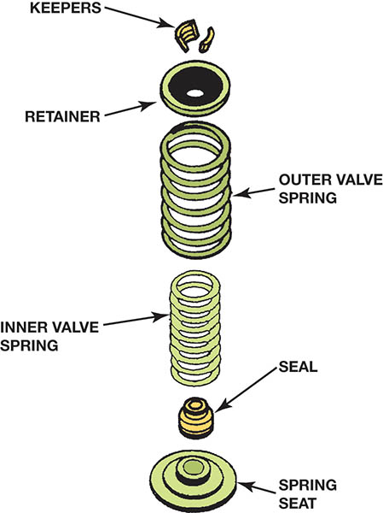
Figure 31.2 Typical valve spring and related components. Dual valve springs are used to reduce valve train vibrations and a spring seat is used to protect aluminum heads

Slide 8
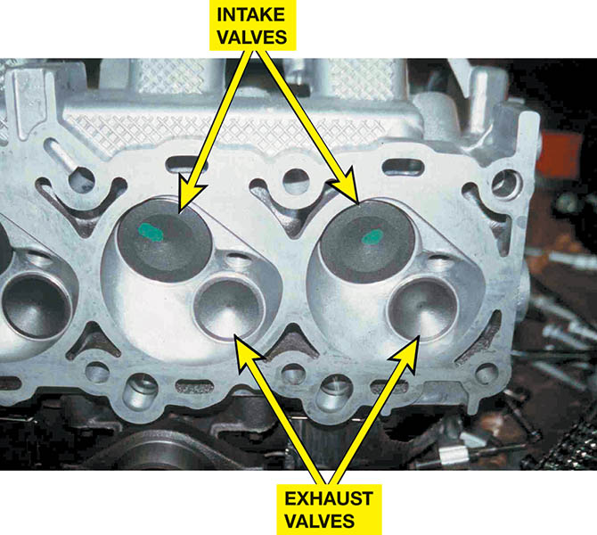
Figure 31.3 The intake valve is larger than the exhaust valve because the intake charge is being drawn into the combustion chamber at a low speed due to differences in pressure between atmospheric pressure and the pressure (vacuum) inside the cylinder.

Slide 9
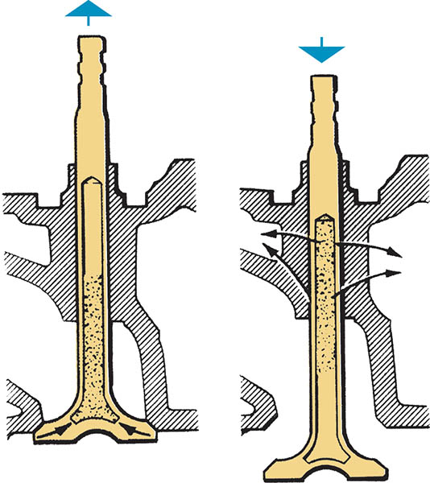
Figure 31.4 A sodium-filled valve uses a hollow stem, which is partially filled with metallic sodium (a liquid when hot) to conduct heat away from the head of the valve

Slide 10
VALVE SEATS
Integral Seats
The seat is generally formed as part of the cast-iron head
Insert Seats
An insert seat fits into a machined recess in the steel or aluminum cylinder head.

Slide 11
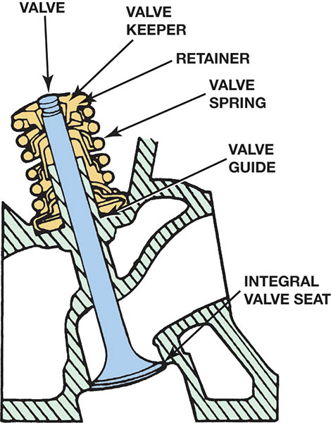
Figure 31.5 Integral valve seats are machined directly into the cast-iron cylinder head and are induction hardened to prevent wear

Slide 12
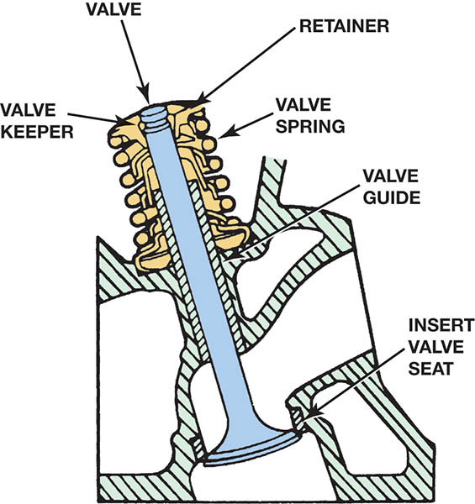
Figure 31.6 Insert valve seats are a separate part that is interference fitted to a counterbore in the cylinder head

Slide 13
VALVE FAULT DIAGNOSIS (1 OF 2)
Poor Valve Seating
A valve seat recession can result from improper valve lash adjustments on solid lifter engines. It can also result from misadjustments on a valve train using hydraulic lifters.
Carbon Deposits
If there is a large clearance between the valve stem and guide or faulty valve stem seals, too much oil will go down the stem. This will increase deposits.

Slide 14
VALVE FAULT DAIGNOSIS (2 OF 2)
Excessive Temperatures
High temperatures caused by cooling system concerns or preignition and detonation.
Valve Seat Erosion
Found in engines that require leaded gasoline.
High-Velocity Seating
Excessive wear caused by impact failure.

Slide 15
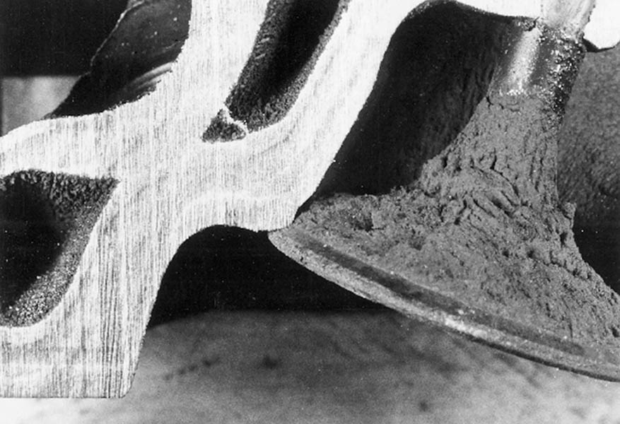
Figure 31.7 Typical intake valve seat wear

Slide 16
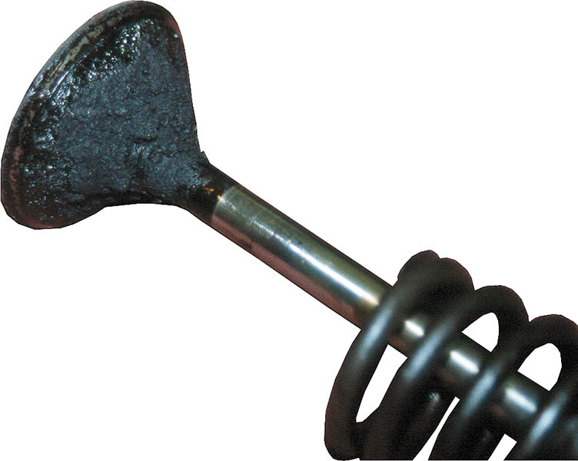
Figure 31.8 Carbon deposits on the intake valve are often caused by oil getting past the valve stems or fuel deposits

Slide 17
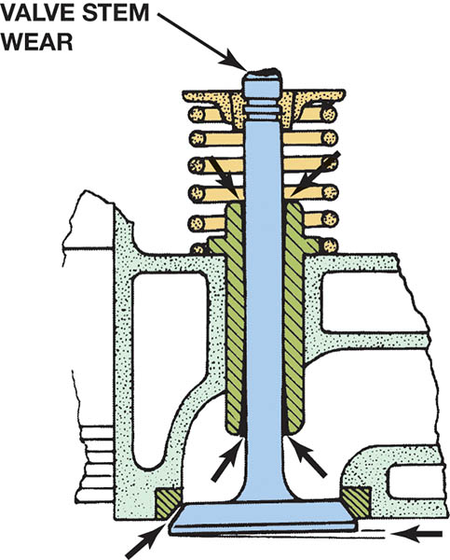
Figure 31.9 Excessive wear of the valve stem or guide can cause the valve to seat in a cocked position

Slide 18
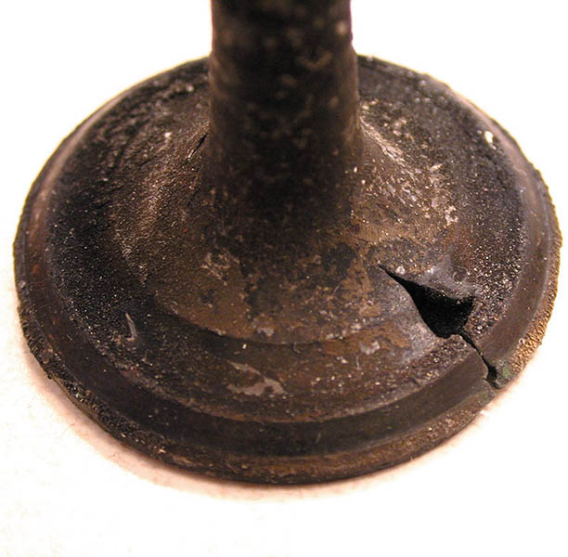
Figure 31.10 Valve face guttering caused by thermal shock

Slide 19
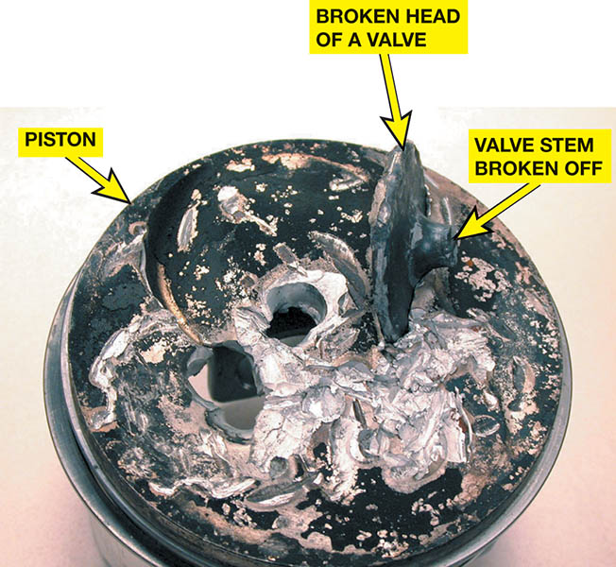
Figure 31.11 Note the broken piston caused by a valve breaking from the stem

Slide 20
QUESTION 1: ?
What are the two of the most common valve fault failures?

Slide 21
ANSWER 1:
Valve seat failure and carbon deposits.

Slide 22
VALVE SPRINGS (1 OF 2)
Purpose and Function
A valve spring holds the valve against the seat when the valve is not being opened.
Spring Materials and Design
The springs are generally made of chromium vanadium alloy steel.
Valves usually have a single valve spring.
Multiple valve springs are used where large camshaft lobe lifts are required and a single spring does not have enough strength to control the valve.

Slide 23
VALVE SPRINGS (2 OF 2)
Variable Rate Springs
Variable rate springs, also called progressive rate or variable pitch springs, have uneven spacing between the coils.
Valve Spring Inspection
The valve springs are checked for squareness by rotating them on a flat surface with a square held against the side.
Only the springs that are square should be checked to determine their compressed force.

Slide 24
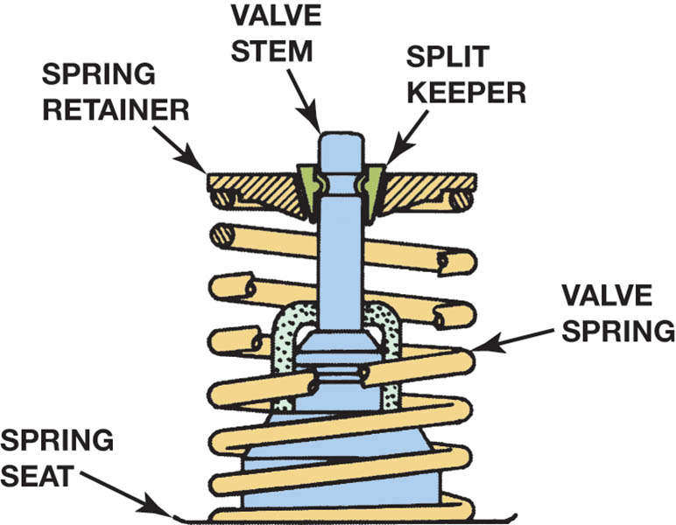
Figure 31.12 A retainer and two split keepers hold the spring in place on the valve. A separate metal washer is used on aluminum heads.

Slide 25
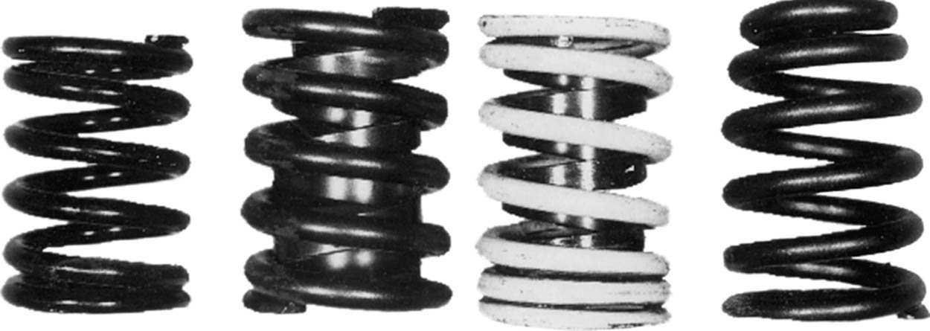
Figure 31.13 Valve spring types (left to right): coil spring with equally spaced coils; spring with damper inside spring coil; closely spaced spring with a damper; taper wound coil spring

Slide 26
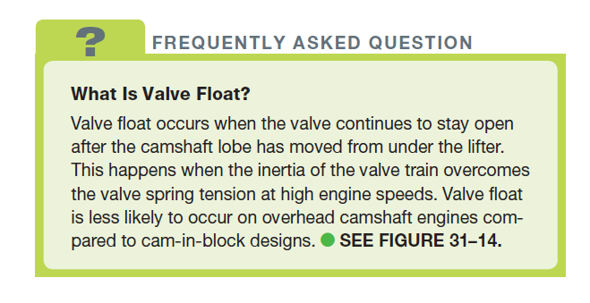
FREQUENTLY ASKED QUESTION

Slide 27
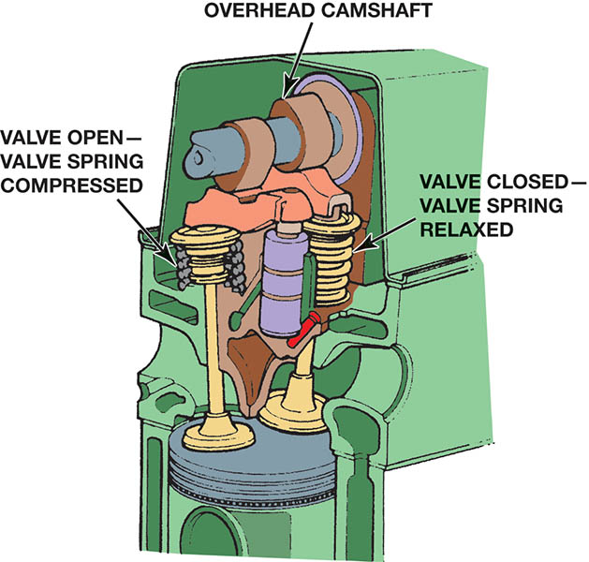
Figure 31.14 Valve springs maintain tension in the valve train when the valve is open to prevent valve float, but must not exert so much tension that the cam lobes and lifters begin to wear

Slide 28
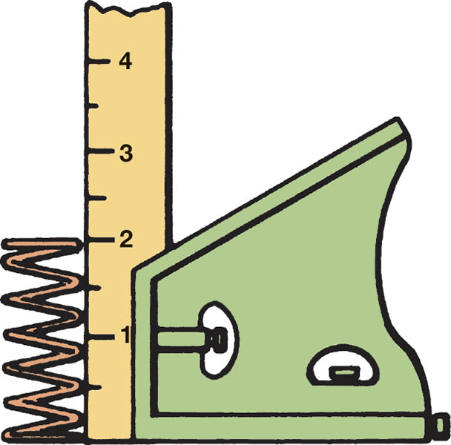
Figure 31.15 All valve springs should be checked for squareness by using a square on a flat surface and rotating the spring while checking.

Slide 29
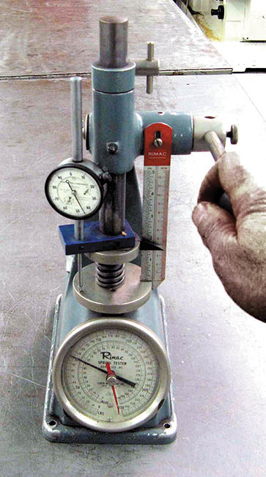
Figure 31.16 One popular type of valve spring tester used to measure the compressed force of valve springs.

Slide 30
QUESTION 2: ?
What two items must be checked when testing valve springs?

Slide 31
ANSWER 2:
Squareness and compression.

Slide 32
VALVE KEEPERS AND ROTATORS
Valve Keepers
Valve keepers (locks) are used on the end of the valve stem to retain the spring.
Valve Rotators
Cause the valve to rotate in a controlled manner as it is opened.
Free and Positive designs used.

Slide 33
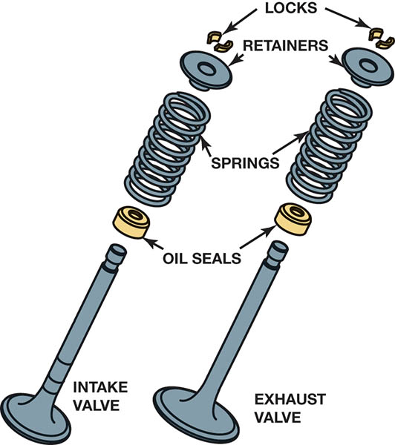
Figure 31.17 Valve keepers (also called locks) are tapered so they wedge into a tapered hole in the retainer

Slide 34
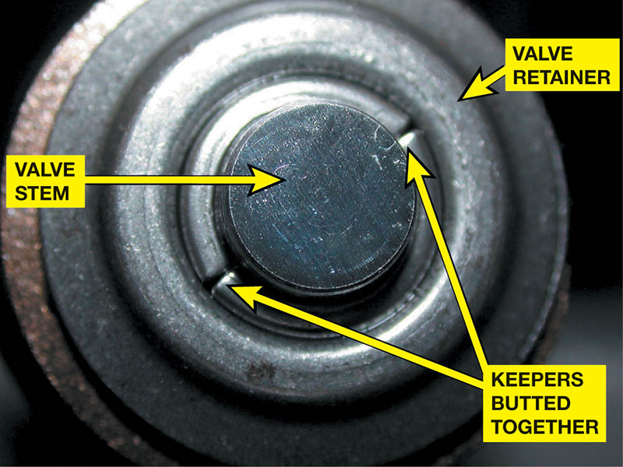
Figure 31.18 Notice that there is no gap between the two keepers (ends butted together).

Slide 35
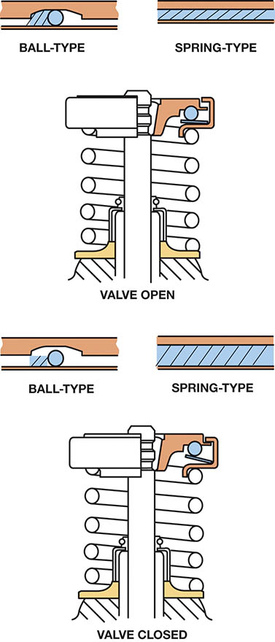
Figure 31.19 Type of valve rotator operation. Ball-type operation is on the left and spring-type operation is on the right

Slide 36
VALVE CONDITIONING PROCEDURE
Step One: The stem is lightly ground and chamfered.
Step Two: The face is ground at the proper angle.
Step Three: The seat is ground.
Step Four: The valve spring installed height is checked.
Step Five: After a complete cleaning the valve is installed with a new seal.

Slide 37
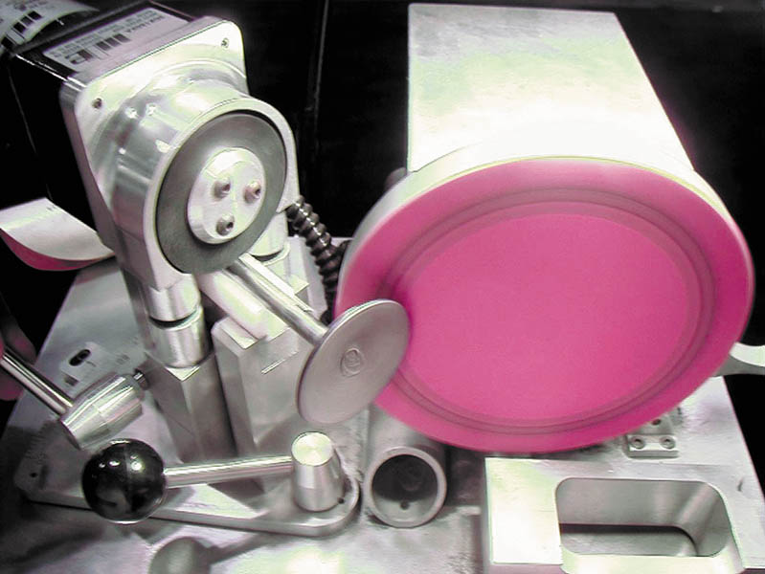
Figure 31.20 Resurfacing the face of a valve. Both the valve and the grinder stone or disc are turned to ensure a smooth surface finish on the face of the valve

Slide 38
VALVE FACE GRINDING
Purpose and Function
To restore a smooth surface to the valve that seals the cylinder and transfer heat.
Margin
The margin is the distance between the head of the valve and the seat of the value.

Slide 39
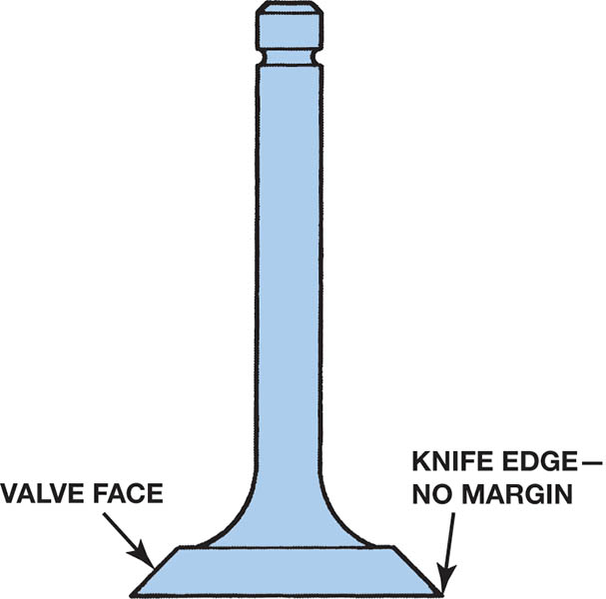
Figure 31.21 Never use a valve that has been ground to a sharp edge. This weakens the valve and increases the chance of valve face burning

Slide 40
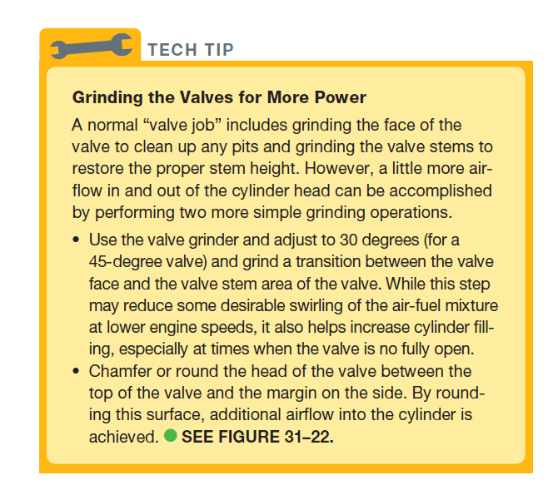
Tech Tip

Slide 41
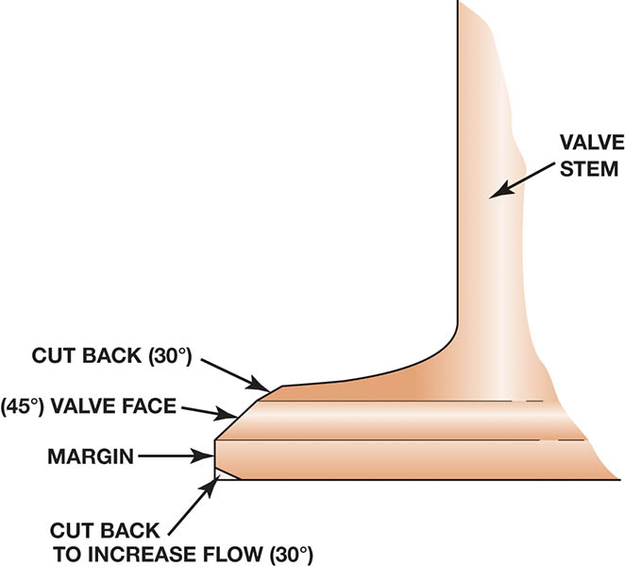
Figure 31.22 After grinding the 45-degree face angle, additional airflow into the engine can be accomplished by grinding a transition between the face angle and the stem.

Slide 42
VALVE SEAT RECONDITIONING
Purpose and Function: Performed after cleaning or the replacement of the seat.
Valve Seat Angles: 45 or 30 degrees
Interference Angles: The valve is 1 degree less than the face.
Valve Seat Width: 1/16th to 1/32nd inch (1.5 to 2.5 mm) wide.
Three-Angle Valve Job: means that the valve seats are ground three times.

Slide 43
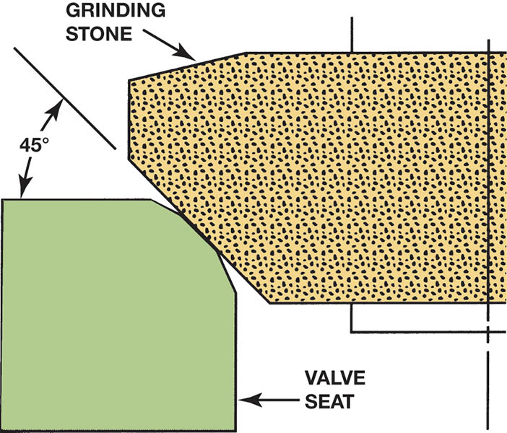
Figure 31.23 Grinding a 45-degree angle establishes the valve seat in the combustion chamber

Slide 44
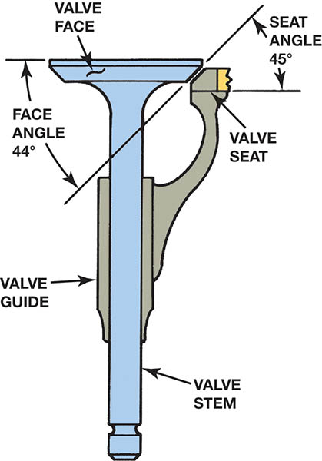
Figure 31.24 Some vehicle manufacturers recommend that the valve face be resurfaced at a 44-degree angle and the valve seat at a 45-degree angle. This 1-degree difference is known as the interference angle

Slide 45
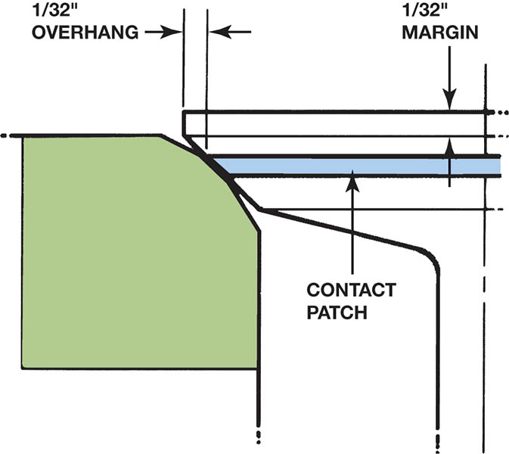
Figure 31.25 The seat must contact evenly around the valve face. For good service life, both margin and overhang should be at least 1/32 inch (0.8 mm)

Slide 46
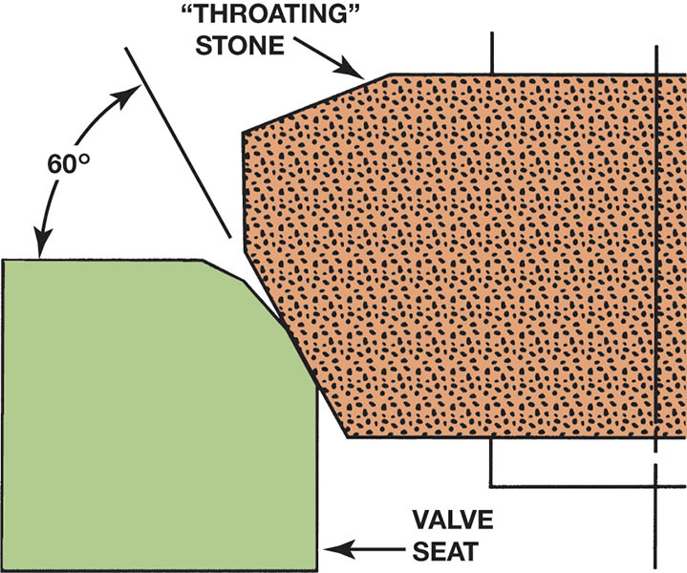
Figure 31.26 Grinding a 60-degree angle removes metal from the bottom to raise and narrow the seat

Slide 47
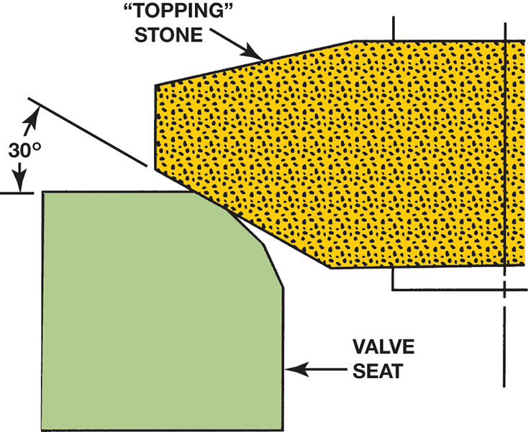
Figure 31.27 Grinding a 30-degree angle removes metal from the top to lower and narrow the seat

Slide 48
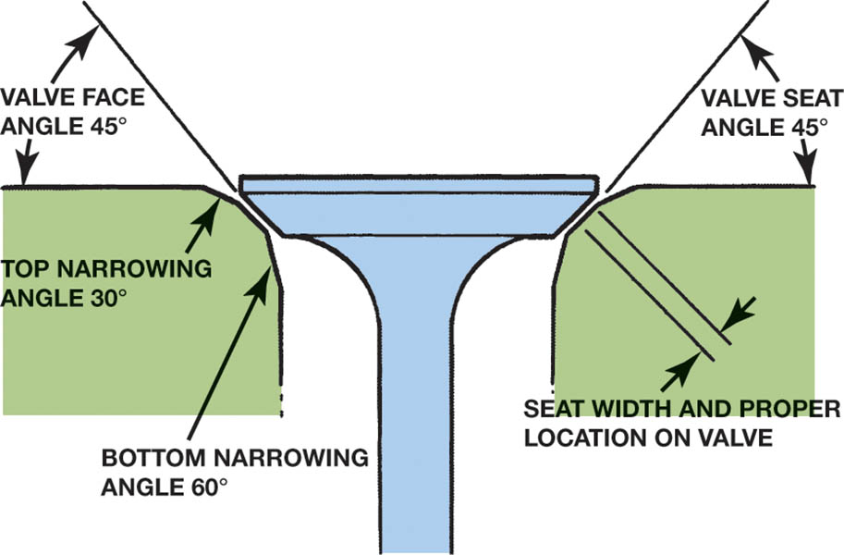
Figure 31.28 A typical three-angle valve job using 30-, 45-, and 60-degree stones or cutters

Slide 49
VALVE GUIDE PILOTS
Valve seat reconditioning equipment uses a pilot in the valve guide to align the stone holder or cutter in the exact same location as the valve stem.
Tapered Pilots
Locate themselves in the least worn section of the guide.
Expandable Pilots
Expands to contact the ends of the guide where there has been the greatest wear.

Slide 50
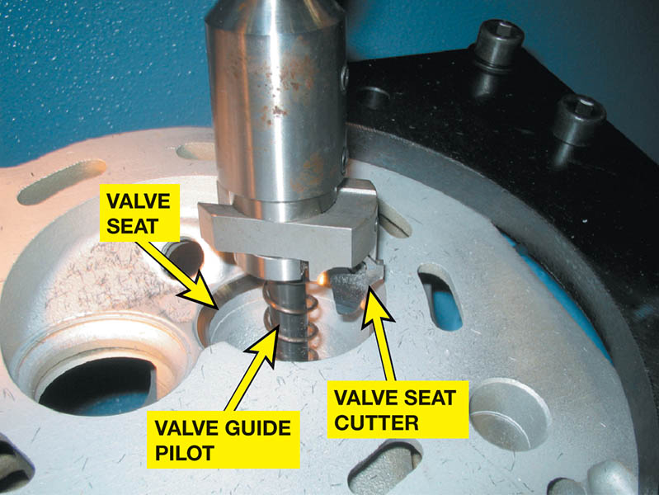
Figure 31.29 A valve guide pilot being used to support a valve seat cutter

Slide 51
VALVE SEAT GRINDING STONES
Roughing Stone
Used to rapidly remove large amounts of seat metal.
Finishing Stone
Is used to put the proper finish on the seat.
Hard Seat Stones
Are used on hard Stellite® exhaust seat inserts

Slide 52
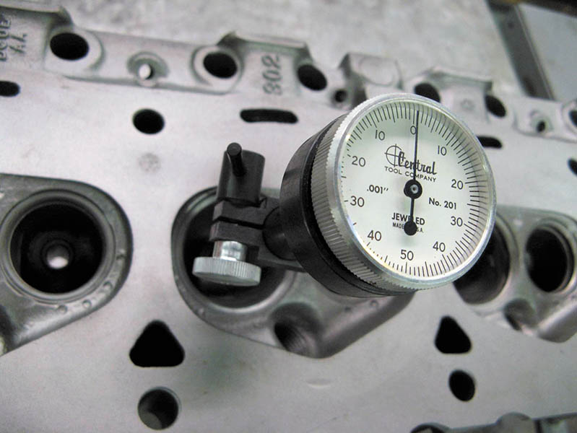
Figure 31.30 Checking valve seat concentricity using a dial indicator

Slide 53
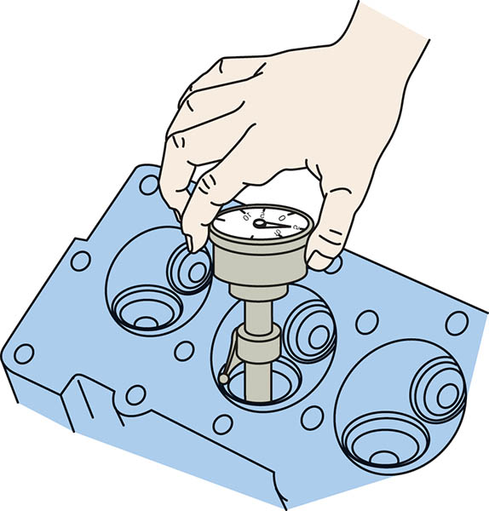
Figure 31.31 Typical dial indicator type of micrometer for measuring valve seat concentricity

Slide 54
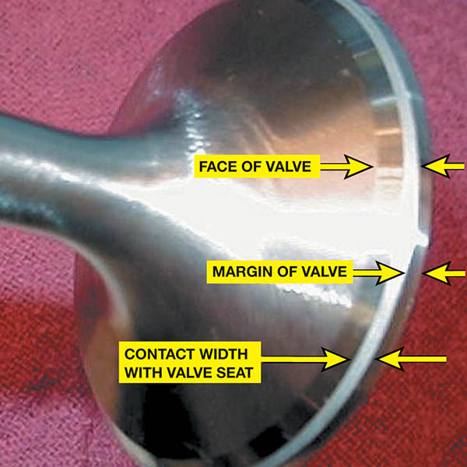
Figure 31.32 After the valve face and the valve seat are ground (reconditioned), lapping compound is used to smooth the contact area between the two mating surfaces.

Slide 55
VALVE SEAT CUTTERS
The valve seats can be reconditioned to commercial standards in much less time when using the cutters, rather than the grinders.
Do not require dressing like stones
Only leave metal chips to be cleaned.

Slide 56
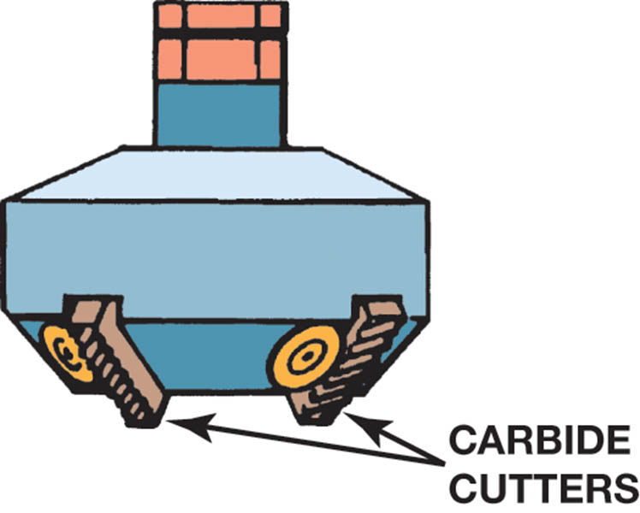
Figure 31.33 A cutter is used to remove metal and form the valve seat angles

Slide 57
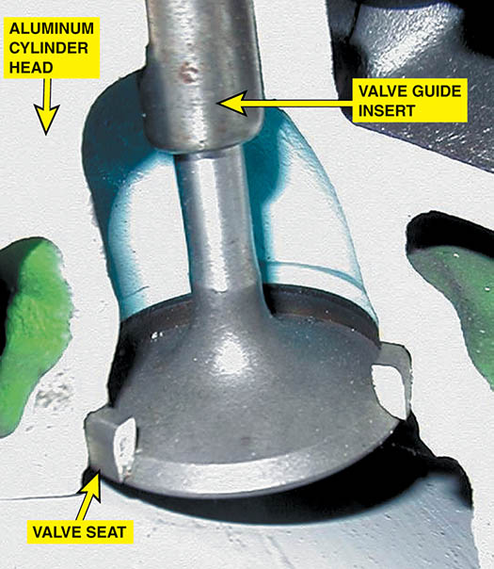
Figure 31.34 All aluminum cylinder heads use valve seat inserts.

Slide 58
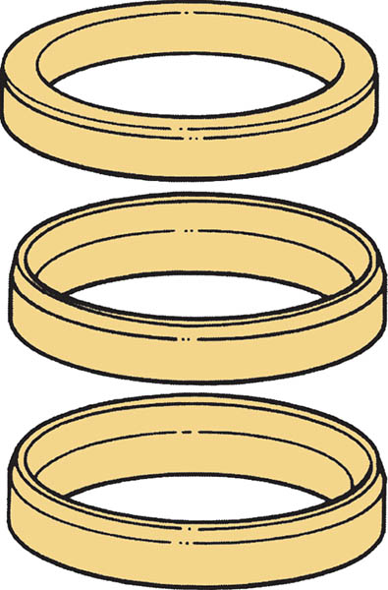
Figure 31.35 Insert valve seats are rings of metal driven into the head

Slide 59
VALVE STEM HEIGHT
Valve stem height is the distance the valve stem is above the spring seat.
Valve stem height is important to maintain for all engines, but especially for overhead camshaft engines.

Slide 60
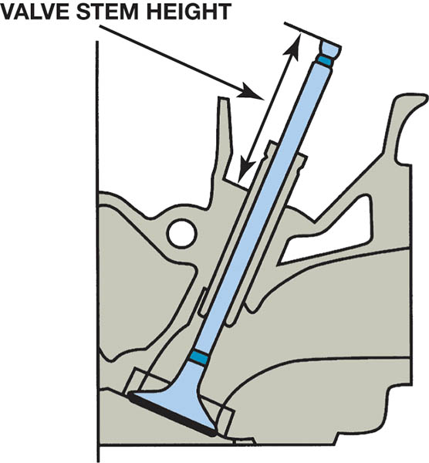
Figure 31.36 Valve stem height is measured from the spring seat to the tip of the valve after the valve seat and valve face have been refinished.

Slide 61
INSTALLED HEIGHT
Installed height is the distance between the valve spring seat and the underside of the valve spring retainer.
To restore original valve spring tension, special valve spring spacers, inserts, or shims are installed under the valve springs.

Slide 62
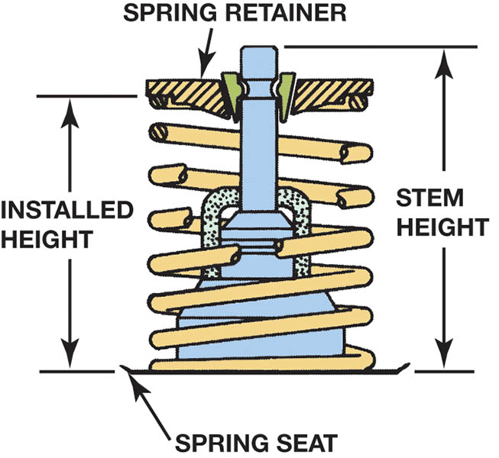
Figure 31.37 Installed height is determined by measuring the distance from the spring seat to the bottom of the valve spring retainer

Slide 63
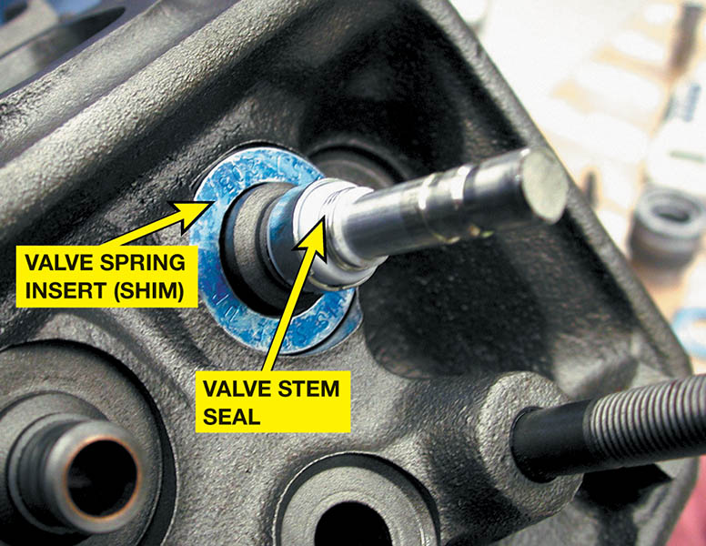
Figure 31.38 Valve spring inserts are used to restore proper installed height

Slide 64
VALVE STEM SEALS
Purpose and Function
Ensure oil does not leak past valve guides.
Types of Valve Seals
Umbrella
O-Ring
Positive Stem Seals
Valve Seal Materials
Nitrile
Viton
Polyacrylate

Slide 65
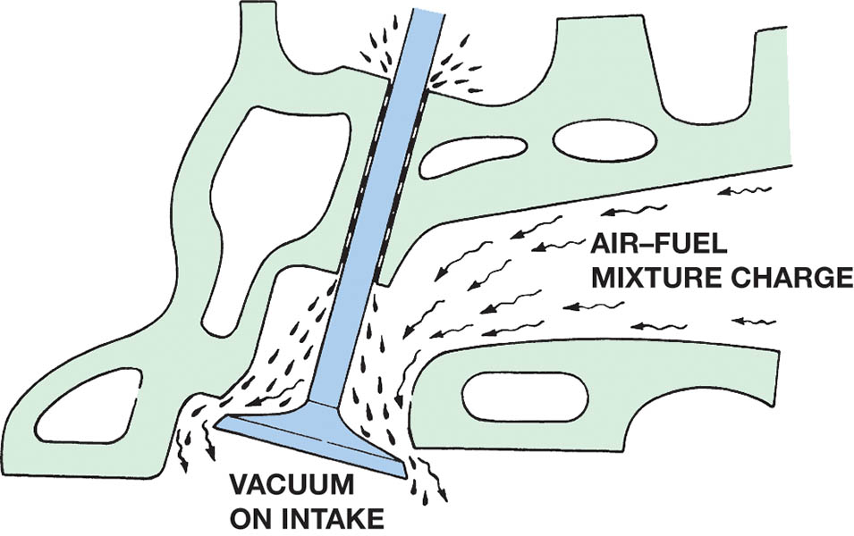
Figure 31.39 Engine vacuum can draw oil past the valve guides and into the combustion chamber. The use of valve stem seals limits the amount of oil that is drawn into the engine.

Slide 66
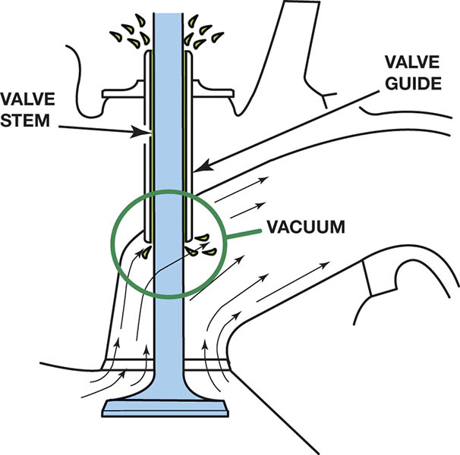
Figure 31.40 Engine oil can also be drawn past the exhaust valve guide because of a small vacuum created by the flow of exhaust gases.

Slide 67
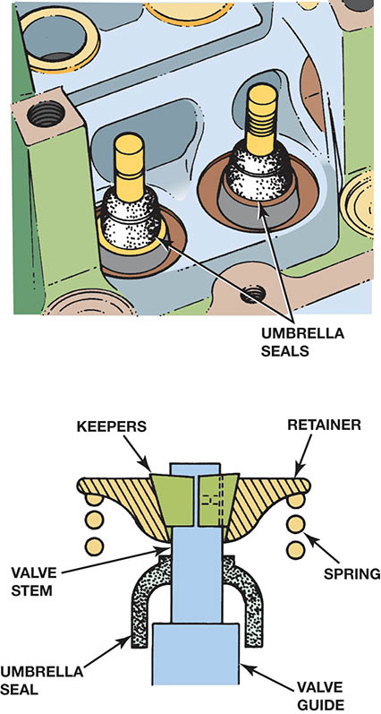
Figure 31.41 Umbrella seals install over the valve stems and cover the guide

Slide 68
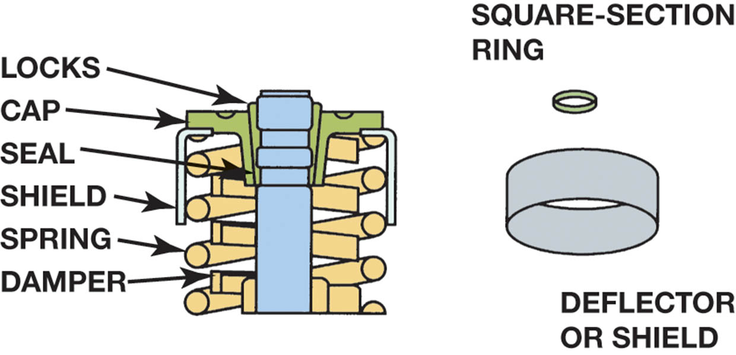
Figure 31.42 A small square cut O-ring is installed under the retainer in a groove in the valve under the groove(s) used for the keepers (locks)

Slide 69
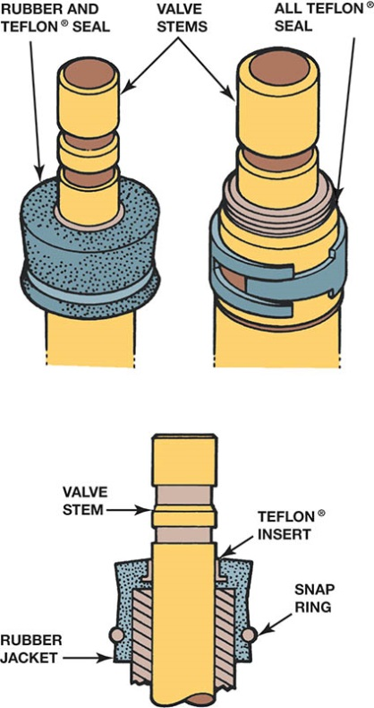
Figure 31.43 Positive valve stem seals are the most effective type because they remain stationary on the valve guide and wipe the oil from the stem as the valve moves up and down

Slide 70
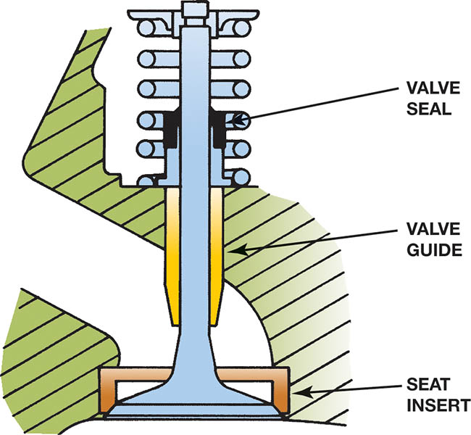
Figure 31.44 The positive valve stem seal is installed on the valve guide

Slide 71
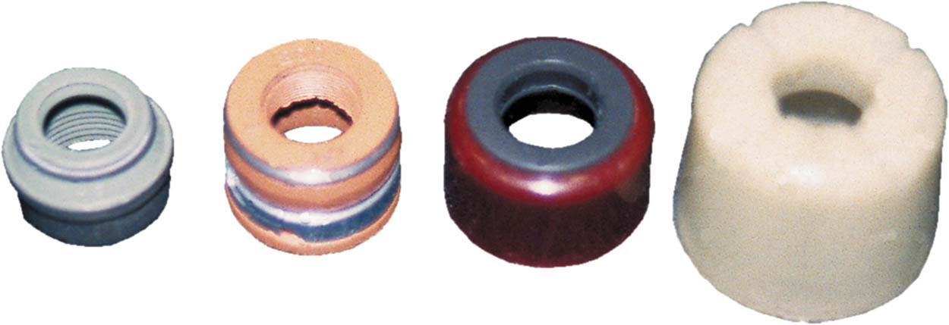
Figure 31.45 An assortment of shapes, colors, and materials of positive valve stem seals

Slide 72
QUESTION 3: ?
What are the three most common types of valve seals?

Slide 73
ANSWER 3:
Umbrella, O-Ring and Positive Stem Seals.

Slide 74
INSTALLING THE VALVES
Step 1: Clean the cylinder head.
Step 2: The valve is installed in the guide.
Step 3: The valve seal is installed.
Step 4: Install the valve spring.
Step 5: Install the valve keepers.
Step 6: Remove the spring compressor and make sure the keepers are properly seated.

Slide 75
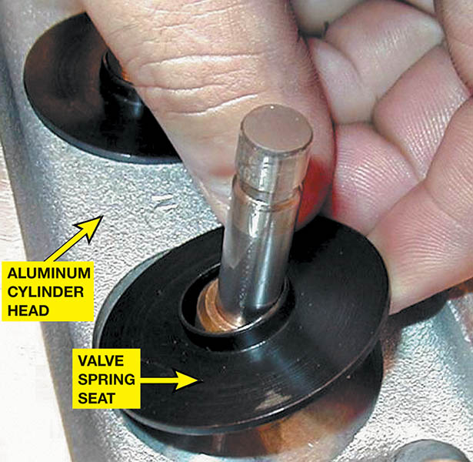
Figure 31.46 A metal valve spring seat must be used between the valve spring and the aluminum cylinder head.

Slide 76
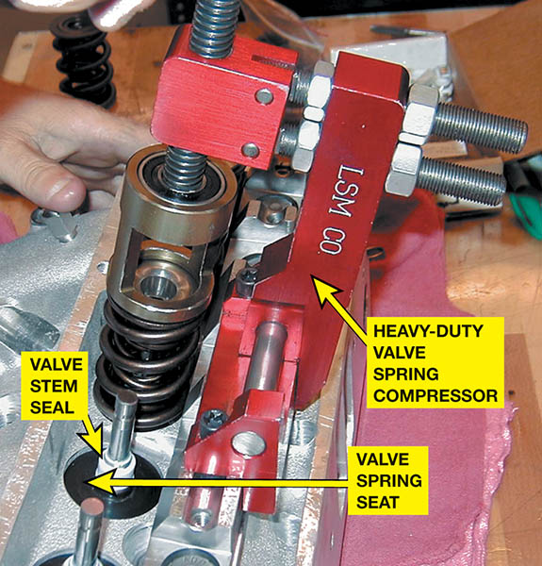
Figure 31.47 Assembling a race engine using a heavy-duty valve spring compressor

Slide 77
INSTALLING A NEW VALVE SEAT

Slide 78
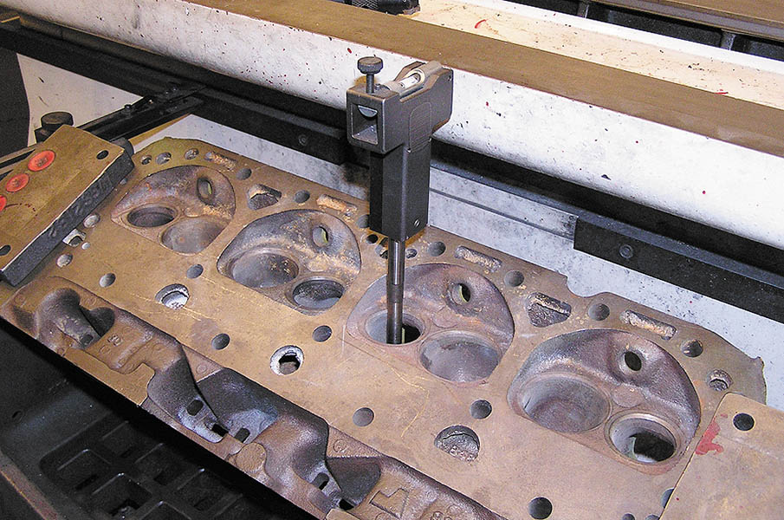
1. After the valve guide has been replaced or checked for being within specification, insert a pilot into the valve guide.

Slide 79

2. Level the bubble on the pilot by moving the cylinder head, which is clamped to a seat/guide machine.

Slide 80

3. Select the proper valve seat for the application. Consult the manufacturer’s literature for recommendations.

Slide 81

4. Select the correct cutter and check that the cutting bits are sharp.

Slide 82

5. Carefully measure the exact outside diameter (O.D.) of the valve seat.

Slide 83

6. Adjust the diameter of the cutter bit to achieve the specified interference fit for the valve seat.

Slide 84

7. Install the pilot into the valve guide to support the seat cutter.

Slide 85

8. Install the seat cutter onto the pilot.

Slide 86

9. Adjust the depth of cut, using the new valve seat to set it to the same depth as the thickness of the seat.

Slide 87

10. With the cylinder head still firmly attached to the seat and guide machine, start the cutter motor and cut the head until it reaches the stop.

Slide 88

11. The finish cut valve seat pocket. Be sure to use a vacuum to remove all of the metal shavings from the cutting operation.

Slide 89

12. Place the chilled valve seat over the pilot being sure that the chamfer is facing toward the head as shown.

Slide 90

13. Install the correct size driver onto the valve seat.

Slide 91

14. Using the air hammer or press, press the valve seat into the valve pocket.

Slide 92

15. A new valve seat is now ready to be machined or cut.

Slide 93

Copyright

