Slide 1

Automotive Technology Principles, Diagnosis, and Service
Sixth Edition
Chapter 3
Starting A Career in the Automotive Industry
Copyright © 2018, 2015, 2011 Pearson Education, Inc. All Rights Reserved

Slide 2
LEARNING OBJECTIVES (1 of 2)
3.1 Explain the options and preparations for applying for a job.
3.2. Describe what the resume and cover letter should include.
3.3. Discuss the process of applying for employment, interviewing, and accepting employment.

Slide 3
LEARNING OBJECTIVES (2 of 2)
3.4 Explain how the flat-rate pay plan works.
3.5 Discuss the payroll deductions and the expenses of an employee working in the automotive industry.

Slide 4
PREPARING FOR AN AUTOMOTIVE SERVICE CAREER (1 of 3)
Desire and Interest
Strong computer skills
Interest in vehicles
Enjoy working on own vehicles and projects
Technical Knowledge and Skills
Owning and experience using hand tools
A basic knowledge for understanding parts and procedures.

Slide 5
PREPARING FOR AN AUTOMOTIVE SERVICE CAREER (2 of 3)
Job Shadowing
Follow a professional for a day or more.
Arranged through an automotive program.
Does not allow the person to work on vehicles.
Cooperative Education Programs
Formal plans of study
Attend class and work in local shop or dealership

Slide 6
PREPARING FOR AN AUTOMOTIVE SERVICE CAREER (3 of 3)
Apprentice Programs
Beginning technician
Works in the shop during the day
Attends class at night
Part-time Employment
Working part-time to gain hands-on experience
Allows flexibility with class schedules and provides needed income.

Slide 7
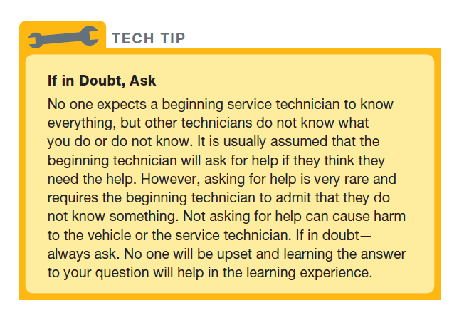
TECH TIP

Slide 8
QUESTION 1: ?
What is job shadowing?

Slide 9
ANSWER 1:
Following a professional for a day or more.

Slide 10
DEVLOPING AN EMPLOYMENT PLAN
Soft Skills
Working cooperatively
Communicating effectively
Working as a team member
Locating Employment Possibilities
Job description
Tools needed
Hours needed
Drug testing

Slide 11
PREPARING A RESUME
Personal Information
Educational Information
Experience and Skills
References

Slide 12
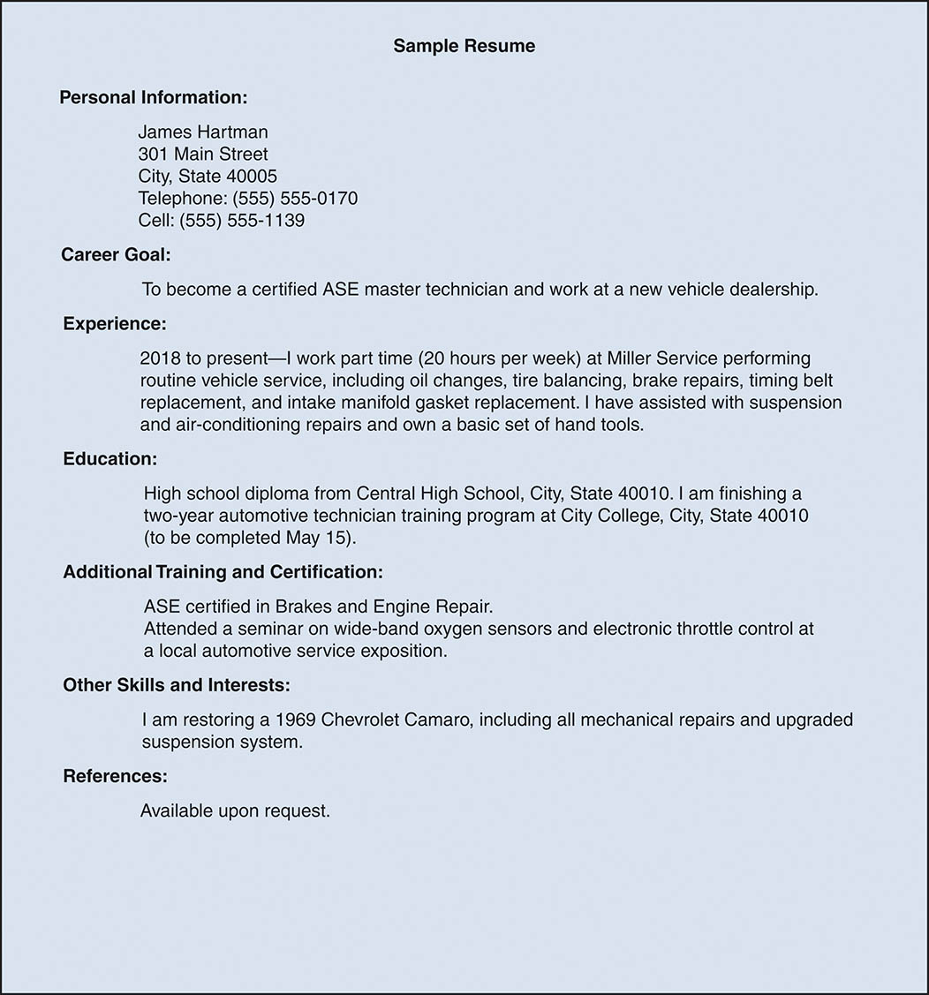
UNNUMBERED FIGURE 1

Slide 13
PREPARING A COVER LETTER
Include:
Details of the where ad was seen
Specified skills and training needed
Contact the correct person

Slide 14
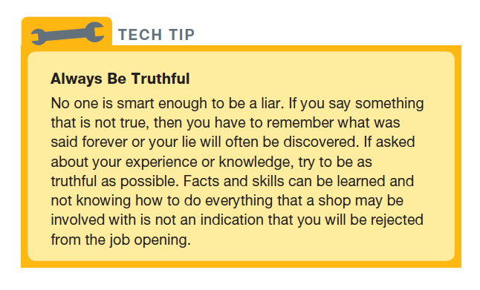
Tech Tip

Slide 15
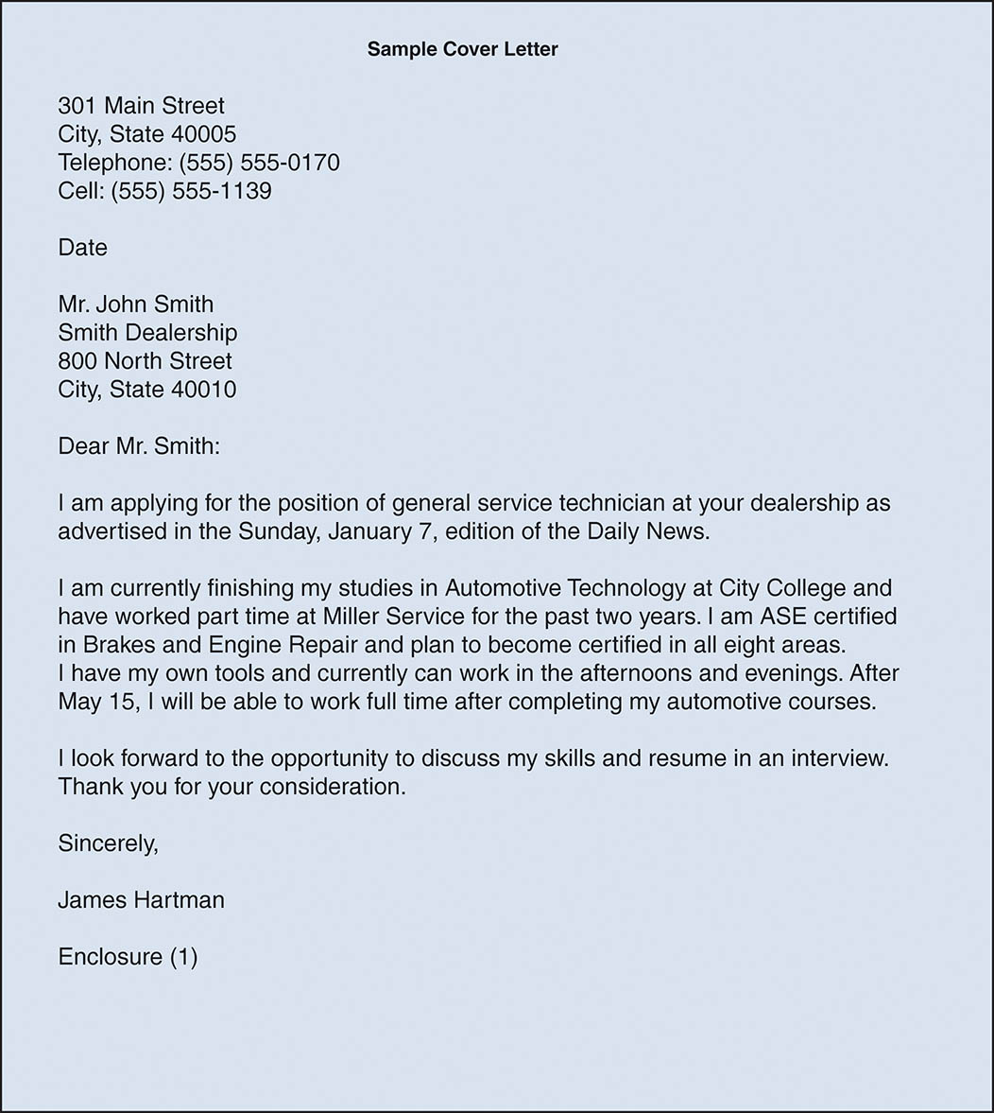
UNNUMBERED FIGURE 2

Slide 16
CONTACTING POTENTIAL EMPLOYERS
Completing the employment application
Provide the needed information
The interview
Dress appropriately and show enthusiasm
After the interview
Follow up with a thank you letter
Accepting employment
Complete the required paperwork and processes

Slide 17
TECHNICIAN PAY METHODS
Straight Time Pay Methods
The technician is payed on clock time.
Used on difficult or repairs not covered in the guide.
Flat Rate Pay Methods
Technician is payed a specific amount for a repair.
The amount of time actually taken to make the repair does not effect the amount payed.
Experienced technicians

Slide 18
PAYROLL DEDUCTIONS AND EXPENSES
Gross versus net compensation
Taxes may be deducted from pay
Retirement information and payments
Employer sponsored 401(k) accounts
Additional service technician benefits
Vacation
Training
Healthcare

Slide 19
HOUSING AND LIVING EXPENSES
Housing: 30% of gross income
Vehicle: 25% of gross income

Slide 20
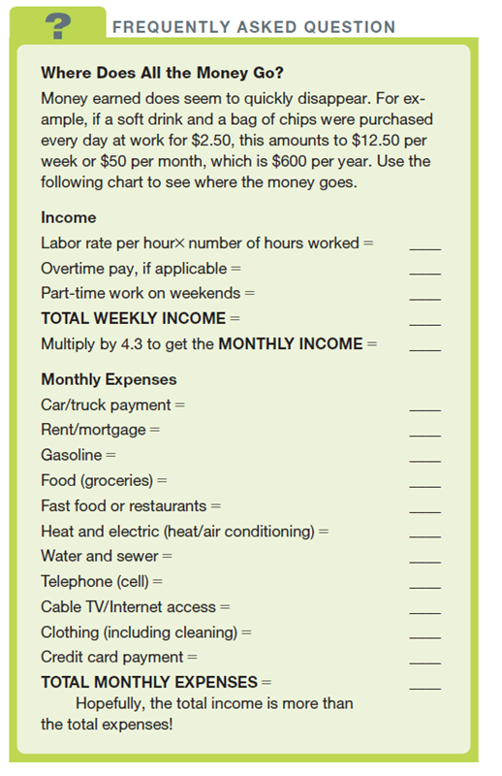
FREQUENTLY ASKED QUESTION

Slide 21
QUESTION 2: ?
What is the difference between gross pay and net pay?

Slide 22
ANSWER 2:
Gross pay is what you earn, net pay is the amount you receive after taxes and other deductions.

Slide 23
BECOMING A SHOP OWNER
Non-automotive repair duties:
Handling customers
Ordering and paying for shop equipment
Bookkeeping and payroll
Budgeting
Rent
Advertising
Hiring and firing employees

Slide 24

COPYRIGHT

