Slide 1

Automotive Technology Principles, Diagnosis, and Service
Sixth Edition
Chapter 29
Engine Cleaning and Crack Detection
Copyright © 2018, 2015, 2011 Pearson Education, Inc. All Rights Reserved

Slide 2
LEARNING OBJECTIVES
29.1 Explain the mechanical cleaning procedure of engines.
29.2 Discuss chemical cleaners.
29.3 Compare spray and steam washing, thermal cleaning, tank and vapor cleaning, and ultrasonic and vibratory cleaning.
29.4 Explain crack detection and crack repair.

Slide 3
MECHANICAL CLEANING
Scraping
The scraper most frequently used is a putty knife, or a plastic card.
Abrasive Pads or Discs
White: Finest grit size
Yellow: Course Grit
Green: Cast-iron Only
Media Blasting
Media blasting with baking soda is the cleaning method of choice for most shops.

Slide 4
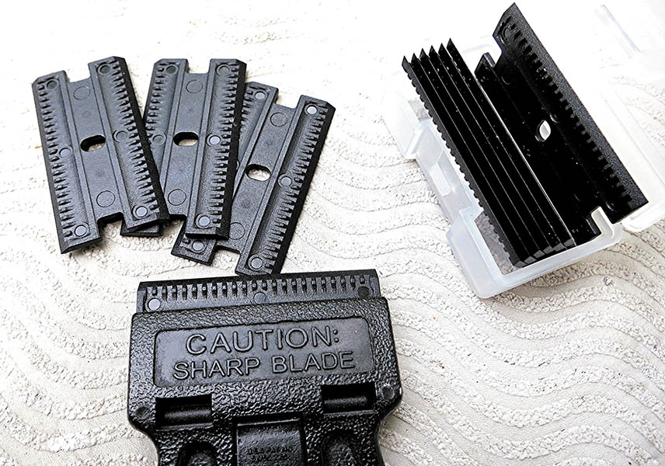
Figure 29.1 Plastic razor blades are available and make an excellent tool to clean gasket surfaces without causing any harm to the engine surfaces

Slide 5
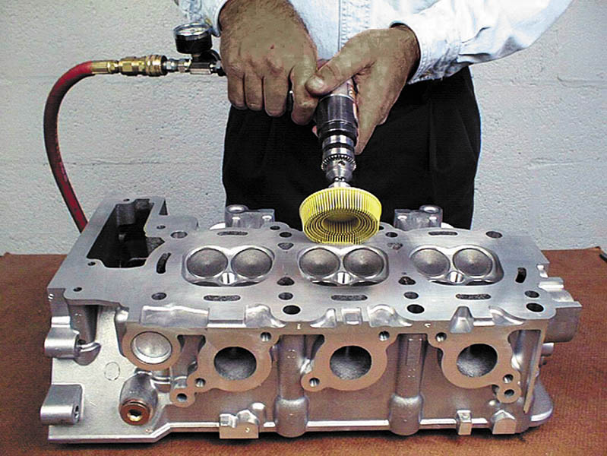
Figure 29.2 An air-powered grinder attached to a bristle pad being used to clean the gasket surface of a cylinder head.

Slide 6
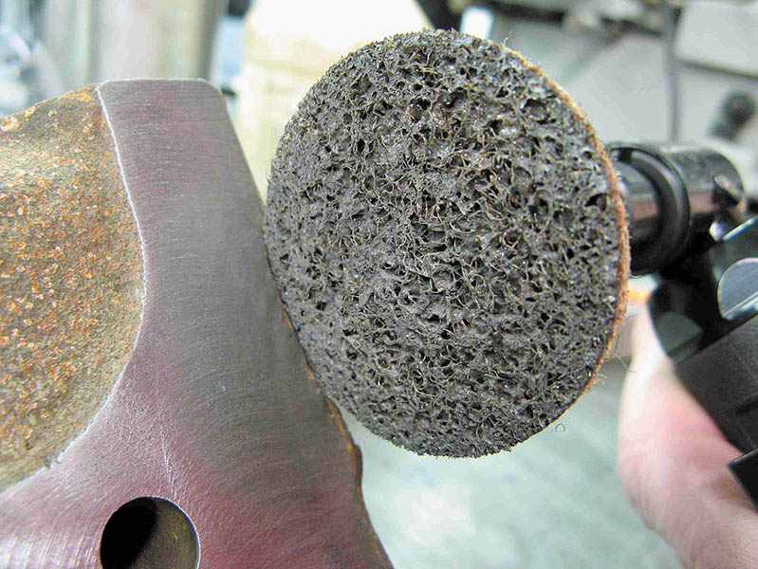
Figure 29.3 An abrasive disc commonly called by its trade name, Scotch Brite™ pad

Slide 7
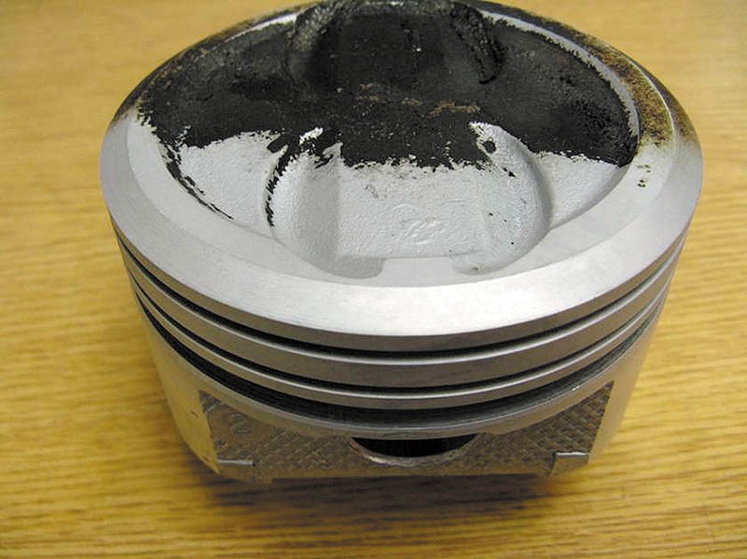
Figure 29.4 Using baking soda is the recommended way to clean engine parts because any soda that is left on or in the part is dissolved in oil or water, unlike either sand or glass beads, which can be engine damaging

Slide 8
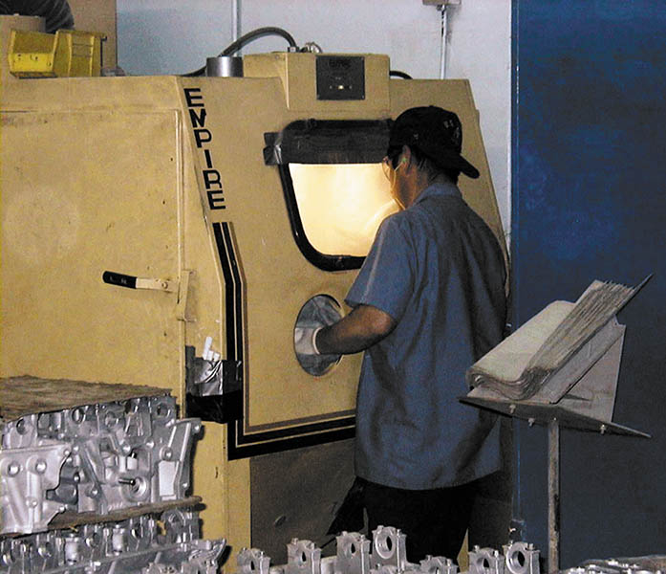
Figure 29.5 Small engine parts can be blasted clean in a sealed cabinet

Slide 9
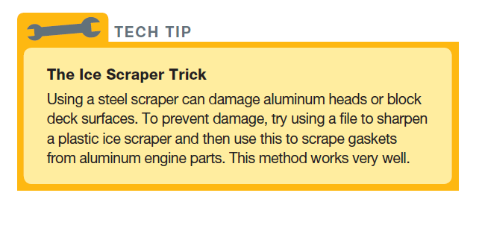
Tech Tip

Slide 10
QUESTION 1: ?
What is the purpose of mechanical cleaning?

Slide 11
ANSWER 1:
The purpose of mechanical cleaning is to remove heavy deposits.

Slide 12
CHEMICAL CLEANERS
pH
Indicates the amount of chemical activity in the soap.
Solvent-Based Cleaning
A deposit is said to be soluble when it can be dissolved with a chemical or solvent.
Water-Base (aqueous) Chemical Cleaning
Used because of environmental concerns.
Most aqueous-type chemicals are silicate–based and are mixed with water.

Slide 13
SPRAY AND STEAM WASHING
Spray Washing
A spray washer directs streams of liquid through numerous high-pressure nozzles to dislodge dirt and grime on an engine surface.
Steam Cleaning
Steam vapor is mixed with high-pressure water and sprayed on the parts.

Slide 14
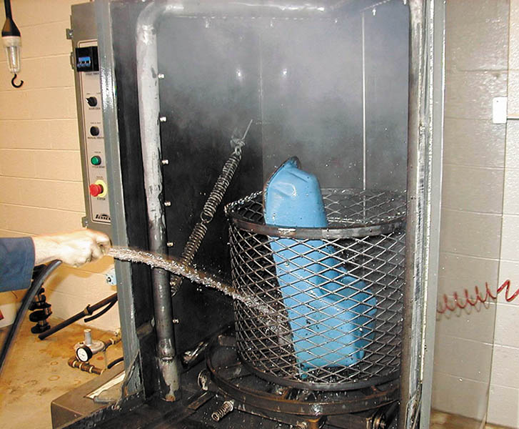
Figure 29.6 A pressure jet washer is similar to a large industrial-sized dishwasher. Each part is then rinsed with water to remove chemicals or debris that may remain there while it is still in the tank

Slide 15
THERMAL CLEANING
Temperatures Involved:
600°F (315°C) to 800°F (425°C)
Advantages:
Cleans the inside as well as the outside
The waste generated is nonhazardous
Microbial Cleaning:
uses microbes (living organisms [single-celled bacteria]) that literally “eat” the hydrocarbons (grease and oils) off of the parts being cleaned.
Pyrolytic Oven:
A high-temperature oven cleans engine parts by decomposing dirt, grease, and gaskets.

Slide 16
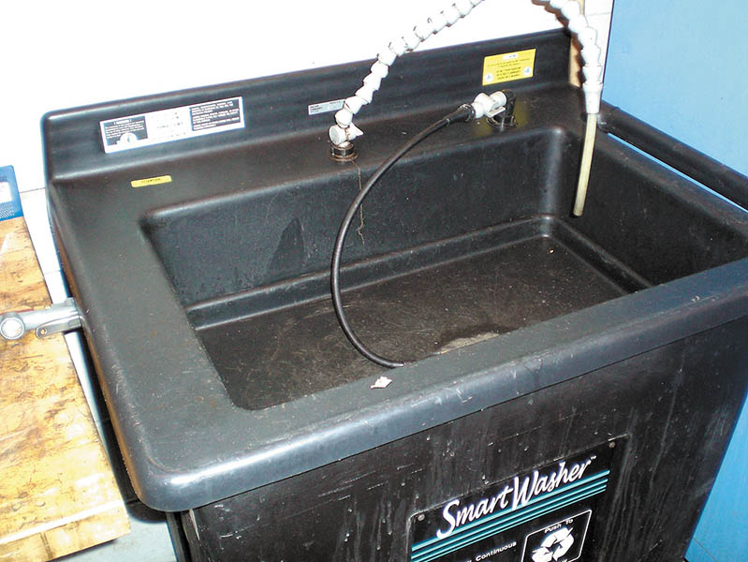
Figure 29.7 A microbial cleaning tank uses microbes to clean grease and oil from parts

Slide 17
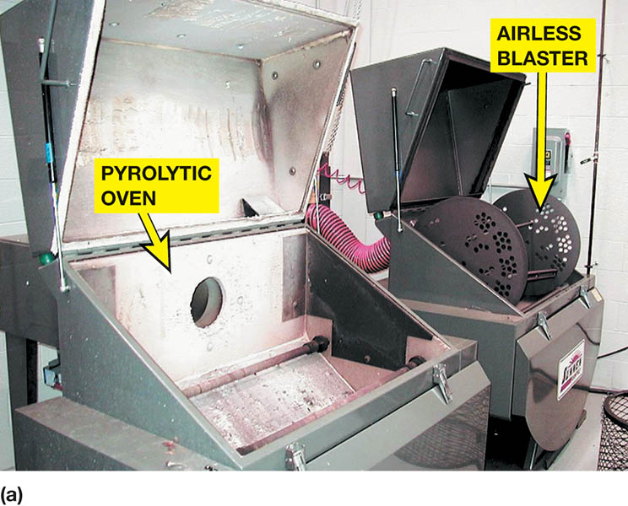
Figure 29.8 (a) A pyrolytic (high-temperature) oven cleans by baking the engine parts. After the parts have been cleaned, they are placed into an airless blaster. This unit uses a paddle to scoop stainless steel shot from a reservoir and forces it against the engine part.

Slide 18
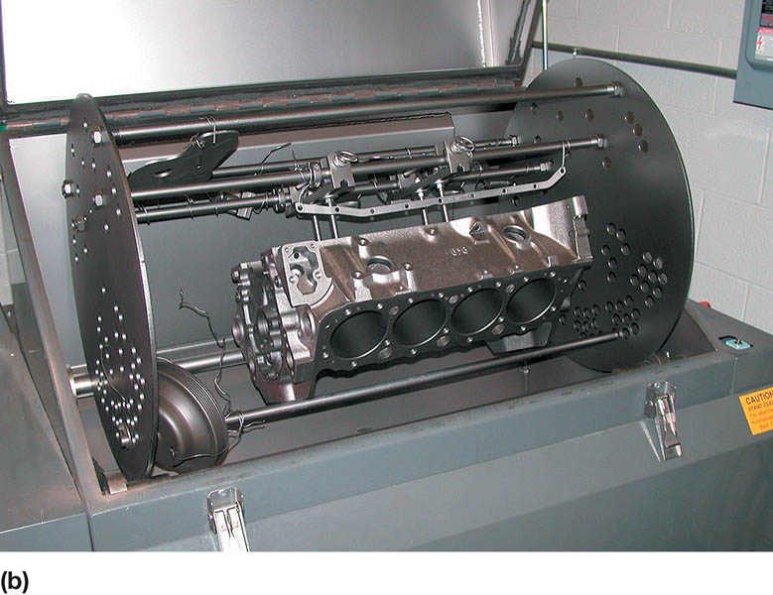
Figure 29.8 (b) This cleaned engine block has been baked and shot blasted

Slide 19
TANK AND VAPOR CLEANING
Cold Tank Cleaning
The cold soak tank is used to remove grease and carbon.
Hot Tank Cleaning
The hot soak tank is used for cleaning heavy organic deposits and rust from iron and steel parts.
Vapor Cleaning
The parts to be cleaned are suspended in hot vapors above a perchloroethylene solution.

Slide 20
ULTRASONIC AND VIBRATORY CLEANING
Ultrasonic Cleaning
The disassembled parts are placed in a tank of cleaning solution that is then vibrated at ultrasonic speeds to loosen all the soil from the parts.
Vibratory Cleaning
A vibrating bin with small odd-shaped ceramic or steel pieces, called media, with a cleaning solution of mineral spirits or water-based detergents are used to clean the small parts.
.

Slide 21
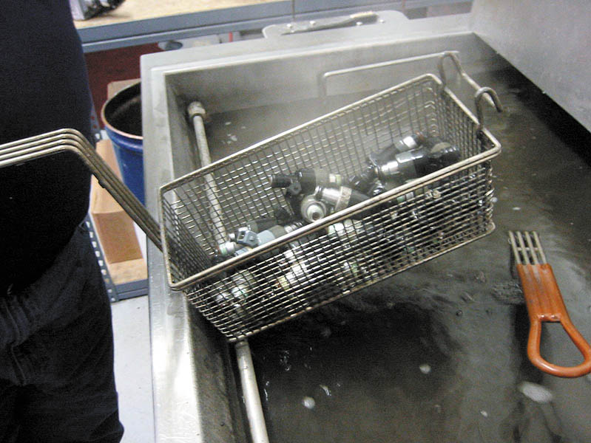
Figure 29.9 An ultrasonic cleaner is used to clean fuel injectors

Slide 22
CRACK DETECTION
Visual Inspection
After cleaning, the parts are reexamined for cracks.
Magnetic Crack Detection
Uses a magnetic field that is commonly referred to by the brand name Magnafluxing.
Fluorescent-Penetrant Detection
A dark red penetrating chemical is sprayed on the component and tested with a black light.
Pressure Testing
The head or block is pressurized and then lowered into water, where air bubbles indicate a leak.

Slide 23
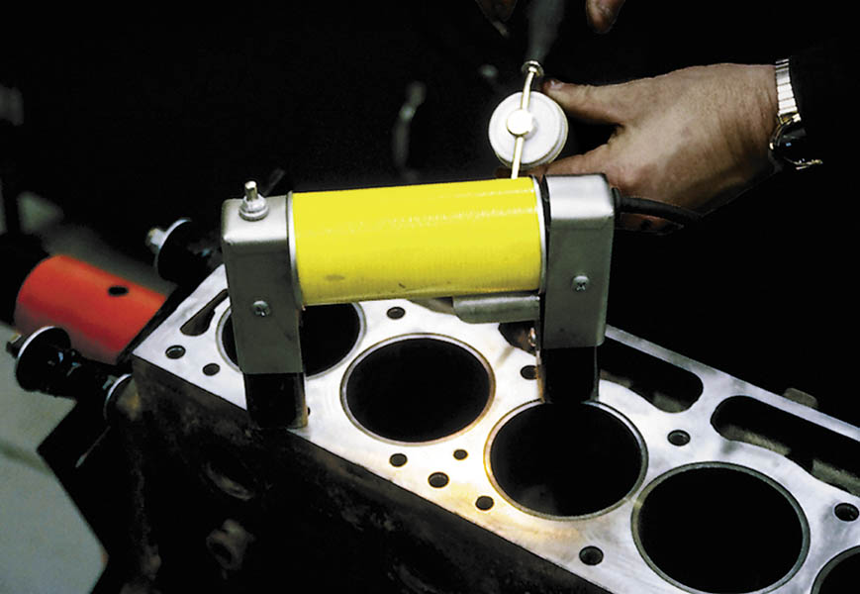
Figure 29.10 The top deck surface of a block is being tested using magnetic crack inspection equipment

Slide 24
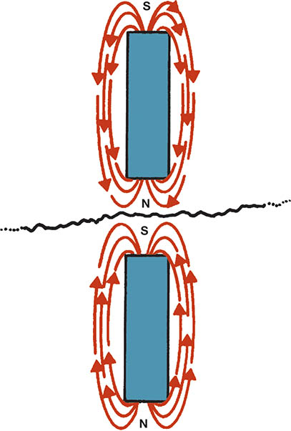
Figure 29.11 If the lines of force are interrupted by a break (crack) in the casting, then two magnetic fields are created and the powder will lodge in the crack

Slide 25
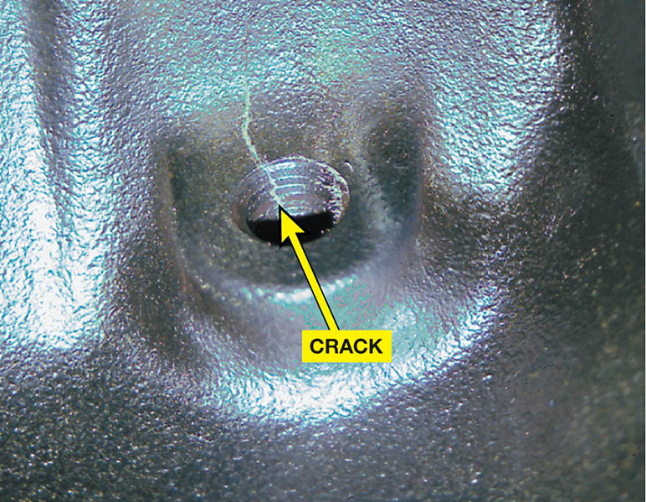
Figure 29.12 This crack in a vintage Ford 289, V-8 block was likely caused by the technician using excessive force trying to remove the plug from the block.

Slide 26
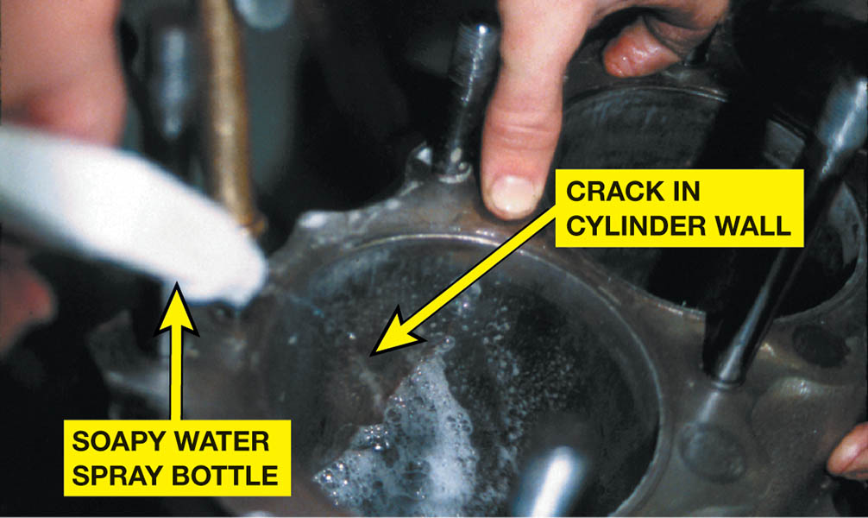
Figure 29.13 To make sure that the mark observed in the cylinder wall was a crack, compressed air was forced into the water jacket while soapy water was sprayed on the cylinder wall. Bubbles confirmed that the mark was indeed a crack

Slide 27
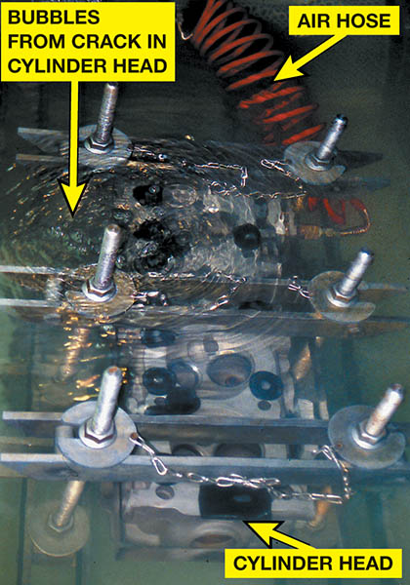
Figure 29.14 A cylinder head is under water and being pressure tested using compressed air. Note that the air bubbles indicate a crack

Slide 28
QUESTION 2: ?
When id the dye-penetrant testing method most commonly used?

Slide 29
ANSWER 2:
On parts constructed of aluminum or other nonmagnetic material.

Slide 30
CRACK REPAIR (1 OF 2)
Crack Concerns
Cracks in the engine block can cause coolant to flow into the oil or oil into the coolant.
Stop Drilling
A hole can be drilled at each end of the crack to keep it from extending further.
Crack-Welding Cast Iron
A highly skilled welding technique that is typically only successful when the entire cast-part is heated red-hot.

Slide 31
CRACK REPAIR (2 OF 2)
Crack-Welding Aluminum
Cracks in aluminum can be welded using a Heli-arc® or similar welder that is specially designed to weld aluminum.
Crack Plugging
In the process of crack plugging, a crack is closed using interlocking tapered plugs. This process can be used on cast-iron or aluminum components.

Slide 32
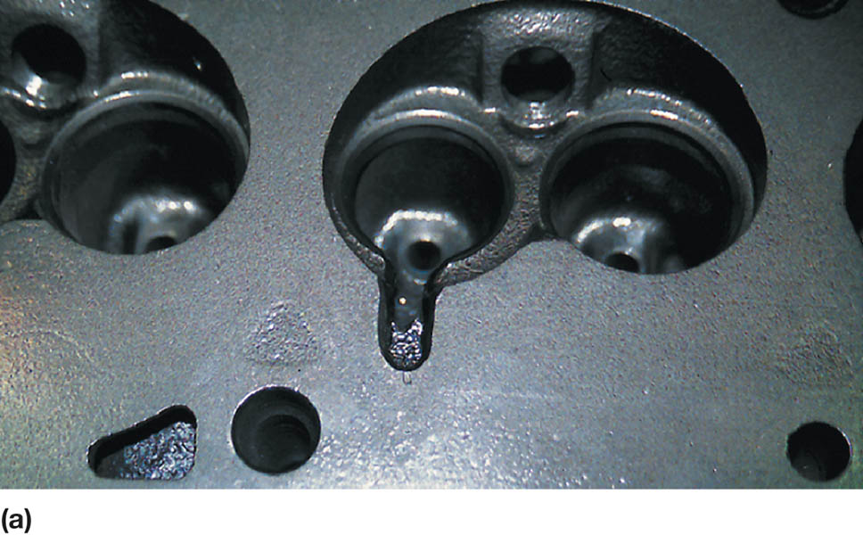
Figure 29.15 (a) Before welding, the crack is ground out using a carbide grinder

Slide 33
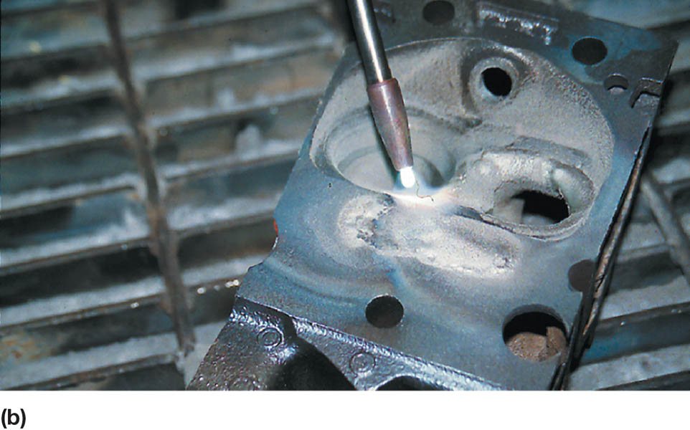
Figure 29.15 (b) Here the technician is practicing using the special cast-iron welding torch before welding the cracked cylinder head

Slide 34
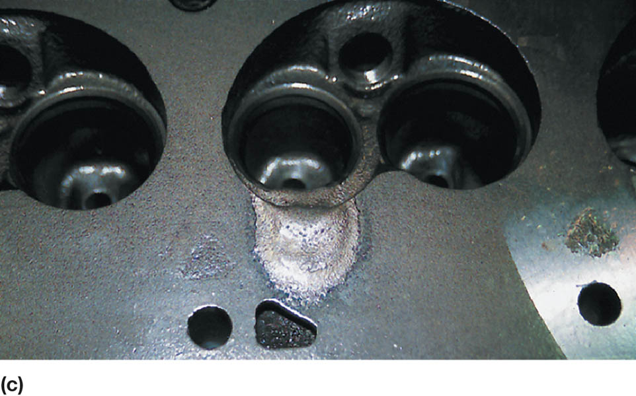
Figure 29.15 (c) This is the finished welded crack before final machining

Slide 35
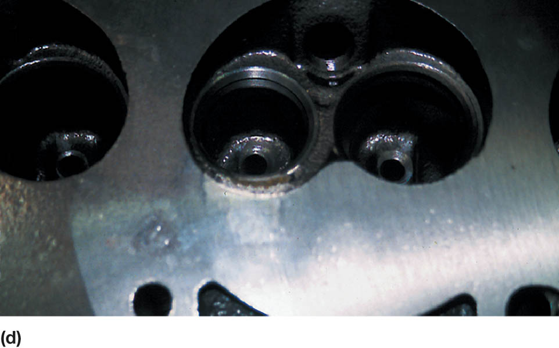
Figure 29.15 (d) Note the finished cylinder head after the crack has been repaired using welding

Slide 36
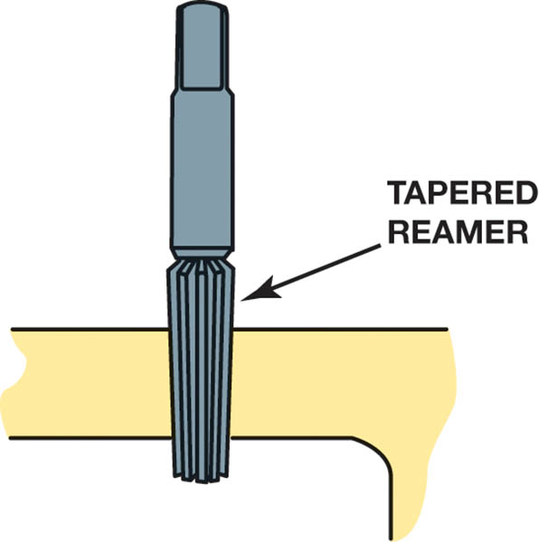
Figure 29.16 Reaming a hole for a tapered plug

Slide 37
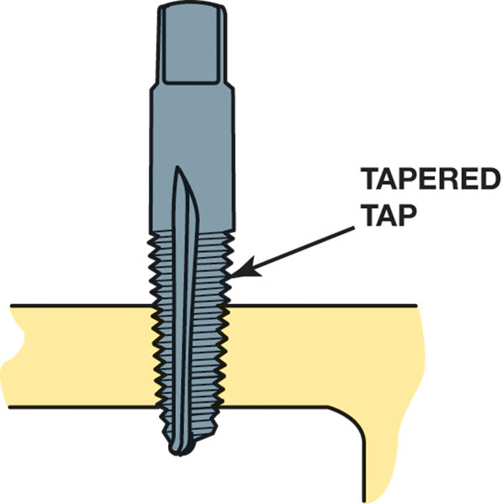
Figure 29.17 Tapping a tapered hole for a plug

Slide 38
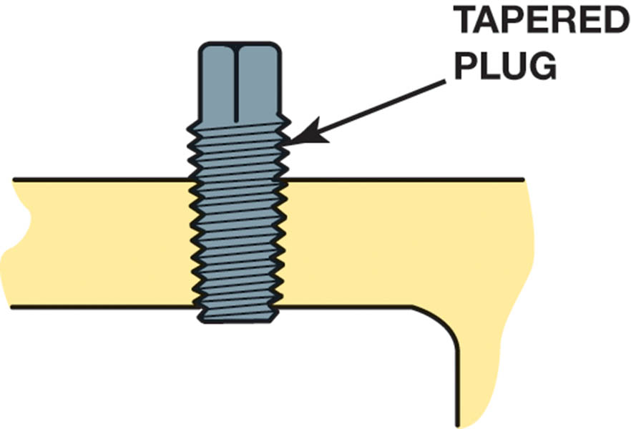
Figure 29.18 Screwing a tapered plug in the hole

Slide 39
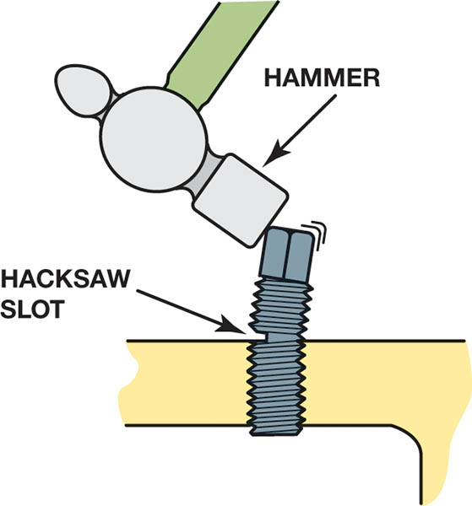
Figure 29.19 Cutting the plug with a hacksaw

Slide 40
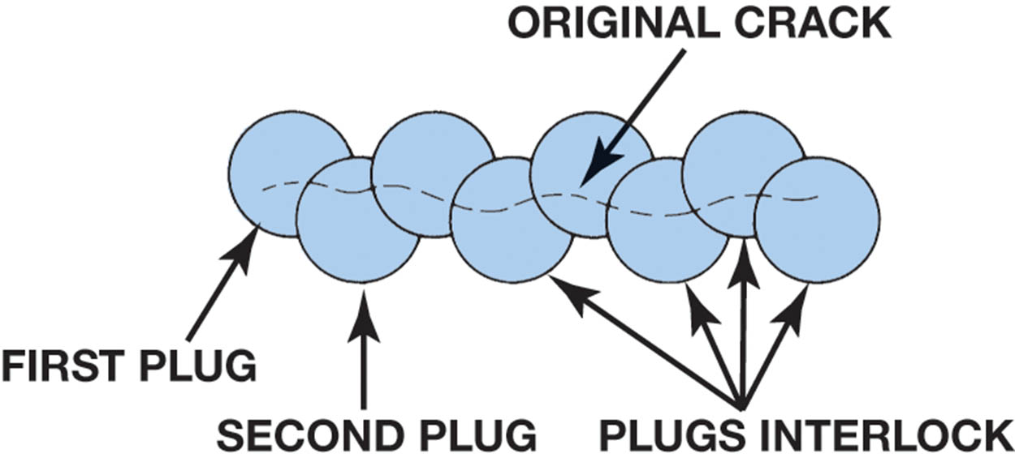
Figure 29.20 Interlocking plugs

Slide 41
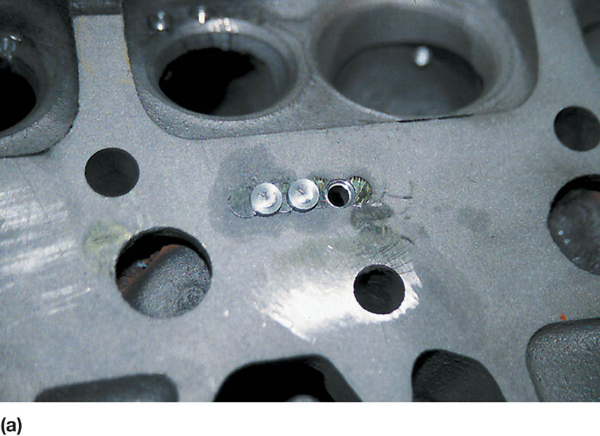
Figure 29.21 (a) A hole is drilled and tapped for the plugs

Slide 42
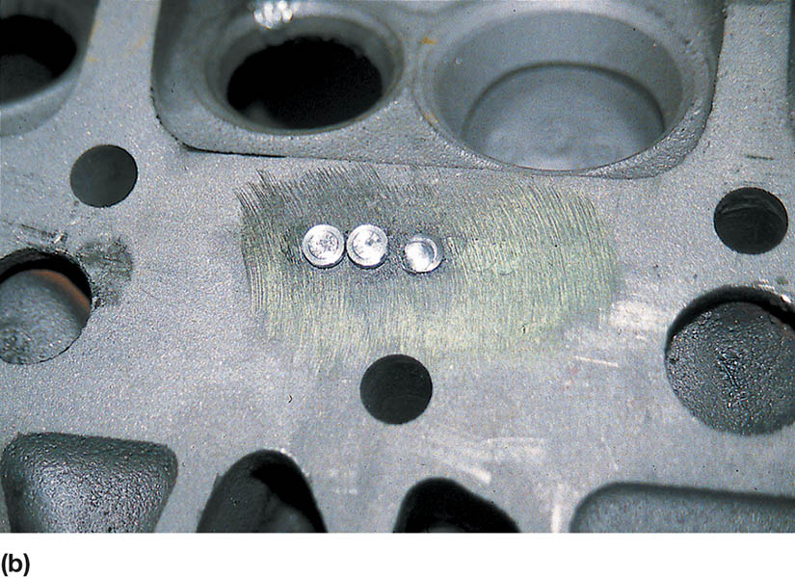
Figure 29.21 (b) The plugs are installed

Slide 43
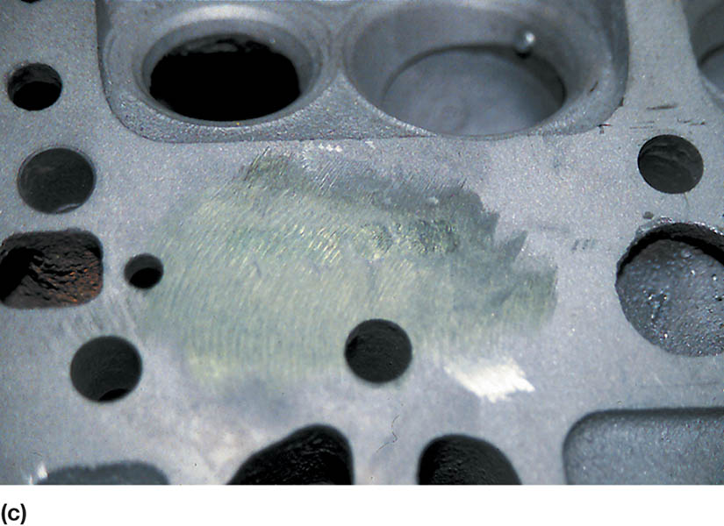
Figure 29.21 (c) After final machining, the cylinder head can be returned to useful service

Slide 44
QUESTION 3: ?
What is the purpose of stop drilling?

Slide 45
ANSWER 3:
To prevent the crack from extending any further.

Slide 46

Copyright

