Slide 1

Automotive Technology Principles, Diagnosis, and Service
Sixth Edition
Chapter 28
Engine Removal and Disassembly
Copyright © 2018, 2015, 2011 Pearson Education, Inc. All Rights Reserved

Slide 2
LEARNING OBJECTIVES
28.1 Discuss the different engine repair options.
28.2 Explain the engine removal procedure.
28.3 Explain the engine disassembly procedure.
28.4 Explain disassembly of the short block, rotating engine assemblies removal, and cylinder head disassembly.

Slide 3
ENGINE REPAIR OPTIONS
Component Replacement
Valve Job
Minor Overhaul
Major Overhaul
Short Block
Long Block
Crate Engine
Remanufactured Engine

Slide 4
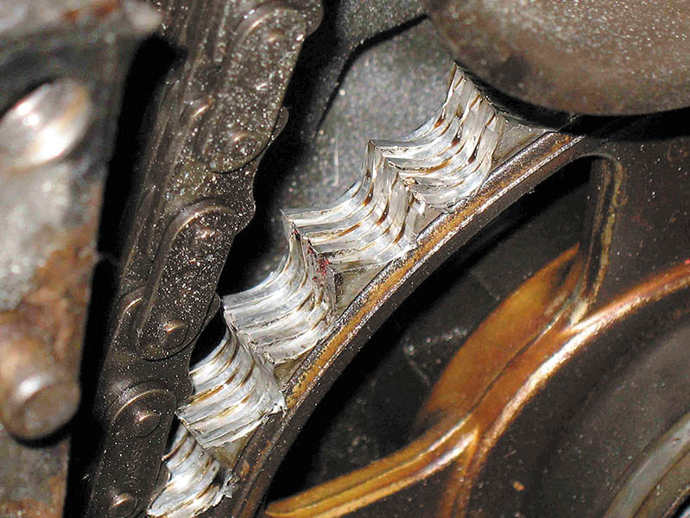
Figure 28.1 A worn timing sprocket that resulted in a retarded valve timing and reduced engine performance

Slide 5
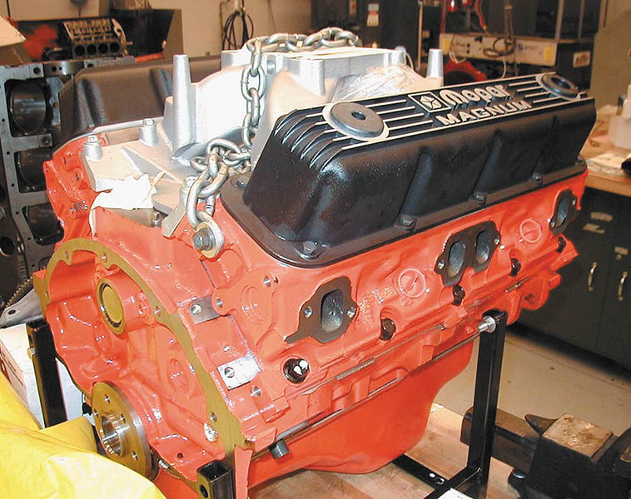
Figure 28.2 A crate engine from Chrysler to be used in a restored muscle car. Using a complete new engine costs more than rebuilding an existing engine, but it has a warranty and uses all new parts

Slide 6
ENGINE REMOVAL
Remove the hood and store safely.
Clean the engine area.
Disconnect the negative battery cable.
Remove the air cleaner and accessories.
Drain the coolant and remove the radiator.
Recover the air conditioning refrigerant.
Remove the power steering pump and drain the oil.
Disconnect the wiring, fuel lines, and vacuum hoses.

Slide 7
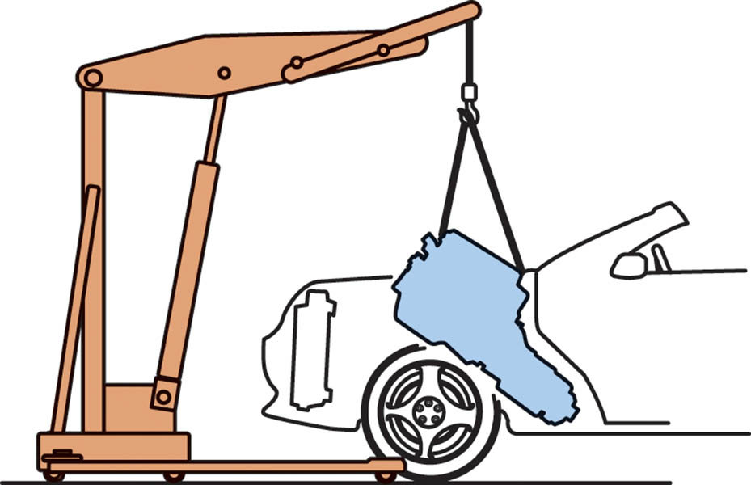
Figure 28.3 An engine must be tipped as it is pulled from the chassis

Slide 8
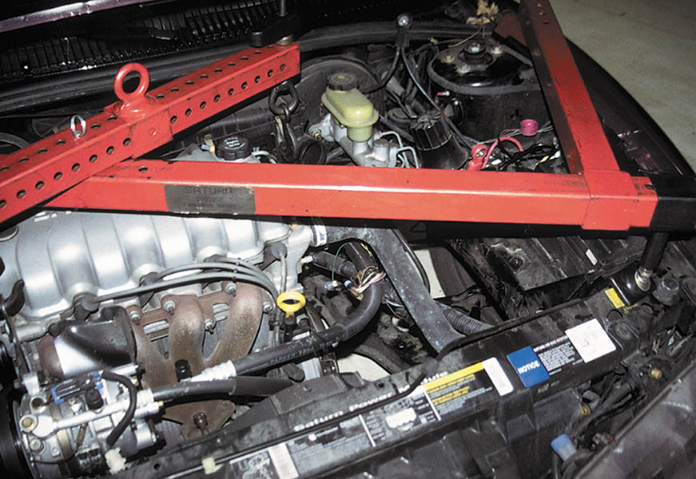
Figure 28.4 When removing just the engine from a front-wheel-drive vehicle, the transaxle must be supported. Shown here is a typical fixture that can be used to hold the engine, if the transaxle is removed, or to hold the transaxle, if the engine is removed

Slide 9
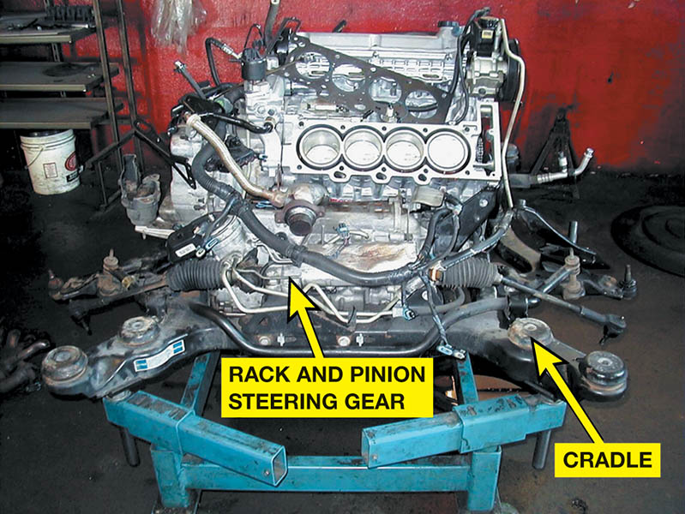
Figure 28.5 The entire cradle, which included the engine, transaxle, and steering gear, was removed and placed onto a stand. The rear cylinder head has been removed to check for the root cause of a coolant leak

Slide 10
QUESTION 1: ?
Why is the use of a new replacement engine beneficial?

Slide 11
ANSWER 1:
New parts are used and the engine comes with a warranty.

Slide 12
ENGINE DISASSEMBLY
Mount engine on a stand
Cam-In-Block Example
Remove rocker covers, rocker arms, and push rods.
Remove the intake manifold
Remove the lifters
Remove the cylinder heads
Overhead Camshaft Example
Remove timing cover, timing belt or chain, and camshaft prior to removing cylinder head.

Slide 13
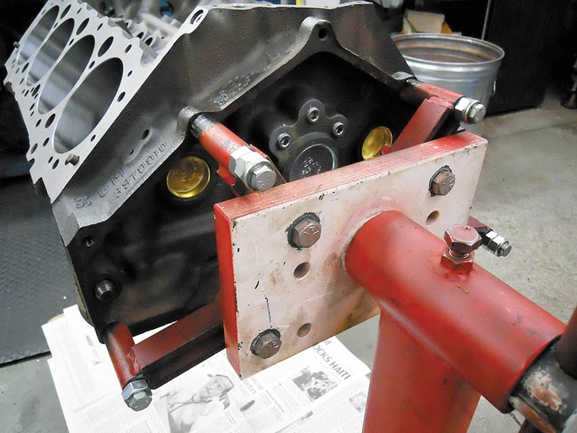
Figure 28.6 Always use graded bolts—either grade 5 or8 bolts—whenever mounting an engine to a stand

Slide 14
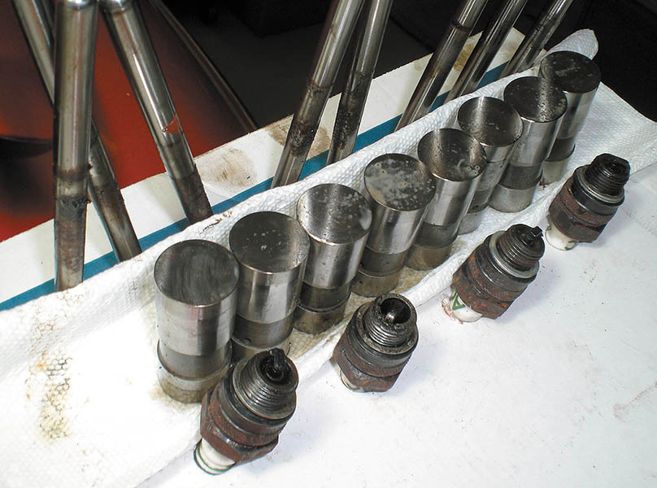
Figure 28.7 Keeping the pushrods and the lifters sorted by cylinder, including the spark plugs, is a wise way to proceed when disassembling the cylinder heads

Slide 15
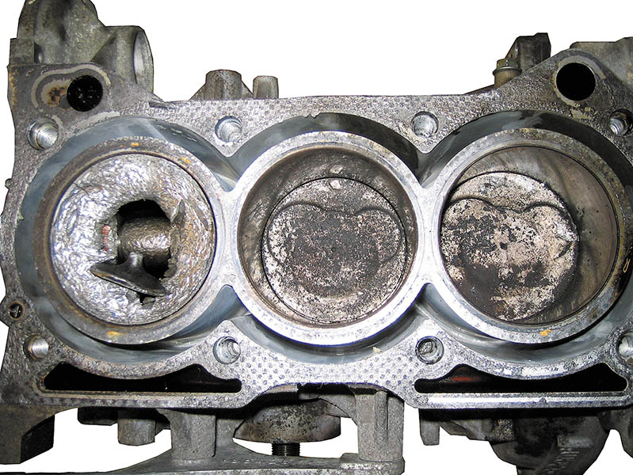
Figure 28.8 Sometimes, after the cylinder head has been removed, the engine condition is discovered to be so major that the entire engine may need to be replaced, rather than overhauled

Slide 16
DISASSEMBLY OF THE SHORT BLOCK
Remove the oil pan
Mark the connecting rods and caps
Remove the cylinder ridge
Remove the pistons

Slide 17
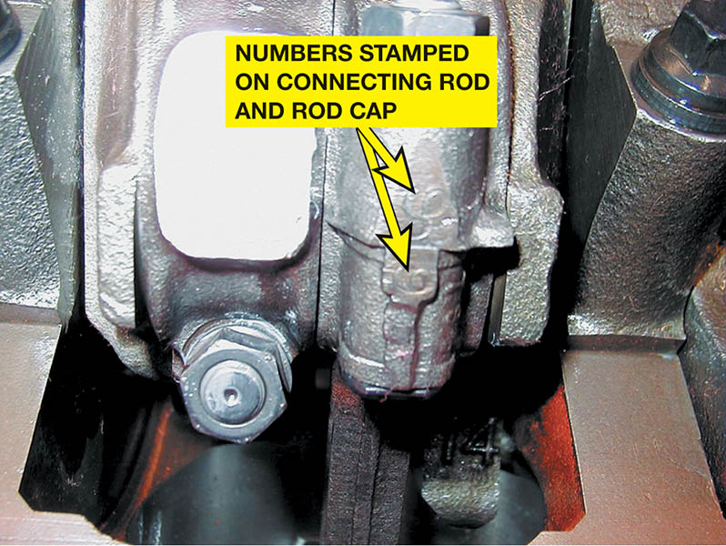
Figure 28.9 These connecting rods were numbered from the factory. If they are not, then they should be marked

Slide 18
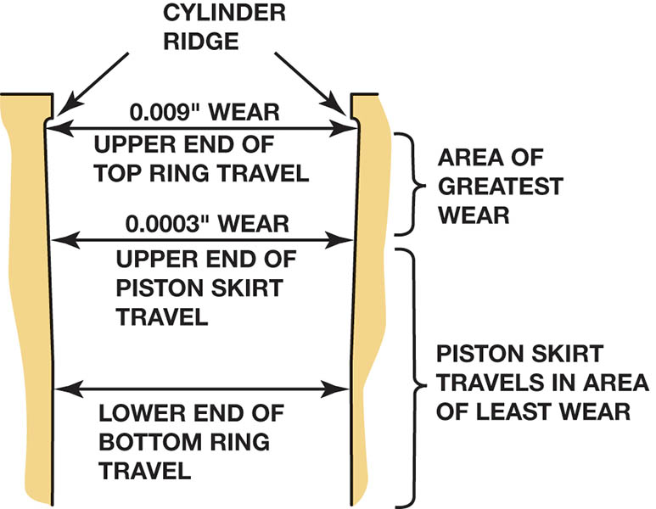
Figure 28.10 Most of the cylinder wear is on the top inch just below the cylinder ridge. This wear is due to the heat and combustion pressures that occur when the piston is near the top of the cylinder

Slide 19
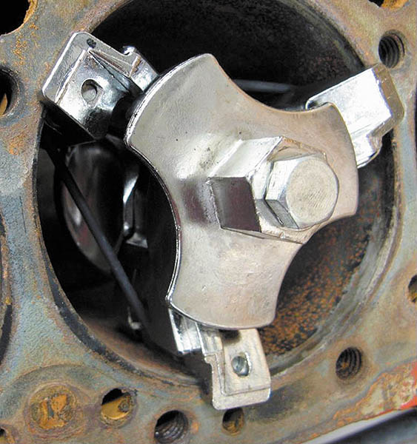
Figure 28.11 This ridge is being removed with one type of ridge reamer before the piston assemblies are removed from the engine

Slide 20
ROTATING ENGINE ASSEMBLIES REMOVAL
Remove the harmonic balancer
Remove the camshaft
Remove the crankshaft and main bearings

Slide 21
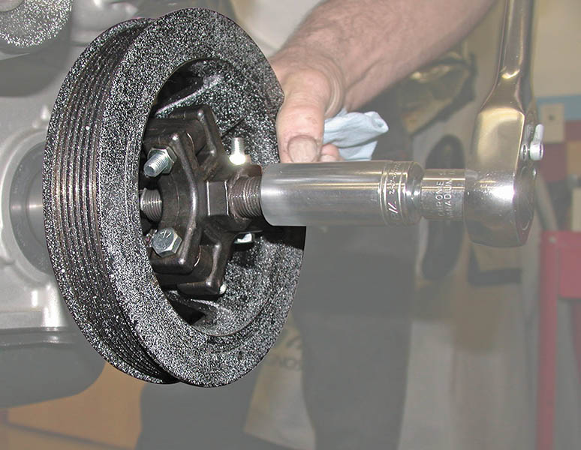
Figure 28.12 Puller being used to pull the vibration damper from the crankshaft

Slide 22
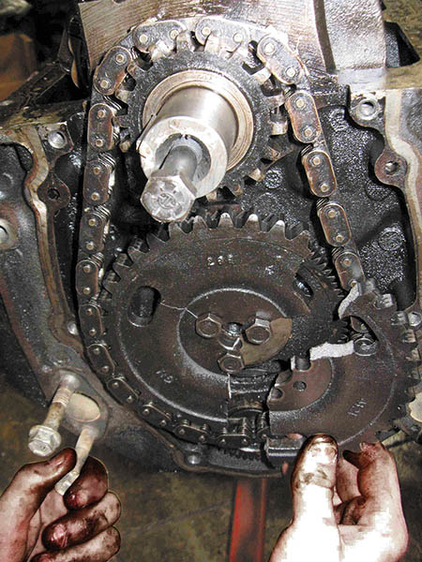
Figure 28.13 When the timing chain cover was removed, the broken timing gear explained why this GM 4.3 liter V-6 engine stopped running

Slide 23
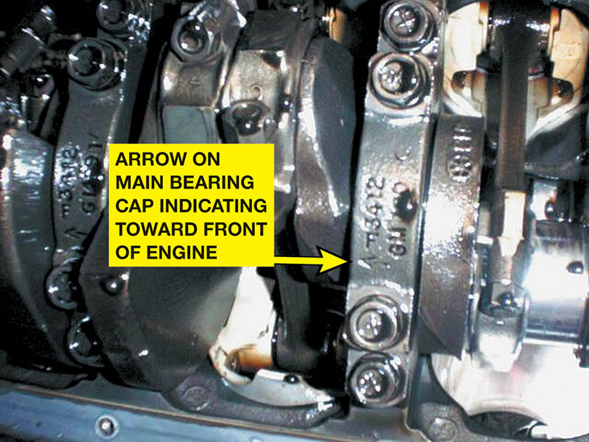
Figure 28.14 Most engines, such as this Chevrolet V-8 with four-bolt main bearing caps, have arrows marked on the bearing caps that should point to the front of the engine

Slide 24
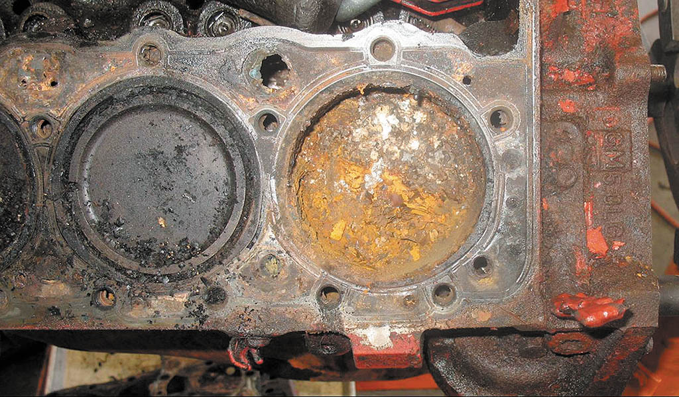
Figure 28.15 This small block Chevrolet V-8 had water standing in the cylinders, causing a lot of rust, which was discovered as soon as the head was removed

Slide 25
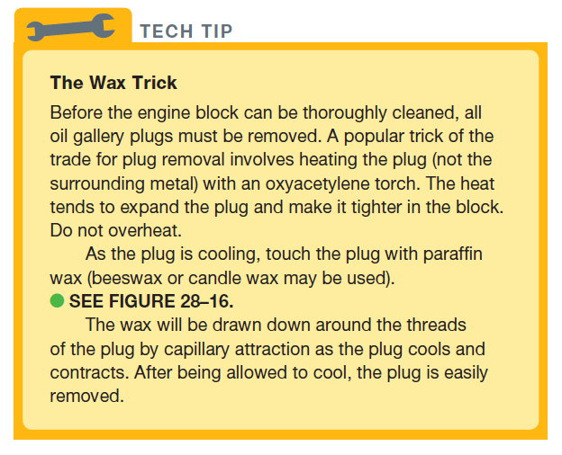
Tech Tip

Slide 26
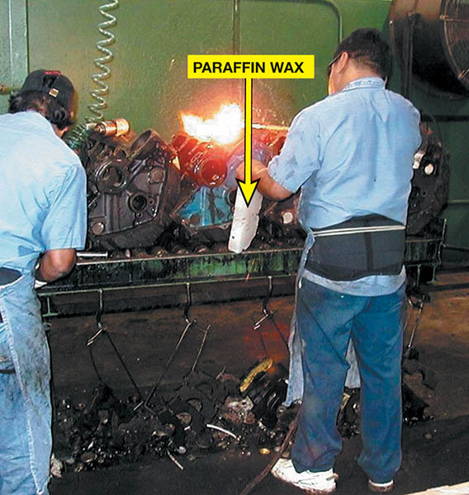
Figure 28.16 A torch is used to heat gallery plugs. Paraffin wax is then applied and allowed to flow around the threads. This procedure results in easier removal of the plugs and other threaded fasteners that cannot otherwise be loosened

Slide 27
CYLINDER HEAD DISASSEMBLY
Tap the valve spring retainer to break the taper.
Compress the spring to expose the keepers.
Remove the keepers and un-compress the spring.
Remove the spring and the valve.
Remove valve seals and spring seats.
Keep all components in order for reassembly.
Overhead cam engines require cam removal first.
.

Slide 28
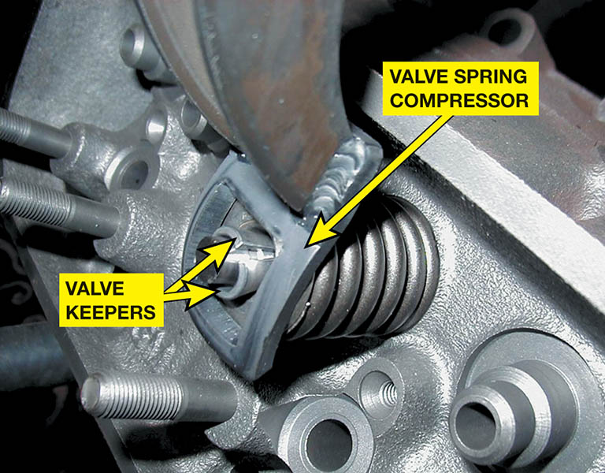
Figure 28.17 A valve spring compressor is used to compress the valve spring before removing the keepers (locks)

Slide 29
QUESTION 2: ?
Why are valve spring retainers tapped with a hammer?

Slide 30
ANSWER 2:
The blow breaks the taper of the keeper and makes them easier to remove.

Slide 31
ENGINE REMOVAL

Slide 32
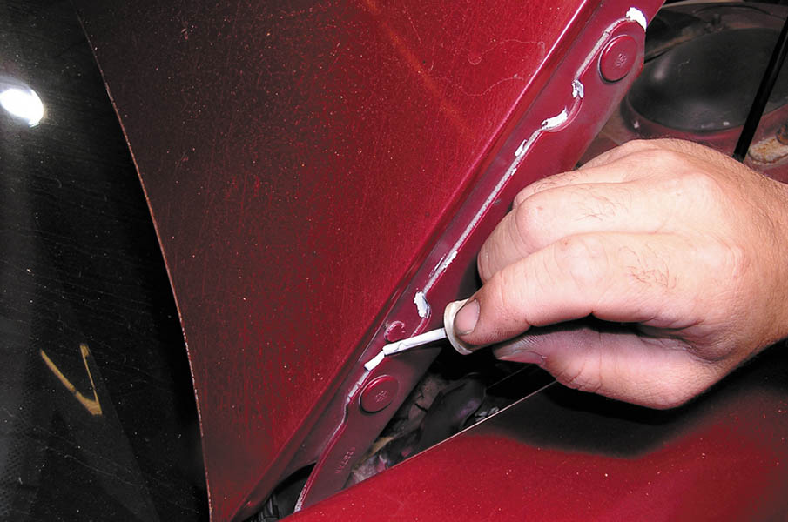
1. Before beginning work on removing the engine, mark and remove the hood and place it in a safe location.

Slide 33
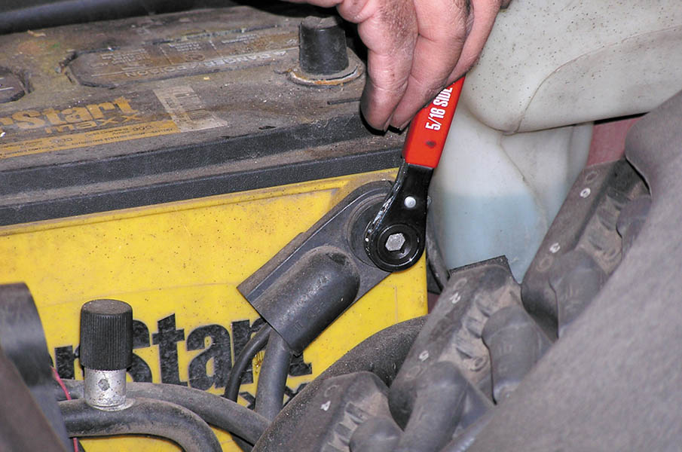
2. For safety, remove the negative battery cable to avoid any possible electrical problems from occurring.

Slide 34
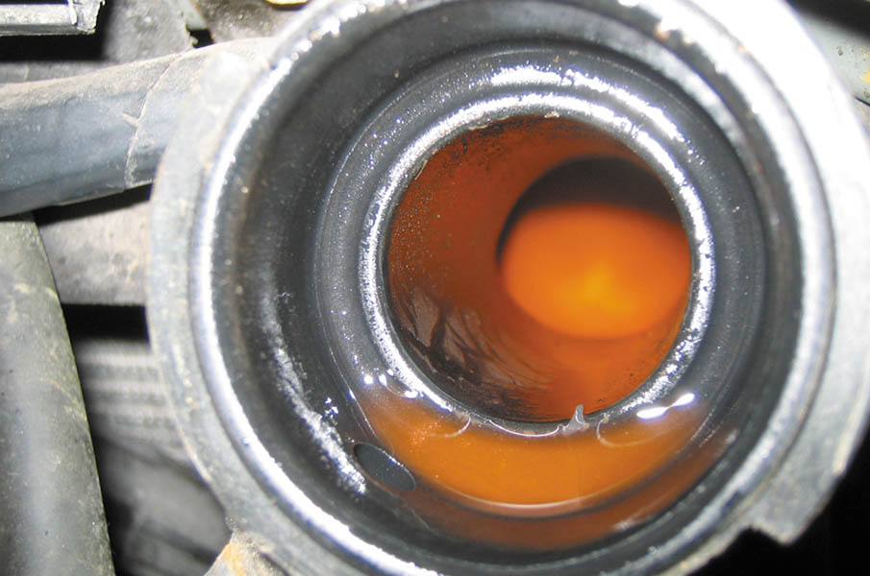
3. Drain the coolant and dispose of properly.

Slide 35
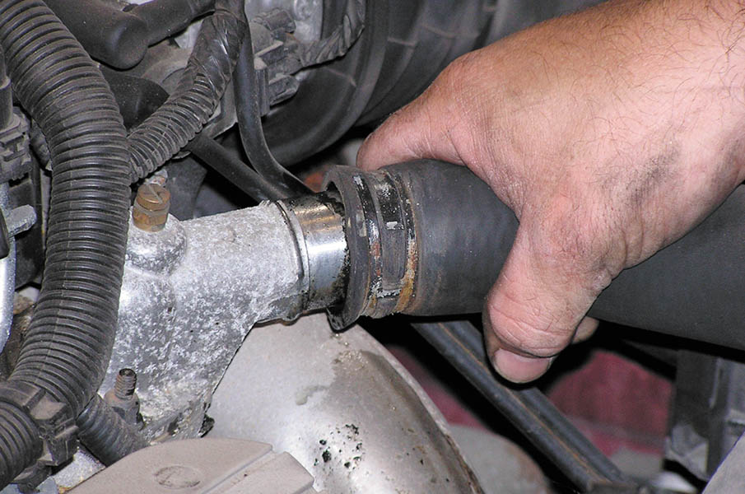
4. Disconnect all cooling system and heater hoses and remove the radiator.

Slide 36
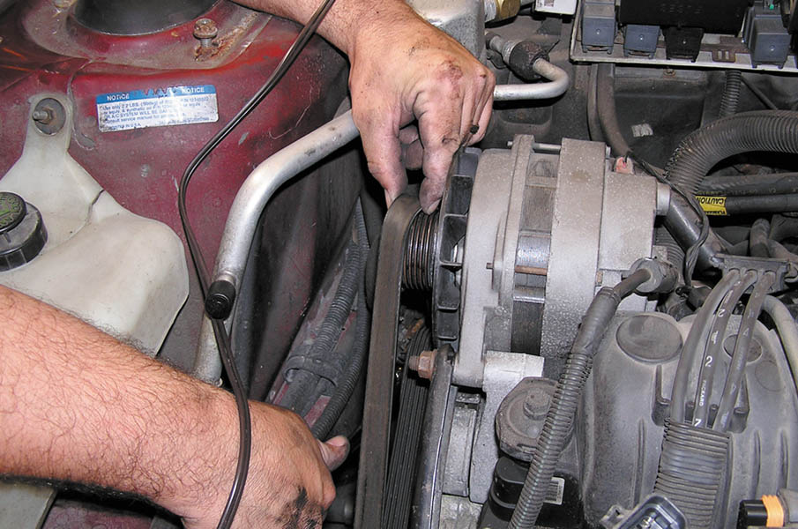
5. Remove the accessory drive belt(s) and set the alternator, power steering pump, and air-conditioning compressor aside.

Slide 37
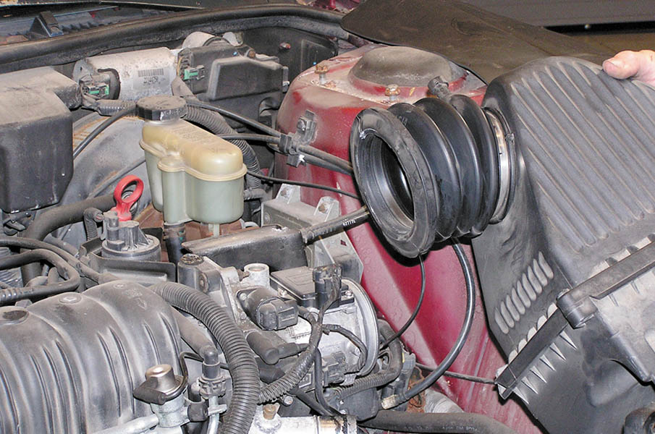
6. Remove the air intake system, including the air filter housing, as needed.

Slide 38
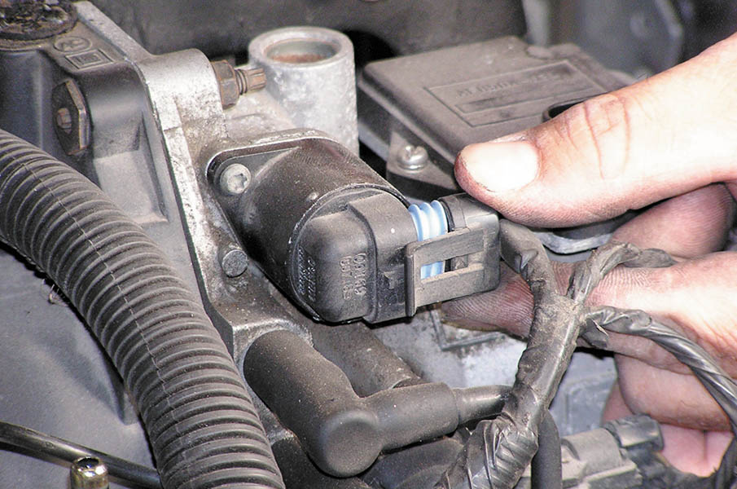
7. Remove the electrical connector from all sensors and label.

Slide 39
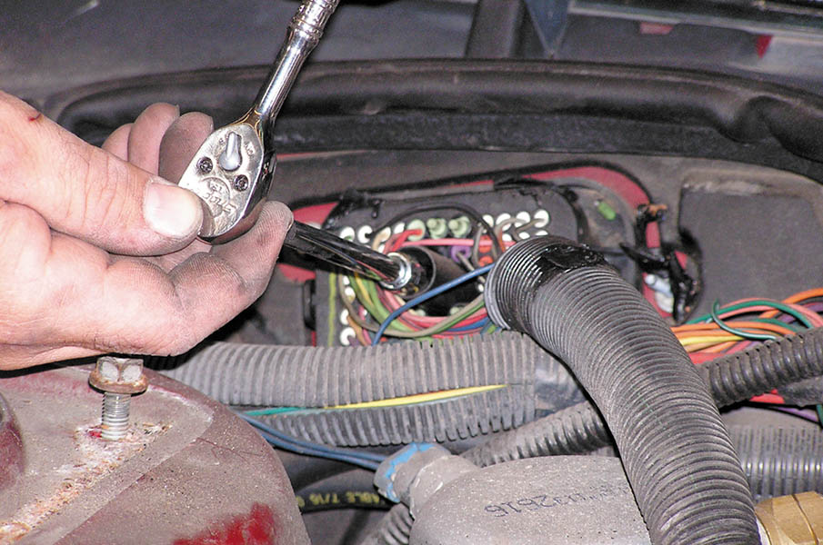
8. Disconnect the engine wiring harness connector at the bulkhead.

Slide 40
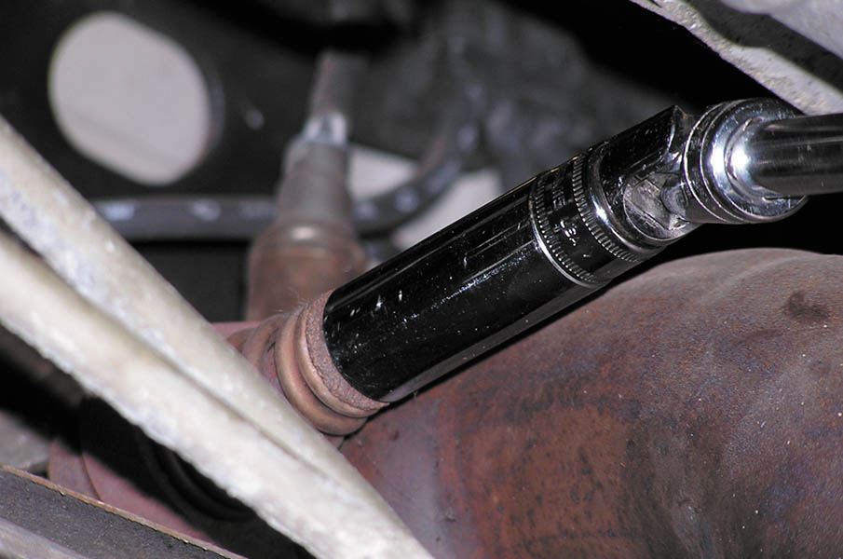
9. Safely hoist the vehicle and disconnect the exhaust system from the exhaust manifolds.

Slide 41
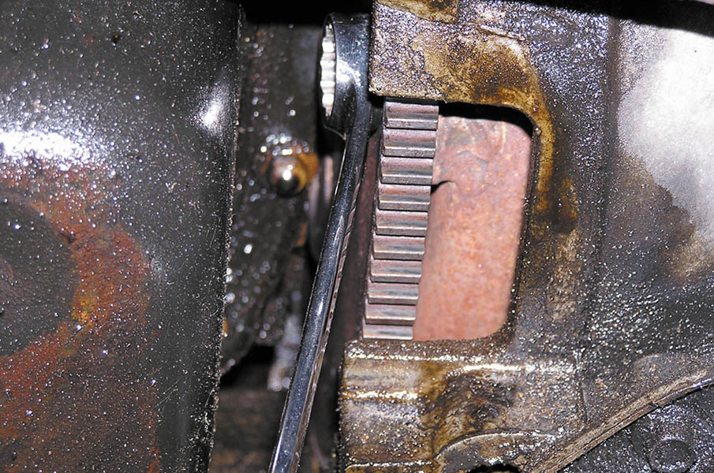
10. Mark and then remove the fasteners connecting the flex plate to the torque converter.

Slide 42
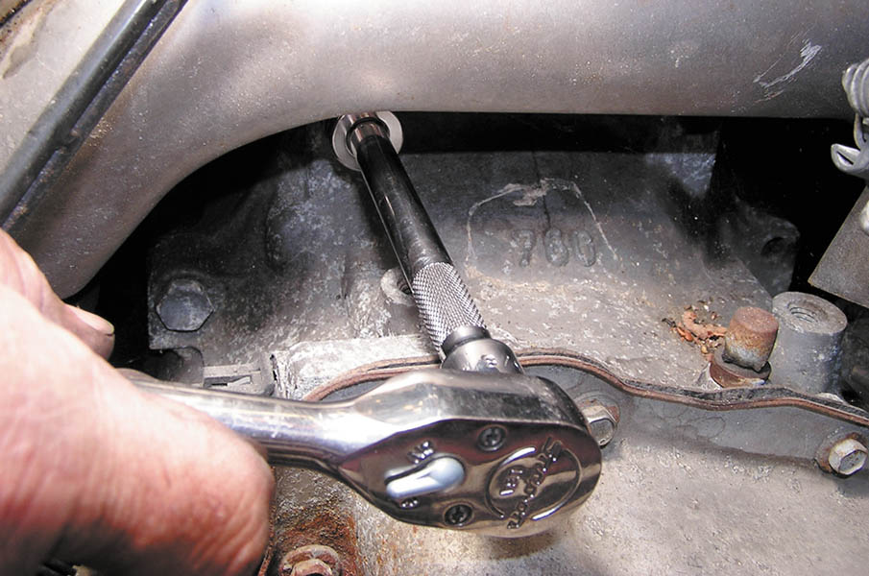
11. Lower the vehicle and remove the engine mount bolts and transaxle bell housing fasteners.

Slide 43
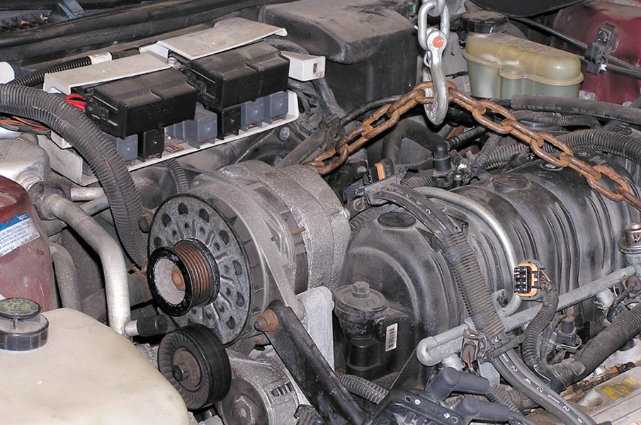
12. Secure the lifting chain to the engine hooks and carefully remove the engine from the vehicle.

Slide 44

Copyright

