Slide 1

Automotive Technology Principles, Diagnosis, and Service
Sixth Edition
Chapter 27
In-Vehicle Engine Service
Copyright © 2018, 2015, 2011 Pearson Education, Inc. All Rights Reserved

Slide 2
LEARNING OBJECTIVES (1 of 2)
27.1 Explain thermostat replacement and water pump replacement in engines.
27.2 Discuss intake manifold gasket inspection and replacement.
27.3 Describe the steps for timing belt replacement.

Slide 3
LEARNING OBJECTIVES (2 of 2)
27.4 Describe the steps for engine mount replacement.
27.5 Discuss hybrid engine precautions.

Slide 4
THERMOSTAT REPLACEMENT
Failure Patterns
Stuck open
Stuck closed
Stuck partially open
Skewed ( does not operate in correct range)
Thermostat Replacement
Allow system to cool, then drain.
Replace thermostat per manufacturer’s instructions.
Refill system and check for proper operation.

Slide 5
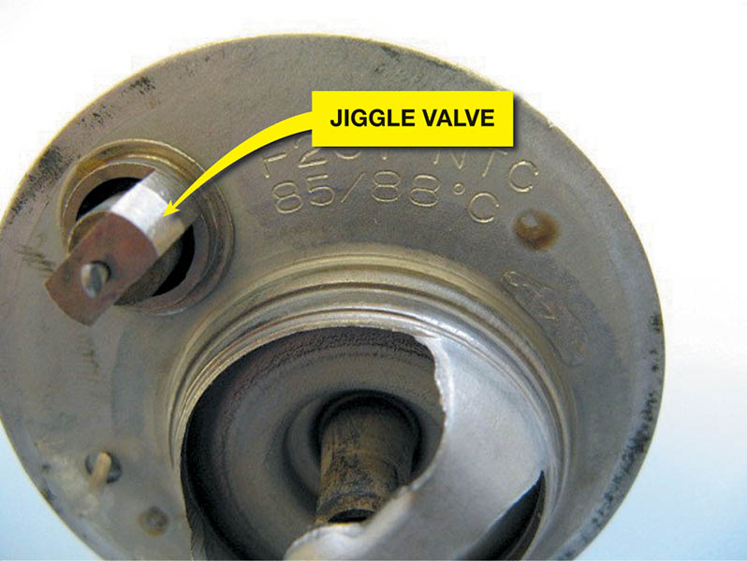
Figure 27.1 If the thermostat has a jiggle valve, it should be placed toward the top to allow air to escape.

Slide 6
QUESTION 1: ?
What are the four pattern failures of a thermostat?

Slide 7
ANSWER 1:
Stuck open, stuck closed, stuck partially open, skewed.

Slide 8
WATER PUMP REPLACEMENT
Need for replacement:
Coolant leaking from the weep hole.
Bearing noisy or loose
Lack of proper coolant flow
Replacement guidelines:
Allow the system to cool, then drain.
Remove and replace water pump per the manufacturer’s specifications.
Refill system and verify proper operation

Slide 9
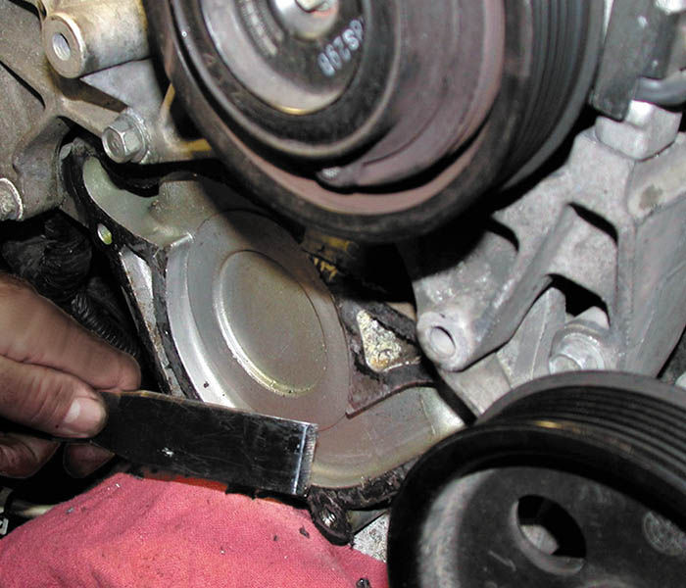
Figure 27.2 Use caution if using a steel scraper to remove a gasket from aluminum parts. It is best to use a wood or plastic scraper

Slide 10
INTAKE MANIFOLD GASKET INSPECTION
To diagnose a possible leaking intake manifold gasket, perform the following tests.
Visual inspection
Coolant leak
Air (vacuum) leak

Slide 11
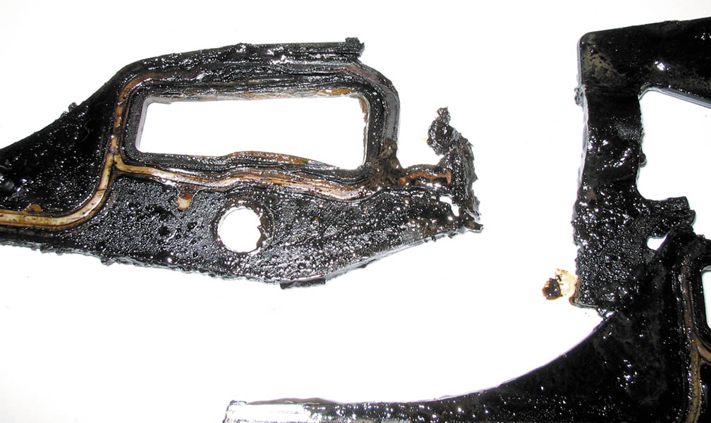
Figure 27.3 An intake manifold gasket that failed and allowed coolant to be drawn into the cylinder(s)

Slide 12
INTAKE MANIFOLD GASKET REPLACEMENT
Allow the cooling system to cool, then drain.
Remove intake manifold making sure not to warp any components that will be reused.
Clean all surfaces.
Replace defective components per the manufacturer’s specifications.
Refill the cooling system and verify proper operation.

Slide 13
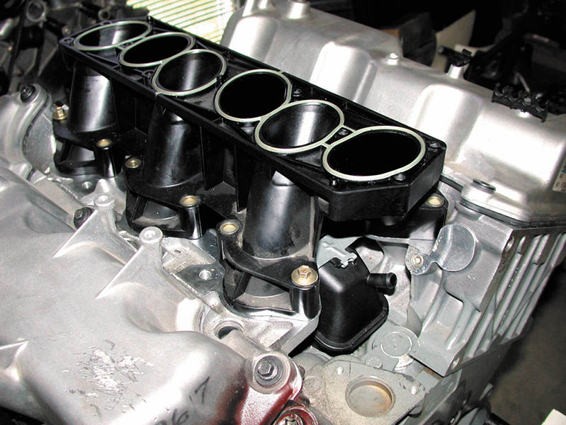
Figure 27.4 The lower intake manifold attaches to the cylinder heads

Slide 14
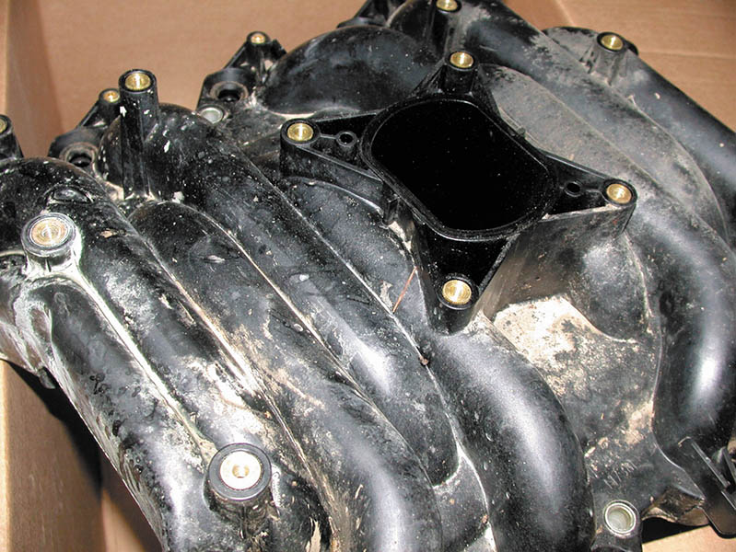
Figure 27.5 The upper intake manifold, often called a plenum, attaches to the lower intake manifold

Slide 15
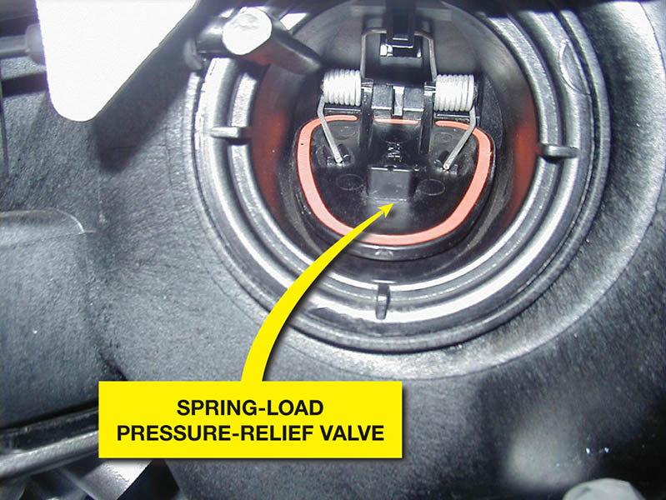
Figure 27.6 Some plastic intake manifolds are equipped with a pressure relief valve that would open in the event of a backfire condition to prevent the higher internal pressures from causing damage to the manifold

Slide 16
TIMING BELT REPLACEMENT
Timing belts are required to be replaced if any of the following conditions occur.
Manufacturer’s recommended timing belt replacement interval.
The timing belt has been contaminated with coolant or engine oil.
The timing belt has failed (missing belt teeth or broken).
Before replacing the timing belt make sure all needed special tools are available.

Slide 17
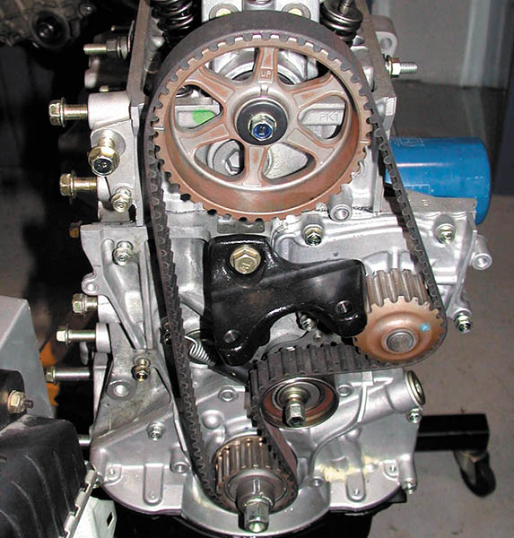
Figure 27.7 A single overhead camshaft engine with a timing belt that also rotates the water pump

Slide 18
QUESTION 2: ?
Why must timing belts be replaced?

Slide 19
ANSWER 2:
Replacement interval, fluid contamination, or physical damage.

Slide 20
ENGINE MOUNT REPLACEMENT
Engine mounts are designed to perform the following functions:
Support the weight and torque of the powertrain.
Isolate noise and vibrations
Inspection:
Obvious damage or fluid leaks
Loose or damaged fasteners
Replacement:
Follow the manufacturer’s procedures when replacing.
.

Slide 21
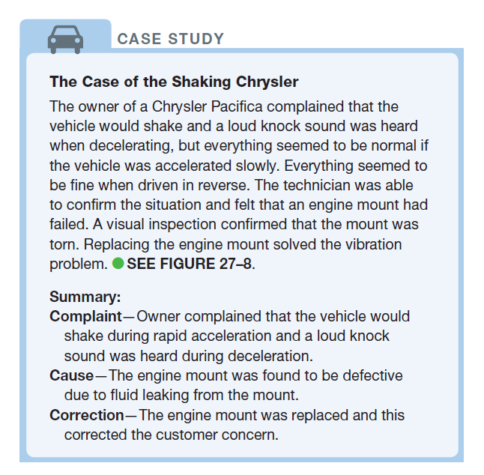
CASE STUDY

Slide 22
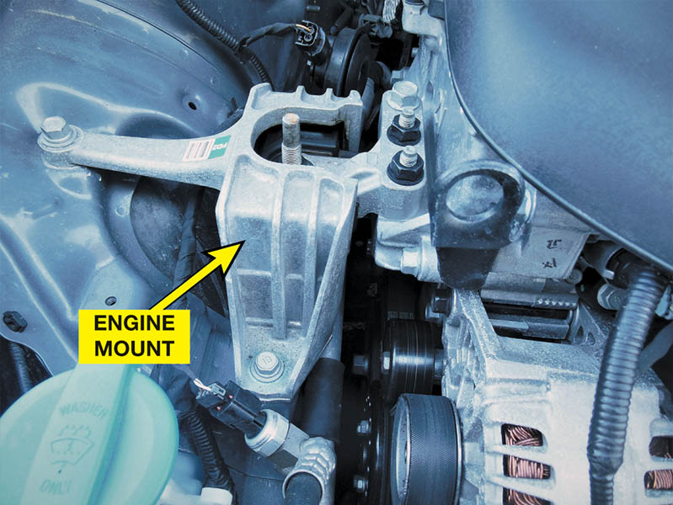
Figure 27.8 The old front engine mount contained hydraulic fluid. The oil was leaking from a split in the mount. The new original equipment (OE) mount is ready to be installed

Slide 23
HYBRID ENGINE PERCAUTIONS
Make sure the ignition is off and the key is out of the vehicle.
Check that the “ready” light is off.
Do not touch any of the circuits with “orange” conduit.
Always use high-voltage lineman’s gloves when depowering the high-voltage system.

Slide 24
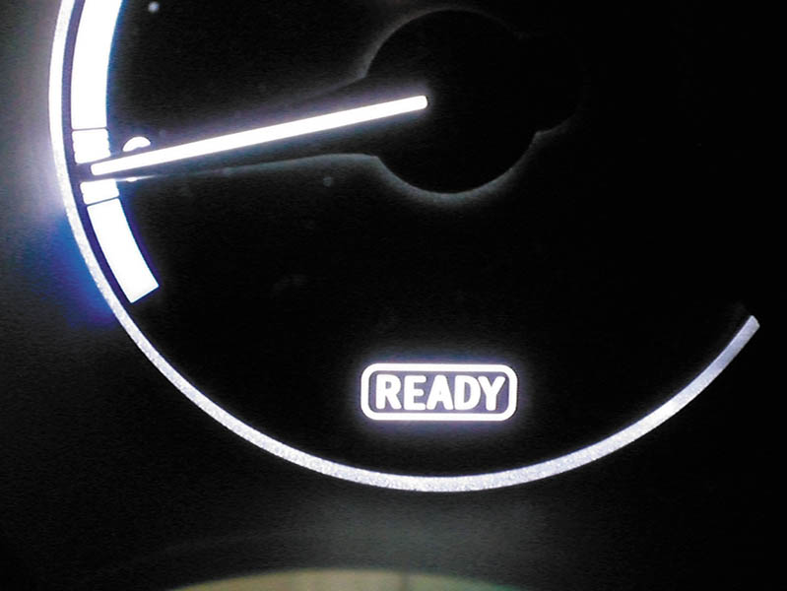
Figure 27.9 A Toyota/Lexus hybrid electric vehicle has a ready light. If the ready light is on, the engine can start at anytime without warning

Slide 25
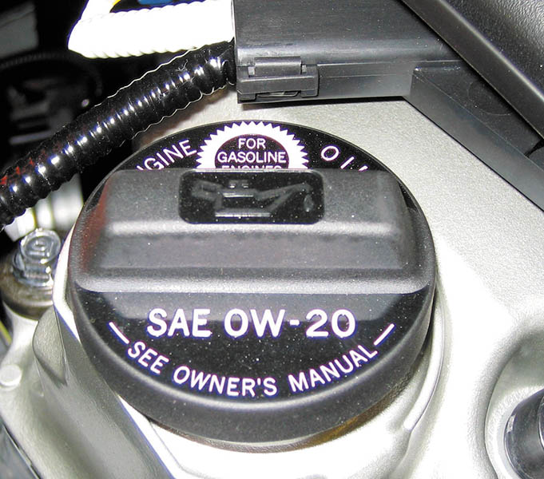
Figure 27.10 Always use the viscosity of oil as specified on the oil fill cap

Slide 26
QUESTION 3: ?
Why is it important that the READY light be out on the dash before working under the hood of a hybrid electric vehicle?

Slide 27
ANSWER 3:
Any time the “ready” light is illuminated, the vehicle may start.

Slide 28
VALVE ADJUSTMENT

Slide 29
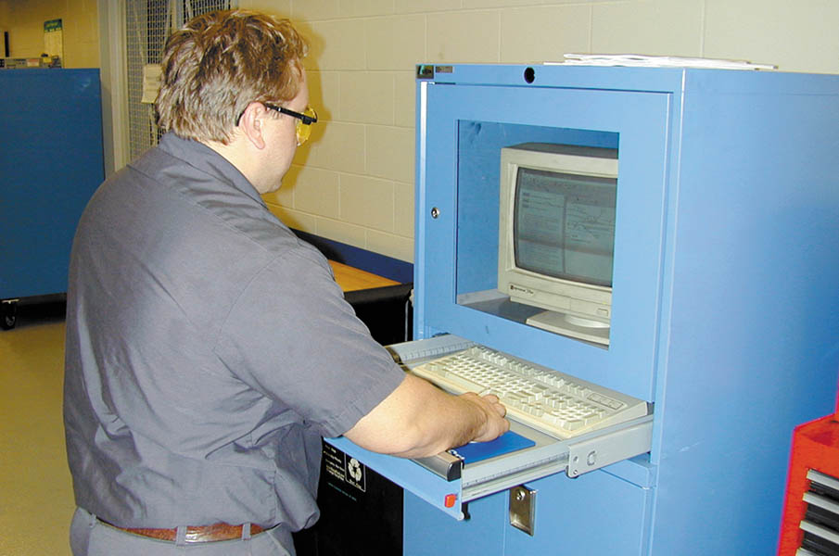
1. Before starting the process of adjusting the valves, look up the specifications and exact procedures.

Slide 30
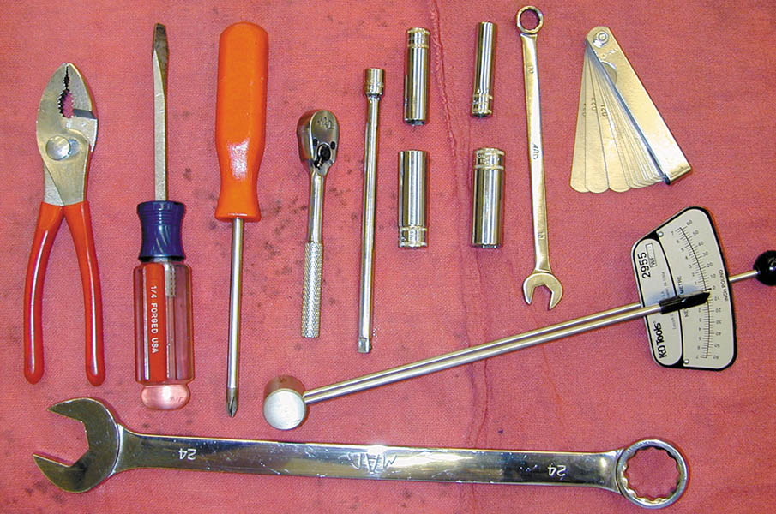
2. The tools necessary to adjust the valves on an engine with adjustable rocker arms include basic hand tools, feeler gauge, and a torque wrench.

Slide 31
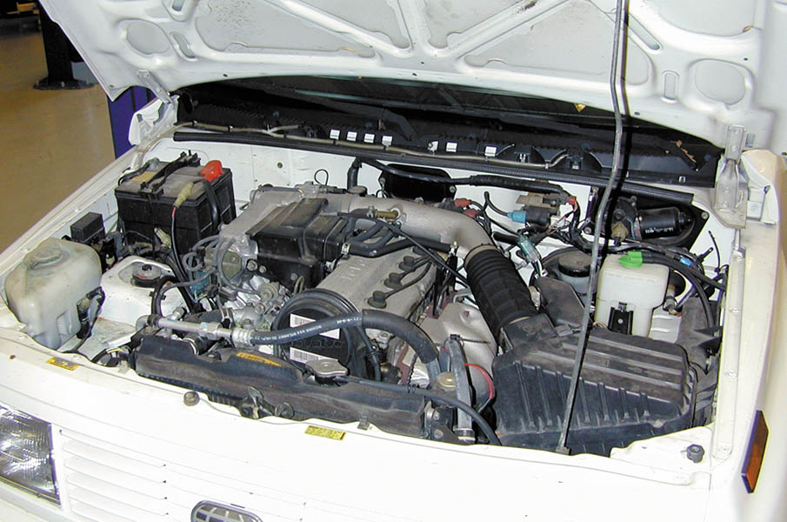
3. An overall view of the 4-cylinder engine that is due for a scheduled valve adjustment, according to the vehicle manufacturer’s recommendations.

Slide 32
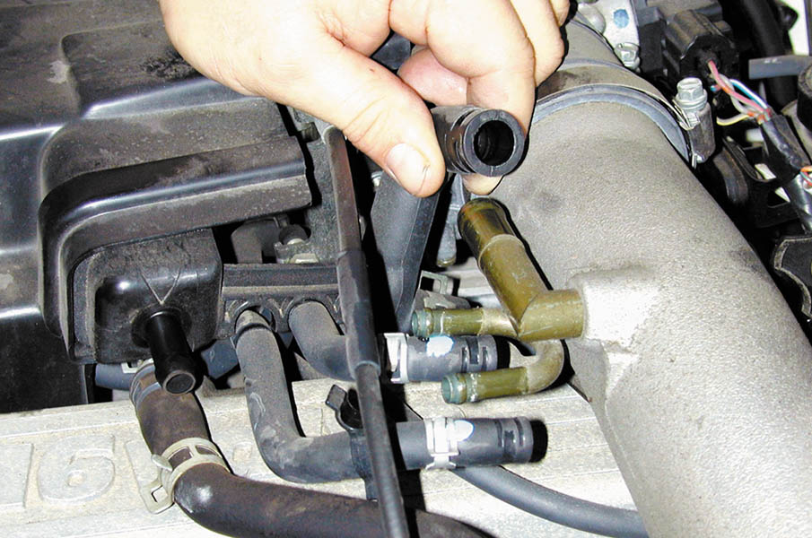
4. Start the valve adjustment procedure by first disconnecting and labeling, if necessary, all vacuum lines that need to be removed to gain access to the valve cover.

Slide 33
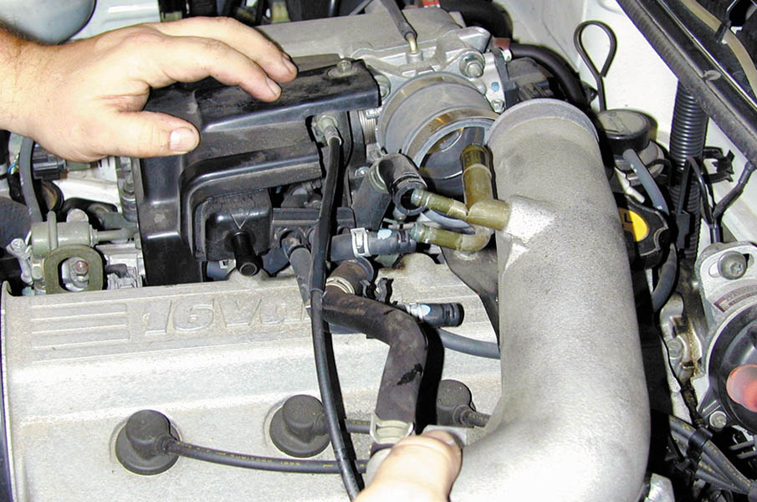
5. The air intake tube is being removed from the throttle body.

Slide 34
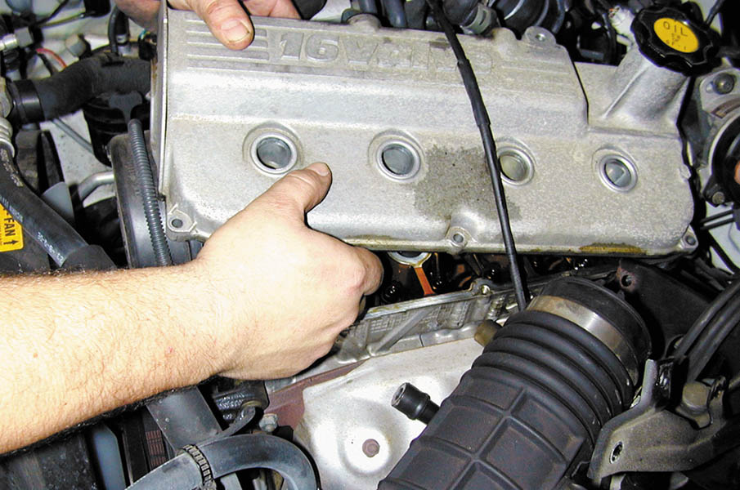
6. With all vacuum lines and the intake tube removed, the valve cover can be removed after removing all retaining bolts.

Slide 35
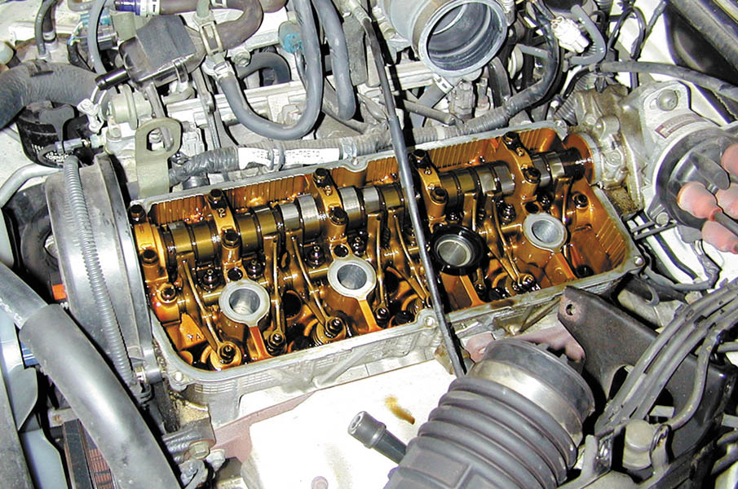
7. Notice how clean the engine appears. This is a testament of proper maintenance and regular oil changes by the owner.

Slide 36
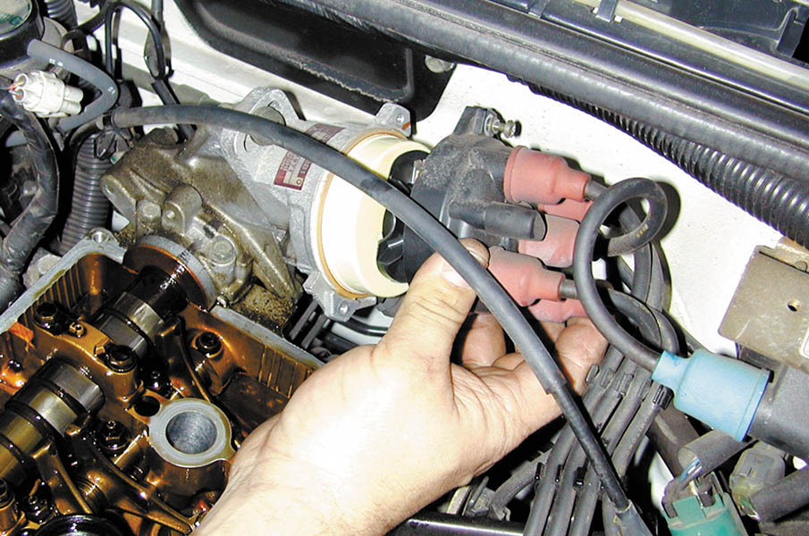
8. To help locate how far the engine is being rotated, the technician is removing the distributor cap to be able to observe the position of the rotor.

Slide 37
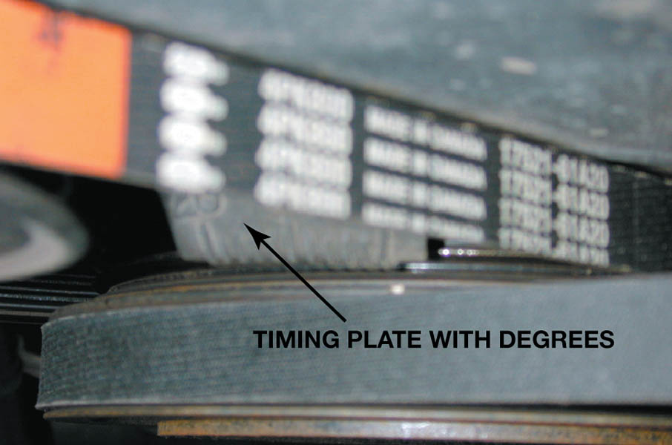
9. The engine is rotated until the timing marks on the front of the crankshaft line up with zero degrees—top dead center (TDC)—with both valves closed on #1 cylinder.

Slide 38
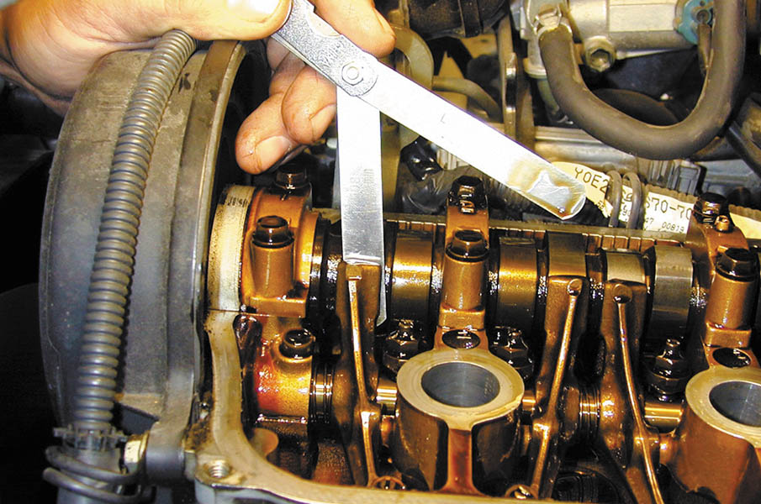
10. With the rocker arms contacting the base circle of the cam, insert a feeler gauge of the specified thickness between the camshaft and the rocker arm. There should be a slight drag on the feeler gauge.

Slide 39
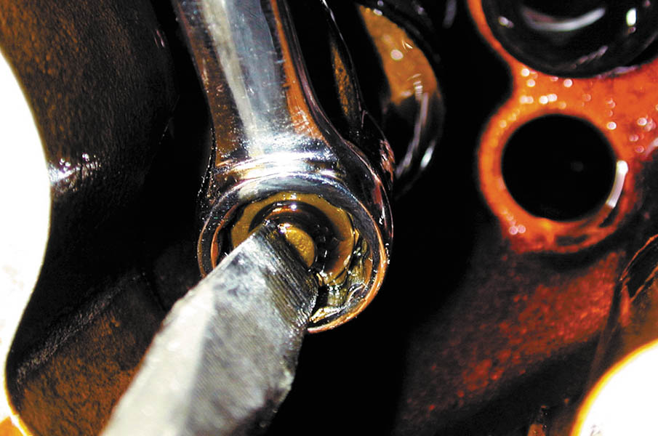
11. If the valve clearance (lash) is not correct, loosen the retaining nut and turn the valve adjusting screw with a screwdriver to achieve the proper clearance.

Slide 40
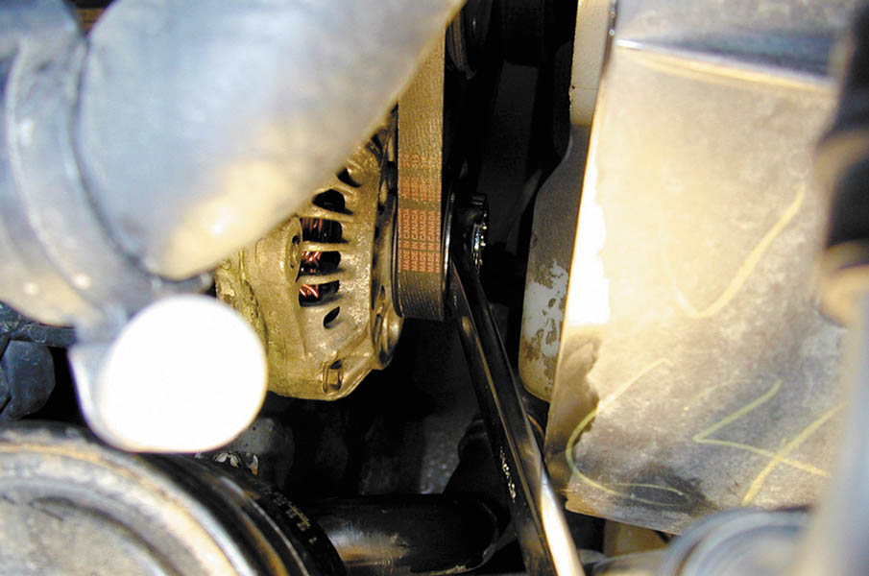
12. After adjusting the valves that are closed, rotate the engine one full rotation until the engine timing marks again align.

Slide 41
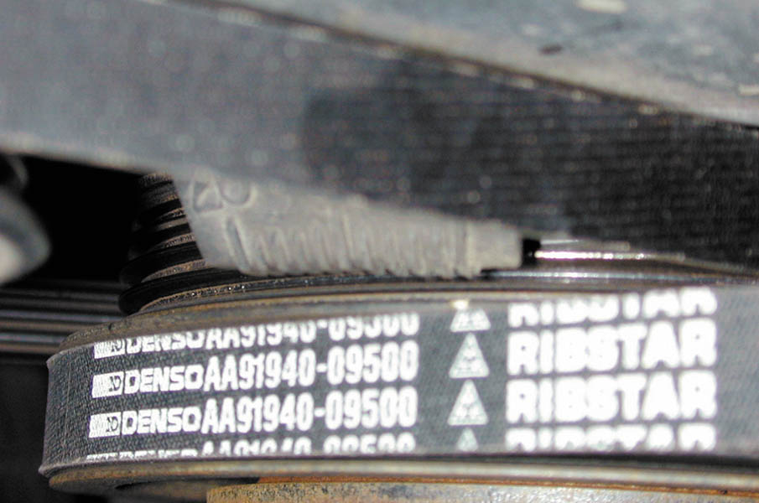
13. The engine is rotated until the timing marks again align, indicating that the companion cylinder will now be in position for valve clearance measurement.

Slide 42
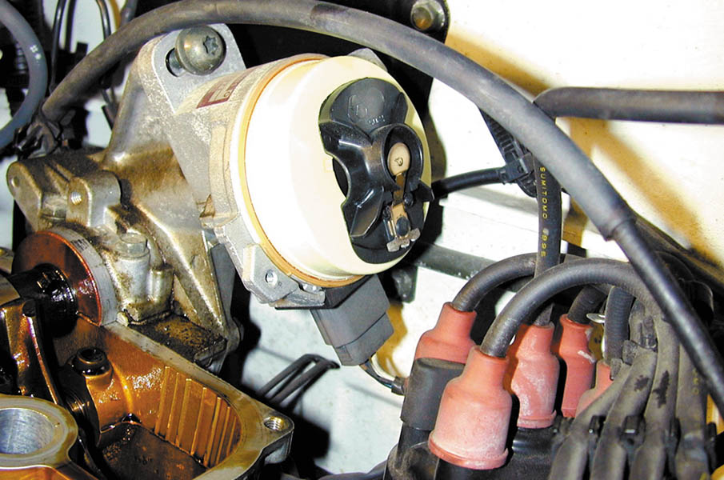
14. On some engines, it is necessary to watch the direction the rotor is pointing to help determine how far to rotate the engine.

Slide 43
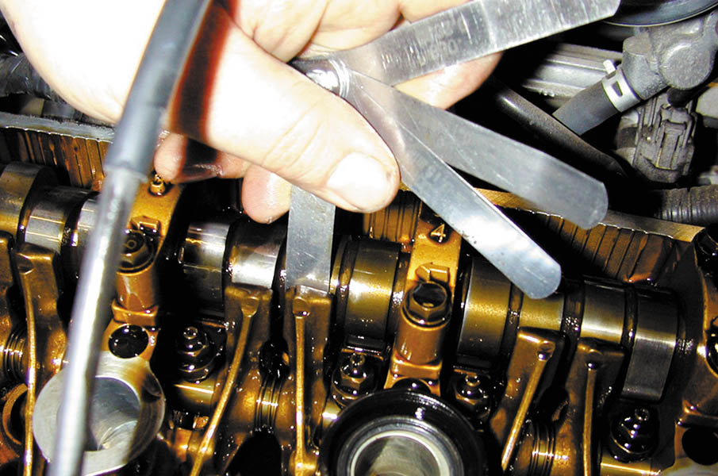
15. The technician is using a feeler gauge that is one thousandth of an inch thinner and another one thousandth of an inch thicker than the specified clearance as a double-check that the clearance is correct.

Slide 44
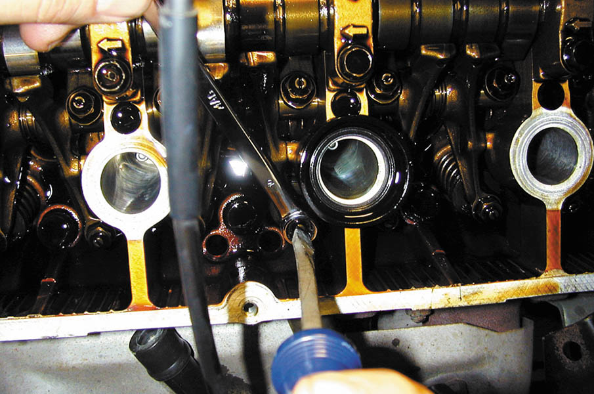
16. Adjusting a valve takes both hands—one to hold the wrench to loosen and tighten the lock nut and one to turn the adjusting screw.

Slide 45
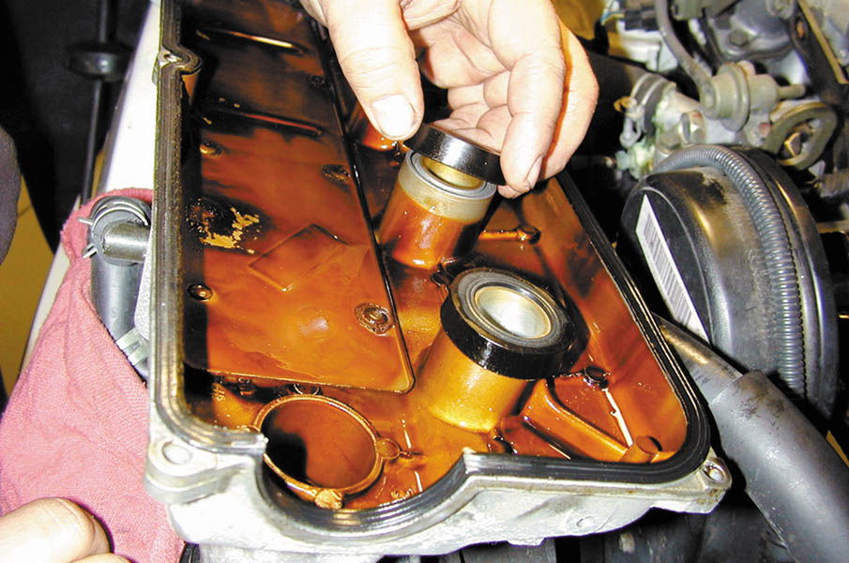
17. After all valves have been properly measured and adjusted as necessary, start the reassembly process by replacing all gaskets and seals as specified by the vehicle manufacturer.

Slide 46
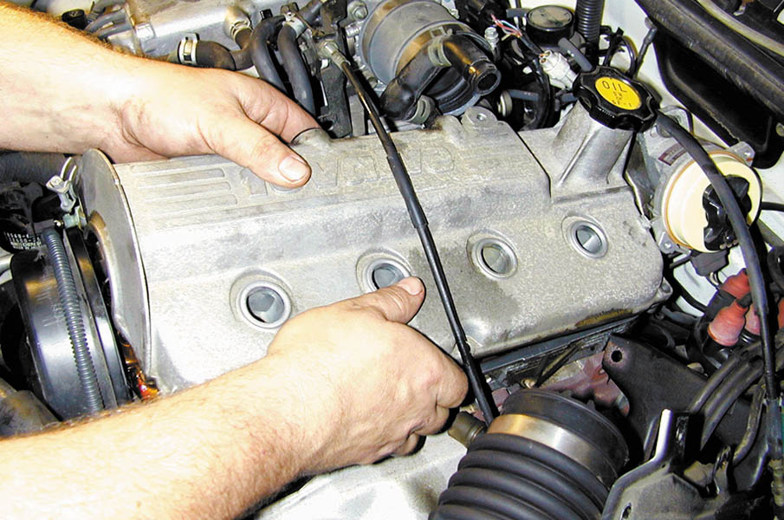
18. Reinstall the valve cover, being careful to not pinch a wire or vacuum hose between the cover and the cylinder head.

Slide 47
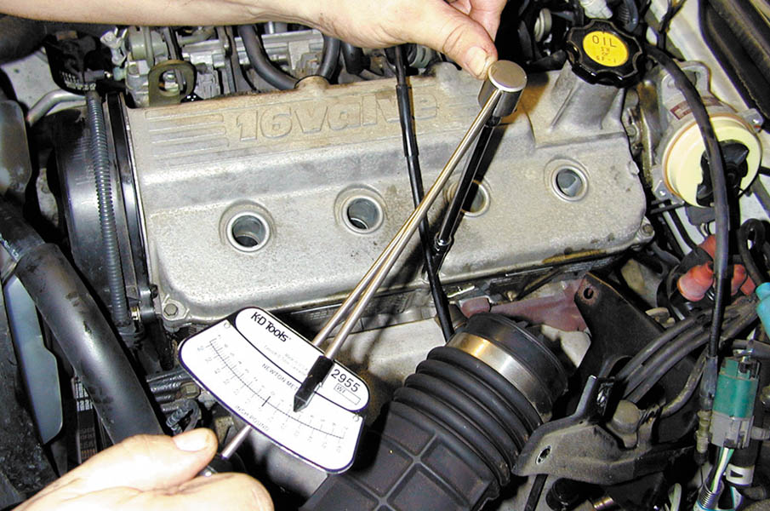
19. Use a torque wrench and torque the valve cover retaining bolts to factory specifications.

Slide 48
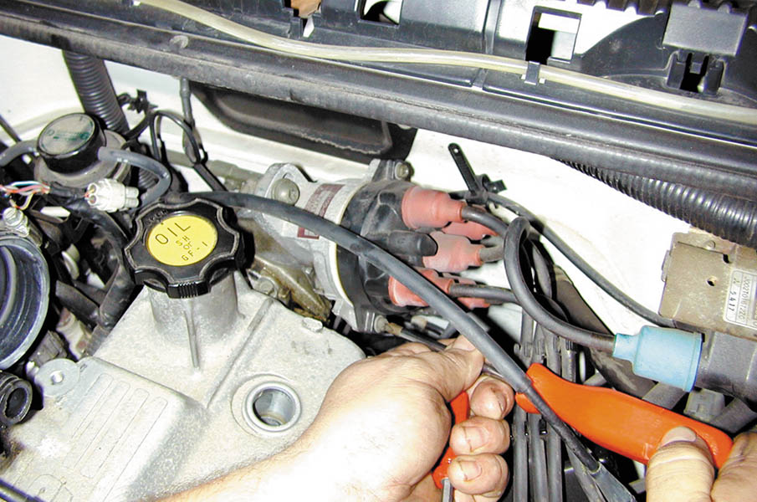
20. Reinstall the distributor cap.

Slide 49
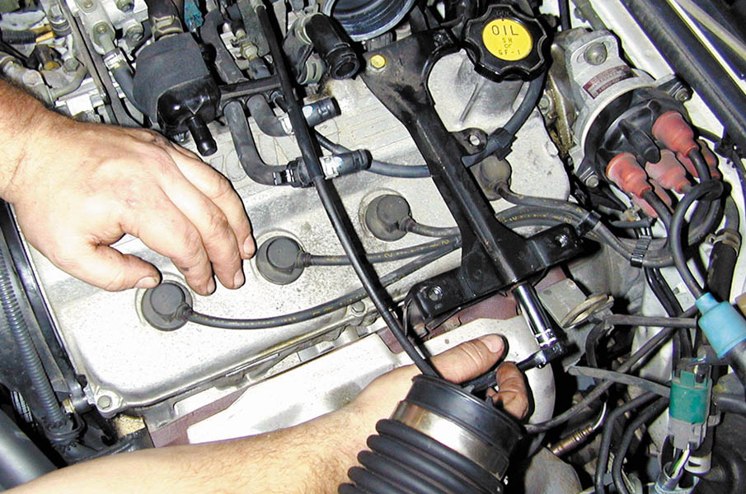
21. Reinstall the spark plug wires and all brackets that were removed to gain access to the valve cover.

Slide 50
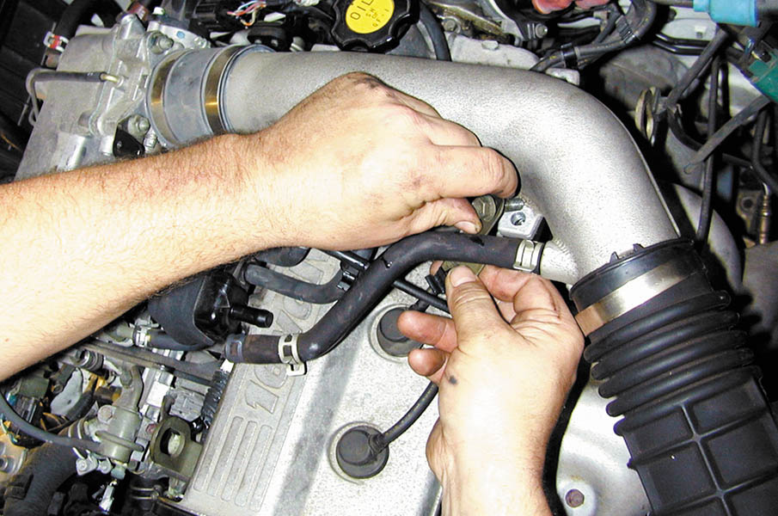
22. Reconnect all vacuum and air hoses and tubes. Replace any vacuum hoses that are brittle or swollen with new ones.

Slide 51
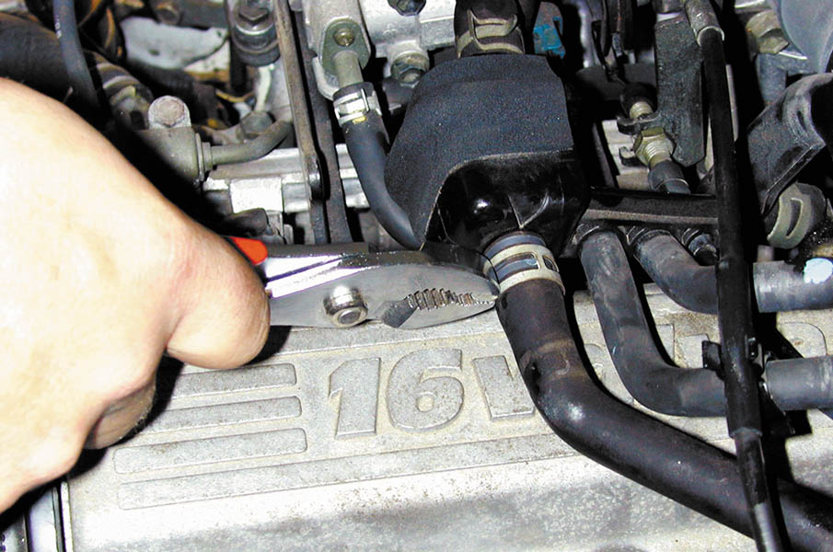
23. Be sure that the clips are properly installed. Start the engine and check for proper operation.

Slide 52
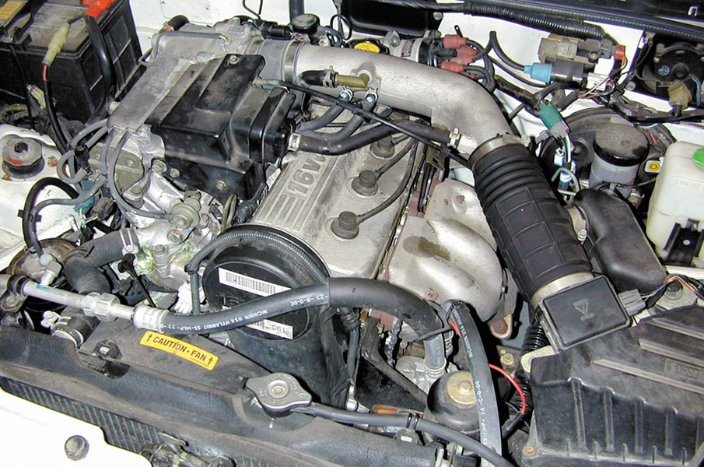
24. Double-check for any oil or vacuum leaks after starting the engine.

Slide 53

Copyright

