Slide 1

Automotive Technology Principles, Diagnosis, and Service
Sixth Edition
Chapter 26
Engine Condition Diagnosis
Copyright © 2018, 2015, 2011 Pearson Education, Inc. All Rights Reserved

Slide 2
LEARNING OBJECTIVES (1 of 2)
26.1 Discuss typical engine-related complaints and engine smoke diagnosis.
26.2 Discuss the importance of the driver’s description and visual checks.
26.3 Discuss engine noise diagnosis.
26.4 Explain oil pressure testing and the purpose of oil pressure warning lamps.

Slide 3
LEARNING OBJECTIVES (2 of 2)
26.5 Explain compression testing, and compare wet and running compression tests.
26.6 Describe cylinder leakage test and cylinder power balance test.
26.7 Explain the vacuum test and exhaust restriction test.
26.8 Explain how to test back pressure with a vacuum gauge and a pressure gauge, and how to diagnose head gasket failure.
26.9 Discuss the operation of dash warning lights.

Slide 4
TYPICAL ENGINE-RELATED COMPLAINTS
Excessive oil consumption
Engine misfiring
Loss of power
Smoke from the engine or exhaust
Engine noise

Slide 5
ENGINE SMOKE DIAGNOSIS
Blue: Indicates the engine is burning oil.
Black: Indicates excessive fuel in the combustion chamber.
White (steam): Indicates water (coolant) in the combustion chamber.

Slide 6
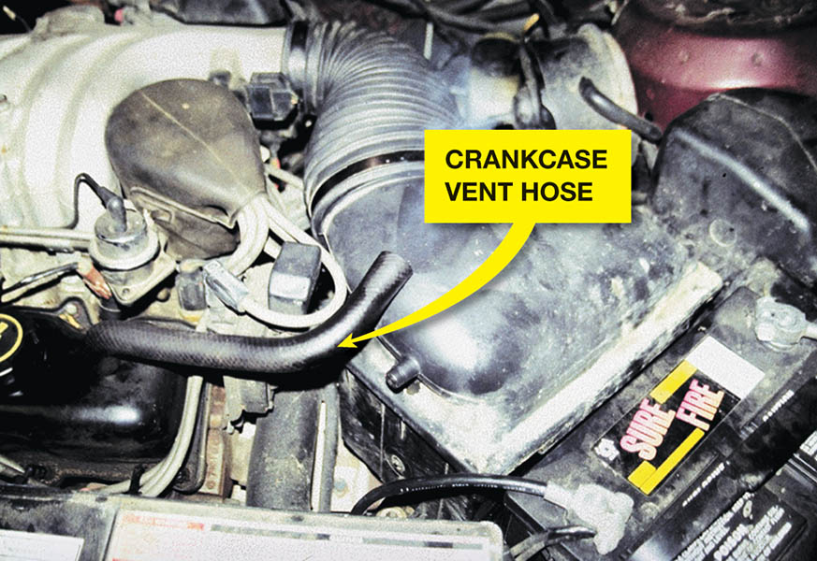
Figure 26.1 Blowby gases coming out of the crankcase vent hose. As seen on this old high-mileage engine, excessive amounts of combustion gases flow past the piston rings and into the crankcase

Slide 7
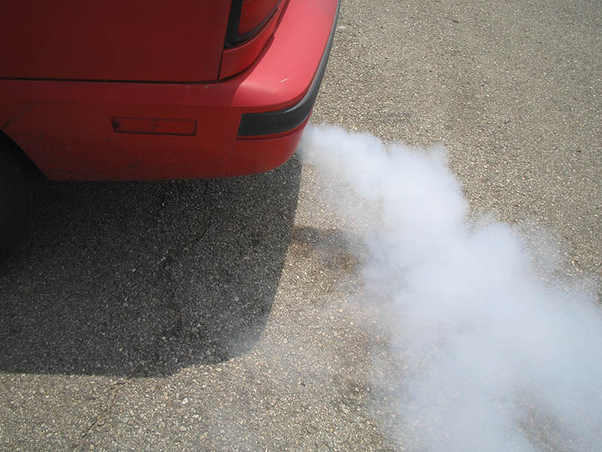
Figure 26.2 White steam is usually an indication of a blown (defective) cylinder head gasket that allows engine coolant to flow into the combustion chamber where it is turned into steam

Slide 8
QUESTION 1: ?
What does blue exhaust smoke indicate?

Slide 9
ANSWER 1:
The engine has an oil consumption concern.

Slide 10
THE DRIVER IS YOUR BEST RESOURCE
Ask the following questions:
When did the problem first occur?
Under what conditions does it occur?
Cold or hot?
Acceleration, cruise, deceleration?
How far was it driven?
What recent repairs have been performed?

Slide 11
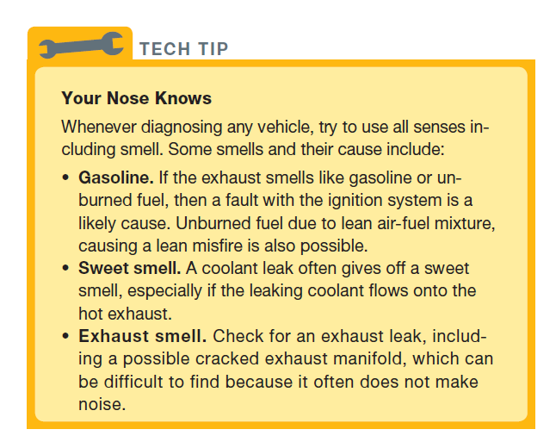
Tech Tip

Slide 12
VISUAL CHECKS
Oil level and condition
Coolant level and condition
Oil leaks

Slide 13
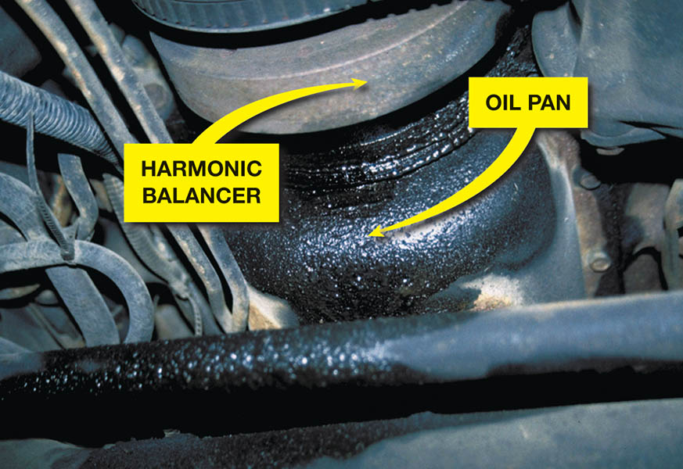
Figure 26.3 What looks like an oil pan gasket leak can be a rocker cover gasket leak. Always look for the highest and most forward place you see oil leaking; that should be repaired first

Slide 14
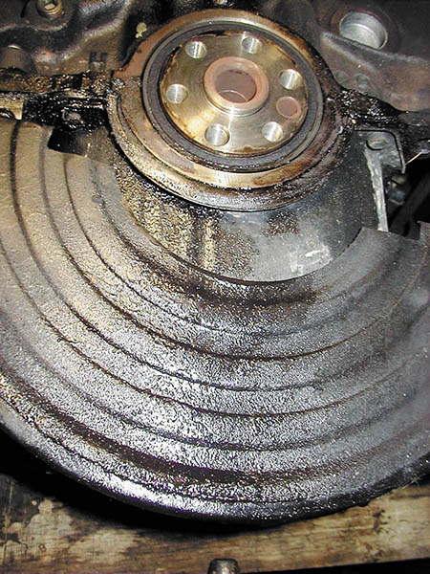
Figure 26.4 The transmission and flexplate (flywheel) were removed to check the exact location of this oil leak. The rear main seal and/or the oil pan gasket could be the cause of this leak

Slide 15
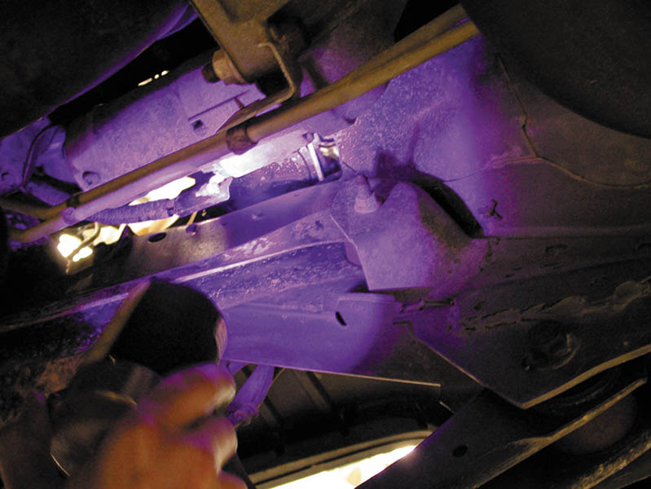
Figure 26.5 Using a black light to spot leaks after adding dye to the oil

Slide 16
ENGINE NOISE DAIGNOSIS
Engine noises are often difficult to diagnose. Several items that can cause an engine noise include:
Valves clicking
Torque converter
Cracked flex plate
Loose or defective drive belts or tensioners.
Piston pin knock
Timing chain noise
Rod or main bearing noise

Slide 17
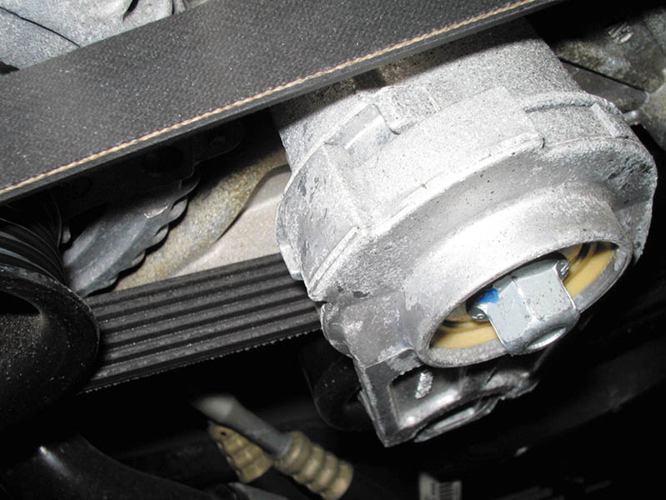
Figure 26.6 An accessory belt tensioner. Most tensioners have a mark that indicates normal operating location. If the belt has stretched, this indicator mark will be outside of the normal range. Anything wrong with the belt or tensioner can cause noise

Slide 18
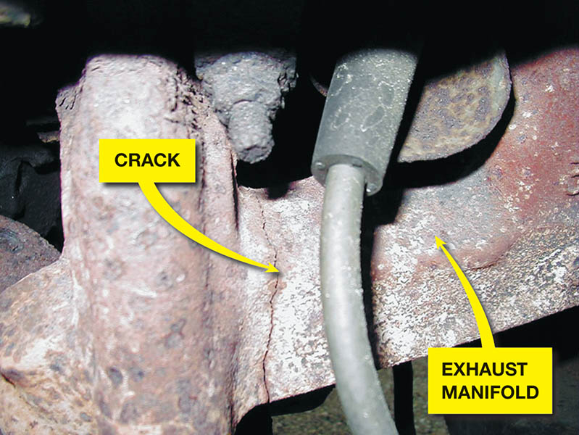
Figure 26.7 A cracked exhaust manifold on a Ford V-8

Slide 19
OIL PRESSURE TESTING
Proper oil pressure is very important for the operation of any engine.
Low oil pressure can cause engine wear, and engine wear can cause low oil pressure.
Other issues include:
Low oil level
Diluted oil
Stuck oil pressure relief valve
The oil pressure warning lamp will illuminate when pressures drop below 4-7 PSI.
.

Slide 20
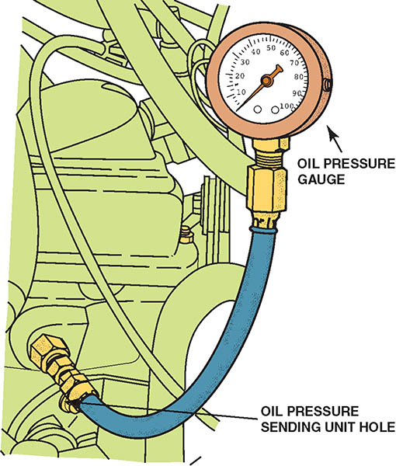
Figure 26.8 To measure engine oil pressure, remove the oil pressure sending (sender) unit usually located near the oil filter. Screw the pressure gauge into the oil pressure sending unit hole

Slide 21
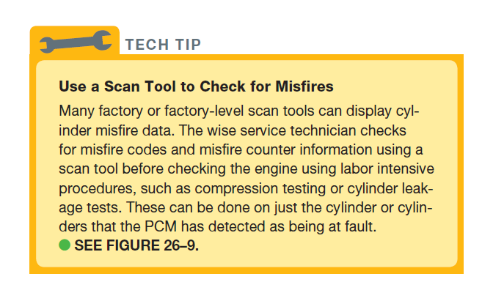
TECH TIP

Slide 22
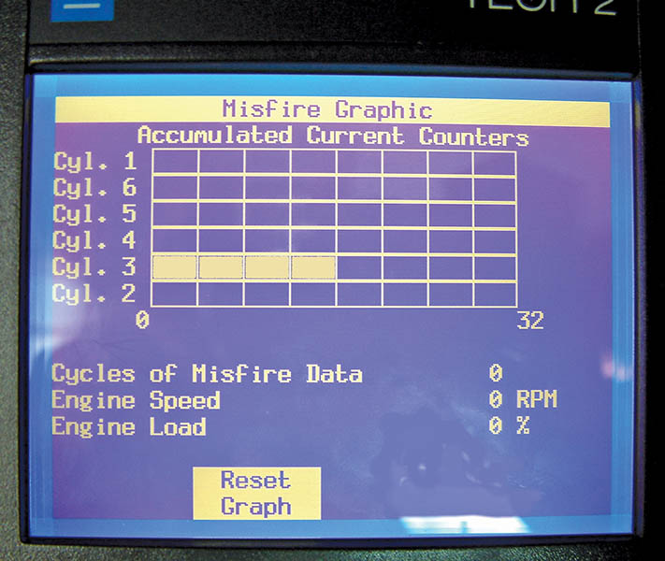
Figure 26.9 A Tech 2 scan tool display showing a fault with cylinder 3. Once the cylinder has been identified, then more detailed tests can be performed to determine the root cause, which could be an ignition, fuel or mechanical issue

Slide 23
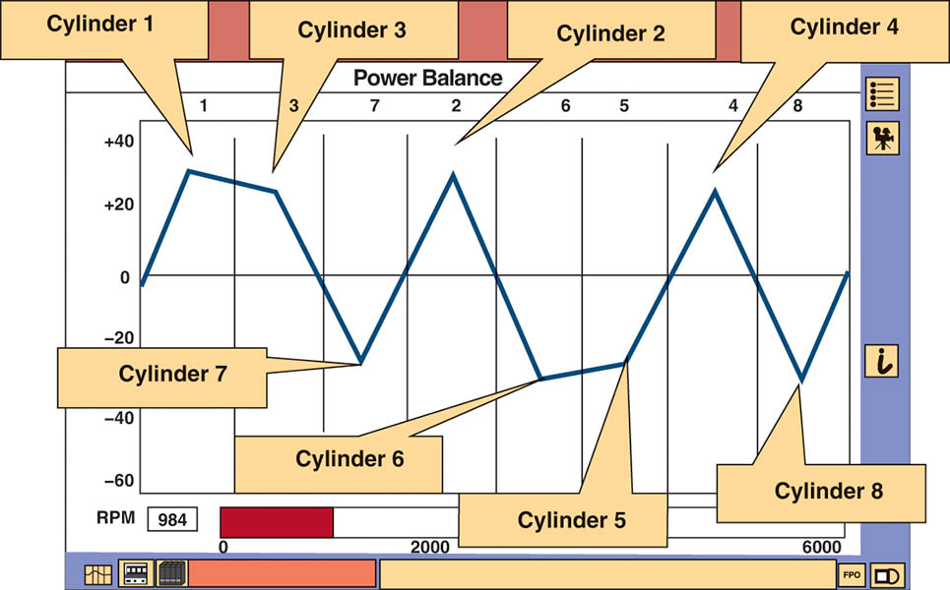
Figure 26.10 The Ford IDS scan tool has a graph function that allows the technician to view the data on the cylinder contribution test visually, making diagnosis easier. In this example, the cylinders on bank 2 on a Ford V-8 (cylinders 7, 6, 5, and 8) are weak

Slide 24
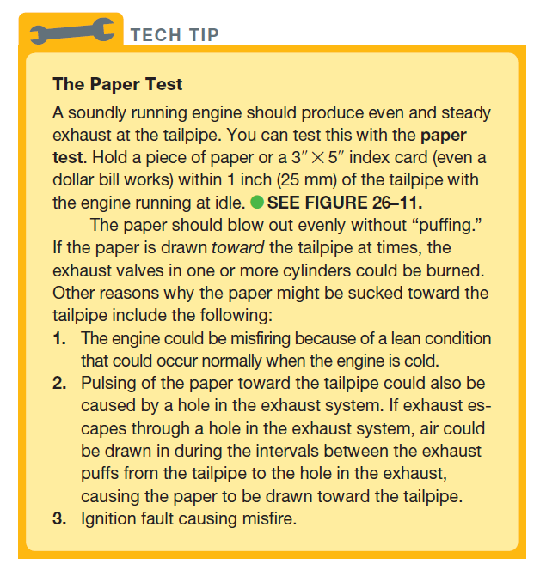
TECH TIP

Slide 25
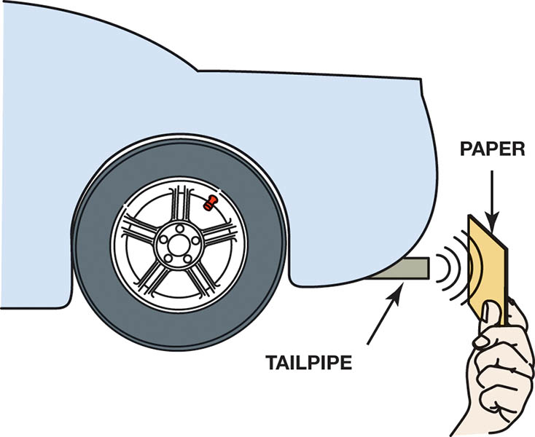
Figure 26.11 The paper test involves holding a piece of paper near the tailpipe of an idling engine. A good engine should produce even, outward puffs of exhaust. If the paper is sucked in toward the tailpipe, a burned valve is a possibility

Slide 26
COMPRESSION TEST
Cranking compression test
Dry
Wet
Running (dynamic) compression test
Relative compression test
Cylinder leakage test

Slide 27
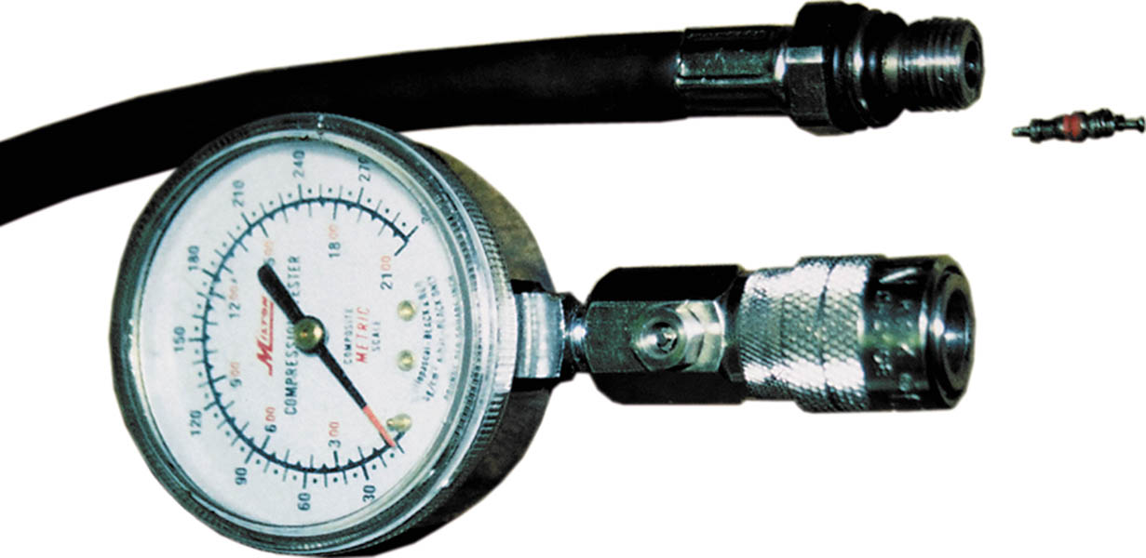
Figure 26.12 A two-piece compression gauge set. The threaded hose is screwed into the spark plug hole after removing the spark plug. The gauge part is then snapped onto the end of the hose

Slide 28
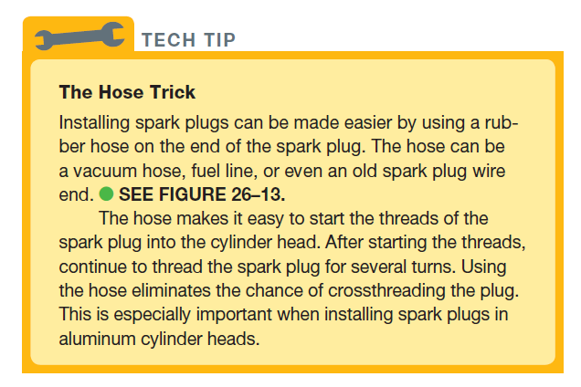
TECH TIP

Slide 29
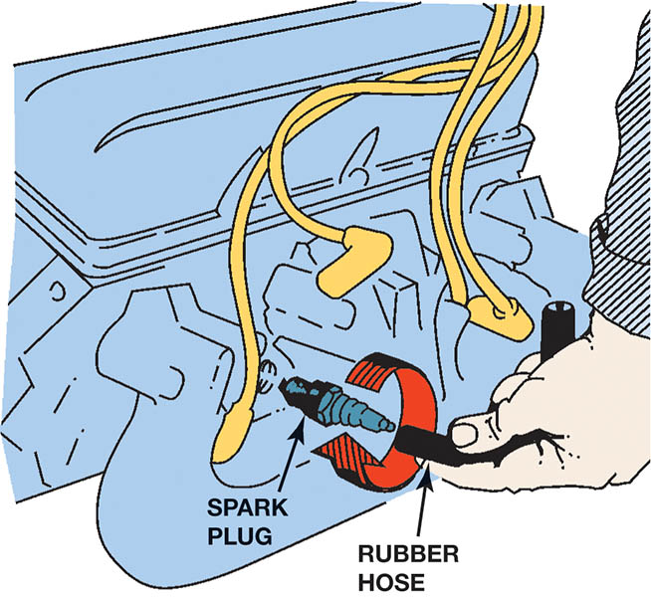
Figure 26.13 Use a vacuum or fuel line hose over the spark plug to install it without danger of cross-threading the cylinder head

Slide 30
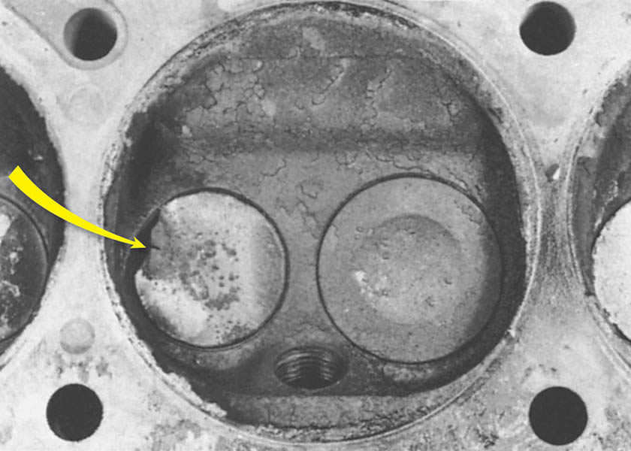
Figure 26.14 Badly burned exhaust valve. A compression test could have detected a problem, and a cylinder leakage test (leakdown test) could have been used to determine the exact problem

Slide 31
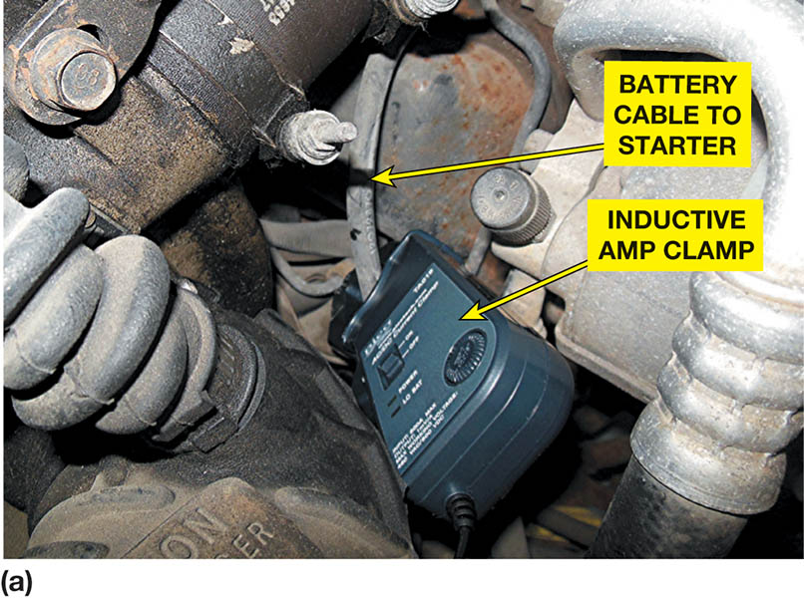
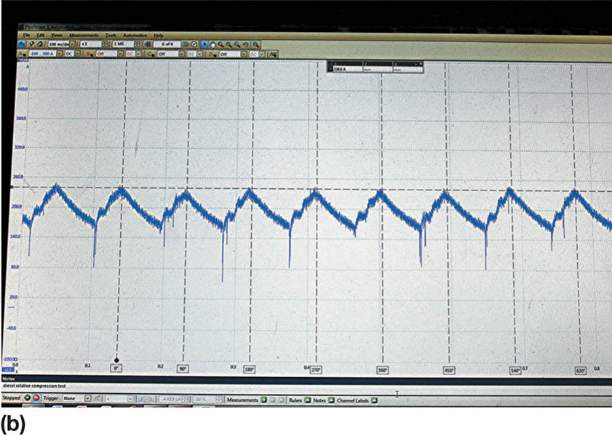
Figure 26.15 (a) A relative compression test using an amp clamp around the starter motor power cable and a Pico scope. (b) The result is a waveform that displays the current needed for each cylinder is the same, indicating that all cylinders have the same relative compression

Slide 32
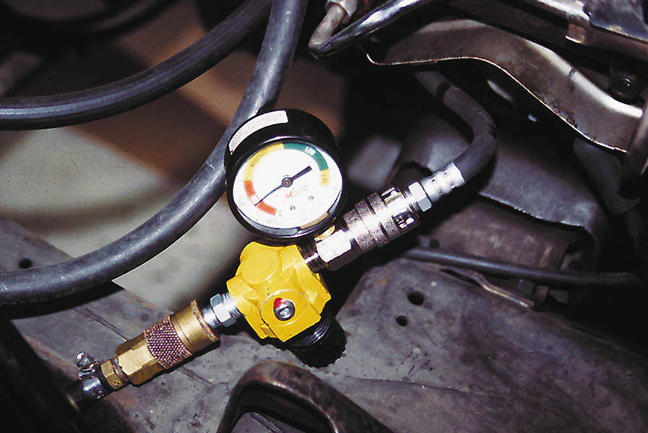
Figure 26.16 A typical handheld cylinder leakage tester

Slide 33
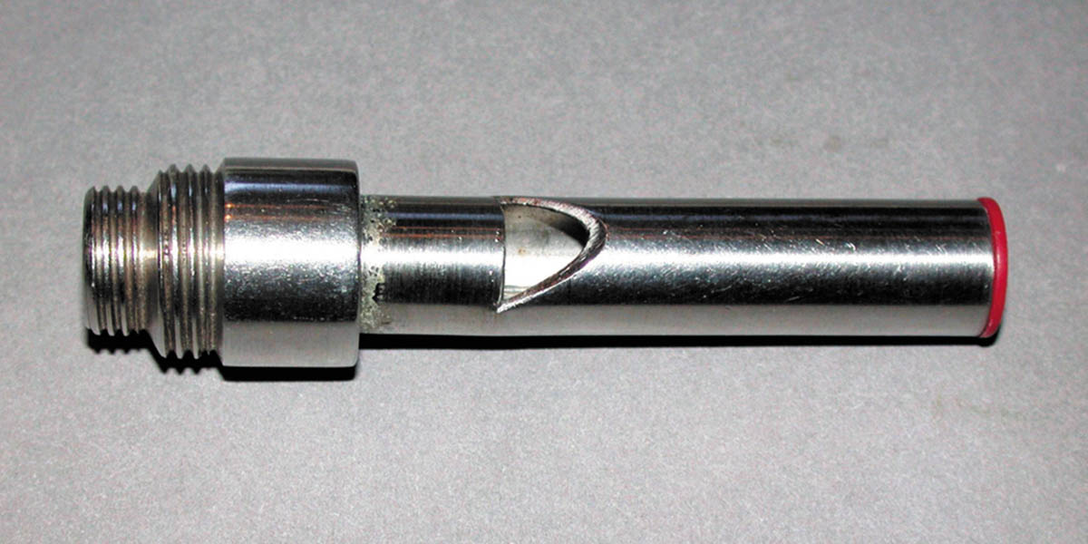
Figure 26.17 A whistle stop used to find top dead center. Remove the spark plug and install the whistle stop, then rotate the engine by hand. When the whistle stops making a sound, the piston is at the top

Slide 34
QUESTION 2: ?
What the three types of compression test?

Slide 35
ANSWER 2:
Cranking, running and relative compression tests.

Slide 36
CYLINDER BALANCE TEST
The purpose of a cylinder power balance test is to determine if all cylinders are contributing power equally.
The acceptable method of canceling cylinders, which will work on all types of ignition systems, including distributorless, is to ground the secondary current for each cylinder.

Slide 37
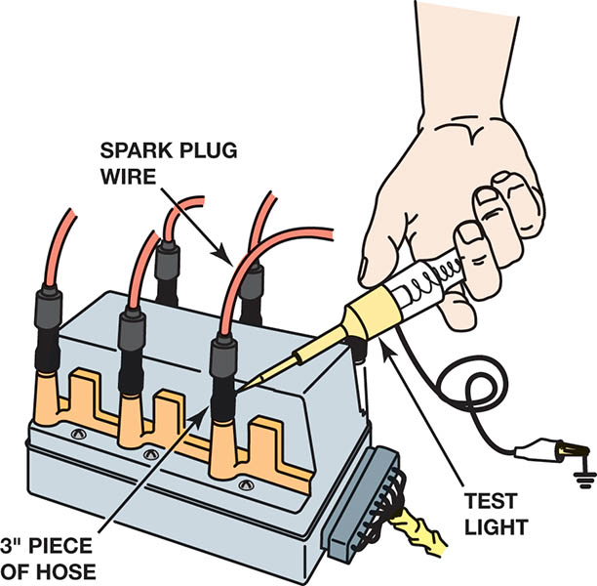
Figure 26.18 Using a vacuum hose and a test light to ground one cylinder at a time on a distributorless ignition system.

Slide 38
VACUUM TESTS
Vacuum is pressure below atmospheric pressure and is measured in inches (or millimeters) of mercury (Hg).
Cranking Vacuum Test
Idle Vacuum Test
Low and Steady Vacuum
Fluctuating Vacuum

Slide 39
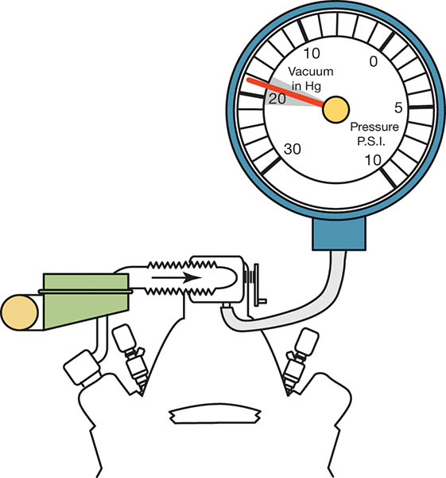
Figure 26.19 An engine in good mechanical condition should produce 17 to 21 inch Hg of vacuum at idle at sea level

Slide 40
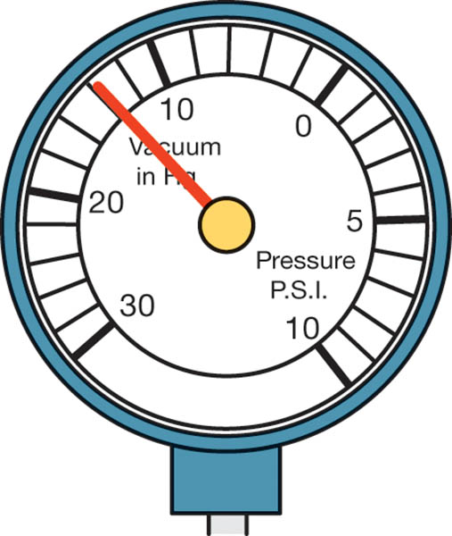
Figure 26.20 A steady but low reading could indicate retarded valve or ignition timing

Slide 41
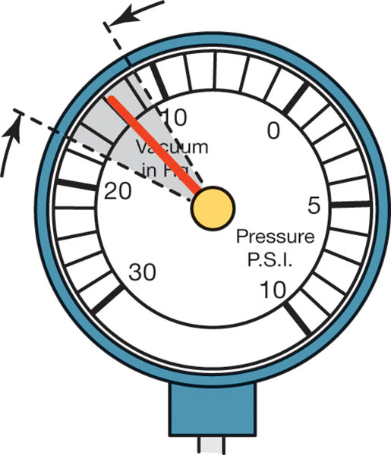
Figure 26.21 A gauge reading with the needle fluctuating 3 to 9 inch Hg below normal often indicates a vacuum leak in the intake system

Slide 42
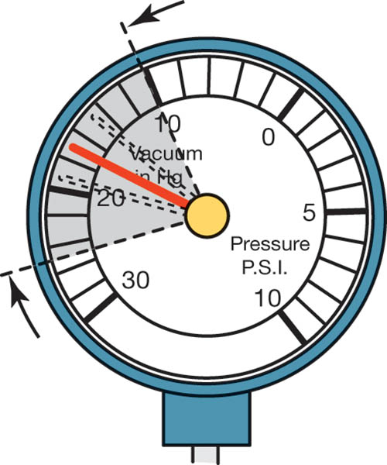
Figure 26.22 A leaking head gasket can cause the needle to vibrate as it moves through a range from below to above normal

Slide 43
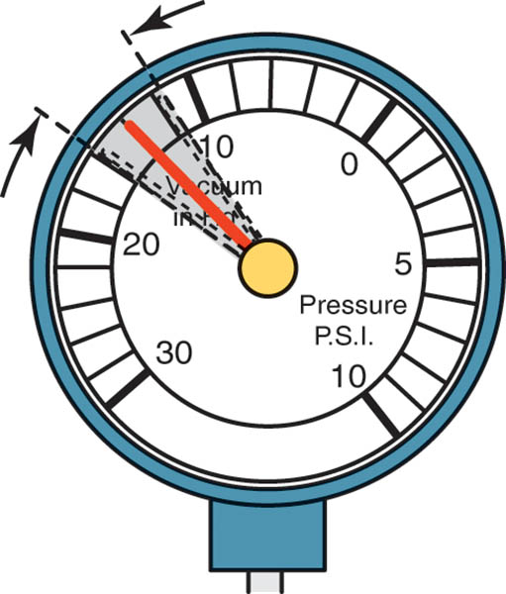
Figure 26.23 An oscillating needle 1 or 2 inch Hg below normal could indicate an incorrect air-fuel mixture (either too rich or too lean)

Slide 44
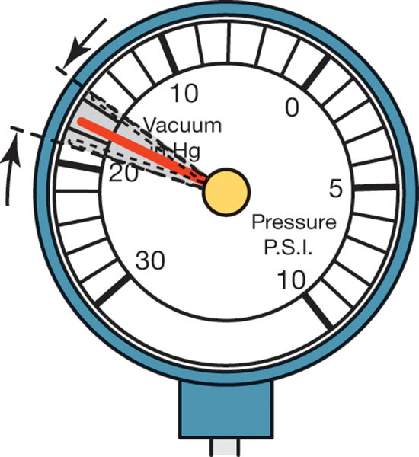
Figure 26.24 A rapidly vibrating needle at idle that becomes steady as engine speed is increased indicates worn valve guides

Slide 45
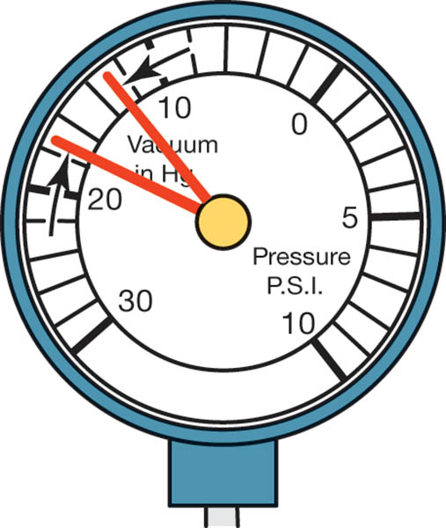
Figure 26.25 If the needle drops 1 or 2 inch Hg from the normal reading, one of the engine valves is burned or not seating properly

Slide 46
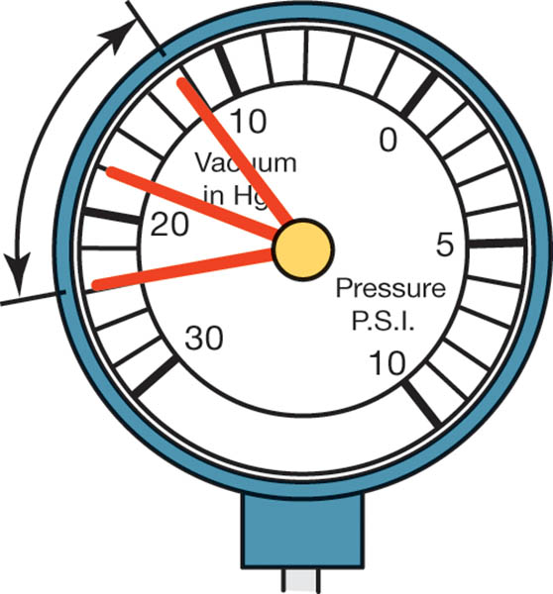
Figure 26.26 Weak valve springs will produce a normal reading at idle, but as engine speed increases, the needle will fluctuate rapidly between 12 and 24 inch Hg

Slide 47
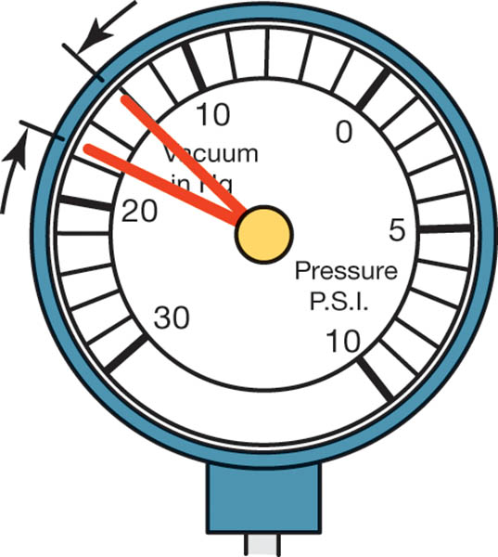
Figure 26.27 A steady needle reading that drops 2 or 3 inch Hg when the engine speed is increased slightly above idle indicates that the ignition timing is retarded

Slide 48
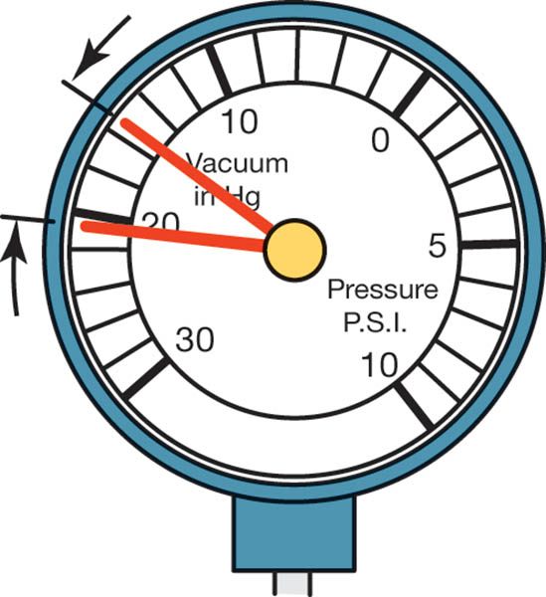
Figure 26.28 A steady needle reading that rises 2 or 3 inch Hg when the engine speed is increased slightly above idle indicates that the ignition timing is advanced

Slide 49
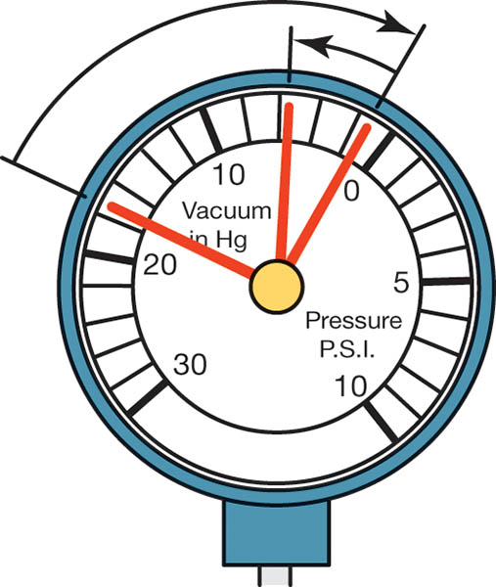
Figure 26.29 A needle that drops to near zero when the engine is accelerated rapidly and then rises slightly to a reading below normal indicates an exhaust restriction

Slide 50
QUESTION 3: ?
What does a fluctuating vacuum gauge indicate?

Slide 51
ANSWER 3:
A vacuum leak in the intake system.

Slide 52
EXHAUST RESTRICTION TEST
Common causes of restricted exhaust include the following:
Clogged catalytic converter
Clogged or restricted muffler
Damaged or defective piping
Test back pressure:
With a vacuum gauge
With a pressure gauge

Slide 53
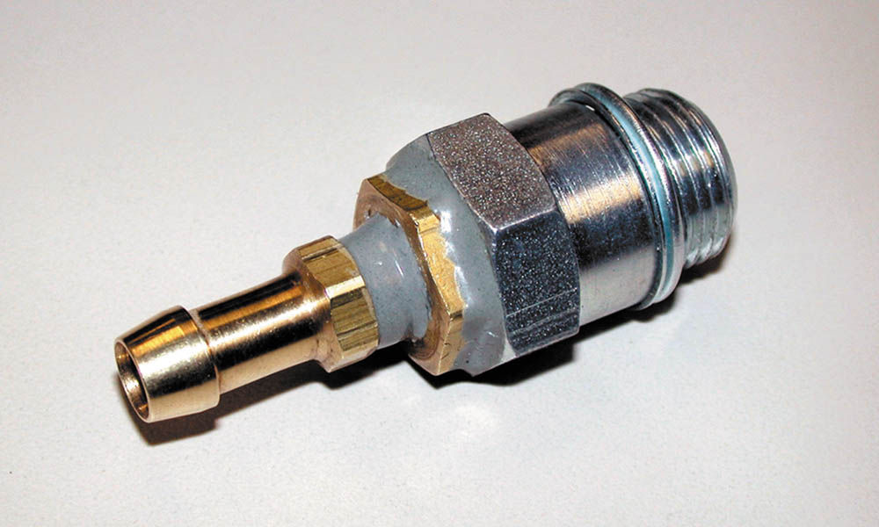
Figure 26.30 A technician-made adapter used to test exhaust system back pressure

Slide 54
DIAGNOSING HEAD GASKET FAILURE
Several items can be used to help diagnose a head gasket failure.
Exhaust gas analyzer
Chemical test
Bubbles in coolant
Excessive exhaust steam

Slide 55
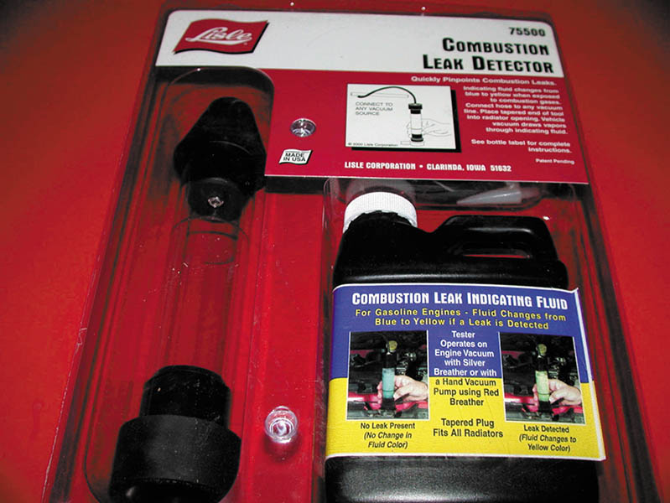
Figure 26.31 A tester that uses a blue liquid to check for exhaust gases in the exhaust, which would indicate a head gasket leak problem

Slide 56
COMPRESSION TEST

Slide 57
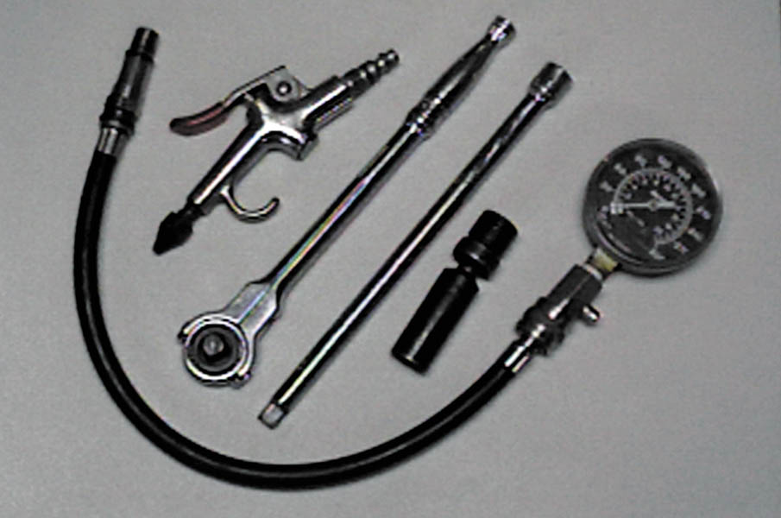
1. The tools and equipment needed to perform a compression test include a compression gauge, an air nozzle, and the socket ratchets and extensions that may be necessary to remove the spark plugs from the engine.

Slide 58
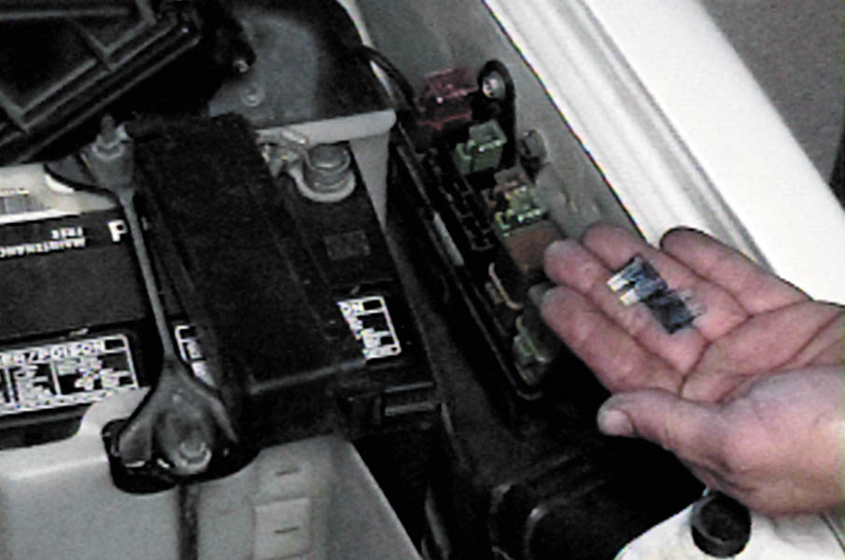
2. To prevent ignition and fuel-injection operation while the engine is being cranked, remove both the fuel injection fuse and the ignition fuse.

Slide 59
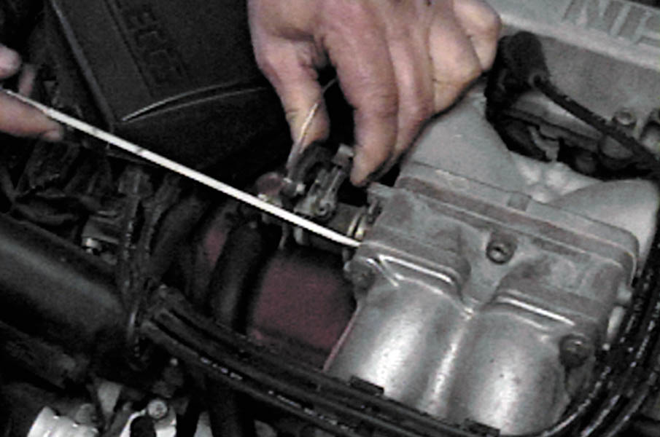
3. Block open the throttle (and choke, if the engine is equipped with a carburetor). Keeping the throttle open ensures that enough air will be drawn into the engine so that the compression test results will be accurate.

Slide 60
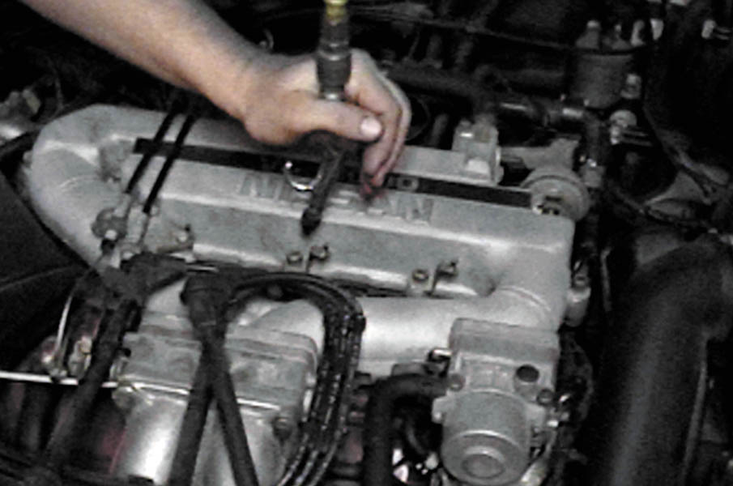
4. Before removing the spark plugs, use an air nozzle to blow away any dirt that may be around the spark plug.

Slide 61
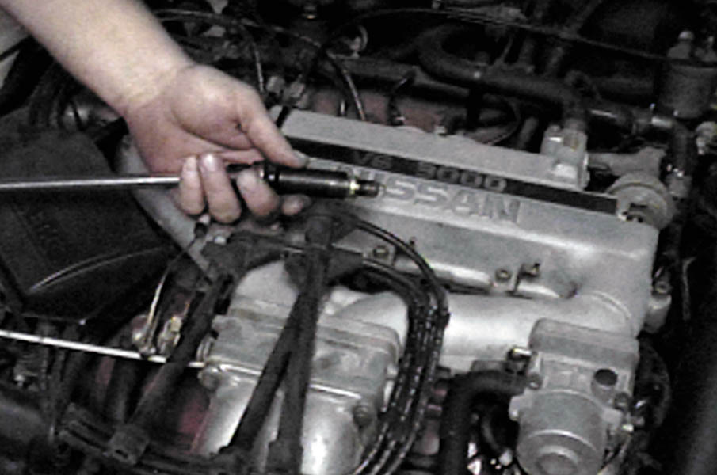
5. Remove all of the spark plugs. Be sure to mark the spark plug wires so that they can be reinstalled onto the correct spark plugs after the compression test has been performed.

Slide 62
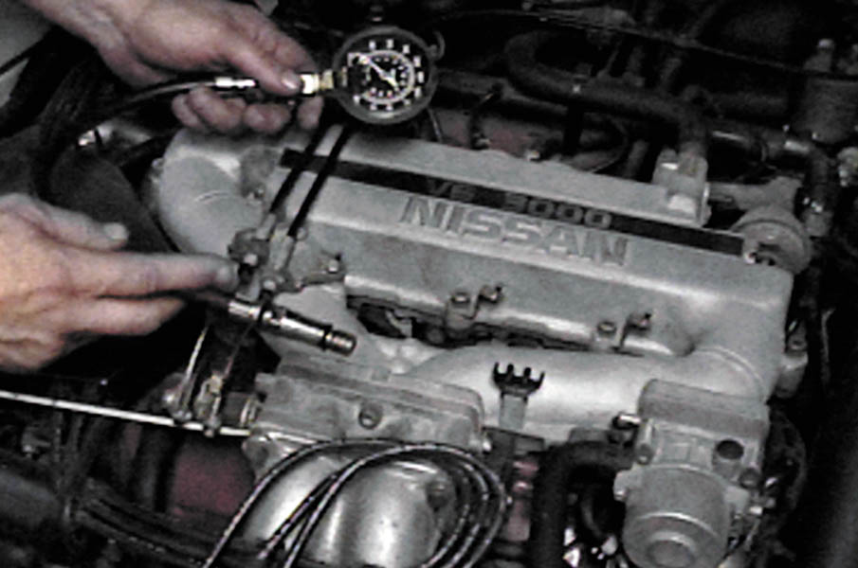
6. Select the proper adapter for the compression gauge. The threads on the adapter should match those on the spark plug.

Slide 63
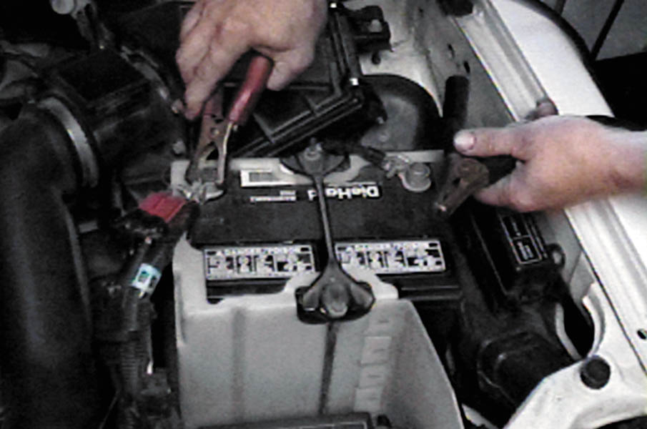
7. If necessary, connect a battery charger to the battery before starting the compression test. It is important that consistent cranking speed be available for each cylinder being tested.

Slide 64
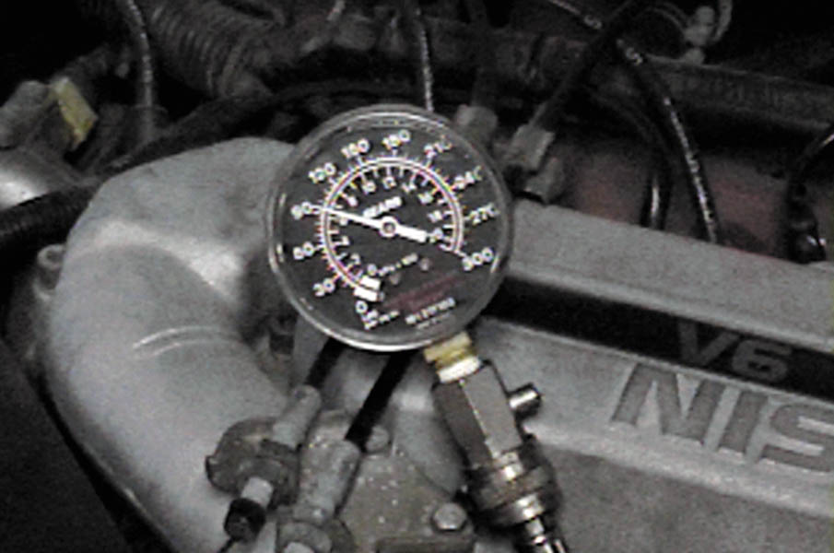
8. Make a note of the reading on the gauge after the first “puff,” which indicates the first compression stroke that occurred on that cylinder as the engine was being rotated.

Slide 65
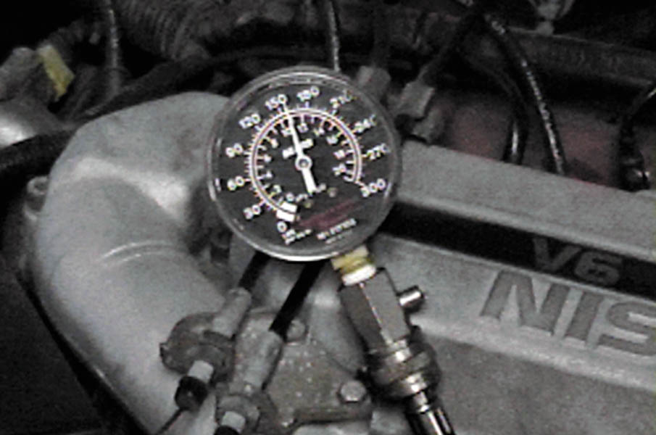
9. After the engine has been cranked for four “puffs,” stop cranking the engine and observe the compression gauge.

Slide 66
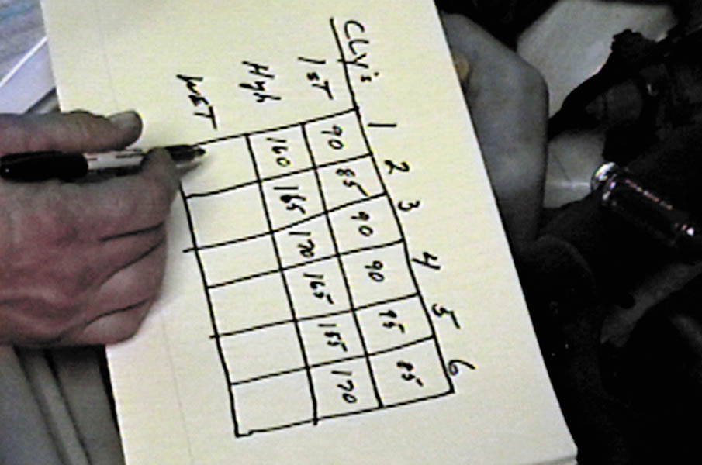
10. Record the first puff and this final reading for each cylinder. The final readings should all be within 20% of each other.

Slide 67
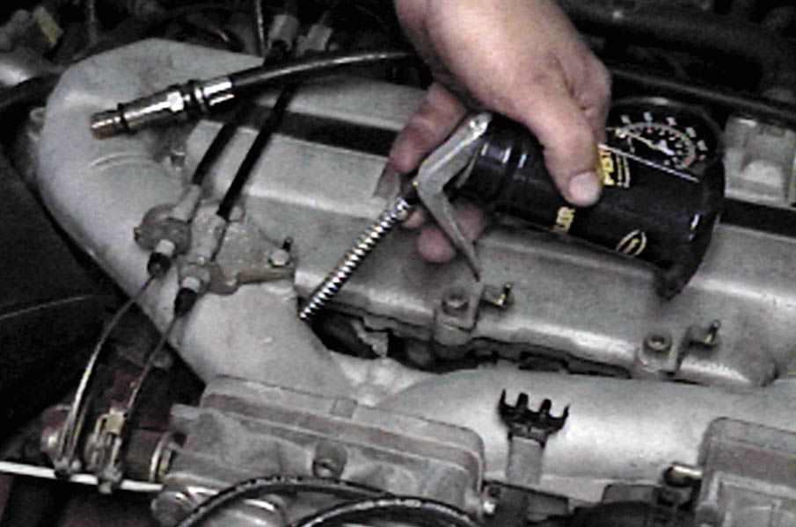
11. If a cylinder(s) is lower than most of the others, use an oil can and squirt two squirts of engine oil into the cylinder and repeat the compression test.

Slide 68
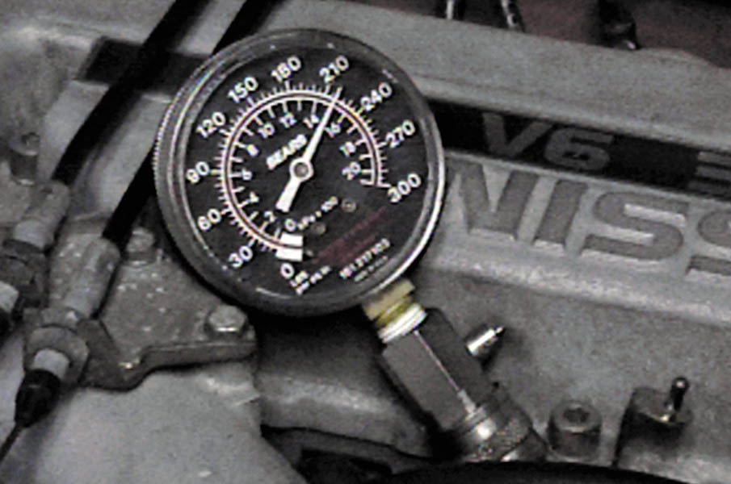
12. If the gauge reading is now much higher than the first test results, then the cause of the low compression is due to worn or defective piston rings.

Slide 69

Copyright

