Slide 1

Automotive Technology Principles, Diagnosis, and Service
Sixth Edition
Chapter 25
Turbocharging and Supercharging
Copyright © 2018, 2015, 2011 Pearson Education, Inc. All Rights Reserved

Slide 2
LEARNING OBJECTIVES (1 of 2)
25.1 Discuss airflow requirements and volumetric efficiency of engines.
25.2 Explain forced induction principles.
25.3 Discuss superchargers.

Slide 3
LEARNING OBJECTIVES (2 of 2)
25.4 Discuss turbochargers and turbocharger failures.
25.5 Explain boost control.
25.6 Describe the purpose of a nitrous oxide system.

Slide 4
INTRODUCTION
Air Flow Requirements
Calculate engine airflow requirements using three factors.
Engine displacement
Engine Revolutions Per Minute (RPM)
Volumetric Efficiency
Volumetric Efficiency
A measure of how well an engine breathes.
A new engine is about 85% efficient.
Turbochargers or superchargers can increase volumetric efficiency to over 100%.

Slide 5
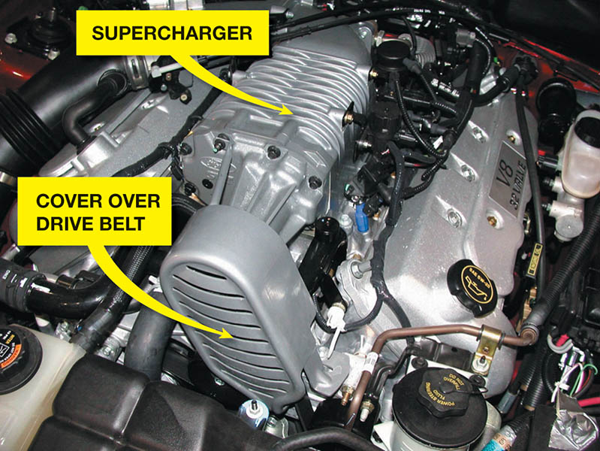
Figure 25.1 A supercharger on a Ford V-8

Slide 6
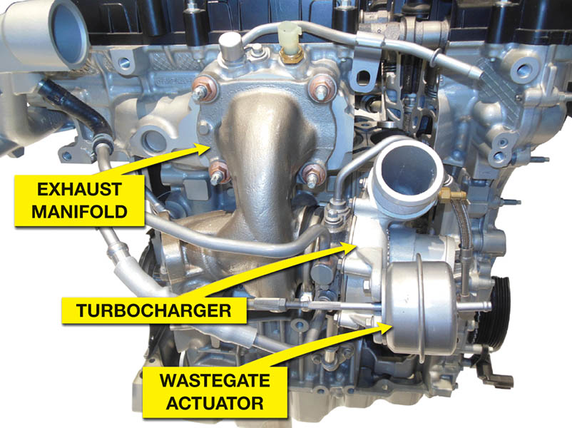
Figure 25.2 A turbocharged Ford three-cylinder 1.0 liter Eco Boost engine

Slide 7
QUESTION 1: ?
What is volumetric efficiency?

Slide 8
ANSWER 1:
A measure of how well an engine breathes.

Slide 9
FORCED INDUCTION PRINCIPLES (1 of 2)
Charge density is a term used to define the amount of the air-fuel charge introduced into the cylinders.
When air is pumped into the cylinder, the combustion chamber receives an increase of air pressure known as boost.
Boost can measured in:
Pounds per square inch (PSI)
Atmospheres (ATM) (1 atmosphere is 14.7 PSI)
Bars (1 bar is 14.7 PSI)

Slide 10
FORCED INDUCTION PRINCIPLES (2 of 2)
Forced induction systems use an air pump to pack a denser air-fuel charge into the cylinders.
The weight of the air-fuel charge is higher.
Power is increased because it is directly related to the weight of an air-fuel charge consumed within a given time period.
Atmospheric pressure drops as altitude increases, but boost pressure remains the same.
Boost increases the amount of air drawn into the cylinder during the intake stroke.

Slide 11
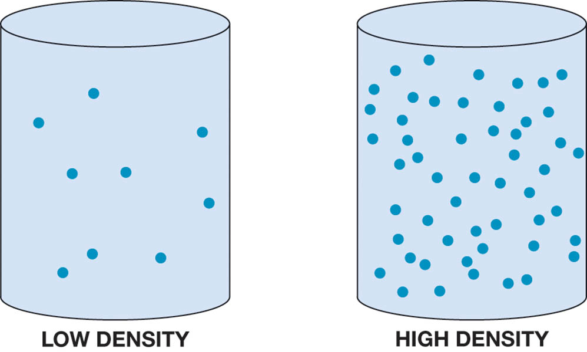
Figure 25.3 The more air and fuel that can be packed in a cylinder, the greater the density of the air-fuel charge

Slide 12
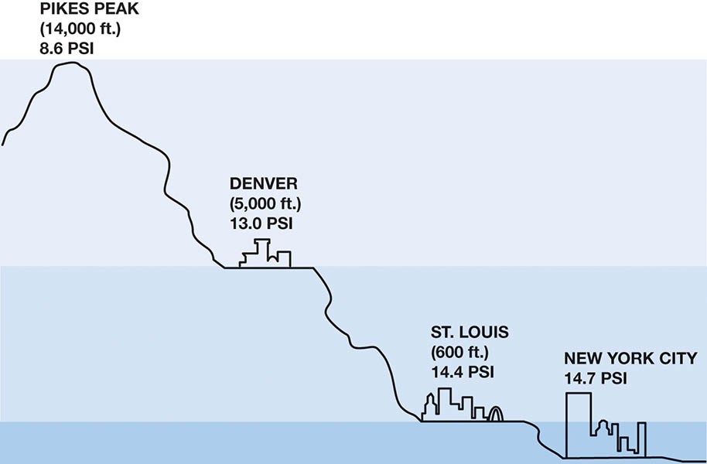
Figure 25.4 Atmospheric pressure decreases with increases in altitude

Slide 13
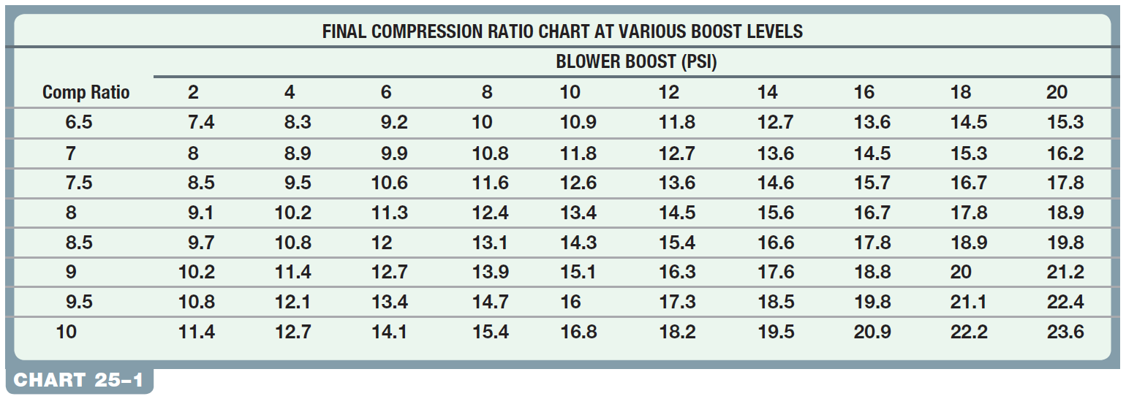
Chart 25-1 The effective compression ratio compared to the boost pressure.

Slide 14
SUPERCHARGERS
A supercharger is an engine-driven air pump that supplies more than the normal amount of air into the intake manifold, and boosts engine torque and power.
The roots type of supercharger is positive displacement design, because all of the air that enters is forced through the unit.
A centrifugal supercharger is not a positive displacement pump and all of the air that enters is not forced through the unit.
A bypass valve allows intake air to flow directly into the intake manifold.

Slide 15
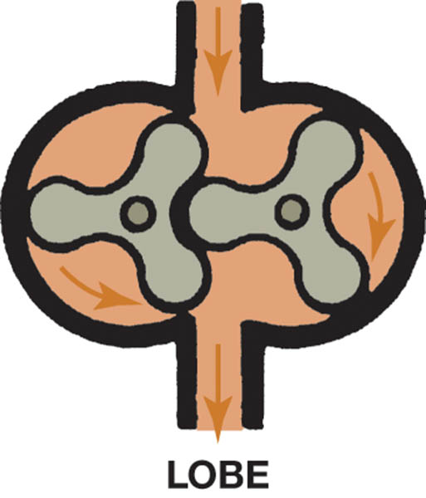
Figure 25.5 A roots-type supercharger uses two lobes to force the air around the outside of the housing and into the intake manifold

Slide 16
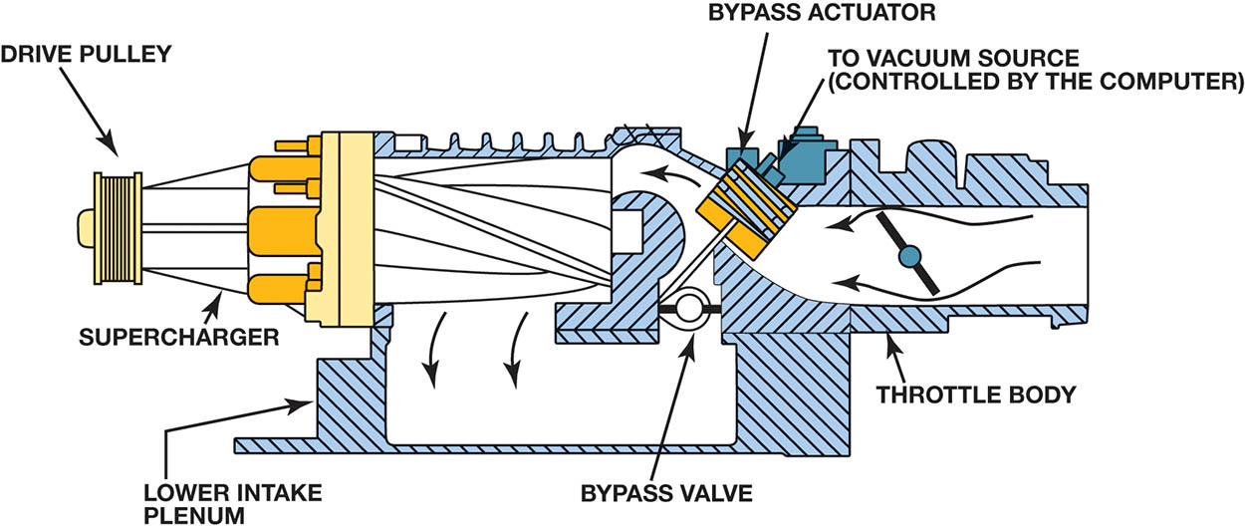
Figure 25.6 The bypass actuator opens the bypass valve to control boost pressure

Slide 17
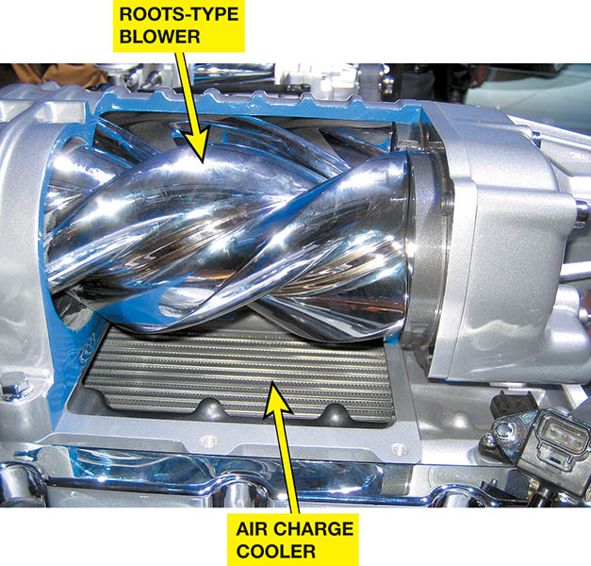
Figure 25.7 A Ford supercharger cutaway display showing the roots-type blower and air charge cooler (intercooler). The air charge cooler is used to reduce the temperature of the compressed air before it enters the engine.

Slide 18
TURBOCHARGERS
A turbocharger uses the heat of the exhaust to power a turbine wheel and, therefore, does not directly reduce engine power.
The turbine wheel turns an impeller (compressor) wheel which is connected by a shaft in the center housing.
The delay between acceleration and turbo boost is called turbo lag.

Slide 19
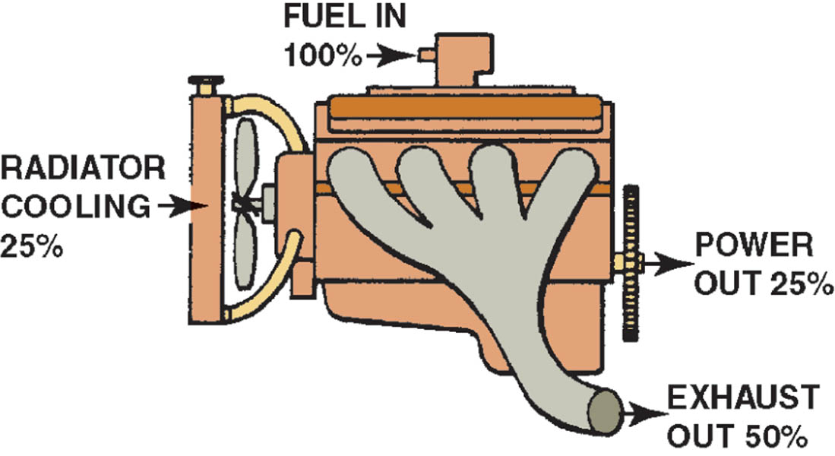
Figure 25.8 A turbocharger uses some of the heat energy that would normally be wasted

Slide 20
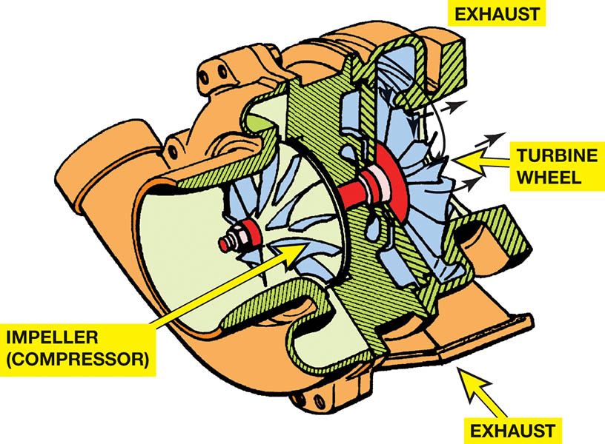
Figure 25.9 A turbine wheel is turned by the expanding exhaust gases

Slide 21
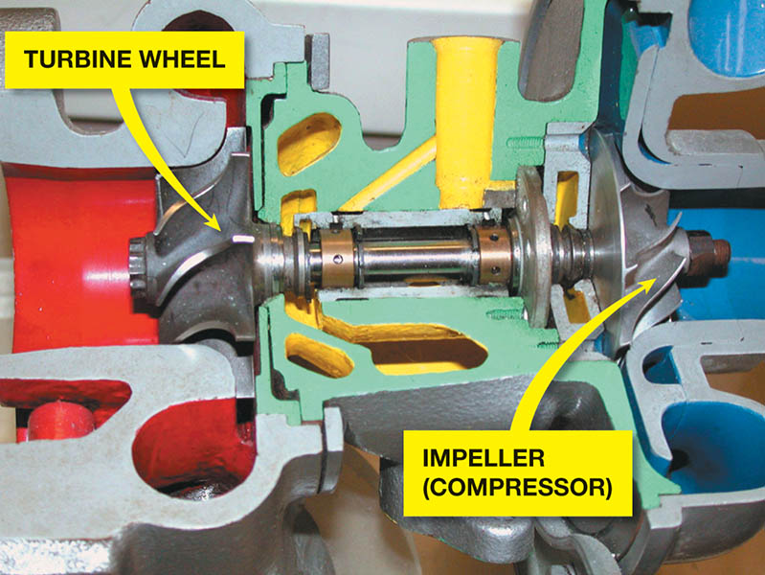
Figure 25.10 The exhaust drives the turbine wheel on the left, which is connected to the impeller wheel on the right through a shaft. The bushings that support the shaft are lubricated with engine oil under pressure

Slide 22
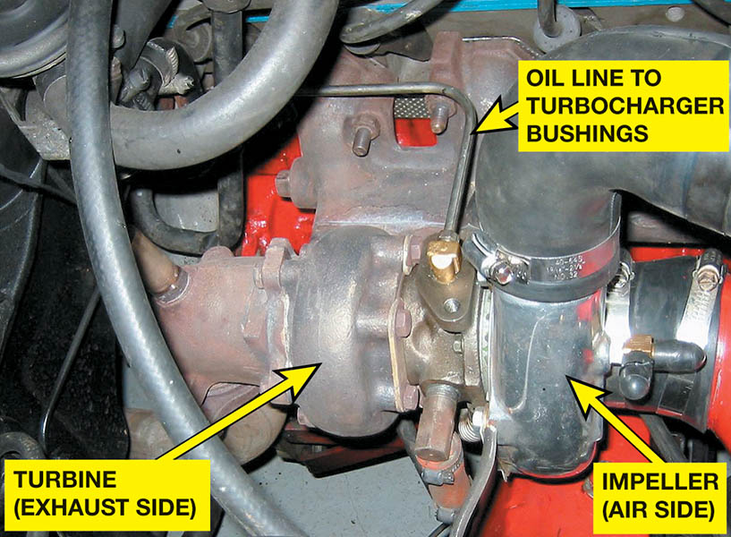
Figure 25.11 Engine oil is fed to the center of the turbocharger to lubricate the bushings and returns to the oil pan through a return line

Slide 23
TURBOCHARGER FAILURES
Creates a noticeable drop in power.
Bearing failure is the most common cause.
Excessive oil consumption due to wear.
Most failures are preventable by performing regular maintenance.

Slide 24
QUESTION 2: ?
What is a common cause of turbocharger failures?

Slide 25
ANSWER 2:
Bearing failures.

Slide 26
BOOST CONTROL
Wastegate: It is a bypass valve at the exhaust inlet to the turbine, which allows all or part of the exhaust gas to enter the turbine.
Relief Valves: It vents pressurized air from the connecting pipe between the outlet of the turbocharger and the throttle
Two types of relief valves:
Compressor bypass valve (CBV)
Blow-off valve (BOV)
.

Slide 27
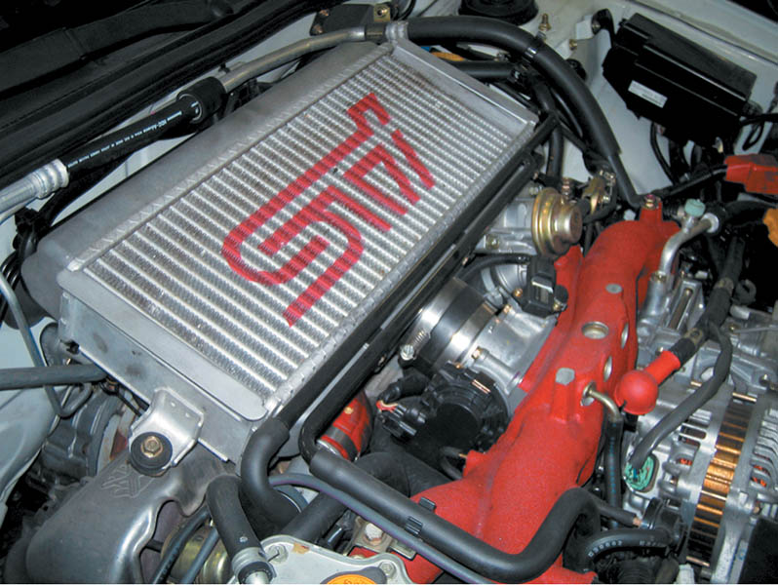
Figure 25.12 The unit on top of this Subaru that looks like a radiator is the intercooler, which cools the air after it has been compressed by the turbocharger

Slide 28
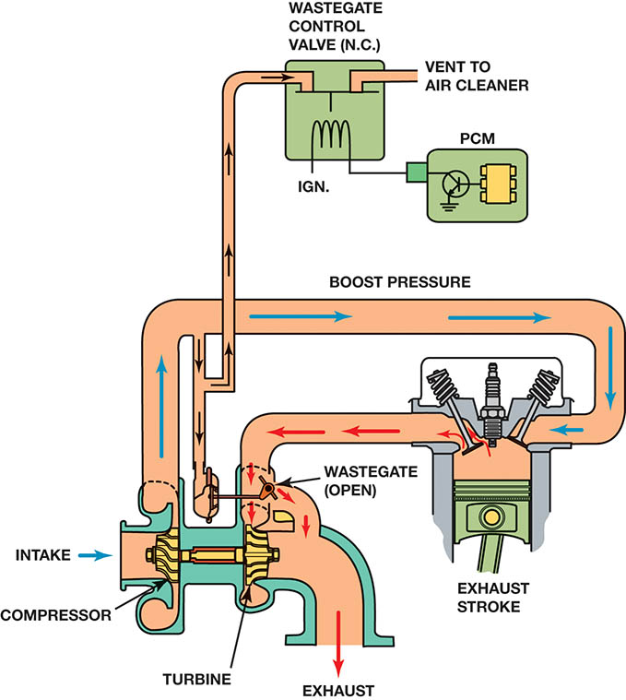
Figure 25.13 A wastegate is used on many turbocharged engines to control maximum boost pressure. The wastegate is controlled by a computer-controlled valve

Slide 29
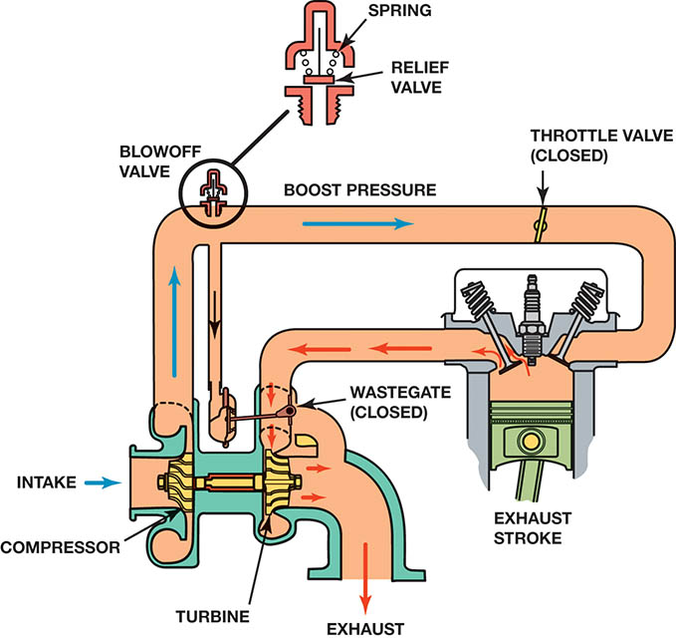
Figure 25.14 A blow-off valve is used in some turbocharged systems to relieve boost pressure during deceleration

Slide 30
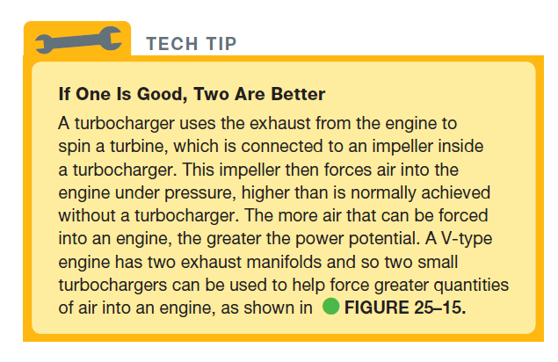
Tech Tip

Slide 31
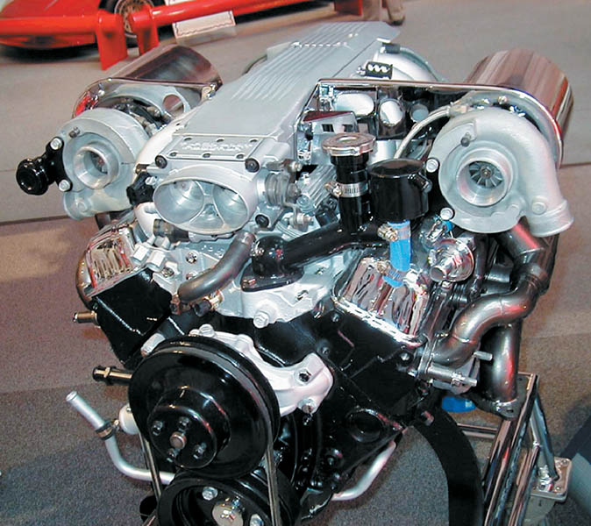
Figure 25.15 A dual turbocharger system installed on a small block Chevrolet V-8 engine

Slide 32
QUESTION 3: ?
What is the purpose of an intercooler?

Slide 33
ANSWER 3:
Reduce the temperature of the air entering the engine.

Slide 34
NITROUS OXIDE
Nitrous oxide is used for racing or high performance only, and is not used from the factory on any vehicle.
Nitrous oxide has two nitrogen atoms and one oxide atom.
A relatively inexpensive way to get additional power from an engine.
Engine damage can occur if not used properly.

Slide 35
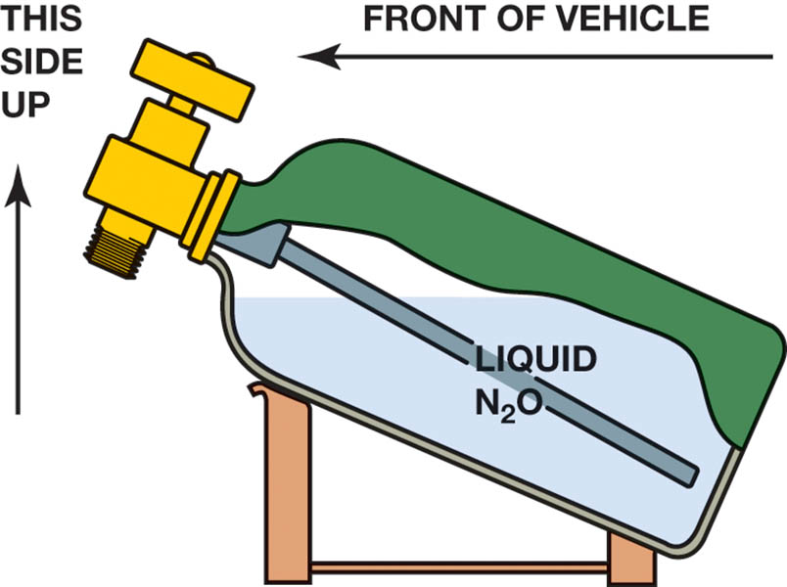
Figure 25.16 Nitrous bottles have to be mounted at an angle to ensure that the pickup tube is in the liquid N₂O

Slide 36
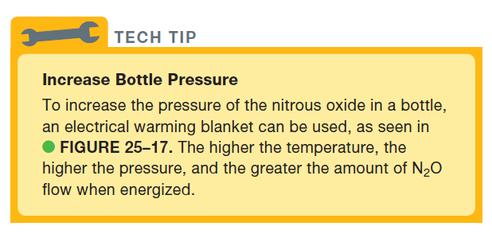
TECH TIP

Slide 37
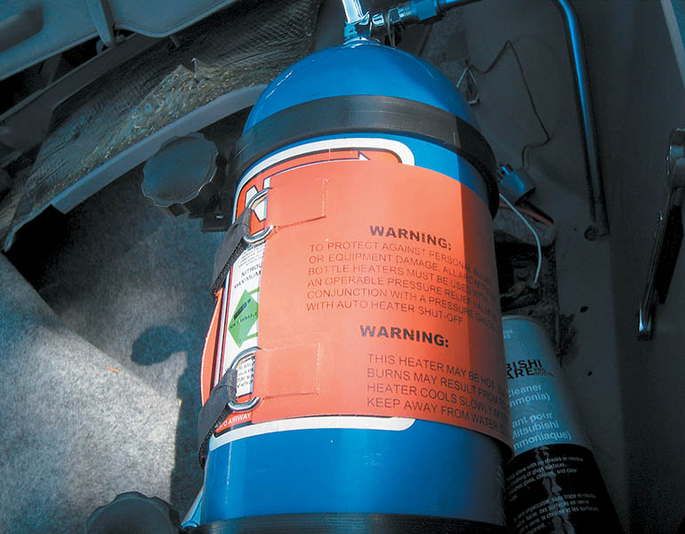
Figure 25.17 An electrical heating mat is installed on the bottle of nitrous oxide to increase the pressure of the gas inside

Slide 38
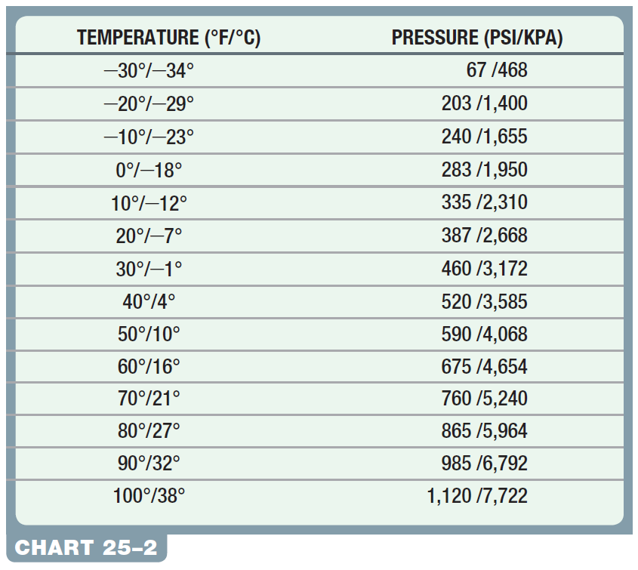
Chart 25-2 Temperature/pressure relation for nitrous oxide: The higher the temperature, the higher the pressure.

Slide 39

Copyright

