Slide 1

Automotive Technology Principles, Diagnosis, and Service
Sixth Edition
Chapter 23
Lubrication System Operation and Diagnosis
Copyright © 2018, 2015, 2011 Pearson Education, Inc. All Rights Reserved

Slide 2
LEARNING OBJECTIVES (1 of 2)
23.1 Explain the purpose of the lubrication system, and state the lubrication principles.
23.2 Discuss engine lubrication systems.
23.3 Describe the purpose and function of oil pumps.

Slide 3
LEARNING OBJECTIVES (2 of 2)
23.4 Discuss the purpose and function of oil passages.
23.5 Discuss oil pans, oil coolers, and the dry sump system.

Slide 4
PURPOSE AND FUNCTION
Lubricate all moving parts to prevent wear.
Help cool the engine.
Help seal the piston rings.
Cleaning and holding dirt in suspension in the oil.
Neutralizing acids formed from combustion.
Reducing friction.
Preventing rust and corrosion.

Slide 5
LUBRICATION PRINCIPLES
Create an oil film that separates the surfaces and supports the load.
The specified oil viscosity and oil clearances must be adhered to during service to help prevent boundary lubrication and unintended wear.
Hydrodynamic lubrication occurs when a wedge-shaped film of lubricating oil develops between two surfaces that have relative motion between them.

Slide 6
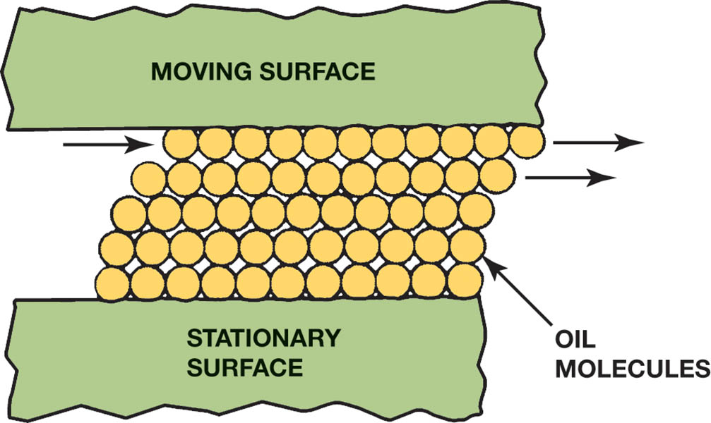
Figure 23.1 Oil molecules cling to metal surfaces but easily slide against each other

Slide 7
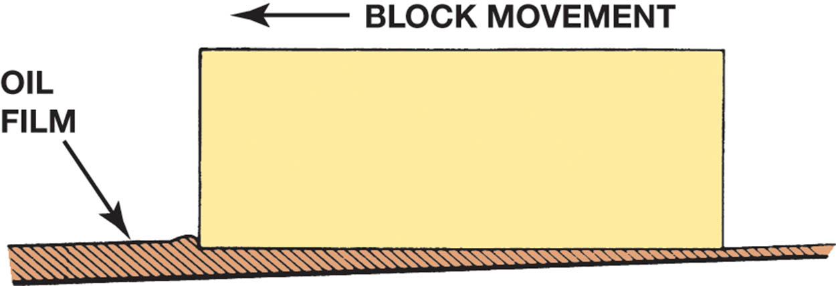
Figure 23.2 Wedge-shaped oil film developed below a moving block

Slide 8
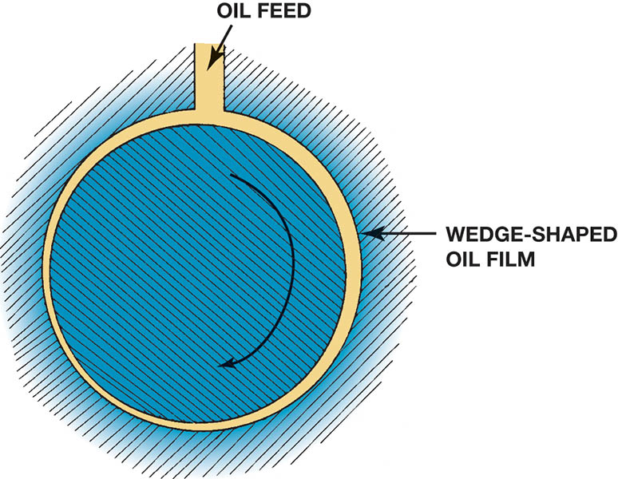
Figure 23.3 Wedge-shaped oil film curved around a bearing journal

Slide 9
QUESTION 1: ?
What is hydrodynamic lubrication?

Slide 10
ANSWER 1:
The wedging action of oil between two surfaces that have relative motion.

Slide 11
ENGINE LUBRICATION SYSTEMS
The primary function of the engine lubrication system is to maintain a positive and continuous oil supply to the bearings.
The normal engine oil pressure range is from 10 to 60 PSI (200 to 400 kPa) or 10 PSI per 1000 engine RPM.
Estimated oil temperature = Outside air temperature + 120°F”?

Slide 12
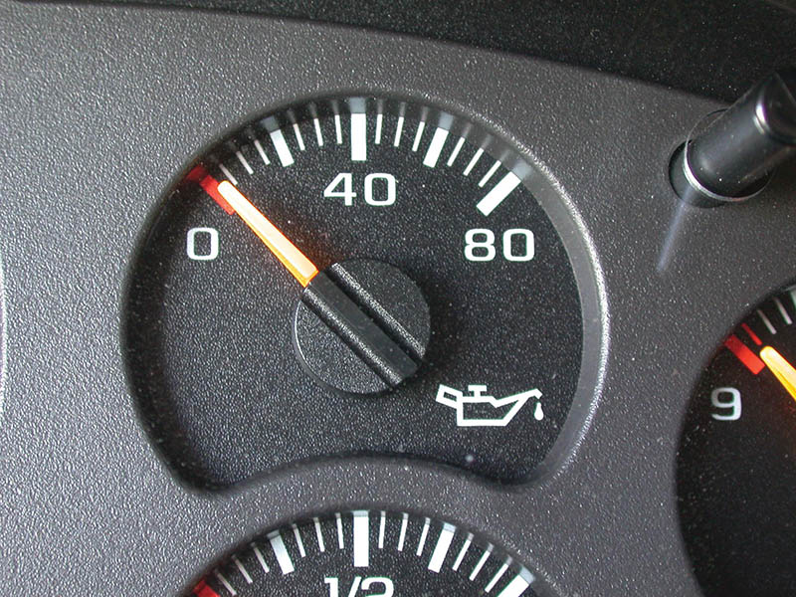
Figure 23.4 The dash oil pressure gauge may be a good indicator of engine oil pressure. If there is any concern about the oil pressure, always use a mechanical gauge to be sure

Slide 13
OIL PUMPS
Provide 3 to 6 gallons per minute of engine oil.
Maintain pressure, by forcing the oil into the lubrication system.
All oil pumps are called positive displacement pumps.

Slide 14
TYPES OF OIL PUMPS (1 of 2)
External gear type.
  A gear-type oil pump is usually driven by a shaft from the distributor, which is driven by the camshaft.
Internal/external gear type.
  This type of oil pump is driven by the crankshaft and operates at engine speed.

Slide 15
TYPES OF OIL PUMPS (2 of 2)
Rotor type.
  This rotor-type oil pump is driven by the crankshaft and uses a special lobe-shape gear meshing with the inside of a lobed rotor.
Gerotor type.
  This type of positive displacement oil pump uses an inner and an outer rotor. The term is derived from two words: “generated rotor,” or gerotor.
.

Slide 16
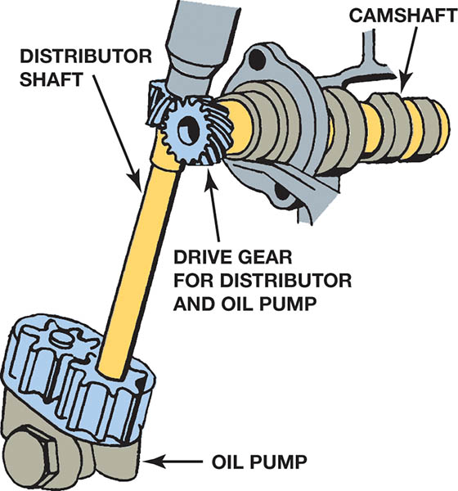
Figure 23.5 An oil pump driven by the camshaft

Slide 17
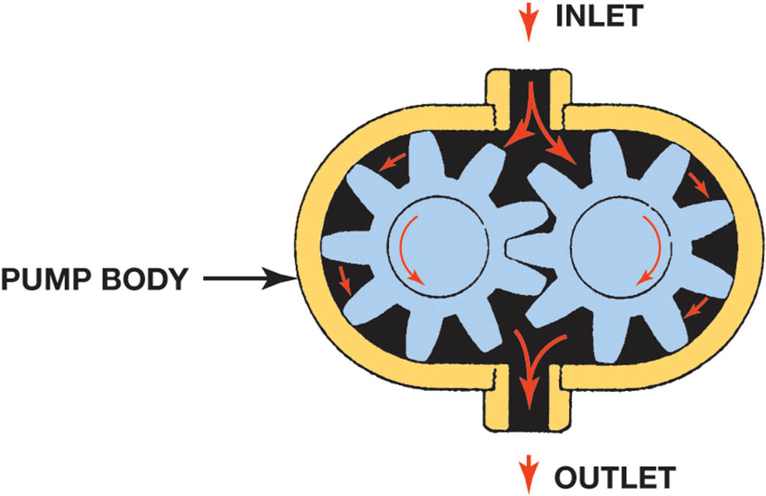
Figure 23.6 In an external gear-type oil pump, the oil flows through the pump around the outside of each gear. This is an example of a positive displacement pump, where everything entering the pump must leave the pump

Slide 18
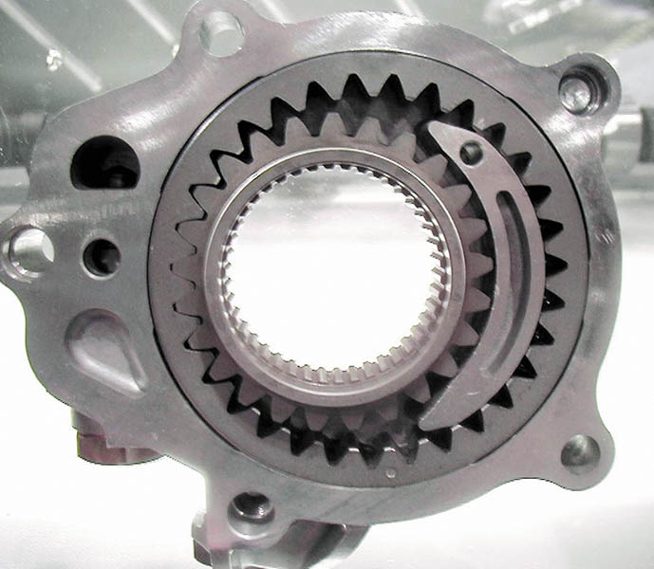
Figure 23.7 A typical internal/external oil pump mounted in the front cover of the engine that is driven by the crankshaft

Slide 19
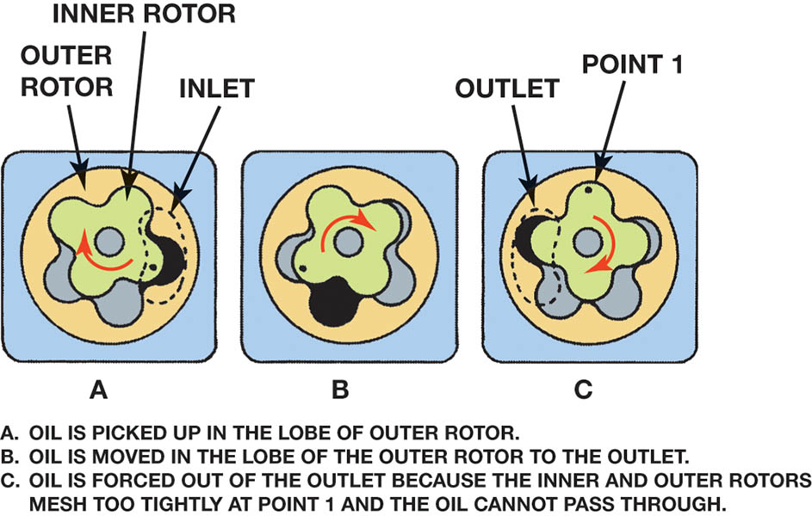
Figure 23.8 The operation of a rotor-type oil pump

Slide 20
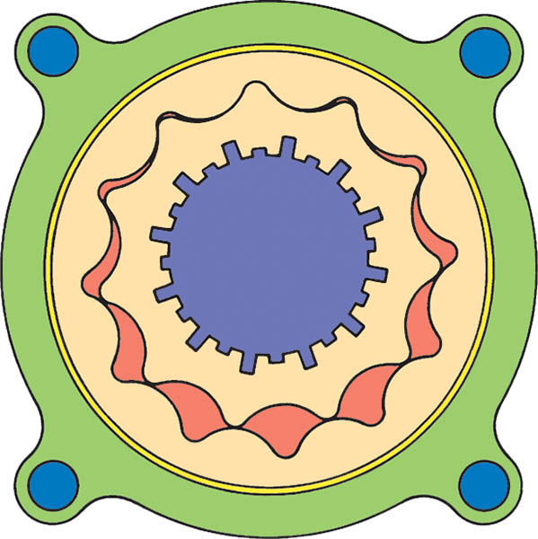
Figure 23.9 Gerotor-type oil pump driven by the crankshaft

Slide 21
QUESTION 2: ?
What are the four types of oil pumps?

Slide 22
ANSWER 2:
External gear type, internal/external gear type, rotor type, and gerotor type.

Slide 23
OIL PRESSURE REGULATION
Maximum pressure is limited with a pressure relief valve. The relief valve (sometimes called the pressure regulating valve) is located at the outlet of the pump.
Factors affecting oil pressure.
  Leaks
  Oil pump capacity
  Viscosity of engine oil

Slide 24
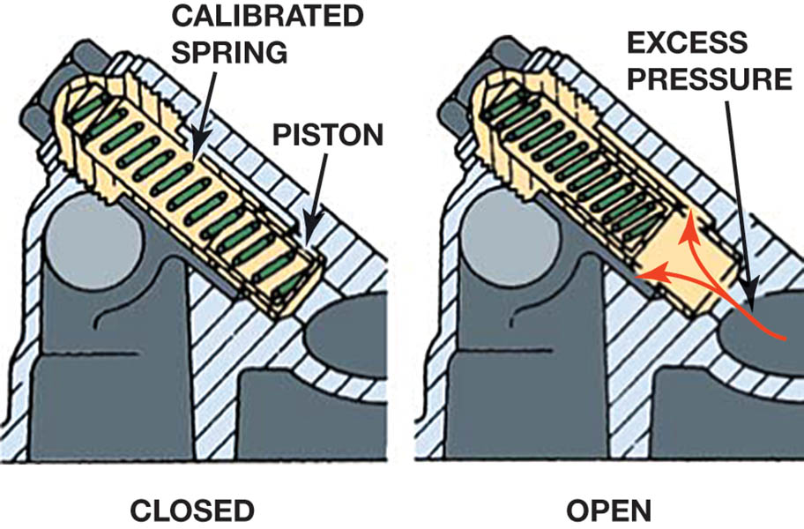
Figure 23.10 Oil pressure relief valves are spring loaded. The stronger the spring tension, the higher the oil pressure

Slide 25
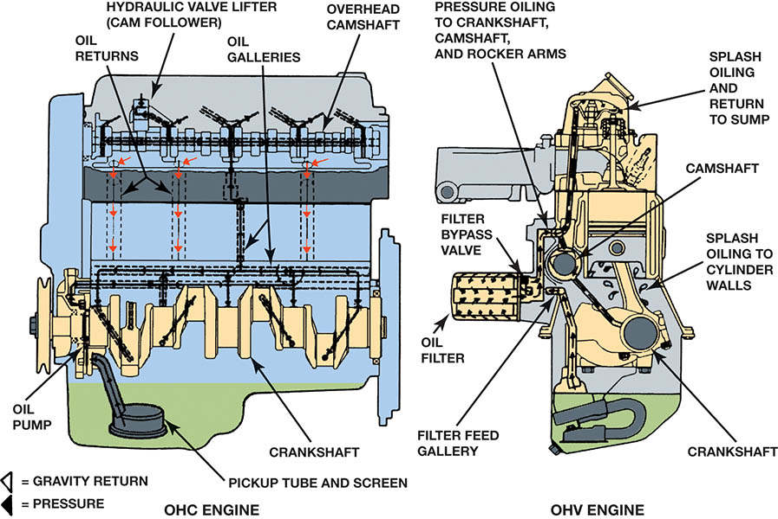
Figure 23.11 A typical engine design that uses both pressure and splash lubrication.

Slide 26
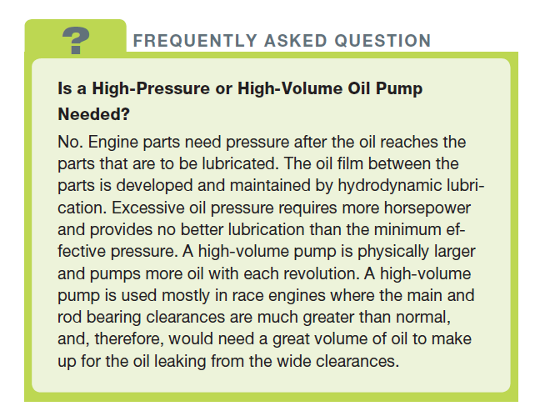
FREQUENTLY ASKED QUESTION

Slide 27
OIL PUMP CHECKS
Visual inspection.
  The gears and housing are examined for scoring.
Measurements.
  If they are lightly scored, the clearances in the pump should be measured.

Slide 28
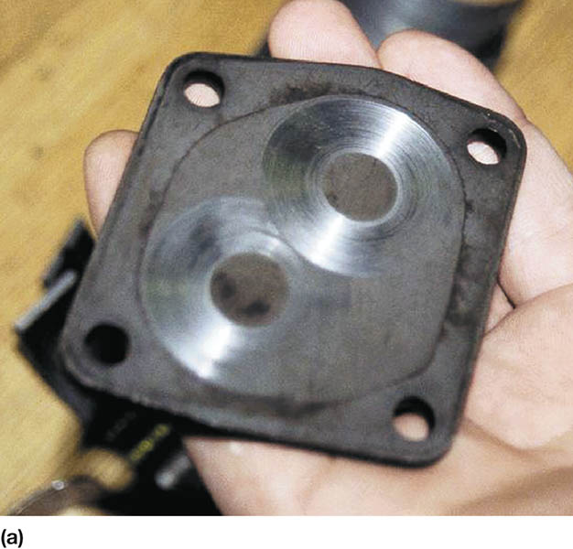
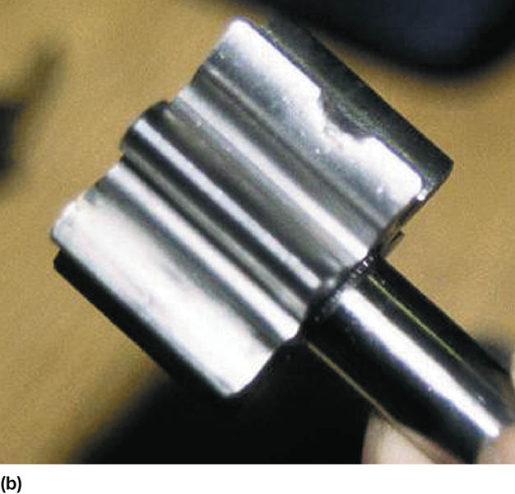
Figure 23.12 (a) A visual inspection indicated that this pump cover was worn. (b) An embedded particle of something was found on one of the gears, making this pump worthless except for scrap metal

Slide 29
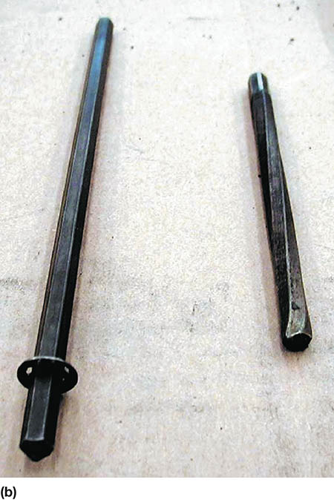
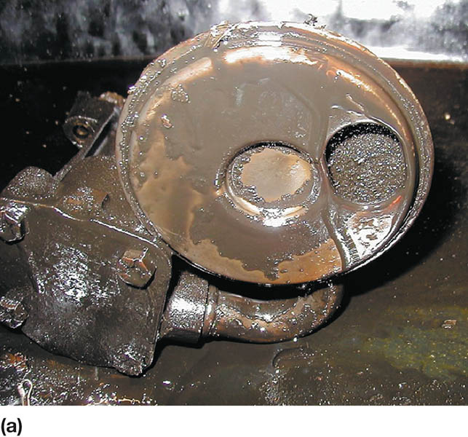
Figure 23.13 (a) The oil pump is the only part in an engine that gets unfiltered engine oil. The oil is drawn up from the bottom of the oil pan and is pressurized before flowing to the oil filter. (b) If debris gets into an oil pump, the drive or distributor shaft can twist and/or break.

Slide 30
OIL PASSAGES
Oil from the oil pump first flows through the oil filter, and then goes through a drilled hole that intersects with a drilled main oil gallery.
Passages drilled through the block bulkheads allow the oil to go from the main oil gallery to the main and cam bearings.
The valve train components are the last to receive oil and the first to suffer from a lack oil or oil pressure.

Slide 31
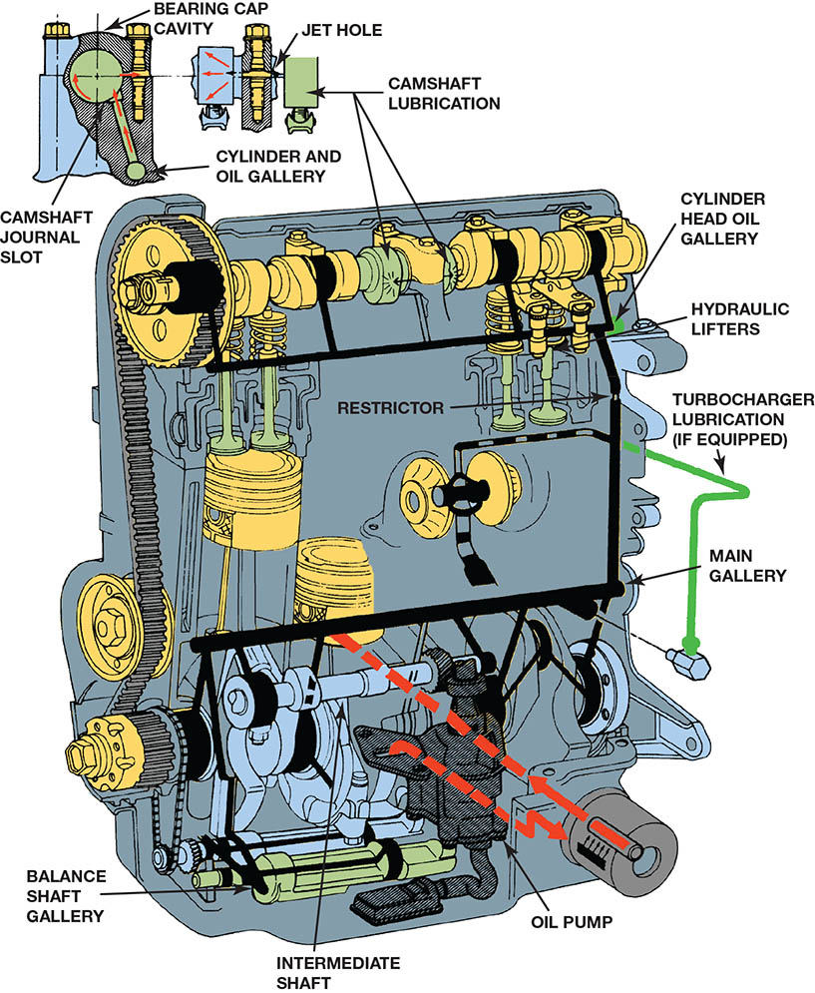
Figure 23.14 An intermediate shaft drives the oil pump on this overhead camshaft engine. Note the main gallery and other drilled passages in the block and cylinder head

Slide 32
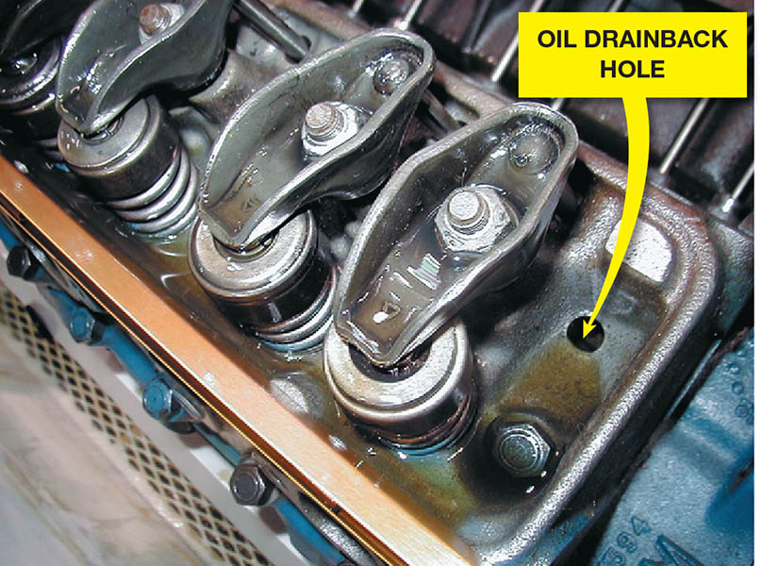
Figure 23.15 Oil is sent to the rocker arms on this Chevrolet V-8 engine through the hollow pushrods. The oil returns to the oil pan through the oil drainback holes in the cylinder head

Slide 33
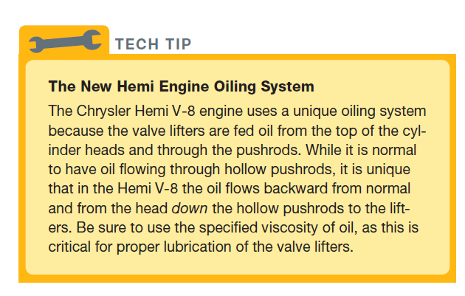
Tech Tip

Slide 34
OIL PANS
The oil pan is where engine oil is used for lubricating the engine. Another name for the oil pan is a sump.
A baffle or windage tray is sometimes installed in engines to eliminate the oil churning problem.

Slide 35
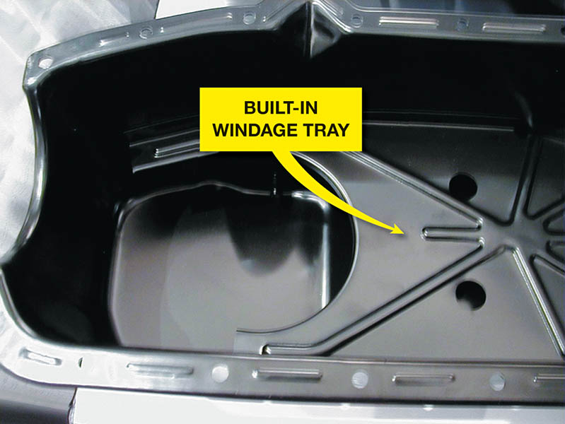
Figure 23.16 A typical oil pan with a built-in windage tray used to keep oil from being churned up by the rotating crankshaft

Slide 36
QUESTION 3: ?
What is the purpose of a windage tray?

Slide 37
ANSWER 3:
To eliminate oil churning.

Slide 38
DRY SUMP SYSTEM
In a dry sump system, the oil pan is shallow and the oil is pumped into a remote reservoir.
Advantages:
  The engine to be mounted lower in the vehicle
  The oil capacity can be greatly expanded
  A dry sump system also allows the engine to develop more power as the oil is kept away from the moving crankshaft.
Disadvantages:
  The system is expensive and complex and extra components can lead to more leaks.

Slide 39
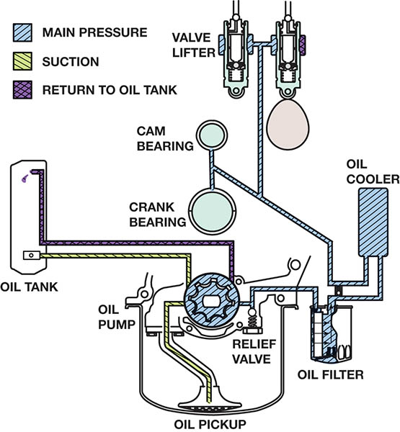
Figure 23.17 A dry sump system as used in a Chevrolet Corvette

Slide 40
OIL COOLERS
Oil temperature must be controlled on many high-performance or turbocharged engines.
Coolant flows through the oil cooler to help warm the oil when the engine is cold and cool the oil when the engine is hot.
Oil temperatures should be:
  Above 212°F (100°C) to boil off any accumulated moisture
  Below 280°F to 300°F (138°C to 148°C)

Slide 41
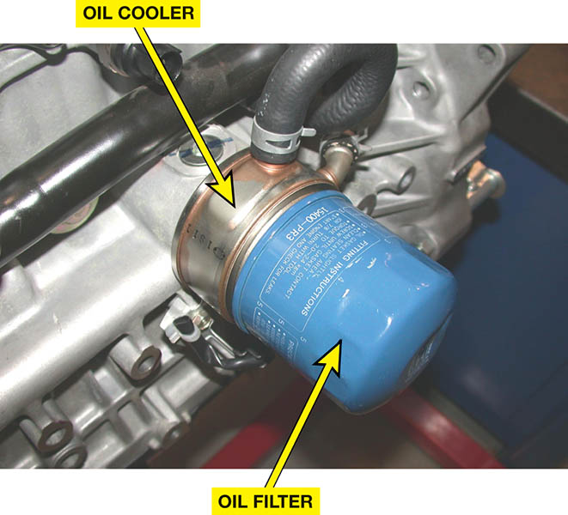
Figure 23.18 Oil is cooled by the flow of coolant through the oil filter adaptor

Slide 42

Copyright

