Slide 1

Automotive Technology Principles, Diagnosis, and Service
Sixth Edition
Chapter 2
Careers in the Automotive Service Industry
Copyright © 2018, 2015, 2011 Pearson Education, Inc. All Rights Reserved

Slide 2
LEARNING OBJECTIVES
2.1 Discuss the need for servicing vehicles and the sites at which servicing is performed.
2.2 Describe the various technician positions and the training experience needed for each.
2.3 Explain the relationship of the service advisor and the service manager to others in a shop.
2.4 Discuss parts-related jobs and sales jobs in the automotive service industry and explain the typical automotive organization arrangement.

Slide 3
THE NEED FOR AUTOMOTIVE TECHNICIANS
Vehicles are becoming more complex and require a higher level of knowledge and skills.
Electrical and electronic components and sensors are included throughout the vehicle.
Construction of parts and materials being used has changed over the last few years, requiring that all service work must be done to specified procedures to help avoiding damage to the vehicle.
Increasing numbers of different types of lubricants and coolants make even routine service challenging.

Slide 4
THE NEED FOR CONTINOUS VEHICLE SERVICE
Vehicles last longer.
  Achieving 200,000 miles without a major repair is now common.
Warranties
  New vehicle limited warranty that covers most components.
  Powertrain warranty covers the engine, transmission/transaxle, and final drive units.
  Sheet metal rust through warranty is usually longer.
  Emission control device warranties are covered for 8 years and 80,000 miles up to 10 years and 150,000 miles.

Slide 5
THE NEED FOR CONTINOUS VEHICLE SERVICE
Increasing Age of the Vehicle
  The average age of a vehicle on the road today has increased to older than nine years.

Slide 6
TECHNICIAN WORKSITES (1 of 3)
New Vehicle Dealerships
  One or more brands of vehicles
  Technician must meet minimum training standards.

Slide 7
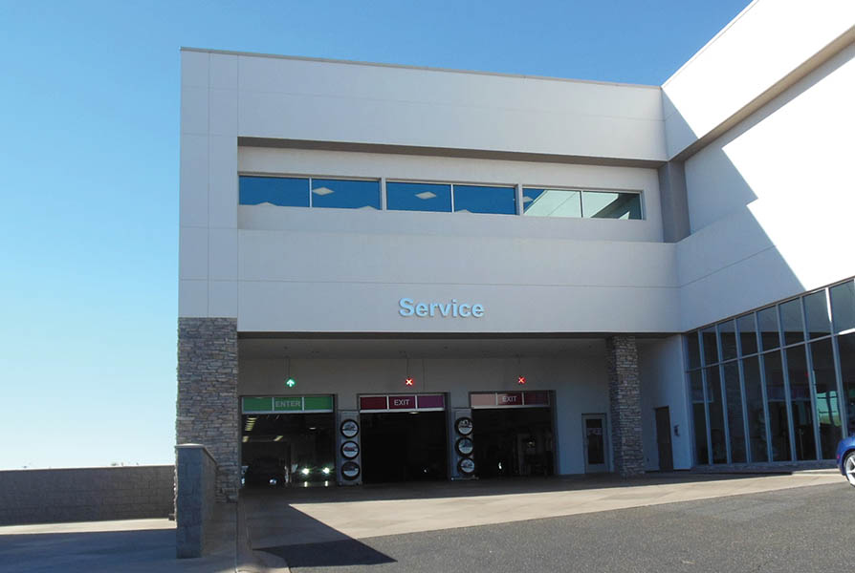
Figure 2.1 Most large dealerships are busy in the morning with customers dropping off their vehicle and in the evening when they are being picked up

Slide 8
TECHNICIAN WORKSITES (2 of 3)
Independent Service Facilities
  Small to medium size
  Work on a variety of vehicles
  Depend on aftermarket training

Slide 9
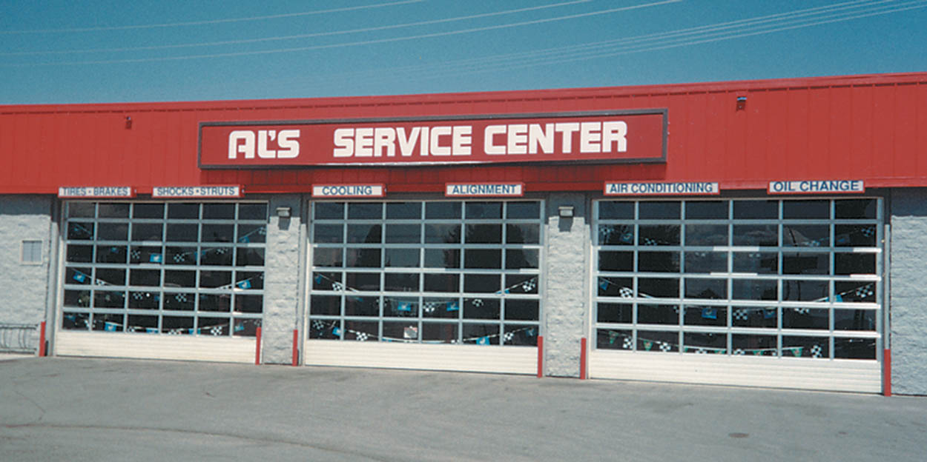
Figure 2.2 A typical independent service facility. Independent garages often work on a variety of vehicles and perform many different types of vehicle repairs and service. Some independent garages specialize in just one or two areas of service work or in just one or two makes of vehicles

Slide 10
TECHNICIAN WORKSITES (3 of 3)
Mass Merchandiser
  Examples include Goodyear and Firestone
Specialty Service Facility
  Examples include Midas and AAMCO
Fleet Facility
  Examples include city, county and state government

Slide 11
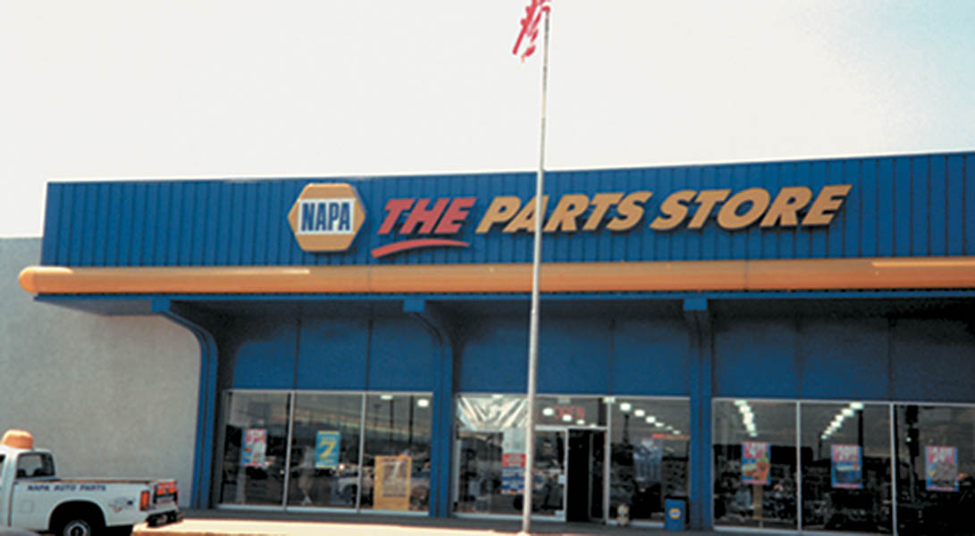
Figure 2.3 This NAPA parts store also performs service work from the garage area on the side of the building

Slide 12
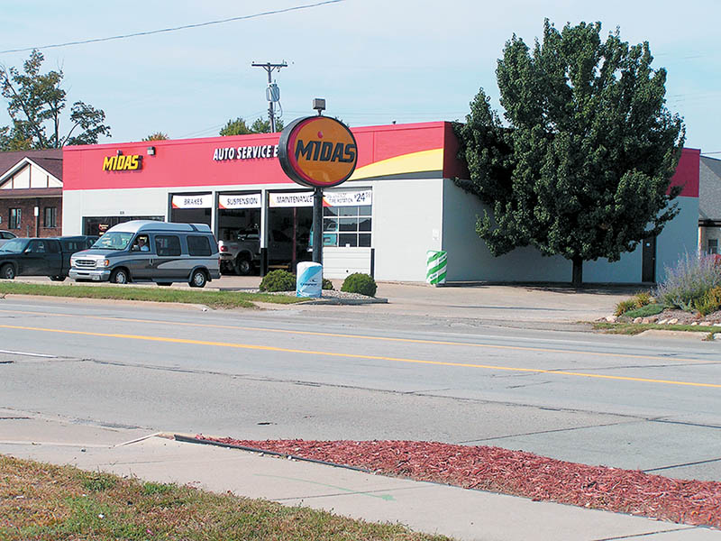
Figure 2.4 Midas is considered to be a specialty service shop

Slide 13
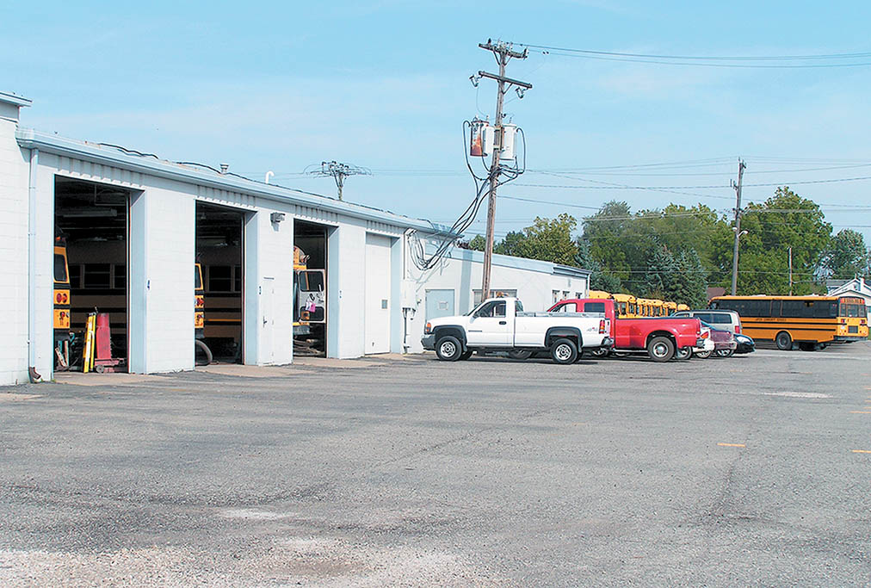
Figure 2.5 A school bus garage is a typical fleet operation shop that needs skilled service technicians

Slide 14
QUESTION 1: ?
What are some examples of mass merchandiser facilities?

Slide 15
ANSWER 1:
Goodyear and Firestone.

Slide 16
TECHNICAIN JOB CLASSIFICATIONS
Lube Tech/ Quick Service Technician
New Vehicle Preparation Technician
General Service Technician
Technician Team Leader

Slide 17
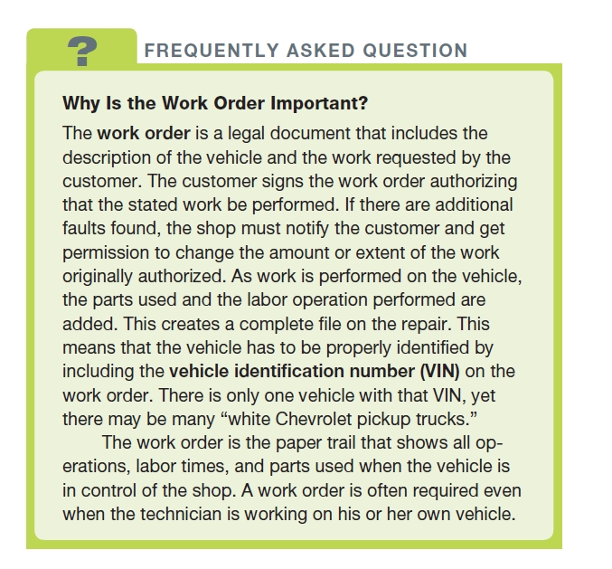
FREQUENTLY ASKED QUESTION

Slide 18
SERVICE MANAGEMENT JOB CLASSISFICATIONS
Shop Foreman
  Assigns work to the technicians and assists with the repairs.
Service Advisor
  Communicates the customer needs and accurately completes the work order.
Service Manager
  Organizes the service facility and keeps it running smoothly.

Slide 19
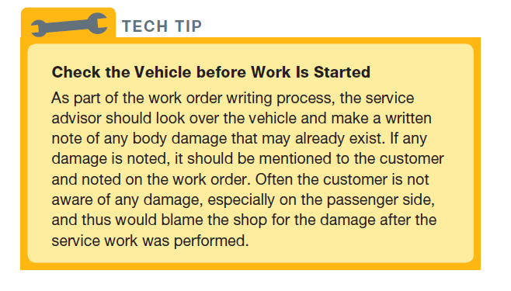
Tech Tip

Slide 20
PARTS RELATED POSITIONS
Parts Counter Person
  Greet Customer
  Locate parts
  Stock Shelves
Parts Manager
  Order parts
  Organize departments
  Develop contacts

Slide 21
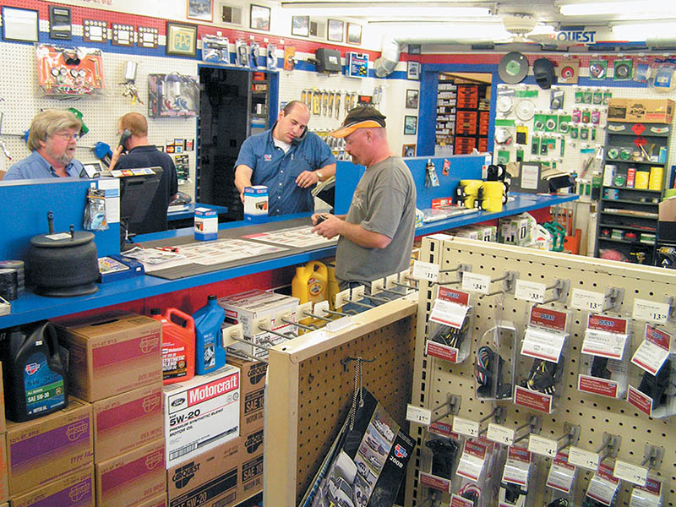
Figure 2.6 Parts counter people need to know many aspects of automotive repair to be effective with customers

Slide 22
VEHICLE SALES JOBS
Salesperson
  Greet Customer
  Qualify the customer
  Demonstrate the vehicle
Sales Manager
  Establish work schedules
  Train new sales people
  Conduct sales promotional activities

Slide 23
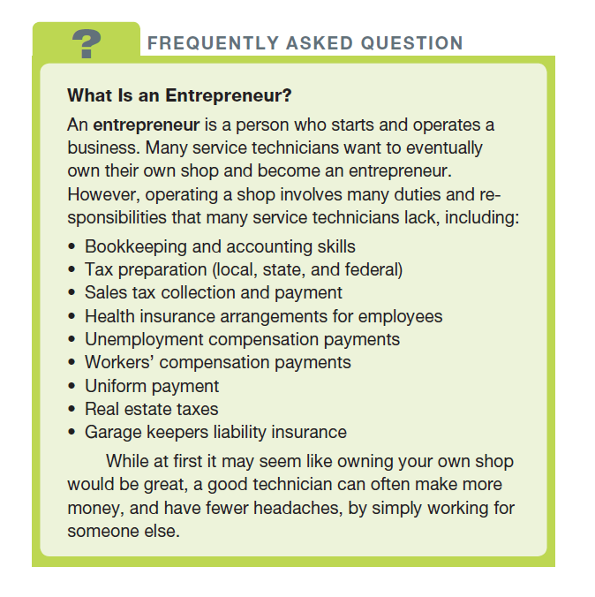
FREQUENTLY ASKED QUESTION

Slide 24
OTHER CAREERS IN THE AUTOMOTIVE INDUSTRY
Sales representative for automotive tool and equipment company
Technical trainers
Technical school instructors
Wholesale parts warehouse management
Insurance adjuster
Automotive technical writer
Warranty claim examiner

Slide 25
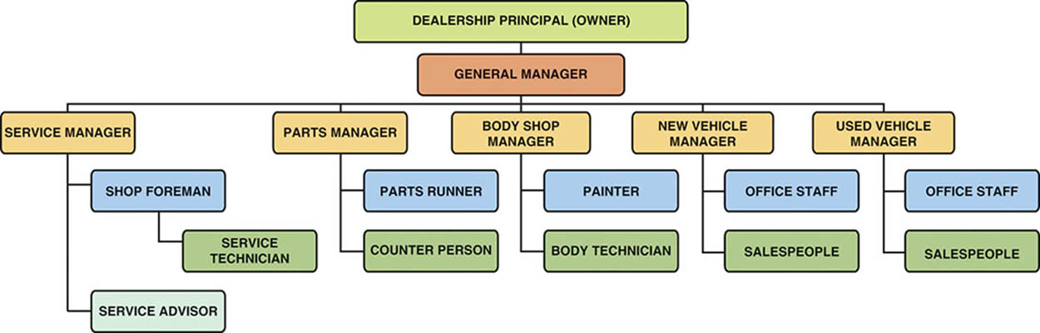
Figure 2.7 A typical large new vehicle dealership organizational chart

Slide 26
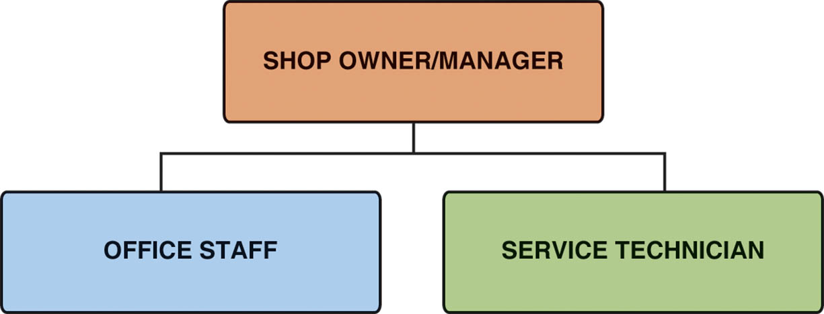
Figure 2.8 A typical independent shop organizational chart

Slide 27
QUESTION 2: ?
What is the role of the service advisor?

Slide 28
ANSWER 2:
To communicate the needs of the customer and complete the repair order.

Slide 29
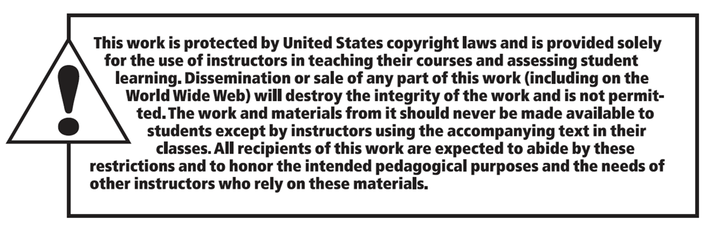
Copyright

