Slide 1

Automotive Technology Principles, Diagnosis, and Service
Sixth Edition
Chapter 19
Diesel Engine Operation and Diagnosis
Copyright © 2018, 2015, 2011 Pearson Education, Inc. All Rights Reserved

Slide 2
LEARNING OBJECTIVES (1 of 2)
19.1 State the characteristics of diesel engines.
19.2. Describe the fuel tank, lift pump, injection pump, and engine-driven vacuum pump.
19.3. Explain the HEUI system.
19.4 Discuss the purpose of glow plugs, diesel fuel heaters, diesel injector nozzles, and accelerator pedal position sensors.
19.5 Explain the purpose of diesel engine turbochargers.

Slide 3
LEARNING OBJECTIVES (2 of 2)
19.6 Discuss the purpose of the exhaust gas recirculation system, selective catalytic reduction, and diesel oxidation catalysts.
19.7 Explain diesel particulate matter, and discuss the function of diesel exhaust particulate filters and selective catalytic reduction.
19.8 Discuss diesel exhaust smoke diagnosis and performance diagnosis.
19.9 Discuss compression testing, glow plug resistance balance test, injector pop testing, and diesel emission testing.

Slide 4
DIESEL ENGINES (1 of 3)
Fundamentals
1892: Rudolf Diesel perfects the compression ignition engine.
16:1 compression ratio to generate heat of compression.
Fuel burns and gasses expands creating power.
Advantages/Disadvantages
More torque, greater fuel economy, long service life.
Engine noise, exhaust smell, cold weather startability.

Slide 5
DIESEL ENGINES (2 of 3)
Construction
Heavier than gasoline engine.
Torque much greater than same size gasoline engine.
Air-Fuel Ratios
Varies from 85:1 (very lean) to 20:1 (rich)
Higher air fuel ratio leads to increased efficiency.

Slide 6
DIESEL ENGINES (3 of 3)
Indirect Injection
Fuel is injected into a prechamber.
Direct Injection
Fuel is injected directly into the cylinder.
Diesel Fuel Ignition
Intake stroke fills cylinder with air.
Compression stroke raises cylinder pressure.
Fuel injected near TDC on compression stroke.
Power stroke a result of fuel ignition.
Exhaust stroke starts flow of gasses out of cylinder.

Slide 7
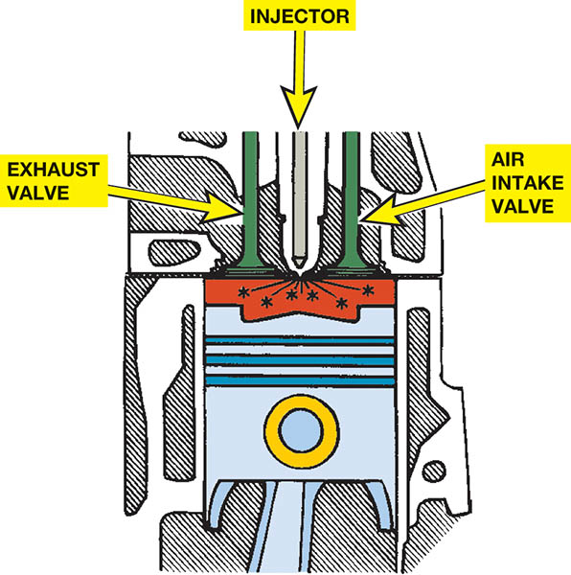
Figure 19.1 Diesel combustion occurs when fuel is injected into the hot, highly compressed air in the cylinder

Slide 8
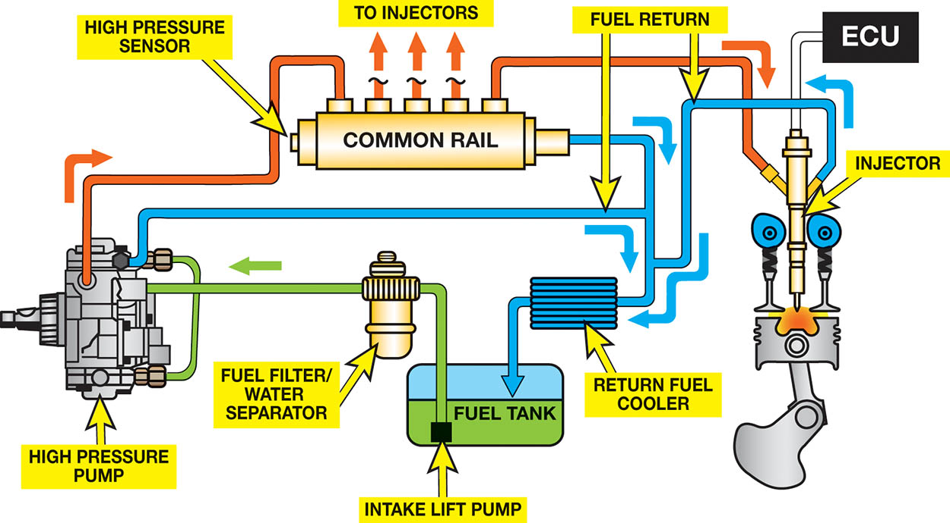
Figure 19.2 A typical high-pressure common rail (HPCR)-type diesel fuel system

Slide 9
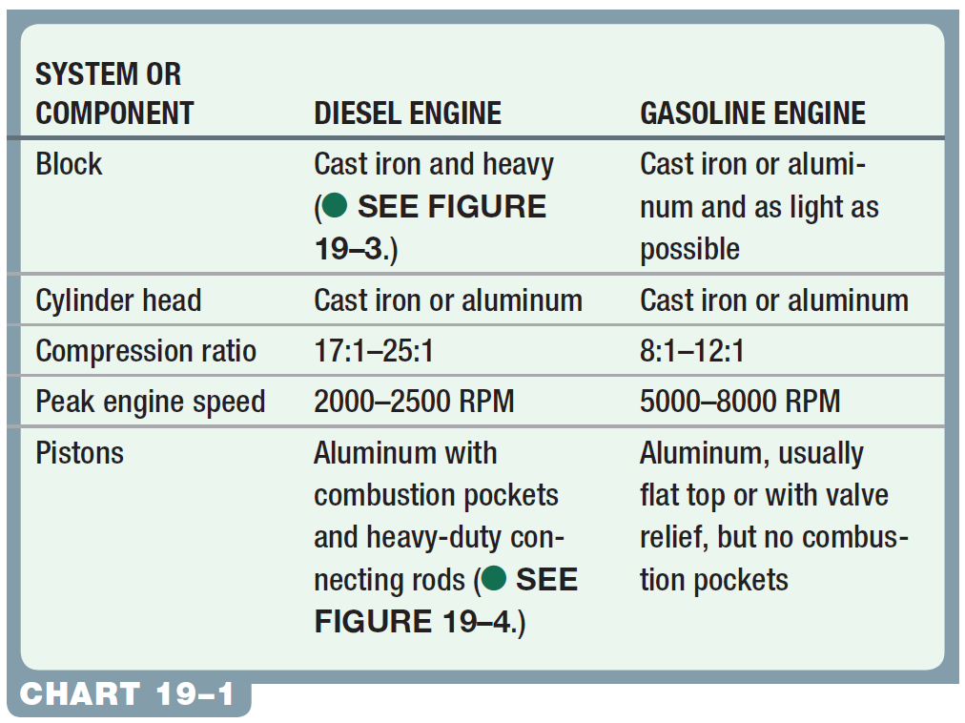
Chart 19-1: Comparison between a typical gasoline and a diesel engine.

Slide 10
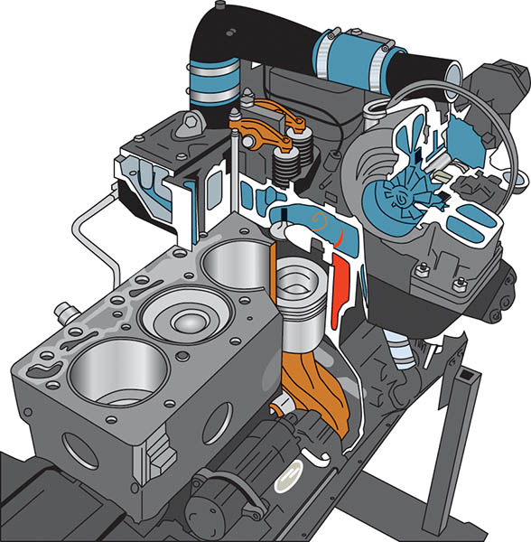
Figure 19.3 A Cummins diesel engine as found in a Dodge (Ram) pickup truck. A high-pressure pump (up to 30,000 PSI) is used to supply diesel fuel to this common rail, which has tubes running to each injector. Note the thick cylinder walls and heavy duty construction

Slide 11
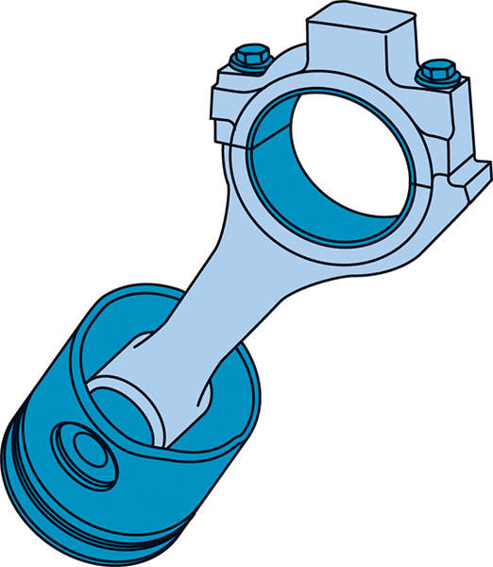
Figure 19.4 A rod/piston assembly from a 5.9 liter Cummins diesel engine used in a Ram pickup truck

Slide 12
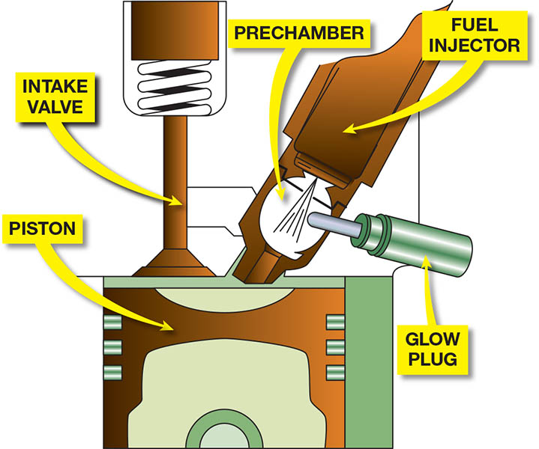
Figure 19.5 An indirect injection diesel engine uses a prechamber and a glow plug

Slide 13
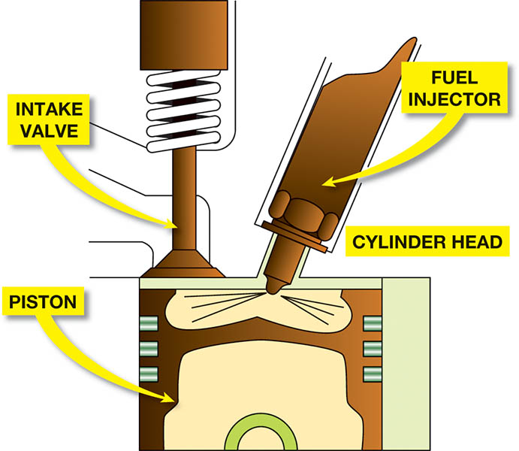
Figure 19.6 A direct injection diesel engine injects the fuel directly into the combustion chamber. Many designs do not use a glow plug

Slide 14
QUESTION 1: ?
What is the difference between direct injection and indirect
injection?

Slide 15
ANSWER 1:
Fuel is injected into a prechamber in an indirect injection system and directly into the cylinder in a direct injection system.

Slide 16
THREE PHASES OF COMBUSTION
Ignition Delay: Fuel injection begins but ignition does not occur immediately.
Rapid Combustion: The fuel first starts to burn creating a sudden rise in cylinder pressure.
Controlled Combustion: The burning of fuel after rapid combustion and the continued injection of fuel.

Slide 17
FUEL TANK AND LIFT PUMP
Filler Neck: Larger neck for diesel fuel (24 mm for diesel versus 21 mm for gasoline)
No evaporative emission devices.
Lift Pump: Typically an in-tank low-pressure fuel pump.
Water-Fuel Separator: Separates the heavier water from the diesel fuel.
Fuel Temperature Sensor: Adjust fuel delivery based on density of fuel.

Slide 18
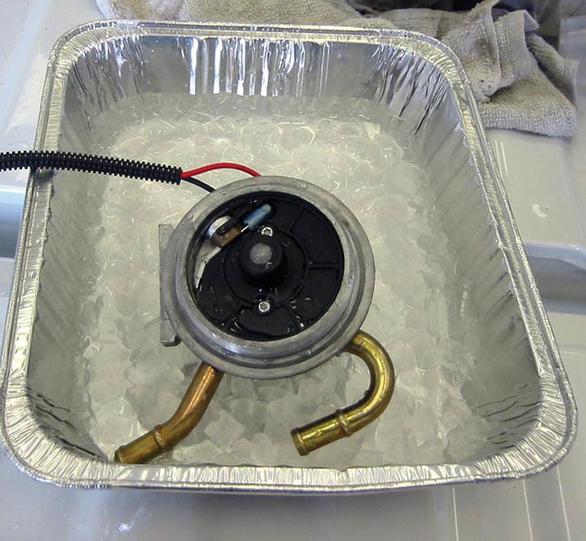
Figure 19.7 A fuel temperature sensor is being tested using an ice bath

Slide 19
INJECTION PUMP
The Need for High-Pressure Fuel Pump: Increase fuel pressure to the extremely high pressures needed for injection.
Distributor Injection Pump: Provide high pressure fuel to each individual injector.
High-Pressure Common Rail: High pressure fuel is feed to common rail. Computer controlled injectors use this fuel source for injection.

Slide 20
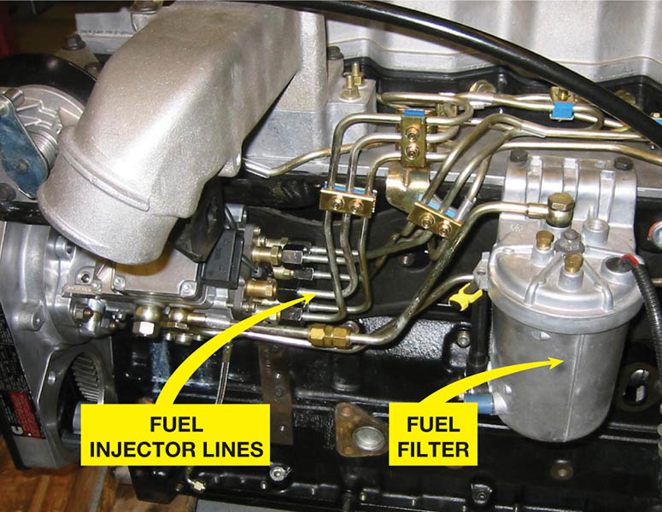
Figure 19.8 A typical distributor-type diesel injection pump showing the pump, lines, and fuel filter

Slide 21
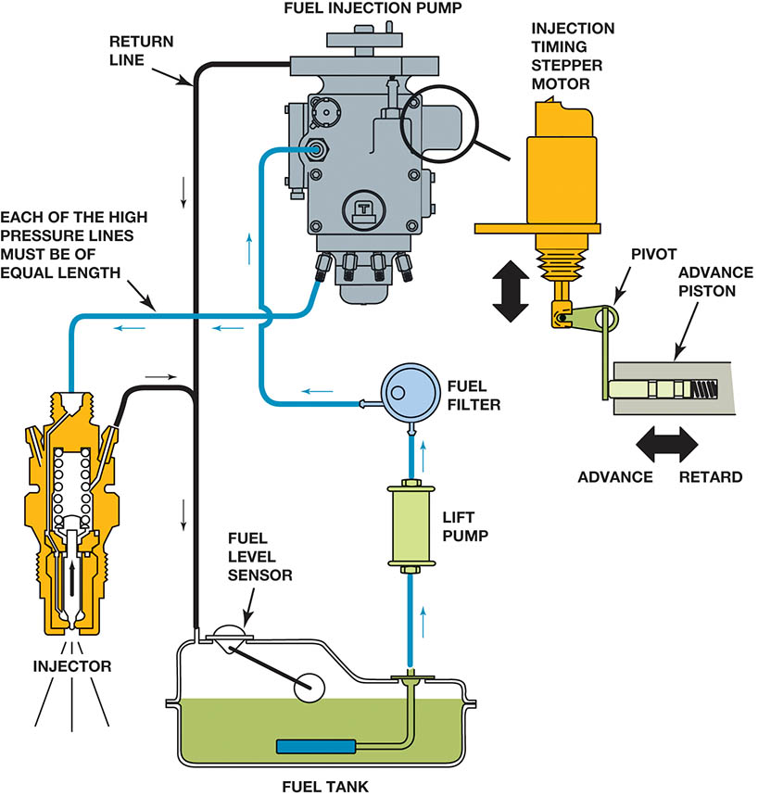
Figure 19.9 A schematic of a Stanadyne diesel fuel–injection pump assembly showing all of the related components

Slide 22
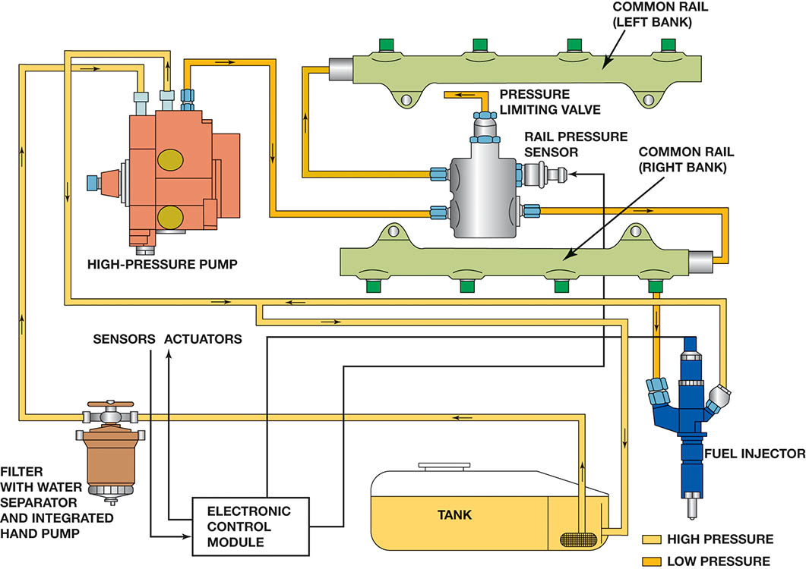
Figure 19.10 Overview of a computer-controlled high-pressure common rail V-8 diesel engine

Slide 23
ENGINE-DRIVEN VACUUM PUMP
Diesel engines create little or no vacuum.
Engine driven vacuum pump supplies vacuum to components that need it to operate.

Slide 24
HEUI SYSTEM
Operation
The engine oil is pressurized to provide an opening pressure strong enough to overcome the fuel pressure when the solenoid is commanded to open by the PCM.
The injectors, which are hydraulically actuated by engine oil pressure from the high-pressure oil pump, are then fired by the powertrain control module (PCM).

Slide 25
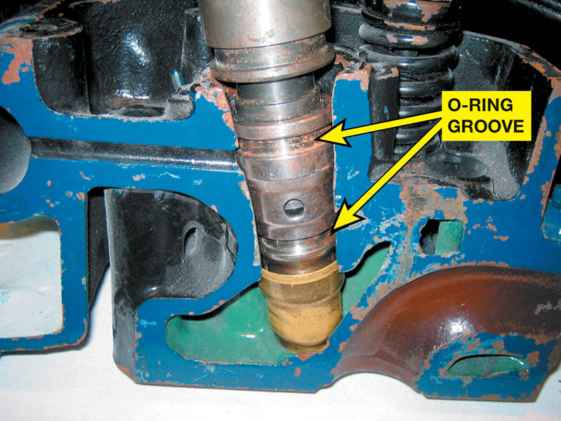
Figure 19.11 A HEUI injector from a Ford Power Stroke diesel engine. The O-ring grooves indicate the location of the O-rings that seal the fuel section of the injector from coolant and from the engine oil

Slide 26
DIESEL INJECTOR NOZZLES
Diesel injector nozzles are spring-loaded closed valves that spray fuel directly into the combustion chamber or pre-combustion chamber when the injector is opened.
Heat Shield
Injector Body
Diesel Injector Needle Valve
Injector Pressure Chamber

Slide 27
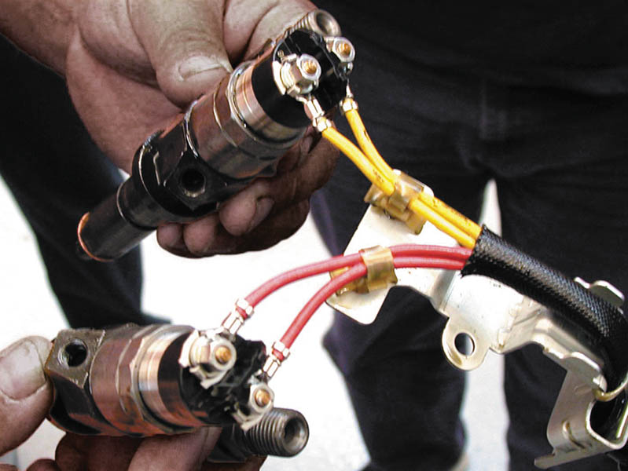
Figure 19.12 Typical computer-controlled diesel engine fuel injectors

Slide 28
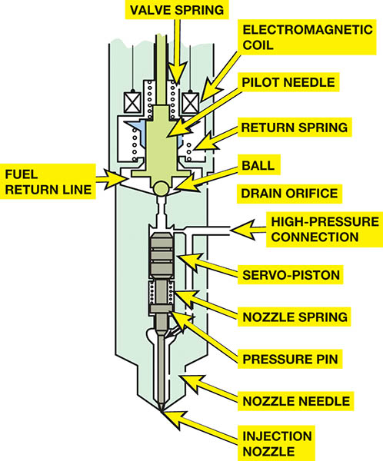
Figure 19.13 A Duramax injector showing all the internal parts

Slide 29
GLOW PLUGS
Equipped on both indirect and direct injection fuel systems.
Used to provide heat to help ignite the fuel.
As glow plug heats its resistance increases.
Operation controlled by Powertrain Control Module (PCM)
May be operated after vehicle start-up to reduce white smoke.

Slide 30
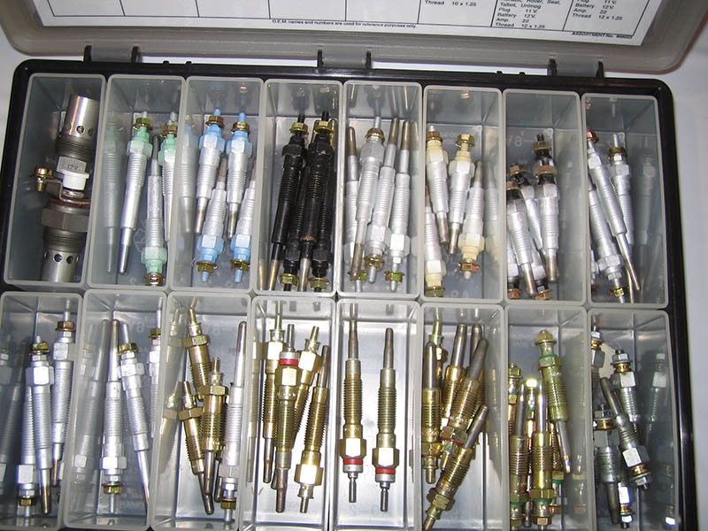
Figure 19.14 A glow plug assortment showing the various types and sizes of glow plugs used. Always use the specified glow plugs

Slide 31
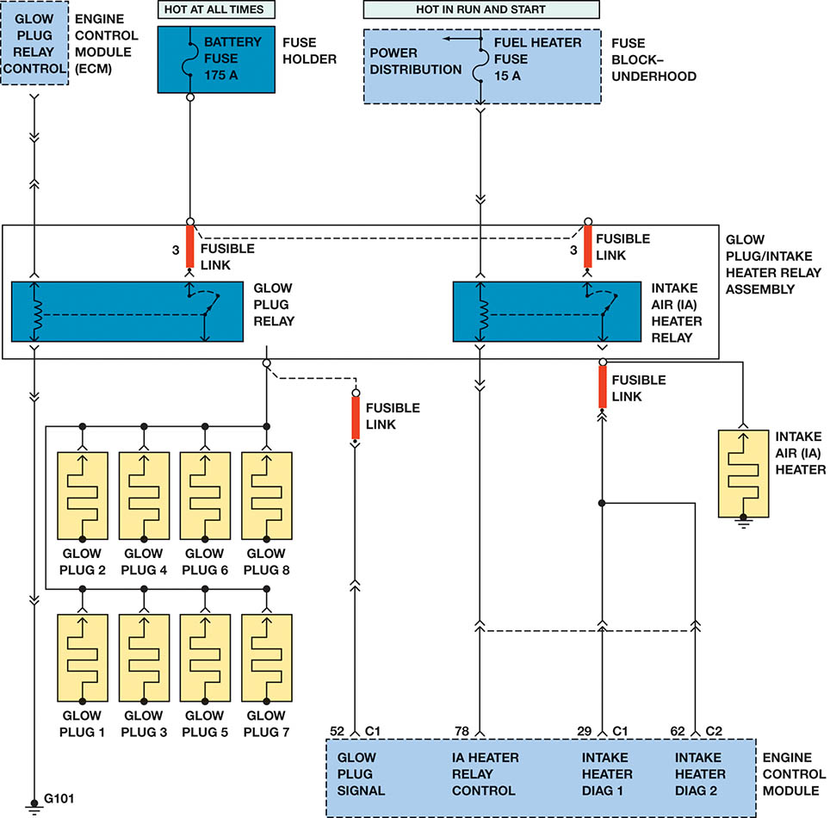
Figure 19.15 A schematic of a typical glow plug circuit. Notice that the glow plug relay and intake air heater relay are both computer controlled

Slide 32
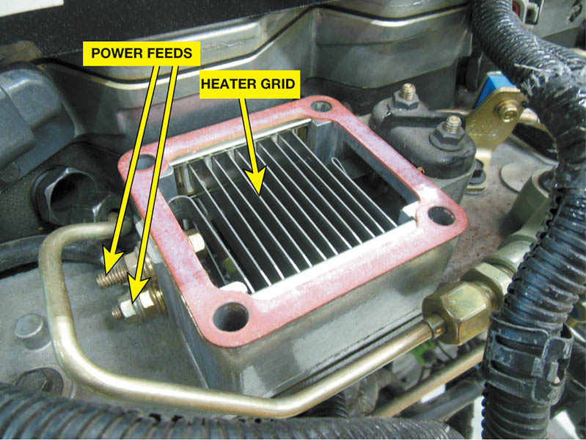
Figure 19.16 The intake heater grid is used to warm the intake air and increase pre-ignition temperatures. The heater may continue to be cycled to decrease the amount of time needed to warm the engine

Slide 33
QUESTION 2: ?
Why are glow plugs kept working after the engine starts?

Slide 34
ANSWER 2:
To reduce white tailpipe smoke.

Slide 35
DIESEL FUEL HEATERS
Diesel fuel heaters help prevent power loss and stalling in cold weather.
The heater is placed in the fuel line between the tank and the primary filter.
Some fuel heaters are thermostatically controlled, which allows fuel to bypass the heater once it has reached operating temperature.

Slide 36
ACCELERATOR PEDAL POSITION SENSOR
Instead of a mechanical link from the accelerator pedal to the diesel injection pump, a throttle-by-wire system uses an accelerator pedal position (APP) sensor.
To ensure safety, it consists of (up too) three separate sensors that change in voltage as the accelerator pedal is depressed.
The computer checks for errors by comparing the voltage output of each of the three sensors

Slide 37
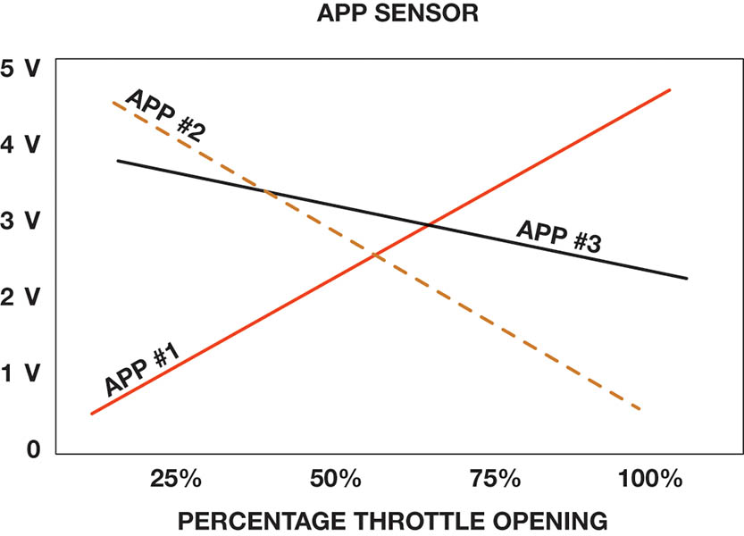
Figure 19.17 A typical accelerator pedal position (APP) sensor uses three different sensors in one package with each creating a different voltage as the accelerator is moved

Slide 38
DIESEL ENGINE TURBOCHARGERS
Turbocharged Diesels
A turbocharger greatly increases engine power by pumping additional compressed air into the combustion chambers.
Air Charge Cooler
Cooler air entering the engine means more power can be produced by the engine.
Variable Turbocharger
The variable vanes allow for optimal flow at all engine RPMs.

Slide 39
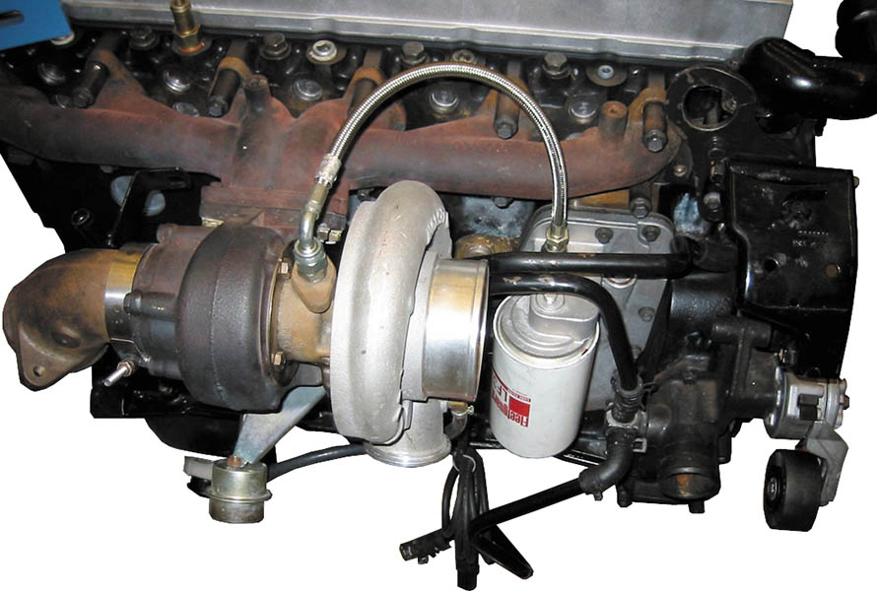
Figure 19.18 A Cummins diesel turbocharger is used to increase the power and torque of the engine

Slide 40
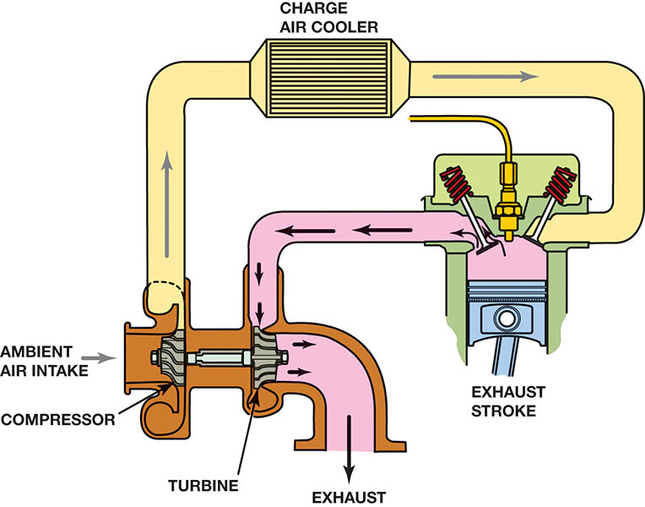
Figure 19.19 An air charge cooler is used to cool the compressed air

Slide 41
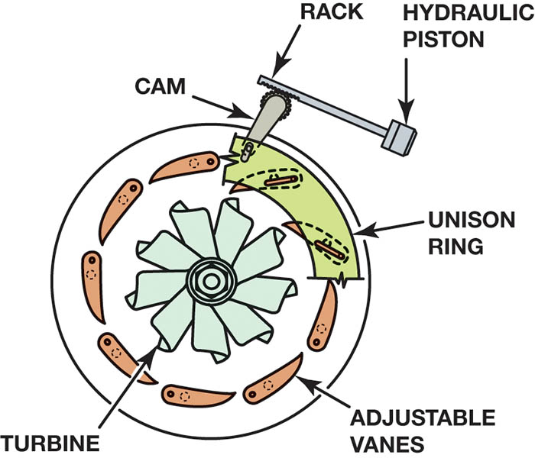
Figure 19.20 A variable vane turbocharger allows the boost to be controlled without the need of a wastegate

Slide 42
EXHAUST GAS RECIRCULATION
The EGR system recycles some exhaust gas back into the intake stream to cool combustion, which reduces oxides of nitrogen (NOx) emissions.
EGR System Components
EGR Valve
EGR Cooler
EGR Pipes

Slide 43
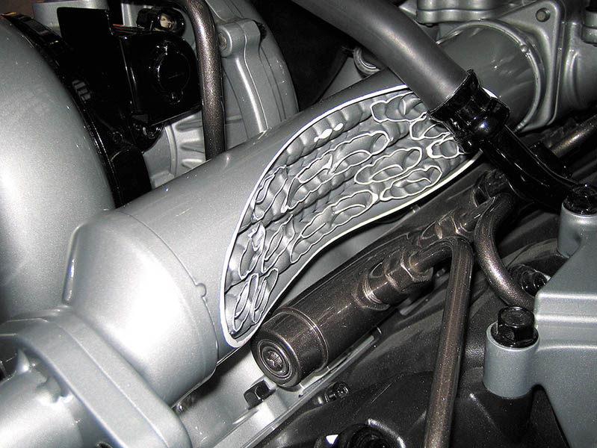
Figure 19.21 A cutaway showing the exhaust cooler. The cooler the exhaust is, the more effective it is in controlling NO_{x} emissions

Slide 44
DIESEL PARTICULATE MATTER
Particulates are generally categorized as follows:
Total suspended particulate (TSP). Refers to all particles between 0.1 and 50 microns.
PM10. Refers to particulate matter of 10 microns or less (approximately 1/6 the diameter of a human hair).
PM2.5. Refers to particulate matter of 2.5 microns or less (approximately 1/20 the diameter of a human hair), also called “fine” particles.
Soot Categories
Fine. Less than 2.5 microns
Ultrafine. Less than 0.1 micron, and make up 80% to 95% of soot

Slide 45
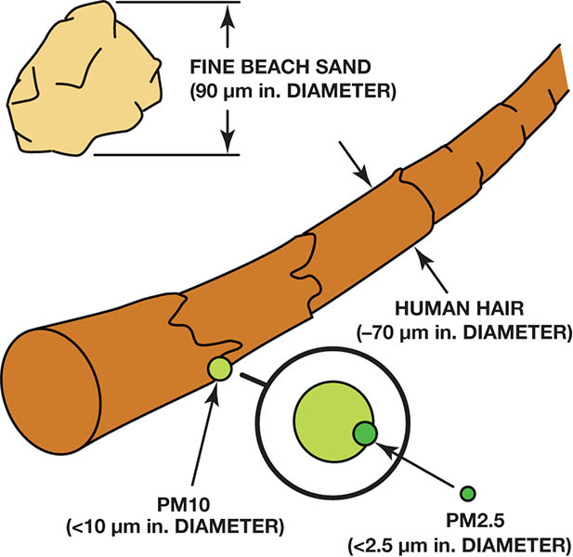
Figure 19.22 Relative size of particulate matter to a human hair

Slide 46
DIESEL OXIDATION CATALYST
Purpose and Function
Diesel oxidation catalysts (DOC) are used in all light-duty diesel engines, since 2007.
The main function of the DOC is to start a regeneration event by converting the fuel-rich exhaust gases to heat.
The DOC reduces Carbon Monoxide (CO) and Hydrocarbons (HC) as well as odor-causing componds.

Slide 47
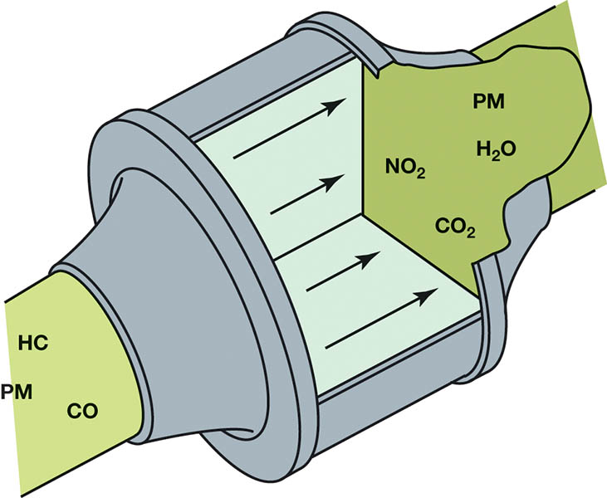
Figure 19.23 Chemical reaction within the DOC

Slide 48
DIESEL EXHAUST PARTICULATE FILTER (1 OF 2)
Purpose and Function
The diesel particulate filter is a wall flow design filter designed to capture and hold particulate matter and allow exhaust gases to flow through the system.
Operation
Over time, the trapped particulate matter will begin to clog the filter. The filter must therefore be purged periodically to remove accumulated soot particles. The process of purging soot from the DPF is described as regeneration.

Slide 49
DIESEL EXHAUST PARTICULATE FILTER (2 OF 2)
Exhaust Gas Temperature Sensors
Exhaust gas temperature sensors are used to help the PCM control the DPF.
DPF Differential Pressure Sensor
Measures the level of restriction in the filter assembly.
DPF Regeneration
Passive Regeneration
Active Regeneration
Ash Loading
To service the ash load, most DPF units are replaced.

Slide 50
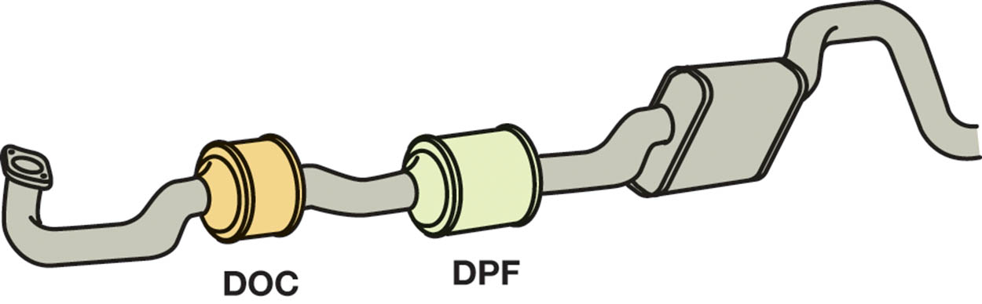
Figure 19.24 After-treatment of diesel exhaust is handled by the DOC and DPF

Slide 51
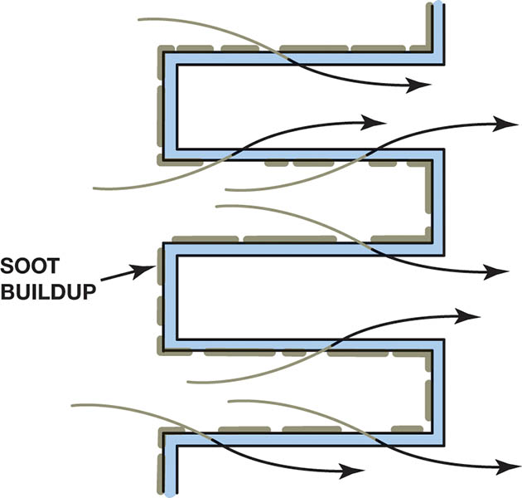
Figure 19.25 The soot is trapped in the passages of the DPF. The exhaust has to flow through the sides of the trap and exit

Slide 52
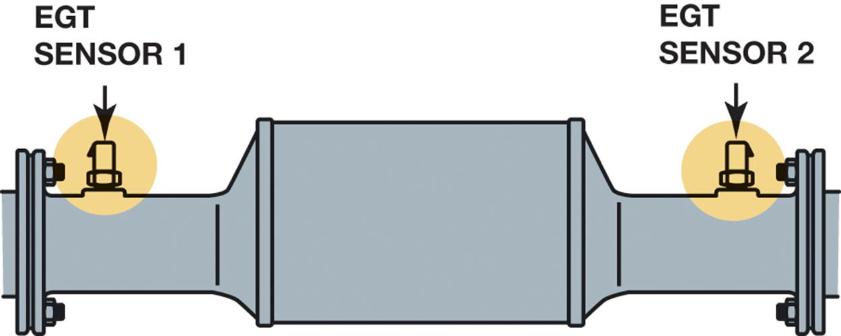
Figure 19.26 EGT 1 and EGT 2 are used by the PCM to help control after-treatment system operation

Slide 53
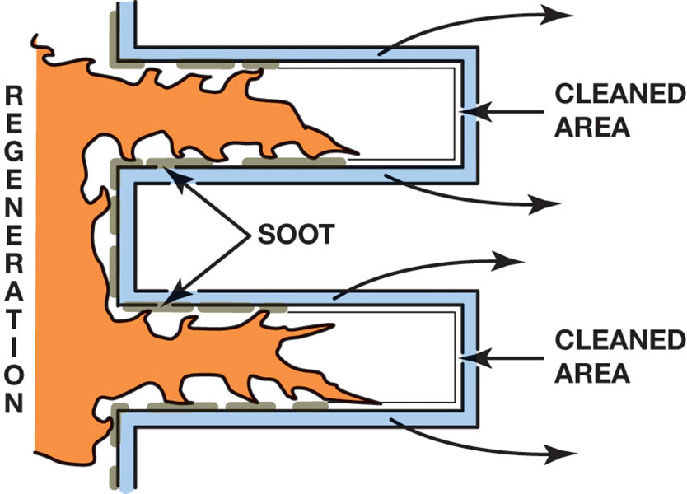
Figure 19.27 Regeneration burns the soot and renews the DPF

Slide 54
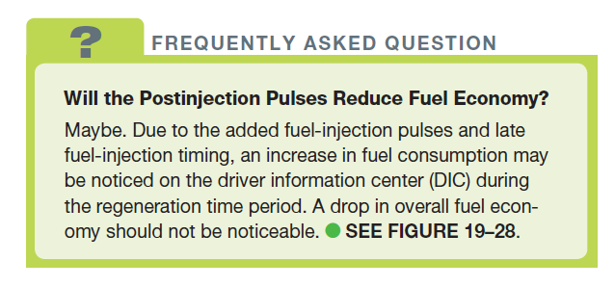
FREQUENTLY ASKED QUESTION

Slide 55
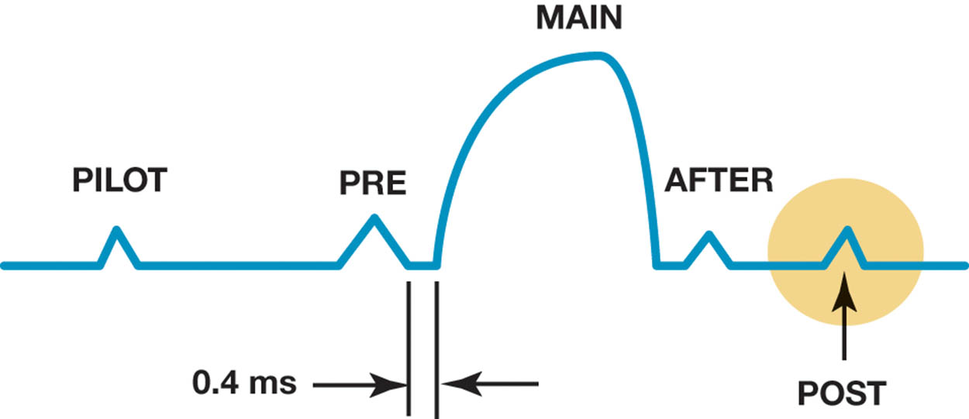
Figure 19.28 The post-injection pulse occurs to create the heat needed for regeneration

Slide 56
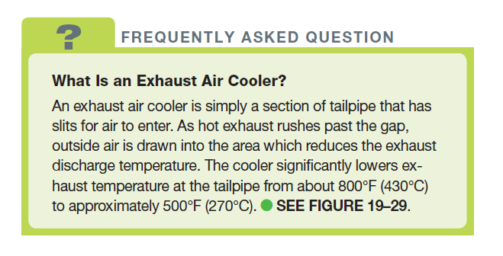
FREQUENTLY ASKED QUESTION

Slide 57
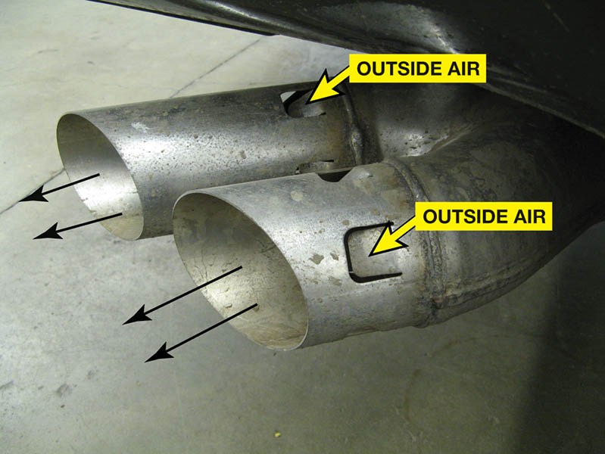
Figure 19.29 The exhaust is split into two outlets and has slits to help draw outside air in as the exhaust leaves the tailpipe. The end result is cooler exhaust gases exiting the tailpipe

Slide 58
SELECTIVE CATALYST REDUCTION
Purpose and Function
Selective catalytic reduction (SCR) is a method used to reduce NOx emissions by injecting urea into the exhaust stream.
Advantages of SCR
Potential higher engine power output for the same size engine and reduced NOx emissions up to 90%.
Disadvantages of SCR
Onboard storage tank required for the urea, and increased customer costs due to refilling.

Slide 59
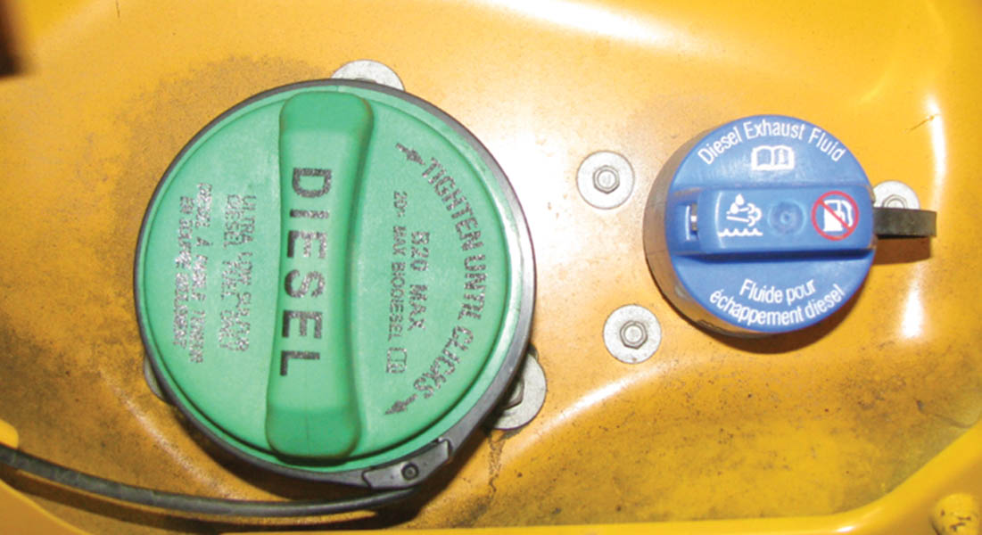
Figure 19.30 Diesel exhaust fluid is housed in a separate container that holds from 5 to 10 gallons, or enough to last until the next scheduled oil change, in most diesel vehicles that use SCR

Slide 60
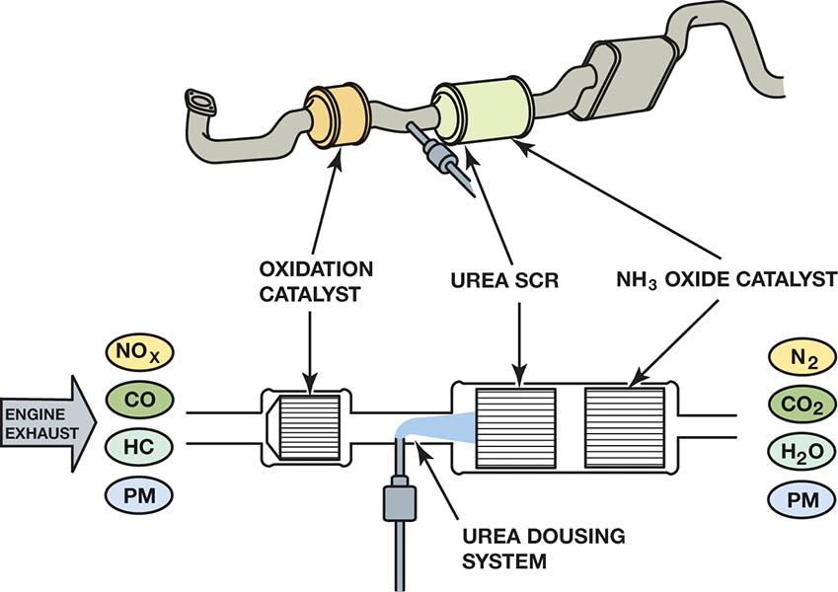
Figure 19.31 Urea (diesel exhaust fluid) injection is used to reduce NO_{x} exhaust emissions. It is injected after the diesel oxidation catalyst (DOC) and before the diesel particulate filter (DPF) on this 6.7 liter Ford diesel engine

Slide 61
DIESEL EXHAUST SMOKE DIAGNOSIS
Black Smoke
Incomplete combustion because of a lack of air or a fault in the injection system.
White Smoke
Occurs most often during cold engine starts because the smoke is usually condensed fuel droplets.
Blue or Gray Smoke
Is usually due to oil consumption caused by worn piston rings, scored cylinder walls, or defective valve stem seals.

Slide 62
DIESEL PERFORMANCE DIAGNOSIS
Begin by checking the oil
High oil level may indicate fuel in the crankcase.
Scan data is used to find common faults:
Hard starting
No start
Extended cranking before start
Low Power

Slide 63
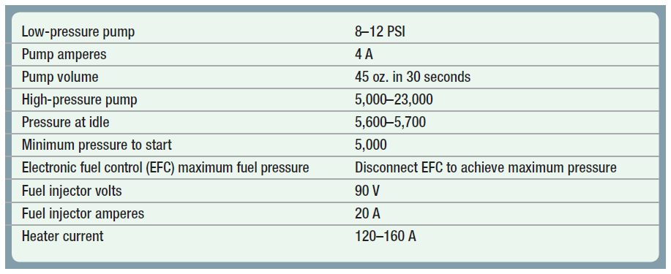
Chart 19-2: Cummins 5.9 and 6.7 liter. The values can be obtained by using a scan tool and basic test equipment. Always follow the vehicle manufacturer’s recommended procedures.

Slide 64
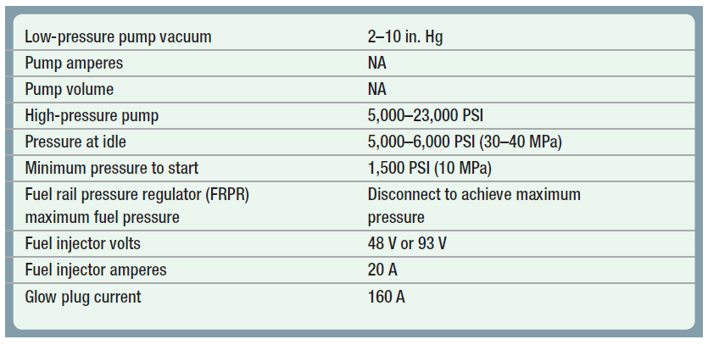
Chart 19-2: GM Duramax. The values can be obtained by using a scan tool and basic test equipment. Always follow the vehicle manufacturer’s recommended procedures.

Slide 65
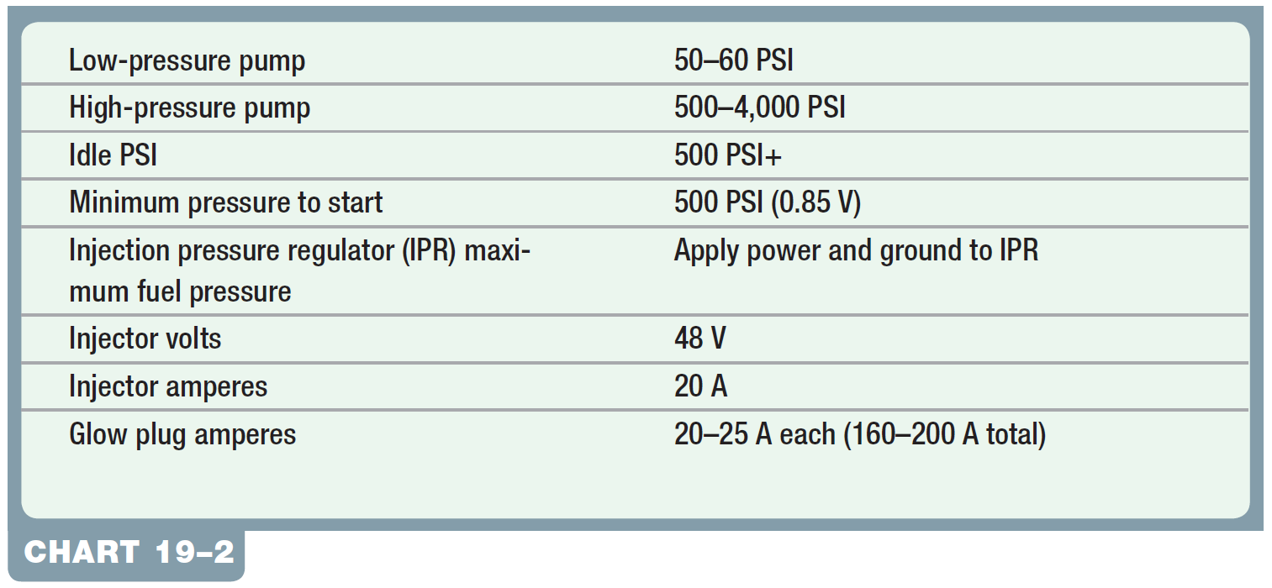
Chart 19-2: Ford Power Stroke. The values can be obtained by using a scan tool and basic test equipment. Always follow the vehicle manufacturer’s recommended procedures.

Slide 66
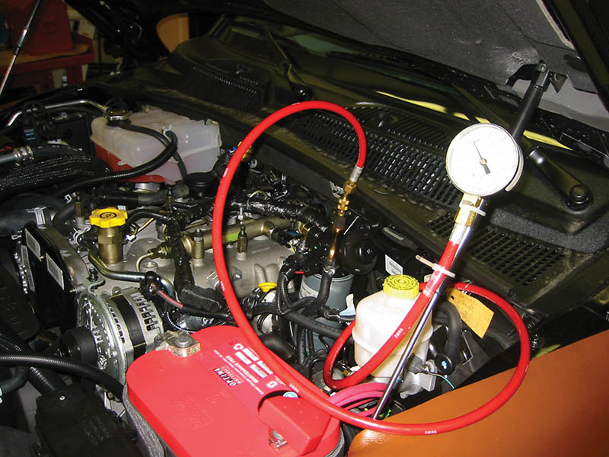
Figure 19.32 A pressure gauge checking the fuel pressure from the lift pump on a Cummins 6.7 liter diesel

Slide 67
COMPRESSION TESTING
A compression test is fundamental for determining the mechanical condition of a diesel engine.
To perform a compression test the following will have to done:
Remove the glow plug (if equipped) or the injector.
Use a diesel compression gauge, as the compression is too high to use a gasoline engine compression gauge.

Slide 68
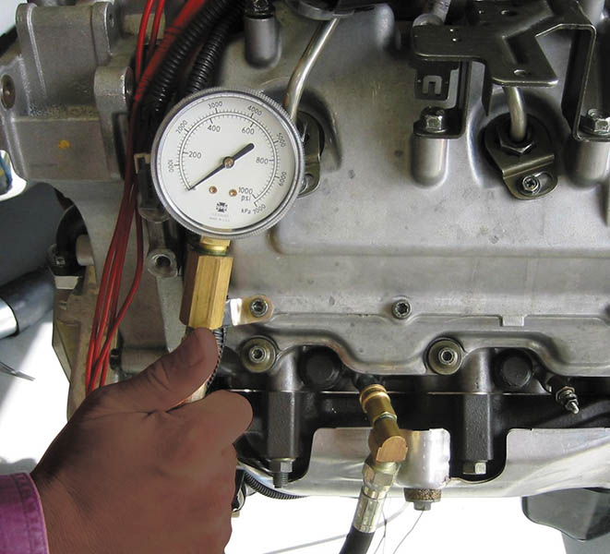
Figure 19.33 A compression gauge that is designed for the higher compression ratio of a diesel engine should be used when checking the compression

Slide 69
GLOW PLUG RESISTANCE BALANCE TEST
Glow plugs increase in resistance as their temperature increases.
All glow plugs should have about the same resistance when checked with an ohmmeter.
A similar test of the resistance of the glow plugs can be used to detect a weak cylinder.
A weak cylinder will generate less heat and the resistance of the glow plug will be different.

Slide 70
INJECTOR POP TESTING
A pop tester is a device used for checking a diesel injector nozzle for proper spray pattern.
The spray pattern should be a hollow cone, but will vary depending on design.
The nozzle should also be tested for leakage (dripping of the nozzle) while under pressure.

Slide 71
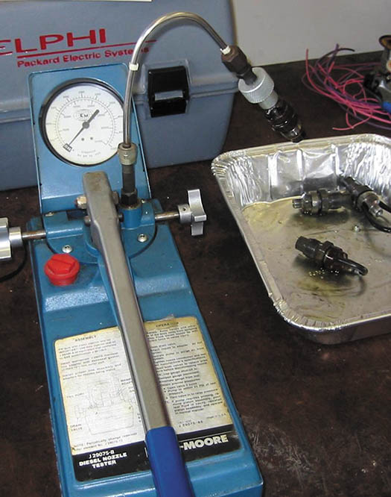
Figure 19.34 A typical pop tester used to check the spray pattern of a diesel engine injector

Slide 72
DIESEL EMISSION TESTING
Opacity Test
Opacity means the percentage of light that is blocked by the exhaust smoke.
Snap Acceleration Test
White smoke emissions are measure during a rapid acceleration of the engine.
Rolling Acceleration Test
White smoke emissions are measured in low gear on acceleration.
Stall Acceleration Test
Opacity measured during an engine stall test.

Slide 73
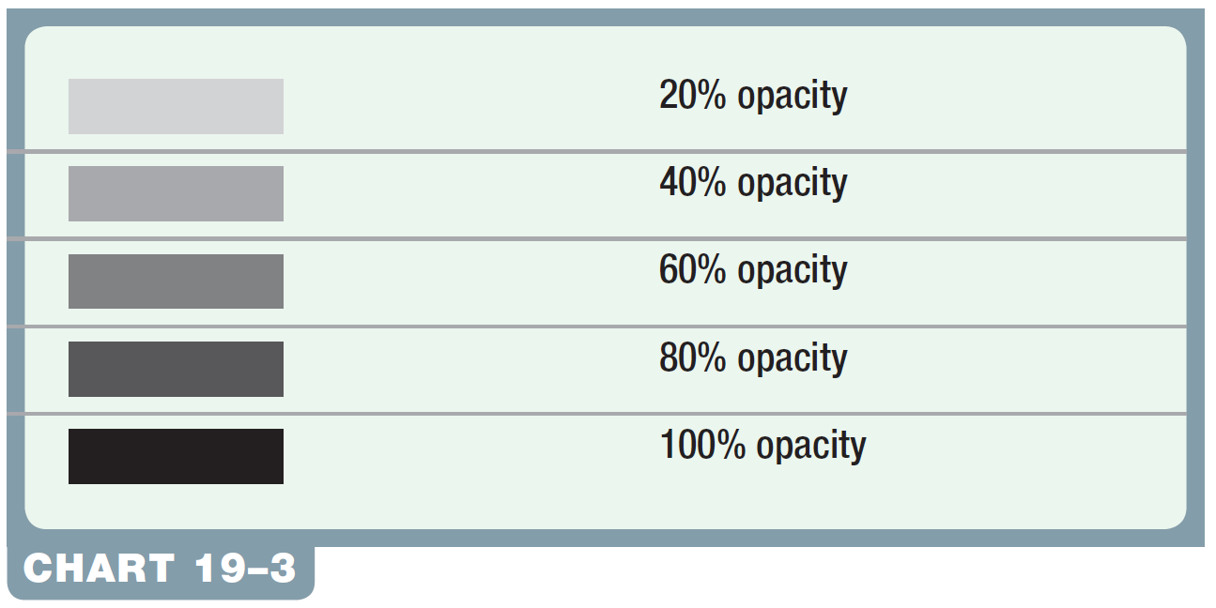
Chart 19-3: An opacity test is sometimes used during a state emission test on diesel engines.

Slide 74
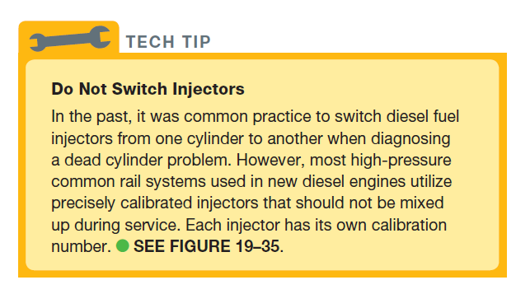
Tech Tip

Slide 75
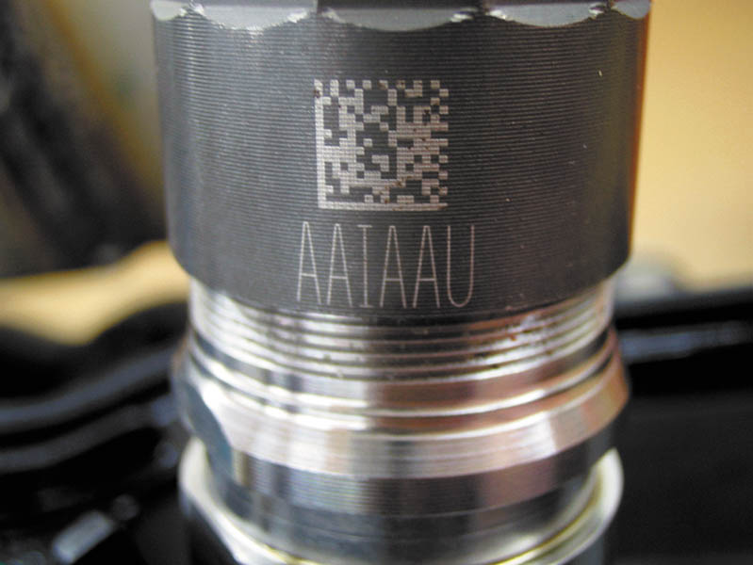
Figure 19.35 The letters on the side of this injector on a Cummins 6.7 liter diesel indicate the calibration number for the injector

Slide 76
QUESTION 3: ?
What is the purpose of the letters and numbers on the side of a common rail injector?

Slide 77
ANSWER 3:
They represent the calibration code.

Slide 78

Copyright

