Slide 1
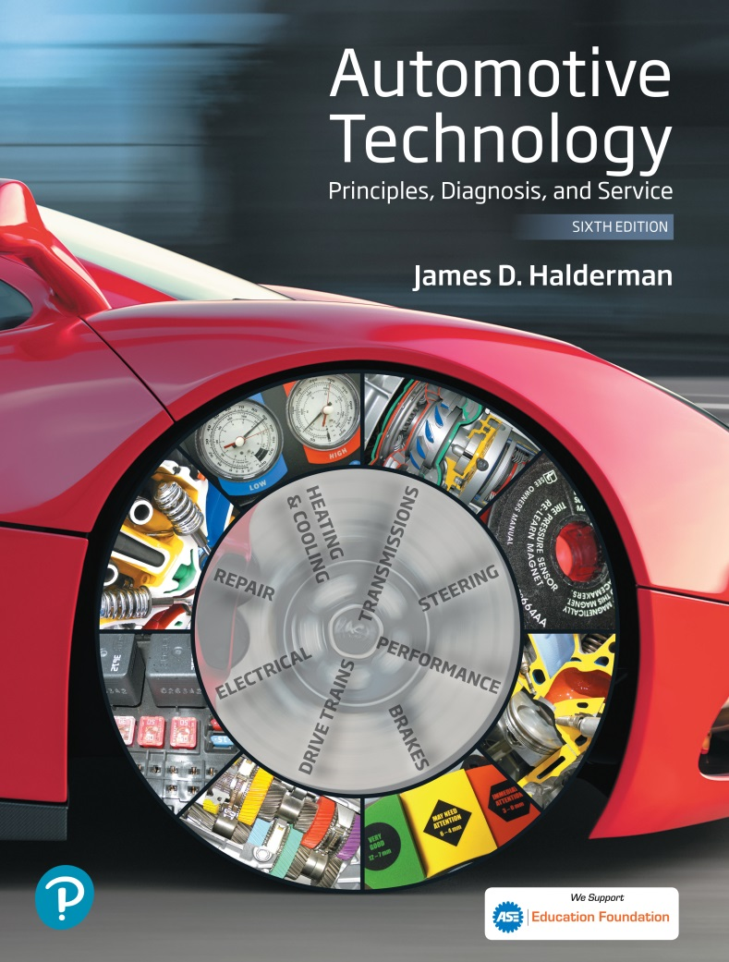
Automotive Technology Principles, Diagnosis, and Service
Sixth Edition
Chapter 17
Preventative Maintenance and Service Procedures
Copyright © 2018, 2015, 2011 Pearson Education, Inc. All Rights Reserved

Slide 2
LEARNING OBJECTIVES (1 of 2)
17.1 List the items or systems that require routine maintenance and describe when it should be performed.
17.2. Describe the steps to follow when getting a vehicle ready for service.
17.3. Explain the process to be followed in safety inspection, windshield wiper service, cabin filter replacement, and air filter inspection.
17.4 Describe the brake fluid and engine oil inspection procedure.

Slide 3
LEARNING OBJECTIVES (2 of 2)
17.5 Explain the process of inspecting the cooling system.
17.6 Explain how to check automatic transmission and power steering fluids.
17.7 Describe how to measure accessory belt tension.
17.8 Describe how to check wheels and tires.
17.9 Describe how to lubricate the chassis, check the differential and the manual transmission fluid, and perform under-vehicle inspection.

Slide 4
PREVENTATIVE MAINTENANCE
Preventative maintenance (PM) means periodic service work performed on a vehicle that will help keep it functioning correctly for a long time.
Intervals expressed in time and/or miles:
Every six months (could be longer for many vehicles)
Every 5,000 to 10,000 miles (8,000 to 16,000 km) depending on the vehicle and how it is being operated
Either of the above, whichever occurs first

Slide 5
GETTING READY FOR SERVICE
Pre-Service Inspection.
Note any pre-existing damage
Check for valid license plates
Protect the vehicle.
Install seat, floor and steering wheel covers
Protect the technician
Connect the exhaust hose to the tailpipe
Wear personal protective equipment

Slide 6
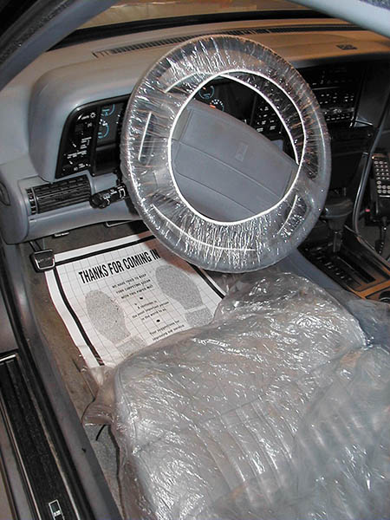
Figure 17.1 Before service begins, be sure to cover the seats, floor, and steering wheel with protective coverings

Slide 7
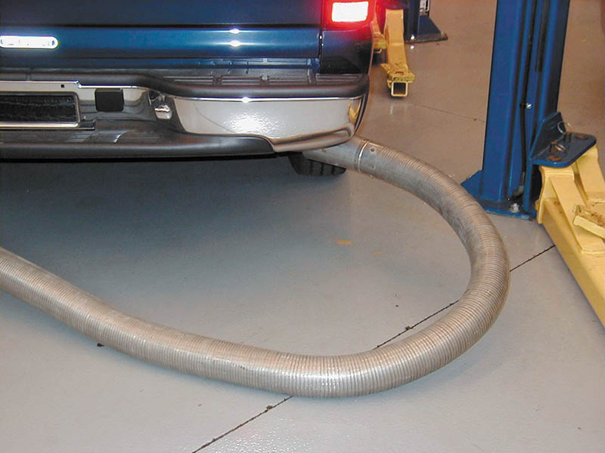
Figure 17.2 An exhaust system hose should be connected to the tailpipe(s) whenever the engine is being run indoors

Slide 8
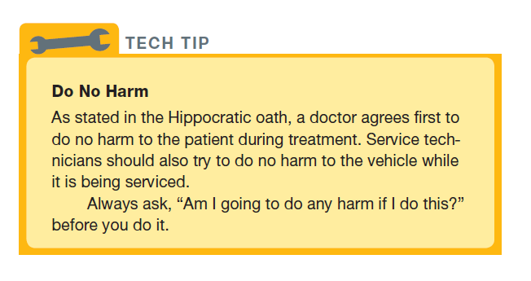
Tech Tip

Slide 9
SAFETY INSPECTION
These inspections should include all of the following:
Exterior lights
Horn
Windshield wipers
Mirrors
Defroster fan operation
Steering for excessive looseness or leaks
Tire condition
Exhaust system
Shock Absorbers
Parking brake operation

Slide 10
WINDSHIELD WIPER AND WASHER FLUID SERVICE
Check for:
Proper operation of the wipers and the washers
Condition of the wiper blades (front and rear)
The washer reservoir level

Slide 11
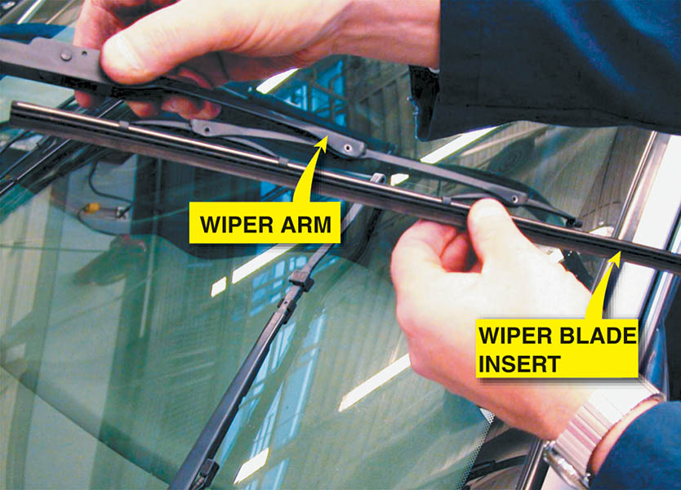
Figure 17.3 Installing a wiper blade insert into a wiper arm

Slide 12
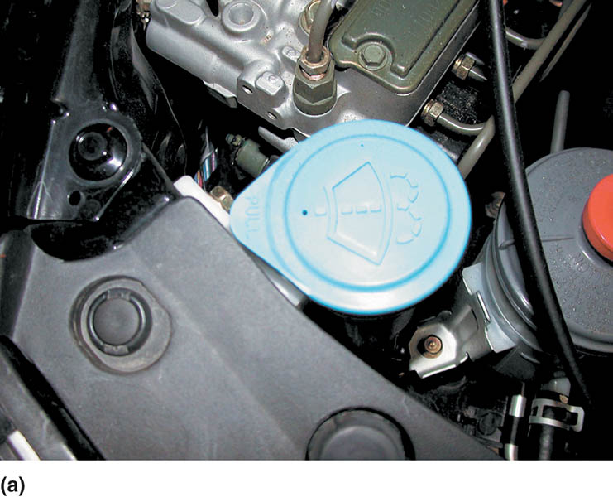
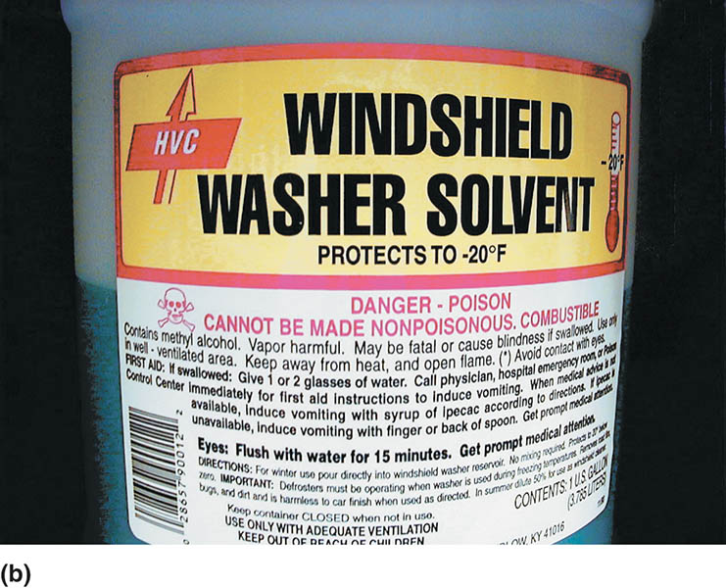
Figure 17.4 (a) The windshield wiper fluid reservoir cap is usually labeled with a symbol showing a windshield washer. (b) Use only the recommended washer fluid. Never use antifreeze in the windshield washer reservoir

Slide 13
CABIN FILTER REPLACEMENT
Is used in the heating, ventilation, and air-conditioning (HVAC) system to filter the outside air drawn into the passenger compartment.
Some filters contain activated charcoal to help eliminate odors.
The cabin air filter should be replaced often—every year or every 12,000 miles (19,000 km).

Slide 14
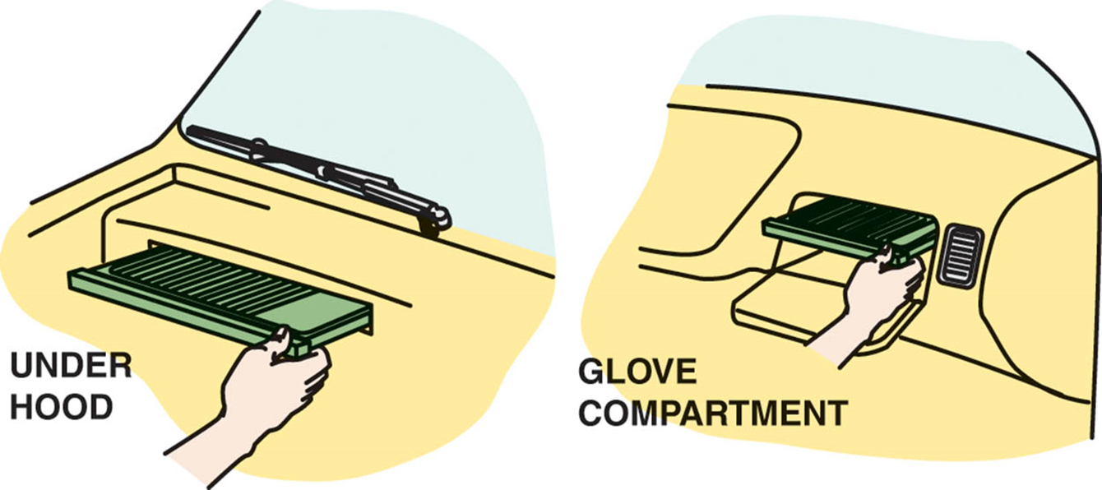
Figure 17.5 A cabin filter can be accessed either through the glove compartment or under the hood on most vehicles

Slide 15
AIR FILTER INSPECTION/ REPLACEMENT
It filters dirt from the air before it enters the intake system of the engine.
Should be replaced according to vehicle manufacturer’s recommendations.
A clogged filter will decrease the engine efficiency.
Should be replaced more frequently under dusty conditions.
.

Slide 16
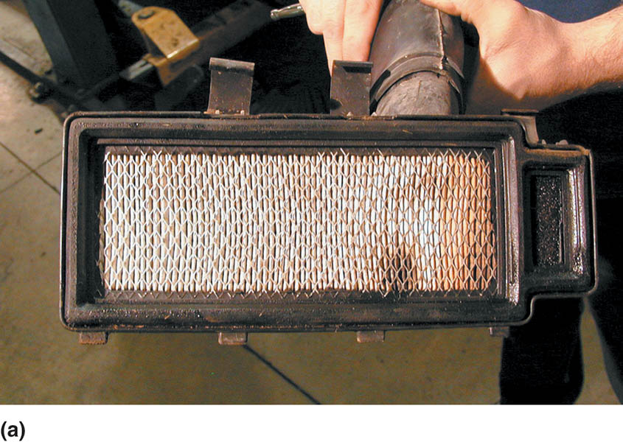
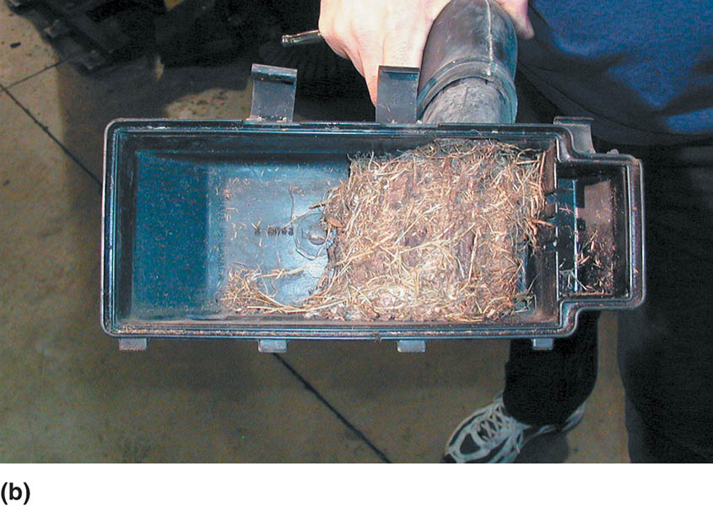
Figure 17.6 (a) A typical dirty air filter. (b) Always check the inlet passage leading to the air filter for debris that can reduce airflow to the engine

Slide 17
BRAKE FLUID INSPECTION
The brake fluid should be checked at the same time the engine oil is changed.
Low fluid level can be caused by:
Normal disc brake wear.
A leak in the hydraulic system.
Use the correct replacement fluid:
DOT 3
DOT 4
DOT 5
DOT 5.1

Slide 18
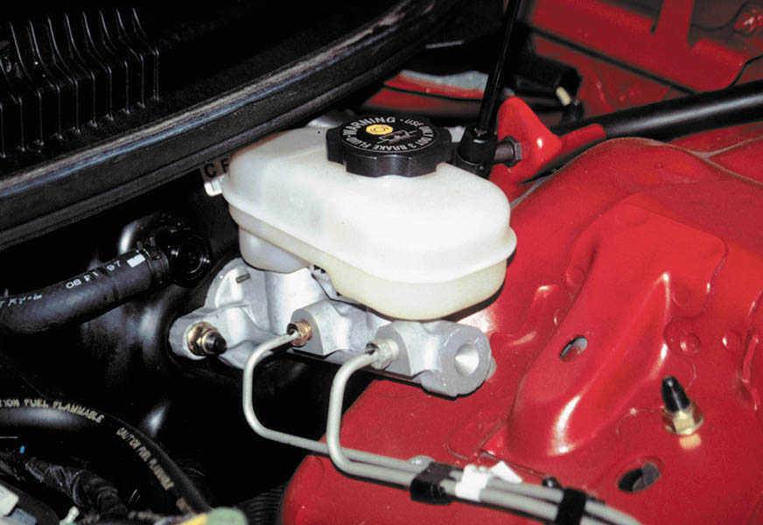
Figure 17.7 A master cylinder with a transparent reservoir. The brake fluid level should be between the MAX and the MIN levels as marked on the reservoir

Slide 19
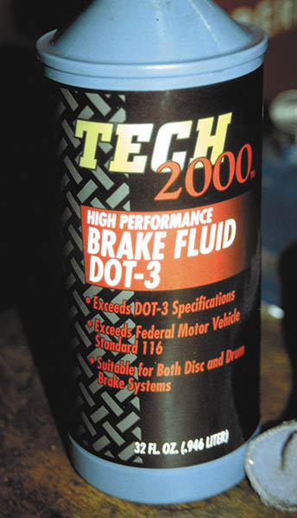
Figure 17.8 DOT 3 brake fluid. Always use fluid from a sealed container because brake fluid absorbs moisture from the air

Slide 20
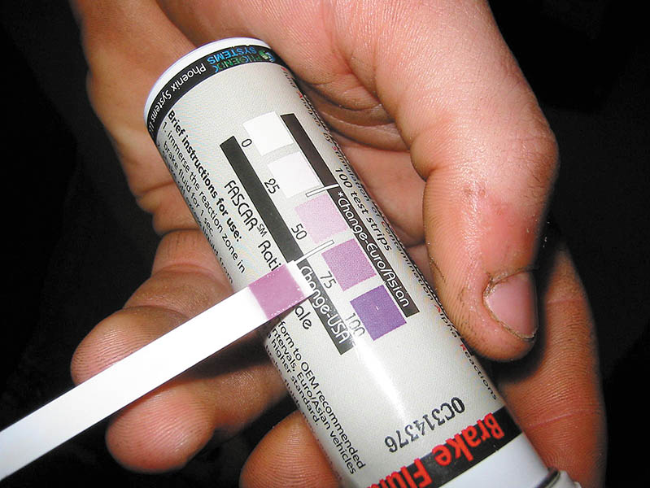
Figure 17.9 Brake fluid test strips are a convenient and easy-to-use method to determine if the brake fluid needs to be replaced

Slide 21
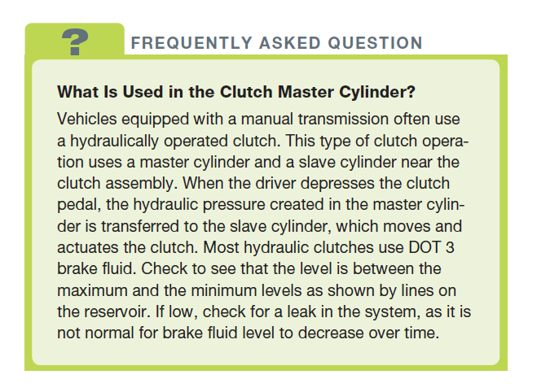
FREQUENTLY ASKED QUESTION

Slide 22
QUESTION 1: ?
Why should brake fluid not be filled above the full or MAX level as indicated on the master cylinder reservoir?

Slide 23
ANSWER 1:
To allow for expansion of the fluid due to heat.

Slide 24
ENGINE OIL INSPECTION
Should be checked when the vehicle is parked on level ground and after the engine has been off for at least several minutes.
The oil level indicator, commonly called a dipstick, is clearly marked and in a convenient location.
The “add” mark is usually at the 1 quart low point.

Slide 25
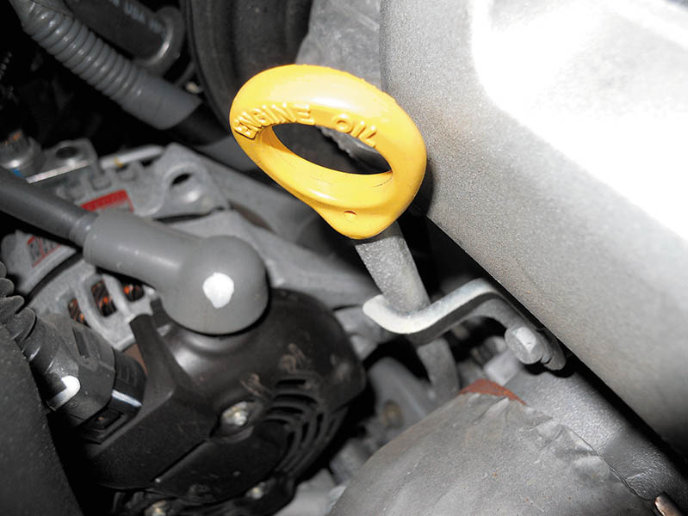
Figure 17.10 A typical oil level indicator (dipstick)

Slide 26
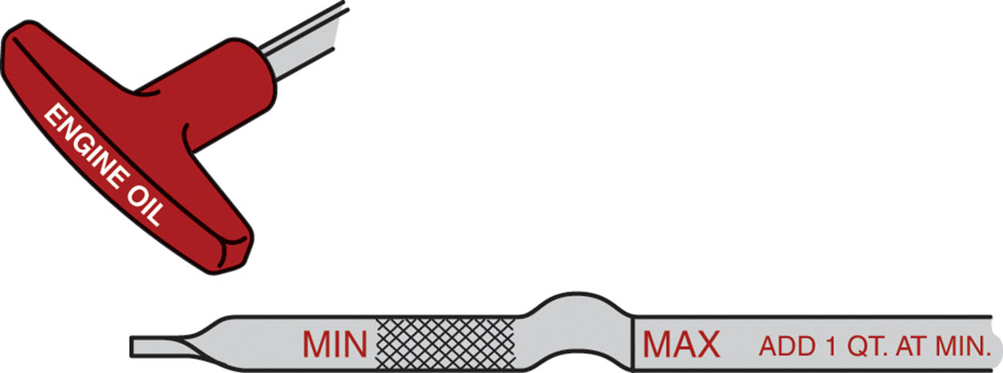
Figure 17.11 The oil level should be between the MAX and the MIN marks when the vehicle is on level ground and the oil has had time to drain into the oil pan

Slide 27
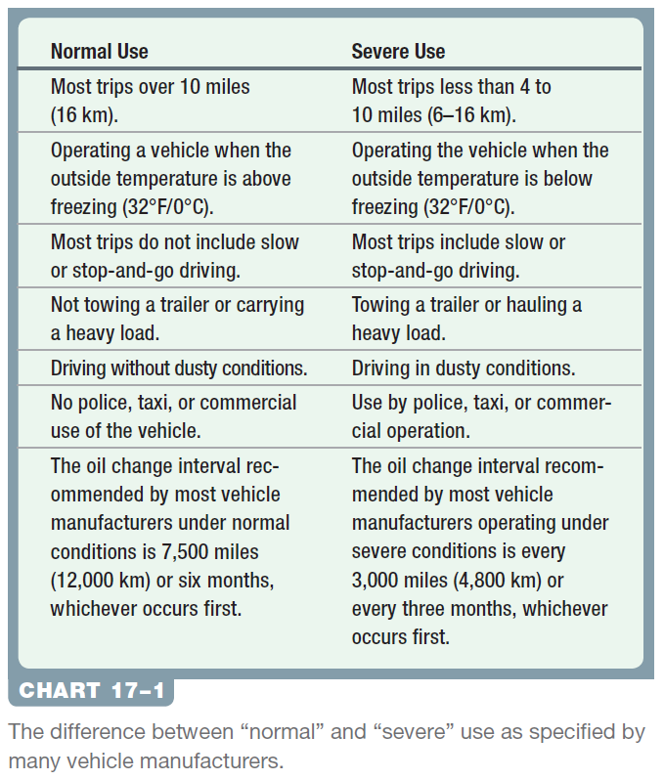
Chart 17-1 The difference between “normal” and “severe” use as specified by many vehicle manufacturers.

Slide 28
COOLING SYSTEM INSPECTION
Inspection methods:
Visual
Test Strips
Boiling/Freeze Points (refractometer and hydrometer)
Hybrid vehicles may have multiple cooling systems.
Use the correct coolant when servicing.
Dispose of old coolant according to local and federal laws.
Inspect hose and clamps, radiator and heater core for leaks.

Slide 29
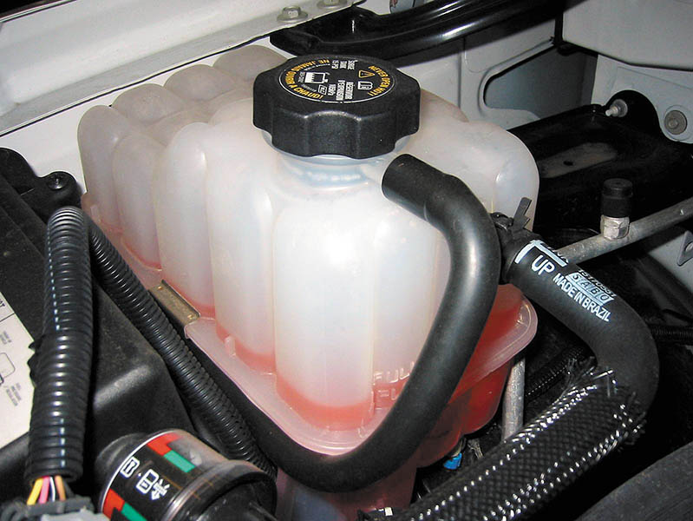
Figure 17.12 Visually check the level and color of coolant in the coolant recovery or surge tank

Slide 30
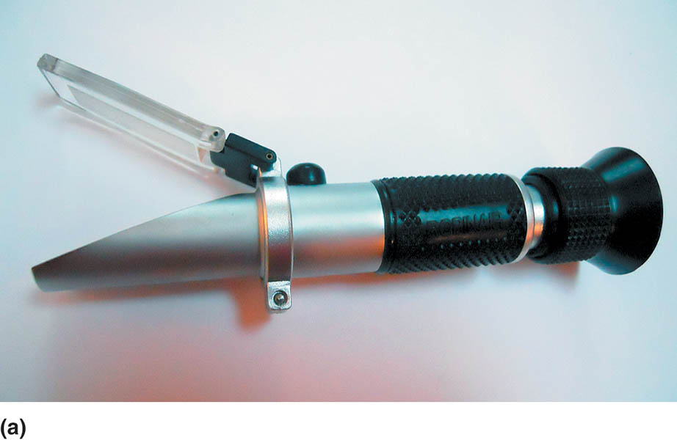
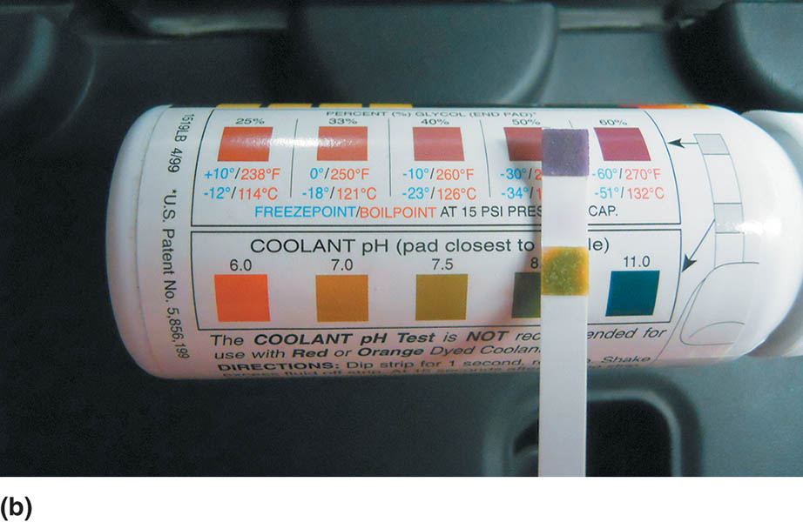
Figure 17.13 (a) A refractometer is used to measure the freezing point of coolant. A drop of coolant is added to a viewing screen, the lid is closed, and then held up to the light to view the display on the tool. (b) The use of tests strips is a convenient and cost-effective method to check coolant condition and freezing temperature

Slide 31
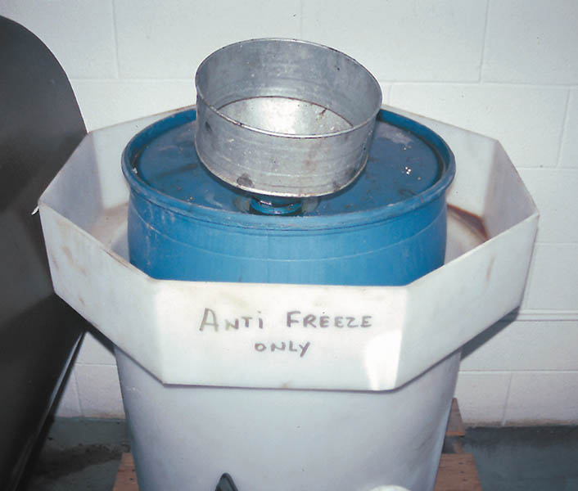
Figure 17.14 Used coolant should be stored in a leak-proof container until it can be recycled or disposed of according to local, state, or federal laws. Note that the storage barrel is placed inside another container to catch any coolant that may spill out of the inside container

Slide 32
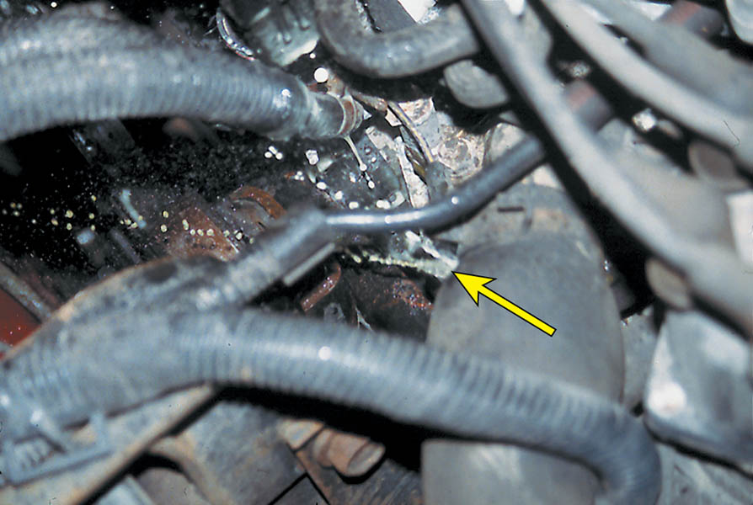
Figure 17.15 Using a hand-operated pressure tester. Do not exceed the pressure rating of the radiator cap when pressurizing the system. This vehicle had a leaking upper radiator hose that only leaked when the system was pressurized

Slide 33
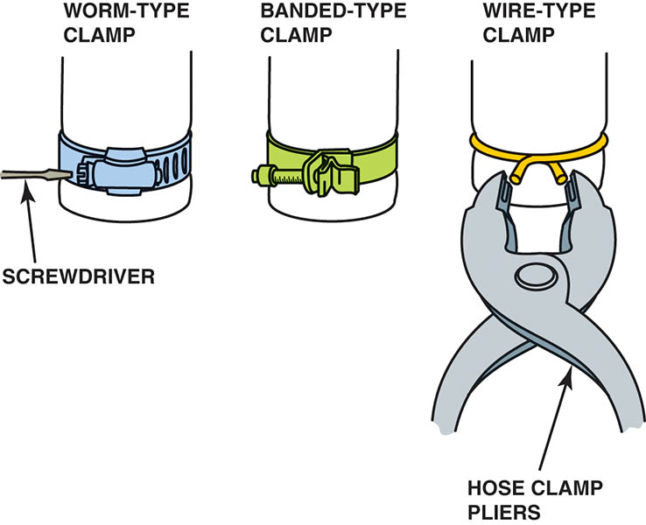
Figure 17.16 Hose clamps come in a variety of shapes and designs

Slide 34
QUESTION 2: ?
What are the three methods for inspecting the cooling system?

Slide 35
ANSWER 2:
A visual inspection, test strips, and boiling/freezing points.

Slide 36
AUTOMATIC TRANSMISSION FLUID CHECK
Follow the manufacture's procedure for checking the fluid.
Transmission gear and temperature typically must be met.
Ensure the correct type of transmission fluid is used when adjusting the fluid level.
The use of the wrong fluid may create shift quality concerns or transmission failure.
The condition of the fluid (smell and color) may indicate further service is needed.

Slide 37
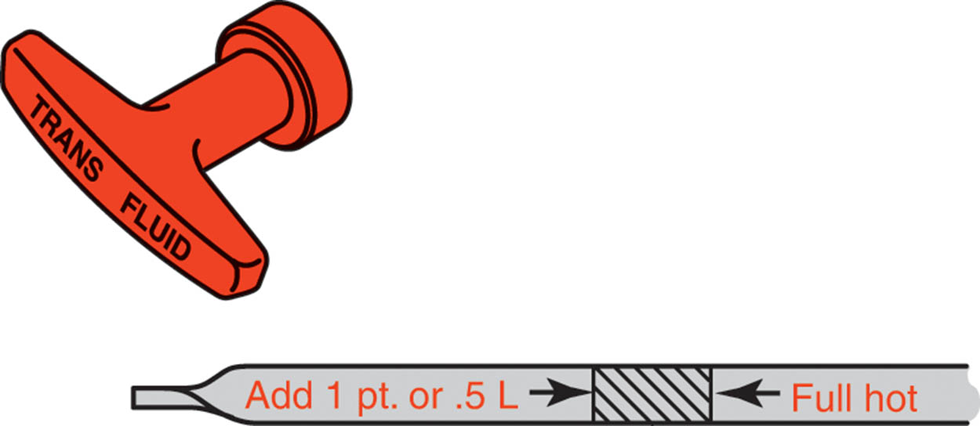
Figure 17.17 A typical automatic transmission dipstick

Slide 38
POWER STEERING FLUID
The level is checked with the engine off.
Most reservoirs have a hot and cold file mark.
A low fluid level may indicate a leak.
A high fluid level must be adjusted by removing fluid.
It is critical to use the correct type of power steering fluid when adjusting the fluid level.

Slide 39
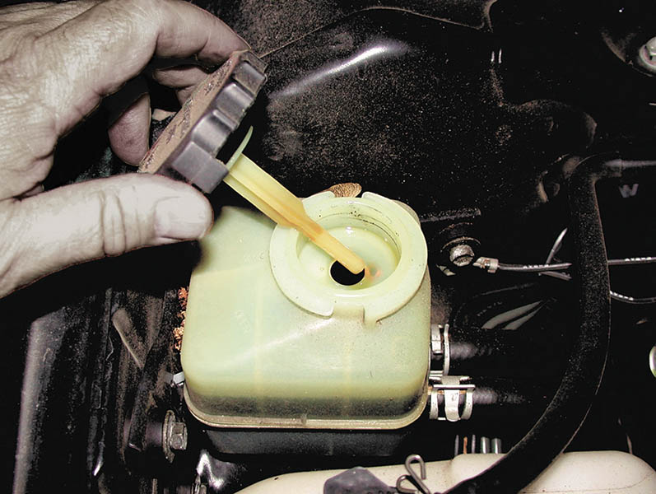
Figure 17.18 Most vehicles use a combination filler cap and level indicator (dipstick) that shows the level of power steering fluid in the reservoir

Slide 40
ACESSORY DRIVE BELT INSPECTION
Accessory drive belts should be replaced every four to seven years.
Belts are tensioned in a variety of manners:
Using a belt tension gauge
Marks on a tensioner
Torque wrench reading
Deflection
The belt routing guide is located on an underhood sticker and in the service information.

Slide 41
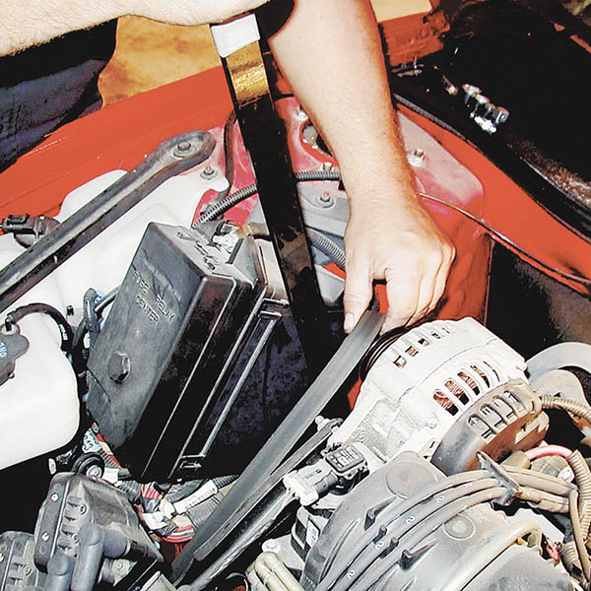
Figure 17.19 A special tool is useful when installing a new accessory drive belt. The long-handled wrench fits in a hole of the belt tensioner

Slide 42
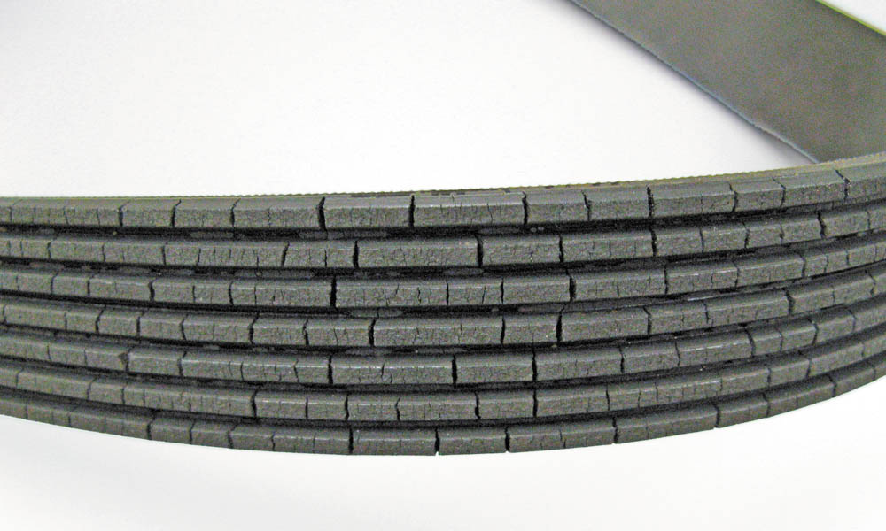
Figure 17.20 A typical worn serpentine accessory drive belt. Newer belts made from ethylene propylene diene monomer (EPDM) do not crack like older belts that were made from neoprene rubber

Slide 43

Figure 17.21 If the wear gauge can be moved side to side, then the belt is worn and should be replaced. It is almost impossible to check a serpentine belt made from EPDM for wear visually without using a wear gauge

Slide 44
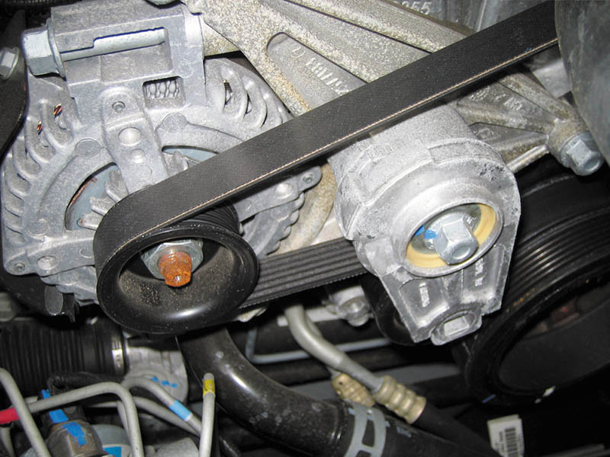
Figure 17.22 A spring-loaded accessory drive belt tensioner

Slide 45
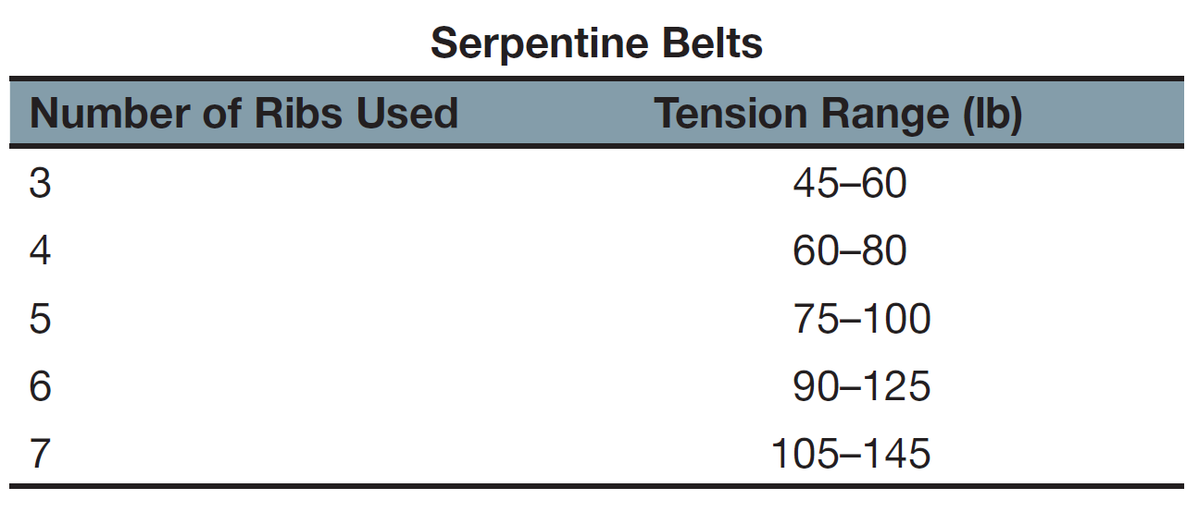
Replace any serpentine belt that has more than three cracks in any one rib that appears in a 3-inch span.

Slide 46
TIRE AND WHEEL SERVICE
Tire inflation pressure should be checked when the tires are cold.
Tire pressure should be checked with a quality gauge.
The tire pressure should be listed on the placard on the driver’s door and in the service information.
Tires should be inspected for faults and tread depth.
Rotate the tires per the manufactures specifications.
Torque the wheels with a torque stick and then a torque wrench.

Slide 47
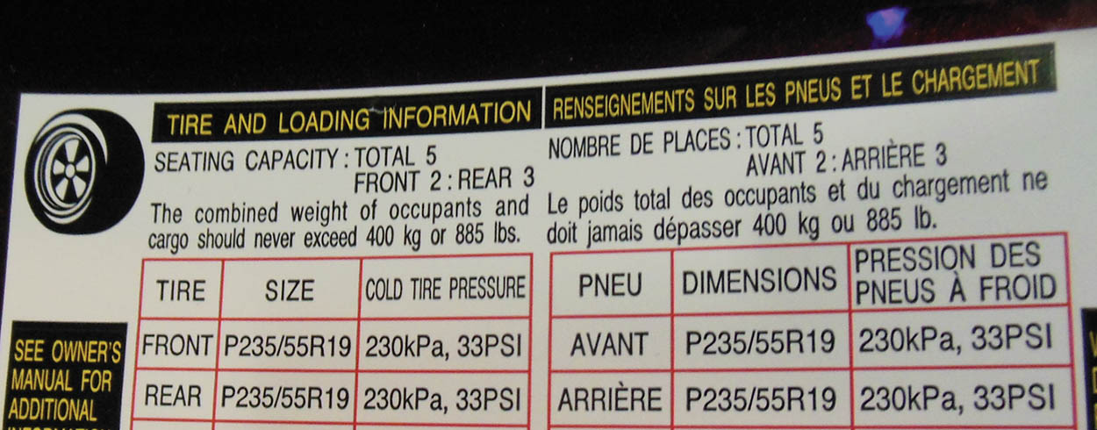
Figure 17.23 The specified tire inflation pressure is printed on a placard on the driver’s door or doorpost. This information may also be located in the glove compartment, the owner’s manual, and in service information

Slide 48
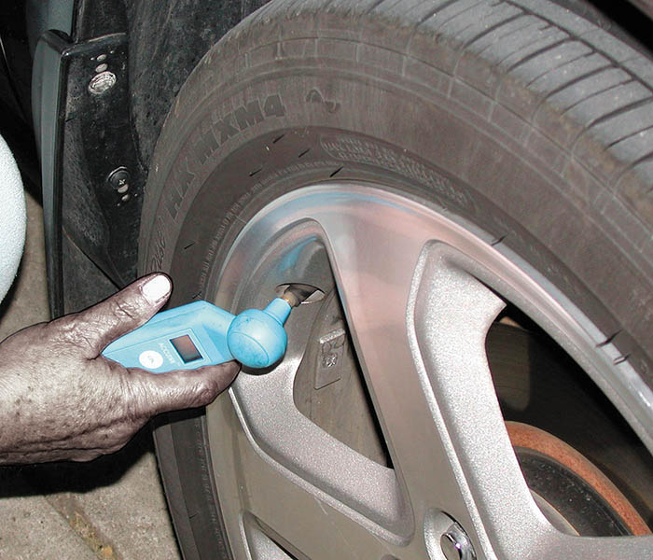
Figure 17.24 An electronic tire pressure gauge is usually more accurate than a mechanical “pencil type” gauge and more likely to provide consistent pressure readings. Do not allow air to escape when testing or the reading will not be accurate

Slide 49
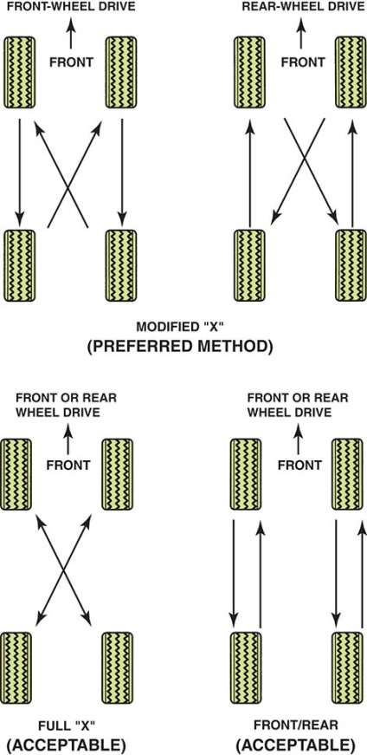
Figure 17.25 The method most often recommended is the modified X method. Using this method, each tire eventually is used at each of the four wheel locations.

Slide 50
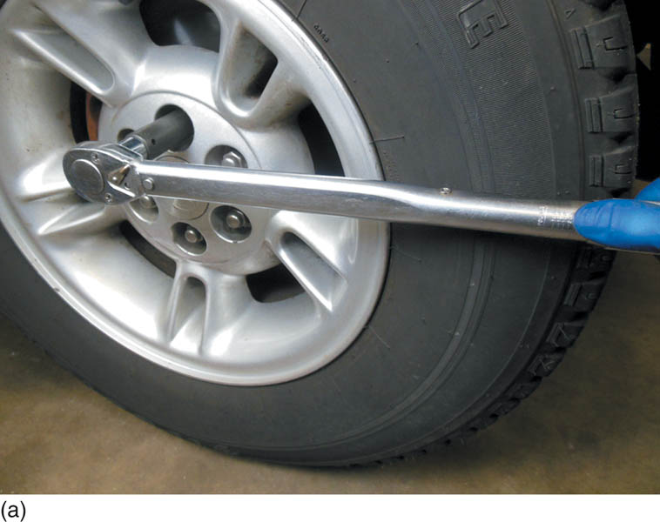
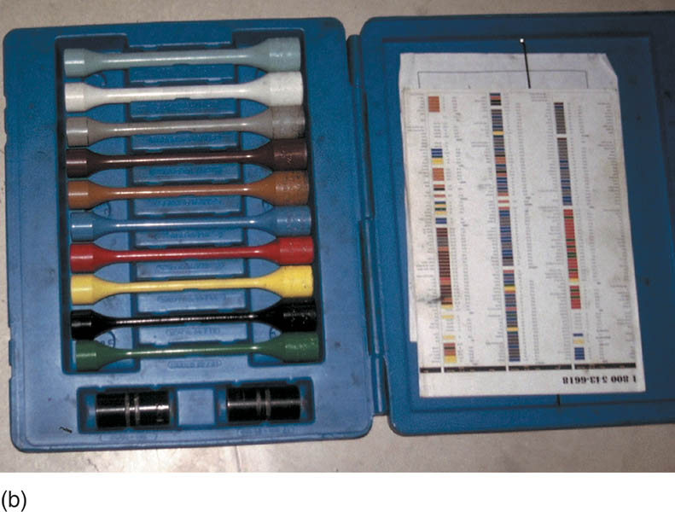
Figure 17.26 (a) Using a torque wrench is the preferred method to use when installing wheels. Check service information for the specified torque. (b) A color-coded assortment of torque sticks

Slide 51
CHASSIS LUBRICATION
Grease fitting require lubrication to prevent noise and wear.
The proper lubricant must be used.
Grease with a “GC” rating is for the wheel bearings.
Grease with a “LB” rating is for the chassis.
Some grease has both ratings and is acceptable for the chassis or the wheel bearings.

Slide 52
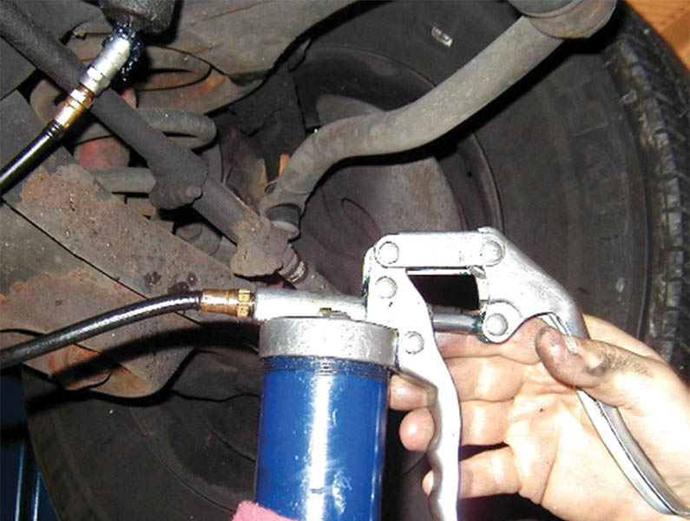
Figure 17.27 A hand-operated grease gun is being used to lubricate the steering component through a grease fitting

Slide 53
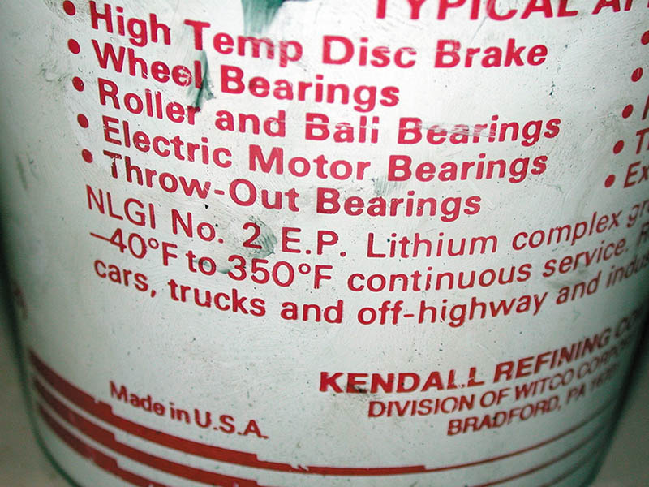
Figure 17.28 Most vehicle manufacturers recommend the use of grease meeting the NLGI #2 and “GC” for wheel bearings and “LB” for chassis lubrication.

Slide 54
DIFFERENTIAL FLUID CHECK
Hoist the vehicle safely.
Visually check for signs of leakage.
Remove the inspection plug.
Check the fluid level according to the manufacturers procedure.
Different gear lubes are specified based on the application (API rating).
Some units will require a limited slip additive.

Slide 55
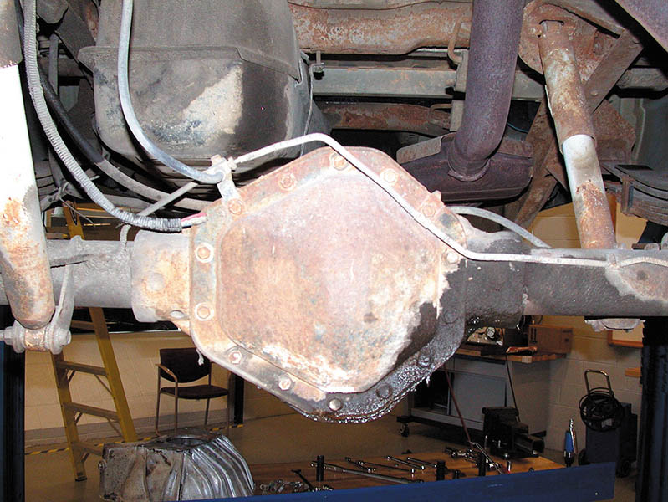
Figure 17.29 This differential assembly has been leaking fluid. The root cause should be determined and the unit filled to the proper level using the specified lubricant, to help prevent early failure and an expensive repair later.

Slide 56
MANUAL TRANSMISSION/TRANSAXLE LUBRICANT CHECK
Manual transmissions may use any of the following lubricants:
Gear lube (80W-90)
Automatic Transmission Fluid (ATF)
Engine Oil (5W-30)
Do not drain a manual transmission until the fill plug can be removed.
Fill the transmission until fluid is level with the fill plug.

Slide 57
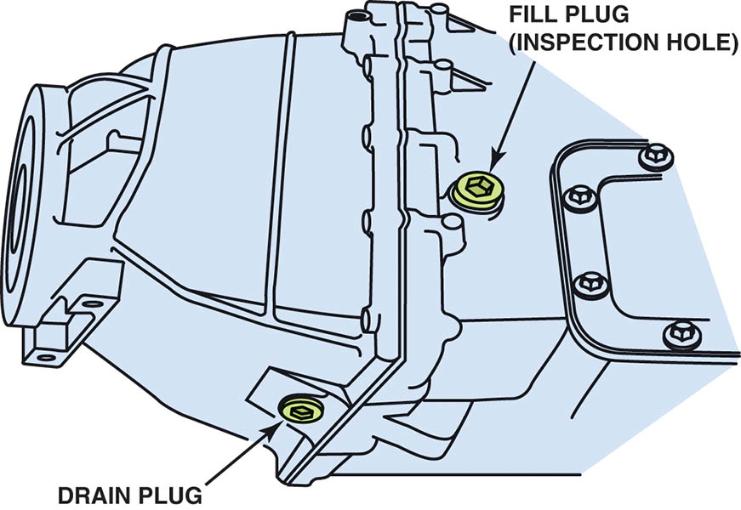
Figure 17.30 Always ensure that the fill plug can be accessed and removed before draining the fluid from a manual transmission.

Slide 58
UNDER VEHICLE INSPECTION
Visual Inspection of the following:
Shock absorbers and springs
Exhaust system
Transmission linkage
Brake lines
Steering linkage for obvious looseness or damage.
Evidence of leaks
Parking brake cables

Slide 59
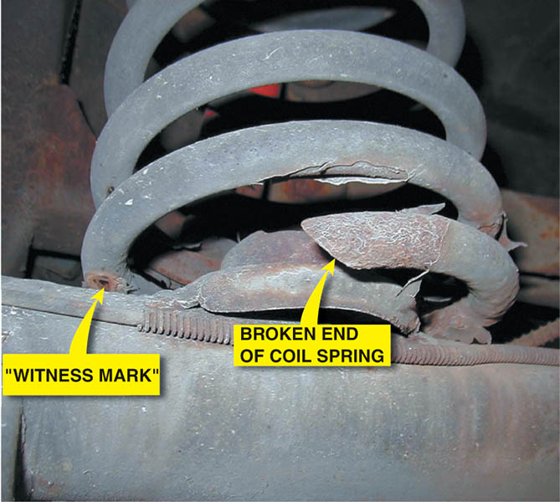
Figure 17.31 A broken coil spring was found during an under-vehicle inspection. The owner was not aware of a problem and it did not make any noise, but the vehicle stability was affected.

Slide 60
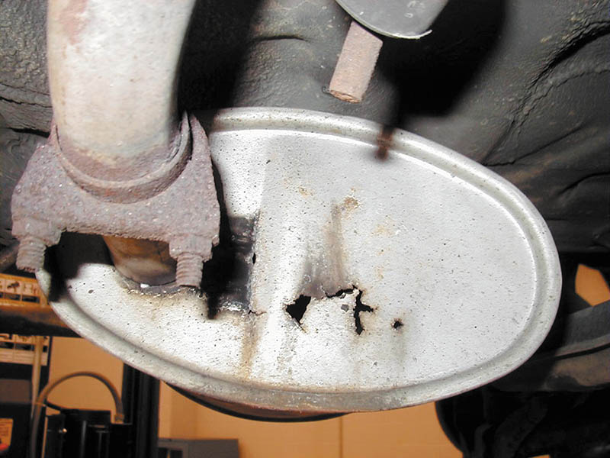
Figure 17.32 This corroded muffler was found during a visual inspection, but was not detected by the driver because it was relatively quiet.

Slide 61
DIESEL EXHAUST FLUID
Many diesel engines after 2007 require the use of diesel exhaust fluid (DEF).
DEF is a mixture od 32.5% laboratory grade urea and 67.5% deionized water.
It must be refilled regularly.
Most vehicles have a large enough reservoir so the fluid lasts until the next scheduled oil service.

Slide 62
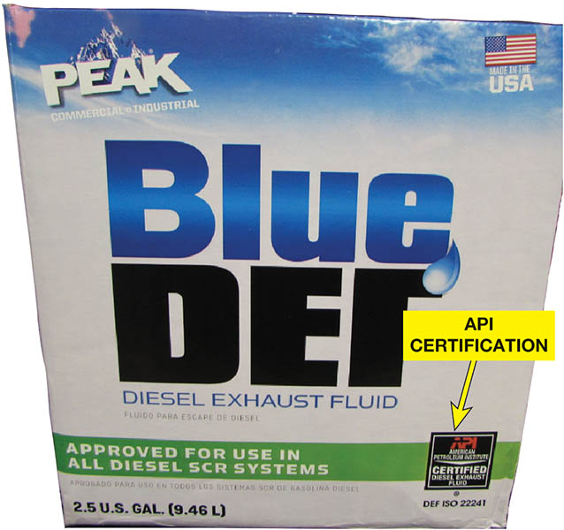
Figure 17.33 Diesel exhaust fluid (DEF) is available in consumer-friendly containers or in bulk.

Slide 63
QUESTION 3: ?
How often does the diesel exhaust fluid (DEF) need to be refilled?

Slide 64
ANSWER 3:
During each scheduled oil service.

Slide 65
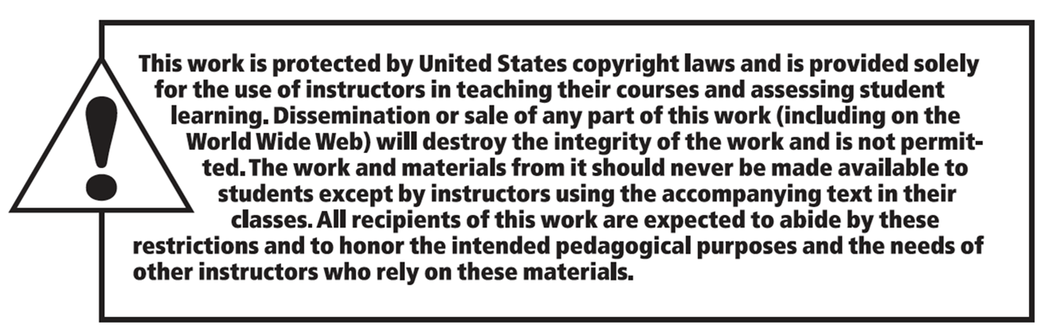
Copyright

