Slide 1

Automotive Technology Principles, Diagnosis, and Service
Sixth Edition
Chapter 16
Vehicle Identification and Emission Ratings
Copyright © 2018, 2015, 2011 Pearson Education, Inc. All Rights Reserved

Slide 2
LEARNING OBJECTIVES
16.1 Discuss the parts of a vehicle, and differentiate between front-wheel drive and rear-wheel drive.
16.2 Explain vehicle identification, vehicle safety certification label, and the VECI label.
16.3 Discuss the different types of emission standards.
16.4 Explain calibration codes and casting numbers.

Slide 3
VEHICLE IDENTIFICATION
Usually abbreviated as VIN.
Required for most service work.
Identifies country of origin, model year, body style, engine type and production sequence.
Needed to obtain correct replacement parts.

Slide 4
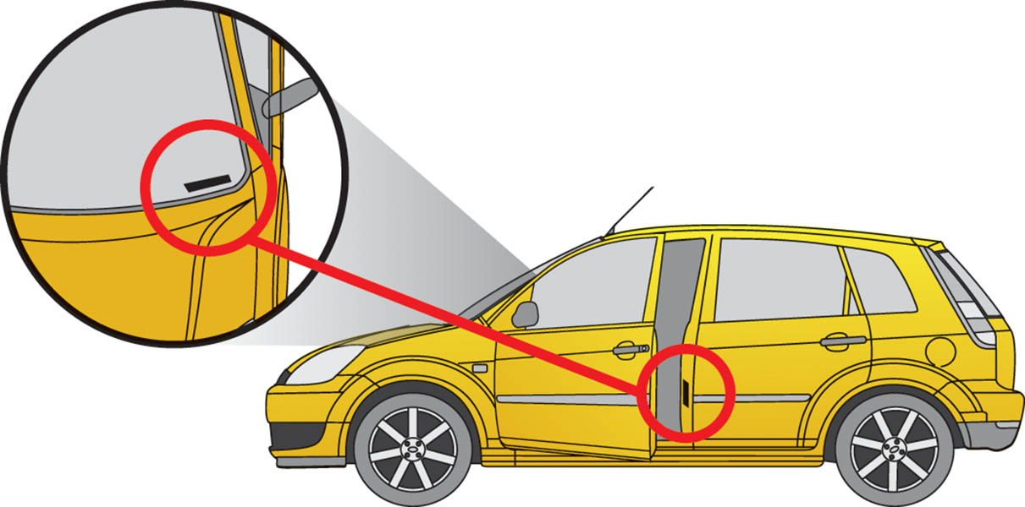
Figure 16.1 The vehicle identification number (VIN) is visible through the base of the windshield and on a decal inside the driver’s door

Slide 5
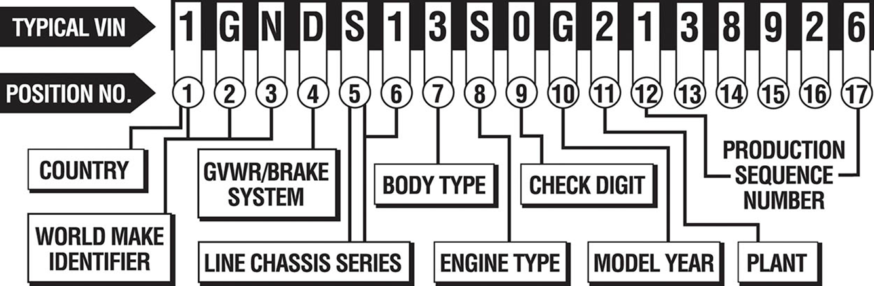
Figure 16.2 A typical VIN showing the information that is represented

Slide 6
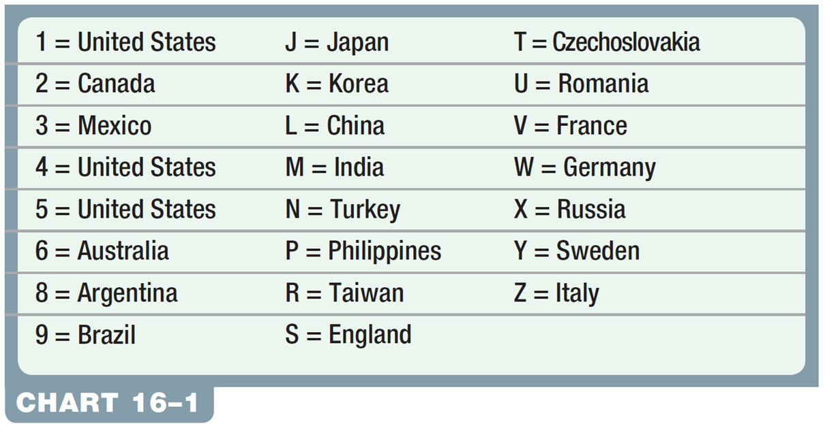
Chart 16-1 The first number or letter designates the country of origin.

Slide 7
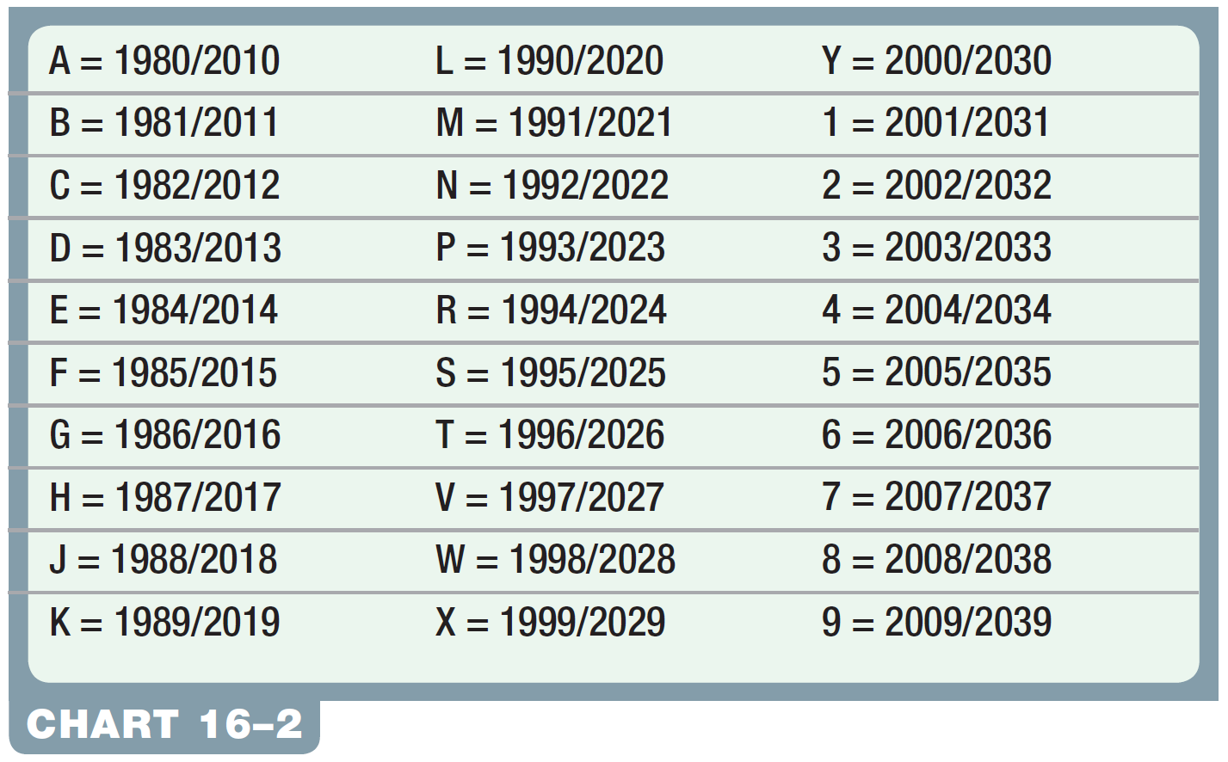
Chart 16-2 VIN year chart (The pattern repeats every 30 years).

Slide 8
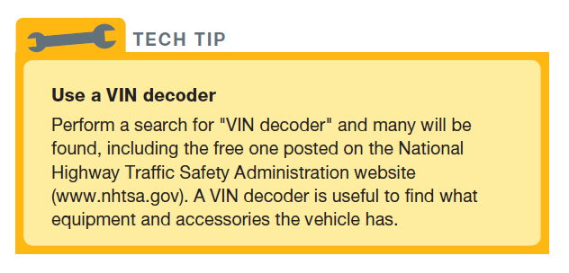
Tech Tip

Slide 9
QUESTION 1: ?
What are the major pieces of information that are included in
the vehicle identification number (VIN)?

Slide 10
ANSWER 1:
The country of origin, the model of the vehicle, the engine code, and the model year.

Slide 11
VEHICLE SAFETY CERTIFICATION LABEL
Indicates month and year of manufacturer.
Contains the VIN number.
Gross Vehicle Weight Rating: (GVWR) The maximum (upper limit) weight of a vehicle as specified by the vehicle manufacturer.
Gross Axle Weight Rating: (GAWR) The maximum weight that an axle can support is usually followed by “FR” for front axle and “RR” for rear axle.
.

Slide 12
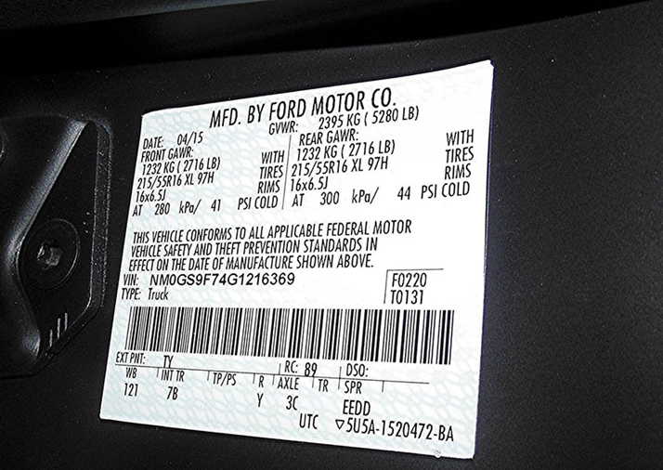
Figure 16.3 A typical vehicle safety certification label which shows the gross vehicle weight, gross axles weight rating as well as the size and inflation pressure of the tires

Slide 13
VECI LABEL
Shows vehicle emission certification.
Displays emission hose routing.
Typically located on the underside of the hood, radiator fan shroud, radiator core support or the strut tower.

Slide 14
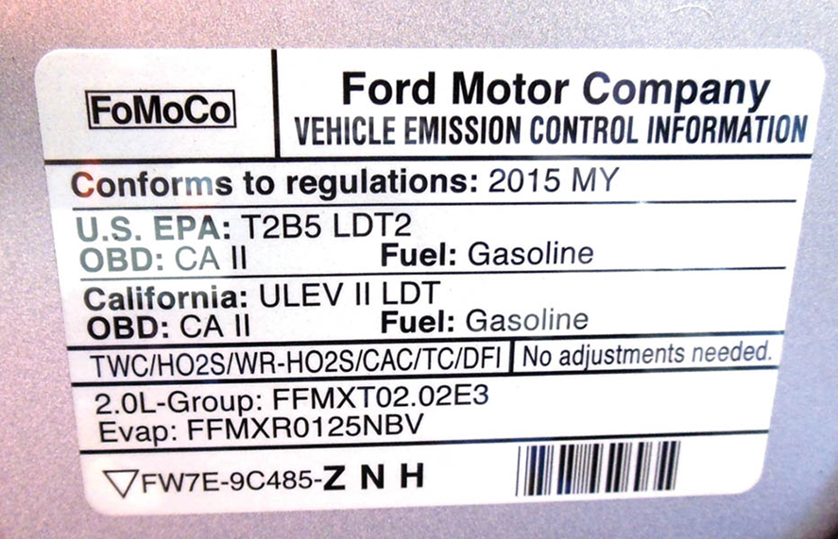
Figure 16.4 This vehicle emission control information (VECI) decal indicates this vehicle meets both national EPA Tier 2, Bin 5 (T2B5) and California (ULEV II) emission standards

Slide 15
EMISSION STANDARDS IN THE UNITED STATES
Managed by:
Environmental Protection Agency (EPA)
California Air Resources Board (CARB)
Tier 1 and Tier 2: Standards established by the Clean Air Act Amendments (CCA) for automobiles and light trucks.
Emissions defined: Emissions that are measured.
HC - Unburned Hydrocarbons
Co – Carbon Monoxide
NOx – Oxides of Nitrogen

Slide 16
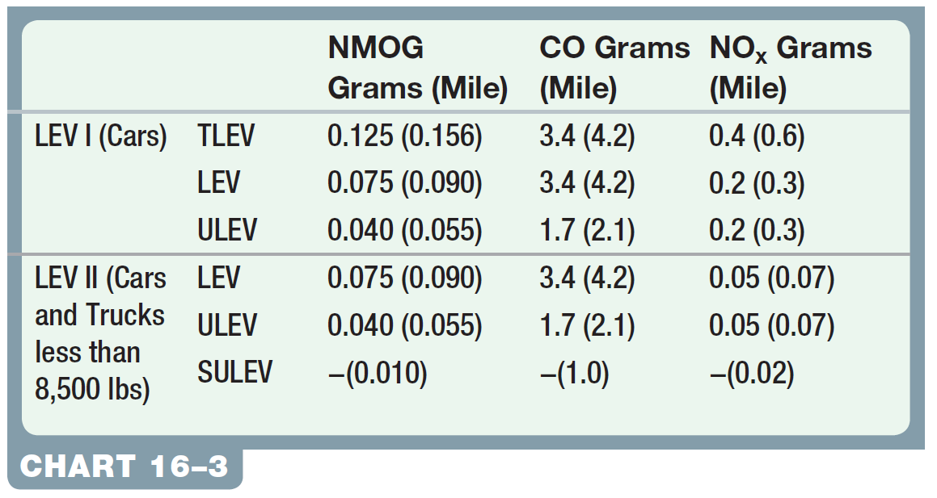
Chart 16-3 LEV Standard Categories

Slide 17
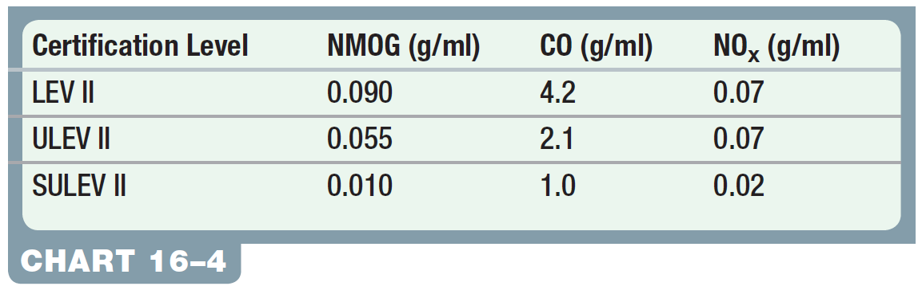
Chart 16-4 California LEV II 120,000 Mile Tailpipe Emissions Limits

Slide 18
EUROPEAN STANDARDS
Europe has its own set of standards that vehicles must meet, which includes the following tiers:
Euro I (1992–1995)
Euro II (1995–1999)
Euro III (1999–2005)
Euro IV (2005–2008)
Euro V (2008–2013)
Euro VI (2014+)

Slide 19
QUESTION 2: ?
What information is included on the VECI label under the hood?

Slide 20
ANSWER 2:
The emission settings and emission hose routing.

Slide 21
CALIBRATION CODES
Usually located on powertrain control modules (PCMs) or other controllers.
Some calibration codes are only accessible with a scan tool.
It is often necessary to know the calibration code to be sure that the vehicle is the subject of a technical service bulletin or other service procedure.

Slide 22
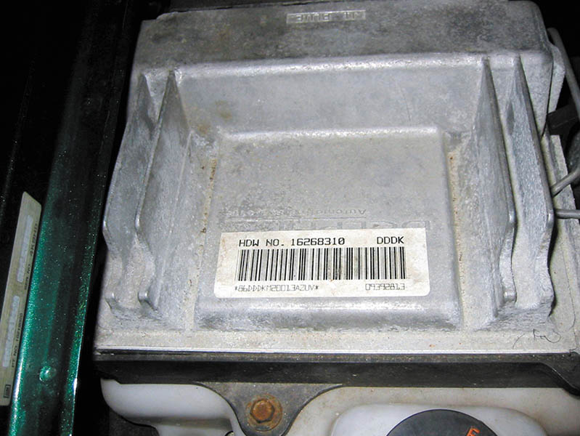
Figure 16.5 A typical computer calibration sticker on the case of the controller. The information on the sticker is often needed when ordering parts or a replacement controller

Slide 23
CASTING NUMBERS
Whenever an engine part, such as a block, is cast, a number is put into the mold to identify the casting.
Can be used to check dimensions, such as the cubic inch displacement, and other information.

Slide 24
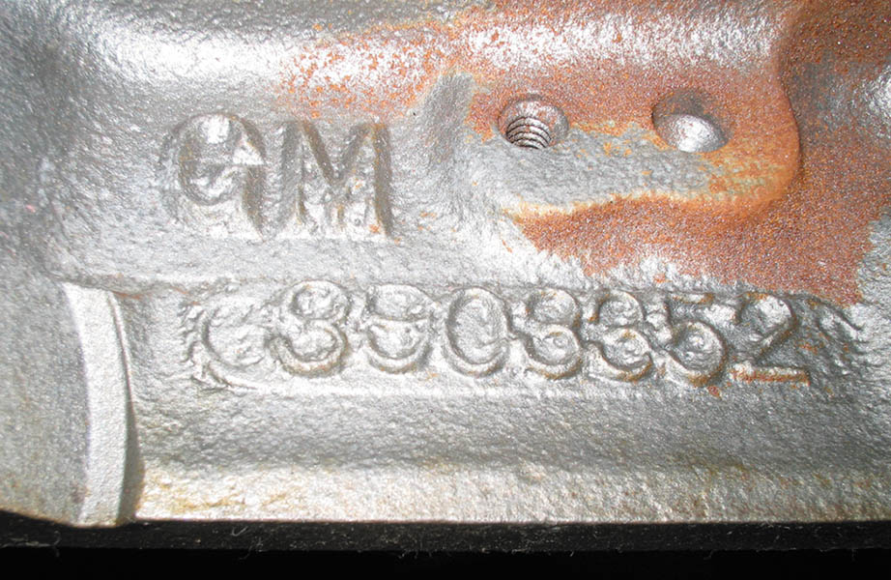
Figure 16.6 Engine block identification number cast into the block is used for identification

Slide 25
QUESTION 3: ?
What is the purpose of casting numbers?

Slide 26
ANSWER 3:
They can be used to check dimensions, such
as the cubic inch displacement, and other information.

Slide 27

Copyright

