Slide 1

Automotive Technology Principles, Diagnosis, and Service
Sixth Edition
Chapter 14
Math, Charts, and Calculations
Copyright © 2018, 2015, 2011 Pearson Education, Inc. All Rights Reserved

Slide 2
LEARNING OBJECTIVES
14.1 Discuss mathematic principles relevant to service technicians and the use of decimals in representing percentages and fractions.
14.2 Explain the concept of mathematical formulas and the steps to calculate the fuel economy of an automobile.
14.3 Compare the different categories of gear ratios.
14.4 Explain how to interpret graphs, charts, and diagrams.

Slide 3

DECIMALS
Tenths: 0.1
Hundredth: 0.01
Thousandth: 0.001
Adding and subtracting decimals:
The decimal point has to be aligned

Slide 4

PERCENTAGE AND SCIENTIFIC NOTATION
Percentage is the relationship of a value or number out of 100.
Example: 70 is what percentage of 120?
58%
Scientific Notation is written as a number multiplied by the number of zeros to the right or left of the decimal point.

Slide 5
ADDING AND SUBTRACTING
Technicians are often required to add or subtract measurements when working on vehicles.
For example, if the valve clearance specification is 0.012 inch and the clearance is actually 0.016 inch, and the shim that is in place between the camshaft lobe and the valve bucket is 0.080 inch thick, what size (thickness) of shim needs to be installed to achieve the correct valve clearance?
Answer: 0.004

Slide 6
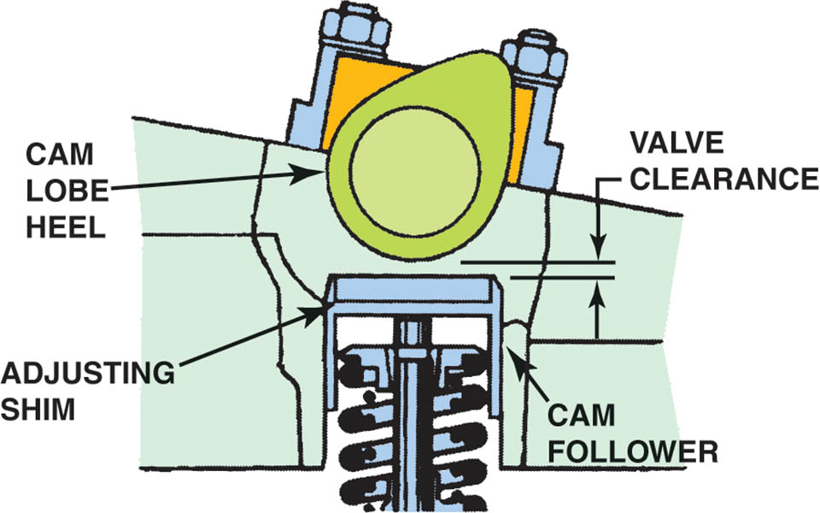
Figure 14.1 Valve clearance allows the metal parts to expand and maintain proper operation, both when the engine is cold or at normal operating temperature. Adjustment is achieved by changing the thickness of the adjusting shim

Slide 7
FRACTIONS
Parts of a whole number
Examples: ½, ¼, ¾
May be converted to decimal numbers

Slide 8
MULTIPLYING AND DIVIDING
Used by the service technician to determine:
Gear ratios
Fuel economy
Circuit resistance

Slide 9

MATHEMATICAL FORMULAS
A formula uses letters to represent values or measurements and indicates how these numbers are to be multiplied, divided, added, or subtracted.
To use a formula, the technician needs to replace the letters with the actual number and perform the indicated math functions.
.

Slide 10
FUEL ECONOMY CALCULATOR
How many miles was the vehicle driven?
How many gallons of fuel were needed?
Divide the miles driven by the gallons used to determine fuel economy.

Slide 11
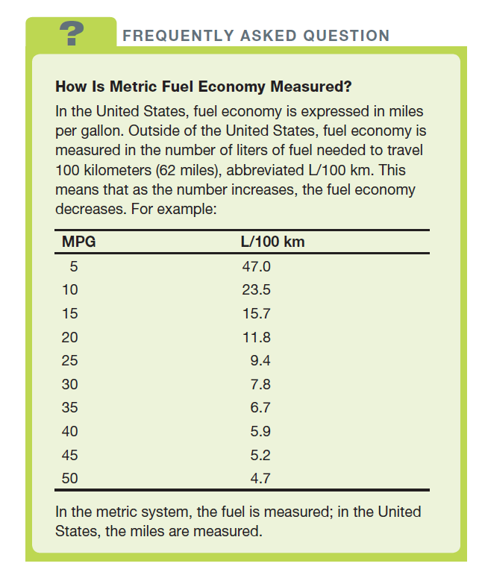
FREQUENTLY ASKED QUESTION

Slide 12
QUESTION 1: ?
What is the formula for determining fuel economy?

Slide 13
ANSWER 1:
Miles driven divided by gallons of fuel used.

Slide 14
GEAR RATIOS
Direct Drive: The drive gear turns at the same speed as the driven gear. A 1:1 Ratio.
Gear reduction: The driven gear turns slower than the drive gear. Also referred to as underdrive.
Overdrive: The driven gear turns faster than the drive gear.

Slide 15
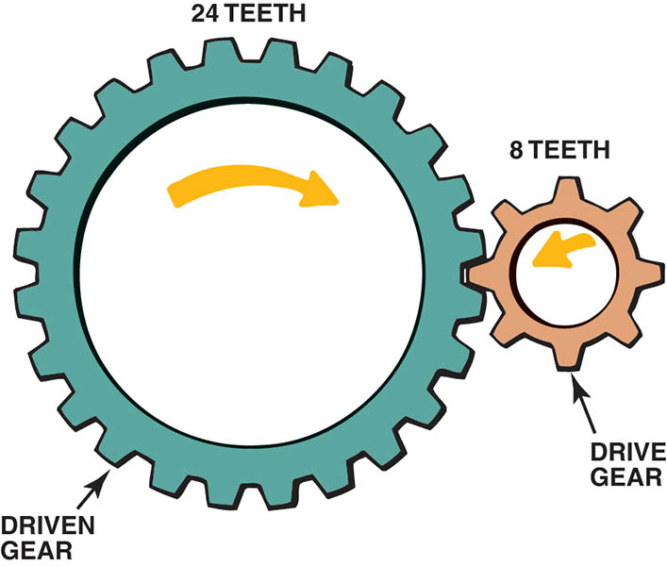
Figure 14.2 The drive gear is attached or is closer to the power source and rotates or drives the driven gear

Slide 16
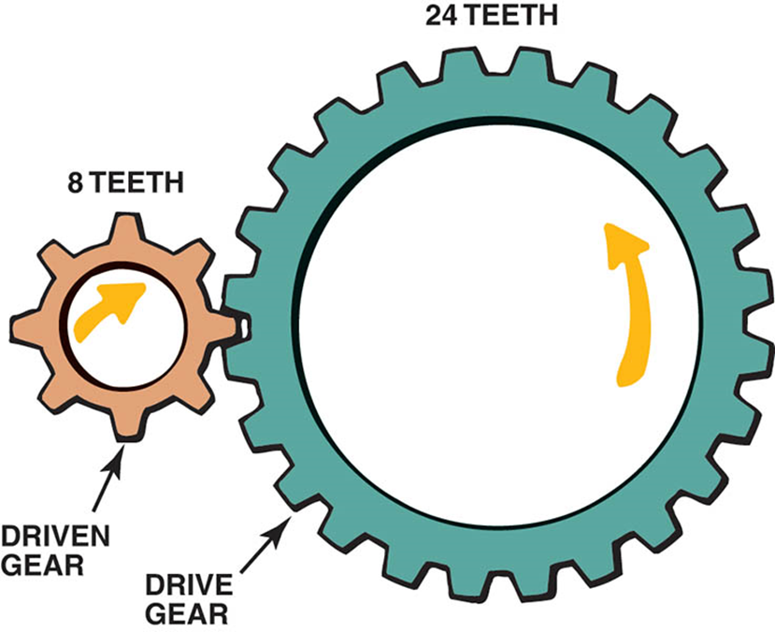
Figure 14.3 If the driven gear is rotating faster than the drive gear, it is called an overdrive ratio

Slide 17
QUESTION 2: ?
What gear ratio occurs when the driven gear turns faster than the drive gear?

Slide 18
ANSWER 2:
Overdrive.

Slide 19
GRAPHS CHARTS AND DIAGRAMS
Graph Reading: A visual display of information.
Two variables displayed
One on the “X” axis
One on the “Y” axis
Chart Reading: Is used to represent data, such as numbers or specifications, along with another variable.
Diagram Reading: Is a graphic design that explains or shows the arrangement of parts.

Slide 20
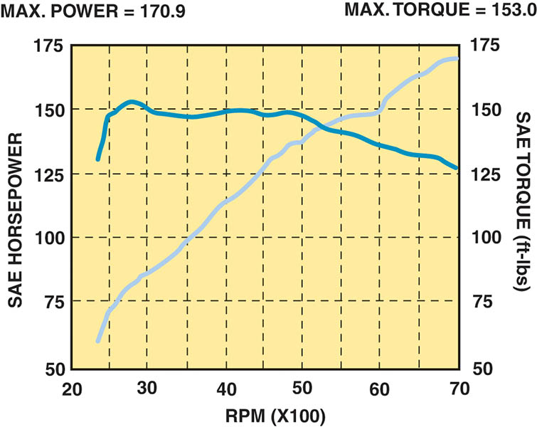
Figure 14.4 A graph showing horsepower and torque. Notice that the curves cross at 5252 RPM or a little bit to the right of the 50, which is expressed as the graph number multiplied by 100. The example is 52 multiplied by 100 equals 5200 RPM. The torque and horsepower curves cross at 5252 RPM because torque is measured by a dynamometer. The horsepower is then calculated using a formula that causes both values to be the same at that one engine speed

Slide 21
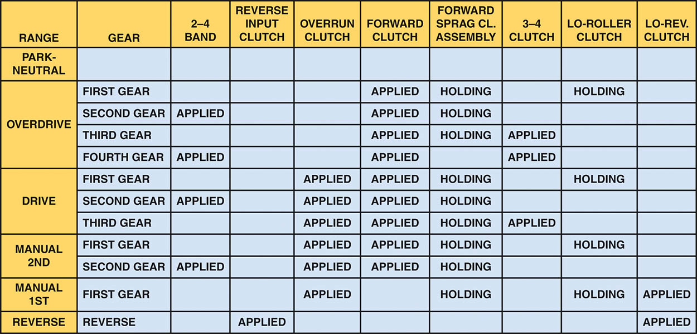
Figure 14.5 A typical chart showing what is applied in what gear in an automatic transmission

Slide 22
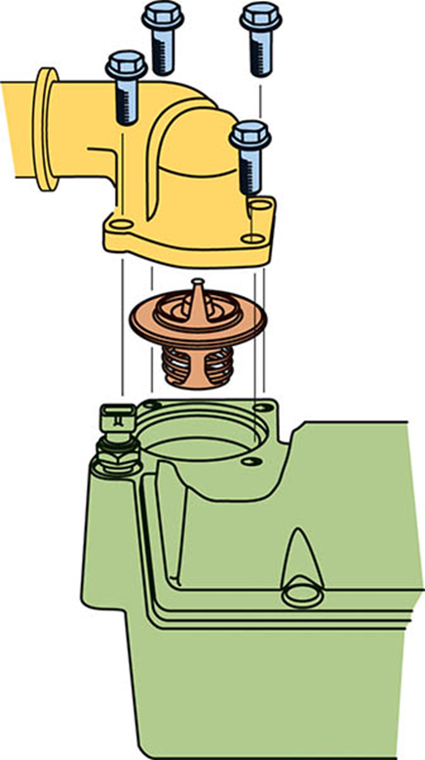
Figure 14.6 An exploded view showing how the thermostat is placed in the engine

Slide 23

Copyright

