Slide 1

Automotive Technology Principles, Diagnosis, and Service
Sixth Edition
Chapter 136
Automatic Transmission/ Transaxle Unit Repair
Copyright © 2018, 2015, 2011 Pearson Education, Inc. All Rights Reserved

Slide 2
LEARNING OBJECTIVES
136.1 Discuss the steps involved in removing and disassembling the automatic transmission/transaxle.
136.2 Describe how to reassemble, reinstall, and test an automatic transmission/ transaxle.

Slide 3
VERIFY THE NEED FOR UNIT REPAIR
Verify the Fault
Verify that the fault is inside, not outside, the unit.
In-Vehicle Repairs
Parts and components that may be replaced with the transmission/transaxle still in the vehicle include:
Pressure switches
Transmission range switch
Turbine and output speed sensors
Valve body replacement
Select gaskets and seals

Slide 4
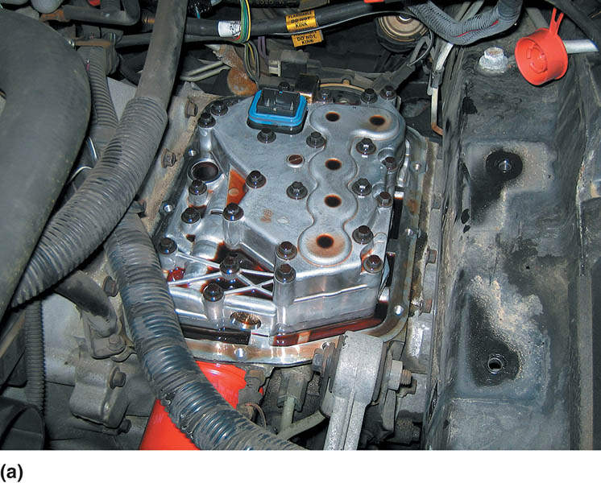
Figure 136.1 (a) This Saturn did not shift correctly and one technician was ready to replace the unit; however, another technician thought that the problem could be due to a fault in the valve body

Slide 5
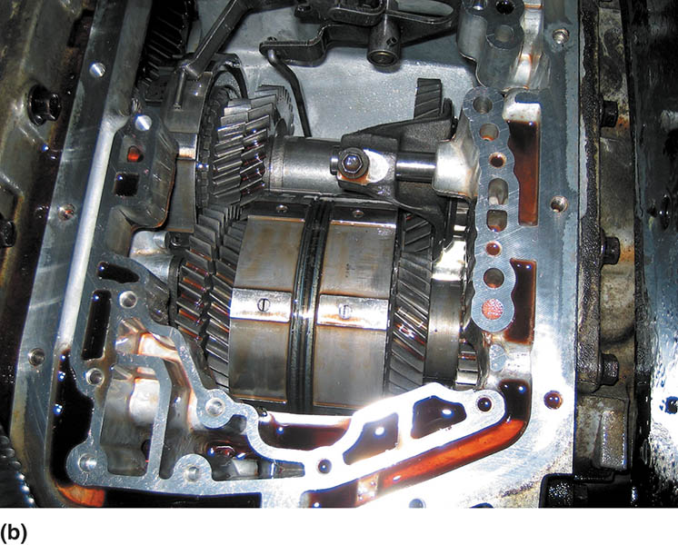
Figure 136.1 (b) Removing the valve body shows the nonplanetary gears used in the Saturn automatic transaxle

Slide 6
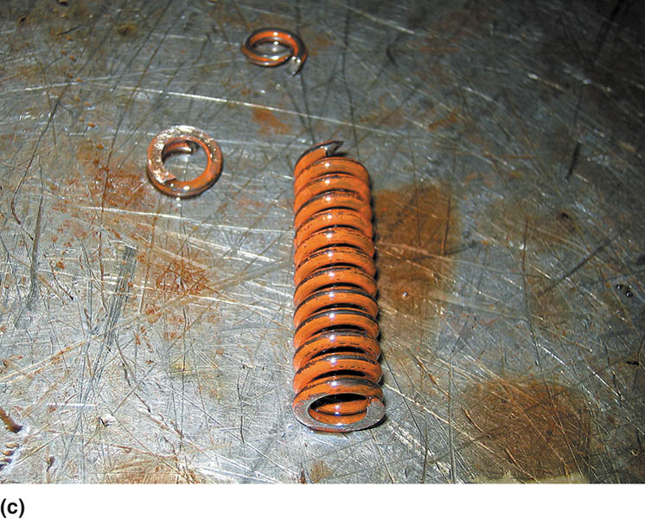
Figure 136.1 (c) The valve body was disassembled and a broken pressure regulator spring was found to be the cause of the customer concern

Slide 7
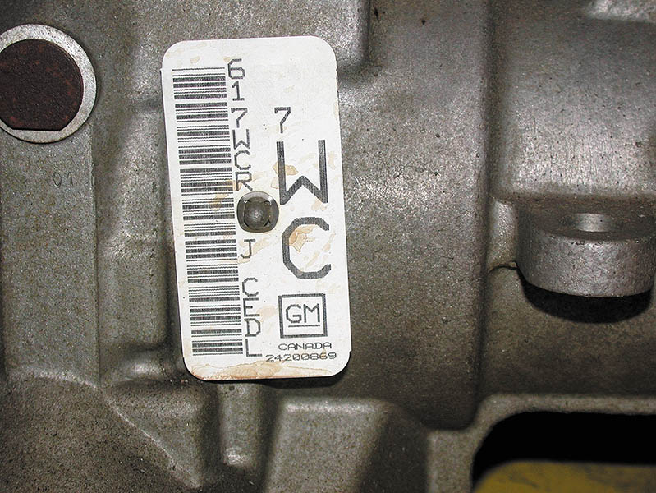
Figure 136.2 A transmission identification number on the side of the unit. The information on this tag is needed when ordering parts, as there are often several versions of the same transmission used in similar vehicles and the differences could affect the parts needed

Slide 8
REMOVING THE AUTOMATIC TRANSMISSION/ TRANSAXLE FOR SERVICE
Steps Involved
Disconnect the battery
Hoist the vehicle and drain the unit.
Disconnect the drive shaft or drive axle shafts.
Disconnect all cooler lines, linkage, and electrical connections.
Disconnect the torque converter from the flex plate.
Support the engine.
Remove the transmission fasteners and safely remove the transmission from the vehicle.

Slide 9
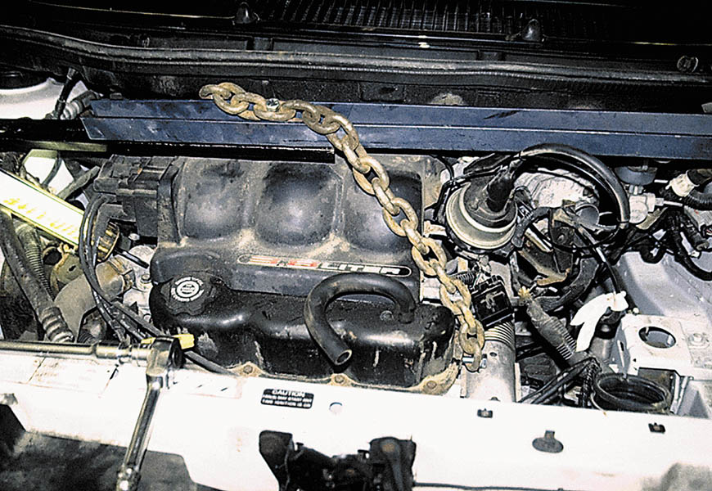
Figure 136.3 A chain and holding fixture being used on this front-wheel-drive vehicle to support the engine when the transaxle is removed

Slide 10
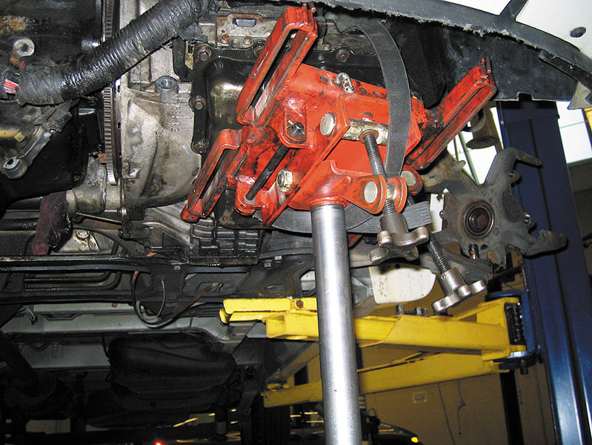
Figure 136.4 A transaxle being supported by a transmission jack prior to removal of the unit from underneath the vehicle

Slide 11
AUTOMATIC TRANSMISSION/ TRANSAXLE DISASSEMBLY (1 OF 5)
Mount to a Holding Fixture
For best results, the automatic transmission/transaxle should be attached to a holding fixture that allows the unit to be rotated yet properly supported during disassembly and reassembly.
Torque Converter Checks
Visually check for wetness that could indicate a leak such as at the welded seam.
Inspect the hub for seal and wear.
Check that the one-way clutch of the stator is working.
Check for end play of the stator.

Slide 12
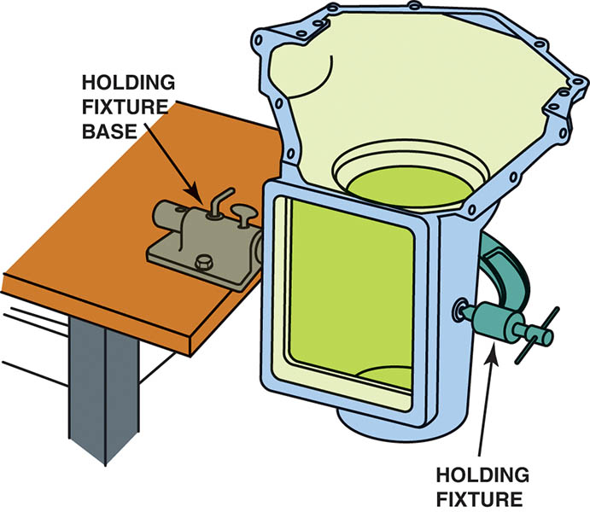
Figure 136.5 A holding fixture makes working on a transmission easier

Slide 13
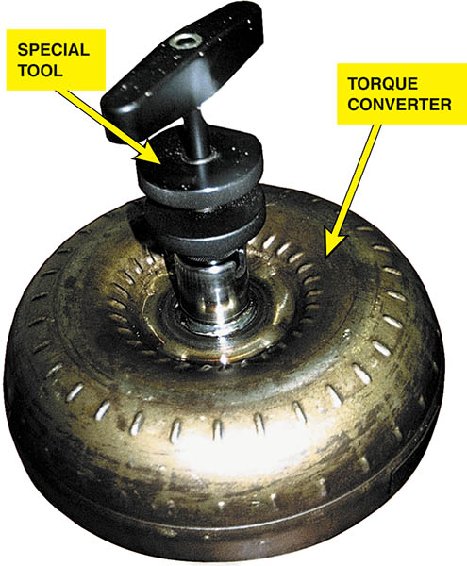
Figure 136.6 A special tool being used to check the end play of the stator inside the torque converter

Slide 14
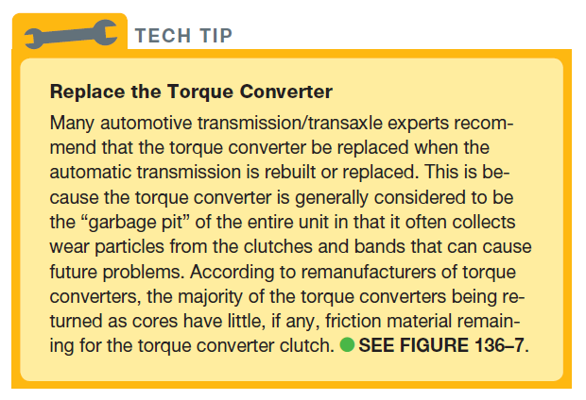
Tech Tip

Slide 15
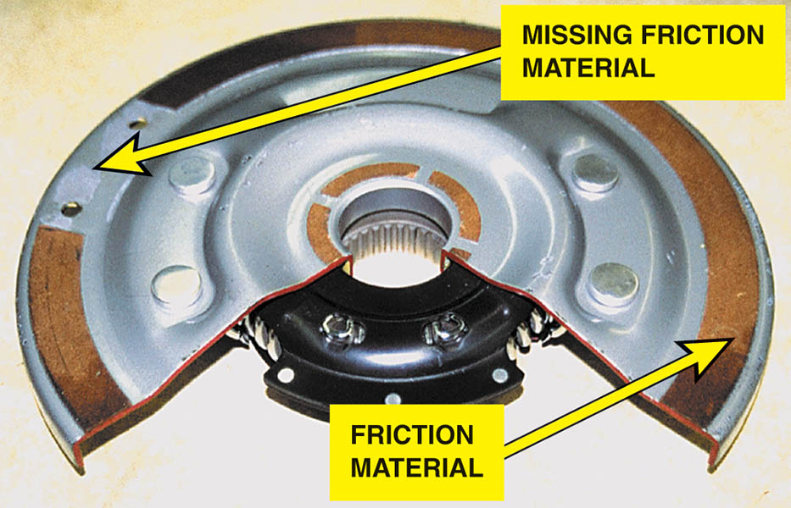
Figure 136.7 A cutaway of the torque converter clutch showing the paper-thin friction material

Slide 16
AUTOMATIC TRANSMISSION/ TRANSAXLE DISASSEMBLY (2 OF 5)
Valve Body
Carefully check the operation of all shift valves by using a plastic tool or compressed air to move the valves in their bores. All valves should be free to move and should return to the home position by spring pressure.
Pump Assembly
Check the pump for wear by checking service information for the recommended procedure and specifications.

Slide 17
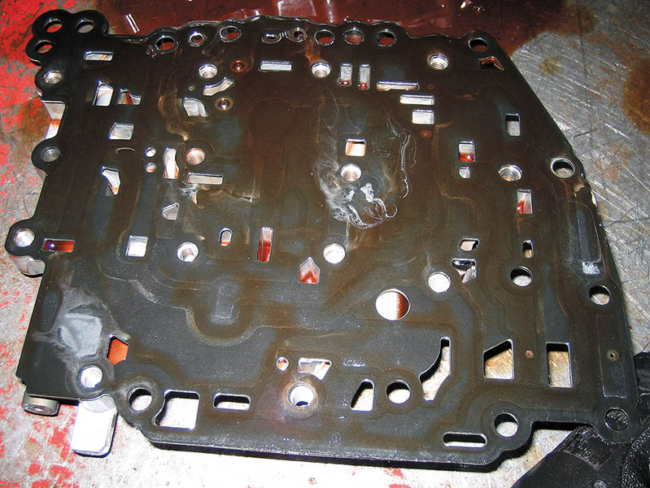
Figure 136.8 A typical separator plate. Check holes over check balls to make sure that the metal balls have not caused damage to the separator plate during operation

Slide 18
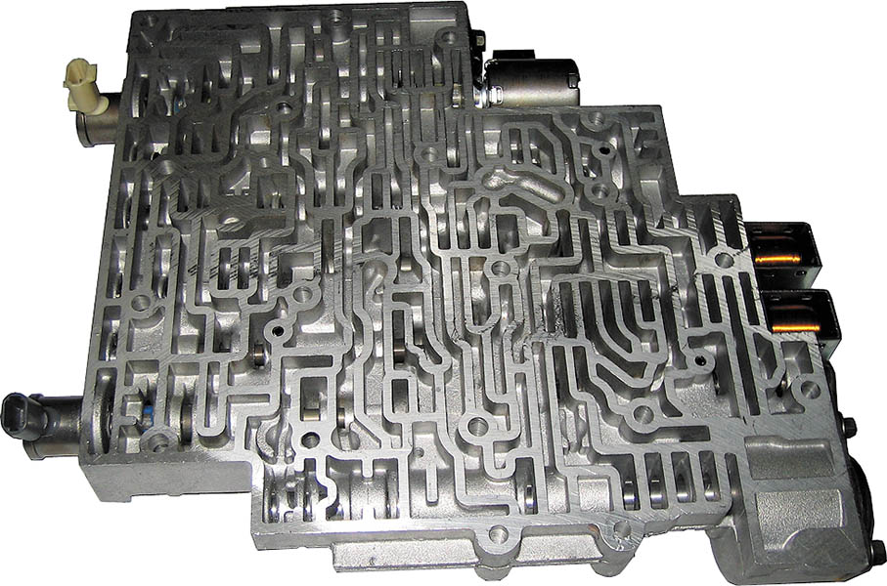
Figure 136.9 Check that all valves are free to move, and look for signs that the valves have caused wear to the valve bore. This causes fluid to leak around the valves, which can also cause shifting problems. If the bore is found to be worn, then the valve body will require repair using specialized tools or replacement

Slide 19
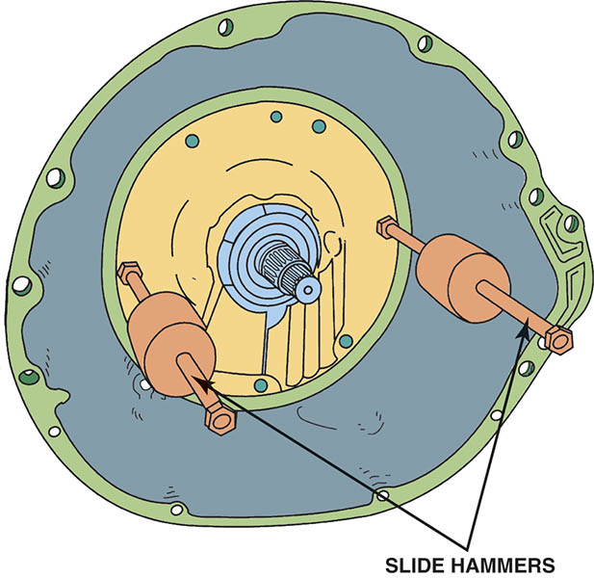
Figure 136.10 Two slide hammers are often used to remove a pump from older automatic transmissions

Slide 20
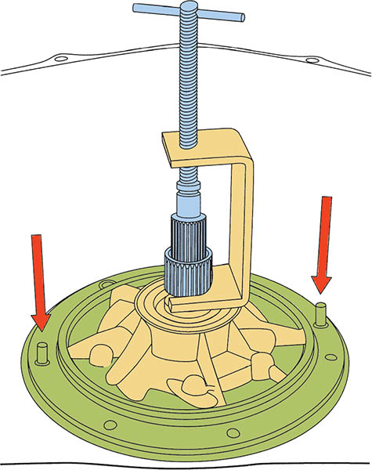
Figure 136.11 A special puller is usually specified to remove aluminum pumps from automatic transmission/transaxles. Alignment pins (arrows) are used to properly align the gasket and pump on the case during reassembly

Slide 21
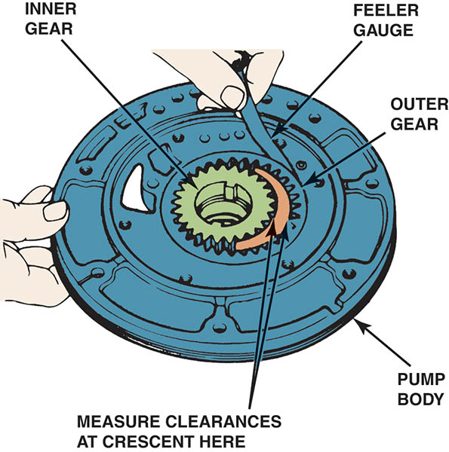
Figure 136.12 Checking a transmission pump assembly for wear using a feeler gauge. Compare the reading to factory specifications

Slide 22
AUTOMATIC TRANSMISSION/ TRANSAXLE DISASSEMBLY (3 OF 5)
Unit Disassembly
Before disassembly, measure input shaft end play.
Some transmissions require the measurement of output shaft end play.
Always check service information for the specified procedures to follow.
Clutch Packs
Begin disassembling a clutch pack by removing the snap ring that holds the discs in the housing.

Slide 23
AUTOMATIC TRANSMISSION/ TRANSAXLE DISASSEMBLY (4 OF 5)
Friction Disc Inspection
If any friction disc shows signs of one or more of the defects, replace the entire set.
Steel Disc Inspection
Replace the entire set of steels if you note a rough surface or there is uneven or spotty discoloration on any of the discs.
Clutch Piston Removal and Inspection
To remove the snap ring holding the clutch piston in place, compress the piston return springs using the proper compressor tool.

Slide 24
AUTOMATIC TRANSMISSION/ TRANSAXLE DISASSEMBLY (5 OF 5)
Return Spring Inspection
Coil springs should be straight and provide proper pressure.
Clutch Piston Inspection
Check the piston for cracks, scoring, seal damage, and ensure any check valve works normally.
Hubs, Drums, Shells, and Planetaries
Carefully check drums and shells for cracks before reusing.
Gear sets should be checked for proper pinion gear end play

Slide 25
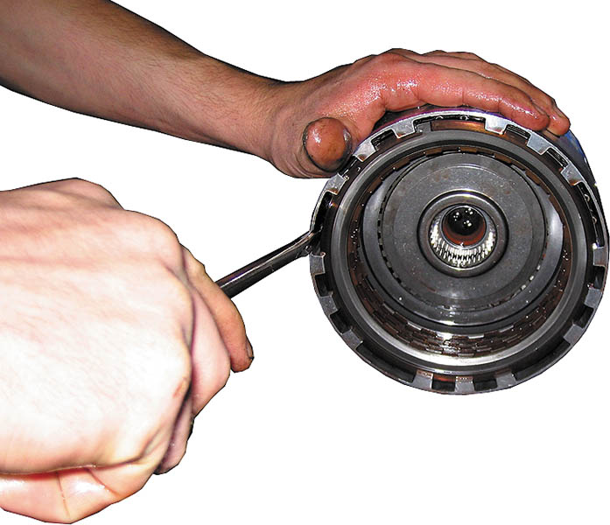
Figure 136.13 A straight-blade screwdriver can help remove the snap ring that is used to retain the frictions and steels in the clutch pack

Slide 26
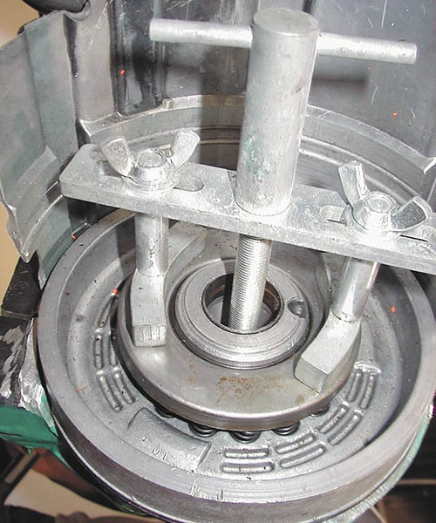
Figure 136.14 A compressor tool is usually necessary to compress the springs of the clutch piston to remove the snap ring

Slide 27
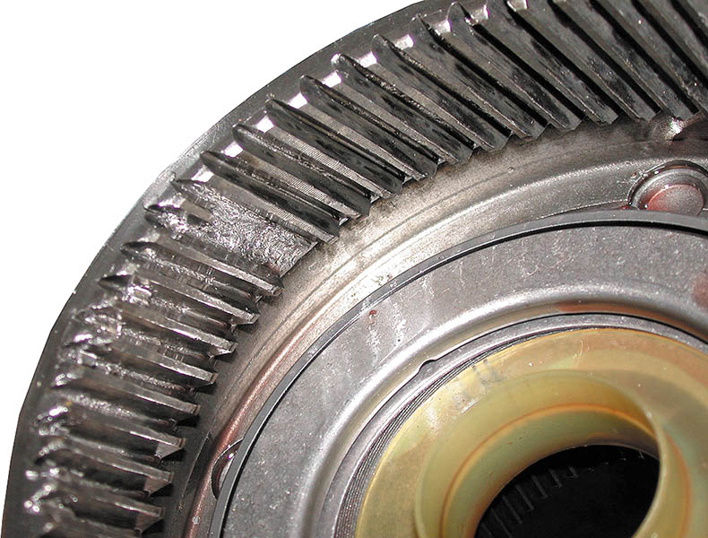
Figure 136.15 The ring gear has damaged gear teeth. This entire planetary gear set must be replaced because the damage also affected the gear teeth of the planetary pinion gears and the sun gear

Slide 28
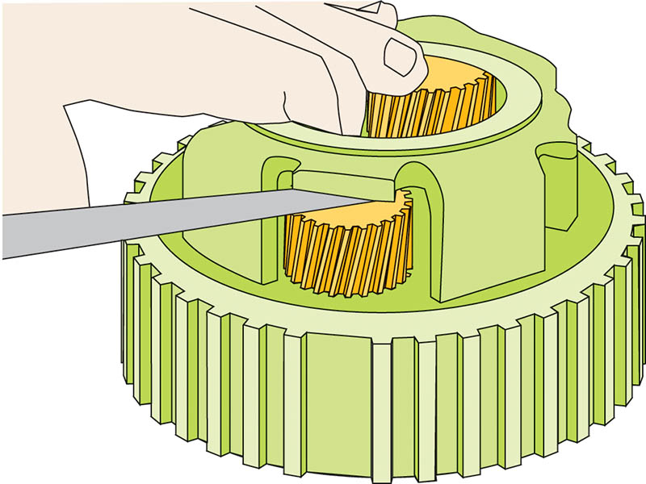
Figure 136.16 Pinion gear end play can be checked using a feeler gauge

Slide 29
REASSEMBLING AN AUTOMATIC TRANSMISSION/ TRANSAXLE (1 OF 3)
Clutch Assembly
Before assembling a clutch assembly, soak all friction plates in automatic transmission fluid (ATF).
Air Pressure Checks
An air pressure check uses air to apply clutches and/or bands to verify that components such as clutch packs perform correctly.
Bushings
All bushings should be inspected and replaced if necessary.

Slide 30
REASSEMBLING AN AUTOMATIC TRANSMISSION/ TRANSAXLE (2 OF 3)
One-Way Clutches
Always double check that all one-way roller clutches are installed correctly.
Special Tools
Special tools are often specified by the vehicle manufacturer.
Pump Assembly
Follow the vehicle manufacturer’s recommended procedures.

Slide 31
REASSEMBLING AN AUTOMATIC TRANSMISSION/ TRANSAXLE (3 OF 3)
End Play Checks
Perform all end play checks during assembly to ensure that the unit was properly assembled and that the proper internal clearances are achieved.
Valve Body Checks
The valve body should be checked for leaks and to ensure all valves move freely.

Slide 32
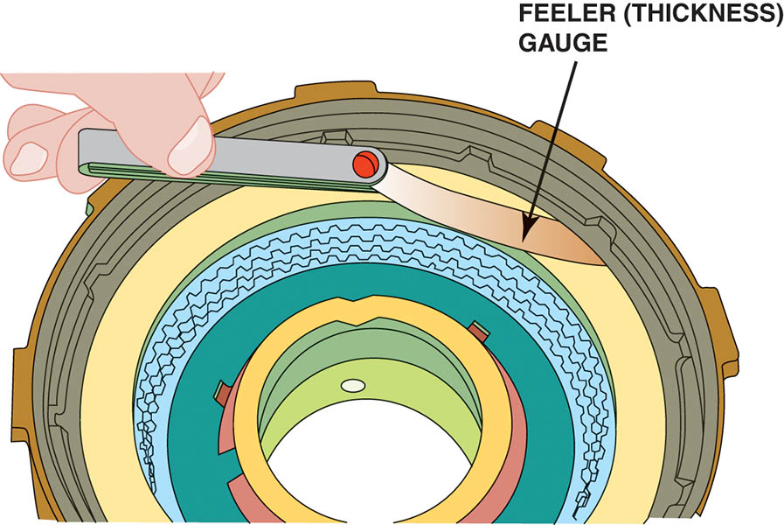
Figure 136.17 All clutch packs should be checked for proper clearance. Here, a feeler (thickness) gauge is used to check the clearance to make sure it is within factory specifications

Slide 33
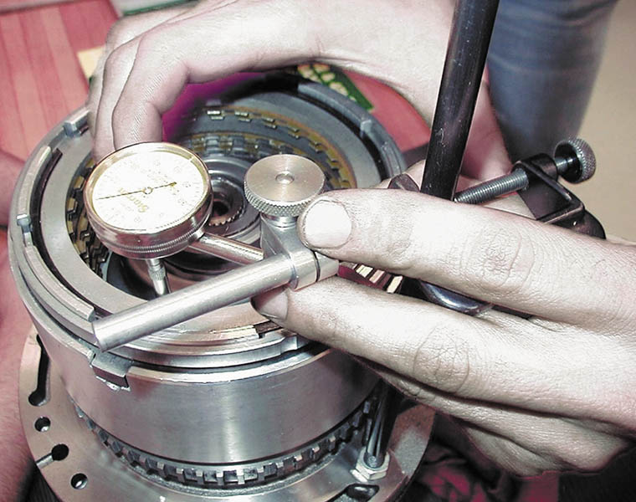
Figure 136.18 Checking clutch pack clearance using a dial indicator. This method is used when a feeler gauge cannot be inserted to check for proper clearance

Slide 34
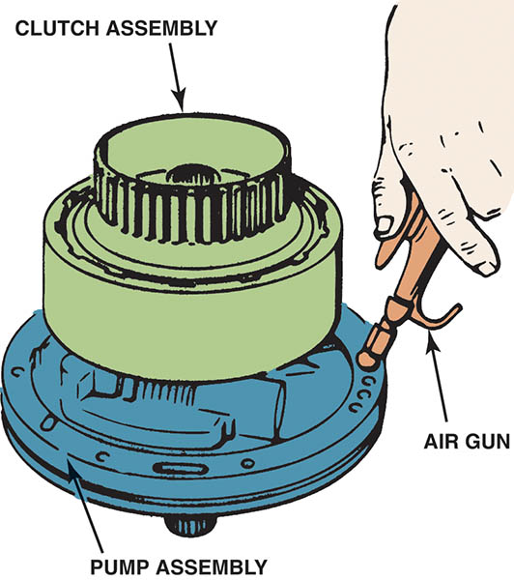
Figure 136.19 Air testing a clutch pack before installing it into an automatic transmission or transaxle

Slide 35
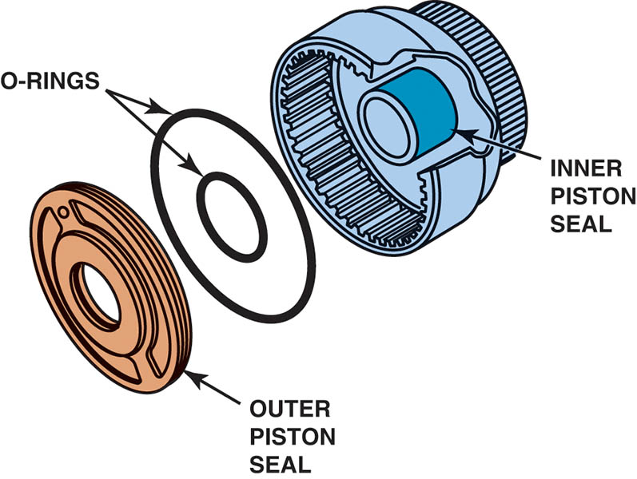
Figure 136.20 Both the inner and outer seals are checked when air testing a clutch pack assembly

Slide 36
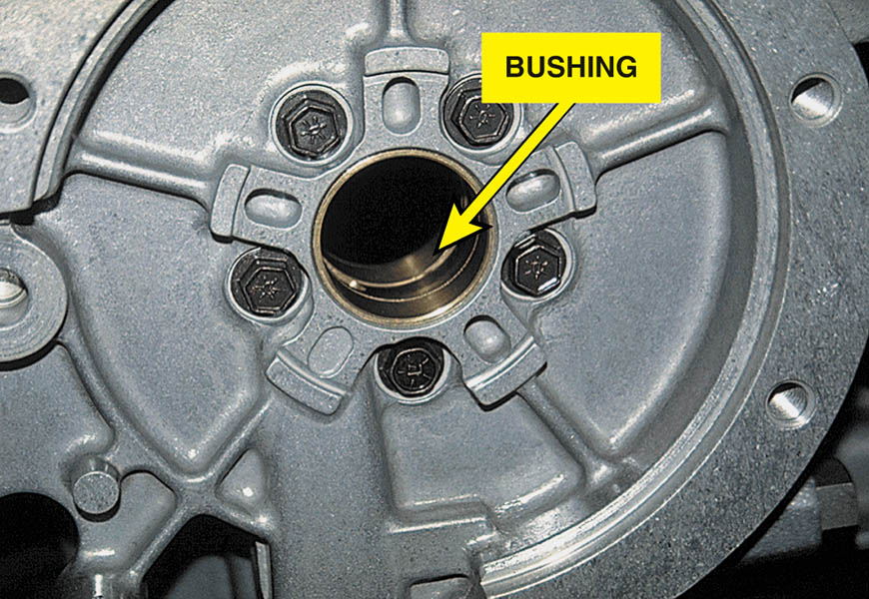
Figure 136.21 A typical brass bushing used in an automatic transmission

Slide 37
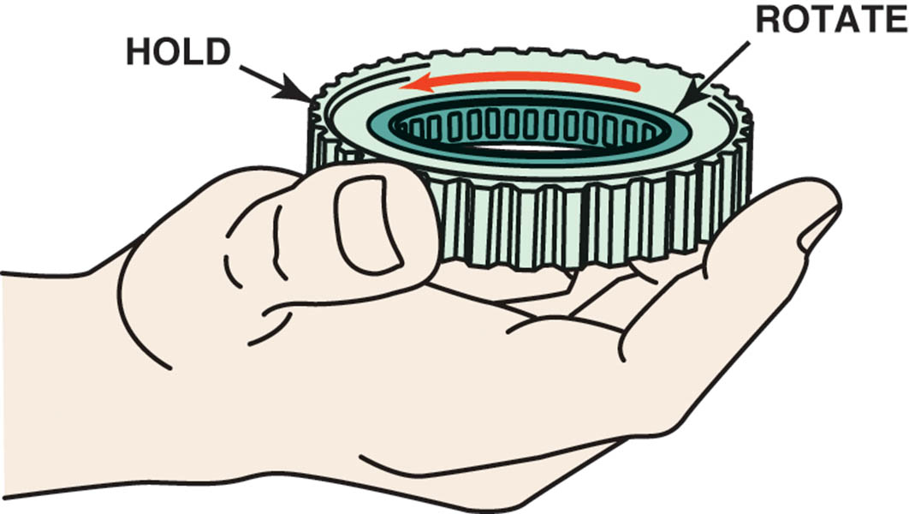
Figure 136.22 Service information states that this one-way roller clutch should be installed as shown. Check by holding the outer race so that the inner race is free to rotate counterclockwise as shown

Slide 38
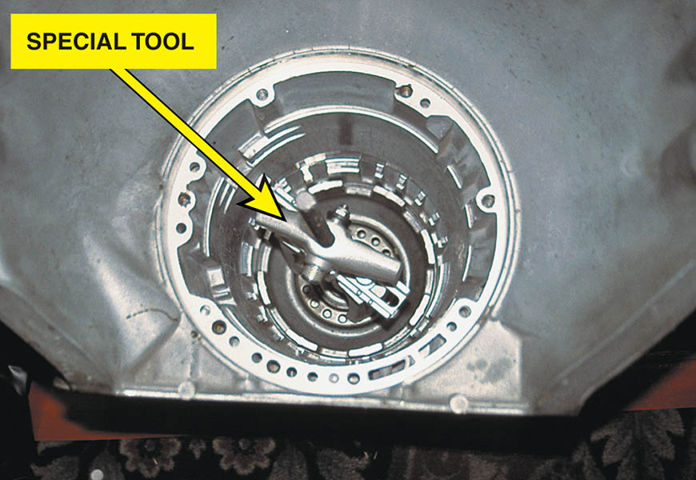
Figure 136.23 A special clamp makes removal and reinstallation of this clutch pack easier

Slide 39
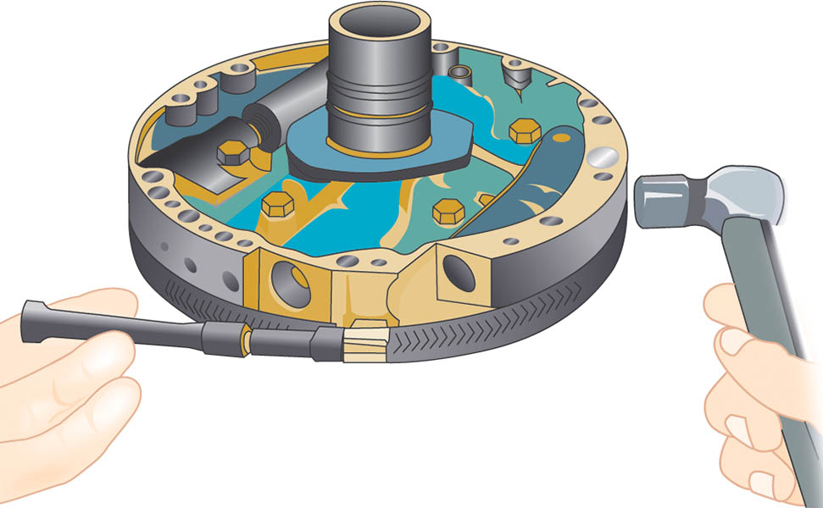
Figure 136.24 Using an alignment clamp to assemble both pump halves. To ensure proper alignment, many experts recommend lightly tapping the outer edges of the pump while tightening the clamp

Slide 40
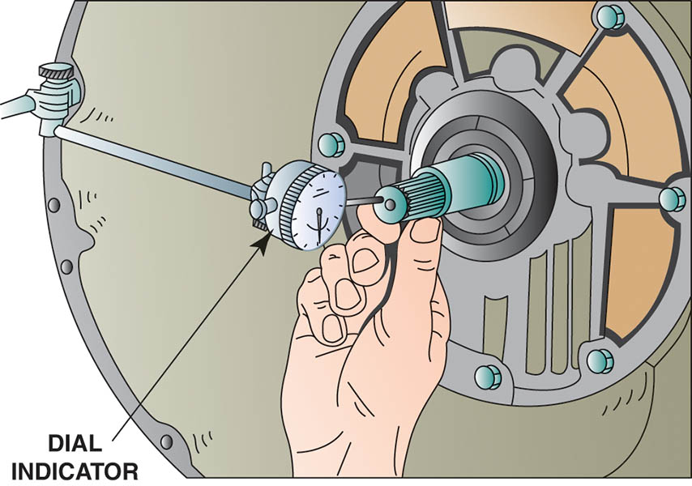
Figure 136.25 A dial indicator being used to measure the end play of an input shaft. If the end play is not within factory specifications, the unit may not have been assembled correctly

Slide 41
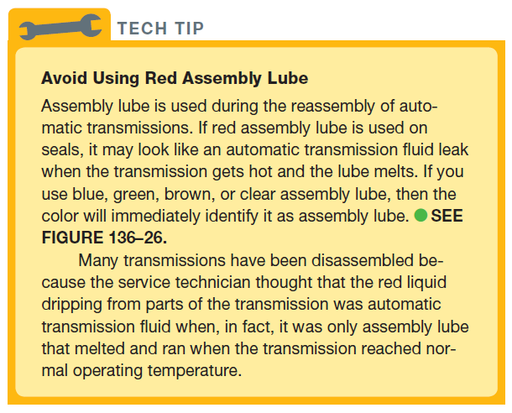
TECH TIP

Slide 42

Figure 136.26 Blue assembly lube

Slide 43
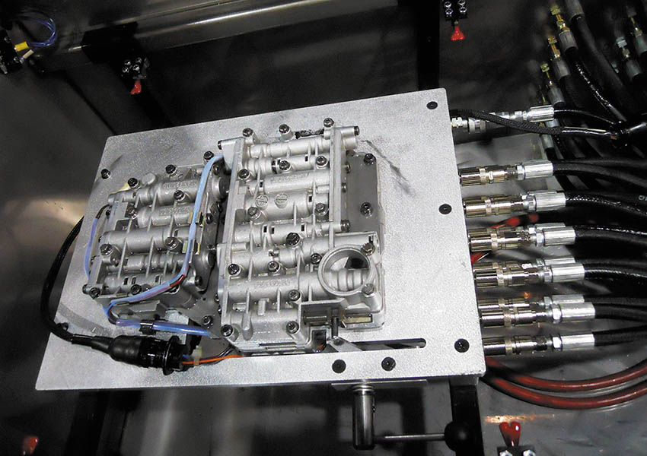
Figure 136.27 A valve body being tested on a valve body tester. While it takes some setup time to adapt each valve body to the proper hoses, this type of machine can find valve body problems before the transmission/transaxle is installed in the vehicle

Slide 44
FLUSHING THE COOLER AND THE TORQUE CONVERTER
Purpose
The transmission fluid cooler should be checked for proper flow.
The cooler can be flushed using special machines that pulsate ATF through the cooler.

Slide 45
DYNAMOMETER TESTING THE AUTOMATIC TRANSMISSION/ TRANSAXLE
A rebuilt automatic transmission/transaxle can be tested on a dynamometer powered by:
An electric motor
A gasoline engine
Most dynamometers are equipped with pressure gauges to provide a load so the operation of the unit can be checked before being installing in the vehicle.

Slide 46
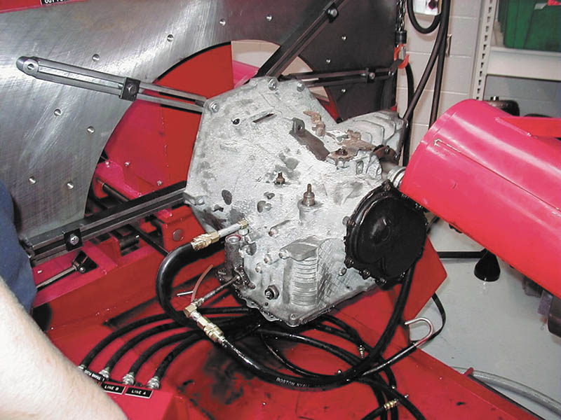
Figure 136.28 An electric motor-driven dynamometer being used to check the operation of a 41 TE transaxle

Slide 47
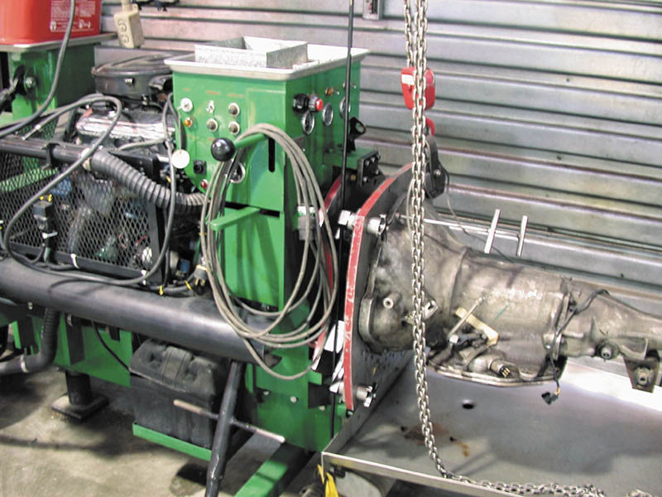
Figure 136.29 A gasoline-powered dynamometer being used to test a rear-wheel-drive automatic transmission

Slide 48
REINSTALLING THE AUTOMATIC TRANSMISSION/ TRANSAXLE
Double Check End Play
After the unit has been reassembled and all end play checks indicate that the unit is properly assembled, reinstall the automatic transmission/transaxle in the vehicle.
Torque Converter Installation
Carefully install the torque converter onto the input shaft being sure to fully engage the pump gears, the stator splines and the turbine splines.

Slide 49
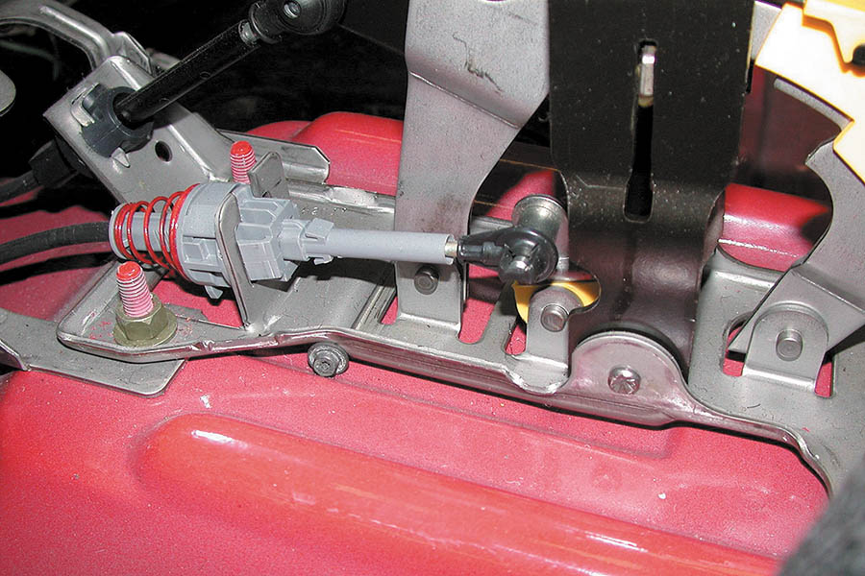
Figure 136.30 Check the linkage for proper adjustment so that the shift interlock works correctly and the PRNDL is aligned with the transmission range switch

Slide 50
ROAD TEST
Fast Learn the PCM/ TCM
This action will get the adaptive settings close to what they should be and will help prevent damage to the unit if this procedure is not done.
Road Test Procedure
Carefully test drive the vehicle, checking for proper operation and shift points.
Hoist the vehicle and check for any possible ATF leaks before returning the vehicle to the customer.

Slide 51
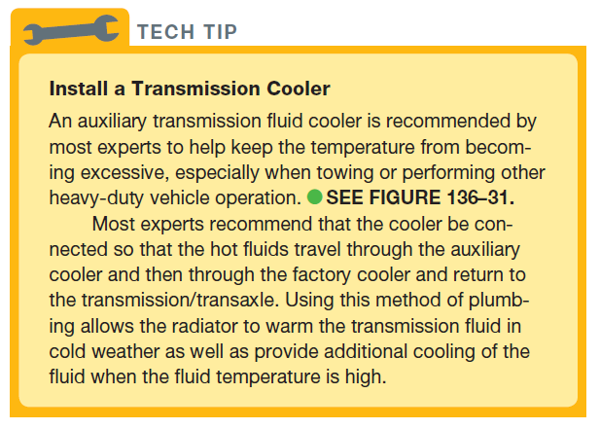
TECH TIP

Slide 52
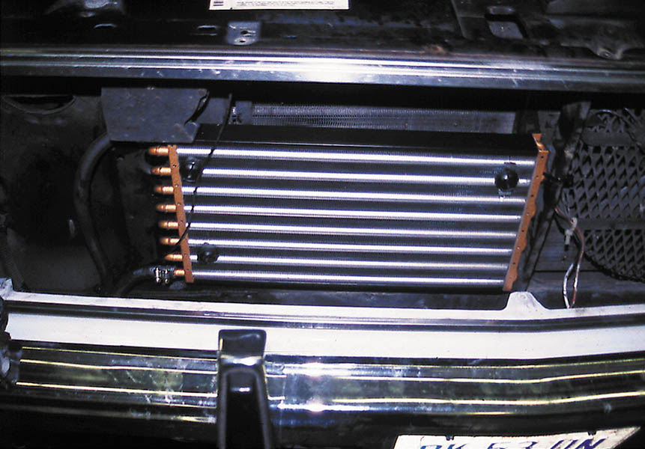
Figure 136.31 An auxiliary automatic transmission fluid cooler installed on a Chevrolet pickup truck used to haul a car trailer

Slide 53
Transaxle Removal

Slide 54
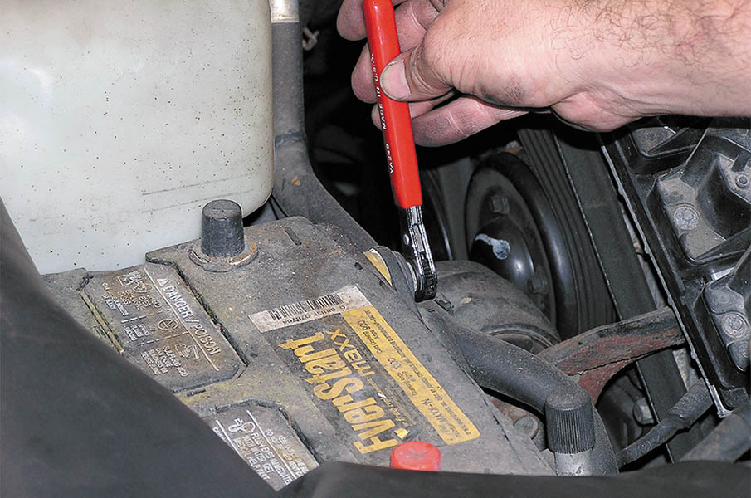
1 For safety purposes, remove the negative battery cable before starting the removal procedure.

Slide 55
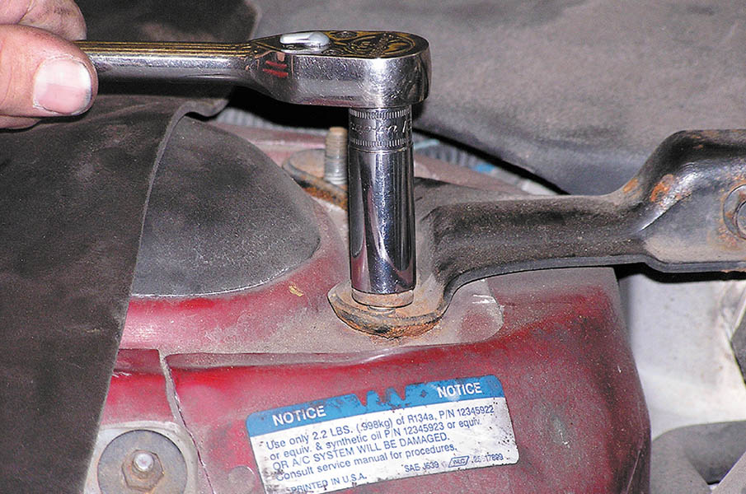
2 Remove engine bay cross members that may interfere with access to the transaxle fasteners.

Slide 56
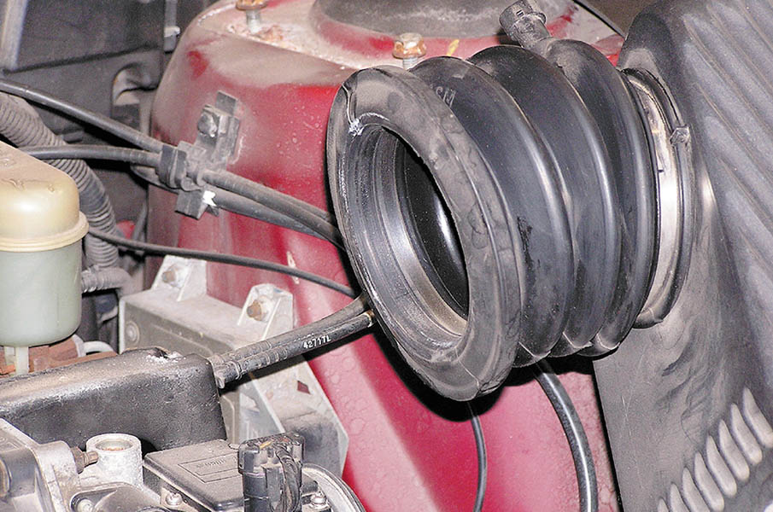
3 Remove the air intake and air filter assembly, which is covering the transaxle in this vehicle.

Slide 57
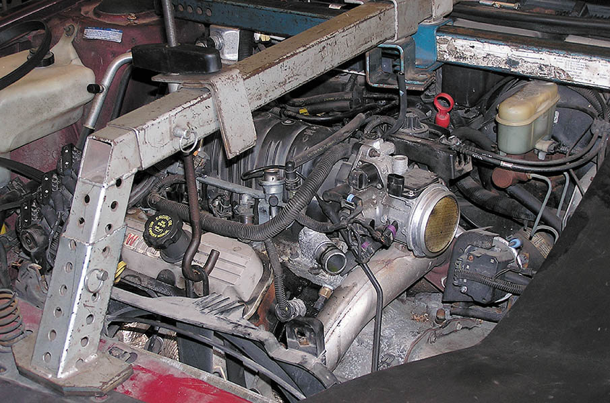
4 Install a support for the engine.

Slide 58
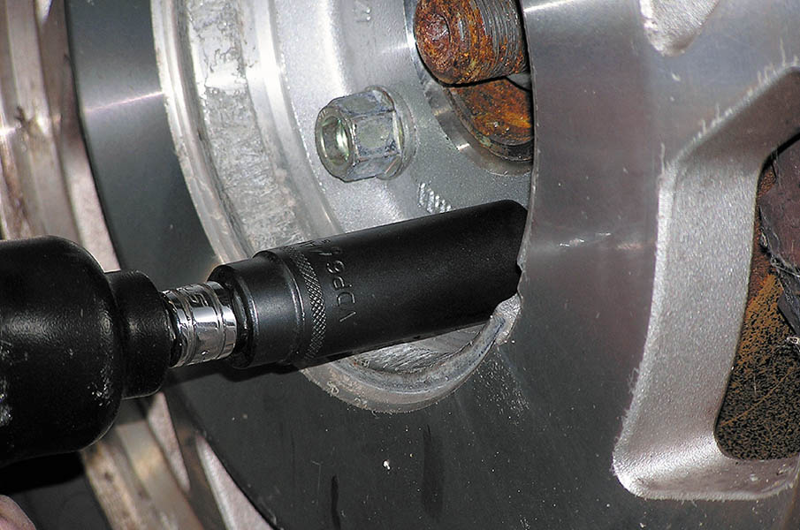
5 Safely hoist the vehicle and remove the wheels.

Slide 59
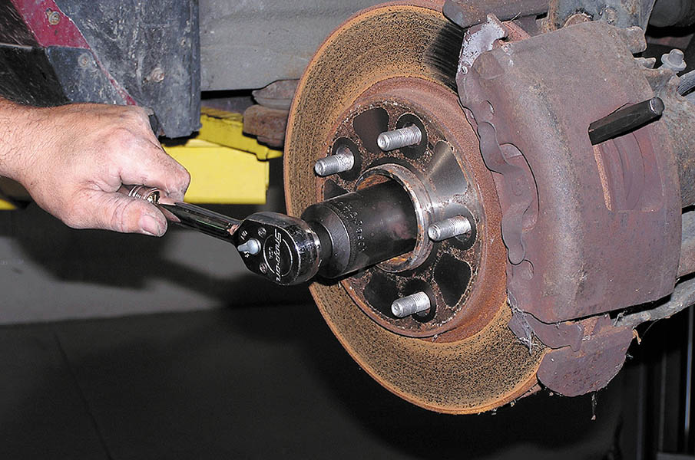
6 Remove the retaining nut from the drive axle shaft.

Slide 60
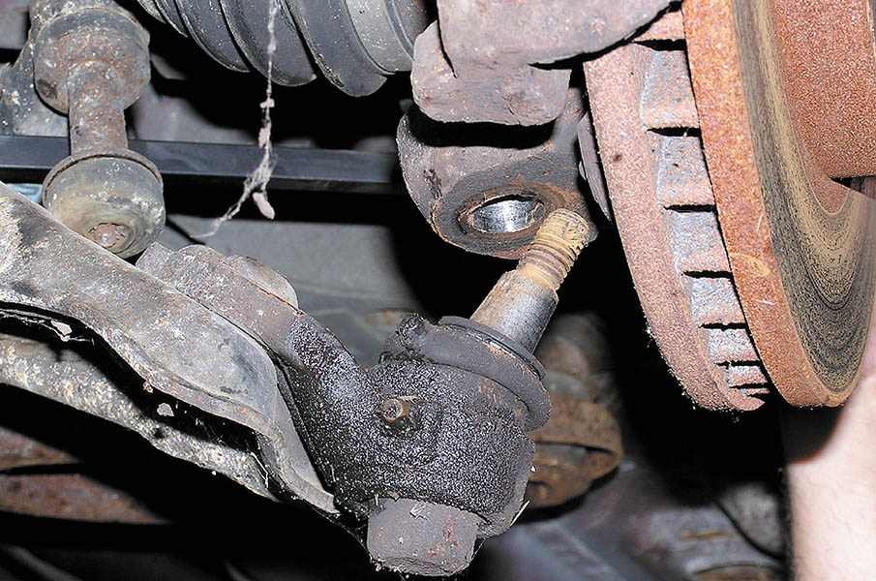
7 Disconnect the lower ball joint on the front-wheel-drive vehicle to allow removal of the drive axle shaft.

Slide 61
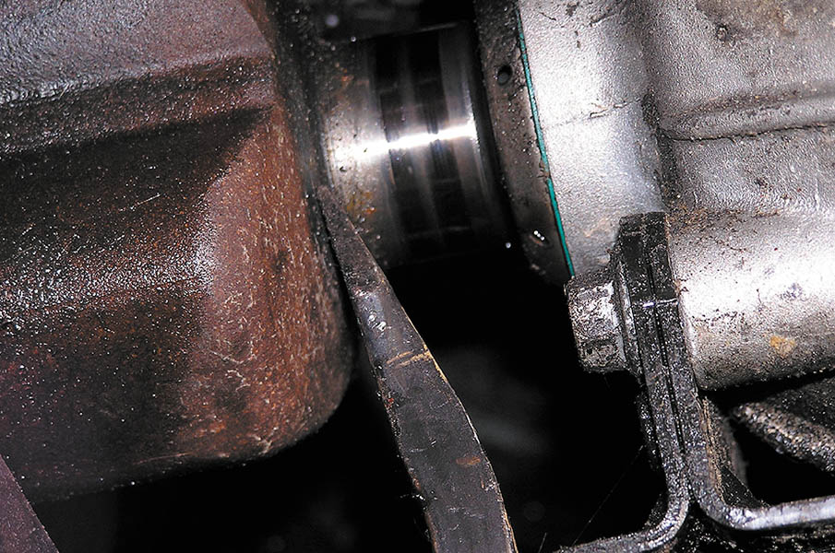
8 Remove the drive axle shaft from the transaxle using a pry bar.

Slide 62
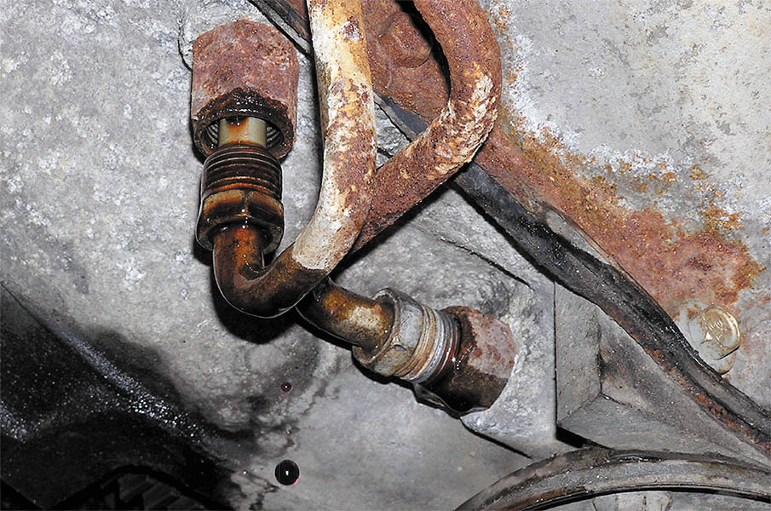
9 Disconnect the cooler lines from the transaxle using a line wrench.

Slide 63
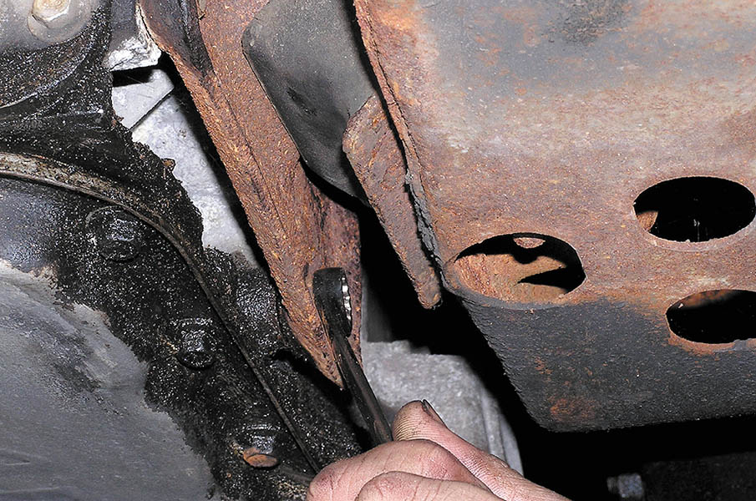
10 Unbolt the torque converter from the flexplate, then remove the transaxle mounts.

Slide 64
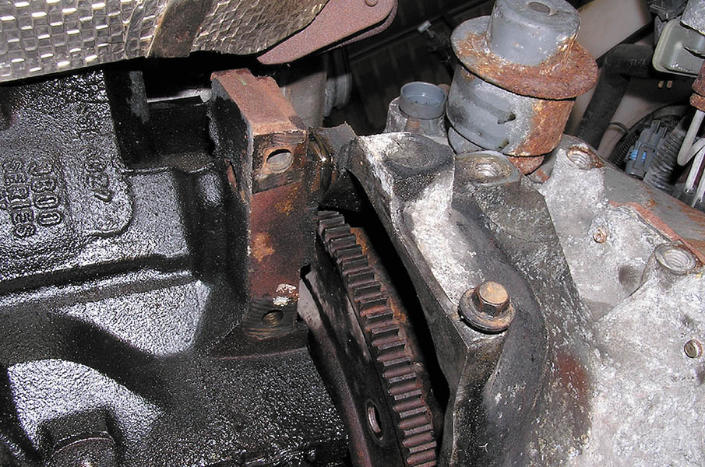
11 With the transaxle supported on a transmission jack, remove the retaining bolts from the bell housing.

Slide 65
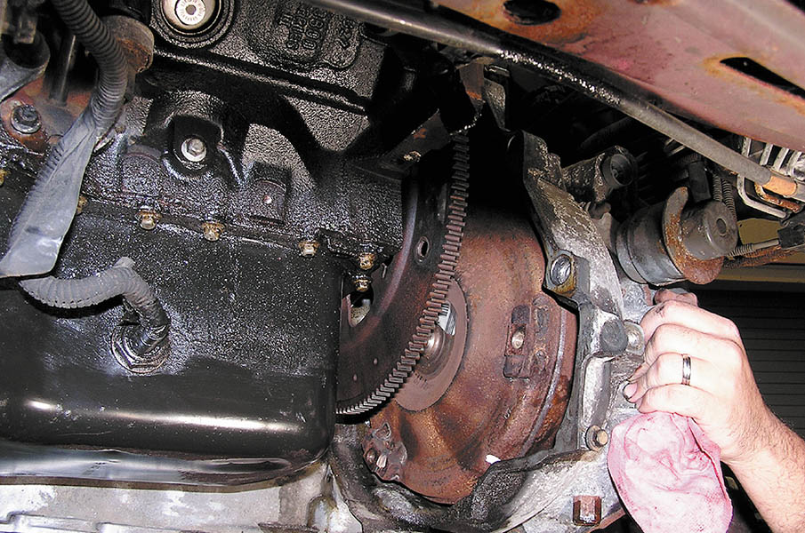
12 Carefully remove the transaxle from the vehicle.

Slide 66
Transaxle Disassembly and Assembly

Slide 67
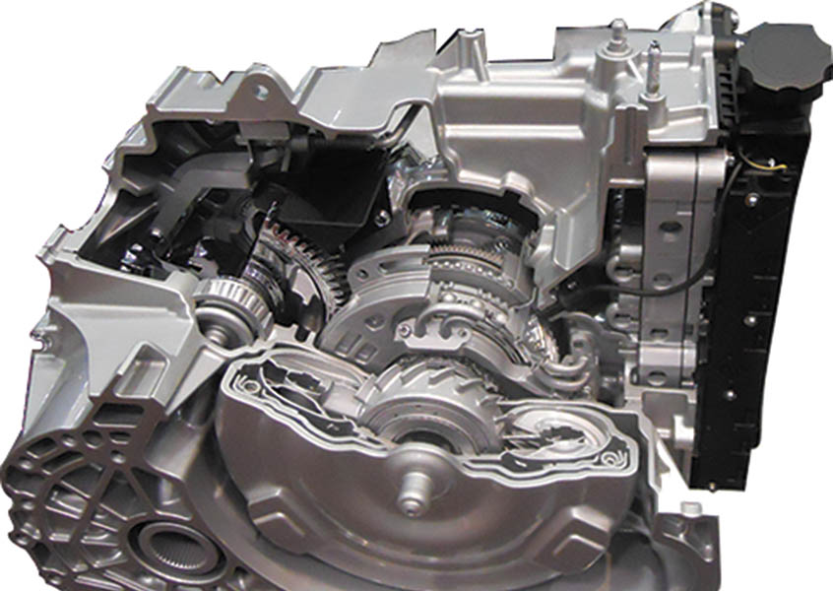
1 The GM 6T70 6 forward speed transaxle was a joint venture with Ford and therefore is similar to the 6F50.

Slide 68
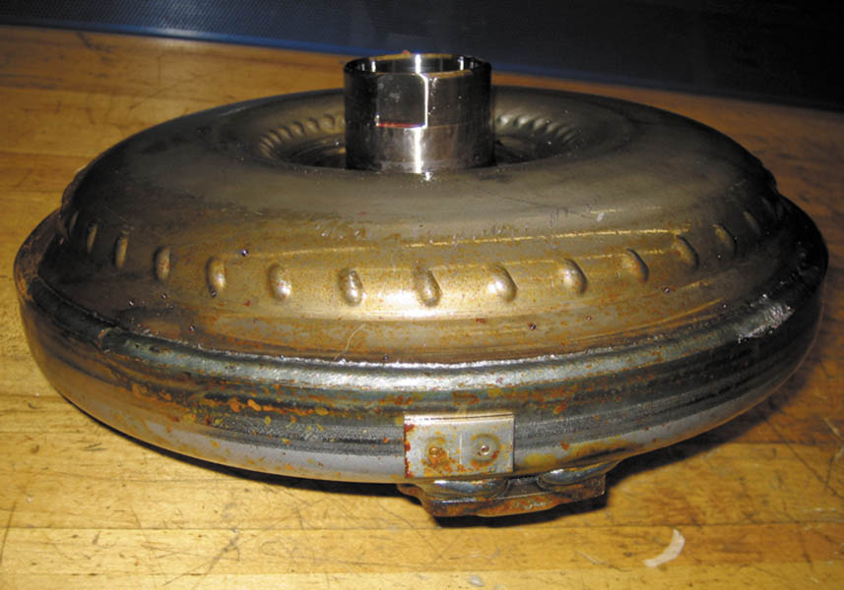
2 A unique thin torque converter is used to help reduce the overall length of the transaxle.

Slide 69
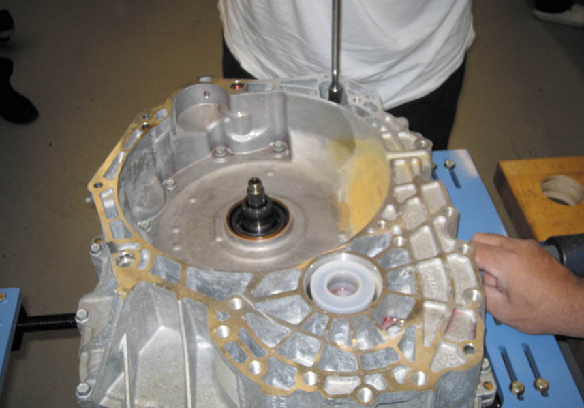
3 After removing the torque converter, the housing is being removed.

Slide 70

4 The final drive assembly is exposed after the housing has been removed.

Slide 71

5 The final drive is easily lifted out after the housing has been removed.

Slide 72

6 Note the tapered roller bearing used in the final drive assembly component.

Slide 73

7 The transaxle is rotated and the plastic side cover is removed.

Slide 74

8 Under the side cover is the valve body and integrated solenoid assembly.

Slide 75

9 Under the plastic electrical solenoid assembly is the valve body assembly.

Slide 76

10 Removing the valve body assembly.

Slide 77

11 Turning the assembly around, showing the end cover.

Slide 78

12 Removing the end cover shows the clutch packs and planetary gear set.

Slide 79

13 Removing the first of five clutch packs (two driving and three holding).

Slide 80

14 A typical clutch pack in a 6T70 showing the selective thickness steel used to determine clutch pack clearance.

Slide 81

15 A view down into the case where multiple clutch packs are found.

Slide 82

16 The output planetary gear set with four pinions used on 6T70 units. The 6T75 version uses a five pinion carrier and a reinforced case.

Slide 83

17 Reassembly of the clutches. Check service information for specified clutch pack clearance.

Slide 84

18 Notice that the final drive is equipped with tapered roller bearings and this means that the preload must be adjusted.

Slide 85

19 A special set of spacers and blocks used to determine the preload needed. A feeler gauge is then used to measure the clearance.

Slide 86

20 Following the procedure in service information, the designated thickness of shim is selected, which is placed under the bearing race in the bearing packet.

Slide 87

21 The selective shim and race before the race is driven into position.

Slide 88

22 Driving the race into position using the specified driver.

Slide 89

23 Reassembly of the valve body being sure that all fasteners are tightened to factory specifications.

Slide 90

24 The solenoid assembly is replaced as an assembly only if defective and all the fasteners need to be torqued to factory specifications.

Slide 91

Copyright

