Slide 1

Automotive Technology Principles, Diagnosis, and Service
Sixth Edition
Chapter 135
Automatic Transmission/ Transaxle Diagnosis and In-Vehicle Service
Copyright © 2018, 2015, 2011 Pearson Education, Inc. All Rights Reserved

Slide 2
LEARNING OBJECTIVES
135.1 Explain the process of diagnosing transmission problems.
135.2 Discuss the procedures for performing in-vehicle service.

Slide 3
TRANSMISSION PROBLEM DIAGNOSIS (1 OF 2)
Verify the Customer Concern
Fluid Check
  With a dipstick
  Without a dipstick
Test Drive
  Try to drive under the same conditions as the owner.
Commanding Shifts
  Use the scan tool to command shifts.
Check Diagnostic Trouble Codes
  These problems should be corrected before further diagnosis.

Slide 4
TRANSMISSION PROBLEM DIAGNOSIS (2 OF 2)
Scan Data
  May assist in determining the root cause of the problem.
Check Technical Service Bulletins
  30% of all problems can be solved with TSBs.
Transmission/Transaxle Identification
  Important when trying to order parts.
Stall Testing the Torque Converter
  Often performed to verify the proper operation of the torque converter.

Slide 5
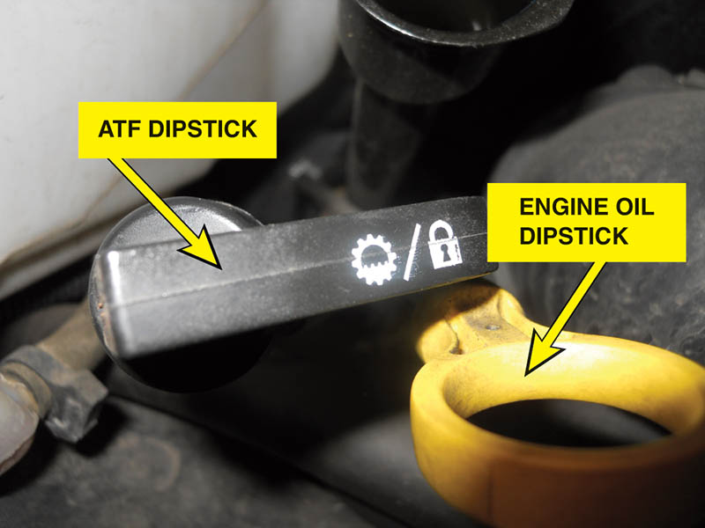
Figure 135.1 A typical automatic transmission dipstick(fluid level indicator). Many use a clip to keep it from being forced upward due to pressure changes inside the automatic transmission. A firm seal also helps keep water from getting into the fluid, which can cause severe damage to the clutches and bands

Slide 6
Figure 135.2 The “add” mark on most automatic transmission dipsticks indicates the level is down 0.5 quart (0.5 liter). Always follow the instructions stamped or printed on the dipstick

Slide 7
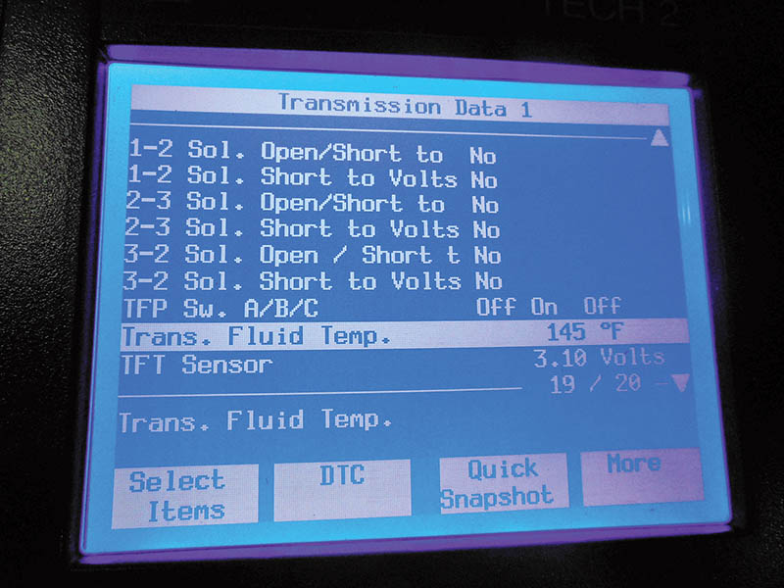
Figure 135.3 The temperature of the automatic transmission fluid is displayed on a factory or factory-level scan tool. It may require that the vehicle be driven under a load for the fluid to reach the specified temperature and can often be achieved by simply allowing the engine to idle

Slide 8
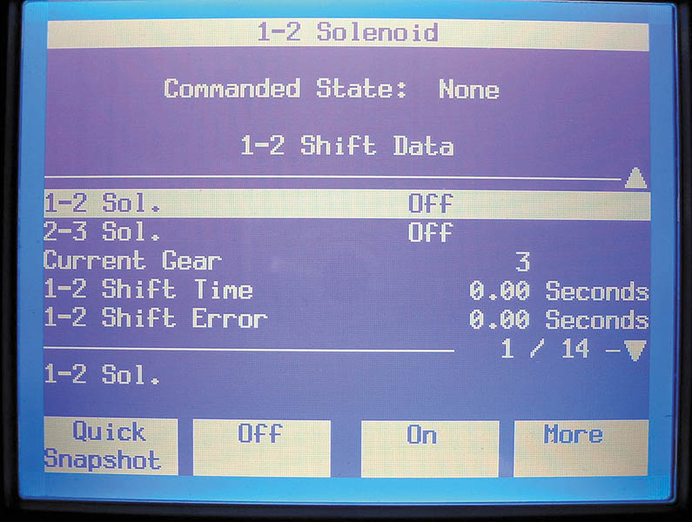
Figure 135.4 Most factory or factory-level scan tools are capable of bidirectional control of the automatic transmission or transaxle

Slide 9
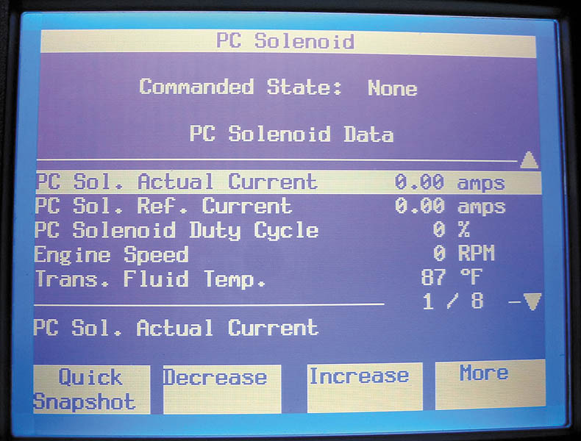
Figure 135.5 A Tech 2 scan tool is able to display shift solenoid current. Use this information and check service information for the specified current to help diagnose shift solenoid-related faults

Slide 10
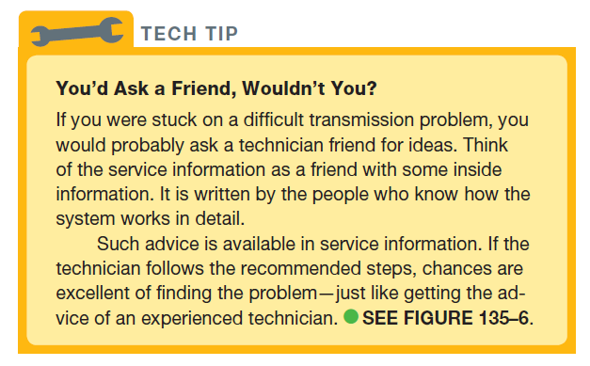
Tech Tip

Slide 11

Figure 135.6 Checking service information for how to perform diagnosis on an automatic transmission fault is a wise step

Slide 12
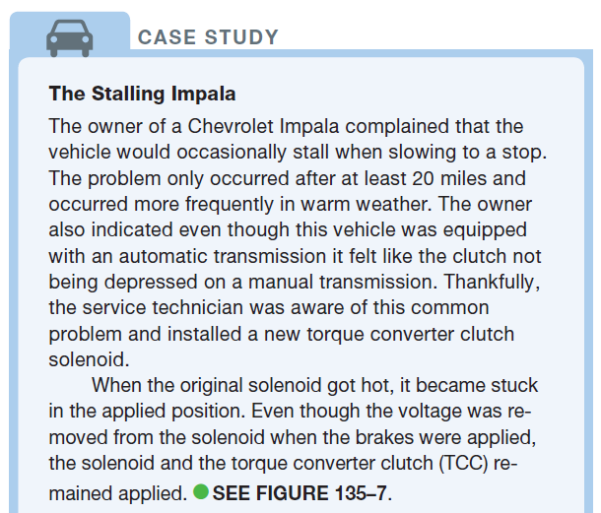
CASE STUDY

Slide 13
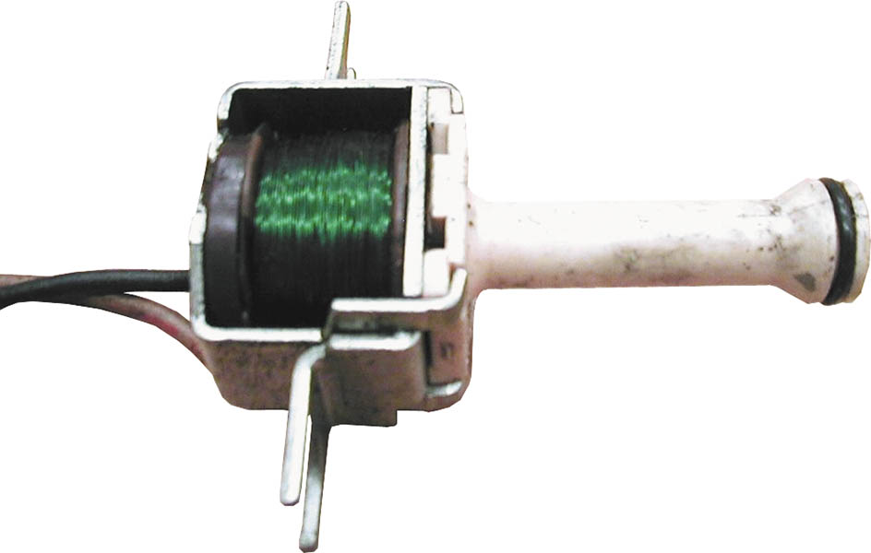
Figure 135.7 A torque converter clutch (TCC) solenoid. This TCC can be replaced on a General Motors vehicle without having to remove the transmission/transaxle from the vehicle

Slide 14
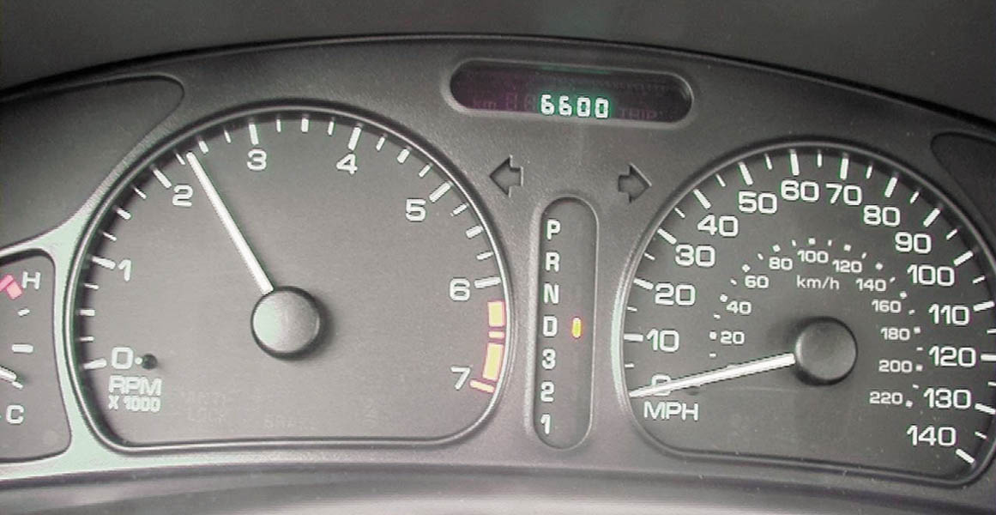
Figure 135.8 This 4-cylinder General Motors vehicle has a stall speed of about 2350 RPM. Notice that the gear selector is in drive and the speedometer is reading zero

Slide 15
TRANSMISSION FLUID LEAK DIAGNOSIS
Visual Inspection
  Due to gravity and the forward movement of the vehicle, leaking fluid will travel downward and toward the rear.
Dye Testing
  Used to locate difficult to find leaks.
  Follow the instruction on the bottle of dye
  Typically involves the use of a black light.

Slide 16
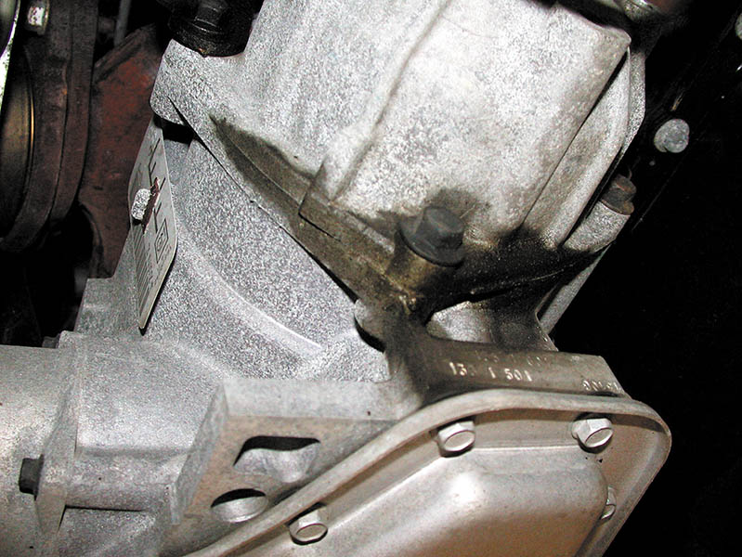
Figure 135.9 Sometimes the location of a transmission fluid leak is easy to see, but with others it can be difficult to find the exact location. Look closely at places where O-rings or gaskets are used, as these are the most common areas where fluid leaks occur

Slide 17
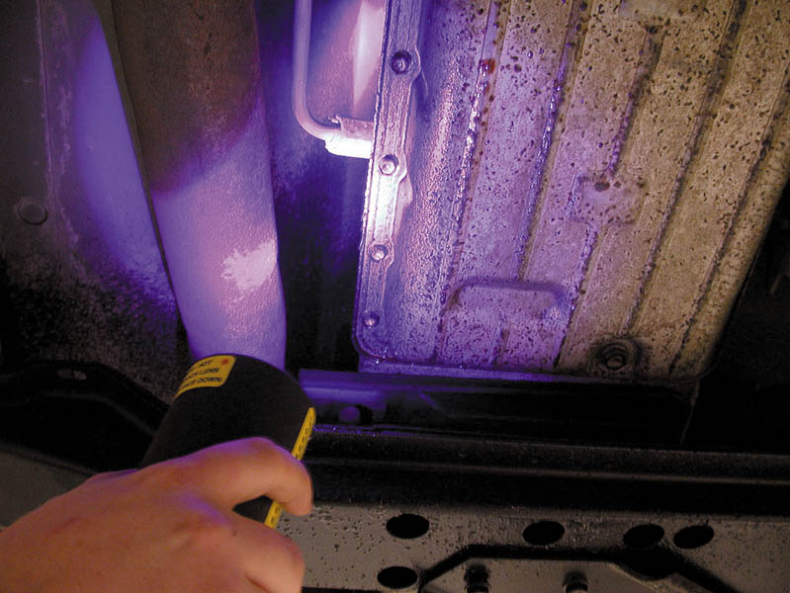
Figure 135.10 A black light being used to locate the source of an automatic transmission fluid leak

Slide 18
TORQUE CONVERTER CLUTCH DIAGNOSIS
The torque converter clutch is usually applied above 30 MPH (48 km/h) when the automatic transmission/transaxle is in second, third, or overdrive gear, depending on the vehicle speed and the throttle position.
To test for proper operation of the torque converter clutch, simply drive the vehicle and watch either the tachometer on the dash or connect a scan tool to observe the engine RPM.

Slide 19
PRESSURE TESTING
Pressure testing involves connecting a pressure gauge to pressure taps located on the outside of the automatic transmission/transaxle.
Transducers
  A transducer-equipped vehicle will usually provide an actual pressure reading on a scan tool.

Slide 20
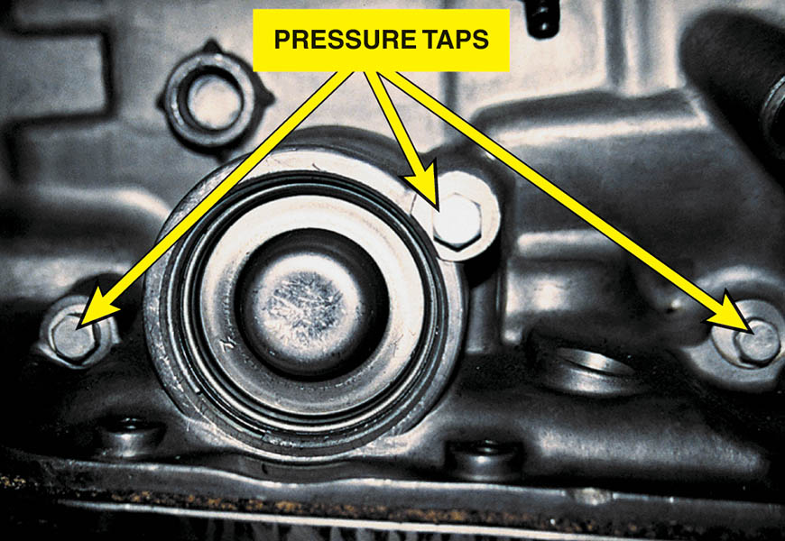
Figure 135.11 The locations (taps) for connecting a pressure gauge to measure the pressure of the various hydraulic circuits are usually found on the side of the automatic transmission/transaxle. Check service information for the exact locations for the vehicle being tested

Slide 21
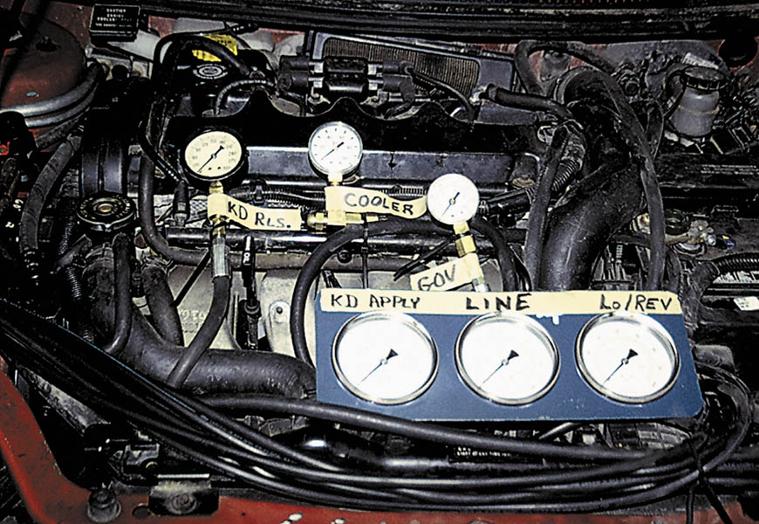
Figure 135.12 Six pressure gauges are installed on this vehicle to show students how the pressures vary and how the gauges can be used to find faults or possible problem areas before the unit is removed and disassembled

Slide 22
IN-VEHICLE SERVICE (1 OF 2)
Pan Removal
  Inspect the inside of the pan for excessive friction material and wear metals (such as lead and copper from bushings).
Filter Replacement
  Check service information for the exact procedure to follow when replacing the filter.
Flushing ATF
  Refer to the instructions on the flushing machine.

Slide 23
IN-VEHICLE SERVICE (2 OF 2)
Band Adjustment
  The procedure usually involves tightening the adjustment nut or bolts to a specified torque reading and then backing off the adjustment nut or bolts a specified number of times.
Linkage Adjustment
  The linkage may need to be adjusted to compensate for worn linkage components.
  Before adjusting the linkage, check the engine and transmission/transaxle mounts carefully, because a defective mount is a common reason for needing a linkage adjustment.

Slide 24
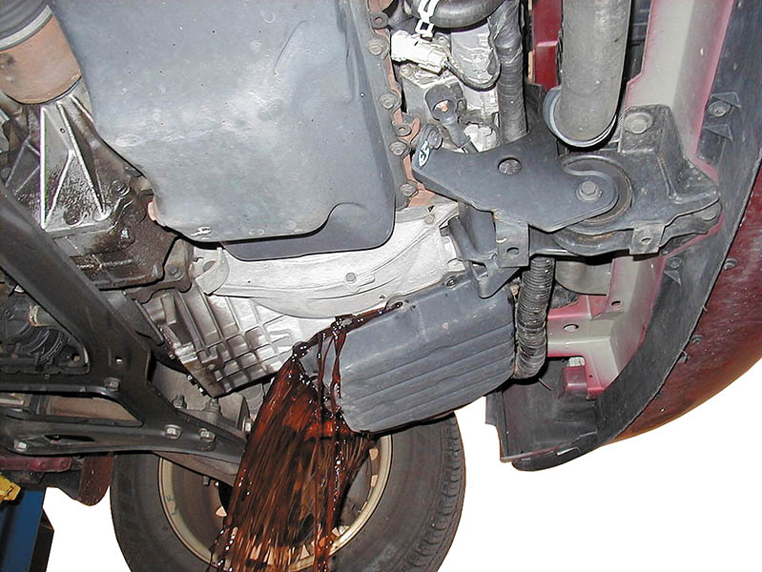
Figure 135.13 Draining the fluid from an automatic transaxle by allowing the fluid to flow into a container after most of the retaining bolts have been removed

Slide 25
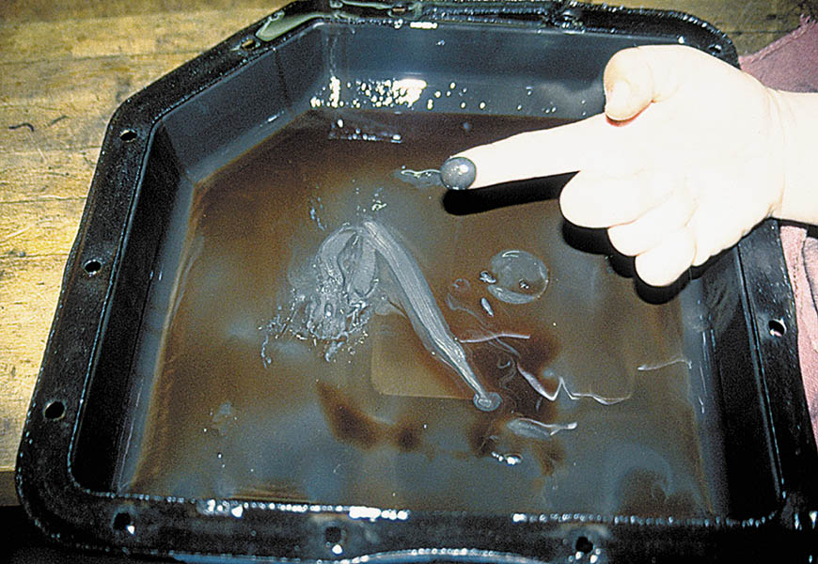
Figure 135.14 This is a normal amount of wear material in the bottom of an automatic transmission pan

Slide 26
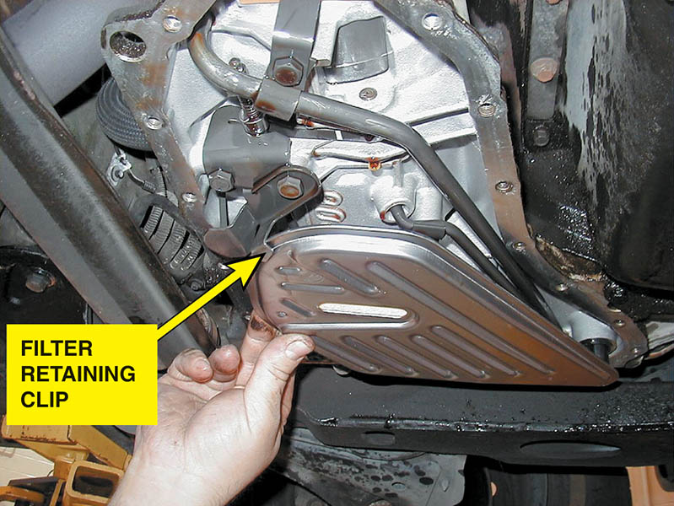
Figure 135.15 Always check that the filter is secured by a clip or other fastener to keep it from dropping out of location

Slide 27
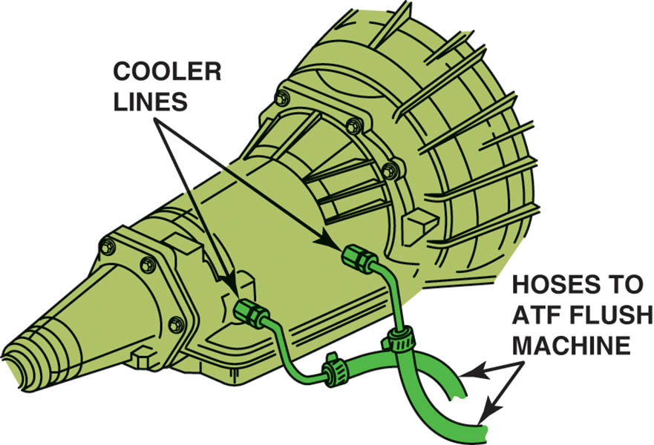
Figure 135.16 A fluid exchange machine uses the engine and the transmission pump to force the fluid into the machine where the old fluid is used to push against a diaphragm, which then forces new fluid back through the transmission.

Slide 28
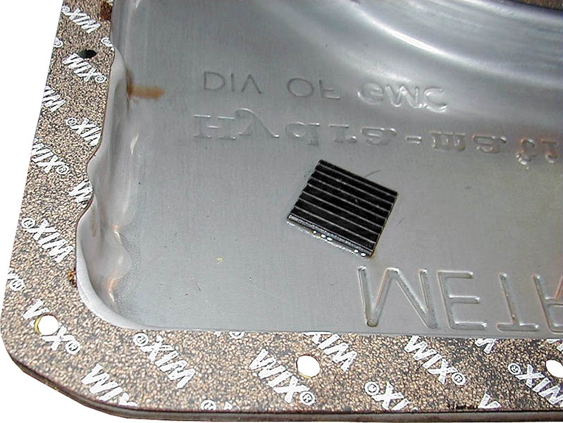
Figure 135.17 In this case, the cork-rubber gasket is glued to the pan and is ready to be installed. The retaining bolts need to be tightened in sequence, but be aware that overtightening will cause a leak. Also, some manufacturers recommend using only an RTV sealer, but never use an RTV sealer and a gasket together

Slide 29
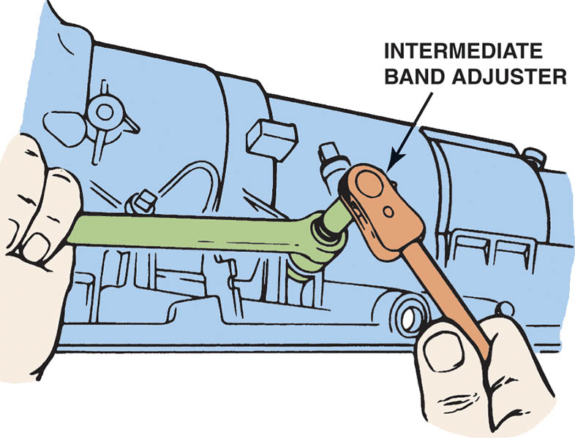
Figure 135.18 Adjusting the intermediate band on a Ford A4LD transmission

Slide 30
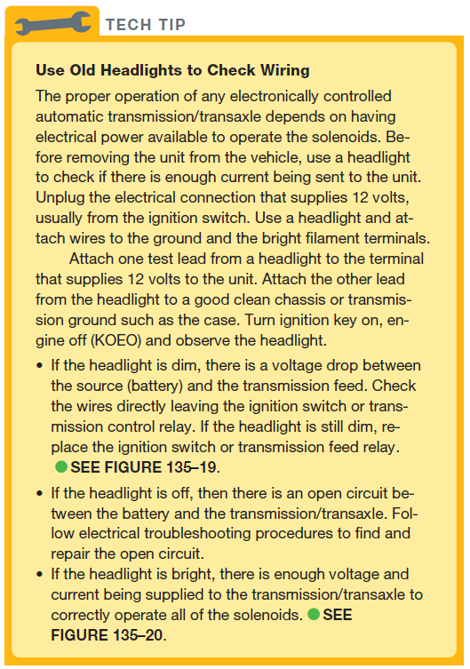
TECH TIP

Slide 31

Figure 135.19 A dim headlight indicates excessive resistance between the battery and the electrical connector to the automatic transmission/transaxle

Slide 32

Figure 135.20 A bright headlight indicates that there should be sufficient current flow available at the automatic transmission/ transaxle to operate all the solenoids correctly

Slide 33

Copyright

