Slide 1
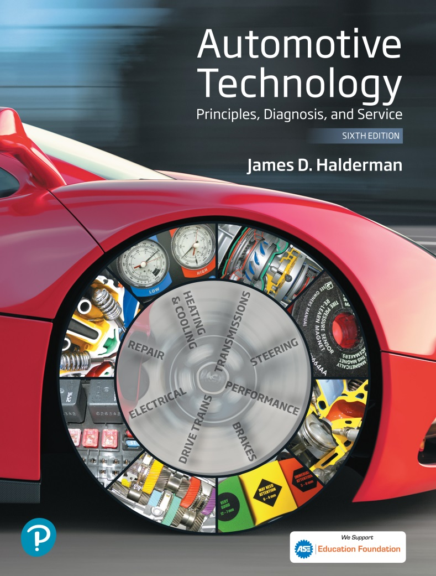
Automotive Technology Principles, Diagnosis, and Service
Sixth Edition
Chapter 134
Hydraulic Components and Control Systems
Copyright © 2018, 2015, 2011 Pearson Education, Inc. All Rights Reserved

Slide 2
LEARNING OBJECTIVES (1 of 2)
134.1 Discuss the different types of automatic transmission fluid.
134.2 Explain the function of automatic transmission fluid coolers, pumps, and apply/holding devices.
134.3 Discuss bands, multi-plate clutches, accumulators, and one-way clutches.

Slide 3
LEARNING OBJECTIVES (2 of 2)
134.4 Explain the construction of a valve body and discuss the operation of hydraulically controlled transmission valves.
134.5 Explain electronically controlled transmissions and discuss the typical torque flow in these transmissions.

Slide 4
AUTOMATIC TRANSMISSION FLUID (1 OF 2)
Purpose and Function
  Automatic transmission fluid (ATF) is highly refined oil that is specially designed for use in an automatic transmission.
Purposes and functions of ATF are as follows:
  Transfers power in torque converter
  Provides hydraulic pressure in clutches and servos
  Lubricates bearings, bushings, and gears
  Transfers heat to cool transmission parts
  Provides the correct friction for clutch and band application

Slide 5
AUTOMATIC TRANSMISSION FLUID (2 OF 2)
The three basic types of ATF include:
  Non-friction modified.
  Friction modified.
  Highly friction modified.
Typical ATF Applications
  Automatic transmission fluid is formulated to work in specific transmissions. Using the specified fluid is the key to proper operation.

Slide 6
AUTOMATIC TRANSMISSION FLUID COOLER
Purpose and Function
  Most vehicles use a small section of the engine cooling system radiator to transfer heat from the ATF to the coolant, which cools the ATF.
Parts and Operation
  The ATF is pumped (directed) from the torque converter (greatest source of heat) to the cooler when the torque converter clutch is not applied.
Transmission Fluid Heater
  Some vehicles are equipped with a transmission fluid heater to improve lubrication when the fluid is cold.

Slide 7
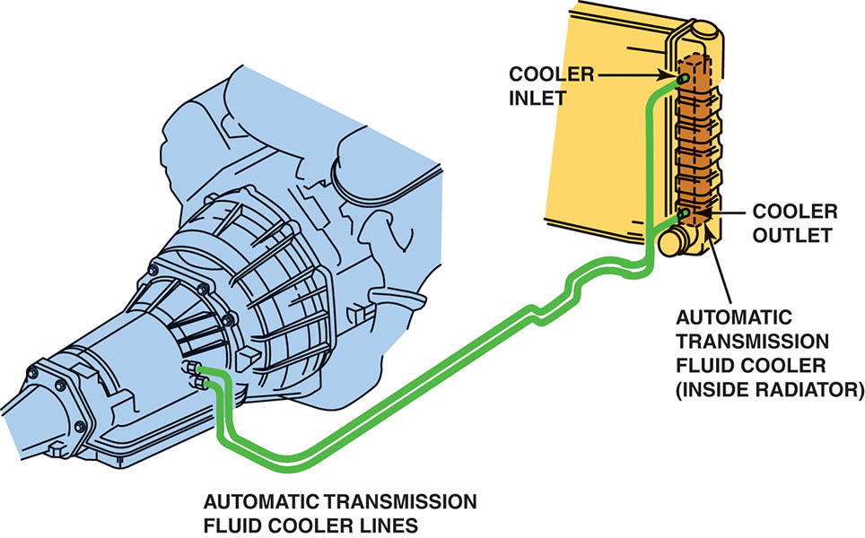
Figure 134.1 Automatic transmission fluid is routed from the torque converter, where most of the heat is generated, to the radiator where it is cooled. The fluid then returns to the transmission/transaxle to lubricate the bearings and bushings

Slide 8
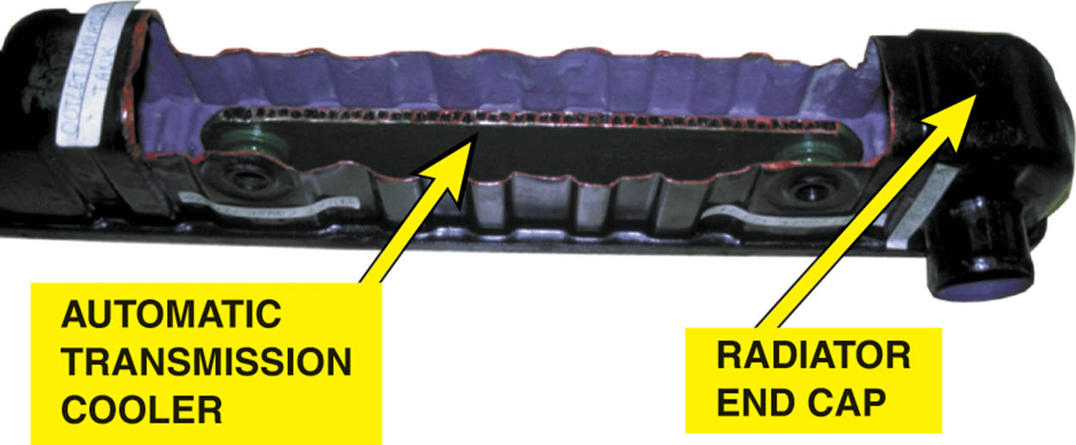
Figure 134.2 A cutaway of a typical radiator showing the automatic transmission cooler. The heat from the automatic transmission fluid is released to the engine coolant. The engine coolant also warms the fluid as soon as the coolant flows through the radiator

Slide 9
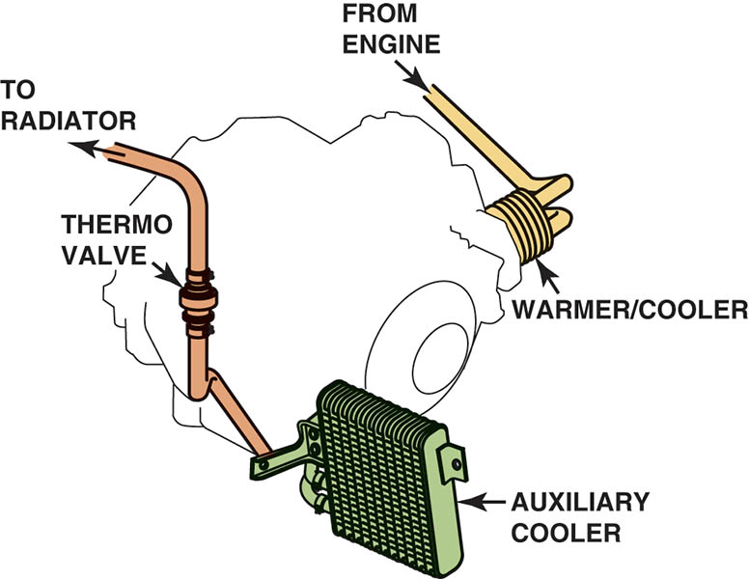
Figure 134.3 Engine coolant from the engine block flows through the passages in the cooler /warmer, and then out through the thermo valve to the upper radiator tank. The thermo valve uses a wax element–type valve to control the flow of engine coolant through the case-mounted cooler/warmer.

Slide 10
QUESTION 1: ?
What is the purpose of a transmission cooler?

Slide 11
ANSWER 1:
To dissipate heat created primarily in the torque converter.

Slide 12
TRANSMISSION OIL PUMP (1 OF 2)
Purpose and Function
  The pump is used to supply fluid flow and to pressurize the system.
Parts and Operation
  Most oil pumps mount directly behind the torque converter and are usually driven by the converter drive hub.
Pressure Regulation
  A pressure regulator valve, or pressure control valve is used to control hydraulic pressure.

Slide 13
TRANSMISSION OIL PUMP (2 OF 2)
Variable Displacement Pump
  Many newer automatic transmissions and transaxles use a variable displacement pump to reduce the power needed to achieve fluid pressure.
Electronic Pressure Regulation
  Transmissions/transaxles often regulate hydraulic system pressure using computer-controlled solenoids.
Typical Pressures
  Normal line pressure = 60 to 120 PSI (414 to 830 kPa)
  Wide open throttle (WOT) = 90 to 150 PSI (620 to 1,034 kPa)

Slide 14
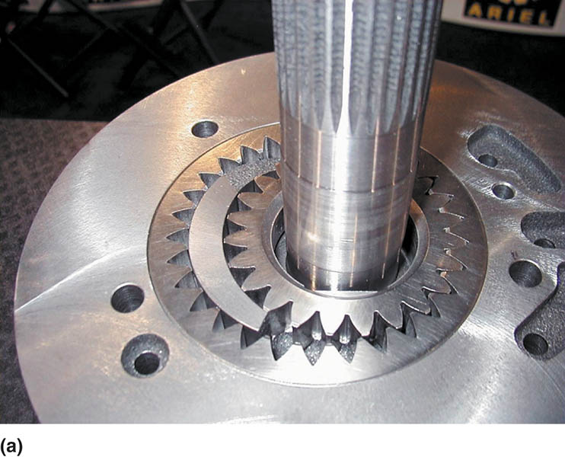
Figure 134.4 (a) Gear-type pump

Slide 15
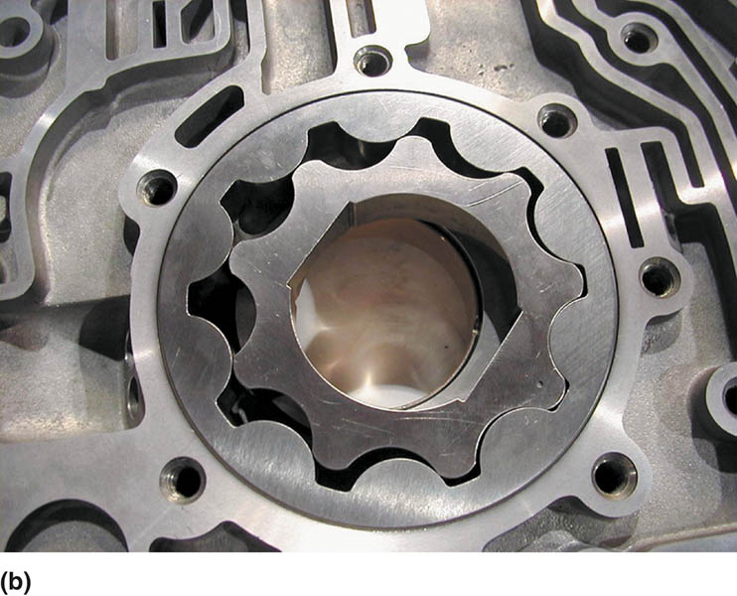
Figure 134.4 (b) Geroter-type pump

Slide 16
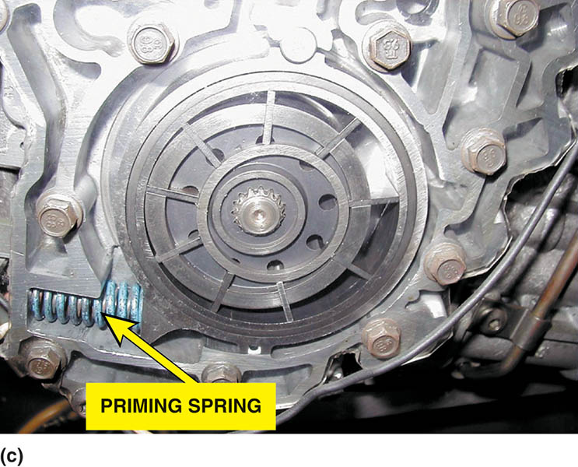
Figure 134.4 (c) Vane-type pump

Slide 17
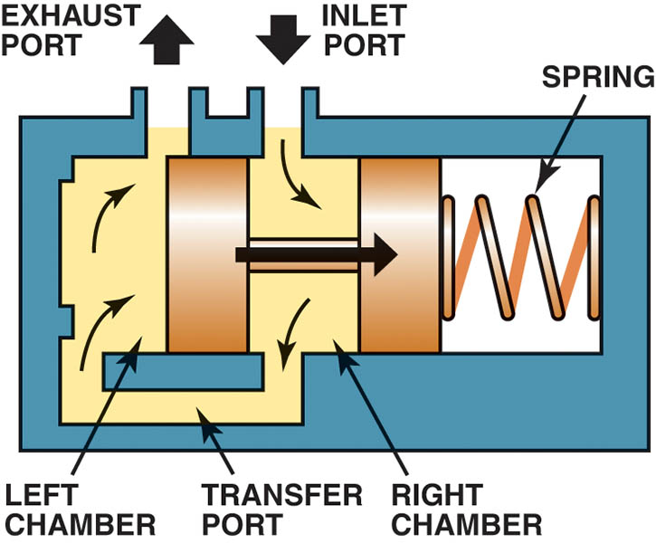
Figure 134.5 When pressure on the face of the pressure regulator valve overcomes spring force, the valve moves to open the exhaust port

Slide 18
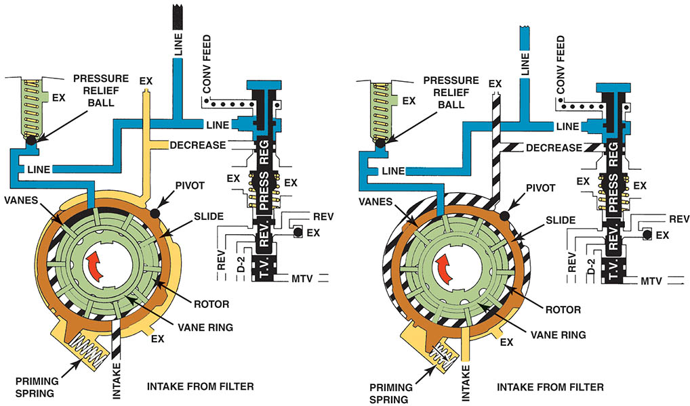
Figure 134.6 The variable pump is at the maximum output position until the regulator valve moves enough to decrease volume by rotating the slide against the force of the priming spring.

Slide 19
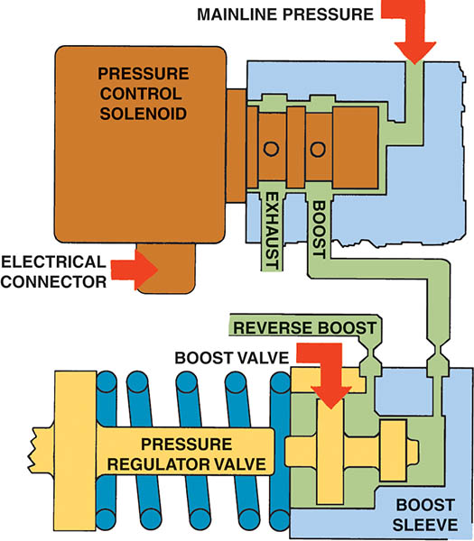
Figure 134.7 The pressure control solenoid controls the mainline pressure, which is in turn controlled by the powertrain control module (PCM) or the transmission control module (TCM), by applying pressure to the spring side of the pressure regulator valve

Slide 20
APPLY OR HOLDING DEVICES
Purpose and Function
  Mechanical or hydraulic assemblies that provide the force to hold or drive members of a planetary gear set.
Automatic transmissions typically use the following as apply devices.
  Bands
  Multi-plate clutches
  One-way clutches

Slide 21
BANDS
Terminology
  Transmission bands are holding (braking) devices.
  A transmission band stops and holds one planetary gear set member.
Hydraulic Servos
  A band is applied by using a hydraulically operated piston that travels inside a machined cylinder bore.
Servo Linkages
  Servo rods and struts transfer the servo apply force to the transmission band.

Slide 22
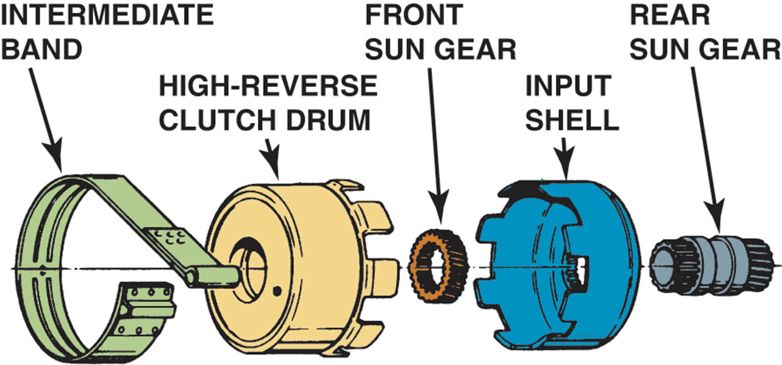
Figure 134.8 Gear set members are attached to a drum and are held stationary when the band applies

Slide 23
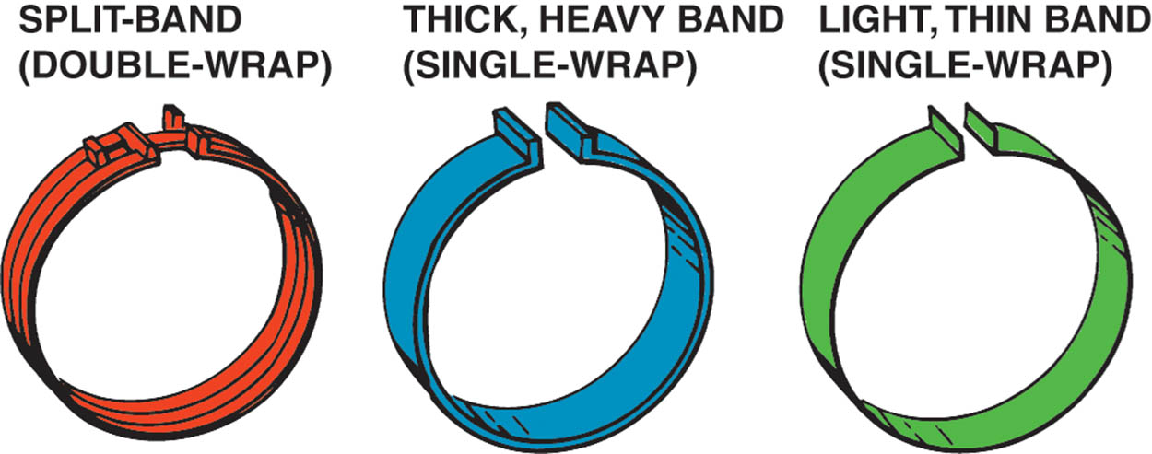
Figure 134.9 Transmission bands come in several designs and thicknesses

Slide 24
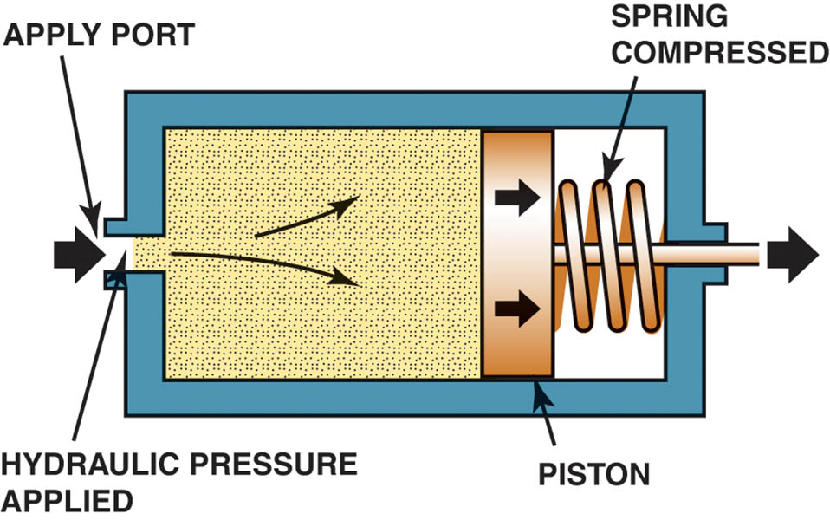
Figure 134.10 A servo uses hydraulic pressure to move a piston, which applies a band

Slide 25
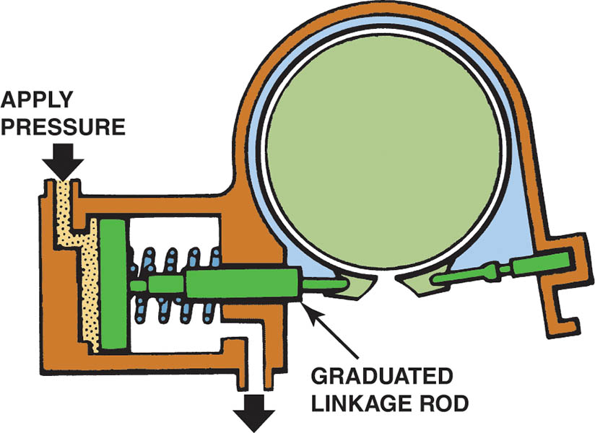
Figure 134.11 One end of a band is held stationary and the other end is attached to the servo

Slide 26
MULTIPLE-PLATE CLUTCHES (1 OF 2)
Terminology
  Clutches have more friction area so they can develop more force and handle more torque than a band, and they are self-adjusting.
Parts
  The multiple-plate clutch consists of plates, a piston, drum (retainer), and snap ring.

Slide 27
MULTIPLE-PLATE CLUTCHES (2 OF 2)
Clutch Operation
  To apply the clutch, pressurized fluid enters the drum through an internal passage in the input shaft.
  To release the clutch the piston return spring returns the piston to it’s at rest position.
Two Types of Clutches
  Holding (braking) clutches
  Driving clutches

Slide 28
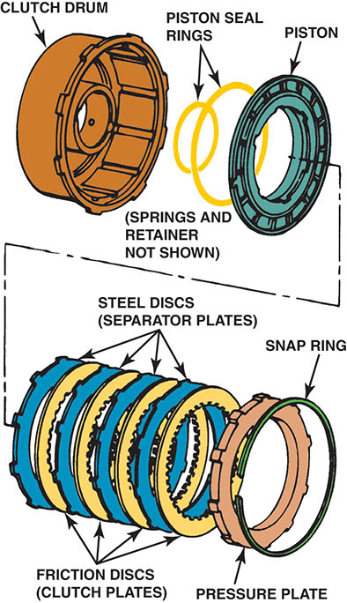
Figure 134.12 An exploded view of a multiple-plate clutch pack assembly

Slide 29
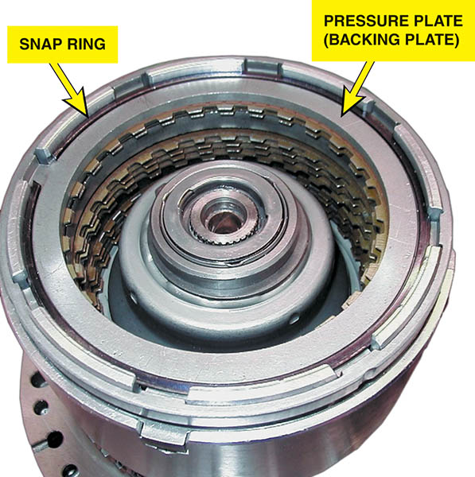
Figure 134.13 A typical clutch pack assembly

Slide 30
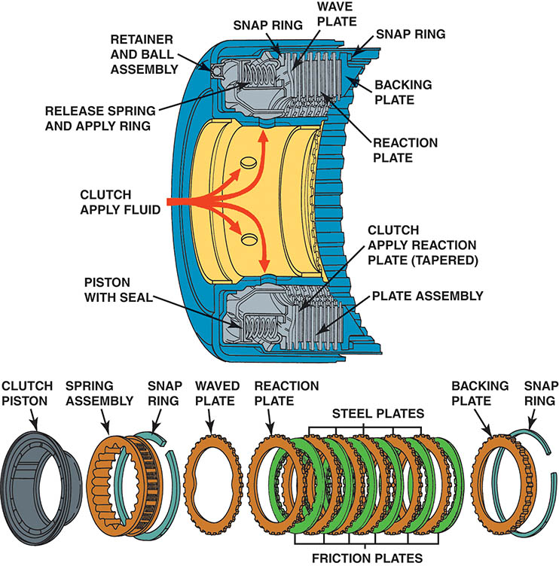
Figure 134.14 Hydraulic fluid under pressure enters the clutch housing and exerts a force on the clutch piston. The clutch piston forces the steel plates and the friction plates together, creating a shift

Slide 31
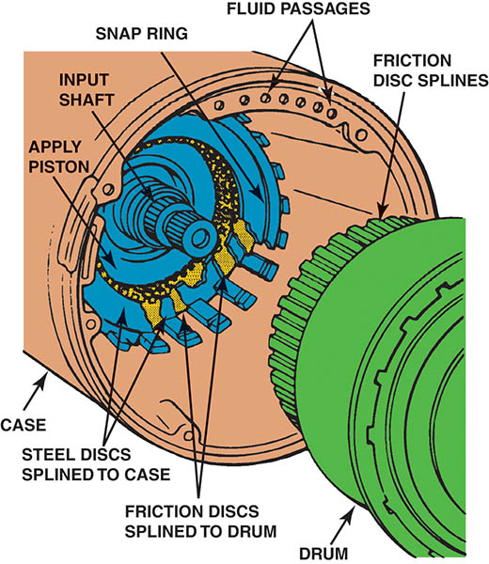
Figure 134.15 In a holding clutch, one set of discs engages splines on the transmission case and the other set engages splines on the drum. By applying the clutch, the drum is locked to the case

Slide 32
QUESTION 2: ?
What is the function of a holding clutch?

Slide 33
ANSWER 2:
To hold a member of a planetary gear set.

Slide 34
ACCUMULATORS
Purpose and Function
  An accumulator cushions or dampens the apply force during a shift.
Operation
  The accumulator piston area and spring are designed to absorb fluid during the clutch circuit pressure rise when the clutch piston stops moving.

Slide 35
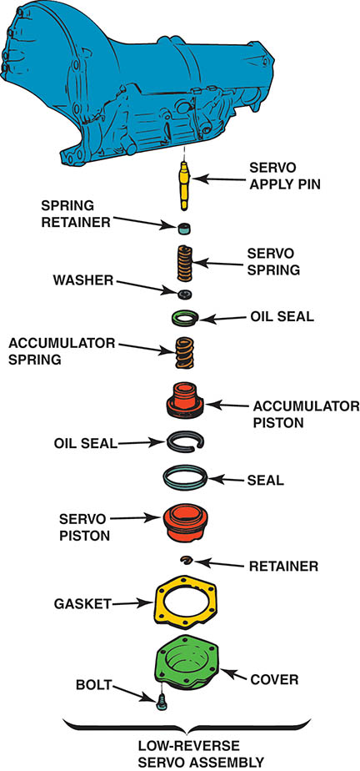
Figure 134.16 An integral accumulator is combined with a servo in a single bore in the transmission housing

Slide 36
ONE-WAY CLUTCHES
Terminology
  A one-way clutch is always a holding device.
  One-way clutches are either roller or sprag clutches.
One-Way Roller Clutch
  A one-way roller clutch consists of a hub, rollers, and springs that fit inside a drum.
One-Way Sprag Clutch
  A one-way sprag clutch that consists of a hub and a drum separated by a number of figure-eight shaped metal pieces called sprags.

Slide 37
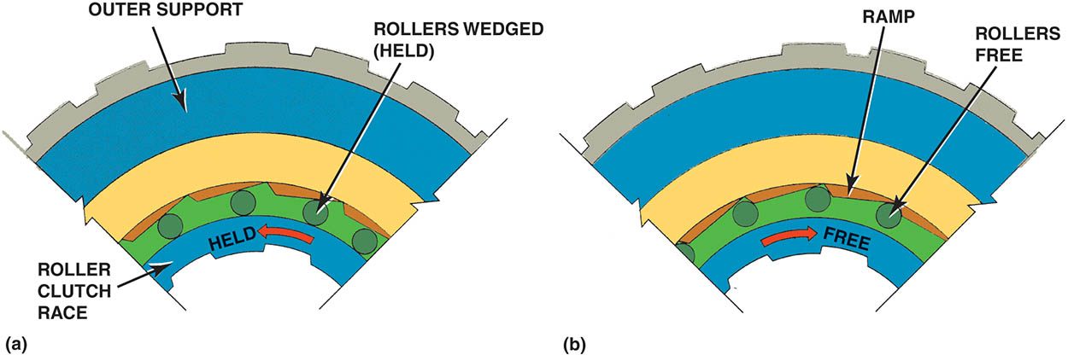
Figure 134.17 (a) Roller one-way clutch in the locked (held) position. Note how the rollers are wedged into the ramp that is machined into the outer support

Slide 38
Figure 134.17 (b) Roller one-way clutch in released (free) position. When the inner roller clutch race rotates faster than the outer support, the rollers move out of the wedge and are free to rotate, thereby unlocking the one-way clutch

Slide 39
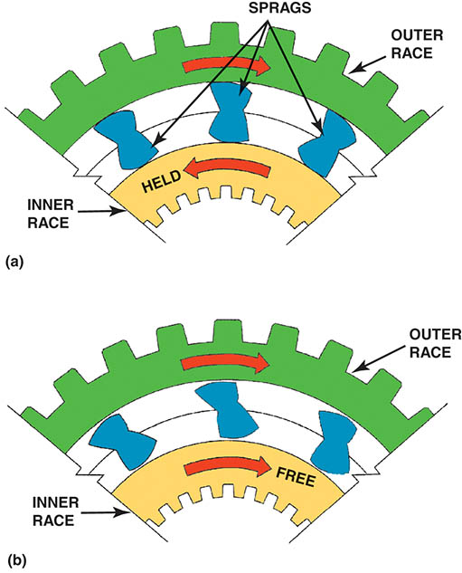
Figure 134.18 (a) The sprag in the holding (locked) position. Note how the long portion of the sprag is wedged between the inner and outer race

Slide 40
Figure 134.18 (b) The sprag in the released position. The inner race is free to rotate faster than the outer race

Slide 41
VALVE BODY (1 OF 2)
Purpose and Function
  A valve body is where most of the valves in a transmission are located, and is attached to the case with bolts.
Parts
  Valve bodies have many fluid passages for the various transmission hydraulic circuits as well as check balls, a separator plate and mounting locations for solenoids.

Slide 42
VALVE BODY (2 OF 2)
Flow-Directing Valves
  Control the direction and distribution of fluid flow in the hydraulic system.
One-Way Valves
  A one-way valve allows fluid to flow in one direction.
Check Balls and Orifices
  Control rate of fluid flow.
Manual Valve
  The primary flow-directing valve in an automatic transmission.

Slide 43
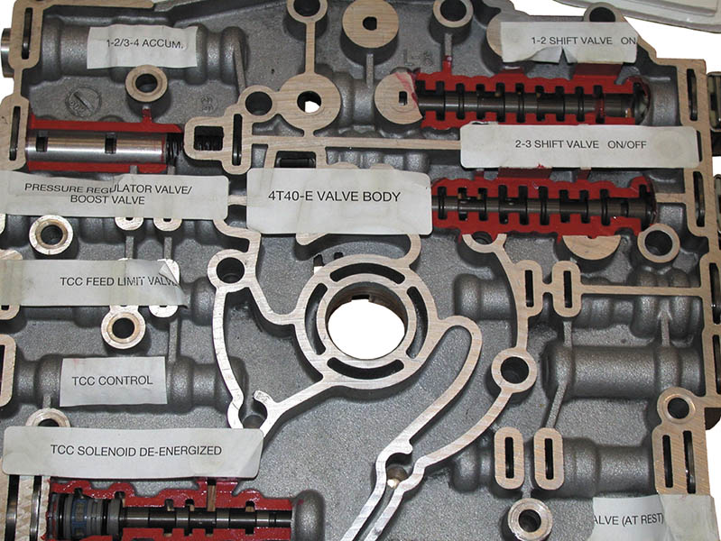
Figure 134.19 A partially cutaway valve body from a General Motors 4T40-E transaxle

Slide 44
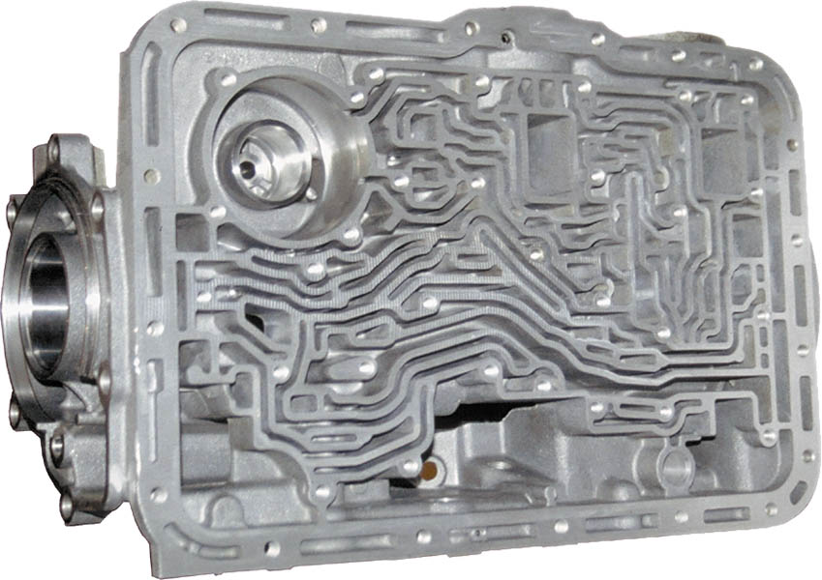
Figure 134.20 A typical upper valve body showing the fluid passages (“worm holes”)

Slide 45
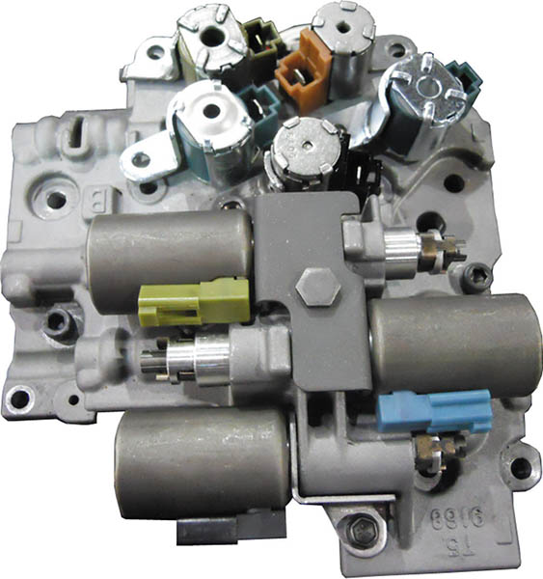
Figure 134.21 Electronically controlled automatic transmissions/transaxles use solenoids located in the valve body to control line pressure and to open and close passages in the valve body to control shifts

Slide 46
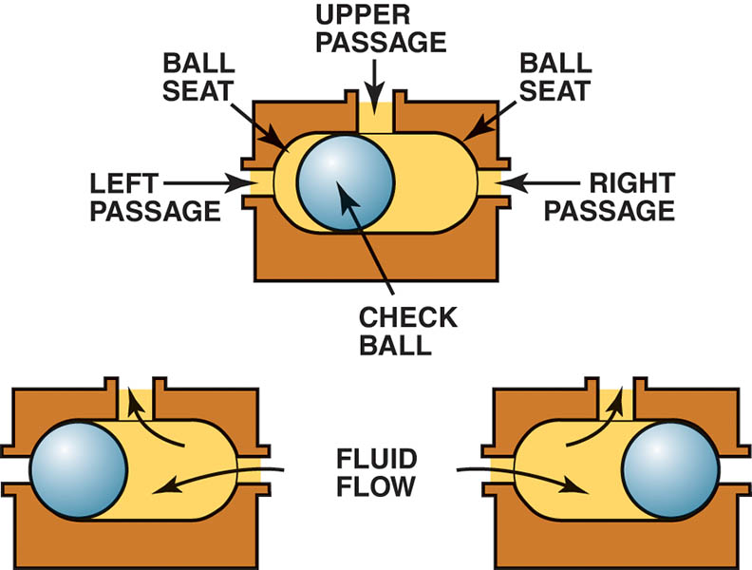
Figure 134.22 Check balls are used in the valve body to allow hydraulic circuits to share a common passage

Slide 47
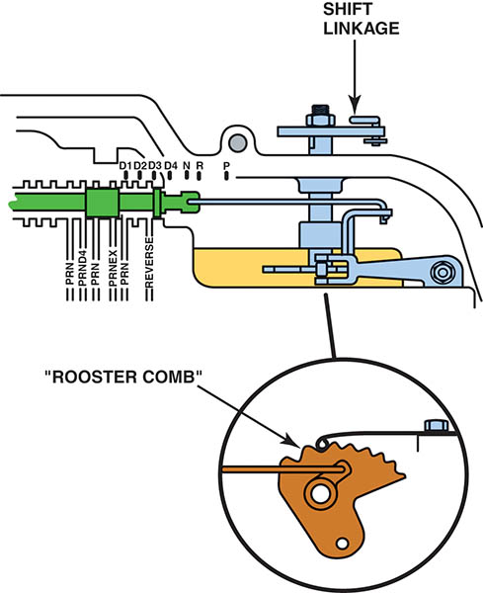
Figure 134.23 A rooster comb is the detent that helps retain the manual valve in the various positions in the valve body

Slide 48
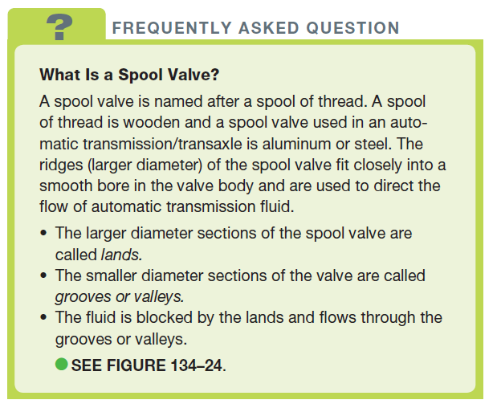
FREQUENTLY ASKED QUESTION

Slide 49
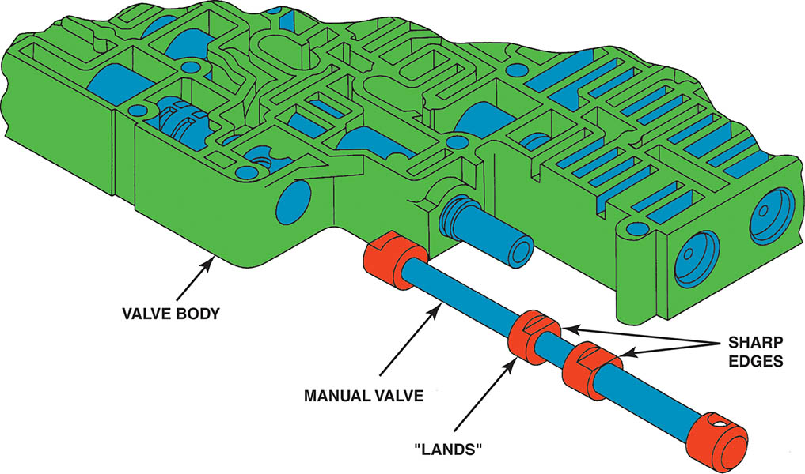
Figure 134.24 The manual valve is a spool valve that is moved by the shift linkage. All valves in the valve body have sharp edges on the lands. Any dirt in the valve body area can cause shifting problems due to the close tolerances between the valves and the bores in the valve body

Slide 50
HYDRAULICALLY CONTROLLED TRANSMISSION VALVES (1 OF 2)
Purpose and Function
  Hydraulically controlled automatic transmissions/transaxles use valves to control when to shift.
Throttle Valve
  The transmission throttle valve senses engine load and uses that operating signal to develop throttle pressure on hydraulically controlled automatic transmissions.

Slide 51
HYDRAULICALLY CONTROLLED TRANSMISSION VALVES (2 OF 2)
Vacuum Modulator Valve
  A vacuum modulator is used to convert engine manifold vacuum into a signal pressure that increases as engine vacuum decreases.
  Shift timing is affected by this signal.
Governor Valve
  The governor valve monitors vehicle road speed and uses that operating signal to develop governor pressure.
Shift Valves
  Controls the transmission upshift and downshift circuits.

Slide 52
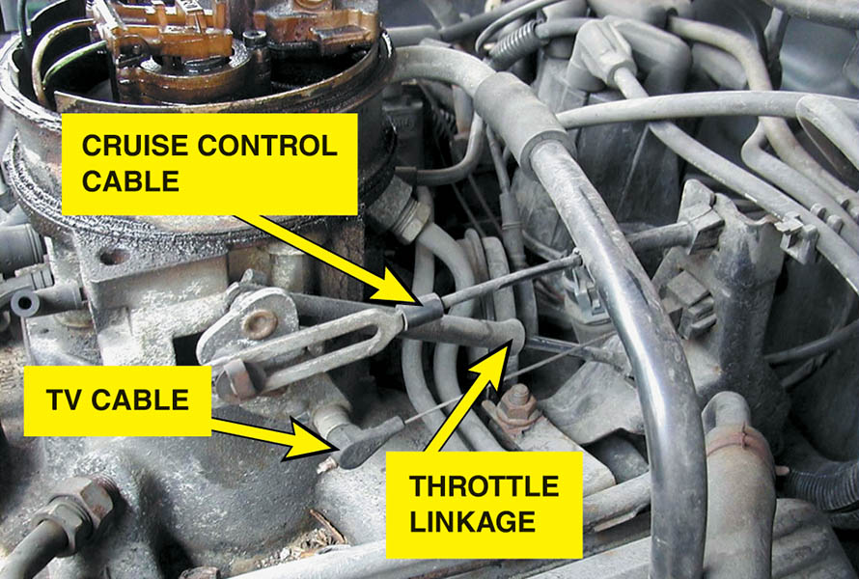
Figure 134.25 The throttle valve (TV) cable on a 4L60

Slide 53
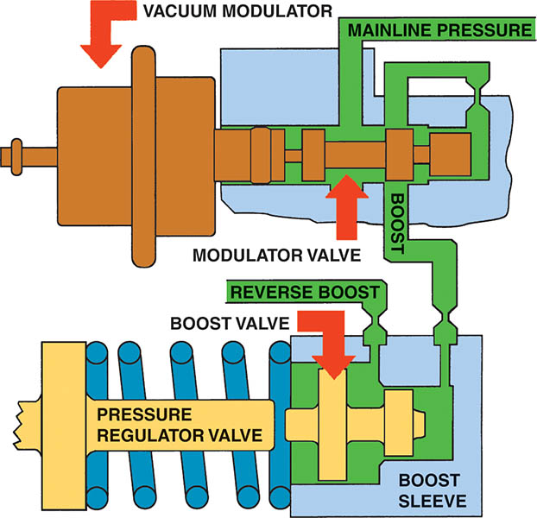
Figure 134.26 A vacuum modulator moves the modulator valve depending on the vacuum of the engine. A heavy load on the engine causes the vacuum to be lower than when the engine is operating under a light load. The spool valve applies mainline pressure to the boost sleeve of the pressure regulator valve which causes the mainline pressure to increase

Slide 54
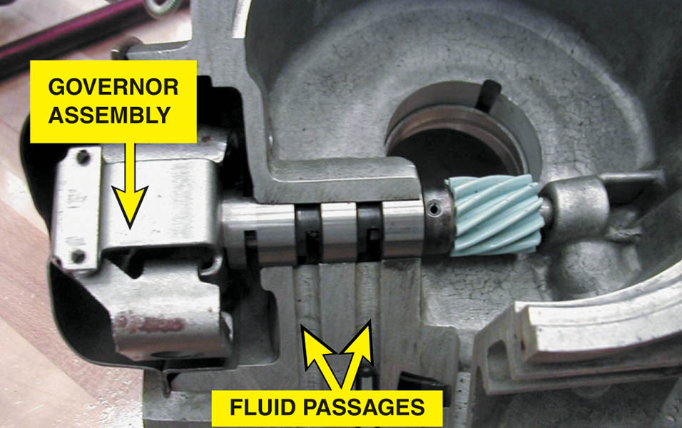
Figure 134.27 A governor assembly is used on older hydraulically controlled automatic transmissions/transaxles to control shift points based on vehicle speed

Slide 55
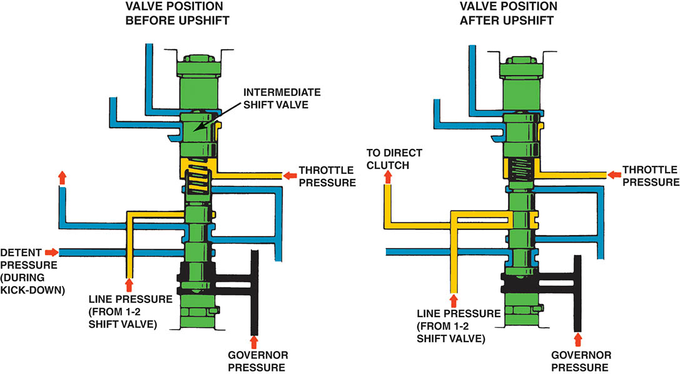
Figure 134.28 Shift valves move when there is a difference in pressure. In a hydraulically controlled automatic transmission/transaxle, the shift valves compare governor pressure force against throttle valve (TV) pressure force to determine when to upshift or downshift

Slide 56
ELECTRONICALLY CONTROLLED TRANSMISSIONS (1 OF 2)
Background
  The powertrain control module (PCM) or the transmission control module (TCM) control shifting.
Inputs
  The control module uses information from various sensors to make shift calculations.
Outputs
  The control module uses various actuators to control transmission operation.

Slide 57
ELECTRONICALLY CONTROLLED TRANSMISSIONS (2 OF 2)
Adaptive Learning
  Most late model electronically controlled automatic transmissions/transaxles use the PCM or TCM to monitor the time it takes to complete a shift.
  The control module can control fluid volume and/or pressure as the transmission wears to ensure a proper shift.
Shift Solenoids
  On-Off Solenoids
  Linear Solenoids

Slide 58
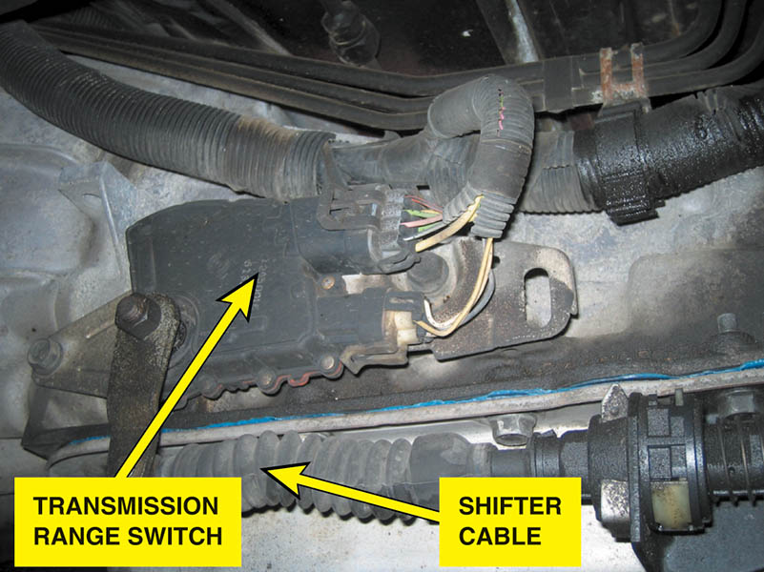
Figure 134.29 A transmission range switch on a rear-wheel-drive automatic transmission mounted directly to the side of the case of the unit and accessible from underneath the vehicle

Slide 59
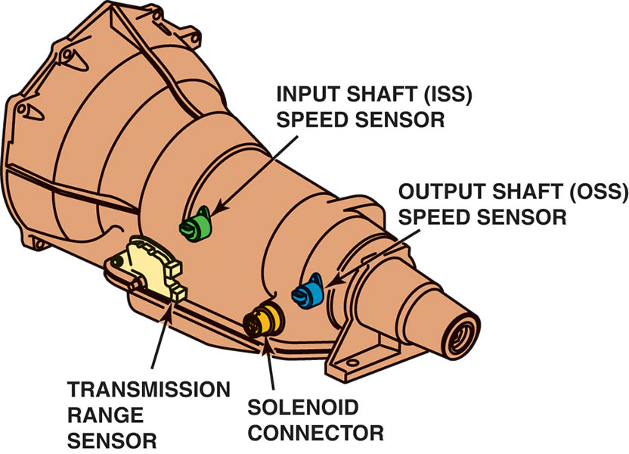
Figure 134.30 Speed sensors are used by the powertrain control module (PCM) or the transmission control module (TCM) to control shifts and detect faults such as slippage when the two speeds do not match the predetermined ratio for each gear commanded

Slide 60
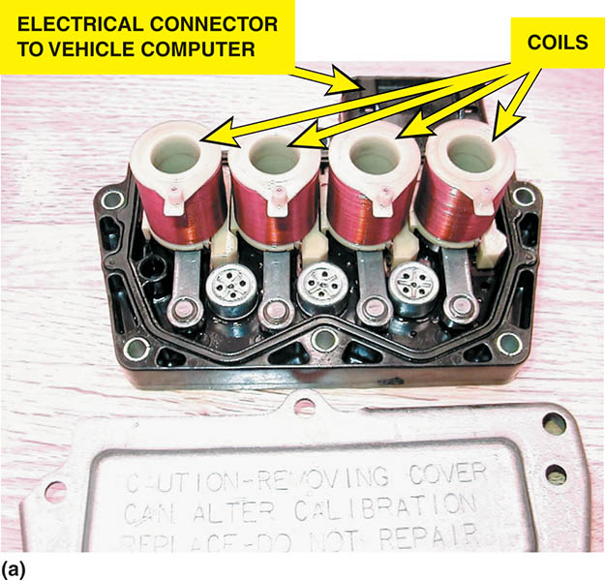
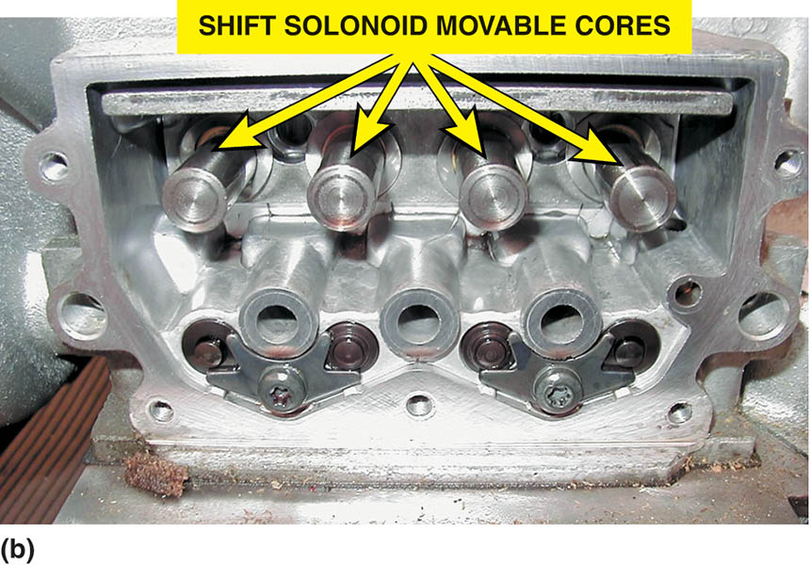
Figure 134.31 An example of a solenoid valve installed in a valve body assembly

Slide 61
QUESTION 3: ?
What is adaptive learning?

Slide 62
ANSWER 3:
The transmissions ability to change fluid pressure and volume as the transmission wears.

Slide 63
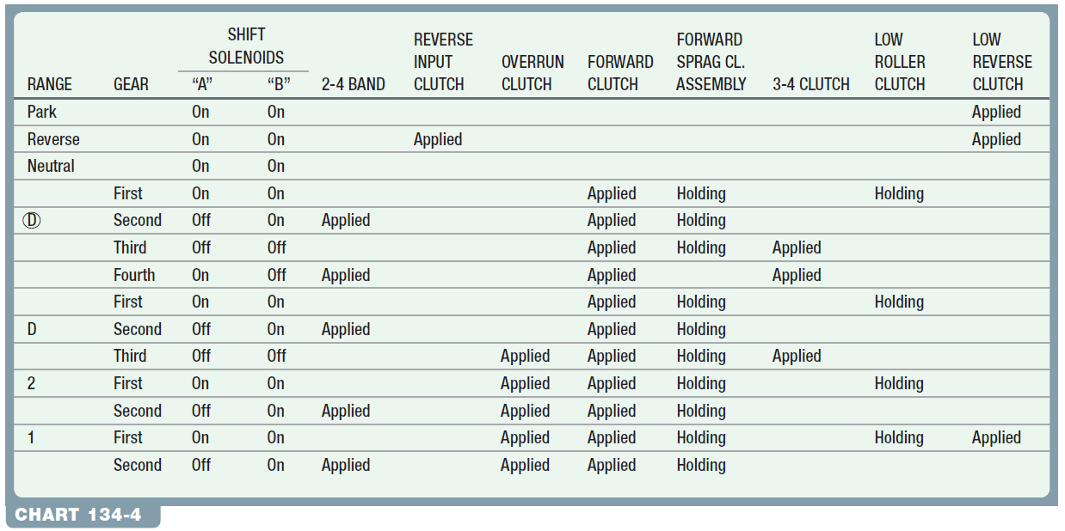
TYPICAL TORQUE FLOW

Slide 64
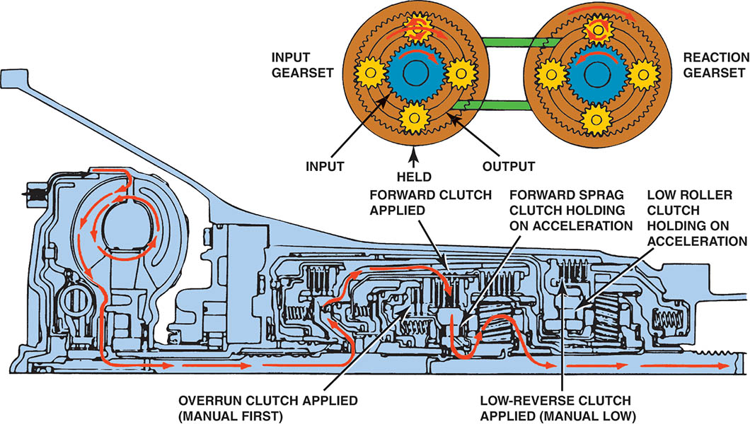
Figure 134.32 A GM 4L60-E torque (power) flow in overdrive first gear

Slide 65
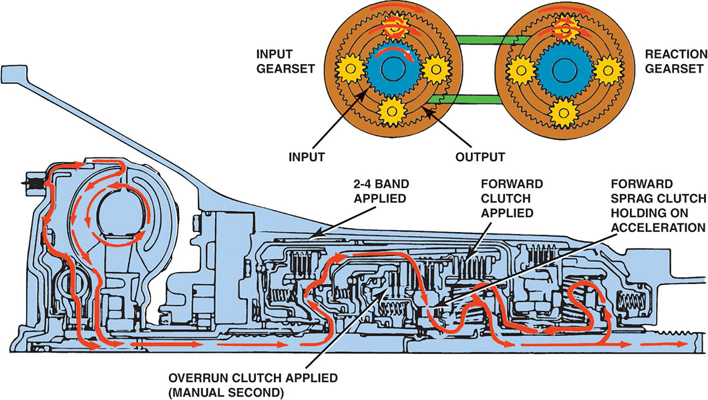
Figure 134.33 A GM 4L60-E torque (power) flow in overdrive second gear

Slide 66
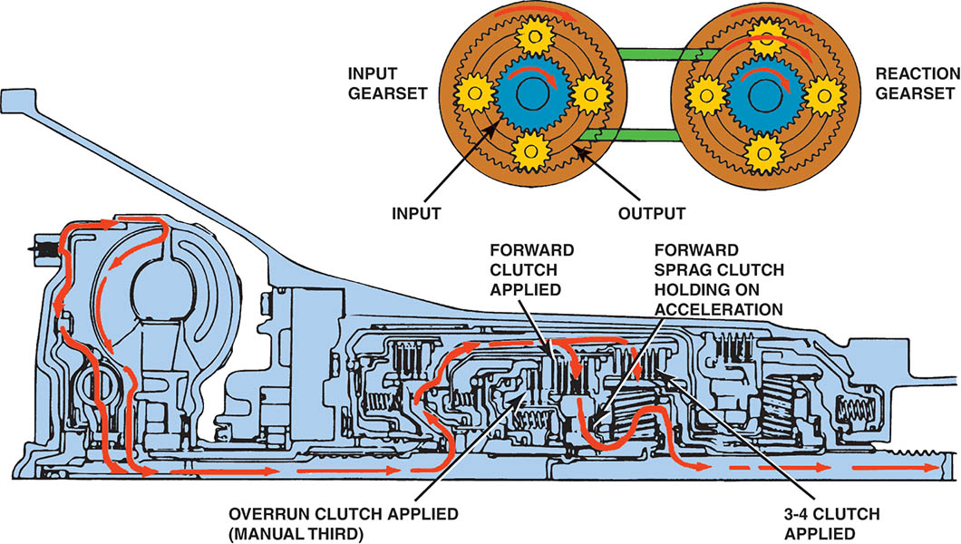
Figure 134.34 A GM 4L60-E torque (power) flow in overdrive third gear

Slide 67
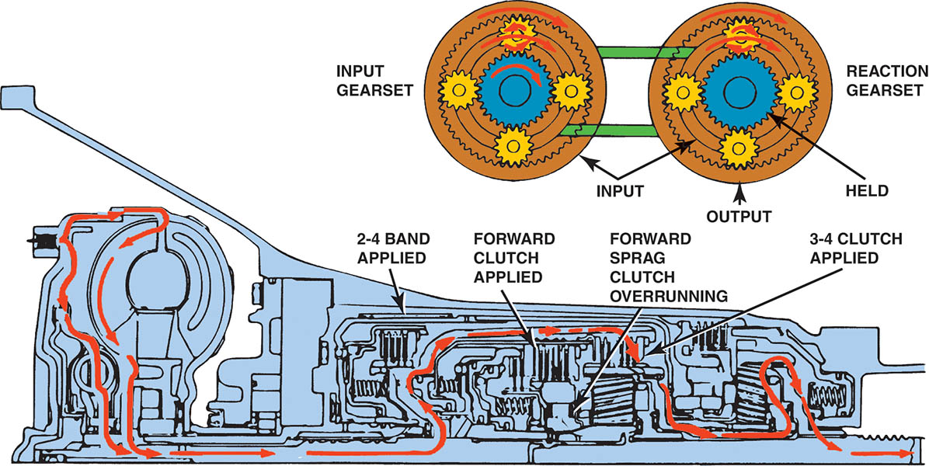
Figure 134.35 A GM 4L60-E torque (power) flow in overdrive fourth gear

Slide 68
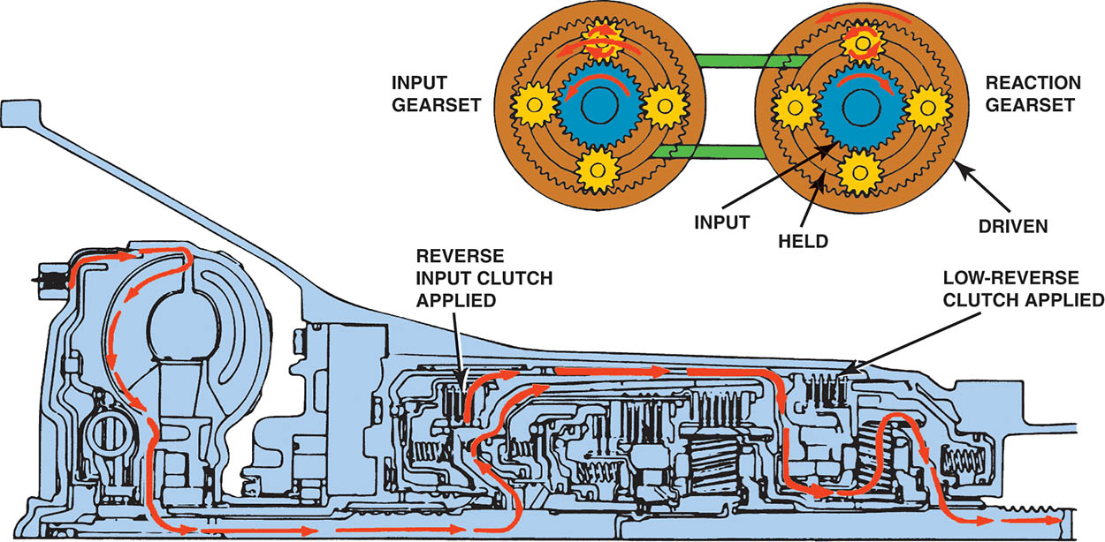
Figure 134.36 A GM 4L60-E torque (power) flow in reverse

Slide 69

Copyright

