Slide 1
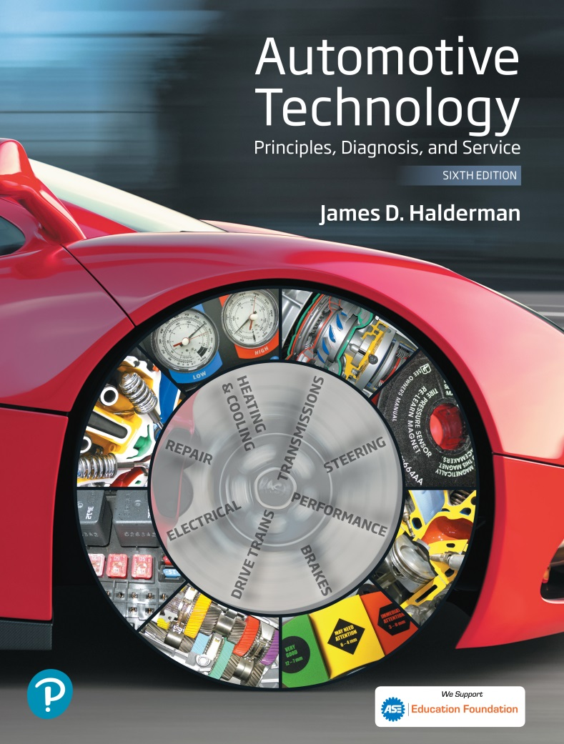
Automotive Technology Principles, Diagnosis, and Service
Sixth Edition
Chapter 133
Automatic Transmission/ Transaxle Principles
Copyright © 2018, 2015, 2011 Pearson Education, Inc. All Rights Reserved

Slide 2
LEARNING OBJECTIVES (1 of 2)
133.1 Explain the purpose, function, and operation of torque converters.
133.2 Explain the purpose, function, and operation of lockup torque converters.
133.3 Describe the various shift modes.
133.4 Discuss planetary gear sets and compound planetary gear sets.

Slide 3
LEARNING OBJECTIVES (2 of 2)
133.5 Discuss automatic transaxles and non-planetary gear automatic transaxles.
133.6 Discuss the operation and servicing of continuously variable transmission.
133.7 Explain how a dual clutch automatic transmission works.

Slide 4
BACKGROUND
Automatic transmissions were first used on a large scale in the early 1950s, and now over 95% of the vehicles in North America are so equipped.
The history of automatic transmission goes back over 100 years.

Slide 5
TORQUE CONVERTERS (1 OF 7)
Purpose and Function
  The torque converter is located between the engine and the transmission/transaxle and performs the following functions:
  Transmits and multiplies engine torque
  Acts as a clutch between the engine and the transmission/ transaxle
  Allows slippage, which makes it possible for the transmission to be engaged in gear even when the vehicle and wheels are stopped

Slide 6
TORQUE CONVERTERS (2 OF 7)
Parts
  Impeller.
  Turbine.
  Stator.
Operation
  The fluid only connection between the impeller and the turbine allows for absorption of sudden and harsh shocks in speed and/or torque.
  The stator is located between the impeller and turbine, and multiplies the torque from the impeller.

Slide 7
TORQUE CONVERTERS (3 OF 7)
Torque Converter Flexplate
  The flexplate is bolted to the engine and the torque converter and replaces the flywheel on a manual transmission vehicle.
Torque Converter Drives the Pump
  Oil pump drive shafts generally pass through the converter inside a hollow input or transfer shaft and internally connect to the converter housing by splines or a hexagon-shape shaft.

Slide 8
TORQUE CONVERTERS (4 OF 7)
Transmission Input Shaft
  Most rear-wheel-drive transmissions use an inline method to drive the converter and provide a direct mechanical connection between the turbine and the transmission input shaft.
Torque Converter Operation
  The two types of fluid flow inside a torque converter are rotary flow and vortex flow.
  Rotary flow is created by the rotation of the torque converter.
  Vortex flow is the flow of the fluid from the impeller to the turbine and back to the impeller.

Slide 9
TORQUE CONVERTERS (5 OF 7)
Torque Multiplication
  Torque multiplication occurs whenever the vortex flow makes a full cycle from impeller to turbine, through the stator and back to the impeller.
Coupling Phase
  When the speed ratio is 90° or more, fluid flow in the torque converter is mostly rotary flow and the angle of flow from turbine to stator increases creating a coupling phase.

Slide 10
TORQUE CONVERTERS (6 OF 7)
Stall Speed
  Stall speed is the engine speed when the engine drives the impeller at the maximum speed possible without moving the turbine.
Normal Operation
  When the transmission selector is moved from park (P) or neutral (N) into a drive gear, some engine torque is transferred to the input shaft of the transmission or transaxle.

Slide 11
TORQUE CONVERTERS (7 OF 7)
Torque Converter Diameter
  The outside diameter of a torque converter and the angle of its stator blades determine the stall speed of the converter.
Vehicle manufacturers select torque converters to match the powertrain requirements and operating demands of each vehicle application.

Slide 12
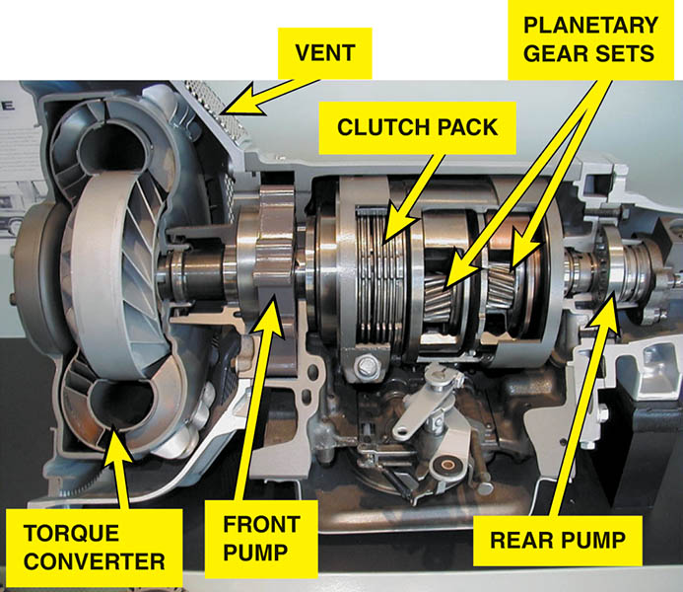
Figure 133.1 A cutaway of a Chrysler PowerFlite two speed automatic transmission used in the 1950s

Slide 13
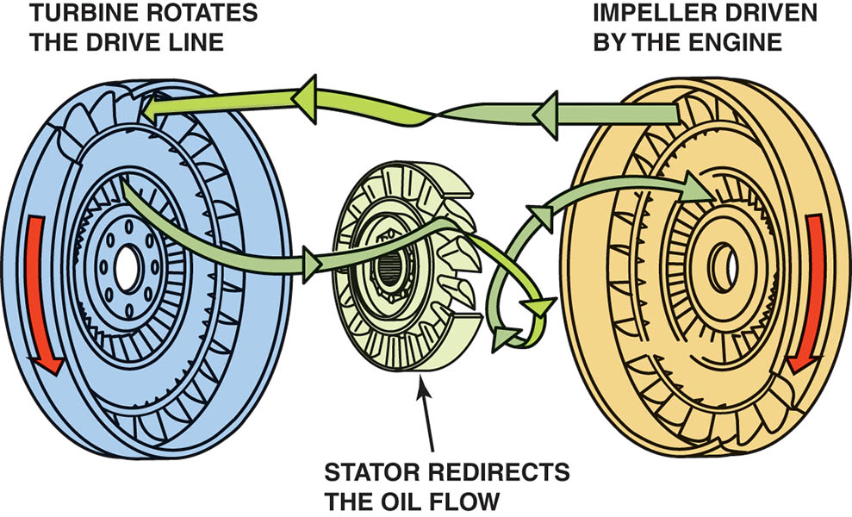
Figure 133.2 A torque converter is made from three parts: The impeller is located at the transmission end, attached to the housing, and is driven by the engine. The turbine is located at the engine side and is driven by the fluid flow from the impeller and drives the input shaft of the transmission. The stator redirects the flow to improve efficiency and multiply torque

Slide 14
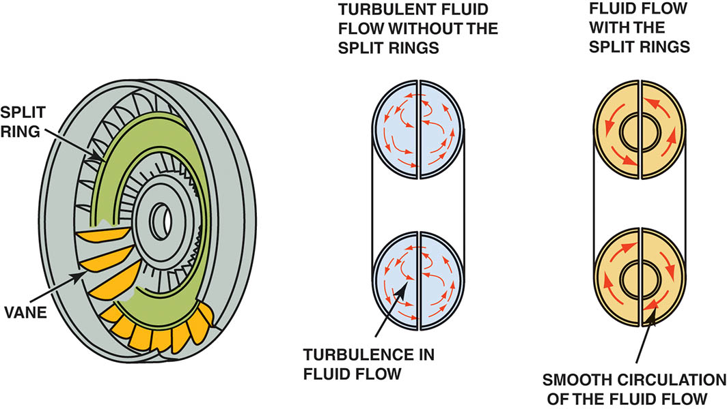
Figure 133.3 The split rings help direct the flow of fluid and improve the efficiency of the torque converter by reducing turbulence

Slide 15
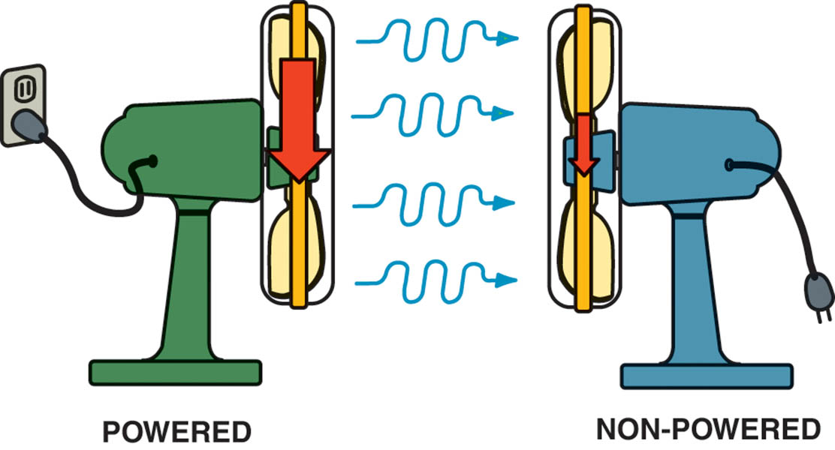
Figure 133.4 Two fans can be used to show how fluid, or air in the case of fans instead of automatic transmission fluid, can be used to transfer energy. If one fan is operating, the blades of a second fan will be rotated by the flow of air past the fan that is unplugged, causing the blades to rotate

Slide 16
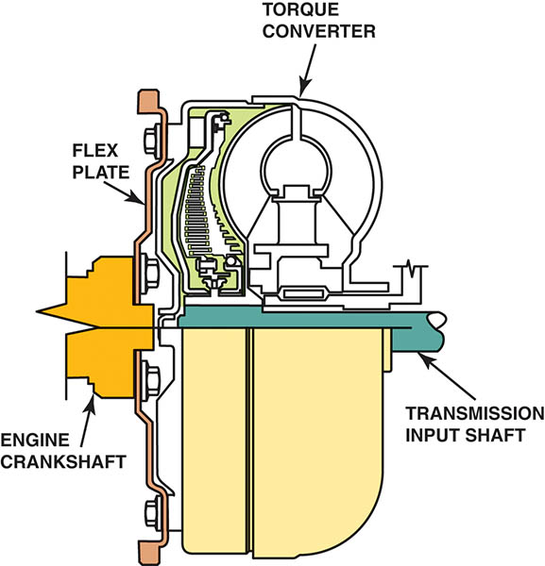
Figure 133.5 The torque converter bolts to the flexplate which is attached to the engine crankshaft and rotates at engine speed

Slide 17
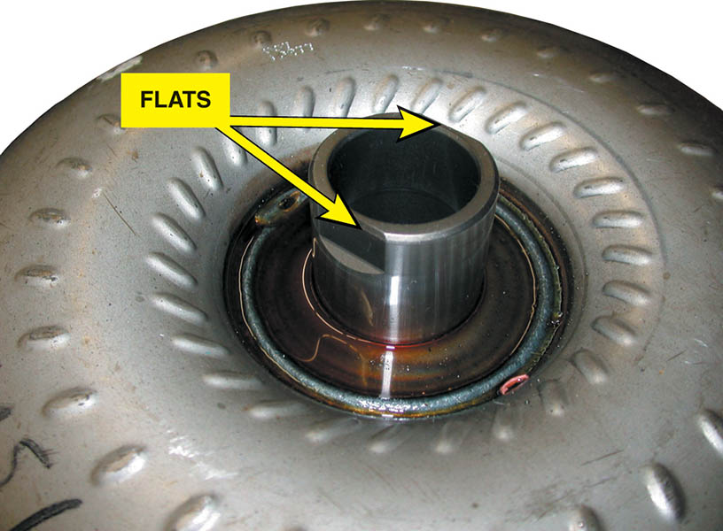
Figure 133.6 The flat sections that are cut into the hub of the torque converter are used to drive the fluid pump

Slide 18
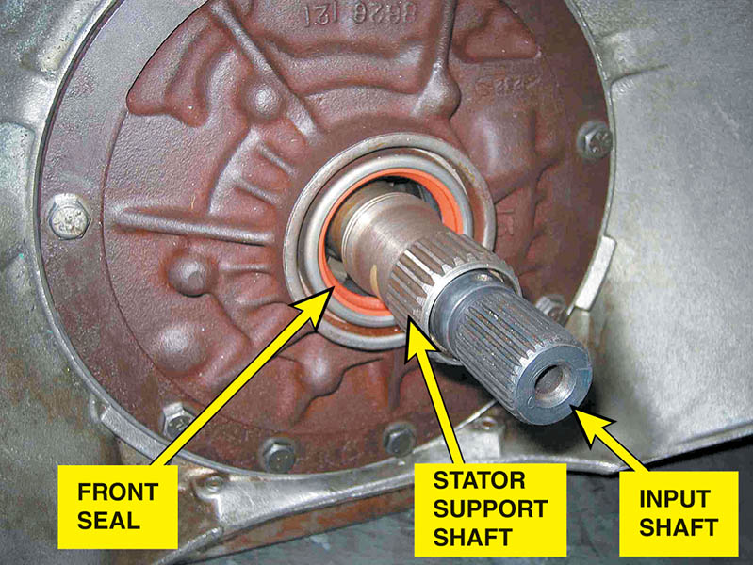
Figure 133.7 The internal splines inside the torque converter are connected to the splines on the stator support shaft and the turbine splines to the input shaft

Slide 19
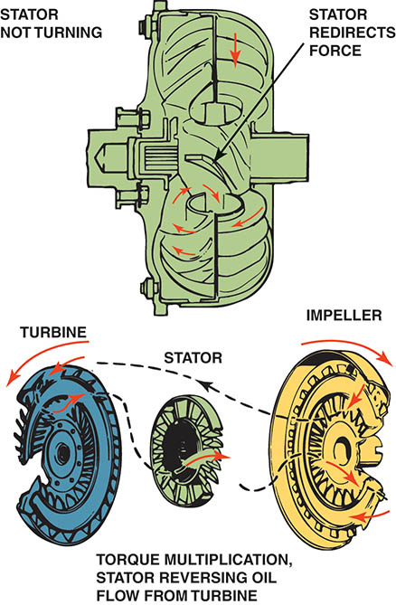
Figure 133.8 Torque multiplication occurs when fluid leaving the turbine strikes the front of the stator vanes and is redirected back to the impeller

Slide 20
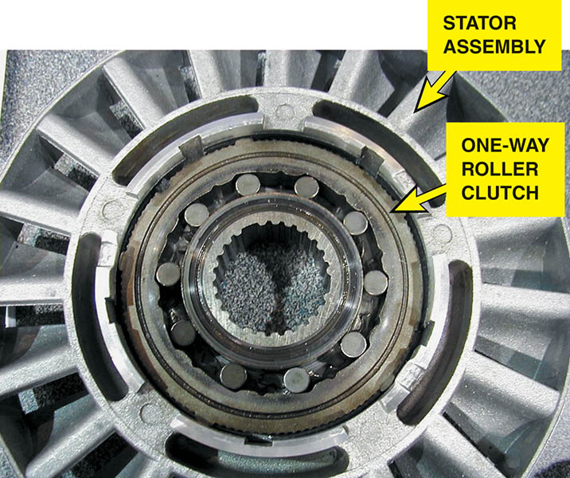
Figure 133.9 A stator contains a one-way roller clutch which locks it from rotating in one direction and allows it to rotate freely in the opposite direction

Slide 21
QUESTION 1: ?
What is the main purpose of a torque converter?

Slide 22
ANSWER 1:
Transmit and multiply engine torque.

Slide 23
LOCKUP TORQUE CONVERTER
Purpose and Function
  Lockup torque converters reduce slippage by using a torque converter clutch (TCC) to lock the impeller to the cover (shell).
  Eliminating torque converter slippage can improve fuel economy approximately 4% to 5% during freeway cruising.
Converter Clutch Control
  The powertrain control module (PCM) or the transmission control module (TCM) regulates the timing and application of the clutch.

Slide 24
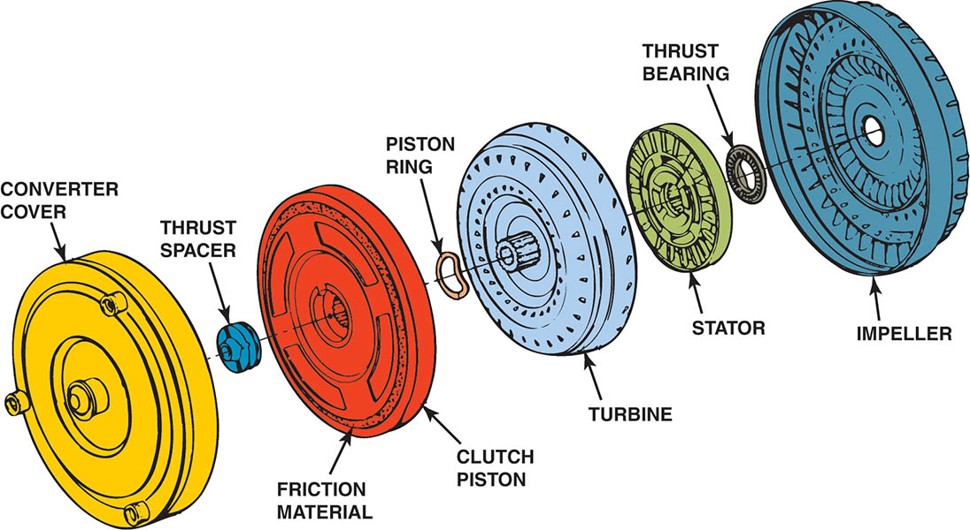
Figure 133.10 An expanded view of a typical torque converter assembly showing the torque converter clutch (TCC)

Slide 25
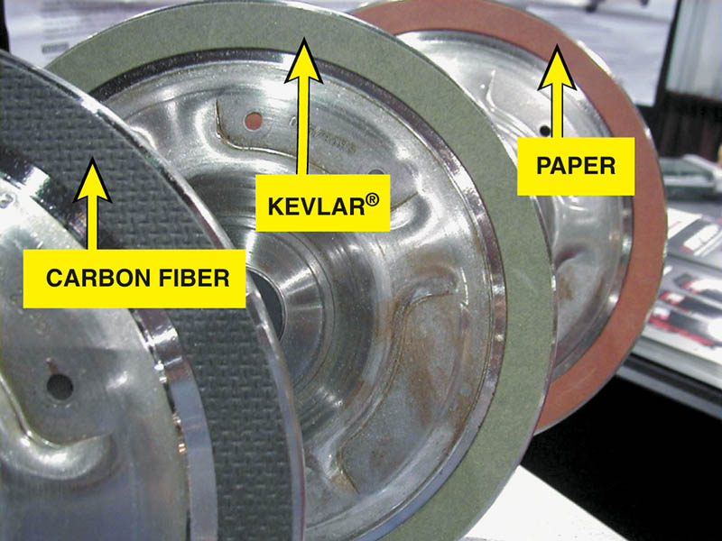
Figure 133.11 Torque converter clutch friction material is determined by the vehicle manufacturer to provide the needed coefficient of friction needed.

Slide 26
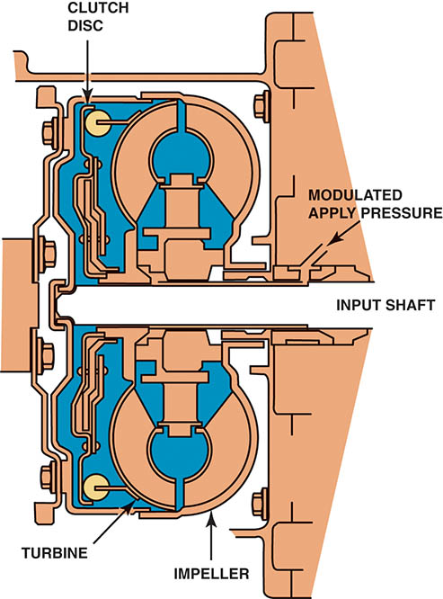
Figure 133.12 A cross-sectional view of a pulse-width-modulated (PWM) torque converter clutch. The powertrain control module (PCM) pulses the control solenoid which then controls the fluid flow to apply the torque converter clutch

Slide 27
SHIFT MODES
Most automatic transmissions and transaxles include the following shift modes.
  Park (P)
  Reverse (R)
  Neutral (N)
  Overdrive (OD)
  Drive (D)
  Third (3)
  Second (2)
  First (1 or Low)

Slide 28
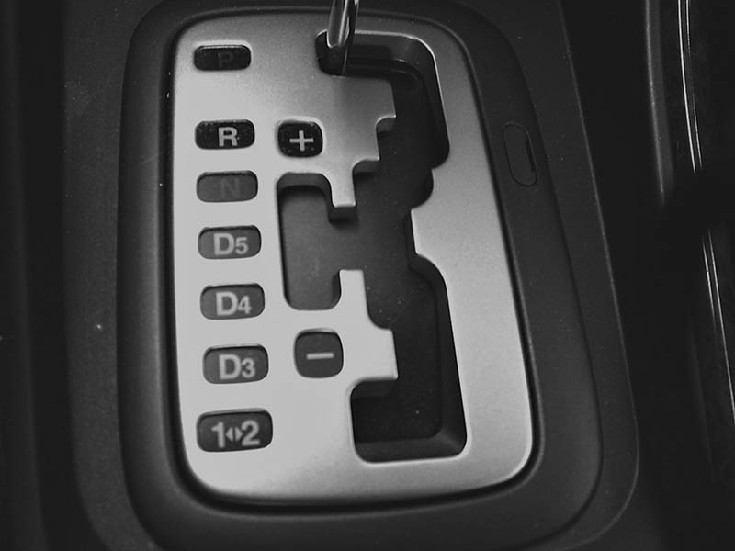
Figure 133.13 The gear selector is often called the “PRNDL,” pronounced “prindle,” regardless of the actual letters or numbers used

Slide 29
PLANETARY GEAR SETS (1 OF 2)
Purpose and Function
  Planetary gear sets are used in the automatic transmission to obtain different gear ratios.
Parts and Operation
  Sun Gear
  Planet Carrier
  Ring Gear

Slide 30
PLANETARY GEAR SETS (2 OF 2)
Planetary Gear Set Torque Flow
  One of the members is being driven (input).
  One of the members is being held (reaction member).
  One of the members is the output.
Simple Planetary Gear Set
  A simple planetary gear set system consists of one sun gear, the carrier, and a ring gear.

Slide 31
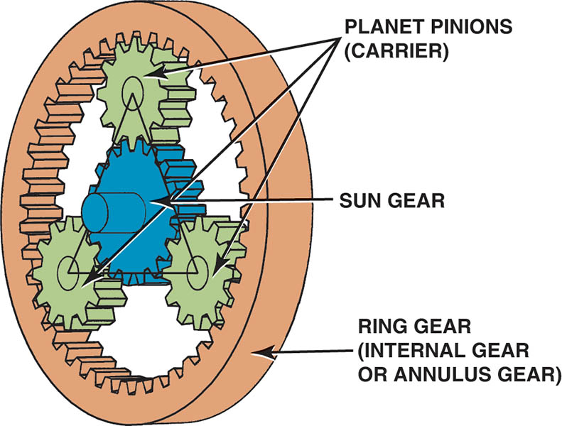
Figure 133.14 A typical planetary gear set showing the terms that are used to describe each member

Slide 32
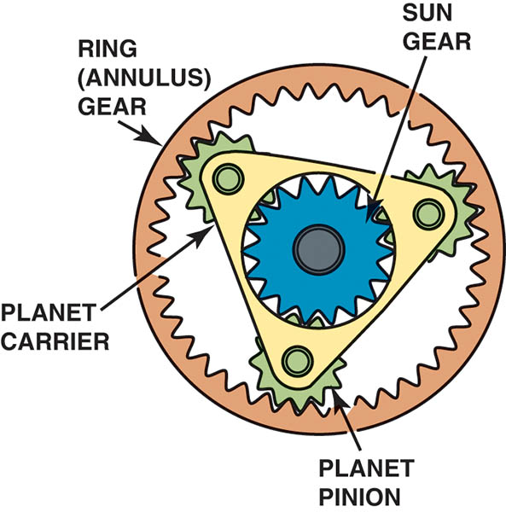
Figure 133.15 A typical planetary gear set showing the planet carrier which supports all of the pinion gears (also called planet pinion gears)

Slide 33
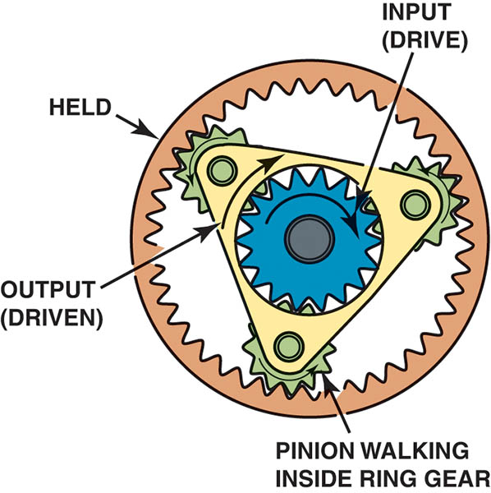
Figure 133.16 Maximum reduction can be achieved by using the sun gear as the input, holding the ring gear and using the planet carrier as the output

Slide 34
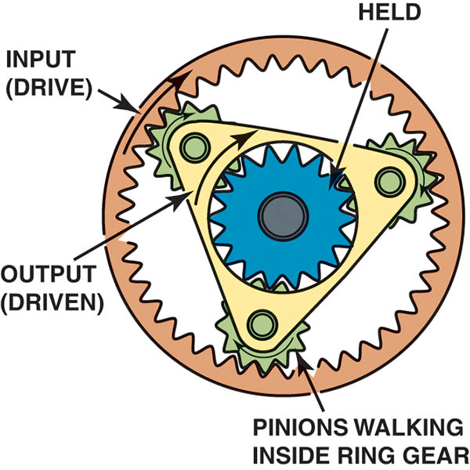
Figure 133.17 Minimum reduction can be achieved by using the ring gear as the input, holding the sun gear and using the planet carrier as the output

Slide 35
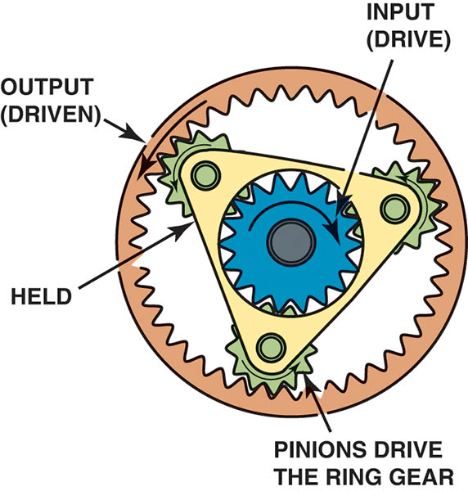
Figure 133.18 Reverse can be achieved by using the sun gear as the input, holding the planet carrier and using the ring gear as the output

Slide 36
QUESTION 2: ?
What are the three parts of a simple planetary gear set?

Slide 37
ANSWER 2:
The sun gear, the ring gear, and the planet pinions.

Slide 38
COMPOUND PLANETARY GEAR SET
Simpson Gear Set
  The Simpson gear set consists of two simple planetary gear sets that share a common sun gear.
Ravigneaux Gear Set
  The Ravigneaux system has two sun gears, two planet pinion sets, and a single ring gear.
Lapelletier Gear Set
  The Lapelletier gear set is constructed by connecting a planetary gear set in front of a Ravigneaux gear set.

Slide 39
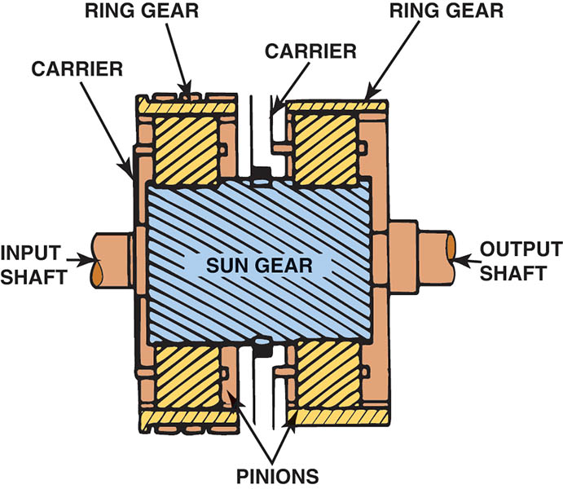
Figure 133.19 A Simpson planet gear set is composed of two ring gears and two planet carrier assemblies that share one sun gear

Slide 40
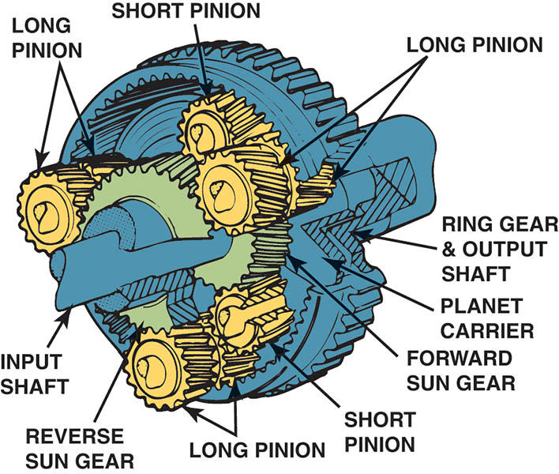
Figure 133.20 A Ravigneaux gear set is composed of two sun gears, one planet carrier that supports two sets of pinion gears, and a single ring gear

Slide 41
AUTOMATIC TRANSAXLES
Terminology
  Automatic transaxles include a differential assembly as well as the planetary gear sets of an automatic transmission.
Final Drive Units
  A transaxle includes a differential assembly, often called a final drive assembly as part of the transaxle.
  This final drive assembly connects the output from the gear sets to the drive axle shafts.

Slide 42
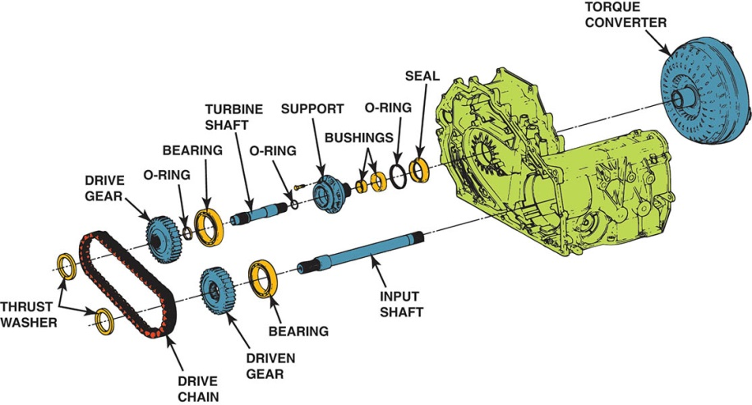
Figure 133.21 On one style of transaxle the turbine shaft drives the input shaft through a drive chain assembly

Slide 43
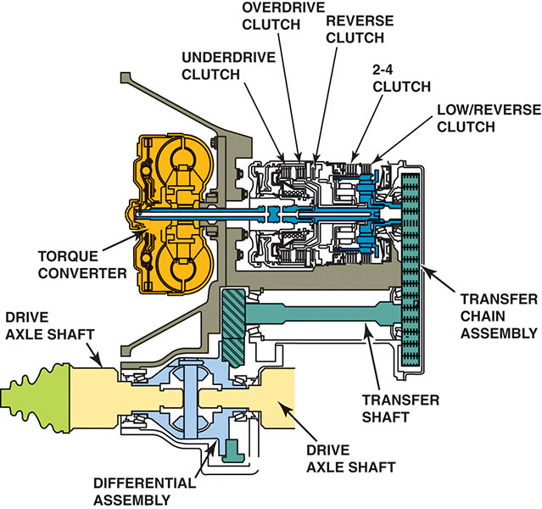
Figure 133.22 Another type of transaxle uses a chain to transfer engine torque from the output of the gear sets to the differential assembly (final drive)

Slide 44
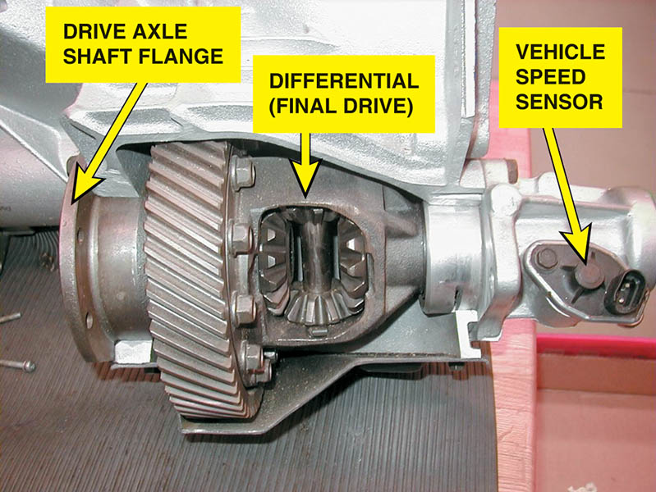
Figure 133.23 A cutaway showing the final drive assembly of a transaxle

Slide 45
NONPLANETARY GEAR AUTOMATIC TRANSAXLES
Honda and Saturn vehicles use an automatic transmission with no planetary gear sets.
This design uses hydraulic clutches instead of synchronizers to make the shift between gears.

Slide 46
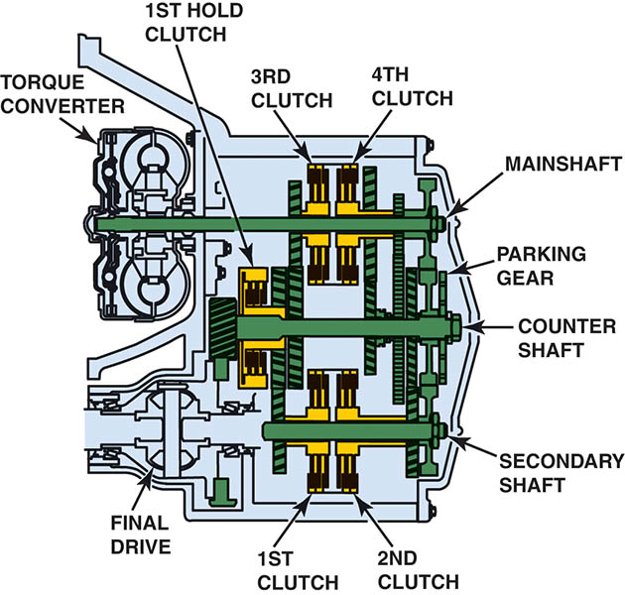
Figure 133.24 A Honda nonplanetary gear set type automatic transmission that uses helical cut gears instead of planetary gears. Hydraulically applied clutches as commanded by the PCM with fluid flow controlled by shift solenoids to make the shifts

Slide 47
CONTINUOUSLY VARIABLE TRANSMISSION (1 OF 4)
Terminology
  Instead of using three or more gears, a continuously variable transmission uses two variable width pulleys, sometimes called variators, to change the gear ratio from about 2.5:1 to an overdrive ratio of 0.5:1.
Purpose and Function
  Allow the engine to operate in a speed range where it is most efficient.

Slide 48
CONTINUOUSLY VARIABLE TRANSMISSION (2 OF 4)
Parts and Operation
  The two pulleys are moved at the same time. One pulley is made smaller in diameter while at the same time the other pulley is enlarged.
  The chain is pushed rather than pulled through the pulleys and is made of hundreds of individual steel elements.
The transmission has a total of four parallel shafts:
  Input shaft, drive pulley shaft, driven pulley shaft, and a secondary gear shaft.

Slide 49
CONTINUOUSLY VARIABLE TRANSMISSION (3 OF 4)
CVT Operation
  The pulleys used in this CVT design can vary their width by varying the hydraulic pressure applied to them.
  Each pulley has a movable face and a fixed face.
  The movable face for each pulley is attached to a piston that has hydraulic control pressure applied to it.
  A multiple disc clutch is used for forward and reverse.
  Some models uses a start clutch instead of a torque converter.

Slide 50
CONTINUOUSLY VARIABLE TRANSMISSION (4 OF 4)
Servicing a CVT Transmission
  Pressure and stall test
  Start clutch calibration
  Fluid level check

Slide 51
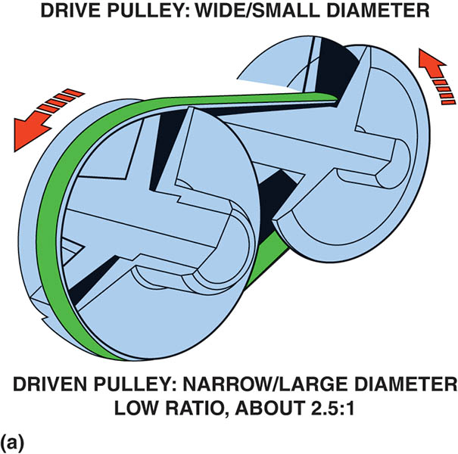
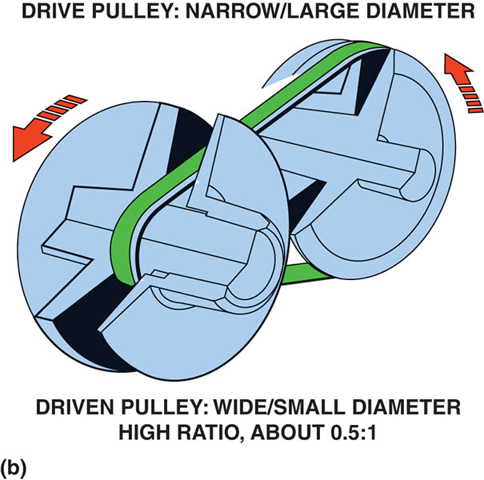
Figure 133.25 A belt and pulley CVT uses variable width pulleys and a special chain to provide an infinite number of speed ratios

Slide 52
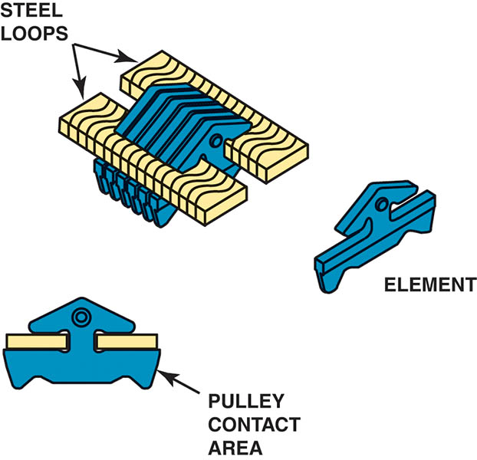
Figure 133.26 CVT belt construction

Slide 53
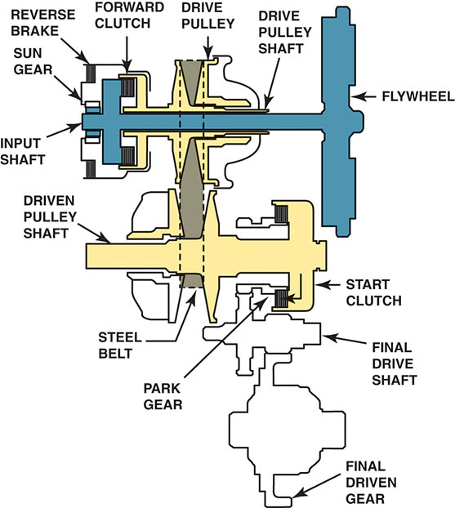
Figure 133.27 Honda CVT power flow in park (P) and neutral (N)

Slide 54
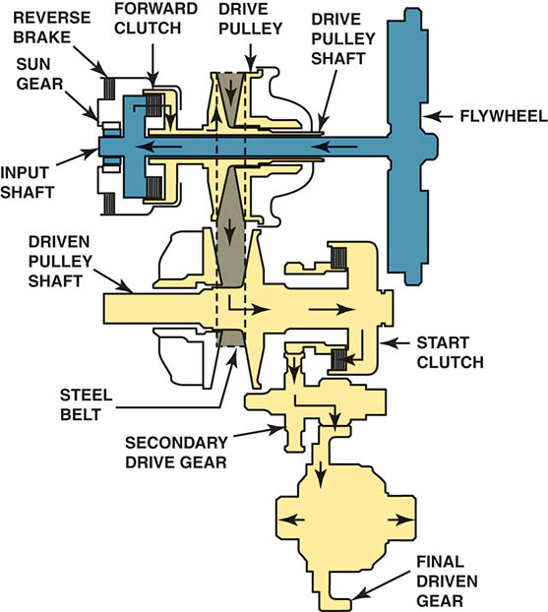
Figure 133.28 Honda CVT operation in drive (D) or low (L)

Slide 55
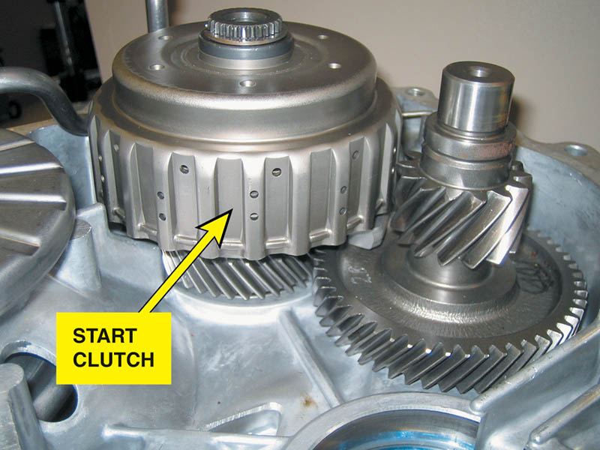
Figure 133.29 Location of the Honda CVT start clutch

Slide 56
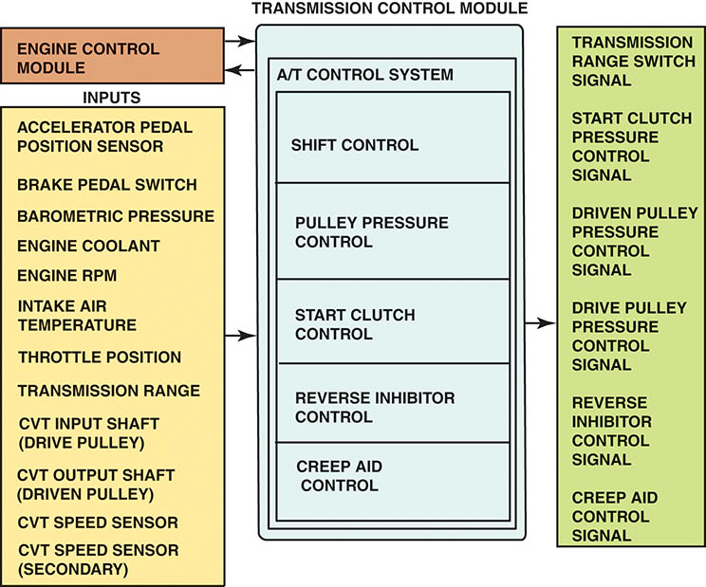
Figure 133.30 The Honda CVT transmission control module (TCM) showing the inputs (sensors) on the left and the outputs on the right

Slide 57
DUAL CLUTCH AUTOMATIC TRANSMISSIONS (1 OF 3)
Purpose and Function
  A dual clutch automatic transmission or transaxle uses a manual-type transmission and two clutches that engage either the main input shaft or the counter shaft to achieve the same function as a n automatic transmission.
  Improve the fuel economy.
  Reduce the cost of the assembly by using manual transmission components.
  Improve the speed of the gear changes.
  Provide smoother operation.

Slide 58
DUAL CLUTCH AUTOMATIC TRANSMISSIONS (2 OF 3)
Parts and Operation
  A dual clutch automatic transmission uses two clutches that are mounted together concentrically. The larger clutch drives the odd number gears (first, third, fifth, and seventh).
  The smaller clutch drives the even number gears (second, fourth, and sixth).
There are two types of clutches used depending on application.
  Dual dry clutches
  Dual wet clutches

Slide 59
DUAL CLUTCH AUTOMATIC TRANSMISSIONS (3 OF 3)
Advantages
  Quicker throttle response
  Instant gear changes
  Improved fuel economy
Disadvantages
  No torque multiplication advantage of a torque converter
  Not as fuel efficient as a continuously variable (CV) transmission or transaxle

Slide 60
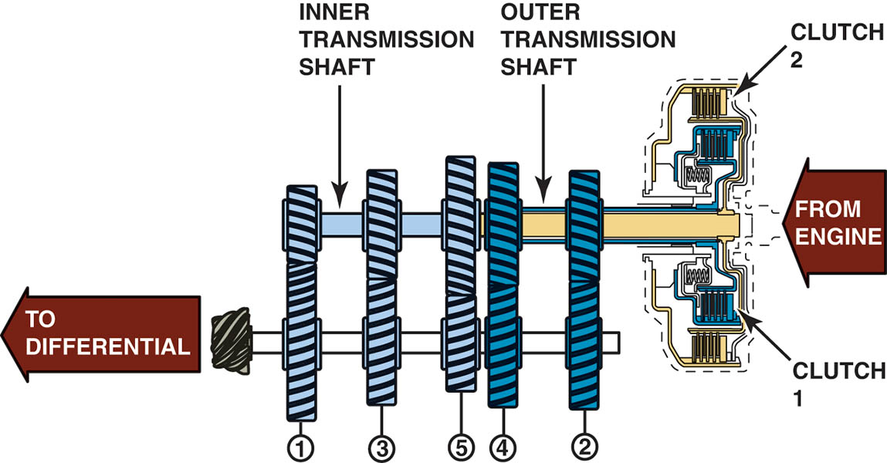
Figure 133.31 A dual clutch automatic uses the best features of an automatic transmission without the power loss of a torque converter

Slide 61
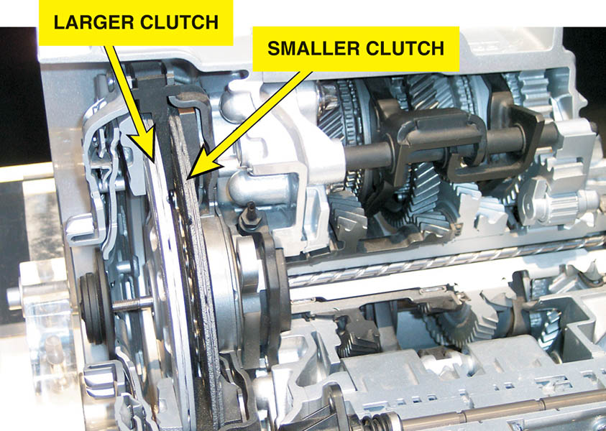
Figure 133.32 Dual clutch automatic transaxles that use two dry clutches. The larger clutch drives the odd number gear ratios (first, third, and fifth) and the smaller clutch drives the even numbered gear ratios (second, fourth, and sixth)

Slide 62
QUESTION 3: ?
What are the advantages of a dual clutch transmission?

Slide 63
ANSWER 3:
Quicker throttle response, instant gear changes, and improved fuel economy.

Slide 64

Copyright

