Slide 1
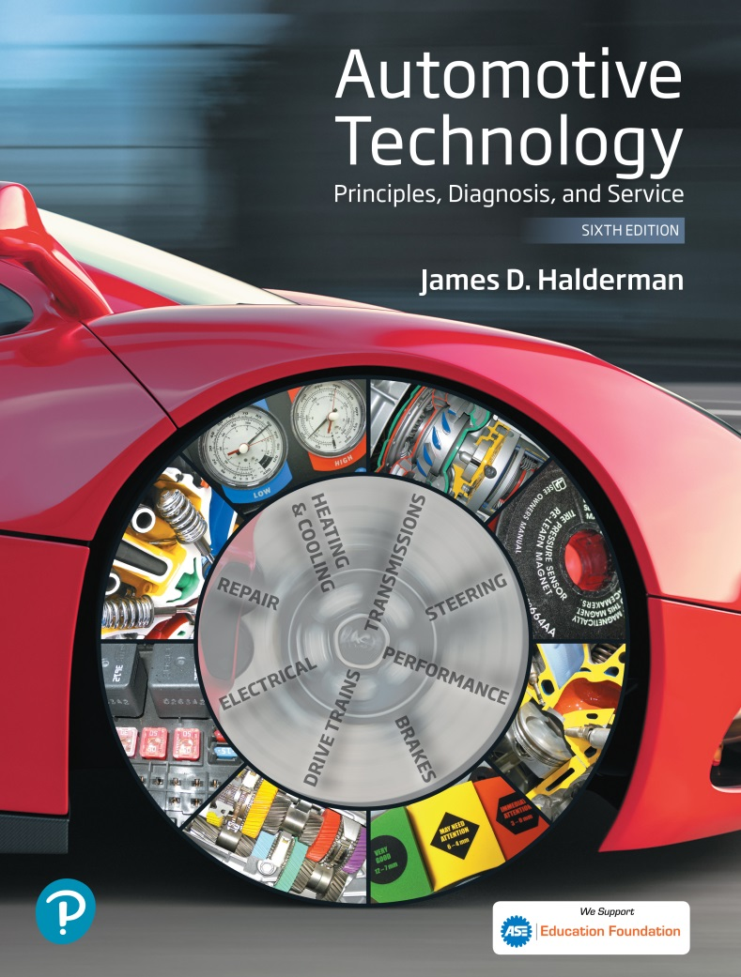
Automotive Technology Principles, Diagnosis, and Service
Sixth Edition
Chapter 132
Vibration and Noise Diagnosis and Correction
Copyright © 2018, 2015, 2011 Pearson Education, Inc. All Rights Reserved

Slide 2
LEARNING OBJECTIVES (1 of 2)
132.1 List the possible vehicle components that can cause a vibration or noise.
132.2 List the procedures for a test-drive and neutral run-up test for vibration/noise problems.
132.3 Explain the vibration speed ranges and how to determine the frequency of the vibration.
132.4 Explain how to check driveline angles and driveshaft runout.

Slide 3
LEARNING OBJECTIVES (2 of 2)
132.5 Discuss the methods for measuring driveshaft U-joint phasing and balancing the driveshaft.
132.6 Diagnose and correct noise problems.
132.7 This chapter will help prepare for Suspension and Steering (A4) ASE certification test content area “C” (Related Suspension and Steering Service).

Slide 4
CAUSES OF NOISE AND VIBRATION
Vehicles are designed and built to prevent most vibrations and to dampen out any vibrations that cannot be eliminated.
If a new vehicle has a vibration or noise problem, then the most likely cause is an assembly or parts problem.
If an older vehicle has a vibration or noise problem, the first step is to question the vehicle owner as to when the problem first appeared.

Slide 5
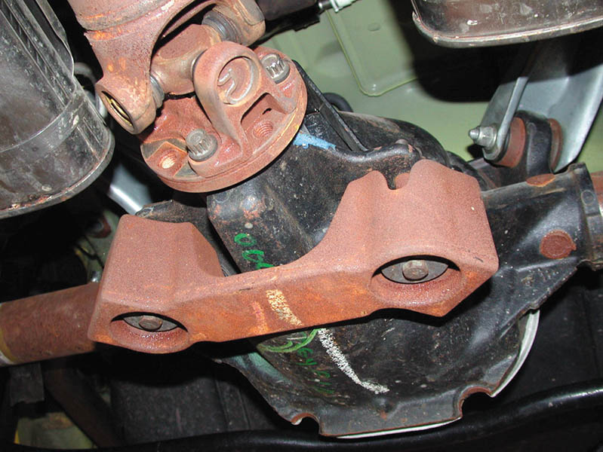
Figure 132.1 Many vehicles, especially those equipped with four-cylinder engines, use a dampener weight attached to the exhaust system or differential, as shown, to dampen out certain frequency vibrations

Slide 6
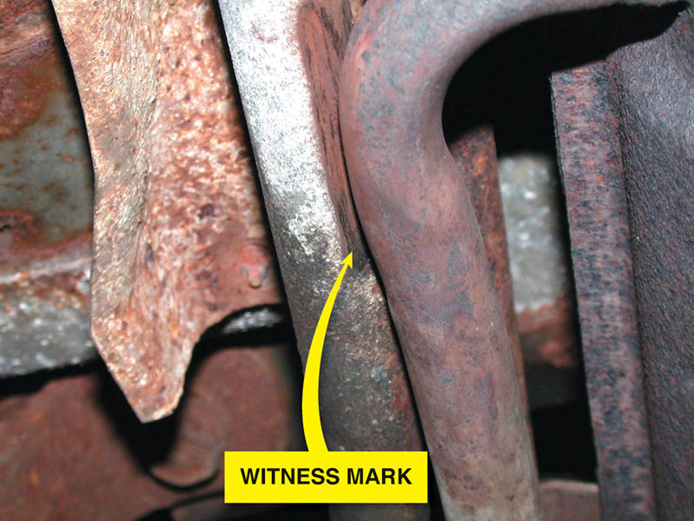
Figure 132.2 The exhaust was found to be rubbing on the frame rail during a visual inspection. Rubber exhaust system hangers are used to isolate noise and vibration from the exhaust system from entering the interior. These rubber supports can fail causing the exhaust system to be out of proper location. It was found by looking for evidence of witness marks

Slide 7
TEST DRIVE
While on the test-drive, try to gather as much information about the vibration or noise complaint as possible.
Determine the vehicle speed (mph or km/h) or engine speed (RPM) where the vibration occurs.
Change the engine speed and load to help determine if vibration is wheel speed or engine speed related.

Slide 8
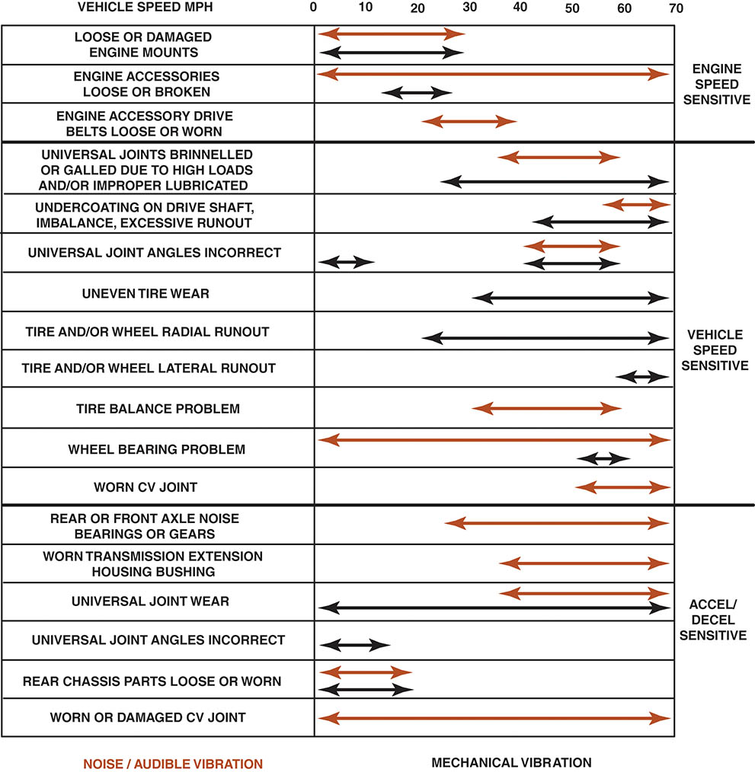
Figure 132.3 A chart showing the typical vehicle and engine speeds at which various components will create a noise or vibration and under what conditions

Slide 9
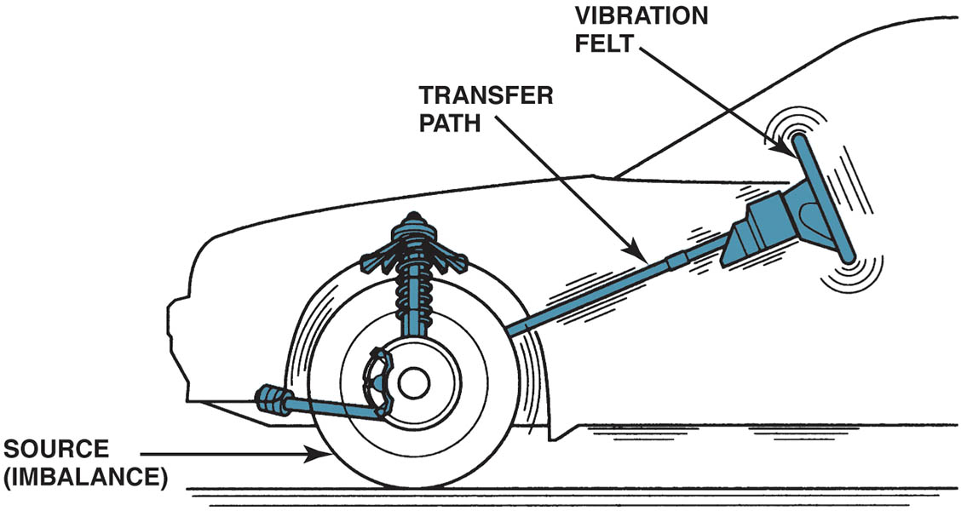
Figure 132.4 Vibration created at one point is easily transferred to the passenger compartment. MacPherson strut suspensions are more sensitive to tire imbalance than SLA-type suspensions

Slide 10
NUETRAL RUN-UP TEST
The neutral run-up test is used to determine if the source of the vibration is engine-related.
With the transmission in Neutral or Park, slowly increase the engine RPM and with a tachometer, observe the RPM at which the vibration occurs.

Slide 11
VIBRATION DURING BRAKING
A vibration during braking usually indicates out-of-round brake drums, warped disc brake rotors, or other braking system problems.
The front rotors are the cause of the vibration if the steering wheel is also vibrating (moving) during braking.
The rear drums or rotors are the cause of the vibration if the vibration is felt throughout the vehicle and brake pedal, but not the steering wheel.

Slide 12
VIBRATION SPEED RANGES (1 OF 2)
Frequency
The number of times a complete motion cycle takes place during a period of one second is called frequency and is measured in hertz (Hz).
Vibration Order
Vibration order is the number of vibrations created in one revolution of a component.
Tire and Wheel Vibrations
Typical vibrations occur in low frequency ranges at or around 50 mph (80 km/h).

Slide 13
VIBRATION SPEED RANGES (2 OF 2)
Driveline Vibrations
Medium Frequency (20–50 HZ). This frequency range of vibrations may also be described as a shake, oscillation, or shimmy.
Engine Related Vibrations
High Frequency (50–100 HZ). Vibrations in this range may also be heard as a moan or hum.

Slide 14
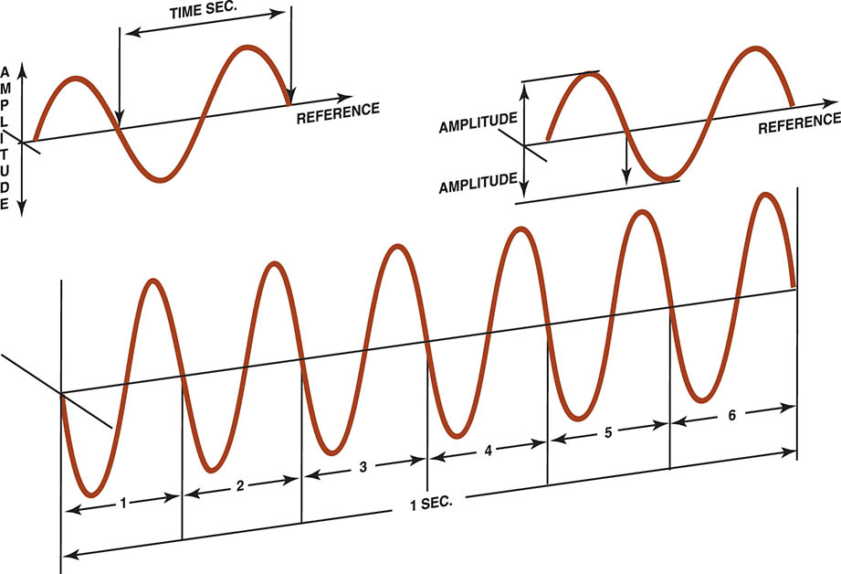
Figure 132.5 Hertz means cycles per second. If six cycles occur in one second, then the frequency is 6 Hz. The amplitude refers to the total movement of the vibrating component

Slide 15
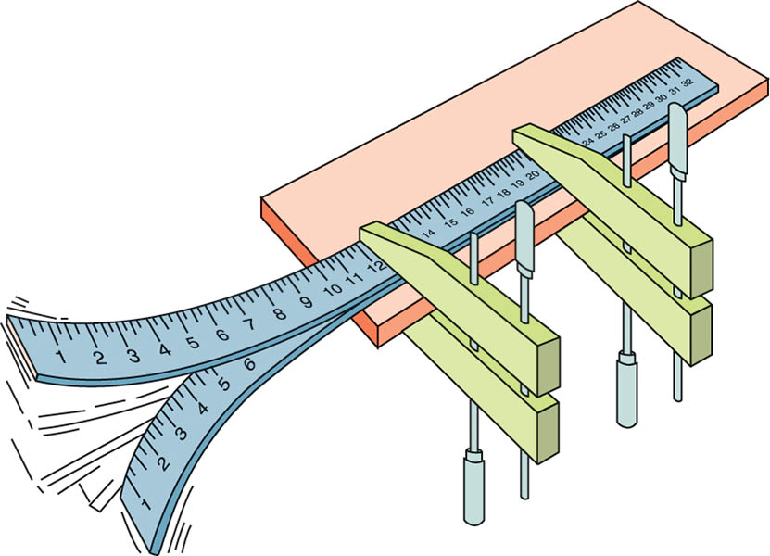
Figure 132.6 Every time the end of a clamped yardstick moves up and down, it is one cycle. The number of cycles divided by the time equals the frequency. If the yardstick moves up and down 10 times (10 cycles) in two seconds, the frequency is 5 Hertz (10 ÷ 2 = 5)

Slide 16
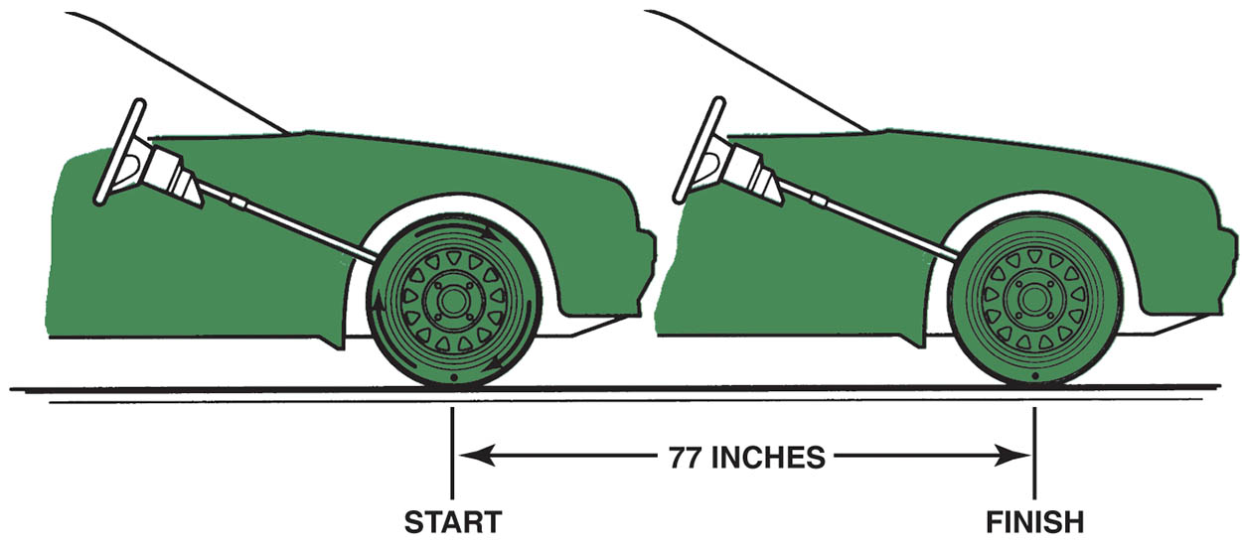
Figure 132.7 Determining the rolling circumference of a tire

Slide 17
QUESTION 1: ?
What is vibration frequency?

Slide 18
ANSWER 1:
The number of times a complete motion cycle takes place during a period of one second.

Slide 19
VIBRATION FREQUENCY (1 OF 2)
Measuring Frequency
Vibration can be measured using a reed tachometer or an electronic vibration analyzer (EVA).
Correcting Low-Frequency Vibrations
Tire and/or wheel imbalance.
Tire and/or wheel radial or lateral runout.
Radial force variation within the tire itself.
Warped rotors.

Slide 20
VIBRATION FREQUENCY (2 OF 2)
Correcting Medium-Frequency Vibrations
Medium-frequency vibrations (20–50 Hz) can be caused by imbalances of the driveline as well as such things as the following:
U-joints
Drive shaft imbalance
Incorrect or unequal drive shaft angles
Correcting High-Frequency Vibrations
High frequency vibrations (50–100 Hz) are commonly caused by a fault of the clutch, torque converter, or transmission main shaft that rotates at engine speed; in the engine itself

Slide 21
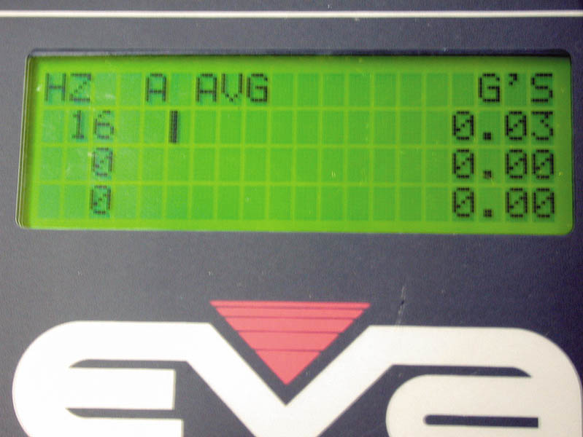
Figure 132.8 An electronic vibration analyzer

Slide 22
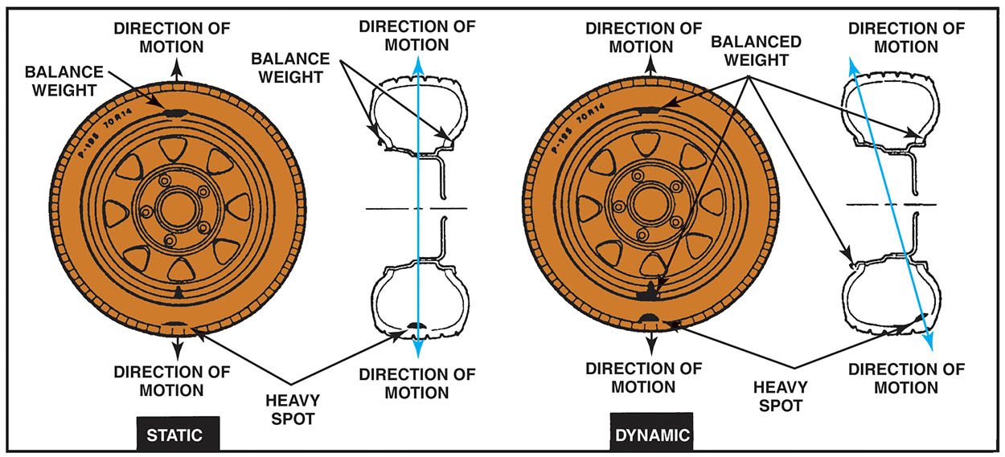
Figure 132.9 Properly balancing all wheels and tires solves most low-frequency vibrations

Slide 23
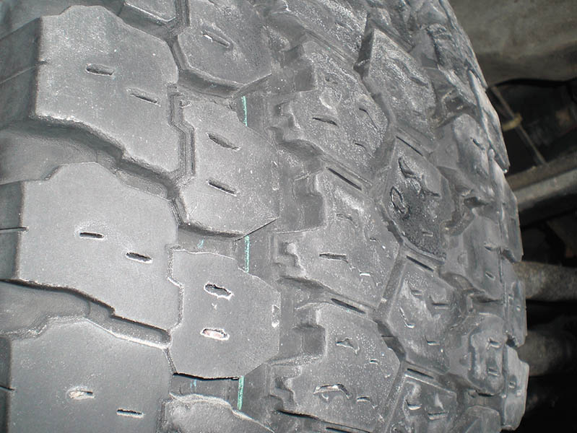
Figure 132.10 An out-of-balance tire showing scallops or bald spots around the tire. Even if correctly balanced, this cupped tire would create a vibration

Slide 24
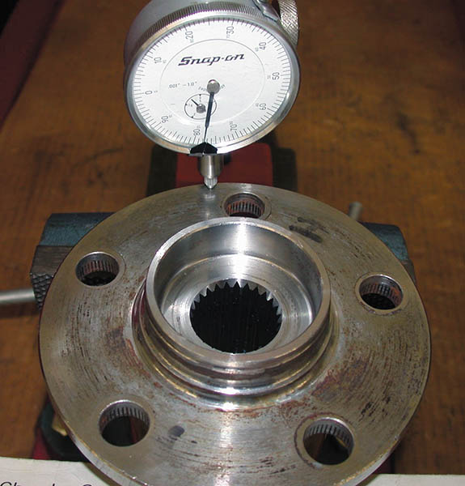
Figure 132.11 Another cause of a vibration that is often blamed on wheels or tires is a bent bearing hub. Use a dial indicator to check the flange for runout

Slide 25
QUESTION 2: ?
What is the purpose of an EVA?

Slide 26
ANSWER 2:
To record the frequency and strength of the vibration.

Slide 27
CORRECTING DRIVELINE ANGLES
Incorrect driveline angles are usually caused by one or more of the following:
Worn, damaged, or improperly installed U-joints.
Worn, collapsed, or defective engine or transmission mount(s).
Incorrect vehicle ride height.
Bent or distorted driveshaft.

Slide 28
CHECKING DRIVESHAFT RUNOUT
Check to see that the driveshaft is not bent by performing a driveshaft runout test using a dial indicator.
The maximum allowable runout is 0.030 inch (0.8 mm).
If runout exceeds 0.030 inch, re-index the driveshaft and re-measure.
If the runout is still greater than 0.030 inch, the driveshaft should be replaced.

Slide 29
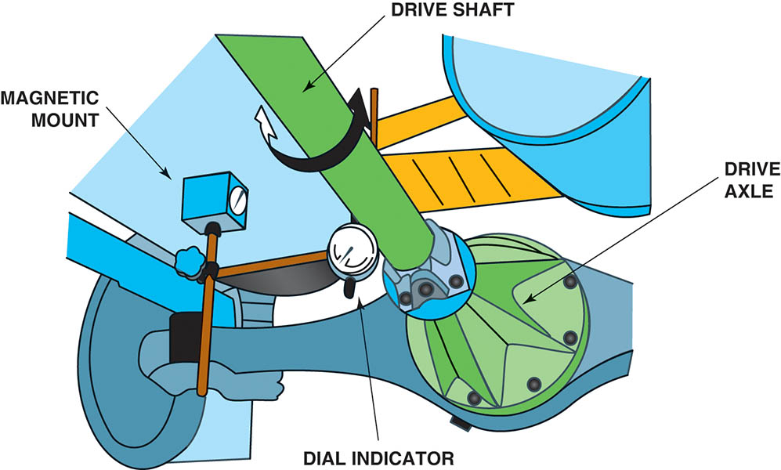
Figure 132.12 Checking a drive shaft for runout using a magnetic mounted dial indicator

Slide 30
MEASURING DRIVESHAFT U-JOINT PHASING
Measuring driveshaft U-joint phasing involves checking to see if the front and rear U-joints are directly in line or parallel with each other.
Place an inclinometer on the front U-joint bearing cup and rotate the driveshaft until horizontal; note the inclinometer reading.
Move the inclinometer to the rear U-joint. The angles should match.

Slide 31
CHECKING COMPANION FLANGE RUNOUT
Two items should be checked on the companion flange while diagnosing a vibration:
The companion flange should have a maximum runout of 0.006 inch (0.15 mm) while being rotated.
Check the companion flange for a missing balance weight.

Slide 32
BALANCING THE DRIVESHAFT
The procedure for testing driveshaft balance using a strobe balancer includes the following:
Raise the vehicle and mark the driveshaft with four equally spaced marks around its circumference.
Attach the strobe balancer sensor to the bottom of the differential housing.
Put the transmission into gear to allow the drive wheels to rotate.
Hold the strobe light close to the marks on the driveshaft. A flash indicates an imbalance condition.
Use hose clamps opposite of the flash to correct imbalance.

Slide 33
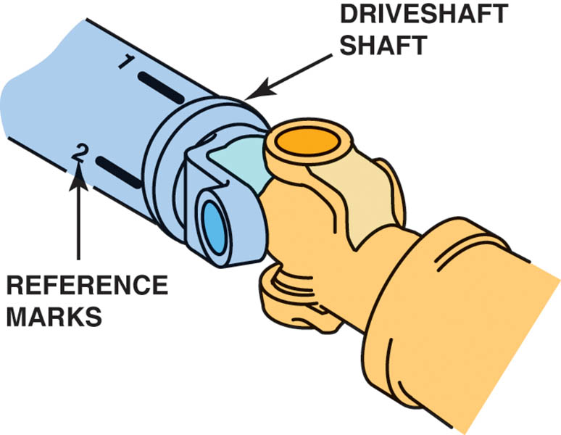
Figure 132.13 When checking the balance of a driveshaft, make reference marks around the shaft so that the location of the unbalance may be viewed when using a strobe light

Slide 34
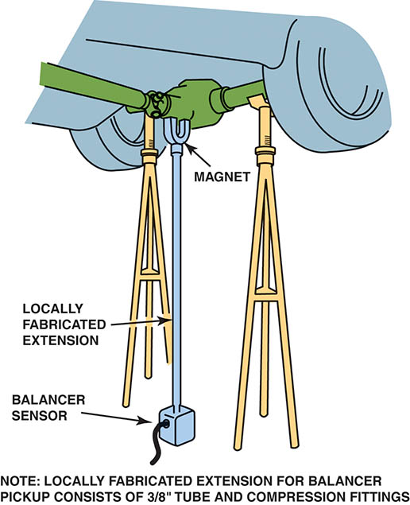
FIGURE 132.14 Using a strobe balancer to check for driveline vibration requires that an extension be used on the magnetic sensor. Tall safety stands are used to support the rear axle to keep the driveshaft angles the same as when the vehicle is on the road

Slide 35
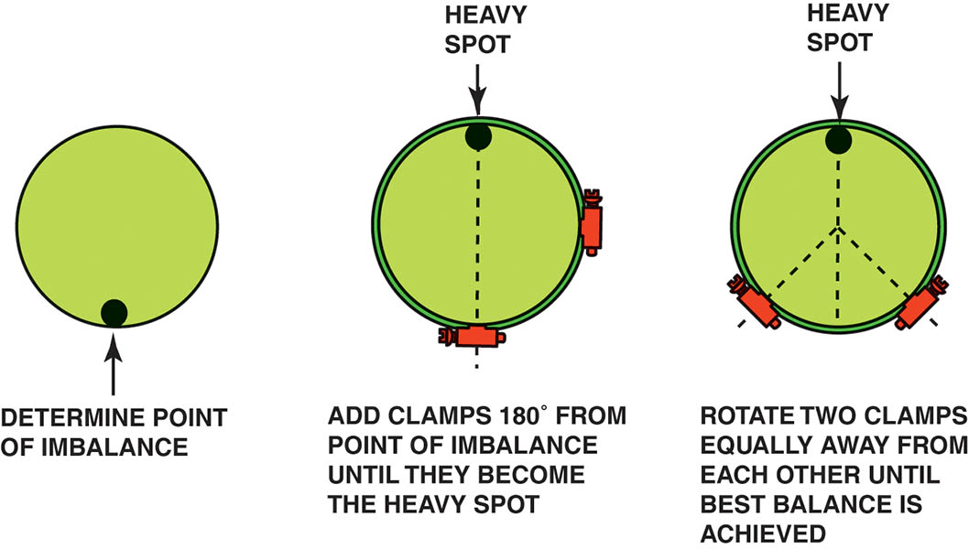
Figure 132.15 Typical procedure to balance a driveshaft using hose clamps

Slide 36
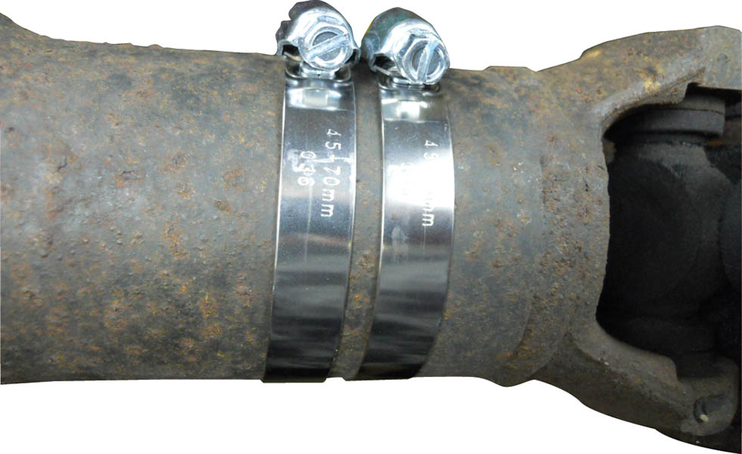
Figure 132.16 Two clamps were required to balance this front driveshaft of a four-wheel-drive vehicle. Be careful when using hose clamps so that the ends of the clamps do not interfere with the body or other parts of the vehicle

Slide 37
NOISE DIAGNOSIS
Noise diagnosis is difficult because a noise is easily transmitted from its source to other places in the vehicle.
To help pin down the exact location of the sound, perform a thorough test-drive, including driving beside parked vehicles or walls with the vehicle windows open.

Slide 38
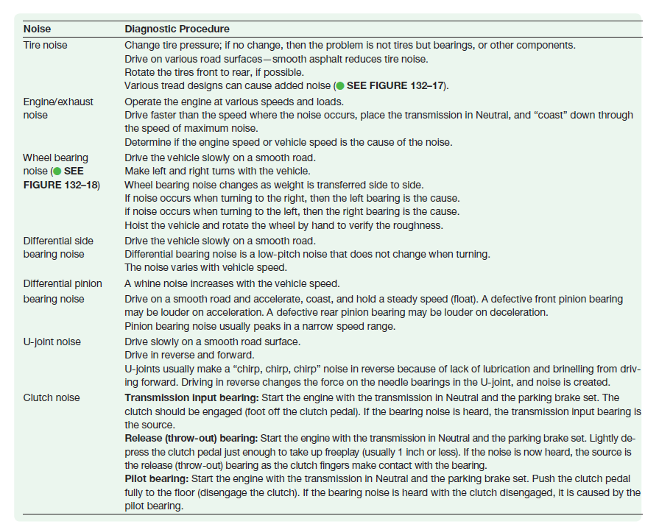
NOISE CORRECTION

Slide 39
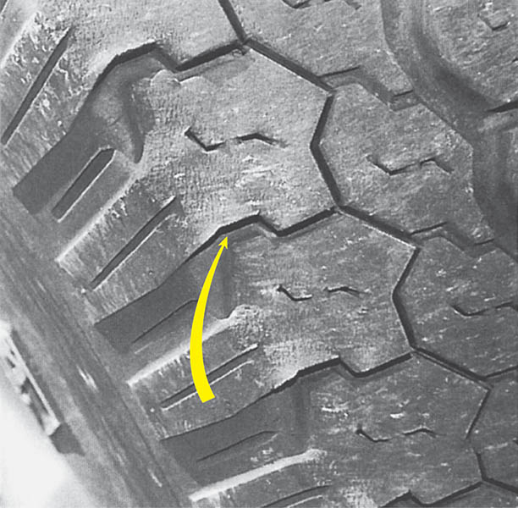
Figure 132.17 Tire wear caused by improper alignment or driving habits, such as high-speed cornering, can create tire noise. Notice the feather-edged outer tread blocks

Slide 40
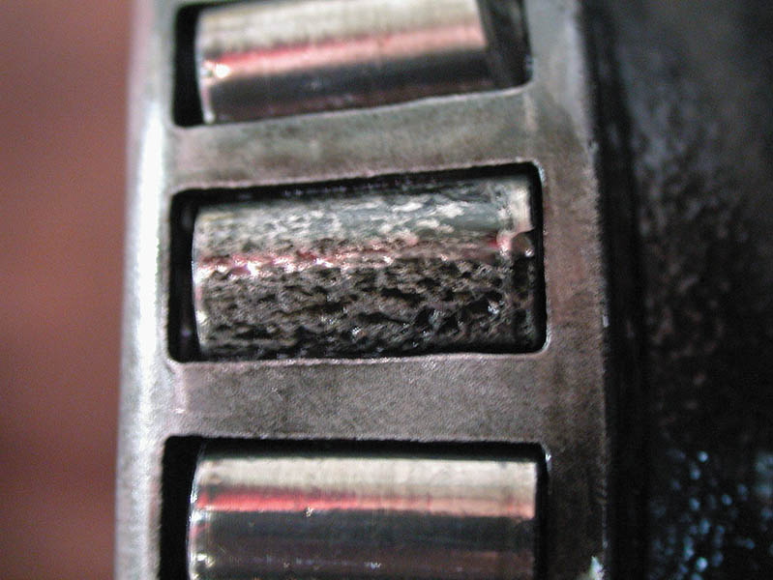
Figure 132.18 This bearing was found on a vehicle that had been stored over the winter. This corroded bearing produced a lot of noise and had to be replaced

Slide 41
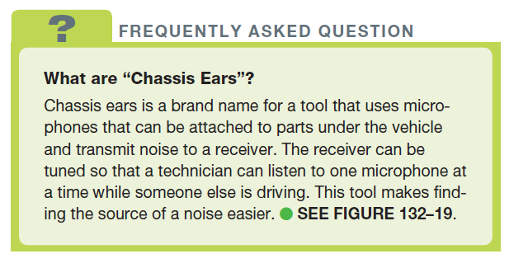
FREQUENTLY ASKED QUESTION

Slide 42
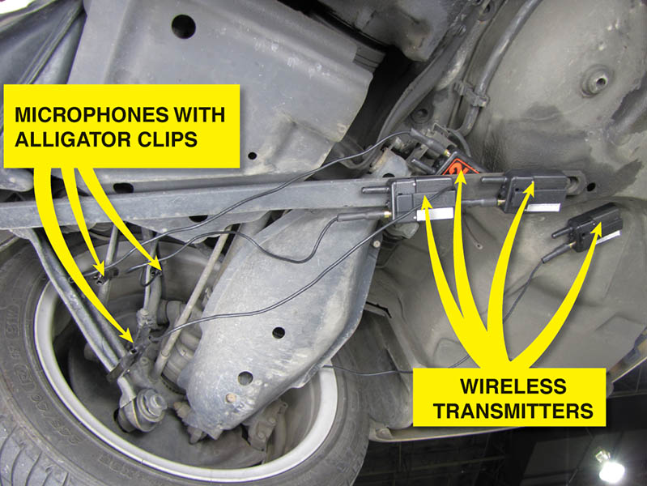
Figure 132.19 Chassis ear microphones attached to various suspension components using the integral clamps. The sound is transmitted wirelessly to the receiver inside the vehicle where an assistant technician can listen for noises while the vehicle is being driven

Slide 43
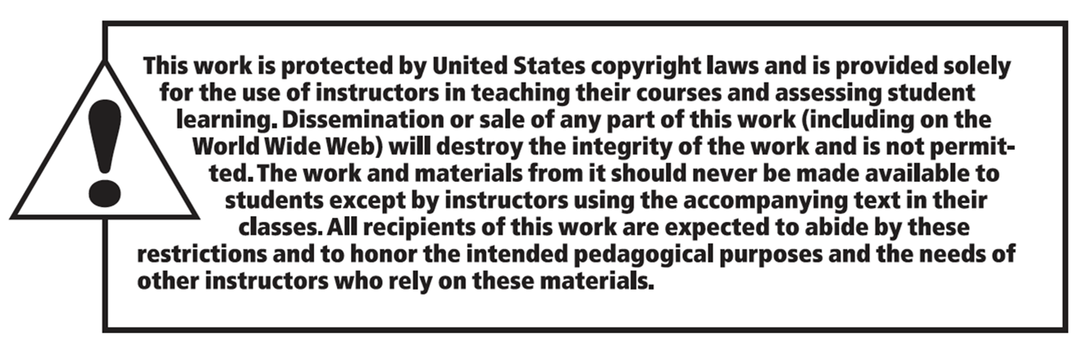
Copyright

